Slide 1
www.xeleraresearch.com

Slide 2
Company Overview
Formed in 2013 by 5 partners – 150+ years of accelerator design expertise
Most of Xelera were from the Cornell ERL development team, who designed and built the world’s highest current, high brightness photoinjector, which is being used now in the 4-pass ERL: CBETA
Now at 9 total employees
The Xelera team is experienced in designing and building a variety of particle accelerator components, including:
Electron Sources (Photo-Guns and Thermionic Guns)
Beam Stops
Vacuum System components
SRF HOM Absorbers

Slide 3
Company Overview
The team provides broad consulting services, including:
Radiation Protection for electron and X-ray beams.
Shielding design and assessment
Penetration Recommendations
Radiation safety interlock design and procedures
Radiation monitoring equipment needs and placement
Radiation Safety Training procedures
EMI consulting for high-voltage RF systems
Laser system safety planning

Slide 4
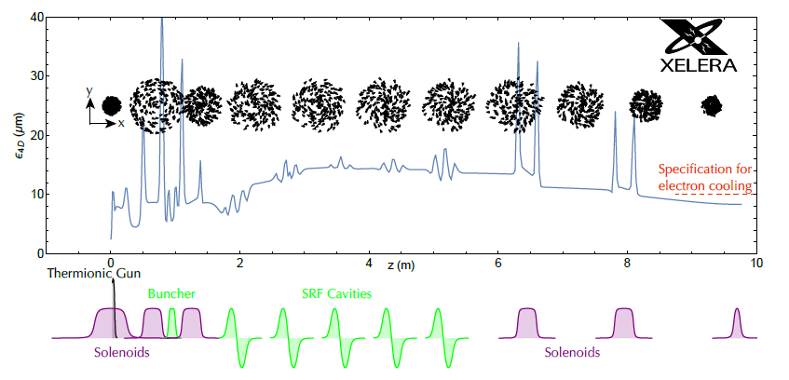
Accelerator design & simulations: EIC magnetized injector design

Slide 5
Accelerator design & simulations: EIC magnetized injector design (Movie)

Slide 6
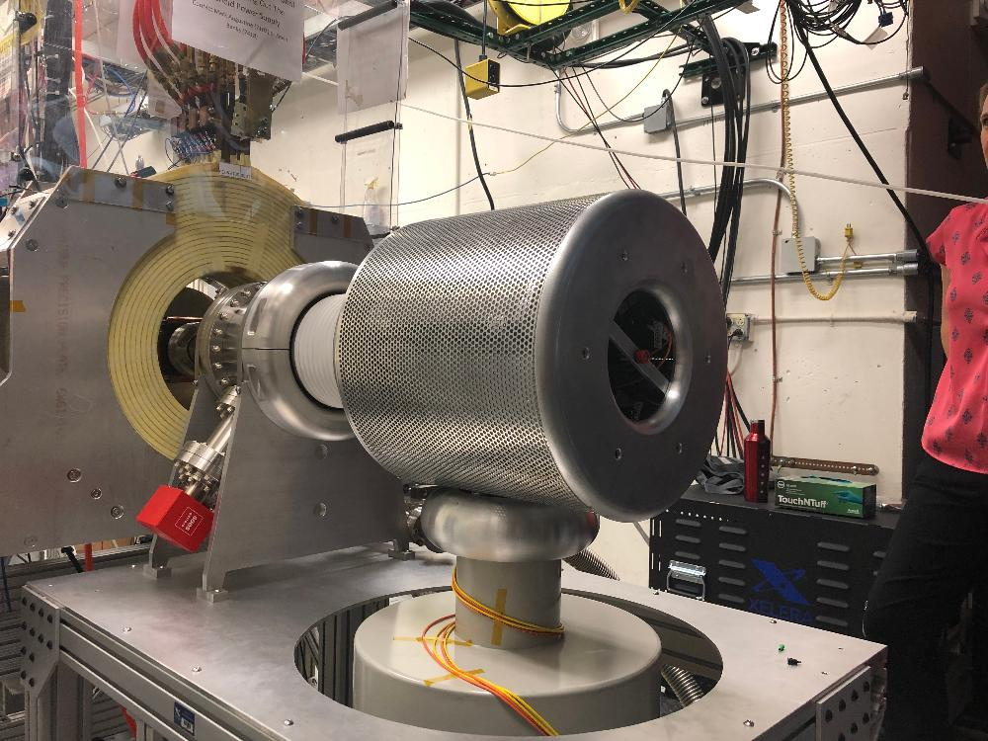
Electron Sources: Tgun
Xelera Research LLC, in collaboration with a team at JLab, designed, built, and tested a thermionic electron source (Tgun) to drive a magnetized electron cooler for a future electron-ion collider project. This device was delivered to JLab in July of 2019, and achieved first beam in December 2019. This work was funded through the U.S. Department of Energy SBIR program.
All electrostatic, mechanical, and rf drive systems were designed and built in-house.
The Tgun is now integrated with the existing JLab Gun Test Stand (GTS).

Slide 7
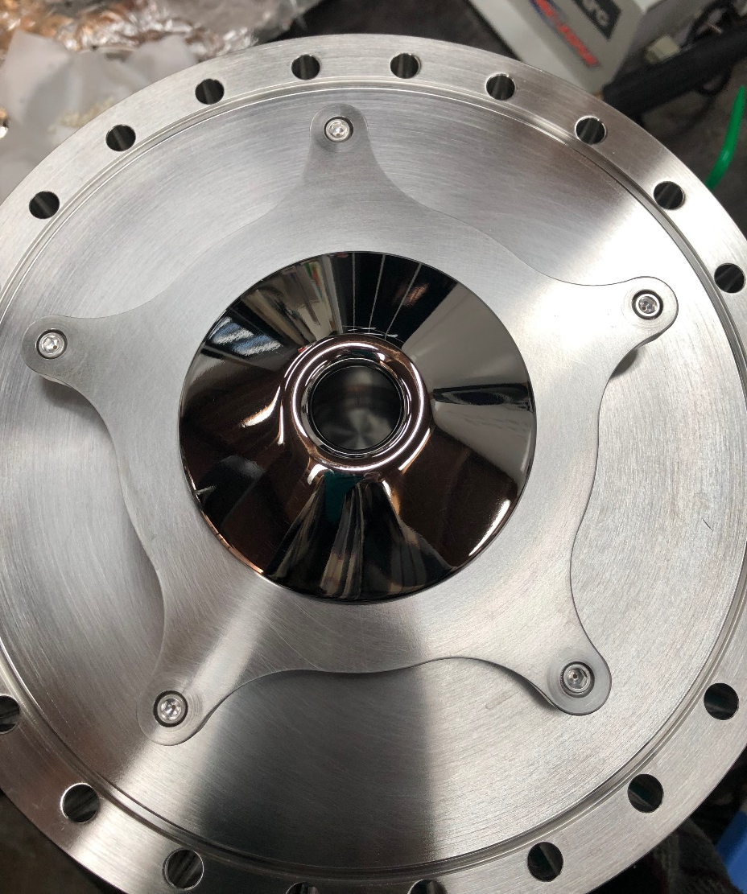
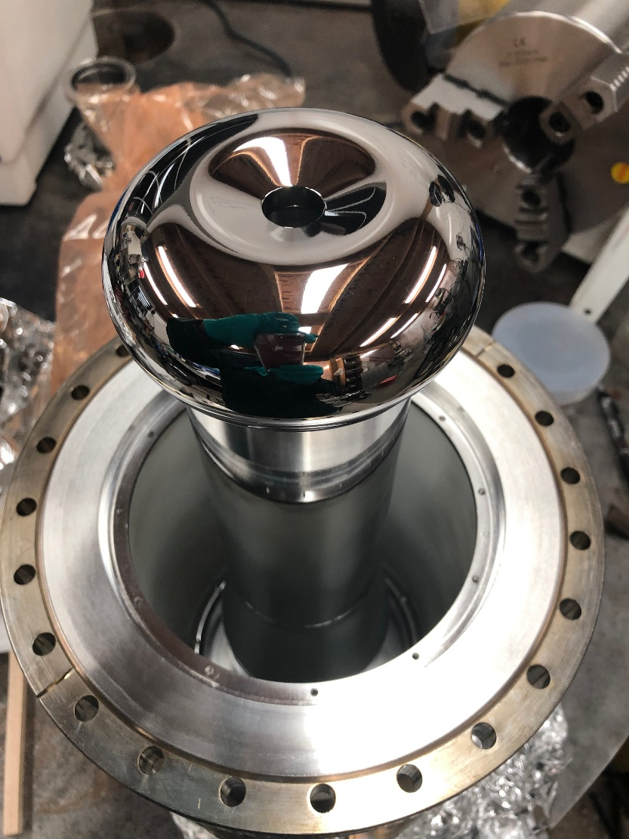
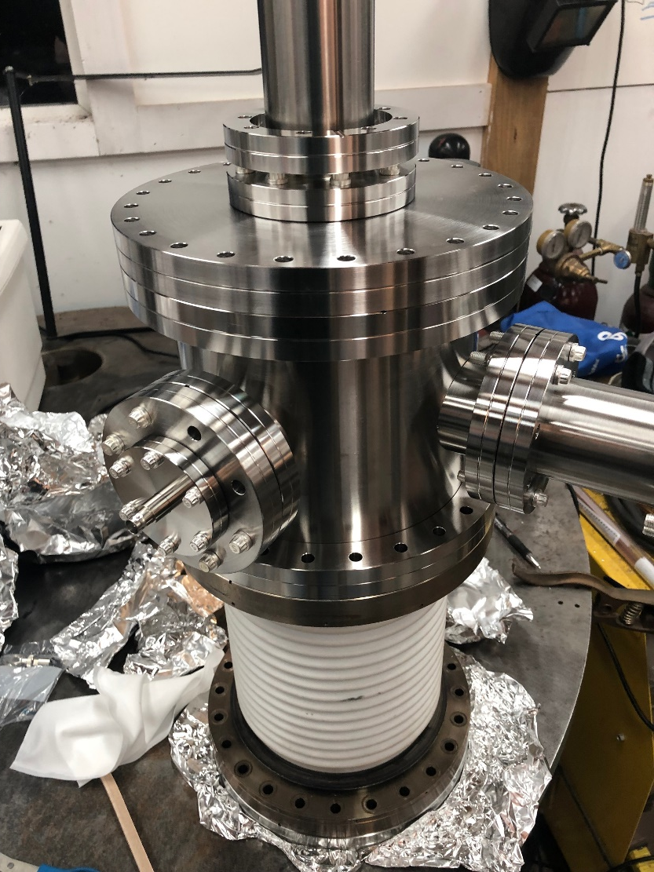
Tgun Cathode & Anode, Vacuum Chamber

Slide 8
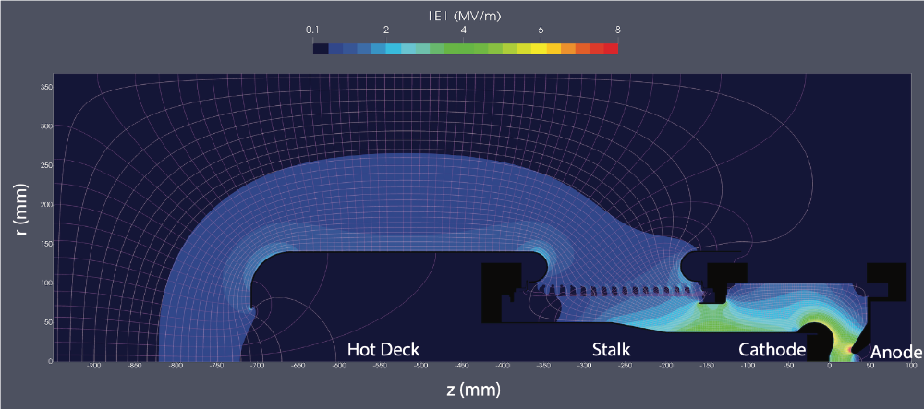
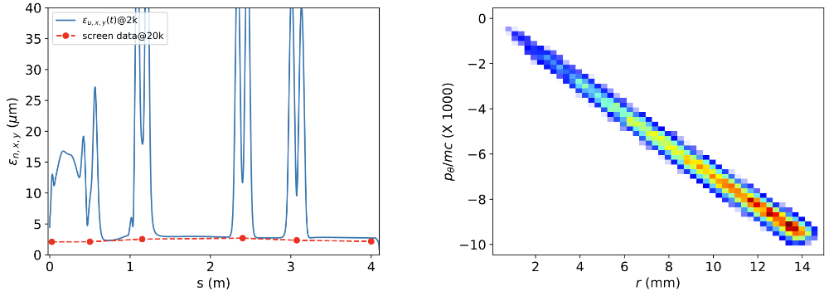
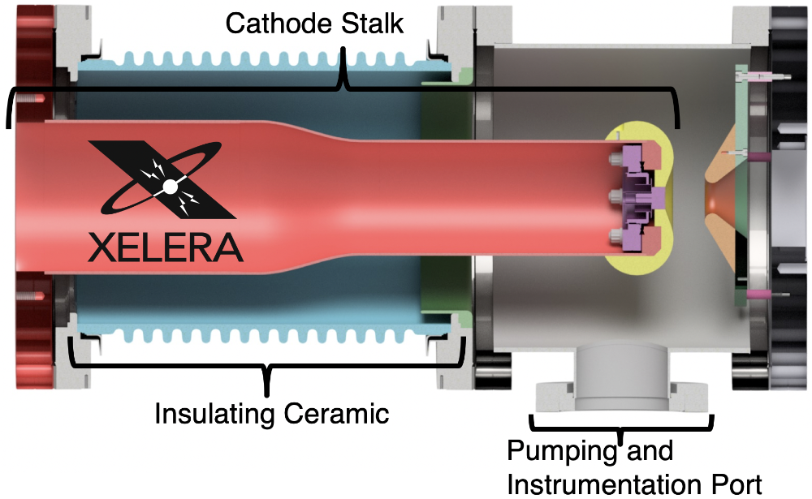
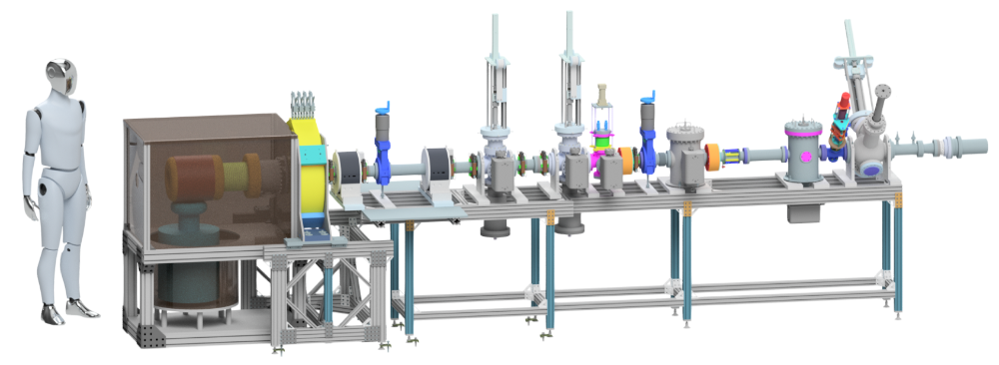
Tgun Design

Slide 9
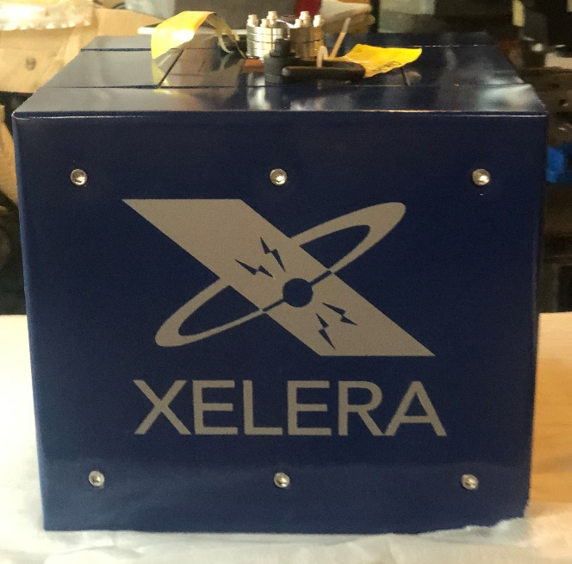
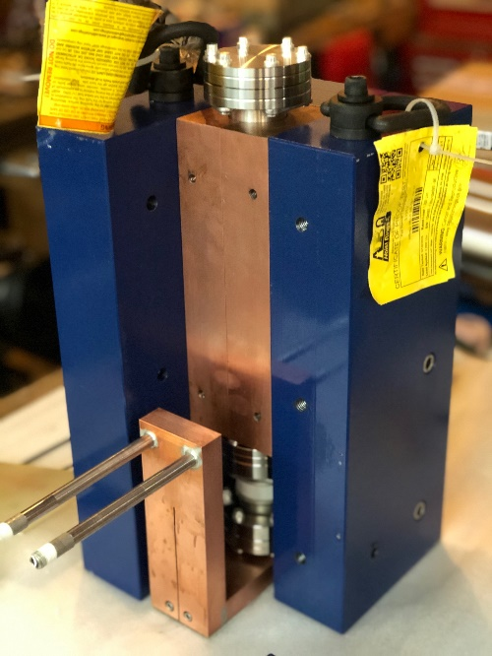
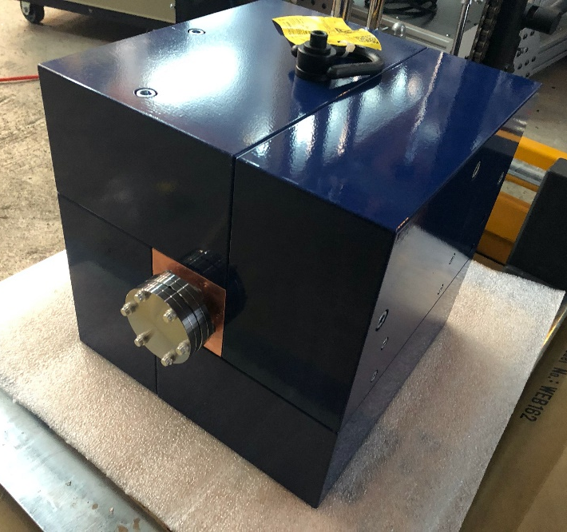
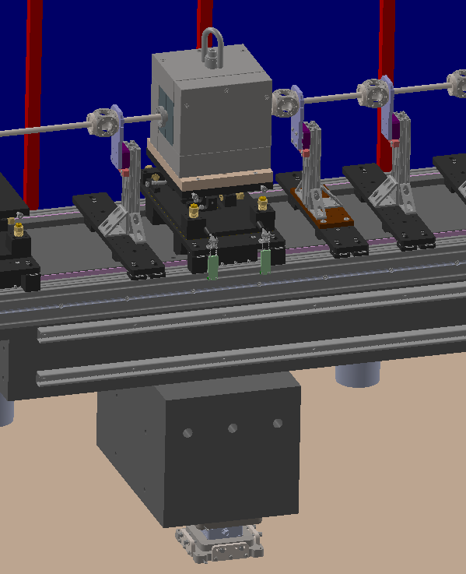
Beam Stops
The Xelera team has experience designing, building, and operating electron beam stops small and large (up to 600 kW). Below are some smaller beam stops recently delivered to the ASU Graves Laboratory.
ASU Beam Stop and detail
ASU Faraday Cup and intended mounting

Slide 10
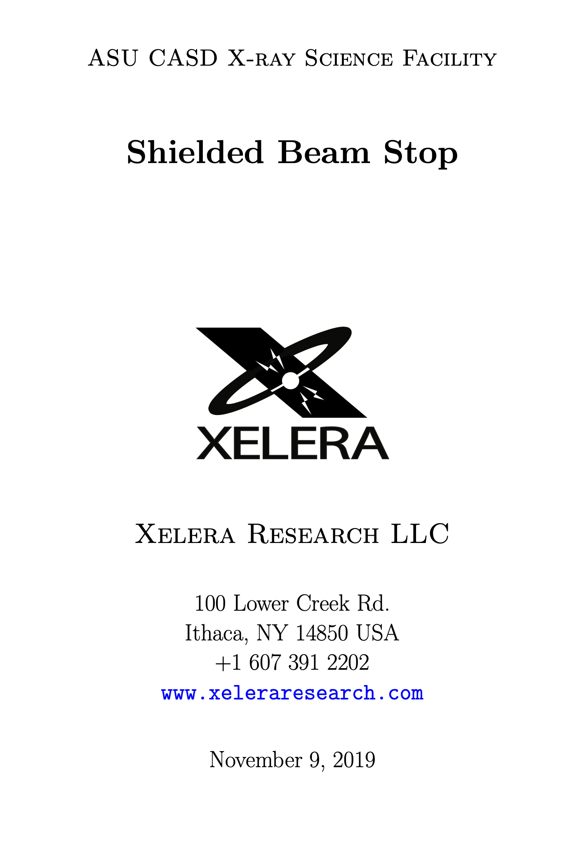
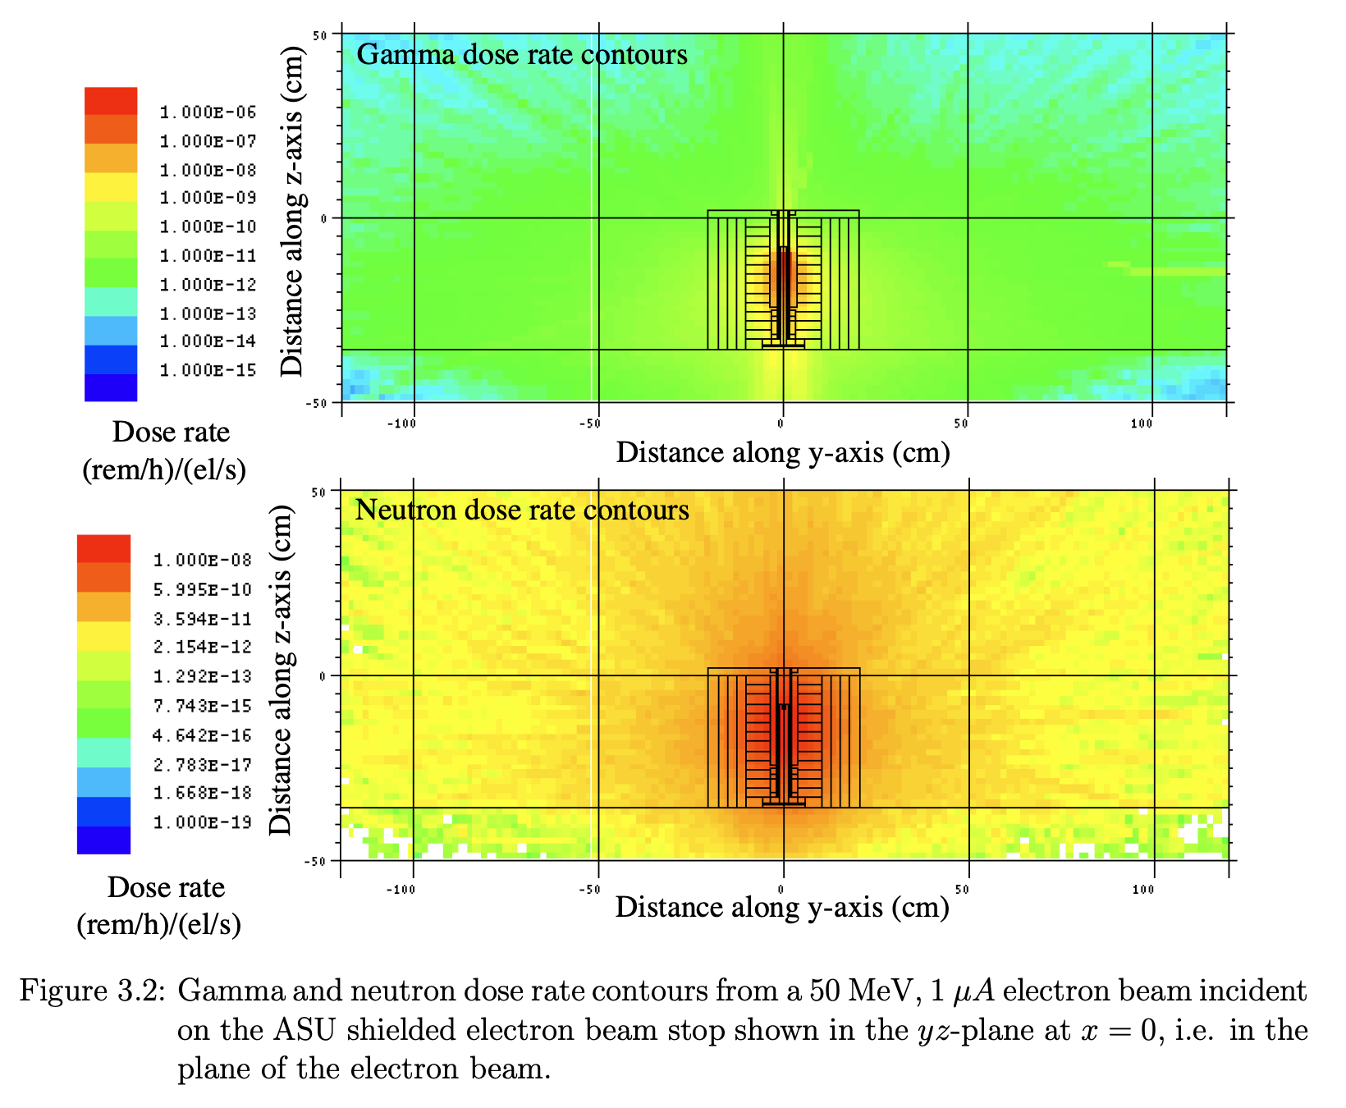
Beam Stop Design
Each device comes with a design report, including the radiation shielding design and simulation results using MCNP.
If required, detailed calculations including the room and equipment materials and geometry can included.

Slide 11
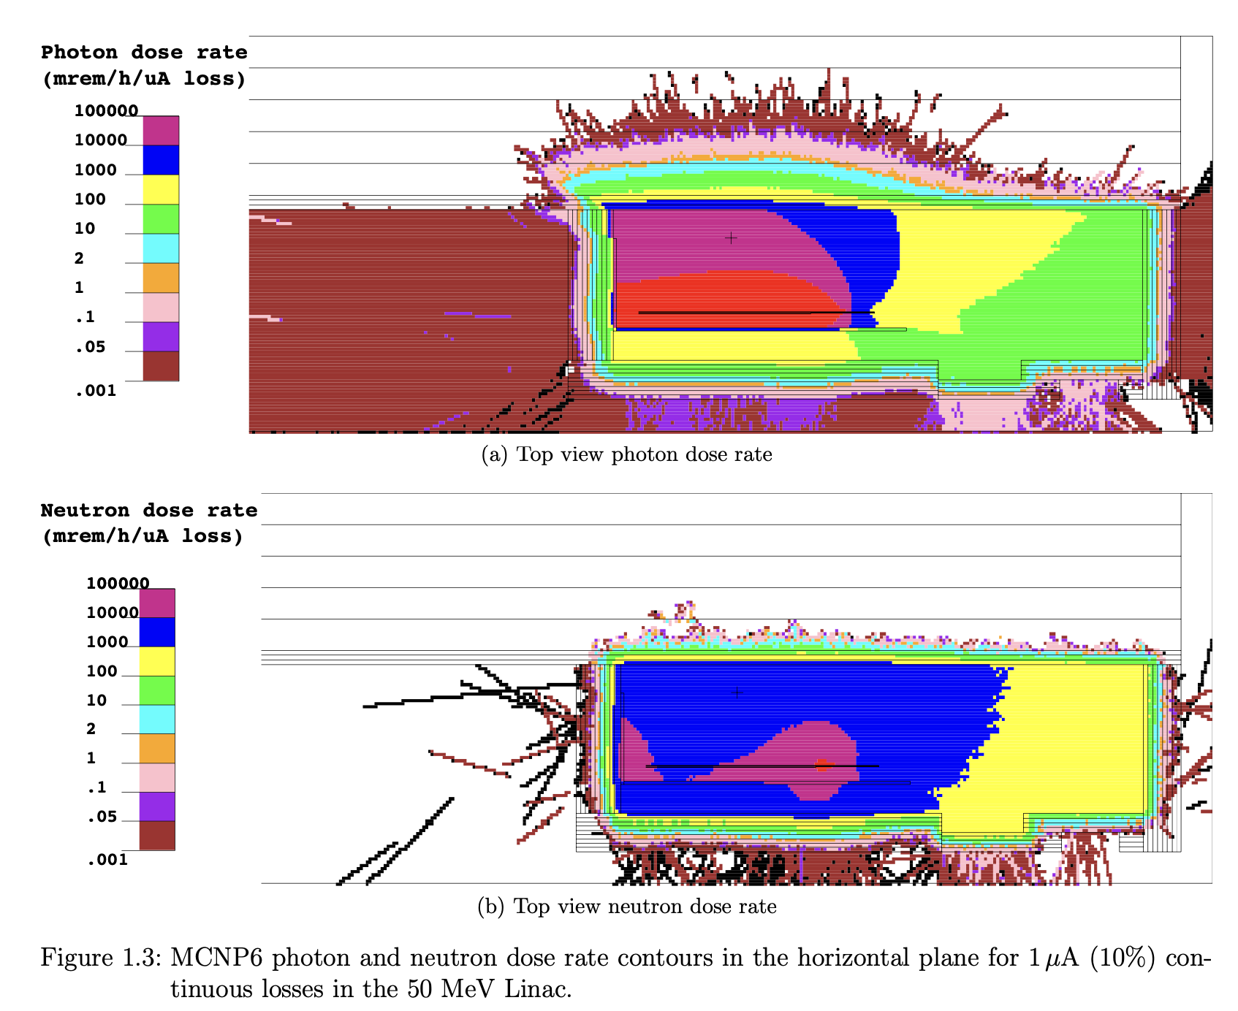
Radiation Physics Consulting
The team at Xelera Research has many decades of experience with radiation producing devices, ranging from medical X-ray diagnostic systems, to electron and ion accelerators, and even with nuclear reactors. We have designed and implemented radiation shielding and safety systems for a number of accelerators covering the range of energies for the planned system at Arizona State University (ASU).
Construction of the ASU Vault 1
Radiation Shielding design and simulations for Vault 1

Slide 12
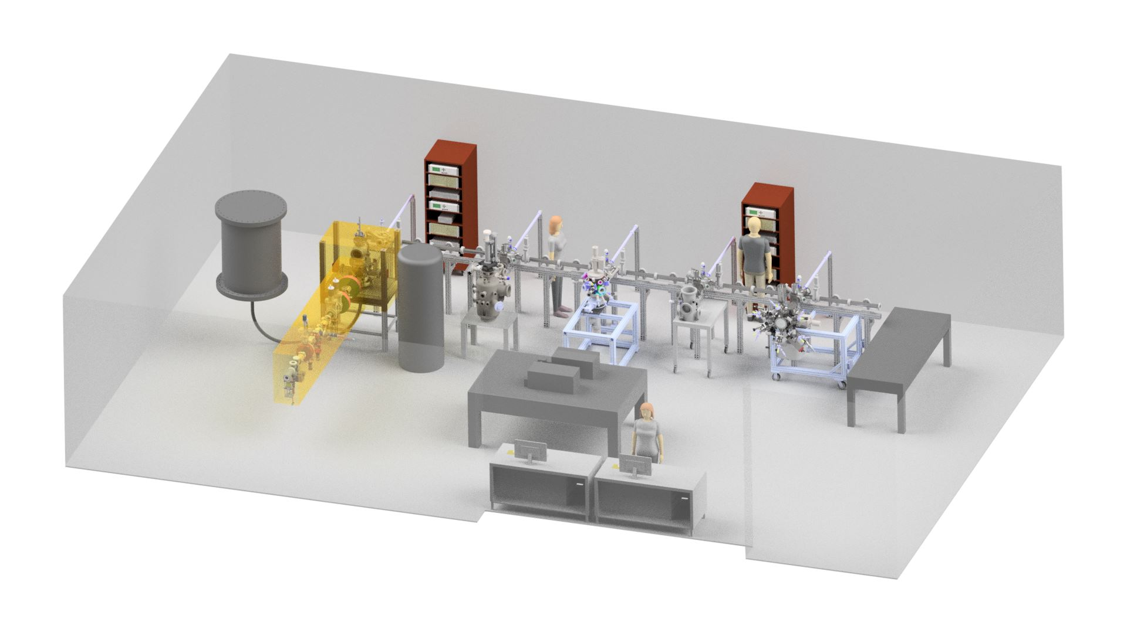
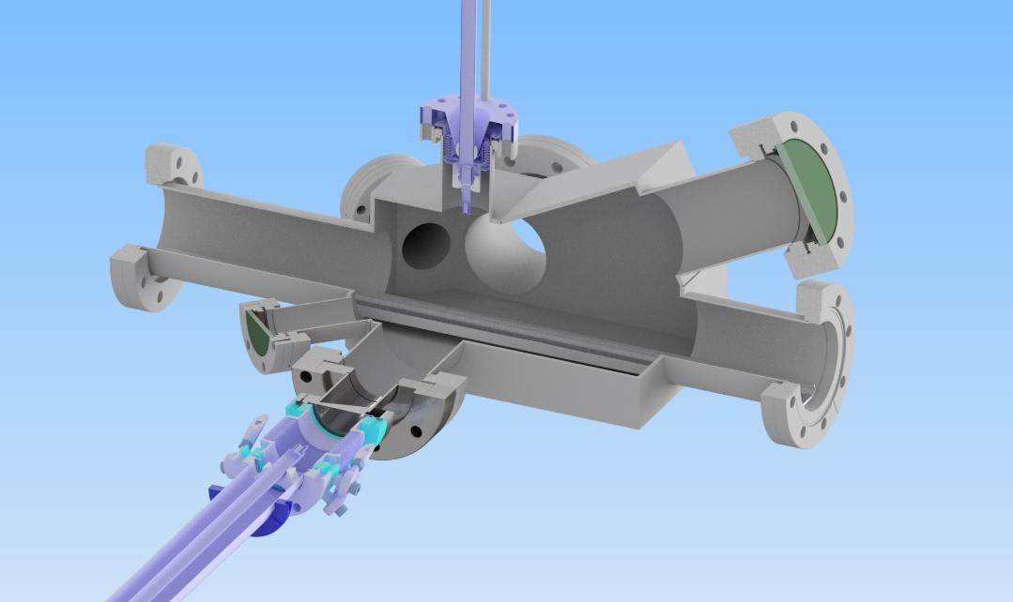
Vacuum Chamber Systems and Devices
Xelera was engaged by the ASU Karkare Laboratory to design a complex vacuum system that bridged a suite of Photocathode growth and surface analysis sub-systems. The vacuum system spanned an entire laboratory and included not only the surface growth and analysis capabilities, but also a 200kV electron beamline to test the properties of the cathodes grown. We were responsible for the radiation safety analysis, the layout, the design of the complex vacuum chambers and the intricate sample transfer system internal to the chambers. In addition we manufactured the high voltage power supply tank that supports the electron gun.
Xelera modeling of the ASU Karkare Laboratory
Novel cathode transport vacuum design and manufacturing

Slide 13
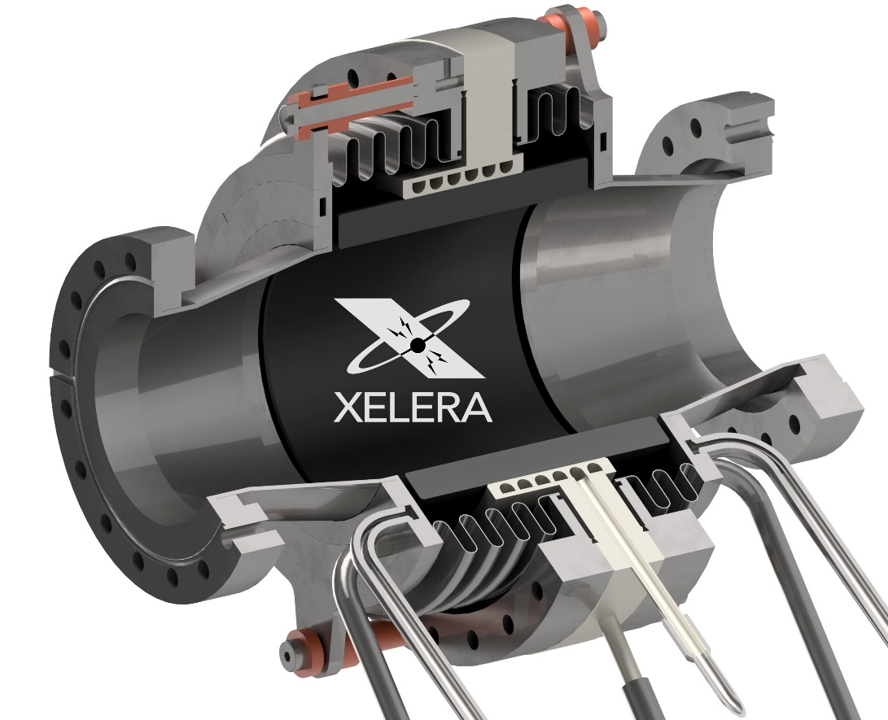
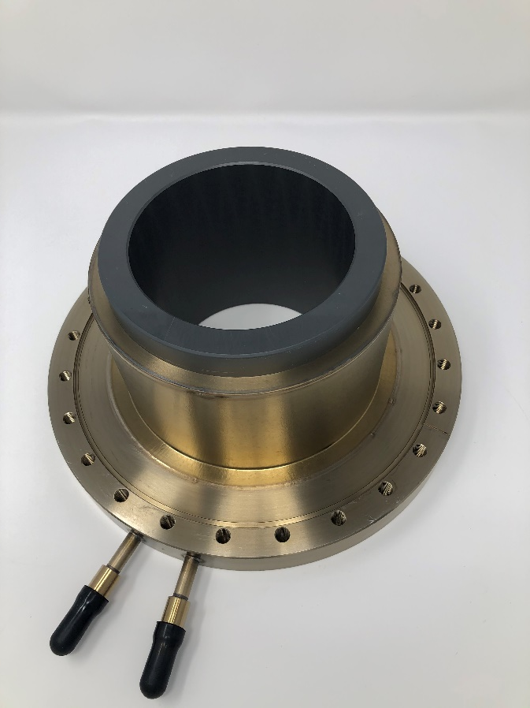
RF HOM Absorbers
The Xelera team has unique experience designing and building Higher Order Mode (HOM) absorbers for high-power RF/SRF systems.
HOM Absorber Design
Shrink Fit SiC absorber

Slide 14
www.xeleraresearch.com

