Slide 1
SRF Systems for the EIC Hadron Cooling
Bob Rimmer
On behalf of the EIC SRF team
ERL22 workshop, Cornell
Oct 3-6, 2022

Slide 2
Outline
Overview of EIC RF systems
Ongoing SRF R&D
591 MHz ESR
197 MHz Crab
394 MHz ESR crab first look
FPC and BLA progress
5-cell cavities required
HSR, RCS and COOLER
Possible low energy pre-cooler
197 MHz QWR
Shared injector
Modular cryostat
Summary

Slide 3
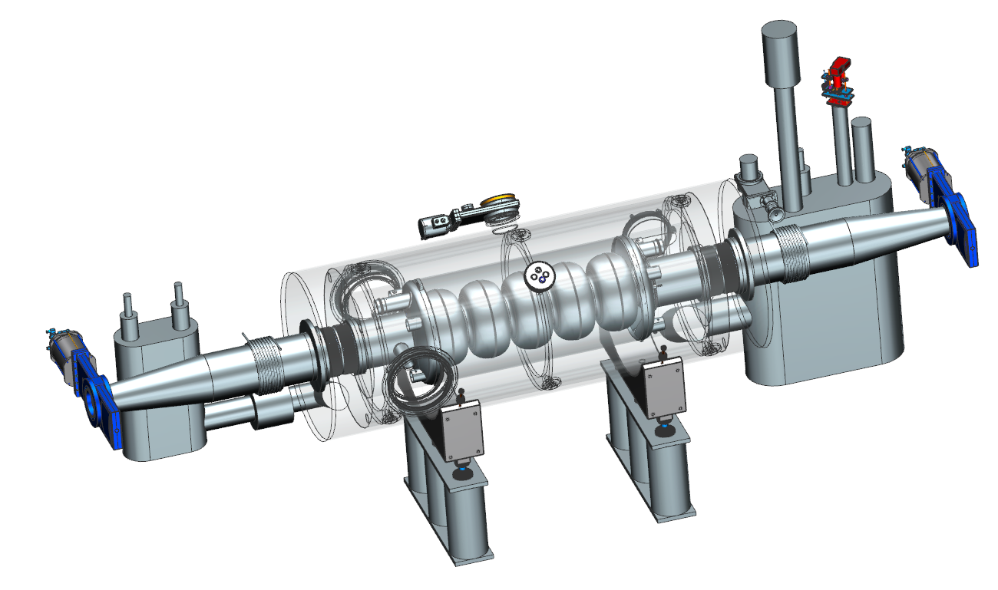
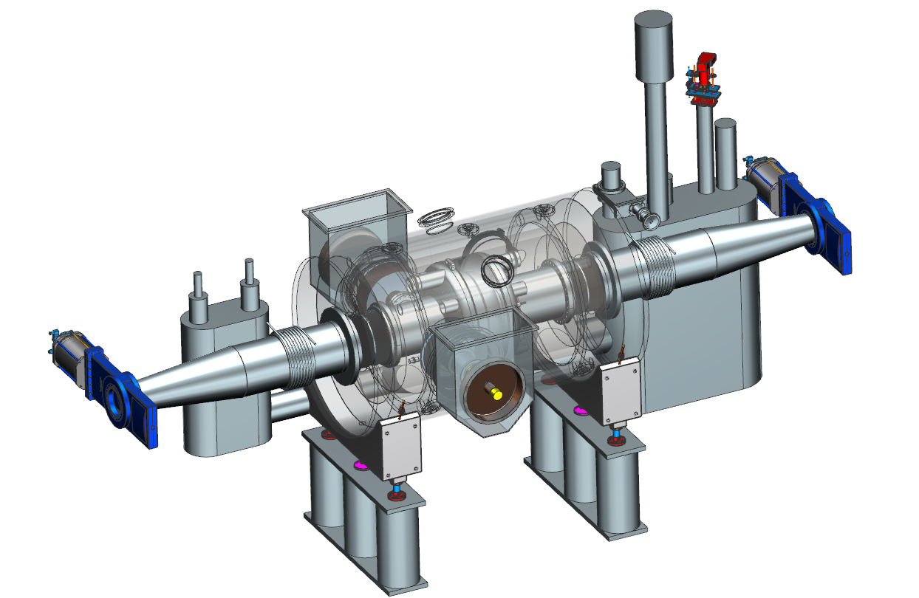
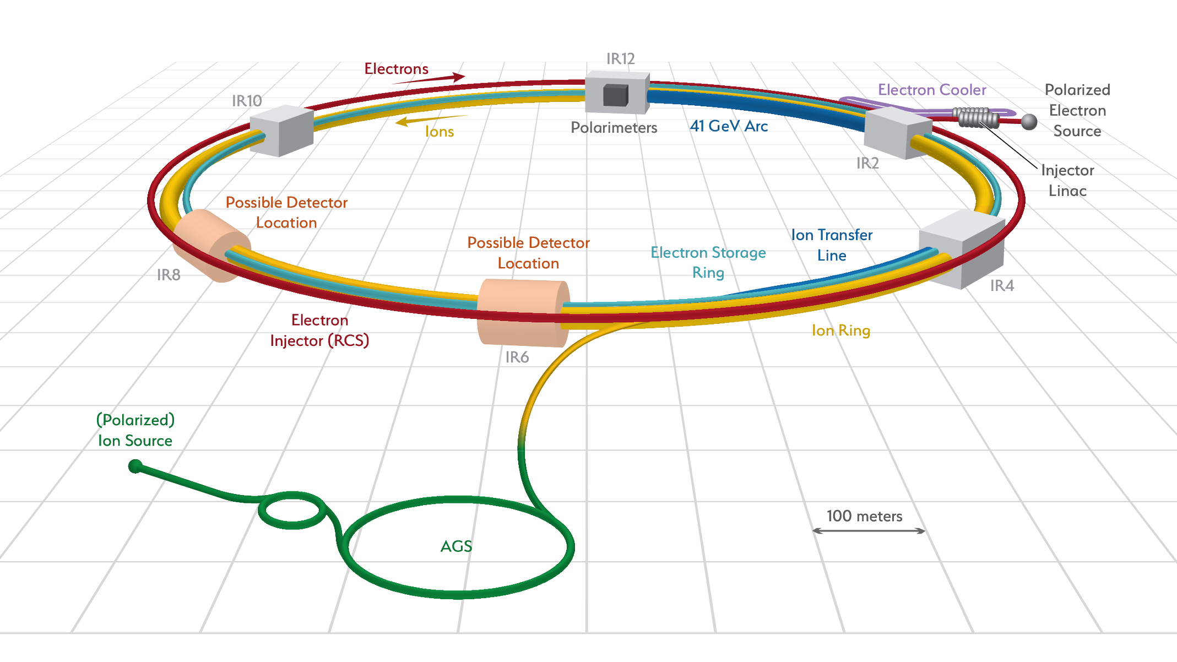
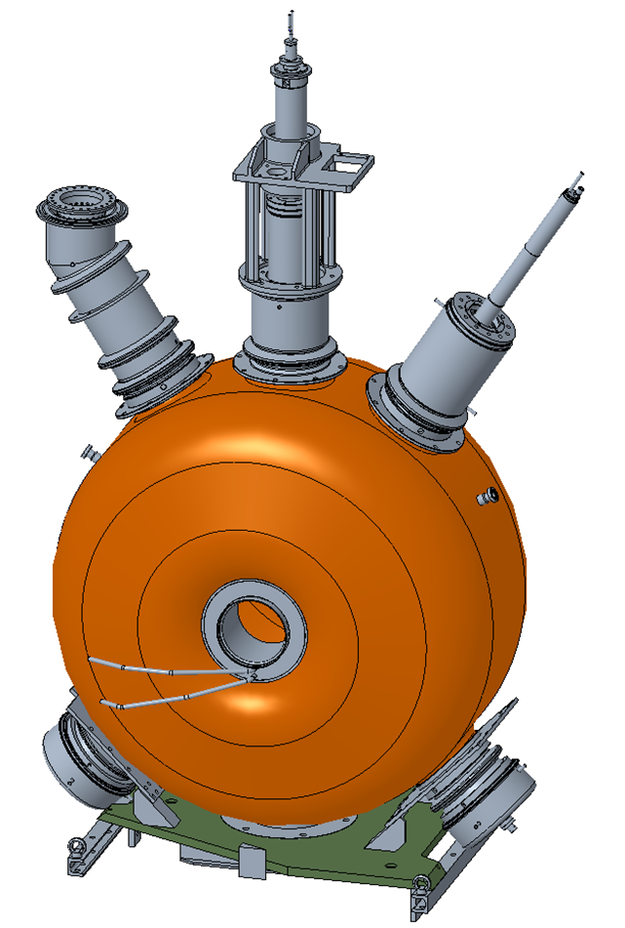
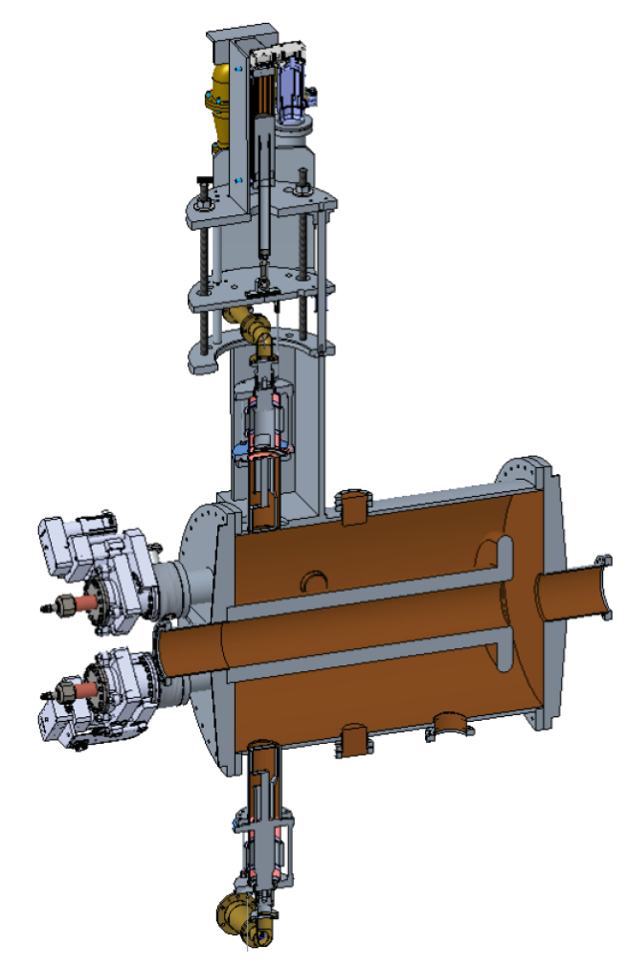
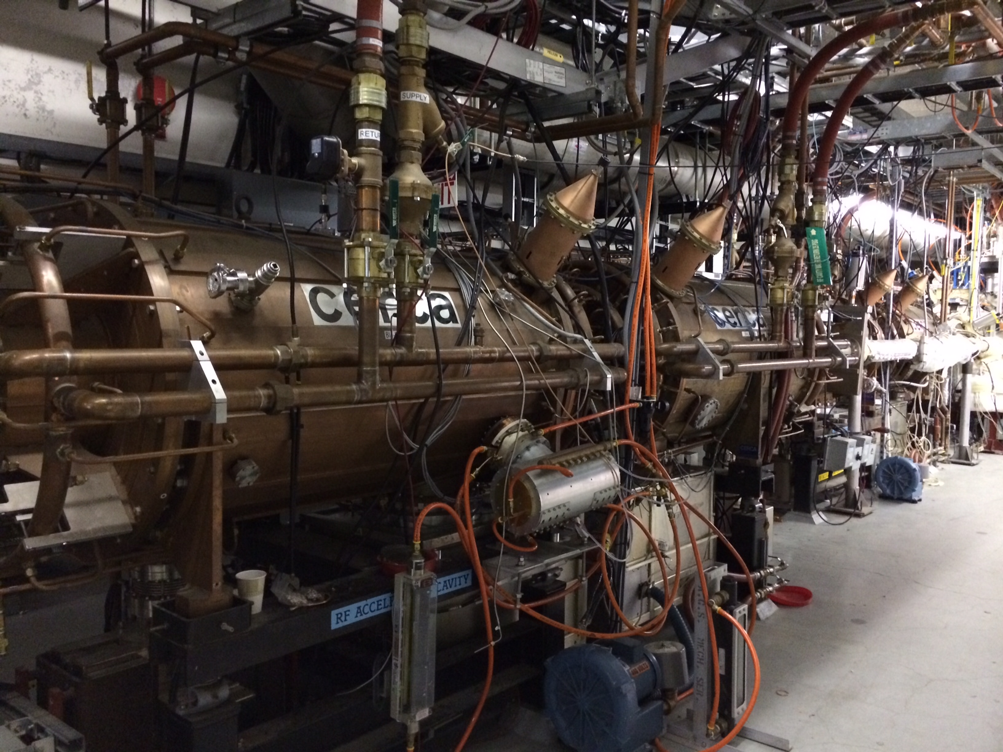
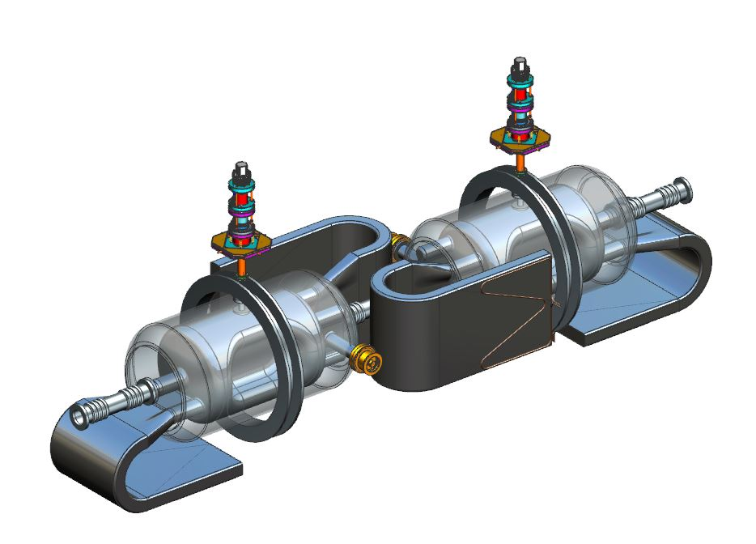
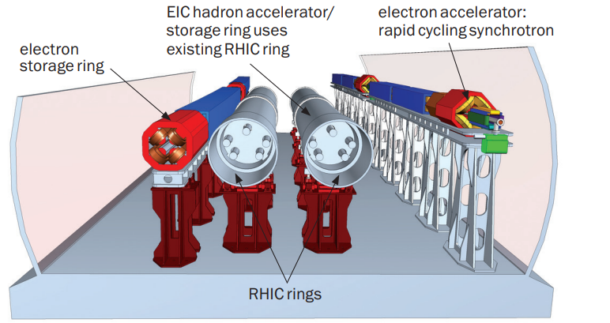
EIC RF systems
Hadron - 591 MHz bunch compression cavity
Hadron Cooling - 591 MHz acceleration cavity
Electron - 591 MHz electron storage cavity
Hadron - 197 MHz bunch compression cavity
Rapid Cycling Synchrotron - 591 MHz acceleration cavity
Hadron – 24.5 MHz acceleration cavity
Hadron – 49.2 MHz and 98.5 MHz bunch splitter cavity
Both rings –crab cavities
3

Slide 4
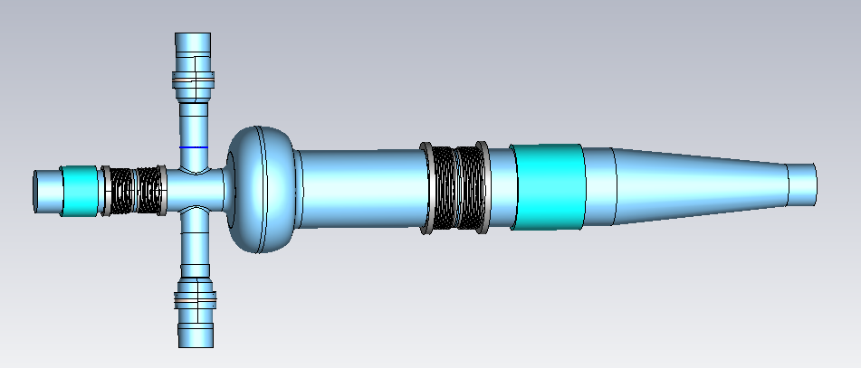
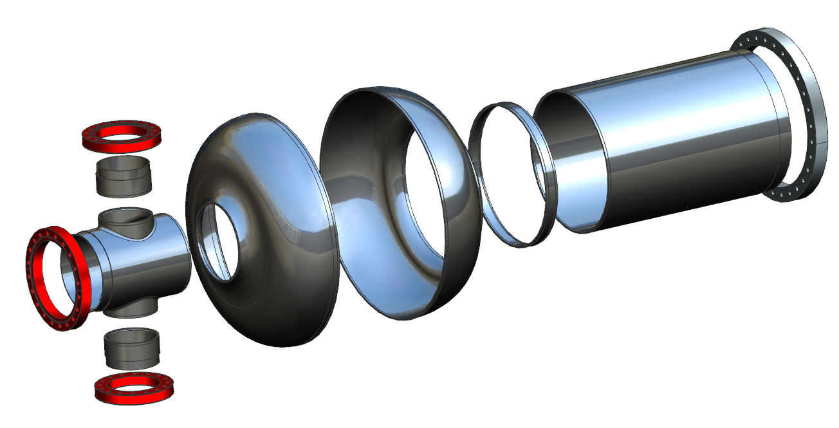
ESR RF system
Up to 68 MV using 17 new 591 MHz 1-cell SRF cavities
maintain 1% Bucket height from 5-18 GeV
Naturally short bunch length <1cm
10MW maximum beam power
>40 kW HOM power per cavity
2.5A maximum current
Two fundamental power couplers per cavity, ~400kW ea.
Thermal analysis under way
Developed asymmetric option
25% shorter, 11% lower loss factor, power to remaining large BLA up 13%
Eliminates one taper, more space for FPC
Fits better in IR10 available space.
Preparing for prototype cavity fabrication
Nb sheet and die material in hand
Fabrication plan and die designs in progress
New asymmetric design

Slide 5
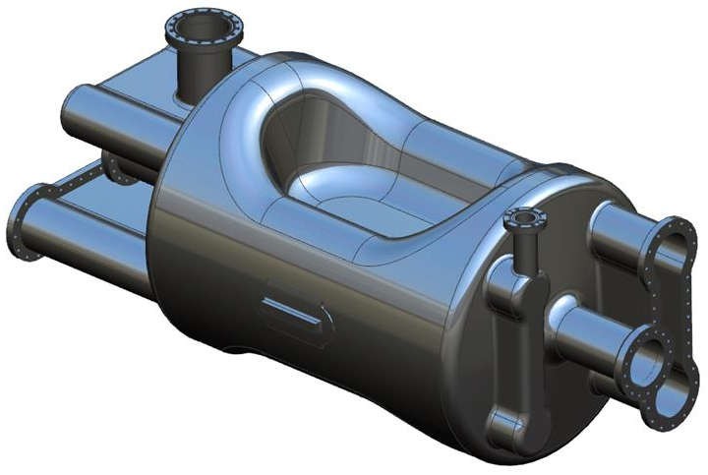
EIC Crab Cavity Systems
FPC
 | V_{t} [MV] |  | No. of cavities (per IP)
System | HSR | ESR | HSR | ESR
197 MHz | 33.83 | – | 8 | –
394 MHz | 4.75 | 2.90 | 4 | 2
Pick Up
VHOM
Dogbone
HHOM
Dogbone
HSR will be installed with two 197 MHz RFD cryomodules and one 394 MHz cryomodule each side of the IP Total length < 12.5 m
ESR requires only one 394 MHz cavity each side of the IP
Impedance budget allows for second IP
197 MHz crab cavity is identified as one of first RF cavities to be prototyped

Slide 6
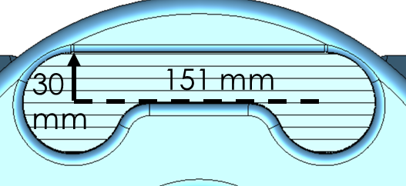
ESR 394 MHz RFD Crab Cavity
Beam aperture = 100 mm
394 MHz design for the ESR has tighter impedance budget
Total impedance budget: Z_{z} = 2.6×10⁴ Ω-GHz and Z_{t} = 0.96×10⁶ Ω/m
Per cavity: Z_{z} = 6.5×10³ Ω-GHz and Z_{t} = 0.24×10⁶ Ω/m (For 4 cavities considering the two IPs) With increased crossing angle at the second IP, no of cavities may need to be increased to 8
Will reduce the impedance threshold per cavity
WOW type crab cavity as the backup plan
Property | Bare Cavity
Operating frequency | 394.0
1st HOM [MHz] | 537
E_{p}/E_{t}* | 3.87
B_{p}/E_{t}* [mT/(MV/m)] | 8.08
B_{p}/E_{p} [mT/(MV/m)] | 2.09
G [Ω] | 125.4
R/Q [Ω] | 308.6
R_{t}R_{s} [Ω²] | 3.9×10⁴
V_{t} [MV] | 2.9 | 1.45
E_{p} [MV/m] | 29.5 | 14.75
B_{p} [mT] | 61.56 | 30.78
Total V_{t} [MV] | 2.9
No. of cavities | 1 | 2
Cavity Length [mm] (iris-to-iris) | 535.6
Cavity Diameter [mm] | 356.3
Pole Length [mm] | 300
Preliminary
Single ridged waveguide cross section
* E_{t} = V_{t}/(λ/2)

Slide 7
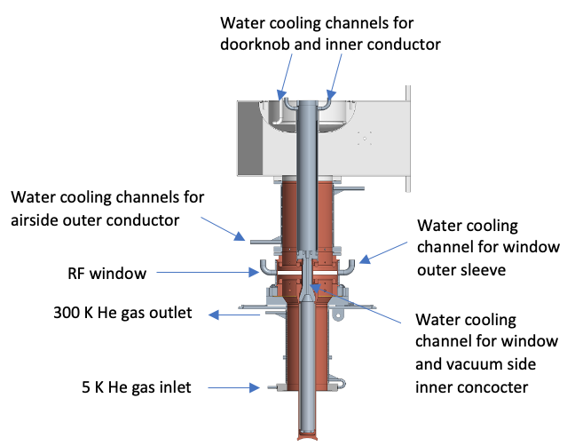
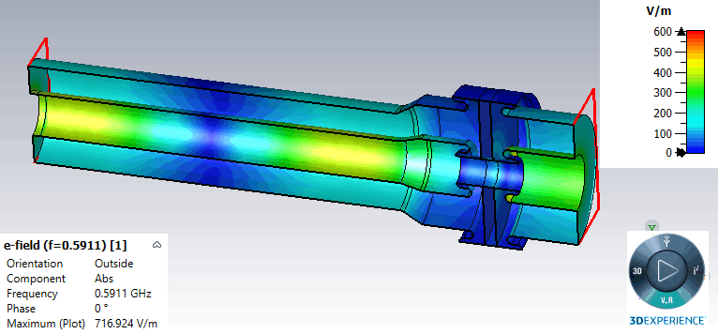
High power FPC Status
A high power ( CW 500 kW standing wave) alumina window FPC was designed for EIC ESR SRF cavity.
The design was reviewed by an international technical review committee in June 2021.
The review committee stated their “support moving forward with this design into prototype stage”.
Detailed engineering design for window and vacuum side has been finalized and in the process of prototyping.
FPC airside is almost finalized, purchasing materials for fabrication.

Slide 8
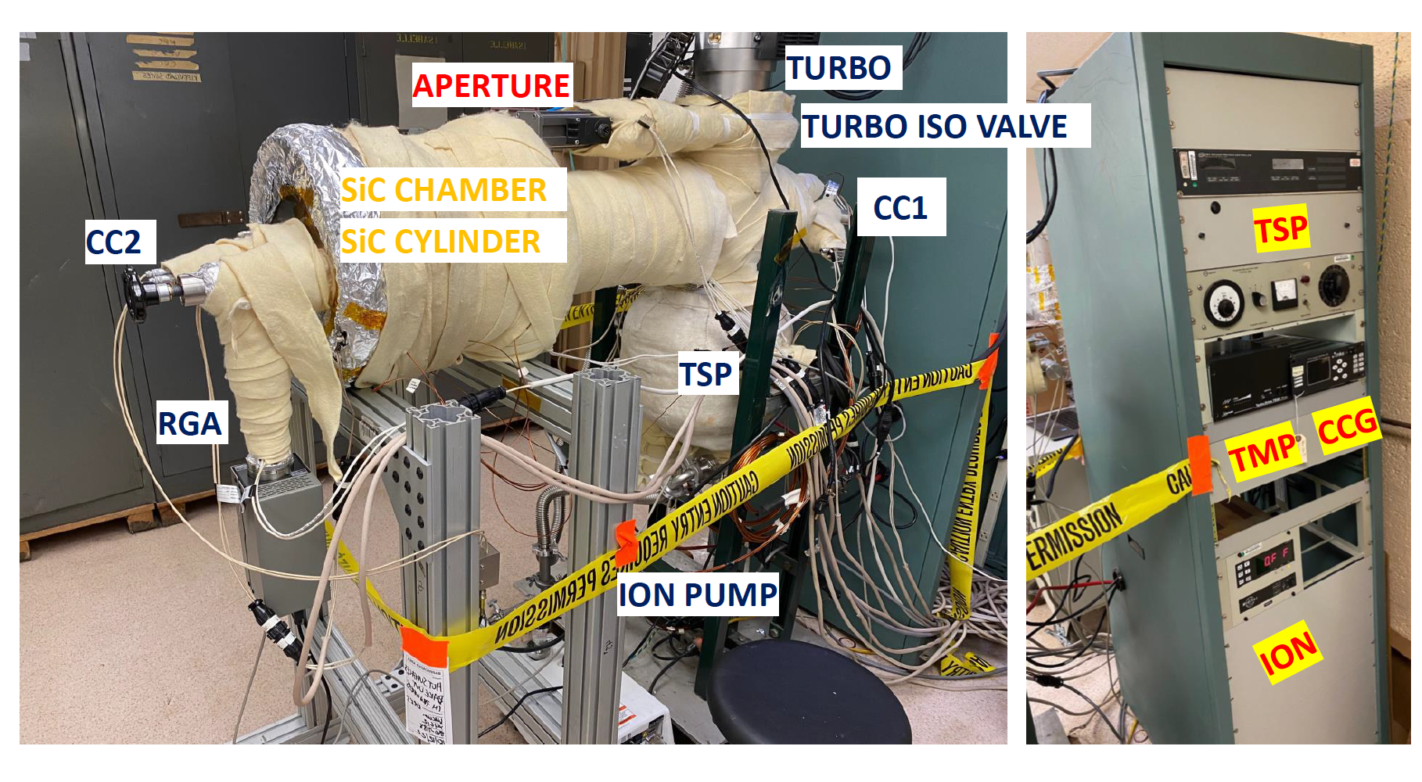
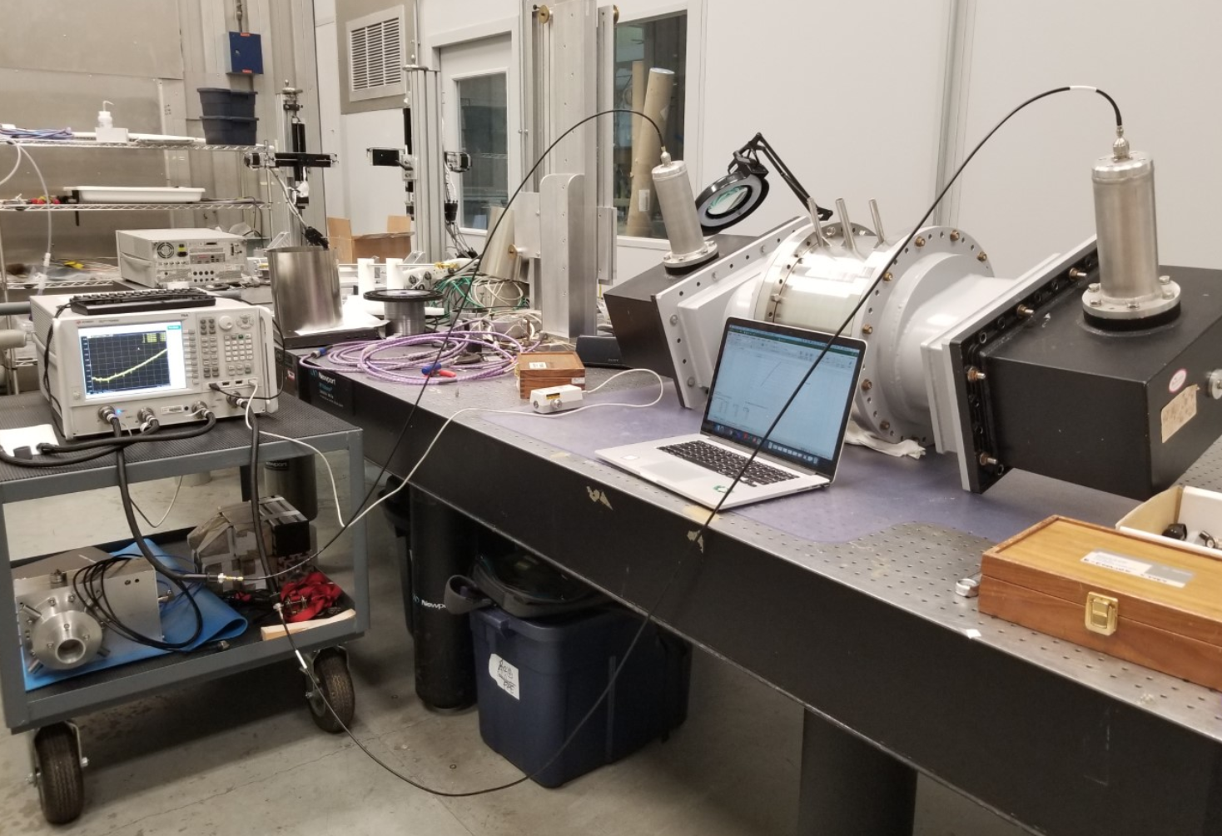
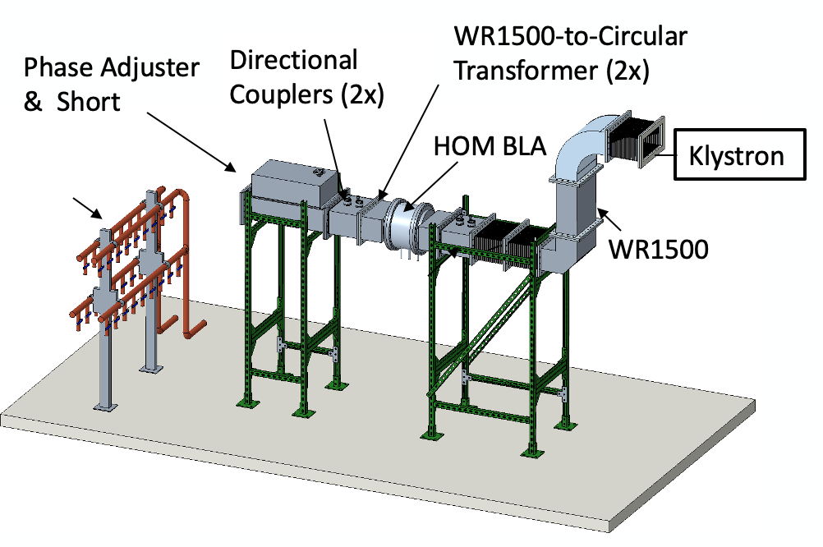
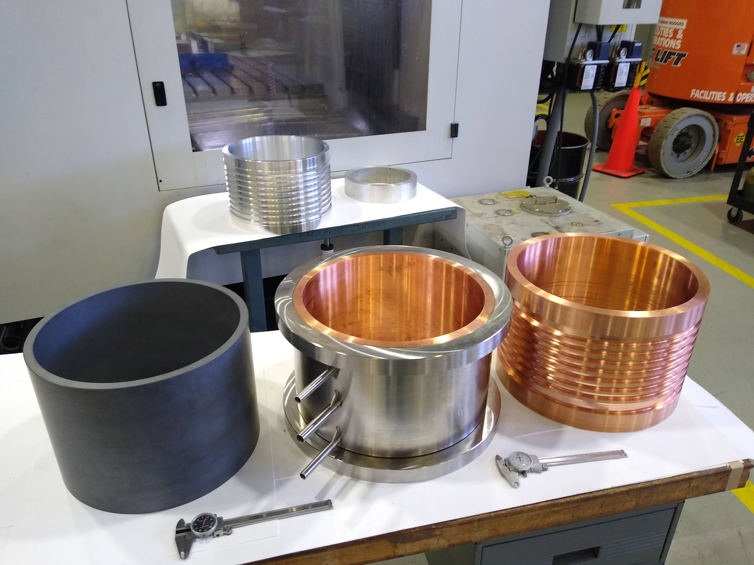
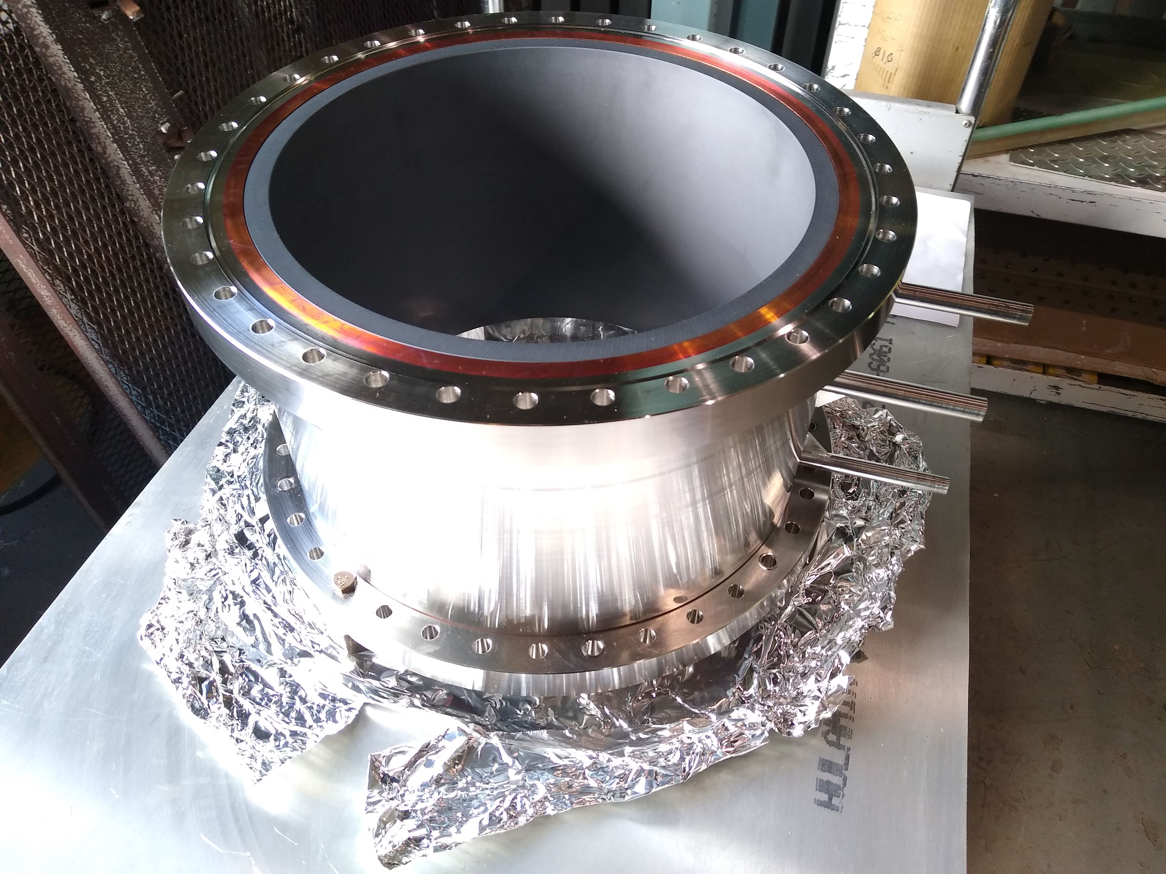
HOM damper R&D status
First outgassing test were completed with solid SiC HOM damper.
Low power measurement on solid SiC HOM damper, result is close to expectation.
SiC samples were ordered and RF properties measurements are ongoing
Back up segmented design being developed via SBIR
8

Slide 9
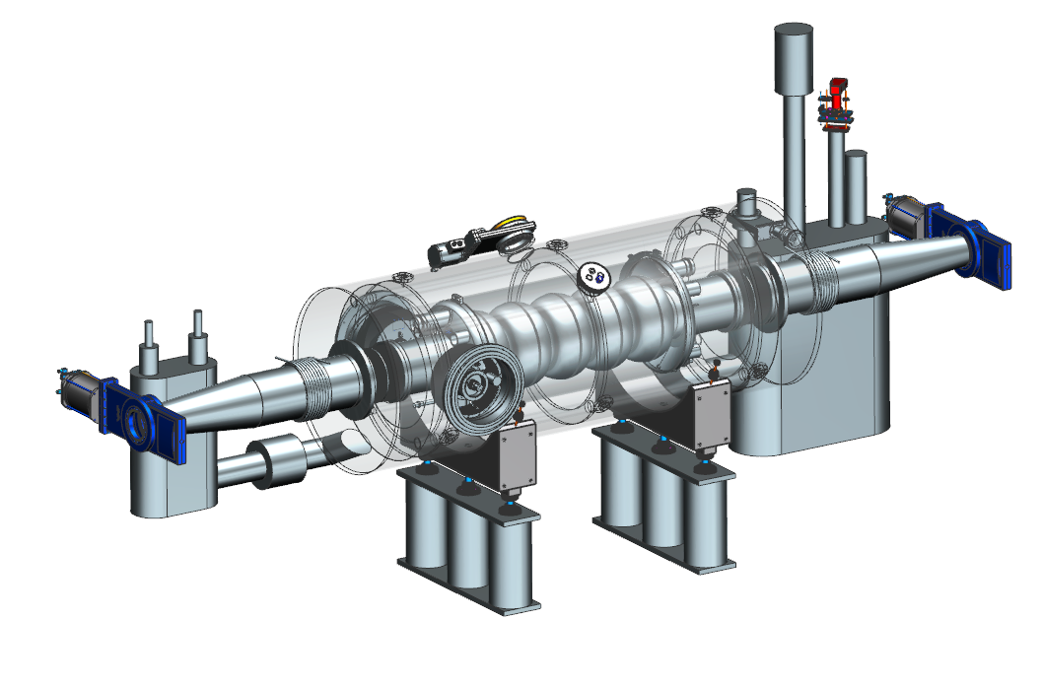
HSR RF system
Keep existing 6 MV 6x197 MHz NCRF system
Re-tune existing 2x 28 MHz system to 24.6 MHz
Add 2x 49.2MHz and 2x 98.5MHz NCRF for binary bunch splitting
Add 20 MV 591 MHz SRF system
Up to 0.75A beam, up to 1160 bunches
Optimum detuning for reactive power (like LHC)
Beam loading transient and collective effects studies started
Hadron - 197 MHz bunch compression cavity
Hadron – 24.5 MHz acceleration cavity
Hadron – 49.2 MHz and 98.5 MHz bunch splitter cavity
Hadron - 591 MHz bunch compression cavity

Slide 10
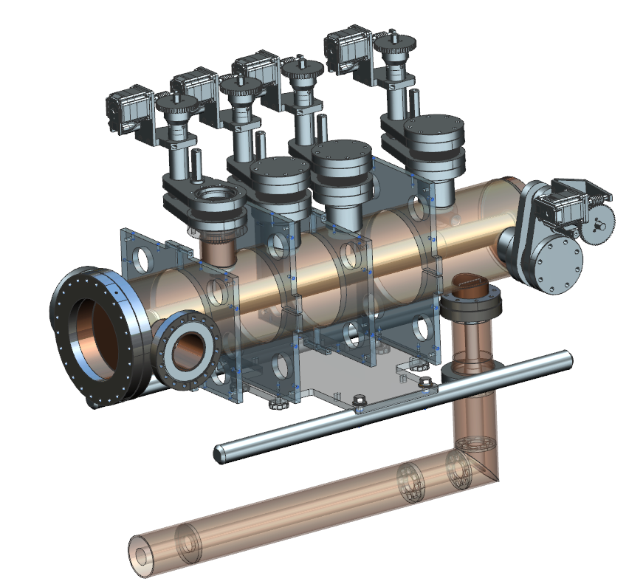
RCS
Requires rapid acceleration of one or two high charge bunches per cycle for full energy injection
3x 591 MHz 5-cell cavities
Bunch merging to achieve peak bunch charge
Harmonic injection kicker into RCS
Fast kickers for injection into ESR
new
RCS- 591 MHz acceleration cavity
Harmonic kicker cavity

Slide 11
Cooler 591 MHz 5-cell
In CDR common design assumed for HSR, RCA and cooler ERL
Baseline scaled from ESR 1-cell
Warm BLA HOM dampers
Symmetric FPC’s
Long tapers
ERL has the most 5-cell cavities
Lower HOM power
Tight space constraints
Evaluating other HOM options
591 MHz 5-cellcavity

Slide 12
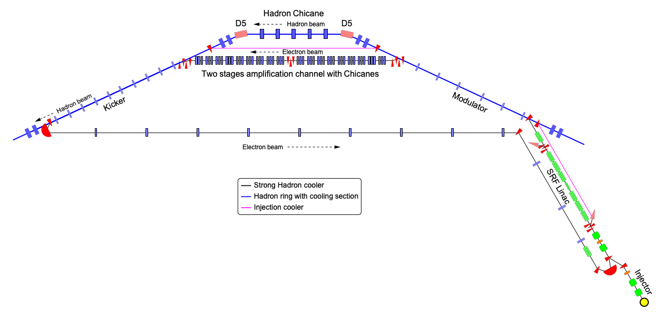
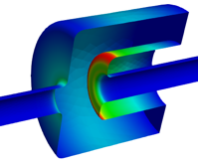
Strong Hadron Cooler ERL layout
591 MHz 5-cells +
1773 MHz 5 cells
400-500kV DC gun for 100 mA of beam and 5.6 MV SRF injector
Dogleg ERL merger
149 MeV Superconducting Energy Recovery LINAC
Electron and hadron overlapped cooling sections.
Amplification section with chicanes and triplets for electrons
Hadron chicane path length matching & R₅₆ adjust
Return transport of electron beam to ERL
Possibility to include injection pre-cooler in the same location
197 MHz QWR

Slide 13
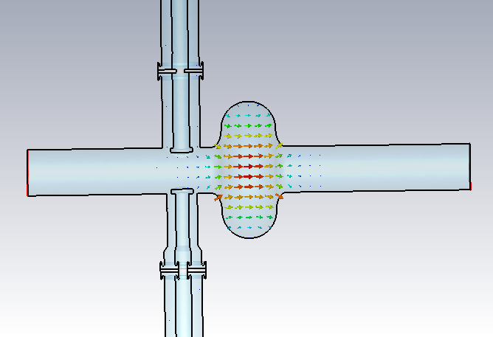
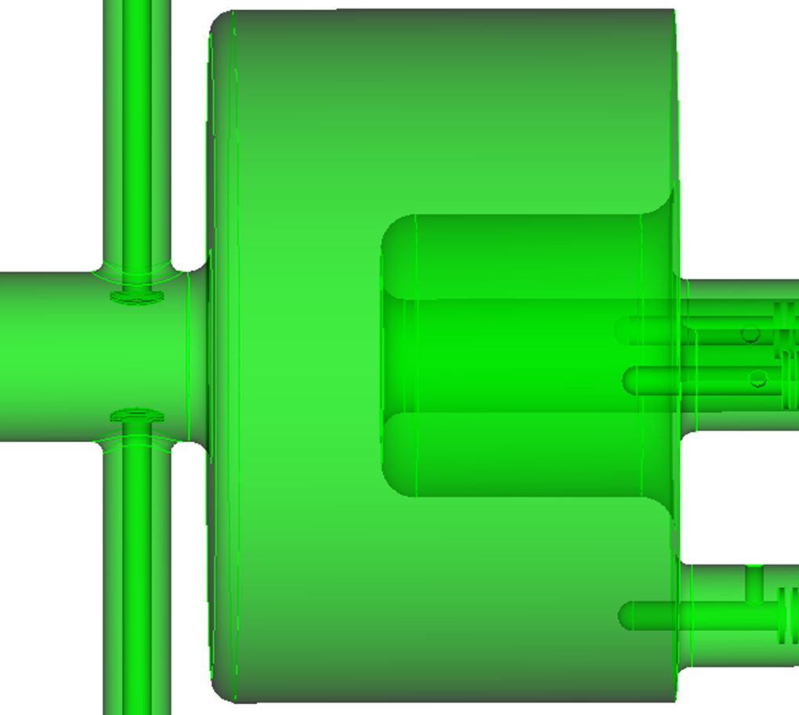
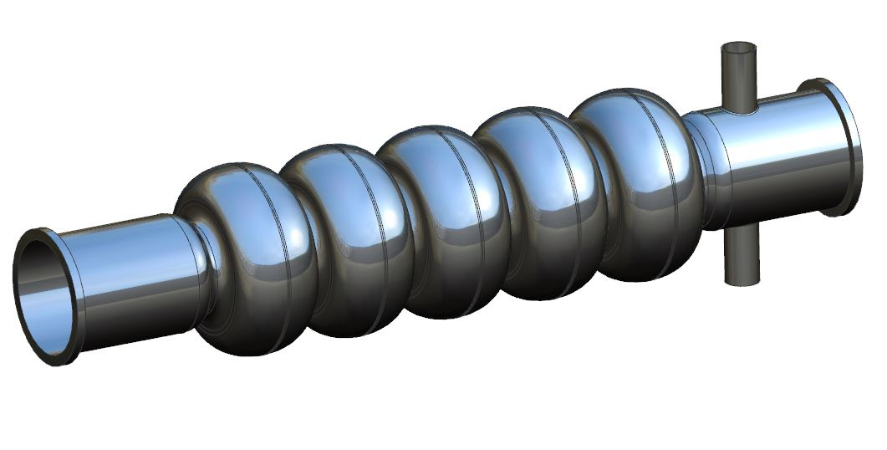
The SRF cavities for the cooler-ERL
A single-cell elliptical cavity @ 591MHz (booster)
197 MHz QWR (booster + precooler)
FPC
HOM dampers
A five-cell elliptical cavity @ 591MHz (Linac)
Small beam pipes, weak HOM damping
Large beam pipes, strong HOM damping

Slide 14
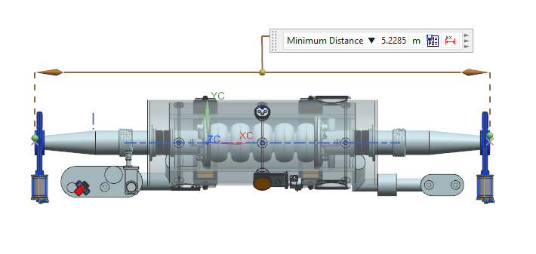
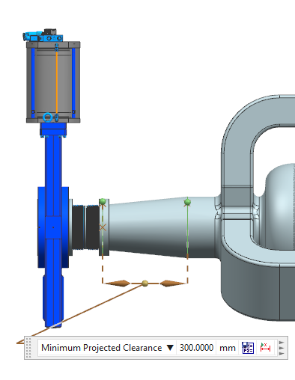
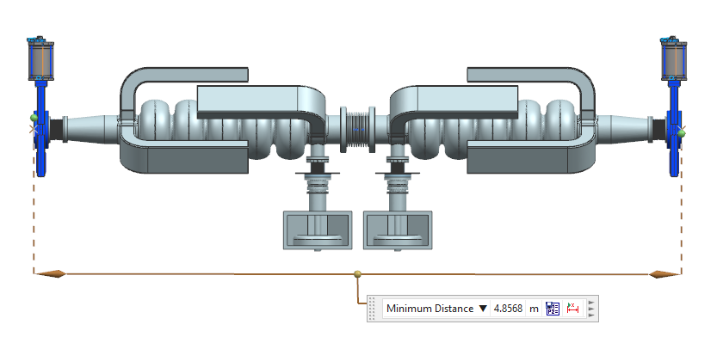
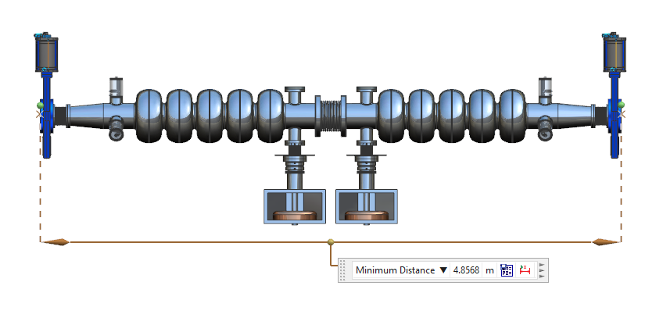
Compact 5-cell options
For 100 mA HSR cavity may be overkill
Standard 5-cell
Two per string
Compact end groups
Waveguide
JLab, HZB
Coaxial
HERA, LHC,
TESLA, C100
Need more analysis
150mm
DIA
210mm
DIA
WAVEGUIDE END GROUPS
COAXIAL END GROUPS

Slide 15
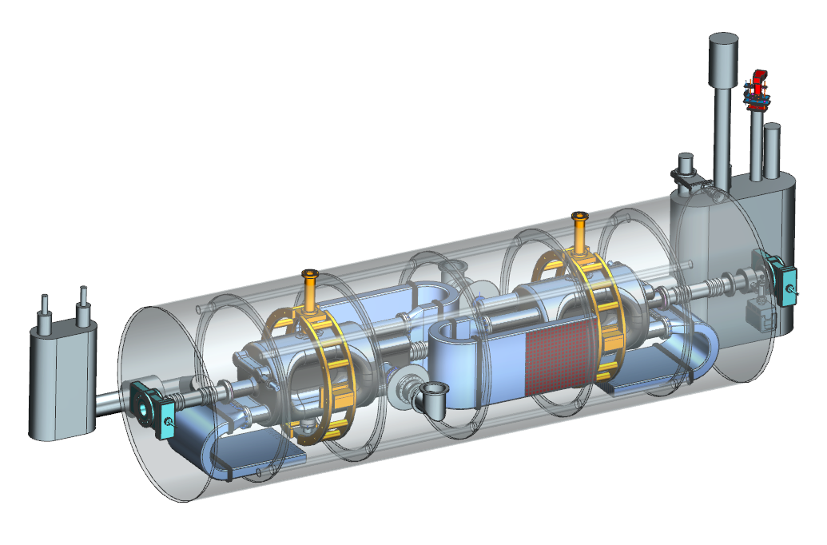
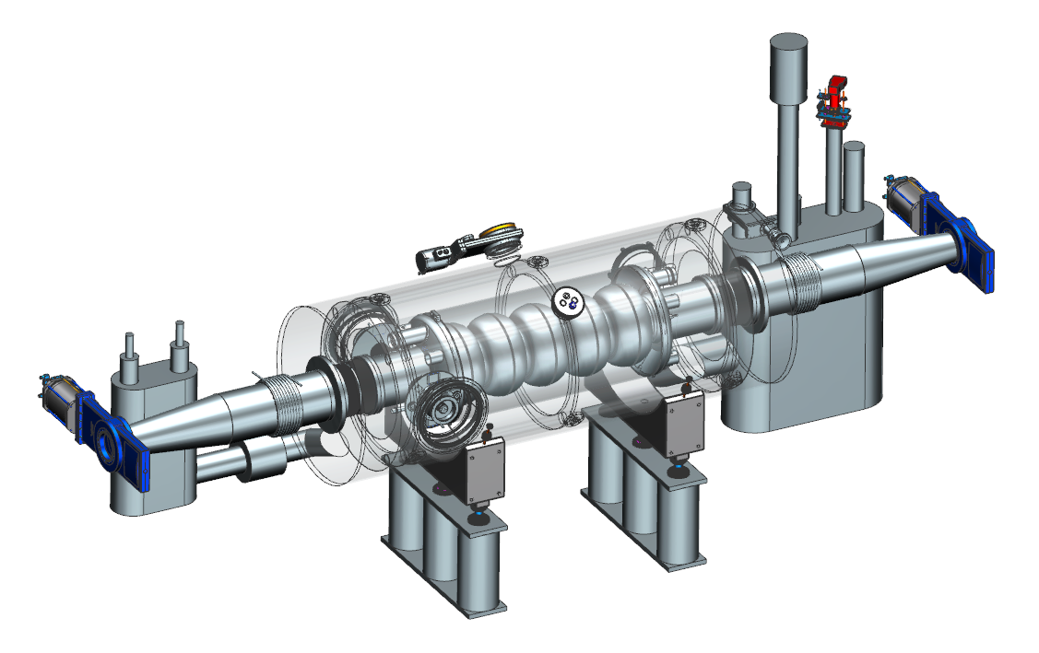
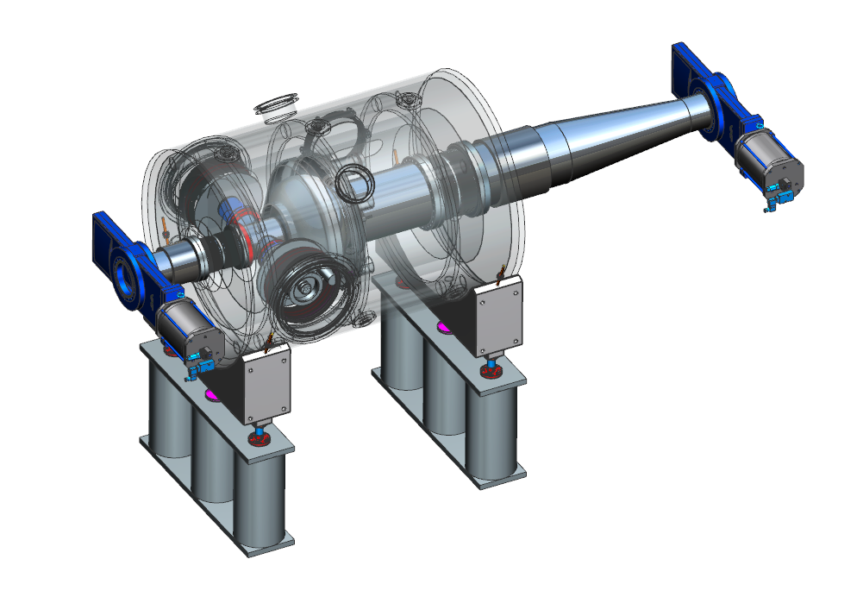
Modular cryostat
Based on SNS cryostat dimensions
High degree of commonality of components
Takes advantage of much existing tooling
Cryogenic distribution TBD (SNS PPU shown)
ESR 591 MHz 1-cell
HSR 197 MHz crab
And others!
394 MHz crab
197 MHz QWR
1773 MHz elliptical
Cooler injector
HSR 591 MHz 5-cell
Also RCS and ERL

Slide 16
Summary
Continuing to develop SRF designs
ESR 591 MHz asymmetric cavity
197 MHz Crab cavity
394 MHz RF design starting, not just a simple scaling
FPC and BLA R&D progressing according to plan
Cooler ERL is a challenging machine by itself
591 MHz 5-cells can be developed from the 1-cell
Baseline BLA HOM damping
More compact options possible
197 MHz and 1773 MHz also needed
Modular cryostat
Will speed up development, minimize total design effort

Slide 17
Thank You
^{References:}
EIC Conceptual Design Report, 2021, https://www.bnl.gov/ec/files/EIC_CDR_Final.pdf
Design of the Electron Ion Collider Electron Storage Ring SRF cavity, ^{J. Guo et. Al., Proc. IPAC22}
HOM damper design for BNL EIC 197MHz crab cavity, Binping Xiao et. al. Proc IPAC21, Brazil

Slide 18
Back ups

Slide 19
Strong Hadron Cooler ERL Specifications
The EIC cooler ERL features unprecedented beam current and small energy spread.
The 1D cooling simulation yields a cooling rate higher than the IBS heating.
Case 100 GeV 275 GeV
Electron Energy (MeV) 55 150
Electron Norm. Emit. (x/y) (mm-mrad) 2.8 / 2.8 2.8 / 2.8
Repetition rate (MHz) 98.5 98.5 Electron Bunch Charge (nC) 1 1 Electron Peak Current (A) 8.5 17 Electron Bunch Length (mm, rms)* 14 7 Electron Fractional Energy Spread 10⁻⁴ 10⁻⁴ Hor./Vert. Elec. Betas in Modulator (m) 86.6 / 14.1 64/ 11
Hor./Vert. Electron Betas in Kicker (m) 49.7 / 10 16 / 2 Modulator Length (m) 55 55 Kicker Length (m) 55 55
H/V/L Cooling time(hr) 1.3/2.5/1.7 0.8/2.1/1.2
* Gaussian bunch assumed

Slide 20
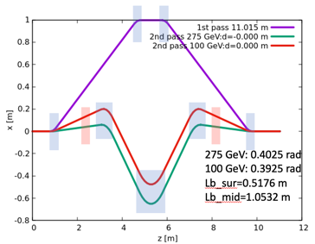
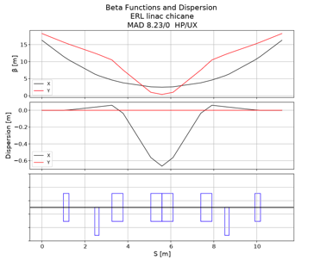
New design: SHC+precooler injector and Linac
off-crest=30 deg
R56=0.475 m
off-crest=1.2 deg
Precooler bunch charge is 2 nC for 10⁻⁴ dp/p, 197 MHz cavities will be needed.
SHC takes advantage of using 197 MHz and compresses the beam at 14 MeV using chicane.
The chicane has four dipoles for 14 MeV beam and other three dipoles for high energy return beam. They have the same time of flight.
Using 591 MHz+1774 MHz cavity to accelerate beam to the cooling energy.

Slide 21
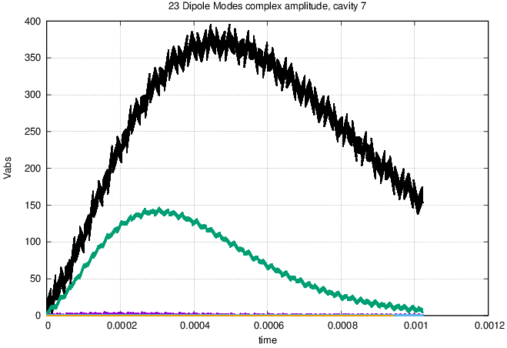
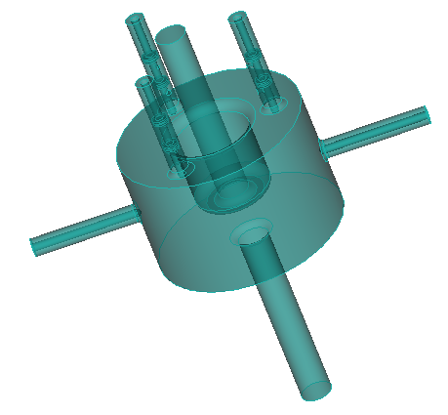
QWR HOM coupler tuning
dipoleModeQ[0] = 2.0e5;
dipoleModeQ[2] = 1.8e5;
dipoleModeQ[11] = 5.0e5;
Q_{ext} (x10⁵)
Case | 28 | 39 | 40v1 | 40v2 | Target
Fundamental mode | 8.33 | 8.33 | 8.33 | 8.32 | 8.33
Dipole Mode 0 | 5.96 | 3.03 | 5.47 | 2.59 | 2.0
Dipole Mode 2 | 4.23 | 2.13 | 8.66 | 0.361 | 1.8
Dipole Mode 11 | 10.6 | 7.0 | 0.052 | 0.072 | 5.0

Slide 22
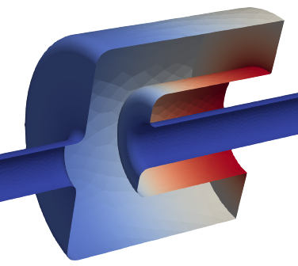
Starting point and geometry parameter scanning
cav_L
gap_L
Rounding_2
cav_IR
cav_OR
Shaoheng Wang
cav_OR = 305 mm
cav_IR = 125 mm
cav_L = 408 mm
gap_L = 150 mm

Slide 23
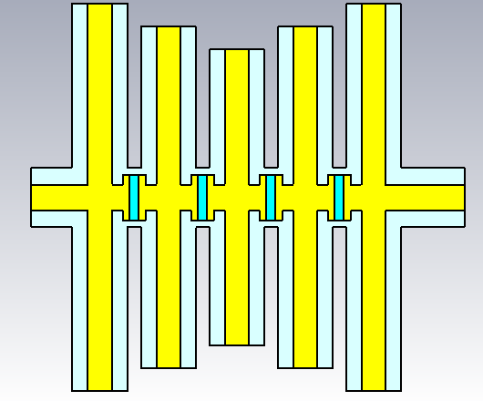
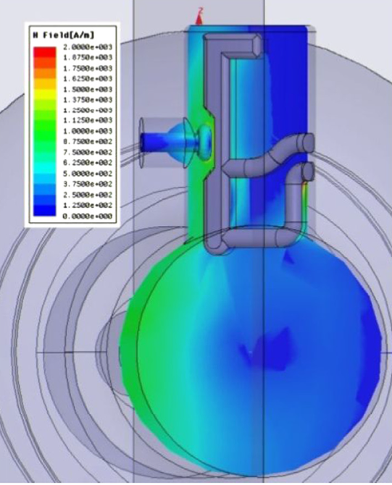
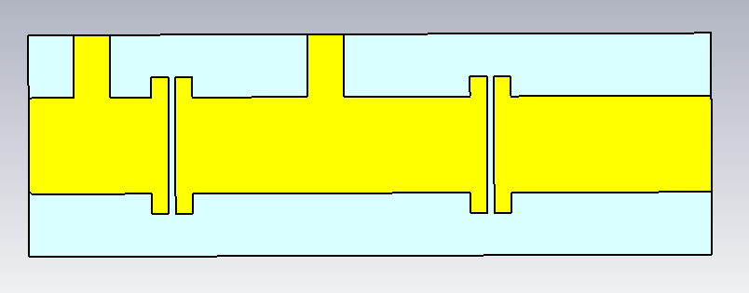
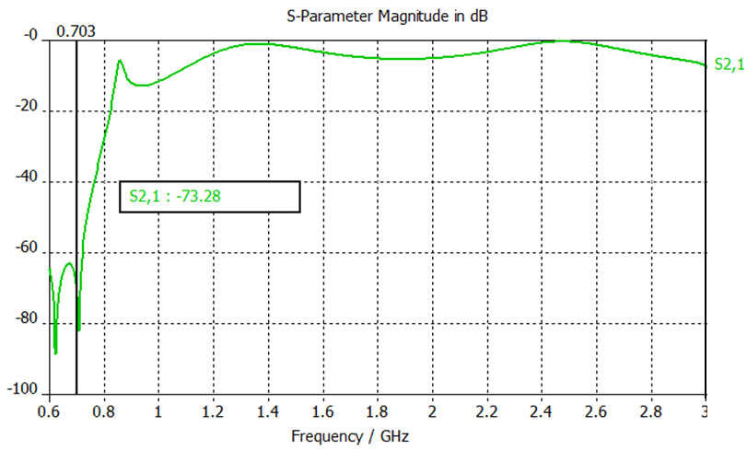
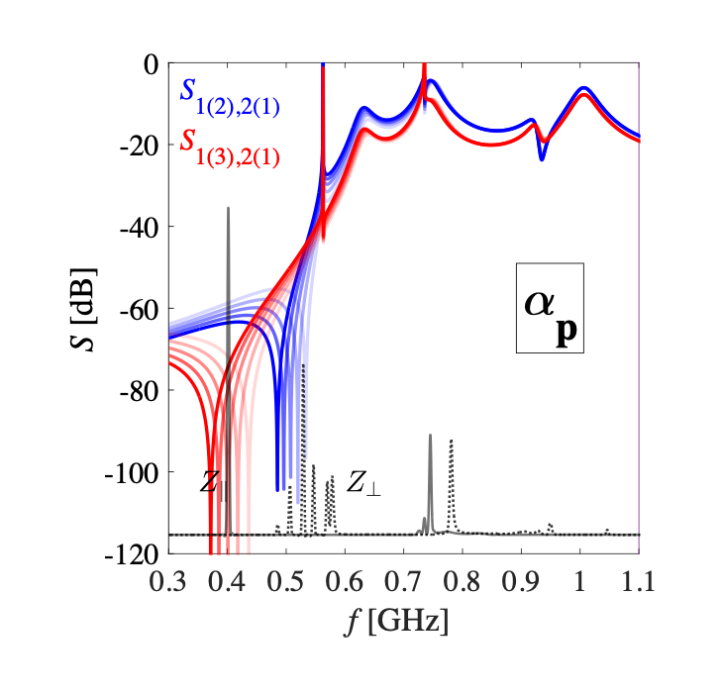
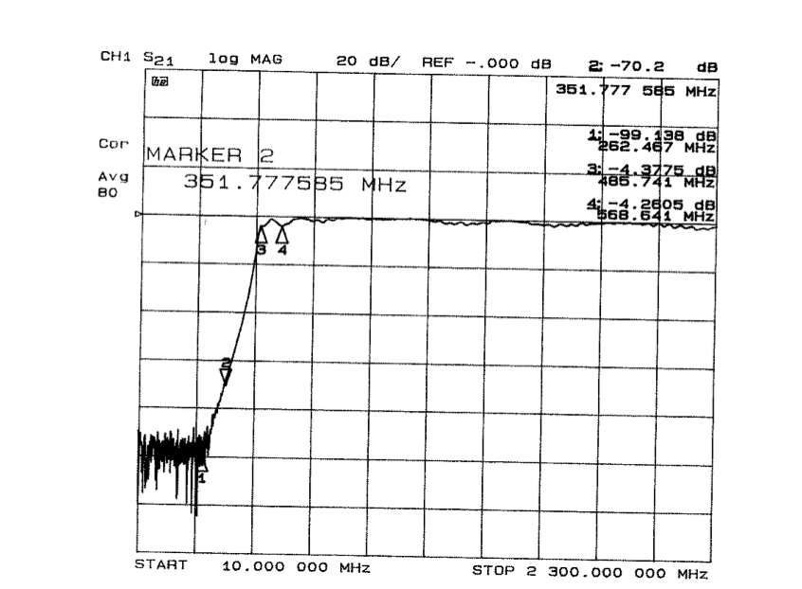
Alternative models for the HOM damper (transmission part)
The 9th order Chebyshev filter
The TESLA type
The 4th order Butterworth filter

Slide 24
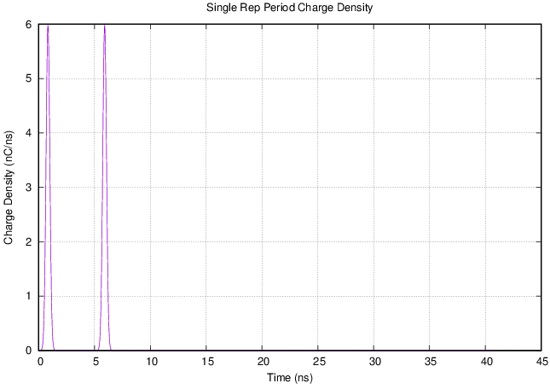
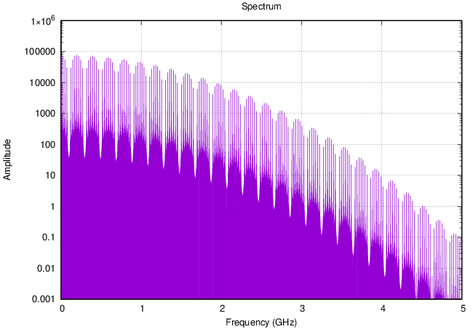
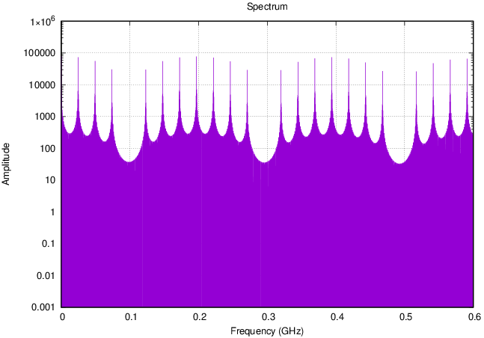
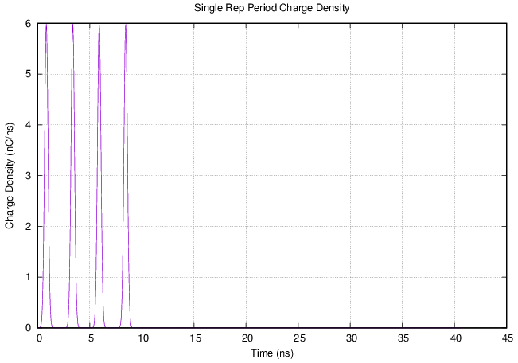
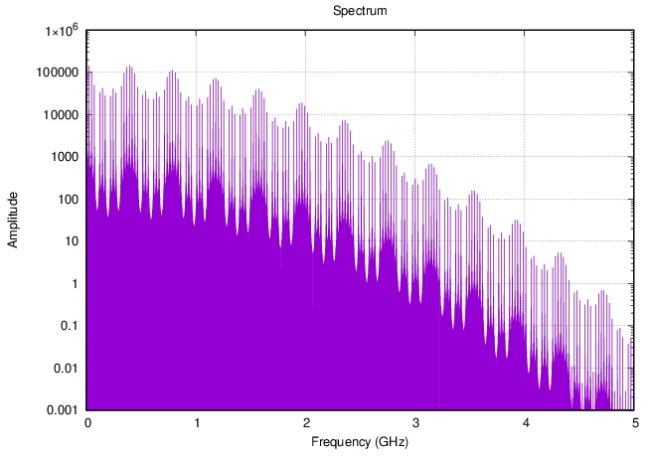
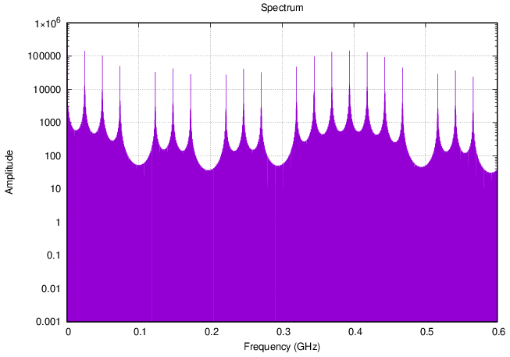
HOM spectrum pre-cooler 23.8 GeV Case, with Gap
Electron bunches in one proton bunch interval
ERL Mode
Electron bunches in one proton bunch interval

Slide 25
ERL Challenges
Low noise electron beam
High current ERL
Beam halo
BBU
Ion trapping
High current high charge electron source (EIC R&D)
Beam diagnostics: beam noise, beam halo, e-h alignment (~250 nm), energy spread measurement(<1e-4).
CW multi-XFEL
1 GW
CW with P_{beam}>P_{RF}
EUV FELs
100 MW
S-DALINAC
EIC Cooler ERL
10 MW
legacy
operating
under construction
proposed
1 MW
1 kW
10 kW
100 kW

