Slide 1
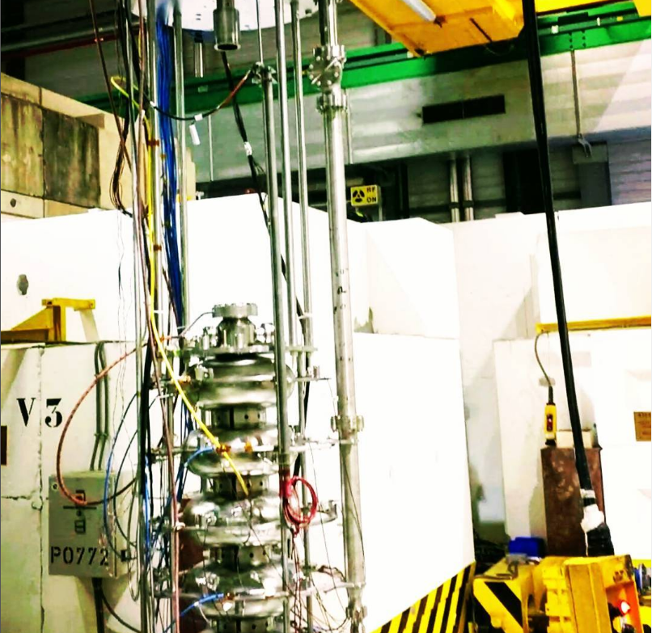
FRT Developments at CERN
N. Shipman on behalf of:
I. Ben-Zvi, J. Bastard, G. Burt, M. Coly, A. Edwards, C. Jing, A. Kanareykin, A. Macpherson, N. Stapley, H. Timko
Acknowledgements
M. Barnes, D. Barrientos, A. Castilla, F. Gerigk, W. Hofle, P. Kohler, E. Montesinos, G. Pechaud, P. Schneider, D. Smekens, D. Valuch, W. Venturini
Presented at:
ERL Workshop 3-6th October Cornell University

Slide 2
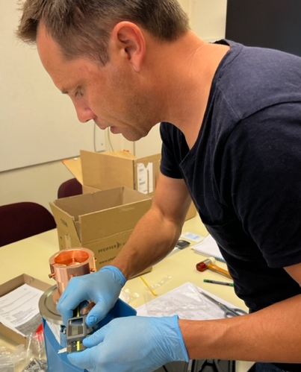
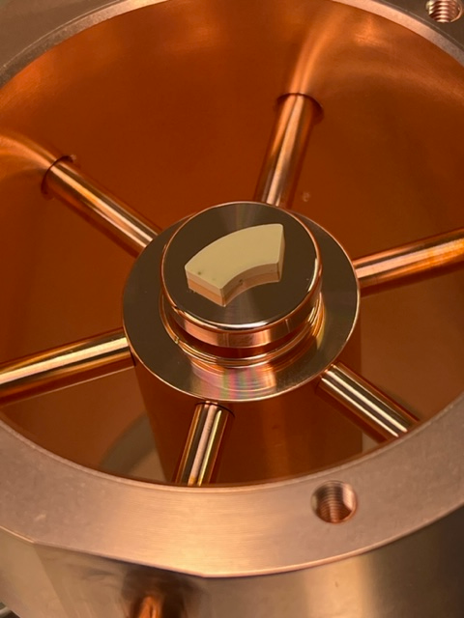
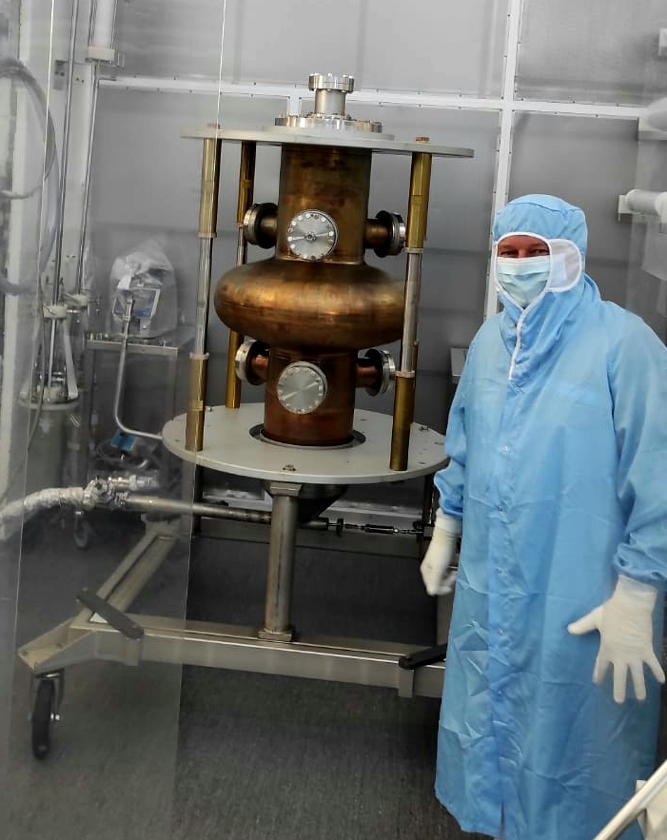
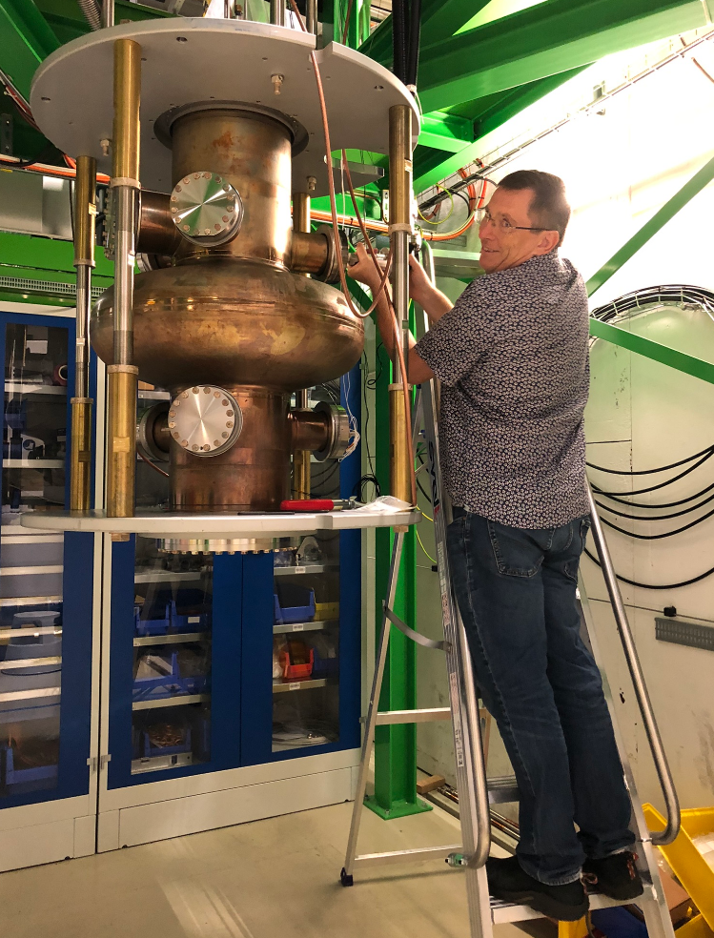
Introduction
FRTs are a new type of extremely fast non-mechanical tuner
Microphonics suppression with a prototype FRT has been demonstrated
CERN is developing and testing improved FRT designs
Research focus at CERN is now “transient detuning” for HL-LHC
Compensation of transient beam loading using an FRT

Slide 3
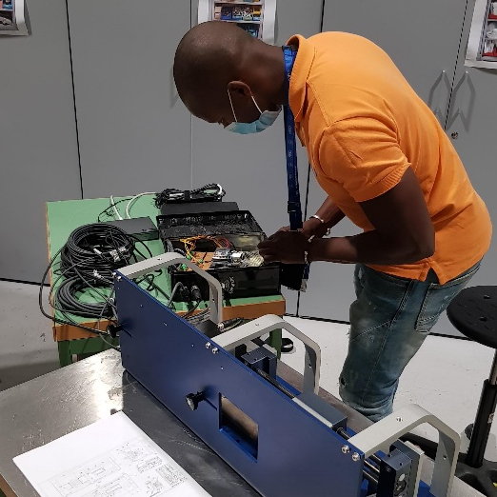
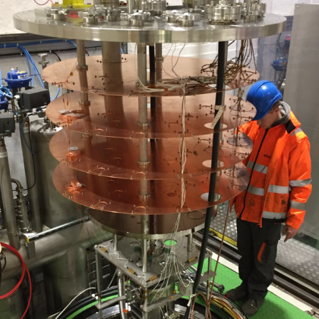
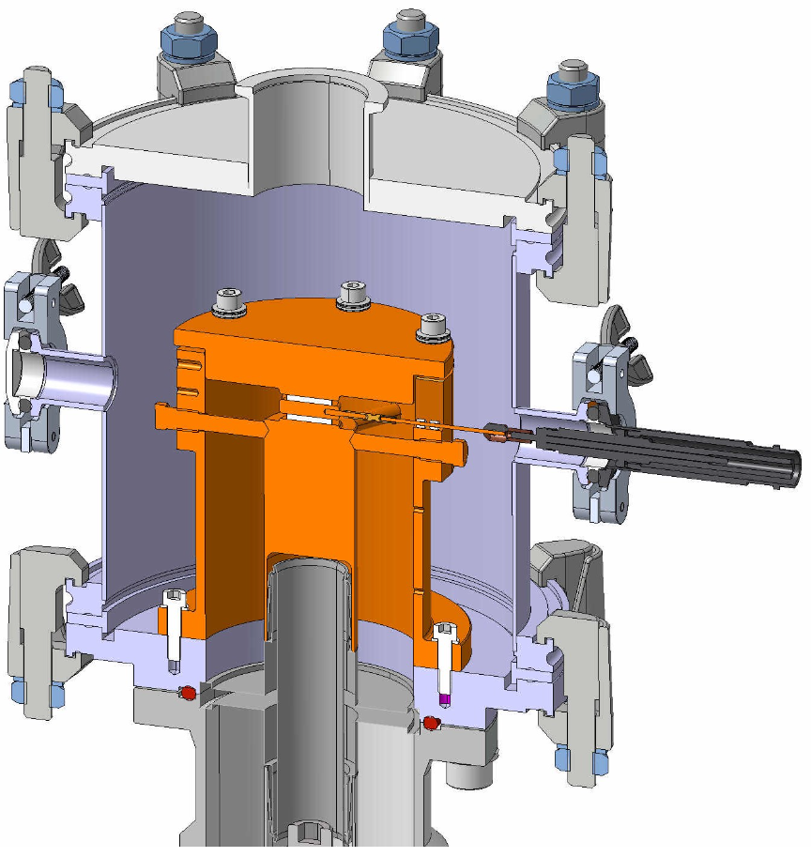
Agenda
FRTs
Use Cases
Microphonics Suppression Results
Transient Detuning Project
Summary

Slide 4
FRTs
Introduction to Ferro-Electric Fast Reactive Tuners

Slide 5
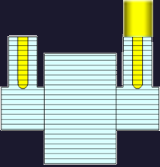
FRT Concept
Circulator
HV Line
FRT
RF Amplifier
FPC
FRT Antenna
Load
An FRT is a shorted co-axial structure containing a ferro-electric element
RF power flows into the FRT and is reflected back to the cavity
Voltage applied to the ferro-electric changes its permittivity
Permittivity change → Phase change of the reflected power → Cavity frequency change
Usually, the FRT would require its own port, although other arrangements have been proposed
Operates outside cryomodule at room temperature
Tunes cavity without mechanical deformation
Tuning speed measured at less than 600ns, limited by HV circuit

Slide 6
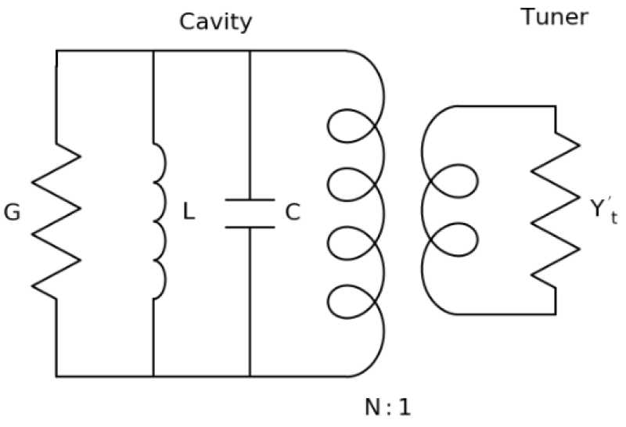
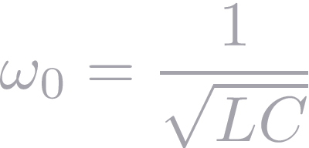
Equivalent Circuit Theory
The admittance of the FRT is:
The change in angular frequency between high voltage states n and m is:
The increase in the system bandwidth due to the FRT in high voltage state n is:
Here the R-over-Q is defined as:
The angular frequency of the cavity without FRT is:
Equivalent circuit of FRT connected to cavity
Notation | Meaning
 | Conductance of FRT
 | Susceptance of FRT
 | Coupler turn ratio
 | Cavity voltage
 | Cavity stored energy
Symbol definitions

Slide 7
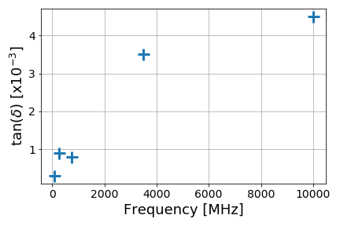
Figure of Merit and Ferro-Electric (FE) Material
Parameter | Value
Relative Permittivity | 160
Tunability | 1.4
Tuning Field | 8 Vµm⁻¹
Breakdown Strength | 20 Vµm⁻¹
Thermal Conductivity | 7.02 Wm⁻¹K⁻¹
FoM allows:
Comparison of FE-FRT designs
Estimation of benefit e.g. power reduction
FoM is ~tuning range divided by increase in bandwidth
Subscripts 1 and 2 refer to the two extreme high voltage ‘end’ states
Material FoM is FoM of a FE capacitor with only dielectric losses
Material FoM is a theoretical upper limit of FoM
Would allow comparison of different ferro-electric materials
FE is BaTiO₃-SrTiO₃ with Mg based additives
Loss tangent roughly ~ frequency
FE material parameters
30 mm
33 mm
Loss tangent vs RF frequency
(Courtesy Euclid TechLabs)
A BST(M) Ferroelectric Sample

Slide 8
Use Cases
Microphonics Suppression, RF Switching, Transient Detuning

Slide 9
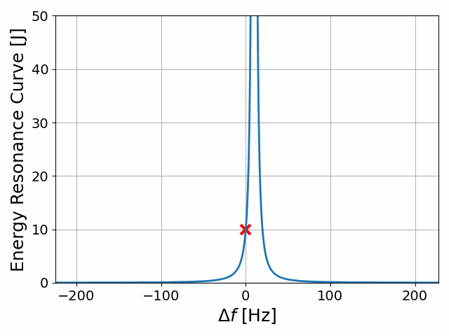
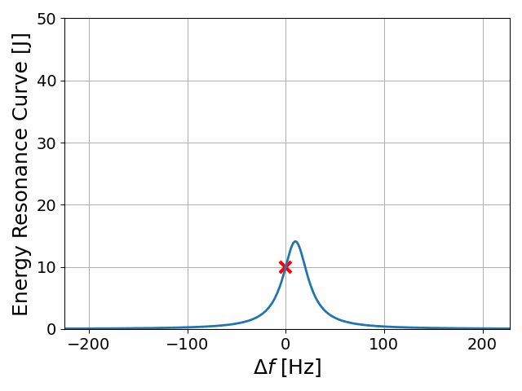
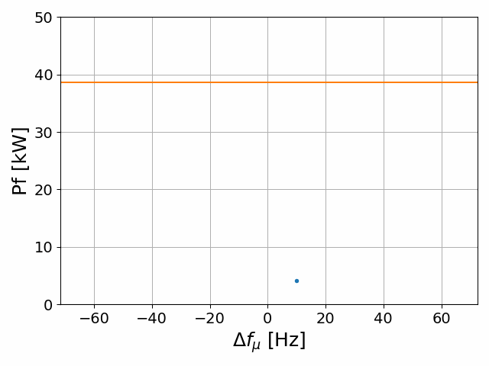
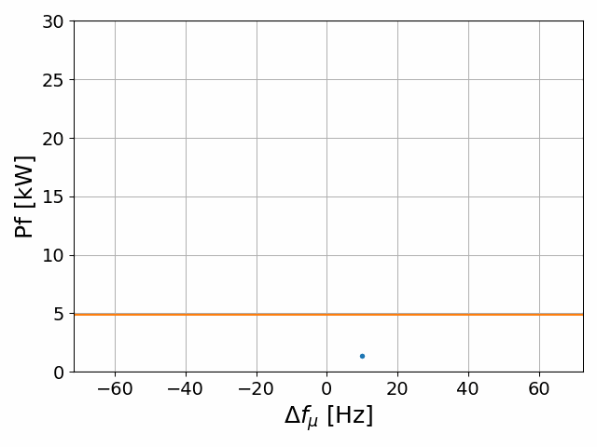
Use cases: microphonics suppression
For low beam loading machines RF power is dominated by microphonics
The effect of microphonics can be reduced passively or actively
Stiffening of cavity
Isolation of noise sources
Active feedback e.g. piezo tuners
Residual microphonics require over-coupled FPC
Typically, RF power required is still many times larger than for critical coupling case
Decreasing Q_{L}

Slide 10
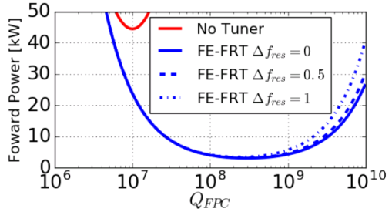
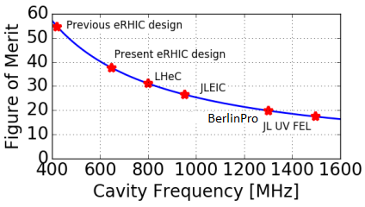
Use cases: microphonics suppression
FRTs are an excellent tool for microphonics suppression
High Tuning speed
~600ns measured limited by external HV circuit
No excitation of mechanical modes
Simple transfer function/negligible phase delay at frequencies of interest
Peak and average RF power reduced by and respectively
Increased dielectric and conductor losses at higher RF frequencies reduce effectiveness
FRTs can be combined with other suppression technologies
E.g. piezo tuners
Estimate FRTs could still beneficial up to ~2-3 GHz
Not experimentally verified
Case study: RF power for PERLE vs Qe with and without FRT
Estimated FRT FoM vs RF frequency

Slide 11
Use cases: transient detuning
RF power required for cavity with beam
Can change
Fixed
will change so either:
or must change
Normally, choice between:
Increased RF power
Cavity phase errors
Simplifying assumptions
Recently we proposed a new scheme “Transient detuning”
Transient detuning uses FE-FRT to change
Reduced average RF power (by up to FoM/2)
Increased phase stability
Fixed RF bucket position → ideal for injection
In the future, we hope to apply this to HL-LHC, project underway!
Notation | Meaning
 | RF power
 | Cavity phase derivative
 | Detuning
 | Beam Current

Slide 12
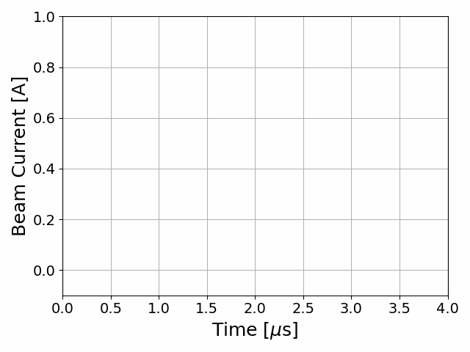
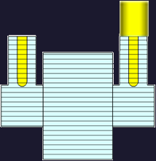
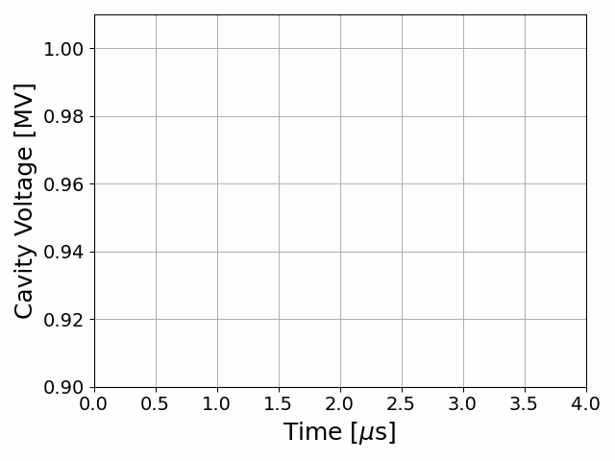
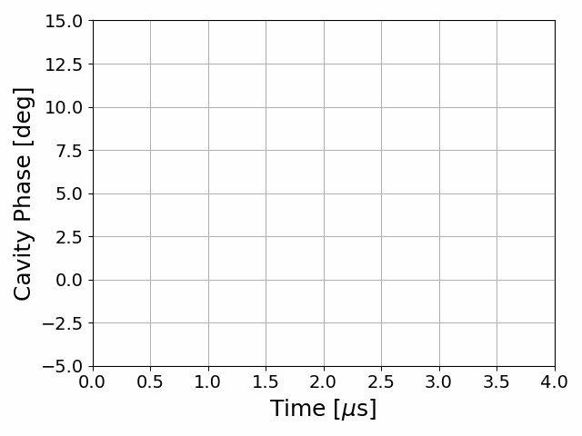
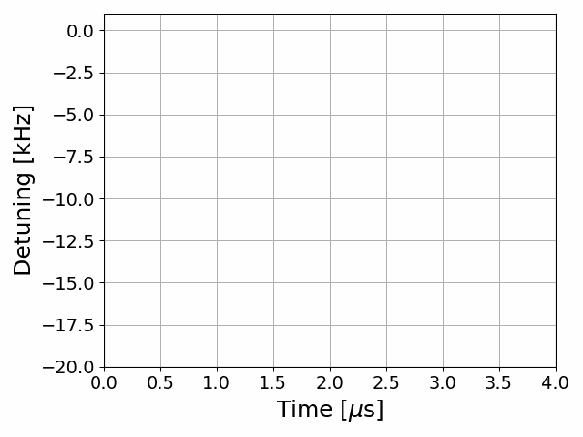
Use cases: transient detuning
Beam + fixed detuning
Circulator
HV Line
FRT
RF Amplifier
FPC
FRT Antenna
Load

Slide 13
Use cases: transient detuning
Beam + transient detuning
Circulator
HV Line
FRT
RF Amplifier
FPC
FRT Antenna
Load

Slide 14
Microphonics Suppression Results
Overview of results with prototype FRT

Slide 15
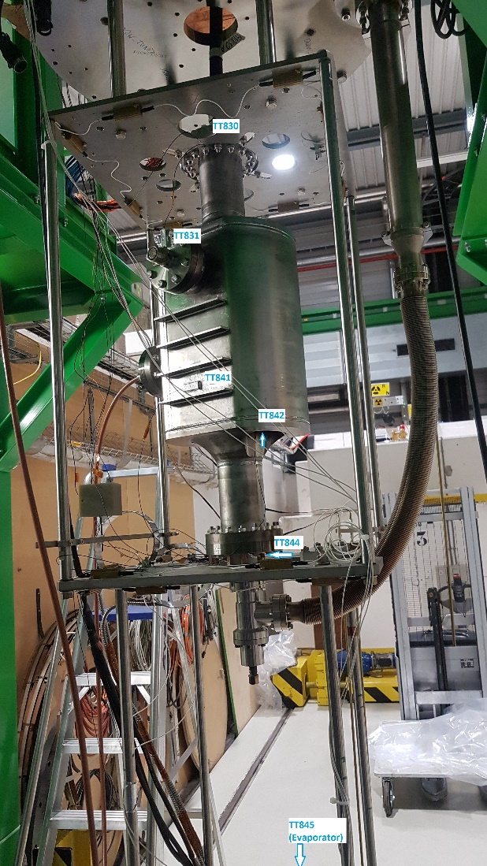
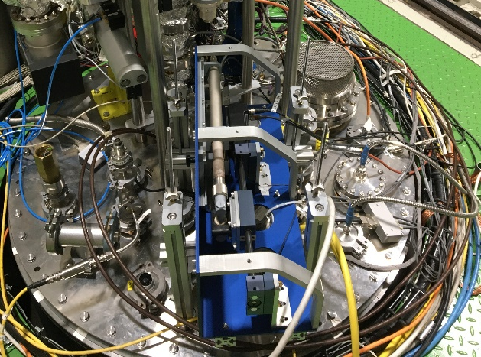
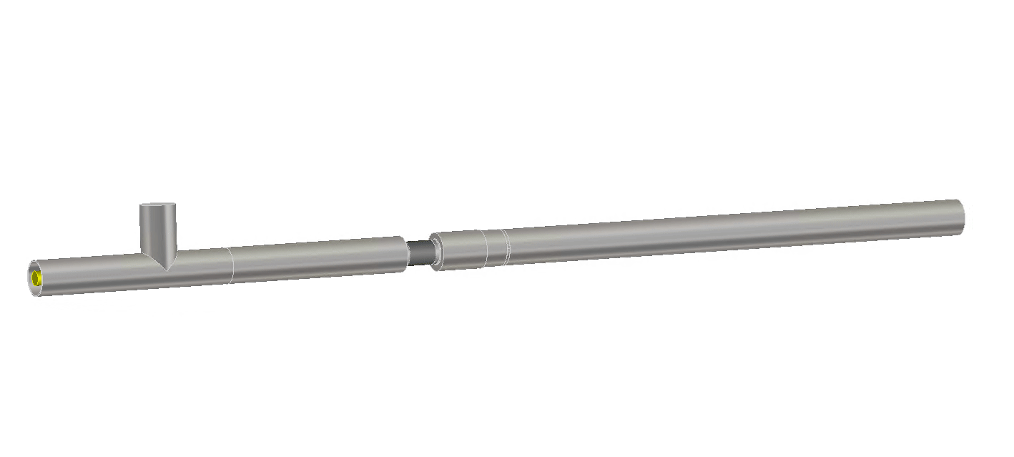
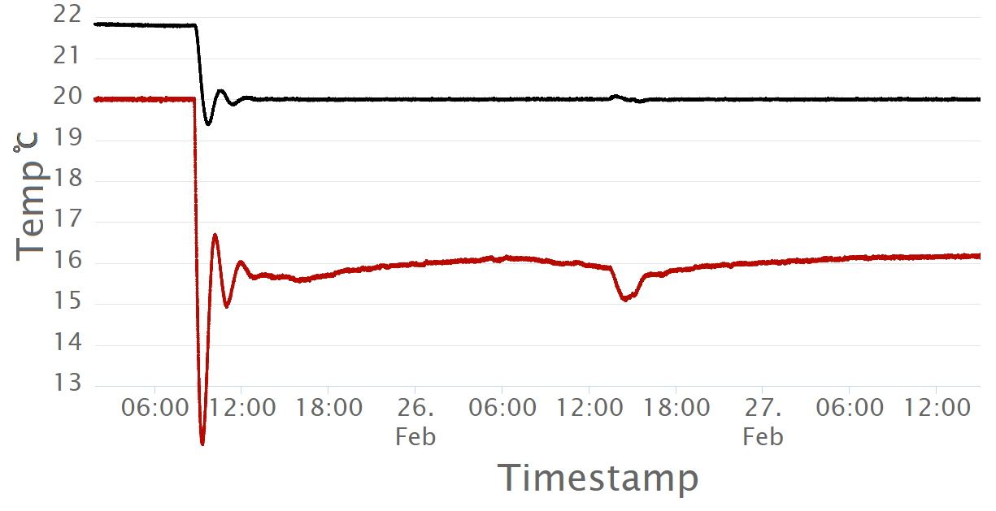
Microphonics suppression results
Lower order mode of UK4R crab cavity at 374MHz
Very stiff → very low levels of microphonics → used vibration generator
Euclid Techlabs designed prototype FRT
No slow tuner → driven in Self Excited Loop mode
Chiller, phase shifter, vibration generator
Deliberately simple purely integral feedback used
More performant solutions surely possible
Phase shifter on top plate
FE-FRT temp.
UK4R on insert
regulation on
Bath temp.
bunker opened
Euclid FE-FRT prototype
Temperature regulation with chiller
Vibration generator

Slide 16
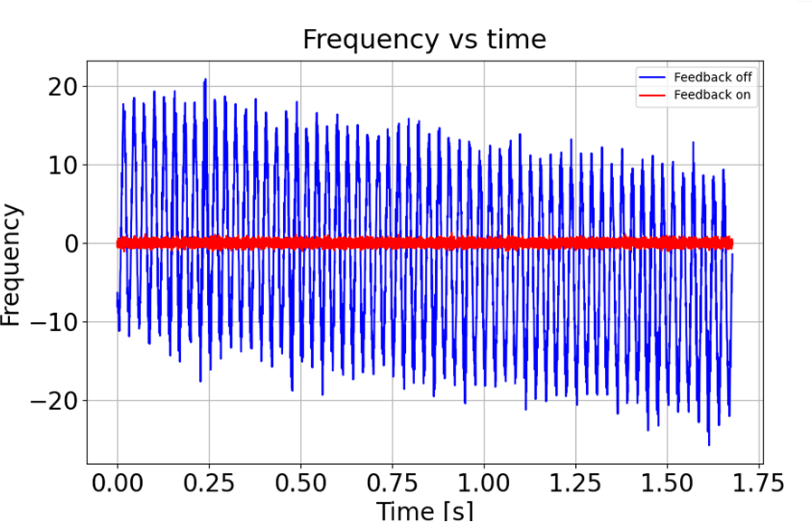
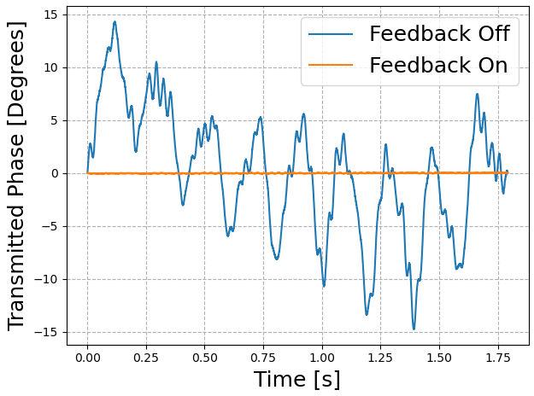
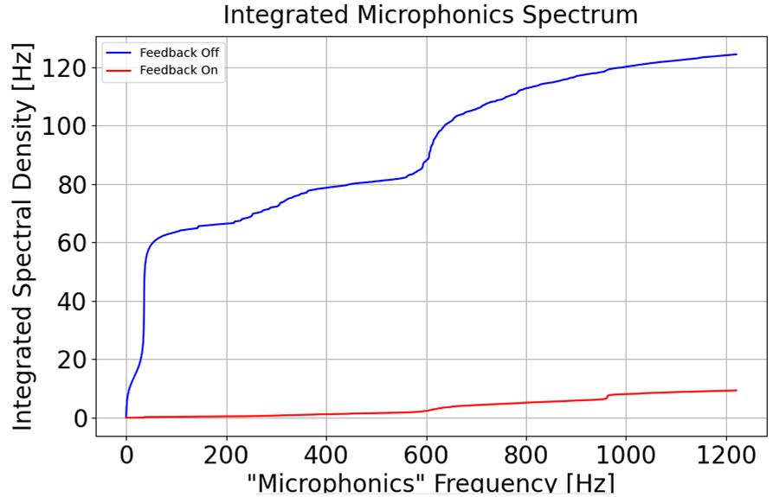
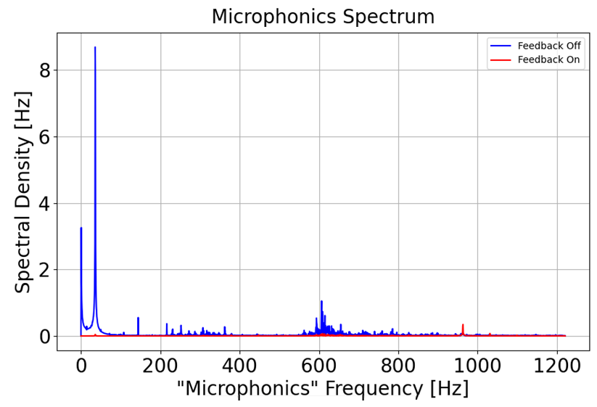
Microphonics suppression results
Vibration generator set to 37Hz
Spectral density also shows good suppression at higher frequencies e.g. ~600Hz
Peak deviation with correction 1.2Hz
Prototype issues: long transmission line, lossy brazing
Low FoM
Little to no RF power reduction
F
No correction
With correction

Slide 17
Transient Detuning Project
Overview of transient detuning research at CERN

Slide 18
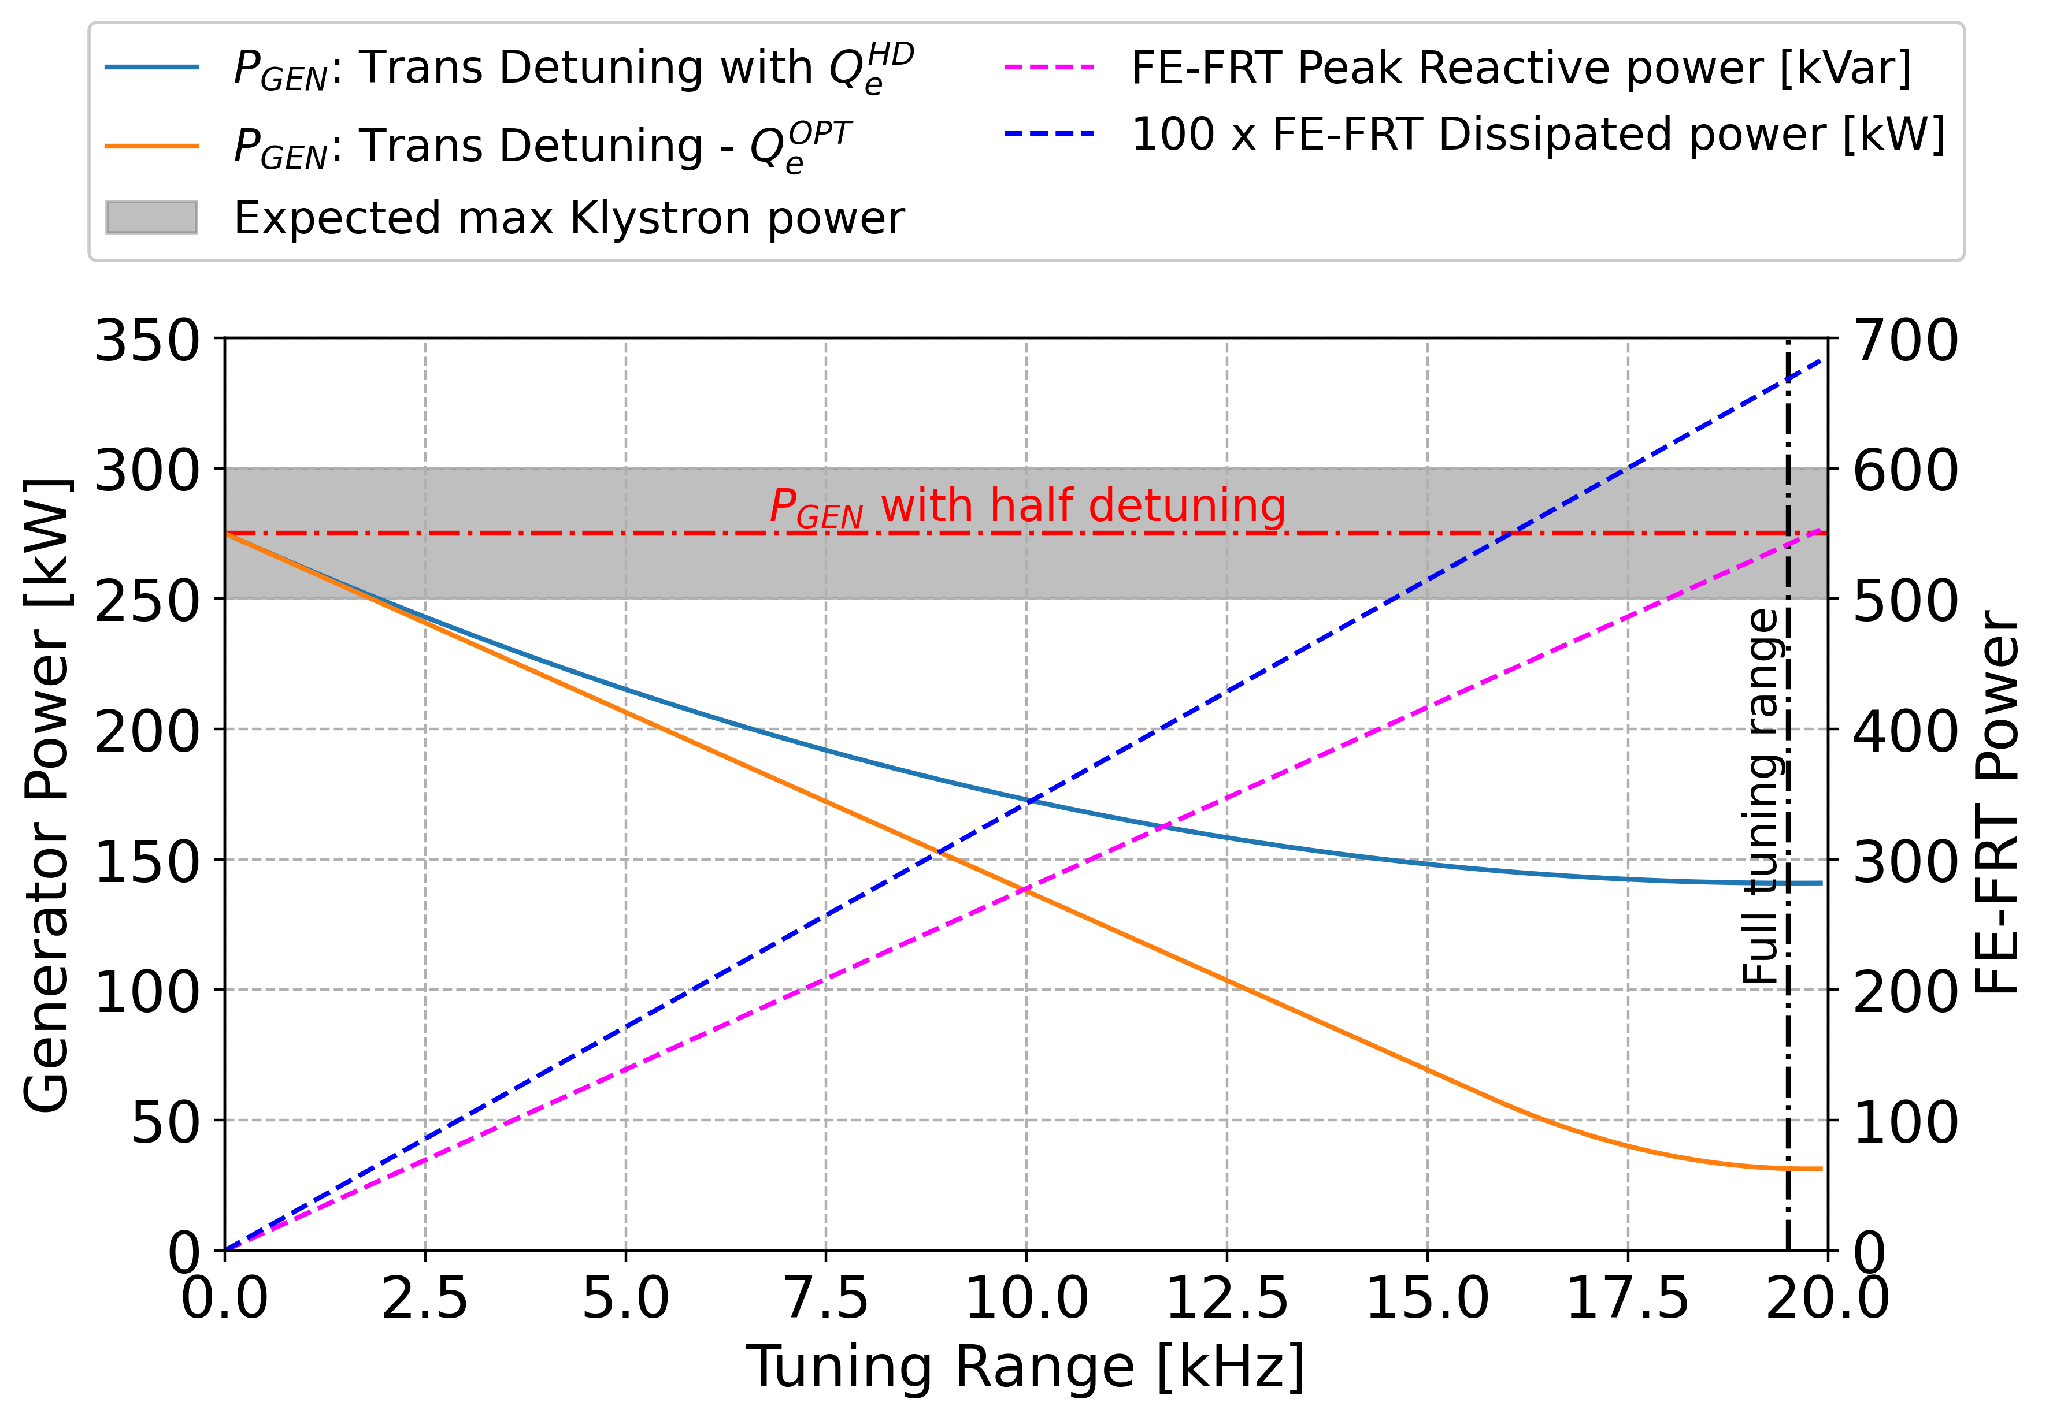
Transient Detuning Project: Overview
Likely HL-LHC will not have sufficient RF power to capture full beam current at injection
Install high efficiency Klystrons
Add new cryomodule
Transient detuning with FE-FRT
Perfect compensation of beam loading with FRT would reduce RF power requirements 10-fold
If Qe of FPC is increased by optimal amount
Would require FE-FRT to handle high reactive power ~500kVar
Partial compensation can also give significant reductions
If proven feasible transient detuning is elegant and cost-effective solution
Electricity saving up to ~ 2GWh per year ~1M€ (very rough estimate from French electricity cost on 28.09.22)
Aim: demonstrate an FE-FRT could compensate transient beam loading for HL-LHC at injection
Estimated power reduction vs achievable tuning range with transient detuning

Slide 19
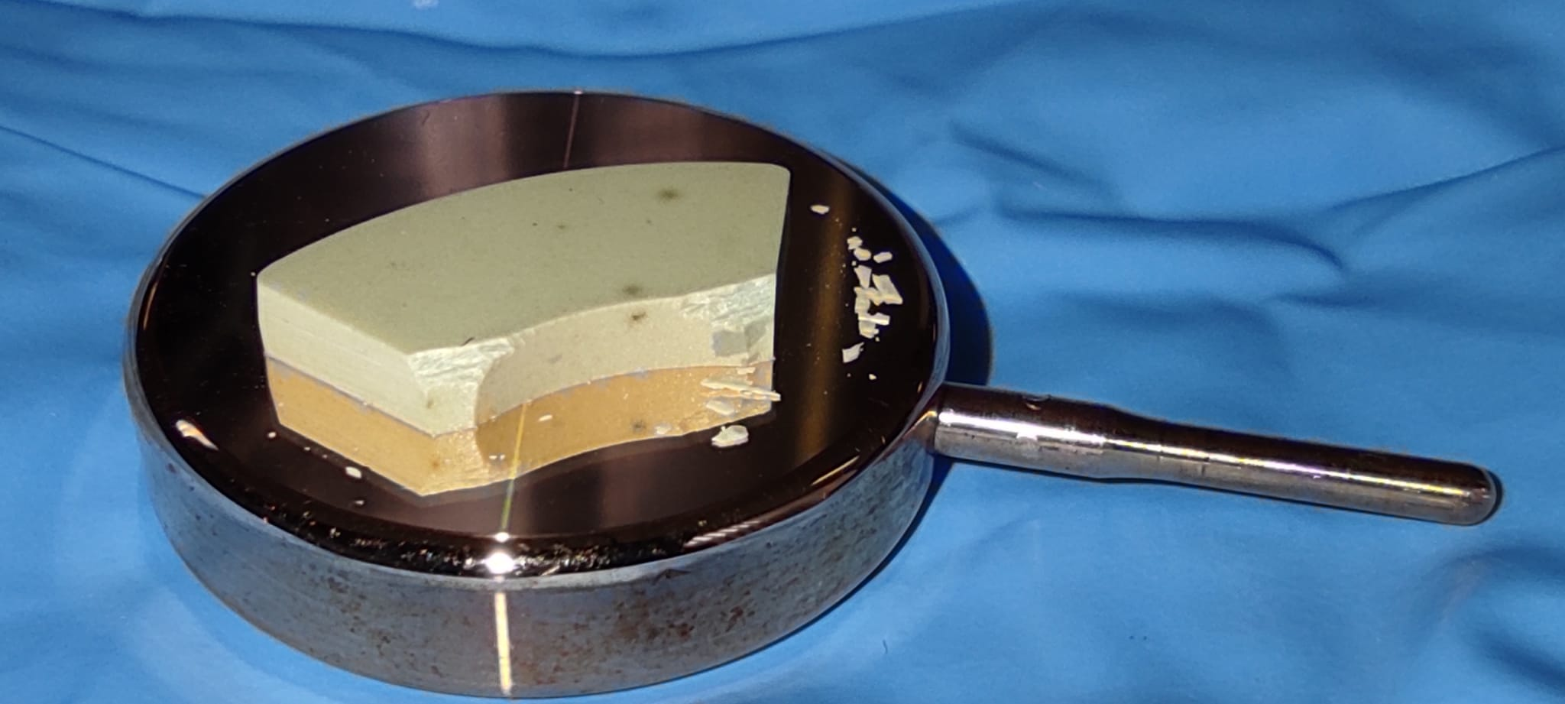
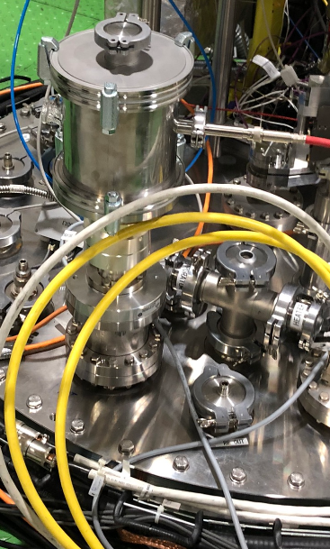
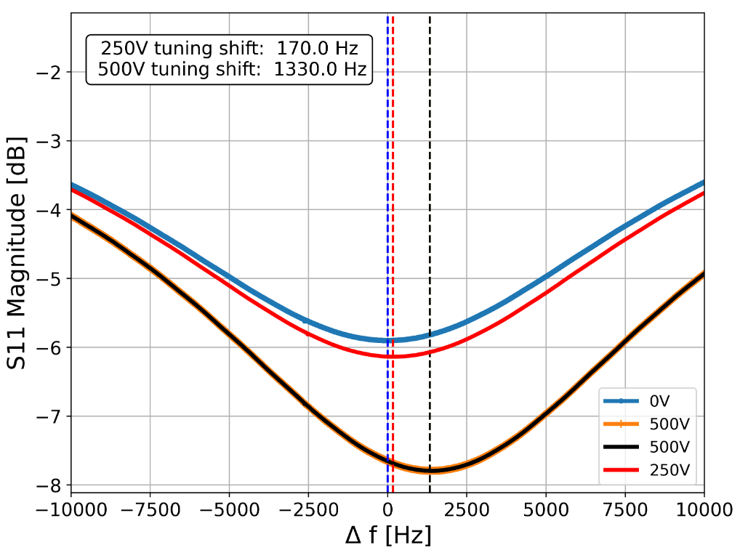
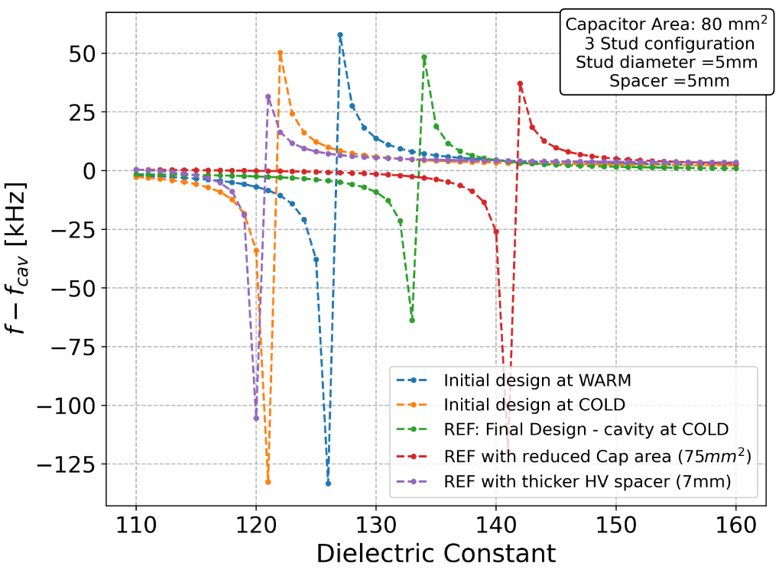
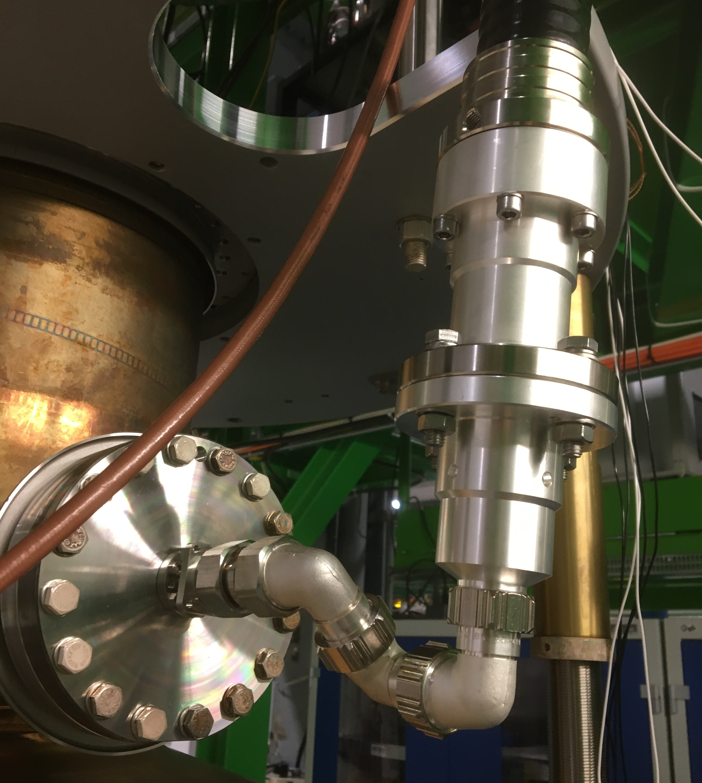
Transient Detuning Project: TDD0
RF designs of FRT focused on coupled mode scheme
FRT resonance jumped across cavity resonance
Greater phase shift and larger tuning range with smaller antenna
Discontinuous tuning range – not suitable microphonics suppression
Brazeless (compression fit) thin wafers of ferro-electric in vacuum
Aim: reduced losses + higher biasing electric fields
+ greater change in permittivity at reduced voltage
First prototype TDD0 (Transient Detuning Demonstrator) built and tested on cold LHC cavity
Result: 1.3kHz tuning shift observed with 500V
Test cut short due to cavity vacuum leak
TDD0 designed for 10-16kV, voltage limited due to vacuum leak on TDD0
Lessons learned:
FerrElectric stack sensitive to air gap/compression force
Care must be taken to apply compression evenly
Implementation of rigid line in cryostat susceptible to mechanical stress and losses
Place FRT inside cryostat for next test.
TDD0 produced reproducible 1.3kHz frequency shift on cold LHC cavity with 500V applied across FerroElectric.
Simulated discontinuous frequency shifts of LHC cavity with TDD 0 in different configurations.
Left: TDD 0 during assembly, shape of ferro-electric dictated by geometry of samples in stock.
Right: TDD0 installed on top plate.
TDD 0 design, ferro-electric wafers shown in white.
Top: uneven compression force cracked ceramic.
Left: Large diam. rigid line caused vacuum leak.
Right: Breakdown through ceramic near cracks?

Slide 20
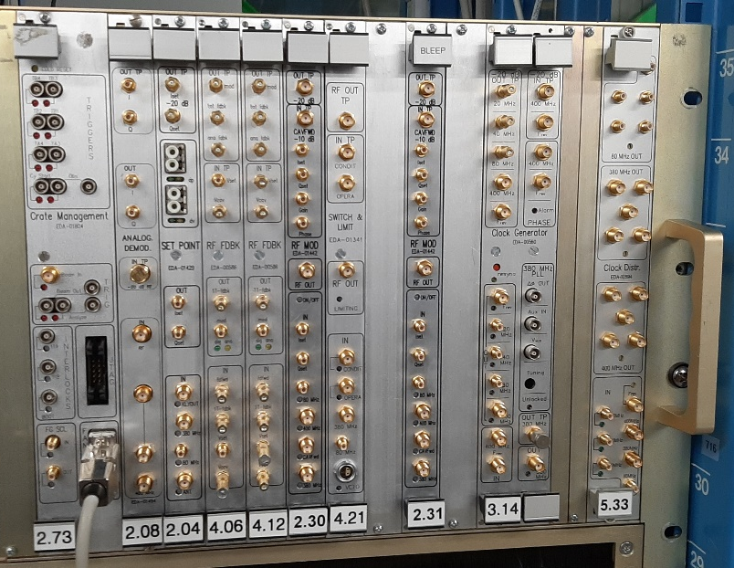
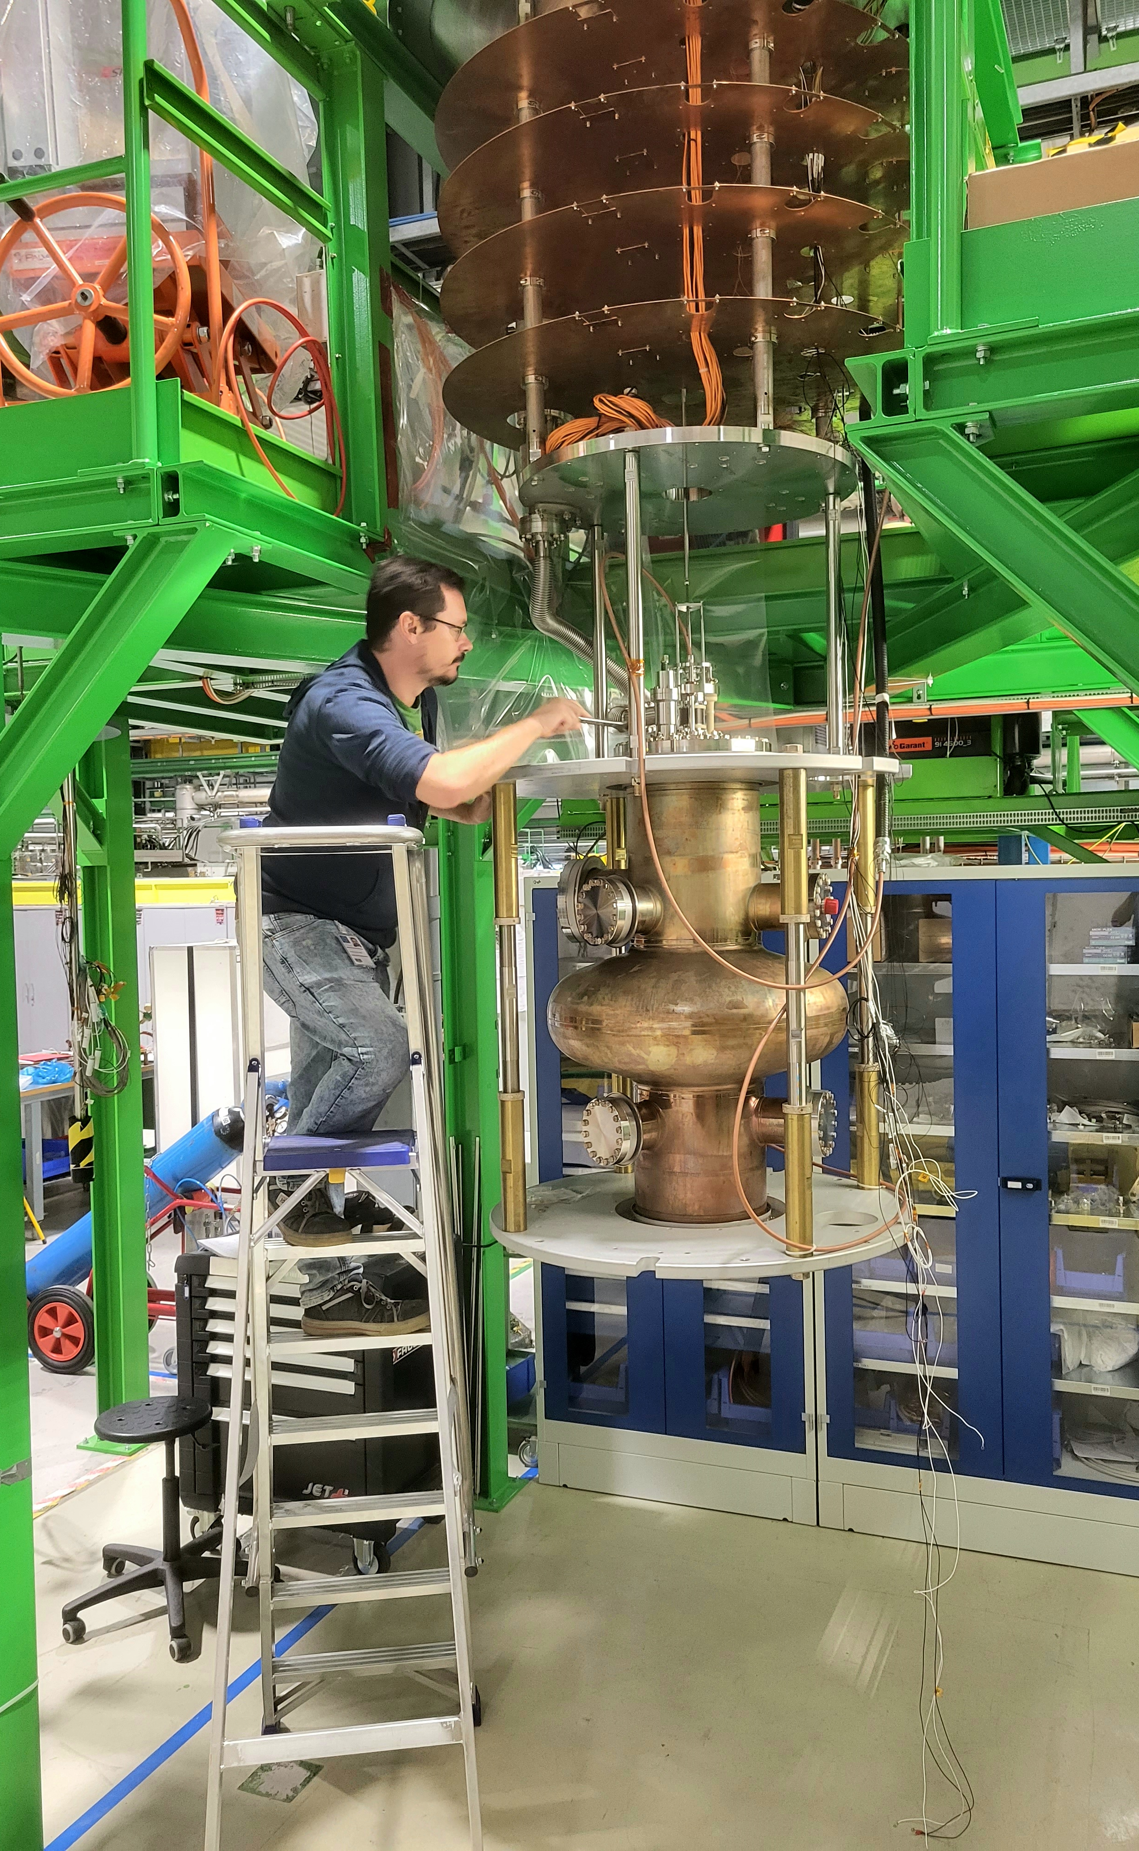
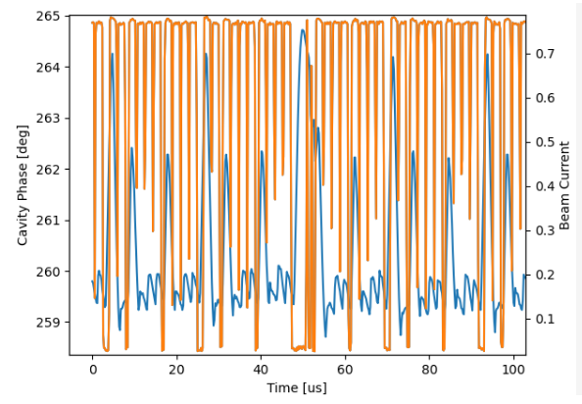
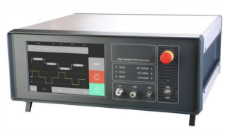
Transient Detuning Project
LHC LLRF System
LHC LLRF system is complex and will not be redesigned for HL-LHC
Transient detuning must work with existing LLRF system
LHC LLRF system replicated in cavity cold testing area
No One Turn Feedback Module in last test now installed, waiting to be tested
BLEEP
Beam Loading Electronic Emulation Project
Testing with cryomodule with real beam not feasible in initial project timescale
BLEEP adds correct RF power and phase to input coupler to replicate beam pattern
High Voltage Pulser for biasing FE ceramic
High voltage pulser design is challenging: must follow bunch train pattern
HVP ordered capable of running @146kHz, 7kV, for ~10ms
Final HVP design would need to run continuously
TDD 1
Fabrication by end of year/Q1 23
Demonstrate transient detuning @ low power with LLRF, BLEEP, HVP: Q1 23
Test high power operation: Q2 23
Parameter | Value | Parameter | Value
Total Capacitance | 2 nF | Rise, Fall Time | 100ns
High Voltage | 7 kV | Power Supply Rating | 14.4 kW
Energy per pulse | 49mJ | (Dis)charge current | 140 A
Burst Pulse Rate | ~146 kHz | Burst Duration | 10ms
High Voltage Pulser specification.
BLEEP and replicated LHC LLRF system in control room of SM18 cavity cold test area.
BLEEP replicated beam pattern causes several degrees of uncorrected phase error if One Turn Feedback Module (OTFB) absent from LLRF.
Orange: LHC beam pattern replicated with BLEEP
Blue: Cavity phase controlled with LLRF without OTFB
Green: Target phase for LLRF
High Voltage Pulser for transient detuning tests.
LHC bare cavity preparation on insert

Slide 21
Summary

Slide 22
Summary
Microphonics
Transient Detuning
Excellent microphonics suppression demonstrated
With very simple feedback
Prototype FRT too lossy
→ no RF power reduction demonstrated
Low hanging fruit!
Presently no FRT microphonics research at CERN
CERN R&D focused on transient detuning
Use case: HL-LHC injection
Much of research generally useful for FRTs
Elegant but demanding application
Offers: Large RF power saving and reduced phase errors
Requires: Large tuning range; high reactive and dissipated powers
TDD 0 built and tested
TDD0 first coupled mode and FE stack assembly FRT
1.3kHz tuning already obtained on LHC cavity
TDD1 coming soon!

Slide 23
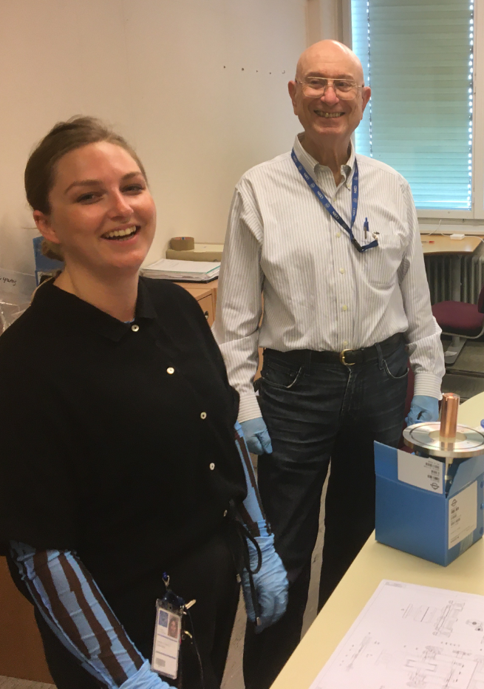
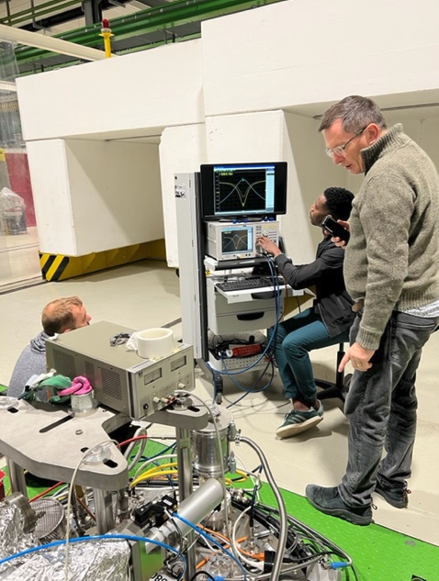
Thank you for your attention
N. Shipman
nicholas.shipman@cern.ch

