Slide 1


Cryomodules for MESA
A quick overview about the experiences with “turn-key” cryomodules for CW operation at Johannes Gutenberg-Universität Mainz
F. Hug for the MESA team
ERL Workshop 2022
supported by
the German Research Foundation (DFG):
EXC 2118/2019
and by the Ministry of Education and Research (BMBF):
project 05H21UMRB1

Slide 2
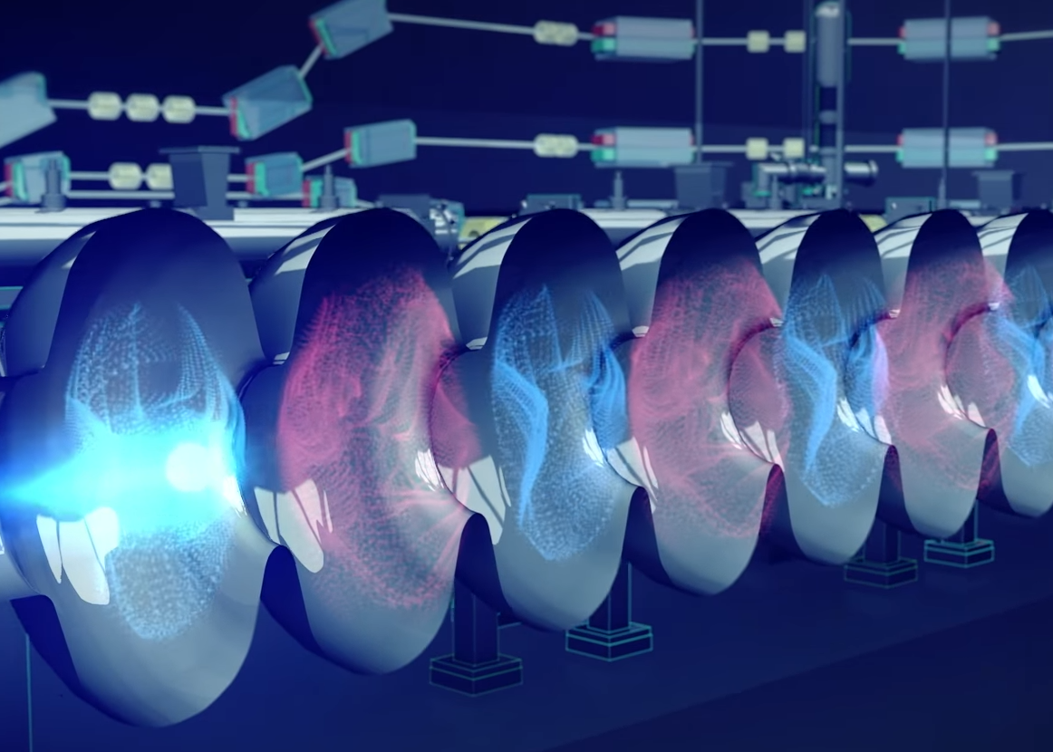


MESA
Enhanced
ELBE-type
Cryomodules

Slide 3
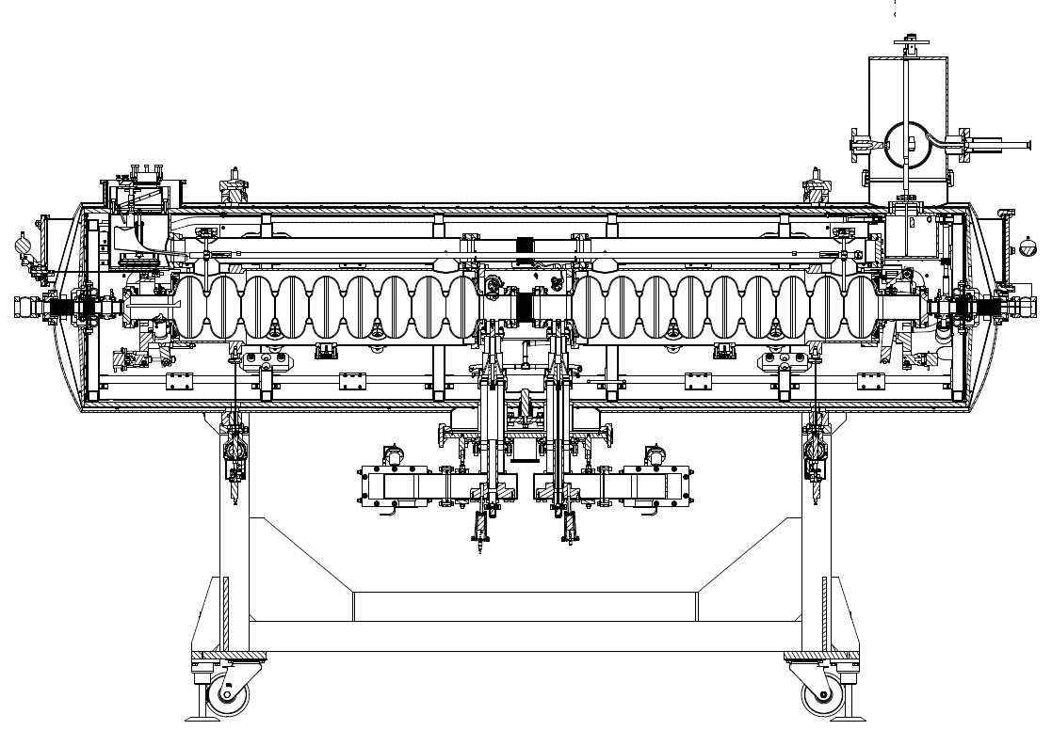
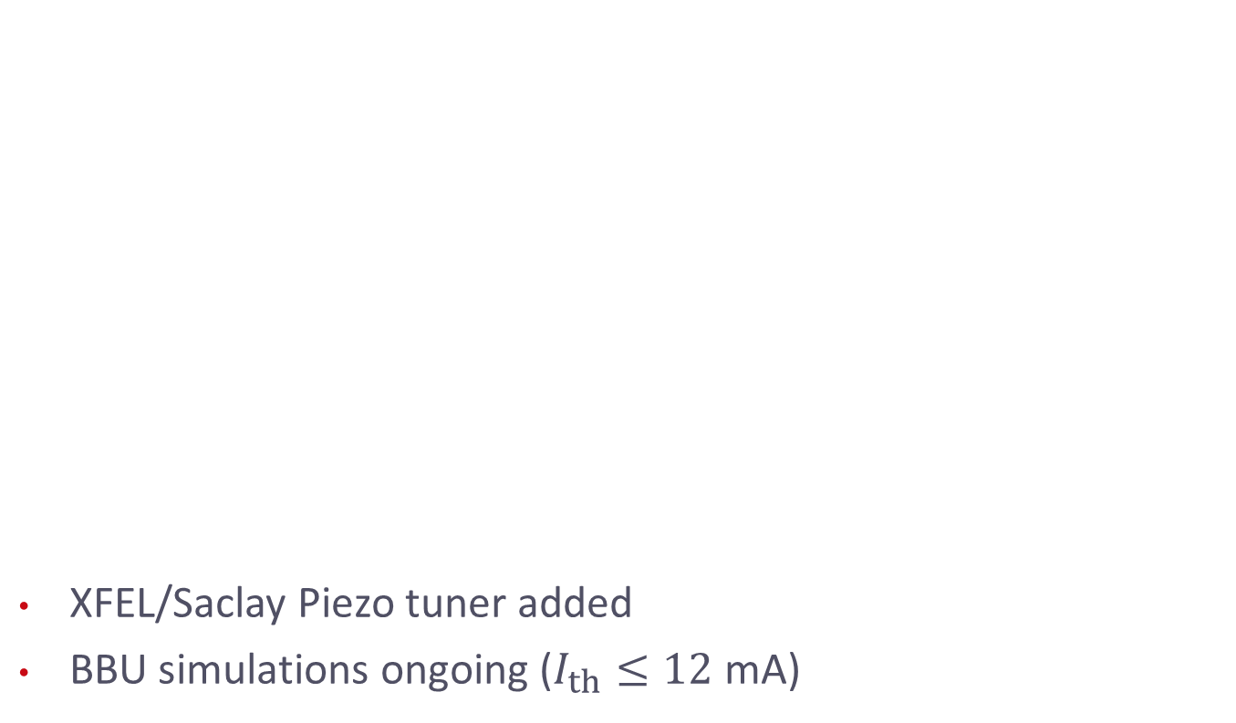
MESA Enhanced ELBE-type Cryomodules
XFEL/Saclay Piezo tuner added
BBU simulations ongoing ($I_{th}≤12$ mA)

Slide 4
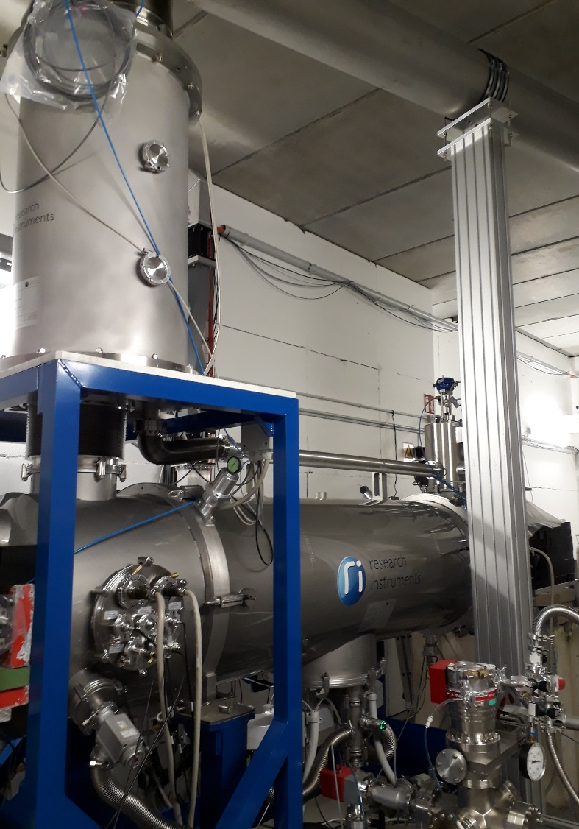
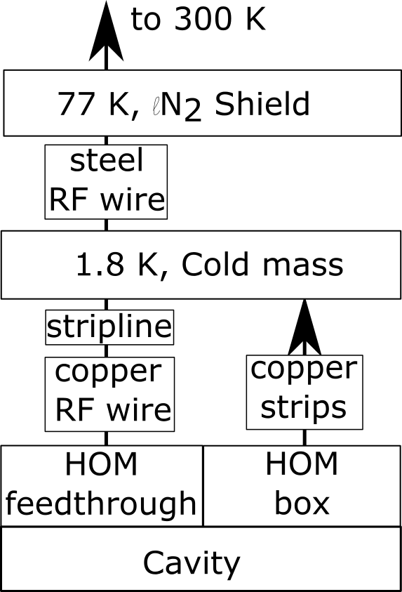
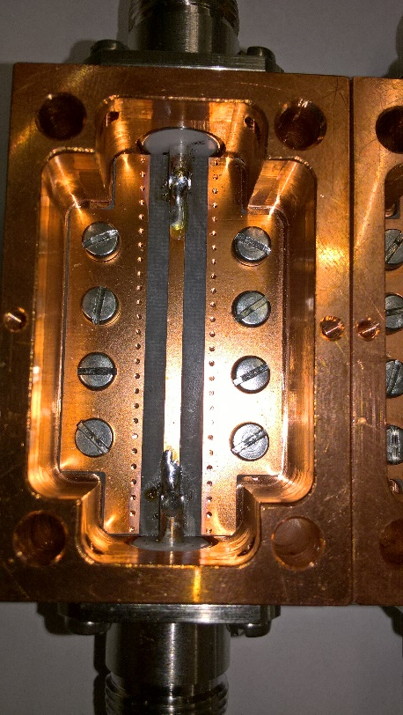
MESA Enhanced ELBE-type Cryomodules
Concern: Heating of the HOM-Antenna
Changes:
Sapphire windows at HOM feedthrough
Strip line in HOM cable for cooling
MCTL (LHe, GHe, LN2)
LHe/LN2 supply box
Cryomodule (2 XFEL Cavities @ 12.5 MV/m)

Slide 5
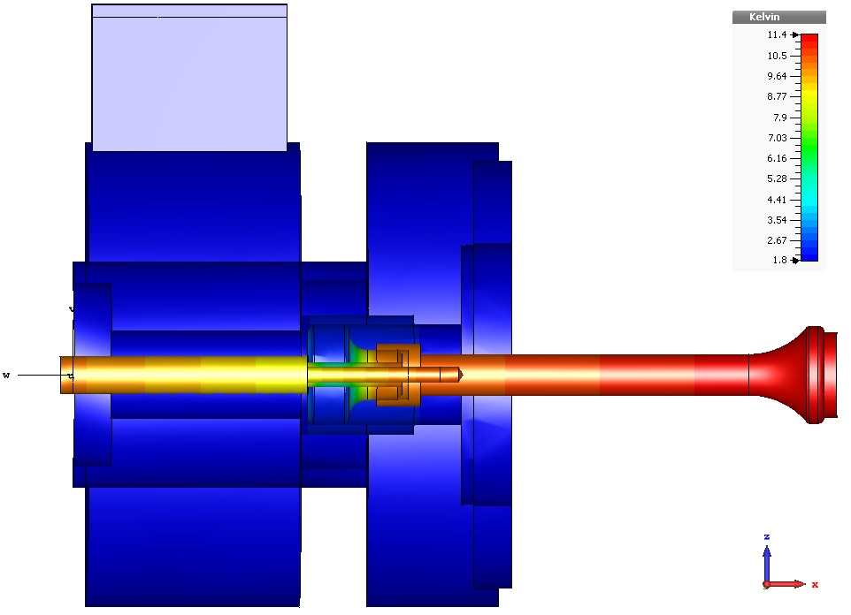
HOM Antenna simulations
„Entwicklung eines supraleitenden
Beschleunigermoduls für den
rezirkulierenden Betrieb am Mainz
Energy-Recovering Superconducting
Accelerator (MESA) “, PhD. Thesis of T. Stengler
Thermal calculations at HOM antenna:
  → Provide optimised thermal connection design to RI
  → Limitation by heat input from cable, need for heat sink
T / K
11.4
Only 1.25 W
heat deposition in
1.8 K LHe bath
per HOM coupler
in cryo budget
1.8
100 mW load
Picture: T. Stengler

Slide 6
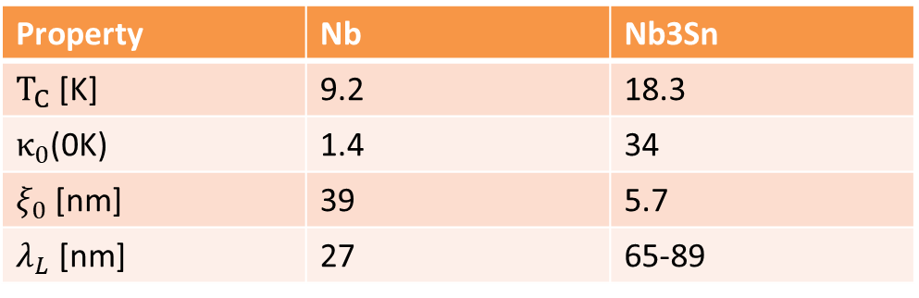
HOM Antenna simulations
Goal:
Reduce heating of HOM Antenna
Prevent quench of whole CM
How: Antenna coating with Nb3SN/NbTiNon Nb/Cu Antennas
Ongoing CST
simulations
Property | Nb | Nb3Sn
$T_{C}$ [K] | 9.2 | 18.3
$κ_{0}$(0K) | 1.4 | 34
$ξ_{0}$[nm] | 39 | 5.7
$λ_{L}$ [nm] | 27 | 65-89
S. Keckert et al 2019 Supercond. Sci. Technol. 32 075004

Slide 7



HOM Antenna simulations
Expectation
$$T_{Nb3Sn}=18.3 K$$
Coated
Antennas
Current HOM Antennas fulfill
ERL at 1 mA
10 mA need improved HOM decoupling
$$T_{NbTiN}=11.8 K$$
$$T_{Nb}=9.2 K$$
Current
1
10
Beam current
[mA]

Slide 8
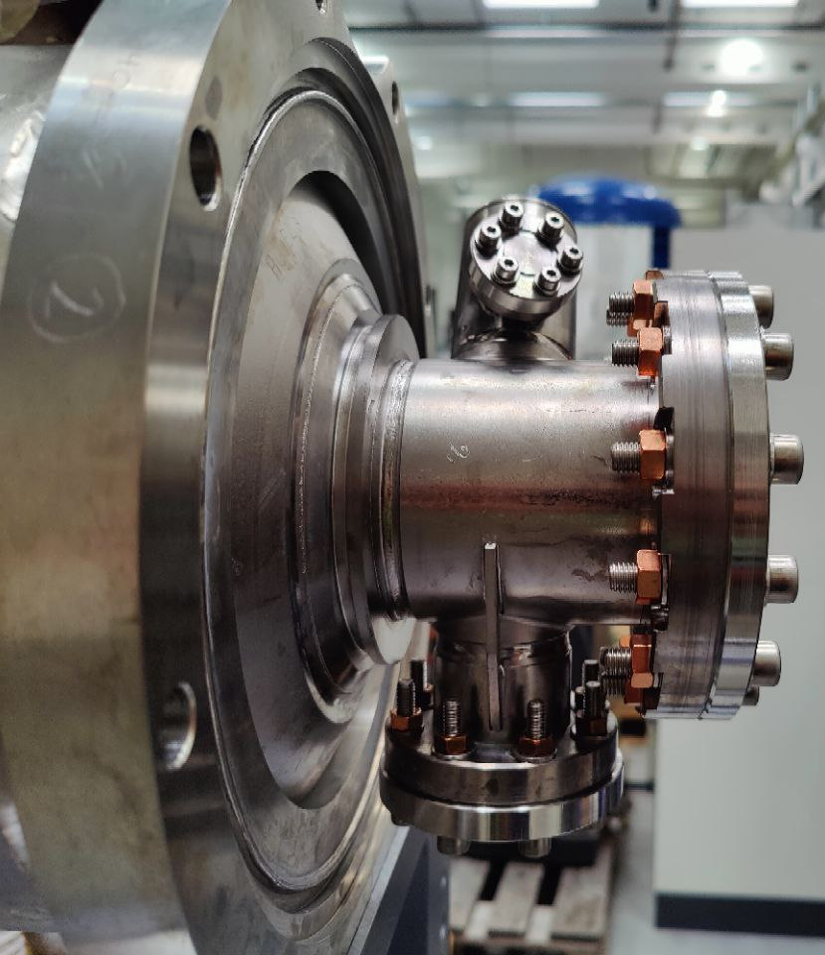
Refurbishment of a decommisioned ALICE module for antenna research (and as future spare module for MESA)
MESA Enhanced ELBE-type Cryomodules (MEEC):
Helium port (Joule-Thomson valve)
Faster DESY/Saclay tuner (higher beam currents)
→ diameter of Helium tank changed
New HOM antennas
Cavity contamination leads to field emission @7 MV/m
→ Clean room treatment!

Slide 9
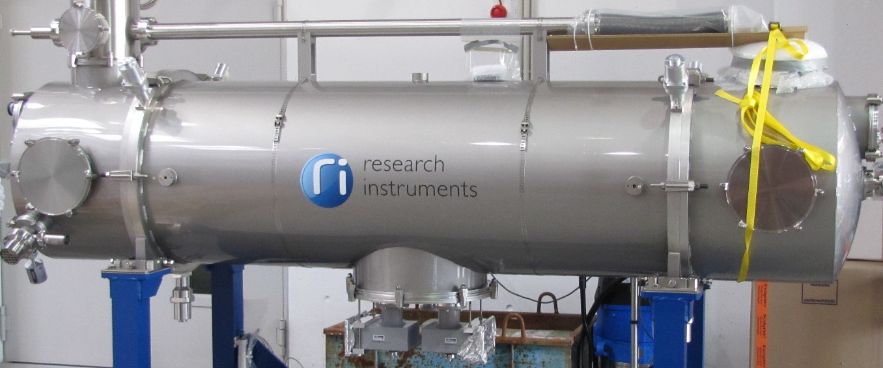
Production of 2 Cryomodules
2015: Ordered at RI Research Instruments GmbH
All changes incl.
  Cryogenic Components (valve box, 2K heat exchanger and JT valve, transfer line)
  Stand alone control system (and connectable to EPICS)
  With expertise of DESY, HZDR and industry partners
Milestones
  VT at DESY AMTF
  FAT at Mainz
  SAT at Mainz

Slide 10
Production of 2 Cryomodules
Close cooperation between RI and Mainz University
  Weekly conference calls
  Personal meetings if necessary approx. 3 per year
  Approval of all changes
  Quality control: All RF measurements verified by JGU
  Effective cooperation between RI and JGU
  Close cooperation needed for project coordination
2 Cryomodules, including modifications, VB, JT valve and control system built by RI

Slide 11
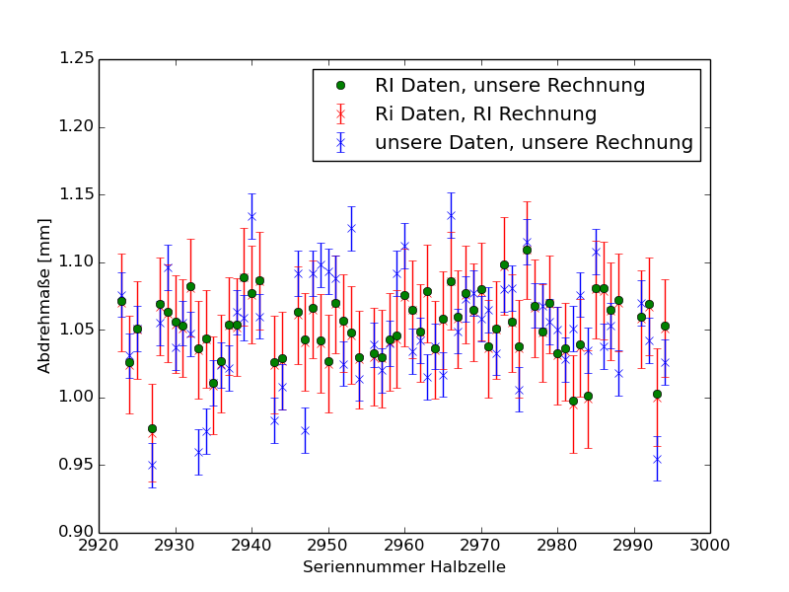
Quality Control of Cavity Production by JGU
Trimming measures calculated by using the different datasets show good consistency between the two calculations:
Pictures: P. Weber

Slide 12
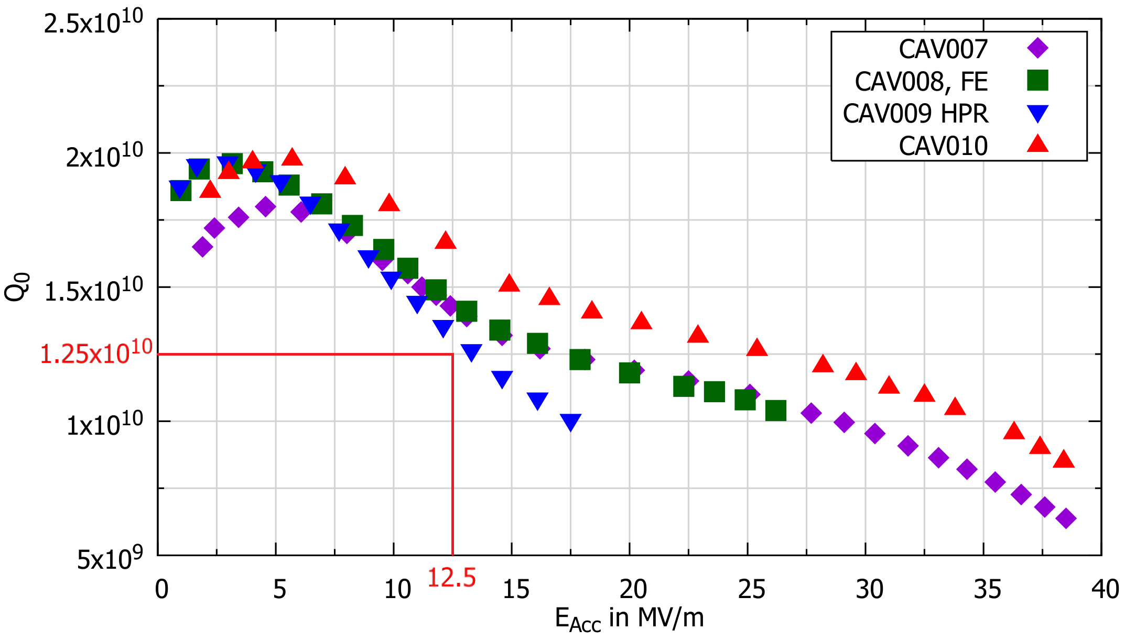
Vertical Test Results @ DESY AMTF

Slide 13

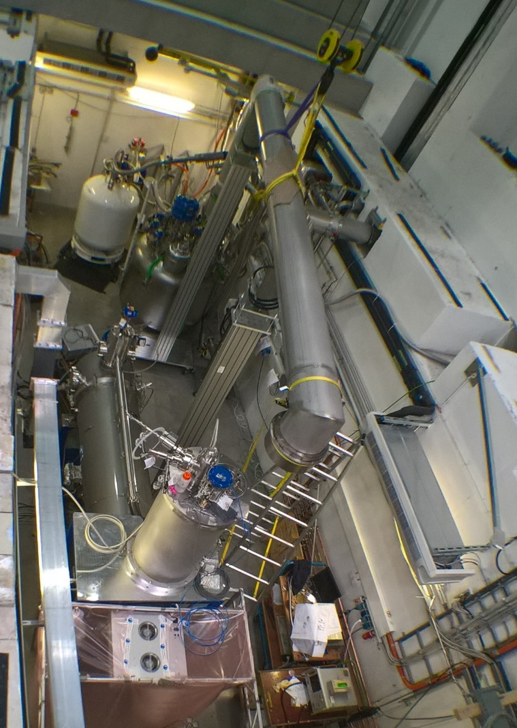
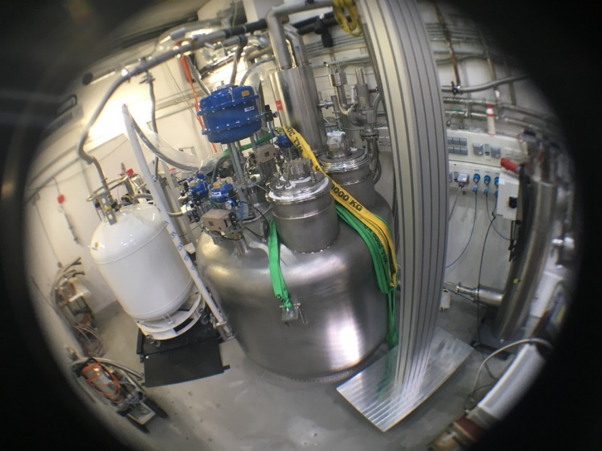
Site Acceptance Test at HIM
Several successful cooldown cycles to 1.8 K at the HIM RF bunker with both cryomodules
CW measurements up to 12.5 MV/m
Static heat load more than 30% better
than design value for both modules
SAT for module #1 approved
recently (30.4.2019)

Slide 14
RF Generator and Possible Gradients
3.10.2022
14

Slide 15
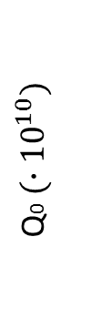


Site Acceptance – Cryomodule 1
CAV007
CAV008
3
CAV008:
Systematic error with LLRF test system occurred
Helium flow indicates $Q_{0}>{1.25∙10}^{10}$ at 12.5 MV/m
To be measured again…
2
Q0$(∙{10}^{10})$
$$1$$
0.1
4
6
8
10
12
14
4
6
8
10
12
14
E_{ACC} in MV/m
E_{ACC} in MV/m

Slide 16
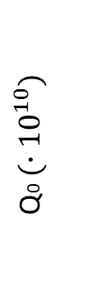
1st Site Acceptance – Cryomodule 2
CAV009
CAV010
3
2
Q0$(∙{10}^{10})$
Field emission because of a valve in a undefined state at the beam pipe
Particles could float in N2
atmosphere
CM received refurbishment
Re-Test in 2020
$$1$$
0.1
4
6
8
10
12
14
4
6
8
10
12
14
E_{ACC} in MV/m
E_{ACC} in MV/m
Valve movement
caused particles

Slide 17
2nd Site Acceptance – Cryomodule 2
CAV009
CAV010
Increased performance close to design value
Still some degradation with respect to vertical test
→ Module accepted as full cryogenic losses within specification

Slide 18
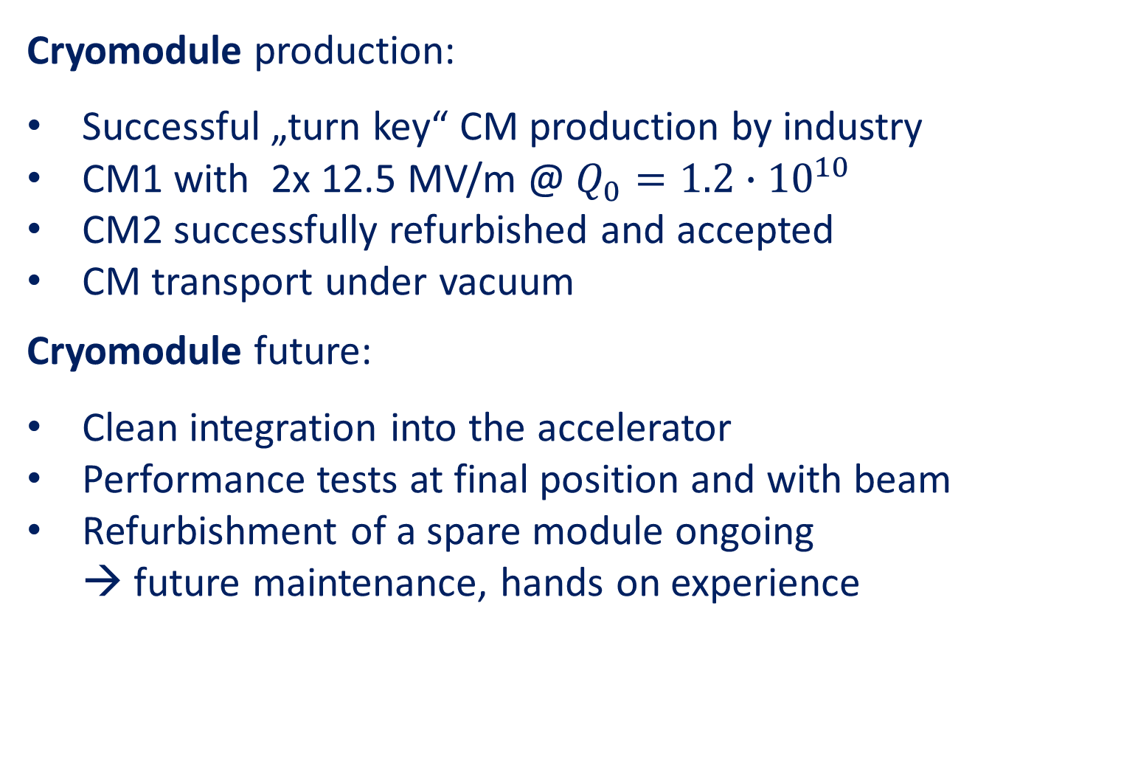
Summary and Outlook
Cryomodule production:
Successful „turn key“ CM production by industry
CM1 with 2x 12.5 MV/m @ $Q_{0}=1.2∙{10}^{10}$
CM2 successfully refurbished and accepted
CM transport under vacuum
Cryomodule future:
Clean integration into the accelerator
Performance tests at final position and with beam
Refurbishment of a spare module ongoing
→ future maintenance, hands on experience

Slide 19
Summary and Outlook
„Turn key“ experience:
Need of close contact to vendor
Successful project in the MESA case
Modules and cavities might not be the ultimate ERL
devices but good compromise for universities/small labs
HOM research:
We would like to thank the Daresbury Laboratory for their generous gift
Module and cavity preparation is ongoing, first tests in 2022

