Slide 1



Overview of Nb₃Sn Cavity Progress
(for CW machines)
October 5, 2022
Presented by Liana Shpani
Grant No. DE-SC0008431
Grant No. PHY-1549132
Special Thanks to:
Sam Posen and Grigory Eremeev, FNAL
Uttar Pudasaini, JLab
Kensei Umemori and Hayato Ito, KEK
Gabriel Gaitan, Matthias Liepe, Ryan Porter, Neil Stilin, Nicole Verbonceour, Cornell University
for their significant contributions!

Slide 2
Outline
1. Why Nb₃Sn?
2. How do we grow it?
3. State-of-the-art performance
4. Case Study: LCLS-II
5. Remaining Challenges

Slide 3
Outline
1. Why Nb₃Sn?
2. How do we grow it?
3. State-of-the-art performance
4. Case Study: LCLS-II
5. Remaining Challenges

Slide 4
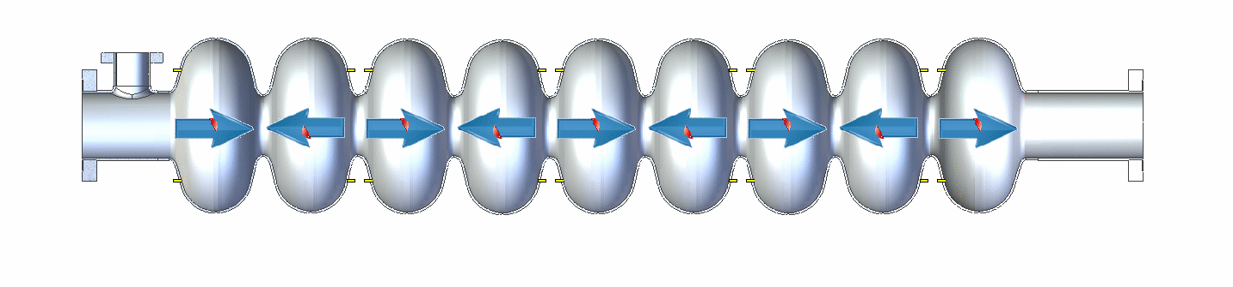


SRF for Accelerators
Goals:
Input RF power at 1.3 GHz
Animation created by Sam Posen
Decrease accelerator length
  Higher accelerating gradients
Decrease cooling power
Slowed down by factor of approximately 4x10⁹
Need lower surface resistance: $Q_{0}∝\frac{1}{R_{S}}$
Need superconductors with higher critical temperature
Need superconductors with higher fundamental flux-free field limit
$$P_{AC, cooling}∝\frac{COP^{−1}(T)}{Q_{0}(T)}$$

Slide 5
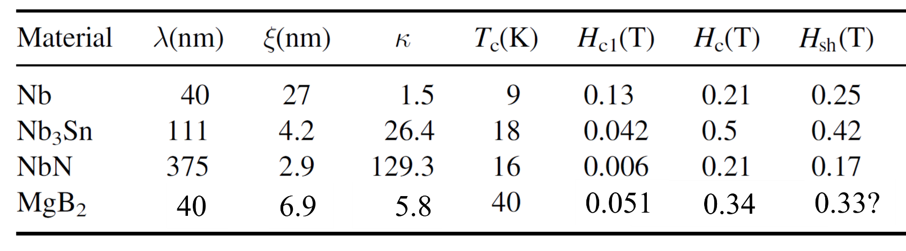



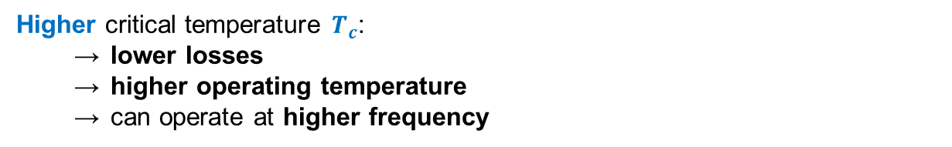

Nb₃Sn: A Very Promising Material
$B_{C1}$(T)
$B_{C1}$(T)
$B_{sh}$(T)
Higher critical temperature $T_{c}$:
  lower losses
  higher operating temperature
  can operate at higher frequency
$$R_{BCS}∝f^{2}e^{−const.×T_{C}/T}$$
Higher superheating field $B_{sh}$= higher accelerating gradients: $E_{acc, max}∝B_{sh}$

Slide 6
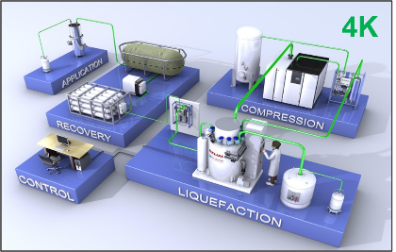
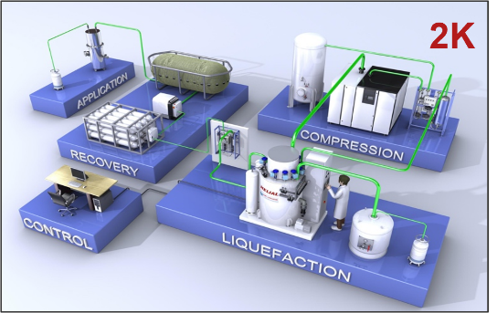
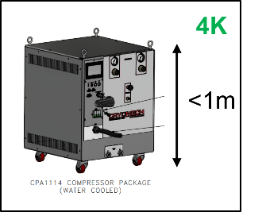
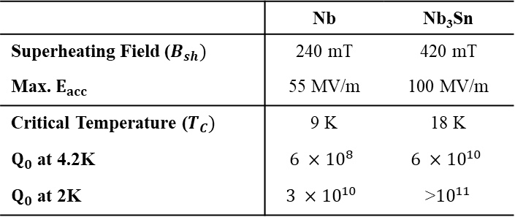
Nb₃Sn Potential
 | Nb | Nb₃Sn
Superheating Field ($B_{sh})$ | 240 mT | 420 mT
Max. $E_{acc}$ | 55 MV/m | 100 MV/m
Critical Temperature ($T_{C})$ | 9 K | 18 K
$Q_{0}$ at 4.2K | $$6 ×{10}^{8}$$ | $$6 ×{10}^{10}$$
$Q_{0}$ at 2K | $$3 ×{10}^{10}$$ | >${10}^{11}$
Higher energy gain
  Shorter accelerators
Lower cooling cost and complexity
  4.2K operation with high cryo-efficiency (!!)
  No superfluid helium
Q₀ given for 1.3 GHz single-cell ILC-shape cavities
~4K
Large Scale
~2K
Small Scale

Slide 7
Outline
1. Why Nb3Sn?
2. How do we grow it?
3. State-of-the-art performance
4. Case Study: LCLS-II
5. Remaining Challenges

Slide 8
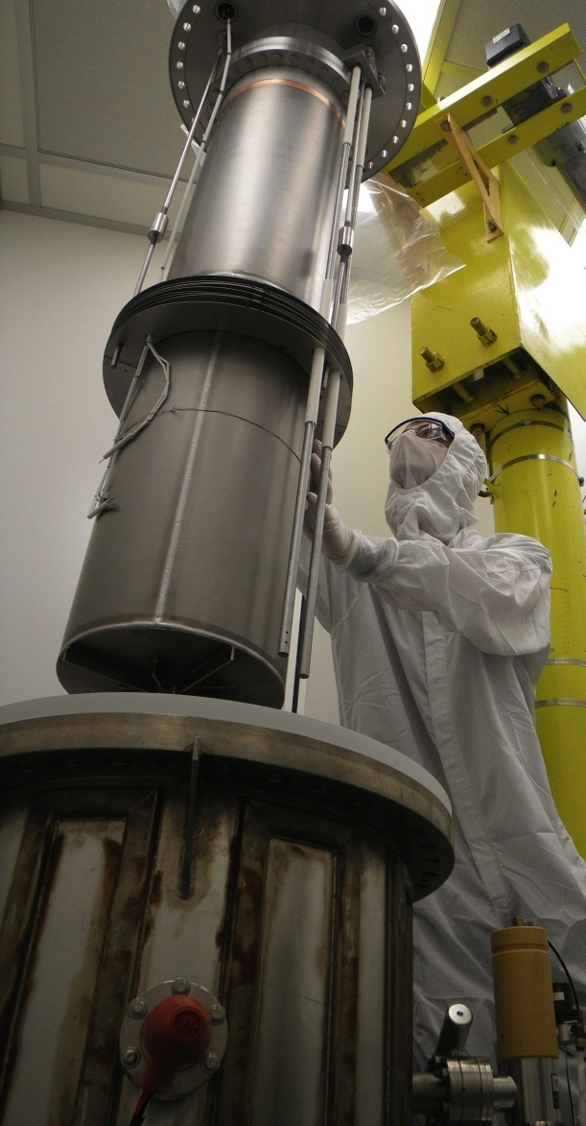
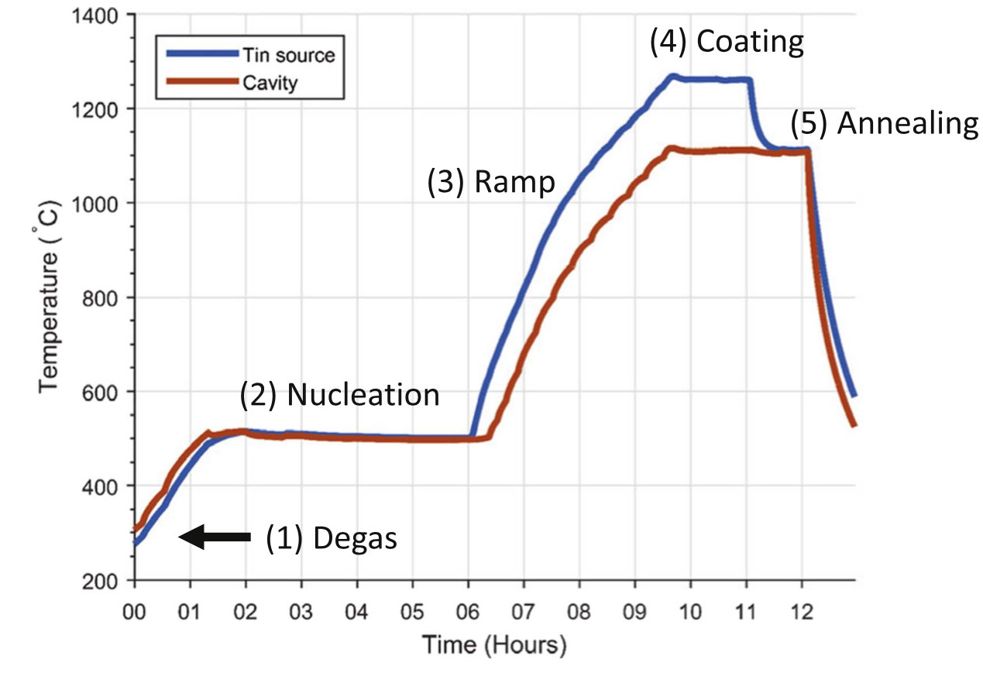
Thermal Vapor Diffusion
Temperature Profile
Coating chamber
Cavity
Nucleation agent (SnCl₂)
Primary heater
Secondary heater
Tin crucible
UHV Furnace
Tin source
“Wuppertal” configuration, i.e., with secondary heater for the tin source
S. Posen and M. Liepe, Phys. Rev. ST Accel. Beams 15, 112001 (2014).

Slide 9
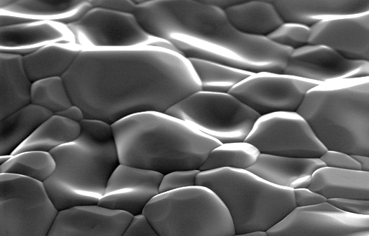
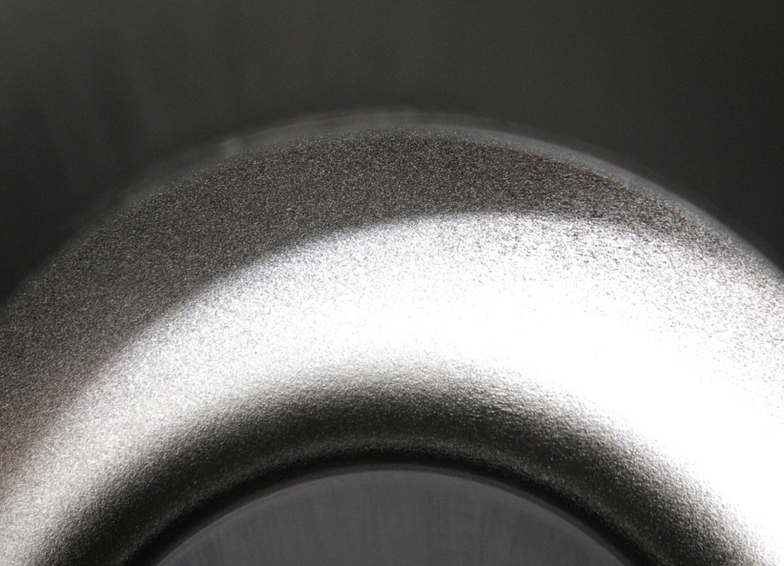
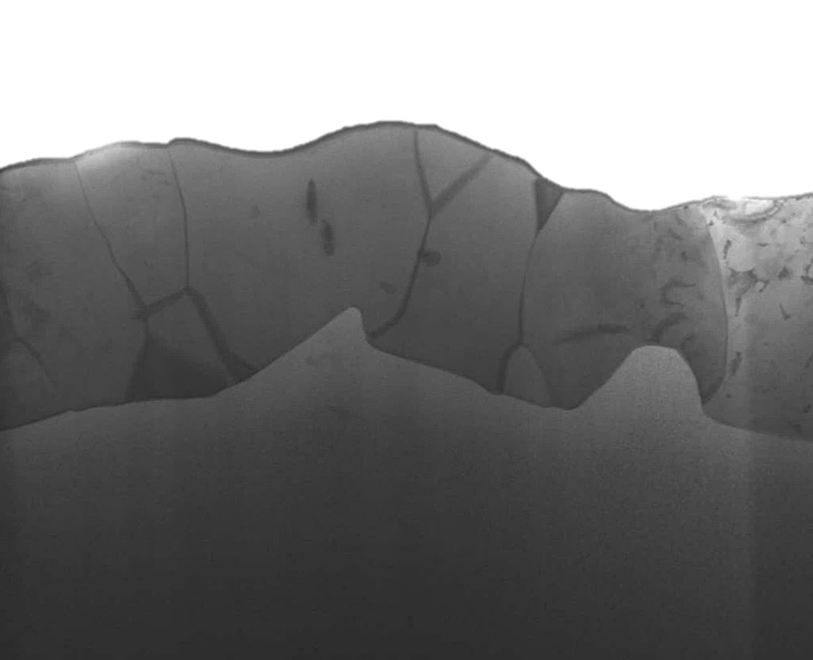
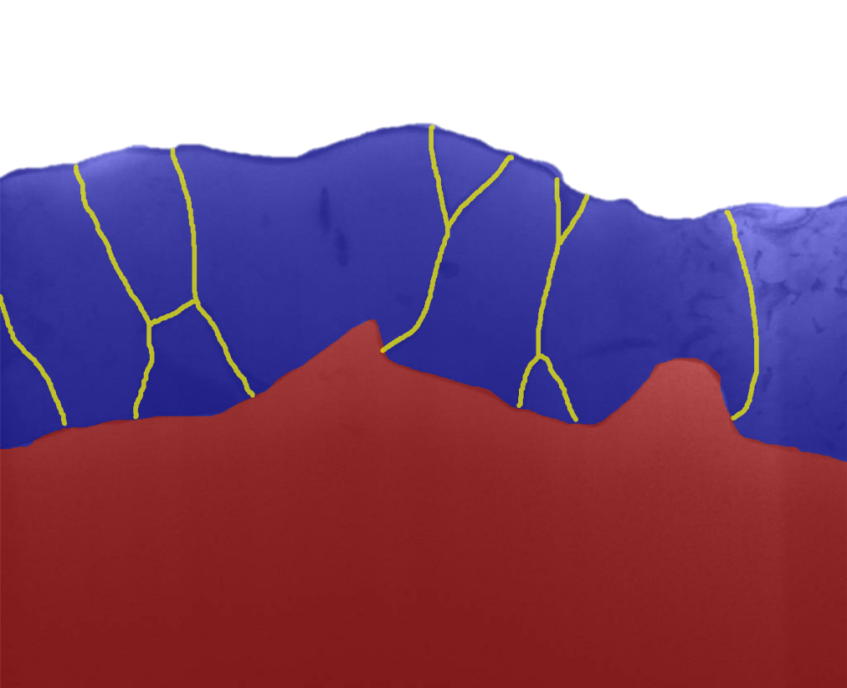
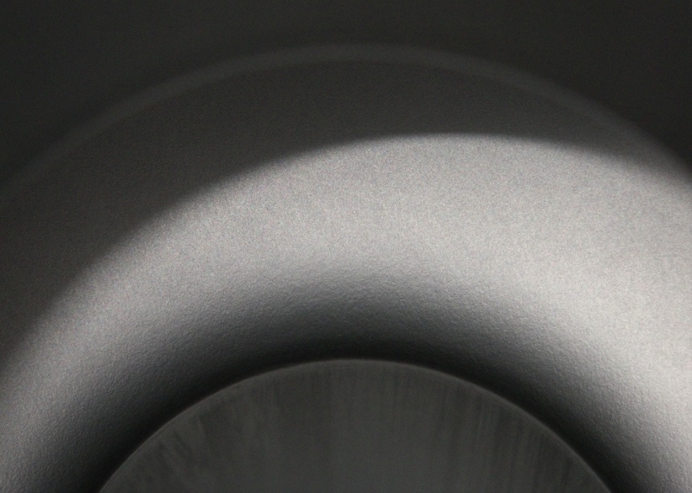
Nb₃Sn Coatings
Nb₃Sn forms a polycrystalline layer on the surface of the niobium
Before Coating
(surface)
2 μm
RF Surface
After Coating
≈3 μm
Nb₃Sn
Nb
(cross section)
1 μm
1 μm

Slide 10
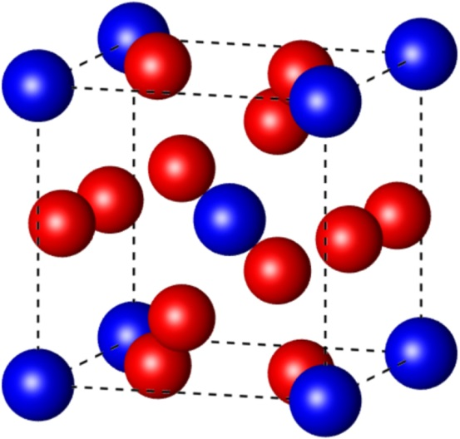
Stoichiometry and T_{C}
Nb₃Sn Phase Diagram
Nb₃Sn Structure
Nb
Sn
Nb₃Sn
Must maintain stoichiometry
Tin-depleted Nb₃Sn has a low T_{C}
16 – 25% Sn

Slide 11
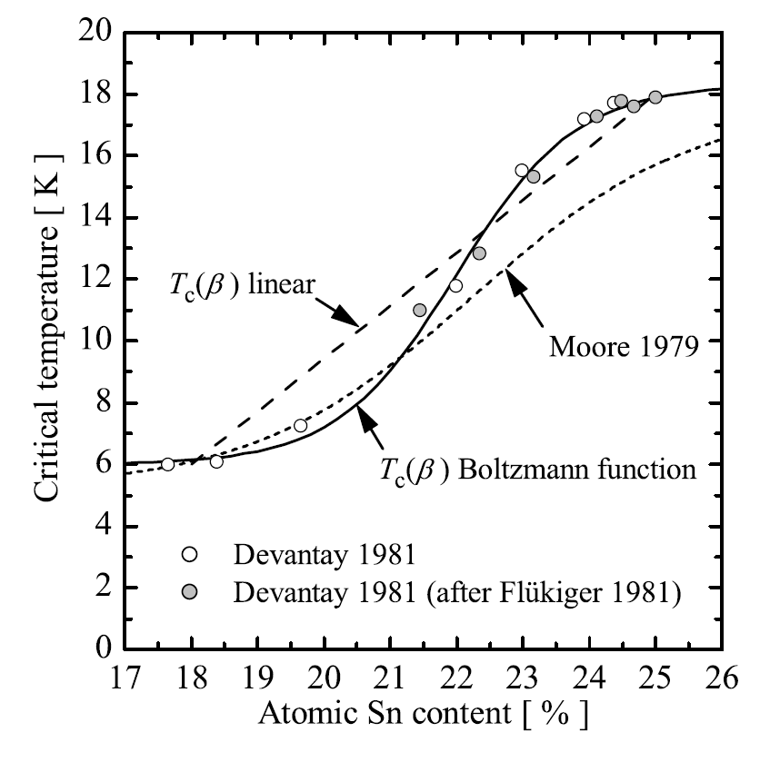
Stoichiometry and T_{C}
T_{c} vs. Tin Content
Nb₃Sn Structure
Nb
24 to 25% target
Sn
Must maintain stoichiometry
Tin-depleted Nb₃Sn has a low T_{C}
A. Godeke, Supercond. Sci. Tech, 2006

Slide 12
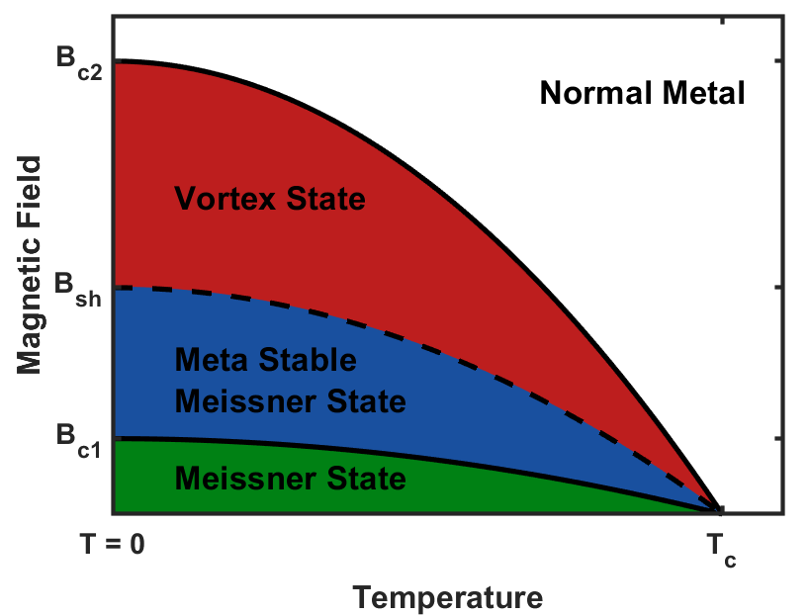
Material Challenges
Material is brittle
Low thermal conductivity
Small coherence length ξ ~ 3-4 nm
  Sensitive to small defects
  Small first critical field B_{c1}
    Need to operate in the flux free metastable Meissner state
Thin films help
  Need high quality Nb₃Sn films!

Slide 13
Outline
1. Why Nb3Sn?
2. How do we grow it?
3. State-of-the-art performance
4. Case Study: LCLS-II
5. Remaining Challenges

Slide 14
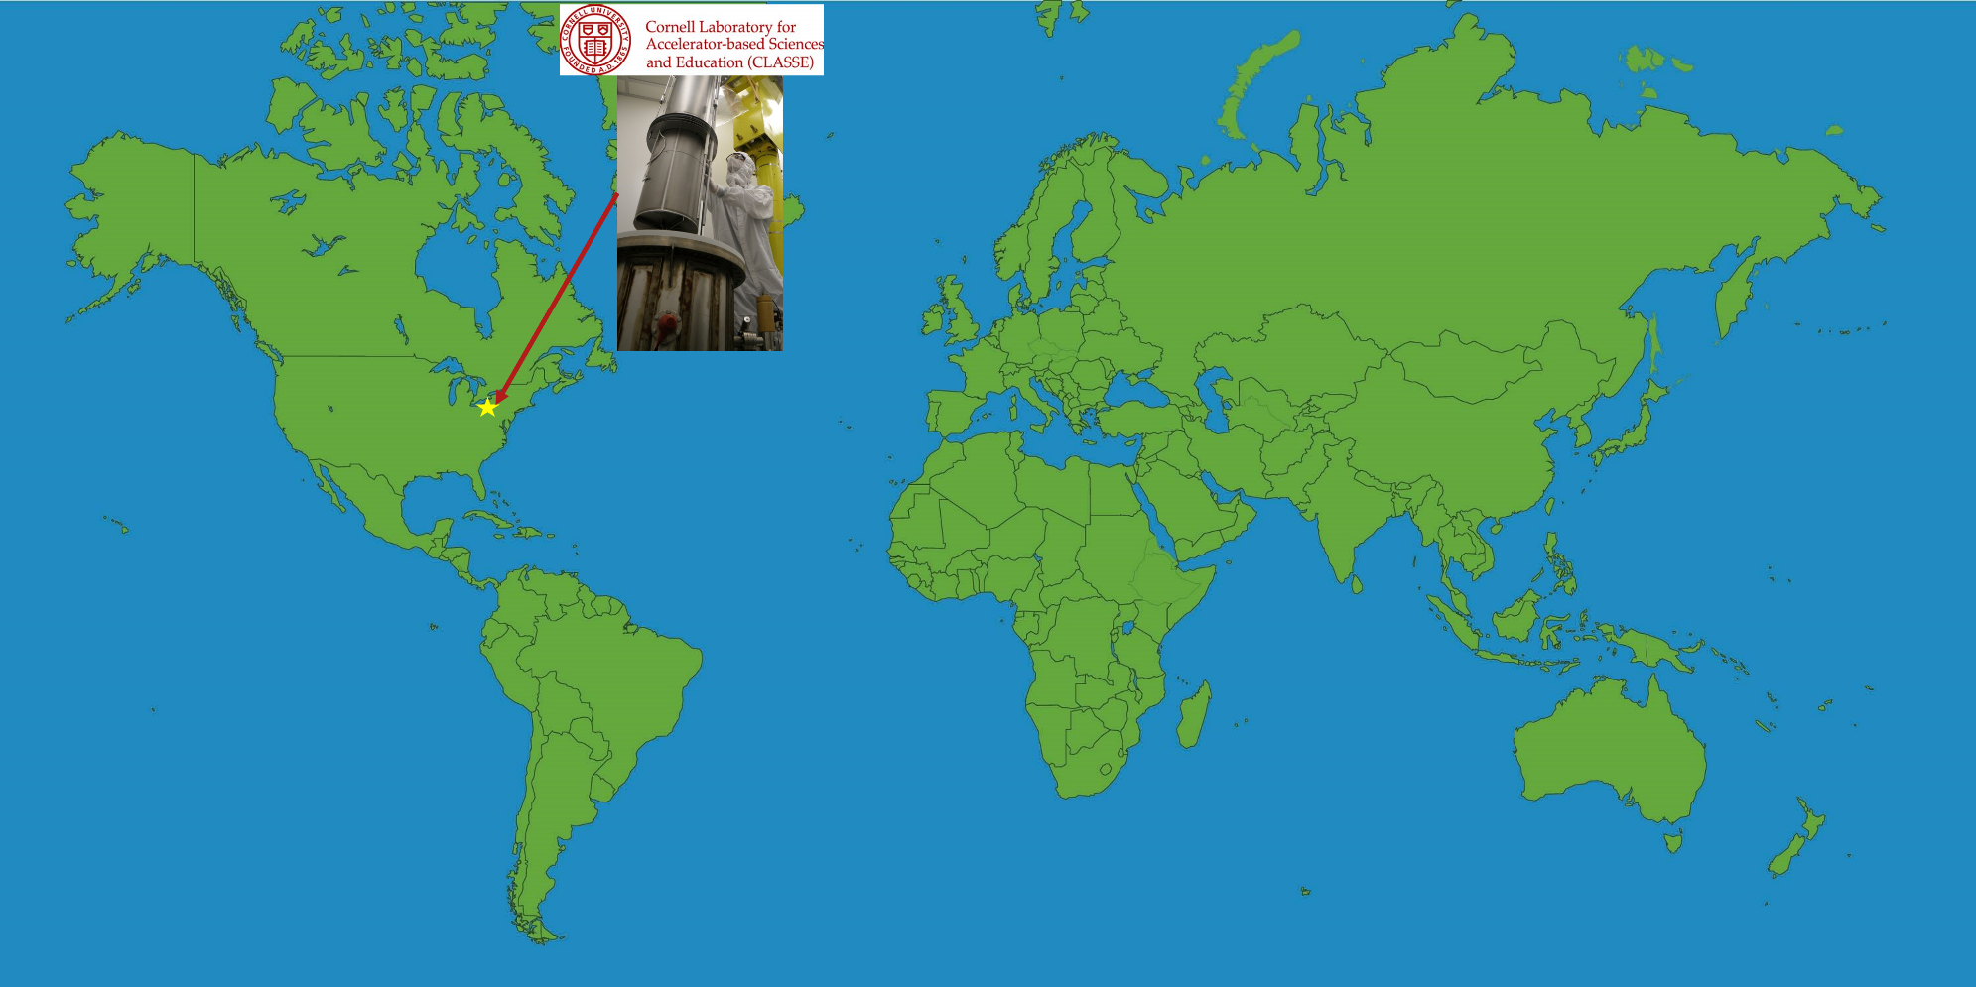
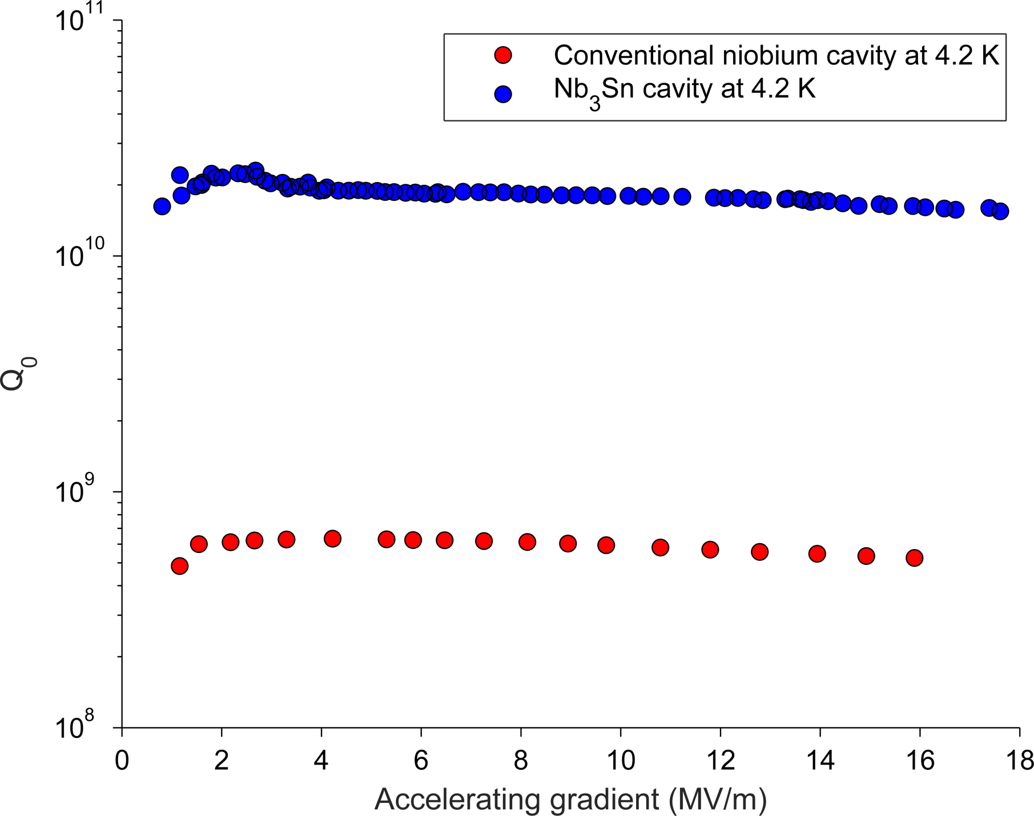
Cornell Nb₃Sn Breakthrough Performance
20× more efficient than Nb at 4.2 K!
First non-Nb accelerator cavities ever that outperform Nb at usable gradients!
S. Posen et al., Applied Physics Letters 106, Issue 8 (2015).

Slide 15
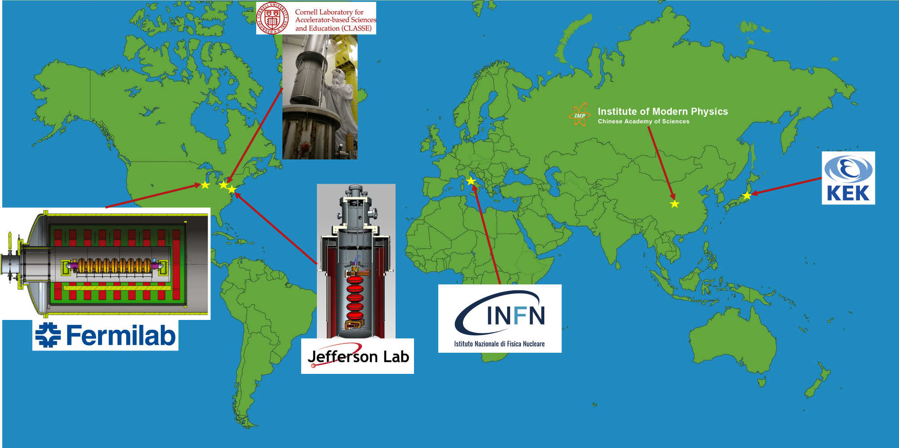
Nb₃Sn Around the World
And many more!

Slide 16


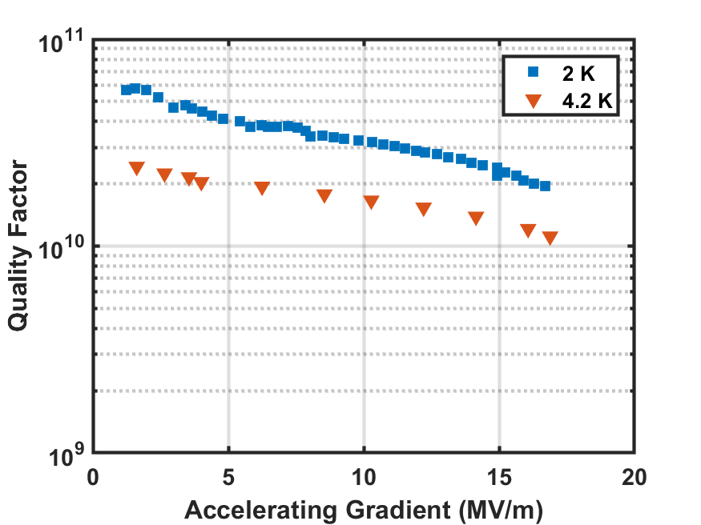
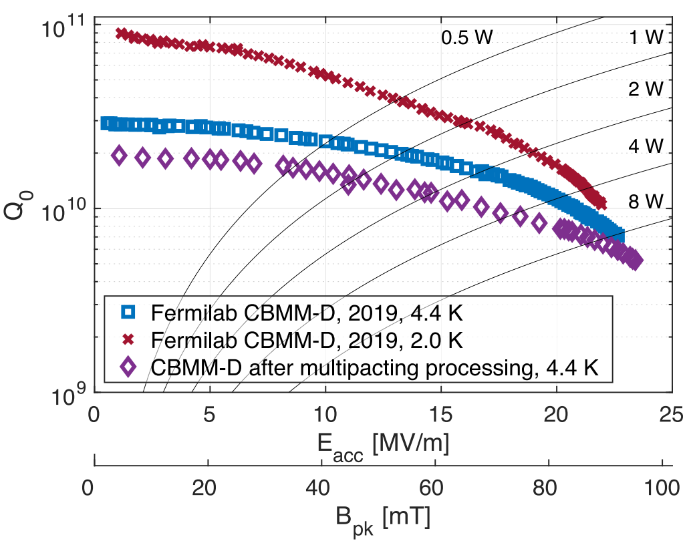
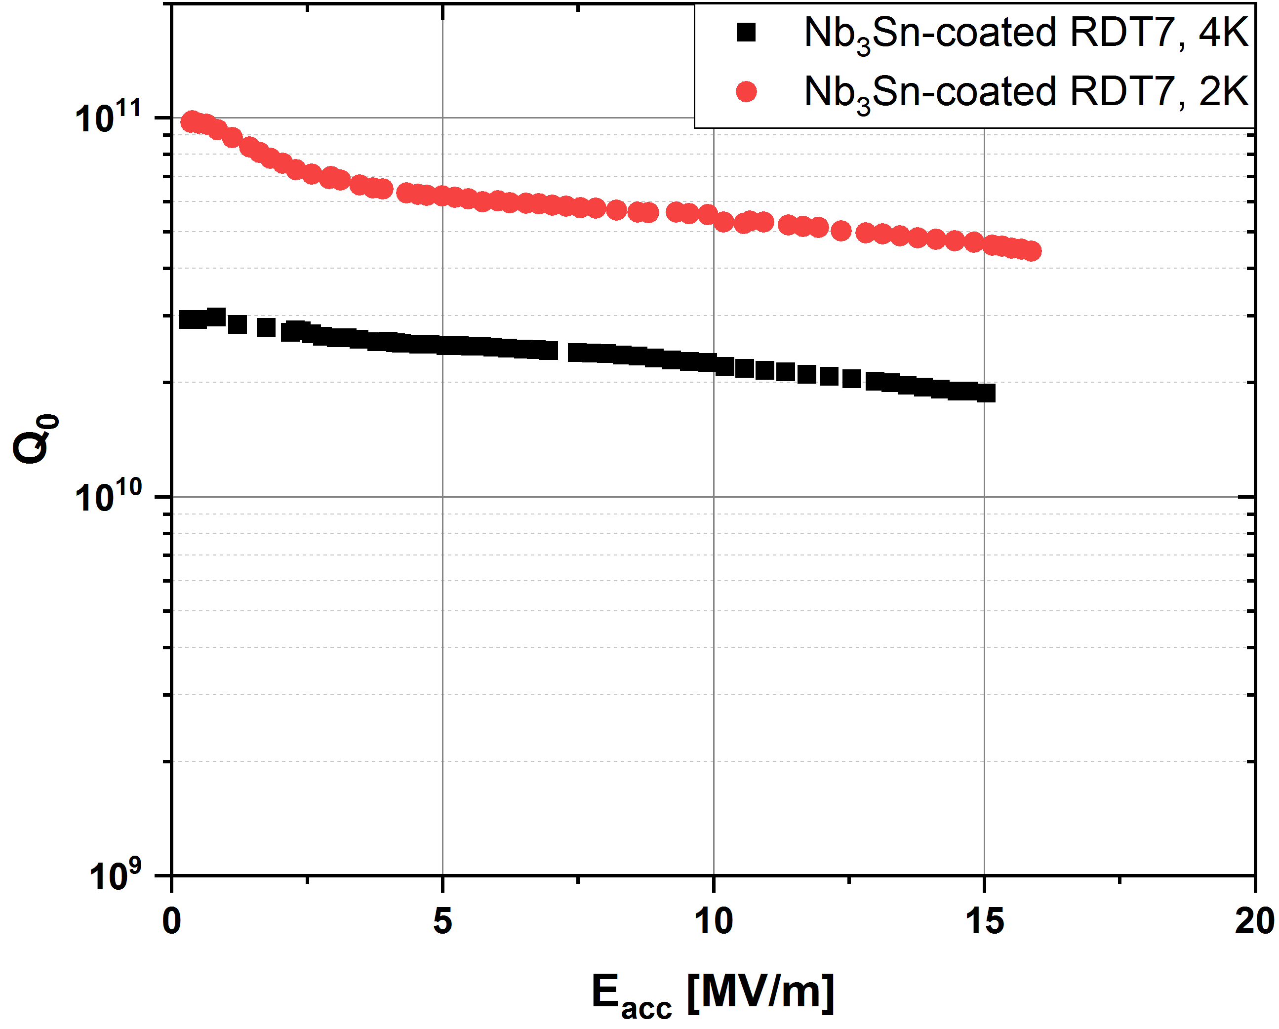
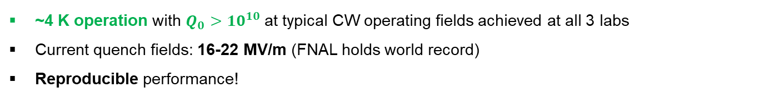
State-of-the-Art
S. Posen, https://doi.org/10.1088/1361-6668/abc7f7
U. Pudasaini, SRF’19
~4 K operation with $Q_{0}>10^{10}$at typical CW operating fields achieved at all 3 labs
Current quench fields: 16-22 MV/m (FNAL holds world record)
Reproducible performance!
(Note: Plots are for single cell cavities)

Slide 17
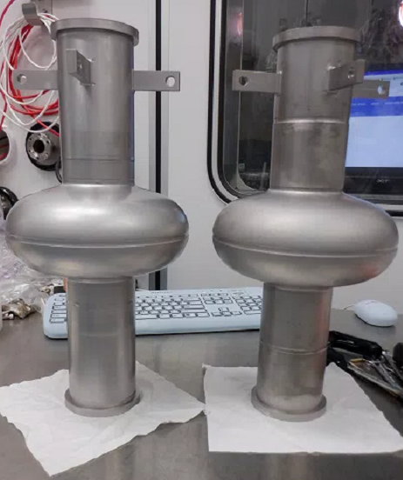
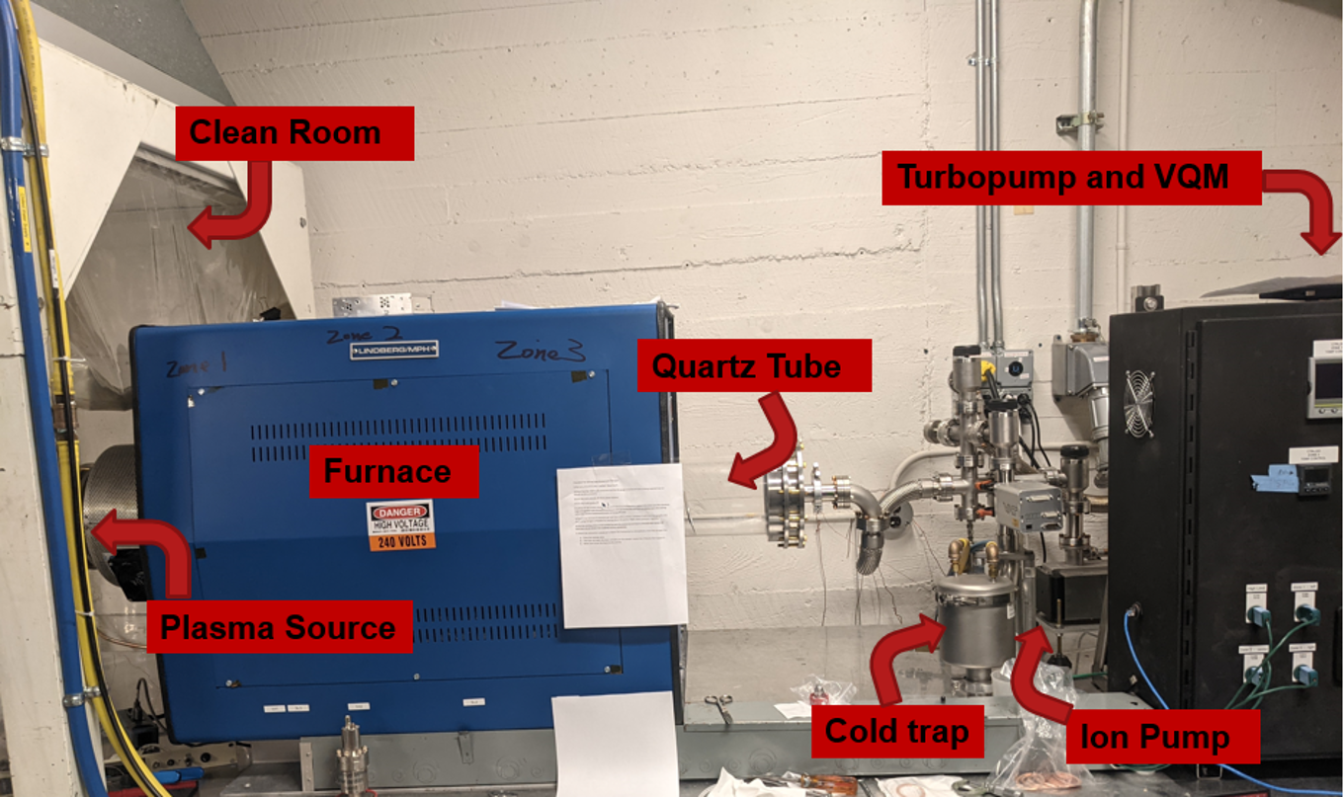
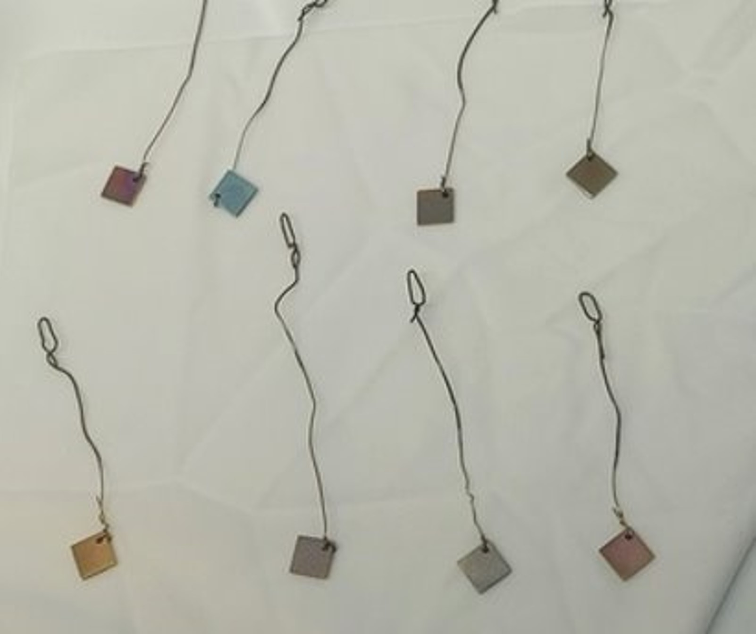
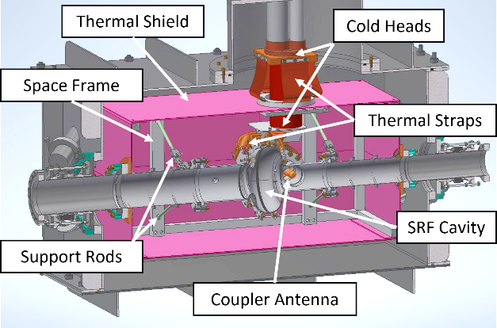
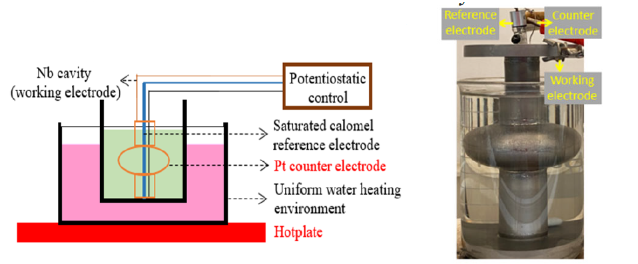
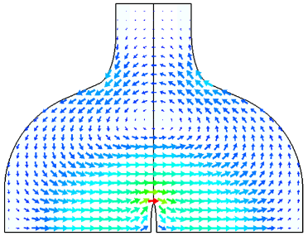
Ongoing R&D at Cornell
Sample studies to improve nucleation step of vapor diffusion
Chemical Vapor Deposition (CVD)
Thin Film Cavity
L. Shpani et al., in Proc. 2022 International Particle Accelerator Conference (IPAC 2022)
N. Verboncoeur et al., in Proc. 2022 International Particle Accelerator Conference (IPAC 2022)
G. Gaitan et al., in Proc. 2022 North American Particle Accelerator Conference (NAPAC 2022)
Nb₃Sn Cryomodule R&D
A high field sample host cavity
Electrochemical deposition
Z. Sun et al., in Proc. 2021 International Conference on RF Superconductivity (SRF’21)
N. Stilin et al., in Proc. 2022 International Particle Accelerator Conference (IPAC 2022)

Slide 18
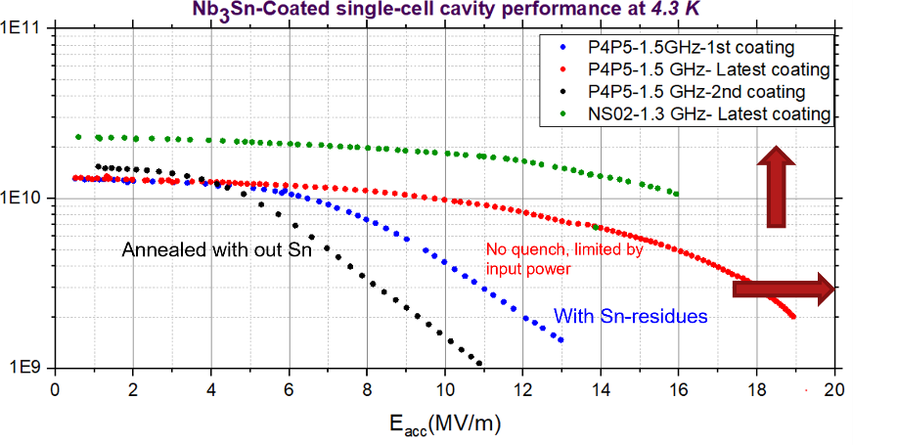
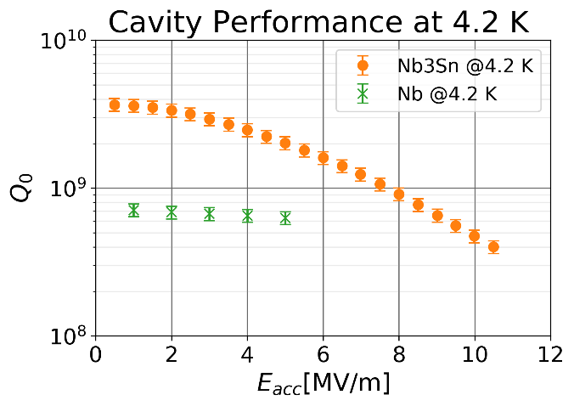


Ongoing R&D outside of Cornell (Examples)
FNAL and JLab are working on optimizing the coating process to reduce surface roughness and achieve thinner coatings.
KEK constructed a Nb₃Sn coating system, first results obtained in 2021.

Slide 19
Outline
1. Why Nb3Sn?
2. How do we grow it?
3. State-of-the-art performance
4. Case Study: LCLS-II
5. Remaining Challenges

Slide 20
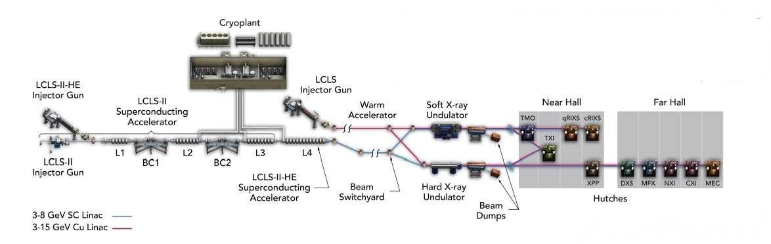
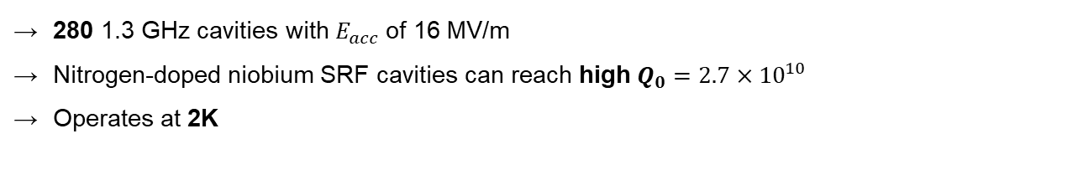
Case Study: LCLS-II
LCLS-II will be the first XFEL based on 4GeV continuous wave superconducting RF (CW-SRF) accelerator technology.
Before Coating
280 1.3 GHz cavities with $E_{acc}$of 16 MV/m
Nitrogen-doped niobium SRF cavities can reach high $Q_{0}=2.7×{10}^{10}$
Operates at 2K
After Coating

Slide 21
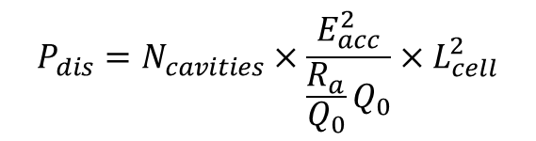
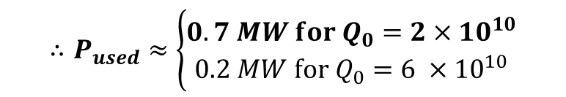
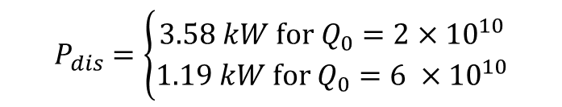


What if we used Nb₃Sn instead?
N-doped Nb at 2K
Nb₃Sn at 4.2K
Before Coating
$$P_{dis}=N_{cavities}×\frac{E_{acc}^{2}}{\frac{R_{a}}{Q_{0}}Q_{0}}×L_{cell}^{2}$$
$$P_{dis}=\left\{\begin{aligned}3.58 kW for Q_{0}=2×{10}^{10} \\ 1.19 kW for Q_{0}=6 ×{10}^{10}\end{aligned}\right.$$
$$=2.65 kW$$
1 W takes 800 W of wall power to cool
1 W takes 200 W of wall power to cool
$$∴P_{used}≈\left\{\begin{aligned}0.7 MW for Q_{0}=2×{10}^{10} \\ 0.2 MW for{ Q}_{0}=6 ×{10}^{10}\end{aligned}\right.$$
$$∴P_{used}≈2 MW$$
Using 2K superfluid helium cryoplant.
Using 4K atmospheric cryoplant.

Slide 22
Outline
1. Why Nb3Sn?
2. How do we grow it?
3. State-of-the-art performance
4. Case Study: LCLS-II
5. Remaining Challenges

Slide 23
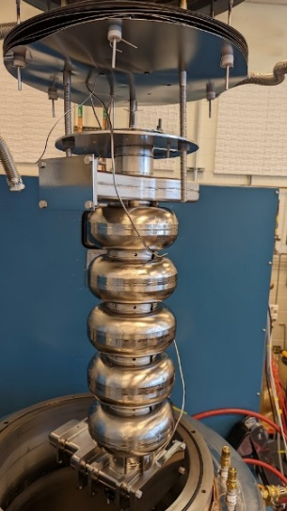
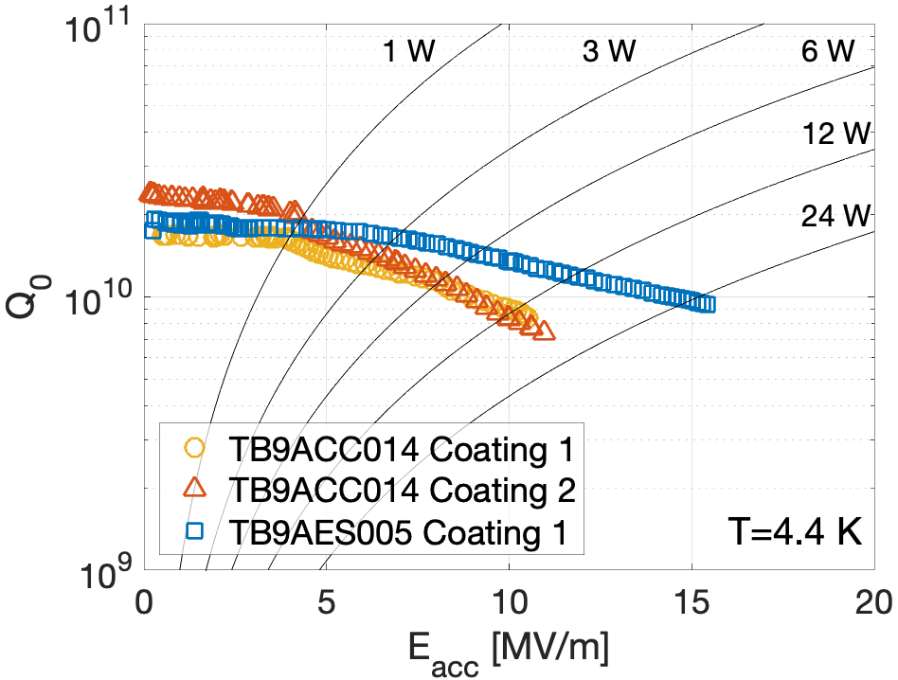
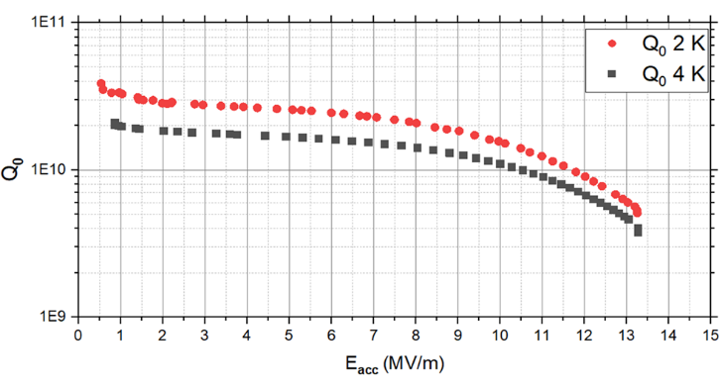
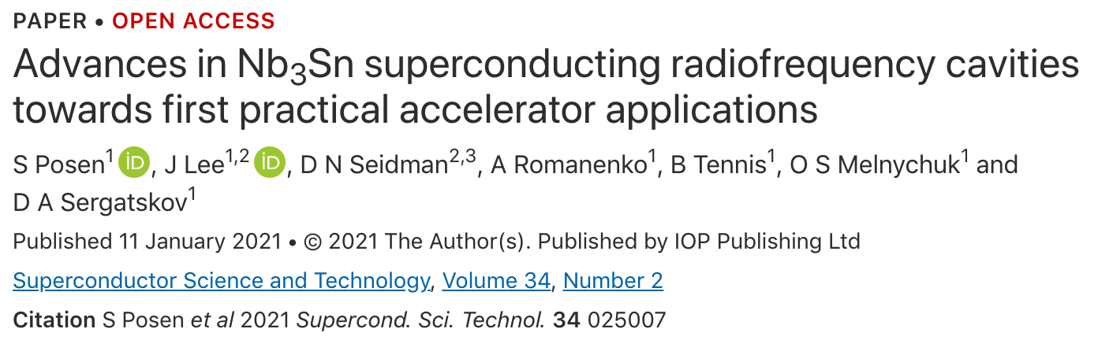
Transferring to Multicell Cavities
9-cell 1.3GHz cavities coated and RF tested.
5-cell 1.5GHz cavity coated and RF tested.
C75-RI-04
At 4K : 1E10 @ >10 MV/m
Q₀ > 9x10⁹ at quench
C75 cavity made from large grain Nb
Cornell: Multicell coating facility under development.

Slide 24
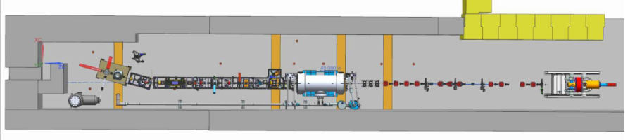
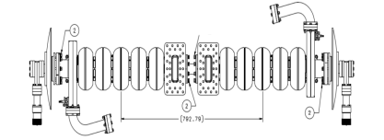
Helium Based Cryomodules
A further challenge is implementing multi-cell cavities in accelerator cryomodules.
Nb₃Sn cavities for Upgraded Injector Test Facility (UITF) at JLab
Material is brittle – sensitive to deforming
Slow cooldown – need small temperature gradient across cavity
4K operation challenges
  Microphonics
G. Eremeev et al., Proceedings LINAC 2016 (MOPLR024)
S. Pokharel et al., Proceedings IPAC 2022 (MOPOTK051)

Slide 25

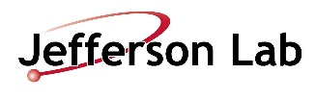
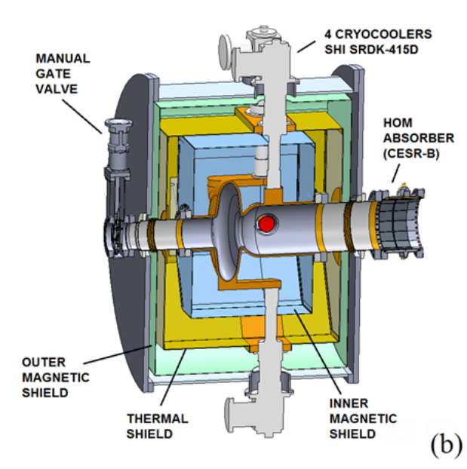

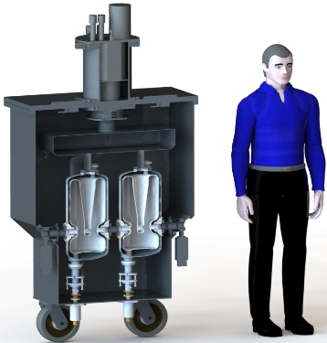

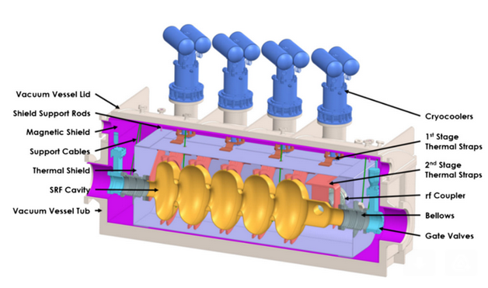
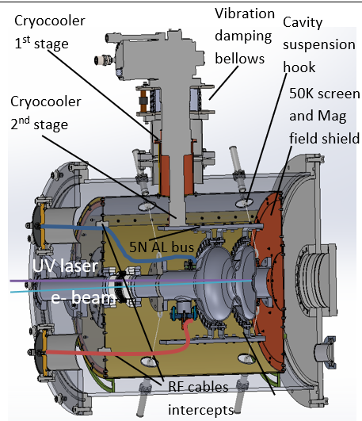

Conduction Cooled Cryomodules
Nb₃Sn for Nuclear Physics (Collaboration ANL/FNAL/Radiabeam)
Lead lab
PI: Mike Kelly
Wastewater Treatment
FNAL Lead: Sam Posen
Nb₃Sn for Industrial Accelerators
(Collab. Euclid/FNAL/BNL)

Slide 26
Key Takeaways
Nb₃Sn is a high-potential material for next-generation SRF cavities
  Higher energy gain
  Lower cooling cost and complexity
Nb₃Sn coating facilities are established around the World (Cornell, FNAL, JLab, KEK, etc.)
Ongoing R&D will improve Nb₃Sn performance of Nb₃Sn films
  Thinner films
  Reduced surface roughness
Applications are at early stages
  Multicell Nb₃Sn cavities
  Prototype cryomodule testing
  Turn-key compact cryomodules
Stay tuned !

