Slide 1
Commissioning of LCLS-II Electron Source and Injector
Feng Zhou (SLAC)
for the injector commissioning team
Presented at ERL22, Ithaca, 10/6

Slide 2
Outline
LCLSII injector layout and major parameters
Commissioning results
    1 MeV electron source (2018-2020)
    100 MeV injector (7/15 – 8/14, 2022)
Summary

Slide 3
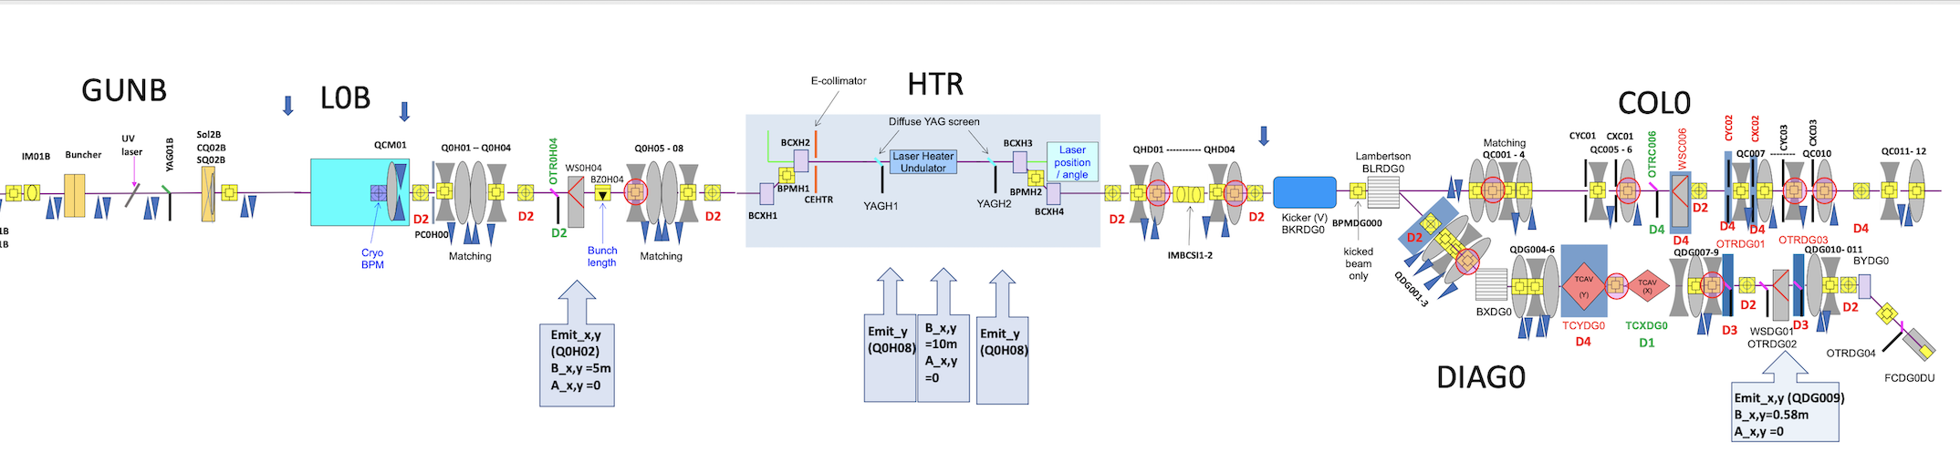
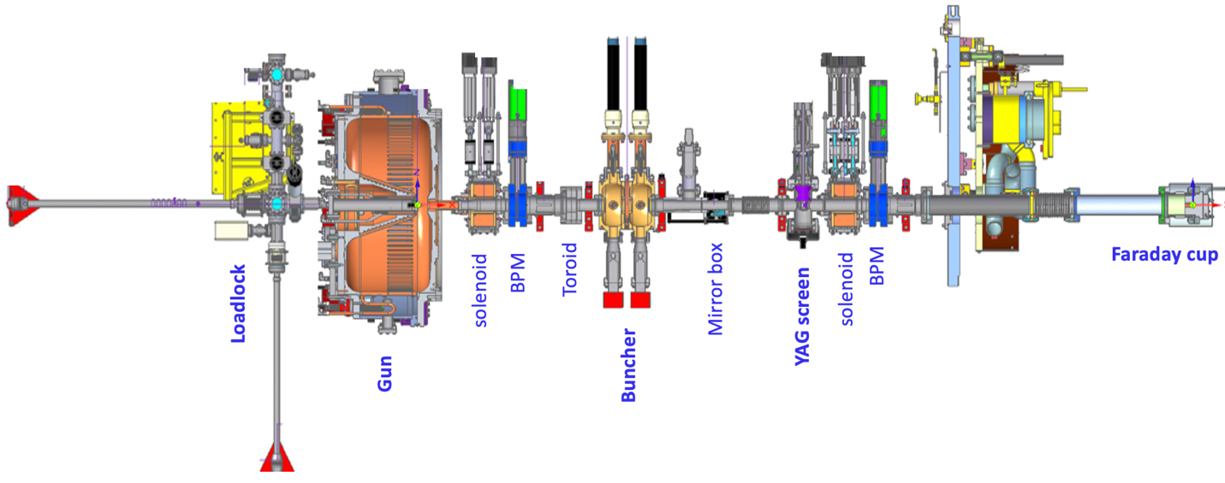
LCLSII Electron Source & Injector Schematic
100MeV injector
CM01
OTR0H04
ACM1/2
1MeV e-source

Slide 4
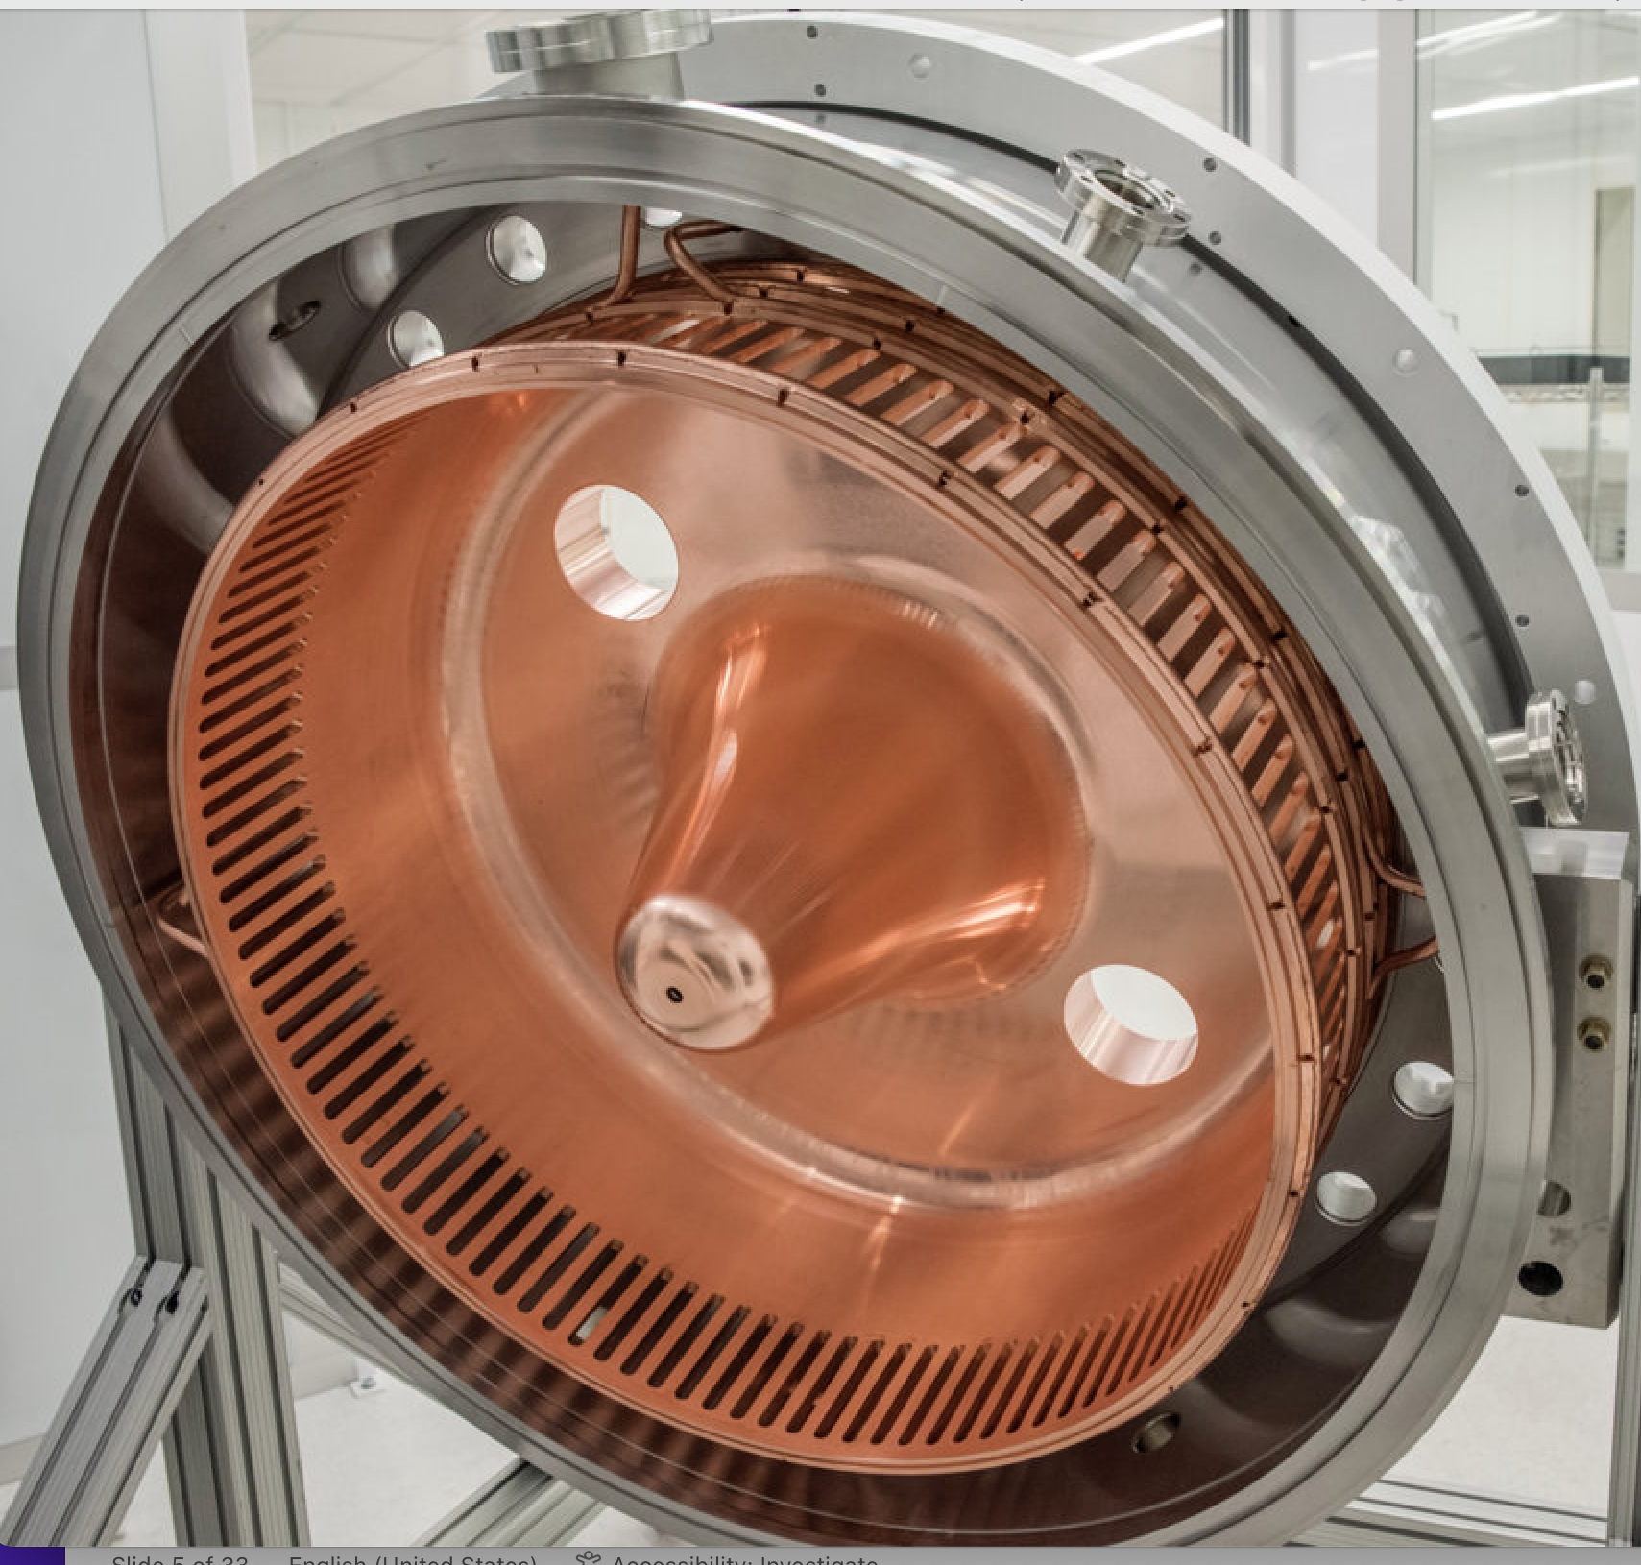
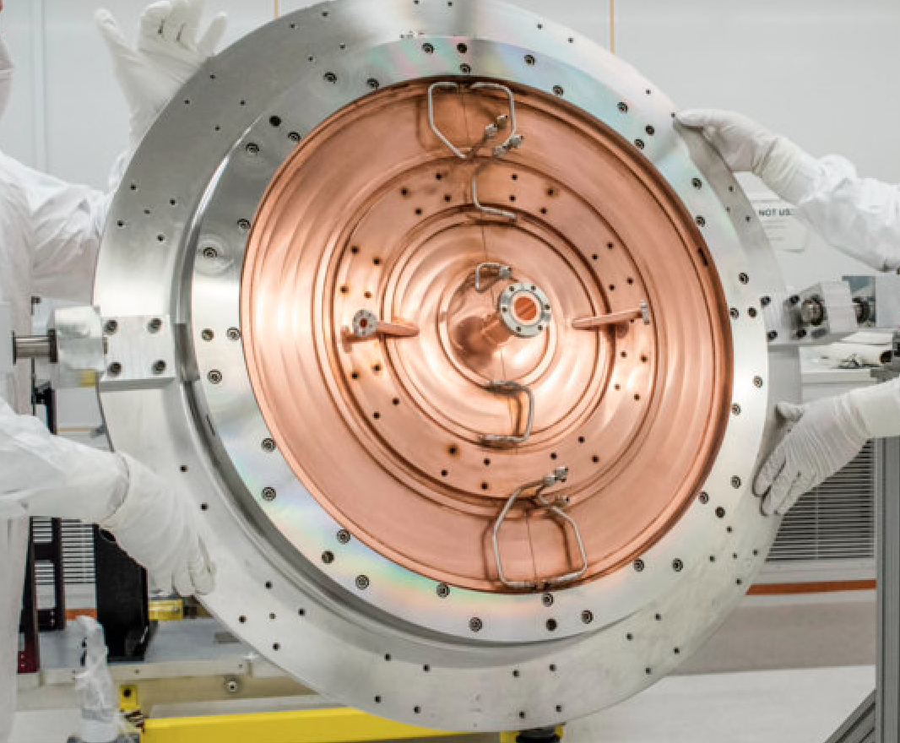
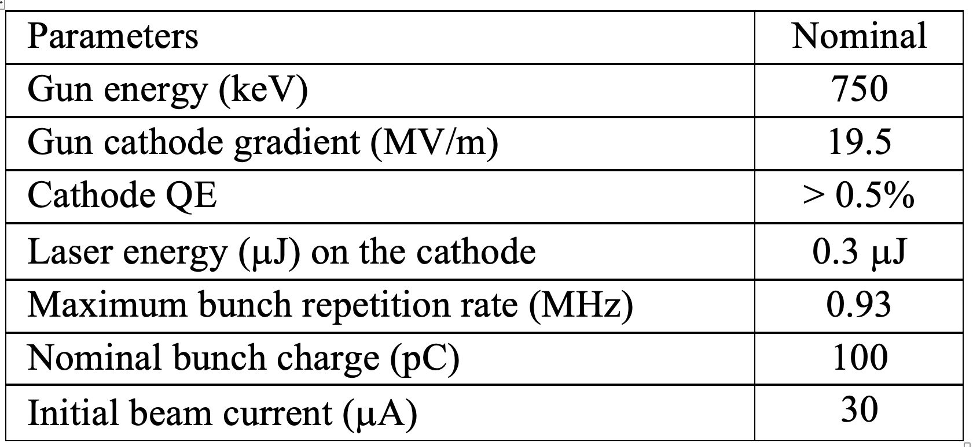
LCLS-II Electron Source Commissioning
(~2 years, 2018 - 2020)
E-source BL was built by LBNL
Laser was manufactured by Amplitude (France):
    Oscillator operates at 46.43 MHz
    Can select pulse rate up to 1 MHz
Addressed a number of severe problems during the 2-year commissioning:
    Severe gun contaminations
    Broken frequency tuners for gun & buncher
    Gun WG damaged and oxidized inner conductors
    Difficult cathode exchange in the loadlock
    Suitcase problems
    Difficult access to the gun and LEB
    Poor solenoids mover (not fixed yet)

Slide 5
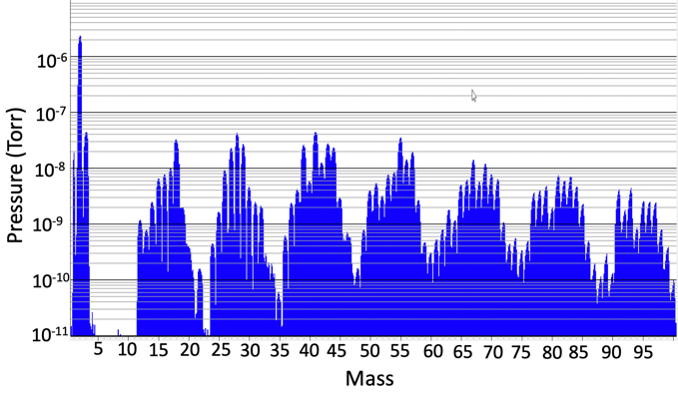
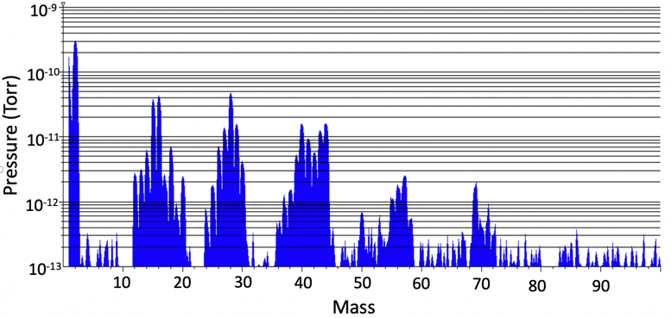
LCLS-II Electron Source Commissioning
Gun Contaminated & Revived Eventually
Multipacting due to significant hydrocarbons prevented feeding RF power >600 W to the gun
Baking at up to 190°C for >10 days did not improve the hydrocarbons.
12 NEGs were identified the source of the contaminations. Special activation of all NEGs improved hydrocarbons, which allows to feed nominal 80 kW peak power into the gun body.
Gun vacuum is now in 8e-10 Torr with nominal CW RF power.
10⁻⁵
Initial RGA without RF due to gun contamination
10⁻⁹
RGA with nominal CW RF power after gun revive

Slide 6
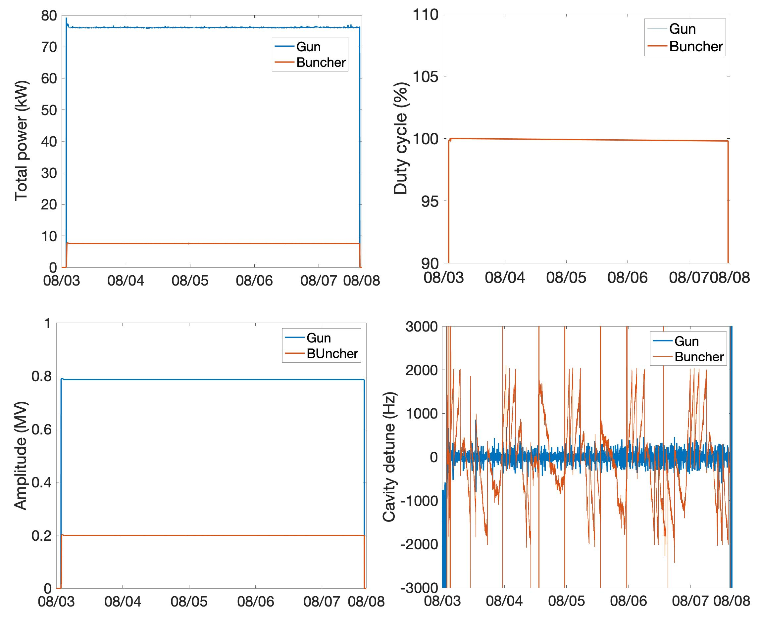
LCLS-II Electron Source Commissioning
Reliable 24/7 Gun & Buncher CW Operation

Slide 7
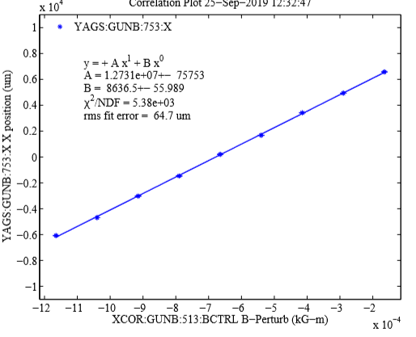
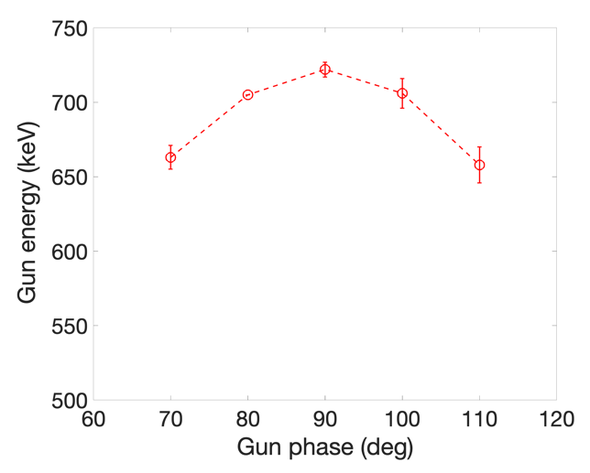
LCLS-II Electron Source Commissioning
Gun Energy Measurement
Multi-ways for energy measurements within 10% difference for same input power to the gun:
  Slope of beam position vs. corrector field strength
  RF probes signal
  Measured input RF power
  Measure time-of-flight between two BPMs after gun
  Measure the minimum beam size of 1pC with the solenoid
slope of beam position vs. corrector strength

Slide 8
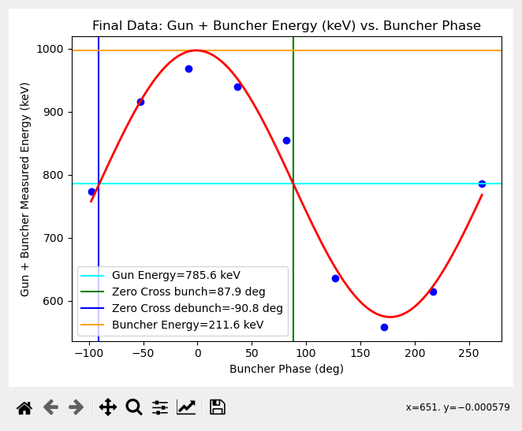
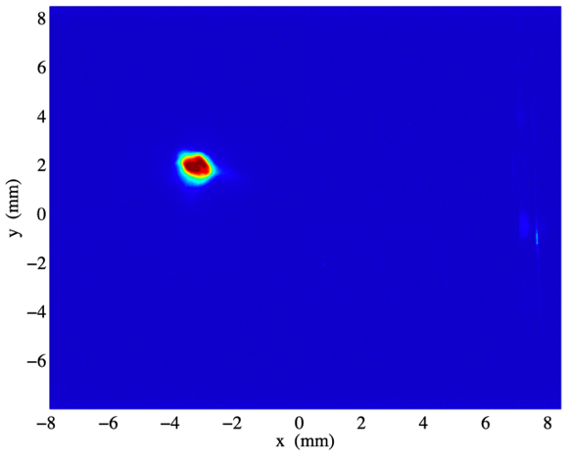
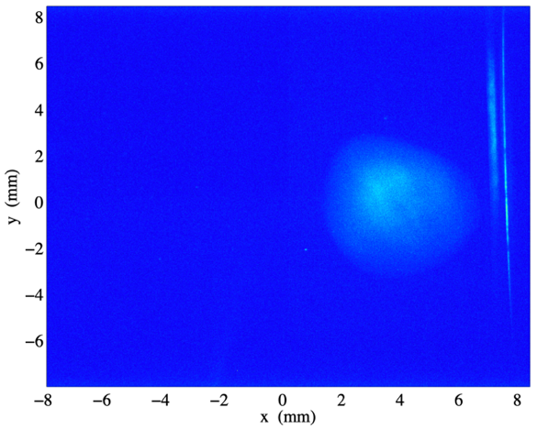
LCLS-II Electron Source Commissioning
Buncher Energy & Phase Measurements
Measured beam energy vs. buncher phase for given gun energy/phase
The inferred gun energy and buncher energy are 785 keV and 212 keV respectively, which agree well with expectation for given power.
Beam size with zero-crossing phase for bunching is much larger than debunching due to the space charge effect.
A: zero-crossing for debunching
B: zero-crossing for bunching

Slide 9
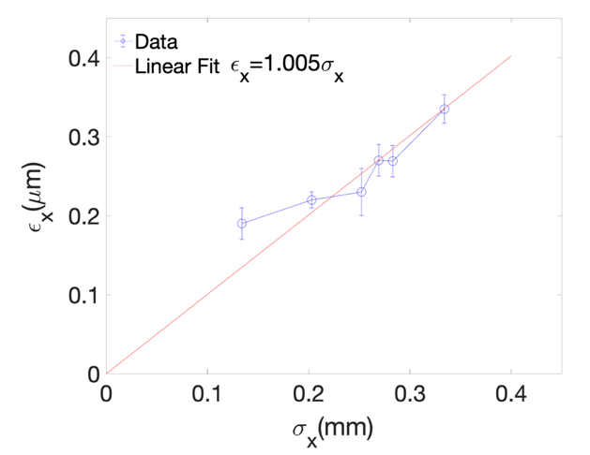
LCLS-II Electron Source Commissioning
Intrinsic Cs₂Te Emittance Met Expectation
Cs₂Te cathodes were produced by INFN/LASA during e-source commissioning – thanks LASA!
Used solenoid to measure the intrinsic emittance at the gun energy with <1 pC charge.
Measured emittance is 1μm/mm-rms, which agree well with the expected intrinsic emittance given 4.84 eV of UV laser energy and 3.2-3.5 eV of work function for Cs₂Te.
SLAC has grown cathodes starting 2020

Slide 10
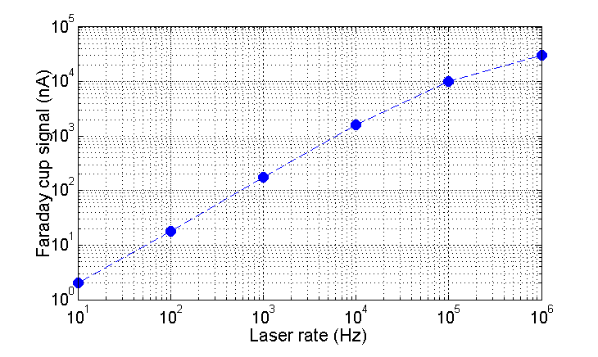
LCLS-II Electron Source Commissioning Demonstrated up-to-1MHz e-Beam Operation
LCLSII requires a bunch repetition rate up to 1MHz. The initial beam current will be kept <30 μA due to head load limitation in the beam dump at the end of 4 GeV SC linac.
Roll-off of the current at high rate was due to drop in the laser pulse energy as a result of component heating

Slide 11
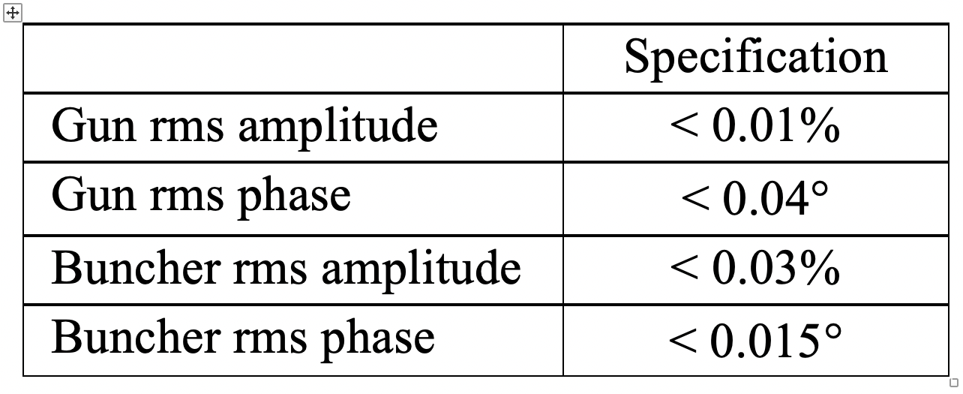
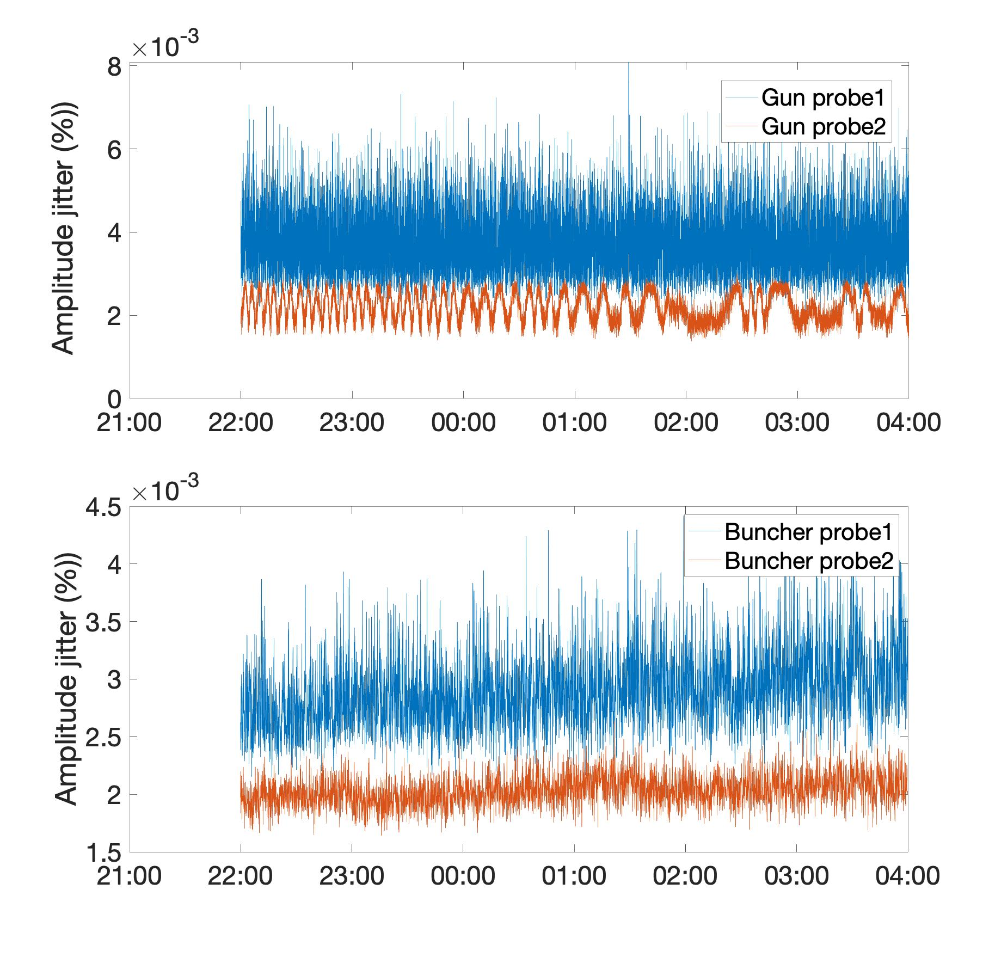
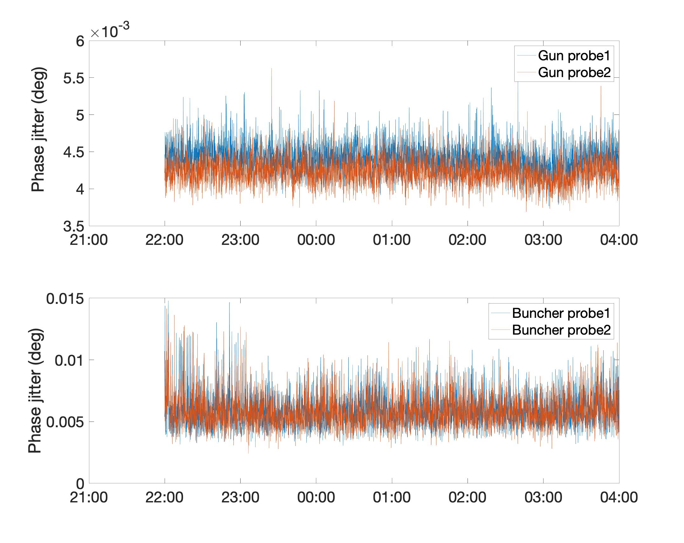
LCLS-II Electron Source Commissioning
Gun/buncher LLRF jitter met specifications
Gun/buncher field amplitude/phase jitter is critical to limit beam arrival time jitter at the end of linac. Simulated specs for attaining fs level timing jitter after two-stage compression. All measurements met with specifications.
<0.01%
<0.04º
<0.03%
<0.015º

Slide 12
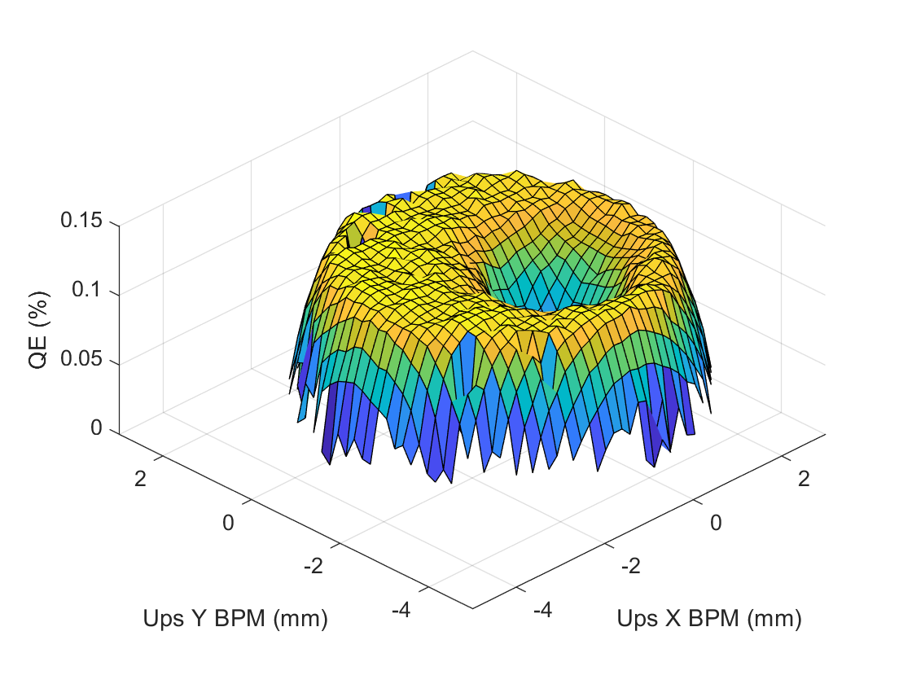
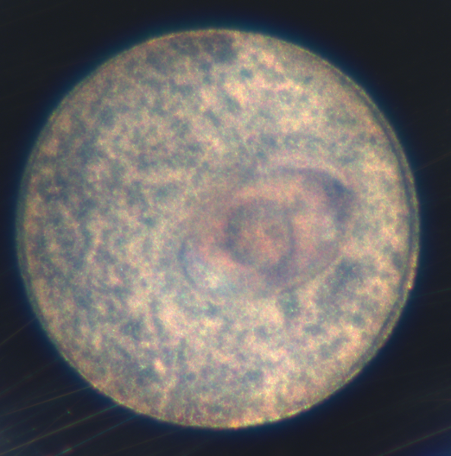
LCLS-II Electron Source Commissioning
Cs₂Te Cathode QE Evolution
Initial QE <0.5% due to a small leak in the transport container.
Three cathodes are used for e-source/injector commissioning
    1st one was operated for 500 hours, and a QE crate near the cathode center was observed
    2nd one was operated for 200 hours, and slight QE decrease near the cathode center was observed
    3rd cathode already operates for 400 hrs and no obvious QE decrease is observed
Ion back-bombardment is unlikely the cause for the QE crate/decrease as beam operated at 10 Hz for most time.
Instead, dark current is probably the cause for the QE crate or decrease.

Slide 13
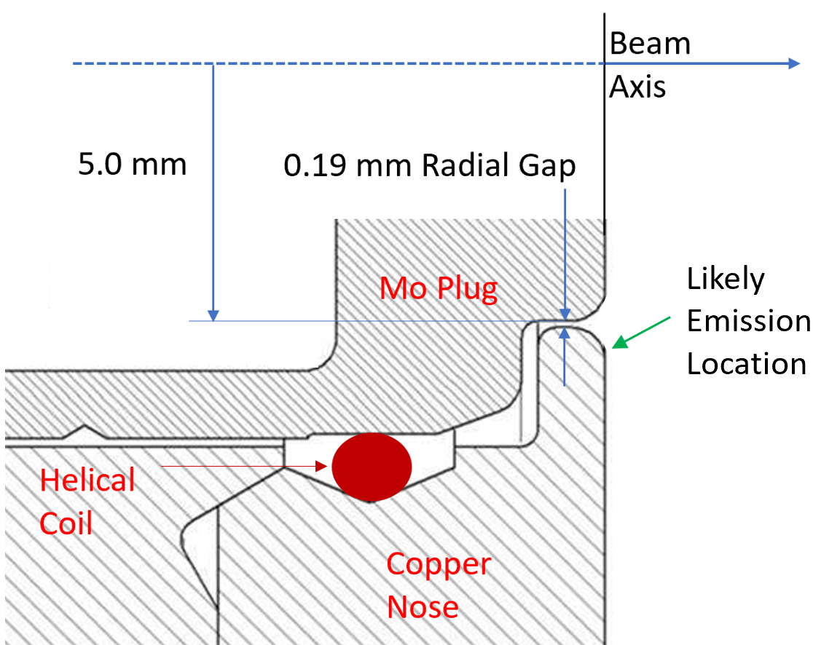
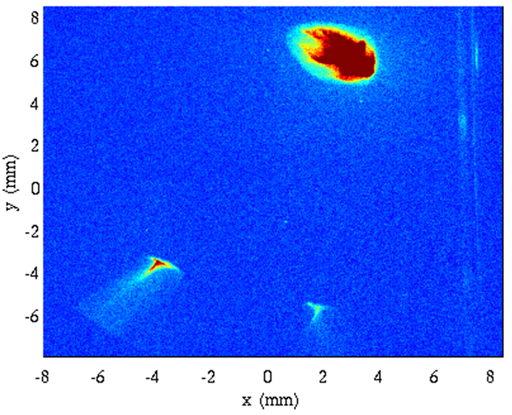
LCLS-II Electron Source Commissioning
Gun Dark Current Measurement Before Cryomodule01 (CM01)
Gun dark current was 10 nA initially but grew to 2.5 μA level after 700 hours of operations, but keeps unchanged since then
Dark current is transversely separated from the e-beam
The field emission is likely near the rounded opening on the cathode nose where the E-field is enhanced by 24% relative to the cathode center.
e-beam
dark current

Slide 14
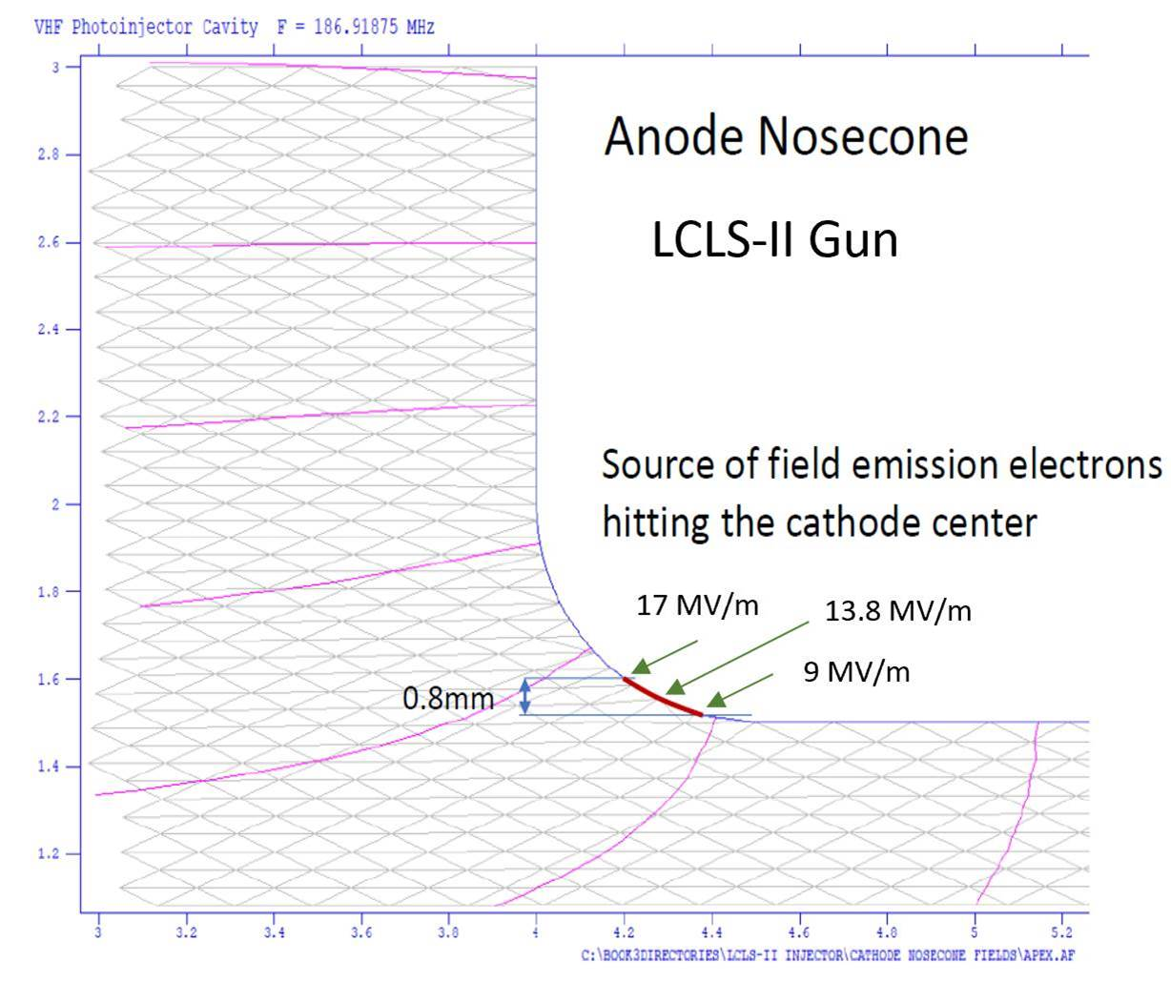
LCLS-II Electron Source Commissioning
Dark Current Analyses
Cathode nose is one of the sources for the field emission, which can transport downstream
    Dark current electrons lost on the mirror box may generate secondary electrons, which can back-propagate to the cathode.
Anode nose could be another source due to higher E-field. The primary dark current electrons can directly hit the cathode.
Anode
Cathode

Slide 15
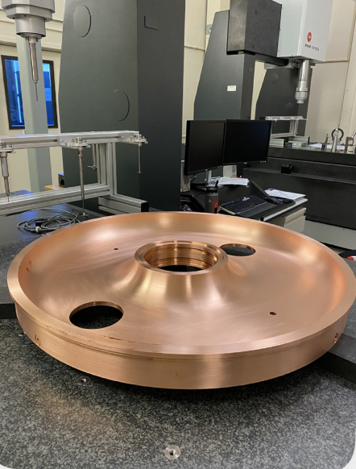
SLAC is building an upgrade gun for spare
SLAC is building an upgraded gun as a spare. A few new features are implemented for the new gun performance improvements.
Implement elliptical shaped plug gap opening to reduce field enhancement and SS insert around the nose opening to reduce the field emission
Parts are being fabricated and the gun is expected to be ready in the Fall 2023

Slide 16
100 MeV Injector Commissioning
(4 weeks, July –August 2022)
We spent 4 weeks for preliminary full-scale injector commissioning:
  Commissioned beam through CM01 to COL0 dump
  Commissioned kicker and sent beam down to DIAG0 dump
  Commissioned Average Current Monitor (ACM) and long beam loss monitor (LBLMs) and completed safety certification
  Preliminarily optimized emittance
Parameters | Nominal
Energy | >90 MeV
Charge | 20 - 100 pC
Bunch length | 0.5 -1 mm rms
Normalized emittance | 0.3 – 0.6 μm rms
e-beam rate | 1 Hz to 1 MHz
To main linac
CM01
e-source
OTR0H04
ACM1/2

Slide 17
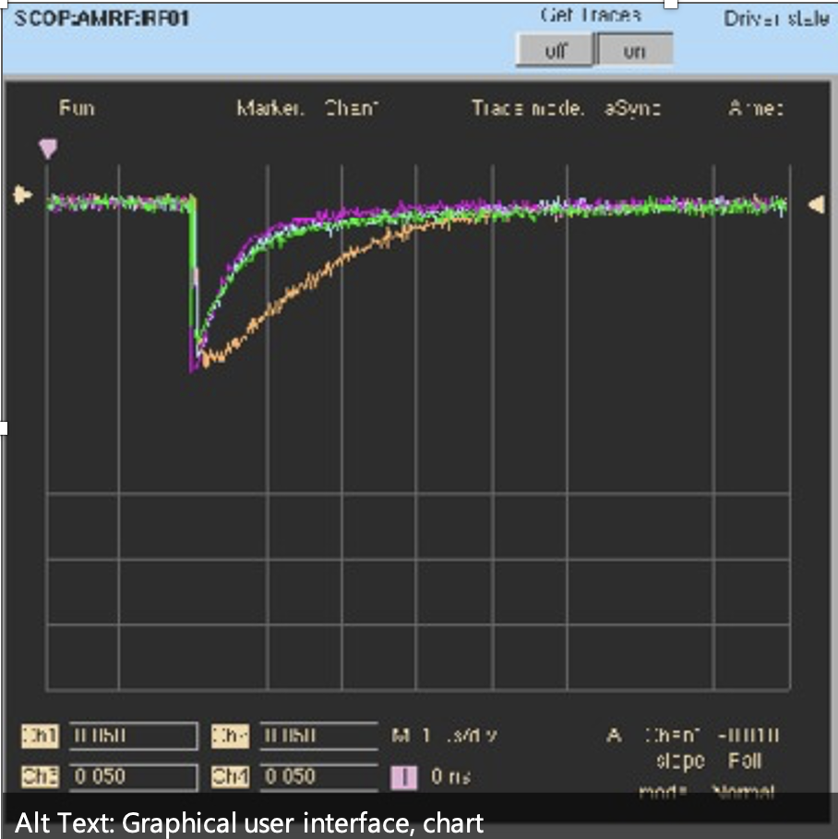
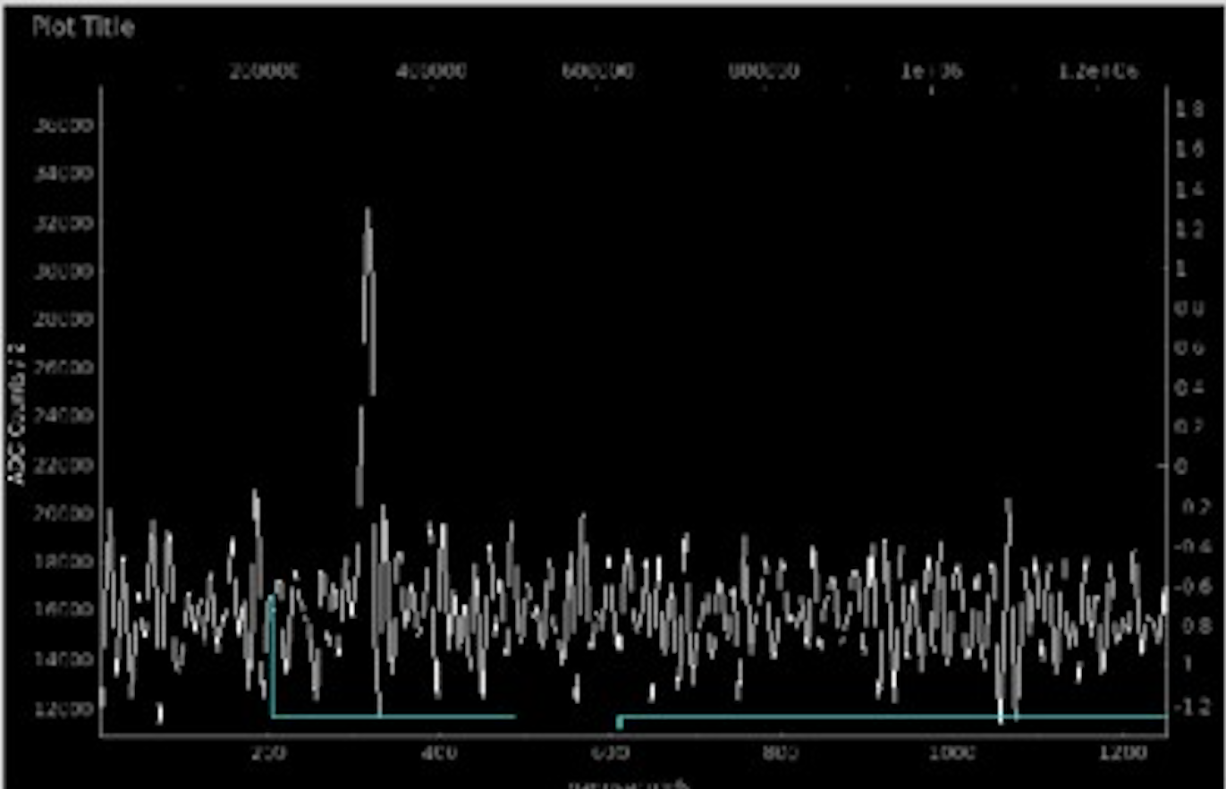
100 MeV Injector Commissioning
Established First Beam through Full Scale Injector
First ~750 keV e-beam from the gun reached CM01 BPM with the aid of HOM BPMs w/ CM01 cavities OFF
In the beginning, roughly determined each cavity’s on-crest phase based on the charge transmission on the CM01 BPM
Then, finely determined each cavity’s phase based on downstream energy BPM in the laser heater chicane
Ensured full beam through CM01 to end of beamline:
    No beam loss observed along the beamline with fast waveform of LBLMs
    Faraday cup signal on the end of beamline confirmed
HOM ‘BPMs’ in CM01
Beam loss on the beam stop

Slide 18
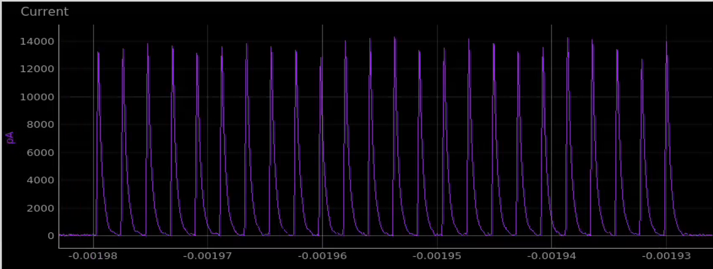
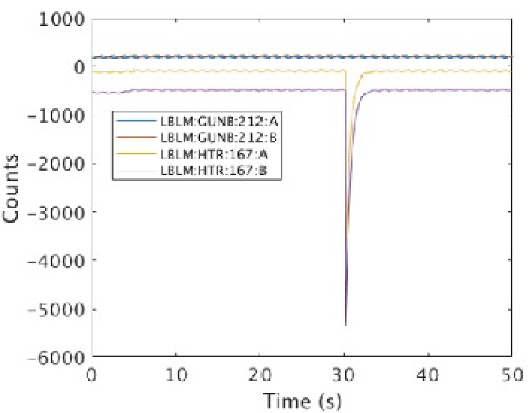
100 MeV Injector Commissioning
ACMs and LBLMs certified for safety system
2 critical safety systems:
    ACM is to measure dark current and e-beam current.
    LBLM is to measure beam loss from dark current and e-beam.
Completed ACM with burst modes up to 2000 bunches with 1-2 μs of spacing:
    Tested 5 -250 pC, for ~100 different bursts
    Tested trips up to 250 μA – tripped as expected
  Completed LBLM with a burst of 500 bunches with 2 μs of spacing:
    Measured beam loss at thin/thick targets
    Tested trips
Example:
Burst mode with a number of bunches
LBLM signals

Slide 19
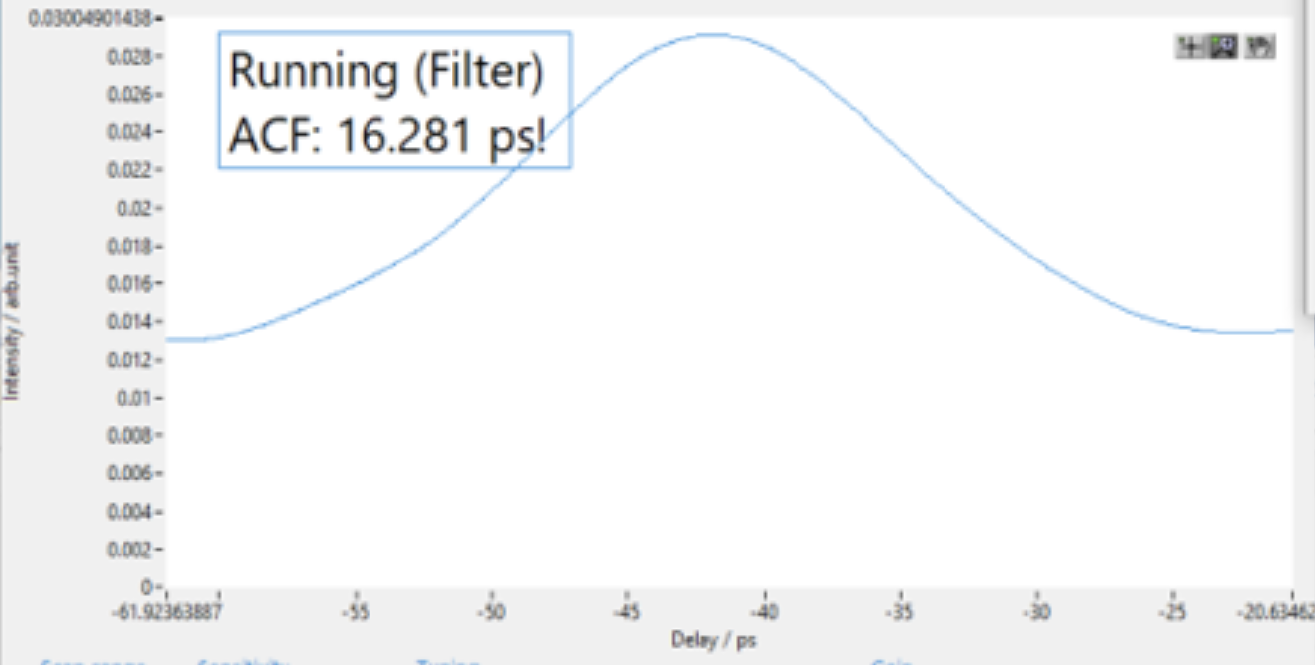
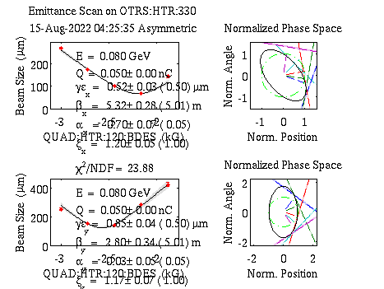
100 MeV Injector Commissioning
Preliminary Emittance Optimization
Current laser parameters:
    ~16 ps FWHM of Gaussian profile
    Not-decent-yet spatial profile
Characterized emittance at 50 pC with 80 MeV using one screen downstream of CM01:
    ~10 knobs are preliminarily touched for initial emittance optimizations
    Has knocked down emittance to 0.5-0.8 μm from 5-10 μm for 50 pC.
    We have not started systematic optimization yet due to limited beam time. Plan to optimize emittance in the next few months.
Temporal laser profile

Slide 20
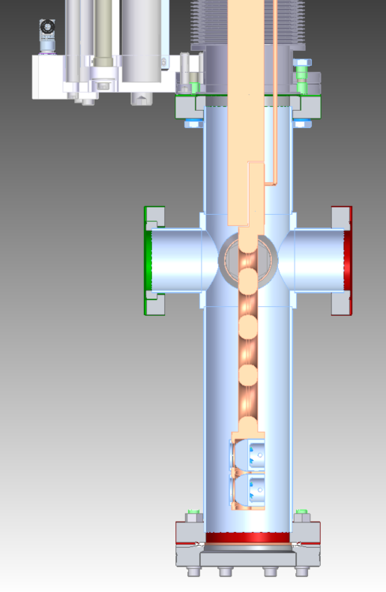
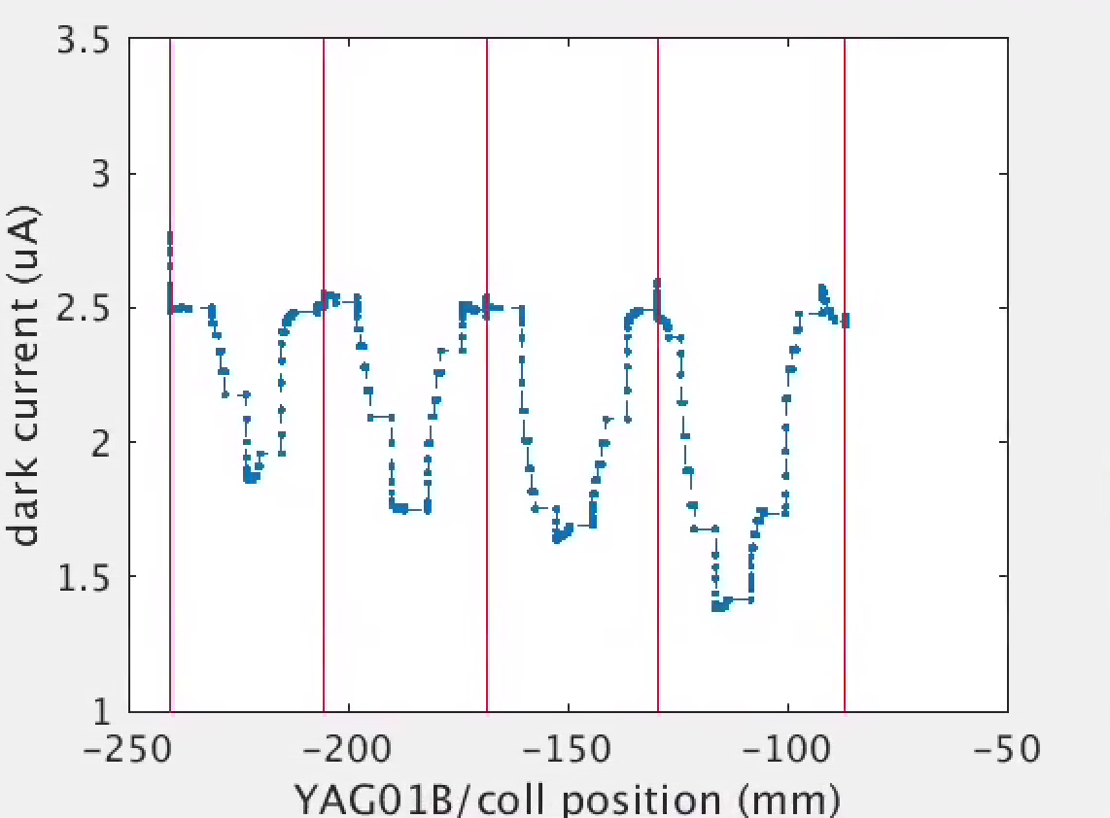
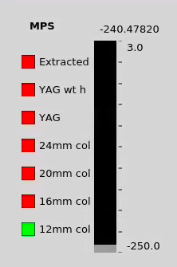
100 MeV Injector Commissioning
Dark Current Measurements and Mitigations
Measured ~2.5 μA of gun dark current before CM01
Dark current images are transversely separated from the e-beam
Use the newly installed collimators to remove & measure dark current at 1 MeV energy
Dark current with different aperture collimators
12mm
16mm
20mm
24mm

Slide 21
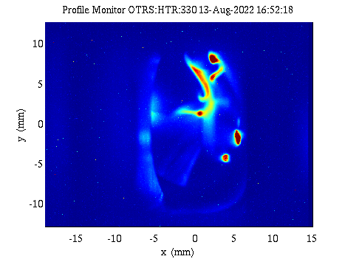
100 MeV Injector Commissioning
Dark Current Mitigation
Choosing collimator size: 1) no impact on e-beam quality, and 2) remove dark current as much as possible
For now, collimator with 20 mm aperture is inserted at 1 MeV location. The dark current at downstream of CM01 is <100 nA based on YAG screen and ACM measurements.
Dark current transporting downstream CM01 strongly depends on the first solenoid strength – see image as an example
An energy collimator is recently installed in the laser heater chicane. It is expected most leaked dark current to be further scraped away by the energy collimator.
Dark current image at 80MeV with lower than nominal solenoid1 strength

Slide 22
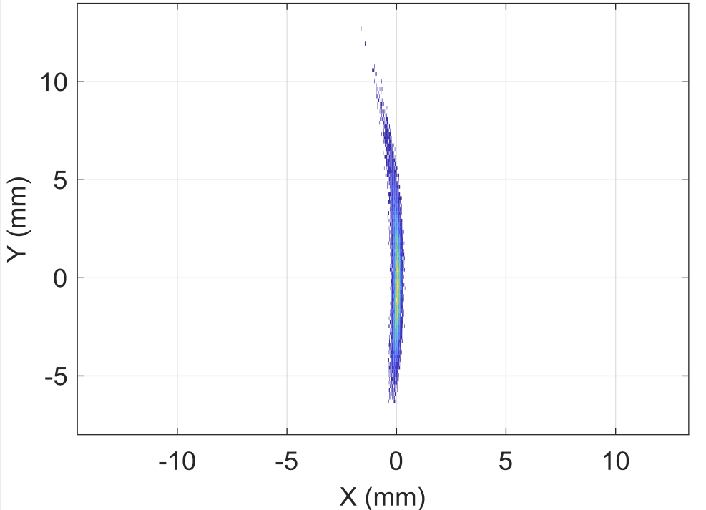
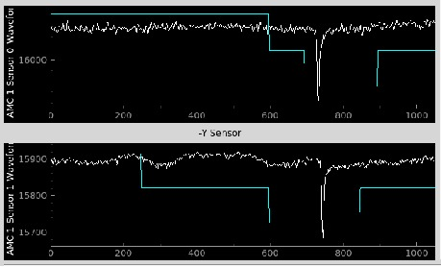
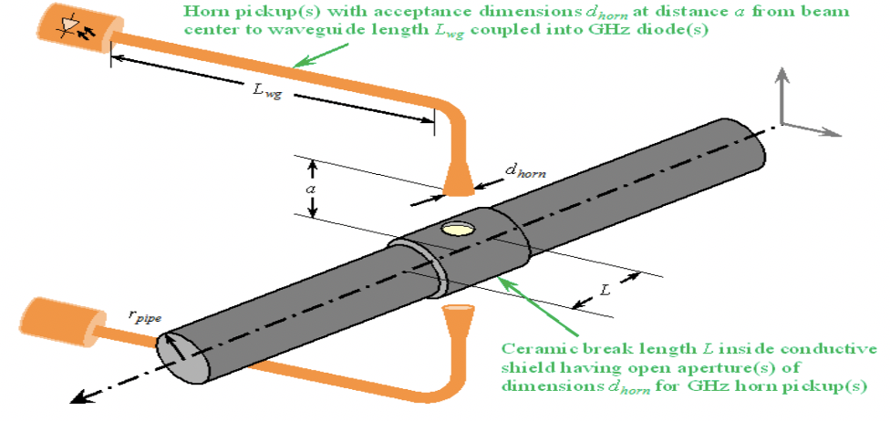
100 MeV Injector Commissioning
Bunch Length Measurement Awaiting
Use RF zero-phasing to measure the bunch length through applying zero-crossing phase for the 8th cavity of CM01
The beam is not seen on two OTR screens in DIAG0 due to OTR problem, resulting in no bunch length measurement this time
    OTR to be fixed during Oct downtime
Gap diode signal is observed for relative measurements but is not calibrated until the bunch length is measured with RF zero-phasing technique
Emma, LCLSII TN-18-01
Measured diode signals
Gap diode
Fisher

Slide 23
Summary
Successfully commissioned LCLSII e-source – all goals achieved (2018-2020)
Have made significant progress for 100 MeV injector commissioning in <4 weeks (7/15 –8/14, 2022)
    Commissioned full BL and ensured full charge transported
    Certified all safety systems
    Achieved ~0.5 μm emittance (close to our design) with 50 pC
    Dark current is effectively mitigated
Next-months plan
    Measure bunch length and calibrate gap diode signals
    Continue to improve emittance at the desired bunch length
    Continue to characterize/improve dark current

Slide 24
Acknowledgements
Heavily involved in e-source and/or injector commissioning:
Adolphsen, Benwell, Bianchini, Brachmann, Brown, Cesar, Colocho, Ding, Dowell, Dunning, Duris, Fisher, Gilevich, G. Huang (LBNL), Jacobson, Liu, Lou, May, Miahnahri, Mock, Neveu, Sannibale (LBNL), Schmerge, Sudar, Vecchione, Welch, Zhang, Zimmer, et al
Physics and engineer support:
Alverson, Balakrishnan, Beuker, Bohler, Bong, Edelen, Hoobler, X. Huang, Lam, Maxwell, Sapozhnikov, Sikora, Woodley et al
SRF team support for CM01:
Aderhold, Gonnella, Nelson, Porter, Zacarias
MFD support: Vac shop technicians and Engineers, and metrology engineers et al
LCLSII Project team for installation
INFN LASA for providing cathodes for e-source commissioning

