Slide 1

66th ICFA Advanced Beam Dynamics Workshop on Energy Recovery Linacs
Low frequency 113 MHz SRF gun with room temperature photocathode for Coherent electron Cooling experiment (CeC-X)
Irina Petrushina (SBU) on behalf of the CeC team

Slide 2
Motivation
The most critical component of an ERL is the electron injector, as it determines the limits for important beam parameters, such as temporal structure, bunch charge, and transverse and longitudinal emittance, which are critical for many applications. The technological challenge within the injector is the electron gun.
SRF electron guns
+ Good vacuum inside Nb cavity at 2K/4K.
+ High accelerating gradients.
+ CW operation.
+ High cathode field and exit energy reduce the impact of space charge.
+ RF field at the cathode can provide additional focusing.
+ Confinement to a single technology.
? Are high-QE photocathodes compatible with the SRF environment?
? Can high-QE cathodes survive in an SRF cavity?
? Risk of cavity contamination
? Multipacting
? Dark current
More operational experience needed to answer these questions!
C. Adolphsen, et al. "The Development of Energy-Recovery Linacs." arXiv:2207.02095 (2022).

Slide 3
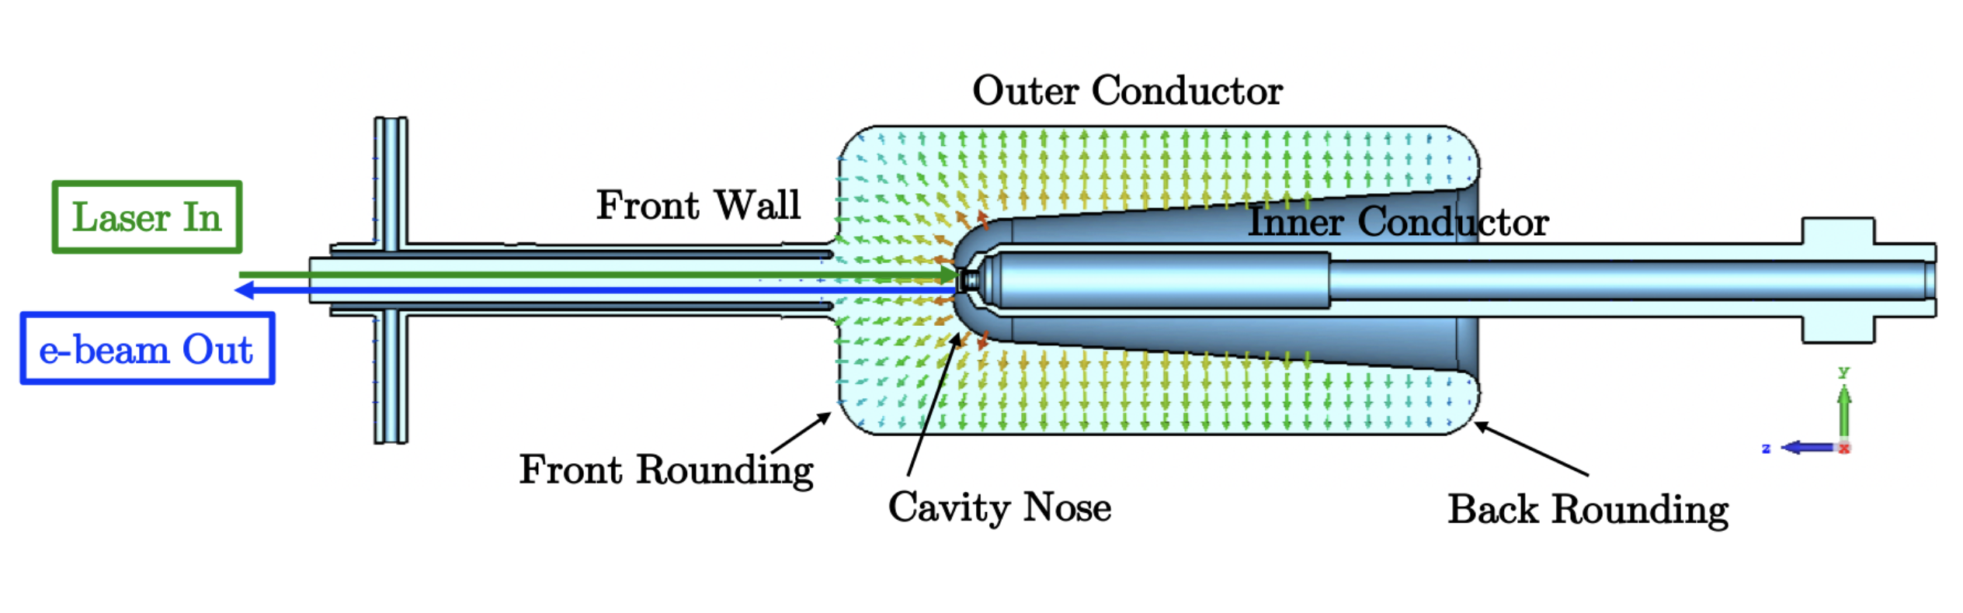
BNL SRF gun for CeC-X
Design parameters
The QWR cavity was developed by Niowave and BNL under the support of the DOE Small Business Innovation Research (SBIR) and Small Business Technology Transfer (STTR) program.
The cavity was built and configured as an SRF gun with a room temperature CsK₂Sb photocathode for the CeC experiment.
The first electron beam from the SRF photoelectron gun with 3 nC charge per bunch was generated in June 2015.
The goal of the CeC-X is to demonstrate cooling of a single hadron bunch circulating in RHIC.
Parameter | Value
Frequency [MHz] | 112
R/Q (linac definition) [Ω] | 126
Geometry factor [Ω] | 38.2
Quality factor Q₀ w/o cathode insert | > 3.5×10⁹
Operating temperature [K] | 4.5
E_{pk}/V_{acc} [m⁻¹] | 19.1
B_{pk}/V_{acc} [mT/MV] | 36.4
Operating voltage [MV] | 2
T. Xin et al., Rev. Sci. Instrum. 87, 093303 (2016)

Slide 4
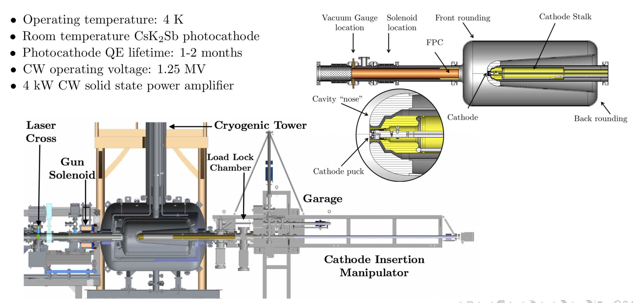
113 MHz SRF gun with warm CsK₂Sb photocathode
Typical operational parameters
Parameter | Units | Value | Parameter | Units | Value
Gun voltage | MV | 1.25 | RF amplifier power | kW | 4
Laser rep-rate | kHz | 78 | FPC design, power limit | kW | 5
Laser power at the cathode | mW | 30 | Charge per bunch | nC | 1-2
Laser wavelength | nm | 532 | Average current | mA | <0.15
CsK₂Sb cathode QE | % | 1-5

Slide 5
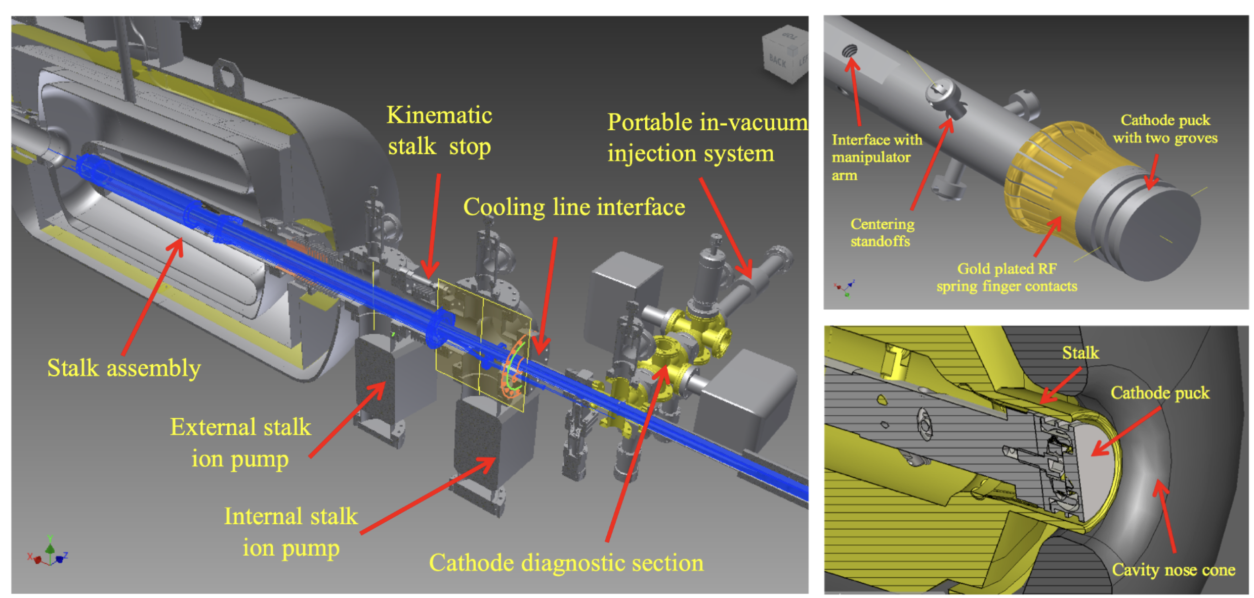
Cathode insertion system

Slide 6
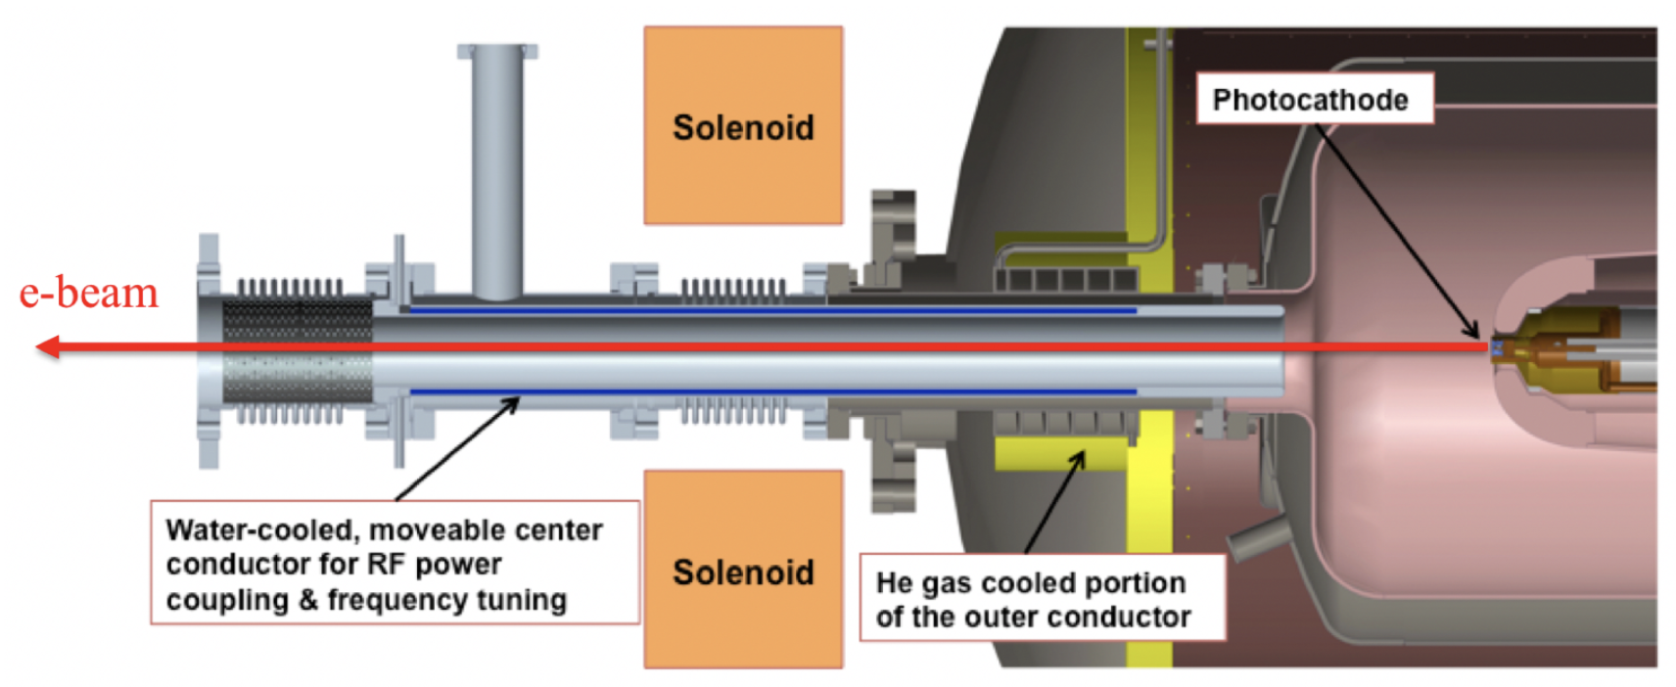
Fundamental Power Coupler (FPC)/ Frequency Tuner
Movable fundamental power coupler serves two purposes: Fine frequency tuning (full range of 4.5 kHz) & Coupling adjustment.
The center conductor and RF windows are water-cooled. The outer conductor copper coated bellows are air-cooled.
The center conductor is gold-plated to reduce heat radiated into the SRF cavity.
Two manual coarse tuners provided 80 kHz tuning range to match the harmonic of the RHIC revolution frequency.

Slide 7
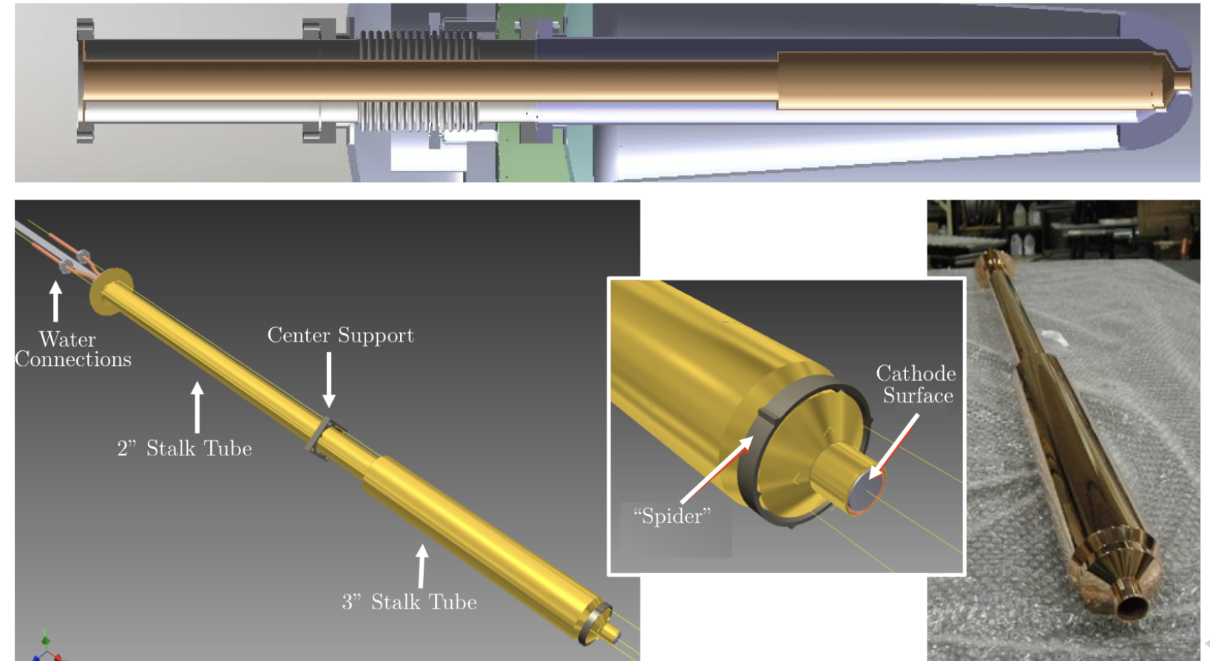
Cathode Stalk Design
The stalk is shorted at one end and is approximately half wavelength long.
A step from the short creates an impedance transformer → reduces RF losses in the stalk from ∼65 W to ∼25 W.
The gold plating reduces radiation heat load from the stalk.

Slide 8

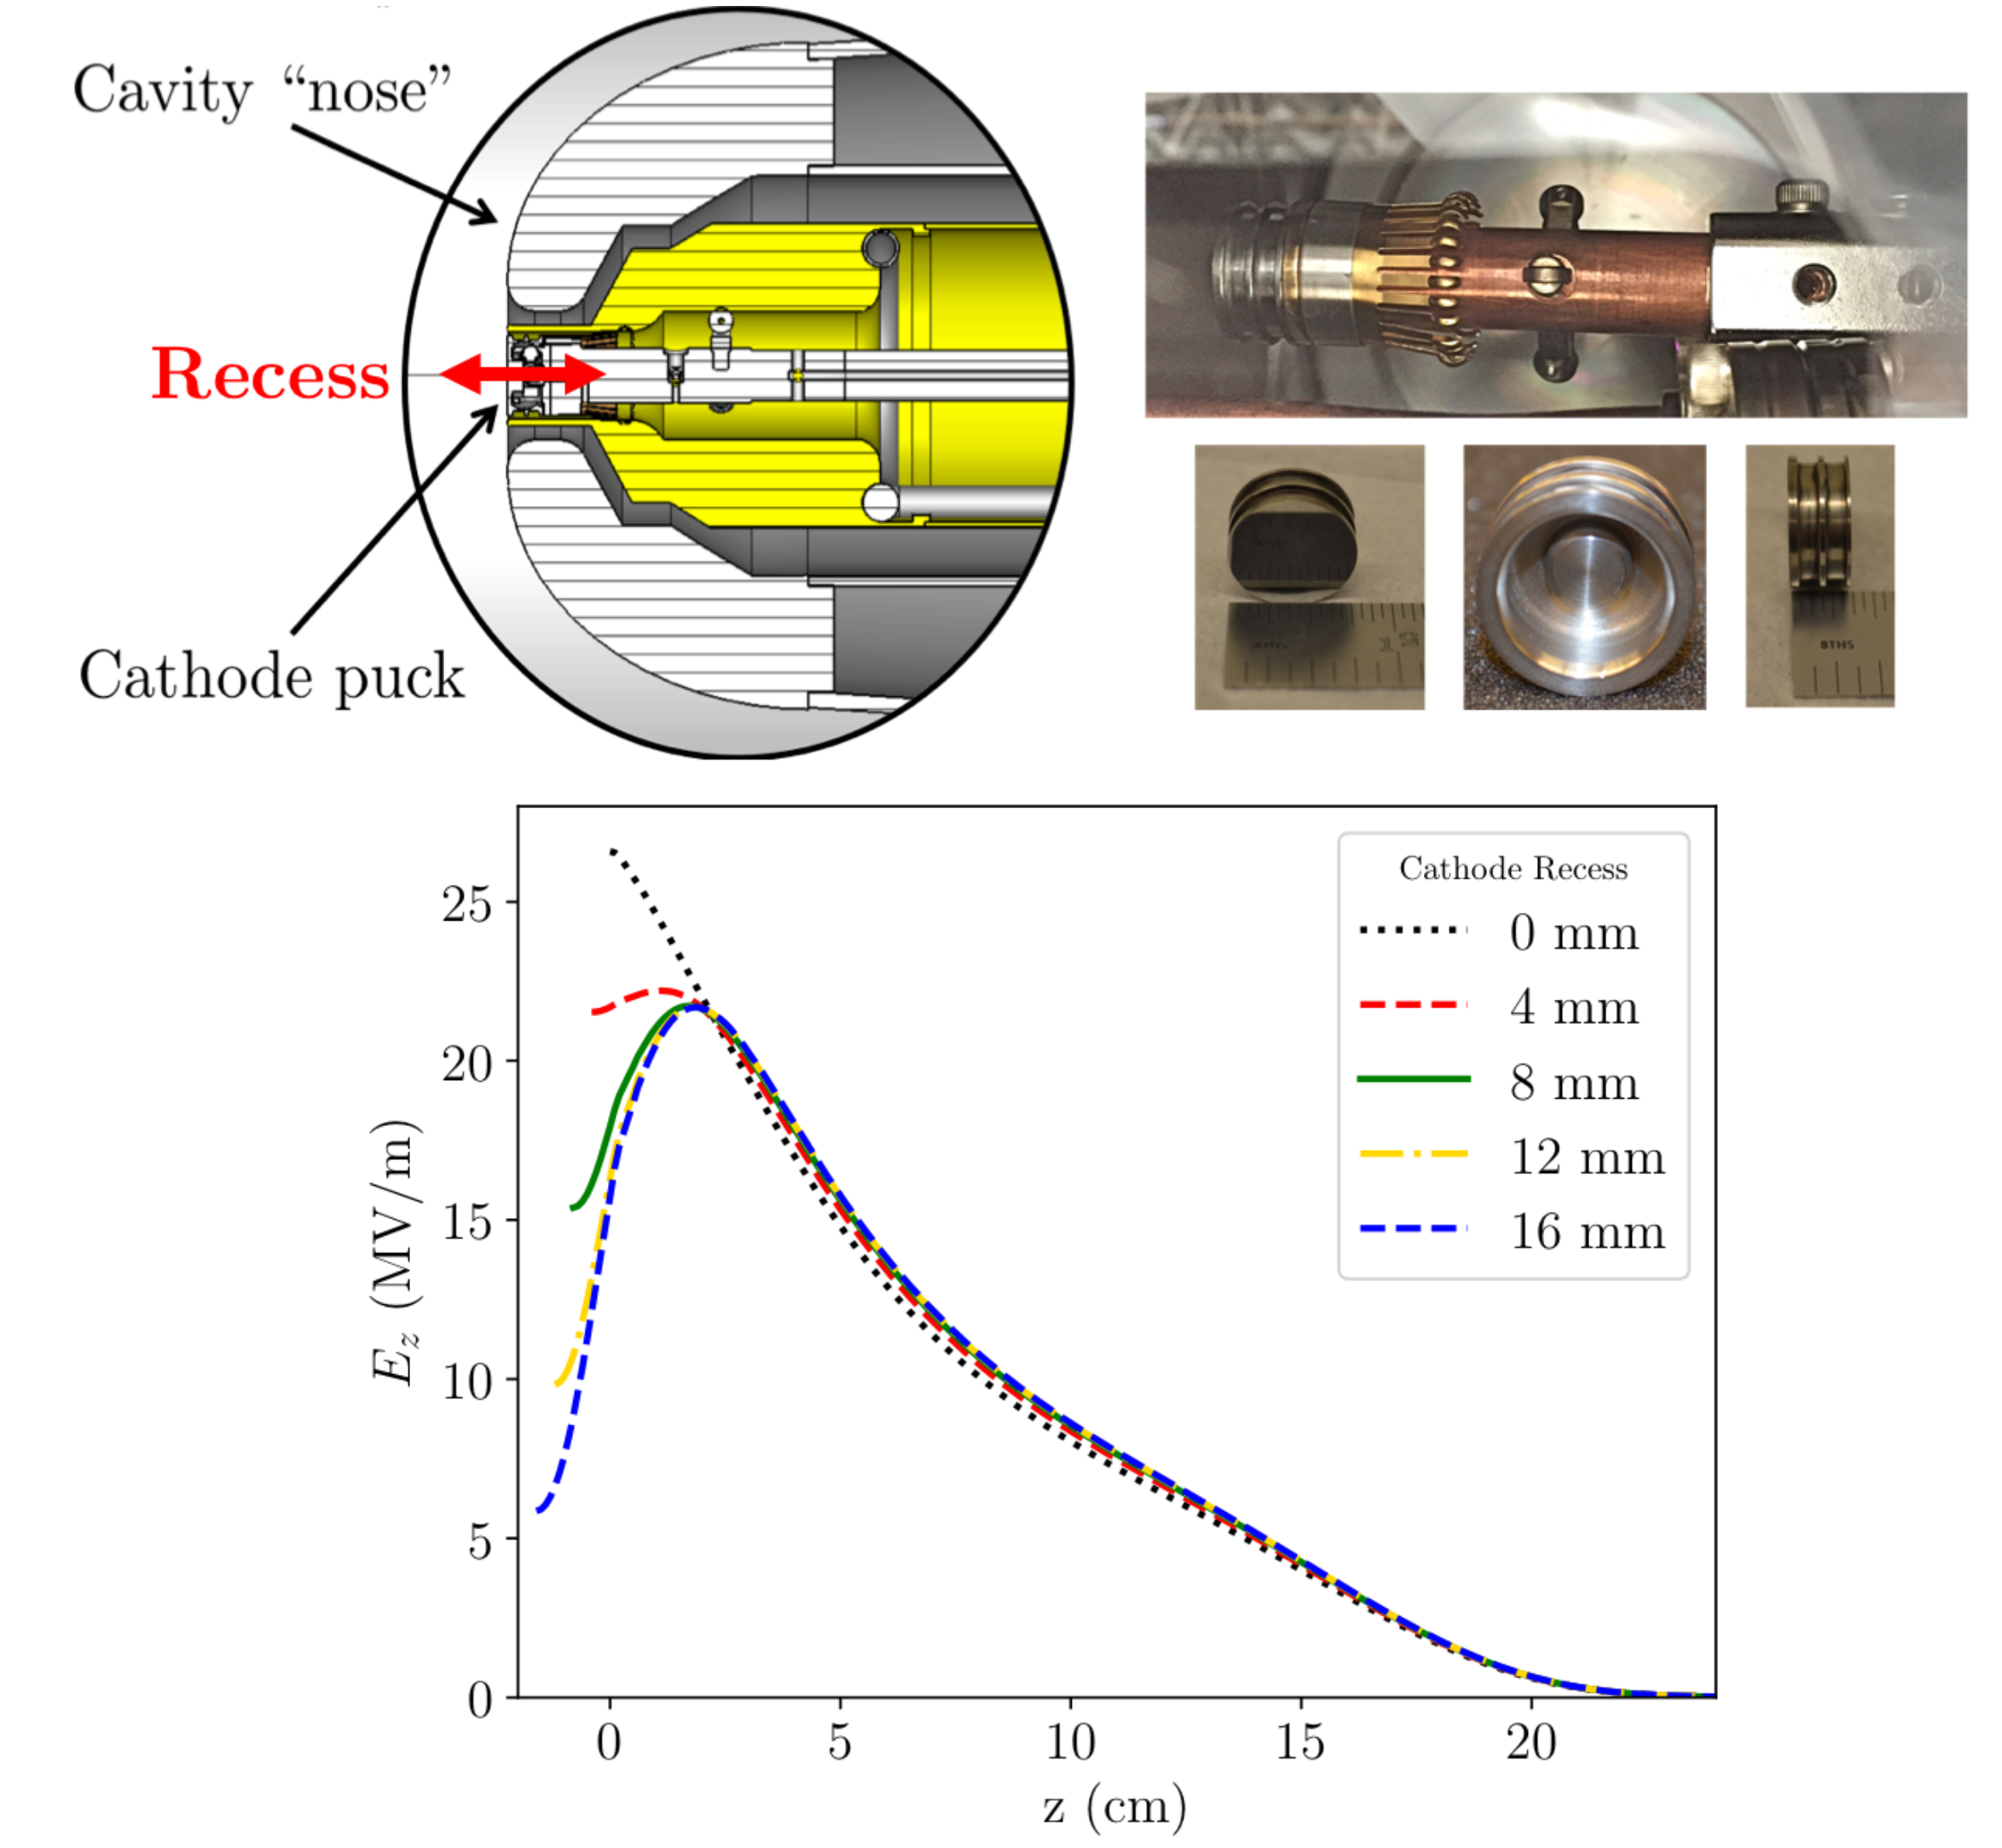
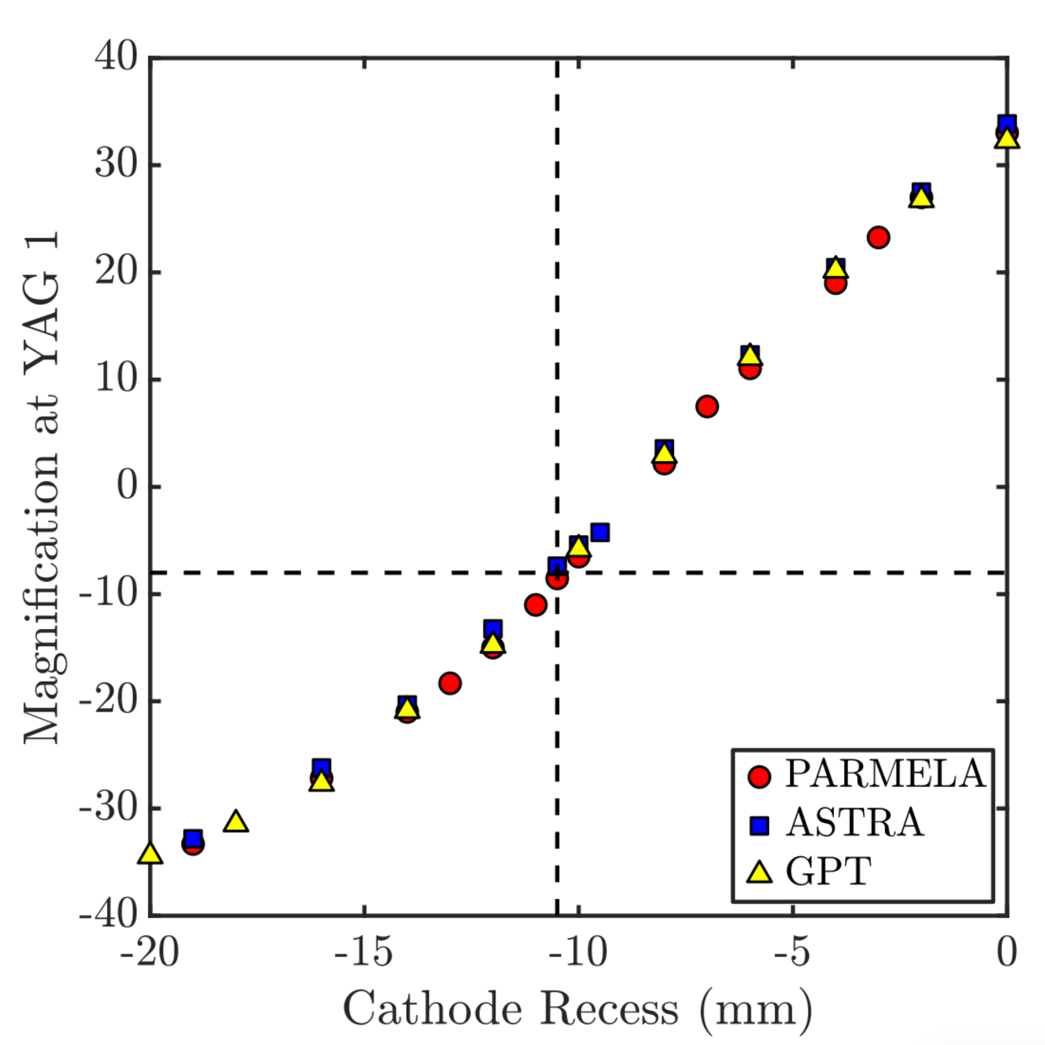
Controlling cathode recess initial focusing of the beam
Procedure:
Scan laser spot position at the cathode and measure electron beam position on the nearest profile monitor – find experimental value of magnification.
Perform simulations for various values of the cathode recess and determine magnification for each recess.
Determine the cathode position.

Slide 9
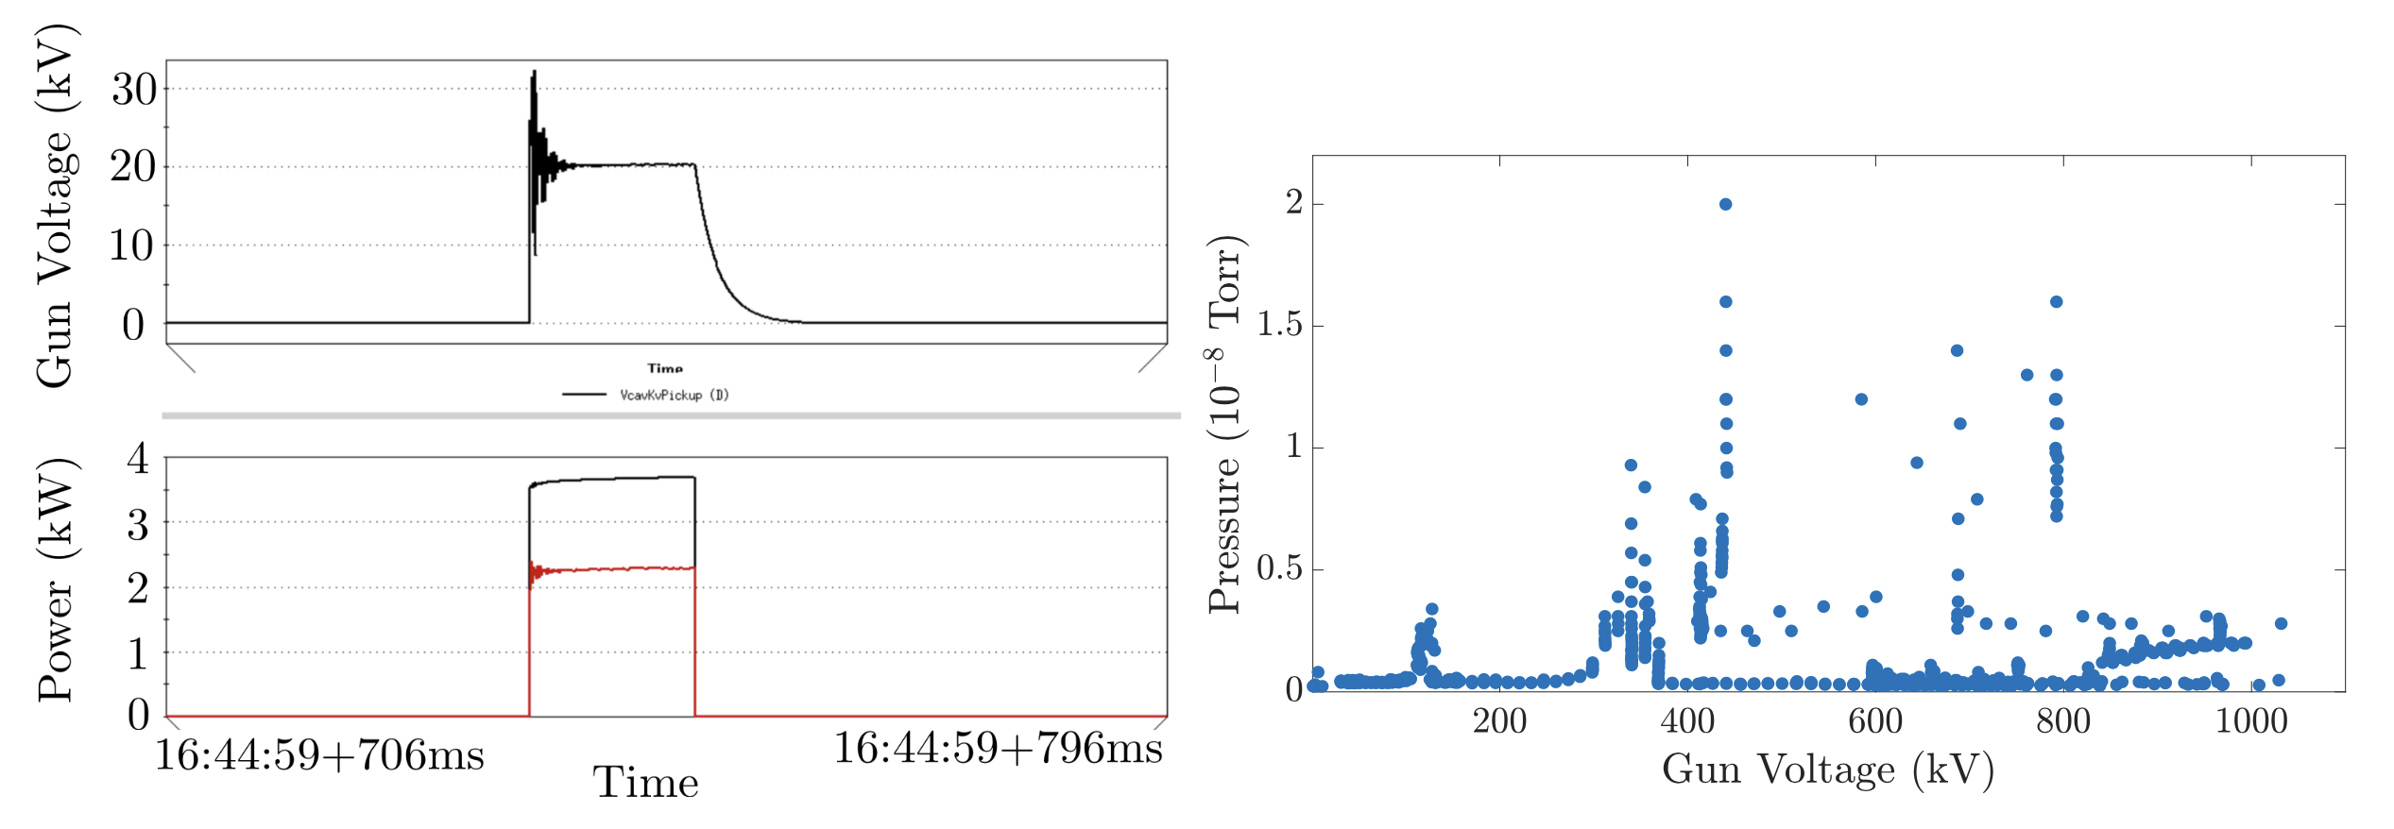
Issues with multipacting during the first years of operation
Strong presence of multipacting was observed during the first years of operation.
Multipacting caused almost immediate death of the cathode QE.

Slide 10
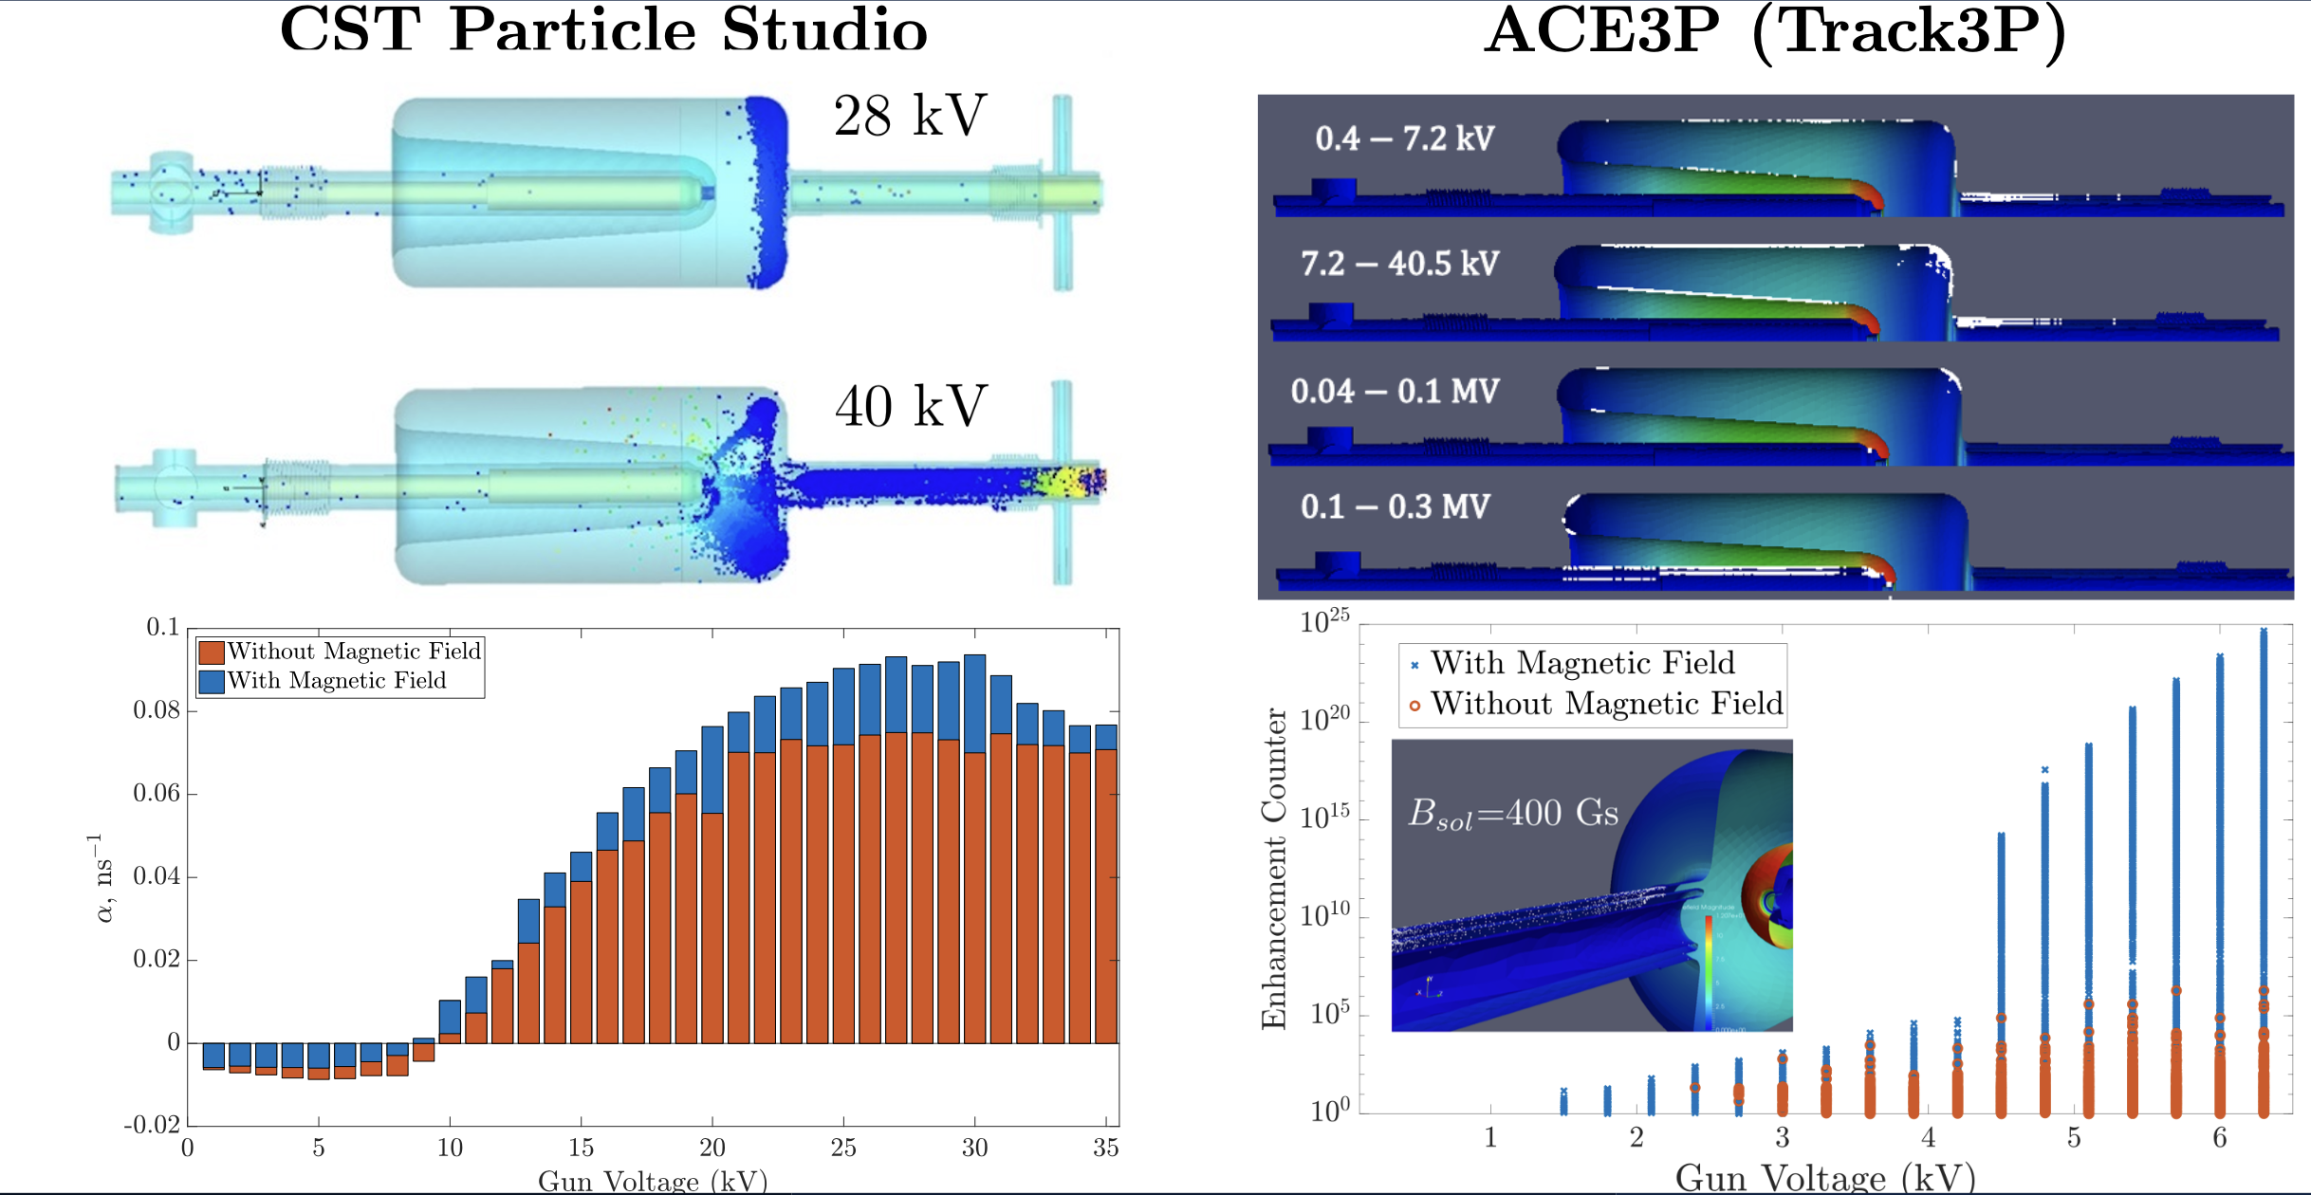
Multipacting – issue of the past

Slide 11
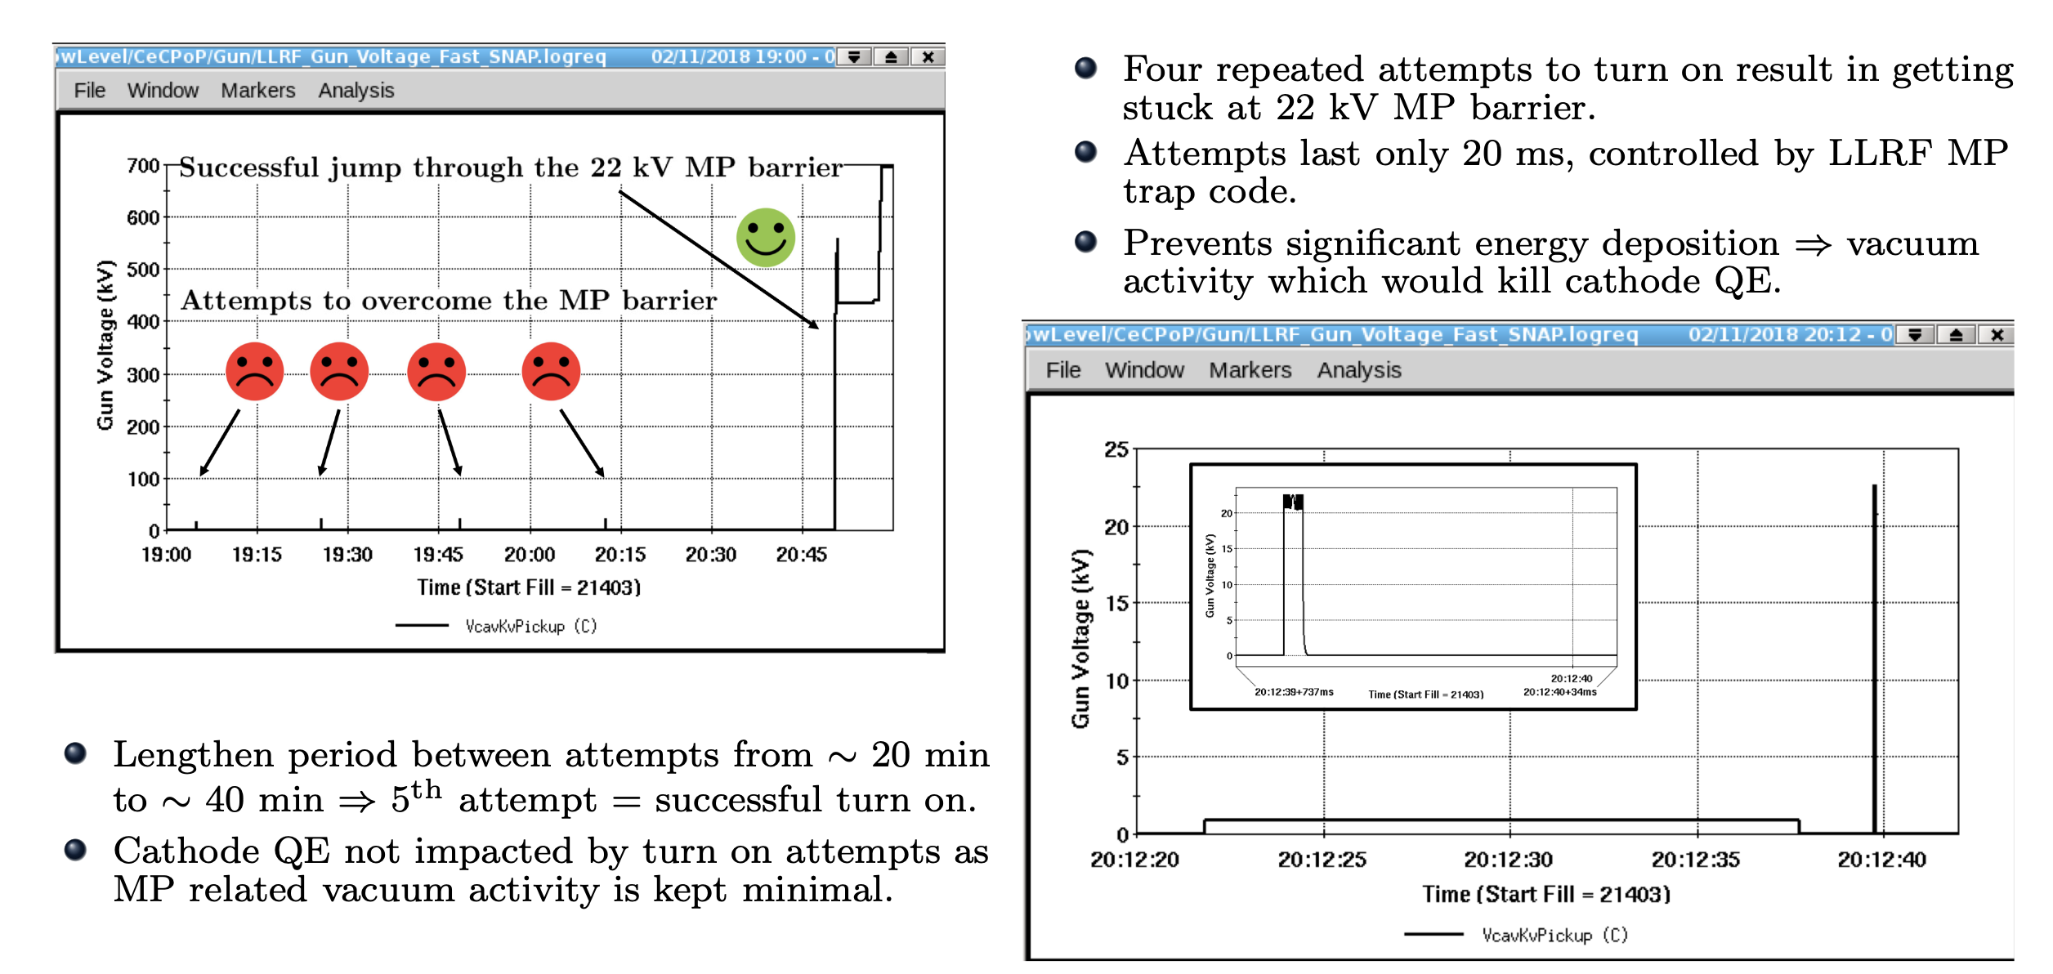
Example of Cavity Turn On Attempt with Strong MP

Slide 12
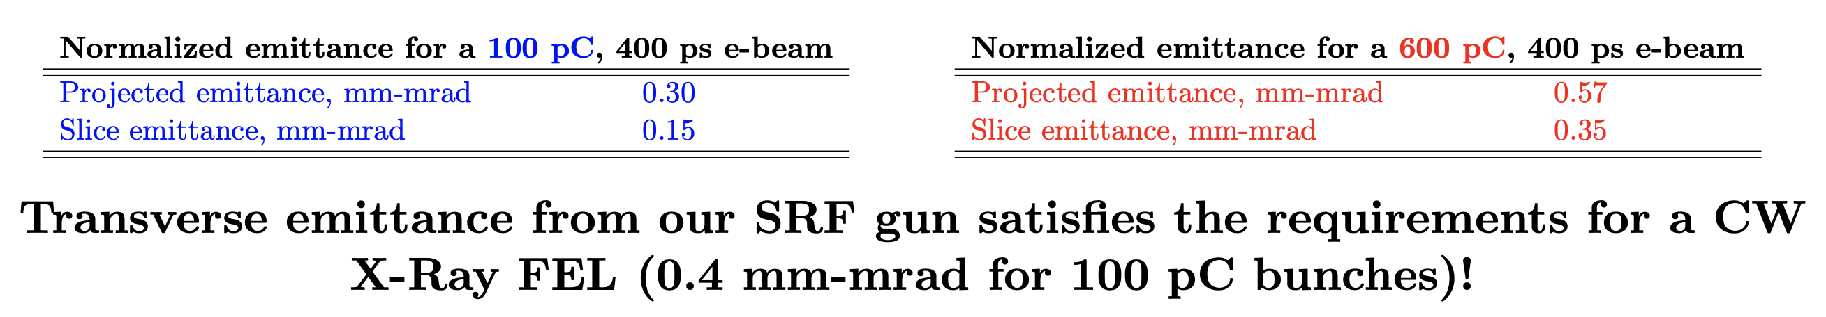
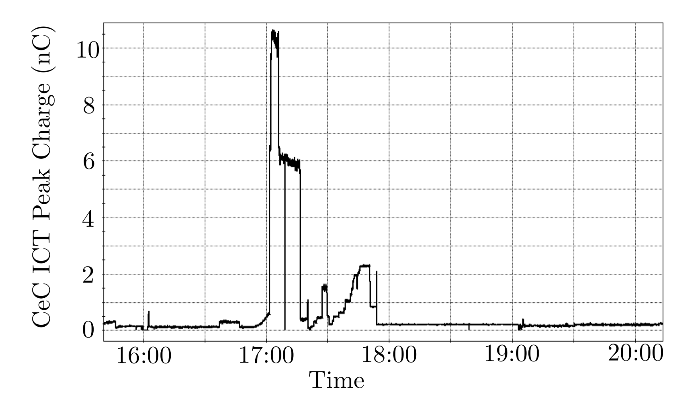
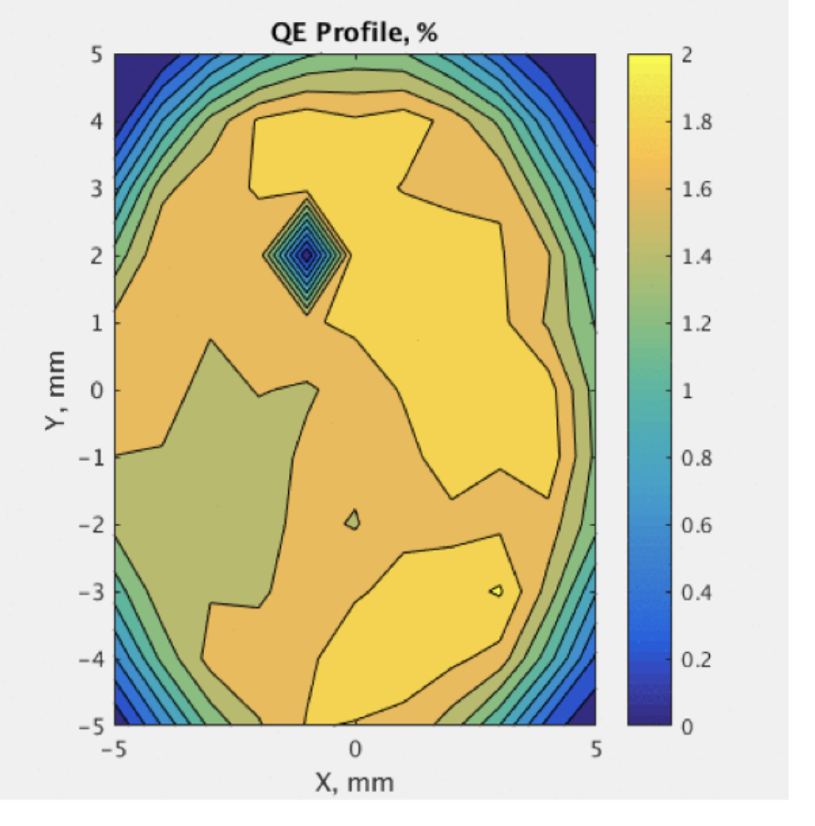
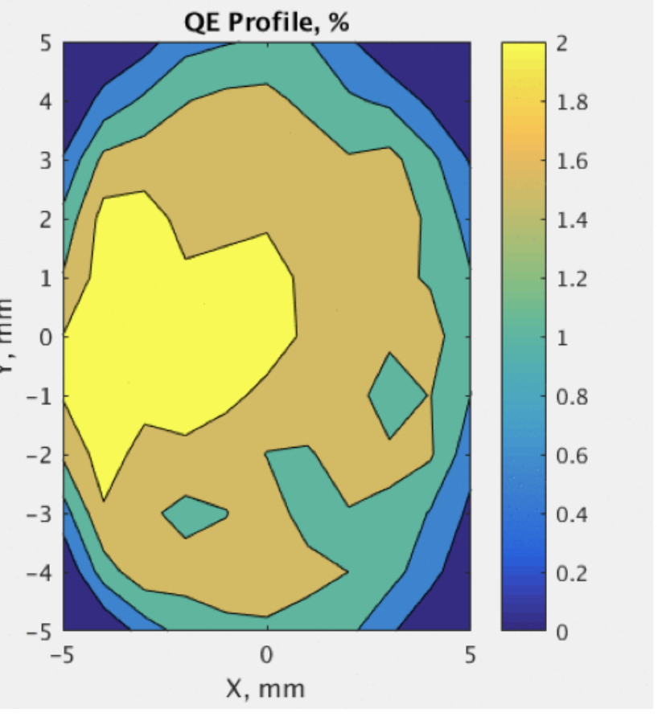
Performance Summary
Good emittance, long cathode lifetime, high bunch charge!
QE map after 1 month of operation
Before
After

Slide 13
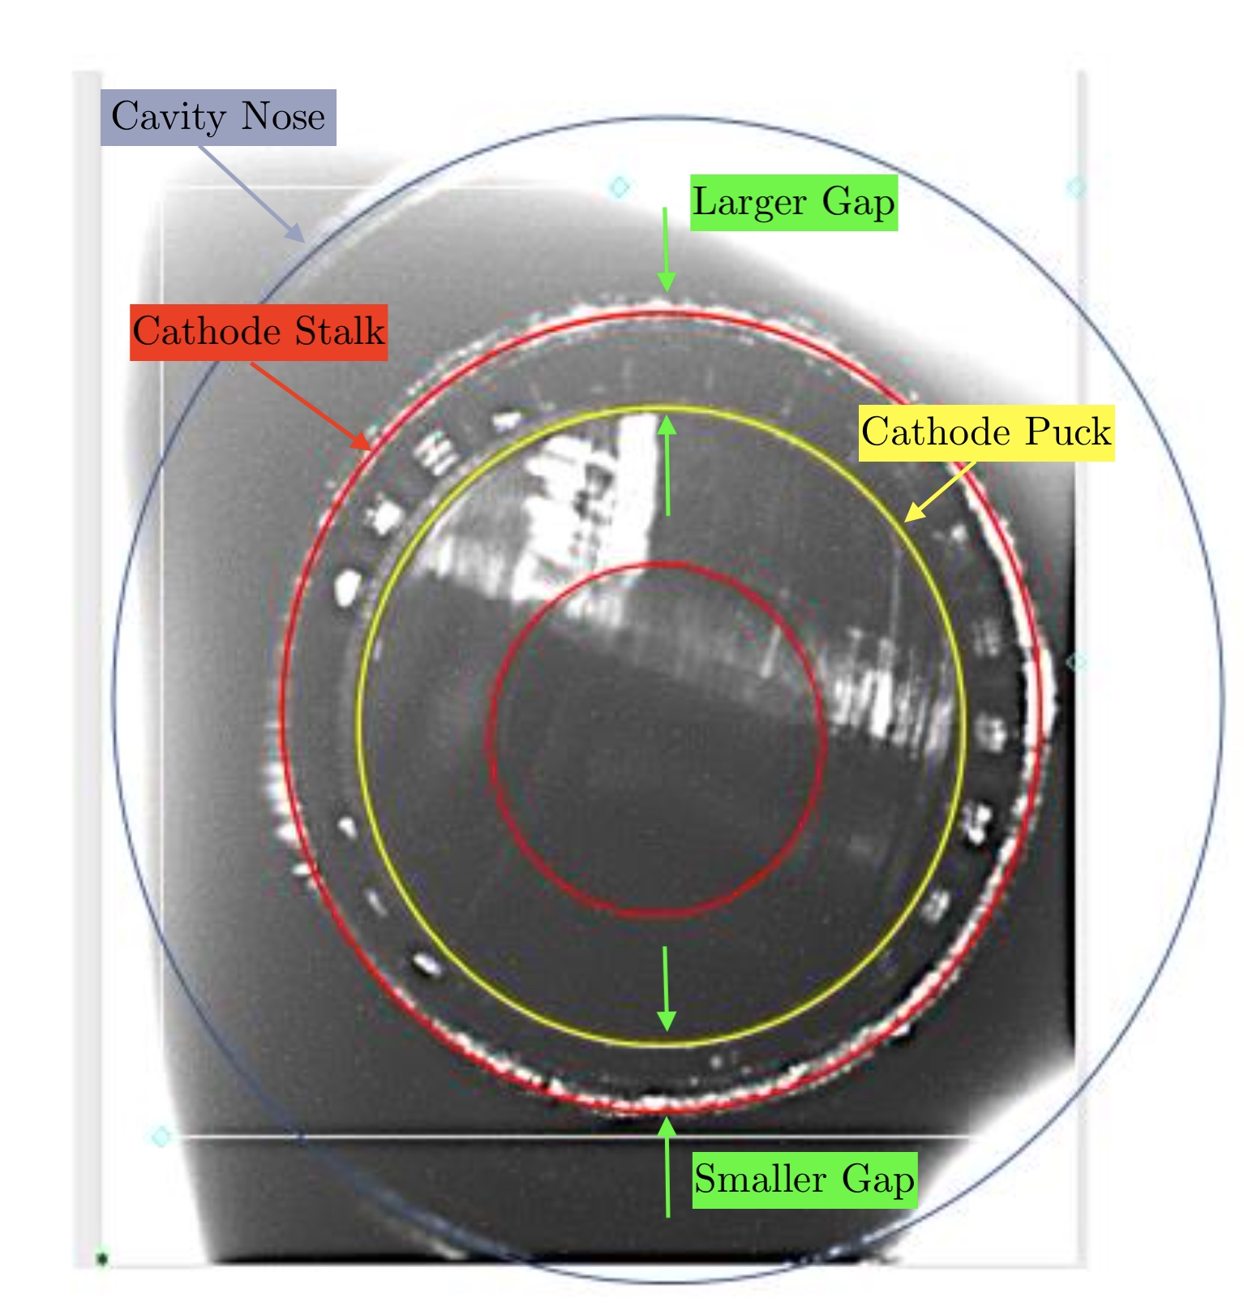
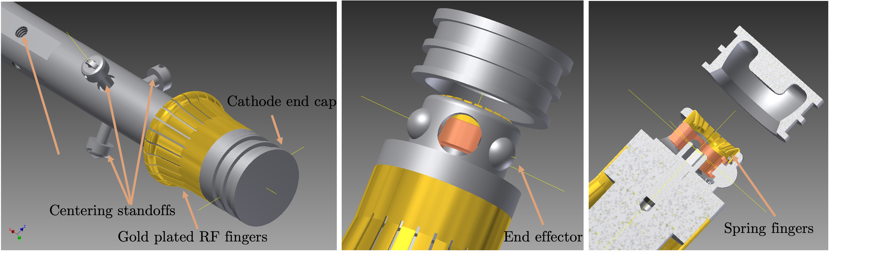
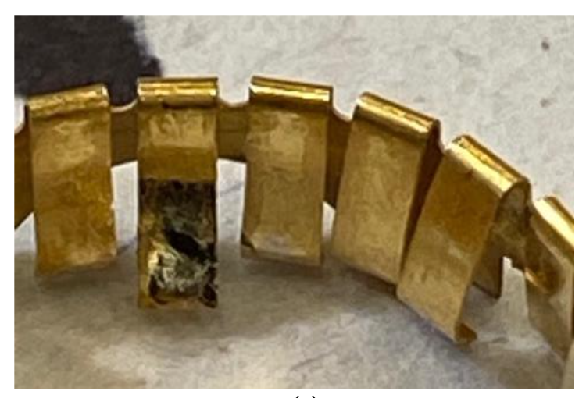
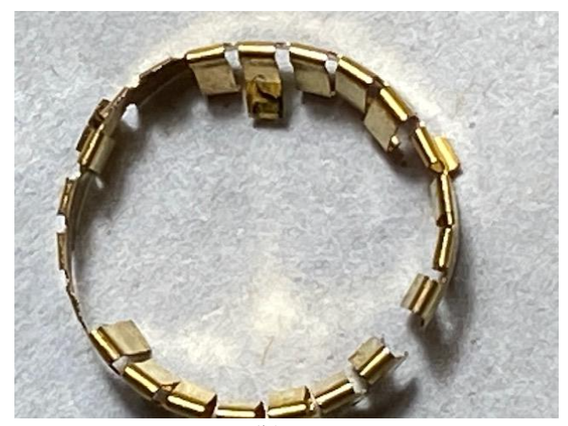
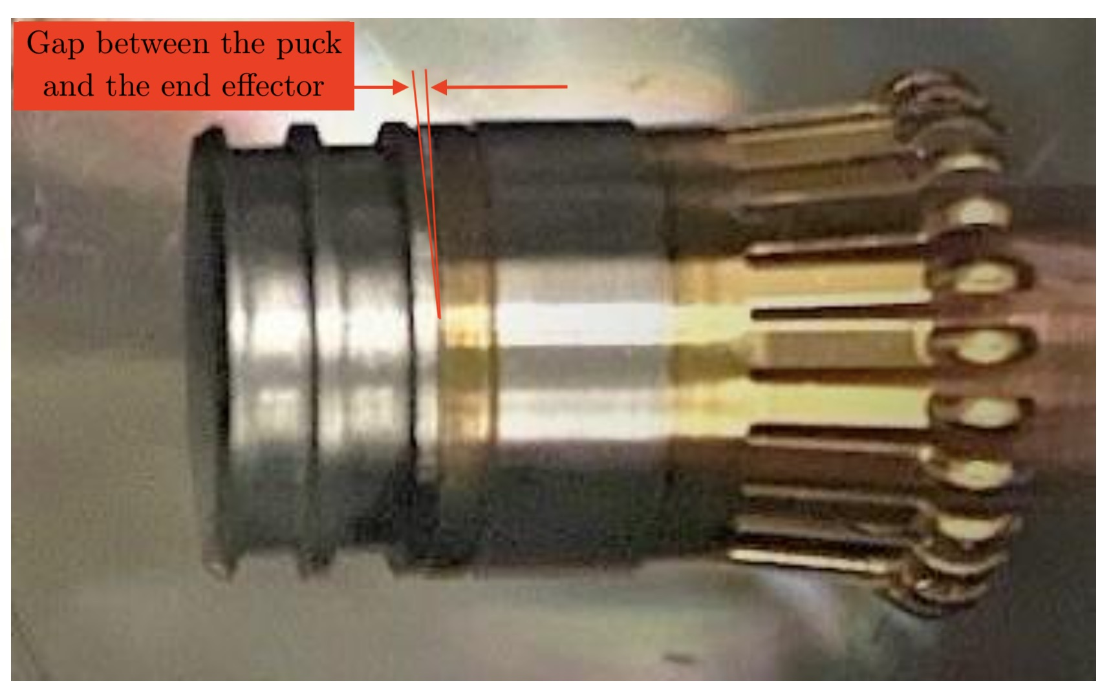
Reality of an SRF gun operation
Run 2021: the gun showed signs of significant performance degradation: decay of the cathode QE, new low-level MP, increased radiation and LHe consumption.
The reported behavior indicated damage to the cathode delivery system and the inevitable presence of the cavity surface contamination.

Slide 14
He Conditioning to the rescue!
After a couple of days of He conditioning, the cavity reached the all-time highest voltage: 1.5 MV CW and 1.7 MV pulsed.
The radiation level at the CeC operational level of 1.25 MV CW improved dramatically and reduced to ~380 mR/hr, ~2 g/sec LHe consumption
The CW voltage limit is defined by the maximum available LHe consumption of 8 g/sec. A quench-like limit occurs at 1.7 MV in pulsed mode as indicated by the steep drop of the cavity voltage.

Slide 15
Unfortunate Incident #2:
February 2022: during a mundane cathode exchange, it was found that the cathode puck wasn’t fully engaged with the end effector of the cathode manipulator once the old cathode was extracted.
The cathode was installed, but the cavity demonstrated an immediate performance degradation.
HeC procedure was highly successful and resulted not only in the complete cavity recovery, but also in an all-time low X-ray radiation from the cavity (~250 mR/hr, compared to ~380 mR/hr before the incident and ~750 mR/hr right after the incident) at the operational voltage of 1.25 MV.

Slide 16
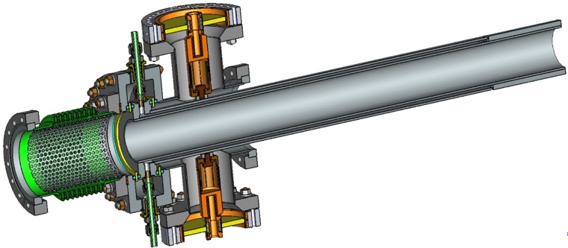
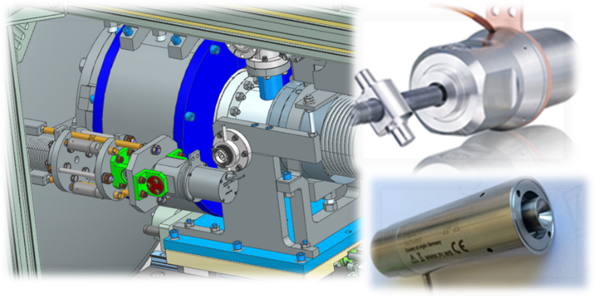


BNL SRF Gun – what’s next?
Demonstration of a reliable operation of the SRF gun with 1-3 mA (Phase I) and 30-100 mA (Phase II).
Generation of polarized electron beams from the SRF gun.
Development of the in-situ cavity restoration techniques.
In Run 22, Preliminary test of 0.25 mA average current were successful!!
Significant modifications are required:
New Fundamental Power Coupler (FPC) capable of delivering 100 kW power and the test stand.
Procurement and installation of 100 kW CW RF.
Assembly and tests of 100 kW FPC and supporting accessories.
Procurement and tests of the cavity tuner.

Slide 17


Thank you for listening!
Special thanks:
CeC team: V.N. Litvinenko, I. Pinayev, G. Wang, Y. Jing, J. Ma, K. Shih, Y.H. Wu
LLRF group: G. Narayan, F. Severino, T. Hayes, K. Smith
J. Tuozzolo, J.C. Brutus, P. Inacker, D. Kayran, L. Cultrera, G. Mahler, M. Mapes, T. Rao, J. Skaritka, Y. Than, E. Wang, B. Xiao, T. Xin, A. Zaltsman.
C. Boulware, T. Grimm
S. Belomestnykh, V. Yakovlev, S. Kazakov, J. Helsper, T. Khabiboulline, Yu. Pischalnikov, Yu. Orlov, M. Martinello, P. Berrutti
R. Suleiman, J. Grames, M. Poelker, E. Voutier

Slide 18
Back-up

Slide 19
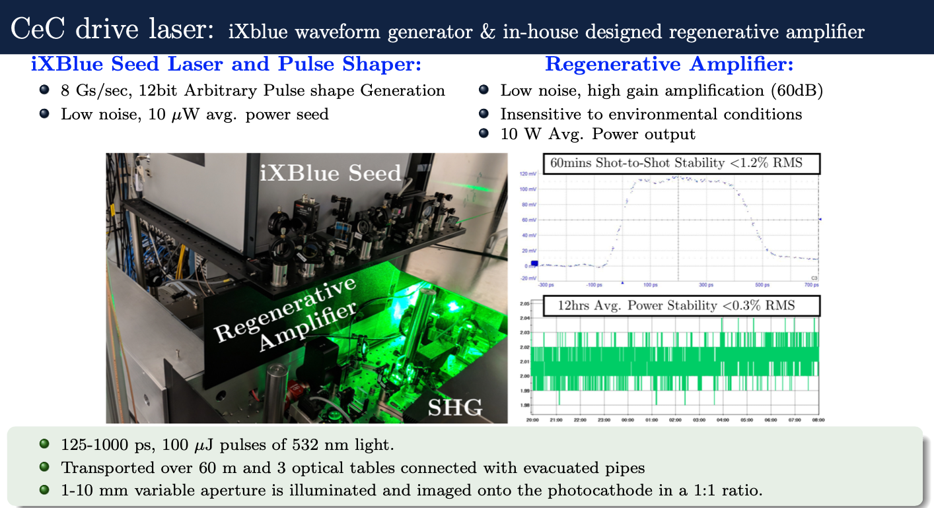
CeC laser system

Slide 20
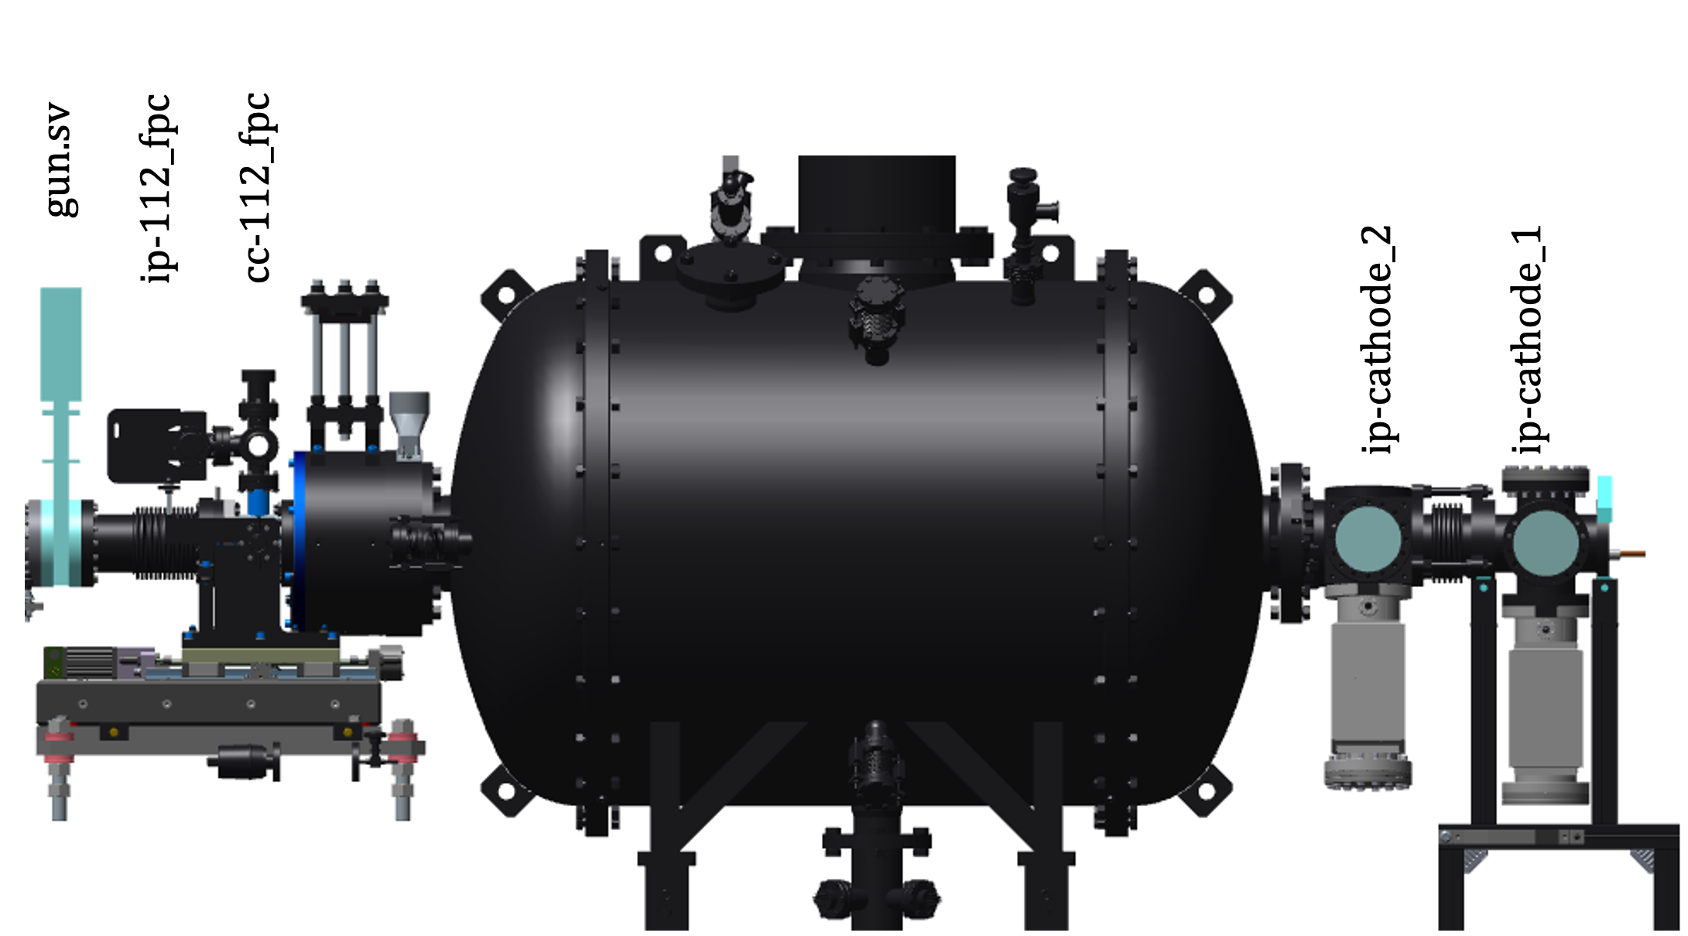
He Conditioning procedure
With all valves closed and the cathode puck retracted, the gun voltage must be brought up well above MP levels (baseline of 700-750 kV).
The protection mechanism for monitoring the cavity voltage is then enabled to prevent the cavity from falling into MP.
The pulsing with 10 Hz repetition and pulse width of 1-2 ms is introduced on top of the baseline.
The He leak valve is opened to introduce He into the cavity at a ~2-5x10⁻⁶ Torr.
Gradually increase the peak cavity voltage that can be achieved through either increase of the pulse length of the pulsing event or increase of the baseline level.
Increase the pulse width in the steps of ~0.5 ms, stay at each level for an extended period of time (10-15 mins) and simultaneously monitor the gun voltage behavior, radiation levels, mass flow of liquid He, pressure in the gun cavity, and gauges of the ion pumps providing the pressure levels of the He used for conditioning.
During the HeC, He and the loose debris are being constantly pumped out of the cavity by a turbo pump.

Slide 21
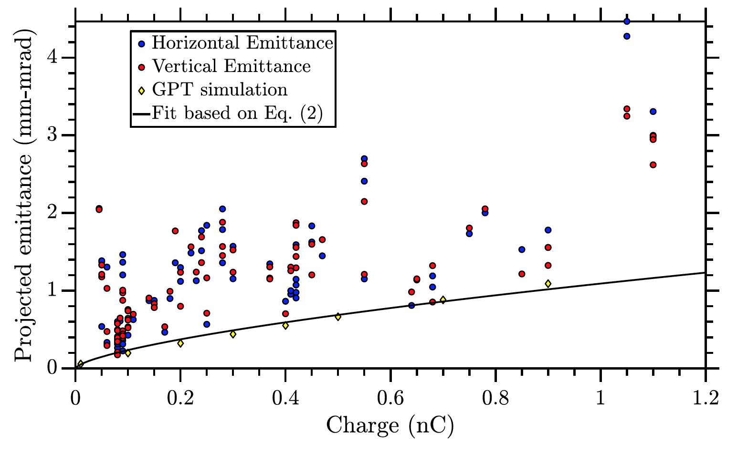
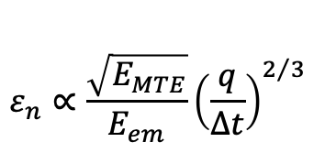
Emittance measurements 2018&2019
$$ε_{n}∝\frac{\sqrt{E_{MTE}}}{E_{em}}{\left(\frac{q}{∆t}\right)}^{2/3}$$

