Slide 1
DC gun for Low Energy RHIC Cooler Project
Xiaofeng Gu, Alexei Fedotov, Dmitry Kayran, Jorg Kewisch, Sergei Seletskiy
Brookhaven National Laboratory
Oct 3-6, 2022
ERL2002 Cornell
1

Slide 2
Outline
LEReC and DC gun
Beam Parameters
High-current Experience
Summary
2

Slide 3
1) LEReC Introduction
LEReC is fully operational electron cooler which:
  utilizes RF-accelerated bunched electron beams
  uses non-magnetized electron beam
  stable 24/7 running of high-current electron accelerator and stable cooling of ion bunches was provided over many months of collider operation in 2020 and 2021.
  Contributed a significant luminosity improvement for RHIC operation at low energies
  provided electron beam for some studies which required by the EIC project, such as the cooling studies and high current beam in 2022.
3

Slide 4
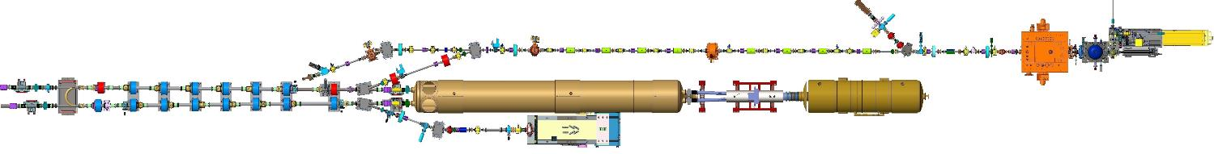


1) LEReC Layout
704 MHz
Cu Deflector Cavity
704 MHz SRF
Booster Cavity
RF Diagnostic Beamline
704 MHz
Cu Cavity
2.1 GHz
Cu Cavity
9 MHz
Cu Cavity
e⁻
e⁻
RHIC TRIPLET
RHIC DX
DC
e⁻ Gun
e⁻
LF solenoid
HF solenoid
Transport solenoid
ERL solenoid
Quad corrector
Trim corrector
Corrector 3.8 ID
Corrector 6.0 ID
BPM 2.4 ID
BPM 4.8 ID
Bellows
Ion pump
180°
Bending
Magnet
High-Power Beam Dump
* NOT to scale
4

Slide 5
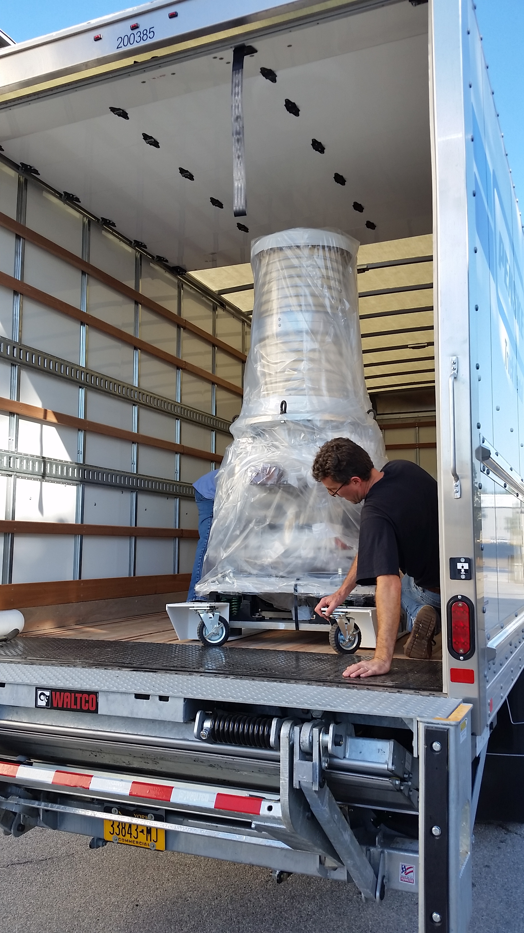
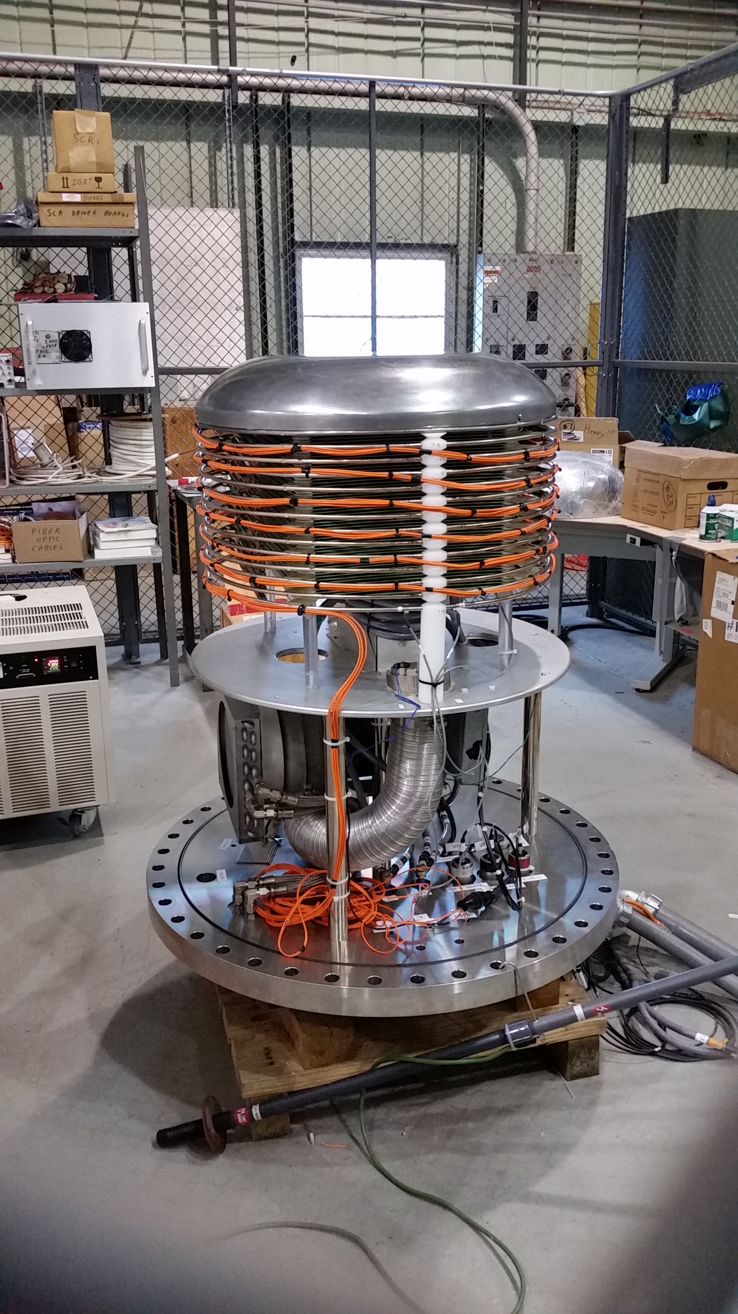
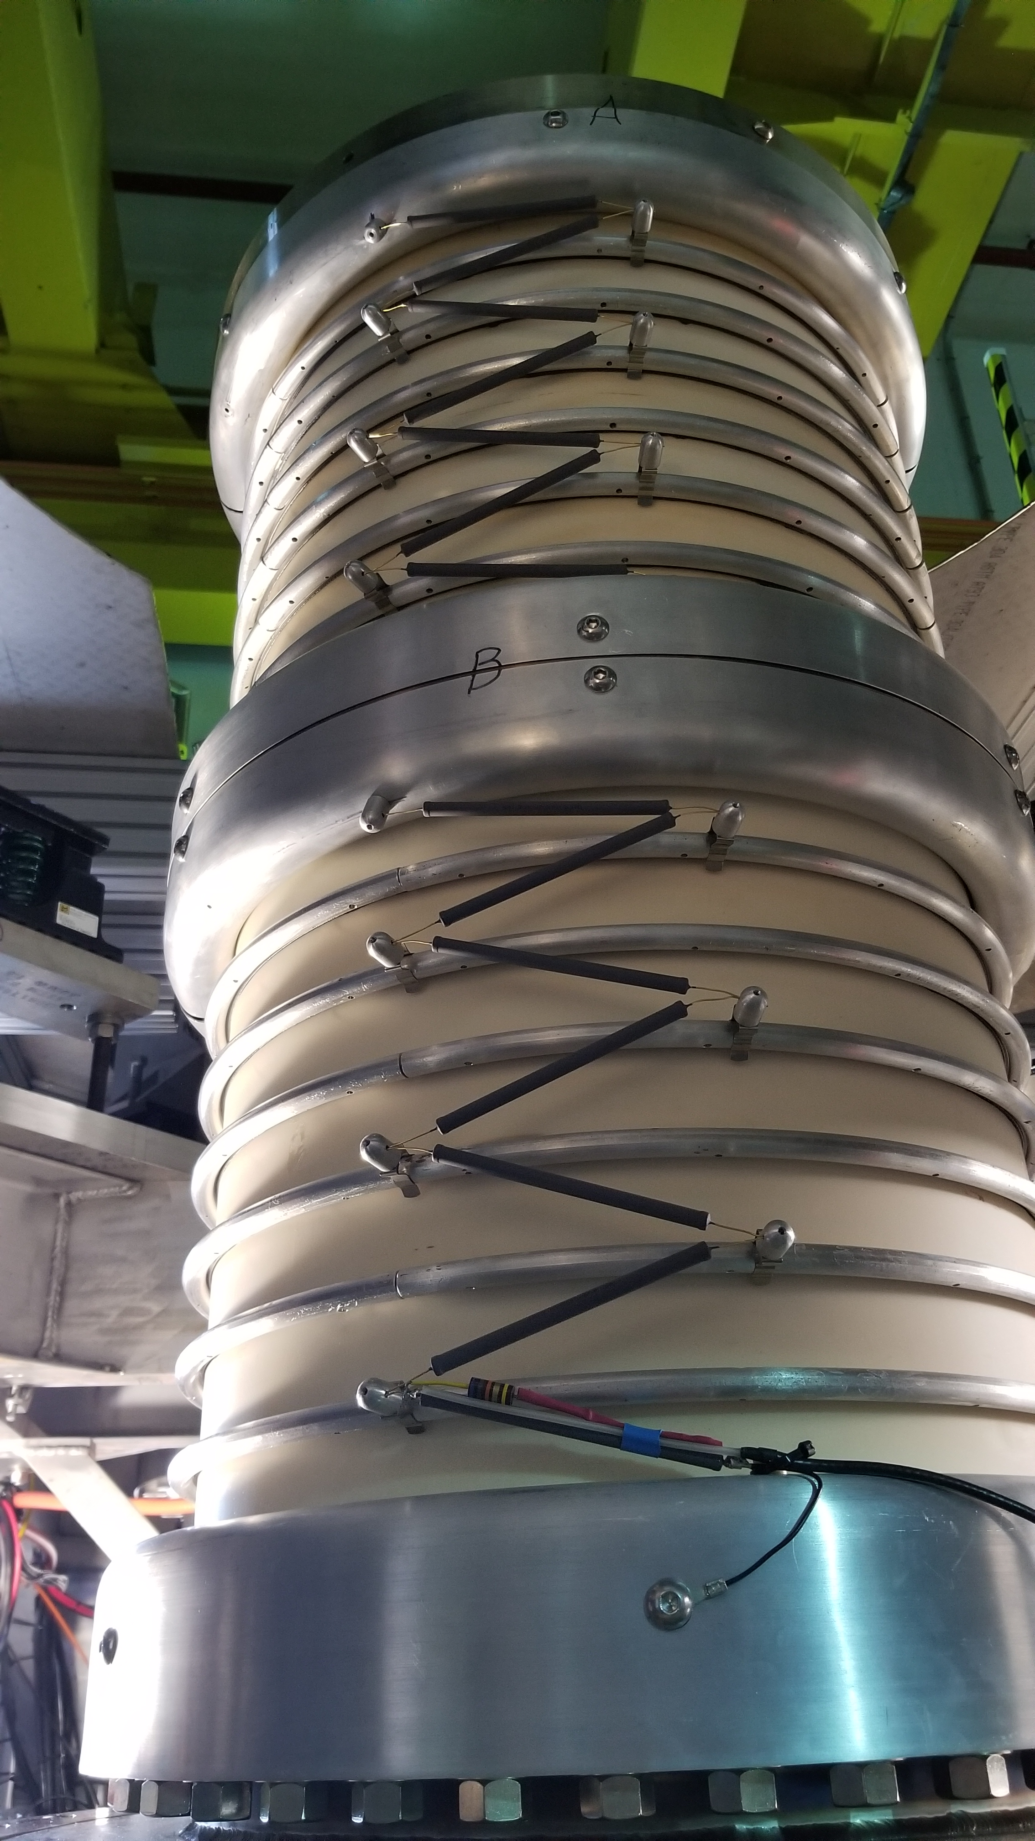
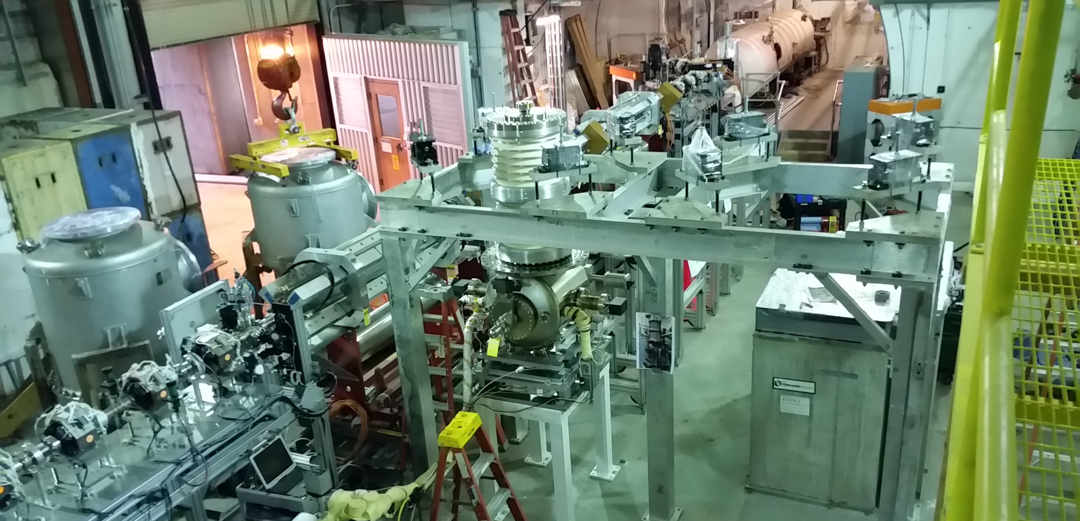
1) DC gun Designed/Built by Cornell University
5

Slide 6
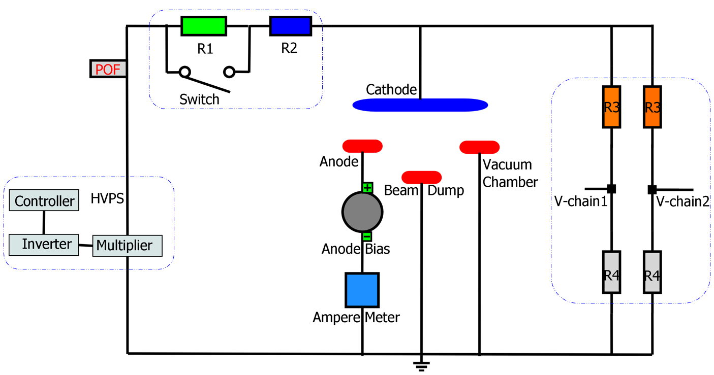
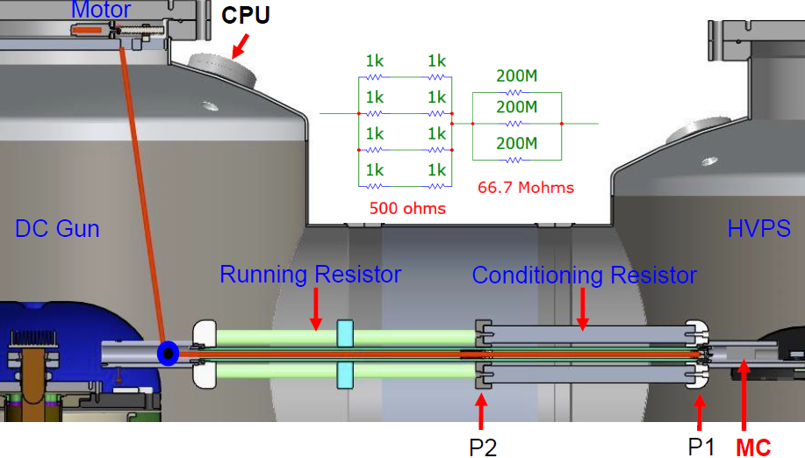
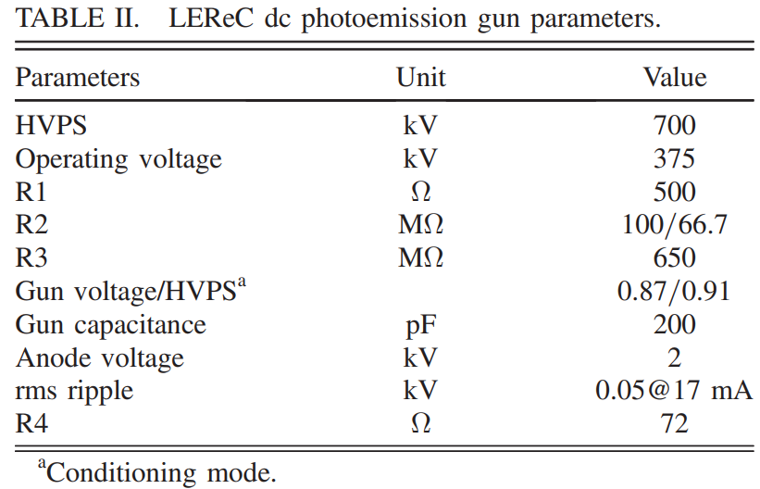
1) Modification: Processing/Running Resistor
A schematic view of the LEReC HV DC gun
Faster remote switch between the beam mode and conditioning mode
several minutes without tunnel accessing and opening the gun SF6 tank (12 hours).
6

Slide 7
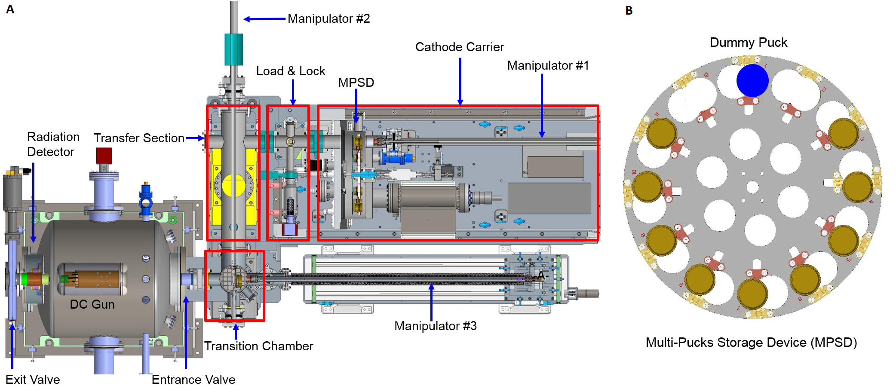
1) Modification: Cathode Insertion System
During RHIC operation with cooling, the LEReC machine needs to run continuously with little interruption the physics program.
The cathode lifetime was estimated as low as one day for high current operation. Therefore, the photocathode needs to be exchanged frequently.
To minimize the cathode exchange time, and to ensure that the LEReC electron beam can be continuously operated with little interruption, a rapid cathode puck insertion system (A) including a MPSD (B) were built.
The total time for a cathode exchange is about 45 minutes with total 12 cathodes in the MPSD (B).
7

Slide 8
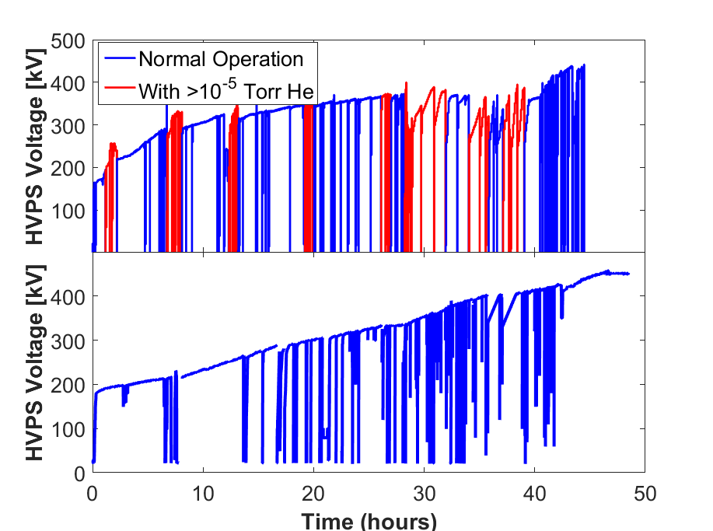
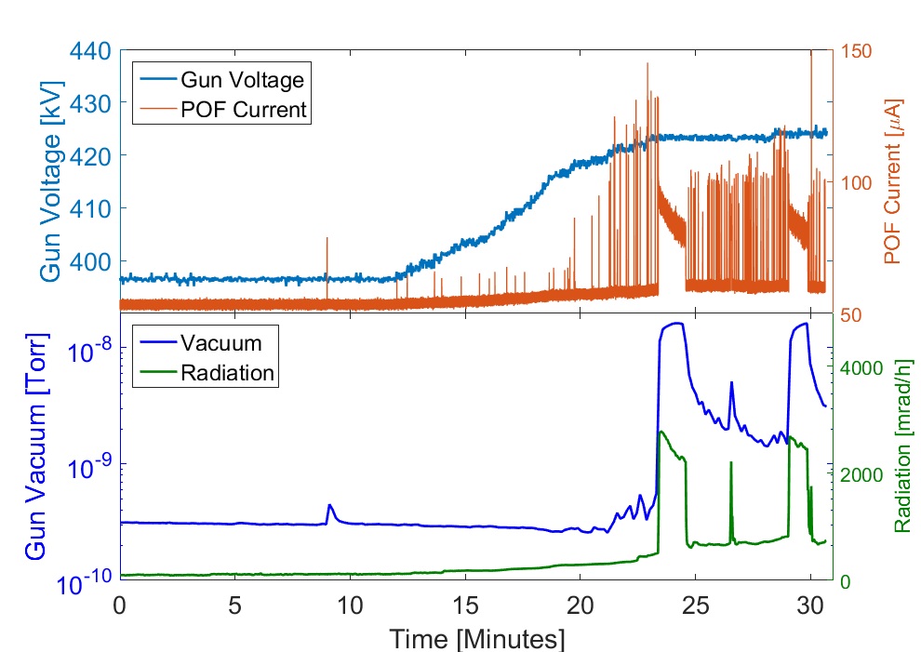
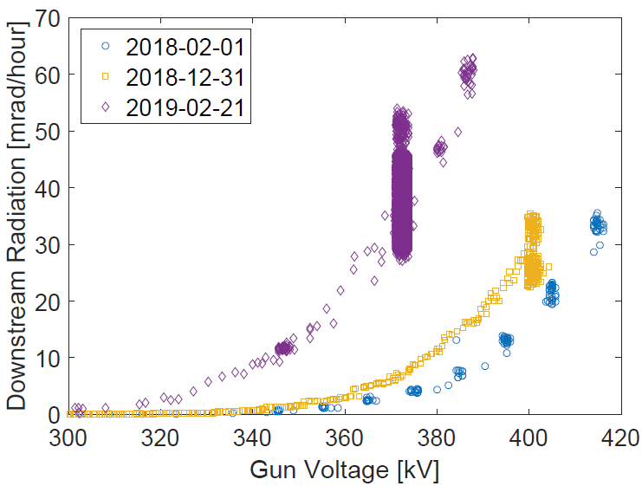
1) Gun Conditioning
Conditioning within vacuum or gas (Helium or Krypton)
Current: Power-Over-Fiber (POF), 850Hz, 0.1 uA
Radiation: two Canberra detectors
Anode leakage current: None
DC gun was built by Cornell University 2016
Gun was tested up to 430kV at Cornell (Top) Oct. 2016
Gun HV conditioning starts at BNL (Bottom) Nov. 2016
Gun reached 440kV Dec. 2016
First operation with CW electron current Aug. 2017
Commissioning of full LEReC accelerator 2018
Gun reached 500kV (high radiation) Jan. 2019
Re-conditioning before each Run (50mrad/hour for 375kV)
8

Slide 9
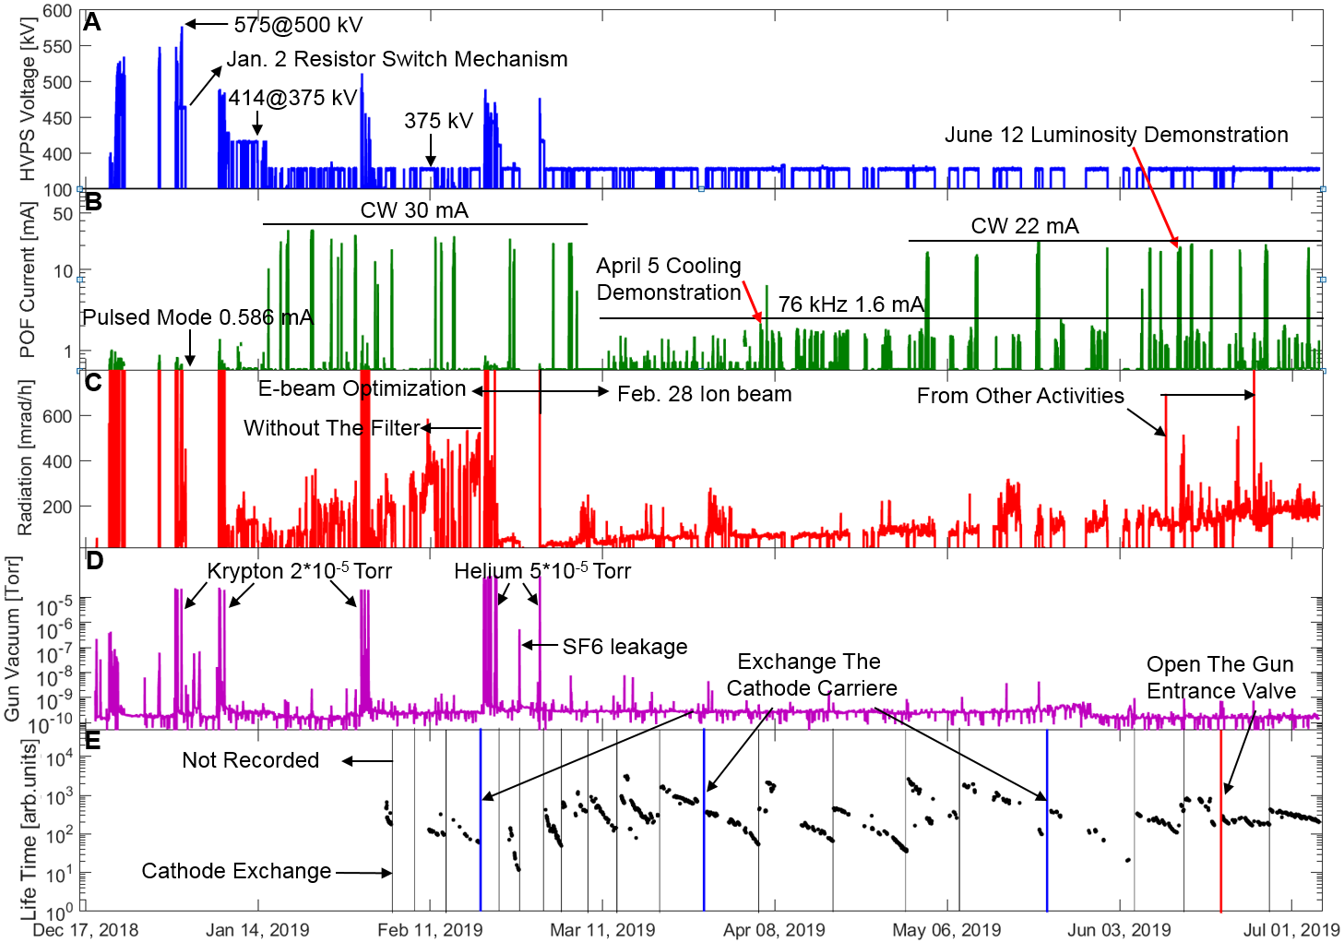
1) Operation Overview in 2019
krypton and the gas filter
9

Slide 10
Outline
LEReC and DC gun
Beam Parameters
High-current Experience
Summary
10

Slide 11
2) LEReC electron beam parameters
Electron beam requirement for cooling |  |  | Measured*
Kinetic energy, MeV | 1.6* | 2 | 1.6, 2.0
Laser pulse duration, psec | 40 | 40 | 40
Bunch duration in cool. sect, psec | 400 | 400 | 400
Electron bunch (704MHz) charge, pC | 130 | 170 | 50-200
Bunches per macrobunch (9 MHz) | 30 | 30 | 30
Charge in macrobunch, nC | 4 | 5 | 1-6
RMS normalized emittance, um | < 2.5 | < 2.5 | 1.6-2
Average current, mA | 36 | 47 | 14-30
RMS energy spread | < 5e-4 | < 5e-4 | <2e-4
RMS angular spread in cooling section | <150 urad | <150 urad | 100-200 urad
11

Slide 12
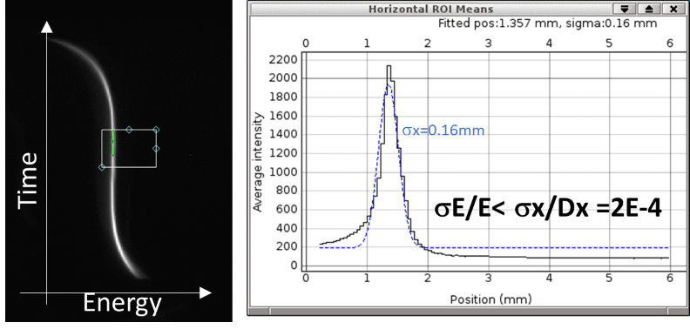
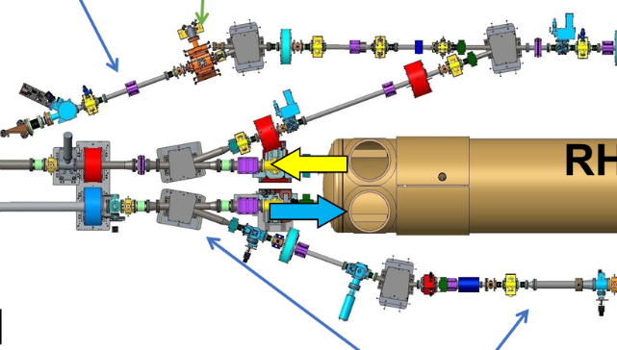
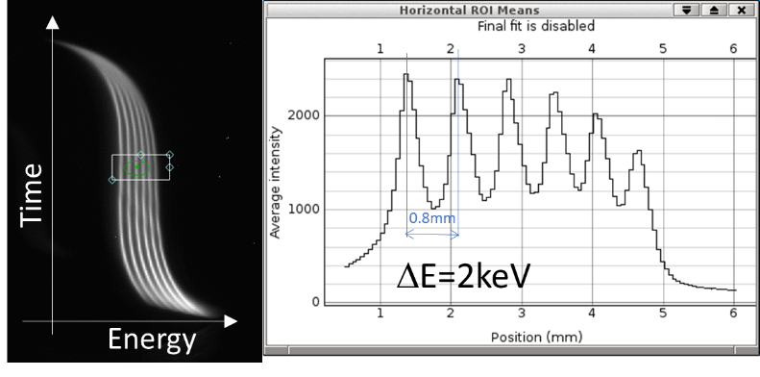
2) The energy spread measurement
1 macrobunch, 3 nC
704MHz RF vertically
deflecting cavity
6 macro-bunches, 3 nC each
First dogleg merger dipole is off and beam goes to RF diagnostic line
20-degree dipole produces dispersion
Deflecting cavity produces a time-dependent vertical kick
Used for energy spread, energy jitter, and slice emittance measurement
In pulsed mode duet o beam loading effect followed bunches have lower energy
12

Slide 13
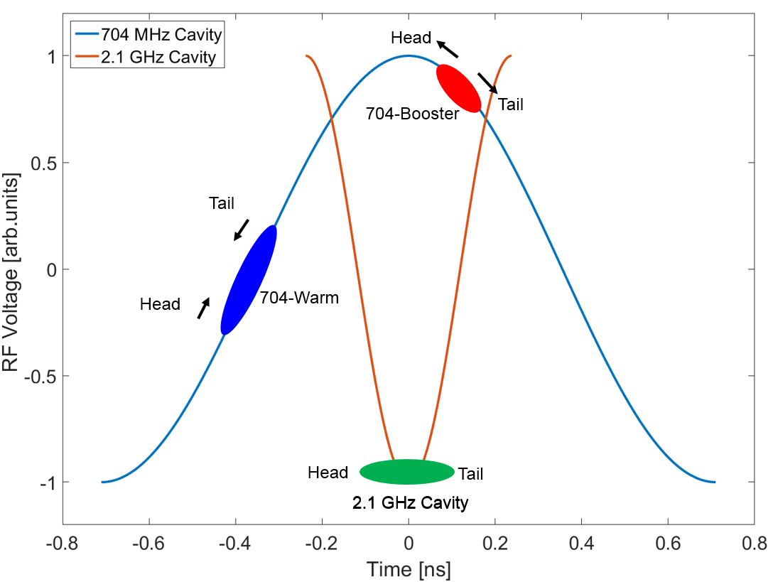
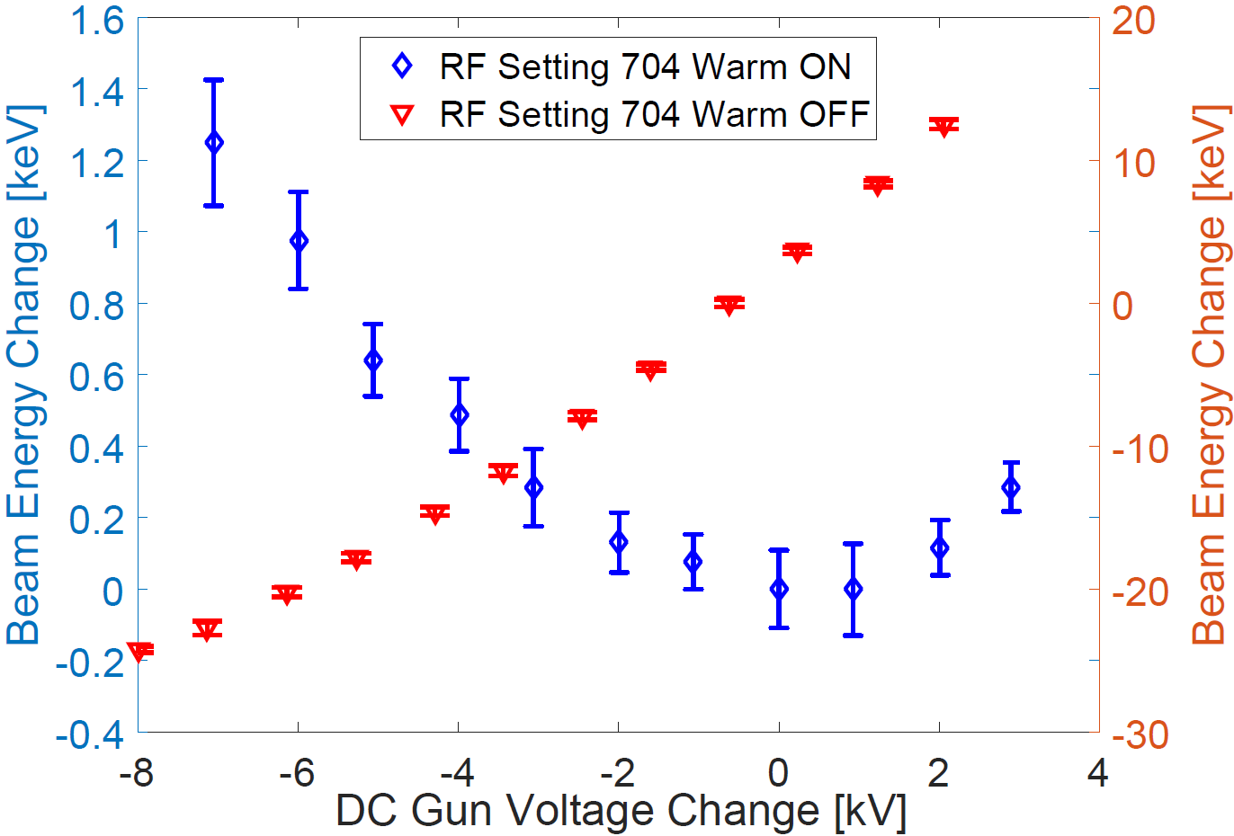
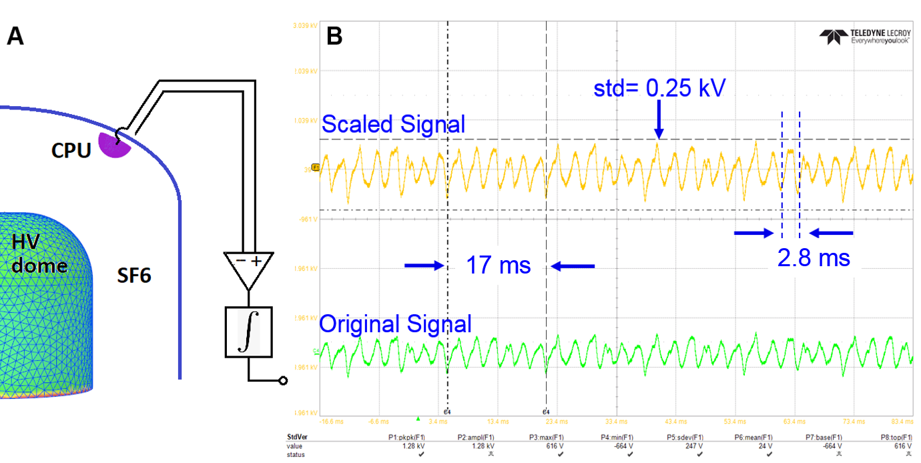
2) The corresponding energy jitter measurement
The corresponding energy jitter reduction due to DC gun voltage ripple is a combination of synchronized work of all RF cavities and longitudinal dispersion of the long drift space.
The electron beam energy stability is a critical factor affecting the ion beam cooling efficiency.
A warm 704 MHz cavity is used to reduce the energy ripple: 3.5kV vs ~0.1kV per 1 kV gun voltage change
Energy jitter: 0.025/1600 ~1.6E-5<2E-4
it is the space charge effect and the emittance, not the HVPS voltage ripple, that dominates the measured energy spread.
166 kHz power supply switching frequency and 360 Hz power line frequency.
reducing the energy ripple
3.5kV/kV
~0.1kV/kV
375kV@17mA
13

Slide 14
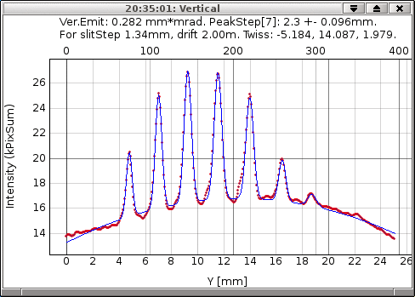
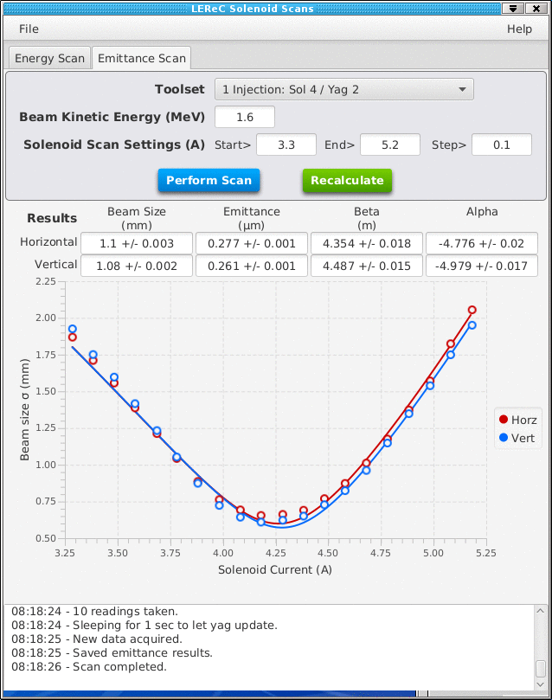
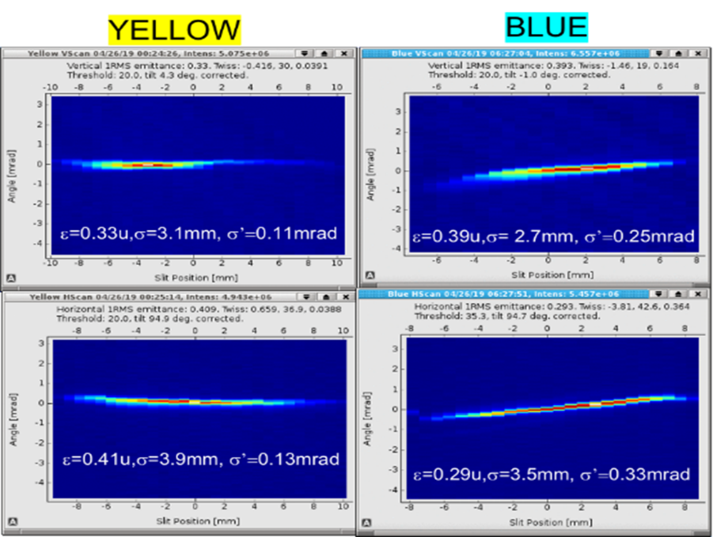
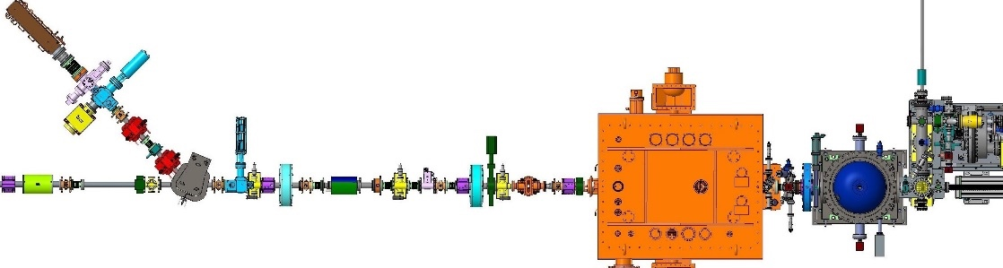
2) The emittance measurement
Injection, Multi slits, geometr. ε=0.282 um
Injection, Solenoid scan, geometr ε=0.277 um
Cooling section, Multi slits geometr. ε∼0.4 um, 75pC
Their normalized emittances (0.9 or 1.25um) < 2.5um
14

Slide 15
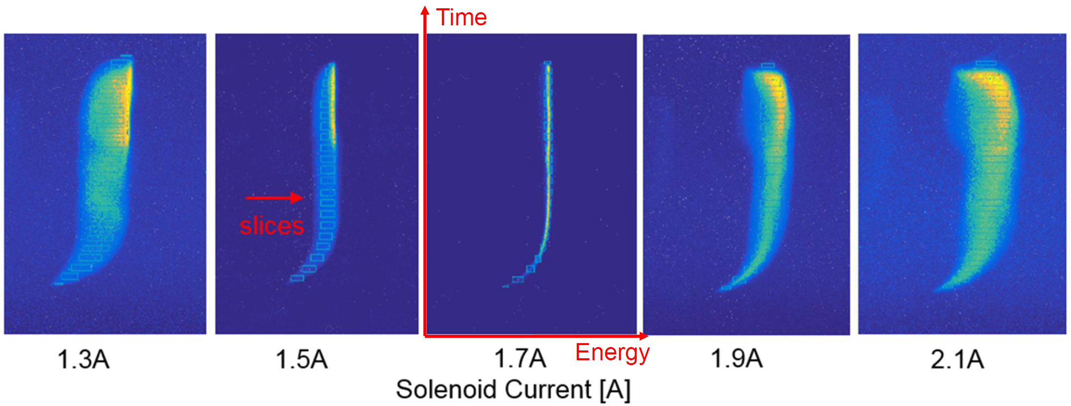
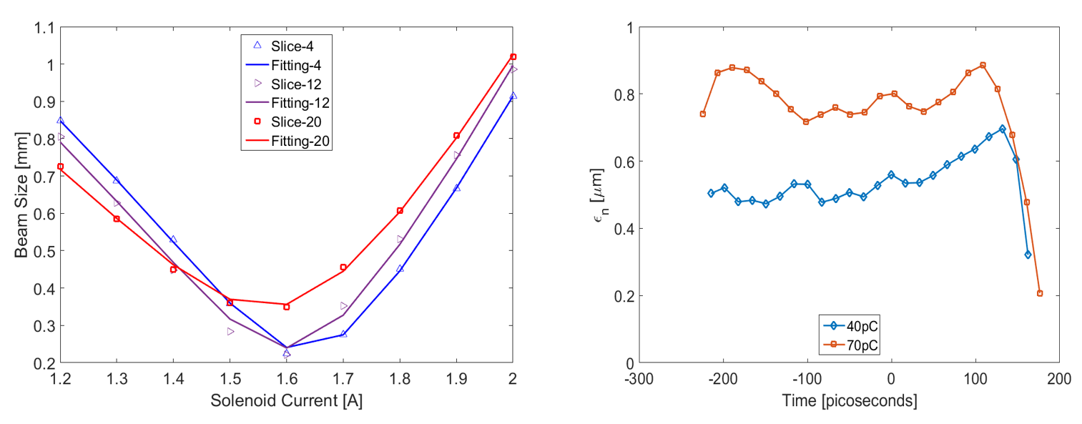
2) The slice emittance measurement
0.8um < 2.5 um
15

Slide 16
2) The CW beam current measurement
No Gun trips
In September 2018, a stable Gun operation at 30mA current was achieved by:
1) 3 kV anode bias to prevent ion back bombardment (without it, the DC gun tripped every 20-30min or so).
2) Using off-center small-area active cathode.
3) Laser feedback, including intensity feedback.
16

Slide 17
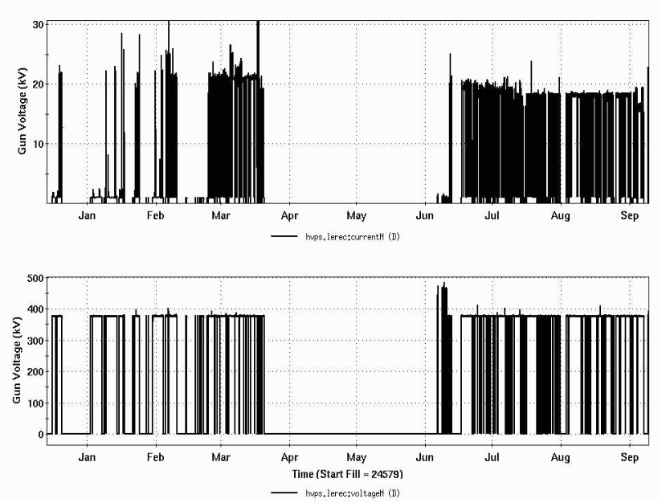
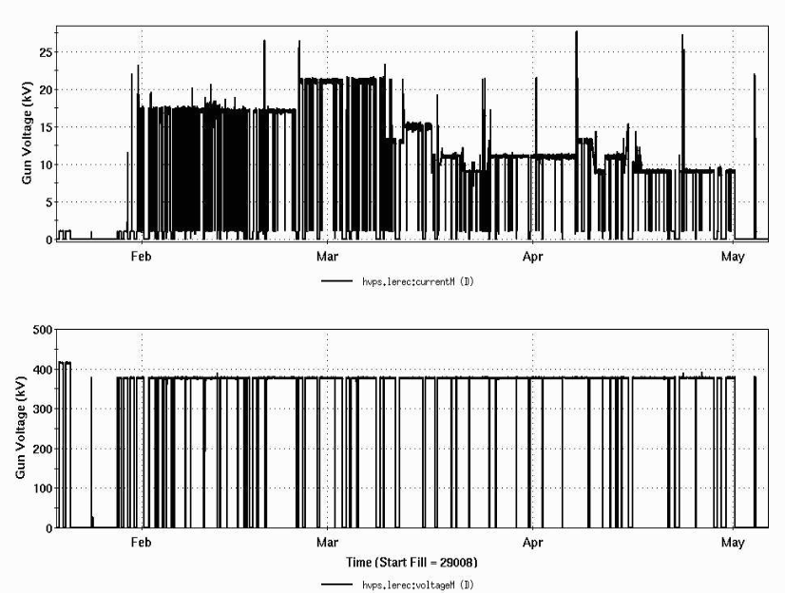
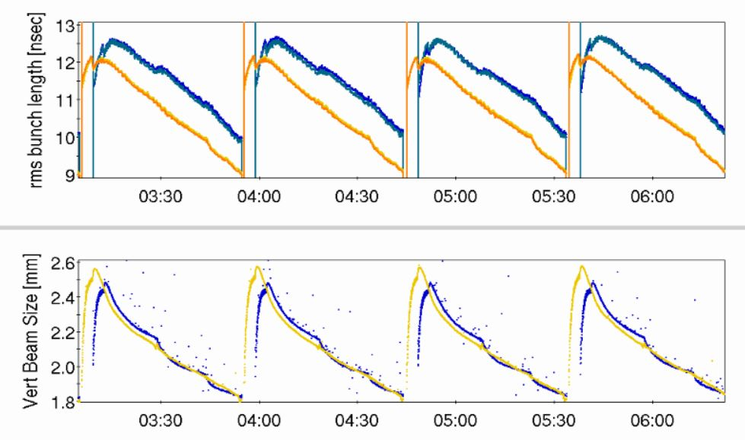
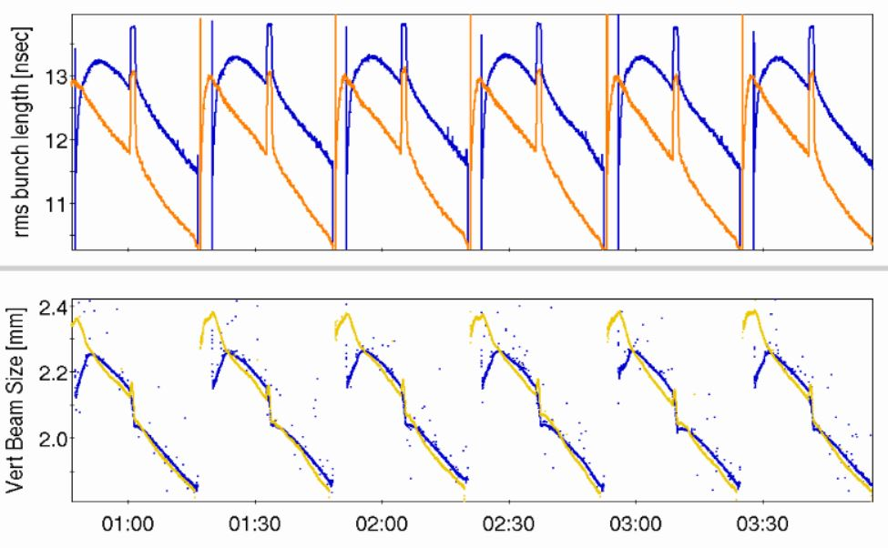
2) Operation Overview
  provided stable 24/7 running of high-current electron accelerator and stable cooling of ion bunches was provided over many months of collider operation in 2020 and 2021.
Current
Voltage
Bunch Length
Beam Size
17

Slide 18
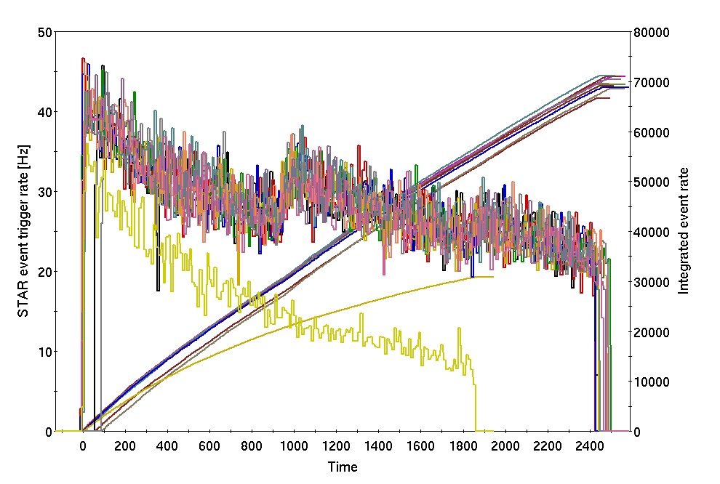
provided significant luminosity improvement for RHIC operation at low energies
Several physics stores at 4.6 GeV/nucleon with cooling (2MeV): vertical axis: events rate [Hz] (left); store integrals (right)
2) RHIC Performance Improvement
With cooling
Without cooling
Time [sec]
Higher initial events rate.
Longer stores with cooling.
Beta* squeeze is possible after the ion beam transverse sizes are cooled.
Gains in integrated luminosity from cooling:
  2020 (4.6 GeV/n): about factor of 2
  2021 (3.85 GeV/n): 30-50%
18

Slide 19
Outline
LEReC and DC gun
Beam Parameters
High-current Experience
Summary
19

Slide 20
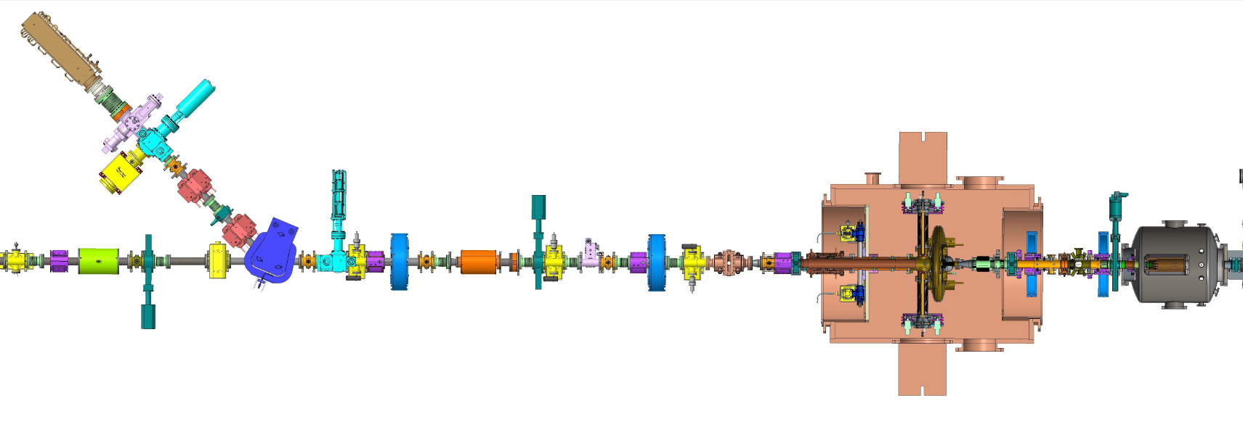
3) The Injection Beam Line
Explore Gun operation at high current in the present LEReC configuration for EIC pre-Cooler:
Running e-beam to high-power beam dump (140kW): requires dedicated RHIC time
Running in parallel to RHIC operations to injection dump (25kW) – limited by dump power
BPM7
BPM6
BPM5
Solenoid
Corrector
Energy Change: BPM7
Bias BPM (5&6): ± 200V
Beam Loss Spiks: PMT(1&2)
DCCT: Smallest Aperture
Temperature Sensors
25kW Dump
Dipole
PMT2
DCCT
2.1GHz Cavity
Booster Cavity
PMT1
DC Gun
7 m
20

Slide 21
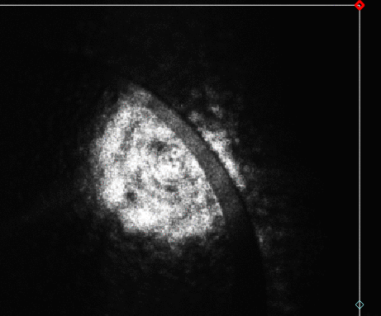
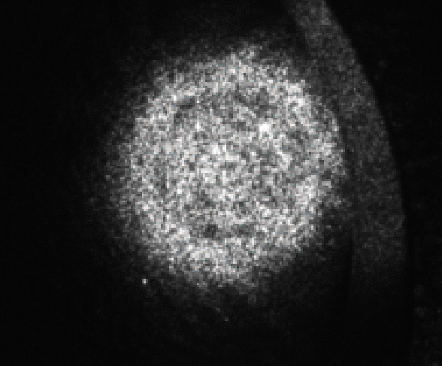
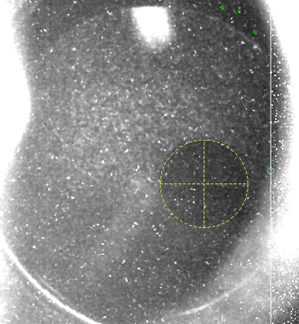
3) The Configuration for High Current
Laser Frequency: 9MHz -> full 704MHz; less space charge effect, focusing on the DC gun.
Laser Micro-Bunch Length: 26ps (40ps or 80ps in the future)
Laser Size: 4 mm -> 3mm (diameter); a better laser propagation from the gun to the gun exit table.
HVPS Voltage: 375kV, 350kV, 320kV; to avoid the possible inverter fault (375kV) and the over-current HVPS fault (350kV).
Booster Cavity: 125kV->165kV; the e-beam energy should be less than 500kV for 50mA, because of the 25kW injection dump.
The offset activated cathode area: 3 mm radius, 4 mm offset.
Anode Bias: 3000 V.
Bias BPM (5&6): ± 200V.
Many experiences from Cornell high current test.
The laser image on the exit table.
4mm
3mm

Slide 22
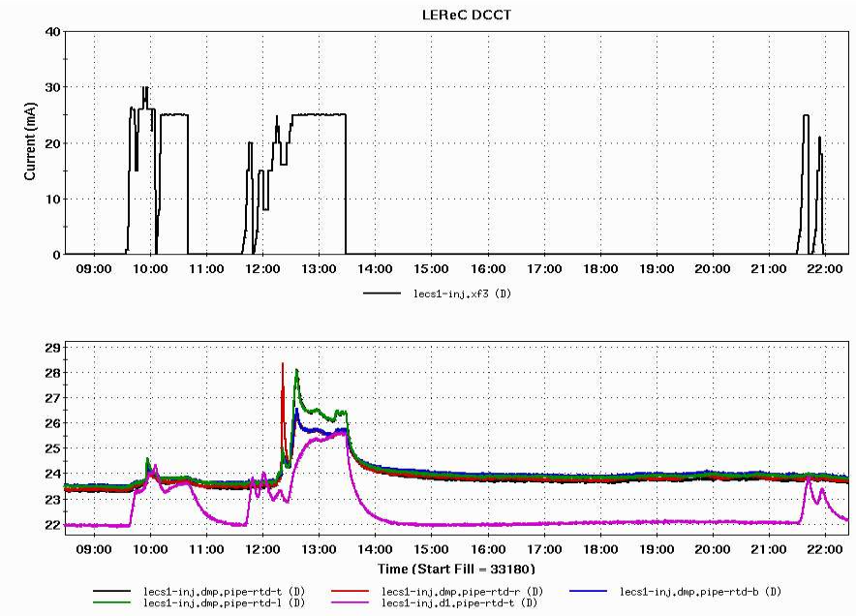
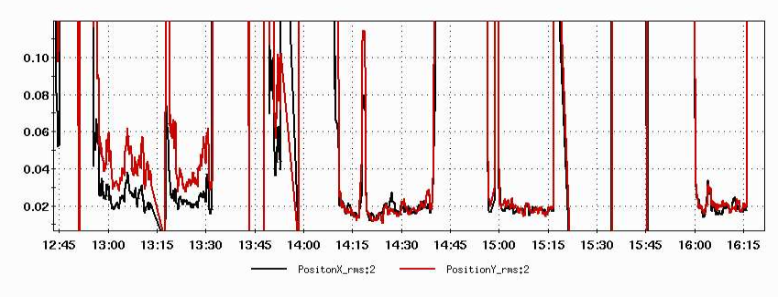
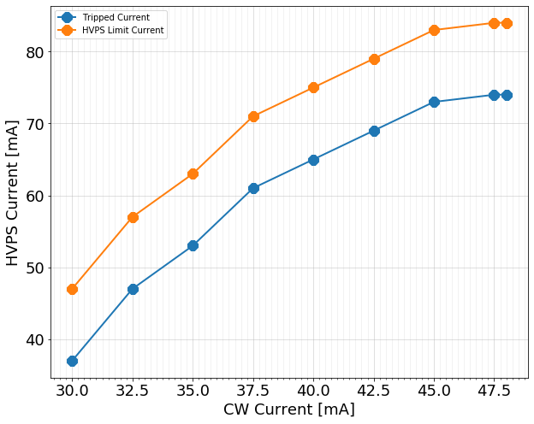
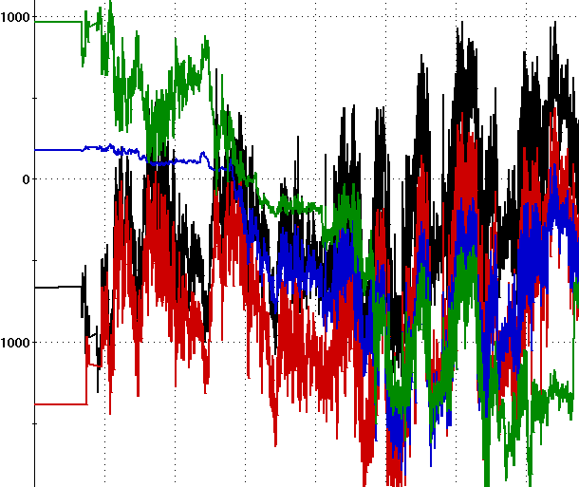
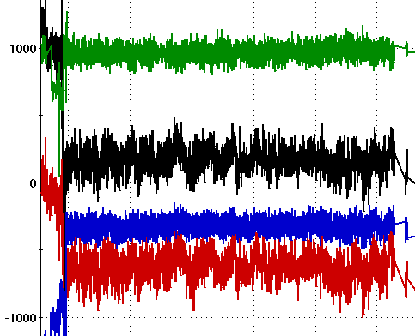
3) The Issues and solutions
The dump vacuum spikes: It had water leakage and was not baked. Resolved by Increasing its trip threshold to 5E-7 Torr.
The DCCT region vacuum spikes: The beam loss is because of the smaller aperture of the DCCT. Resolved by having different optics.
The temperature: nearby the dipole or the beam pipe before the injection dump: Resolved by different optics, better laser position stability via feedback control.
HVPS: Some HVPS Over-Current faults were caused by short HVPS current spikes; resolved by increasing the HVPS current trip level.
Other HVPS Over-Current Trips are not mainly caused by the discharges in the gun and only can be resolved by conditioning or a lower HVPS voltage.
Beam Current
Temperature: Didn’t trip the MPS

Slide 23
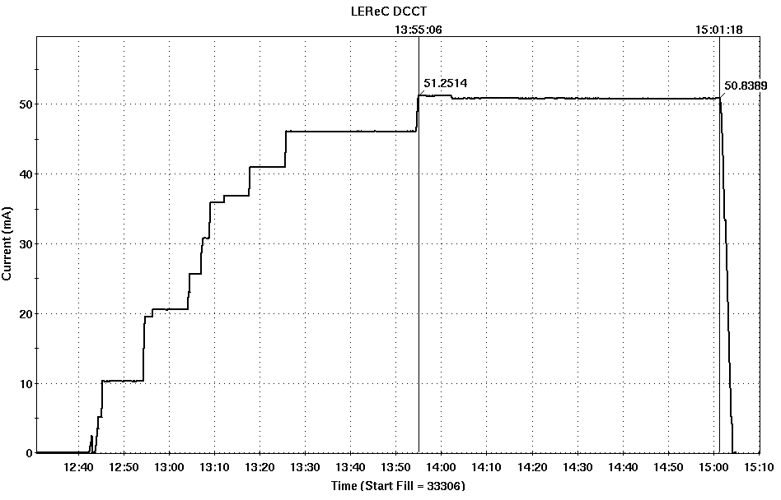
3) Higher Current Test
320kV: if the HVPS Faults are not caused by the voltage, could try 350kV later.
66 minutes: The current was ramped down prior to next polarization measurements in RHIC which typically results in high losses in the location of the Gun.
50 mA: limited by the injection dump power (25kW);
66 minutes
Ramp down

Slide 24
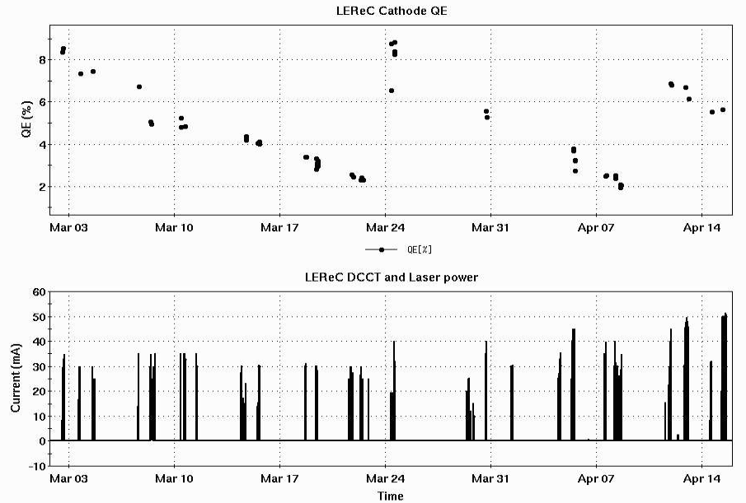
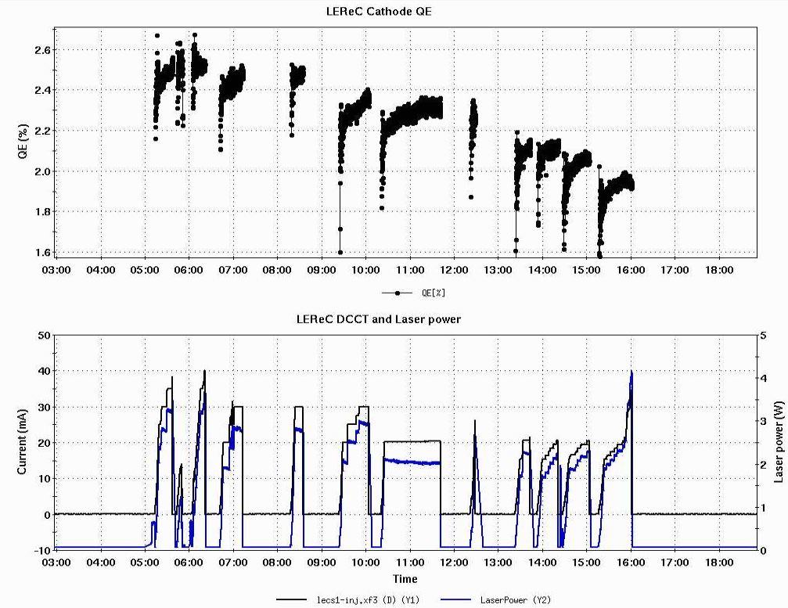
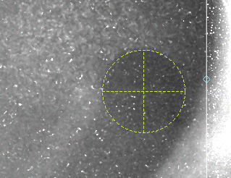
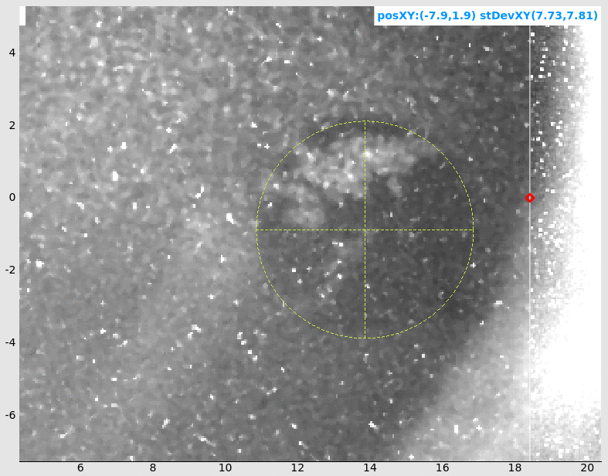
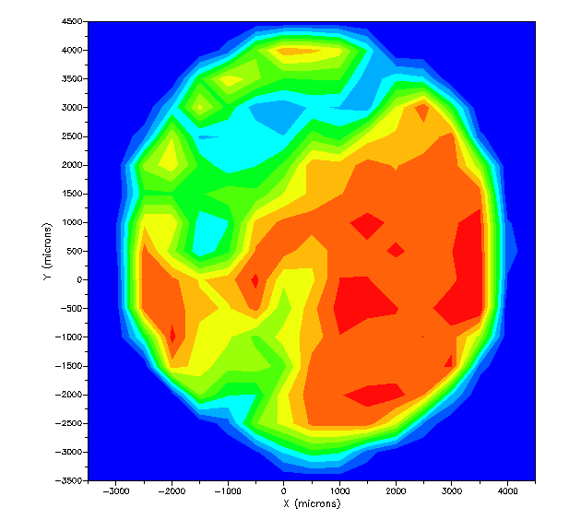
3) QE Drops Because of Gun Trip
Cathode 1 2 3
QE drop
QE degradation.
HVPS Gun Trips
DCCT Current
NO Gun Trips
Several Gun Trips
Arbitrary units

Slide 25
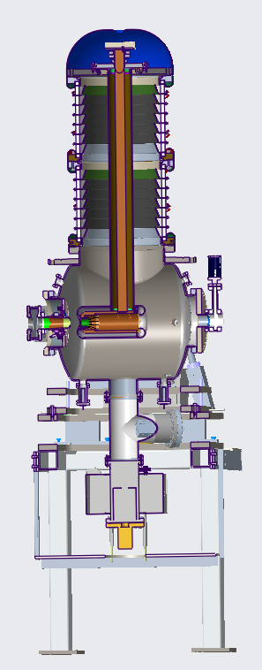
3) Some Limitations
HVPS inverter: The inverter is rated for 37.5kW power. With a single inverter, one can go up to 100mA at 375kV with a single inverter. One can run two inverters for higher currents.
HVPS Multiplier: The boards are rated for 100mA max. One should probably limit current to about 80-90mA (to be tested by Power Supply group).
Tunnel Radiation: Parasitic operation with RHIC, to protect HVPS electronics, we must ramp down the current and Gun voltage when large losses (from RHIC) are expected, such as the beam injection, beam dump, and polarization measurement.
DCCT Aperture: Beam losses are caused by a limiting aperture or space charge.
25

Slide 26
3) Future R&D
DC gun
Explore Gun operation with high-current: 50-100mA and determine the limitation of the Gun and HVPS. The first option is to propagate the e-beam to the high-power beam dump (which requires dedicated time). Another option is to move the high-power beam dump closer to the Gun.
Explore Gun and HVPS long-term (>4 hours) stability at high currents.
Explore Gun voltage limitations: can one have a stable long-term high-current operation at 400kV or 425kV?
Cathode:
Explore operation with active cathode on center vs cathode off center.
Explore large cathode area vs small active area. Explore various laser spot sizes on the cathode.
Explore cathode QE at various laser powers with and without cathode stalk cooling.
Test multi-alkali photocathodes using different growth methods.
Laser:
High-charge high-peak current (beam halo and losses): explore possible upgrade of laser system the allow ramping of high-current for fixed electron bunch charge.

Slide 27
4) Summary
A state-of-the-art electron accelerator was built, commissioned and successfully provided stable high-current high-quality beam for electron cooling, which helped with luminosity improvement during RHIC operations.
The DC gun provided high-current electron beam during 24/7 RHIC operations in 2020-2021. Present and future focus is on dedicated electron cooling experiments and high current R&D.
27

Slide 28
Acknowledgement
LEReC success would not be possible without team effort and expertise of many people from the BNL and Cornell University.
Thank you!
28

Slide 29
Recent LEReC peer-review publications
A. Fedotov et al., ” Experimental demonstration of hadron beam cooling using radio-frequency accelerated electron bunches”, Physical Review Letters 124, 084801 (2020).
D. Kayran et al., ” High-brightness electron beams for linac-based bunched beam electron cooling”, Phys. Rev. Accel. Beams 23, 021003 (2020).
S. Seletskiy et al., ” Accurate setting of electron energy for demonstration of first hadron beam cooling with rf-accelerated electron bunches”, Phys. Rev. Accel. Beams 21, 111004 (2019).
X. Gu et al., ”Stable operation of a high-voltage high-current dc photoemission gun for the bunched beam electron cooler in RHIC”, Phys. Rev. Accel. Beams 23, 013401 (2020).
H. Zhao et al., ”Cooling simulation and experimental benchmarking for an rf-based electron cooler”, Phys. Rev. Accel. Beams 23, 074201 (2020).
S. Seletskiy et al., ”Obtaining transverse cooling with non-magnetized electron beam”, Phys. Rev. Accel. Beams 23, 110101 (2020).
C. Liu et al., “Gold-gold luminosity increase in RHIC for a beam energy scan with colliding beam energies extending below the nominal injection energy”, Phys. Rev. Accel. Beams, vol. 25, 051001 (2022).
29

Slide 30
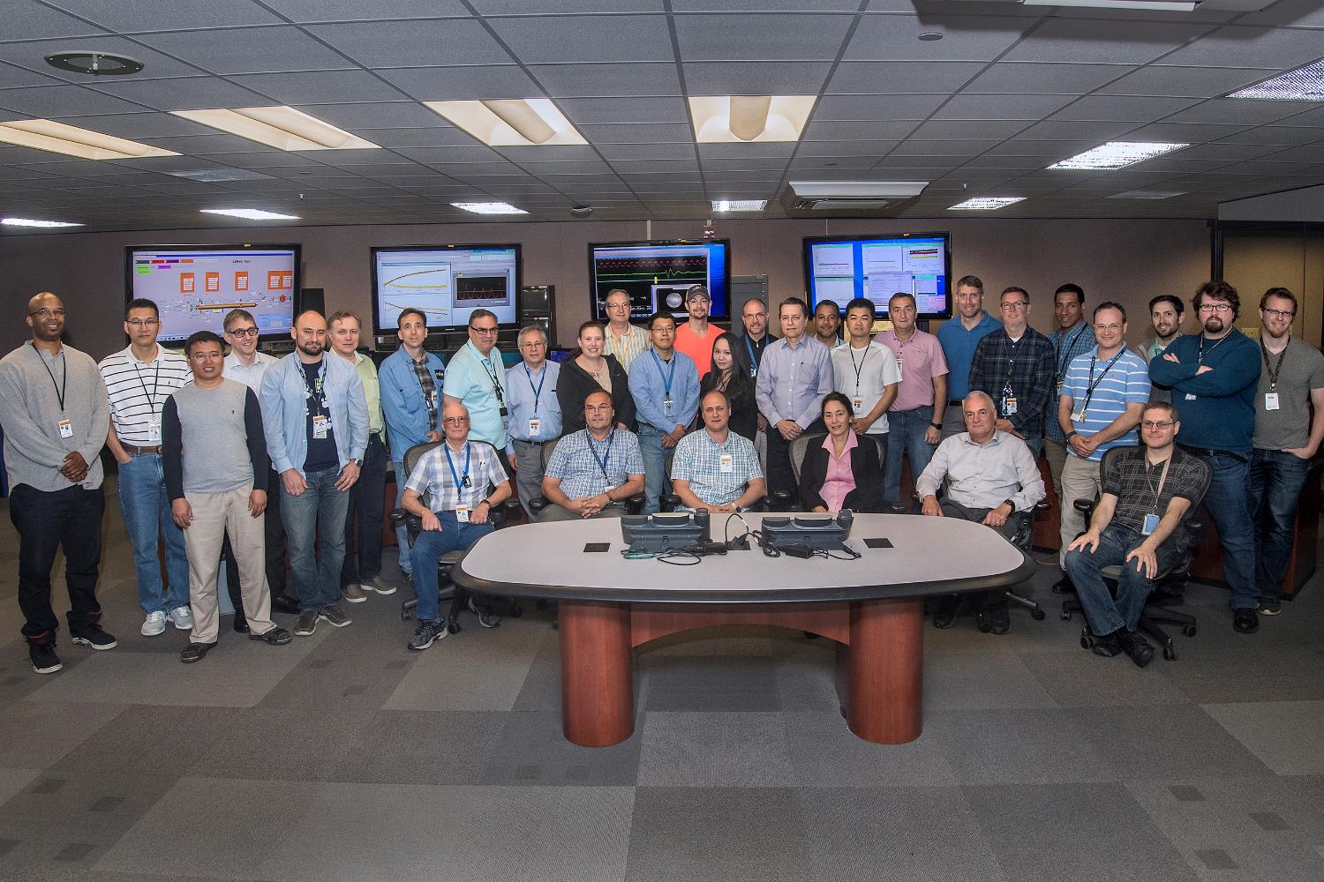
LEReC team
https://www.bnl.gov/newsroom/news.php?a=215585
30

