Slide 1

PERLE photogun and LHeC requirements
M. Baylac, CNRS – LPSC, Grenoble - France
B. Militsyn, STFC, Daresbury – UK
D. Reynet, A. Gallas, W. Kaabi , CNRS – IJCLab, Orsay - France
E. Labussière, CNRS – LPSC, Grenoble - France
B. Fell, L. Jones, K. Middleman, T. Noakes, R. Smith, STFC, Daresbury – UK
B. Hounsell, M. Klein, University of Liverpool (UK)

Slide 2
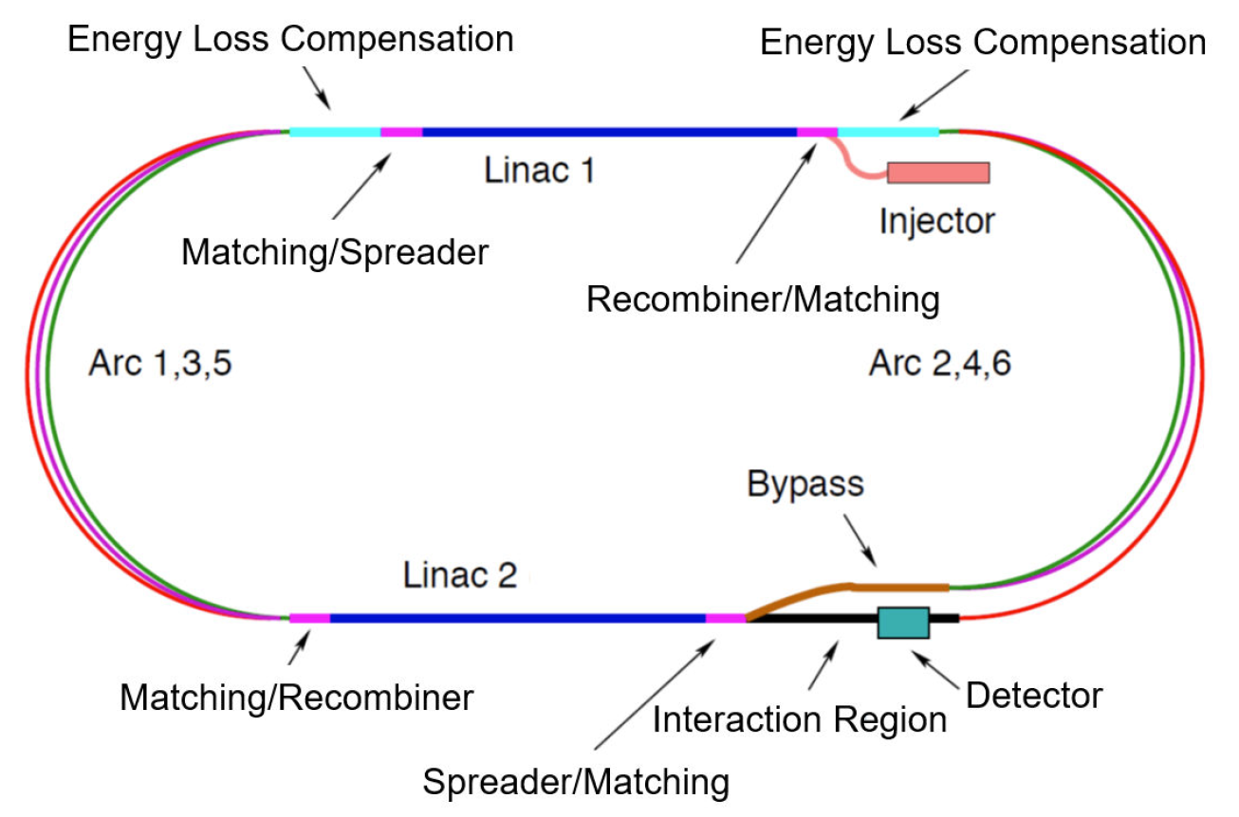
The LHeC concept
Future particle physics impose strong challenges on accelerators and require a variety of accelerator R&D programs
  Energy Recovery Linacs offer one of the main options for energy frontier colliders
To probe deep inelastic scattering at high energy and to study the Higgs boson, LHeC proposes a high luminosity collider at CERN using the LHC protons and an intense electron beam
For the electron beam, the ERL scenario has many advantages
  luminosity, lower interference for installation next to LHC, machine size, energy consumption
  concept also applied to the FCC-eh design
The ERL - ring collider concept of LHeC based on
  synchronous operation of HL – LHC and 50 GeV electron beams
  circumference of e- ring about 1/5 of that of LHC (5.3 km)
  luminosity of 10³⁴ cm⁻².s⁻¹
LHeC ERL design
The Large Hadron–Electron Collider at the HL-LHC, P. Agostini et al., J.Phys.G 48 (2021) 11, 110501, https://doi.org/10.48550/arXiv.2007.14491
M. Baylac, B. Militsyn, ERL workshop, Cornell, October 3-6, 2022

Slide 3
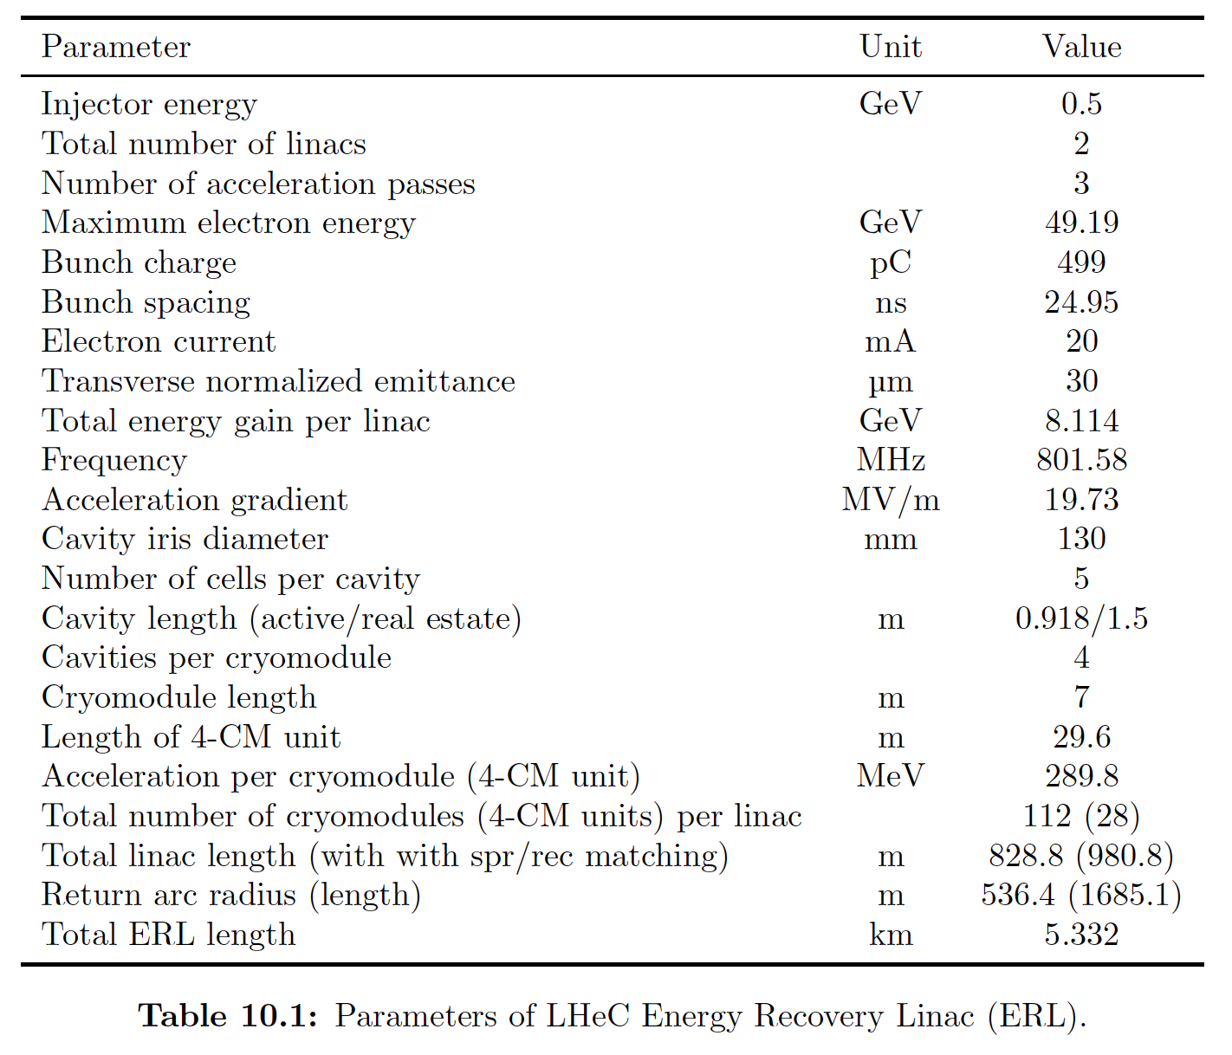
An ERL for LHeC
LHeC ERL parameters
ERL specifications
  3-pass acceleration
  E_{maximum} = 50 GeV
  RF frequency : 802 MHz
  I = 20 mA
  (6 x 20 mA = 120 mA load of the cavities)
Different beam specifications for intensity and polarization
  I = 20 mA (Q _{bunch} = 500 pC), unpolarized beam
  Desirable polarized beam (P=+/-0.9), with max possible current
  Ultimately, positrons considered at low intensity
Electron source requirements
  High intensity, low emittance and future polarization
  ➔ DC photogun
  Load-lock for photocathode loading
The Large Hadron–Electron Collider at the HL-LHC, P. Agostini et al., J.Phys.G 48 (2021) 11, 110501, https://doi.org/10.48550/arXiv.2007.14491
M. Baylac, B. Militsyn, ERL workshop, Cornell, October 3-6, 2022

Slide 4
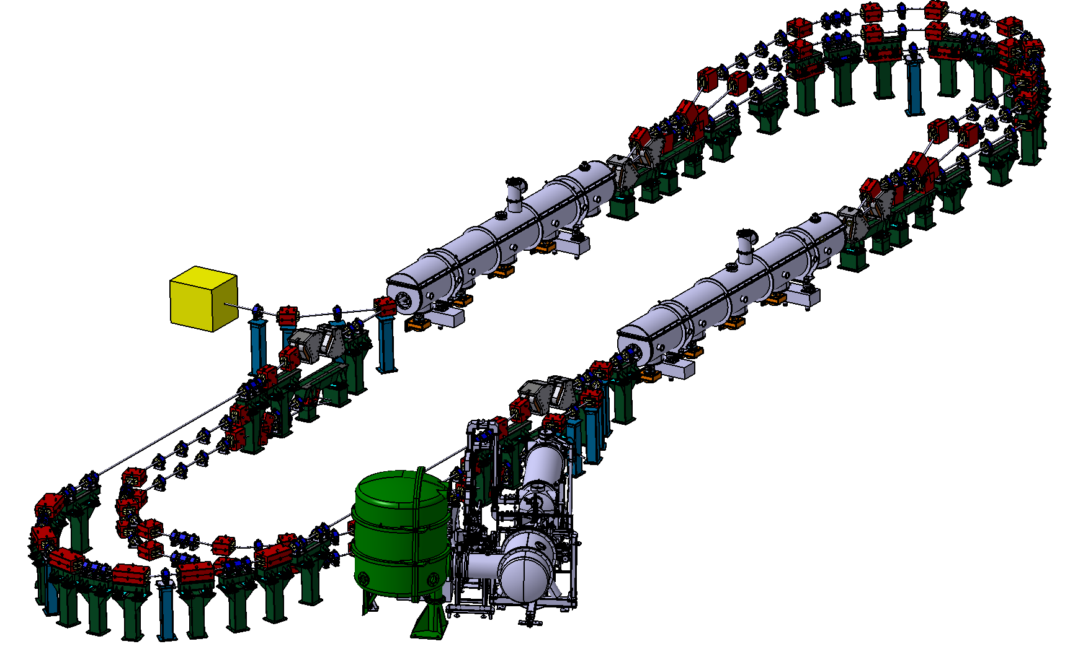
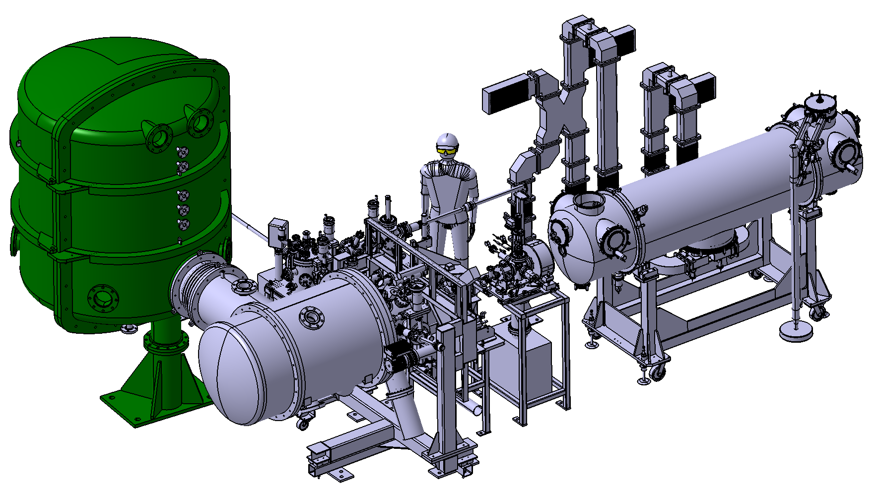
On the pathway to LHeC : PERLE
Several R&D required on the pathway to the LHeC realization
  Multi-turn high power energy recovery, high bunch charge, …
  PERLE is an ERL technology development facility using LHeC parameters
  2 linacs (four 5-cells 801.58 MHz SC cavities)
  3 turns (164 MeV/turn)
  Maximum beam energy : 500 MeV
  Beam current : 20 mA
Arcs 1:3:5
dump (7 MeV)
∆E = 82 MeV
DC = l_{RF}/2
Injector (7 MeV)
Arcs 2:4:6
M. Baylac, B. Militsyn, ERL workshop, Cornell, October 3-6, 2022

Slide 5


PERLE
Powerful Energy Recovery Linac for Experiment (10 MW)
  key part of the European ERL roadmap : presentation by A. HUTTON
Goals
  Investigate high power ERL and test technologies for LHeC
  Conduct physics experiments
Within an international collaboration, project led by IJCLab (Orsay), host of the machine
Contributions on PERLE project at this workshop by
  W. KAABI, C. BARBAGALLO, K. ANDRE and L. PERROT & A. FOMIN (poster)
Target Parameter | Unit | Value
Injection energy | MeV | 7
Electron beam energy | MeV | 500
Normalised Emittance γε_{x,y} | mm mrad | 6
Average beam current | mA | 20
Bunch charge | pC | 500
Bunch length | mm | 3
Bunch spacing | ns | 25
RF frequency | MHz | 801.58
Duty factor |  | CW
PERLE. Powerful energy recovery linac for experiments. Conceptual design report,
J.Phys.G 45 (2018) 6, 065003 • e-Print: 1705.08783 [physics.acc-ph]
M. Baylac, B. Militsyn, ERL workshop, Cornell, October 3-6, 2022

Slide 6
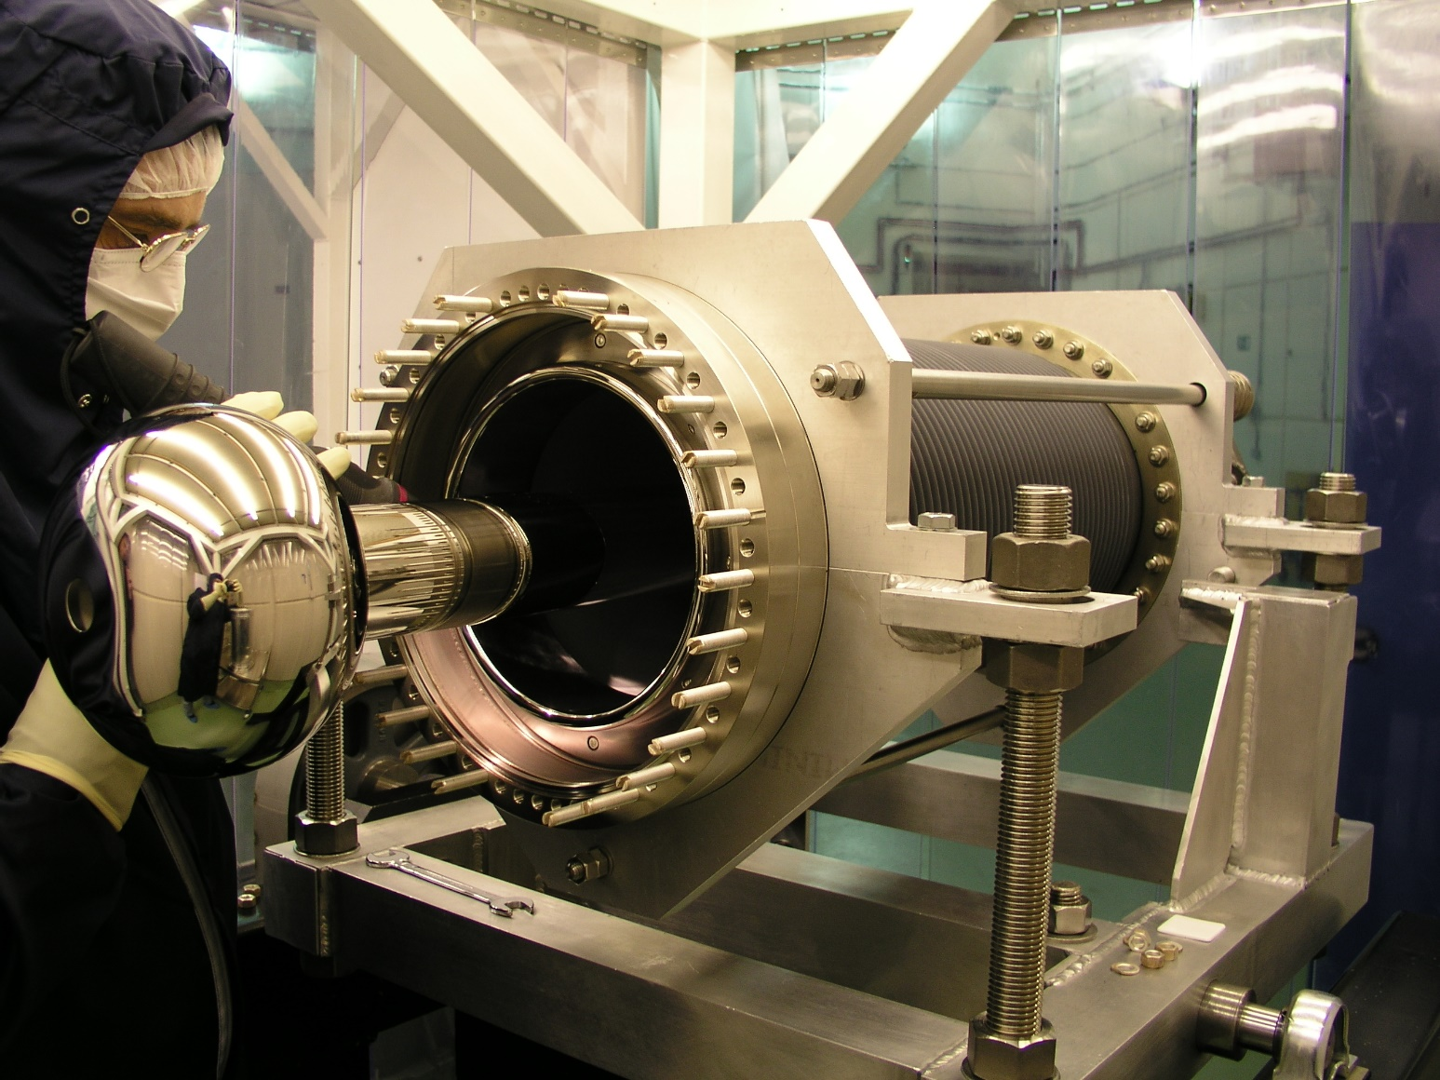
PERLE photogun
PERLE injector based on DC photogun at 350 kV (unpolarized beam)
  Q _{bunch} = 500 pC
  Frequency : 40 MHz
  Multi-alkali antimonide photocathode (CsKSb)
  Green laser (532 nm)
Staged approach
  Stage 1 : ALICE photogun
    Vent-bake gun (photocathode loading = full bake of the gun)
    Not the final version of the gun for PERLE
    Useful to gain experience and practice operation
  Stage 2 : upgraded gun
    Load-lock version (insertion chamber)
    High bunch charge optimization
ALICE photogun
M. Baylac, B. Militsyn, ERL workshop, Cornell, October 3-6, 2022

Slide 7
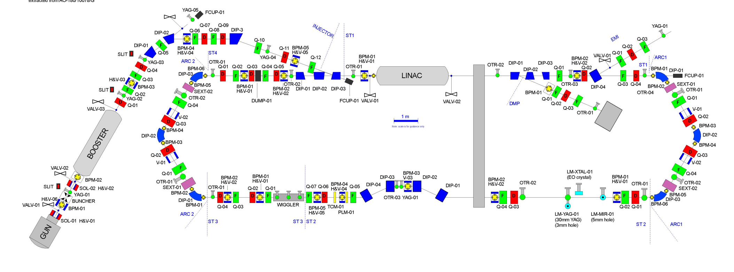
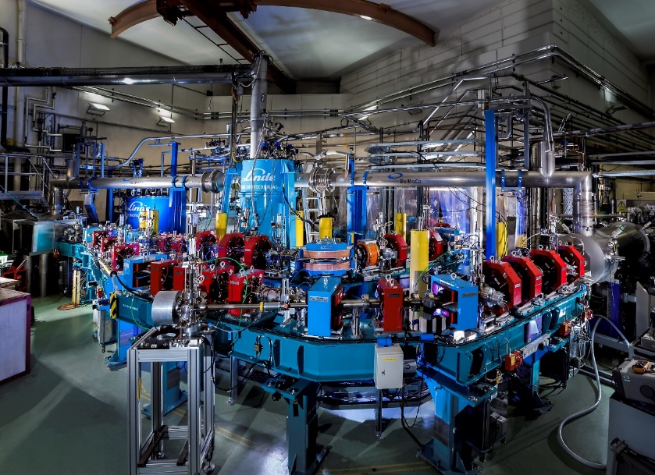
Energy Recovery Linac ALICE
Accelerator and Laser in Combined Experiment (ALICE) : first ERL in Europe
  built and operated by STFC Daresbury, as a test facility for ERL based FEL
  under operation until 2014
M. Baylac, B. Militsyn, ERL workshop, Cornell, October 3-6, 2022

Slide 8
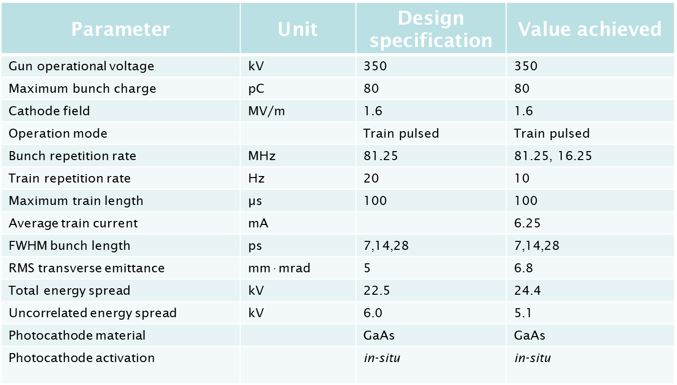
ALICE photogun
ALICE photogun
  Based on JLab IR FEL gun design, with minor modifications
  Successfully used to drive the ALICE ERL at Daresbury
    Beam current of 6.2 mA from GaAs
Status
  Photogun transferred from STFC to IJCLab
Design specifications and achieved operation parameters
M. Baylac, B. Militsyn, ERL workshop, Cornell, October 3-6, 2022

Slide 9
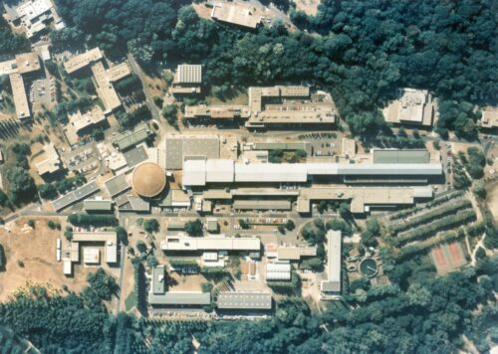
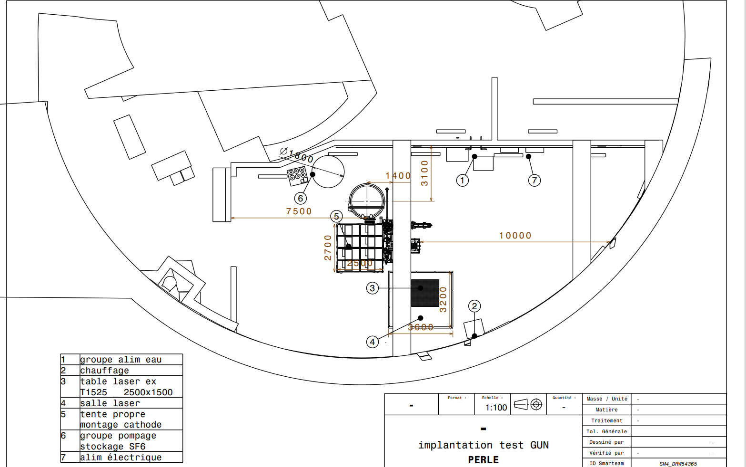
Installation at IJClab-Orsay
Implantation of the full PERLE machine under study in SuperAco hall
Installation of the gun for tests in another hall (igloo) : gun could be tested independently
PERLE
(superAco)
Photogun
(Igloo)
M. Baylac, B. Militsyn, ERL workshop, Cornell, October 3-6, 2022

Slide 10
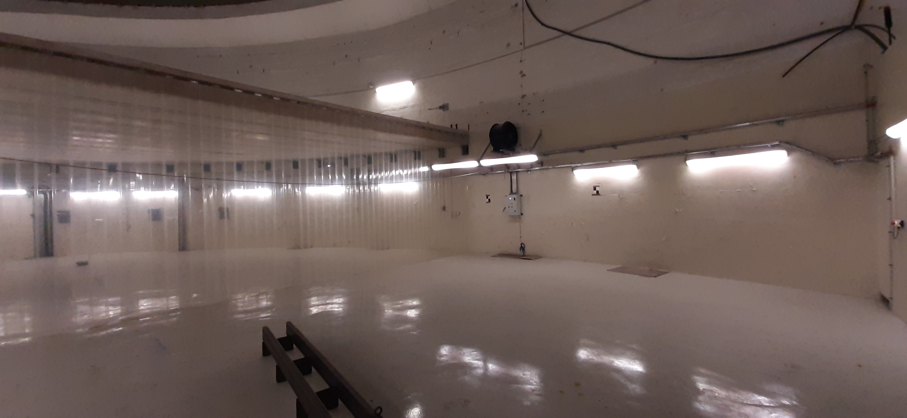
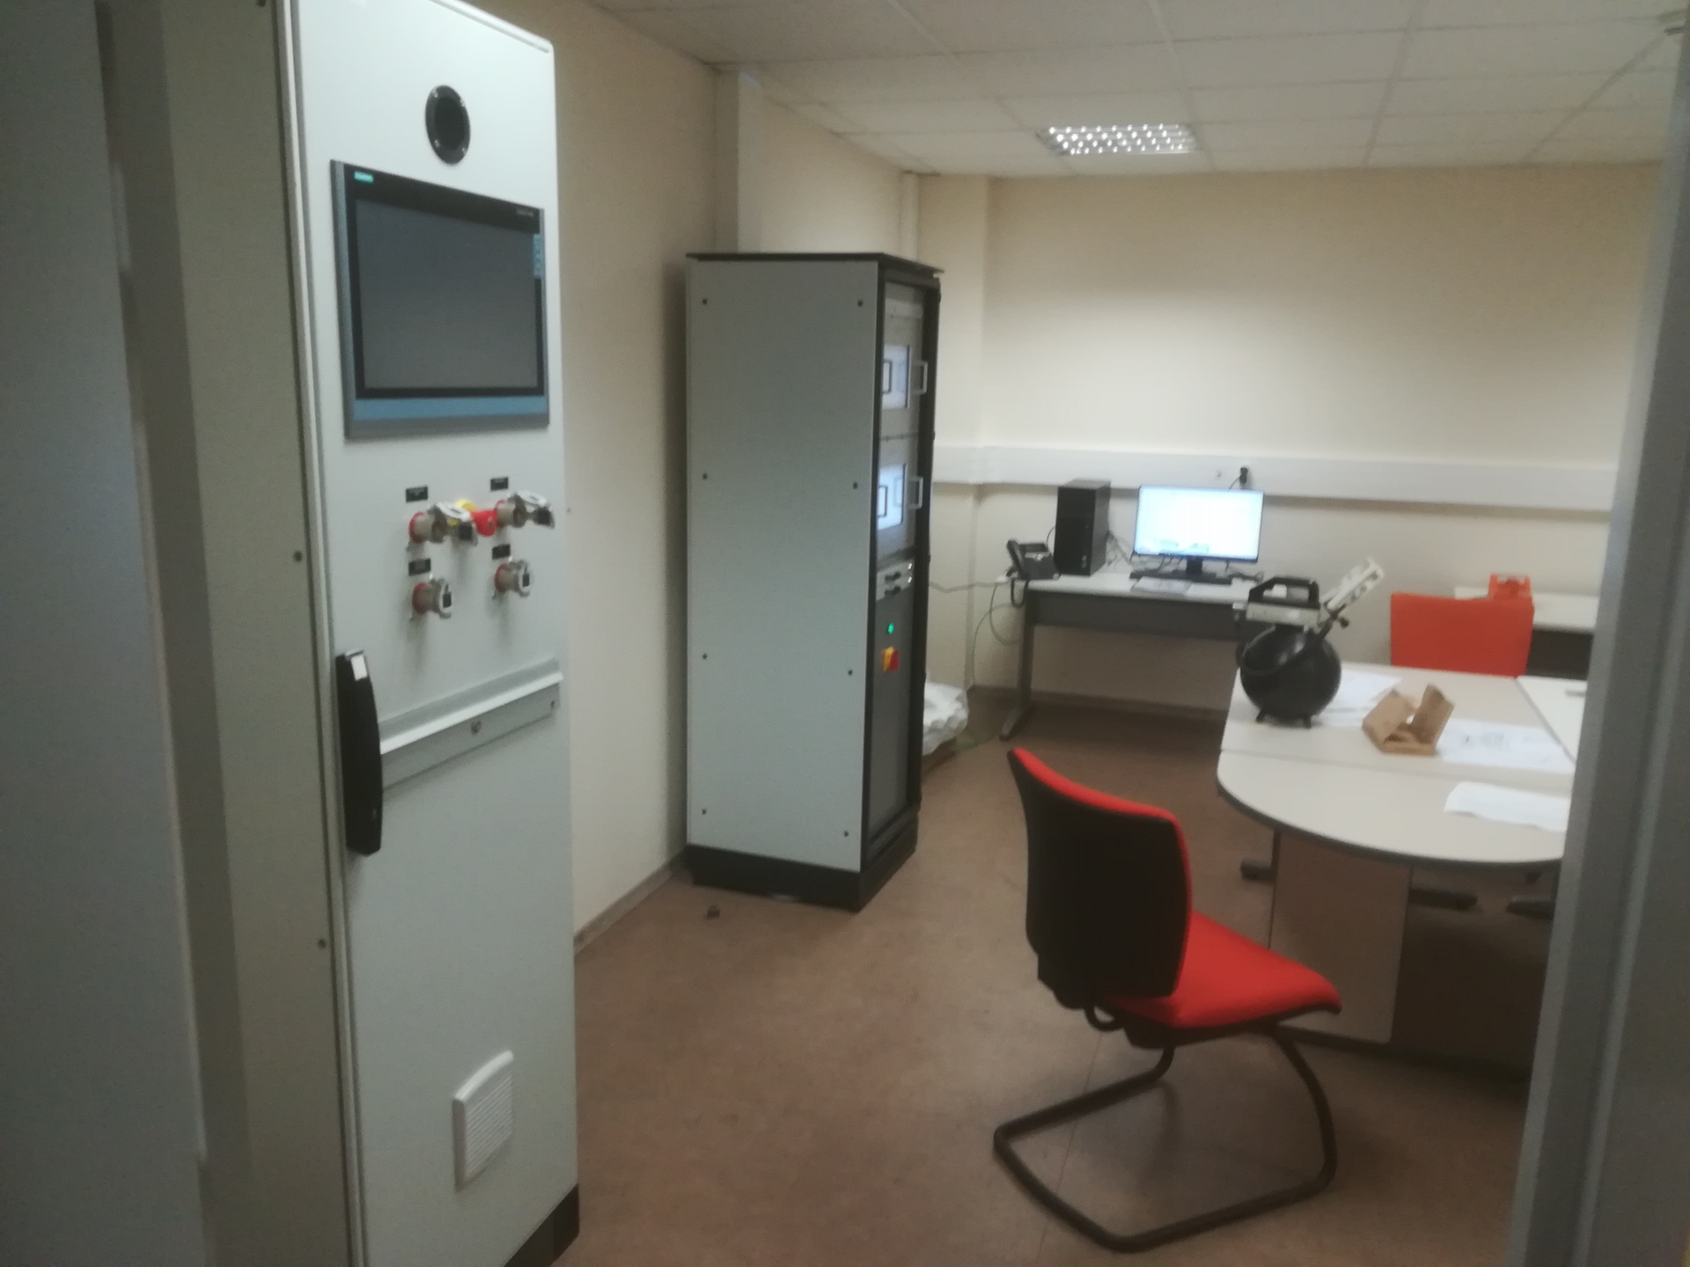
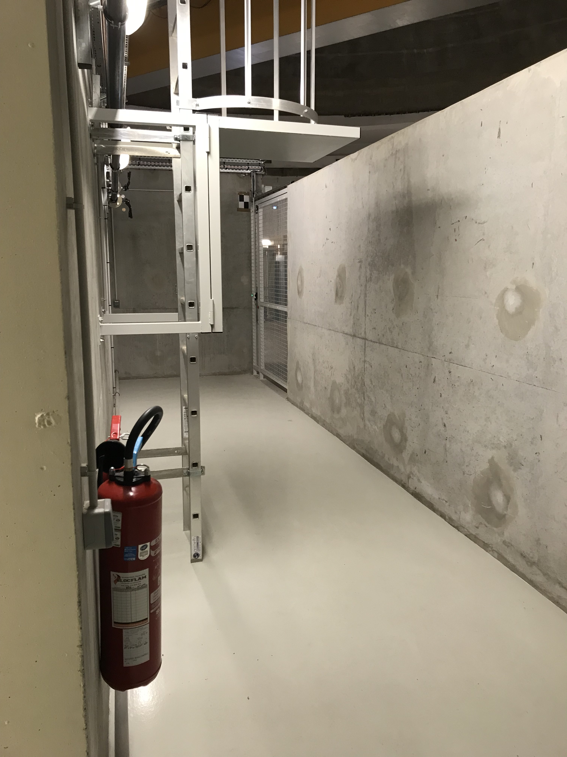
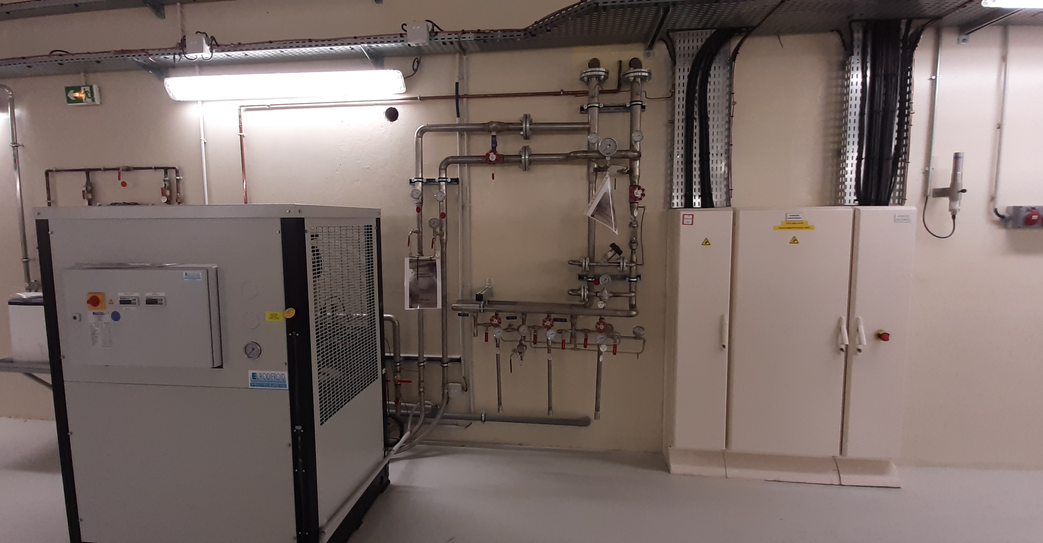
Gun installation site (igloo)
Igloo : fully equiped bunker (radioprotection, crane, electrical power, compressed air …) + control room
February 2022
M. Baylac, B. Militsyn, ERL workshop, Cornell, October 3-6, 2022

Slide 11
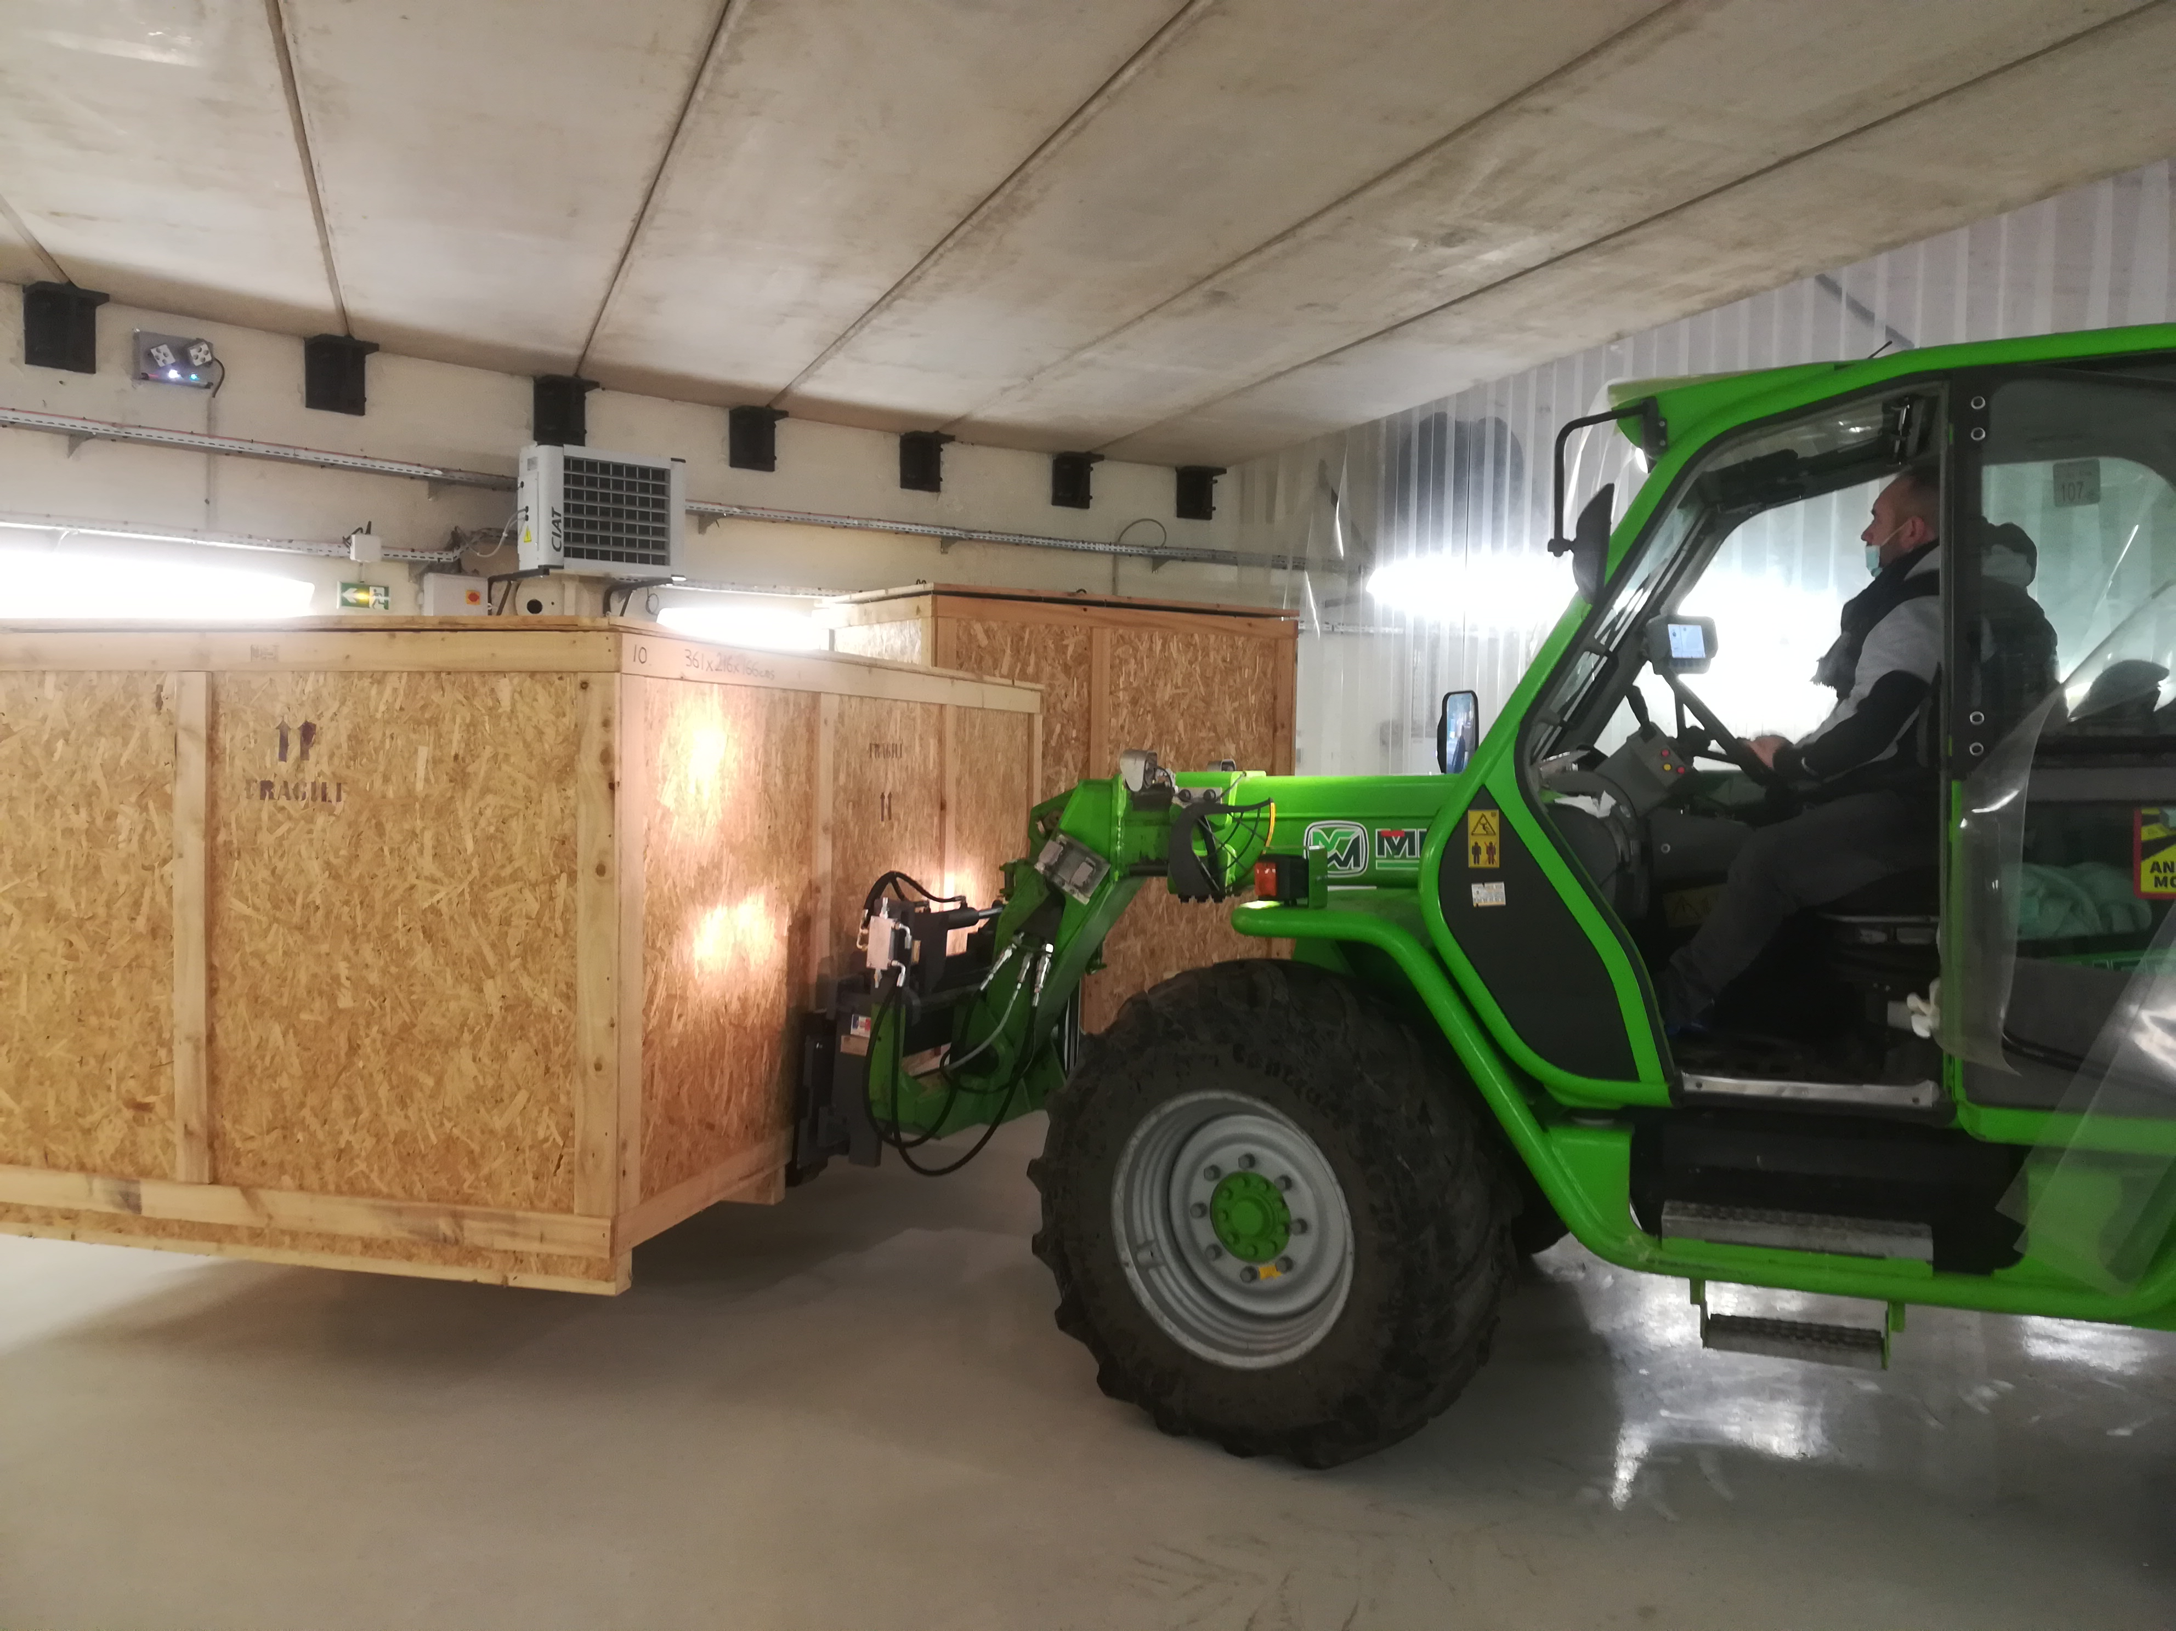
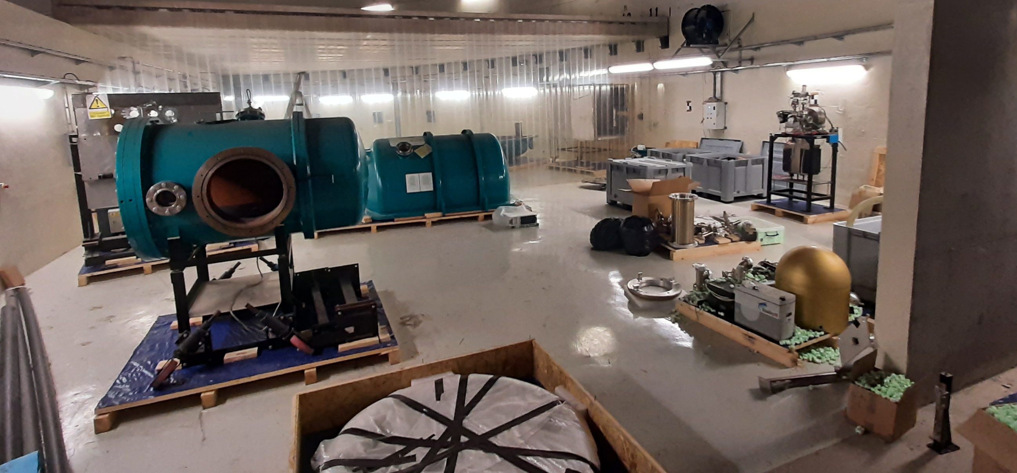
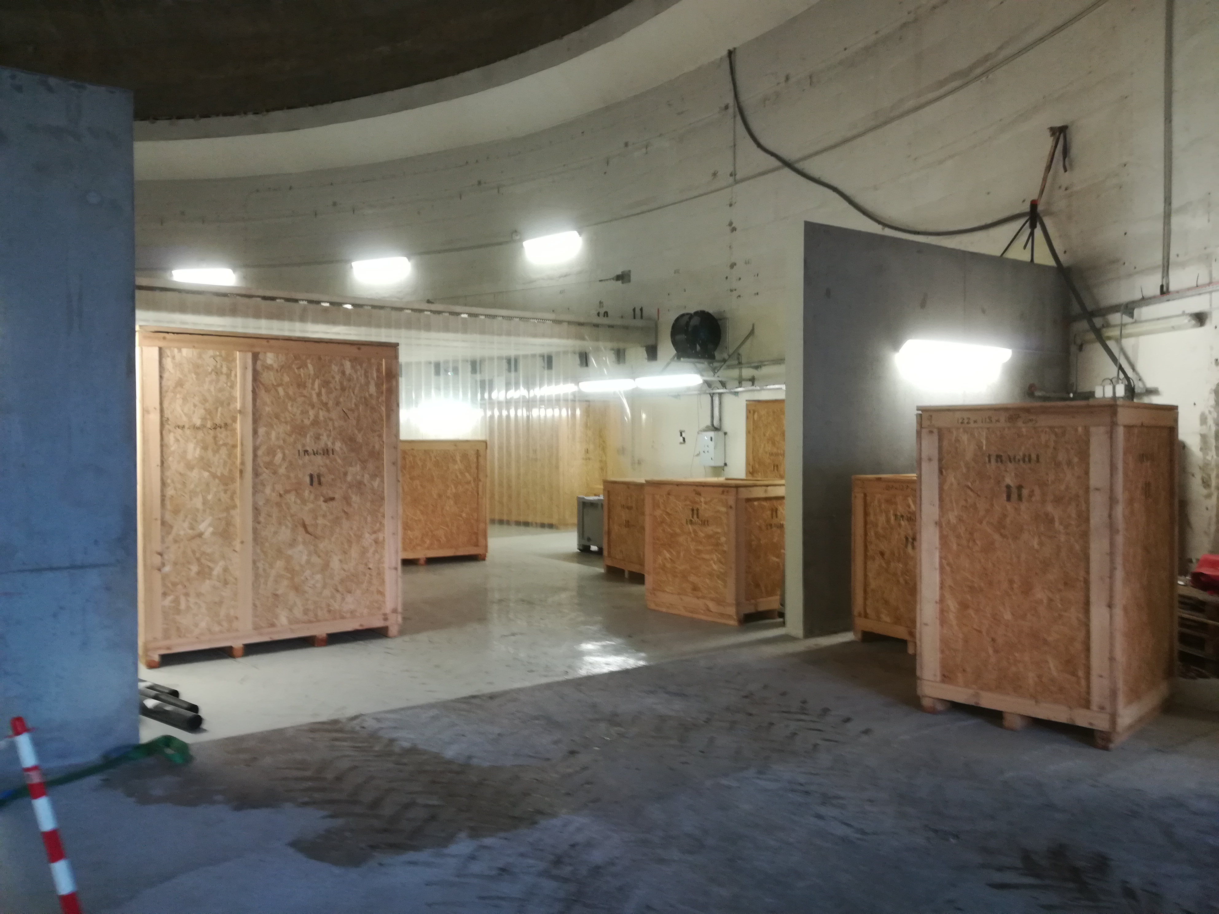
Equipment transferred to the igloo
March 2022
M. Baylac, B. Militsyn, ERL workshop, Cornell, October 3-6, 2022

Slide 12
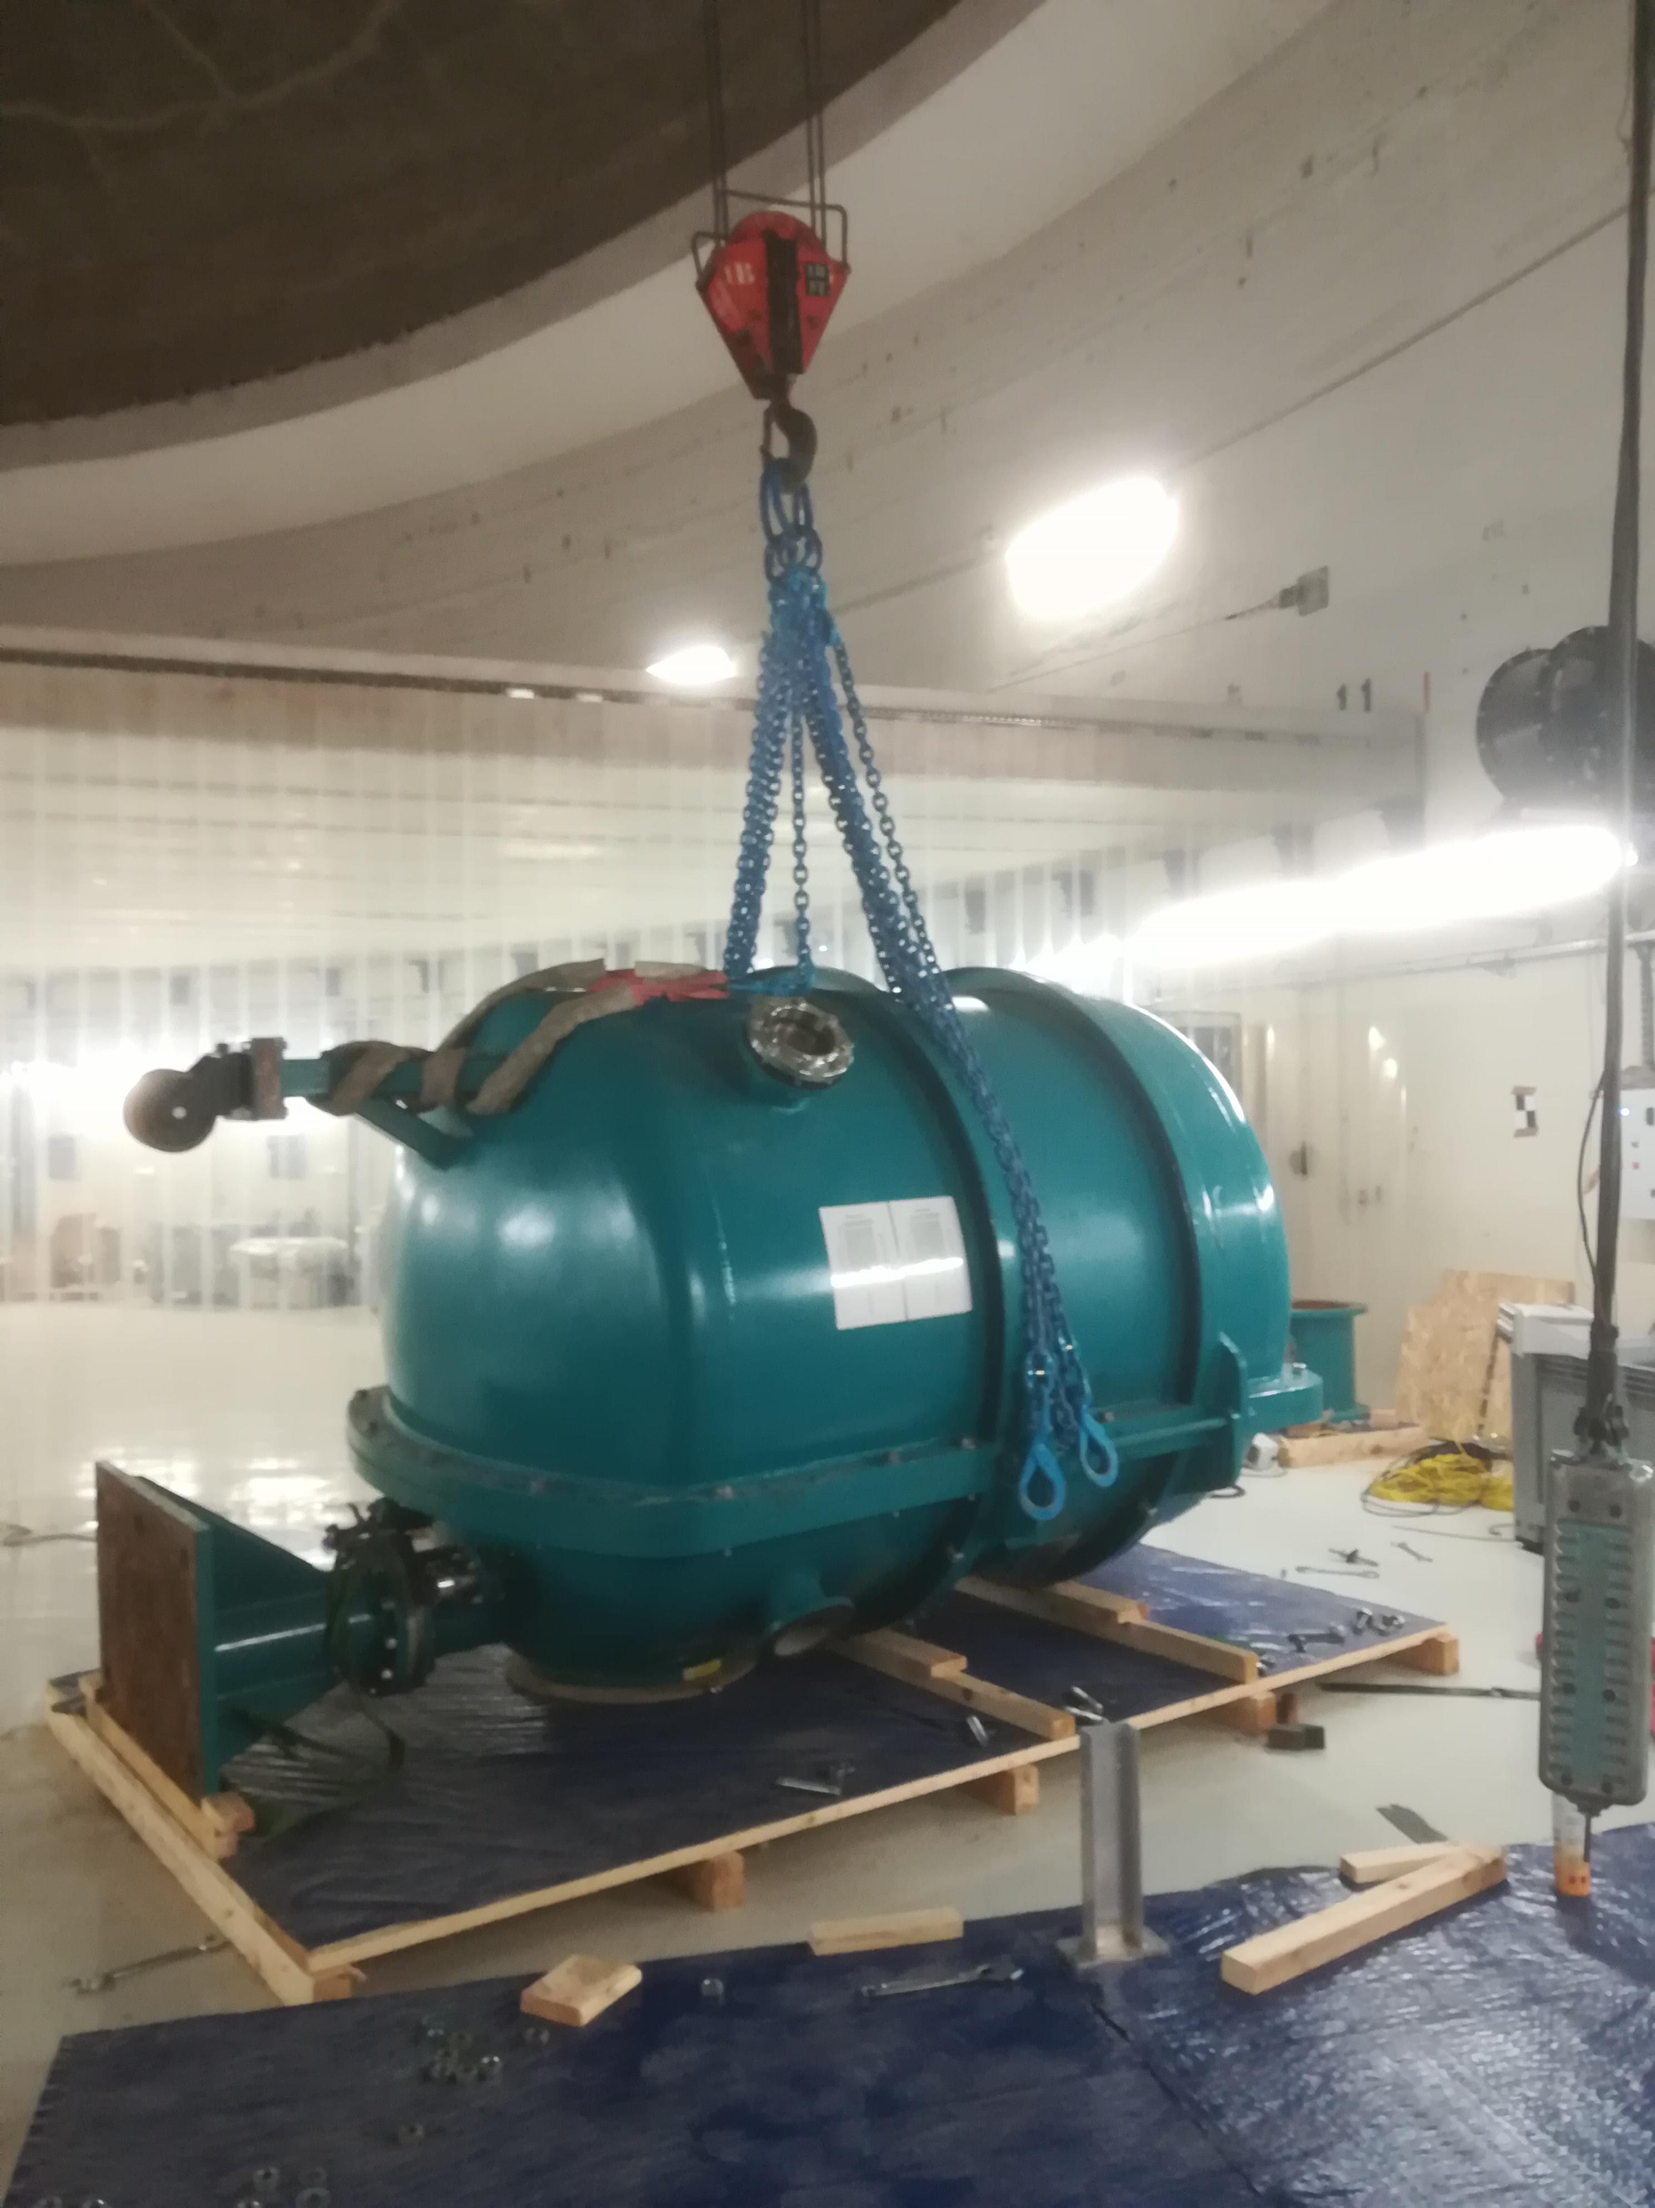
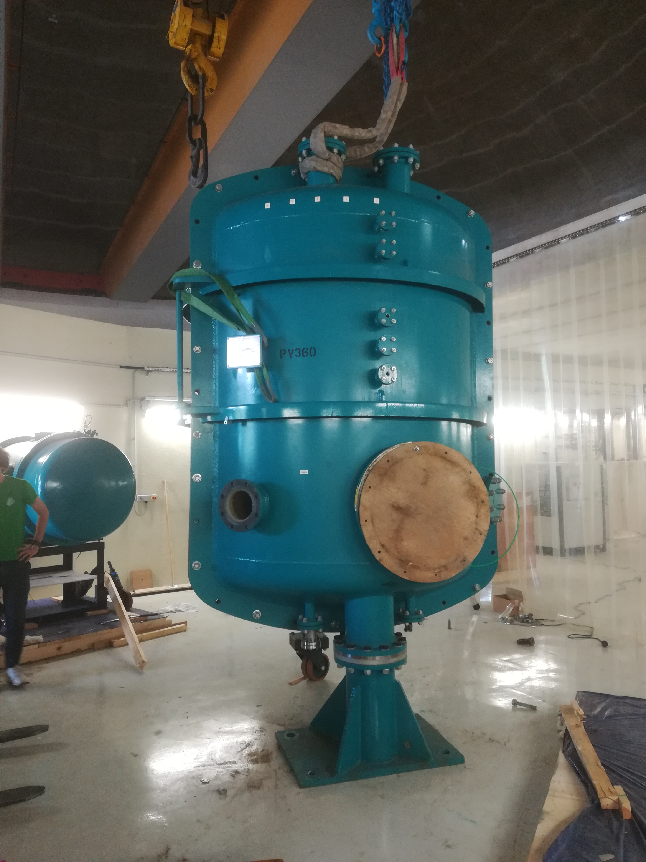
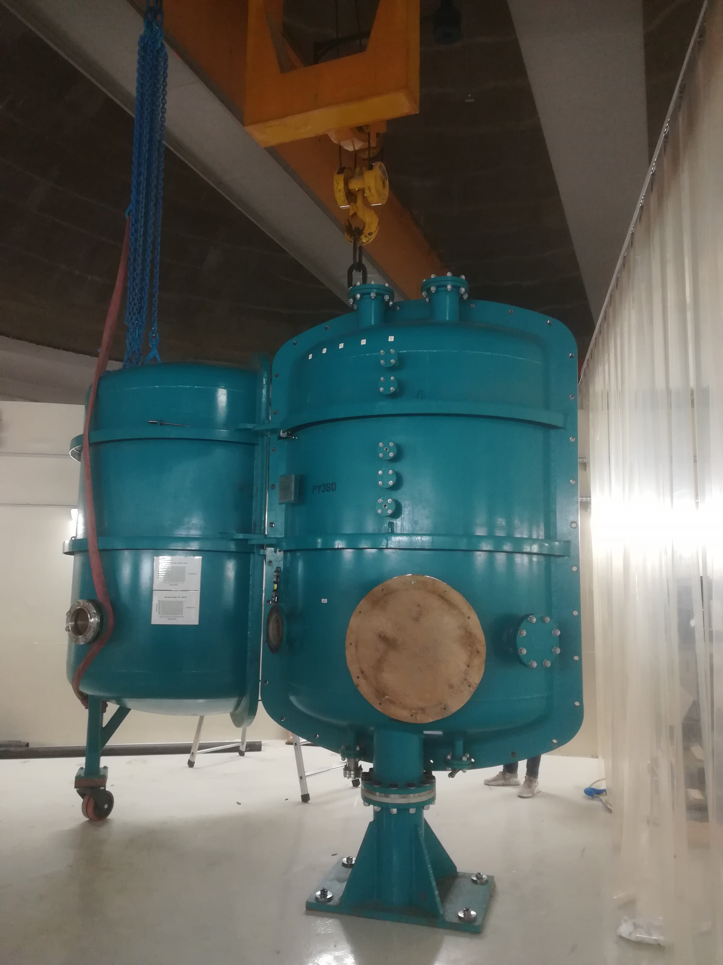
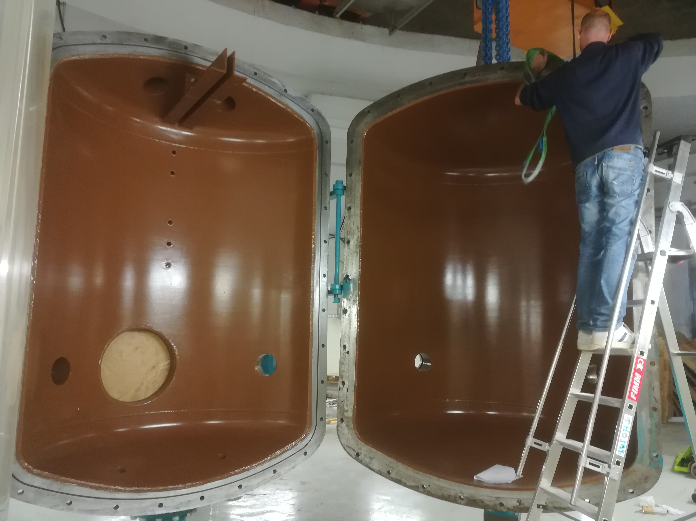
High Voltage vessel installation
Lift up
Opening
June 2022
M. Baylac, B. Militsyn, ERL workshop, Cornell, October 3-6, 2022

Slide 13
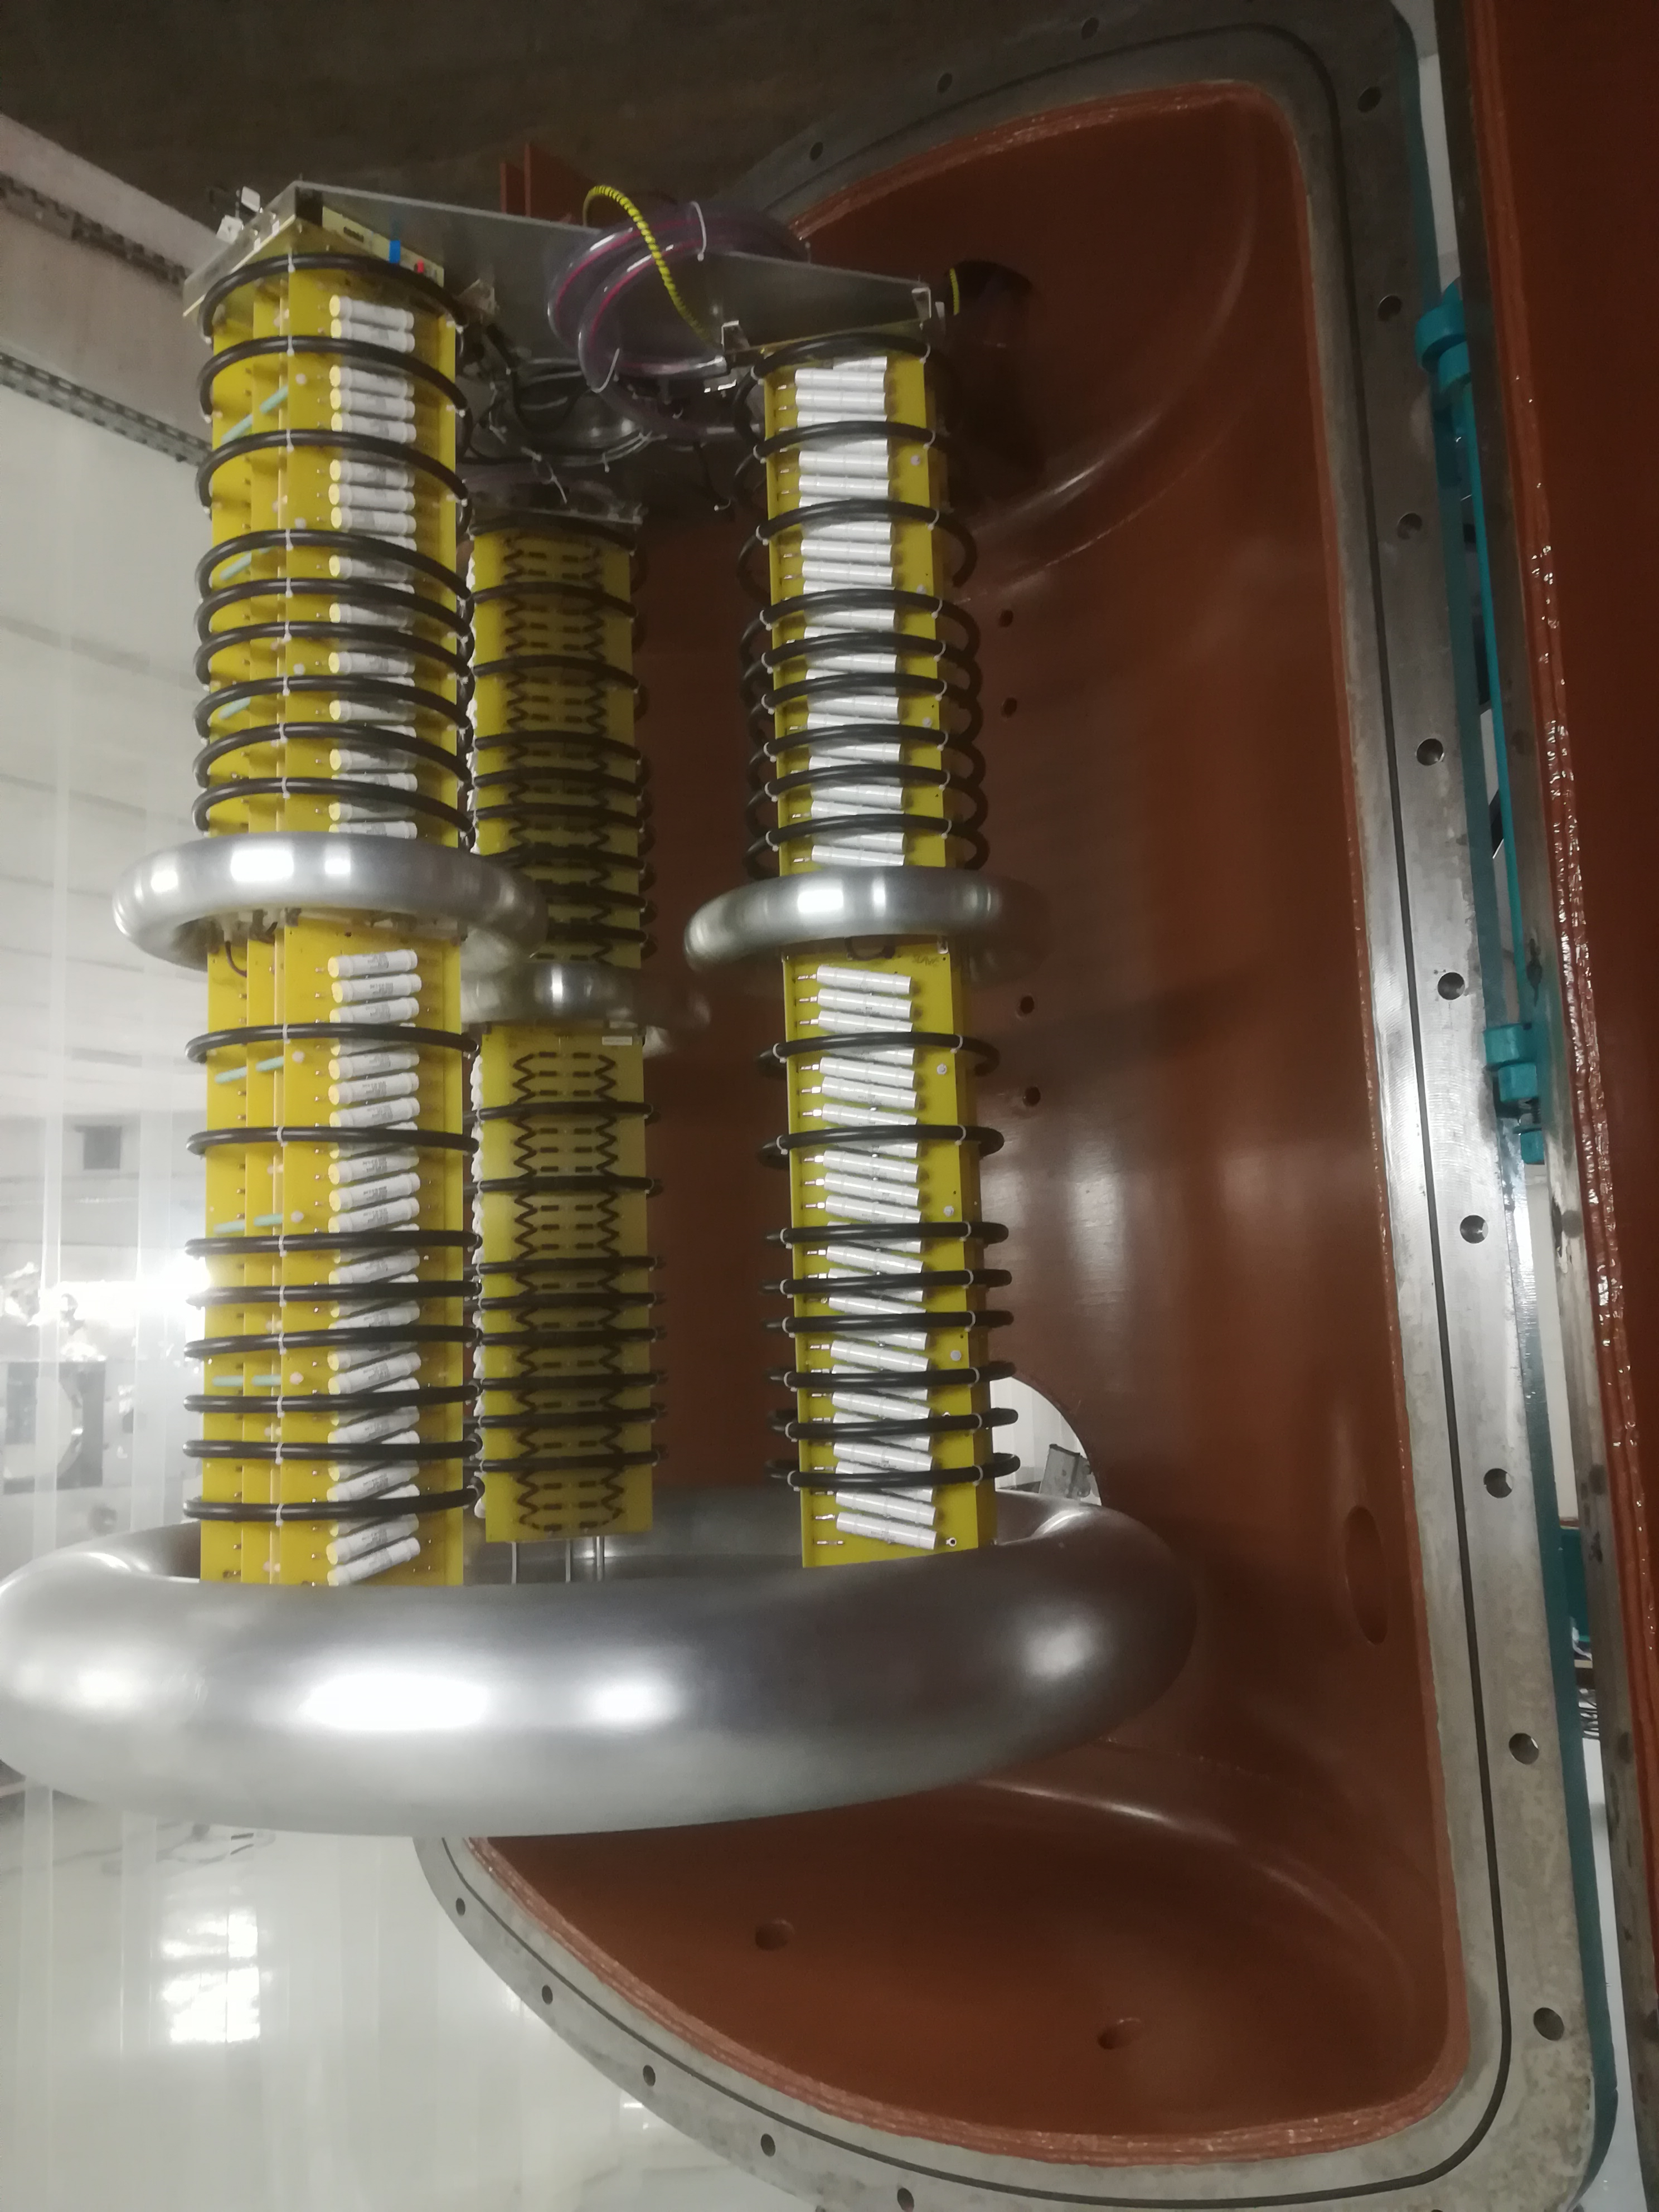
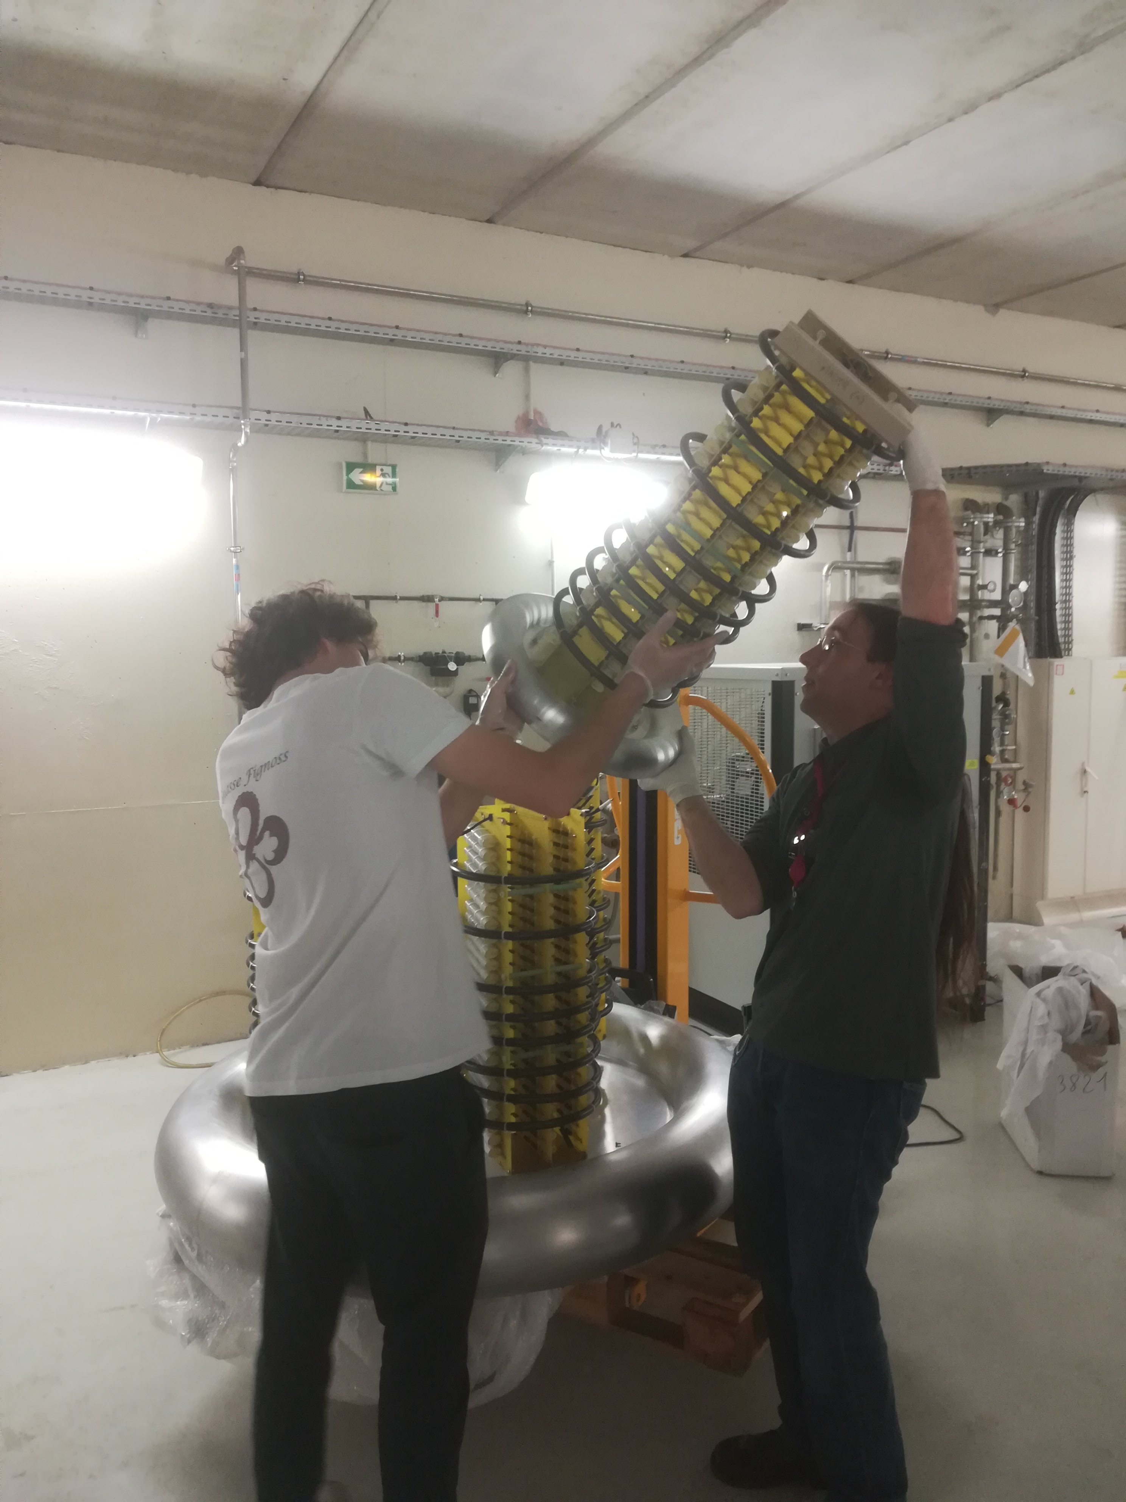
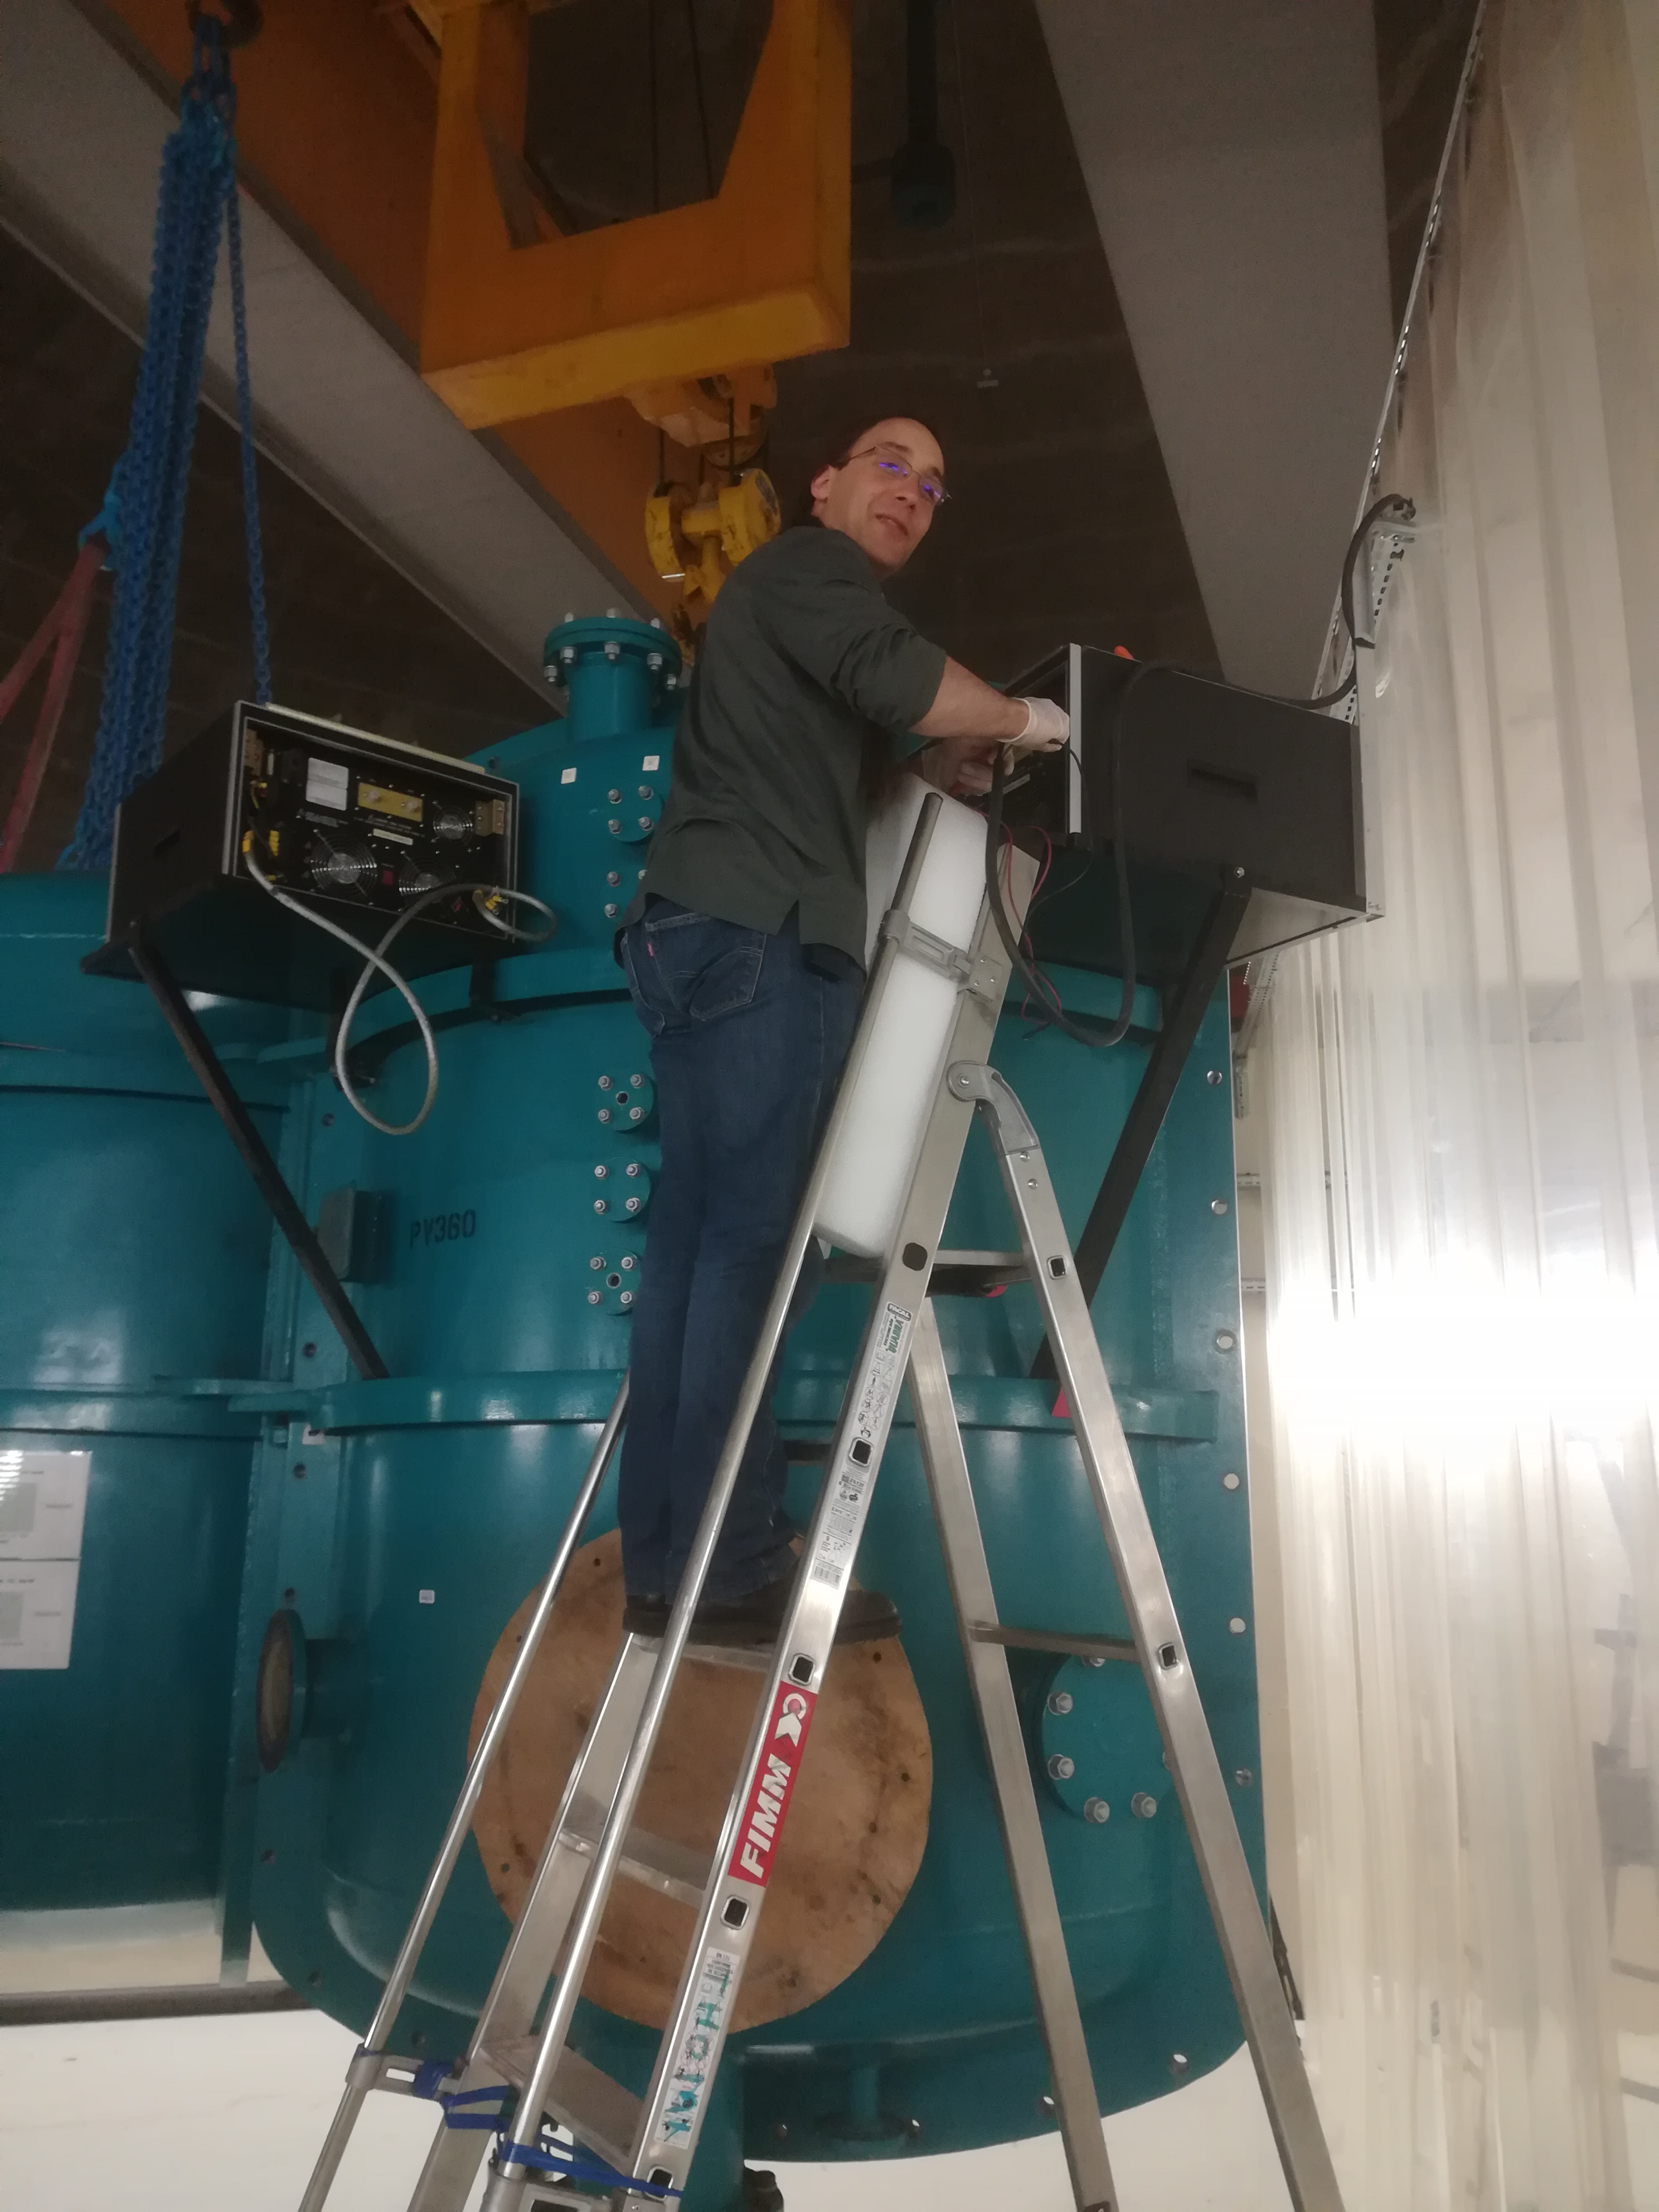
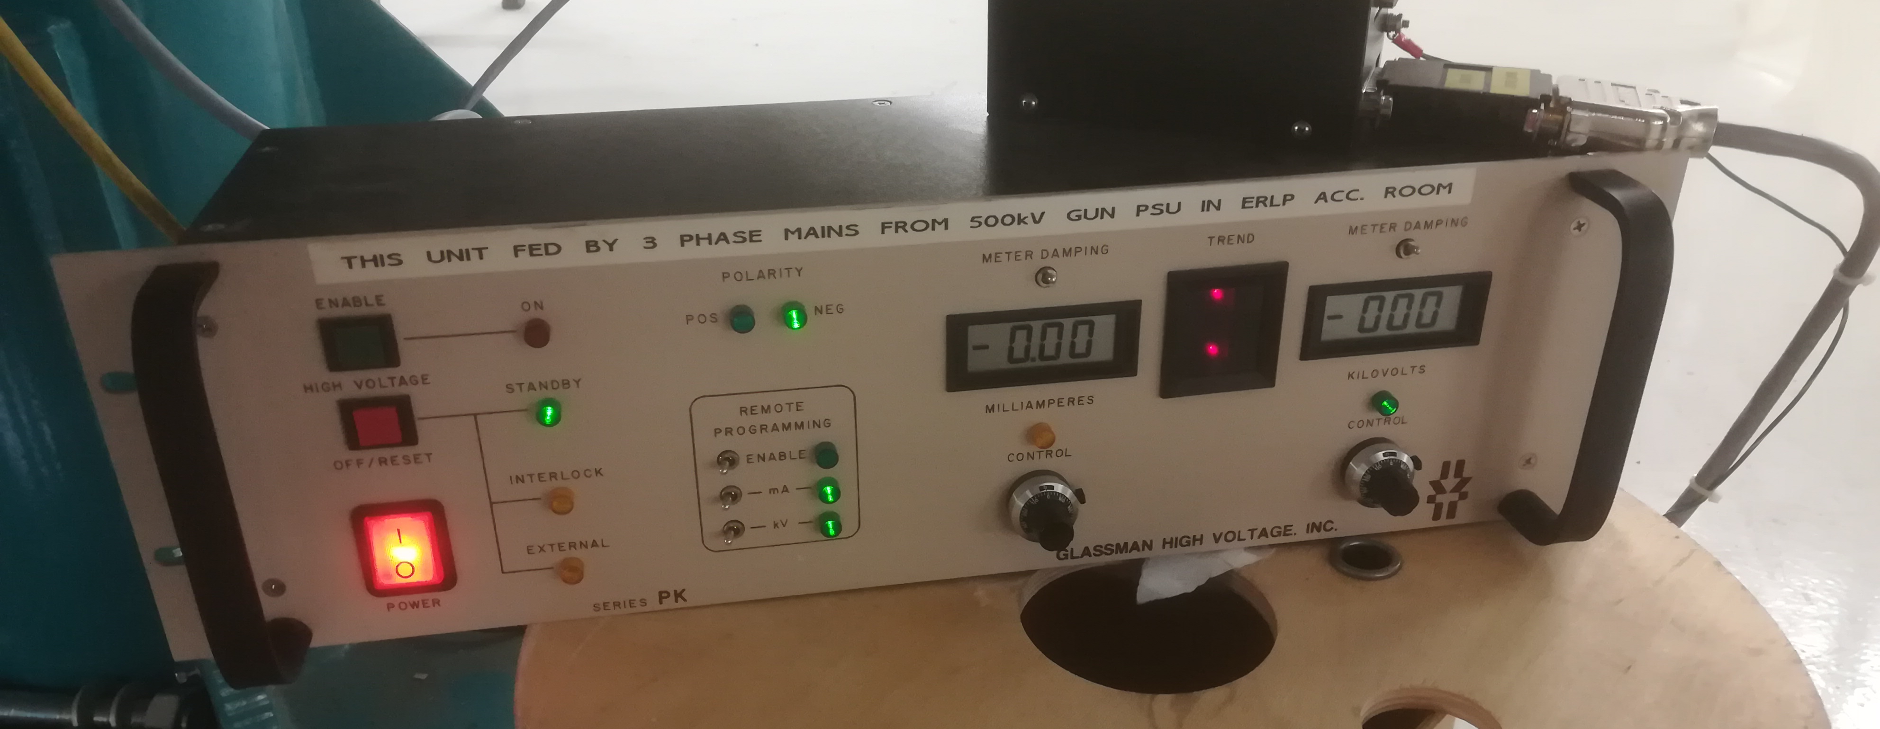
High Voltage assembly
July 2022
M. Baylac, B. Militsyn, ERL workshop, Cornell, October 3-6, 2022

Slide 14
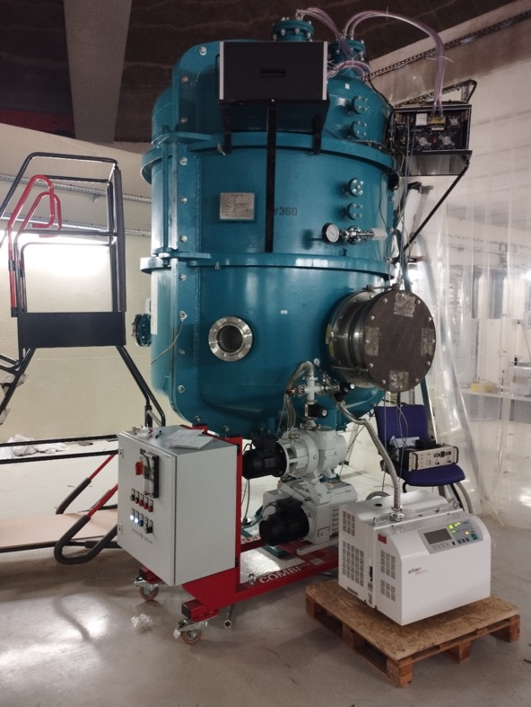
High Voltage conditioning
HV vessel tightness checked under primary vacuum (underway)
Then HV vessel will have to be loaded with SF6
SF6 system procurement
  Call for tender expected early 2023
  Investigate solution with 3M™ Novec™ (environment friendly)
Next steps
  Preliminary tests limited at low voltage (< 30 kV) by french regulations
    HVPS to be tested up to 30 kV in Oct-Nov
  Permit from Nuclear Safety Authorization (ASN) required for operation at high voltage
    Nuclear safety file being prepared
  Permit expected by mid 2023 ➔ HV conditioning to follow
September
M. Baylac, B. Militsyn, ERL workshop, Cornell, October 3-6, 2022

Slide 15
Laser
Multi-alkali antimonide photocathodes require green laser light
  5 W on photocathode
  ➔ 10 to 20 W laser
  IR laser (1030 nm) with frequency doubling
  Pulse duration : 35 ps (3,5 ps rise/fall time)
  Operation 10-40 MHz
    Reduced rep rate due to power limit of HVPS
  Procurement underway
  Identified potential vendor
  Aim for a 10 W laser for initial tests
    upgradable to 20 W
  Call for tender expected before end of 2022
Laser specs for 20 mA Sb-based photocathodes
Lase wavelength, nm | 500-550
Laser pulse repetition rate, MHz | 10-40
Energy in the single pulse at photocathode Qe=1%, µJ | 0.12
Average laser power at photocathode Qe=1%, W | 4.7
Laser pulse duration, ps FWHM | 35
Laser pulse rise time, ps | 3.5
Laser pulse fall time, ps | 3.5
Spot diameter on the photocathode surface, mm | 3 mm
Laser spot shape on the photocathode surface | Flat top
Laser operation mode | CW/Train-pulsed
Train length, µs | 100/TBC
Train repetition rate, Hz | 10/TBC
M. Baylac, B. Militsyn, ERL workshop, Cornell, October 3-6, 2022

Slide 16
ALICE gun commissioning
Next steps
  Gun fully assembled and under vacuum
  SF6 system procurement
  Laser and optical system procurement and installation
  Obtain permit from the French nuclear safety authority (ASN)
  HV conditioning for operation at 350 kV
  Initial functional tests with a robust photocathode (vent-bake gun)
➔ Aim at first functional tests by spring 2024
M. Baylac, B. Militsyn, ERL workshop, Cornell, October 3-6, 2022

Slide 17
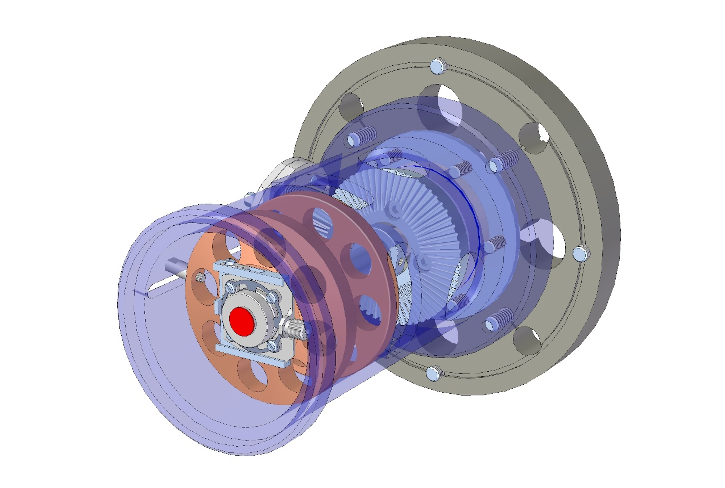
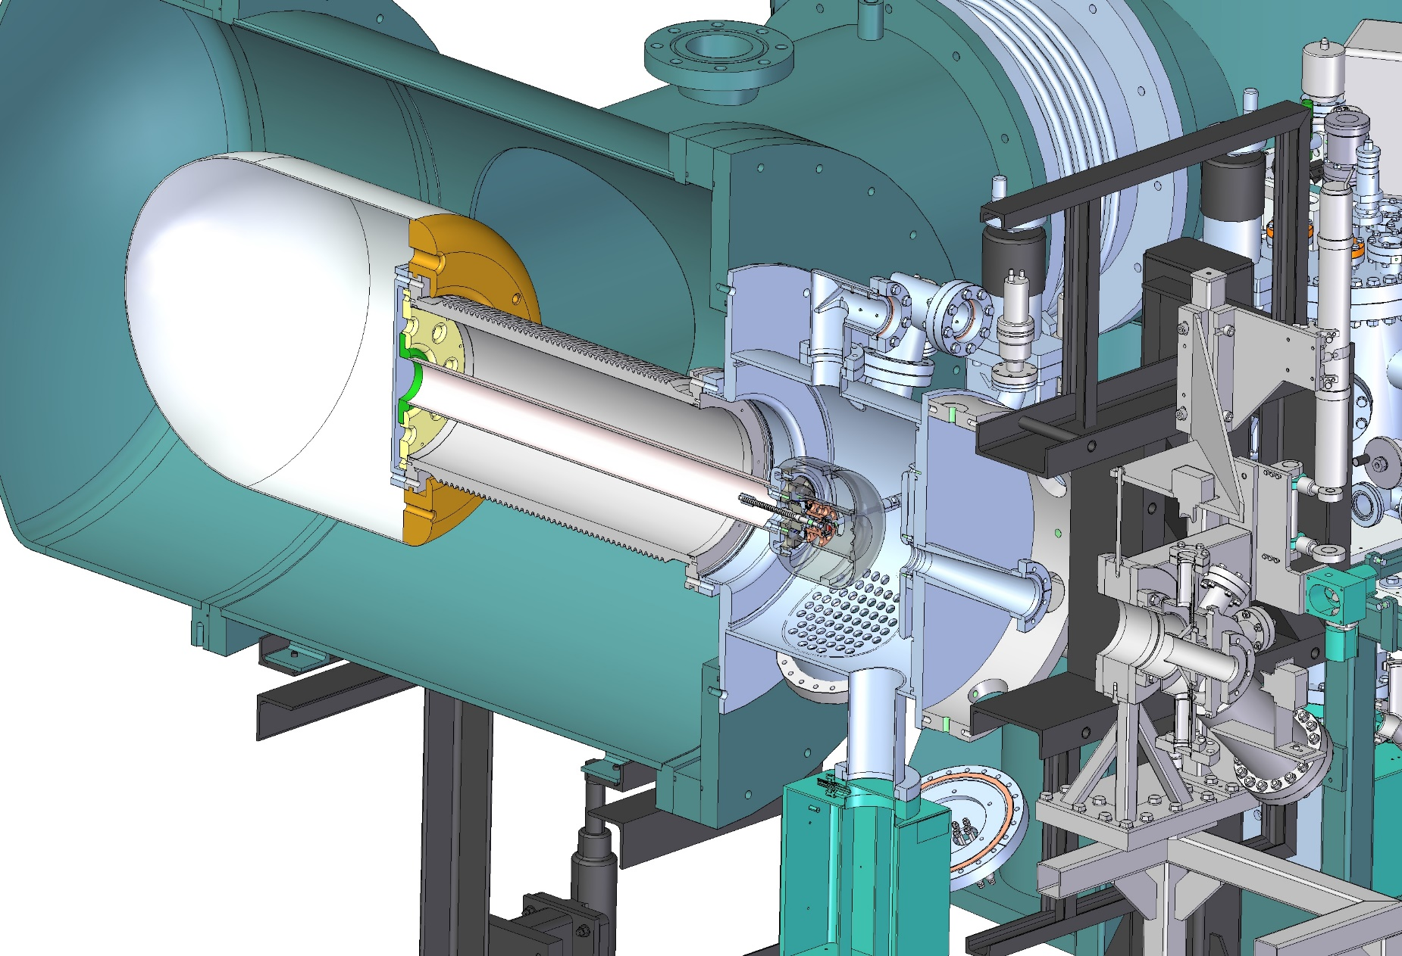
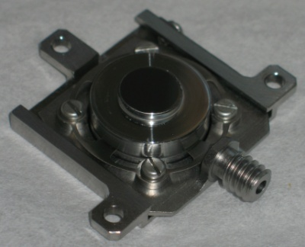
Gun upgrade – 1/2
Design by STFC of a gun upgrade
Implementation of a load-lock system
  Photocathodes can be interchanged without gun venting
  Photocathodes of different types can be installed in the load-lock gun
Photocathode layer
Kovar cathode holder
Inconel
spring
Titanium
base plate
B.L. Militsyn et al, DESIGN OF AN UPGRADE TO THE ALICE PHOTOCATHODE ELECTRON GUN - MOPC073 Proceedings of EPAC08, Genoa, Italy, 2008
Molybdenum plug
M. Baylac, B. Militsyn, ERL workshop, Cornell, October 3-6, 2022

Slide 18
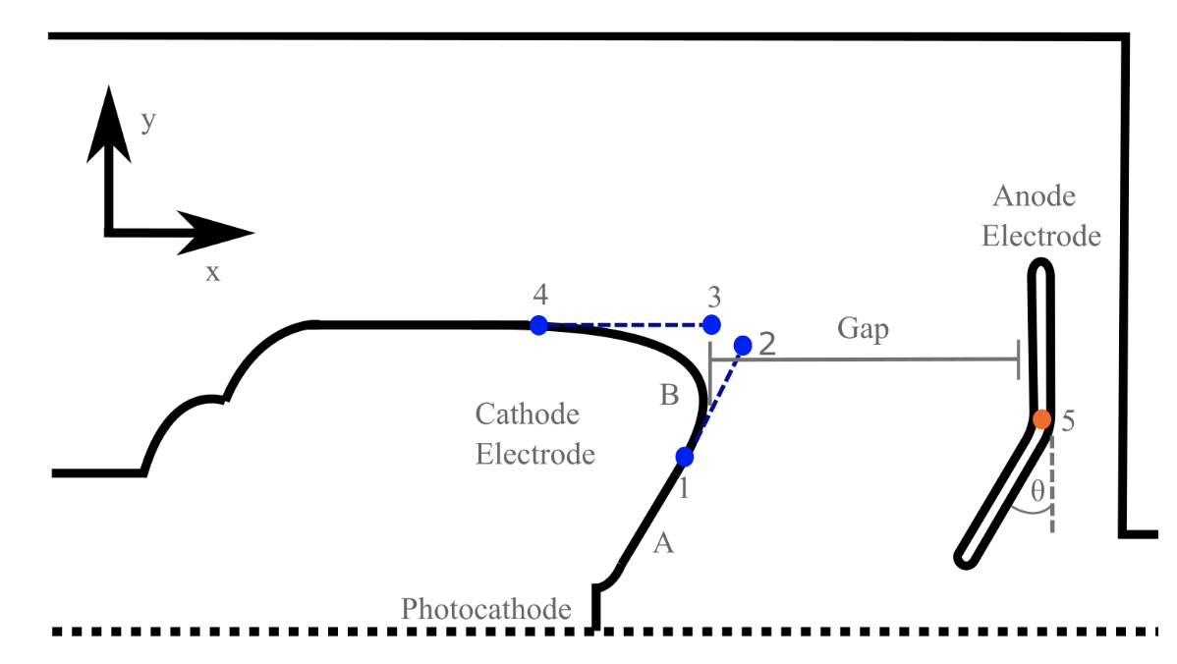
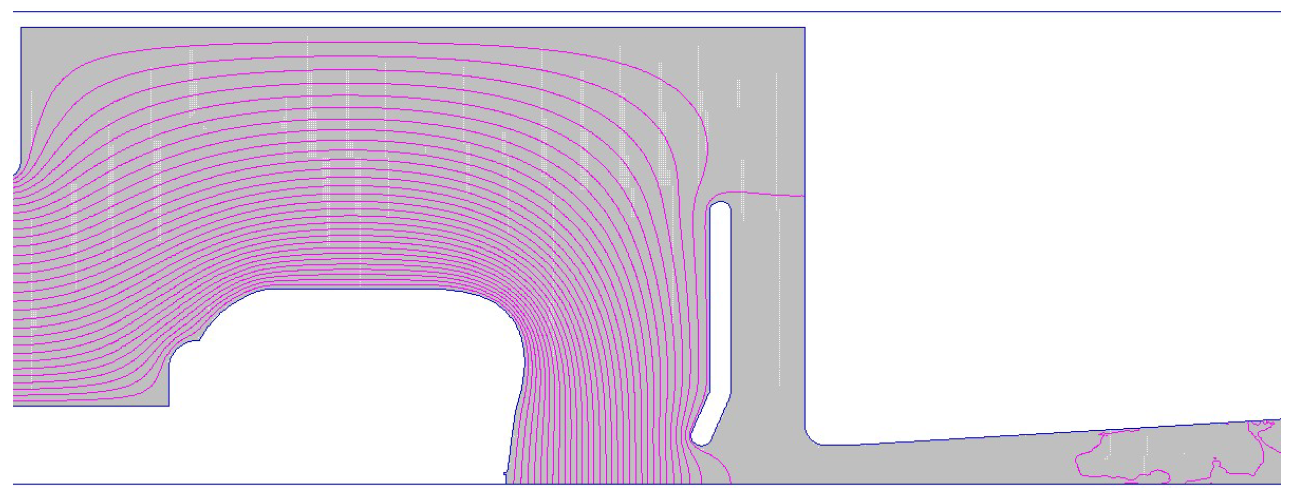
Gun upgrade – 2/2
Electrodes re-design for high bunch charge
      Optimization of the electrode geometry with many-objective genetic algorithm
Anode biasing
  To reduce ion back bombardment to increase the photocathode lifetime
+ Injector optimization (beam transport)
PhD thesis of Ben Hounsell,
univ. Liverpool
Electrodes geometry re-optimized
Re-optimisation of the ALICE Gun Upgrade Design for the 500-pC Bunch Charge Requirements of PERLE. 10th International Particle Accelerator Conference, May 2019, Melbourne, Australia. pp.TUPTS066, ⟨10.18429/JACoW-IPAC2019-TUPTS066⟩
M. Baylac, B. Militsyn, ERL workshop, Cornell, October 3-6, 2022

Slide 19
Summary and outlook
PERLE is tailored for technology developments using LHeC parameters and produce physics experiments
Photogun : R&D endeavor towards high current beams
ALICE gun being re-commissionned in IJCLab
  Exciting time of assembly startup
  Special thanks to our STFC Daresbury colleagues for constant support and help
M. Baylac, B. Militsyn, ERL workshop, Cornell, October 3-6, 2022

Slide 20
Photocathodes for PERLE
Photocathodes of interest to PERLE for production of high bunch charge, unpolarized beam : « green » photocathodes
  Sb-based photocathodes such as Cs₃Sb, Cs₂KSb, Na₂KSb, CsNaKSb : (multi)-alkali antimonide
  Many advantages : widely used for PMT industry, robust for high average current, powerful laser systems are available
  Technology under development for accelerator applications
    Optimisation of deposition procedure to obtain high QE
    Characterisation of lifetime at high average current
    Measurement of Mean Transverse Energy
GaAs based photocathode for delivery of polarized electrons, at a later stage
  Very sensitive to operational vacuum and as result have low charge lifetime, typically in the range of 100’s C
  Major efforts are concentrated on improving operational performance
  Potential shortage of supplying vendors
M. Baylac, B. Militsyn, ERL workshop, Cornell, October 3-6, 2022

Slide 21
Energy Recovery Linac ALICE
Accelerator and Laser in Combined Experiment (ALICE) : first ERL in Europe
  built and operated at Daresbury (UK) as a test facility for ERL based FEL
Parameter​ | Design​ | Operating​ | Units​
Bunch charge​ | 80​ | 20 - 80​ | pC​
Gun energy​ | 350​ | 230 → 325​ | kV​
Booster energy​ | 8.35​ | 6.5​ | MeV​
Linac energy​ | 35​ | 27​ | MeV​
Repetition rate​ | 81.25​ | 16.25 - 81.25​ | MHz​
Current within macropulse​ | Up to 6.5​ | > 6.5​ | mA​

