Slide 1

The MESA facility a new accelerator and its experiments
ERL-22 October, 2022

Slide 2
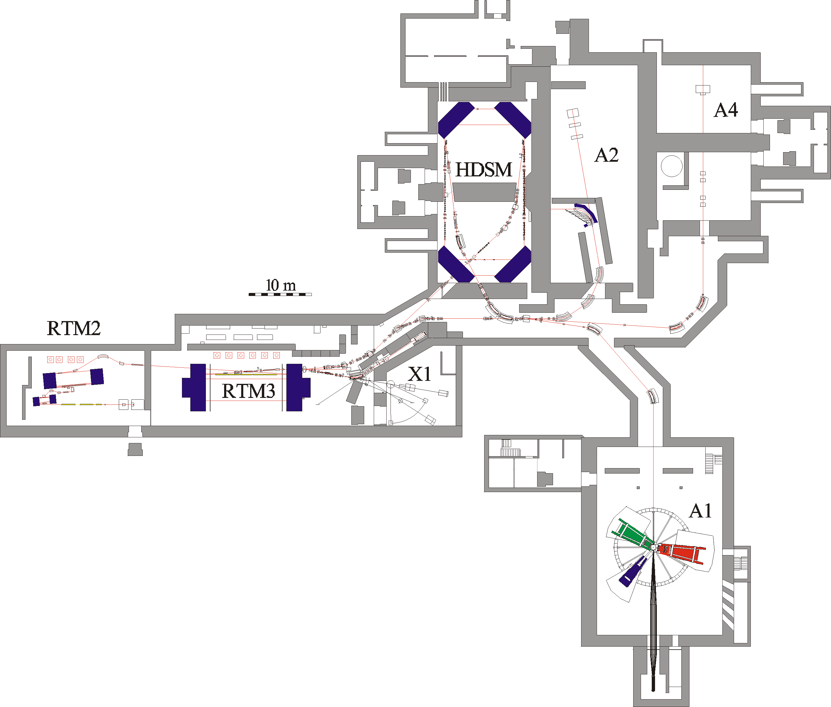
Example for multi-turn
recirculating accelerator:
Mainz Microtron cascade
(MAMI-C)
1.6 GeV beam energy, c.w. beam
up to 150kW beam power
RF-installation : 18 Klystrons (50kW RF each)
In operation since 2007.
Power consumption ~3MW

Slide 3
New project: MESA
(Mainz Energy-recovering
Superconducting Accelerator)
„World class“ electron scattering experiments below Pion production threshold
Requires at least 10 times beam intensity of MAMI (1-10mA vs. 0.1mA)
MESA energy consumption 30% of MAMI
Blue area available for MESA + extension building

Slide 4
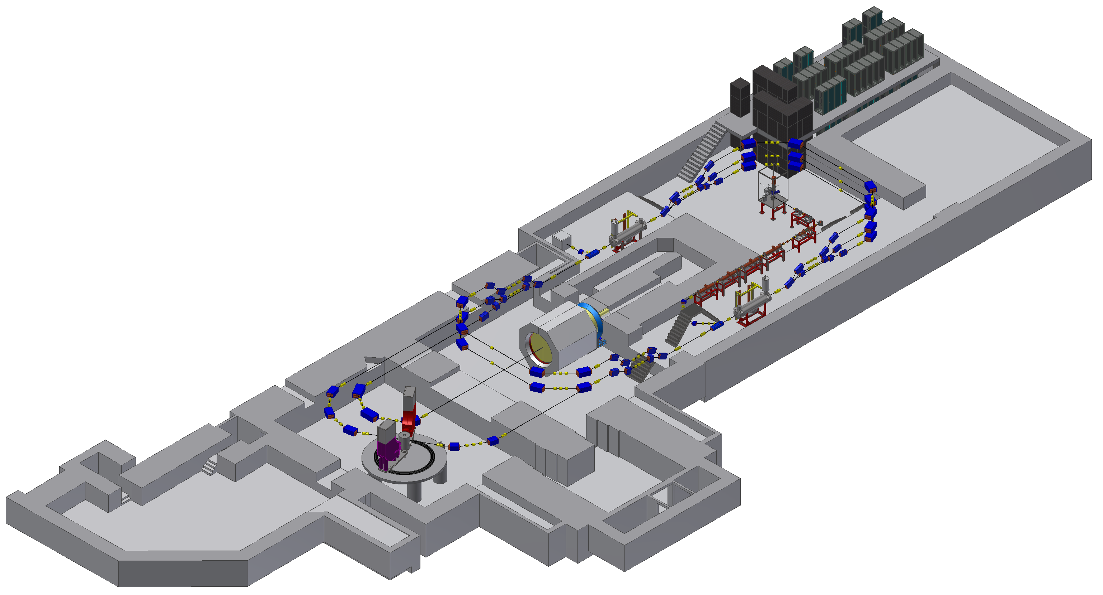
Extension Building “CFP-1” (Hall-1)
New Building
Hall-1
BDX
Old Building
2
3
4
Beam dump
building

Slide 5
Building status November 2020

Slide 6
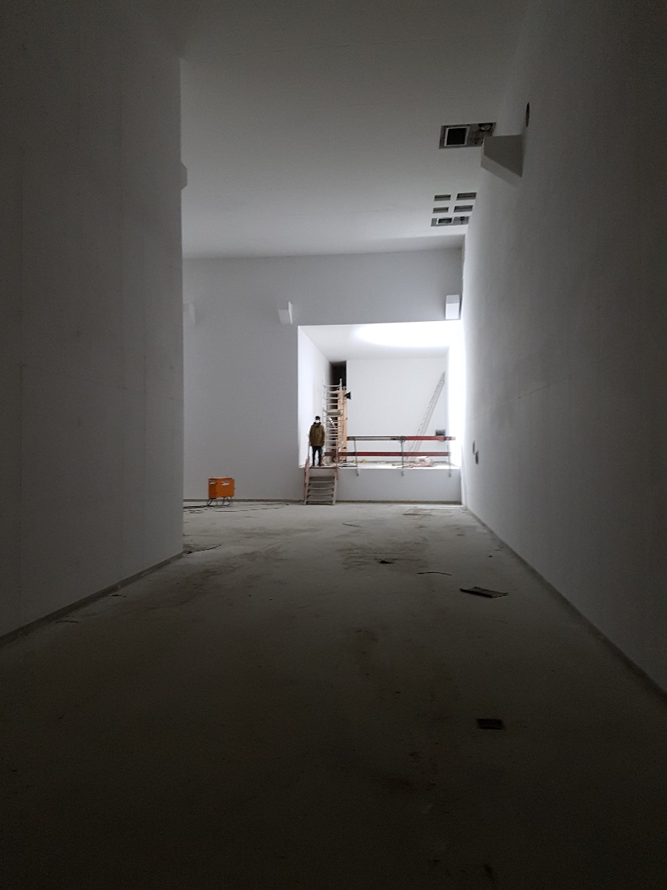
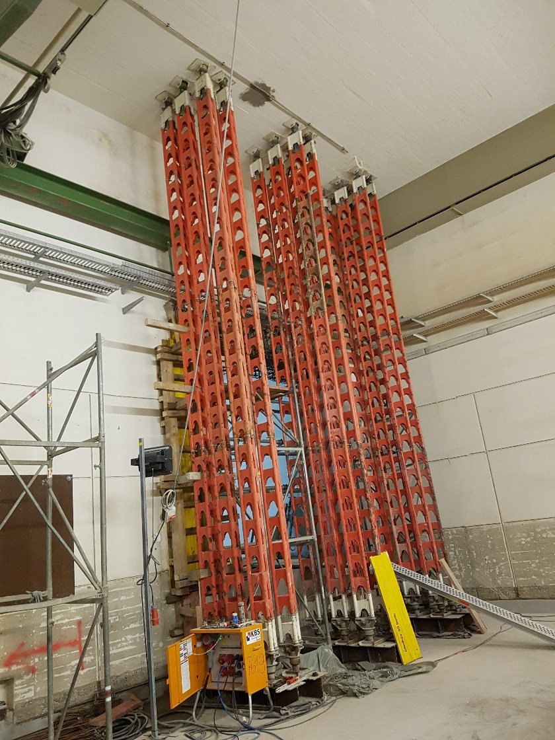
Building status Nov 2021
New experimental hall
View towards breakthrough west
Old experimental hall
Breakthrough east is being made
Installation of experiments & accelerator components begins in autumn 22

Slide 7
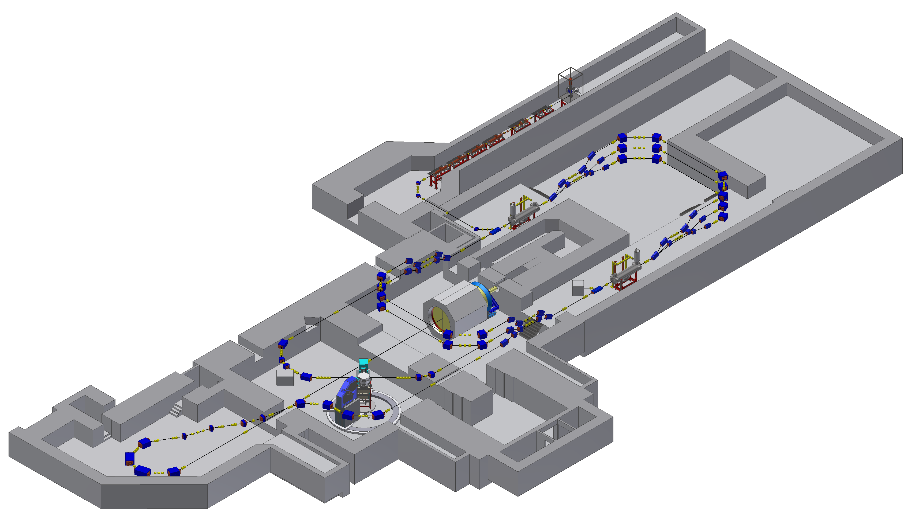
MESA Status
5 MeV Injector is currently being build (old part of building)
Cryomodules tested and within specs
Completion of building end 2022
Experiments begin data taking in 2025
New building

Slide 8
MESA Operational modes
Op-mode | Target | Beam power@target
Ext. Beam (EB) | Solid/ Liquid | 0-25kW
Energy recovery(ERL) | Gas-jet | 0.1-1MW

Slide 9
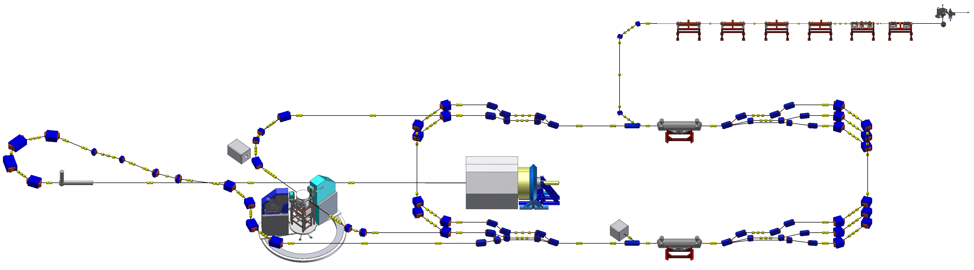
Energy Recovery Mode – MAGIX
Deceleration
Acceleration

Slide 10
MESA- experiments-MAGIX
P2 experiment:
High target density, 0.15mA
External beam mode (EB)
Luminosity >10³⁹ cm⁻²s⁻¹
MAGIX experiment:
low target density, 1mA
Energy recovery mode (ERL)
Luminosity >10³⁵ cm⁻²s⁻¹
H.Merkel Talk at DPG Springmeeting 2022

Slide 11
MAGIX spectrometers
Spectrometes are ordered, expected delivery
March 23
H.Merkel Talk at DPG Springmeeting 2022

Slide 12
Gas Jet target at MAMI A1 /MAGIX
Gas jet target in operation at MAMI
H.Merkel Talk at DPG Springmeeting 2022

Slide 13
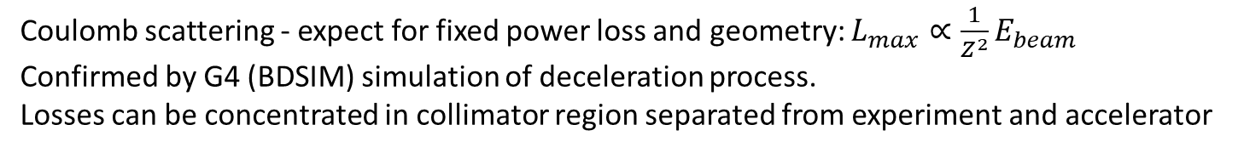
Luminosity limitation ERL gas jet target
Coulomb scattering - expect for fixed power loss and geometry: $L_{max}∝\frac{1}{Z^{2}}E_{beam}$
Confirmed by G4 (BDSIM) simulation of deceleration process.
Losses can be concentrated in collimator region separated from experiment and accelerator
Results for „two collimator“ system
Total loss <100 Watt, loss in accelerator <0.05 W.
Ben LeDroit, PhD thesis Mainz 2021
Calculation for realistic MAGIX geometry
http://doi.org/10.25358/openscience-5808

Slide 14
Experimental program at MAGIX
H.Merkel Talk at DPG Springmeeting 2022

Slide 15
MESA-Experiments
P2 experiment:
High target density, 0.15mA
External beam mode (EB)
Luminosity >10³⁹ cm⁻²s⁻¹
MAGIX experiment:
low target density, 1mA
Energy recovery mode (ERL)
Luminosity >10³⁵ cm⁻²s⁻¹
H.Merkel Talk at DPG Springmeeting 2022

Slide 16
EB-Experiment P2
D. Becker et al. Eur. Phys. J. A 54 (2018) 11, 208
DOI: 10.1140/epja/i2018-12611-6 &166,

Slide 17
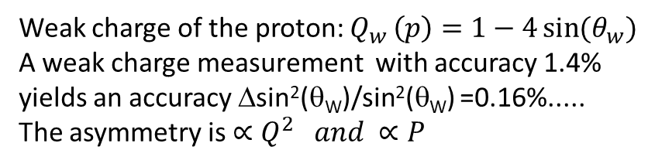
EB-Experiment P2
D. Becker et al. Eur. Phys. J. A 54 (2018) 11, 208
DOI: 10.1140/epja/i2018-12611-6 &166,
Weak charge of the proton: $Q_{w }\left(p\right)=1−4\sin{(θ_{w})}$
A weak charge measurement with accuracy 1.4%
yields an accuracy Δsin²(θ_{W})/sin²(θ_{W}) =0.16%.....
The asymmetry is $∝Q^{2 }and ∝P$

Slide 18
P2-Challenges
D. Becker et al. Eur. Phys. J. A 54 (2018) 11, 208
DOI: 10.1140/epja/i2018-12611-6 &166,

Slide 19
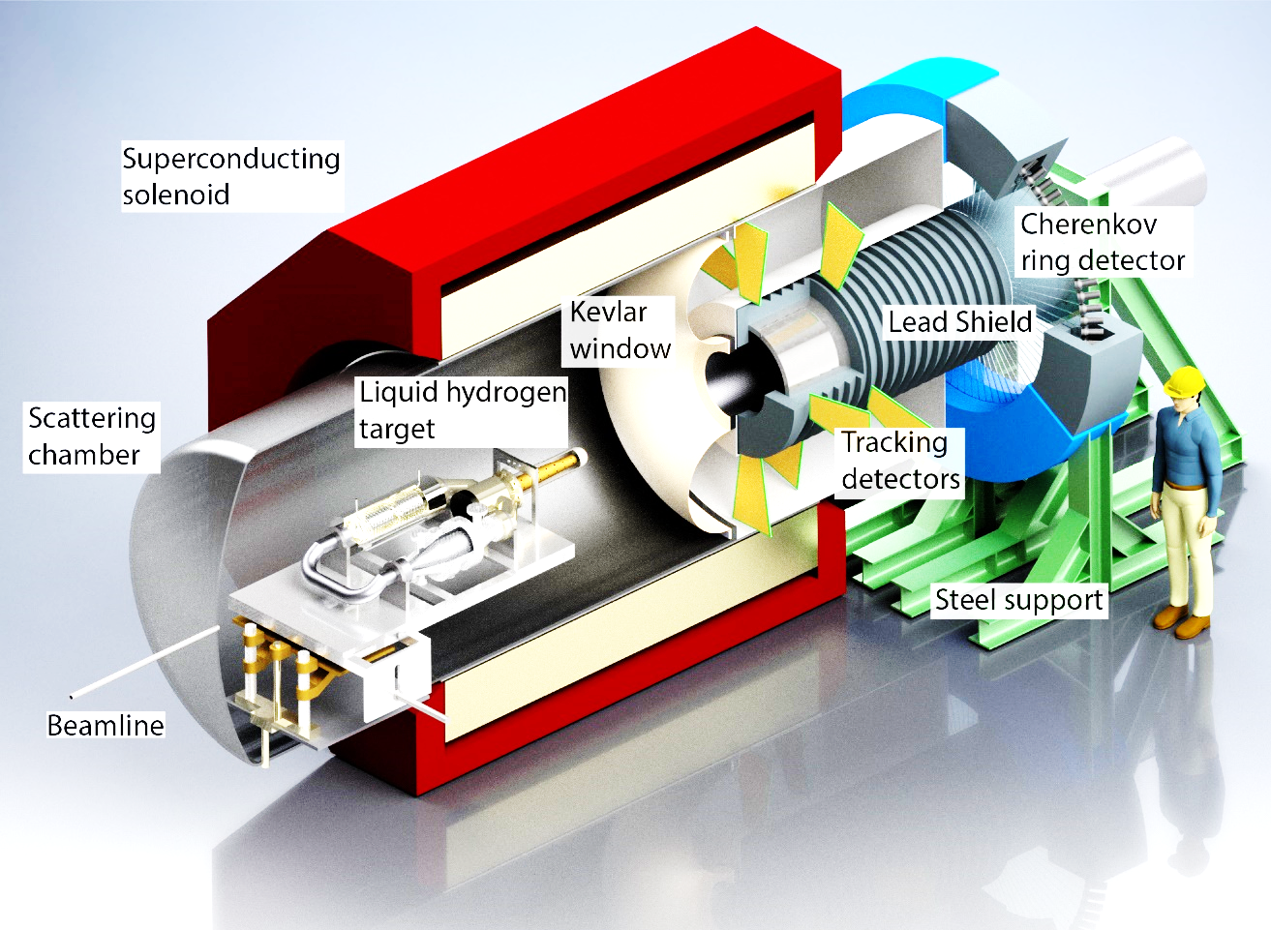
P2 procurement
Large bore solenoid ordered in June 2020, delivery in March 2023
90 Integrating quartz glass bars (high purity, laser grade polish): first 30 pieces delivered
PMT’s HV-channels ordered
More: D. Becker et al. Eur. Phys. J. A 54 (2018) 11, 208 DOI: 10.1140/epja/i2018-12611-6 &166

Slide 20

Polarimeters for P2
5 MeV Mott
MAGIX-Beamline
P2-Beamline
Hydro-Möller
In 2025 we will have at least one polarimeter which will achieve ΔP/P <1% and could realize “quasi” online measurement. The Hydro-Möller may achieve ΔP/P <0.5% and could provide a real online measurement
The Hydro Möller is delayed because of technological, budgetary and, meanwhile, also political problems

Slide 21
Multi- MeV Mottpolarimeter
V. Tioukine et al. REVIEW OF SCIENTIFIC INSTRUMENTS 82, 033303 (2011),
- PRISMA/P2 Team: R. Thapa/V. Tioukine: Explore Multiple scattering/Background
- Full P2 beam power capability expected, “quasi”- online capability being explored
→ Accuracy should be sufficient for P2-H , but not for P2-C

Slide 22
Spin diffusion and background
0.1 MeV
1 MeV
2 MeV
K. Aulenbacher and V. Tioukine proceedings PESP2008
The MC simulation has in principle no parameters to „fit“ the data.
But the experimental data comprise (target induced) background from the beam dump !
→ Both effects can nowadays be simulated simultaneously! → error will be limited by theory

Slide 23
Mitigation of theory problem?
Difficult to calculate self-energy effect
X. Roca-Maza, EPL, 120 (2017) 33002 www.epljournal.org
doi: 10.1209/0295-5075/120/33002
Observation: The extracted value does
not depend on energy at the 0.5% level.
(based on solution of Dirac equation and
no radiative corrections)
Could this indicate that radiative corrections are
Not „so“ important
Other option: Different Z- targets
V. Tioukine et al. REVIEW OF SCIENTIFIC INSTRUMENTS 82, 033303 (2011),

Slide 24

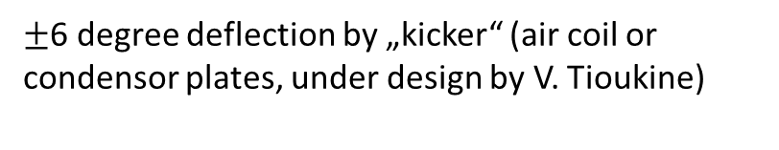
MESA-ARC-0 layout
Jefferson-Lab-type polarimeter/or magnetic spectrometer (MAMI-type) (under investigation by R.Thapa)
MESA MARC-0
Side view
$±$6 degree deflection by „kicker“ (air coil or condensor plates, under design by V. Tioukine)
MESA MARC-0
Top view
Beam dump with longitudinal
Compton-Absorber
-allows pol control even at not
completely transverse angles.
-independent check for drifts
and jumps
!
R Barday et al 2011 J. Phys.: Conf. Ser. 298 012022

Slide 25
Hydro- Möller @ MESA
5 MeV Mott
MAGIX-Beamline
P2-Beamline
Hydro-Möller

Slide 26
Hydro-Möller: Promise
[4] E. Chudakov and V. Luppov, Eur. Phys. J. 24 (2005) 123, doi:10.1140/epjad/s2005- 04-028-8.
Areal density about 10¹⁵ electron spins/cm²→ sufficiently low for online operation
but reasonable statistical efficiency…
Hydrogen Polarization 1-ε with ε<10⁻⁴→ suppression of error from target polarization
No Levchuk effect
→ ΔP/P < 0.5%?
Figure from: D. Becker et al., Eur. Phys. J. A (2018) 54 : 208
Schematic of Hydro-Möller-Target, More: V. Tyukin et al. PSTP2019 (2020) 005 doi 10.22323/1.379.0005

Slide 27
Hydro-Möller: Challenges and status
Powerful dilution refrigerator needed
(50mW at 0.3K ????)
→ expensive (cooling power!)
Cold electron spin polarized
Hydrogen dissociator to be incorporated
→ new technology, to be tested at HIM
Plasma effects – electron trapping?
→ further investigations needed
To P2
Upper frame: Schematic of Refrigerator
Lower frame: cross section
of trap with refrigerator

Slide 28
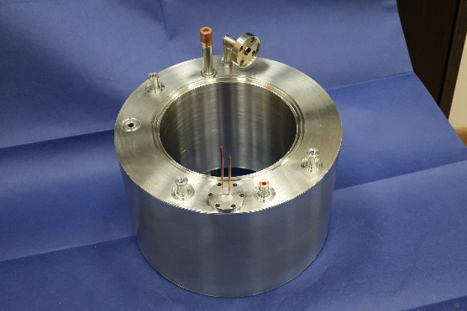
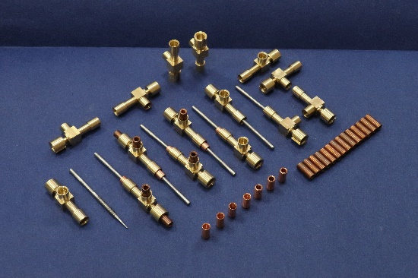
Political issue: Refrigerator parts…
KPH/Swagelock: German products
JINR - Russian products
(examples)
Beam insert and
“Pumping line”
He-4 evaporator
All welded
heat exchangers
For precooling stage
Needle valves
Unavailability of russian institution could be compensated by Mainz machine shops and industry from Rhein Main area. (but at the expense of long delays due to learning curve and limited capacities.)

Slide 29
Conclusion
MESA is currently being build at University Mainz
Construction and commissioning until 2025
Rich portfolio of experiments at the experimental stations P2, MAGIX, and DarkMESA
Options for extensions after starting the experiment exist.

