Slide 1


ERL potential as a γ−ray source
Dmitry Kayran and Vladimir Litvinenko
Brookhaven National Laboratory
Stony Brook University

Slide 2
Outline
Motivation
Why Compton γ-ray sources
Storage Ring, LINAC: why it cannot do it
Examples
Conclusion

Slide 3
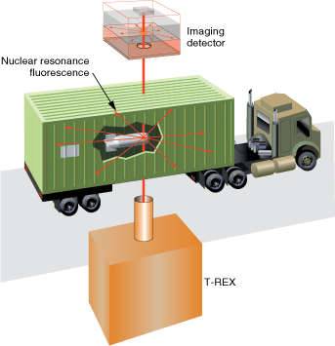
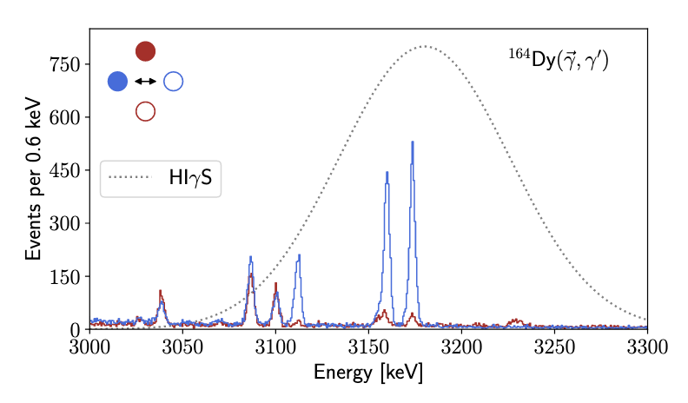
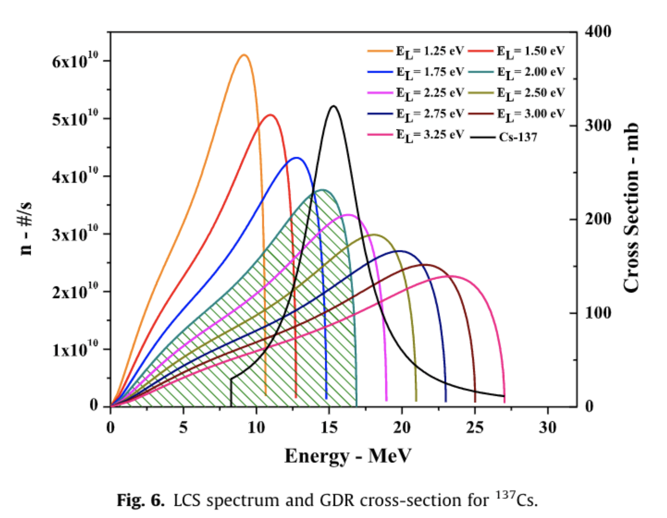
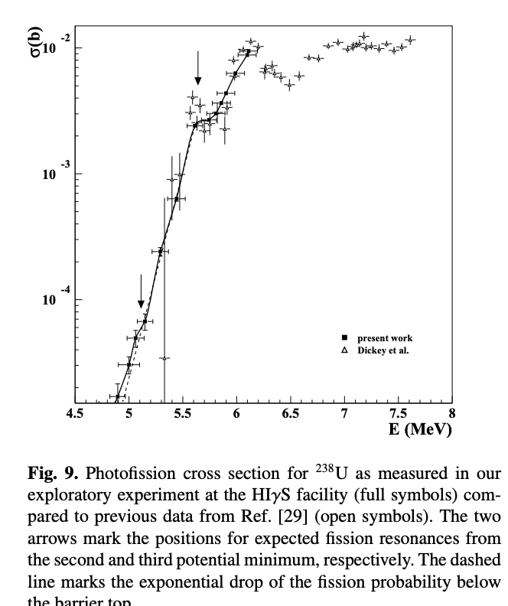
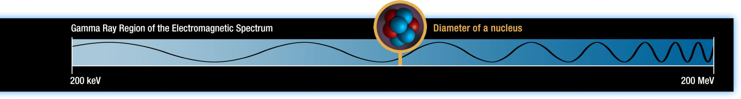
Motivation for γ-ray sources
Medical application
National security
Transmutation of the nuclear waste
Photofission studies
Nuclear physics
  Nuclear resonance fluoresce (NRF)
  Nucleon Structure
Isotope production
Astrophysics puzzles γ+O¹⁶ <=> C¹²+α
γ−γ collider
Investigation of nukes and other heavy object
….
See today talk by Tobias Beck on photonuclear reactions
H.ur Rehman et al. / Annals of Nuclear Energy 105 (2017) 150–160
“Perspectives for photofission studies with highly brilliant, monochromatic γ-ray beams” P. G. Thirolf et. al., EPJ Web of Conferences 38, 08001 (2012)
Some are real, some are far fetched
the list can go on and on
https://science.nasa.gov/ems/12_gammarays

Slide 4
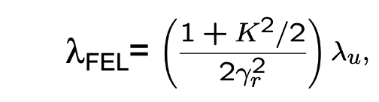
What is important?
Energy E_{γ} >0.5 MeV
Energy spread (resolution) < 0.1%
Polarization > 95%
Flux > 10¹⁰ γ/sec
Spectral density > 10⁵ γ/sec/eV
Tunability 1-1000 MeV
Undulator radiation:
Gamma Energy | 1 MeV | 100 MeV
λ_{u} | ~1 cm | ~1 cm
B | ~1 T | ~1 T
K | ~1 | ~1
Req. Electron energy | 40 GeV | 400 GeV !!!
Very challenging

Slide 5
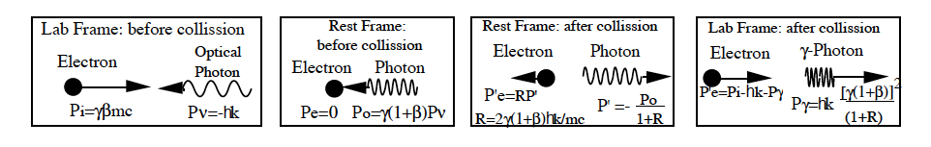
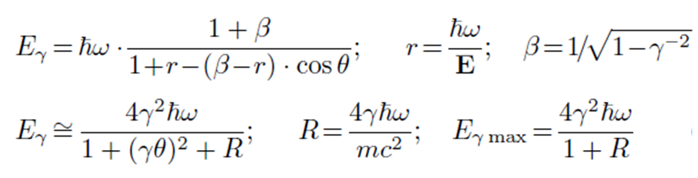
Basic principle of Compton Backscattering
  High-energy electrons collide with the laser coming
  Collisions with electrons cause the laser to scatter in the opposite direction, gaining energy from the electrons and becoming high energy
  The head-on collision of relativistic electrons and photons creates a pencil-like beam of gamma rays with energy
ћω - energy of the initial photons
γ=E_{e}/m_{e}c² ⁻ relativistic factor
θ - angle between the direction of the incident electrons and gamma rays
R- electron recoil parameter
comparison with undulator
Visible light λ~400-700 nm
    λ_{u} ~1-2 cm
> 1e4 difference

Slide 6

Energy of electron accelerator
Using IR or visible laser requires energy above 1.5 GeV to generate γ-rays with peak energy of 100 MeV - it means that e-beams are GeV-class
Nd:YAG laser will need 4 GeV electron beam to reach 250 MeV γ-ray’s energy
Extendingγ-ray’s energy to 1 GeV will require 6 GeV e-beam and red laser light, while it would require 8 GeV beam if Nd:YAG laser is used
CO₂ laser will require electron beams with tens of GeV and therefore is not practical
Photon energy range from 1 eV to 3 eV is a typical for this application
E_{γ}=2 GeV
E_{γ}=1 GeV
E_{γ}=500 MeV
E_{γ}=250 MeV
E_{e}=6 GeV
E_{γ}=100 MeV
E_{e}=5 GeV
E_{e}=4 GeV
E_{e}=4 GeV
E_{e}=3 GeV
E_{e}=3 GeV
E_{e}=2 GeV
E_{e}=2 GeV
E_{e}=1 GeV
E_{e}=1 GeV
CO₂ laser
Nd:YAG lasers

Slide 7
Total energy spectrum depends on recoil
R < 1
R >> 1
2 GeV electrons, 1.75 eV photons,
R=0.054, E_{γmax}=101.8 MeV
2 GeV electrons, 100 eV photons,
R=3.06, E_{γmax}=1.508 GeV
5 GeV electrons, 3 eV photons,
R=0.23, E_{γmax}=934 MeV
10 GeV electrons, 100 eV photons,
R=15.3, E_{γmax}=9.387 GeV GeV

Slide 8

Flux: luminosity of electron-photon collider
x hourglass
Should keep β* ≥ σ_{z}
Equation for flux can be written in multiple forms and strategy its optimizing depends on what is limited?
  For a limited change per bunch, q_{e} and given average power of laser, γ-ray flux does not depend on the collision rate, but e-beam current does
  For given average laser power and beam current, low frequencies are desirable (linacs?)
  For limited charge and laser pulse energy, increasing rep-rate is preferable – and naturally both laser average power and beam current are proportional to collision frequency in this case

Slide 9

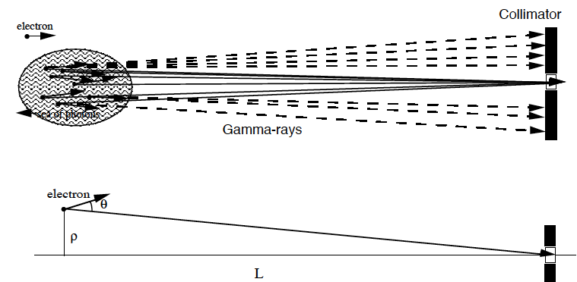
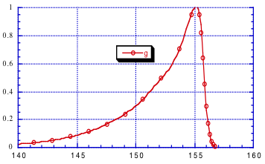
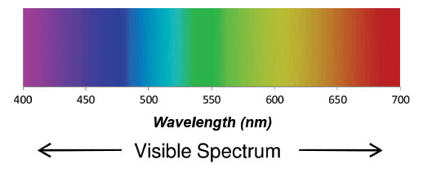
Energy resolution: pinhole collimator
Energy strong depends on its outgoing angle, combine with collimation produce near monoenergetic gamma rays
Energy spread of e-beam
Angular divergence of e-beam
g(E)
Example: 2 GeV e-beam, 450 nm laser, ε_{x,y (norm)} = 0.31 mm mrad, β_{x,y} = 2m, σ_{E} /E_{e} = 0.17%, σ_{Eph} /E_{ph} = 0.1%
results in σ_{Eγ} /E_{γ} = 0.37%, and about 2% (3.1 MeV) FWHM γ-ray energy spread
Energy
spread
Emittance
induced tail
Eγ, MeV

Slide 10
Rules of Thumb
Collimation provides for ~ 1.5% of the γ-ray total flux for each 1% FWHM of the energy spread
  when collimator acceptance is much larger than energy spread for pinhole collimator
Frequently – which is almost always true for GeV scale e-beams – beam quality (energy spread and emittance) and β-functions determine ultimate γ-ray energy spread
If collimator chosen to optimize both the energy spread and flux , then one should expect flux through collimator to be product of total flux and relative energy spread of γ-rays:

Slide 11
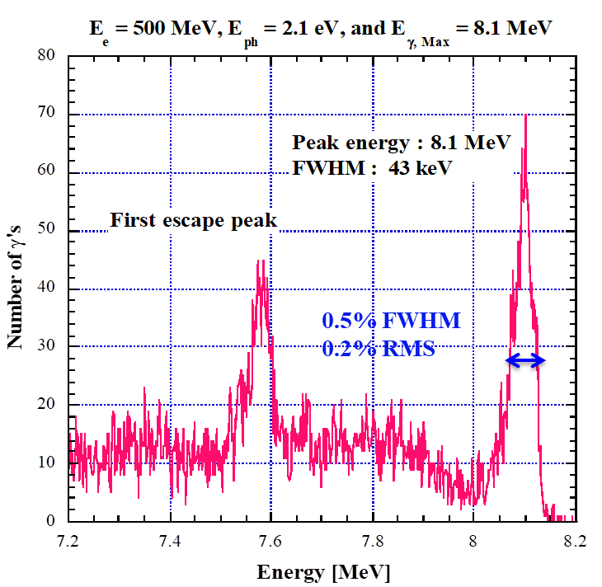
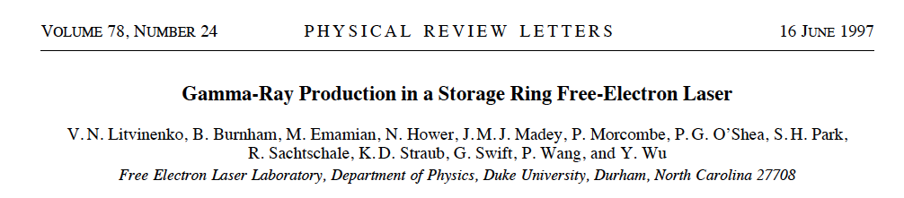
Storage ring FEL-based mono-energetic γ-ray source
OK-4/Duke SR FEL Parameters
Schematic of OK-4 Duke storage ring FEL and γ-ray source (HIγS)
γ-ray beam Parameters
Two electron bunches spatially separated by one half the circumference of the ring participate both in lasing and γ-ray production via Compton scattering of intracavity photons.
A collimator installed downstream selects a narrow cone of quasi-monoenergetic γ-rays
Measured energy spectrum of γ-rays
with HPGe detector through 3 mm dia. collimator
HIγS: first mono-energetic γ-ray beams

Slide 12
Type of accelerators to choose from
  Storage rings could provide high average beam power but cannot tolerate large disruption. As a result, the flux is limited and energy resolution is not the best.
  LINACs , on the other hand, could provide superb beam quality electron beam but falling short then high average power is needed
  ERLs is the only option to satisfy all requirements of the high power high quality γ-source

Slide 13
Best performance achieved at HIγS at Duke as Oct 2022 *
 | HIgS
Maxumum flux @10MeV, phs/sec | 3E+10
Maximum γ-ray energy, MeV | 120
Minimum γ-ray energy, MeV | 0.6
Min Energy spread, FWHM | ~6E-03
Linear collimated polarization | >97%
Circular collimated polarization | 95%
Spectr. Energy density, phs/sec/eV | ~3000
*Ying K. Wu private communication

Slide 14
What ERL can provide
  High flux
  Better energy resolution
  Better energy resolution
  Higher spectral density
  High flux
  Additional tunability
Low emittance ->
Low energy spread ->
Short bunches ->
Optional Use of FELs ->

Slide 15
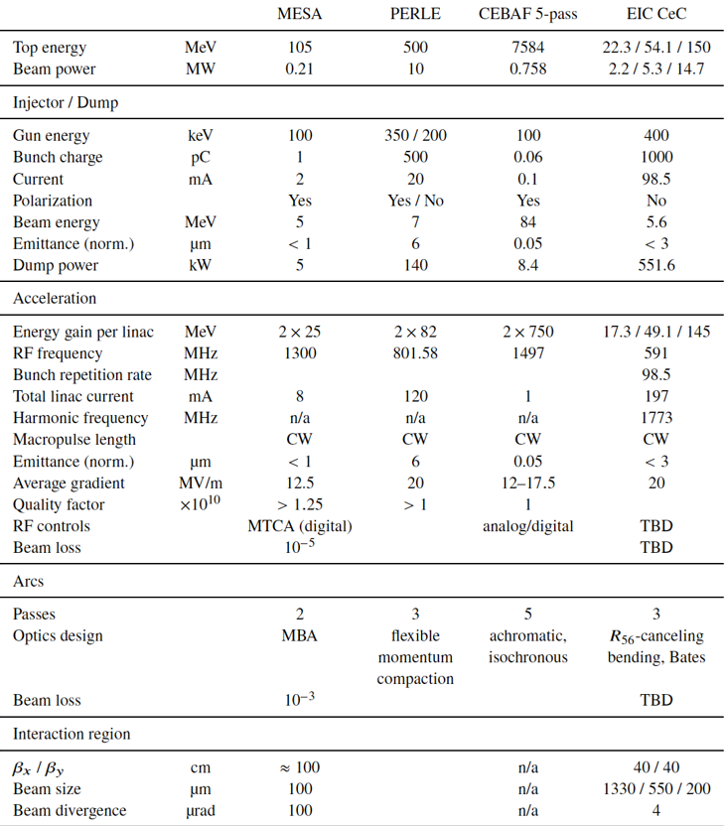
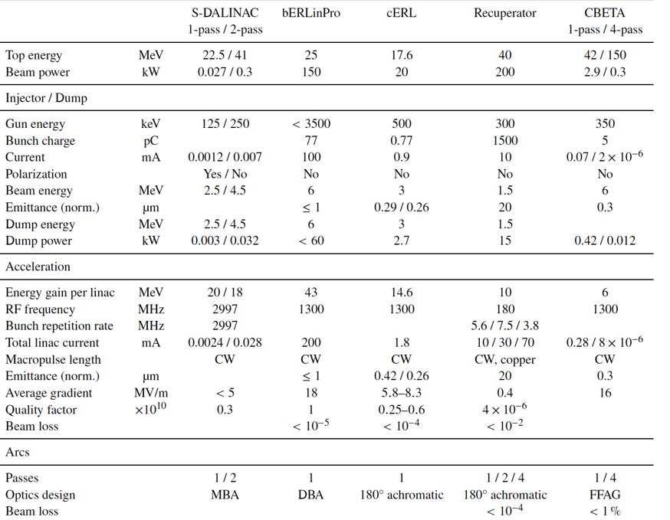
ERLs to consider
Facilities in progress
Ongoing facilities
Andrew Hutton’s talk on Monday

Slide 16
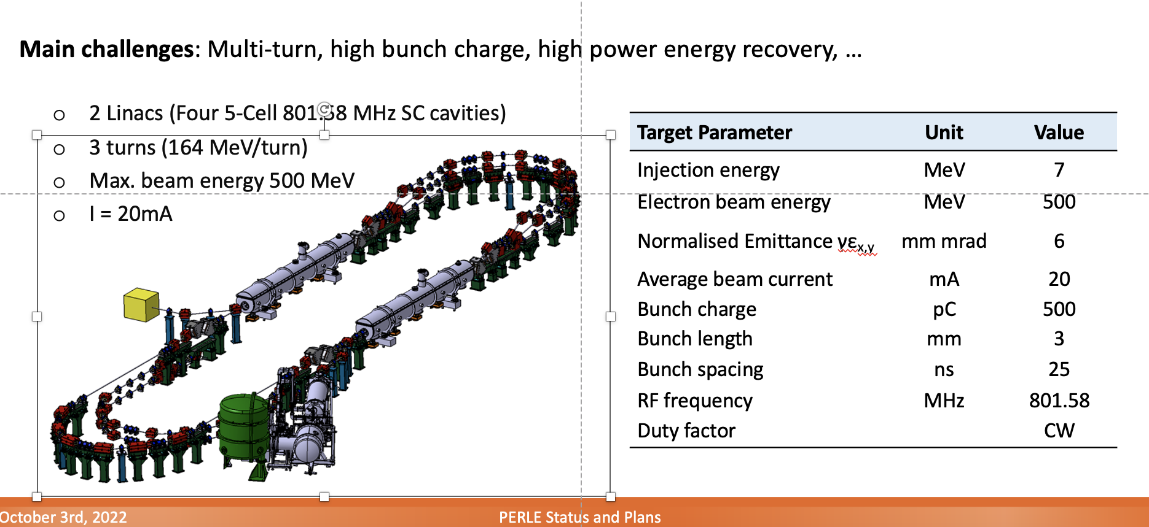
Some examples: PERLE
Walid KAABI’s talk on Monday
 | PERLE+IR | PERL+FEL
Energy, GeV | 0.5 | 0.5
γ | 980 | 980
Beam current, mA | 20 | 20
Bunch frequency, MHz | 40 | 40
Beam power, MW | 10 | 10
Charge per bunch, nC | 0.5 | 0.5
Emittance norm, mm mrad | 6 | 6
Laser type | Convent. IR | Visible FEL
Laser power, kW | 100 | 100
Wavelength, μm | 1.06 | 0.45
Photon energy | 1.17 | 2.76
Recoil parameter | 0.009 | 0.021
γ-ray energy, MeV | 4.4 | 10.3
R_{L}, cm | 1 | 1
β, m | 5 | 5
eRelatrive energy spread | 0.003 | 0.003
Energy spread, min, γ-rays | 1.8 E-3 | 1.8 E-3
Total flux, phs/sec | 1.05E+14 | 1.05E+13
Spectr density, phs/sec/eV | 2.35E+10 | 1.01E+09
Longitudinal emittance keV.mm 25-90
For conventional laser use IR 100 kW average IC power that intensifies the optical bunch intensifier
FEL assumes output power 1% of ERL power, Q₀~1000.
For ex. T. Akagi et al. (PRAB19, 114701 (2016)
Beam with energy ~1GeV could produce γ-rays 4-10 MeV
The flux could be 3 order of magnitude higher then record keeper HIyS

Slide 17
On more example: ER@CEBAF
Gustavo Pérez Segurana’s talk on Monday
 | CEBAF+IR | CEBAF+FEL
Energy, GeV | 7.6 | 7.6
γ | 14800 | 14800
Beam current, mA | 0.1 | 0.1
Bunch frequency, MHz | 40 | 40
Beam power, MW | 0.76 | 0.76
Charge per bunch, pC | 0.06 | 0.06
Emittance norm, mm mrad | 0.05 | 0.05
Laser type | Convent. IR | Visible FEL
Laser power, kW | 100 | 7.6
Wavelength, μm | 1.06 | 0.45
Photon energy | 1.17 | 2.76
Recoil parameter | 0.14 | 0.021
γ-ray energy, MeV | 907 | 1839
R_{L}, cm | 1 | 1
β, m | 5 | 5
eRelatrive energy spread | 0.0003 | 0.0003
Energy spread, min, γ-rays | 6.30E-04 | 6.30E-04
Total flux, phs/sec | 1.25E+10 | 9.50E+07
Spectr density, phs/sec/eV | 1.38E+04 | 5.20E+01
Beam with energy ~7GeV could produce γ-rays 1-2 GeV
More beam current is needed for higher flux
For conventional laser use IR 100 kW average power that intensifies the optical bunch intensifier
Typical FEL assumed 1% output power and Q₀=1000.

Slide 18
Conclusions
The backscattering Compton sources are promising high intensity, monoenergetic and high brightness γ-ray beams
Combination of high current Energy Recovery Linacs with high power lasers (both the “conventional” and FEL with only 100 kW of intra-cavity power!) opens possibility of generating a few order of magnitude higher flux of γ-rays then currently available
Such sources can find applications expending from the high energy and nuclear physics to medical application and potentially disposal of radioactive waste
Thank you for your attention!

