Slide 1
GeV muon beams with picometer-class emittance from electron-photon collisions
Luca Serafini and Camilla Curatolo – INFN-Milano and LASA
EXMP (Electron and X-rays to Muon Pairs):
a Muon Collider Paradigm with ERL as backbone
(a muon photo-cathode based on FELs and ERLs)
av. curr. 200 mA
av. curr. 200 mA
ERL – 2022, Cornell Univ. (USA), Oct. 5th, 2022

Slide 2
Mission of a Muon Collider:
The Challenge
Collisions of muon beams at TeV-class energy,
with large bunch population (10¹²),
Small normalized rms transverse emittance
(< 2.10⁻⁵ m.rad, i.e. < 20 mm.mrad = 20 μm),
Small energy spread (< 10⁻³),
so to achieve
a peak luminosity in the range 10³²⁻³⁴ cm⁻²s⁻¹
ERL – 2022, Cornell Univ. (USA), Oct. 5th, 2022

Slide 3
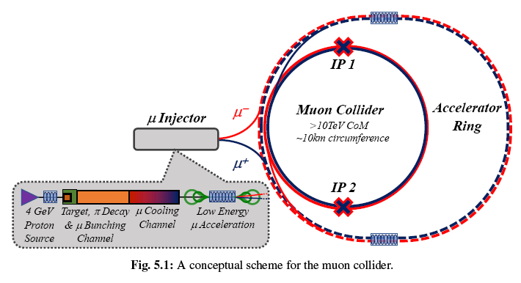
Muon Collider:
a) the conventional approach (MAP, proton-pion cascade) and
b) the alternative approach (LEMMA, 45 GeV positrons on target)
MAP scheme:
10¹² μ/bunch
ε_{n} = 25 mm mrad
L ~ 10³⁴ cm⁻² s⁻¹
Muon colliders to expand frontiers of particle physics. Nat. Phys. 17, 289–292 (2021)
unstable particles
with τ₀ = 2.2 μs
μ @ 1 TeV τ ˜ 20 ms
after ionization cooling
after accumulation, no cooling
Muon production and accumulation from positrons on target. PRAB 23, 051001 (2020)

Slide 4
Main Issue of MAP and LEMMA paradigms:
very intense primary beams (protons, positrons) interacting with targets
(target melting, secondary/tertiary muon beam emittance heating, radio-protection issues, etc)
Can we try to generate muons avoiding targets?
Using Photons?
photons vs. a counter-propagating beam?
sort of a relativistic muon photo-cathode??
ERL – 2022, Cornell Univ. (USA), Oct. 5th, 2022

Slide 5
Luminosity for round beam collisions
Ultra-tight focusing of primary e⁻ beam, no beamstrahlung, no beam disruption
in electron-photon collisions (unlike electron-positron interactions)
$ℒ≅\frac{N_{1}N_{2}f}{4πσ_{x}σ_{y}}≅\frac{N_{1}N_{2}f}{4π\frac{ε_{n}}{γ}β^{∗}}=\frac{N_{1}N_{2}f}{4π\frac{ε_{n}}{γ}σ_{z}}∝\frac{I_{e}\left(N_{2}f\right)}{4π\frac{ε_{n}}{γ}}∝$ $\frac{I_{e}Φ_{X}}{λ_{X}}$
$$σ_{x}σ_{y}=\frac{ε_{n}}{γ}β^{∗}$$
$β^{∗}=$ $σ_{z}$
$$\frac{N_{1}}{σ_{z}}∝I_{e}$$
$$ℬ(brilliance)∝\frac{Φ_{X}}{\frac{ΔE_{X}}{E_{X}}λ_{X}^{2}}$$
short bunches!
Why generate muon beams using X-ray photons? X-ray FELs are capable to achieve brilliances outrunning any other particle beam. Therefore the marriage between X-ray FELs and Energy Recovery Linacs (ERL) carries a potential to attain primary luminosity levels, in an electron-photon collider, that exceed 10⁴² cm⁻²s⁻¹.

Slide 6
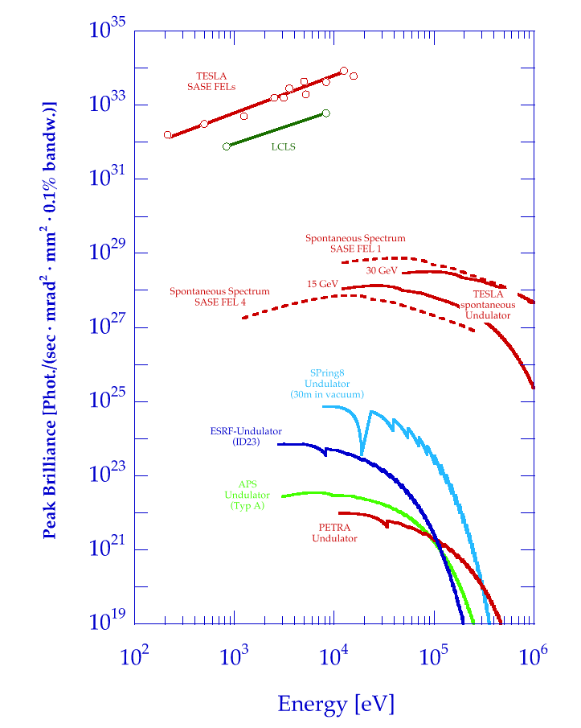
Brilliance of (diffraction limited) X-ray sources
λ/4π = equivalent emittance of a
coherent radiation beam
12.4
1.24
0.124
λ (nm)
$$B_{peak}∝\frac{N_{ph}}{λ^{2}σ_{t}\frac{ΔE_{X}}{E_{X}}}$$
FLASH
Phase Space matching condition,
also known as Pellegrini FEL criterion
Where the High IntensityBrightness Frontier meets the High Energy Frontier
Thomson/Compton Sources
Electron beam 6D normalized Brightness
$$B_{n}∝\frac{I_{e}}{ε_{n}^{2}\frac{Δγ}{γ}}{ ; I}_{e}=\frac{{eN}_{e}}{σ_{t}}$$
ERL – 2022, Cornell Univ. (USA), Oct. 5th, 2022

Slide 7
Why using photons to generate muons?
We have an outstanding photon machine:
the Free Electron Laser
2) We can avoid using positrons/protons
3) We can avoid using targets!
4) Running the collision in vacuum we can get:
a much lower emittance
generate polarized muon beams
ERL – 2022, Cornell Univ. (USA), Oct. 5th, 2022

Slide 8
Why using electrons to generate muons?
Electron Beams achieve highest beam brightness than any other charged particle beam (6D Brightness: short bunches, small emittance / energy spread -> tight focus)
2) We can recover the power stored in the electron beam
via Energy Recovery Linac for a large energy sustainability
(99,9 % of electrons do not interact with FEL pulse – caveat Schwinger…)
3) Using e⁻ beams instead of proton beams (vs. photons) makes the primary collider operating in large recoil regime, where muon beam emittance does not depend on primary beam emittance

Slide 9
What are the drawbacks of in-vacuum based
muon beam generation?
Running a primary collider to generate a beam (not physics events) implies achieving outstanding luminosities: cascaded colliders drop luminosity levels by 9-10 orders of magnitude at each pass in the cascade (10^{4n} -> 10^{3n})
2) Operational stability and reliability of the secondary collider (in our case muon collider) strongly depends on the performances of the primary collider
ERL – 2022, Cornell Univ. (USA), Oct. 5th, 2022

Slide 10
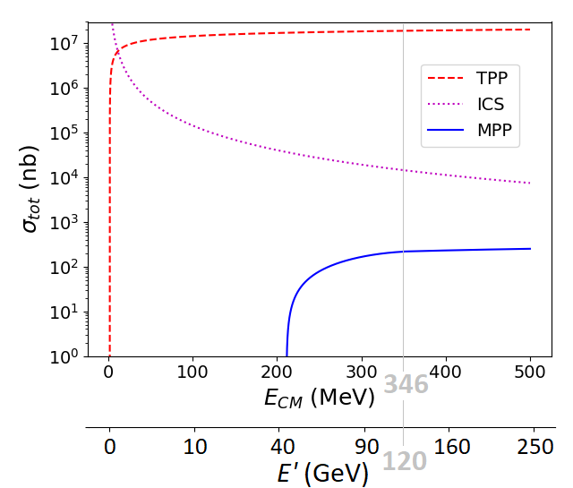
Total cross-section for MPP (muon pair production), Bethe-Heitler:
fraction of a μbarn at photon energies > 100 GeV onto electrons at rest
$$e^{−}+γ→e^{−}+{e^{+}}/{e^{−}}$$
$$e^{−}+γ→e^{−}+γ$$
$$e^{−}+γ→e^{−}+{μ^{+}}/{μ^{−}}$$
EXMP
$σ^{MPP}= αr_{μ}^{2}\left(\frac{28}{9}ln\left(\frac{2γhν}{M_{μ}}\right)−\frac{218}{27}\right)$ ${− σ}^{Borsellino}$
Bethe-Heitler
$$E_{CM}=2\sqrt{M_{e}γhν}$$
$$E^{′}=2γhν=\frac{E_{CM}^{2}}{2M_{e}}$$

Slide 11
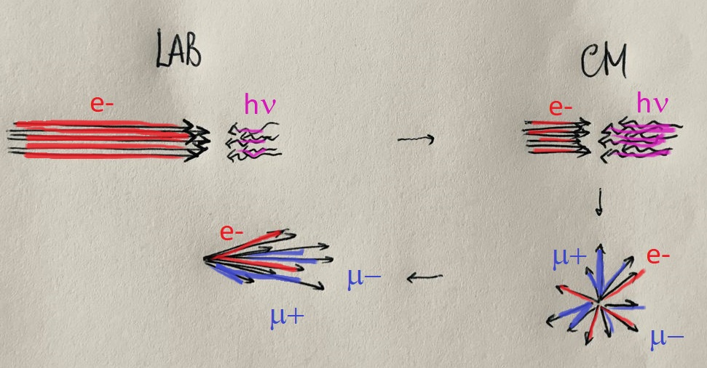
Highly Asymmetric Lorentz-boosted electron-photon collisions with large recoil factor are characterized by much higher phase space densities of secondary generated beams w.r.t. collisions operated with small recoil factor
${e^{−} recoil factor X=\frac{4γhν}{M_{e}} ; when X≫1 E}_{CM}=2\sqrt{M_{e}γhν}$ = $M_{e}\sqrt{X}$
$$σ^{Bethe−Heitler}=αr_{μ}^{2}\left(\frac{28}{9}ln\left(\frac{M_{e}X}{{2M}_{μ}}\right)−\frac{218}{27}\right)$$
$$αr_{μ}^{2}=13.4 nbarn$$
Large Recoil
Inverse Kinematics
500 GeV
60 keV
X = 4.7*10⁵
173 MeV
173 MeV
$$E^{′}=120 GeV$$

Slide 12
EXMP is based on a
X >>1 Asymmetric boosted primary collider
$$e^{−} recoil factor X=\frac{4γhν}{M_{e}}$$
$$E_{CM}=M_{e}\sqrt{X}$$
$$γ_{cm}=\frac{γ}{\sqrt{1+X}}$$
2 operating points selected for EXMP
1) E_{e-} = 200 GeV E_{X} = 150 keV 2) E_{e-} = 500 GeV E_{X} = 60 keV
1) $γ_{cm}=580$ 2) $γ_{cm}=1450$
E_{cm} = 346 MeV ; X = 460.000

Slide 13
EXMP 500 GeV e⁻ vs. 60 keV hν_{FEL}
FEL-graded CW electron beam – 800 MHZ (SC-RF Perle cavities) @ 200 mA
Parameters of Primary Beams
Energy e-beam (GeV) | 500. | 500. | FEL photon energy (keV) | FEL photon energy (keV) | 60.
Bunch charge (pC) | 250. | 250. | Photons per pulse (10¹²) | Photons per pulse (10¹²) | 12.5
N_{e} (10⁹) | 1.6 | 1.6 | Repetition rate (MHz) | Repetition rate (MHz) | 800.
Repetition rate (MHz) CW | 800. | 800. | ε_{x,y} (pm.rad) | ε_{x,y} (pm.rad) | 1.5
Average Current (mA) | 2x200. | 2x200. | Focal spot size (rms, nm) | Focal spot size (rms, nm) | 10.
Nominal beam power (GW) | 2x100. | 2x100. | FEL beam power (MW) | FEL beam power (MW) | 2x100.
beam power recovery fraction | 99.95 % | 99.95 % | FEL-efficiency (tapering) | FEL-efficiency (tapering) | 1%
beam power loss (MW) | 2x50. | 2x50. | FEL e⁻ beam av. curr. (mA) | FEL e⁻ beam av. curr. (mA) | 200.
Bunch length (psec) | 0.2 | 0.2 | FEL e- beam energy (GeV) | FEL e- beam energy (GeV) | 50.
ε_{n}__{x,y} (mm.rad) | 0.4 | 0.4 | FEL e-beam power (GW) | FEL e-beam power (GW) | 2x10.
β_{x,y} (mm) | 0.23 | 0.23 | e⁻ beam power recovery fraction (after FEL) | e⁻ beam power recovery fraction (after FEL) | 99.9%
σ_{x,y} (nm) | 10. | 10. | e⁻ beam power loss (MW) | e⁻ beam power loss (MW) | 2x10.
Total beam power loss (primary+FEL) (MW) |  |  |  |  | 320.
electron-photon collision → no beam-beam, no beam disruption → round beam →
no damping rings , β*=0.23 mm → time jitter for synchronization system 0.6 psec
Peak Luminosity (cm⁻²s⁻¹) = 2 x 1.25.10⁴²

Slide 14
EXMP Simulations Results
(using Wizhard + ad-hoc script to populate phase spaces)
EXMP with 500 GeV electrons | vs. 60 keV FEL photons
E_{CM} | 346 MeV
TPP total cross section | 19 mbarn*
ICS total cross section | 14.7 μbarn
MPP total cross section | 216 nbarn*
N e₊₋ | 2x2.4 10¹⁶ (s⁻¹)
N_{ICS} | 2x1.9 10¹³ (s⁻¹)
N μ₊₋ | 2x2.7 10¹¹ (s⁻¹)
ERL – 2022, Cornell Univ. (USA), Oct. 5th, 2022

Slide 15
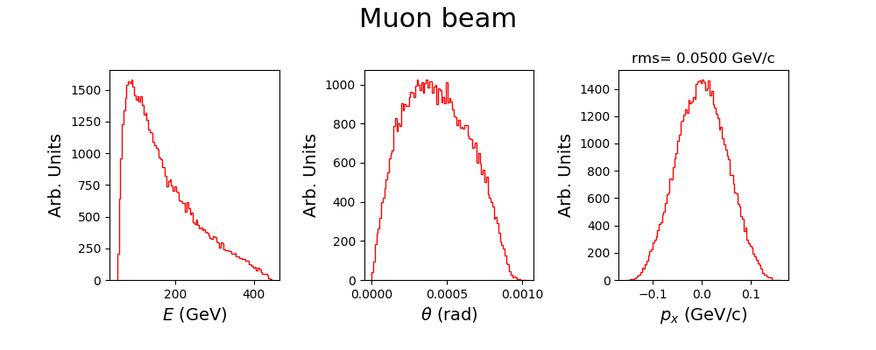
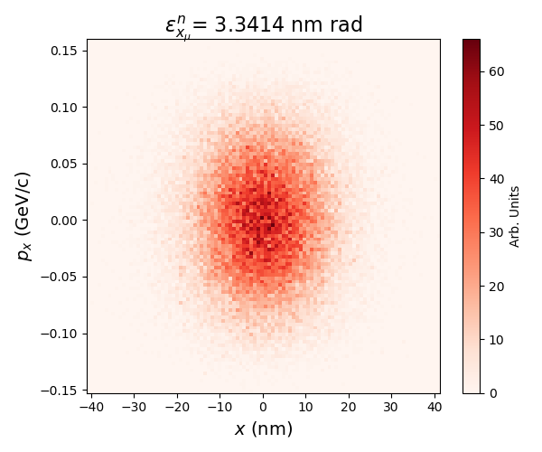
EXMP Simulations Results
(using Wizhard + ad-hoc script to populate phase spaces)
E_{e} = 500 GeV σ₀ = 10 nm $γ_{cm}=1450$ E_{cm} = 346 MeV
$$E_{peak}\sim M_{μ}γ_{cm}\sim 120 GeV$$
geometric emittance 3 pm.rad
MAP norm. emittance 25.*10³ nm.rad
after ionization cooling
LEMMA norm. emittance 40.*10³ nm.rad
ERL – 2022, Cornell Univ. (USA), Oct. 5th, 2022

Slide 16
Charge-Emittance budget in Photo-Injectors similar as in EXMP (thermal emittance and quantum efficiency @ photo-cathode)
r
r’
+π/2
R₀
z
R₀
r
−π/2
T_{cat} = T_{e} represents
the excess energy

Slide 17
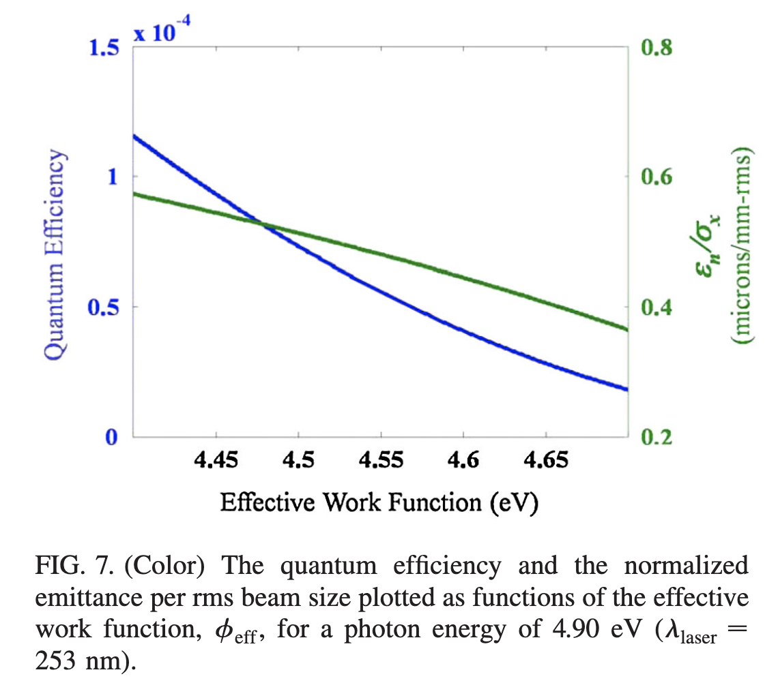
Excess Energy T_{e}
Number of electrons and their emittance increase
(unfortunately) together with the excess energy T_{e}

Slide 18
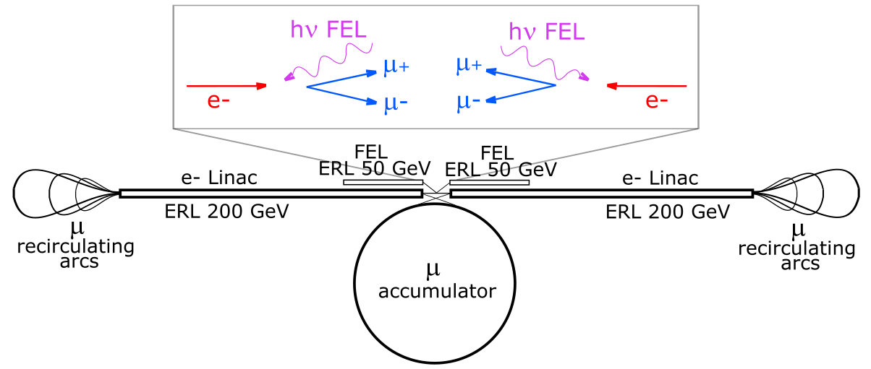
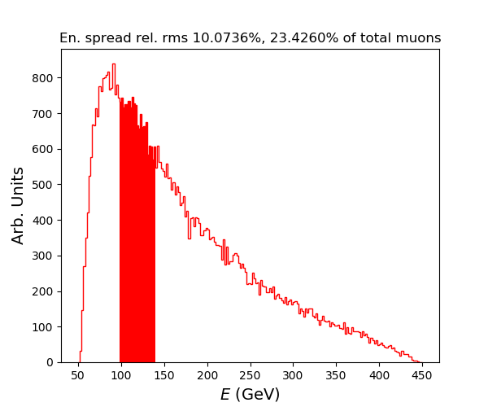
500
500
EXMP
Total flux of muons 5.4.10¹¹ s⁻¹. Selecting a 5% rms energy spread window around the peak in the muon energy spectrum (at about 120 GeV)
we obtain 10¹¹ muon pair per second

Slide 19
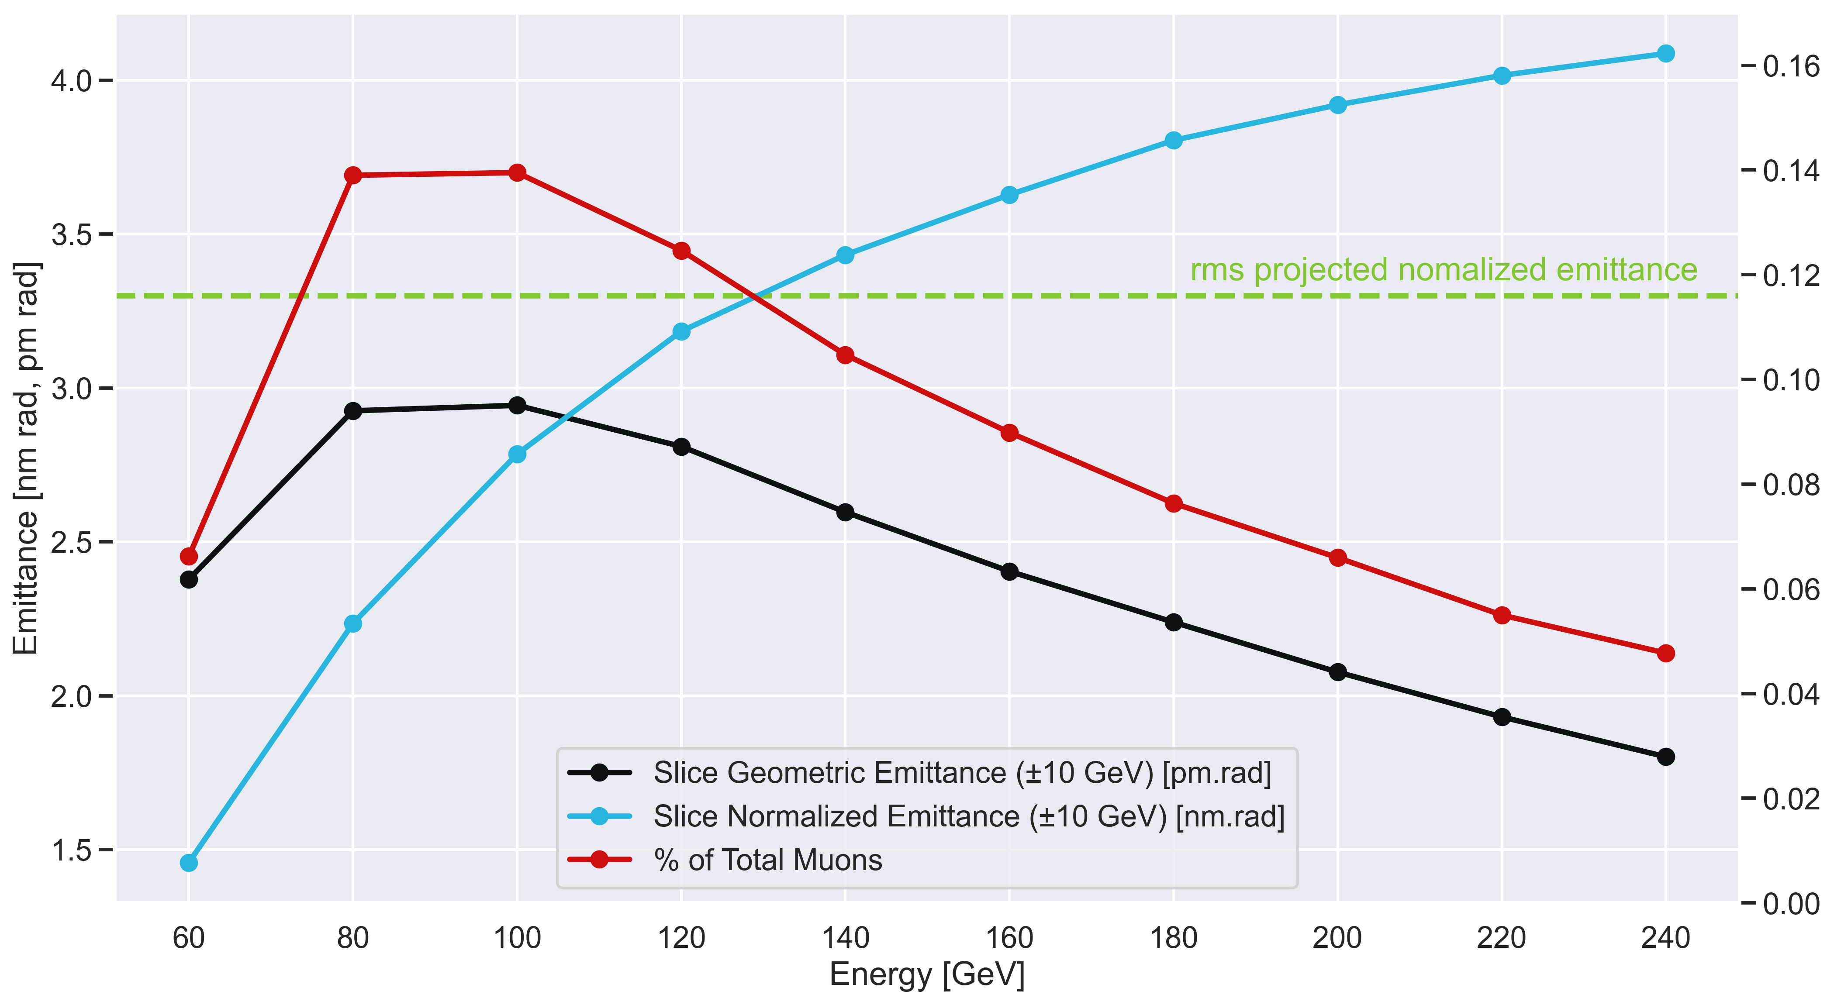
Analytical formula for the muon beam normalized rms transverse emittance that agrees with data within 20-30% (higher than data)
$$\sqrt{X}=678 ; ε_{μ}^{n}=4.0 nm rad ; ε_{e}^{n}=400. nm rad$$
ERL – 2022, Cornell Univ. (USA), Oct. 5th, 2022

Slide 20
EXMP - Conclusions
Muon Pairs generated in vacuum (no target) allows that primary electron beam recovered in energy (E.R.L.) for sustainability, and muon beam emittance down to nm.rad level
Ultra-tight focusing of primary e⁻ beam, no beamstrahlung, no beam disruption, outstanding primary luminosity: 10⁴² cm⁻²s⁻¹
Same Linac can accelerate electron beam and muon pairs!
Polarized muon beams
Mitigation of BIB (beam induced background)
Open issue: stacking from CW muon beam with low bunch population to 10¹² muon/bunch in storage ring
This straw-man design study carried out within BriXSinO’s team (see talk on BriXSinO’s TDR on Monday by D. Giove)

Slide 21
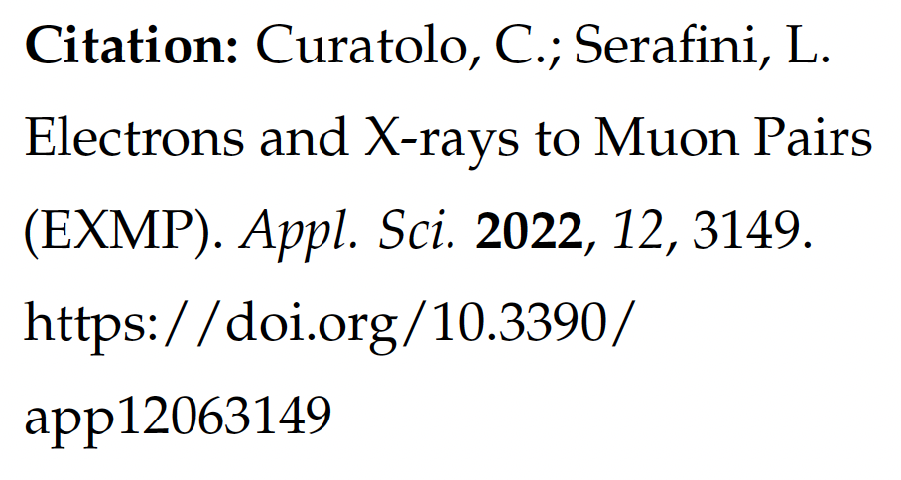
Thank you for your Attention
ERL – 2022, Cornell Univ. (USA), Oct. 5th, 2022

Slide 22
Backup Slides
ERL – 2022, Cornell Univ. (USA), Oct. 5th, 2022

Slide 23
Power budget
Stored power into the colliding beams, electrons and FEL photons, at the collision point: 2x100 GW + 2x10 GW
Total power loss: 320 MW dominated by ERL efficiency and FEL photons
(50% of FEL photon beam power could be recovered through thermal recycling: net 220 MW power loss)
Low power transferred from primary colliding electron/photon beams into the secondary beams:
- muon pairs (10¹¹ s⁻¹ at an average energy of 100 GeV) ~ 8.6 kW
- back-scattered Compton gammas (4.10¹³ s⁻¹ at an average energy of 500 GeV) ~ 3.2 MW
- e-/e+ pairs produced (5.10¹⁶ s⁻¹ at an average energy of 2 GeV) ~ 10 MW
Expected efficiency beam-to-plug not smaller than 20% (range 20-40%): AC power bill in 0.5 - 1 GW range
With 200 GW of “circulating” beam power, energy recovery becomes absolutely mandatory: ERL is the key technique to go. ERLs are exiting their development era, mainly focused on radiation production (as drivers of FELs, ICS, and synchotron light), and they are now entering the future scenario of HEP
The Development of Energy-Recovery Linacs, ArXiv (2022)
ERL – 2022, Cornell Univ. (USA), Oct. 5th, 2022

Slide 24
A Proof-of-Principle experiment at DESY with XFEL and a dedicated ICS: 5 GeV muon beams at moderate flux (˜1 s⁻¹) and small emittance (˜ 0.5 mm.mrad)
20 GeV XFEL electrons | vs. 1.5 MeV ICS photons
E_{CM} | 346 MeV
Qe₋ | 800 pC
effective rep rate | 32 kHz
primary collision spot-size | 2 microns
normalized transv. emittance e⁻ beam | 1 mm.mrad
N_{ICS} @ primary collision | 5. 10⁹
N μ⁺ ⁻ | 0.3 (s⁻¹)
ERL – 2022, Cornell Univ. (USA), Oct. 5th, 2022

Slide 25
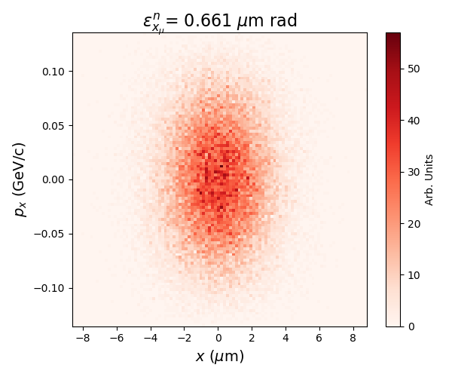
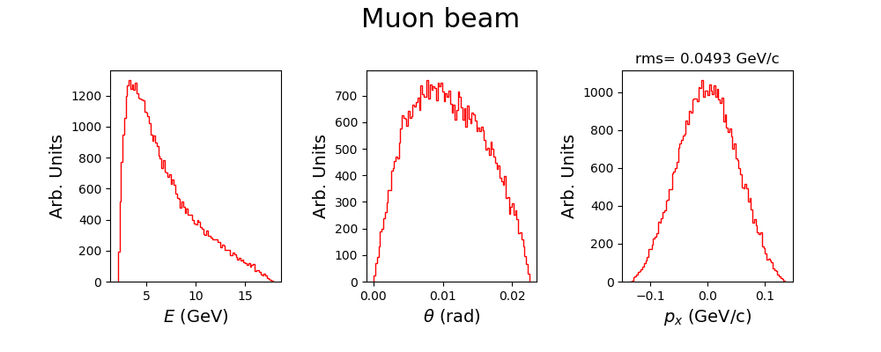
Very good emittance, 0.67 mm.mrad
Moderate amount of time to populate
a phase space (few hours)
Possible Sinergy with LUXE? Sharing
detection beam lines, adding dedicated ICS
ERL – 2022, Cornell Univ. (USA), Oct. 5th, 2022

Slide 26
BriXSinO’s TDR available at www.marix.eu
see talk on BriXSinO’s TDR on Monday by D. Giove
ERL – 2022, Cornell Univ. (USA), Oct. 5th, 2022

Slide 27
ERL – 2022, Cornell Univ. (USA), Oct. 5th, 2022

Slide 28
Trespassing
the Schwinger’s Limit (E = 1.3.10¹⁸ V/m)
@ EXMP (electron vs. FEL photon)
a0 = 4.3*lambda*Sqrt(U/sigmat)/w0
P = 0.94*U/(2*sigmat)
Ip = 2*P / (pi*w0²)
E = Sqrt(754*Ip)
FEL 60 keV U = 0.125 J sigmat = 0.2 psec w0 = 10 nm
a0 = 0.007, eta=Delta=4.6*10⁵ , Chi = 3220
P = 294 GW
Ip = 1.9*10²⁷ W/m2 = 1.9*10²³ W/cm²
E = 1.2*10¹⁵ V/m
E’ = E*γ = (500 GeV) = 1.2*10²¹ V/m

Slide 29
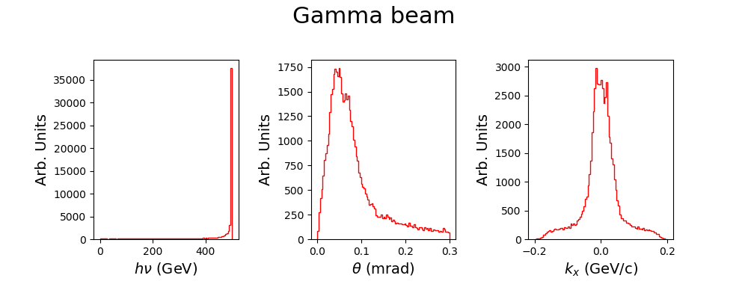
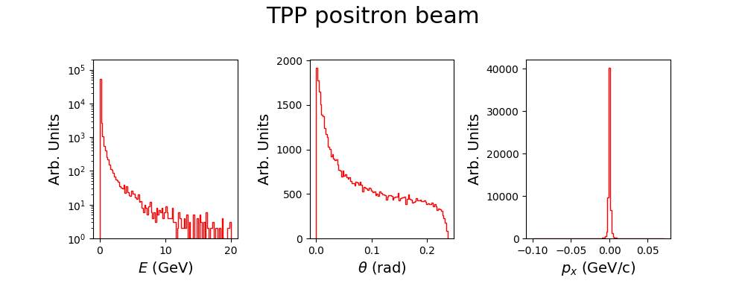
ERL – 2022, Cornell Univ. (USA), Oct. 5th, 2022

Slide 30
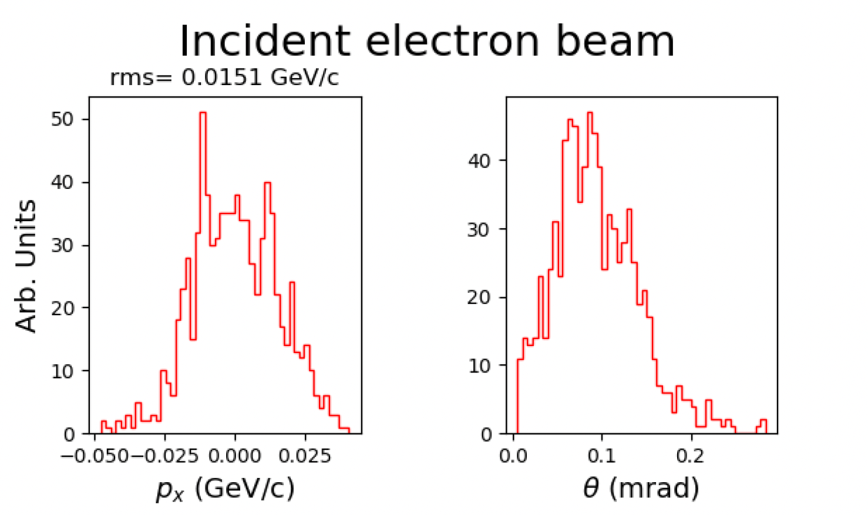
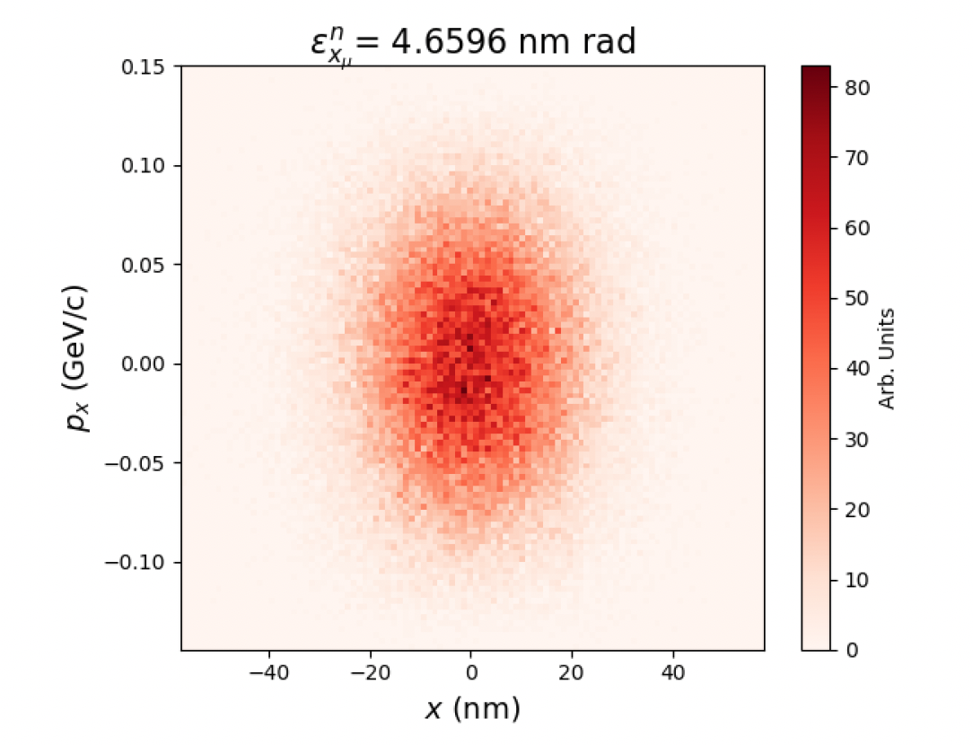
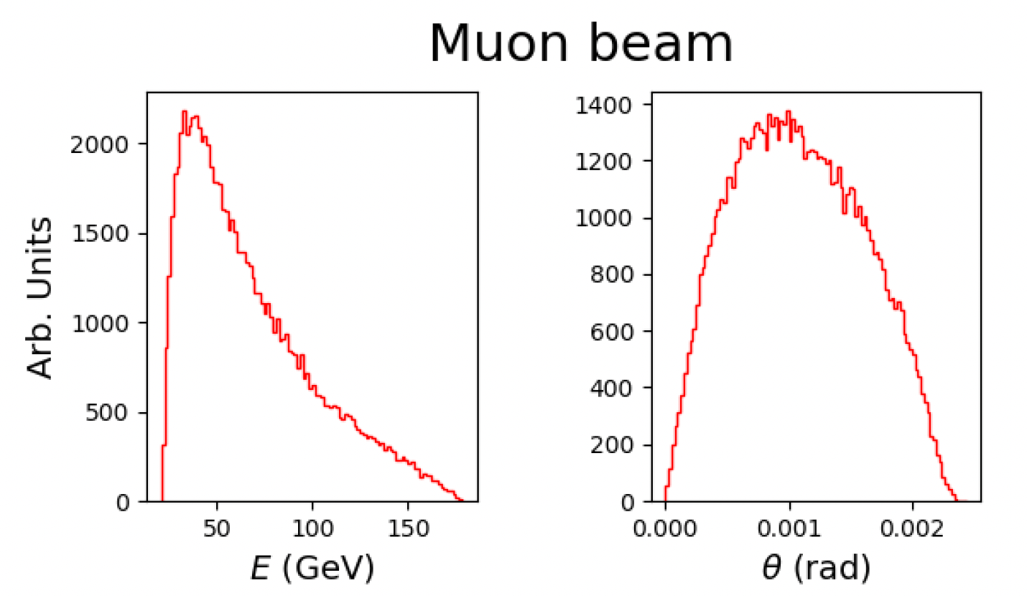
E_{e} = 200 GeV σ₀ = 14 nm $γ_{cm}=580$ E_{cm} = 346 MeV

Slide 31
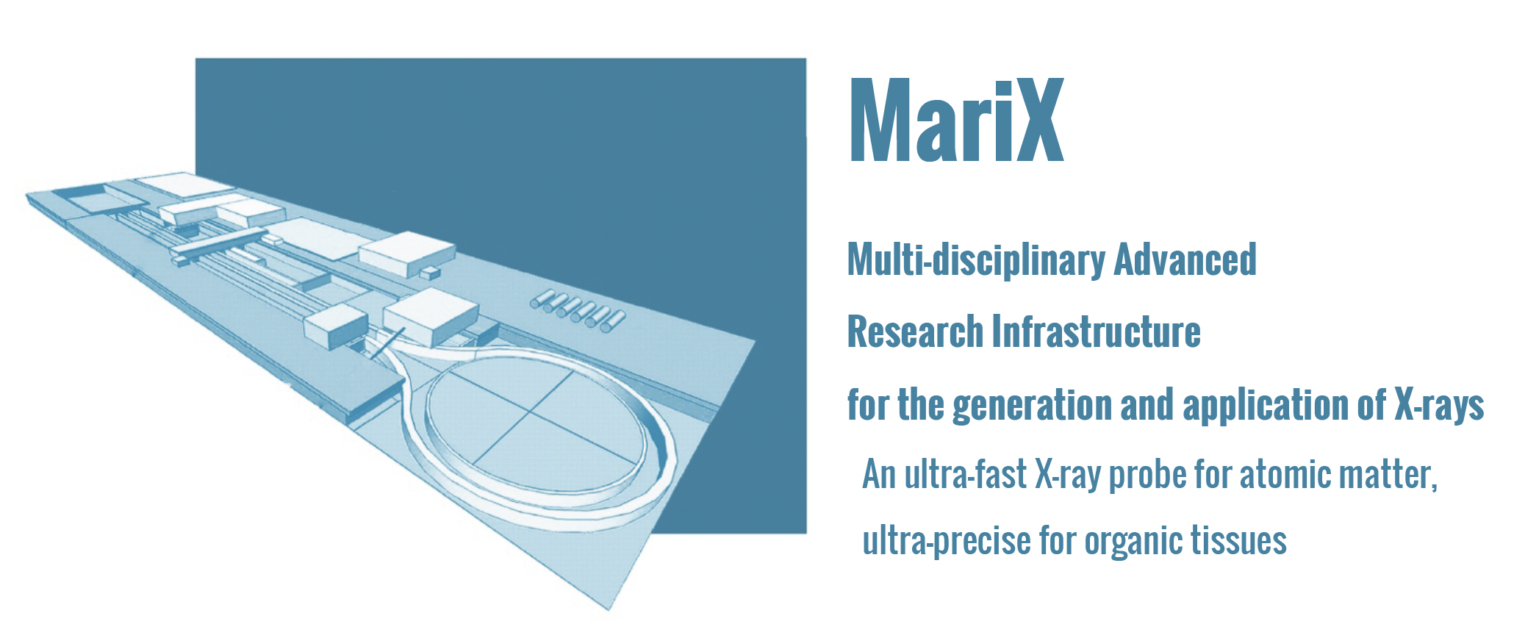
GeV muon beams with picometer-class emittance from electron-photon collisions
Luca Serafini and Camilla Curatolo – INFN-Milano and LASA
Very recent idea (C. Curatolo and L. Serafini, arXiv:2106.03255v1 , 6 Jun 2021) on a new scheme of muon collider based on electron-photon collisions
Idea conceived from decades of expertise on Free Electron Lasers (MariX), High Brightness e⁻ beams (SPARC), secondary beams from electron-photon collisions (Inverse Compton Scattering sources of X and γ –rays, STAR, ELI-NP-GBS), exotic ideas with photons (HPC) -> leading to EXMP (Electron and X-rays to Muon Pairs)

Slide 32
EXMP: a new Paradigm for a Muon Collider
based on Electron-Photon Collisions
Inverse Relativistic Kinematics for Muon Pair generation in particle-photon collision: a basics (through ICS and HPC)
Simulation of Muon Beam Generation in EXMP (Electron and X-rays to Muon Pairs)
Power Budget discussion
A Proof-of-Principle experiment at DESY with XFEL and a dedicated ICS: 5 GeV muon beams at moderate flux (˜1 s⁻¹) and small emittance (˜ 0.5 mm.mrad)
An Italian test facility for ERL and CW FELs – BriXSinO @ LASA
ERL – 2022, Cornell Univ. (USA), Oct. 5th, 2022

Slide 33
Generating an intense beam of 100s GeV photons
implies
running an ICS with several 100s GeV e⁻ beams
ISSUE: the electron beam power
(500 GeV @ 1 mA = 500 MW)
would be significantly burnt into the photon beam power,
that in turns would be burnt into a target for MPP
Energy un-sustainable,
radio-hazard un-sustainable
???
If we cannot generate 100s GeV photon beams, instead
we CAN accelerate electron beams up to 100s GeV
$$hν^{′}=2γhν$$
Se la montagna non viene da Maometto, Maometto andrà alla montagna…

Slide 34
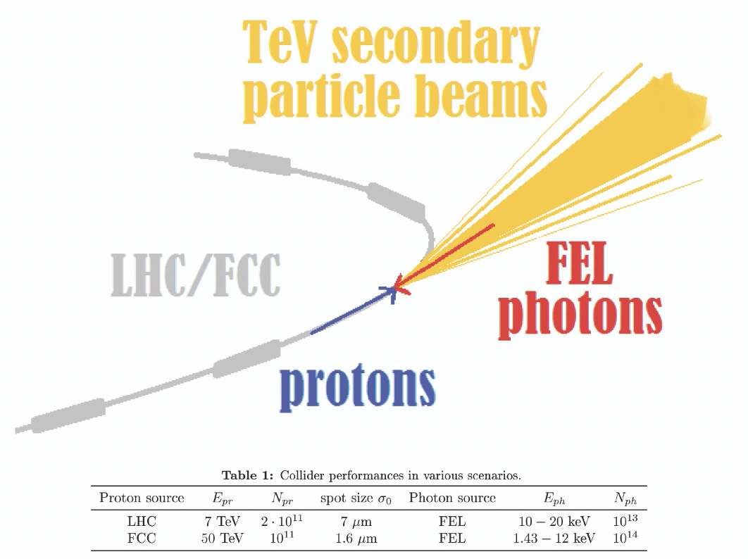
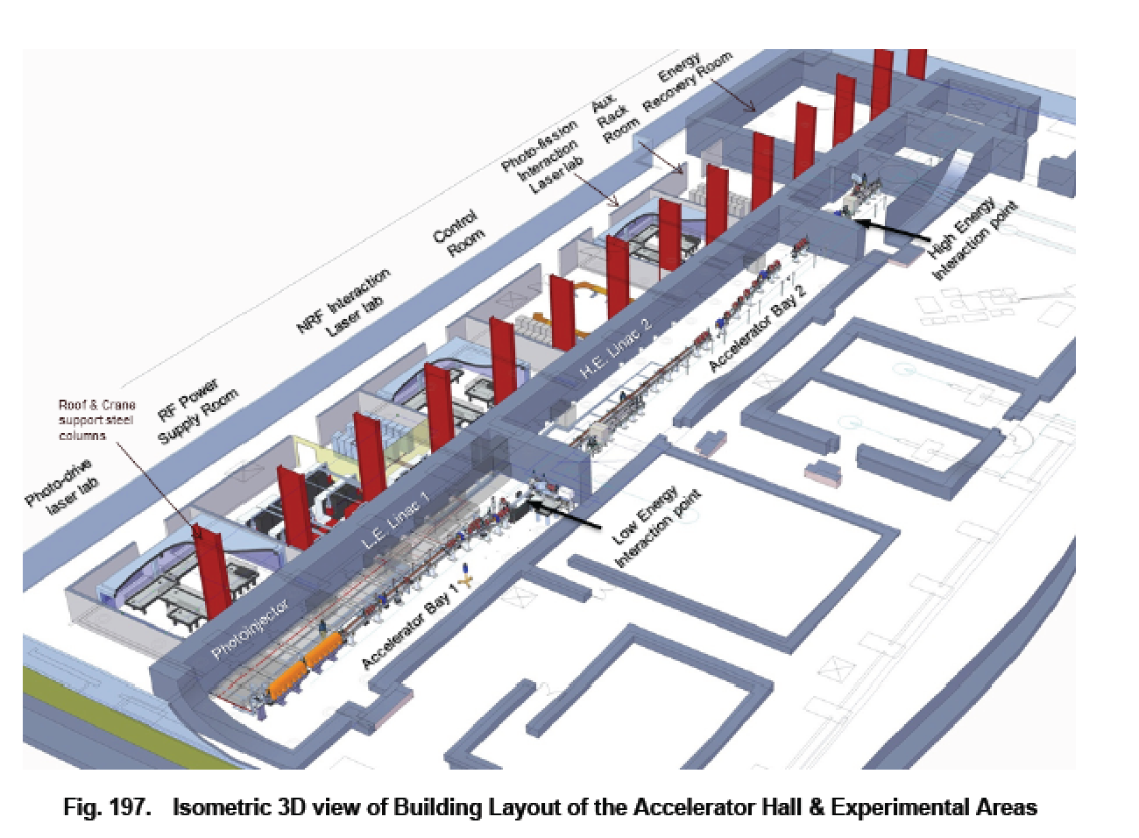
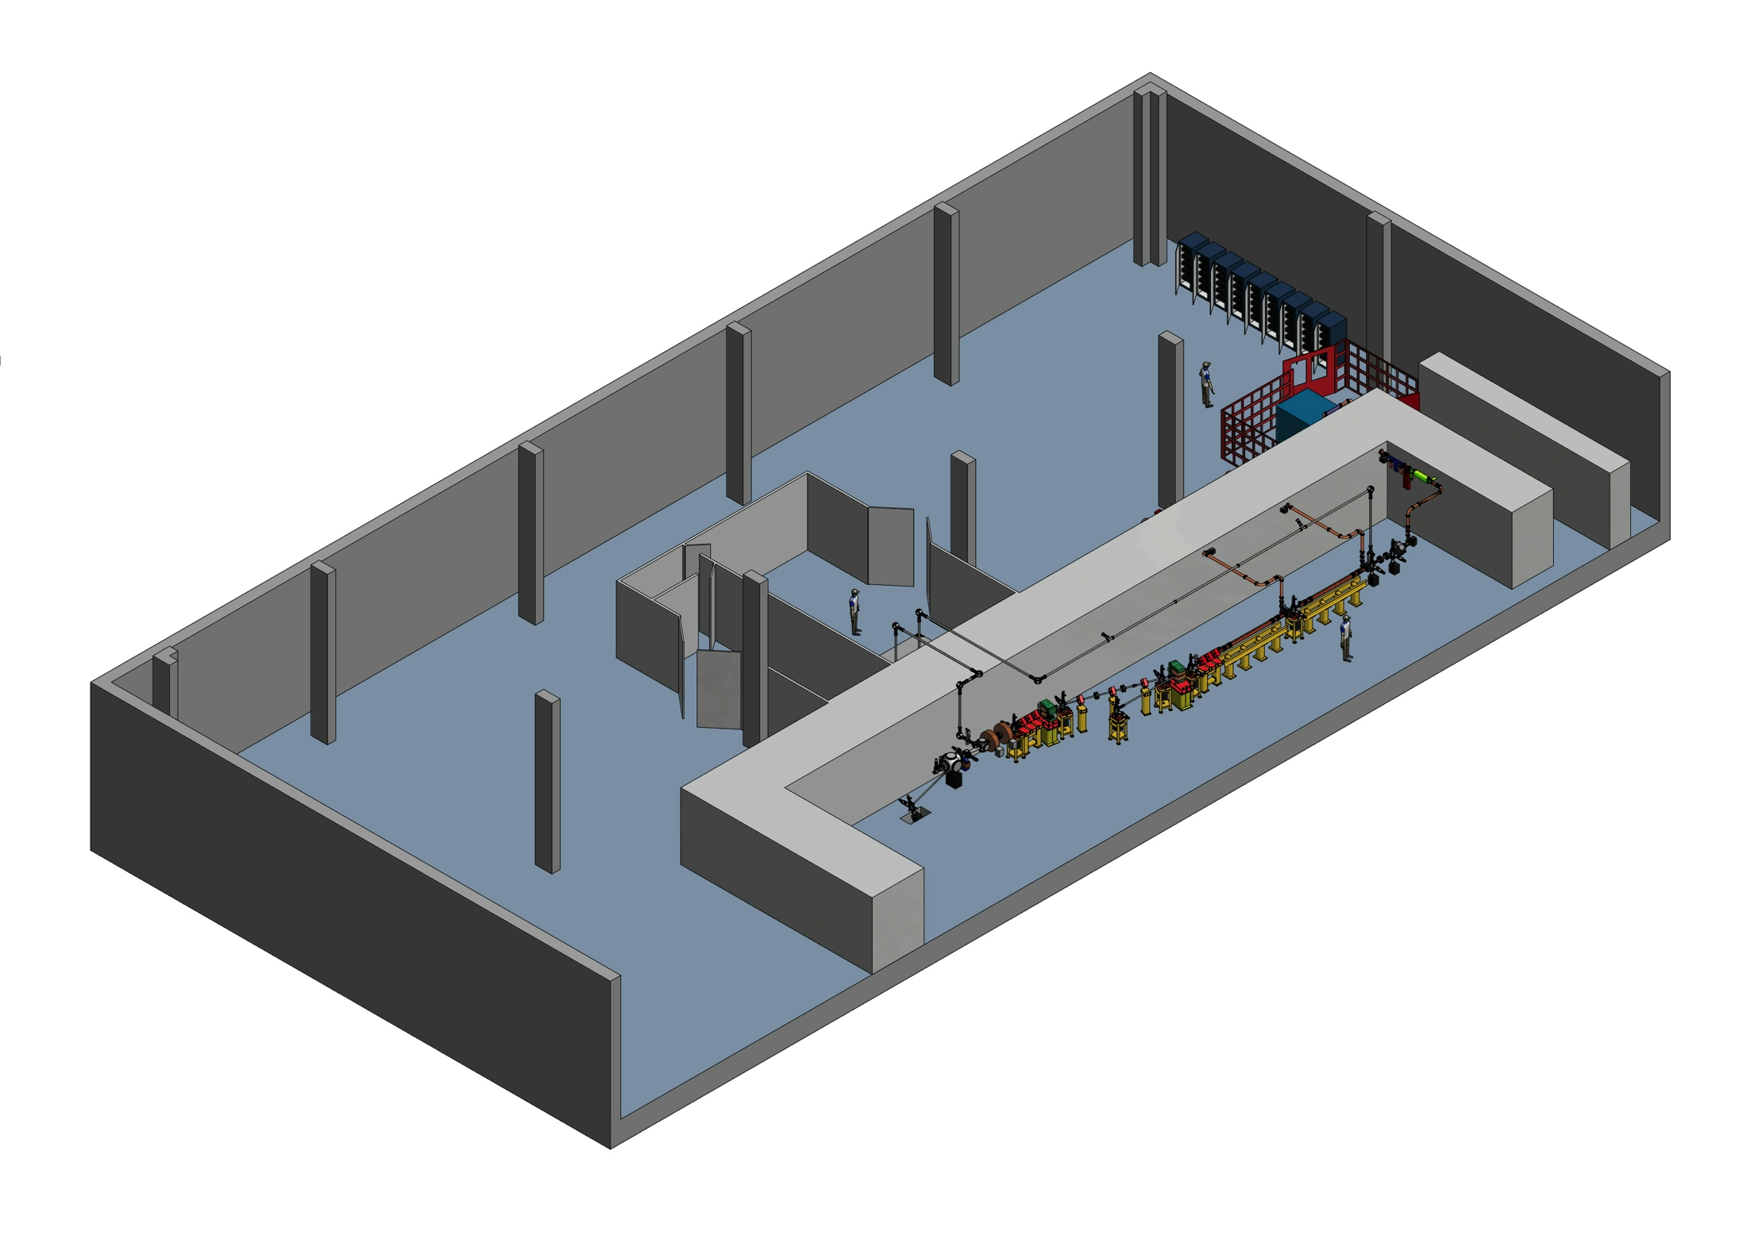
${e^{−} recoil factor Δ=\frac{4γhν}{M_{e}} ; in general E}_{CM}=$ $M_{e}\sqrt{1+∆}$
Inverse Compton Scattering sources (like STAR, 200 keV photons) are operated with very small recoil factor Δ << 1. ICS for Nuclear Photonics (ELI-NP-GBS, 20 MeV photons) runs at Δ < 0.03.
Hadron-Photon Collider works at small recoil factor Δ = 0.2
EXMP is set to run at very large recoil factors, Δ > 10⁵
ELI-NP-GBS
HPC
STAR
X
INFN – CSN1 Meeting – Firenze Nov. 15th, 2021

Slide 35
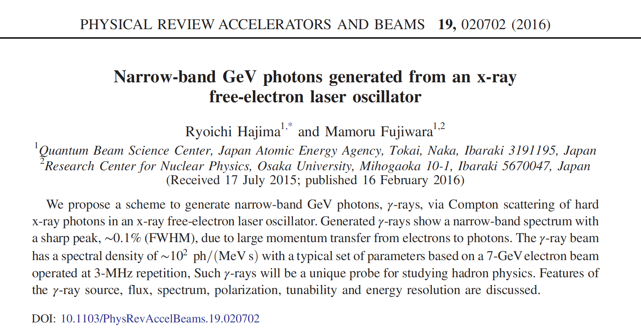
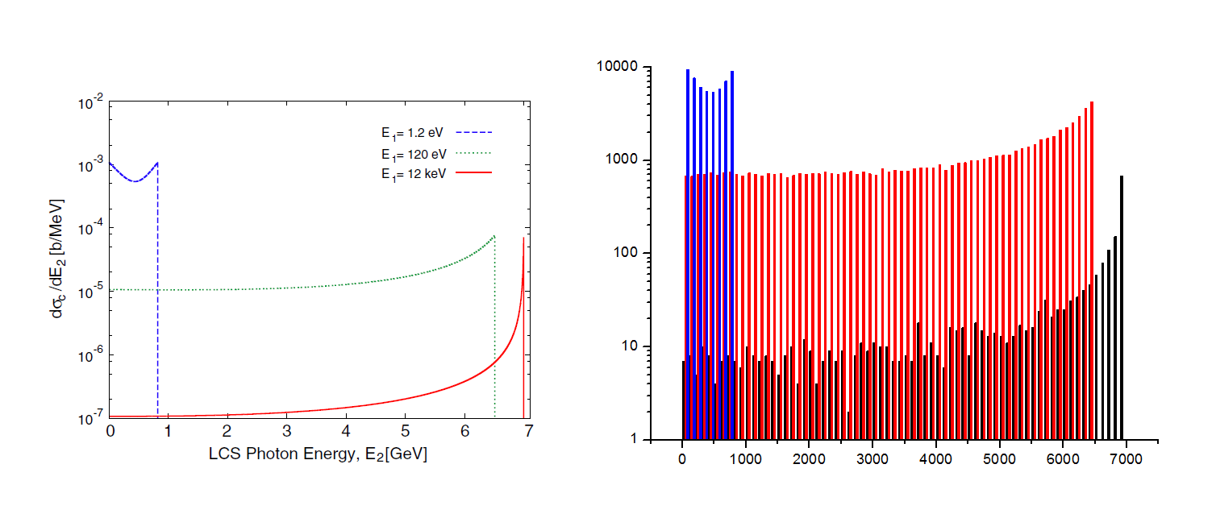
High Recoil of 12 keV photons
scattering off 7 GeV electrons
Laser
UV/FEL
XFEL
In vacuum Lorentz boost driven
channeling in large recoil regime
INFN - Acceleratori, Seminar @ LASA, Oct. 1st, 2021

Slide 36
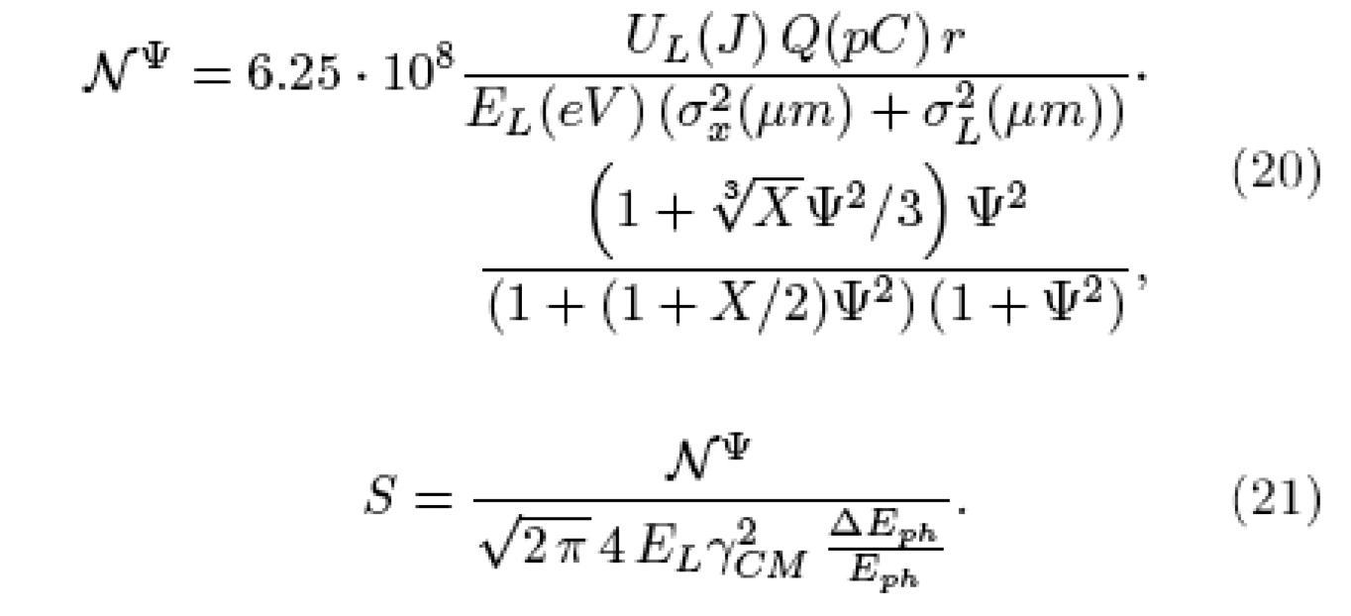
4th order variational expansion over rms phase space distribution of e-hν colliding beams
X = Δ = recoil factor

Slide 37
Power Budget discussion
One should note that the power transferred from the primary colliding electron/photon beams into the secondary beams of muons, photons, and e⁻/e⁺ pairs is quite negligible compared to the stored power into the colliding beams (electrons and FEL photons) at the collision point (2x100 GW + 2x10 GW).
The muon pairs (10¹¹ s⁻¹ at an average energy of 100 GeV) are taking out only 8.6 kW of beam power. The power taken by the back-scattered Compton gammas (4.10¹³ s⁻¹ at an average energy of 500 GeV) is 3.2 MW, and the power taken by the e-/e+ pairs produced (5.10¹⁶ s⁻¹ at an average energy of 2 GeV) is about 10 MW. Quite negligible with respect to the total power loss (320 MW), that is dominated by ERL efficiency and FEL photons. Probably 50% of FEL photon beam power can be recovered through thermal recycling, leaving a net 220 MW of beam power loss.
INFN – CSN1 Meeting – Firenze Nov. 15th, 2021

Slide 38
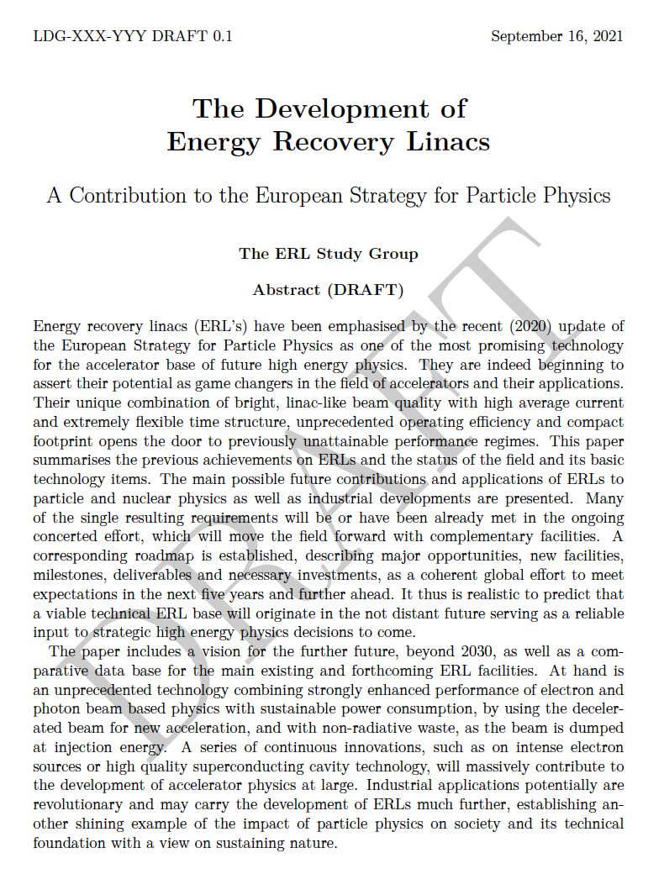
An expected efficiency beam-to-plug not smaller than 20%, actually in the range 20-40%, would set the AC power bill in the 500 MW - 1 GW range.
With 200 GW of “circulating” beam power
energy recovery becomes
absolutely mandatory:
ERL is the key technique to go
ERLs are exiting their infancy, mainly focused on radiation production
(as drivers of FELs, ICS, and synchotron light) are now entering the future scenario of HEP
INFN – CSN1 Meeting – Firenze Nov. 15th, 2021

Slide 39
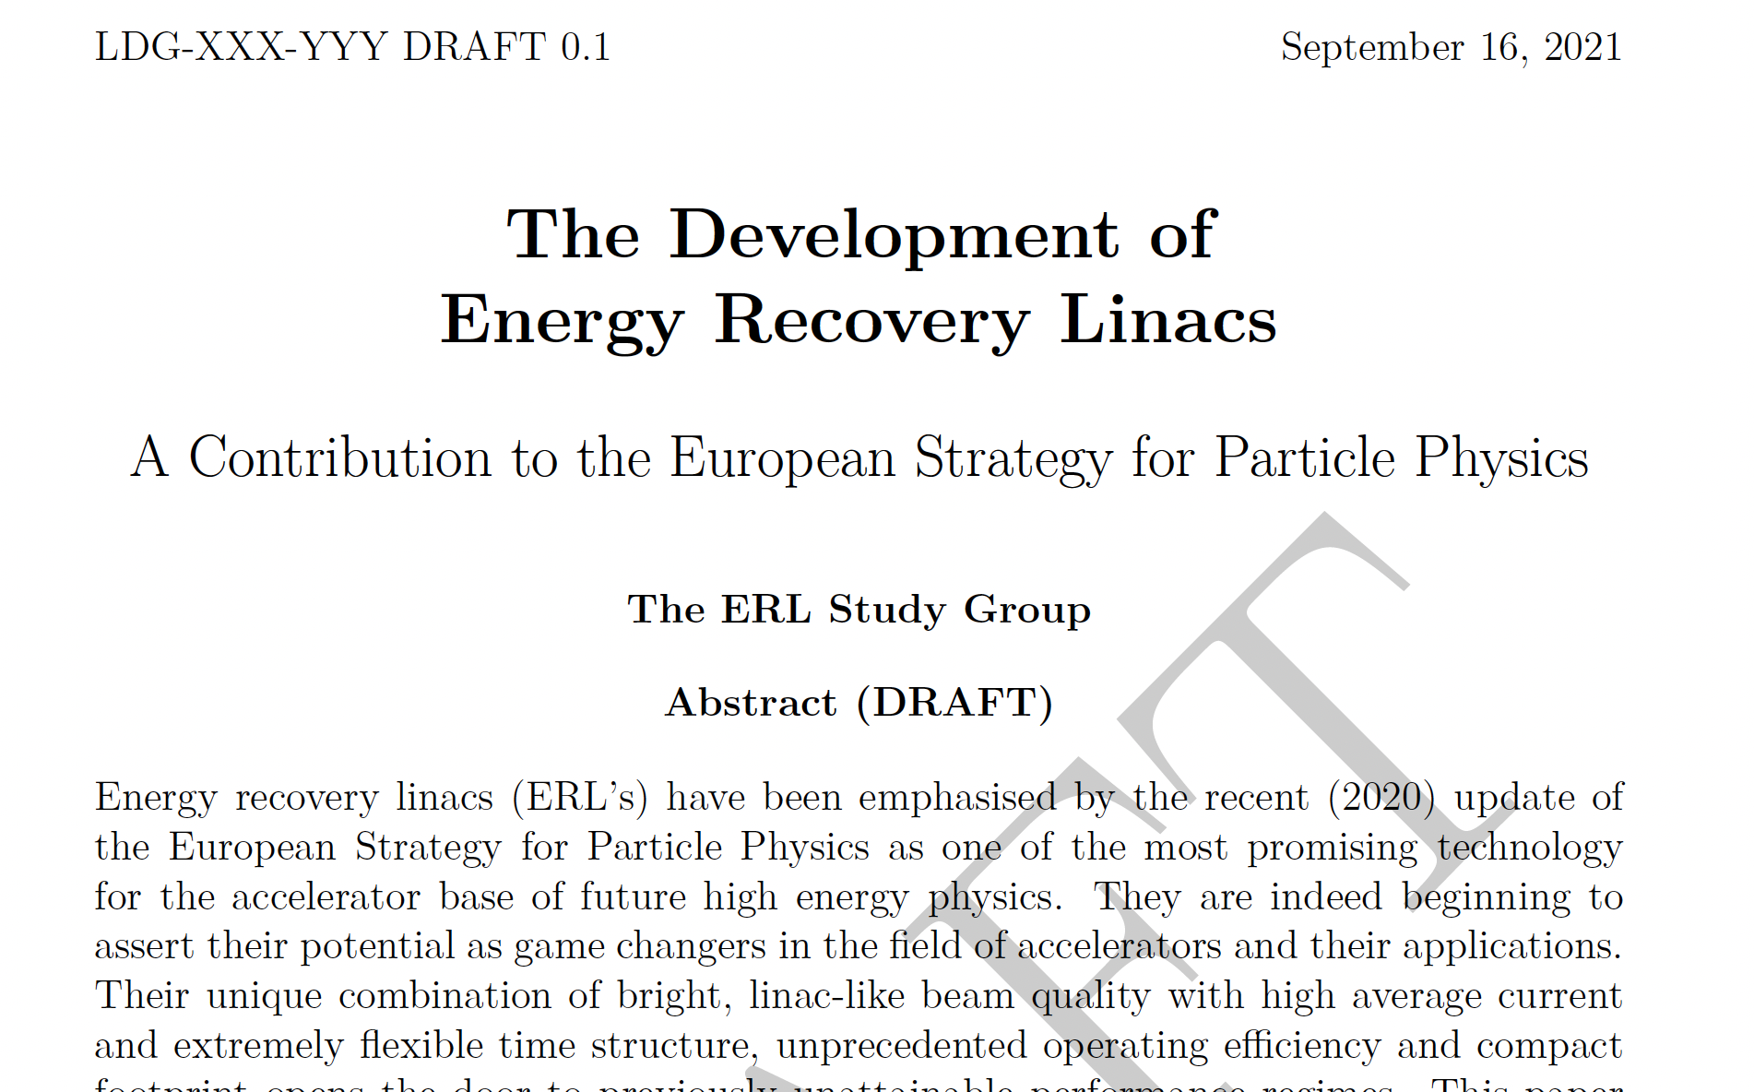
INFN – CSN1 Meeting – Firenze Nov. 15th, 2021

Slide 40
RECOIL PARAMETER X
Inverse Compton Scattering sources (like STAR, 200 keV photons) are operated with very small recoil factor X << 1. ICS for Nuclear Photonics (ELI-NP-GBS, 20 MeV photons) runs at X < 0.03.
Hadron-Photon Collider works at small recoil factor X = 0.2
EXMP is set to run at very large recoil factors, X > 10⁵
HPC
ELI-NP-GBS
STAR
X

Slide 41
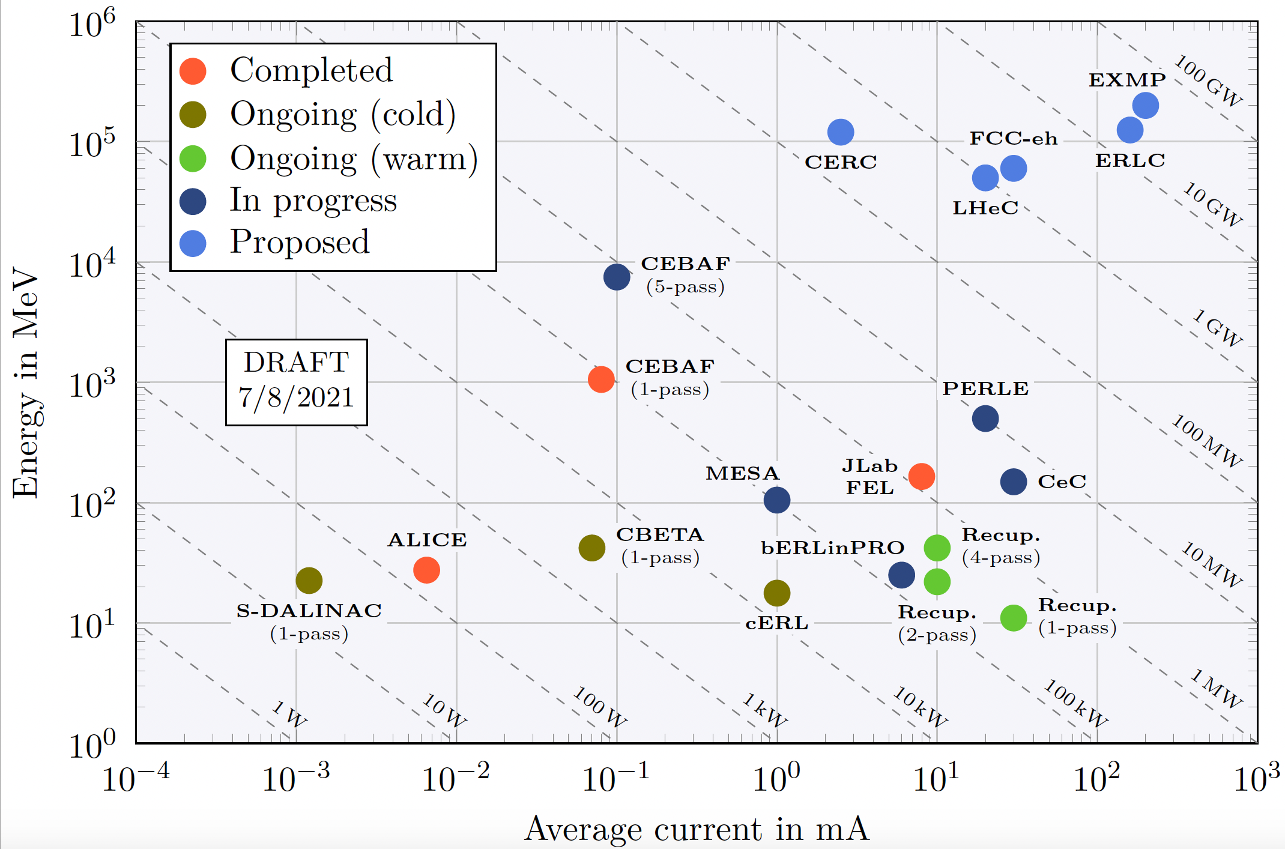

Slide 42
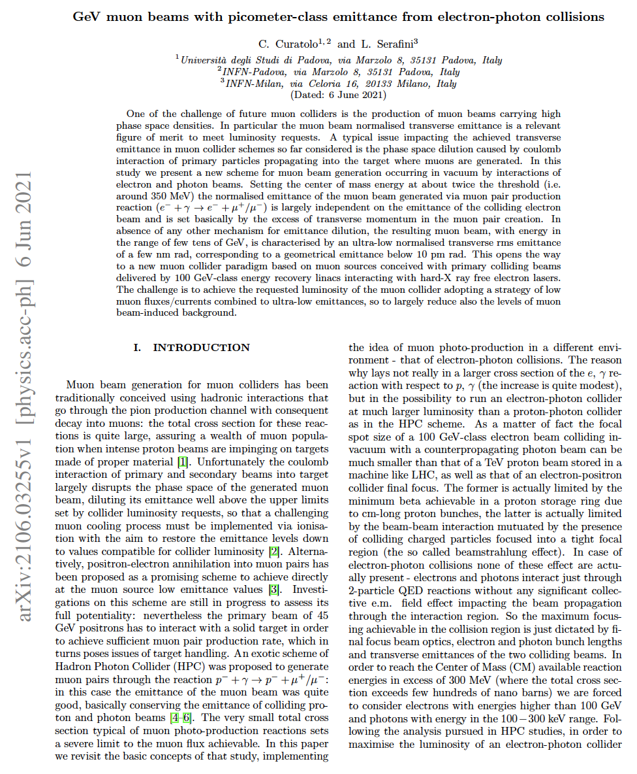
Many details/references can be found in
INFN – CSN1 Meeting – Firenze Nov. 15th, 2021

Slide 43
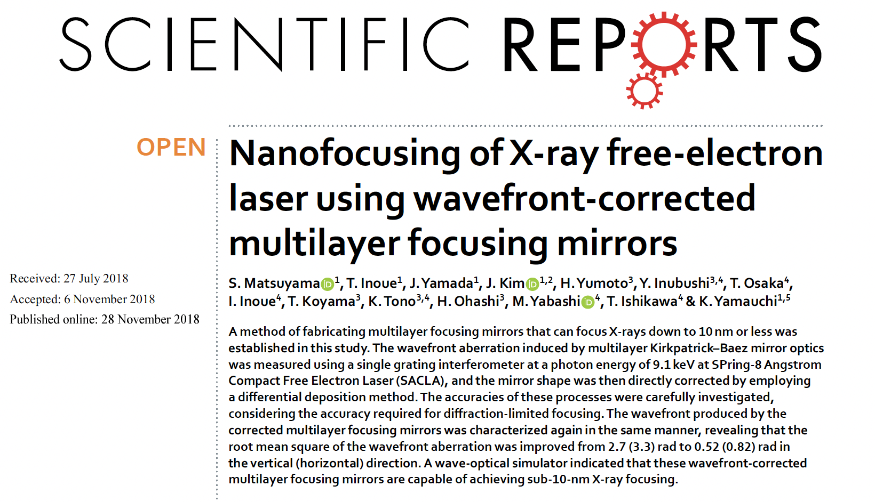

Slide 44
Trespassing
the Schwinger’s Limit (E = 1.3.10¹⁸ V/m)
@ XFEL (electron vs. FEL photon)
a0 = 4.3*lambda*Sqrt(U/sigmat)/w0
P = 0.94*U/(2*sigmat)
Ip = 2*P / (pi*w0²)
E = Sqrt(754*Ip)
XFEL 12 keV U = 5 mJ sigmat = 0.1 psec w0 = 10 nm
a0 = 0.01, eta=Delta=3130 , Chi = 31.3
P = 23.5 GW
Ip = 1.5*10²⁶ W/m² = 1.5*10²² W/cm²
E = 3.4*10¹⁴ V/m
E’ = E*γ = (17 GeV) = 1.1*10¹⁹ V/m

Slide 45
Trespassing
the Schwinger’s Limit (E = 1.3.10¹⁸ V/m)
@ LUXE (electron vs. laser photon)
a0 = 4.3*lambda*Sqrt(U/sigmat)/w0
P = 0.94*U/(2*sigmat)
Ip = 2*P / (pi*w0²)
E = Sqrt(754*Ip)
Laser 1.2 eV U = 20 J sigmat = 0.05 psec w0 = 4 μm
a0 = 20., eta=Delta=0.2 , Chi = 4.
P = 1 PW
Ip = 1.5*10²² W/cm²
E = 3.4*10¹⁴ V/m
E’ = E*γ = (17 GeV) = 1.1*10¹⁹ V/m

Slide 47
FEL photon energy (keV) | 300. | 150. | 60.
Photons per pulse | 10¹² | 5.10¹² | 1.25.10¹³
ε_{x,y} (m.rad) | 3.10⁻¹³ | 6.10⁻¹³ | 1.5.10⁻¹²
Focal spot size (rms, nm) | 20. | 14. | 10.
Repetition rate (MHz) | 800. | 800. | 800.
FEL beam power (MW) | 40. | 2x100. | 2x100.
rho-FEL | 3.10⁻⁴ | 5.10⁻⁴ | 8.10⁻⁴
FEL-efficiency (tapering) | 0.5% | 1% | 1%
FEL e-beam av. curr. (mA) | 200. | 200. | 200.
FEL e- beam bunch ch. (pC) | 250. | 250. | 250.
FEL e- beam energy (GeV) | 70. | 50. | 50.
FEL e-beam power (GW) | 14. | 2x10. | 2x10.
beam power recovery fraction (after FEL) | 99.9% | 99.9% | 99.9%
e- beam power loss (MW) | 14. | 2x10. | 2x10.
Total beam power loss (primary+FEL) (MW) | 202. | 300. | 320.
Peak Luminosity e-γ (cm⁻²s⁻¹) | 2.5.10⁴⁰ | 2x2.5.10⁴¹ | 2x1.25.10⁴²

Slide 48
FEL-graded CW electron beam – 800 MHZ (SC-RF Perle cavities) @ 200 mA
 | FCC-twinLinac track&field | Twin Linac 200 | Twin Linac 500
Energy e-beam (GeV) | 100. | 200. | 500.
Bunch charge (pC) | 250. | 250. | 250.
N_{e} | 1.6.10⁹ | 1.6.10⁹ | 1.6.10⁹
Repetition rate (MHz) | 800. (CW) | 800. (CW) | 800. (CW)
Average Current (mA) | 200. | 2x200. | 2x200.
Nominal beam power (GW) | 20. | 2x40. | 2x100.
Energy loss in 1 turn @ 15 km radius (MeV) | 593. | n.a. | n.a.
Synchrotron power loss in 1 turn @ 15 km radius (MW) | 119. | n.a. | n.a.
beam power recovery fraction | 99.9 % | 99.9 % | 99.95 %
beam power loss (MW) | 20. | 2x40. | 2x50.
Bunch length (psec) | 0.3 | 0.3 | 0.2
ε_{n}__{x} (m.rad) | 4.10⁻⁷ | 4.10⁻⁷ | 4.10⁻⁷
ε_{n_y} (m.rad) | 4.10⁻⁷ | 4.10⁻⁷ | 4.10⁻⁷
β_{x} (mm) | 0.2 | 0.2 | 0.23
β_{y} (mm) | 0.2 | 0.2 | 0.23
σ_{x} (nm) | 20. | 14. | 10.
σ_{y} (nm) | 20. | 14. | 10.

Slide 49
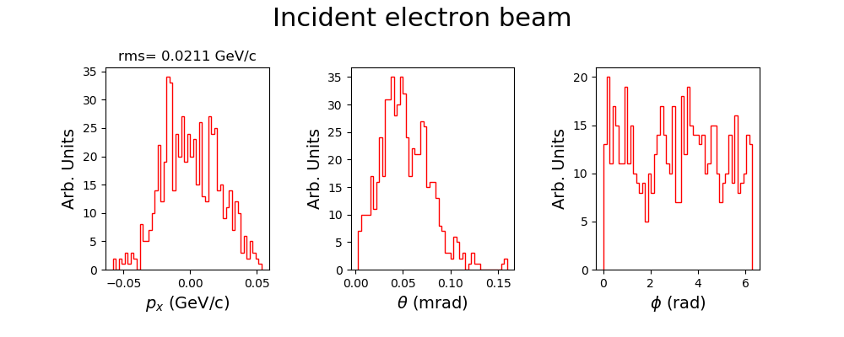
500 GeV

Slide 50
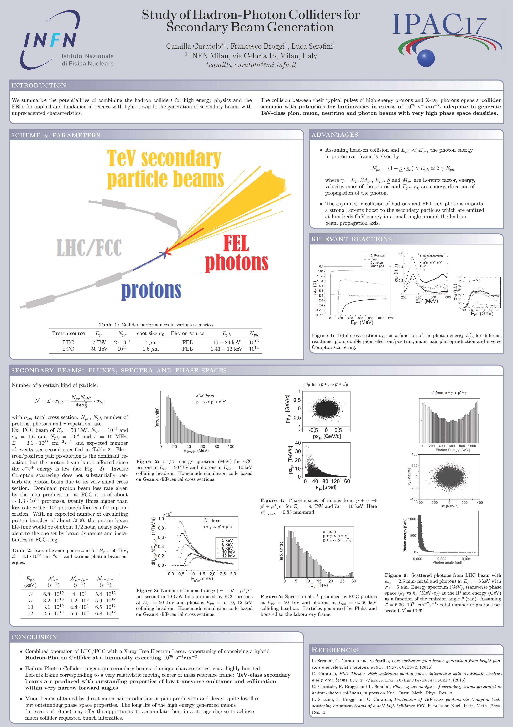

Slide 51
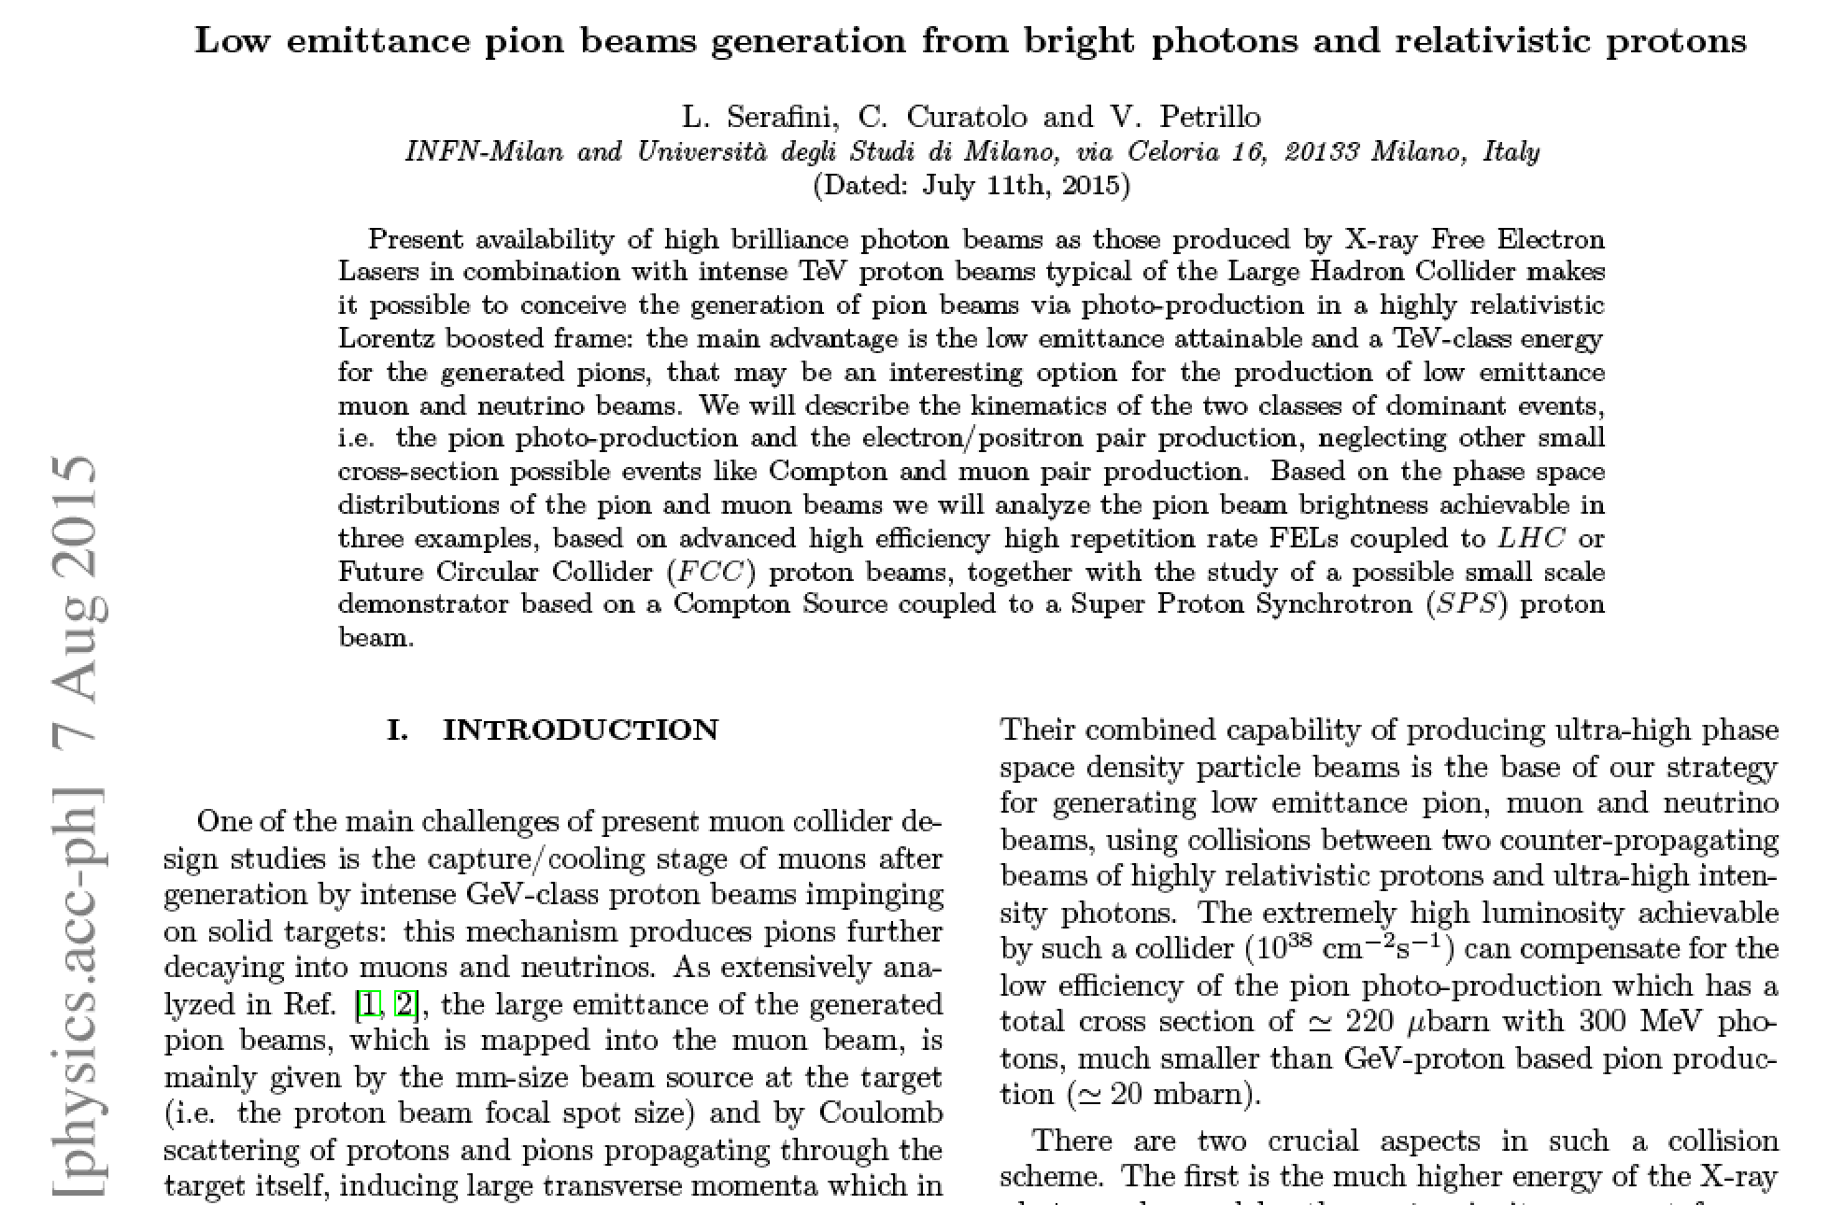

Slide 52
INFN - Acceleratori, Seminar @ LASA, Oct. 1st, 2021

Slide 53
INFN - Acceleratori, Seminar @ LASA, Oct. 1st, 2021

Slide 54
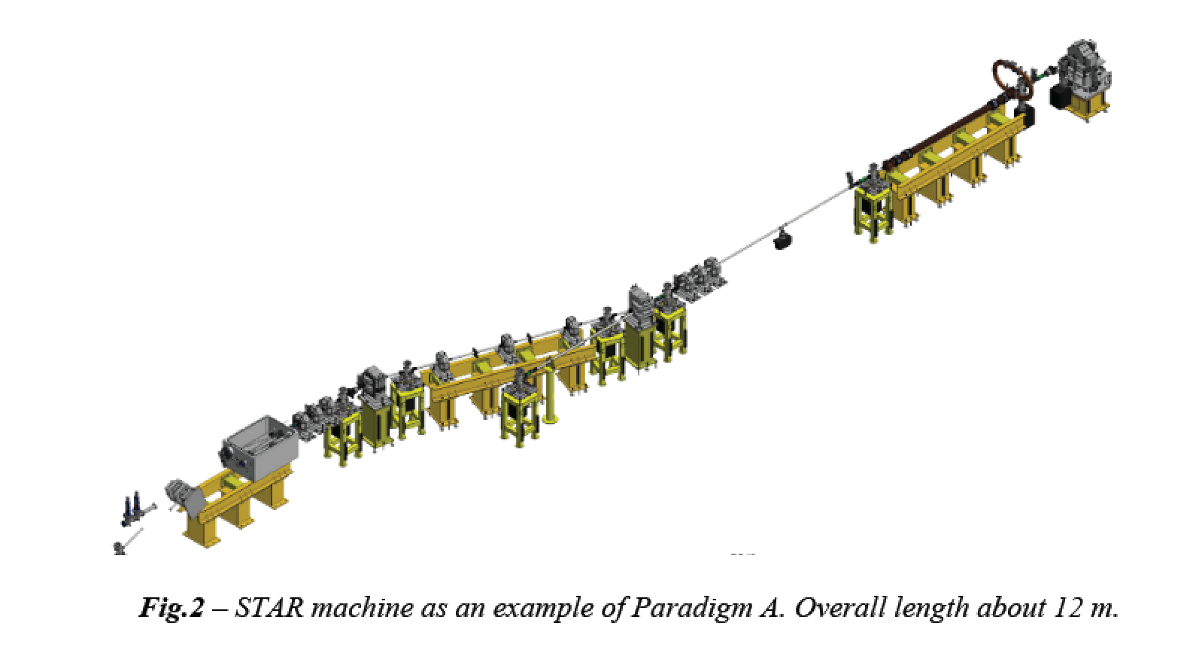
STAR was designed by INFN in 2013-2014 adopting a common paradigm with ELI-NP-GBS: both are e-γ linear collider based on 100 Hz amplified J-class lasers interacting with high brightness RF photo-injector. The design strategy applies Petrillo-Serafini criterion for maximum spectral density.
strong focusing to maximize
Peak Luminosity according
to Petrillo-Serafini criterion
$$S_{d}∝\frac{\left\langle I_{e}\right\rangle U_{las}}{ε_{n}^{2}E_{x}}$$
250-750 MeV e⁻
1-19.5 MeV γ
30-150 MeV e⁻
20-350 keV X

Slide 55
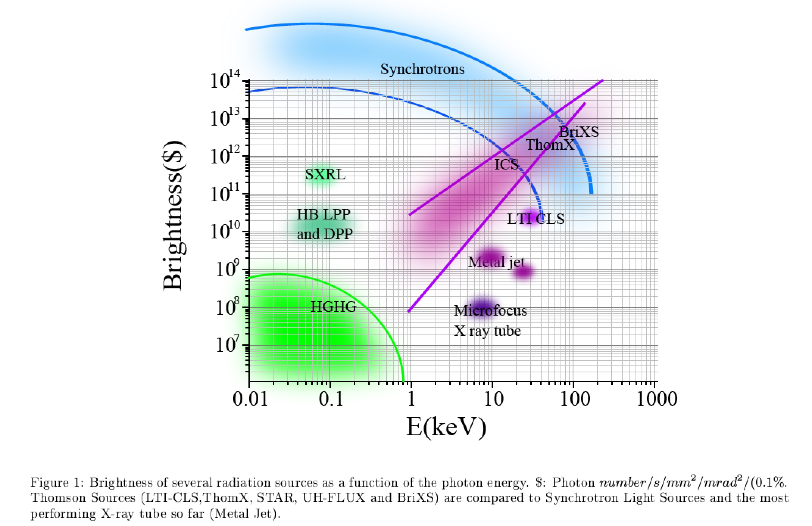
Inverse Compton Sources rivaling in Average Brightness with Synchrotron Light Sources at photon energies above 80-100 keV
ELI-NP-GBS
BriXSinO
STAR2
STAR
I.C.S.

Slide 56
$E_{CM}=2\sqrt{M_{e}γhν}$ ; $2γhν=\frac{E_{CM}^{2}}{2M_{e}}$
$$γ_{cm}=\frac{γ}{\sqrt{1+Δ}}$$
I.C.S.
Δ=0 electron as relativistic mirror
Δ>>1 (A)symmetric collider
INFN - Acceleratori, Seminar @ LASA, Oct. 1st, 2021

Slide 57
EXMP Simulations Results
(using Wizhard + ad-hoc script to populate phase spaces)
EXMP with 200 GeV electrons | vs. 150 keV FEL photons
E_{CM} | 346 MeV
TPP total cross section | 19 mbarn*
ICS total cross section | 14.7 μbarn
MPP total cross section | 216 nbarn*
N e₊₋ | 2x4.8 10¹⁵ (s⁻¹)
N_{ICS} | 2x3.7 10¹² (s⁻¹)
N μ₊₋ | 2x5.4 10¹⁰ (s⁻¹)
$$αr_{e}^{2}=0.57 mbarn$$
$$αr_{μ}^{2}=13.4 nbarn$$
INFN - Acceleratori, Seminar @ LASA, Oct. 1st, 2021

