Slide 1



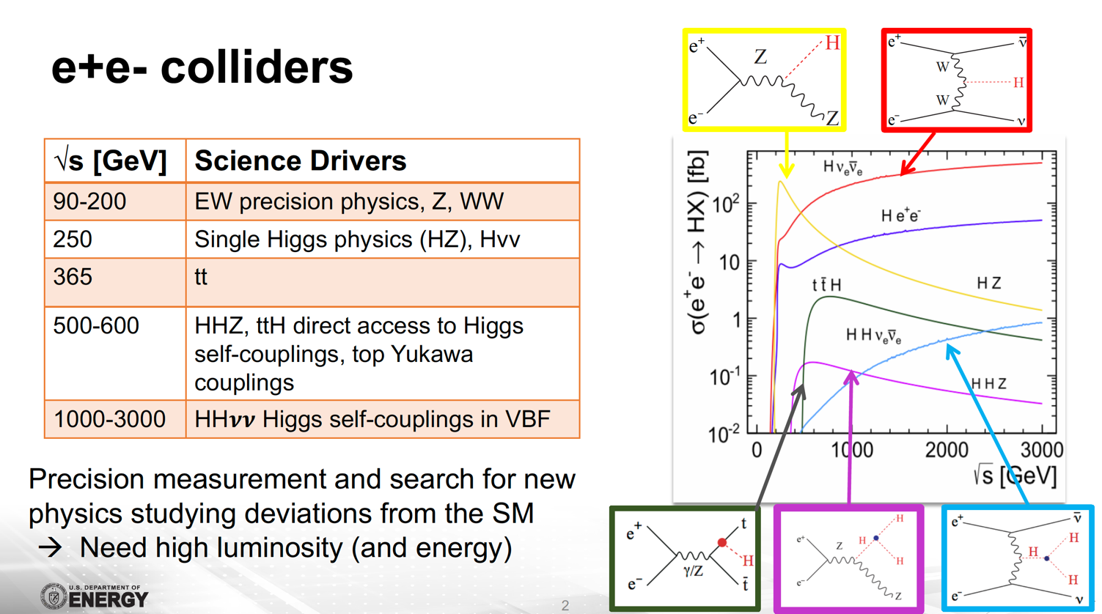
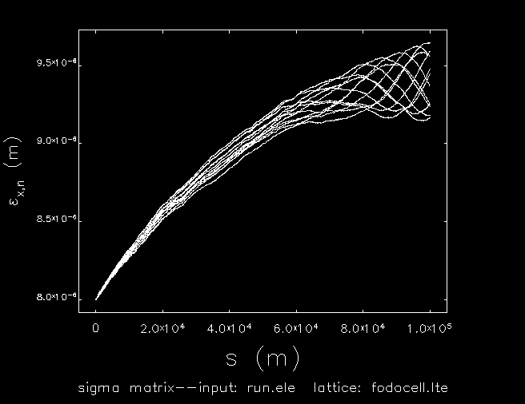
High Energy High Luminosity e⁺e⁻ Colliders using Energy-Recovery Linacs
Vladimir N Litvinenko, Nikhil Bachhawat, Yichao Jing, Francois Meot,
Maria Chamizo Llatas, Irina Petrushina and Thomas Roser
Key development: two concepts including
CERC (Circular Energy-Recovery Collider) and ReLiC (Recycling Linear Collider)
Physics: Investigating details of:
Accelerator: Developing detailed start-to-end simulations
Checked possibility of colliding polarized electron and position beams
October 5, 2022: ERL’22 workshop, Cornell University

Slide 2
CERC and ReLiC: polarized e⁺e⁻ colliders
Impact of polarization
Common features
  Recycling of used particles - no need for high intensity positron source
  Energy recovery
  High luminosity
  High polarization of both electron and positron beams
Differences
  CERC c.m. energy reach is limited to sub-TeV by synchrotron radiation of the beam at the top energy
  ReLiC has potential of operating at higher luminosity that CERC
  ReLiC can also go to few TeV c.m. energy, but requires full energy linacs
The proper combination of polarization for electrons and positrons will significantly enhance the production cross section or will suppress it.

Slide 3
Both CERC and ReLiC would be capable of operating at high c.m. high energies with very high luminosity

Slide 4
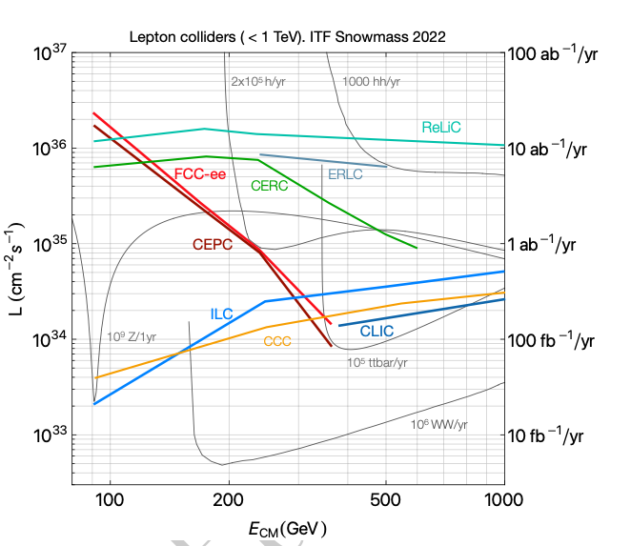
Physics potential in HIGS sector
√s [GeV] | Science Drivers
90-200 | EW precision physics, Z, WW
250 | EW Higgs precision (HZ), Hνν
365 | tt
500-600 | HHZ, ttH direct access to Higgs self-couplings, top Yukawa couplings
1000-3000 | HH𝝂𝝂 Higgs self-couplings in vector-boson fusion sector
CERC @ 30MW of SR and ReLiC provide much higher luminosity than ILC/CCC and FCC-ee/ CEPC at √s >120 GeV
CERC can reach √s~600 GeV, while ReLiC can reach √s>1 TeV

Slide 5
Suitability for future experiments
ReLiC
CERC
FCC ee
Can be also used for hadron-electron and hadron-positron collider in conjunction with LHC or FCC hh

Slide 6
Baseline design
CERC, Circular e+e- Energy Recovery Collider
SRF linac 1
SRF linac 2
Damp electron ring
Damping positron ring
Flat beams cooled in damping rings with top off
Bunches are ejected with collision frequency
Beams accelerated with SRF linacs in two four-path ERLs
After collision at top energy RF phases are changed to deceleration returning most energy to SRF linac
Decelerated beams are reinjected into cooling rings
After few damping times the trip repeats
Luminosity is shared between detectors in any desirable ratio
Only beams at top energy pass through detectors, the rest of beams bypass them
100km ring
Combines advantages of existing colliders:
Storage ring colliders: recycling beam energy and particles
Linear colliders: efficient collisions using a large disruption parameter

Slide 7
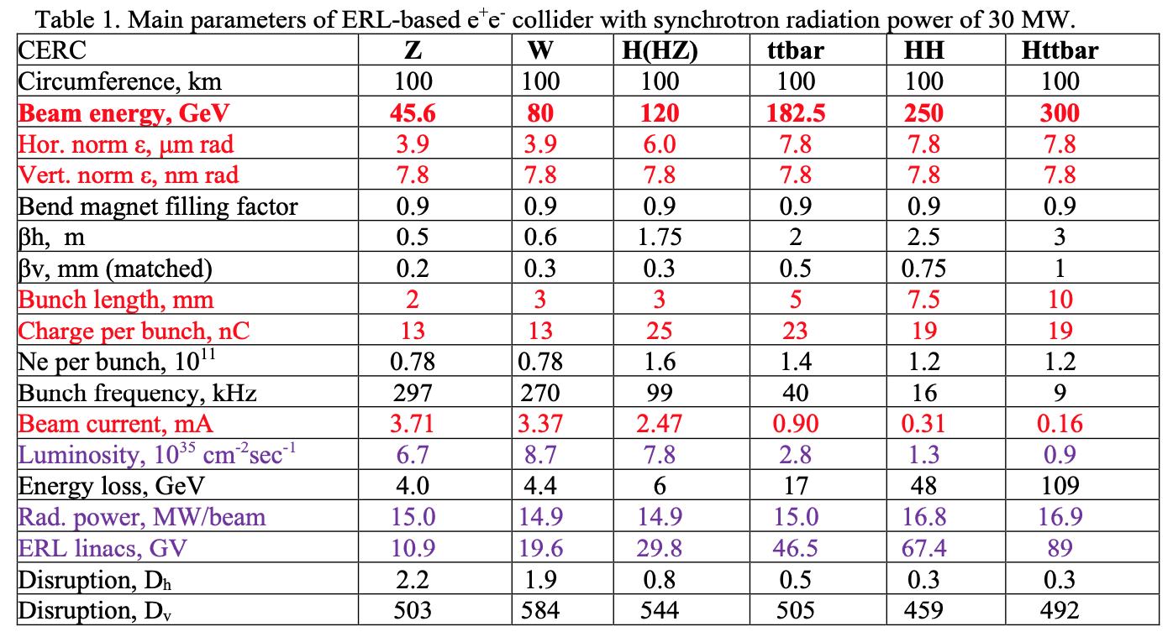
CERC parameters
Damping ring energy [GeV] | 2 | 2 | 2 | 3 | 4.5 | 8

Slide 8
Key technologies and Challenges
Energy Recovery Linacs approach: the energy which the beam receive from the RF field in superconducting accelerating structures is fed back to the structures by decelerating the beams on the opposite RF phase after beams collide at the IP
Two SRF Linacs
  703 MHz 5-cell cavity (so called BNL-3 design)
  16 m long cryostat housing 10 five-cell cavities
  SRF Q₀=10¹¹
16 transport lines: due to synchrotron radiation the recirculating beam lines for accelerated and decelerated beams have to be different
High energy acceptance damping rings to cool down beams at an energy of ~few GeV after collisions. Beamsstrahlung relative energy spread is amplified by a factor 60 with deceleration to the damping ring
High repetition kickers to extract/inject up to 99k bunches into the damping rings
NC magnets with ~15 mm gap
Multi-pass, high energy ERL
Transport beamline lattice preserving a small vertical emittance with large beam aspect ratio
Flat beams and high disruption parameter need full 3D simulations
Using small gap magnets to reduce power consumption and cost of the multiple 100 km beamlines
Absolute beam energy measuring systems with accuracy ∼10⁻⁵ at IRs as pioneered at CEBAF
High repetition rate extraction and injection kickers for a few GeV damping rings
Compressing and de-compressing electron and positron bunches to match energy acceptance of the ~ GeV damping rings
Recirculation lines for e+ and e- are different, 16 lines in total (4-pass ERL)

Slide 9
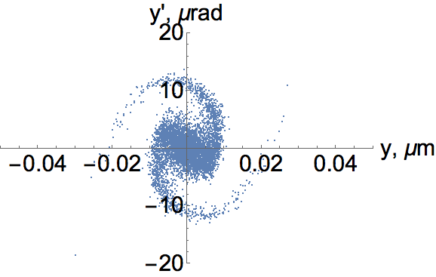
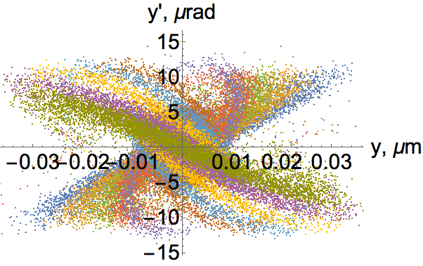
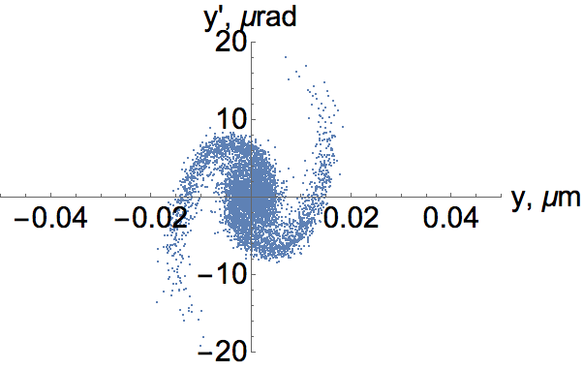
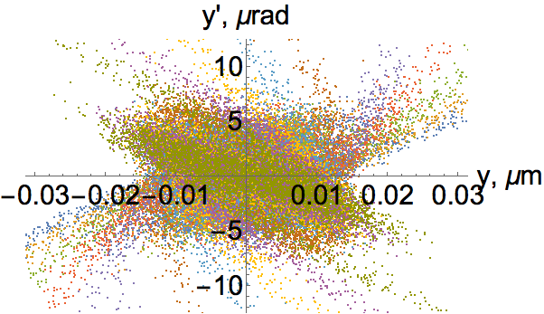
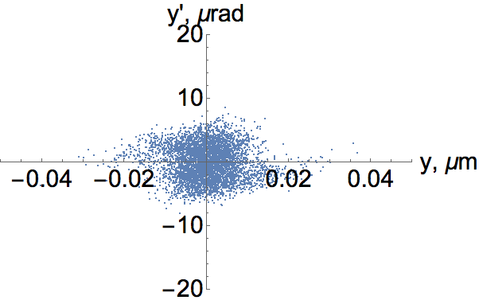
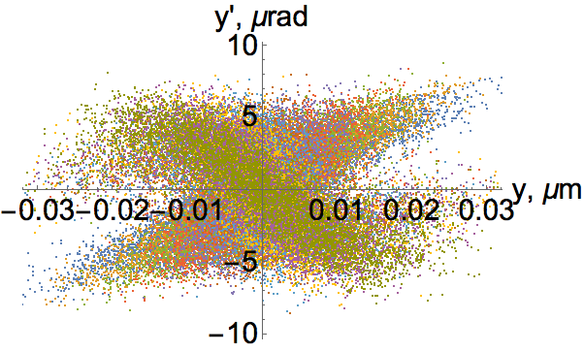
Strong-strong collisions of flat beams in ERL e⁺e⁻ collider: D_{y}=142
(a) (b)
(c) (d)
(e) (f)
Beam distribution in the vertical phase space after the collision. Distributions of the central slice are on the left and combinations of 10 slices covering evenly -3σ_{z} < z< 3σ_{z} , are on the right: (a-b) are for center particles at x=0; (c-d) are for those at x= σ_{x}, (e-f) is for that at x= 2σ_{x}. The horizontal axes are the vertical coordinate and the vertical axes are vertical angle of the particle

Slide 10
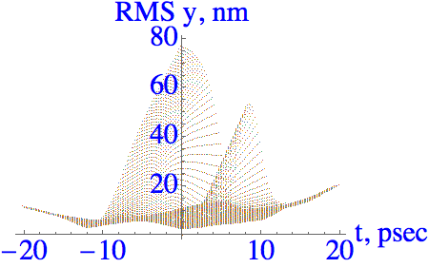
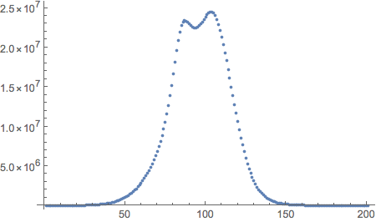
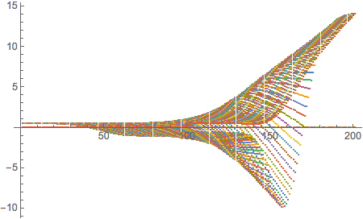
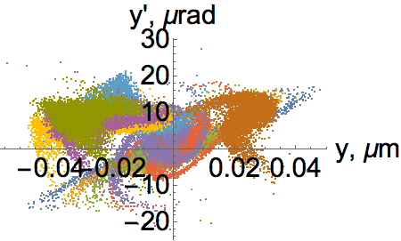
Effects of orbits offsets in IP
Initial beam axis separation is Δy=1σ_{y}
Beam centroids evolution in units
of σ_{y} at the beam waist.
Instantaneous luminosity (a.u.)
Faster drop
after the IP
center
L/L_{max}
Δy/σ_{y}
Main effect from offsets: RMS vertical beam emittance increases ~ 10X after collisions. It does not present any problems for the energy and particles recovery. It may require to increased time in the cooling rings to three-to-four damping times – this should be optimized for actual orbit deviations
Reduction of the luminosity is modest – actually the pinch effect continued delivering significant gain at all deviations of beam orbits

Slide 11
ReLiC – Recycling Linear Collider
Using linear collider approach for IRs: flat, low emittance beams with reasonable vertical disruption
Recycling of the beam energy and recycling and re-use collided electrons and positrons
Bunches are ejected with collision frequency and accelerated on-axis in SRF linacs collide in one of two detectors
ReLiC collides mono-energetic beams by keeping the beamstrahlung under control
Collided bunch trains are decelerated in the opposite linacs where they are periodically separated from colliding with accelerating beam
Decelerated beams are injected into the damping rings to de repaired and polarized.
After few damping times, the trip repeats in the opposite direction and beams collide in a detector located in the opposite
Burned-off particles are replaced in the damping rings by “top off” from low current injectors
ReLiC collider recycles polarized electrons and positrons
Reusing electron and positron beams beam cooled in damping rings provides for natural polarization of both beam via Sokolov-Ternov process. Depolarization in the trip between damping ring is minuscular, which would provide for high degree of polarization. With lifetime ~ 10 hours, necessary replacement of electrons and positrons is at 1 nA level – this is major advantage of ReLiC

Slide 12
ReLiC in HIGS sector
Main parameters
Gain of 40 to 200 at HIGS energy

Slide 13
ReLiC would be capable of very high luminosity at very high energies
Main parameters

Slide 14
Key technologies
CW superconducting RF (SRF) linacs with high Q
5-cell 1.5 GHz SRF cavities with effective HOM damping
Electro-magnetic separators for contra-propagating bunch-trains
Low emittance damping rings with flat beams and large energy acceptance
Bunch compressor/decompressor
MHz rate injection/ejection kickers
nA-scale top-off e⁺e⁻ injectors
Two collision areas (IPs)
Vertical beam stabilization at the IPs

Slide 15
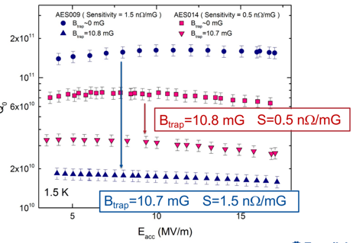
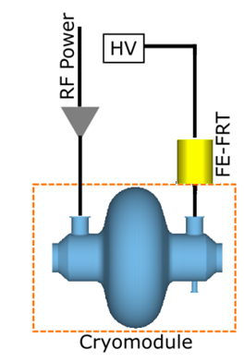
Accelerator design and challenges
On-axis acceleration and deceleration of high energy beams is main advantage of ReLiC, allowing using existing SRF linac technology and other conventional equipment
But still there are a lot of challenges:
1.5 GHz SRF cavities with quality factor Q > 10¹¹ at 1.5 K
High-efficiency 1.5K LiHe refrigerators
Reactive tuners to reduce power to suppressing microphonics
Damping rings with very flat beams (ε_{h}/ε_{v} ~2,000-4,000)
Damping rings with 10% energy acceptance
10-fold bunch compressor/decompressor at 10-20 GeV
MHz rate injection/ejection kickers
Vertical beam stabilization at the IPs
FoM ~75

Slide 16
Summary and Acknowledgements
CERC
  Higgs sector collider that promises high luminosities with a center of mass energy reach up to 600 GeV
  Fists concept proposed as a high-energy, high-luminosity e+e- collider using Energy Recovery Linacs
  Capable of sustaining high degree of polarization in both electron and positron beams
  Strawman lattice developed and initial tracking simulations in IR were performed
  Main challenges – high Q SRF, high-repetition kickers, very flat beams
ReLiC
  ReLiC would excel in HIGS sector – “reasonable” in size and power consumption with huge boost in luminosity and high degree of polarization
  Radiation losses and emittance growth are negligible in separators - c.m. energy can be 3 TeV or even higher
  Beamstrahlung is minuscular when compared with ILC – i.e. ReLiC would collide monoenergetic beams
  Disruption parameters reasonable at HIGS energy and very small at 3 TeV c.m.
  Main challenges – High Q- SRF linac, reactive tuners, MHz rep-rate of kickers, high SR power in damping rings
Acknowledgements
  Authors are thankful to Dr. Sergey Belomestnykh (FNAL) for very detailed estimation of AC power requirement for ReLiC using current SRF technology. We also want to thank Tor Raubenheimer, Spencer Gessner, Vladimir Shiltsev and Marlene Turner for pointing out for inconsistencies in our initial proposals and for thoughtful comments and estimations.

Slide 17
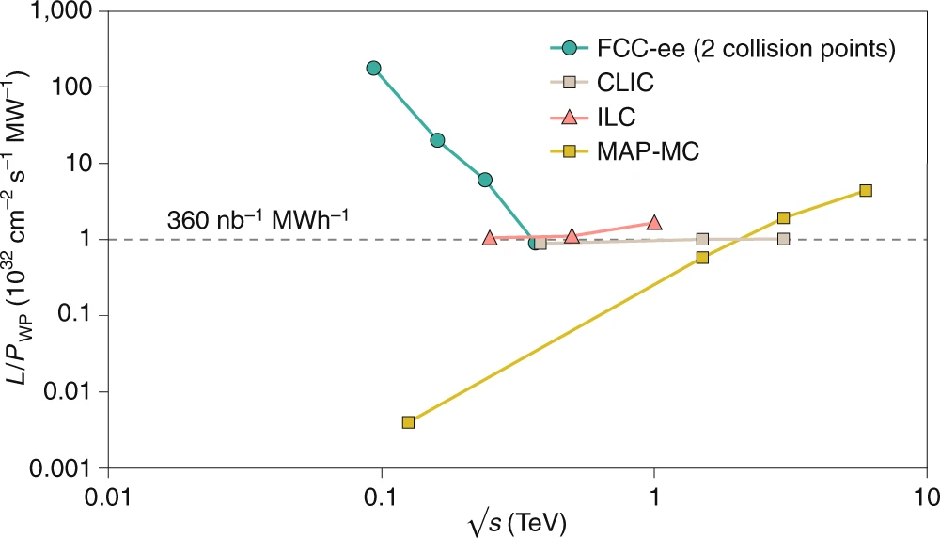
Personal notes (VL)
Key parameters : the productivity
I like ReLiC concept for following reasons:
  In contrast with ILC or CLIC, ReLiC does not suffer from huge energy spread in colliding beams introduced by beamstrahlung and from the insane appetite for fresh polarized positrons.
  At HIGS energy, ReLiC could provide luminosity 40x of FCC ee and 200x of ILC. In other words, “boom for a buck” or Luminosity per unit of AC power would be at least 100 times better.
  The fact that ReLiC technology can be extended to TeV range of energies
ReLiC
CERC
Copied from F. Zimmerman’s presentation
at ICFA e+e- collider workshop

Slide 18
Thank you for your attention

Slide 19
Back-up slides
At high energies the most dangerous effect is beamstrahlung: synchrotron radiation in strong EM field of opposing beam during collision
It can cause significant amount of energy loss, induce large energy spread and loss of the particles
Using very flat beams is the main way of mitigating this effect
Our goal was to maintain energy spread in colliding beams at the same level as in ring-ring FCC ee: 0.15-0.2%
C³ or CLIC at 2x250 GeV
n_{γ}=1.6; Y_{max}=20.4%; <Y>=8.5%

Slide 20
Comparison of ERL and Ring colliders
In storage rings there are strong limitations on maximum allowable beam-beam tune shift and IP chromaticity (e.g. how small is β*). It favors larger emittances and higher collision frequencies.
Linear and ERL colliders, where beams collide only once, do not have such limitations!
Reduction of SR power, e.g. beam currents in both beams while keeping the luminosity high requires reduction of one, two or all factors in the luminosity denominator
.
For simplicity and better comparison, we decided to use the same IR and β* as in FCC ee design
.

Slide 21
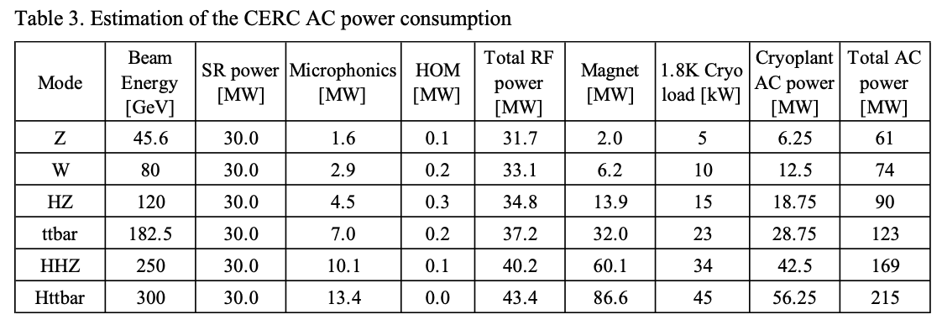
Sustainability: CERC

Slide 22
Sustainability and Carbon footprint studies
With current SRF technology (LSLS HE) ReLiC operating at 250 GeV c.m. energy will consume about 350 MW of AC power, which is about equally split between beam energy losses for radiation and cryogenic
Increasing energy to 3 TeV c.m. with current technology will result in AC power requirement exceeding 2 GW
There is potential of 5-fold in crease in Q, which would make ReLiC operation at all energy from HIGS to 3 TeV much more energy efficient. Still HIGS factory ReLiC will require ~ 200 MW of AC power, and the 3 TeV c.m. operation to under 1 GW.
Current SRF technology: Q=3 10¹⁰
*
*
Future SRF technology: 1.5 K Q=1.5 10¹¹
RF powers needed in damping rings is proportional to ReLiC luminosity and can be reduced if 4x10³⁶ cm⁻²sec⁻¹ luminosity is not needed. Operating 250 GeV c.m. ReLiC with luminosity of 4x10³⁵ cm⁻²sec⁻¹ will reduce accelerator power consumption to 50 MW.
But the cryoplant power is proportional to the total collider energy. It can be further reduced by improving LiHe refrigerators from their current 19% (1/5th) of theoretically possible Carnot (η=T₁/T₂) efficiency. Investments in LiHe refrigerator R&D is probably the best chance of improving Carbon footprint of SRF system, including ReLiC.
* Estimation is provided by Dr. Sergey Belomestnykh (FNAL)

Slide 23
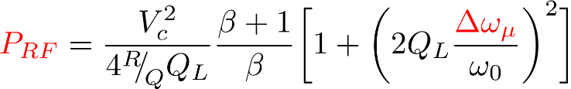
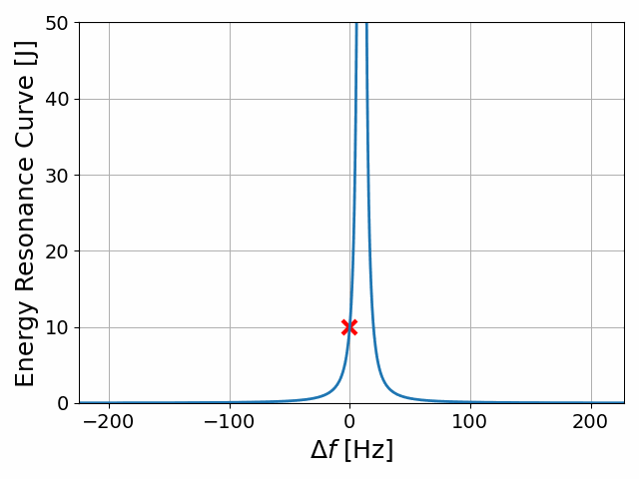
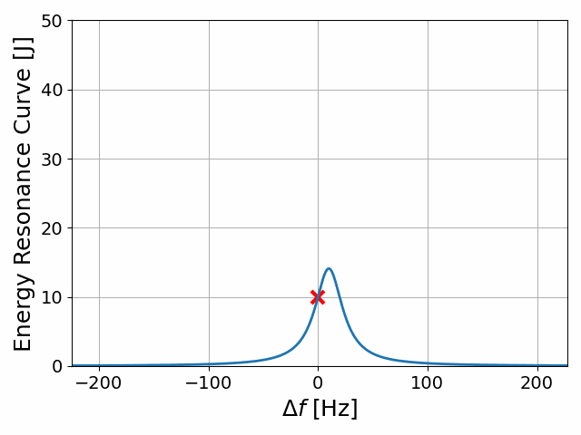
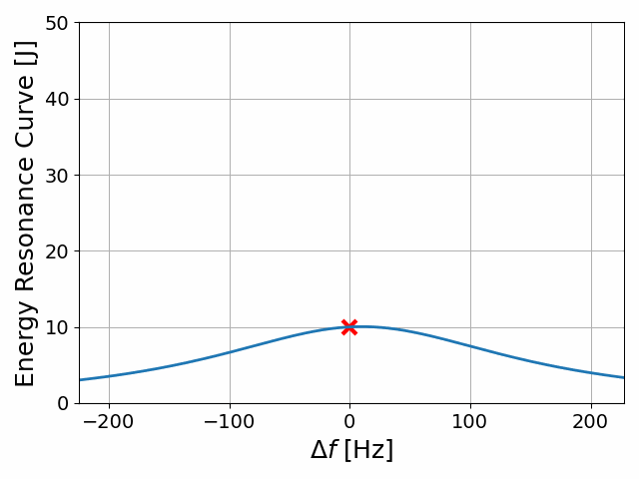
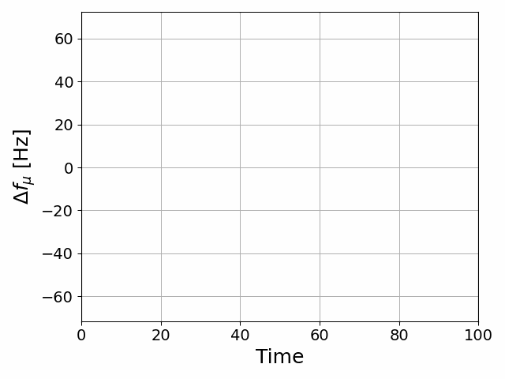
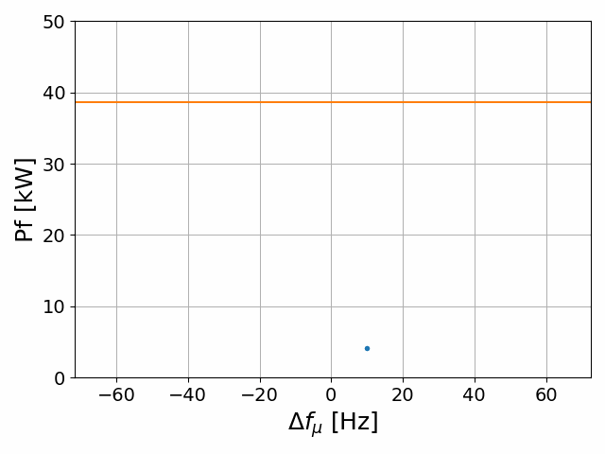
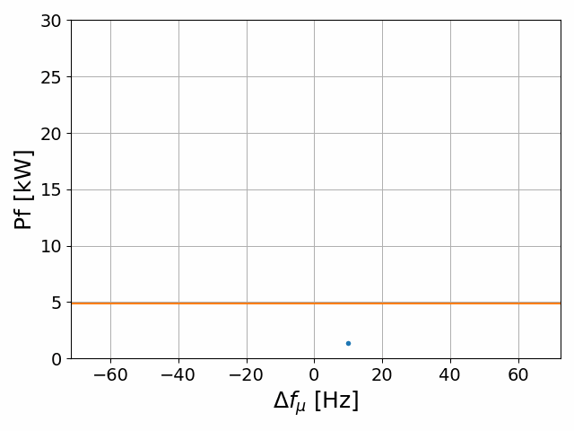
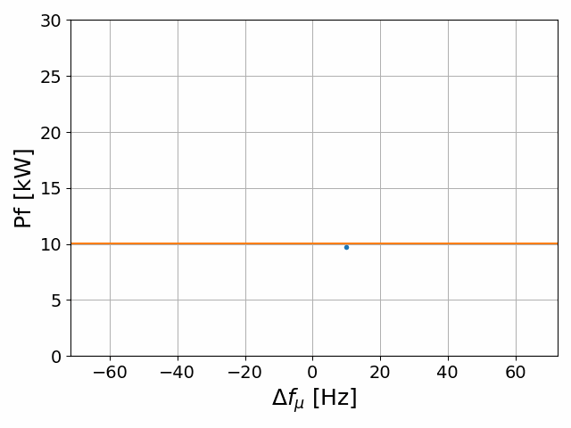

Fast Reactive Tuner and RF power needs for ERLs
N. Shipman, I. Ben-Zvi, G. Burt, J. Cai, A. Castilla, A. Macpherson, I. Syratchev
Microphonics vs Time
ERL power needs often dominated by microphonics
FE-FRTs can almost eliminate microphonics
Huge power savings possible
  Peak power FoM/2
  Average power FoM/4
FoM >~75 @ 800MHz
Decreasing

Slide 24
Important details of ReLiC design
Both accelerating and decelerating beams propagate on axis of SRF cavities where transverse fields are zero. There is no need for asymmetric dual-cavities – unexplored SRF technology.
Focus on limiting energy spread in colliding beams
  We capped critical energy of beamstrahlung photons to 200 MeV and 700 MeV at c.m. energies of 240 GeV and 3 TeV, correspondingly – it is significantly smaller then in ILC and CLIC
  We limited number of bunches in trains to keep the beam loading below 10⁻³*
Separators use commination of DC electric and magnetic fields, which do not affect trajectory of accelerating bunches. This choice preserves emittances of colliding bunches
* Even though, the energy of each colliding bunch is known and can be used for data analysis.
If this feature is used, luminosity can be further increased

Slide 25
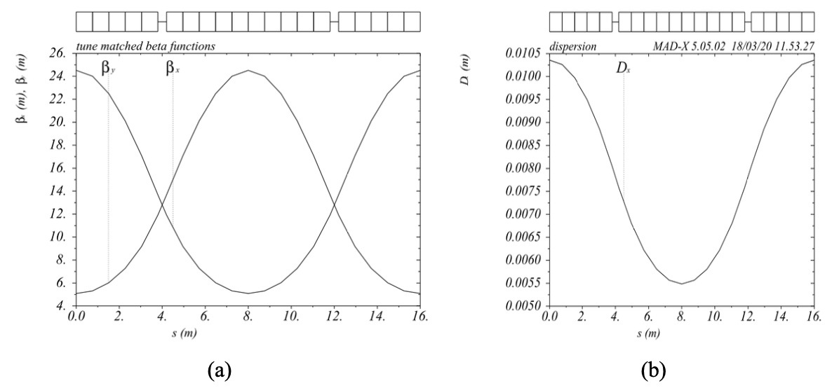
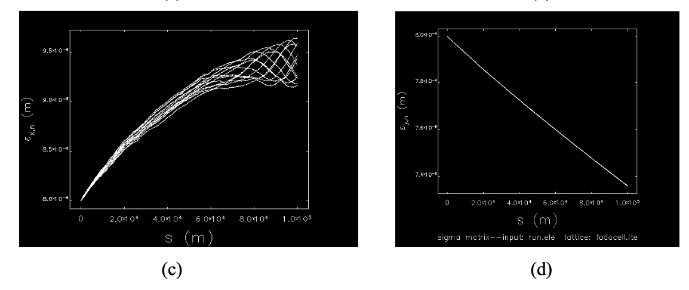
CERC lattice
6250 FODO cells with combined function (dipole, quadrupole and sextupole) magnets and zero chromaticity
Cell length: 16 m, phase advance: 90 degrees
Gaps between magnets: 0.4 m, filling factor 95%
B= 0.0551 T (551 G); GF,D=±32.24 T/m (3.224 kG/cm) Sextupole moments: SF=267 T/m2 (2.67 kG/cm2);
SD=-418 T/m2; (-4.18 kG/cm2)
Aperture: ±1.5 cm; pole tip fields: ~ 5 kG Emittances: H: 8 -> 9.5 um; V: 8 -> 7.3 nm

Slide 26
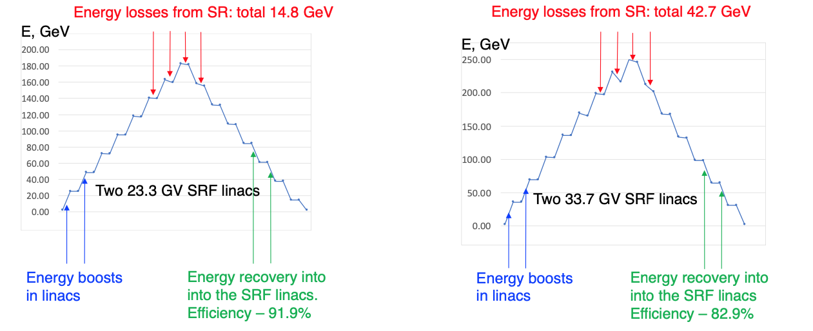
CERC beam energy evolution in 4-pass ERL
E_{beam}= 182.5 GeV
E_{beam}= 250 GeV

