Slide 1
Implications of beam filling patterns on the design of recirculating ERLs ERL 2022
Rob Apsimon¹, Sadiq Setiniyaz¹ and Peter Williams²
¹Lancaster University and Cockcroft Institute, Lancaster, UK
²ASTeC and Cockcroft Institute, Daresbury Laboratory, UK

Slide 2
Filling patterns and beam line topology
Filling pattern: the order bunches are injected into RF buckets on subsequent turns
Depending on the beam line topology, there will be different numbers of arcs:
This can result in different recirculation schemes. In this talk, I will focus on two case:
FIFO (First-In-First-Out): order of bunches does not change relative to each other
Beam loading pattern evolves turn by turn as bunches switch from accelerating to decelerating
SP (Sequence Preserving): bunch on turn n moves to where bunch on turn (n+1) currently is
Beam loading pattern remains constant

Slide 3
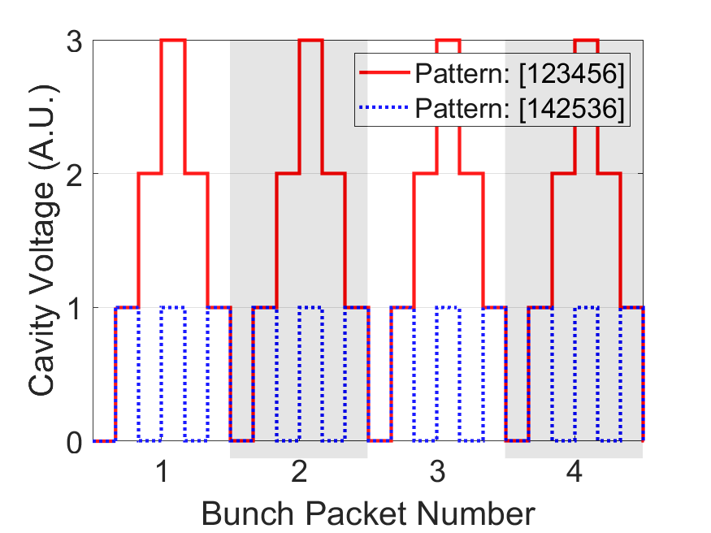
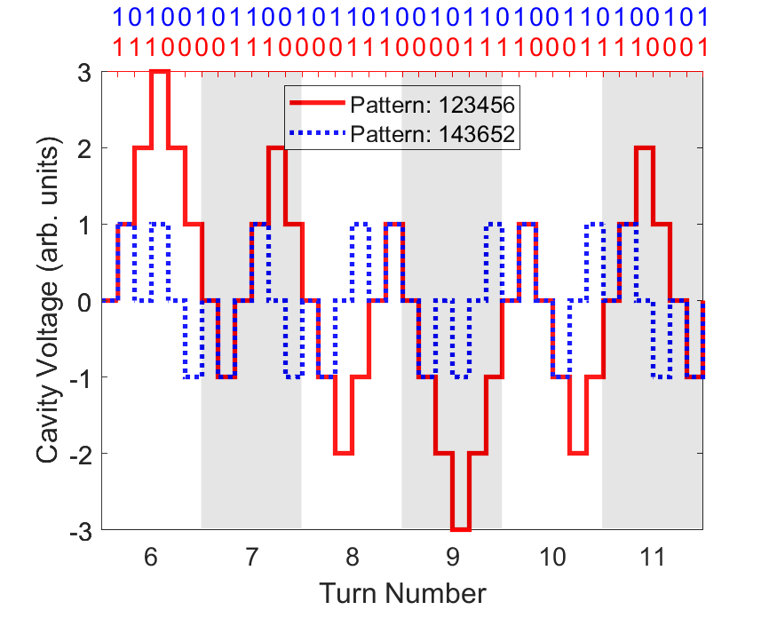
Beam loading in ERLs
For simplicity, let’s assume all accelerating bunches have a phase of 0º and all decelerating bunches have a phase of 180º $δV_{cav}=−\frac{q_{bunch}ω}{2}\left(\frac{R}{Q}\right)\cos{φ}$
Different filling patterns have very different beam loading patterns!
This affects RF and beam stability
This also affects the RF power consumption
SP scheme
FIFO scheme
S. Setiniyaz, R. Apsimon, P. Williams: doi:10.1103/PhysRevAccelBeams.23.072002

Slide 4
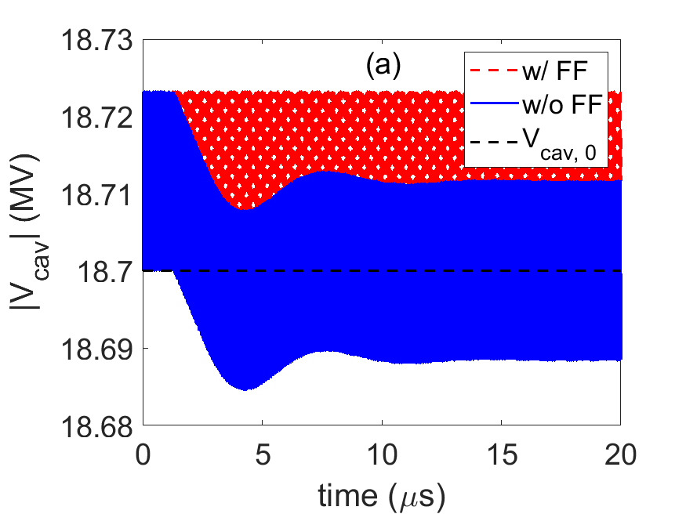
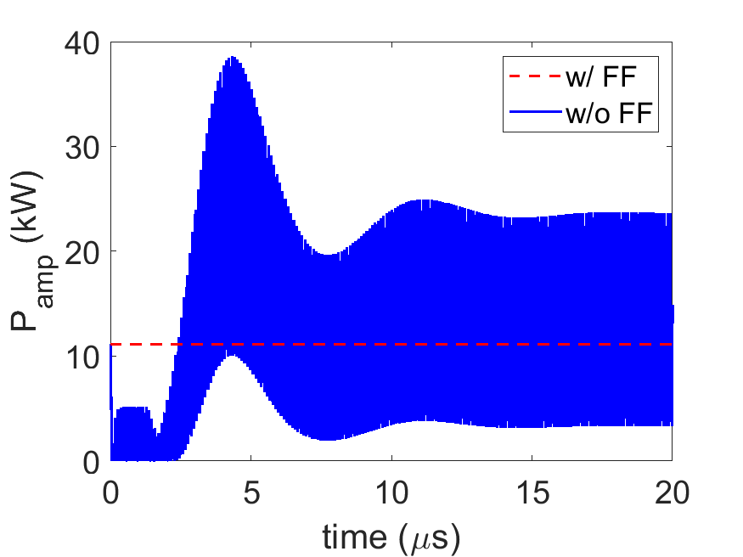
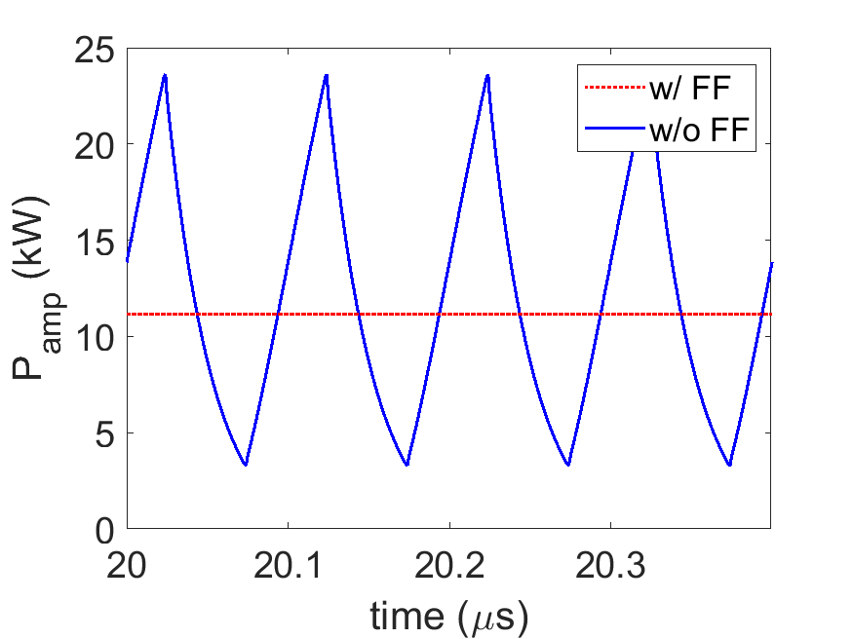
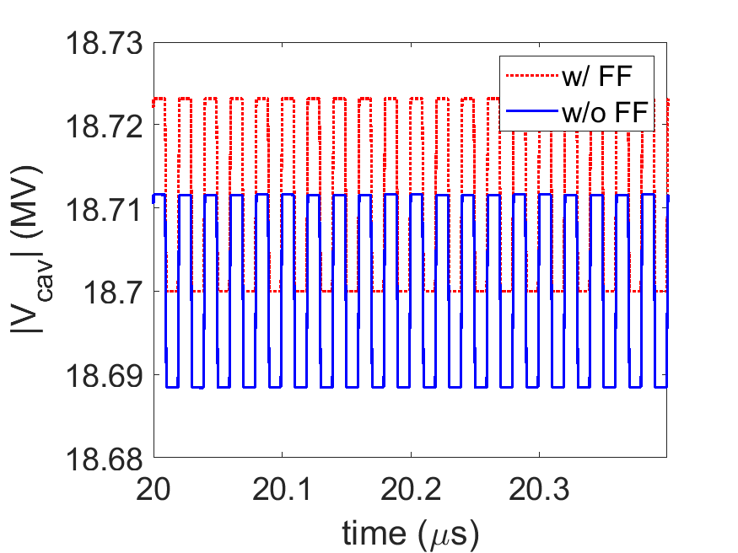
LLRF predictive correction/feed forward
ERLs rely on beam loading to extract energy from spent bunches to accelerate new bunches.
Essential for high energy efficiency
A “simple” LLRF feedback system will fight against this beam loading.
This will require additional RF power
Need to implement predictive correction (or feed forward) to correct RF wrt to EXPECTED amplitude and phase.

Slide 5
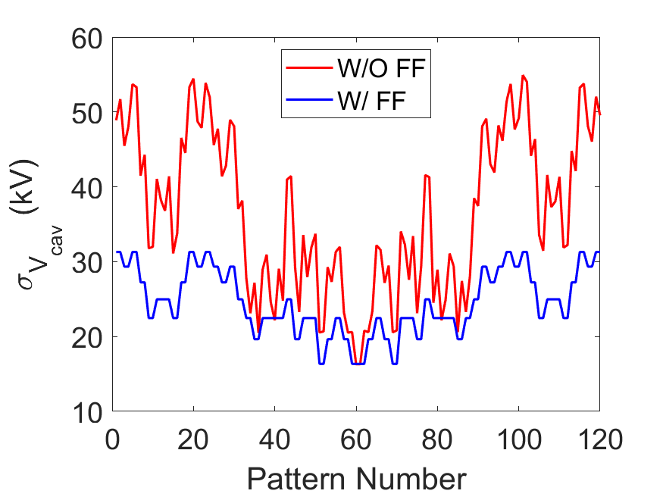
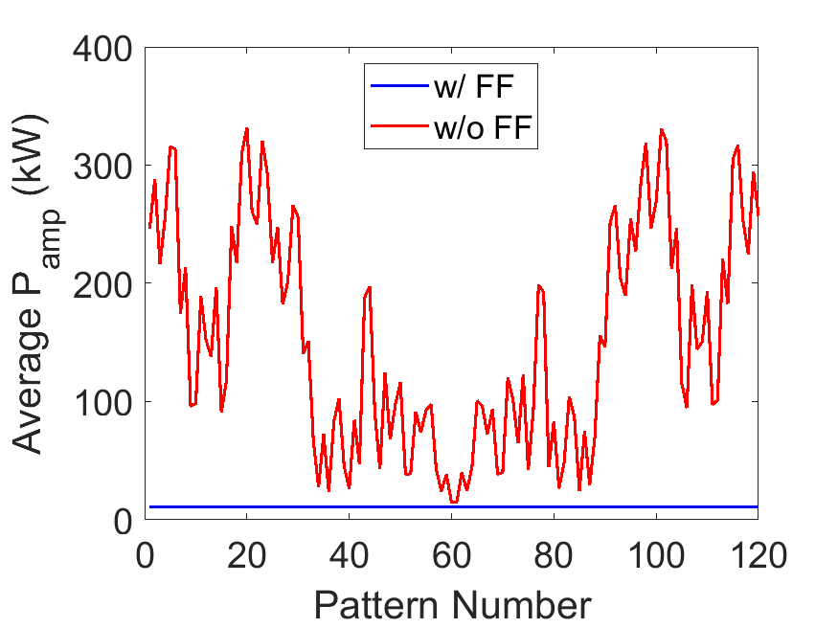
Fundamental mode: pattern dependence for FIFO schemes
Selecting your filling pattern properly can reduce RF amplitude jitter by a factor of ~3, and average RF power consumption by a factor of 30.

Slide 6
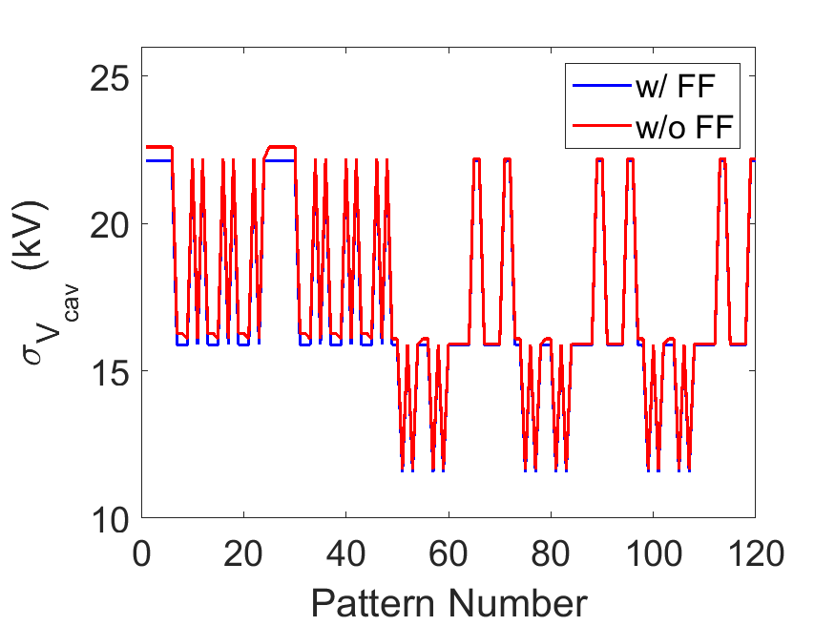
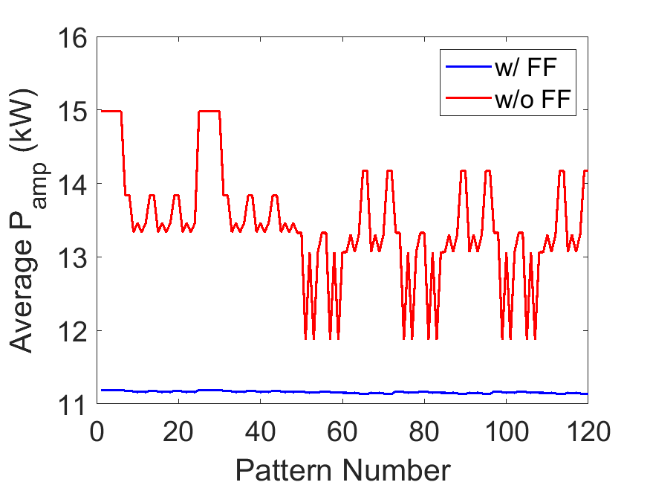
Fundamental mode: pattern dependence for SP schemes
In the SP case, the correct choice of filling pattern can reduce RF amplitude jitter by a factor of 2 and RF power consumption by ~30%.
Note that SP is far less sensitive to LLRF operational mode

Slide 7
Beam Break-Up (BBU) instability
Transverse offset excites HOM: $δV_{HOM}=I_{beam}\frac{ω_{HOM}}{2c}{\left(\frac{R}{Q}\right)}_{⊥}x$
HOM kicks bunch: $δx^{′}=\frac{V_{HOM}}{V_{beam}}$
3. Kick translates to offset $$x_{n+1}=R_{11}x_{n}+R_{12}x_{n}^{′}$$
Above a certain beam current (threshold current), the kick and HOM voltage will grow exponentially until beam losses occur.

Slide 8
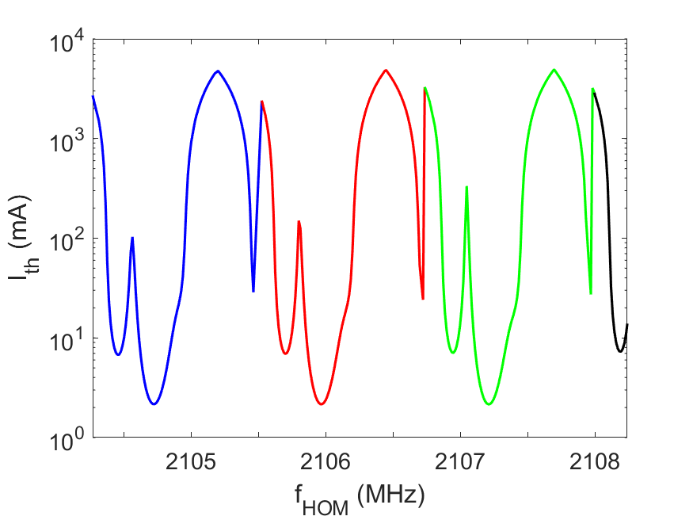
Threshold current vs frequency: SP schemes
The frequency dependence on a filling pattern can vary significantly (or not) from similar patterns
The best (or worst) choice of filling pattern is not fixed as with the fundamental accelerating mode
Choice of filling pattern needs to be optimised for your system parameters
The coarse features of threshold current vs frequency is similar to previous studies
The filling patterns create the fine structure observed around the troughs.
G. H. Hoffstaetter, I. V. Bazarov: doi:10.1103/PhysRevSTAB.7.054401
S. Setiniyaz, R. Apsimon, P. Williams: doi:10.1103/PhysRevAccelBeams.24.061003

Slide 9
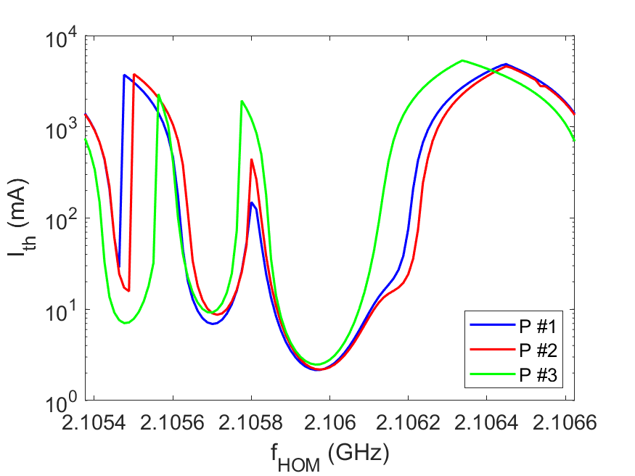
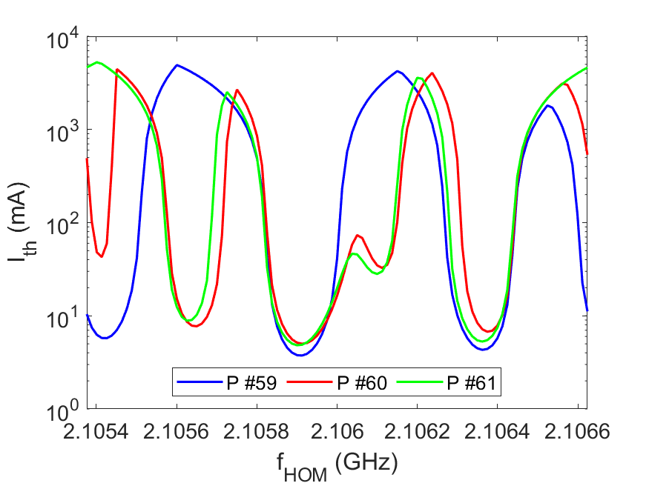
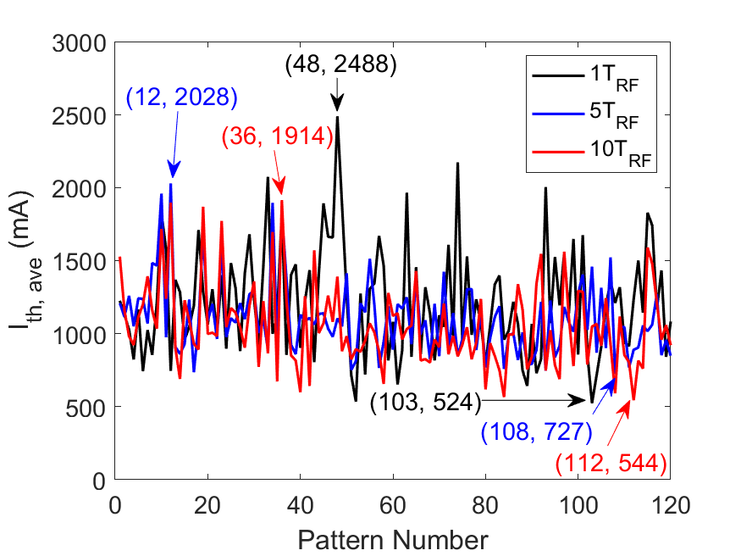
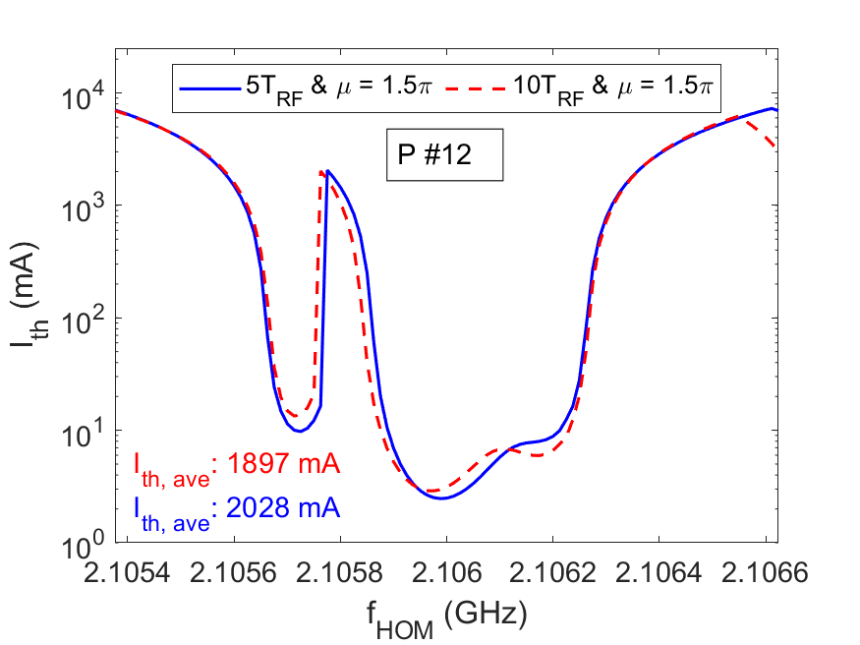
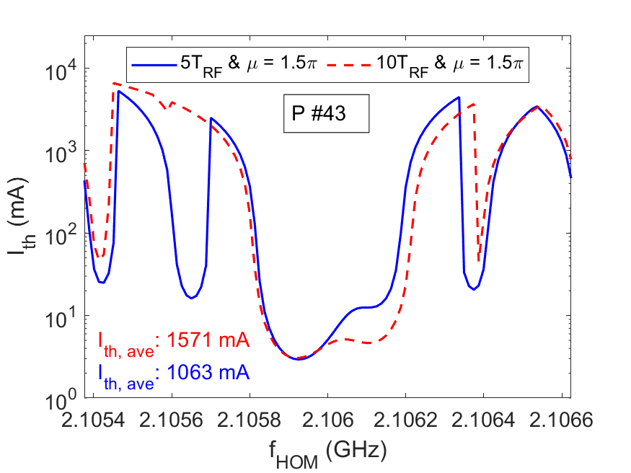
Threshold current vs frequency: SP schemes
The frequency dependence on a filling pattern can vary significantly (or not) from similar patterns
The best (or worst) choice of filling pattern is not fixed as with the fundamental accelerating mode
Choice of filling pattern needs to be optimised for your system parameters

Slide 10
What is a filling pattern and transition set?
Filling pattern: how bunches are injected into buckets on subsequent turns of the ERL ring:
For the example below, we can write the filling pattern as $\left[1_{1} 2_{2} 5_{3} 3_{4} 6_{5} 4_{6}\right]≡\left[1_{1} 2_{2} 3_{4} 4_{6} 5_{3} 6_{5}\right]$
The subscript is the bucket number and the bigger number is the turn number.
The first convention is conceptually easier as the numbers match the spatial ordering of bunches in the ring, however the maths is much easier with the second formalism
Note: we usually don’t bother with subscripting, we just ignore the ordered numbers:
$$\left[1 2 5 3 6 4\right]/\left[1 2 4 6 3 5\right]$$
The transition set is the number of buckets each bunch shifts from one turn to the next.
$$T=\left[T_{1} T_{2} T_{3} T_{4} T_{5} T_{6}\right] \\ =\left[0 1 1 2 1 1\right]$$

Slide 11
Some useful definitions
After each turn, the turn number increases by one, so we either need to update the filling pattern or the transition set.
As a convention, we update the transition set, which requires cyclically permuting it to the left each turn
Using the second definition of filling pattern, the index is the turn number and the value is the bucket number.
Now the filling pattern on the next turn becomes: $F_{n+1}=F_{n}+T_{n}$ $T_{n+1}=\left\{T_{n,2}, T_{n,3},⋯T_{n,N}, T_{n,1}\right\}=C_{1}\left(T_{n}\right)$
Where F is the filling pattern and T is the transition set
If we used the other filling pattern convention, the transition set would shuffle the order of the filling pattern elements
Turn number | $$F_{n}$$ | $$T_{n}$$
1 | $$\left[1 2 4 6 3 5\right]$$ | $$\left[0 1 1 2 1 1\right]$$
2 | $$\left[1 3 5 2 4 6\right]$$ | $$\left[1 1 2 1 1 0\right]$$
3 | $$\left[2 4 1 3 5 6\right]$$ | $$\left[1 2 1 1 0 1\right]$$
4 | $$\left[3 6 2 4 5 1\right]$$ | $$\left[2 1 1 0 1 1\right]$$
5 | $$\left[5 1 3 4 6 2\right]$$ | $$\left[1 1 0 1 1 2\right]$$
6 | $$\left[6 2 3 5 1 4\right]$$ | $$\left[1 0 1 1 2 1\right]$$
7 | $$\left[1 2 4 6 3 5\right]$$ | $$\left[0 1 1 2 1 1\right]$$

Slide 12
Comprehensive studies
N | Brute force checks | Number of groups
2 | 2 | 1
4 | 144 | 3
6 | 86,400 | 12
8 | 203,212,800 | 209
10 | $$1.317×{10}^{12}$$ | 9404
However, not all combinations of filling pattern and transition set works.
Need to determine how to find all allowed schemes.
Finding all allowed combinations of filling pattern and transition set is hard.
Brute force method would require $\frac{{\left(N!\right)}^{2}}{N}$ combinations to check, which grows FAST!
Need a way to reduce to problem to something manageable
Can group the filling patterns (and transition sets!) based on symmetries of the system.
Need to frame this as an eigen-like problem…
Turn number | $$F_{n}$$ | $$T_{n}$$
1 | $$\left[1 2 3 4 5 6\right]$$ | $$\left[0 1 1 2 1 1\right]$$
2 | $$\left[1 3 4 6 6 1\right]$$ | $$\left[1 1 2 1 1 0\right]$$
3 | … | …

Slide 13
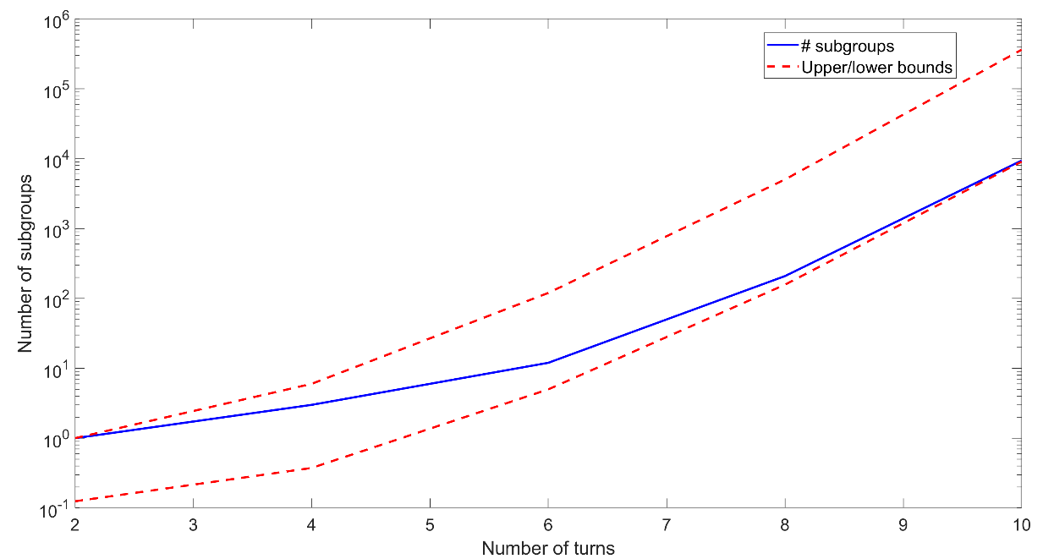
Filling pattern / transition set allowed combinations
Filling patterns (and transition sets) form subgroups based on 4 transformations.
These transformations are based on gauge and reflection symmetries of an ERL.
The rules state that if $X=\left[X_{1} X_{2}⋯X_{N}\right]$ is in a subgroup, then the following are also in the group
Adding a constant: $\left(X+c\right)\operatorname{mod}\left(N\right)$
Choice of bucket number doesn’t matter
A cyclic permutation: $C_{n}\left(X\right)=\left[X_{\left(1+n\right)} X_{\left(2+n\right)}⋯X_{n}\right]$
Choice of “turn 1” doesn’t matter
Negation: $\left(−X\right)\operatorname{mod}\left(N\right)≡\left(N−X\right)\operatorname{mod}\left(N\right)$
Switching direction of space doesn’t matter
Vector “flip”: $X^{M}=\left[X_{N}⋯X_{2} X_{1}\right]$
Switching direction of time doesn’t matter

Slide 14
Filling pattern / transition set allowed combinations
There are approximately $\frac{\left(N−1\right)!}{4N}$ subgroups
If we solve the problem for 1 member of the subgroup, we know all other solutions from the transformations.
Would be nice to solve this as an eigenproblem
Eigenproblems involve finding eigenvectors and eigenvalues for a transformation
In our case, we know the eigenvector ($F$) and eigenvalue (1), but we need to determine the transformation
Once we know the transformations, we know the associated transformations $T$
This is enough to determine all transition sets for a given filling pattern
There are a few minor caveats to this, but I won’t go into them here…
N | Brute force checks | Number of groups
2 | 2 | 1
4 | 144 | 3
6 | 86,400 | 12
8 | 203,212,800 | 209
10 | $$1.317×{10}^{12}$$ | 9404

Slide 15
Worked example: 6-turn ERL
No non-trivial eigen-transformations. But every filling pattern must have an SP transition set associated
These filling pattern groups have the same transformations, but different transition sets
These filling pattern groups have the same transformations, but different transition sets
This “reverse-eigenproblem” approach can be shown to be optimal or near-optimal efficiency

Slide 16
Conclusions
Bunch injection filling patterns and beam line topology has a major impact on ERL performance and stability.
A good choice of filling pattern and/or transition set can drastically reduce beam jitter, RF power consumption and increase BBU threshold current
For BBU and other figures of merit, comprehensive studies of filling pattern and topology are needed
We present a mathematical formalism to do this, which provides a very efficient means of determining all solutions
These studies go beyond simply optimising the filling pattern and have been used to design the arc lengths for PERLE.
This will be discussed at the LHeC/FCCeh and PERLE Workshop in IJCLab later this month

