Slide 1
Using Polynomial Chaos Expansion to determine Solenoid misalignment during the bERLinPro Commissioning
ERL 22, Cornell University,
Bettina Kuske, HZB, 04-10-2022
The magic of
surrogate models

Slide 2
context: Work
Work presented here has been carried out 2019 / 2020
After gun cavity damage commissioning preparation stopped
Work still lacks experimental proof – hopefully in 2023!
During the last years AI applications became common use in accelerator physics
Polynomial Chaos Expansion (PCE) is much less prominent
(PCE is commonly used in engineering and data science)
quantifies uncertainty in parametric systems
provides surrogate models
works on relatively few data point
easy to implement
fast
PCE:
Chaos – doesn’t relate to ‘chaos theory’, but was used in early 20th century for stochastic processes

Slide 3
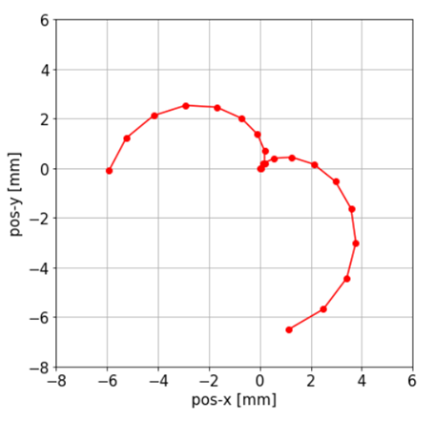
Context: Solenoid misalignment
Beam position on FOMZ1GAF
Due to misalignment of solenoid:
Beam position and size vary on screen with solenoid setting
Strong impact on trajectory (larger than quadrupole misalignments) *
bERLinPro solenoid mounted on ‘Hexapod’, highly precise 6D alignment
Problem:
No absolute positioning system of Hexapod
Cold solenoid: no tracing of movements during cooldown
Experience with GUN0:
Very difficult to manually align (highly non-linear, highly coupled)
Off-line fitting cumbersome
=> Need for beam-based alignment procedure
* IPAC2014, Dresden, Germany, TUPRO038, doi:10.18429/JACoW-IPAC2014-TUPRO038

Slide 4
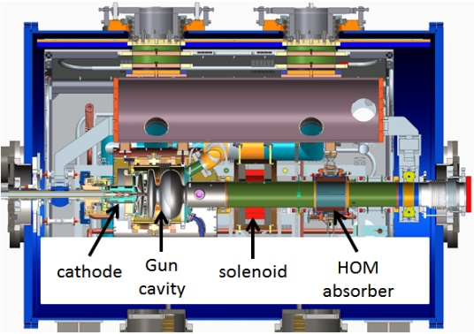
Hardware Gunmodule
The bERLinPro gun module:
First screen 1.78m
behind cathode

Slide 5
Content
Structure of the talk:
PCE in a nutshell
Small example and workflow
Setting up the PCE surrogate model
Sobol’s indices
The ‘real’ problem: inverse PCE
Summary

Slide 6
Pce in a nutshell
Definition * : polynomial chaos is a way of representing random variables/random processes in terms of orthogonal polynomials (Comparable to Taylor expansions of functions)
Definition**: polynomial chaos can be used to determine the evolution of uncertainty in a dynamical system when there is probabilistic uncertainty in the system parameters
Mathematical basis: Cameron-Martin theorem: Every random distribution (with finite variance) can be represented in terms of polynomial series developed around arbitrary probabilistic distributions (uniform, Gaussian…)
* Youtube: PyData meeting Berlin 2017, Emily Gorcenski https://www.youtube.com/watch?v=Z-Qio-n6yPc
** Wikipedia

Slide 7
Pce in a nutshell
Surrogate model
Distributions of solenoid
misalignments
Dx, Dy, Dtheta, Dphi
Mapping to screen
(tracking /
measurement)
Arbitrary distr.
of positions /
sizes on screen
Approximate output
by polynomial series
PCE
The surrogate model is fast to calculate
The coefficients of the polynomial represent the moments of the distribution
“Sobol’s indices” can be extracted from the coefficients
The polynomials used in expansion depend on the input distribution
Uniform – Legendre polynomials
Gaussian – Hermite polynomials
…

Slide 8
workflow
Create tracking/measured data with known input distribution
1
Set up generic polynomials
to different orders
2
3
Build joint distribution
of input parameters
Determine polynomial coefficients by a fitting
Verification:
Calculate polynomial
using test data
Compare PCE to tracking/measured results
Mathematics is implemented in Python package:
(MATLAB UQLab: a framework for uncertainty quantification)
import chaospy as cp
1 distribution = cp.J(cp.Uniform(1.75, 3.40), cp.Normal(0, 1), cp.Normal(0,1))
2 polynomial_expansion3 = cp.orth_ttr(3, distribution)
3 approx3 = cp.fit_regression(polynomial_expansion3, sample, result.T)

Slide 9
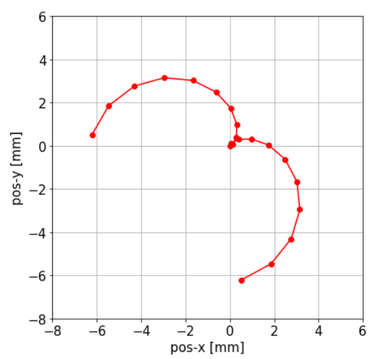
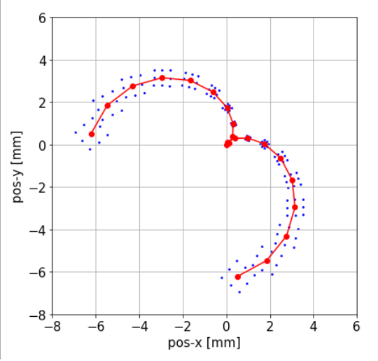
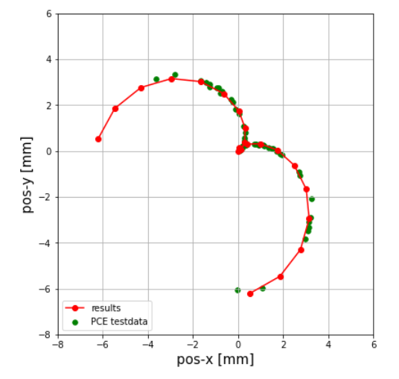
Example
Surrogate model for beam position on screen for different solenoid settings with transverse misalignment
Beam position on FOMZ1GAF
Beam position on FOMZ1GAF
Beam position on FOMZ1GAF
Tracking data:
Solenoid field variation -0.2T – 0.2T
-> uniform distribution
Offsets:
Δx = Δy = 0.25 mm
Δθ = Δϕ = 0
Tracking data:
Solenoid field variation -0.2T – 0.2T
-> uniform distr. offsets:
Δx, Δy = 0.22, 0.25, 0.28 mm
Δθ = Δϕ = 0
PCE model:
Test data:
solenoid field variation -0.4 T - 0.4T
Δx, Δy = 0.23mm - 0.27mm
-> random distribution
PCE
model

Slide 10
Example
Calculate surrogate model for beam position on screen for transverse solenoid offsets
Beam position on FOMZ1GAF
Beam position on FOMZ1GAF
Beam position on FOMZ1GAF
Tracking data:
Solenoid field variation -0.2T – 0.2T
-> uniform distribution
Offsets:
Δx = Δy = 0.25 mm
Δθ = Δϕ = 0
Tracking data:
Solenoid field variation -0.2T – 0.2T
-> uniform distr. offsets:
Δx, Δy = 0.22, 0.25, 0.28 mm
Δθ = Δϕ = 0
PCE model:
Test data:
solenoid field variation -0.4 T - 0.4T
Δx, Δy = 0.23mm - 0.27mm
-> random distribution
PCE
model
PCE calculation:
3 uniform input distributions: Sol, Dx, Dy
3x3x21=189 tracking runs
2 ‘Quantities of Interest’, QoI: pos-x, pos-y
Polynomial series order 7
msec runtime

Slide 11
Setting up the PCE model*
d | p | coeff. | no. SP
3 | 3 | 20 | 64
3 | 5 | 56 | 216
5 | 7 | 225 | 32768
10 | 7 | 3003 | >1e9
d: number of input variables
p: order of the polynomial series
No. of polynomial coefficients to be determined (once): $coeff=\frac{\left(p+d\right)!}{p!d!}$
Recommended no. of sample points to be calculated: $no_SP={(p+1)}^{d}$
** “curse of dimensionality” –other math. option: “low-rank tensor approximation” linear in p, d
Need to test order of polynomial series :
Quality of PCE for different polynomial orders in L2-norm (hor. position on screen)
* Matthias Frey, Andreas Adelmann: arXiv:2001.10411v4 [physics.comp-ph] 2 Sep 2020
** Bruno Sudret, “Surrogate models for global sensitivity analysis - Old and New”, 8th International Conference on Sensitivity Analysis of Model Output

Slide 12
Sensitivity analysis and Sobol’s coefficients
Variance-based Sensitivity Analysis quantifies numerically the contribution of uncertain inputs (taken individually or in combinations) into output uncertainty; *
First order
Sobol’s indices
$$S_{i}=\frac{V_{i}}{Var(Y)}$$
Second order
Sobol’s indices
$$S_{2i}=\frac{\sum{V_{ij}}}{Var(Y)}$$
Fractional part of the total output variance caused by varying the i^{th} input parameter.
Effect of correlations of the i^{th} input parameter with a single other parameter on output
Variance.
The sum of all Sobol’s coefficients is 1.
Sobol’s indices are obtained analytically, at any order, from the coefficients of the PC expansion
* Wikipedia: Variance-based sensitivity analysis
Bruno Sudret, “Global sensitivity analysis using polynomial chaos expansions”, Reliability Engineering & System Safety Volume 93, Issue 7, July 2008, Pages 964-979
Bruno Sudret: ETH Zurich, Professor of “Risk, Safety and Uncertainty Quantification”

Slide 13
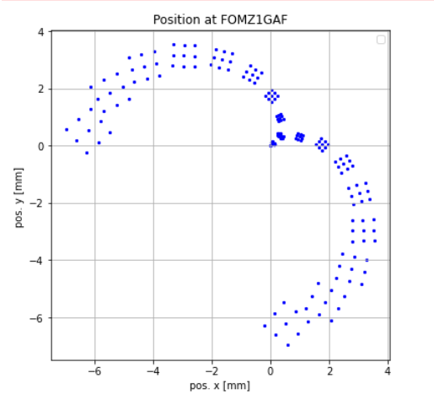
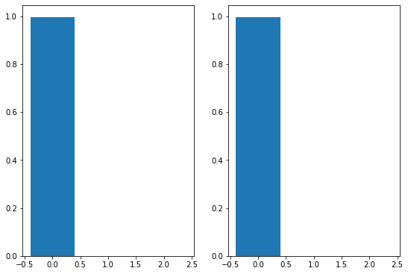
Sobol’s coefficients of the example
Example:
import chaospy as cp
Sobol1 = cp.Sens_m(approx7, distribution) first order
Sobol2 = cp.Sens_m2(approx7, distribution) second order
SobolT = cp.Sens_t(approx7, distribution) total
2022-09-19 18:02:30
Sobol indices:
second order: (3, 3, 2)
poly-order 7
x-pos
[[0. 0.003 0.001]
[0.003 0. 0. ]
[0.001 0. 0. ]]
Sum(pos-x) = 0.0035607
y-pos
[[0. 0.001 0.003]
[0.001 0. 0. ]
[0.003 0. 0. ]]
Sum(pos-y) = 0.0035636
2022-09-19 18:03:15 45sec
pos-x
pos-y
2022-09-19 17:32:31
Sobol indices:
first order (3,2)
poly-order 7
x-pos y-pos
[[9.962e-01 9.962e-01] sol
[1.370e-04 1.020e-04] Dx
[9.600e-05 1.320e-04]] Dy
Sum(pos-x) = 0.99643
Sum(pos-x) = 0.99643
2022-09-19 17:32:58 27sec
Sol Dx Dy
Sol Dx Dy
1. Order Sobol’s indices

Slide 14
The real problem
Actual interest is the determination of the misalignment:
Screen measurements
pos-x, pos-y,
sig-x, sig-y
Solenoid misalignment
Dx, Dy, Dtheta, Dphi
Mapping
(tracking /
measurement)
Reverse problem
Create tracking / measured data
with distributed misalignments
Fit polynomial coefficients to
determine
misalignments
Determine distributions
of 4 parameters
on screen
Set up PCE
for joint distribution
for screen data
Solenoid field dominates everything – no solenoid field variation

Slide 15
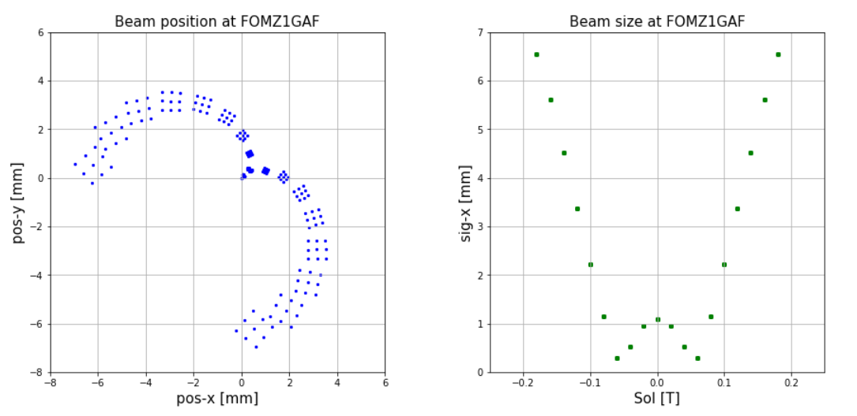
Preparation 1
Solenoid scan -0.2T – 0.2T, Dx = Dy = 0.25mm, Dtheta = Dphi = 0
Screen dimensions
Beam size strongly depends on solenoid field
Beam size is independent of transverse displacements
Screen size of +/- 25mm, limits the detectable beam size to ~2mm RMS
Solenoid settings >0.1T result in beam sizes that exceed screen
For Sol ~ 0.05T focal point lies at screen – minimal beam size

Slide 16
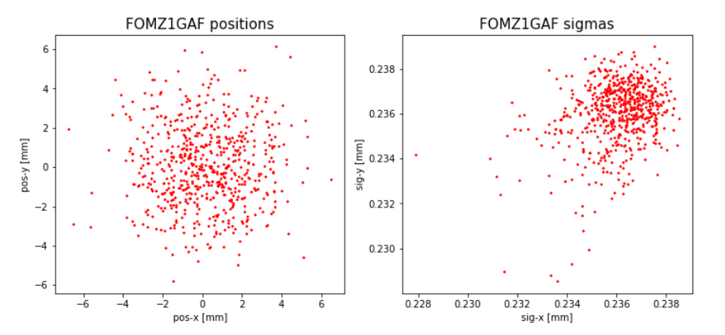
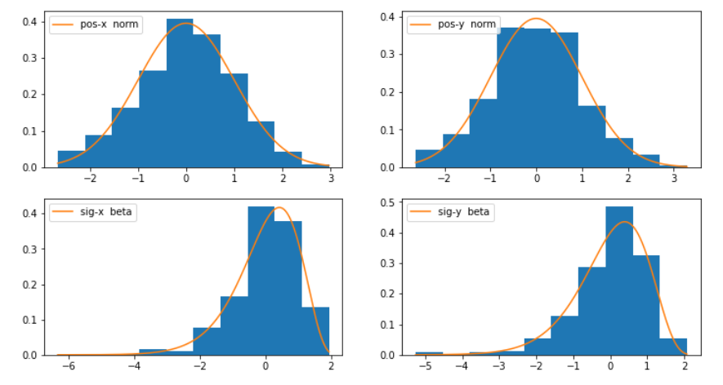
Reverse PCE
Create tracking/measurement data:
Solenoid = 0.05T
Random distribution of solenoid positions and angles
-10mm < Dx, Dy < 10mm
-20mrad < Dtheta, Dphi < 20mrad
PCE input: pos-x, pos-y, sig-x, sig-y on screen
PCE output: 4 solenoid misalignments
625 samples
d | p | coeff. | no. SP
4 | 3 | 35 | 256
4 | 4 | 70 | 625
4 | 5 | 126 | 1296
4 | 6 | 210 | 2401
=> Polynomial order 4, (maybe 5)

Slide 17
Solving the reverse pce
Even polynomial order 4 does not seek satisfactory results!
Need (much) higher order polynomial => too many data points (curse of dimensionality)
Approximate positions and angles separately

Slide 18
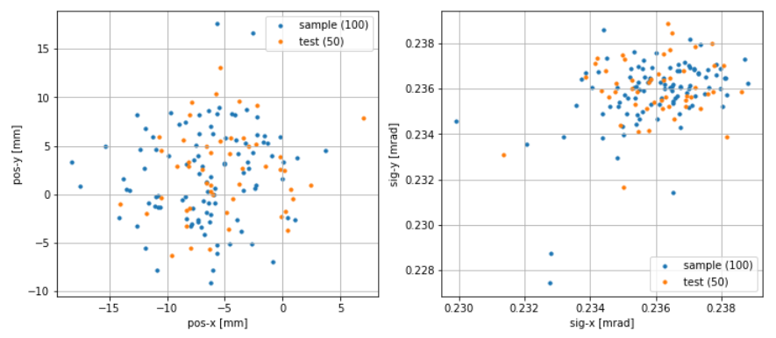
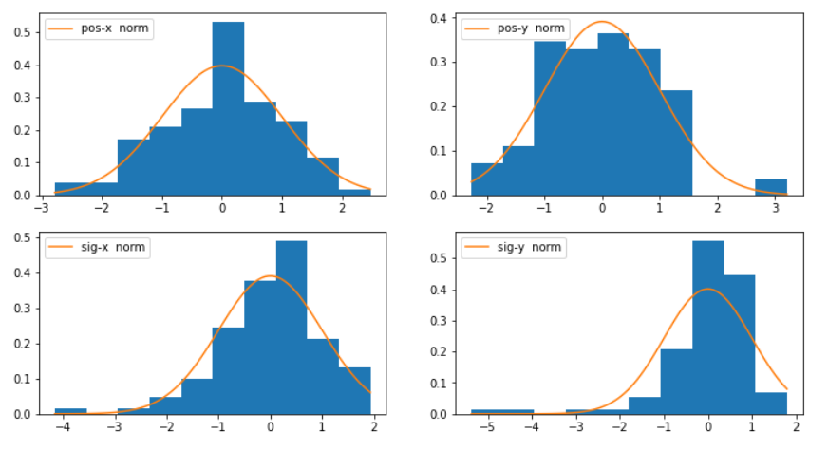
Backward fitting positions only
Create tracking/measurement data:
Solenoid = 0.05T
Random distribution of solenoid transverse offsets
-10mm < Dx, Dy < 10mm
Arbitrary but fixed angular offset
Dtheta = -5mrad, Dphi=7mrad
PCE input: pos-x, pos-y, sig-x, sig-y on screen
PCE output: 2 solenoid transverse offsets
150 runs, 100 samples, 50 test cases
Position and size on FOMZ1GAF
d | p | coeff. | no. SP
4 | 2 | 15 | 81
4 | 3 | 35 | 256
4 | 4 | 70 | 625
4 | 5 | 126 | 1296
=> Polynomial order 2, (maybe 3)

Slide 19
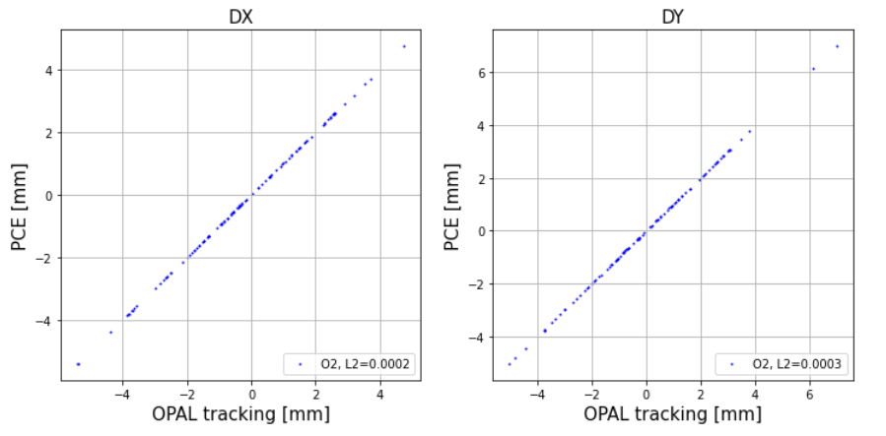
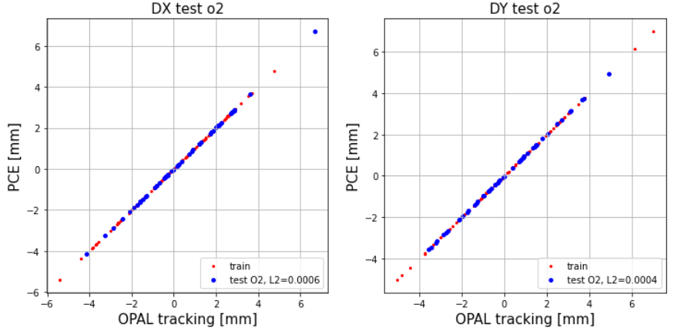
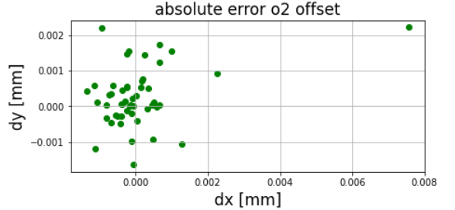
Solving the real problem
Perfect fit with second-order polynomial (on sample data)
Perfect prediction for test particles
PCE(pos-x(0), pos-y(0), sig-x(0), sig-y(0)) => ΔDx, ΔDy

Slide 20
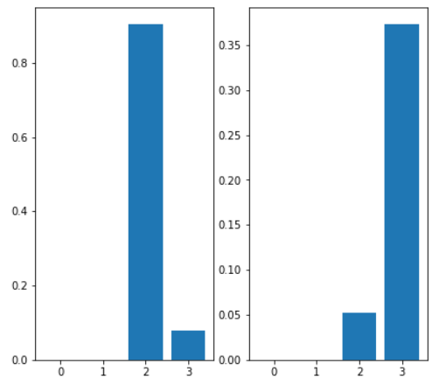
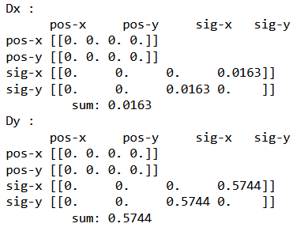
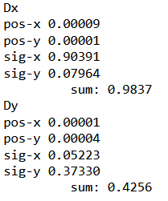
Backward fitting example 2
Sobol’s indices 2. order
Sobol’s indices 1. order
Sobol’s indices 1. order
Dx
Dy
pos-x
pos-y
sig-x
sig-y
pos-x
sig-y
pos-y
sig-x
Asymmetry due to different angular offsets
Ok!
S1(Dx) + S2(Dx) = 1
S1(Dy) + S2(Dy) = 1
→ Repeat procedure for angular misalignment

Slide 21
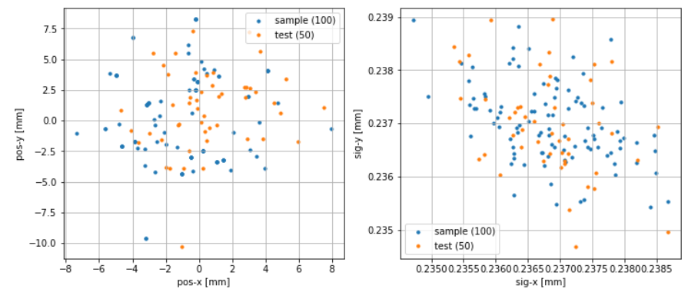
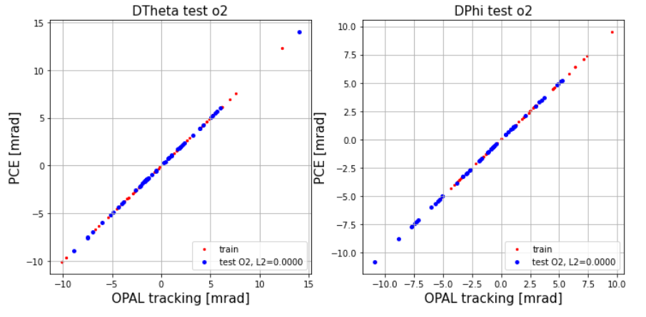
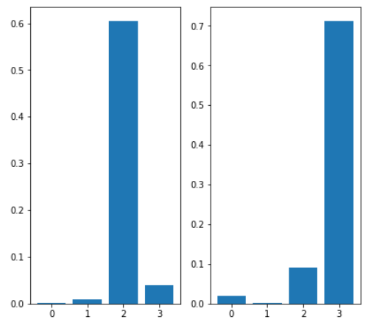
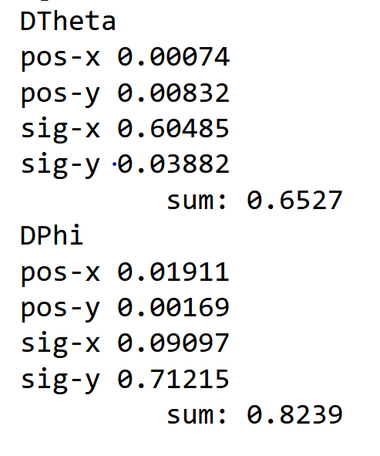
Thanks
Create tracking/measurement data:
Solenoid = 0.05T
Random distribution of solenoid angles
-20mm < Dtheta, Dphi < 20mm
Fixed arbitrary transverse offset
Dx = -0.2mm, Dy=0.3mm
PCE input: pos-x, pos-y, sig-x, sig-y on screen
PCE output: 2 solenoid angular offsets
150 runs, 100 samples, 50 test cases
Dtheta
Dphi
1. order Sobol’s indices
pos-x
pos-y
sig-x
sig-y
pos-x
sig-y
pos-y
sig-x

Slide 22
summary
PCE is an extremely powerful and very low-cost tool!
Beam based determination of solenoid misalignment
Impact of measurement errors should be simulated
How accurately will we determine the beam size? Larger Sol-field?
Surrogate models including field flatness, cathode retreat, laser pulse length,
laser spot size, solenoid field, and gun voltage look promising – not yet reverse
HZB active in AI: neural network-based model with 13 gun variables
~2.0 Mio data points needed; model dependent;

Slide 23
Backup transparencies

Slide 24
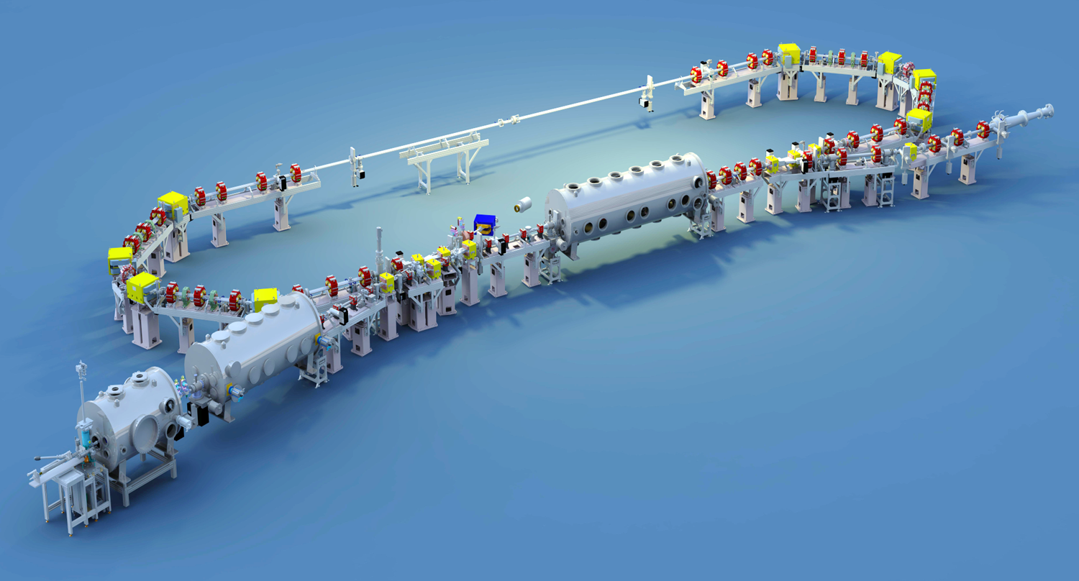
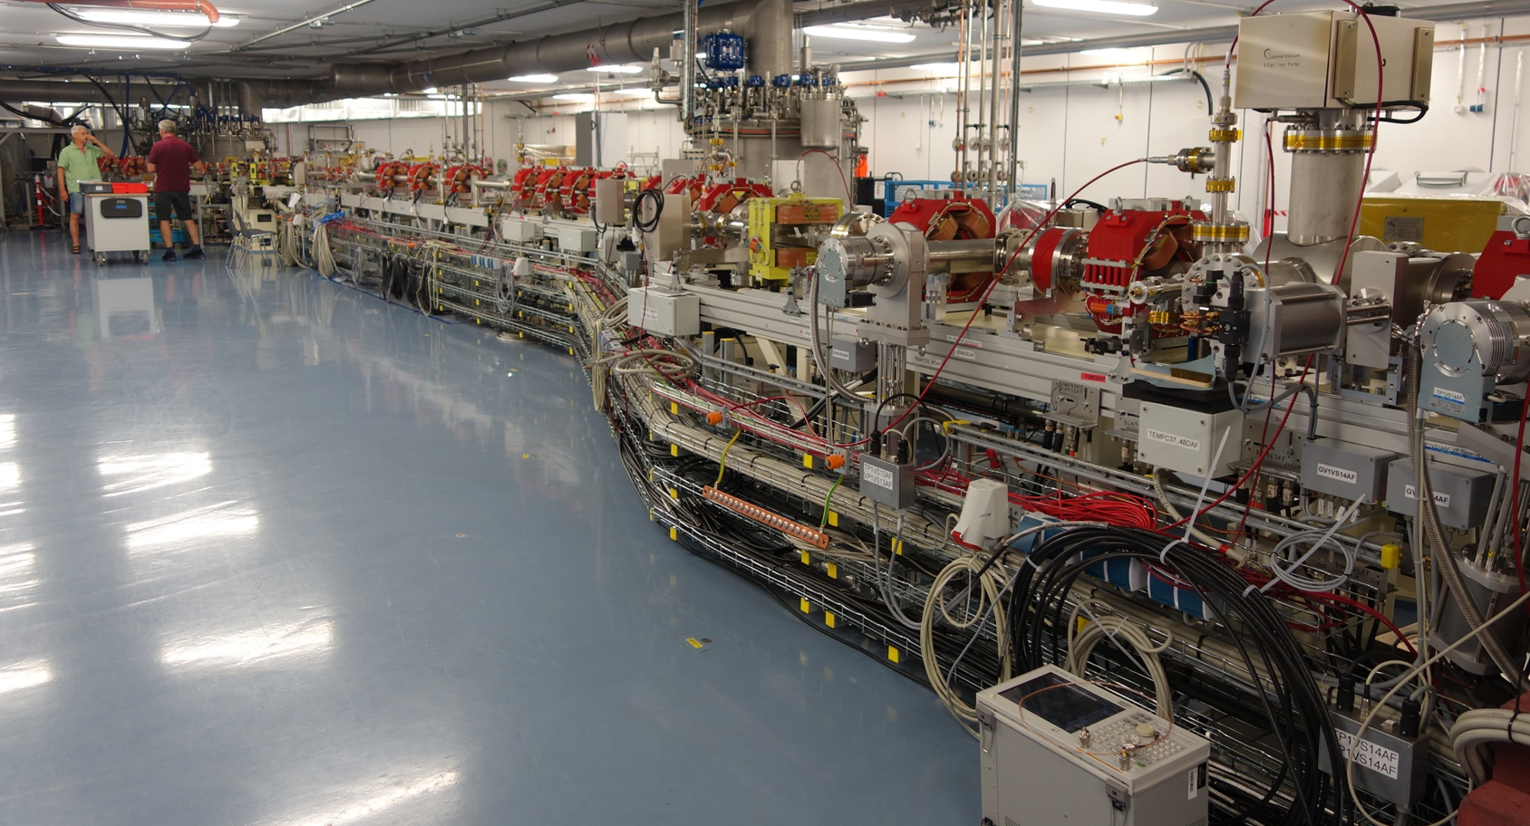
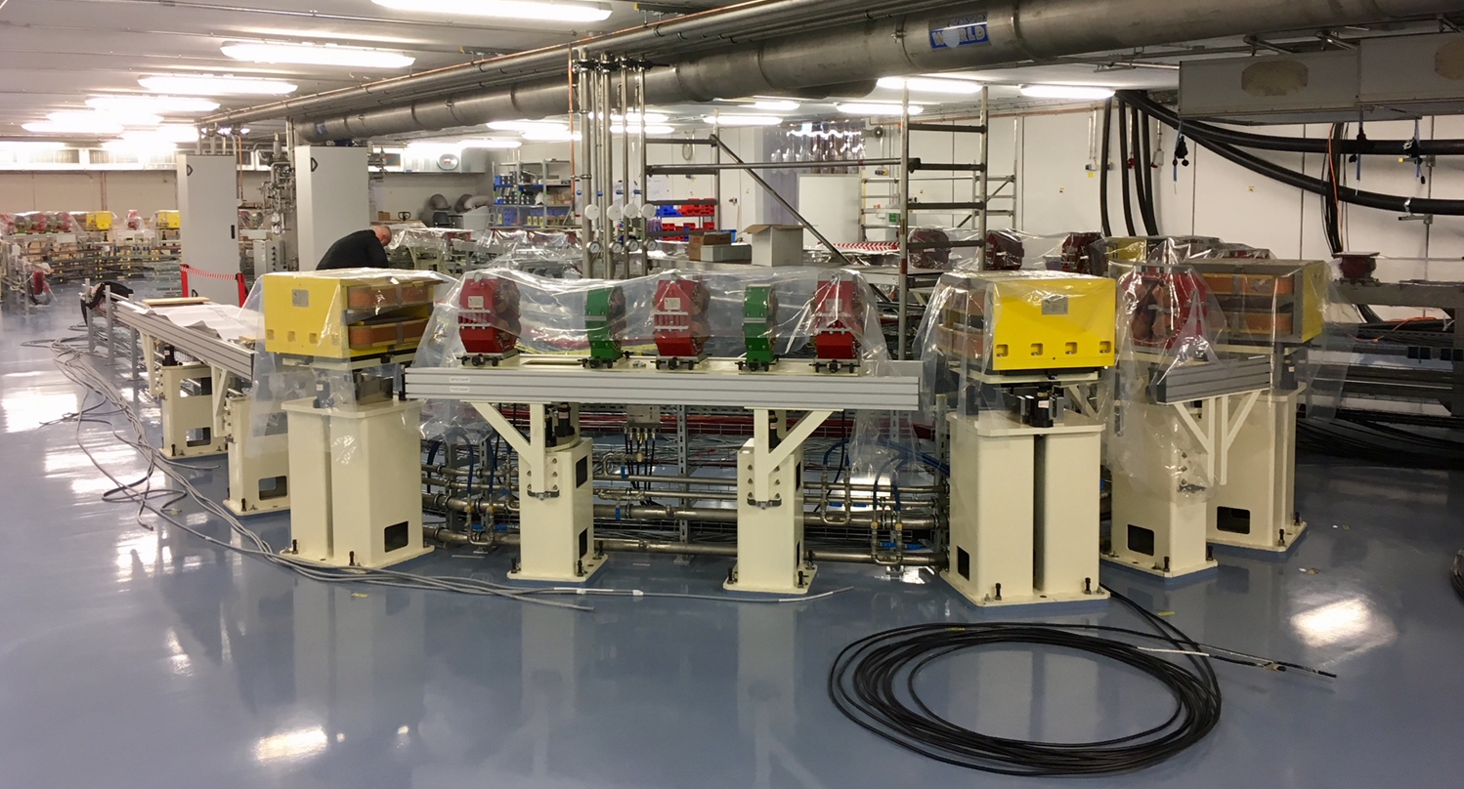
Context: bERLinPro
bERLinPro 2010 – 2020
Energy Recovery Linac project @ HZB
all superconducting (gun-booster-linac)
50MeV
Emphasis on high current (100mA)
High current SRF gun
Linac with high power HOM couplers
600kW beam dump
Warm machine and infrastructure all ready
Project terminated without SRF modules running
bERLinPro / SEALAB
Since 2021 SEALAB (SRF Electron Accelerator LABoratory)
Operation and use of SRF gun and booster within
“Accelerator Research and Development” (ARD)
framework of the Helmholtz Association
Current status Gun:
Cold string disassembly for integration of a different cavity
and different (conditioned) couplers
Gun module installed in bunker waiting for cold mass
Cathode exchange training with transfer system
RF commissioning, first electrons 2023
Current status Booster:
Assembly after gun assembly and commissioning
Linac: not financed so fare

Slide 25
Preparation 2
Solenoid scan -0.2T – 0.2T: very distinct signature for positive or negative transverse offsets
Sign of transverse offsets can be detected beforehand
Scan over respective quadrant is sufficient

Slide 26
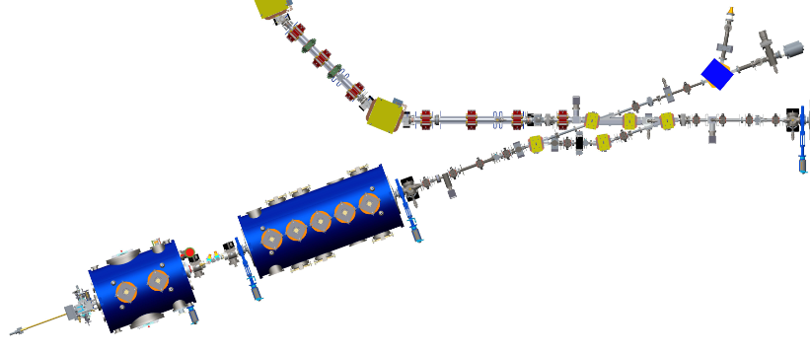
bERLinPro Injector
Cathode (CKSb):
4-retraction
2 Q
TDC /
spectrometer
measurements
Laser:
1-spot size
2-pulse length
3-charge
Gun field:
5-amplitude
6-field flatness
Screens
Diag. Line
18,19 quadrupoles
4 BPMs
BP
Merger:
14-17: quadrupoles
Solenoid:
7: strength
Booster:
8-13: cavity phases and amplitude
19 ‚knobs‘ total

Slide 27
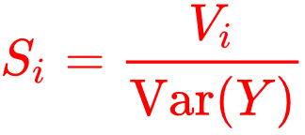
Sensitivity analysis and Sobol’s coefficients
Variance-based Sensitivity Analysis quantifies numerically the contribution of uncertain inputs (taken individually or in combinations) into output uncertainty;
*Variance decomposition: Model Y = f(X), X = (x₁, x₃, x_{3 …} x_{d}), x_{i} = uncertain model input parameter
First order
Sobol’s indices
Second order
Sobol’s indices
$$S_{2i}=\frac{\sum{V_{ij}}}{Var(Y)}$$
Sobol’s indices are obtained analytically, at any order, from the coefficients of the PC expansion
* Wikipedia: Variance-based sensitivity analysis
Bruno Sudret, “Global sensitivity analysis using polynomial chaos expansions”, Reliability Engineering & System Safety Volume 93, Issue 7, July 2008, Pages 964-979
Bruno Sudret: ETH Zurich, Professor of “Risk, Safety and Uncertainty Quantification”

