Slide 1

PERLE Facility Report
Ithaca, October 3rd 2022
Walid KAABI

Slide 2
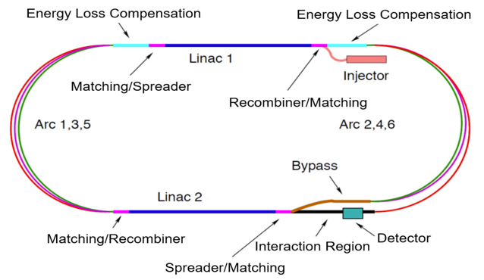
The short story of the PERLE Genesis
Future particle physics imposes strong challenges on accelerators and requires a variety of accelerator R&D programs not only to meet the foreseen performances, but also to lower their energetic consumption and enhance their efficiency.
  → Energy Recovery Linacs offer one of the main options for energy frontier colliders
To probe deep inelastic scattering at high energy and to study the Higgs boson, LHeC proposes a high luminosity collider using the HL-LHC protons and an intense electron beam.
For the electron beam, the ERL scenario has many advantages :
  High luminosity, low interference for installation next to LHC, machine size, energy consumption
  Concept also applied to the FCC-eh design
The ERL-ring collider concept of LHeC based on
  synchronous operation of HL-LHC and 50 GeV electron beams
  circumference of e- loop about 1/5 of that of LHC (5.3 km)
  luminosity of 10³⁴ cm⁻².s⁻¹
  Multi-turn ERL (3+3 passes), 50 GeV, RF frequency: 801 MHz,
  20 mA beam current (6 x 20 = 120mA load in the cavities).

Slide 3
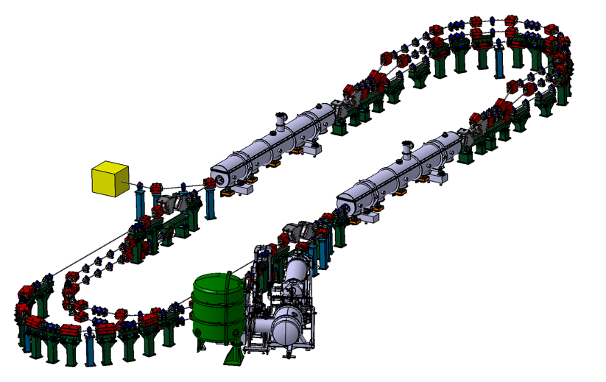
The short story of the PERLE Genesis
PERLE: A testbed to explore and validate a broad range of accelerator phenomena & technical choices on the pathway to the LHeC and other new frontier machines realisation.
Main challenges: Multi-turn, high bunch charge, high power energy recovery, …
2 Linacs (Four 5-Cell 801.58 MHz SC cavities)
3 turns (164 MeV/turn)
Max. beam energy 500 MeV
I = 20mA
Target Parameter | Unit | Value
Injection energy | MeV | 7
Electron beam energy | MeV | 500
Normalised Emittance γε_{x,y} | mm mrad | 6
Average beam current | mA | 20
Bunch charge | pC | 500
Bunch length | mm | 3
Bunch spacing | ns | 25
RF frequency | MHz | 801.58
Duty factor |  | CW

Slide 4
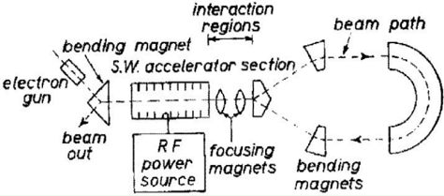
ERL History and achievements
1987 Los Alamos
FEL-operation, nc,
coupled acc/dec cavities
1987 High Energy Physics Lab
Stanford University
SRF cavities, proof of principal experiment
1965 M. Tigner
“A possible apparatus for electron clashing-beam experiments”
2000
Jefferson Lab
“Front End Test”
SRF, first CW
recovery
2002 JEARI, Japan
FEL, SRF, 700kW beam power
2005 Daresbury Lab, GB
“Alice”, SRF, 26MeV, versatile
10-year user program
under construction:
MESA, Germany
particle physics application
PERLE, France
Technology test facility (LHeC/FCC-eh) + eRIB test facility
bERLinPro, Germany
SRF/ERL technology test facility
CeC, BNL, USA
Coherent electron cooling for EIC
2002
Jefferson Lab
“IR-Demo”
SRF, 5mA, 48MeV,
2.1kW beam power IR
2003
CEBAF, 1 GeV, single turn
2007 Upgrade:
9mA, 150MeV
1.1MW beam power with ~300kW total power
2004 BINP, Russia
FEL-operation
normal conducting RF,
30 mA
2007: 4-passes
2013 KEK, Japan
“cERL”, prototype
ERL light source
Industrial applications
2020, Cornell/BNL
cbeta, FFA-arc
4-pass ERL
(80mA injector, e = 0.3mm mrad)
Courtesy to Bettina Kuske

Slide 5
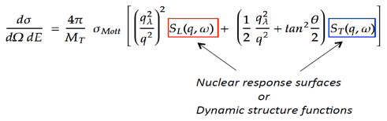
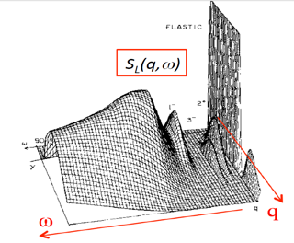
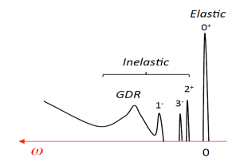
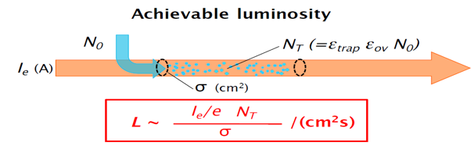
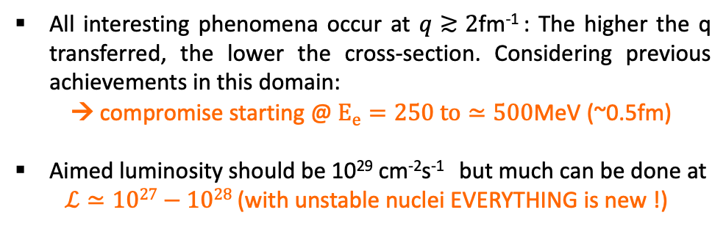
The New Frontier : e-RIB (Radioactive Nuclei Beam) scattering
PERLE is also coupled with Nuclear Physics European Strategy: A completely new horizon to explore the interior of exotic nuclei : charge radius, shape & new properties emerging (halo, pairing..)
All interesting phenomena occur at $q≳2$fm⁻¹ : The higher the q transferred, the lower the cross-section. Considering previous achievements in this domain:
→ compromise starting @ $E_{e}=250 to≃500$MeV (~0.5fm)
Aimed luminosity should be 10²⁹ cm⁻²s⁻¹ but much can be done at
$ℒ≃1027−1028$(with unstable nuclei EVERYTHING is new !)
Simple imaging
Full tomography
A long road ahead before reaching the full tomography of an exotic nucleus → The starting point is : DESTIN [DEep STructure Investigation of (exotic) Nuclei]
The beam will confine RIB in longitudinal plane (e- with positive ions), and traps have to confined RIB in transversal plane
Courtesy to David Verney
DESTIN Starts to be structured in Orsay and involving national and international communities. Coupled to the future of GANIL reflexions. A priority for Nuclear Physics Perspectives at national level

Slide 6







Few words of organisation. PERLE Collaboration & PERLE- France
PERLE international collaboration
A Collaboration Agreement (CA) was signed by all partners.
A bilateral ICRADA between JLab-DOE and IJCLab-CNRS was signed on May 2022.
A collaboration between PERLE & bERLinPro is under discussion and will be formalised by an MoU soon.
Current discussing with other European institutes to join the PERLE collaboration.
PERLE in France. Important News
IN2P3/CNRS National Strategy (end of 2021): Perle a priority for accelerators in line with the ESPP
Application under preparation to the National Recovery Plan (End 2022) to ask for a financial support to realise PERLE phase 1 (250 MeV). Work on going is timely followed by IN2P3-CNRS and led by Maud Baylac.
PERLE infrastructures will benefit of the CPER2 funding (2M€ available from 2022) (programming phase to be started soon)
New Organization in France and significant increase of people involved.

Slide 7
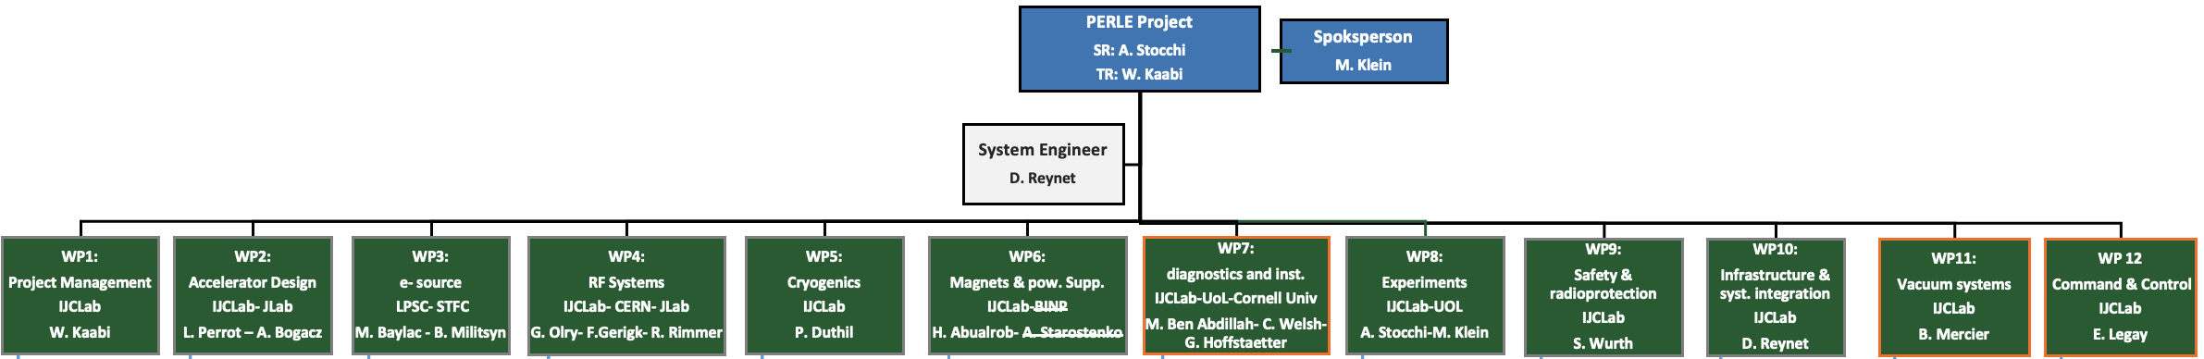
Project Organisation: PERLE Collaboration & PERLE- France
PHD student (ending now) injection lines : Ben Hounsell (100% PERLE)
PHD student (2nd year) on RF/HOM/cavities : Carmelo Barbagallo (100% PERLE)
PHD student (1st year) on Beam Dynamics : Coline Guyot (50% in PERLE)
Postdoc (beam dynamics) Alex Fomin
5 months interns (Magnets/beam dynamics)→PHD thesis 2022:Rasha Abukeshek
From Jul 2022
  Postdoc (Injection line) Joshua Yoskowitz
From Oct. 2022
  Permanent CRNS position (beam dynamics) Julien Michaud
  PHD thesis Liverpool/AsTec/IJCLab (injections) Connor Monaghan
Denis Reynet System Engineers (IJCLab)
Luc Perrot Beam Dynamics (IJCLab)
Maud Baylac Gun Installation and Operation (LPSC)
Guillaume Olry RF System (IJCLab)
Patxi Duthil Cryogenic (IJCLab)
Hadil Abualrob Magnets (An-Najah / IJCLab)
Sébastien Wurth Security Issues (IJCLab)
Marc Langlet Infrastructures (IJCLab)
Bruno Mercier Vacuum System (IJCLab)

Slide 8
PERLE Timeline for TDR phase and beyond
The current phase of the project:
Technical Design phase (→ 2023)
Prepare to Build phase (P2B) (→ 2025)
Machine design (Injector, 250MeV and 500 MeV configurations)
Beam dynamics studies
Main systems design (Buncher, Magnets, HOM couplers, full dressed cavity, power couplers, new CM, IP, dump…)
In-Kind adaptation and/or upgrade studies (DC-Gun, Booster, SPL CM) *
Definition of the needs (Diags, Cryogenics, CC, LLRF, Shielding, machine interlock system, infrastructure…)
Experiments with PERLE beam and their specific needs
DC-Gun reinstallation and test
Equipment specifications (for DC gun)
Prototyping and tests (HOM couplers, Single cell booster cavity, B-COM magnet, 5-cells Nb Cavity) *
In-Kind adaptation and/or upgrade work (DC-Gun, Booster, SPL CM)
PERLE administrative regime (Dossier ASN)
Infrastructure (site investigations and work)
* Design of some systems could continue after TDR publication
* Prototyping results could be included in the TDR phase if available

Slide 9
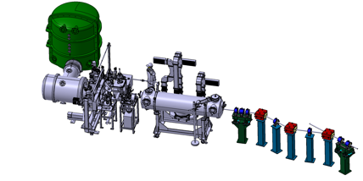
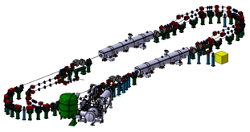
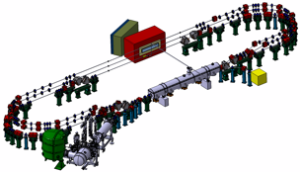
PERLE main Milestones (TDR phase and beyond)
2025
End Phase 0: Injection line
2030
End Phase 2: PERLE @ 500MeV
2023
PERLE TDR
2028
End Phase 1: PERLE @ 250MeV

Slide 10
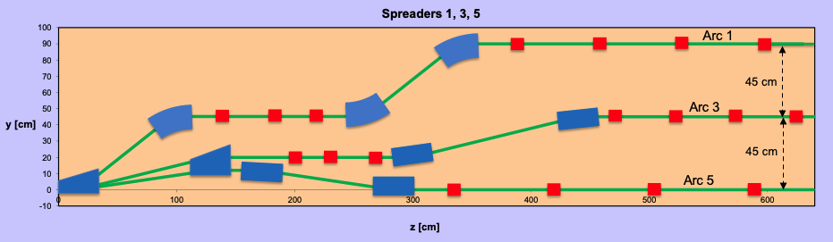

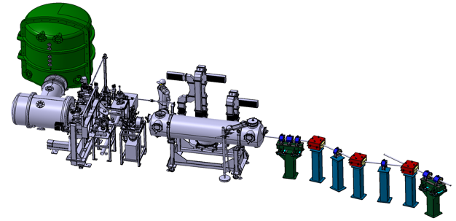
PERLE Configuration
PERLE: first multi-turn ERL, based in SRF technology, designed to operate at 10MW (20 mA, 500 MeV) power regime
Cryomodule with 4 five-Cell cavities
Total gradient 82 MeV
3 acc & 3 decc beams at different energies travelling in the CM.
Switchyard: vertical separation/recombination of beams at different energies
3 staked recirculation arcs for beams at different energies (Arcs 1, 3, 5).
Target Parameter | Unit | Value
Injection energy | MeV | 7
Electron beam energy | MeV | 500
Normalised Emittance γε_{x,y} | mm mrad | 6
Average beam current | mA | 20
Bunch charge | pC | 500
Bunch length | mm | 3
Bunch spacing | ns | 25
RF frequency | MHz | 801.58
Duty factor |  | CW
Beam dump
Interaction Points
HV tank
Photocathodes loading chamber (Sb-based photocathodes)
Buncher
350-500 kV
DC gun
Merger
3 staked (& inversed) recirculation arcs for beams at different energies (Arcs 2, 4, 6)
Injection line delivering 500pC bunches at 7 MeV.
Light box
Green laser 40 MHz
Booster: 5 single-cell cavities (802MHz) individually powered

Slide 11
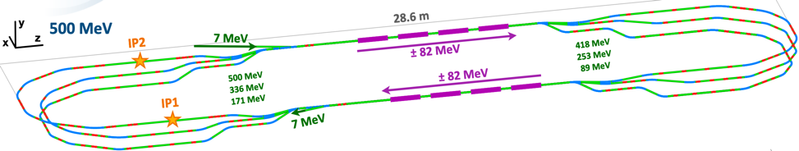
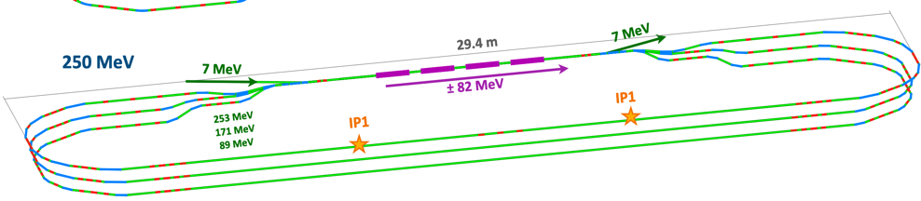
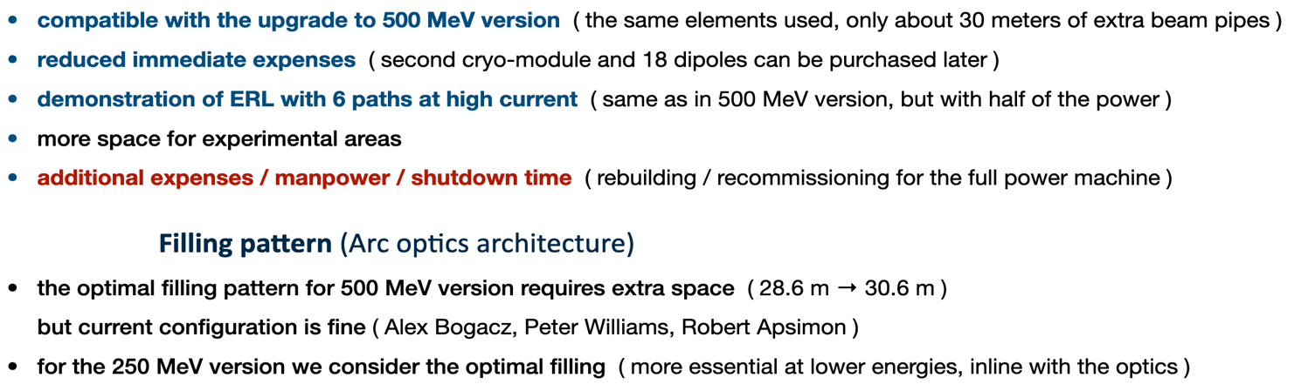
Lattice optimization of the 250 MeV version of PERLE
More details in the poster prepared by Alex Fomin & presented by Luc Perrot
Lattice design of the 250 MeV version of PERLE

Slide 12
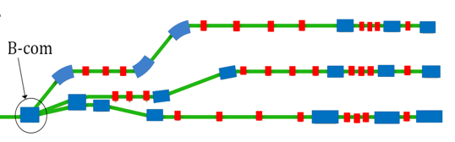
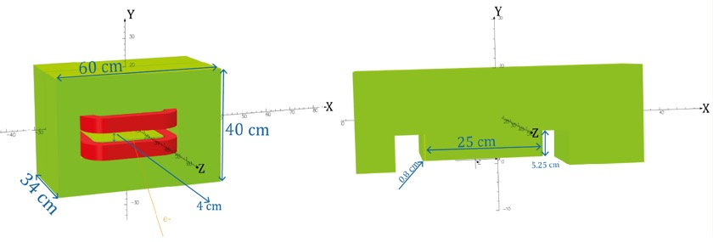
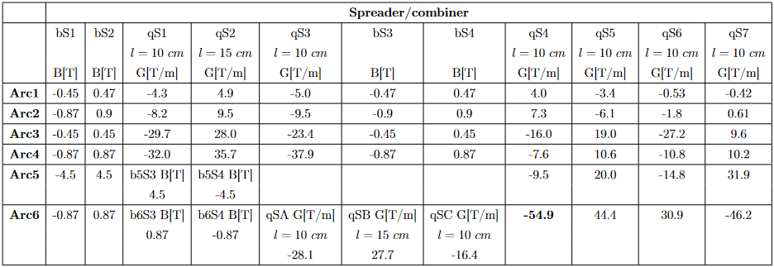
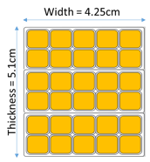
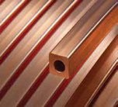
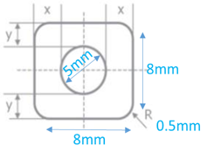
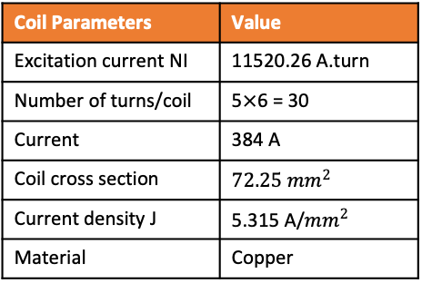
Status of B-com Magnet design
Courtesy to Rasha Abukeshek and Hadil Abualrob
Design parameters
Tool: Opera 3D
Coil
30° bending angle (8.8 cm exit point).
Yoke
Magnet geometry | Initial design * | New design
Width | 40 cm | 40 cm
Height | 57 cm | 60 cm
Length | 34 cm | 34 cm
Aperture | 3.6 cm | 4 cm
Pole width | 22 cm | 25 cm
Pole height | 5.25 cm | 5.25 cm
Pole blend radius | 2.4 cm | 0.8 cm
Coil Parameters | Value
Excitation current NI | 11520.26 A.turn
Number of turns/coil | 5$×$6 = 30
Current | 384 A
Coil cross section | $$72.25{ mm}^{2}$$
Current density J | 5.315 A/${mm}^{2}$
Material | Copper
* Courtesy to Jay Benesch (Jlab)
Optimized aperture of 4 cm.
Pole bend radius modified to lower harmonic content.
Yoke material: standard steel (C content < 0.1%).
Hollow copper conductor
Excitation current calculated at B = 0.87 T

Slide 13
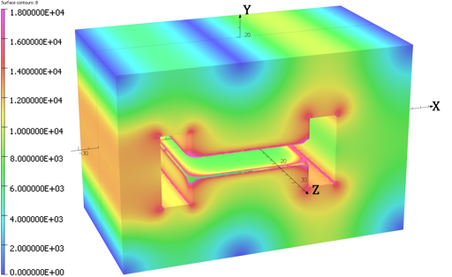
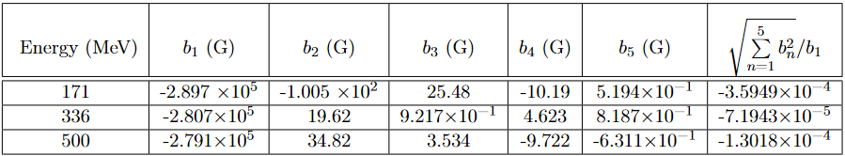
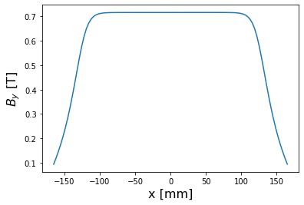
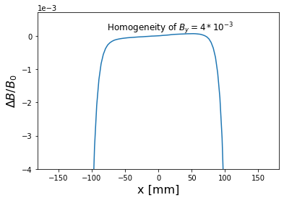
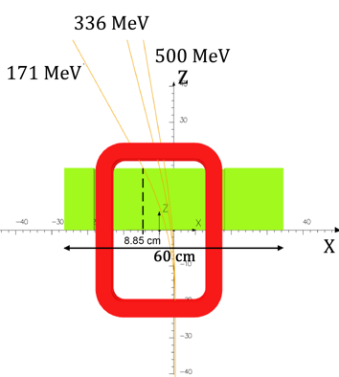
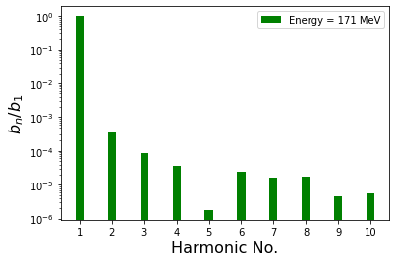
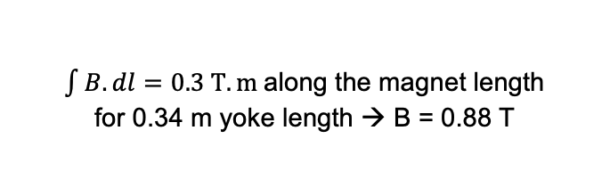


Status of B-com Magnet design
Field calculations:
Harmonics content calculated along beam trajectory:
Field homogeneity along the beam path: 0.036%
→ Quadrupole & sextupole components can be dealt within the lattice.
Initial design: 0.1% field quality
→ Improvement by one order of magnitude
No chamfer or shims added, only a blend radius of 8 mm is used
$$By (0, 0, 0) = 0.716382 T$$
$$\frac{ΔB}{B_{0}}=\frac{B\left(x\right)−B_{0}}{B_{0}}$$
$\int{B.dl}=0.3 T.m$along the magnet length
for 0.34 m yoke length → B = 0.88 T

Slide 14
Plan of magnet activities
Prototype of B-COM magnet:
Pursue the work toward B-COM magnet complete specification.
Proceed to a thermal study and mechanical complete design
Order a B-COM magnet prototype (by mid 2023) to be measured and qualified later.
Design studies of arc magnets
Pursue the ongoing design work on arc dipoles and quadrupoles and set the specifications.
Define the needs on multipoles regarding the two lattice configurations.

Slide 15
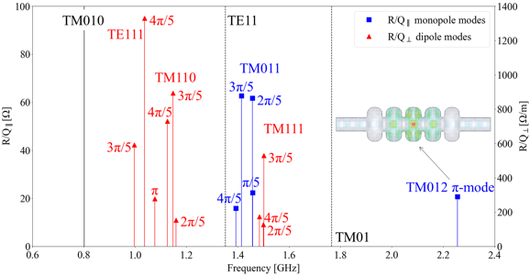
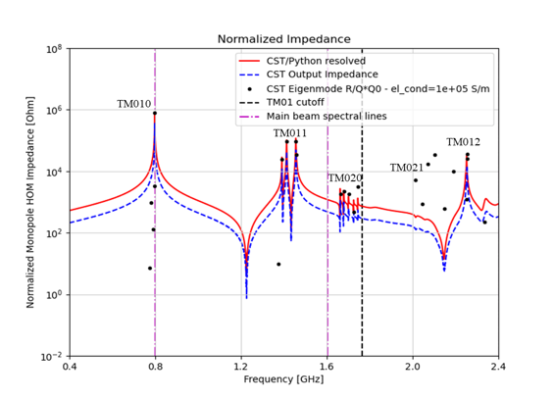
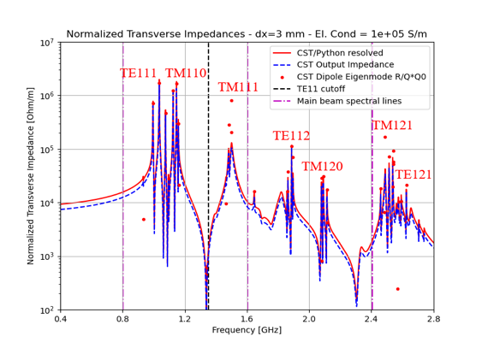
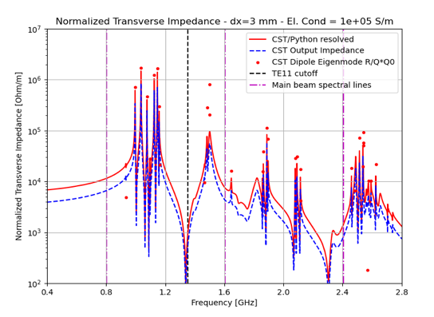

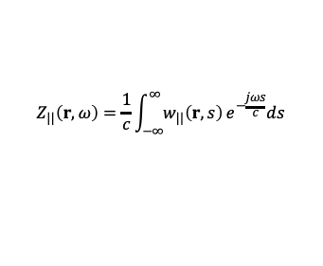
Status of HOM design Studies:
3D- Eigenmode simulation: HOMs Identification in PERLE cavity
More details in a dedicated talk by Carmelo Barbagallo - Thursday 6th @ 9:10 am
Wakefield simulations for multi-beam excitation scheme (CST Studio)
TE111
TM110
TM111
TE112
TM121
TM120
TE121
Longitudinal wake impedance [Ω]:
$$Z_{||}\left(r,ω\right)=\frac{1}{c}\int_{−∞}^{∞}{w_{||}\left(r,s\right)}e^{−\frac{jωs}{c}}ds$$
$$Z_{⊥}\left(r,ω\right)=−\frac{jβc}{ω_{n}r_{0}}∇_{⊥}Z_{||}\left(r,ω\right)$$
Transverse wake impedance [Ω/m] – Panofsky-Wenzel Theorem:

Slide 16
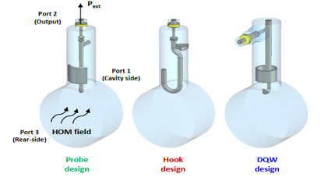
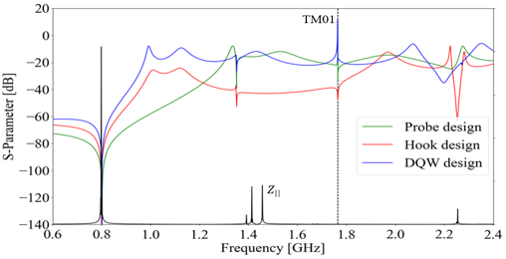
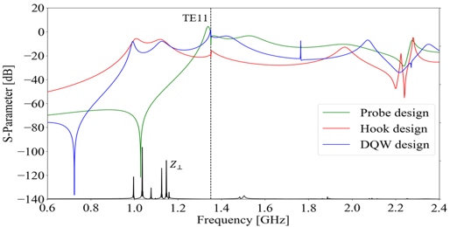
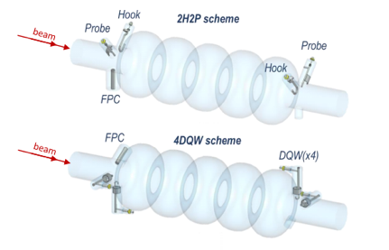
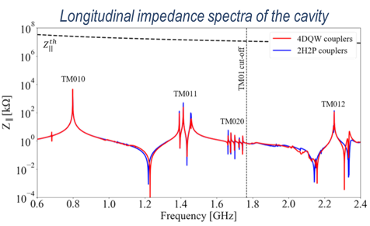
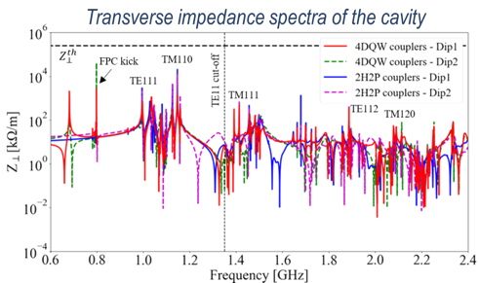
Status of HOM design Studies:
HOM coupler optimization of 3 different designs
Couplers geometrically optimized according to the HOM spectrum & S-parameters btw port 1 (beam pipe) & port 2 (coupler output) studied.
The hook coupler provides higher damping of the first two dipole passbands (TE111 and TM110)
The DQW coupler exhibits a better monopole coupling for TM010 mode than the probe design.
Study of 2 damping schemes with 4 HOM couplers (Especially for dipole HOM extraction)
Promising results of DQW configuration: It allow damping both monopole and dipole HOMs below the analytically-computed beam-stability limits

Slide 17
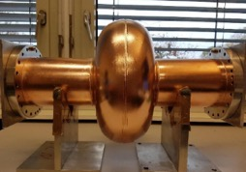
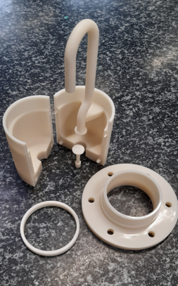
Plans on HOMs and cavity activities :
HOM couplers further studies and prototypes:
Finish the ongoing thermal studies of HOM couplers (COMSOL simulation)
3D printing of 1 DQW, 1 hook and 1 probe HOM couplers (@CERN): in polymer & Copper coated.
→ First tests on a 801 MHz mono-cell Cu cavity (provided by CERN) will be performed at JLab this month.
A DQW coupler 3D metal printed (@CERN) is scheduled once the tests on polymer couplers are done and conclusions are obtained. Other couplers will follow.
Cavity prototypes:
A 5-Cell copper cavity will be fabricated soon @Jlab (same design as the 1st Nb 5-cell cavity fabricated in 2017) to allow end group design optimisation with optimised HOM coupler configuration.
A 5-Cell Niobium cavity with optimised end groups will be fabricated once all the tests are made.
First Hook type polymer coupler 3D printed

Slide 18


Cryomodule design:
Courtesy to Gilles Olivier
Cryomodule design under study: two options are currently considered at IJCLab: the SPL and the ESS design. The two candidates present similar features:
Designed by IJCLab & CERN
Some components available
Designed by IJCLab
Characteristics | ESS (704MHz) | SPL (704MHz) | PERLE (802MHz)
Number of cavities/cells | 4/5 or 6 | 4/5 | 4/5
Coupler to coupler length (mm) | 1500 | 1490,5 | -
Length flange to flange (mm) | 1258,8 (Mβ) / 1316,3 (Hβ) | 1397,3 | 1292,5
Coupler to flange dim. (mm) | 115 (Mβ) / 130 (Hβ) | 116,4 | 96,7
Cells external diameter (mm) | 378,9 (Mβ) / 385,7 (Hβ) | 386,5 | 335

Slide 19
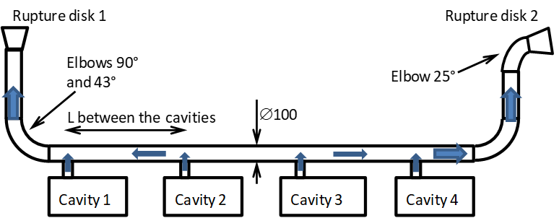
Cryomodule design:
Main dimensioning parameters & constrains
CIRCUIT | Heat load SPL/HG (W) | Heat load ESS Ell. Hβ (W) | Heat load PERLE (W)
RF losses | 200 | 24,4 | 260 (Q0 1.E+10)
Beam losses |  | 3,25 | To be evaluated
HOM ports |  |  | 80
Static losses | 30 | 13,23 | 30
2+2 HOM couplers actively cooled
& RF power extracting circuits
High static & dynamic heat loads for 4 cavities
>> He low pressure circuit to be well dimensioned
Many space need to be available inside the cryomodule
2 Ø100 bursting disk (PED rules)
Ferroelectric fast reactive tuner

Slide 20
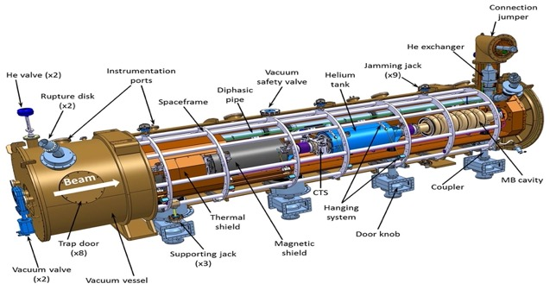
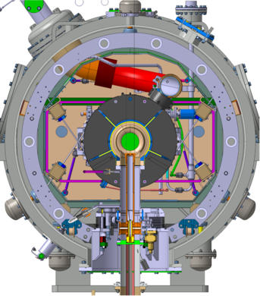
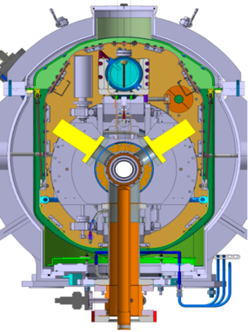
Cryomodule design:
ESS design
Intermediate supporting structure (spaceframe)
Cavity string hung by rods
Insertion of the cavity string by the extremity (rollers)
Trap doors for tuner access
Connexion to the valve box on the top of the vacuum vessel
More available space inside (+ 400mm in diameter and more transversal space between cavities)
Design validated: series fab. & tests ongoing (Qty 30)
SPL design
Vacuum vessel with top cover
Insertion of the assembled cavity string by the top
Cavity string supported by couplers
Connexion to valve box at the extremity of the vacuum vessel
Vacuum vessel fabricated (top cover to be modified)
Compact design >> lack of space

Slide 21
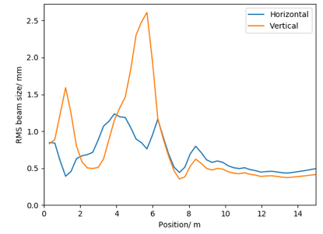
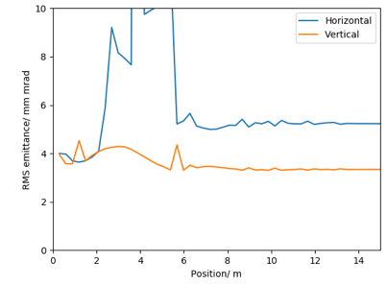


Injection line optimisation
Electron source to booster exist optimisation:
The ALICE electron gun electrode geometry has been re-optimised for PERLE’s new requirements.
Optimisation with a 4 cavity booster, from the cathode to the booster exit, was performed and meets the specification:
Ben Hounsell PhD work
 | Achieved values | Specification
Horizontal emittance | 5.23 mm mrad | < 6 mm mrad
Vertical emittance | 3.34 mm mrad | < 6 mm mrad
Bunch length | 3.22 | 3 mm
Kinetic energy | 86.1 MeV | 88.6 MeV
Horizontal beta function | 7.89 (mismatch 8.3 %) | 8.6
Horizontal alpha function | -0.74 (mismatch 11.6 %) | -0.66
Vertical beta function | 8.76 (mismatch 1.8 %) | 8.6
Vertical alpha function | -0.67 (mismatch 1.5 %) | -0.66
Energy spread
Transverse beam size and emittance

Slide 22



Injection line optimisation
The PERLME merger design:
Ben Hounsell PhD work
The merger is the beamline which transports the beam into the main ERL loop.
The merger presents significant opportunity for emittance growth:
  Longitudinal space charge force induced shift in the dispersion
  Potentially asymmetric emittance compensation.
There are a wide range of possible designs and several were studied.
Generally shorter and smaller bending angles is better
4 dipole schemes were investigated as they have the potential to mitigate the effects of space charge on the dispersion and the consequent emittance growth.
Merger schemes investigated:

Slide 23




PERLE e- Source
Courtesy to Denis Reynet
Alice (Daresbury) DC gun received at Orsay on May 2019. We are currently working on its re-installation and operation at low parameters, then studying its upgrade to meet PERLE requirements.
The “Igloo”: Equipped experimental hall to host the DC gun
All received parts transferred to the installation area (March 22)
More details in a dedicated talk by Maud Baylac- Wednesday 5th at 1:10 pm

Slide 24





PERLE e- Source
HV vessel installation
(June 22)
HV power supply assembly
(July 22)
Checking the HV vessel tightness
(September 22)

Slide 25
Conclusions
ERL machines open a new frontier for the physics of “the electromagnetic probe” (ep, eA, eN). PERLE@Orsay is a key ERL project for HEP and Nuclear Physics communities
PERLE@Orsay has been recognised (together with bERLinPro) an essential pillars of the ERL ESPP strategy. It combines high current and multi-passes (high luminosity / higher energy)
PERLE@Orsay is a very challenging machine : RF CW operation, specific SFR systems, multi-bunches operation, high power machine, complex Lattice design, broad range diagnostics, beam dynamics...
The International collaboration is formed and still opened to new comers.
Important boost in the last 9 months in France (IJCLab and LPSC) and we are actively entered in the TDR and the P2B phases.

Slide 26

Thank you for your attention!

