Slide 1


MESA – a fully instrumented ERL project for nuclear and particle physics experiments
Layout of MESA and experimental setups
Current status of realization
MESA schedule
ERL Workshop 2022
October 3rd 2022
Florian Hug presenting work of the
MESA group
Partially supported by the European Union’s Horizon 2020 Research and Innovation programme under Grant Agreement No 101004730 (iFAST).

Slide 2
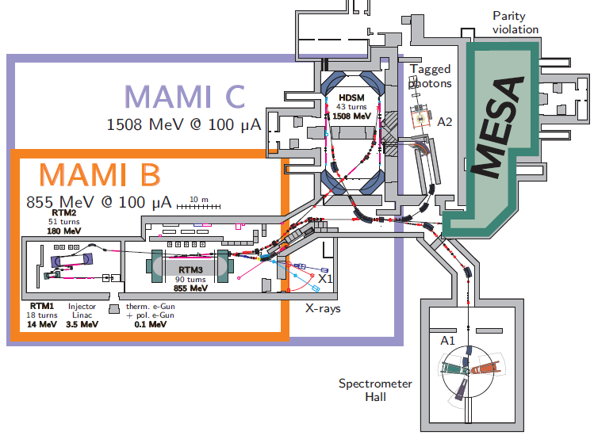
MAMI and MESA at KPH Mainz
MAMI is operating since
>25 years at KPH
In 2012 funding of
PRISMA cluster of
excellence has been
granted including a new
accelerator project:
Mainz Energy Recovery Superconducting
Accelerator (MESA) to be built in the exisisting facility
In June 2015 DFG granted a research building to JGU „Center for Fundamental Physics (CFP)“ including an extension for MESA halls

Slide 3
Detailed informations on MESA experiments:
Talk by Kurt Aulenbacher (presented by F. Hug) on Wednesday

Slide 4
MESA Status
In June 2021
it was offically announced that full occupancy of CFP-1 will be possible in mid/end 2023
Representing a shift by almost
two years
Delay was anticipated early, Mitigation strategy est. 2019….

Slide 5
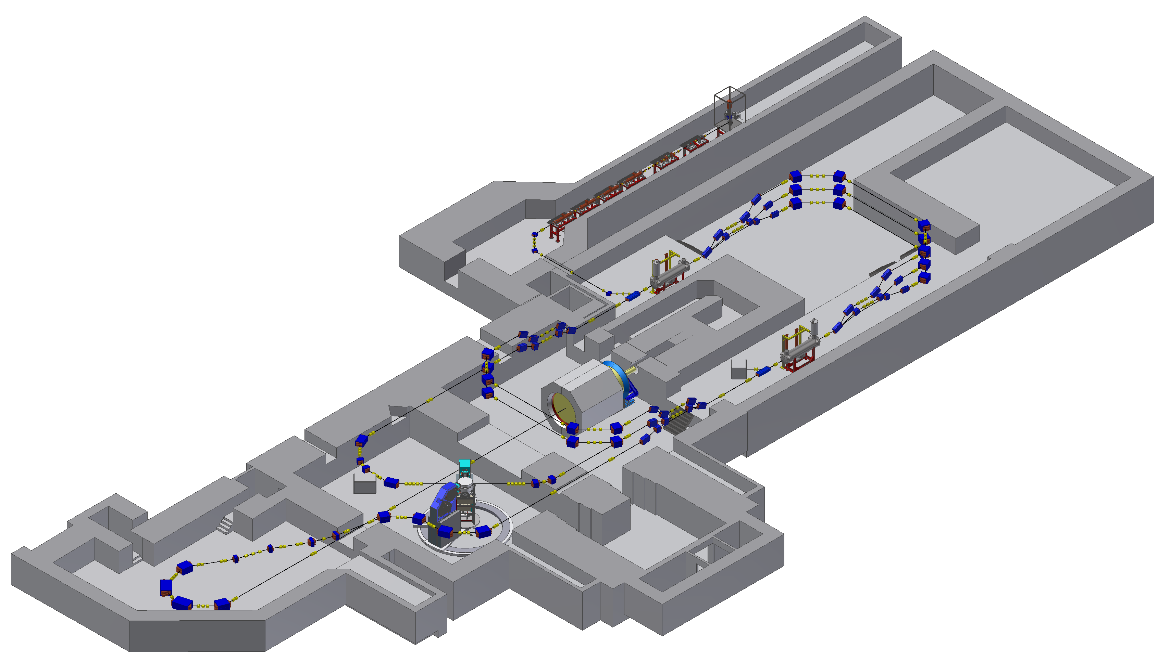
Beschleunigte Aufbaumassnahme MESA (BAM)
Most of instrumen
tation will be installed
in Modulator-halle
Modulatorenhalle
Linac-tunnel
New building (CFP-1, hall-1)
Old building, halls-2-4

Slide 6
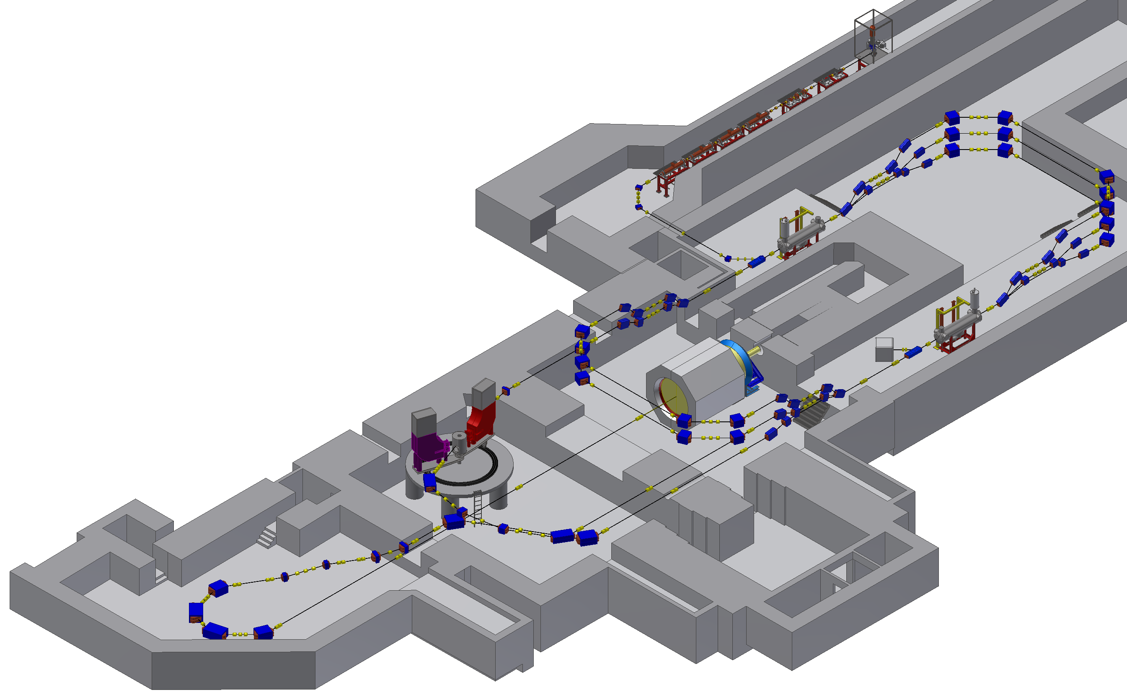
MESA Accelerator Layout
Double sided recirculation design with normal-conducting injector and superconducting main linac
Two different modes of operation:
(1300 MHz CW beam)
- EB-operation (P2/BDX experiment):
polarized beam,
up to 150 µA @ 155 MeV
- ERL-operation (MAGIX experiment):
(un)polarized beam,
up to 1 (10) mA @ 105 MeV
Gun
MELBA
MAMBO
Recirculation arcs 1-3-5
MEEC-1
155 MeV dump
MEEC-2
P2
5 MeV dump
Recirculation arcs 2-4
MAGIX
ERL loop
Ext. beamline
Picture&lattice layout : D. Simon

Slide 7
MESA Accelerator Layout
MELBA
Source and Beam preparation system:
MESA Low Energy Beam Apparatus (MELBA)
- Defines the quality of the MESA beam
Picture &lattice layout : D. Simon

Slide 8
MESA Accelerator Layout
MELBA
MESA injector linear accelerator:
Milli-AMpere-Booster (MAMBO)
In ERL mode, all beam power
(up to 50kW) comes from the injector:
MAMBO is the „powerhouse“
of MESA
MAMBO
Lattice layout : PhD thesis D. Simon

Slide 9
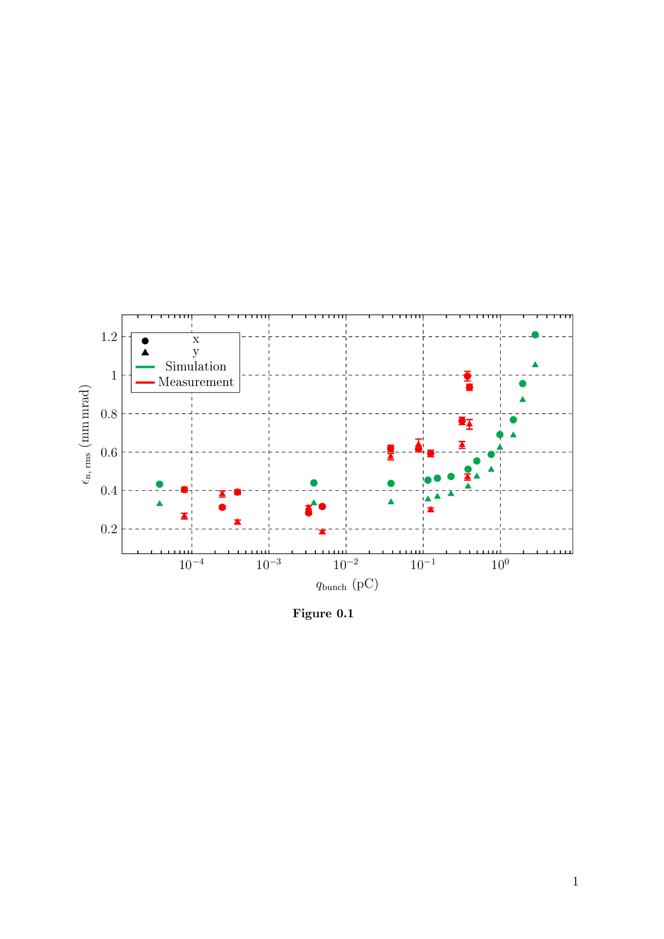
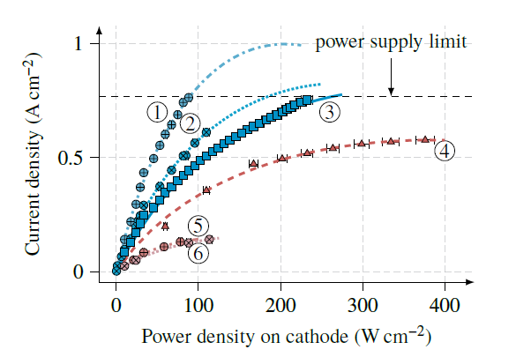
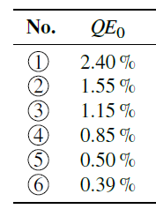
MELBA Tests
Old MELBA Test set-up
Operation with up to 150keV
beam and up to 10mA beam current
MELBA was dis-assembled and put in storage
due to start of hall renovation for MESA
PhD Theses completed
S. Friederich (2019)
R. Kempf (2020)
C. Matejcek (2021)
P. Heil (2021)
Surface photovoltage in NEA GaAs at 10mA
S. Friederich et al .doi:10.18429/JACoW-IPAC2019-TUPGW028
Transverse emittance
C. Matejcek et al. doi:10.18429/JACoW-IPAC2019-TUPGW028
Longitudinal emittance
.
P. Heil et al.
PHYS. REV. ACCEL. BEAMS
24, 042803 (2021)

Slide 10
Source/beam preparation (MELBA) layout
High bunch charge/beam
current source
(unpolarized beam)
Double scattering
Mott polarimeter
Photosource „STEAM“
(polarized beam)
Spin Manipulation
Circular
Chopper
f/2f buncher
cavities
To MAMBO
injector

Slide 11
Injector working principle
S. Friederich at al: IPAC 2021

Slide 12
MELBA/MAMBO: final Accelerator Layout
MESA low energy beam apparatus (MELBA)
In a huge number of online meetings the arrangement of components has been planned
Several issues raised by results of test experiments and MAC suggestions adressed (improved corrector magnets, BPM‘s for P2, Spin manipulation. 5MeV polarimeter… )
„freezing“ & start assembly
in 2/2022
MARC-0 region
Milliampere Booster (MAMBO)
R. Heine: PHYSICAL REVIEW ACCELERATORS AND BEAMS 24, 011602 (2021)

Slide 13
OPAL simulation results for complete injector
S. Friederich at al: IPAC 2021

Slide 14
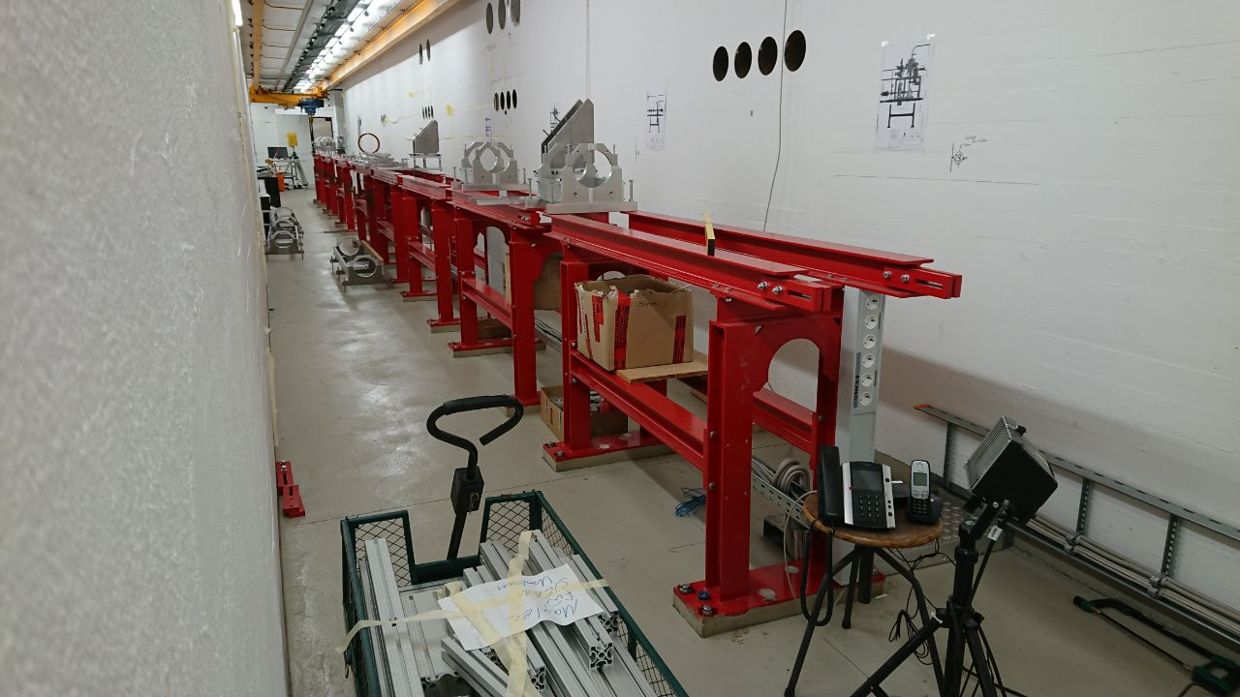
Injector Status today

Slide 15
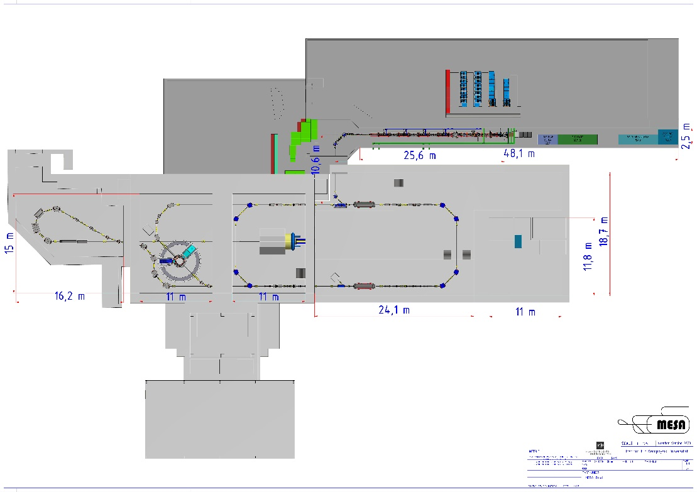
Impact of Pandemic on MESA construction- RF-vendors
RF amplifiers & MAMBO Sections were ordered in 2019
…Based on existing protypes
Supplier for RF-amplifiers went bankrupt in 12/2020
New owner JEMA France continues contract
Successful SAT of 4*550 Watt basic module in 9/2021
Delivery of first (biggest) amplifier now scheduled for end 22
Auxiliary systems (LLRF, vacuum, diagnostics), expected to be
ready before amplifier delivery
74 kW 1300 MHz amplifier (CAD drawing)
Vendor: JEMA France (former SPE)
Amplifier batch: 1*74, 3*54, 4*15 kW

Slide 16
Cryomodules
MESA ELBE-Enhanced Cryomodule (MEEC):
Superconducting RF-cavities provide large
energy gain on small footprint and enable
Energy-recovery-Linac (ERL)-operation
MELBA
MAMBO
MEEC-1
MEEC-2
Picture/beam line&lattice layout : D. Simon

Slide 17
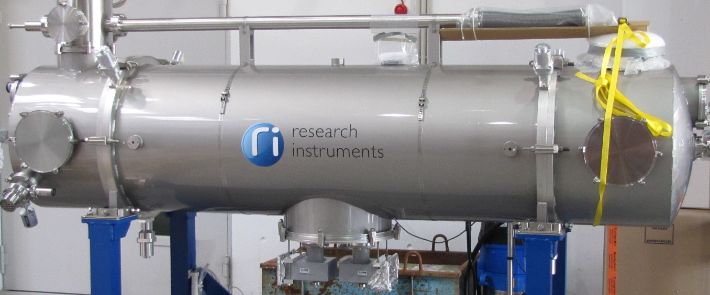
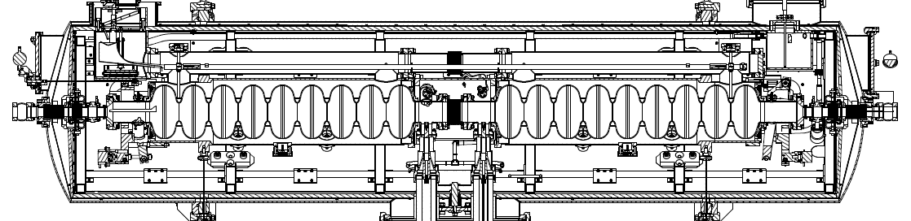
SRF-System: MEEC-Cryomodules
3.5 meter
Specs: 25 MeV Energy gain at <40 Watt thermal loss at 2 Kelvin

Slide 18
Production of 2 Cryomodules
2015: 2 MEEC’s ordered at RI Research Instruments GmbH
Until 2017 SRF testing infrastructure became available at HIM
9/2018: First cryomodule does not meet specs at HIM → refurbishment by vendor,
3/2019: Second tested cryomodule achieves specs during test at HIM/Mainz
8/2020 :refurbished cryomodule tested and fulfills specs.
2K operation
Cryomodules miss dynamical specs slightly but fulfill static specs by wide margin
→ On average the Helium consumption is estimated to be less than anticipated.
PhD thesis Timo Stengler
See also: T. Stengler et al. Proc. SRF 2019
doi:10.18429/JACoW-SRF2019-TUP041

Slide 19
MESA/P2 construction- Cryogenics (main issues only…)
Upgrade of L280 plant will start May 2022
Plant can serve MESA + P2 solenoid
P2-refrigerator – cooling of Hydrogen target - needs separate cryoplant
Negotiations with companies specialized on cryogenic piping ongoing
(More about MESA SRF in a dedicated talk on Tuesday)
SAC
Coldbox with Compressor
(2*, “separate solution” )

Slide 20
Lattice ERL/EB mode
MARC1,3,5
MARC2,4
Erl-loop
EB-beamline
Picture/beam line&lattice layout : D. Simon

Slide 21


Lattice: ERL mode start to end simulation
PhD theses Ch. Stoll and D. Simon
ERL-Lattice – not completely symmetrical due to enery (gain)
dependent focussing of RF-structures.

Slide 22
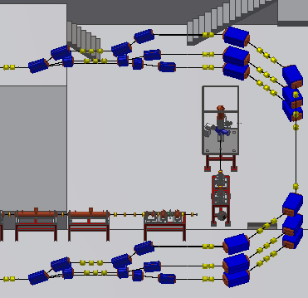
Recirculation arcs optics
Optics symmetric with respect to the middle of the long straight section. α=0 in the middle of the return arc
Return arc is free of transverse and vertical dispersion
Longitudinal dispersion r₅₆ can be adjusted by
changing the gradients of the middle quadrupoles
in the 45° sections
Total length of 1st return arc: ~45m
difference in time-of-flight for
beams of 15 MeV and 30 MeV:
Δt=60.5 ps → 28.3° in RF @ 1.3 GHz
Path length adjustment needed
(2 cm minimum ≈ 35° RF-phase)
for complete flexibility in beam energy
(chicane or moveable magnets)

Slide 23
BBU investigation
Note:
Technical limitation: Heating
of HOM coupler in TESLA cavities.
(~1mA CW estimation, but needs to
be determined experimentally)
13mA BBU limit at Target
in 4pass configuration 2up/2down
(without countermeasures)
PhD thesis Christian Stoll,
See also: C. Stoll and F. Hug: proceedings IPAC 2019 doi:10.18429/JACoW-IPAC2019-MOPGW025
BBU simulations by Ch. Stoll /Thermal modelling T. Stengler

Slide 24
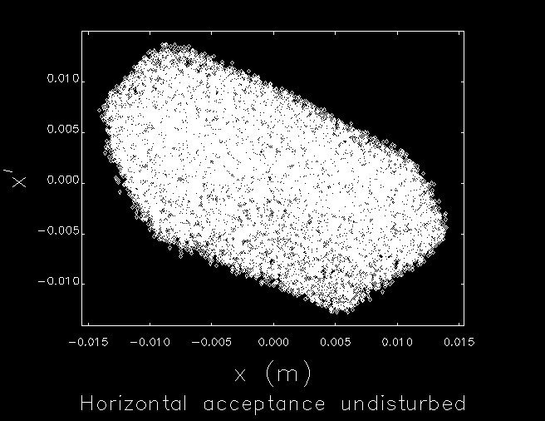
MESA construction- Magnets
F. Hug/D. Simon/C. Stoll
Magnet Basic parameters well known and not demanding
Task before tendering:
Determine lattice tolerance against field errors
→ avoid unnecessary precision requirements
→Tendering started September 2022
MESA ERL Mode beta-functions
MARC 1-5
Spreader/recombiner
ERL-ARC (MAGIX)
EB-Line (P2)

Slide 25
Summary
MESA is a fully instrumented ERL facility for nuclear and particle physics experiments
Construction of injecctor is ongoing, main accelerator construction will be started as
soon as the new building is ready (Jan 2023)
Most critical components are tested already. „Uncritical“ components are in the process of tendering
First beams to at low energy (15-55 MeV, 1 Recirculation) to the experiments can be expected 2 years after building occupancy

