Slide 1
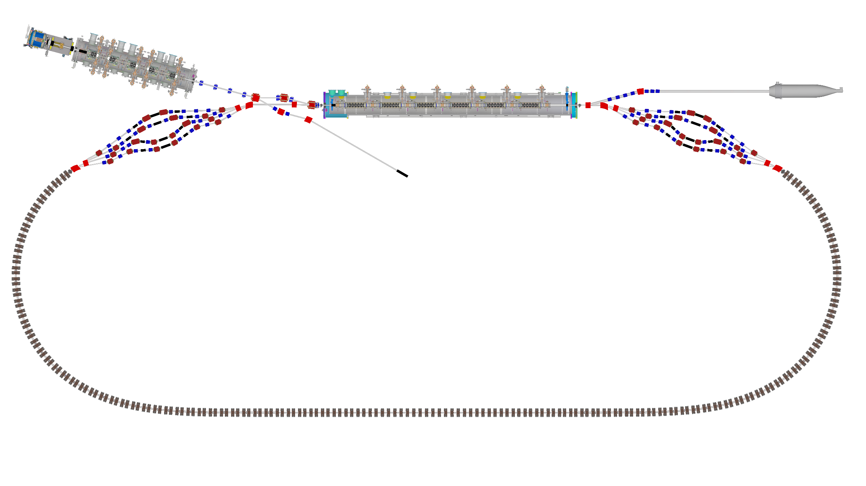
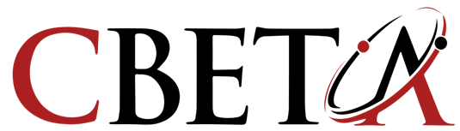


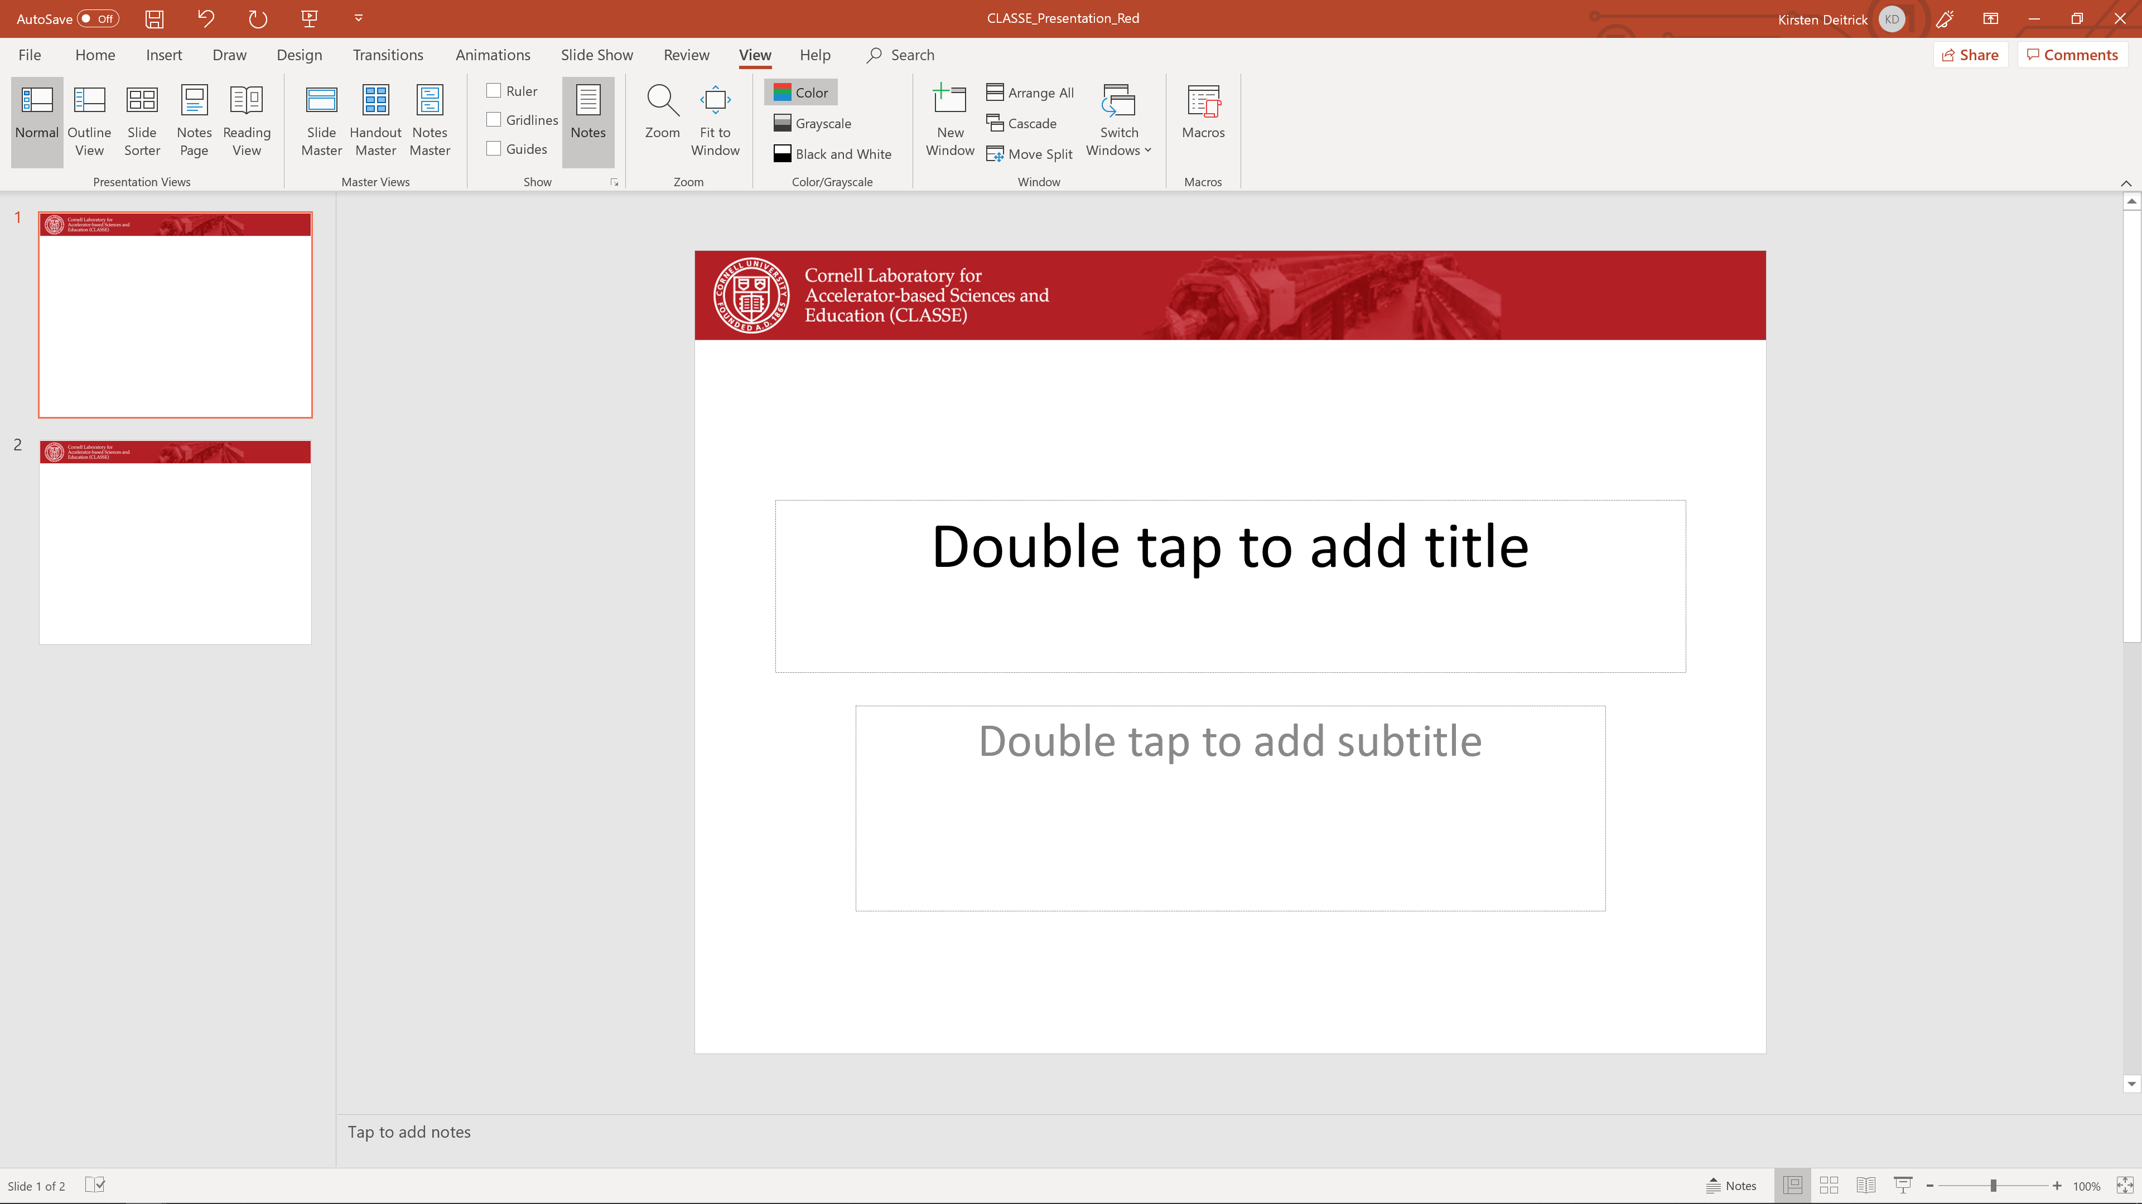
Facility Report CBETA
Georg Hoffstaetter
For the CBETA team

Slide 2
Credit and References
CBETA: First Multipass Superconducting Linear Accelerator with Energy Recovery, A. Bartnik, N. Banerjee , D. Burke, J. Crittenden , K. Deitrick , J. Dobbins , C. Gulliford , G. H. Hoffstaetter , Y. Li, W. Lou, P. Quigley, D. Sagan , and K. Smolenski, J. S. Berg, S. Brooks , R. Hulsart, G. Mahler, F. Meot, R. Michnoff, S. Peggs, T. Roser , D. Trbojevic , N. Tsoupas, Phys. Rev. Letters 125, 044803 (2020)
Measurement of the per cavity energy recovery efficiency in the single turn Cornell-Brookhaven ERL Test Accelerator configuration, C. Gulliford , N. Banerjee , A. Bartnik, J. Crittenden , K. Deitrick , J. Dobbins , G. H. Hoffstaetter , P. Quigley, and K. Smolenski, J. S. Berg , R. Michnoff, S. Peggs, D. Trbojevic, Phys. Rev. AB 24, 010101 (2021)
Intense monochromatic photons above 100 keV from an inverse Compton source, K. Deitrick, G.H. Hoffstaetter, C. Franck, B.D. Muratori, P.H. Williams. G.A. Krafft, B. Terzić, J. Crone, H. Owen, Phys. Rev. AB 24, 050701 (2021)
Ultimate bunch length and emittance performance of an MeV ultrafast electron diffraction apparatus with a dc gun and a multicavity superconducting rf linac, A. Bartnik, C. Gulliford, G. H. Hoffstaetter, J. Maxson, Phy. Rev. AB, 093401 (2022)

Slide 3
High Beam Current at Reduced Cost
By recovering the Energy of accelerated beams, Energy Recovery Linacs (ERLs) make large beam powers possible that would otherwise be prohibitively expensive.
Linacs produce high beam qualities for scientific experiments and for industrial applications, but their beam power is limited by the available electrical power.
ERLs surpass this power limit: much larger beam currents and beam powers become available because the beam energy is recaptured.
How do ERLs compare to other accelerators?
high currents, like storage rings, because the energy is recovered,
high beam quality (low emittance, bunch length, and energy spread) like linacs, because each bunch traverses it only once,
tolerates beam disruption as each bunch is used only once before it’s discarded.
All these strengths of ERLs are beneficial to EIC cooling!

Slide 4

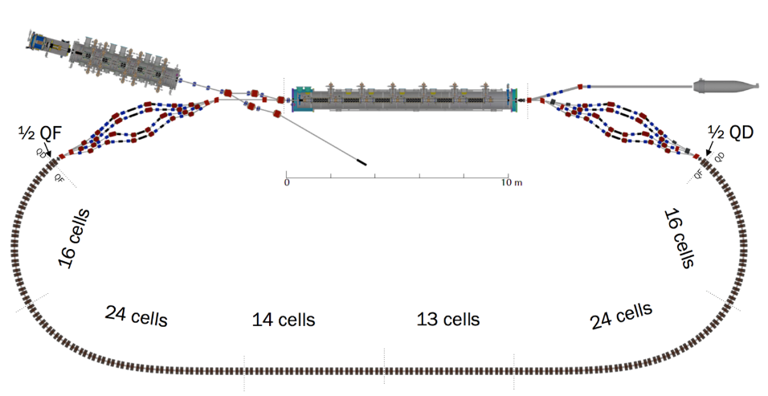
CBETA: The test ERL at CBETA
Cornell DC gun, 2nC peak
6 MeV
6 MeV
DC source
+/- 36 MeV
42, 78, 114, 150 MeV

Slide 5
CBETA: The test ERL at CBETA
Cornell DC gun, 2nC peak
100mA, 6MeV SRF injector (ICM), 1.3GHz
SRF Injector
6 MeV
6 MeV
DC source
+/- 36 MeV
42, 78, 114, 150 MeV

Slide 6
CBETA: The test ERL at CBETA
Cornell DC gun, 2nC peak
100mA, 6MeV SRF injector (ICM), 1.3GHz
320mA, 6-cavity SRF CW Linac (MLC), 1.3GHz
SRF Injector
6 MeV
Main Linac
6 MeV
DC source
+/- 36 MeV
42, 78, 114, 150 MeV
Permanent Magnet FFA cells

Slide 7
CBETA: The test ERL at CBETA
Cornell DC gun, 2nC peak
100mA, 6MeV SRF injector (ICM), 1.3GHz
320mA, 6-cavity SRF CW Linac (MLC), 1.3GHz
4 Spreaders / Combiners with electro magnets
SRF Injector
6 MeV
Main Linac
6 MeV
DC source
+/- 36 MeV
Spreaders
42, 78, 114, 150 MeV

Slide 8
CBETA: The test ERL at CBETA
Cornell DC gun, 2nC peak
100mA, 6MeV SRF injector (ICM), 1.3GHz
320mA, 6-cavity SRF CW Linac (MLC), 1.3GHz
4 Spreaders / Combiners with electro magnets
FFA cells with permanent magnets, 3.8 energy aperture, 7 beams
SRF Injector
6 MeV
Main Linac
6 MeV
DC source
+/- 36 MeV
Spreaders
42, 78, 114, 150 MeV
Permanent Magnet FFA cells

Slide 9
CBETA: The test ERL at CBETA
Cornell DC gun, 2nC peak
100mA, 6MeV SRF injector (ICM), 1.3GHz
320mA, 6-cavity SRF CW Linac (MLC), 1.3GHz
4 Spreaders / Combiners with electro magnets
FFA cells with permanent magnets, 3.8 energy aperture, 7 beams
600kW beam stop
SRF Injector
6 MeV
Main Linac
6 MeV
Beam Stop
DC source
+/- 36 MeV
Spreaders
42, 78, 114, 150 MeV
Permanent Magnet FFA cells

Slide 10
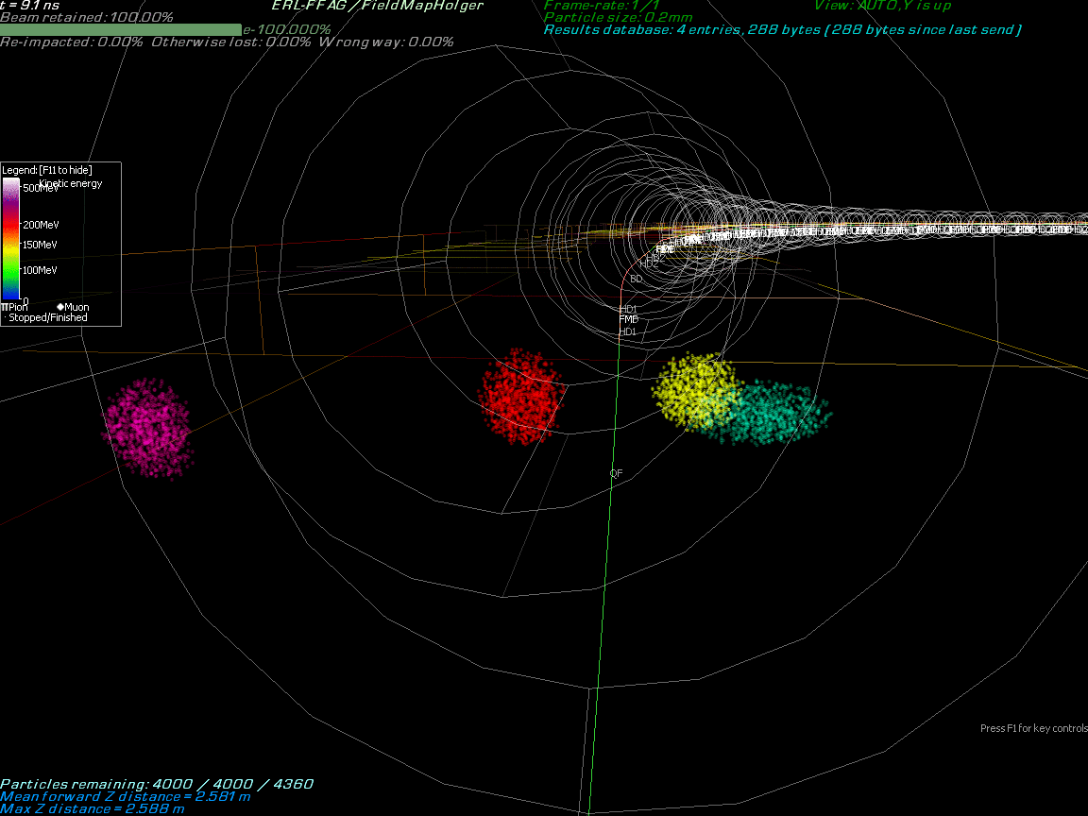
Bunch dynamics in 3-D fields

Slide 11
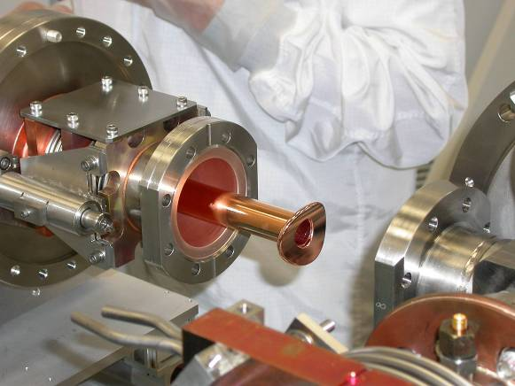
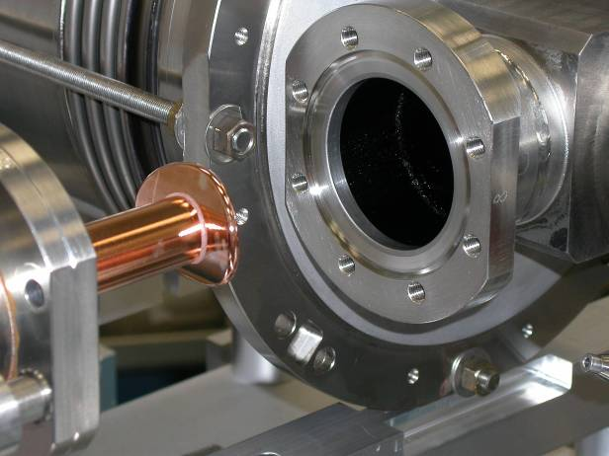
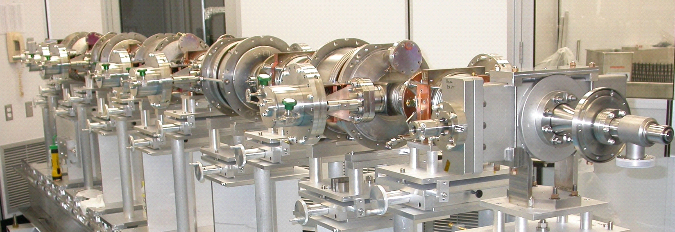
In-house production from DC-source to SRF linac, from cathodes to the full accelerator: The Injector Cryomodule
Gate valve internal
Gate valve internal
to cryomodule
to cryomodule
Vacuum vessel interface flange
Cleanroom assembly fixturing
Vacuum vessel interface flange
Cleanroom assembly fixturing

Slide 12
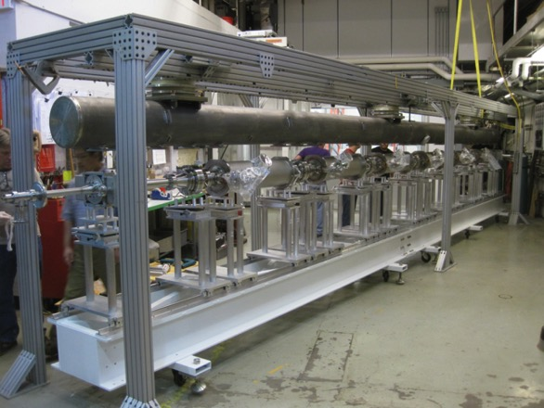
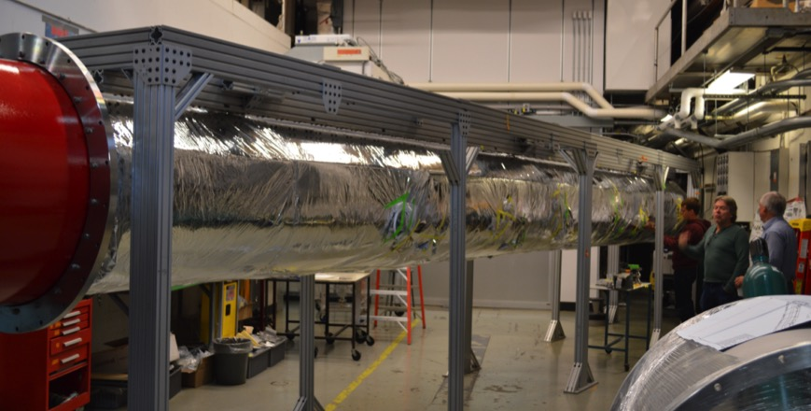
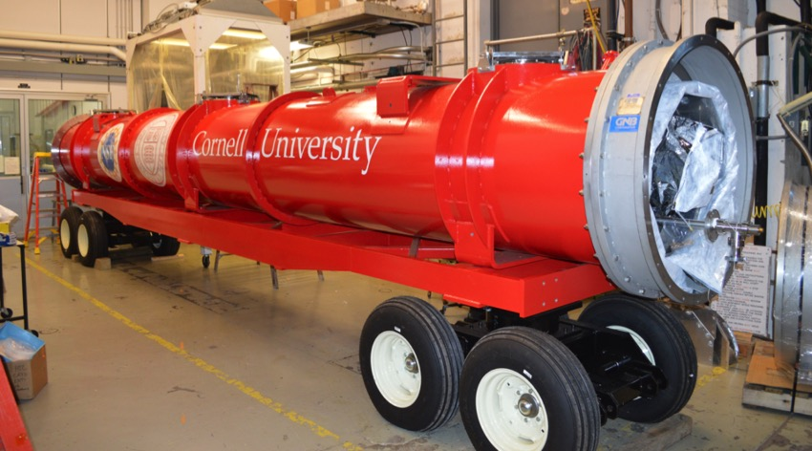
In-house production from DC-source to SRF linac, from cathodes to the full accelerator: The ERL cryomodule
MLC assembly was completed
Cooled down fall 2015, field, Q, and microphonics tested.
Further cold studies will start August 2016

Slide 13
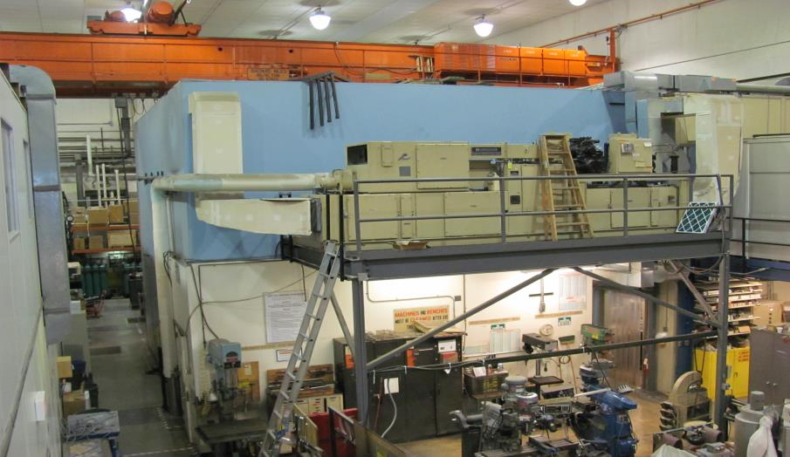
Hall L0E before CBETA
L0E contained approximately 7,000 square feet of Lab and Shop space

Slide 14
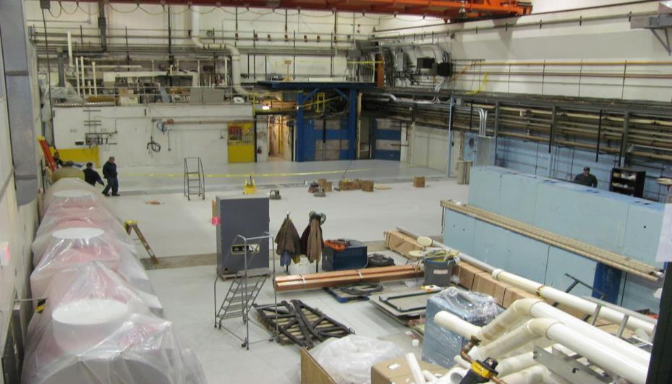
Spring 2015
70% of the existing technical-use space was removed for the initial phase

Slide 15
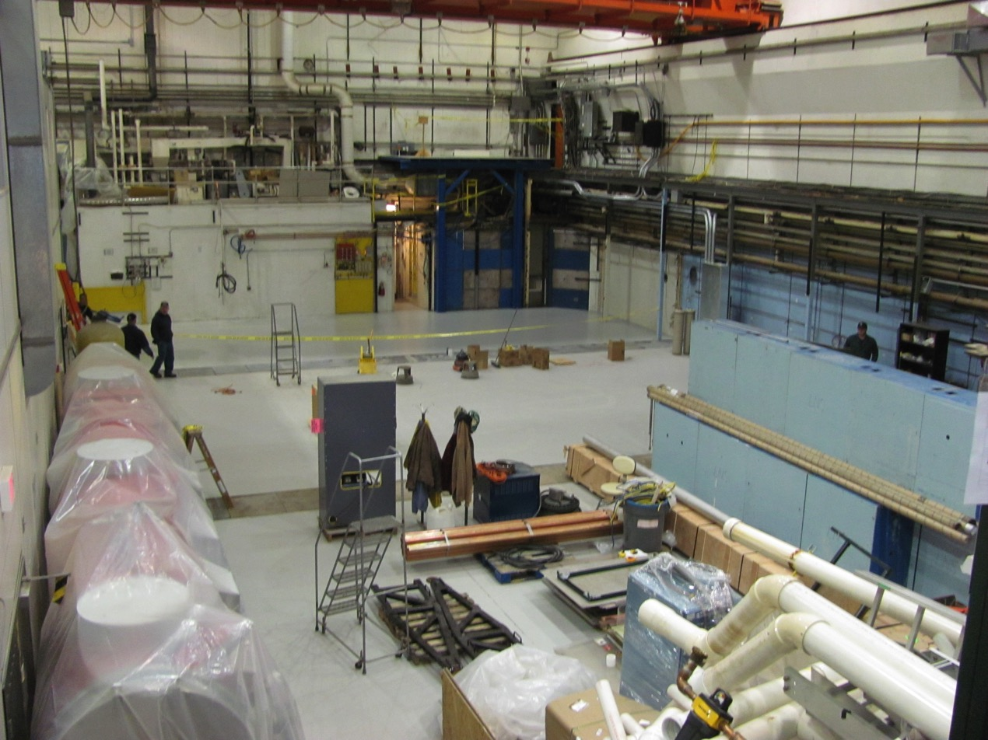
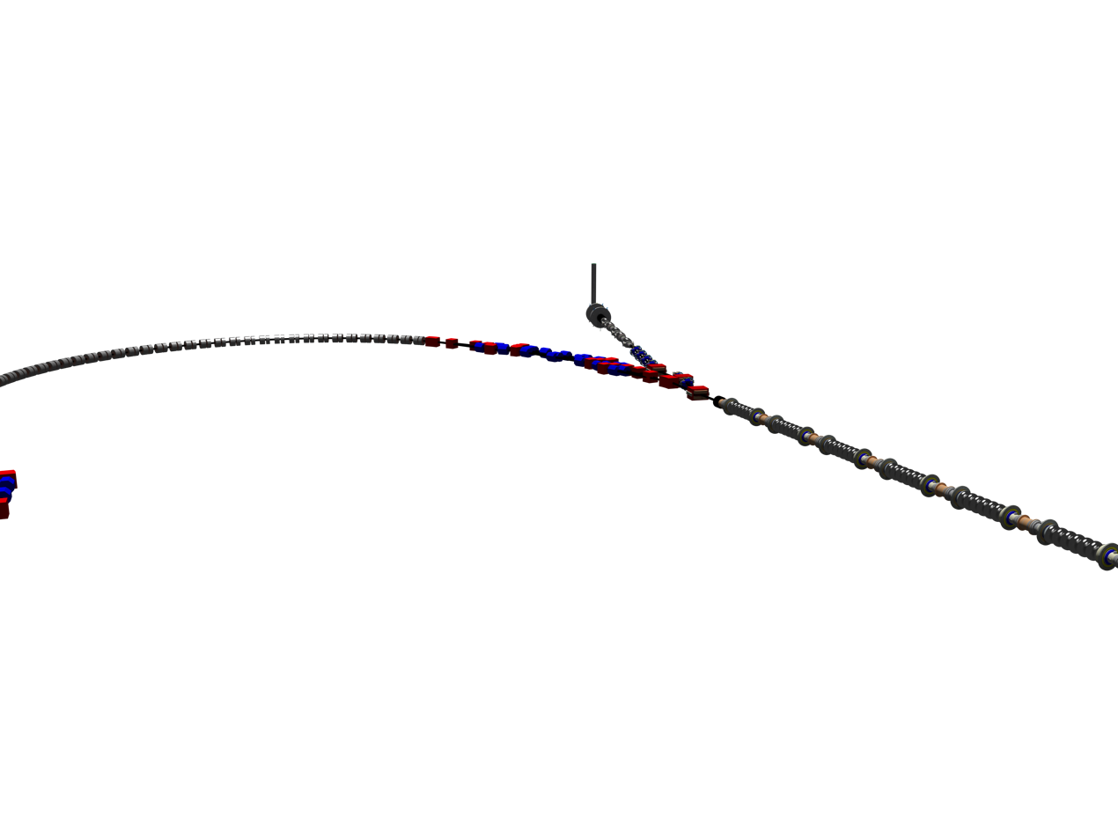
L0E cleaned with CBETA

Slide 16
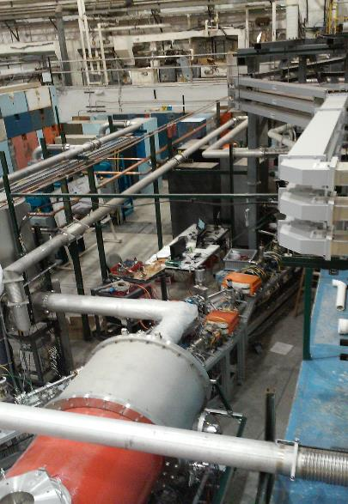
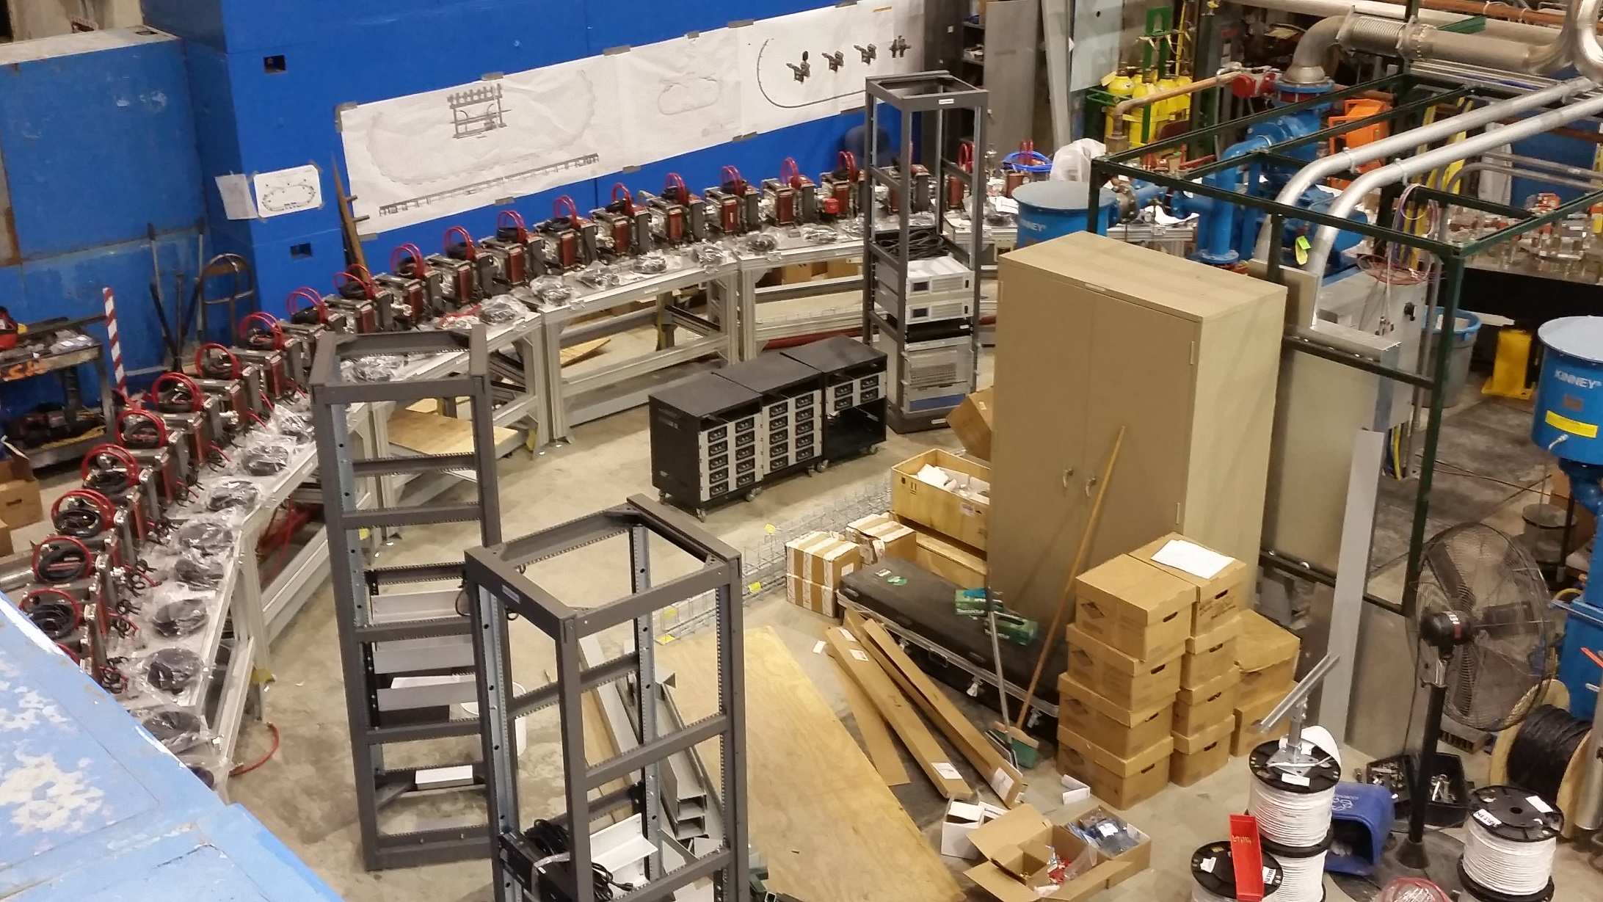
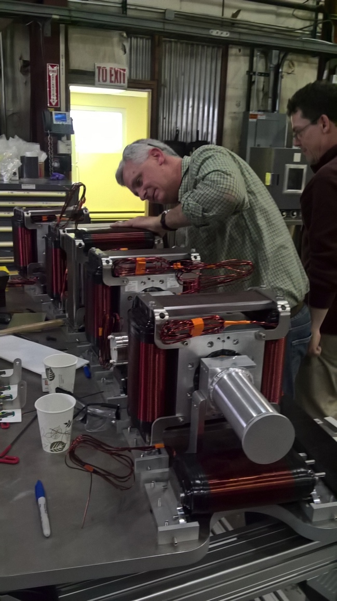
FFA permanent magnet work from BNL

Slide 17
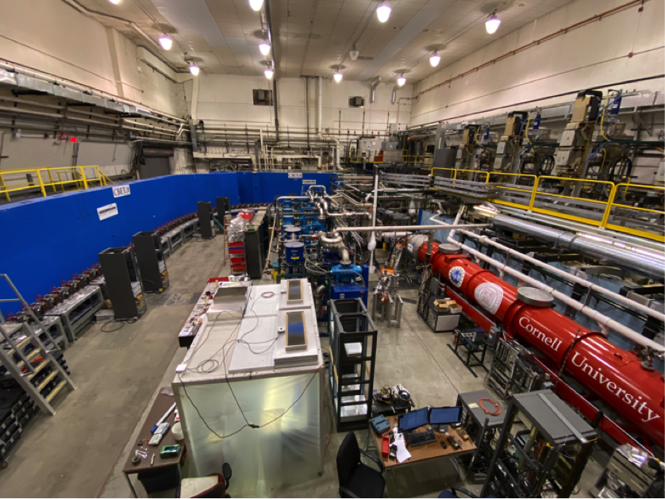
CBETA installation at Cornell, 2019

Slide 18
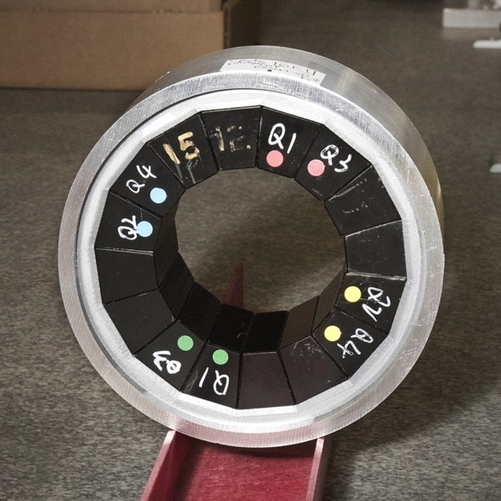
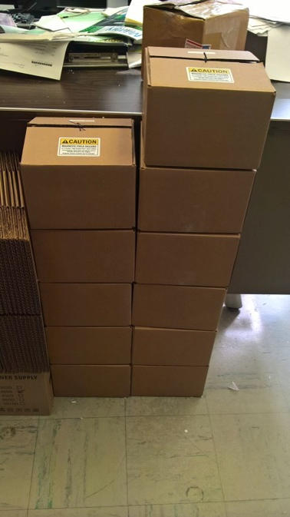
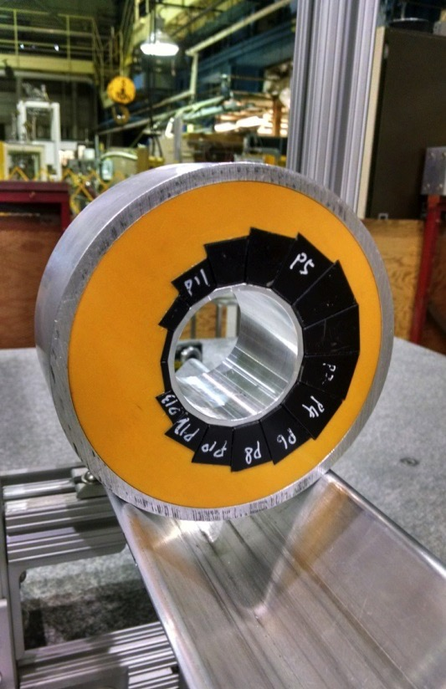
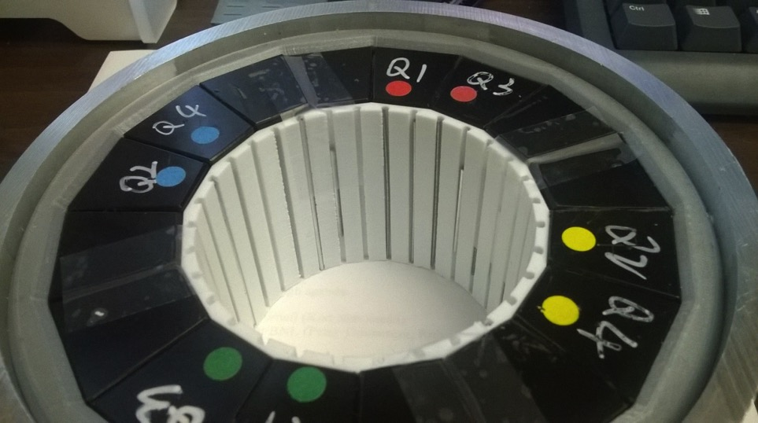
PoP QF
12 proof-of-principle magnets (6 QF, 6 BD) have been built as part of CBETA R&D.
Iron wire shimming has been done on 3 QFs and 6 BDs with good results.
PoP BD
PoP magnet series
Iron wire shims
January 30, 2017
Stephen Brooks, CBETA Technical Review
18

Slide 19
Achieved parameters
Cornell DC gun
75mA short term, 65mA for hours
Detailed phase space diagnostics for space charge dominated beams.
Study of 2nC bunch charges
High power SRF injector linac
Tested up to 13.5MeV
Tested up to 75mA
Investigation of ion / beam interactions
ERL main SRF linac
Operated with 1-turn ERL and 99.4% ERL efficiency
Operated with 4-turn ERL
Detection of micro bunching
1-turn current limited to 70mu for radiation protection.
4-turn current limited to 1nA because of 50% beam loss in the last recovery loop.
FFA return loop
7 simultaneous beams (at 42, 78, 114, 150MeV)
Hardly measurable beam losses in the FFA region

Slide 20
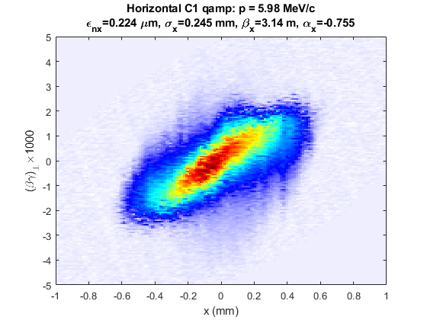
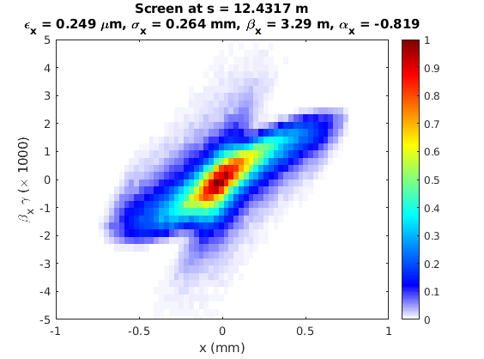
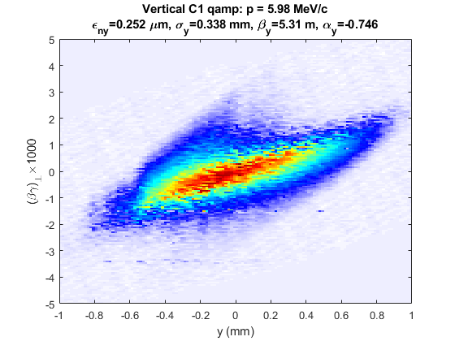
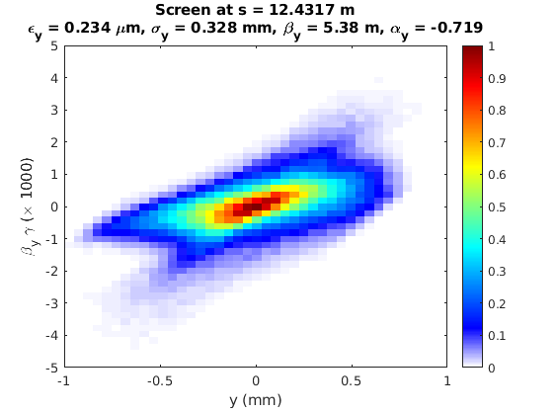
Measured
Simulation
Horizontal
Vertical

Slide 21
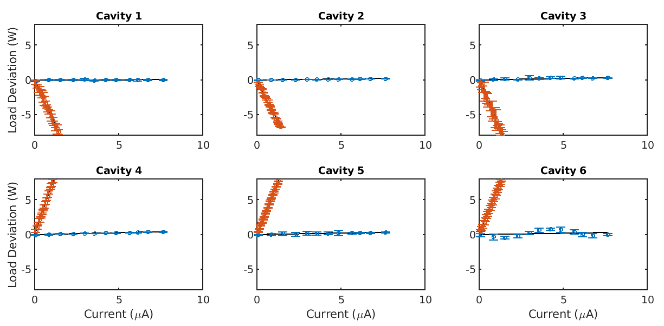
Energy Recovery in every Cavity
Transmission 99.6 ± 0.1% ; energy recovery > 99.8%
Measured up to 8 μA
Each cavity accelerates beam without receiving external power for it.
Power need for acceleration
Power need with energy recovery

Slide 22
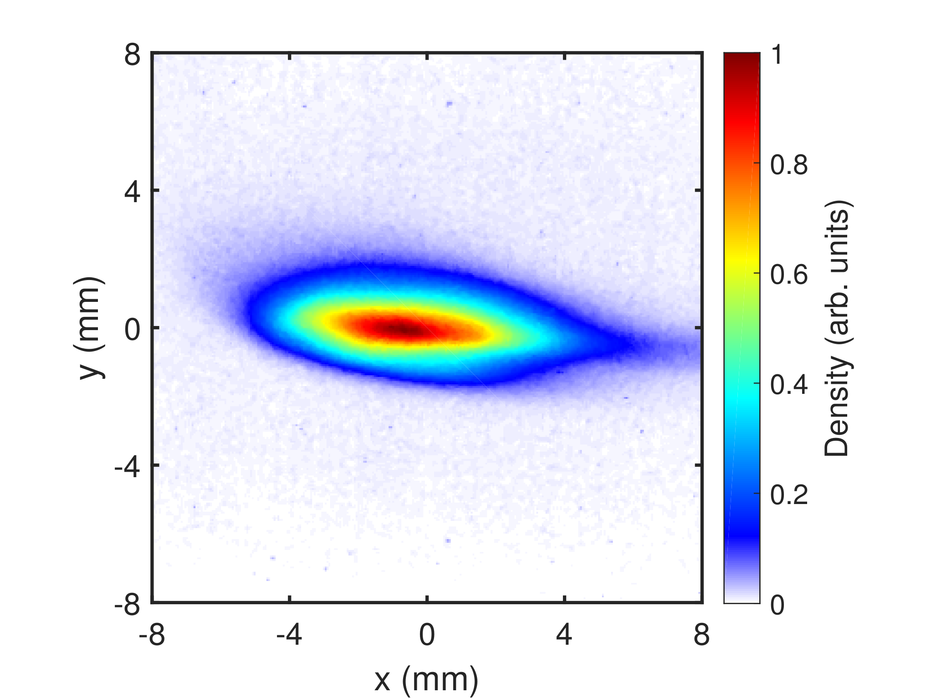
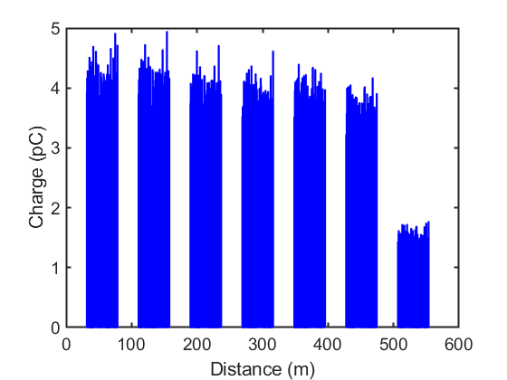
1st multi-turn SRF ERL
First beam Dec. 24, 2019.
Multi-turn energy recovery achieved on operated until February 2020.
Beam in the beam stop line
10% loss
60% loss
Before the 7th FFA pass there
remains an unresolved 60% loss

Slide 23
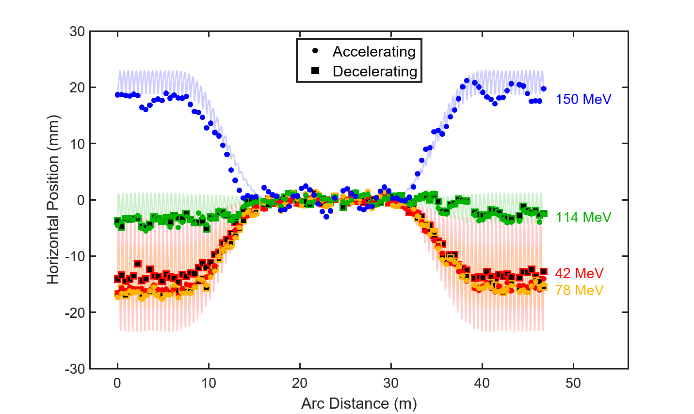
7 orbits simultaneous orbits in FFA
Note: Final 42 MeV orbit (red) has systematic error due to poor transmission
Reports appeared in Nature, Phys. Rev. Letters, Forbes Magazine, IEEE Spectrum, reddid.com, and others.

Slide 24
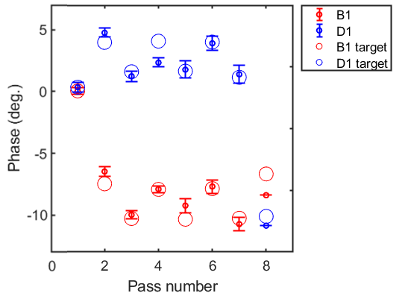
Control of ERL return times inc. FFA transit times
Red = Before MLC
Blue = After MLC
Phases are shown relative to 1st pass for pass 1-4, and offset by 180º for pass 5-8
Circles are target values from an optimized ER in each cavity
Transmission seemed to require accuracy better than 2 degrees

Slide 25
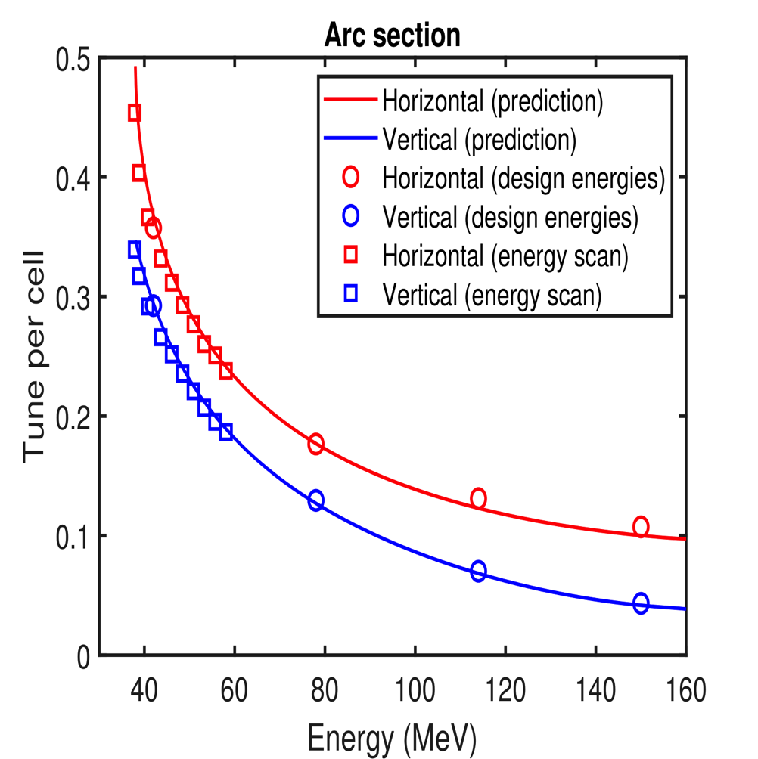
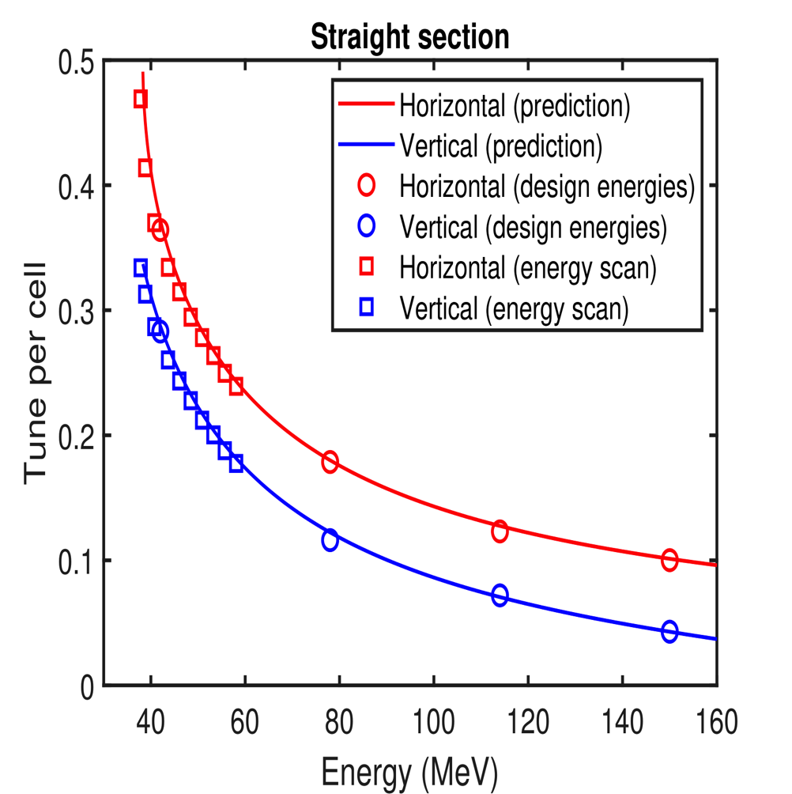
FFA cell phase advance
Energy scan measured during 1-turn run (39 - 59 MeV)
Design energies measured during 4-turn run (42, 78, 114, 150 MeV)
Measurements show a good agreement with the FFA model

Slide 26
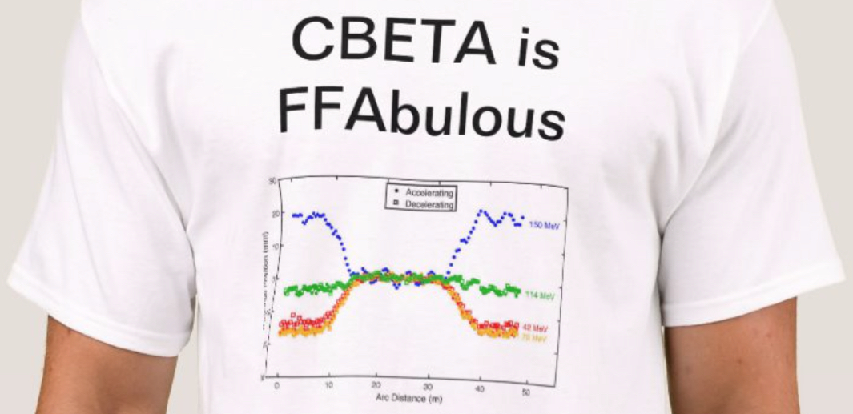
7 orbits simultaneous orbits in FFA
Note: Final 42 MeV orbit (red) has systematic error due to poor transmission
Reports appeared in Nature, Phys. Rev. Letters, Forbes Magazine, IEEE Spectrum, reddid.com, and others.

Slide 27
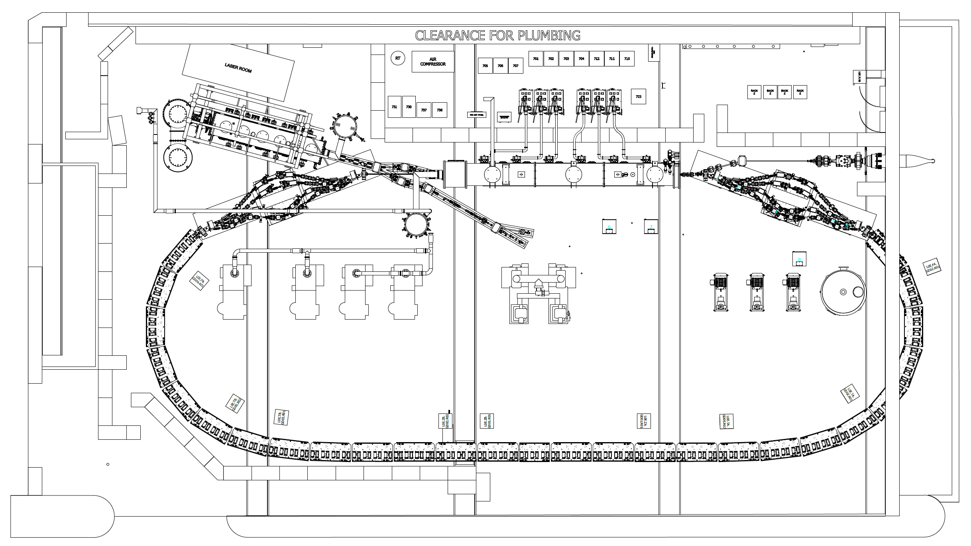
ICS Bypass Design: Current Layout
As is, there’s no room in the FFA for the interaction
Assume linear magnets
Not allowed to take out existing structures
Using 150 MeV electrons
MLC
Schematic of the CBETA enclosure. MLC ~10 m for scale.

Slide 28
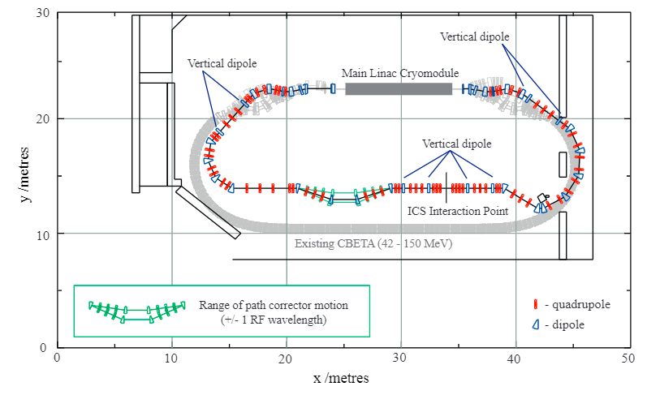
ICS Bypass Design: Overview
Bypass line is elevated above existing plane by 30 cm; IP is further elevated by another 50 cm
Optics are set such that the parameters going into the MLC for the fifth pass match CBETA design parameters
Floor plan of the ICS bypass to CBETA. The existing CBETA return loop is shown in grey. Path length correction system are in green.

Slide 29
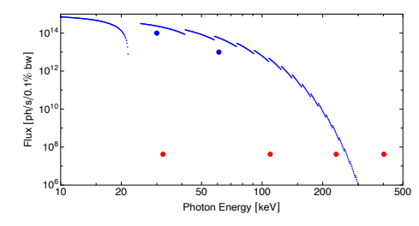
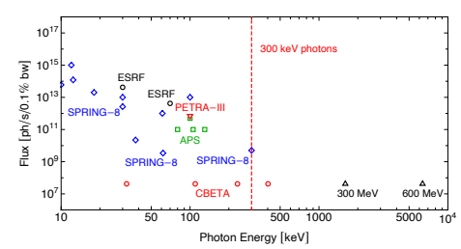
Source Comparison: Synchrotron
Flux per 0.1% BW
Flux per 0.1% BW
Spring 8
ICS @ CBETA
CBETA +
Beyond ~300 keV, undulator radiation production is difficult due to high harmonics and undulator phase errors
ICS footprint for MeV-scale γ-ray sources significantly smaller than synchrotron, while performing better

Slide 30
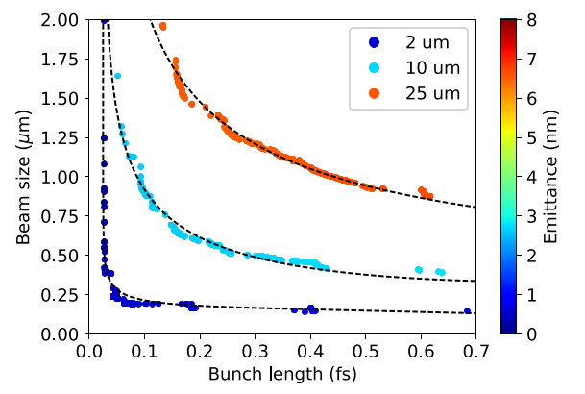
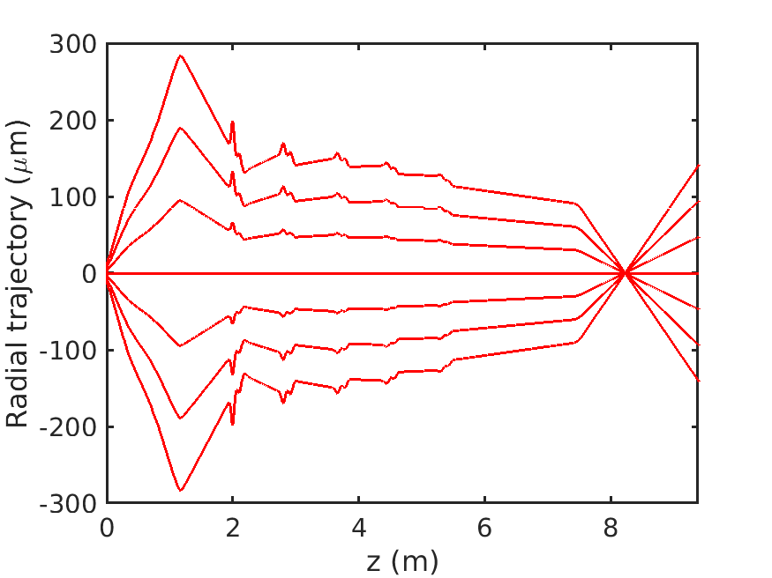

Stroboscopic Mode (low charge)
Sub-fs bunch lengths
  Final machine resolution limited by stability, discussed in later slides
Analytic model
  Bunch length limited by path length spread
MOGA optimized performance for 3 different choices of initial laser spot size, compared to analytic model.
Longer path
Shorter path
  Compensated by longitudinal dynamics
    σ_{x} : cathode spot size
    ε_{n} : emittance
    L : length scale, smaller = better compensation

Slide 31
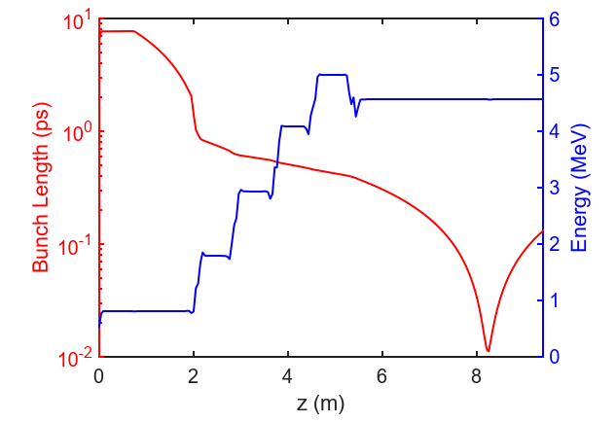
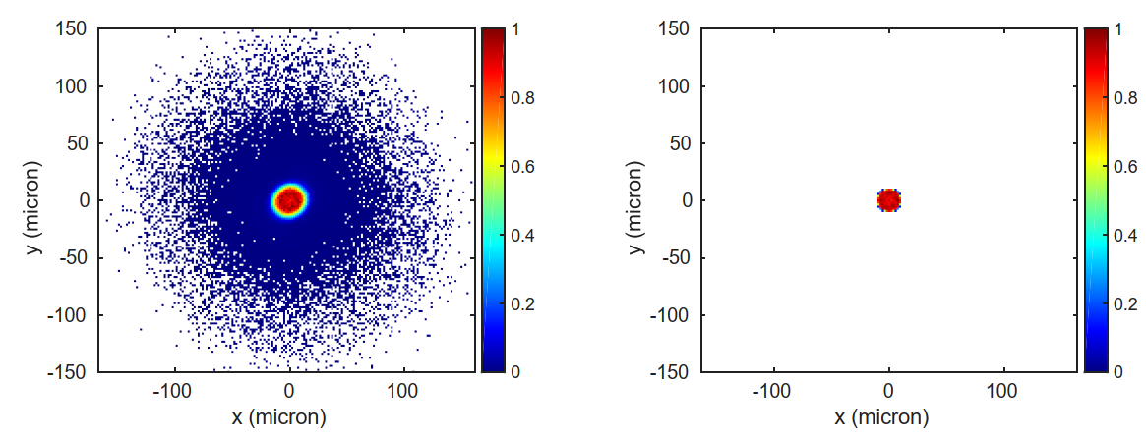
Single shot (10⁵ electrons)
An aperture is used to define the e-beam probe size
  Emit 40 fC at the cathode
  Clip to 16 fC at the aperture
Novel non-laminar space charge dynamics
Space charge limits bunch lengths to >5 fs
Sample location
Before probe-defining aperture
After probe-defining aperture
Predicted Performance | Value | Units
Bunch charge | 16 | fC
Repetition rate (max) | 1.3 | GHz
Beam energy | 4 | MeV
Emittance (at sample) | 3 | nm
Beam width (at sample) | 5 | μm
Bunch length (at sample) | 10 | fs

Slide 32
Conclusion
Summary
First multi-turn SRF ERL
Energy range and design current capabilities of the EIC cooler ERL.
Established energy saving measures: Energy Recovery, SRF, and permanent magnets.
Established Halbach-type permanent magnets for FFA beam transport.
Spinoff
DC source for LEReC bunched beam cooler for RHIC
Licensing of the DC source for EUV chip production
Licensing of the DC source and the SRF injector for medical isotope production
FFA @ CEBAF energy doubler upgrade design
Compton @ CBETA design
UED @ CBETA design
QUESTIONS?

