Slide 1
The high repetition rate thermionic electron injector
ENERGY Recovery Linacs Workshop 2022
Rick van den Berg, Wiebe Toonen, Ali Rajabi, Xavier Stragier, Peter Mutsaers, Peter Smorenburg & Jom Luiten
Coherence and Quantum Technology

Slide 2
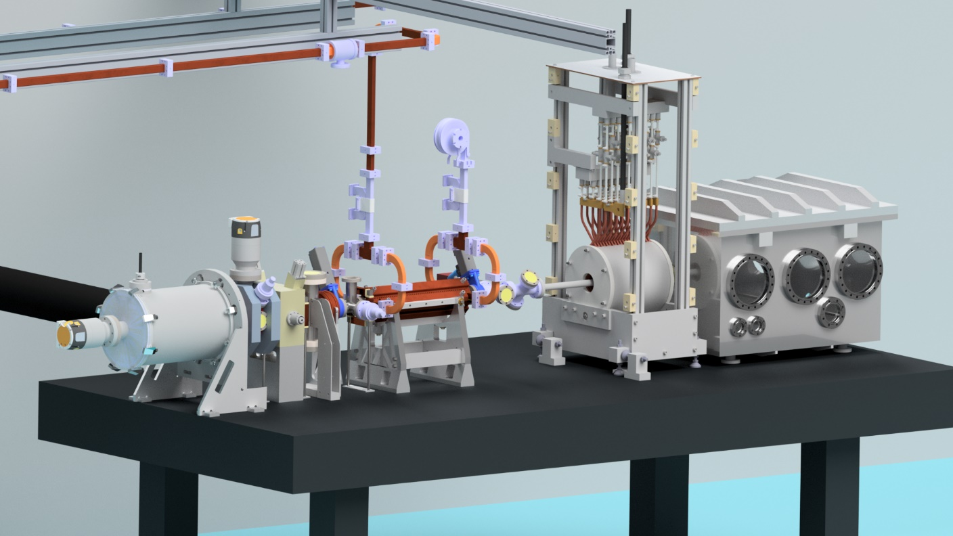
Why build a high repetition rate injector?
Inverse Compton scattering
Made by Daniel Nijhof
Brightness
Interaction
Burst mode
Injector
Gigahertz repetition rate injection
Low emittance
High charge
Acceleration

Slide 3
Overview setup
$$ε≈40 \text{nm} \text{rad}$$
$$ε≈40−100 \text{nm} \text{rad}$$
$$I =10 \text{mA}$$
$$f_{rep}=1.5 \text{GHz}$$
$$E_{kin}=100 \text{keV}$$
$$Q≈2−3 \text{pC}$$
$$τ<\text{2 }\text{ps}$$
$$I_{avg}=3 \text{mA}$$

Slide 4
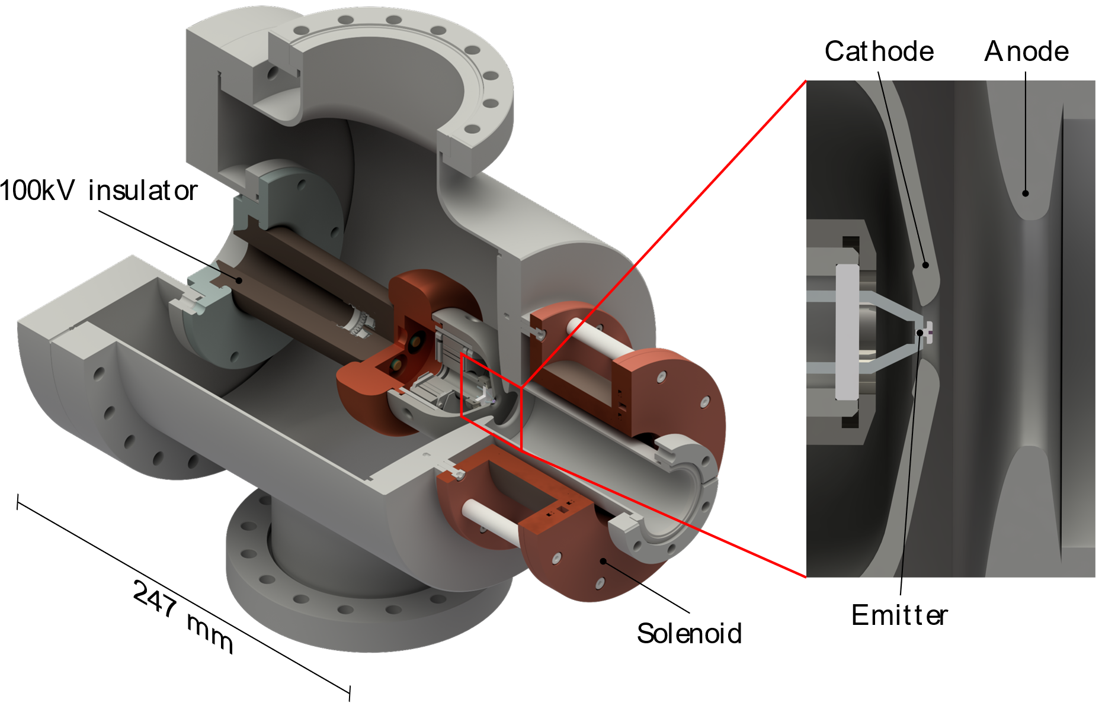
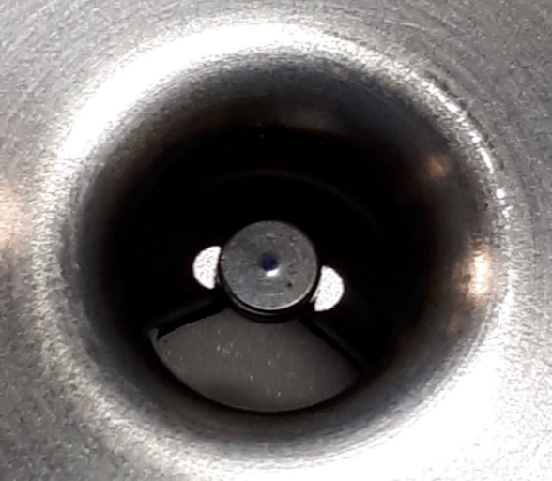
Thermionic Emission and 100kV DC accelerator
$$\text{La}{\text{B}}_{\text{6}}$$
$$r=150 μ\text{m}$$
Carbon ring

Slide 5
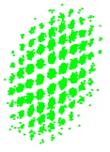
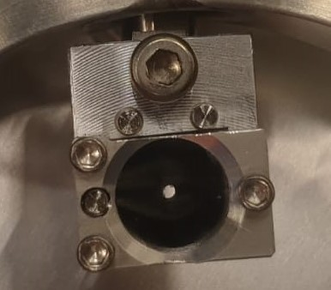
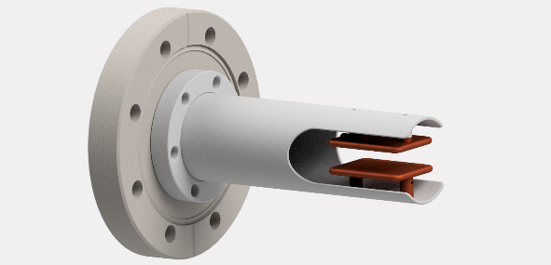
Emittance measurement setup
Phosphor screen
Pepper-pot
LaB6 Emitter
Solenoid
Beam blanker
$$I=10 \text{mA}$$
$$P=1 \text{kW}$$
$$U=100 \text{kV}$$
Faraday cup
$\sim 1$ µs,
single shot
Condensator plate

Slide 6
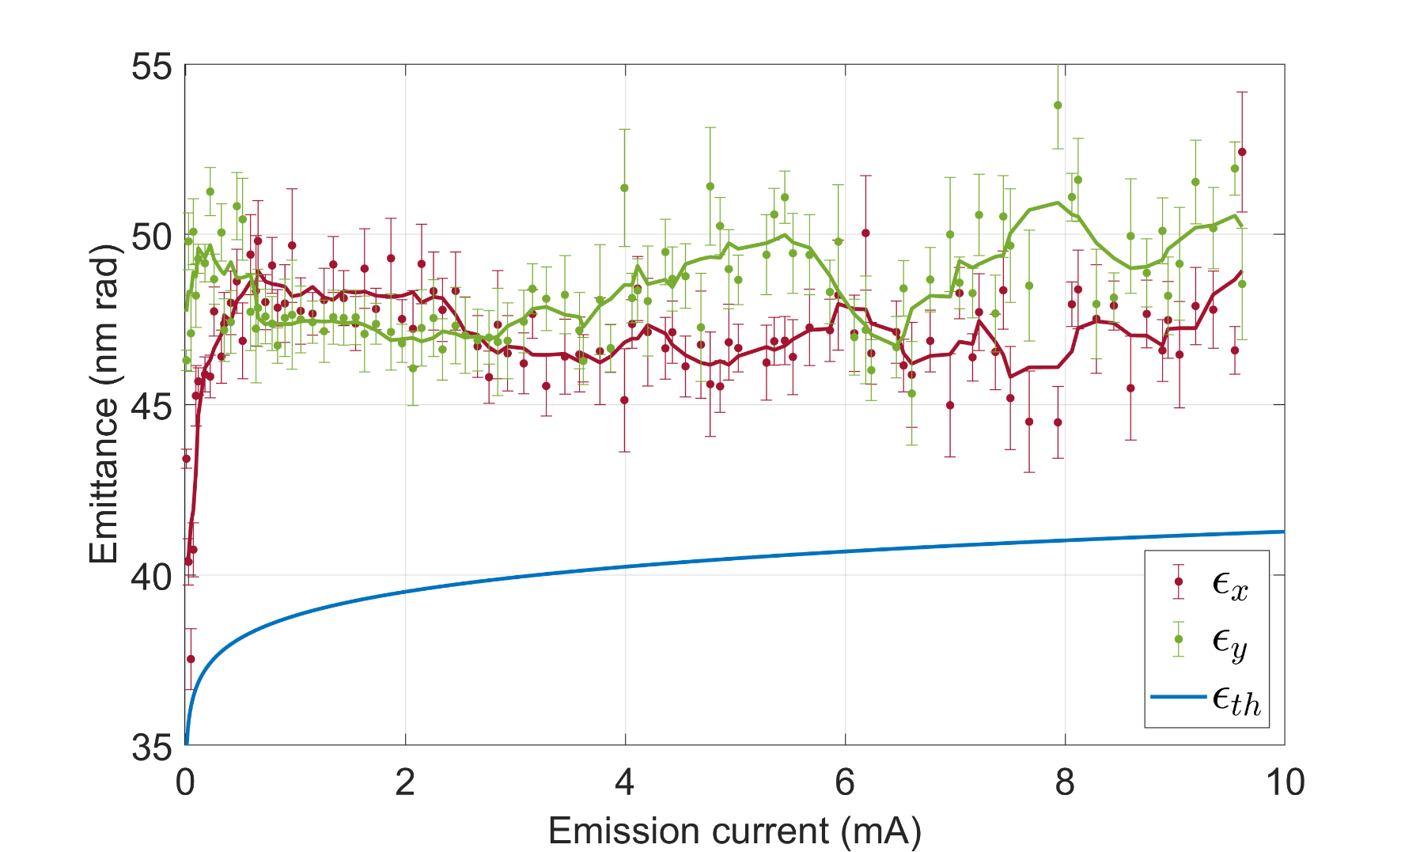
Emittance results of LaB₆
10 mA continuous beam
Higher than expected
Blanker
< $0.4$ nm rad
Solenoid
$\sim 2.3$ nm rad
Apparent exchange $ε_{x}$ and $ε_{y}$

Slide 7
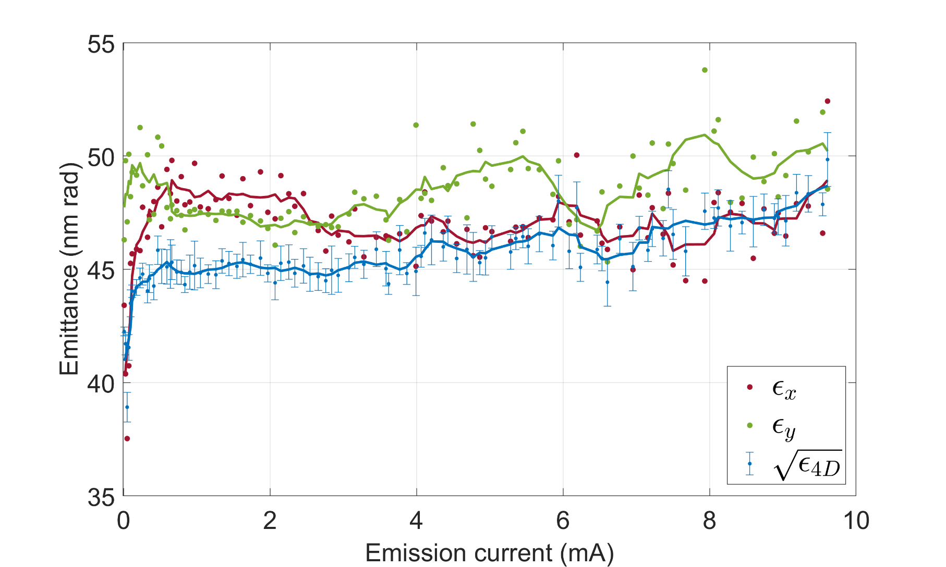
Emittance results of LaB₆
10 mA continuous beam
Higher than expected
Blanker
< $0.4$ nm
Solenoid
$\sim 2.3$ nm rad
Apparent exchange $ε_{x}$ and $ε_{y}$

Slide 8
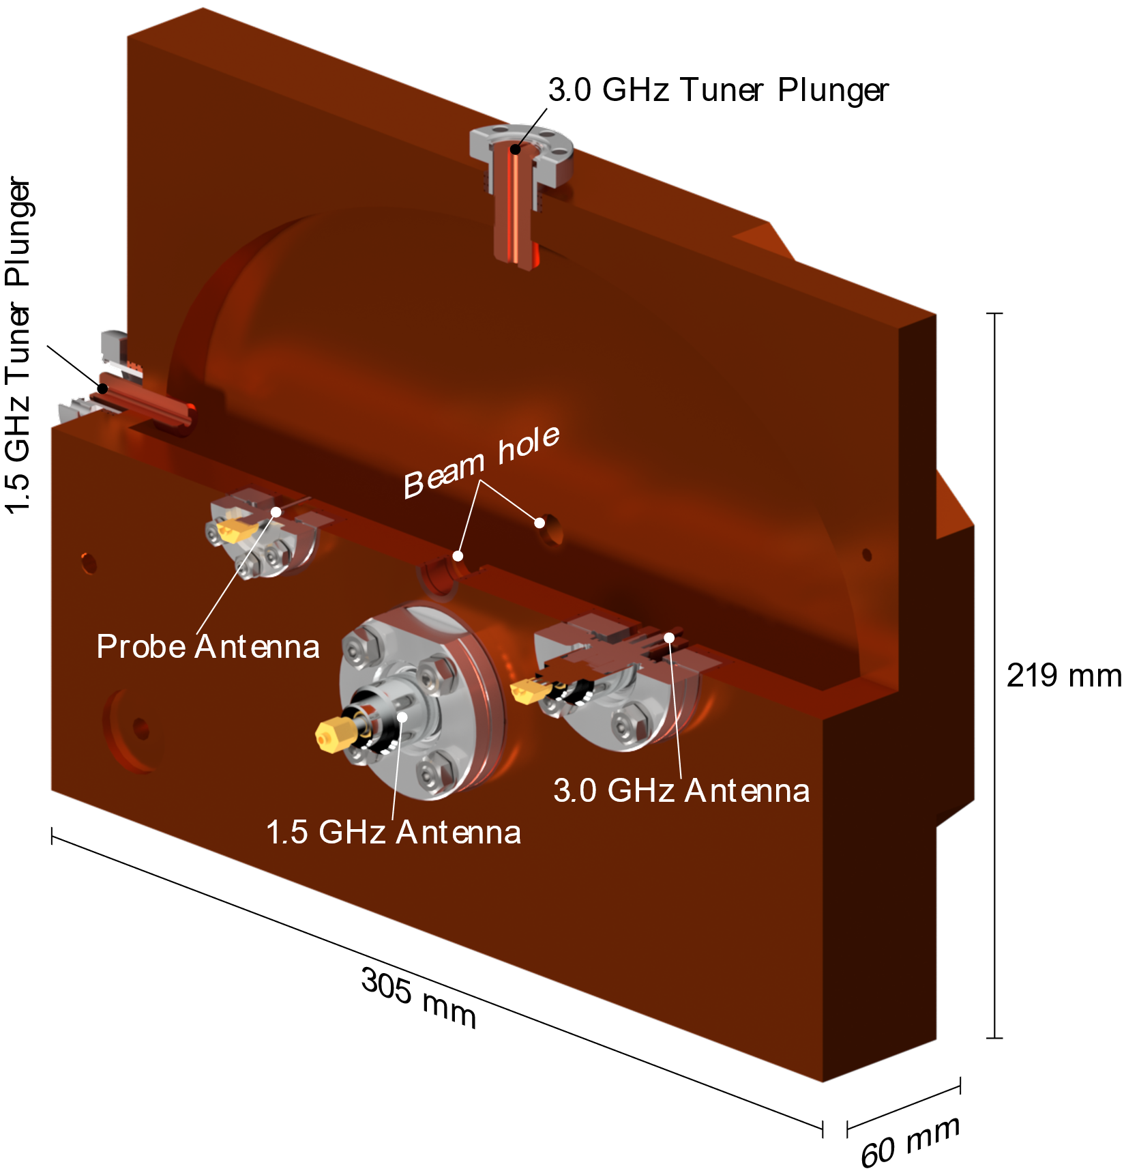
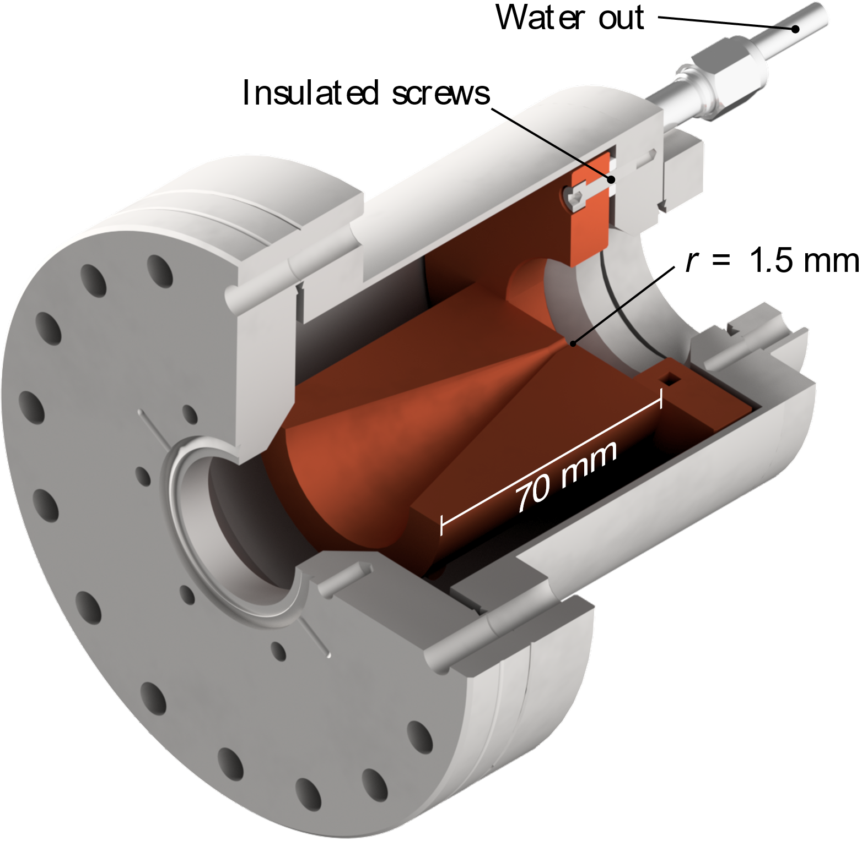
Chopping the continuous beam
$$ε≈40 \text{nm} \text{rad}$$
$$I =10 \text{mA}$$
$$E_{kin} =100 \text{keV}$$

Slide 9
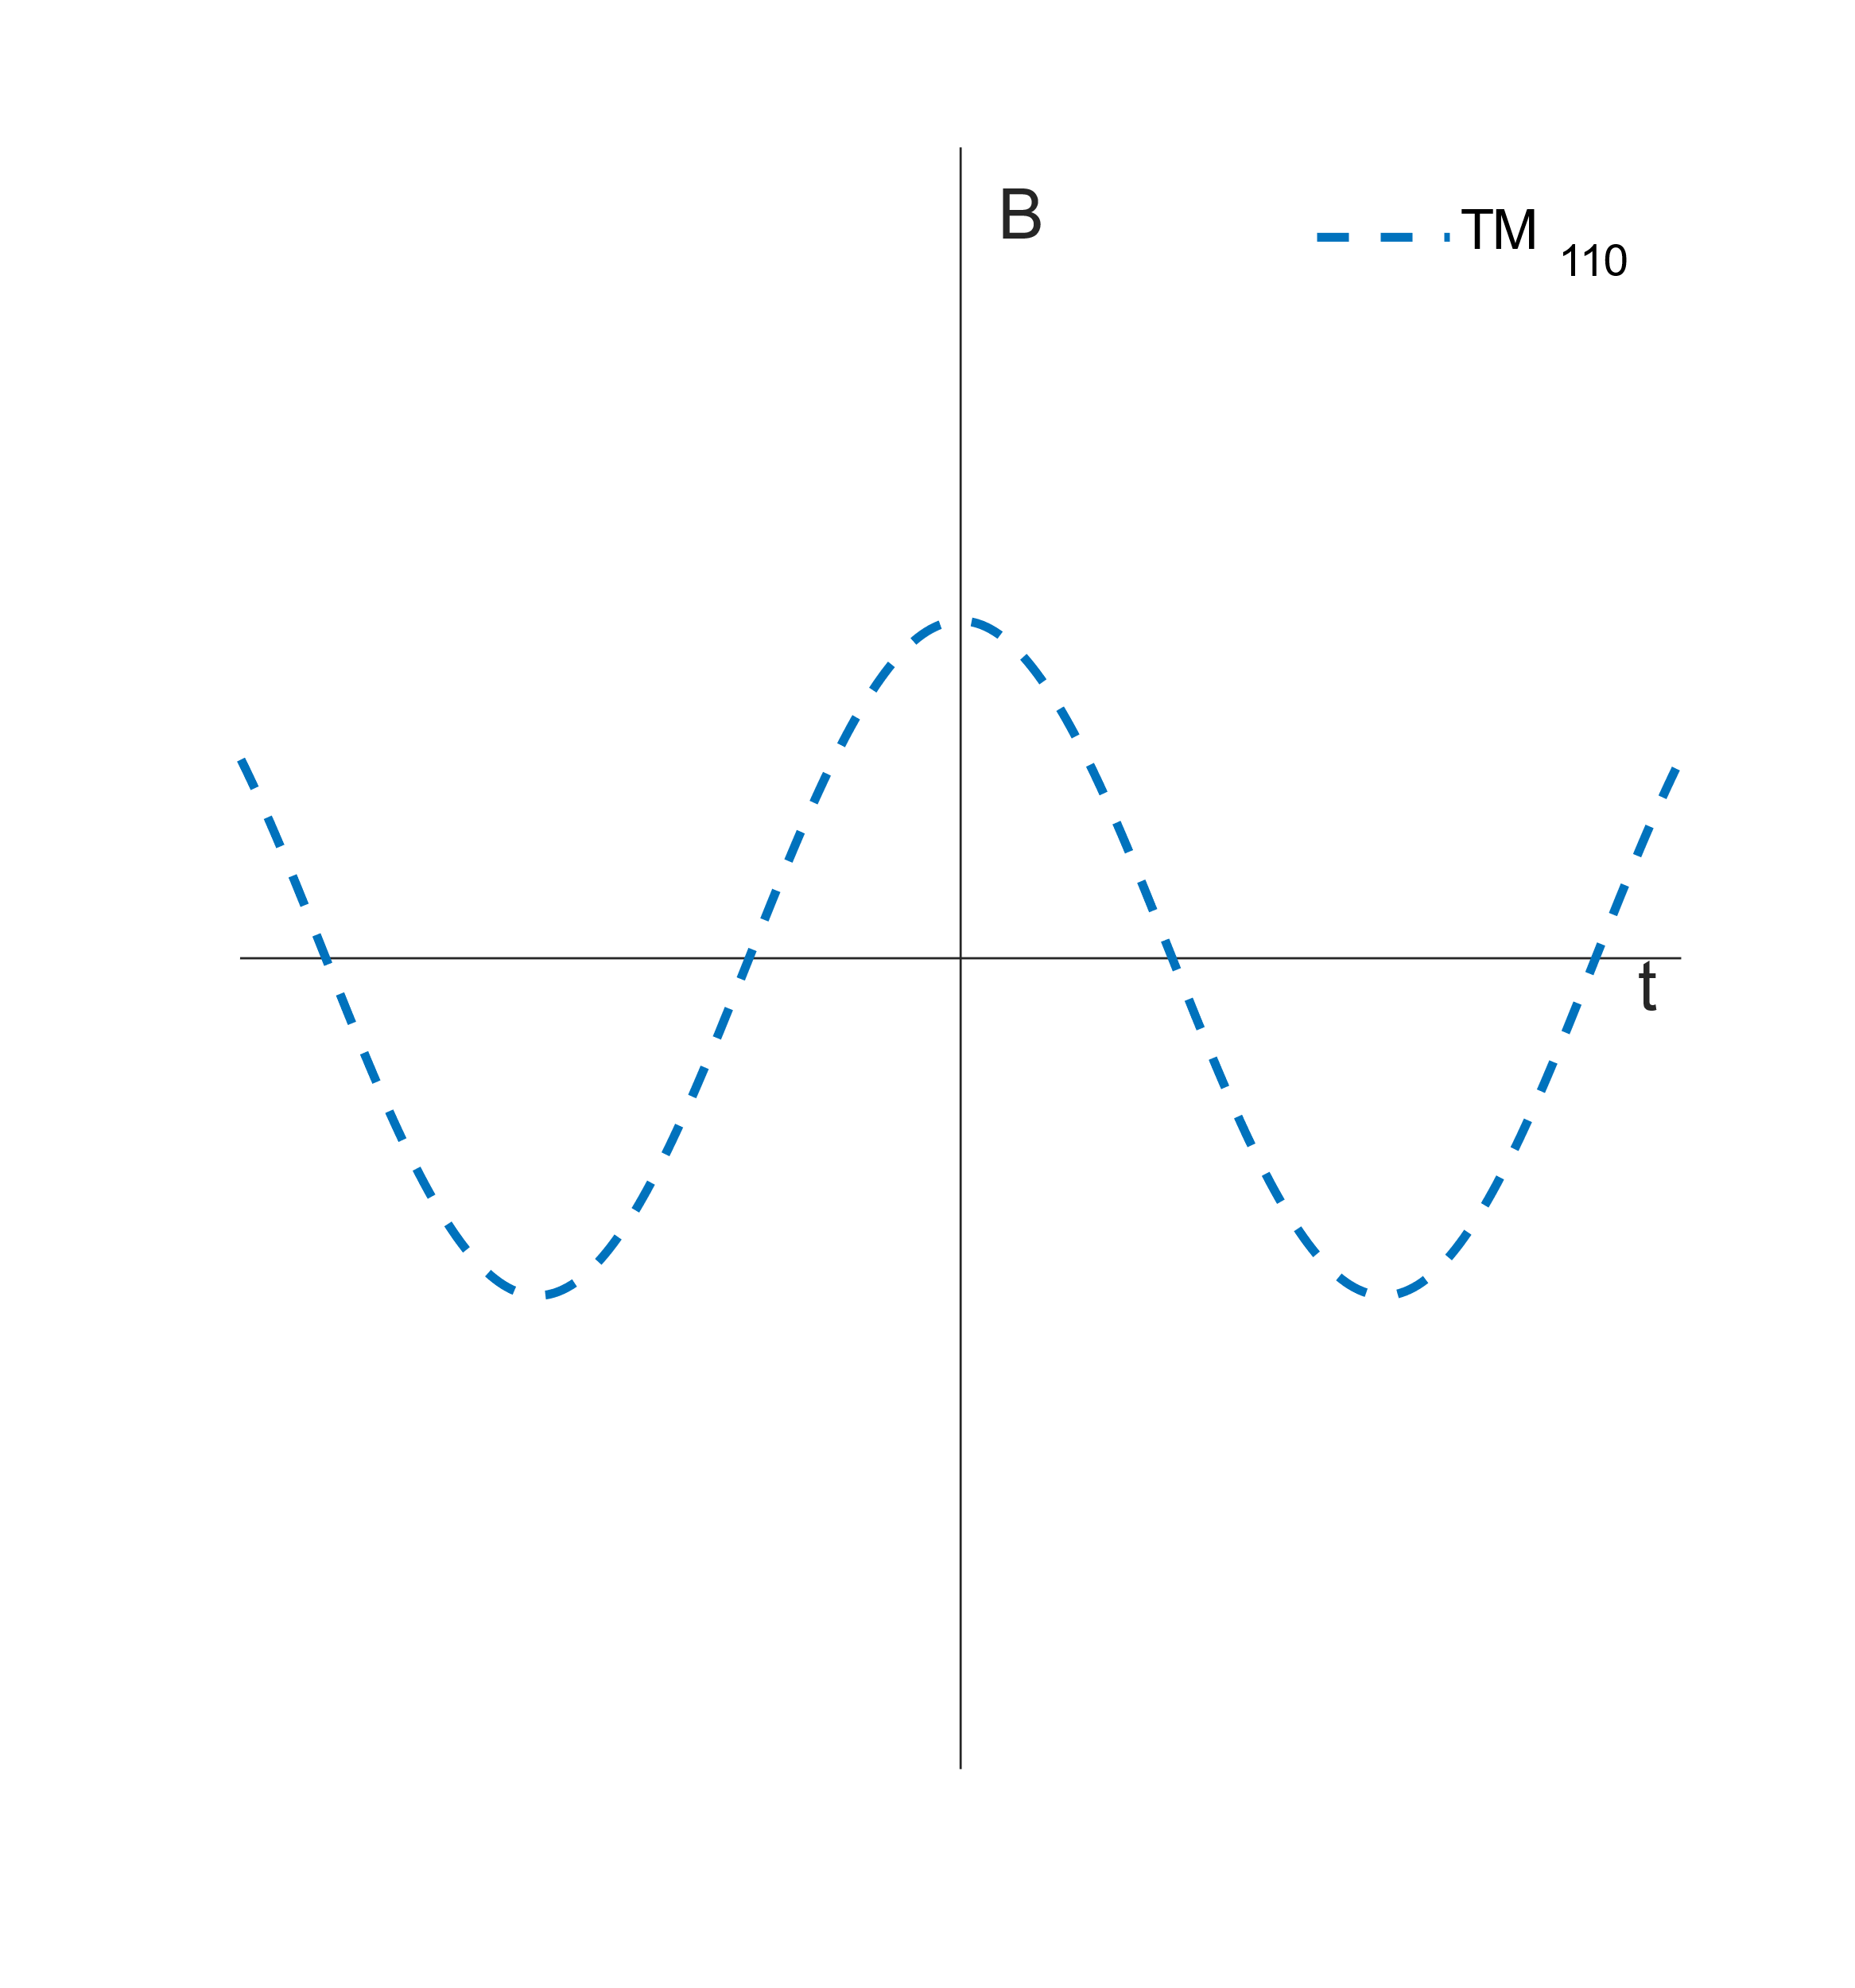
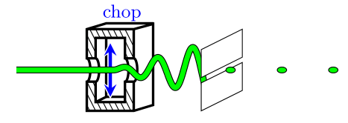
Single mode beam chopping
Single mode chopper
<1% of electrons through slit
Single $\text{T}{\text{M}}_{110}$ mode

Slide 10
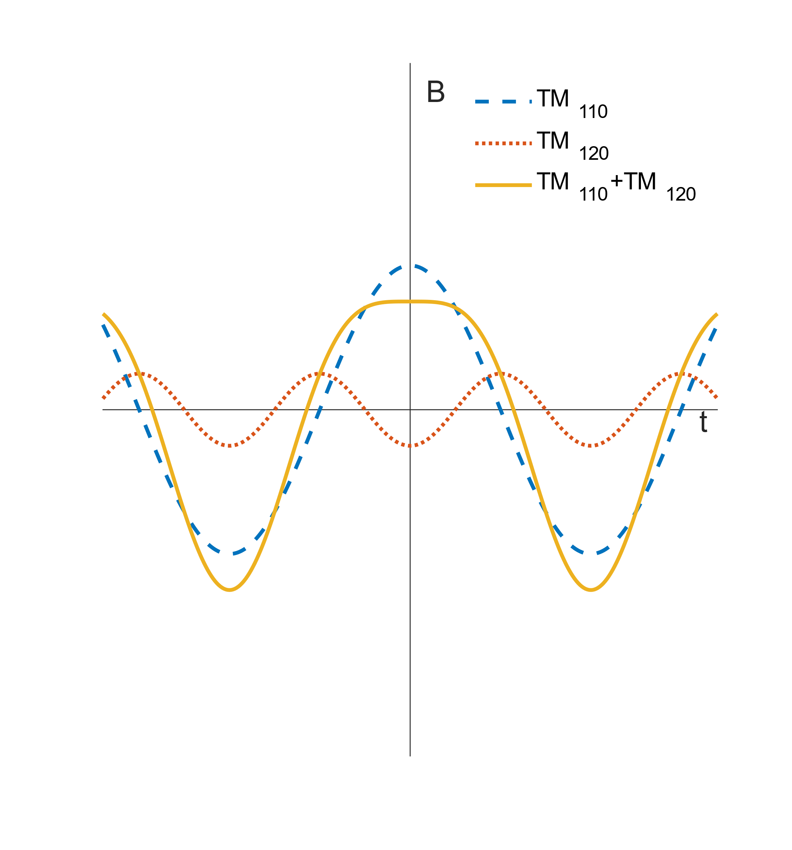
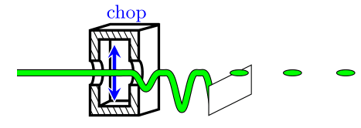
Dual-mode chopping
Single mode chopper
Dual mode deflection
<1% of electrons through slit
Single $\text{T}{\text{M}}_{110}$ mode
$\sim$30% of electrons through slit
$\text{T}{\text{M}}_{110}$ and $\text{T}{\text{M}}_{120}$ modes
Add a constant B-field

Slide 11
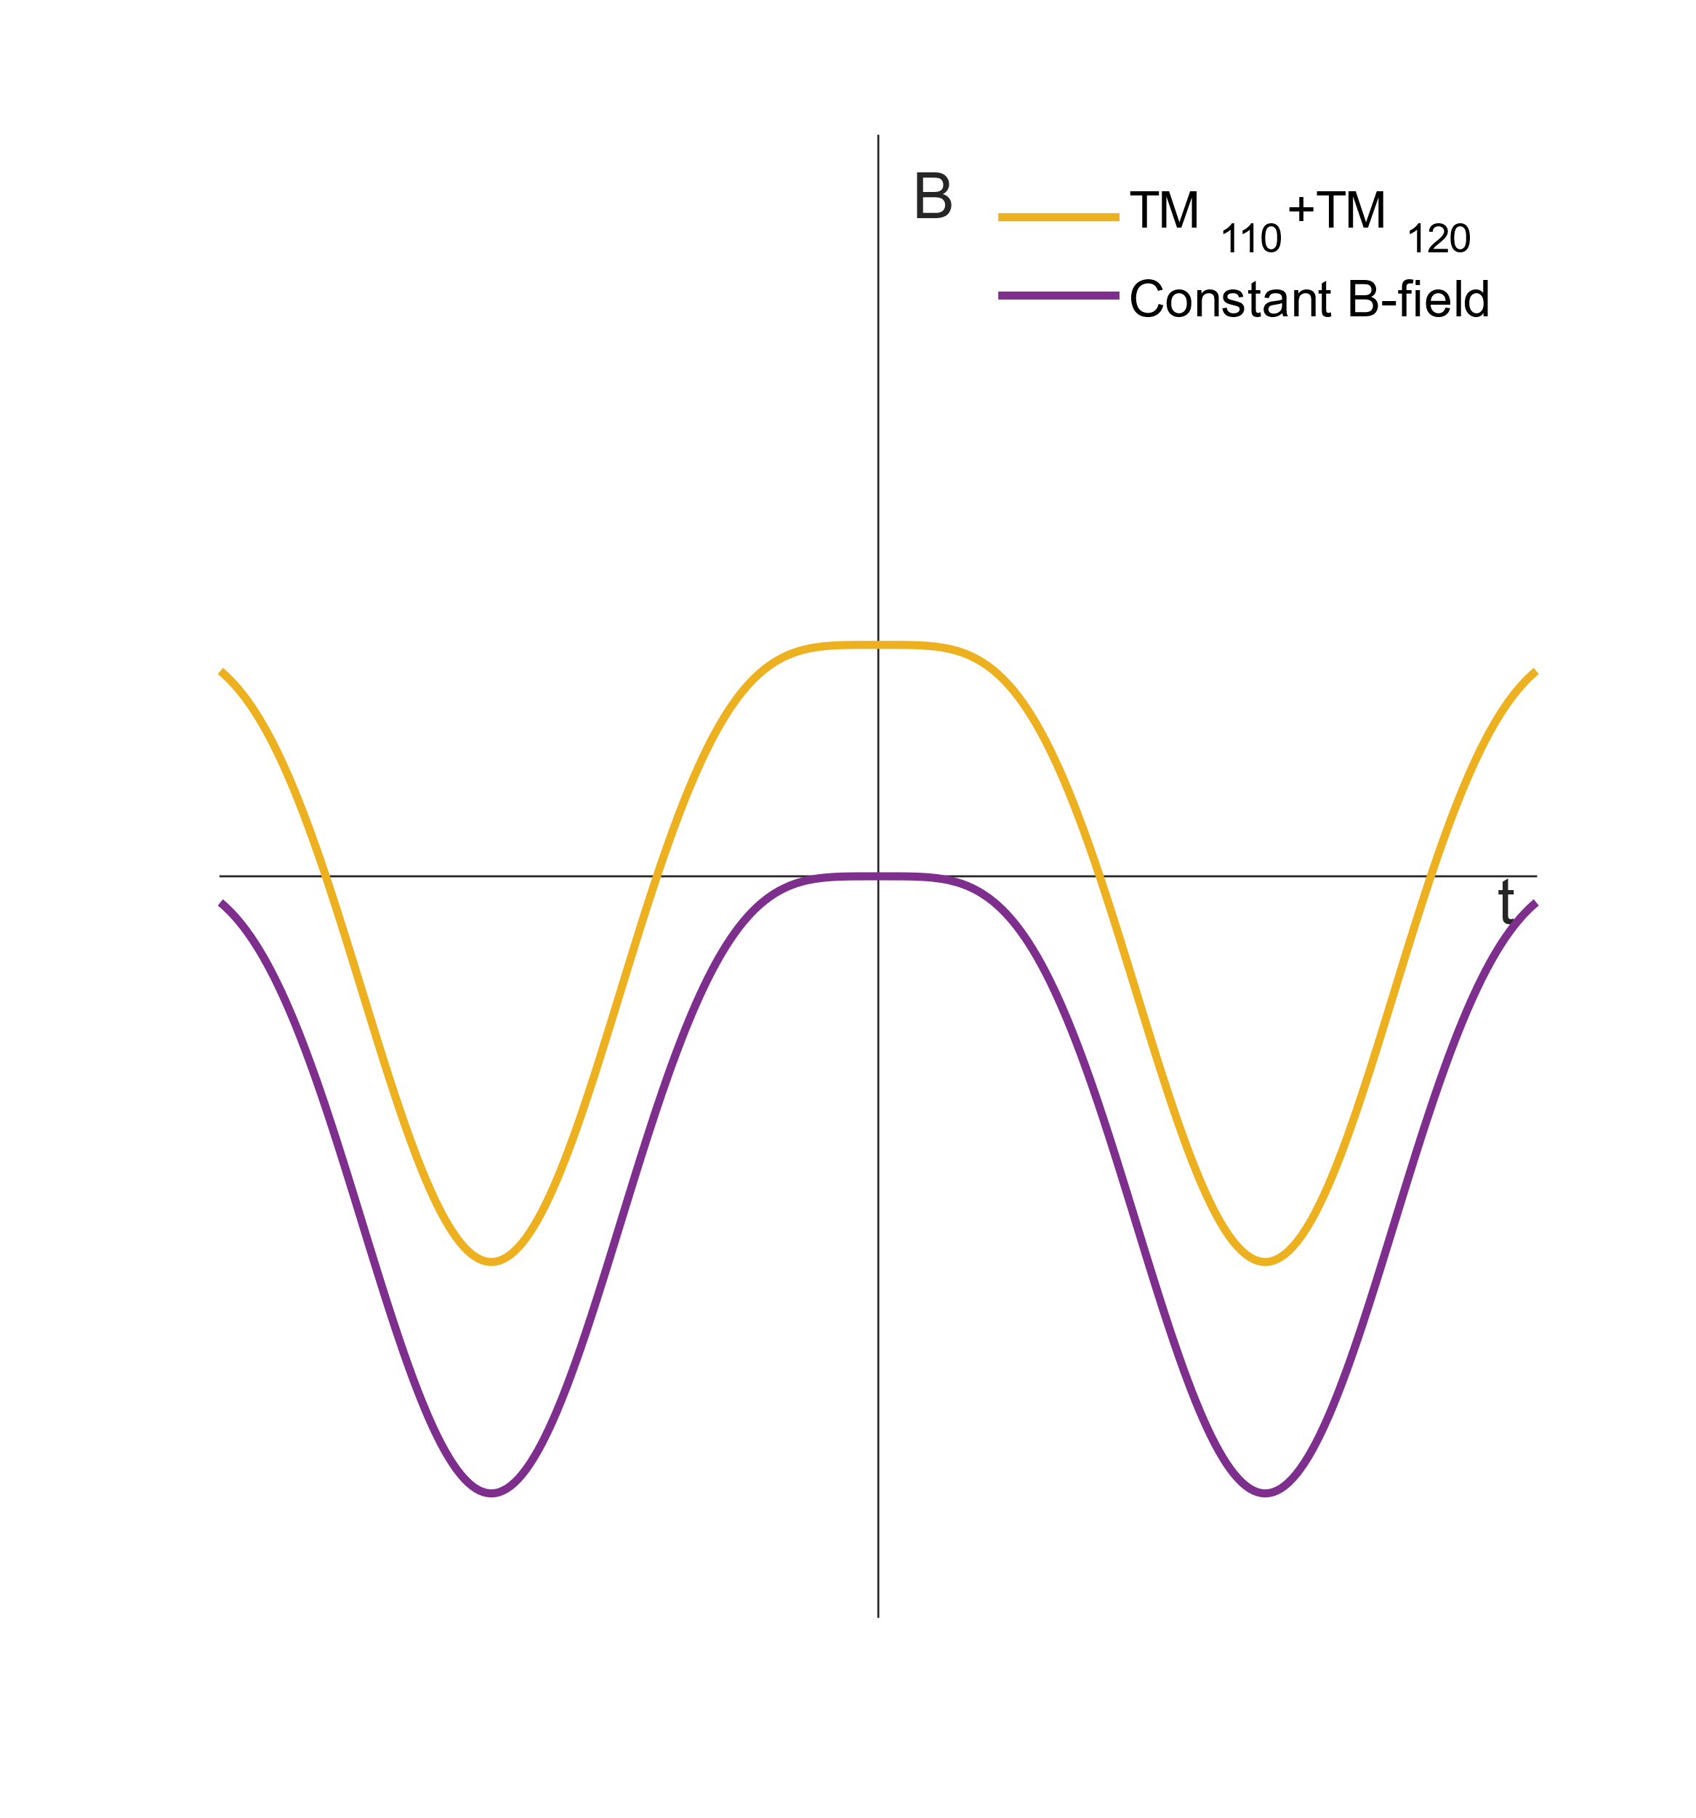
Dual-mode chopping
Single mode chopper
Dual mode deflection
<1% of electrons through slit
Single $\text{T}{\text{M}}_{110}$ mode
$\sim$30% of electrons through slit
$\text{T}{\text{M}}_{110}$ and $\text{T}{\text{M}}_{120}$ modes
Add a constant B-field
Supports 2 modes
Both modes independently tunable
High on-axis magnetic field
$\sim$30% Duty Cycle

Slide 12
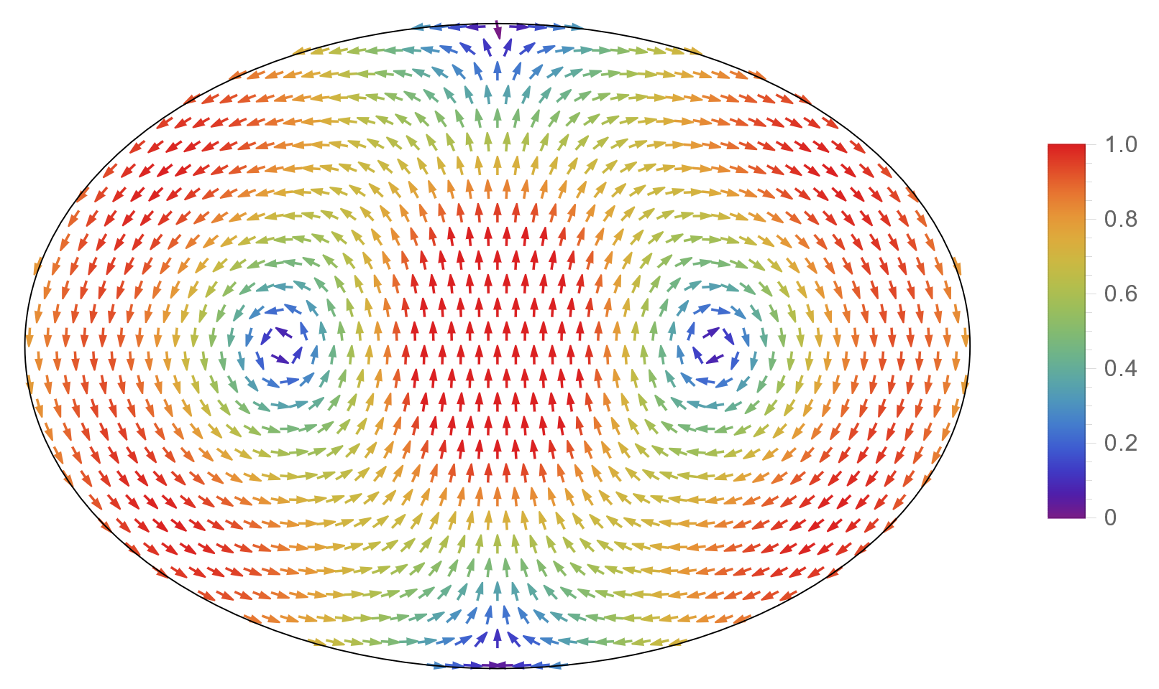
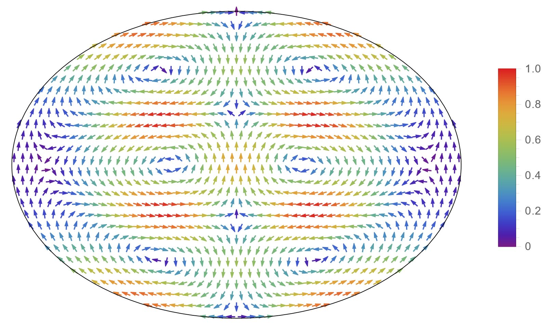
$$\text{T}{\text{M}}_{\text{1}\text{1}\text{0}}$$
1.5 GHz mode
$$T{\text{M}}_{\text{1}\text{20}}$$
3 GHz mode
3 GHz Plunger
1.5 GHz Plunger
3 GHz Loop Antenna
1.5 GHz Loop Antenna

Slide 13
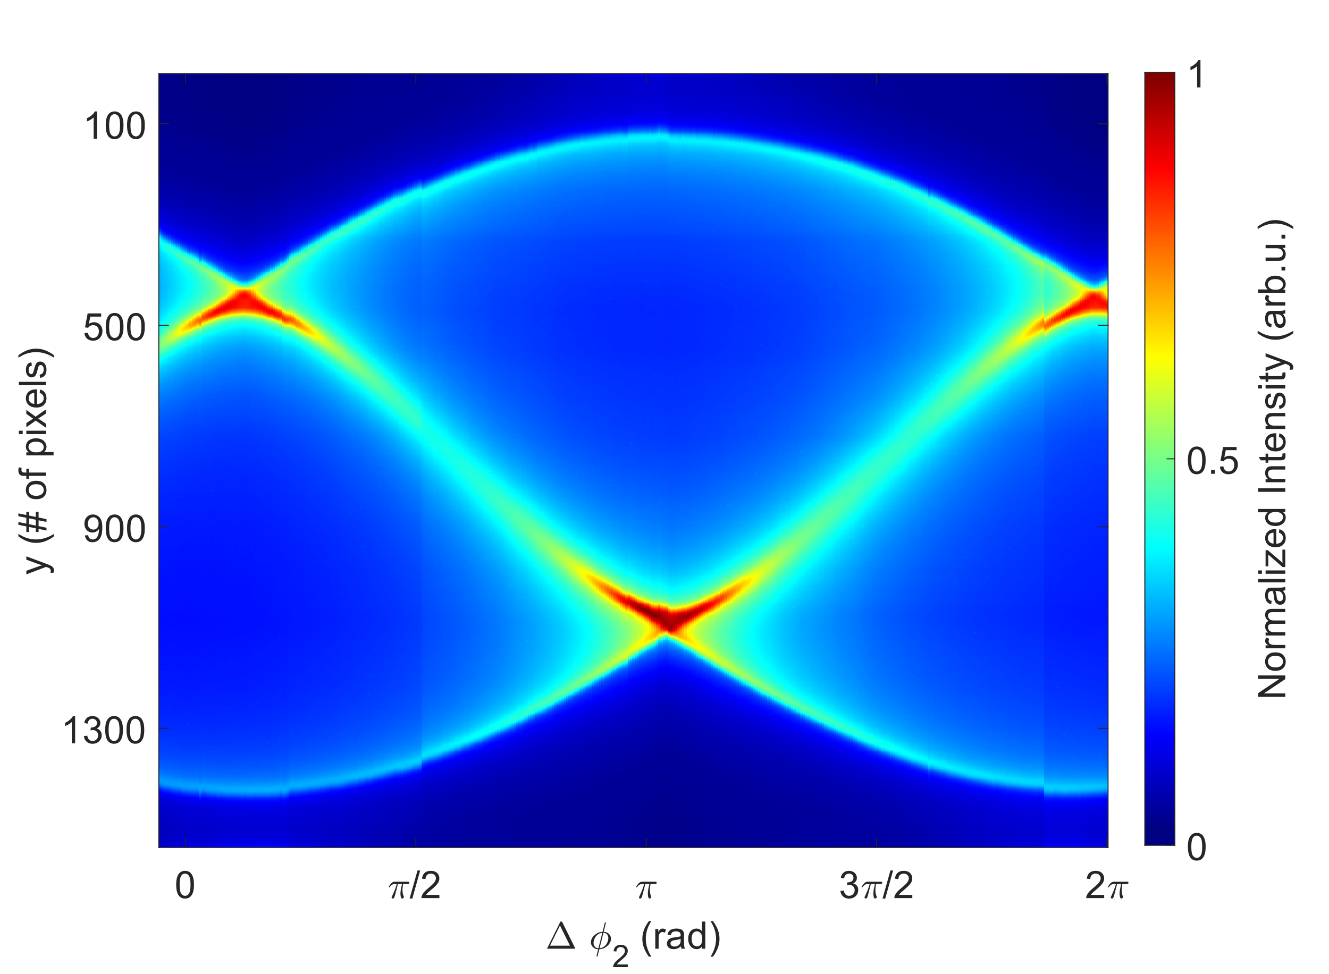
Dual-mode streaking
$$B=B_{1}\sin{ω}+B_{2}\sin{(2ω+φ_{2})}$$
Image of a streak
Varying $φ_{2}$

Slide 14
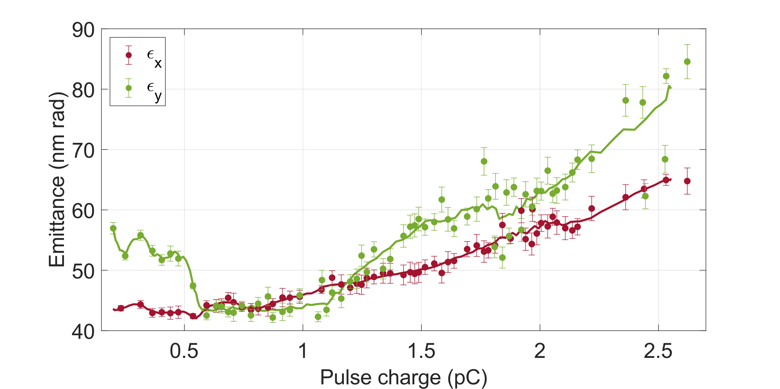
Chopped beam emittance measurement

Slide 15
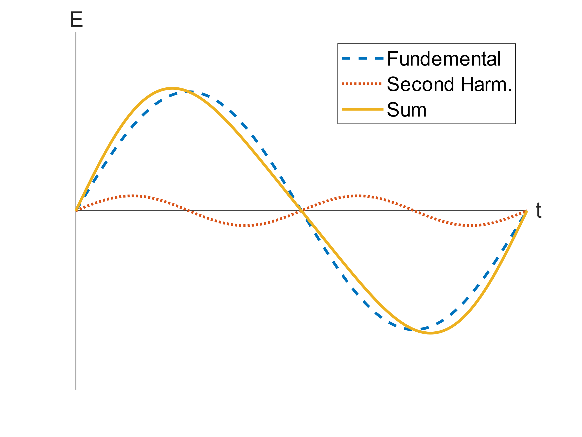
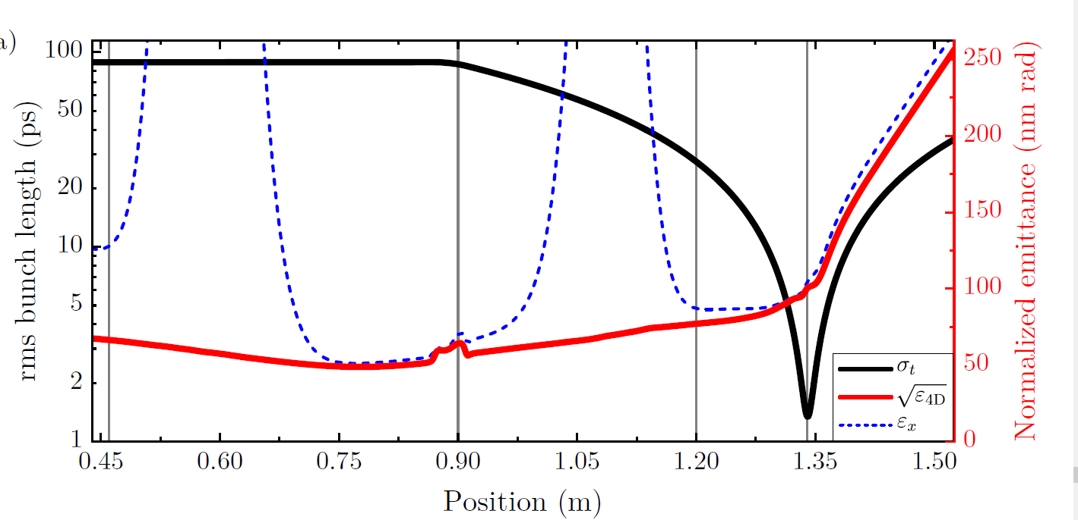
Dual mode compression

Slide 16
Conclusion
 | Present
Continuous emission current | 10 mA
Electron energy | 100 keV
Repetition rate | 1.499275 GHz
Charge per bunch | 2 – 3 pC
Bunch length | < 2 ps
Transverse emittance | 40 – 100 nm rad

Slide 17
Conclusion
 | Present | Upgrade
Continuous emission current | 10 mA | 90-160 mA
Electron energy | 100 keV | 100 keV
Repetition rate | 1.499275 GHz | 1.499275 GHz
Charge per bunch | 2 – 3 pC | 20 – 50 pC
Bunch length | < 2 ps | <2 ps
Transverse emittance | 40 – 100 nm rad | 400 – 1200 nm rad

Slide 18
Backup - Slides

Slide 19
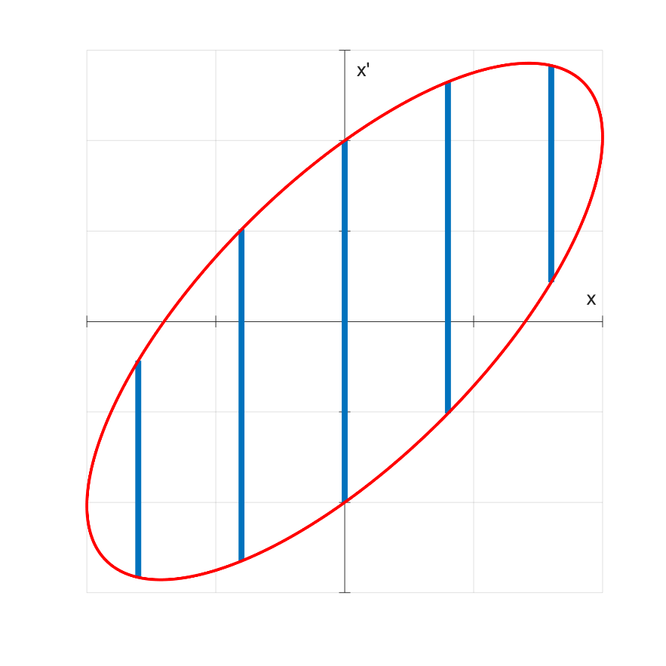
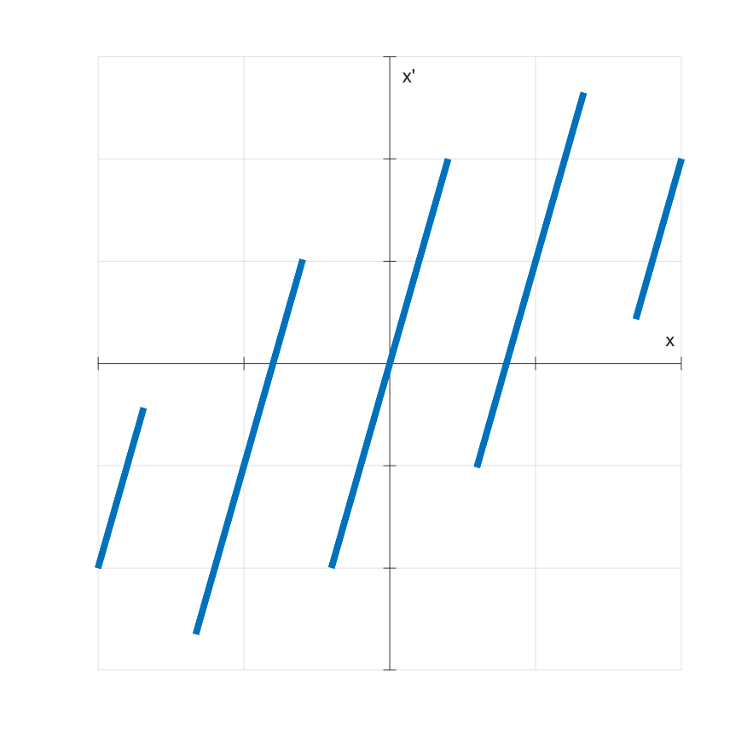
Emittance measurement through a pepper-pot
$$(x,x^{′})$$
Pepper-pot cuts beam
Beam drifts over $L$
$$σ_{x′}$$
$$σ_{x′}$$
drift $L$
$$σ_{x}$$
Phosphor screen

Slide 20
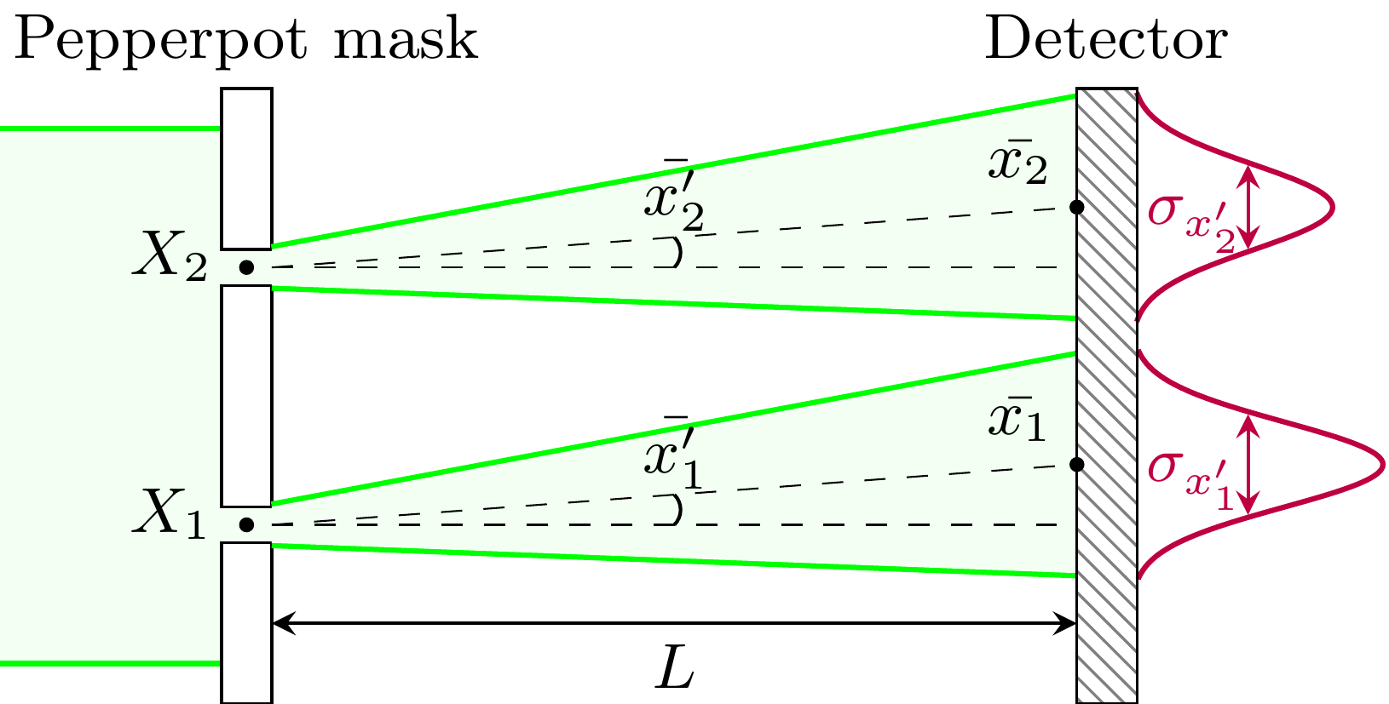
Emittance measurement through a pepper-pot
$$σ_{x^{′}}=\frac{σ_{x}}{L}$$
Reconstruct phase space

Slide 21
Pepper-pot measurement
Measured Data
Fitted Data
$$y$$
$$y$$
$$x$$
$$x$$
Determine any correlation between $x$ and $y$
Measure $ε_{x}$ and $ε_{y}$ simultaneously

Slide 22
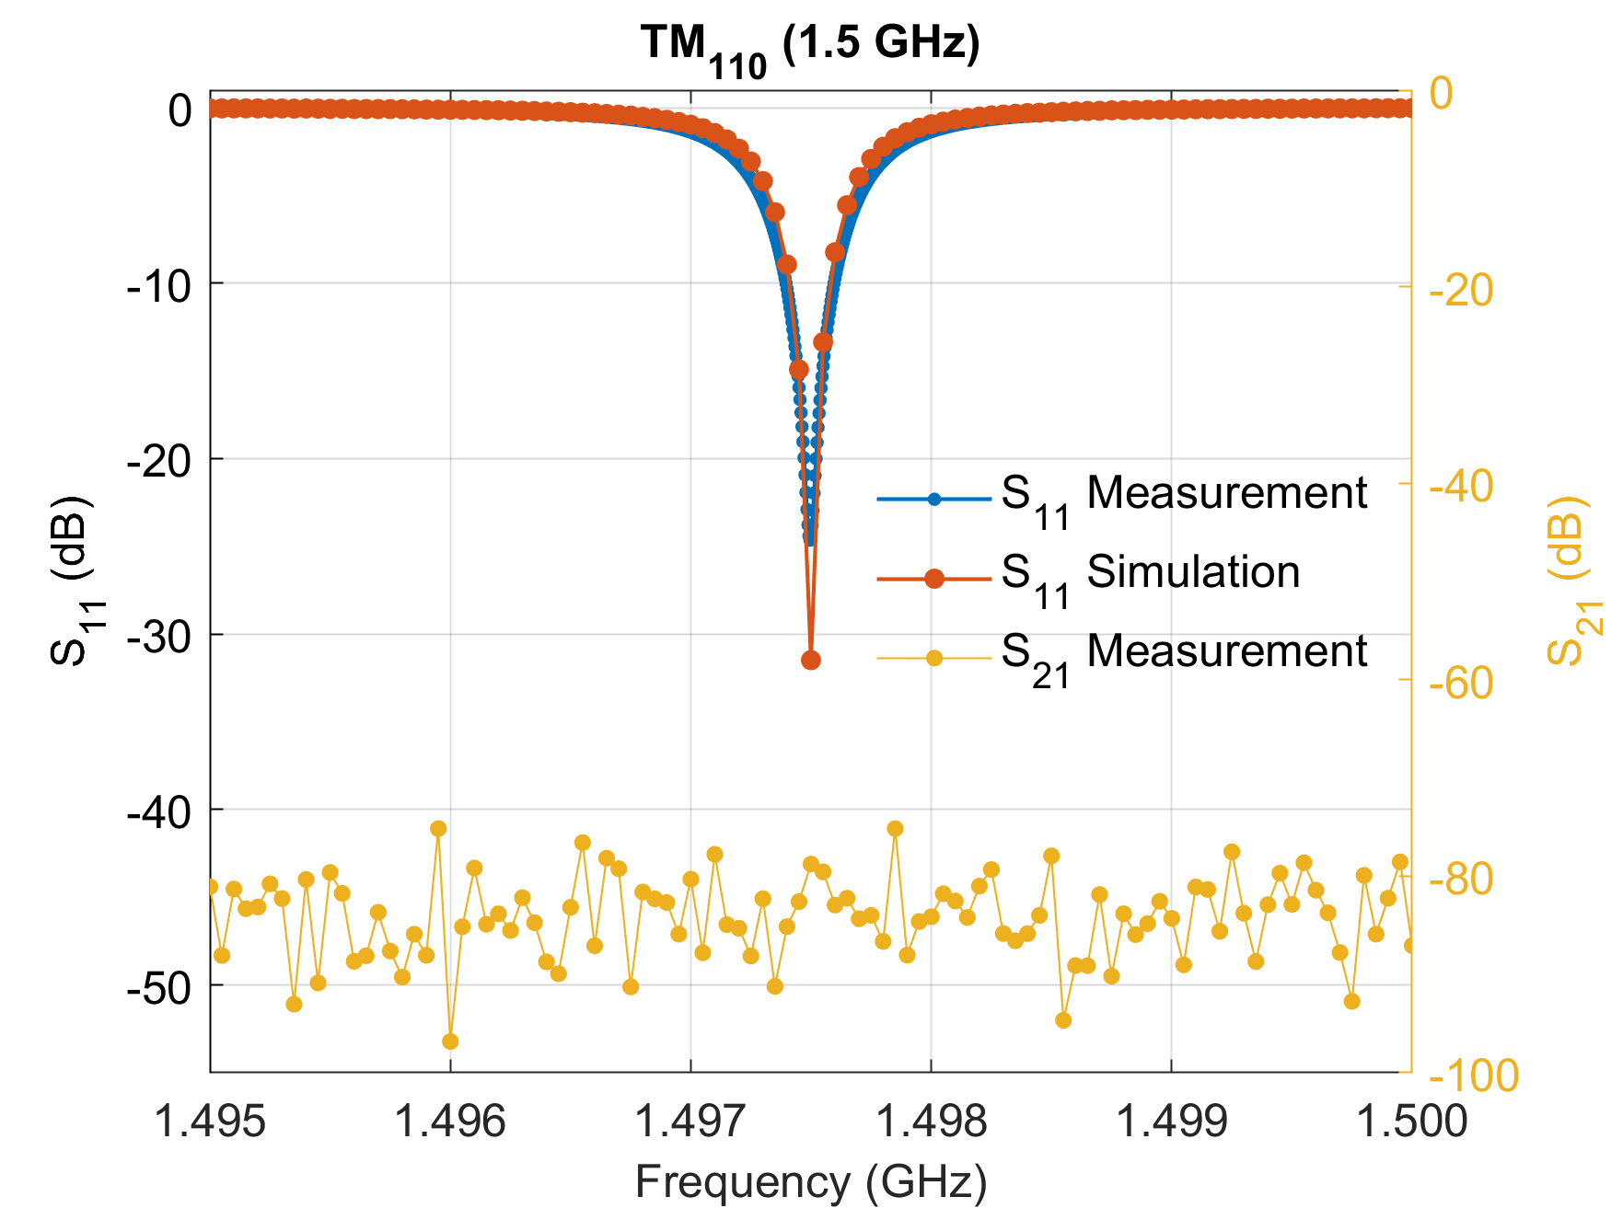
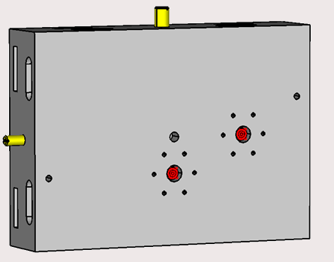
Cavity modes and reflections
$S_{11}$: Reflected power in dB
$S_{21}$: Transmitted power in dB
$${\text{S}}_{\text{21}}$$
$${\text{S}}_{\text{11}}$$

Slide 23
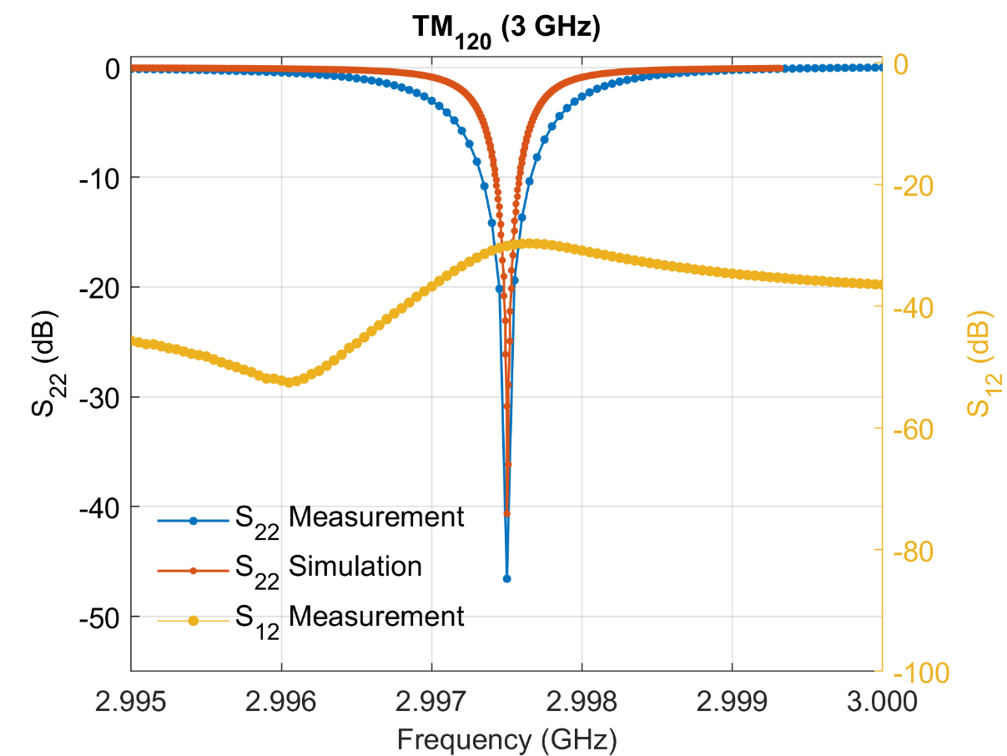
Cavity modes and reflections
$S_{22}$: Reflected power in dB
$S_{12}$: Transmitted power in dB
$${\text{S}}_{\text{22}}$$
$${\text{S}}_{\text{12}}$$

Slide 24
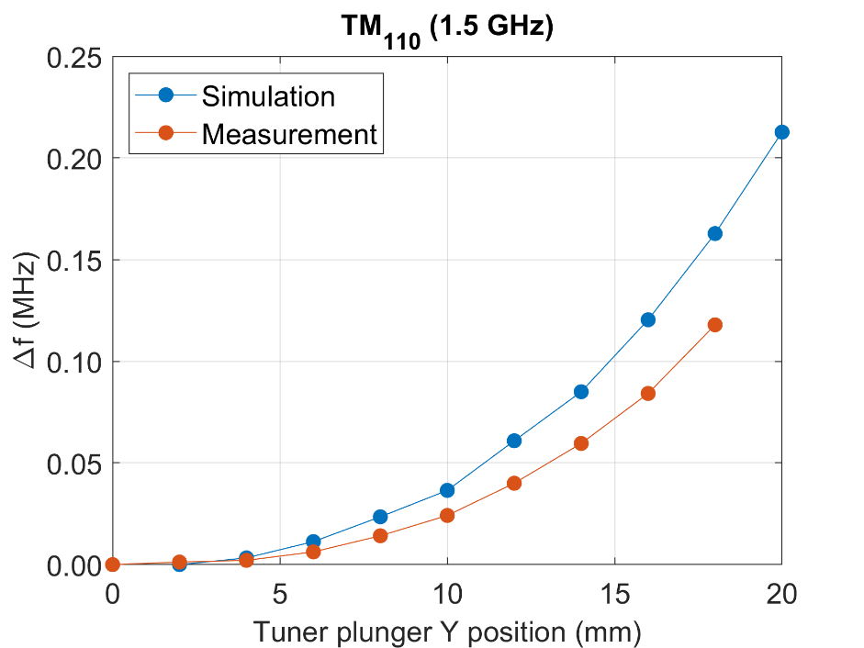
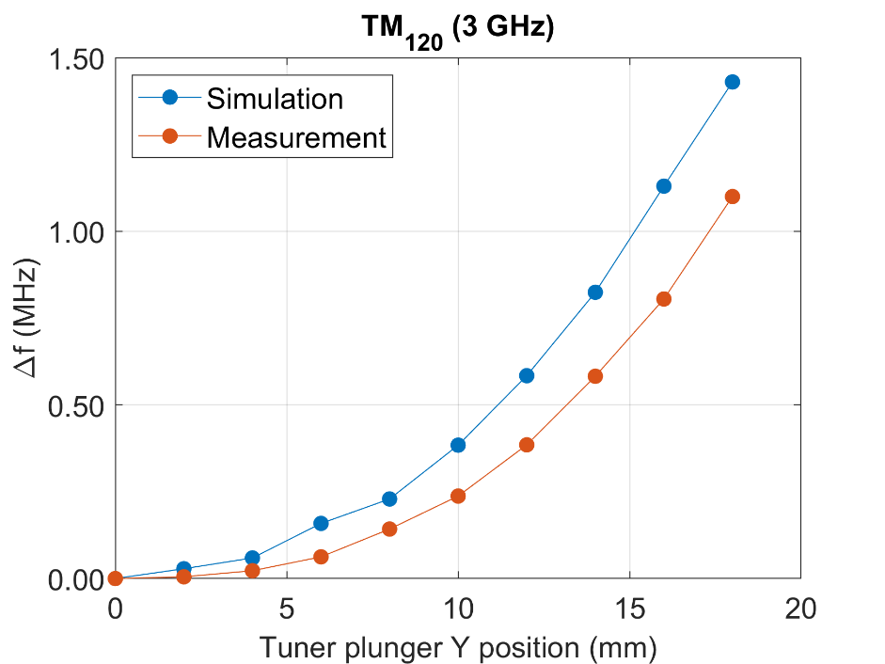
Tuner plunger 3.0 GHz
Tuner plunger Y
$$1.1 \text{M}\text{Hz}$$
$$0.12 \text{MHz}$$

Slide 25
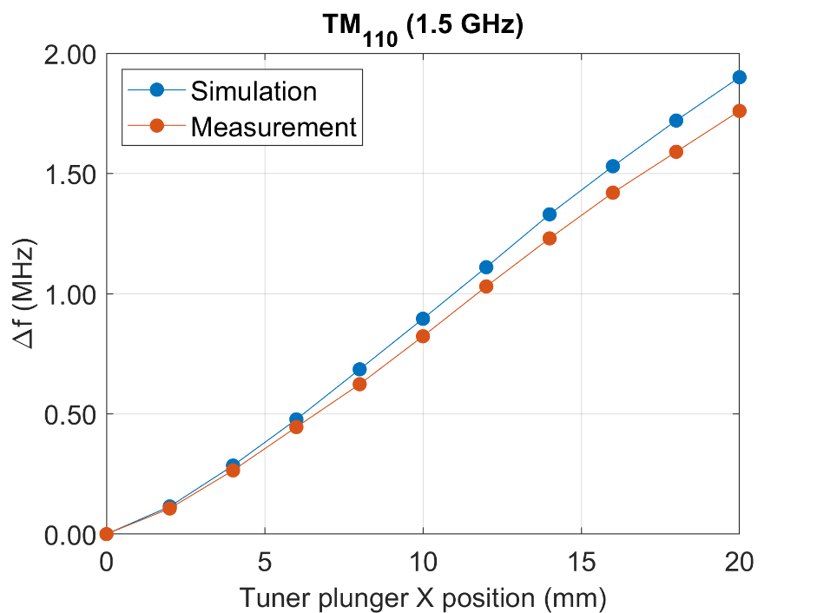
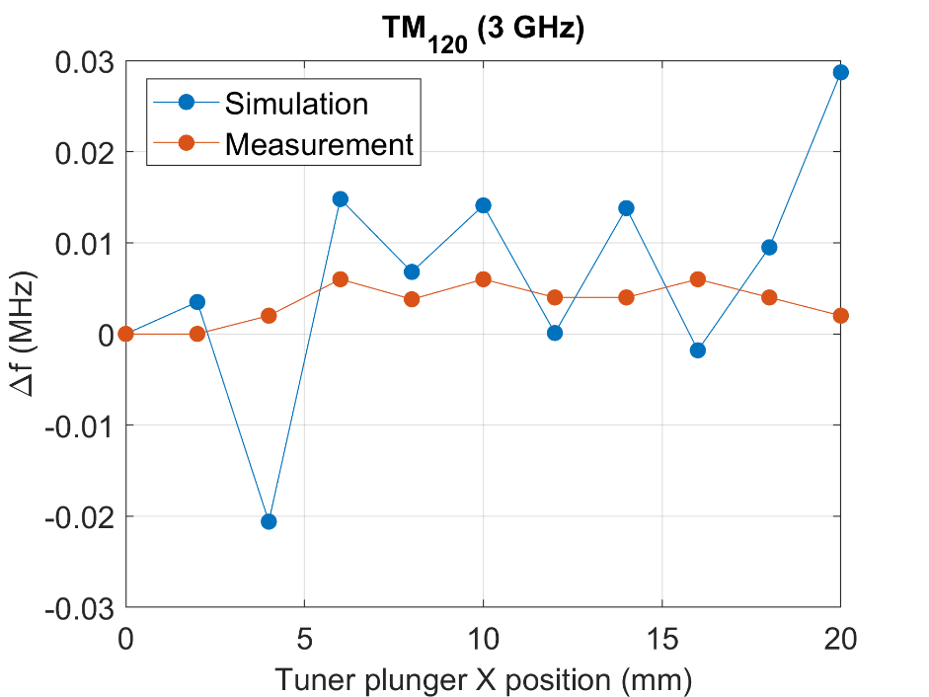
Tuner plunger 1.5 GHz
Tuner plunger X
$$<10 \text{kHz}$$
$$1.8 \text{MHz}$$

Slide 26
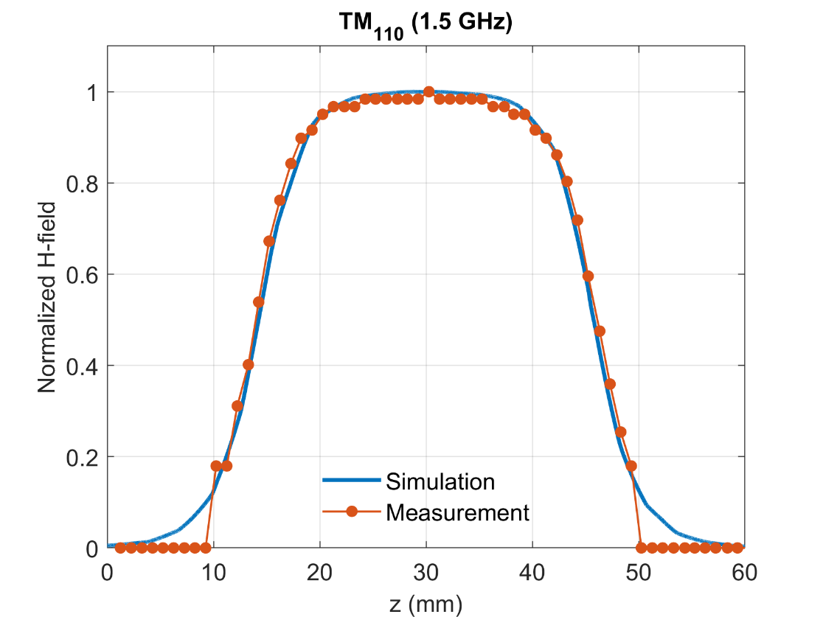
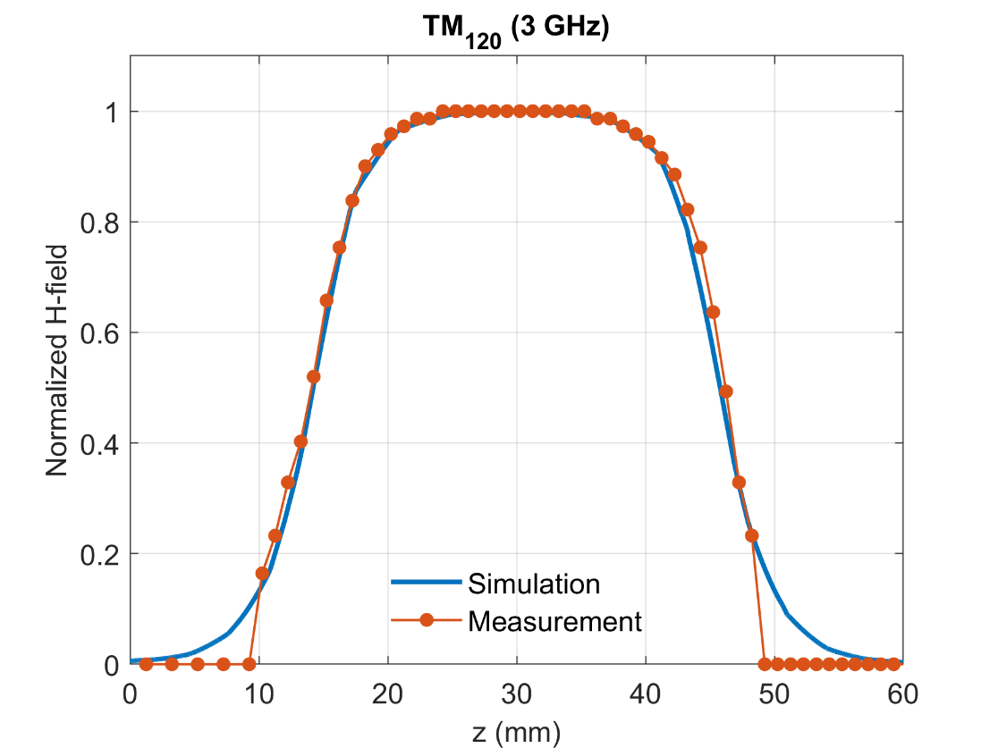
On-axis magnetic field measurement

Slide 27
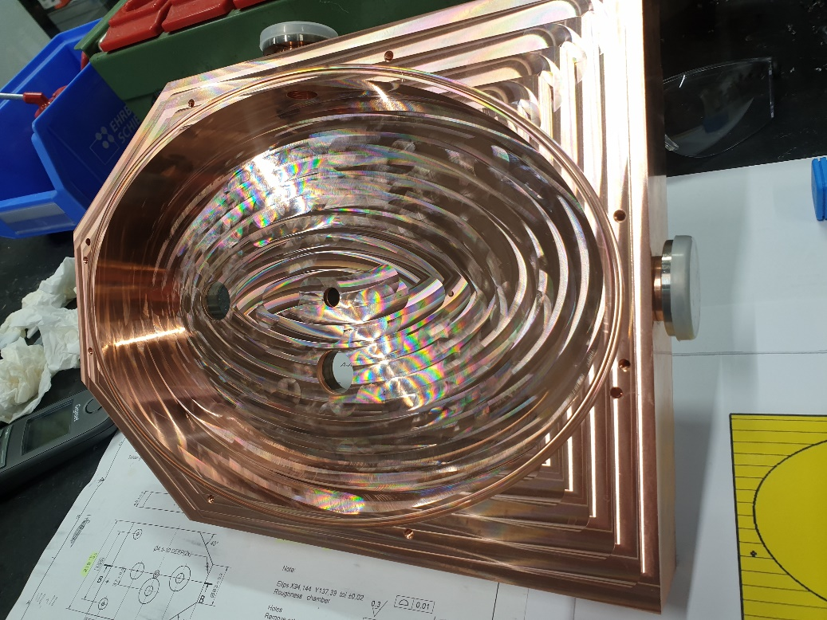
Elliptical cavity

Slide 28
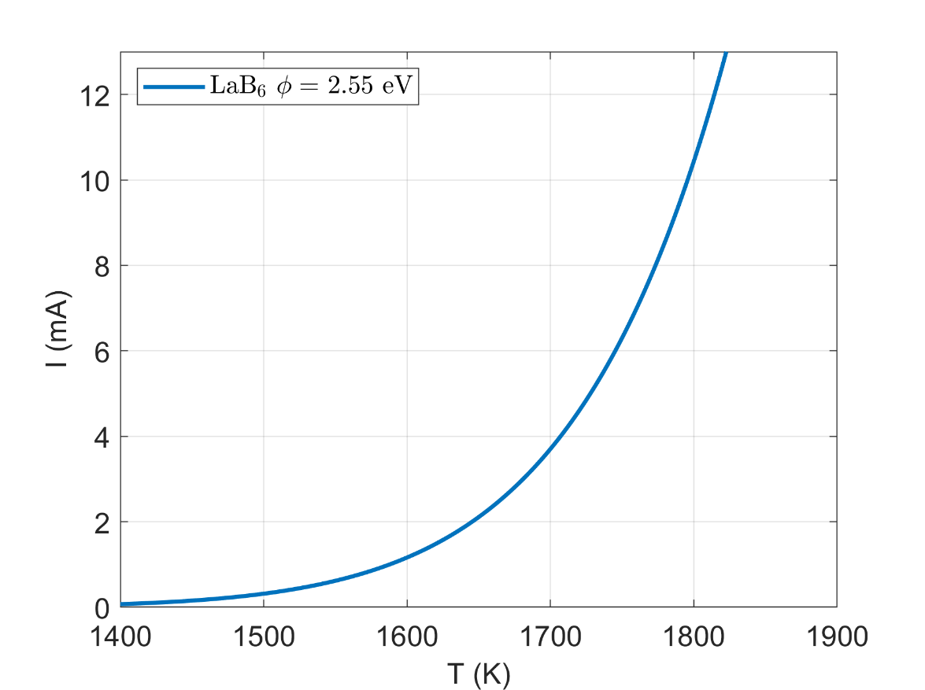
Thermionic Emitter
$$ε_{n}^{rms}=\frac{r}{2}\sqrt{\frac{k_{B}T}{mc^{2}}}$$
$I\left(T\right)=πr^{2}A_{g}T^{2}e^{\frac{−(φ−Δφ)}{k_{b}T}}$
$$r=150 μ\text{m}$$
$$\text{La}{\text{B}}_{\text{6}}$$
$$r=150 μ\text{m}$$
Carbon ring

Slide 29
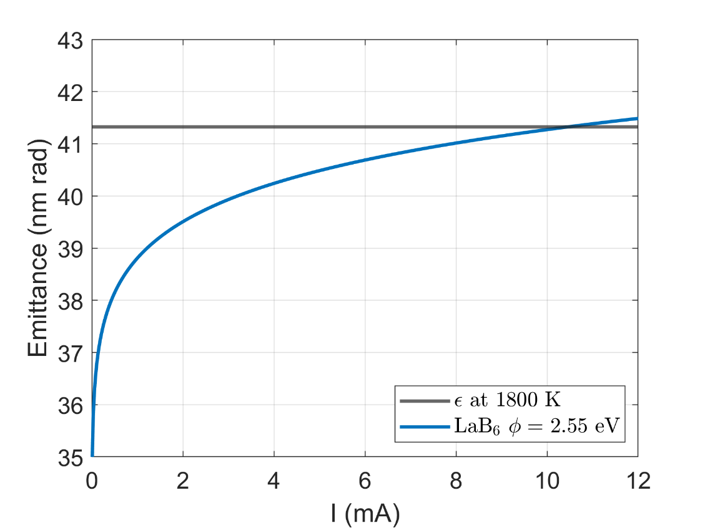
Thermionic Emitter
$$\text{La}{\text{B}}_{\text{6}}$$
$$r=150 μ\text{m}$$
Carbon ring

Slide 30
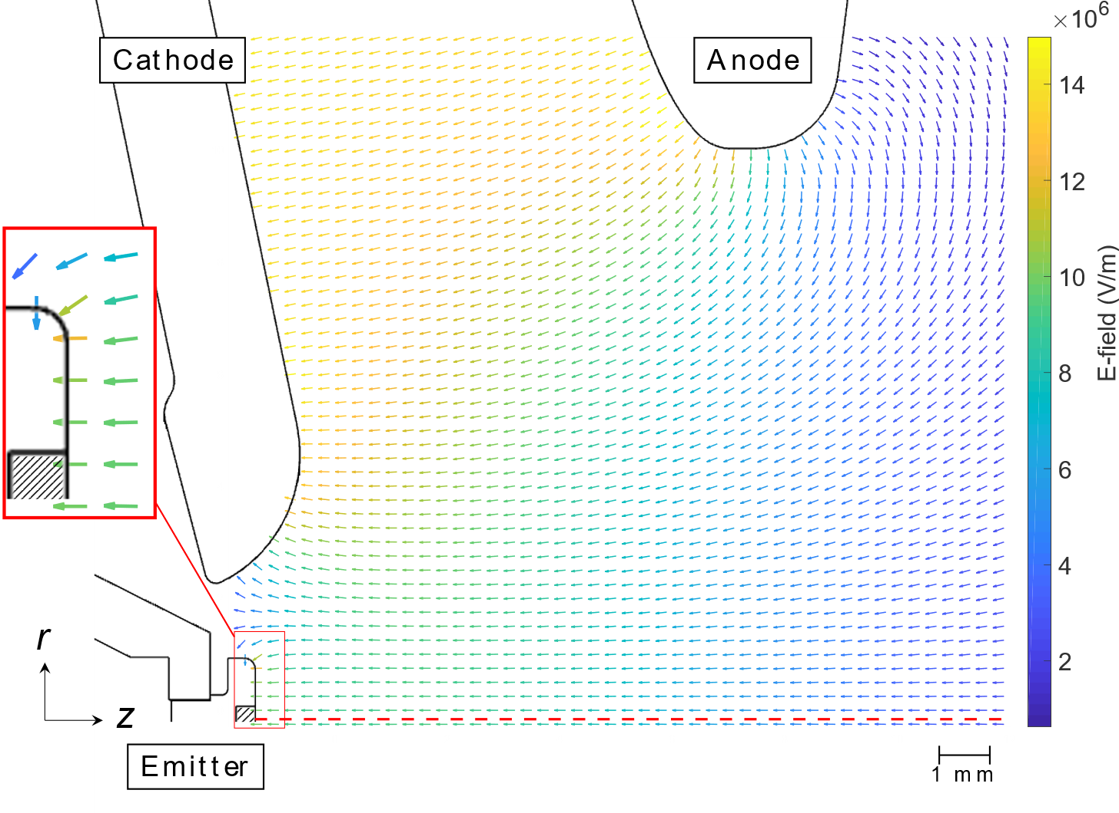
100kV DC accelerator

Slide 31
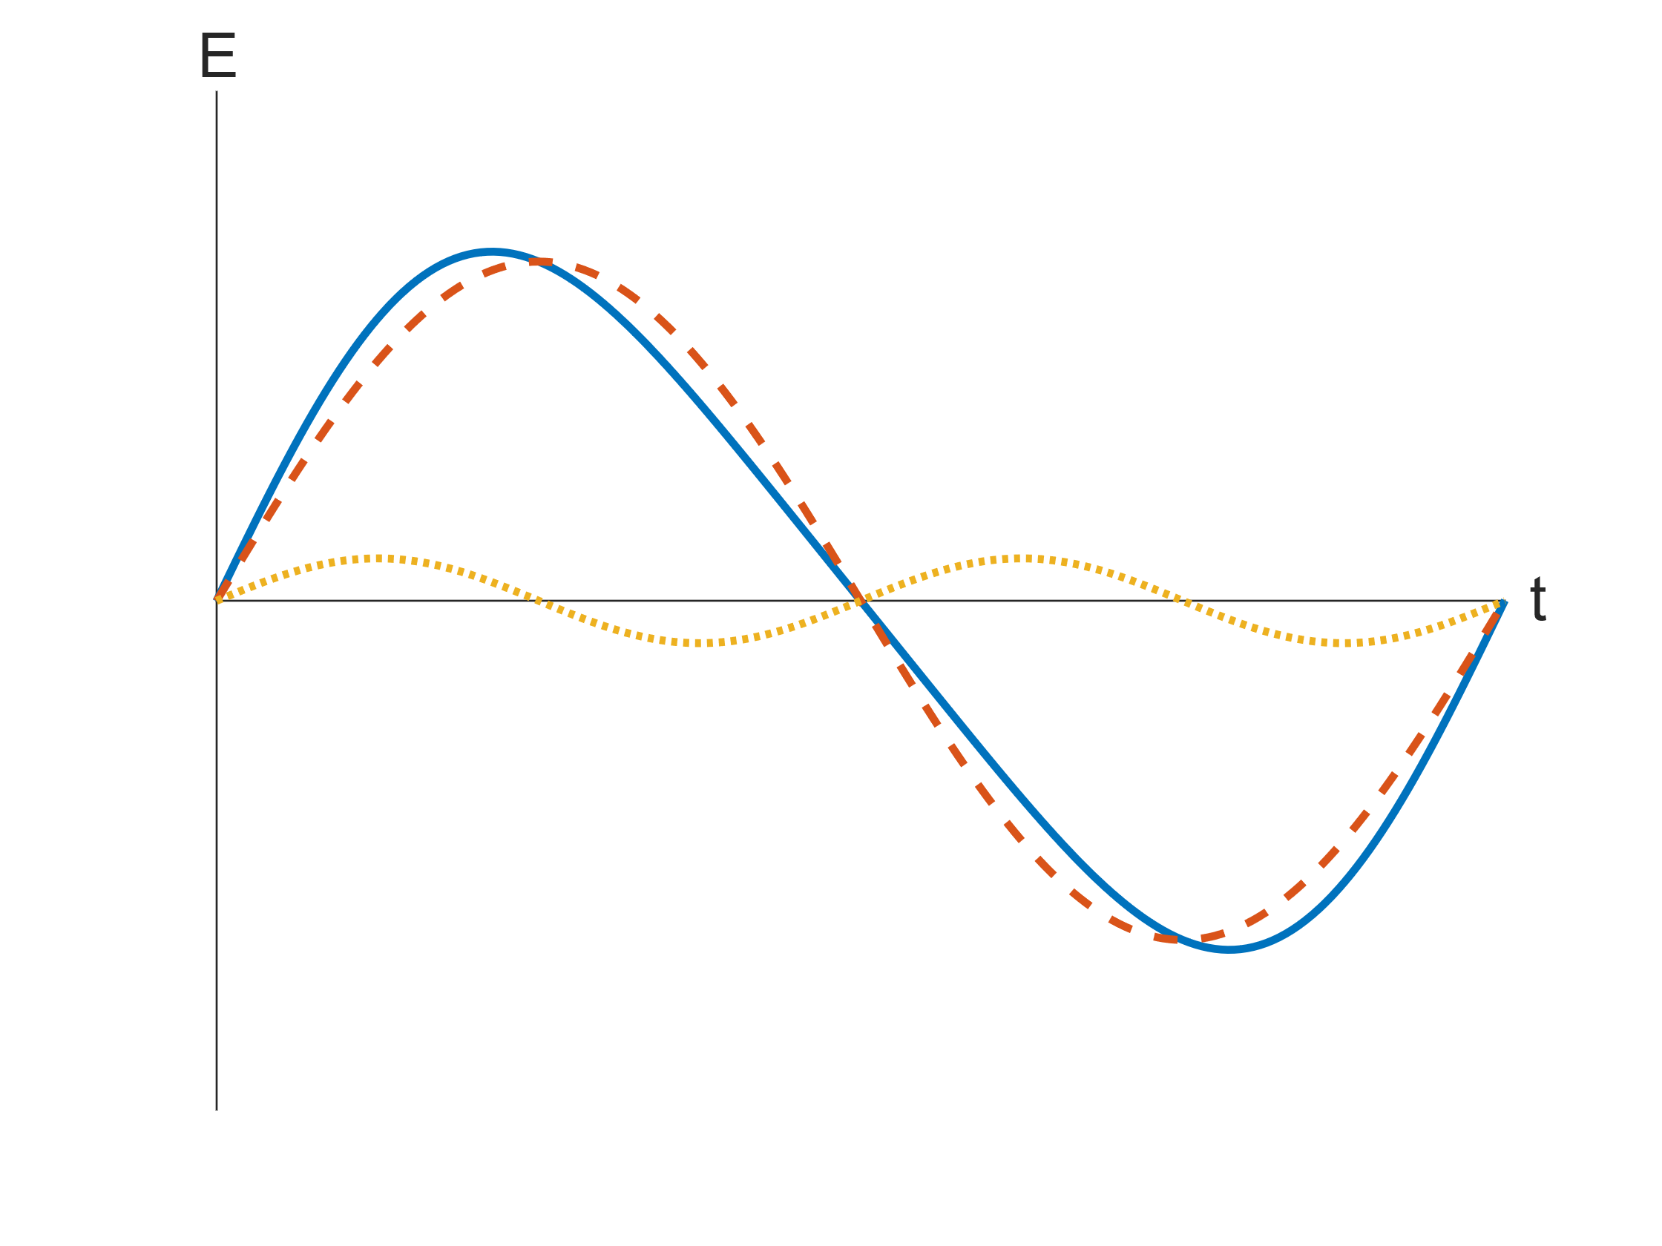
Dual mode compression

