Slide 1
Welcome to ERL 2022
Don Hartill
CLASSE Director

Slide 2
History
First Accelerator at Cornell was a few MeV Cyclotron built in the late 1930’s
Second Accelerator was a 300 MeV weak focusing Synchrotron – pi production and verification of synchrotron radiation and began operation in 1946
Third Accelerator was the first strong focusing Synchrotron with an energy of 1.5 GeV - 1952

Slide 3
History
Next accelerator was the 2.2 GeV Synchrotron with a ceramic vacuum chamber instead of glass and began operation in 1963
The construction of a 10 GeV Synchrotron was proposed in 1965 to the National Science Foundation for 12 M$ and they funded it. Construction was complete including the Wilson Laboratory building and operation began in 1967. An additional RF cavity was added a few years later raising the energy to 12 GeV. The first test of a superconducting RF cavity (muffin tin cavity) a few years later demonstrated that this single cavity could accelerate the beam to 3 GeV alone and that it could survive the vacuum environment of the Synchrotron.
The next step in the path was the construction of the CESR storage ring to collide positrons and electrons at energies up to 8 GeV and began operation in 1979. Initial luminosity was 3 x 10³⁰ cm²/sec and final luminosity in the 4S region was 2 x 10³³ at the end of the CLEO run in 2003. The increase was enabled by a number of inovations including pretzel orbits, stronger focus of the beams at the interaction region, going to only one interaction region, incorporating crossing angles at the interaction region and the replacement of the normal conducting RF cavities with four single cell superconducting RF cavities.

Slide 4
History
Charm physics in the 1.5 to 2.2 GeV was the next phase of CESR/CLEO running interleaved with CHESS running at 5 GeV. Beam stability issues at low energy were overcome by installing superconducting wiggles in various locations around the ring. This phase ended in 2008 and CLASSE was formed.
From 2008 until 2012 CESR was used as a test accelerator for the damping ring development for the proposed ILC.
From 2012 CESR transitioned to serving only the CHESS X-ray beam lines.

Slide 5
Recent History
Towards the end of the Charm Physics running Sol Gruner and Maury Tigner proposed to the NSF a design study and prototype development for a high energy multibeam line X-ray source based on using CESR fed by an energy recovery linac
The proposal was funded, the design study was completed, the injector cryomodule was built, and a linac cryomodule was constructed and tested in early 2015
A large research program in developing a very low emittance DC photocathode was also carried out in parallel

Slide 6
Recent History
These components were moved to LOE for storage
About this same time, BNL was interested in a similar device and submitted a proposal to NYSERDA which was accepted and the Cbeta collaboration was formed. Cbeta was construted in LOE and successfully demonstrated four turn energy recovery at the end of 2017
In parallel with this an upgrade to CHESS was proposed to install four new undulator beam lines which was accepted and funded by a combination of the NY state jobs program and the NSF
Wilson Laboratory was a very busy place during this period
Let me close by showing a few photographs of these various accelerators

Slide 7
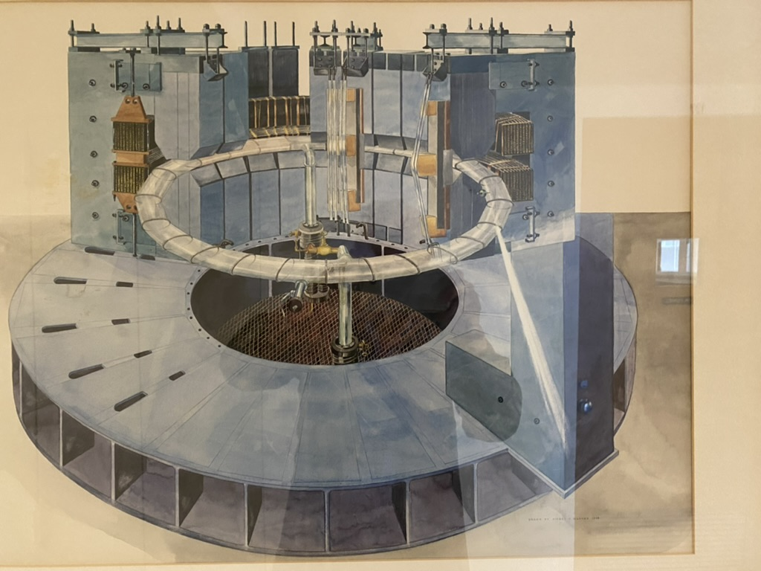

Slide 8
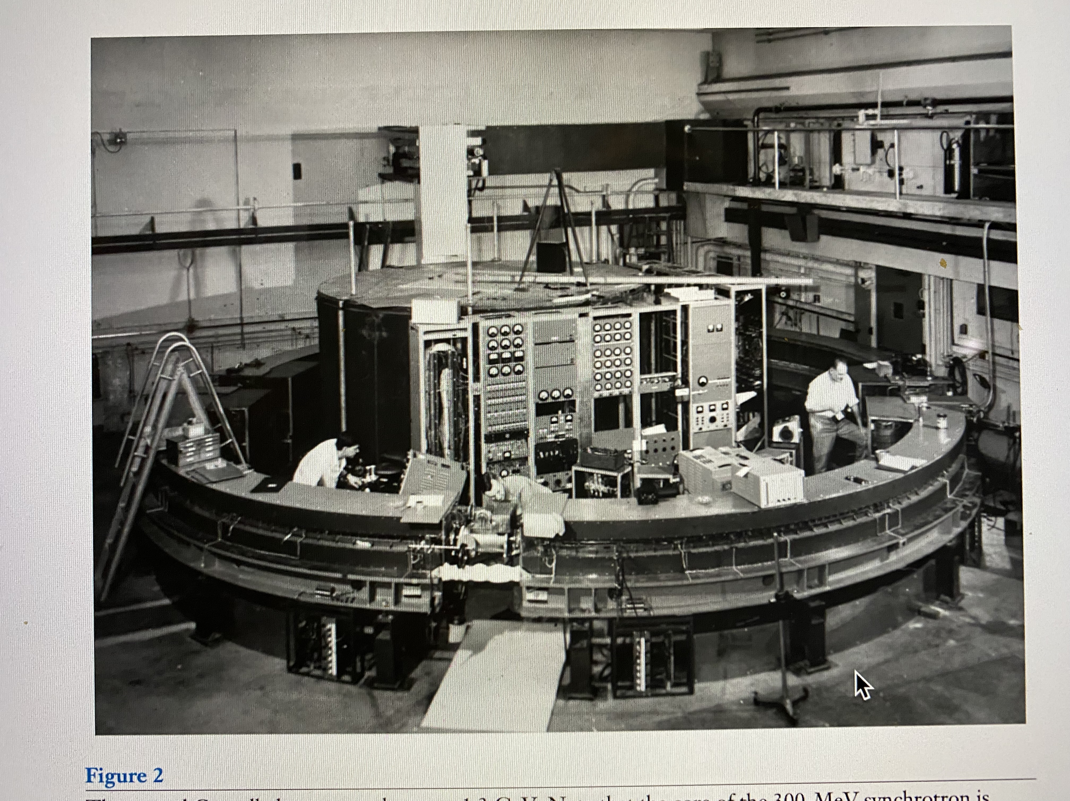

Slide 9
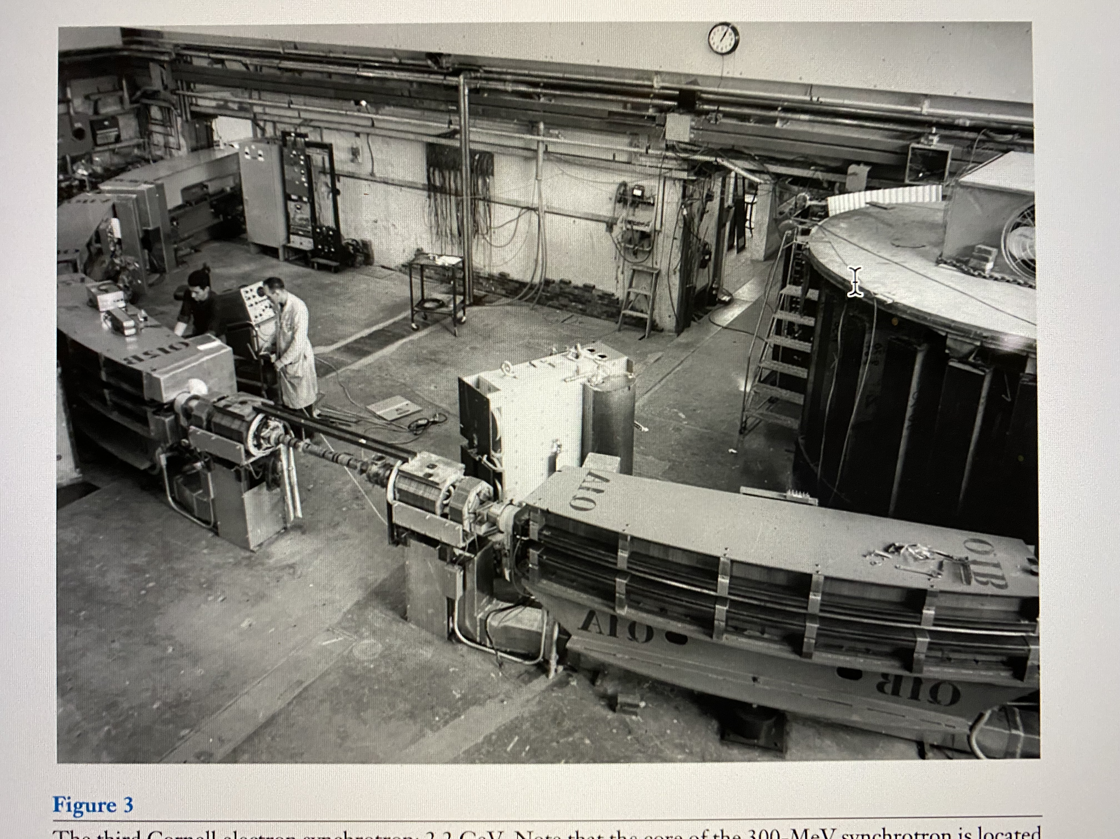

Slide 10
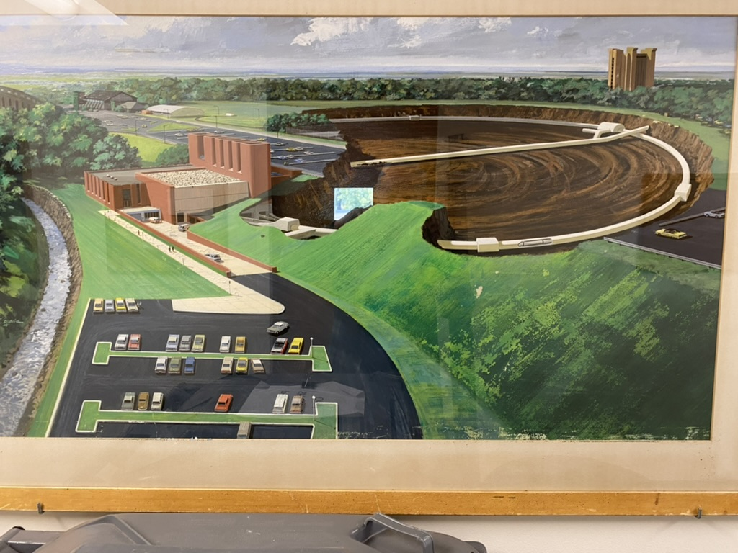

Slide 11
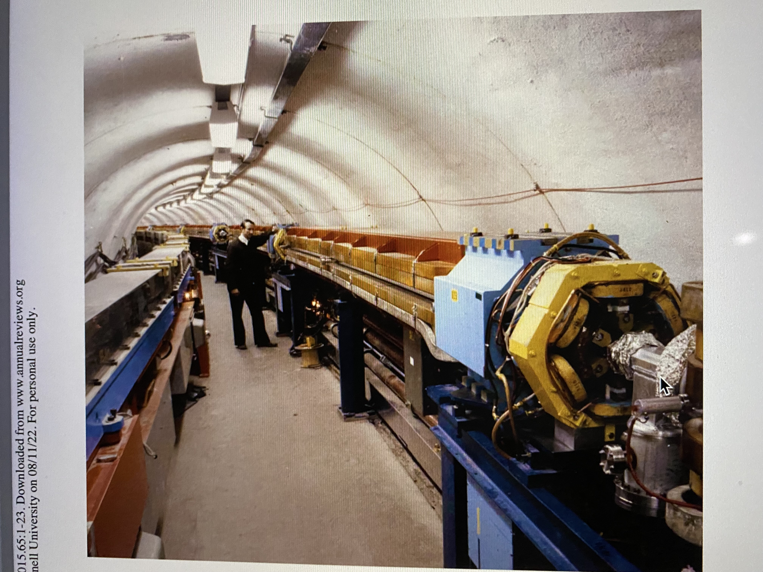

Slide 12
