Slide 1


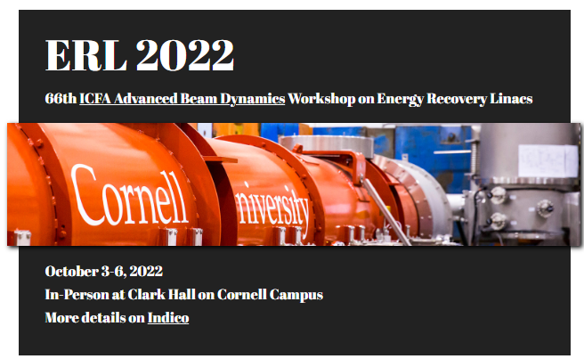
Facility report of Compact ERL (cERL) at KEK
Hiroshi Sakai (on behalf of cERL development team)
Innovation Center for Applied Superconducting Accelerators (iCASA), Accelerator Division
High Energy Accelerator Research Organization (KEK)
22 pages
Introduction
Latest beam operation on three years after ERL2019
Summary
15min+5min
ERL2022 workshop @ Cornell Univ. (2022.Oct.3-6)

Slide 2
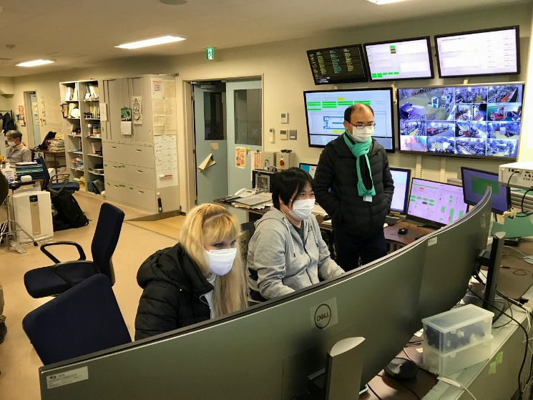
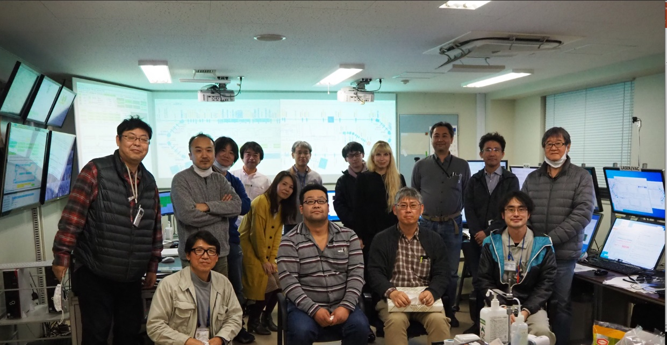
cERL collaboration team 2019-2022
High Energy Accelerator Research Organization (KEK)
M. Adachi, D. Arakawa, H. Araki, M. Egi, S. Eguchi, M. Fukuda, T. Furuya, K. Haga, K. Harada,
N. Higashi, T. Honda, Y. Honda, T. Honma, X. Jin, E. Kako, Y. Kamiya, R. Kato, H. Kawata,
Y. Kobayashi, Y. Kojima, T. Konomi, M.Kurata, H. Matsumura, S. Michizono, C. Mitsuda, T. Miura,
T. Miyajima, H. Miyauchi, Y. Morikawa, S. Nagahashi, H. Nakajima, N. Nakamura, K. Nakanishi,
K. Nigorikawa, T. Nogami, T. Obina, F. Qiu, H. Sagehashi, H. Sakai, M. Shimada, T. Shioya, M. Shiozawa,
M. Tadano, T. Tahara, T. Takahashi, R. Takai, H. Takaki, O. Tanaka, T. Tanikawa, Y. Tanimoto,
K. Tsuchiya, T. Uchiyama, A. Ueda, K. Umemori, M. Yamamoto
National Institutes for Quantum and Radiological Science and Technology (QST)
R. Hajima, K. Kawase, R. Nagai, M. Sawamura, M. Mori, N. Nishimori
National Institutes for Advanced Industrial Science and Technolory (AIST)
T. Sato, M. Kakehata, Y. Yashiro, T. Endo, K. Sakakibara, A. Kumagai
Hiroshima University M. Katoh, M. Kuriki, A. Kano
SLAC National Accelerator Laboratory Nora Peak Norvell
National Institute of Technology, Akita College F. Sakamoto
Institute of Modern Physics (IMP) CAS China Zong Yang
96%
103.5%
Latest pictures under beam operation in 2022

Slide 3
Introduction
Latest beam operation on three years after ERL2019
Summary

Slide 4
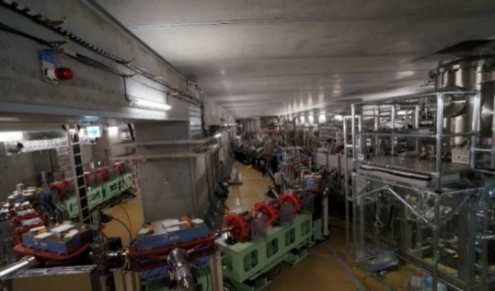
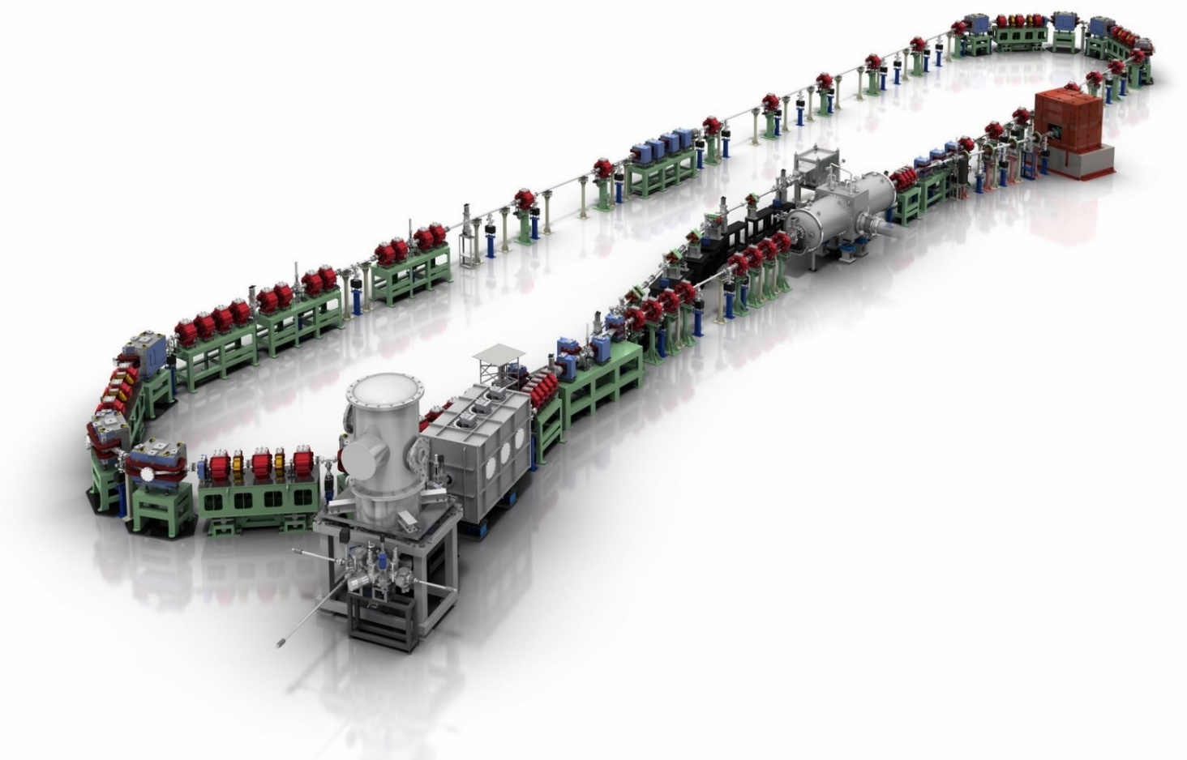
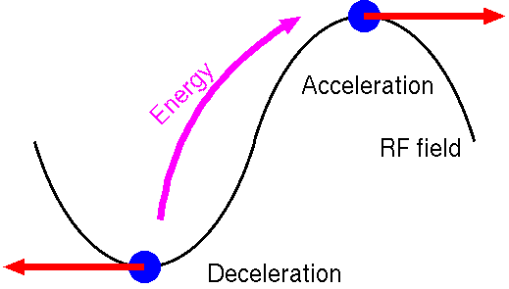
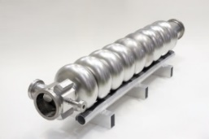
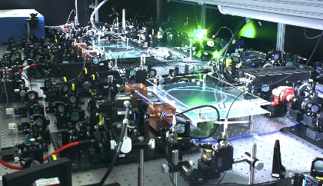
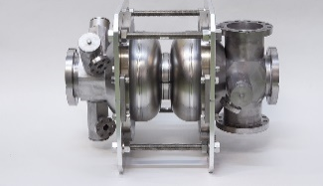
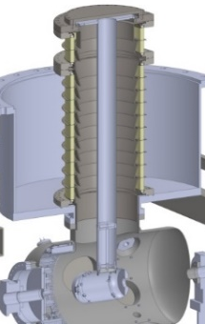
Compact ERL (cERL) in KEK
cERL developed the following key technologies and was constructed in 2013.
High current and high brightness photo cathode DC gun.
CW superconducting cavity for the high current beam operation.
High current CW energy recovery operation achieved 1 mA ERL operation in 2016.
Recently, cERL was used for industrial application by using stable high current beam.
Compact ERL (cERL)
Circumference ~ 90m
Beam Dump
Main LINAC
CW laser
17.7 MeV
Marger
Design parameters of the cERL
Injector LINAC
9-cell SC cavity x 2
Nominal beam energy | 35 MeV → 20MeV
Nominal Injector energy | 5 MeV →2.9MeV
Beam current | 10 mA (initial goal) 100mA (final)
Normalized emittance | 0.1 ‒ 1 mm⋅mrad
Bunch length (bunch compressed) | 1-3ps (usual) 100fs (short bunch)
©Rey.Hori/KEK
RF frequency= 1.3 GHz
2-cell SC cavity x 3
Photocathode DC gun
(Not SRF gun)
Buncher
500kV DC Gun (highest DC voltage in the world)

Slide 5
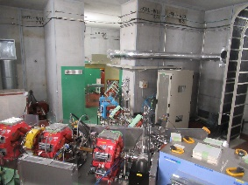
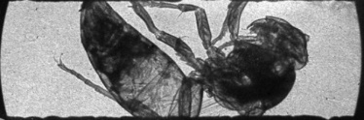
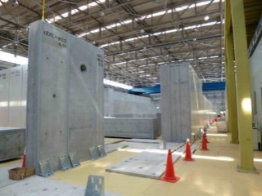
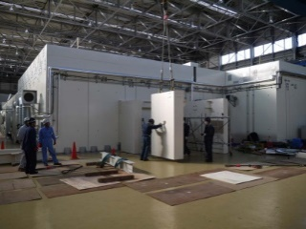
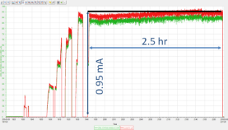
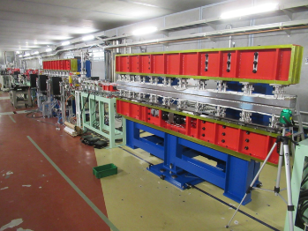
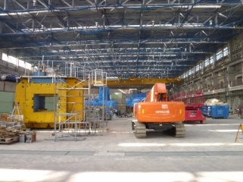
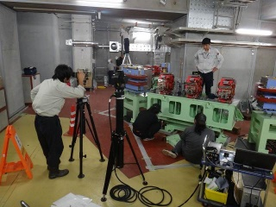
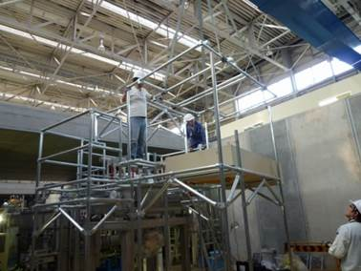
History of construction and Commissioning of cERL
Laser Compton scattering experiment in ERL
(Published) M. Akemoto et al., “Construction and commissioning of the compact energy-recovery linac at KEK” Nucl. Instrum. Method A 877 p.197-219 (2018).
T. Akagi, et., al. “Narrow-band photon beam via laser Compton scattering in an energy recovery linac” Phys. Rev. Accel. Beams 19, 114701 (2016)
Commissioning started
R&D for Industrial application
Beam operation
here
2009 | 2010 | 2011 | 2012 | 2013 | 2014 | 2015 | 2016 | 2017 | 2018 | 2019 | 2020 | 2021 | 2022
RI beam test & production
0.3 mA CW beam with undulator
Construction
Construction of IR-FEL
Commissioning/Operation
High bunch charge
& THz study
Construction of RI beamline
FEL produced
Increasing the beam current
1mA again
Commissioning of LCS system
We will talk latest three years status of beam operation and hardware issues after ERL2019.
Construction of LCS system
Commissioning of cERL (with loop)
Construction of recirculation loop
Commissioning of injector
Related ERL22 presentation of cERL operation (details)
M. Shimada, “Beam tuning for IR-FEL and industrial application at the compact ERL” (focus on development of beam simulation & operation)
H. Sakai, “SRF performance on the cERL at KEK” (focus of development of SRF performance during beam operation)
Construction of
injector
1mA CW ERL achieved
Refurbishment
of building
Clearing radioactive
materials
Construction of
radiation shielding
Construction started in 2009 and commissioning start in 2013.
Now we continue beam operation in 2022
ERL2019 (Sep.2019)
5

Slide 6
Introduction
Latest beam operation on three years after ERL2019
Summary & future plan
Overview of three years of cERL.
Construction of FEL beam line and trial for generation of SASE-FEL
THz operation
High charge ERL & CW operation (briefly)
→ mainly talk about Shimada-san’s presentation
Hardware issue and recovery

Slide 7
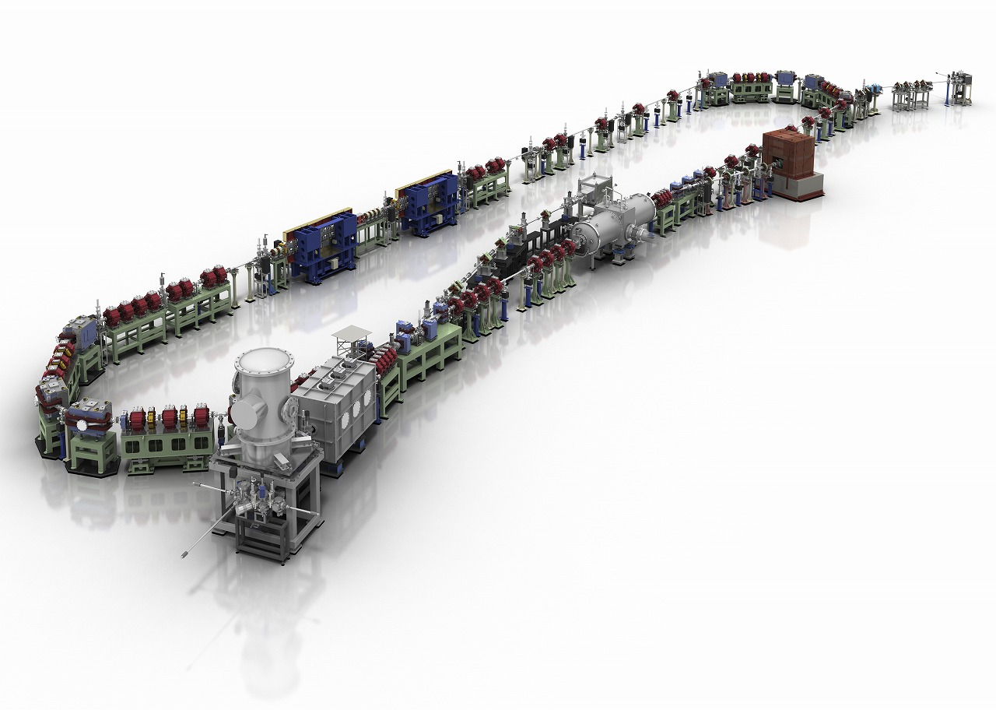
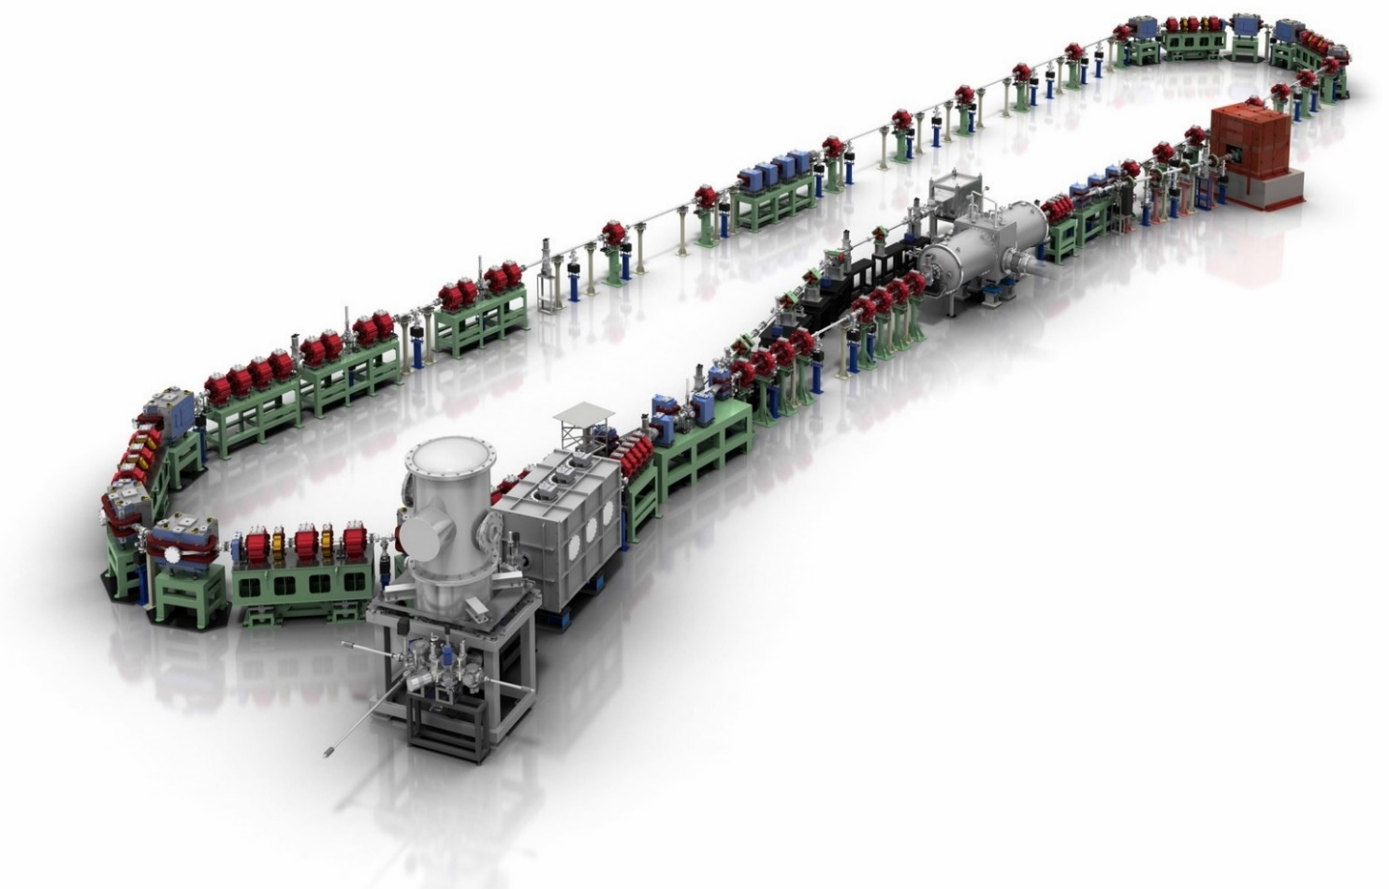
cERL operation after ERL2019
The unique performance (high current, low emittance, short bunch with ERL) gives us several important industrial applications in cERL.
Demonstrate POC of EUV-FEL light source
Irradiation beam line with CW beam (2019)
THz “test beam line” (2020)
Irradiation beam line
was constructed (2019)
Max 26 MeV
10μA
Two undulator for IR-FEL (2020)
cERL beam operation (2019~2022)
IR-FEL project was started under NEDO Project (Dec. 2018 – Mar. 2021) : “Development of high-power mid-infrared lasers for high-efficiency laser processing utilizing photo-absorption based on molecular vibrational transitions.”
Continue to try IR-FEL production with continuous CW & high charge ERL beam operation for POC of EUV-FEL (2022). (explained later)
Irradiation beam line was constructed for RI production. Material processing by CW high-intensity beam irradiation (2019 – now)
  Formation of Nuclear Medical drug (99Mo & 67Cu) (with company)
  Sustain asphalt property by irradiation(with company)
  Fabrication of cellulose nanofibers(CNF) by woods (NEDO）(FYI 2021)
Test for generation of coherent THz beam (2018). construct beam line (2020).

Slide 8
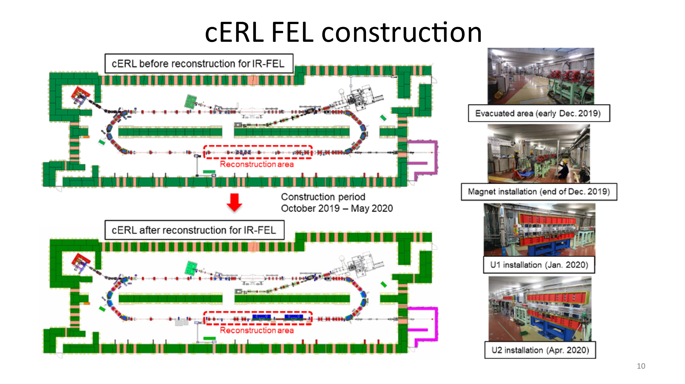
IR-SASE-FEL production in cERL

Slide 9
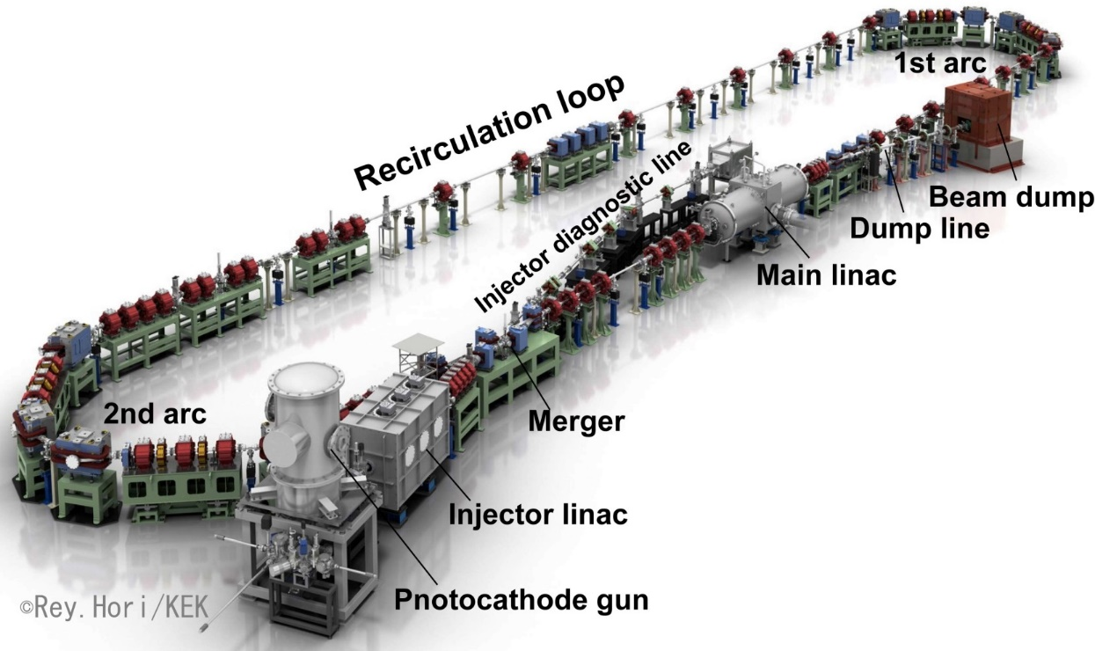
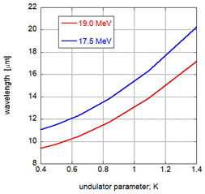
cERL FEL layout & operation
During FEL optimization, we operate Burst mode
NEDO Project (Dec. 2018 – Mar. 2021) : “Development of high-power mid-infrared lasers for high-efficiency laser processing utilizing photo-absorption based on molecular vibrational transitions.”
Burst mode (FEL&e-beam tuning)
Macro pulse of 0.1 ~1 μs at 1 - 5 Hz
New Undulators for FEL
60-pC bunch
High-power IR FEL
12.3 ns (81.25MHz)
0.77ns (1.3 GHz)
Bunch repetition:
1.3 GHz or 81.25 MHz
Requirement of the wavelength range of IR-FEL (10～20um)
Beam Energy | 17.5 - 19.0 MeV
Injector Energy | 3.0 - 5.0 MeV
E-Gun Energy | 500 keV (or 480 keV)
Bunch repetition | 1.3 GHz (or 81.25 MHz)
Average current | 1 mA (or 5 mA ) in CW
Operation mode | CW or Burst
Our target:
1W level IR-FEL
(81.25 MHz)
~12nJ/pulse

Slide 10
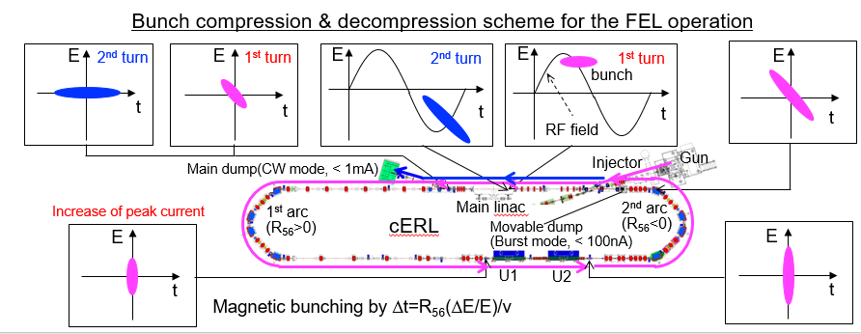
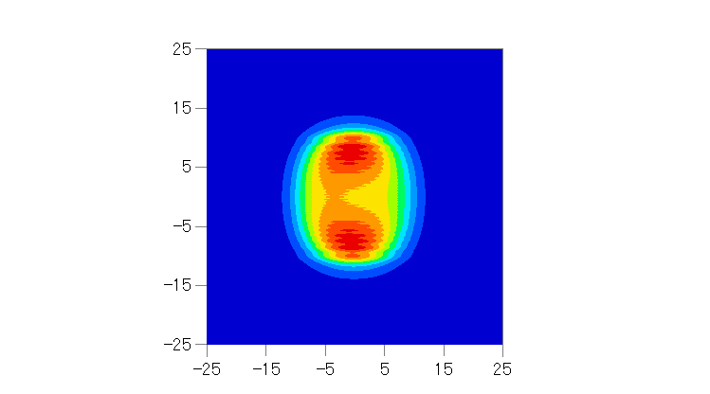
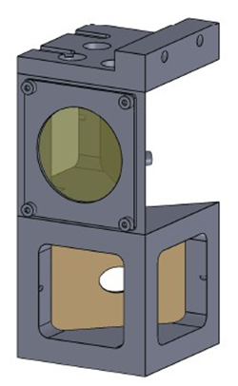
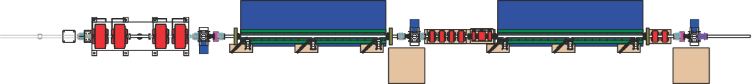

Setup of cERL-FEL
Operation was done by burst mode
FEL profile at mirror
Bunch length compressed in this arc section
FEL monitor port#1
FEL monitor port #2
electron
Undulator #1
Undulator #2
Beam parameter
Undulator parameter
FEL
Energy : 17.5 (– 19.0) MeV
Bunch charge : 60 pC
Repetition : 81.25 MHz
Bunch length : 0.5 – 2 ps (FWHM)
Energy spread : 0.1%
Norm. emittance : 3 π mm mrad
Type: APU (Planar)
Gap: 10 mm (Fixed)
K: 1.42
Period λ_{u} : 24 mm
Total length : 3 m
No. of Undulator : 2
Only FEL was reflected and electron went through the hole
Two 3m undulators
Demonstration of PoC of the EUV-FEL First ERL-based SASE-FEL in the world(explained later)

Slide 11
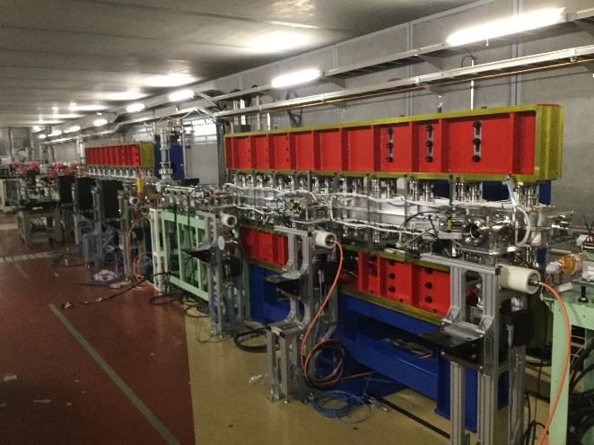
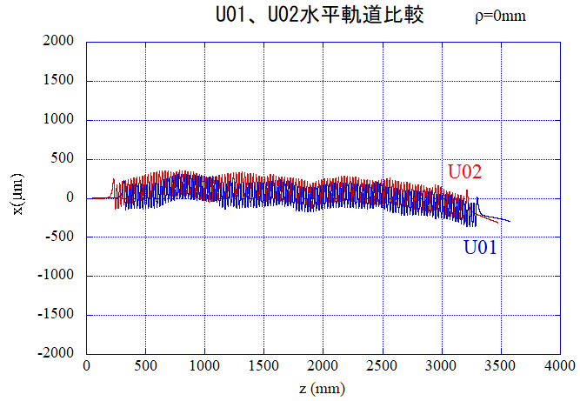
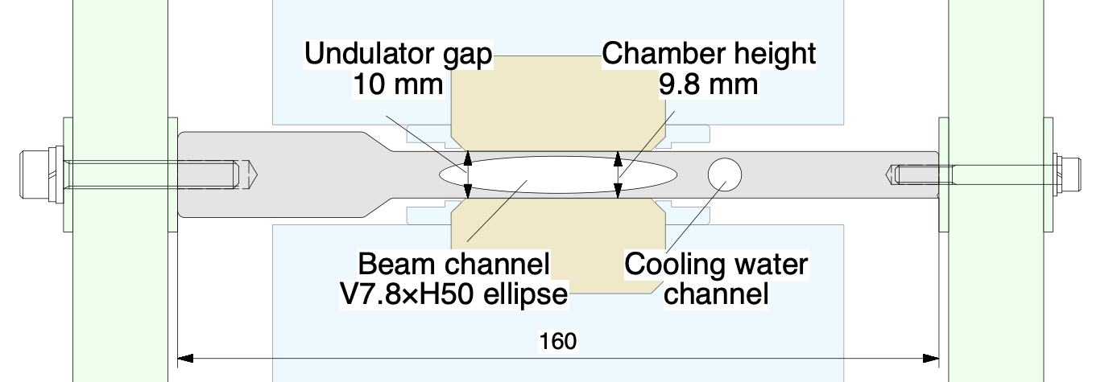
cERL-FEL undulator
  M. Adachi To be submitted
・Apply fixed Gap (Adjustable Phase Undulartor (APU)) → compact & cheaper undulator
K-value max
Magnet array(upper)
e-
Magnet array (lower)
U01
K-value min.
Fix 10 mm gap
→ Reduce the magnetic force under changing the K-value. This results in making compact girder.
U02
e-
Slide lower magnet array
magnet
magnet
Al chamber of 10mm with 50μm space
Can slide the magnet array smoothly
Beam orbit calculation by the magnet arrangement. >100μm of beam orbit。OK for making good magnetic field of undulator.

Slide 12
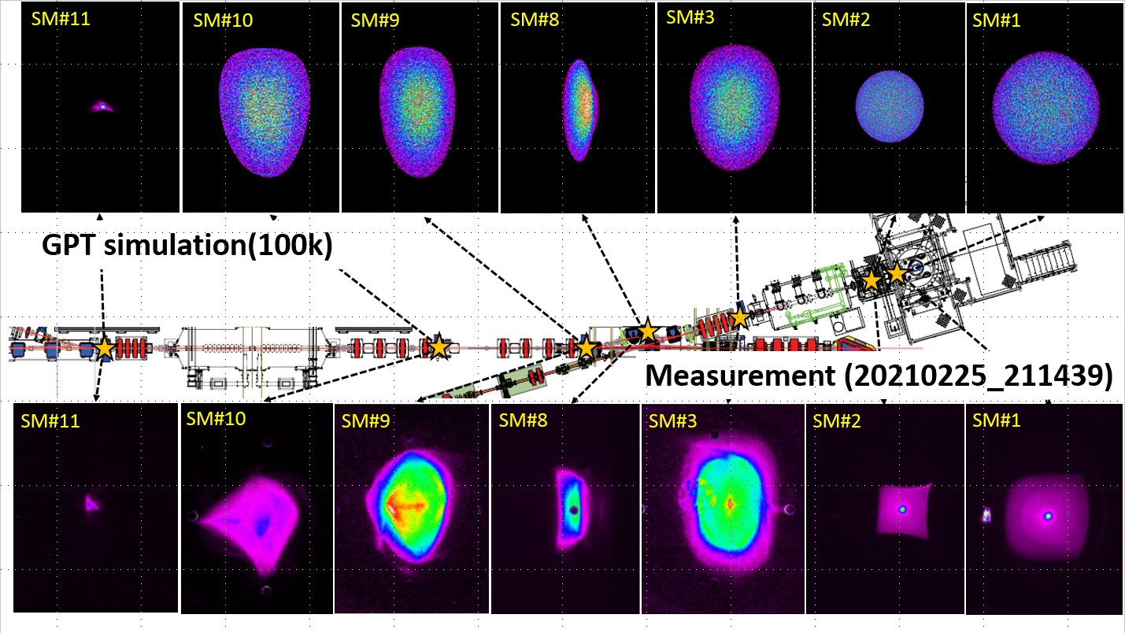
Optics tuning of high charge operation (2021)
O.Tanaka
High charge operation is very difficult to keep small emittance to suppress space charge effect.
High
charge
60pC
/bunch
5MeV
17.5MeV
480kV
We met big trouble
Meausment results of emittances at the exit of main linac
  Design (60pC/bunch):
  1.74 π mm mrad (x) / 1.92 π mm mrad (y).
  Measurement (60pC/bunch) :
  2.87 ± 0.03 π mm mrad (x) /
  1.57 ± 0.02 π mm mrad (y)
Good agreement between simulation and measurement including space charge effect.
We satisflied the requirements for FEL operation.

Slide 13
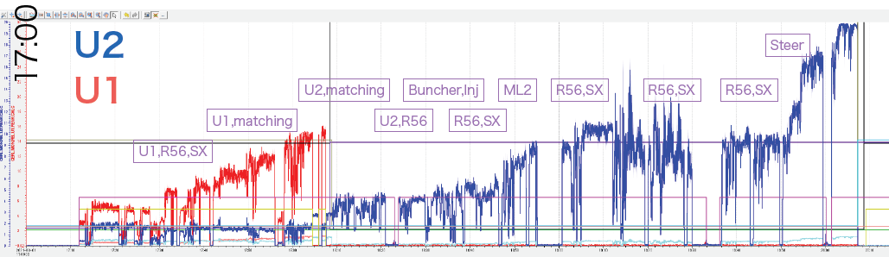
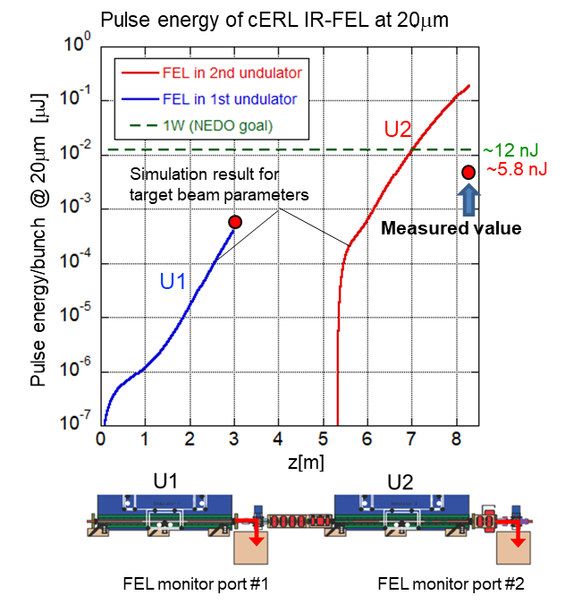
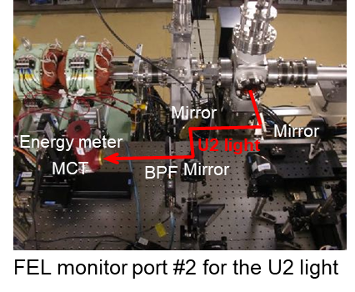
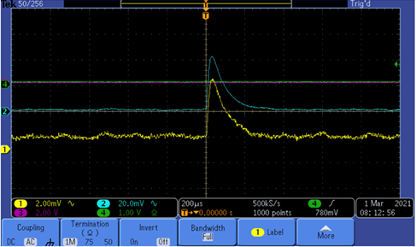
First IR-FEL production in cERL
20:00
We tuned the many components to get higher light at U2 end
Details will be talked in Shimada-san’s presentation in Tuesday.
Commissioning of MIR FEL
By using FEL optimization by using AI under stable cERL beam condition, we successfully obtained 5~10 times higher light signal from U2 than that from U1.
→FEL was produced. And the light intensity almost satisfied our requirements.
Next target is CW ERL-SASE-FEL (for POC of EUV-FEL)
50 mV (U2)
5 mV (U1)
Y. Honda et al. “Construction and Commissioning of Mid-Infrared SASE FEL at cERL"
https://doi.org/10.1063/5.0072511 is published in "Review of Scientific Instruments, (11) Vol.92

Slide 14
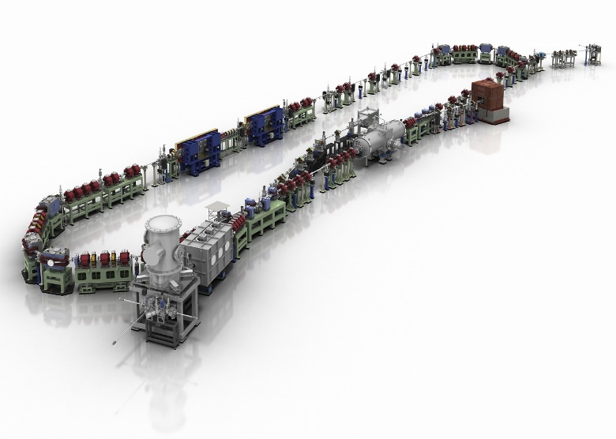
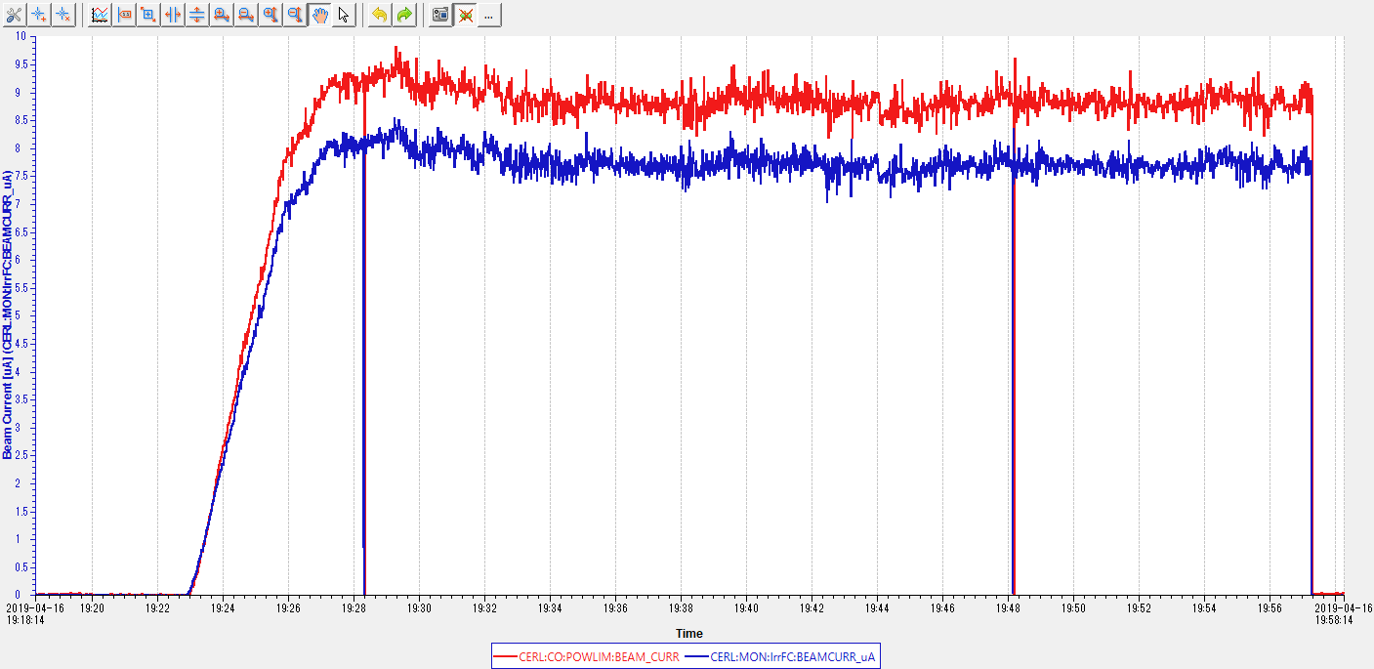
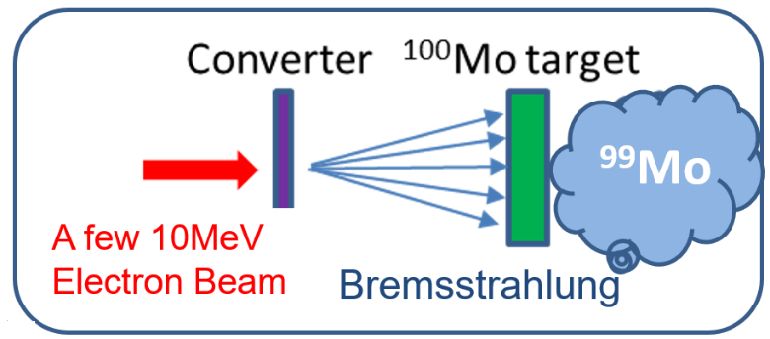
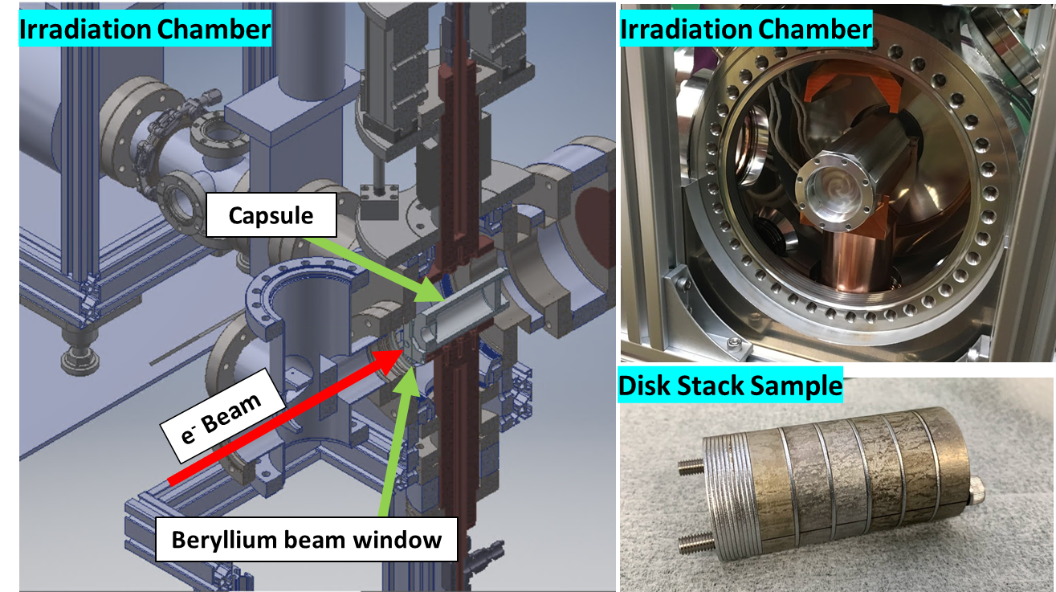
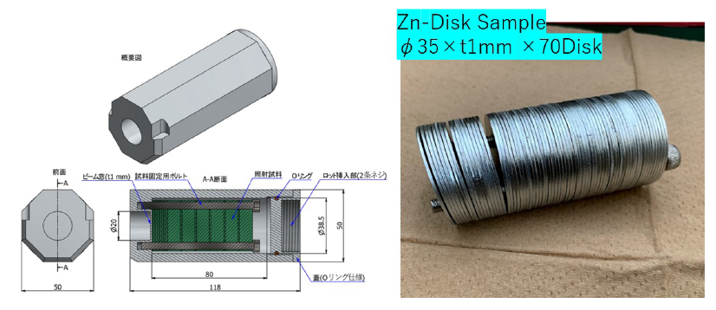
cERL – irradiation beam line
Courtesy of Y.Morikawa, N.Higashi, K.Harada, M. Yamamoto, H.Matsumura and A. Toyoda
Development of RI manufacturing (⁹⁹ Mo / ^{99 m}Tc) by using accelerator for stable supply
Gun current
Beam current is very stable
cERL
9 μA
(CW)
17.5MeV case
30min.
99Mo production was already shown in ERL2019
Aluminum capsule target holder
Typical trend of beam current
(faraday cup set on the same position of target)
For another RI production
e- beam
100Mo targets with 1mm disks and 9mm disks in target folder
Higher energy was needed for 67Cu production from 68Zn. We operate the long pulsed operation to increase beam energy → details are explained in H.Sakai SRF session.
Y. Morikawa, et al., “New Industrial Application Beamline for the cERL in KEK”, Proc. of IPAC2019, (Melbourne, Australia ) p3475-3477, (2019)

Slide 15
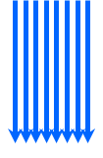

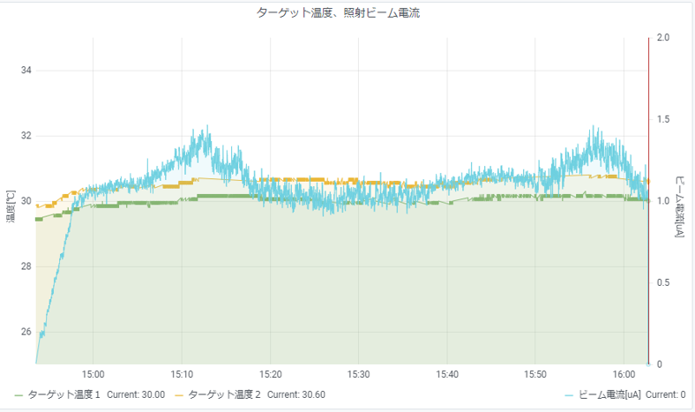
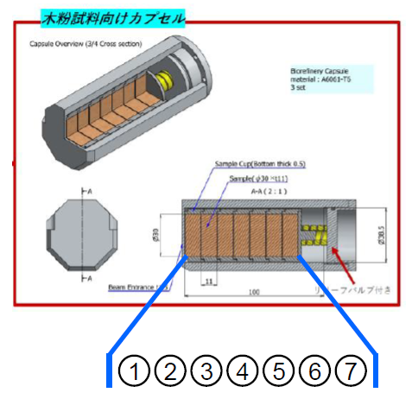
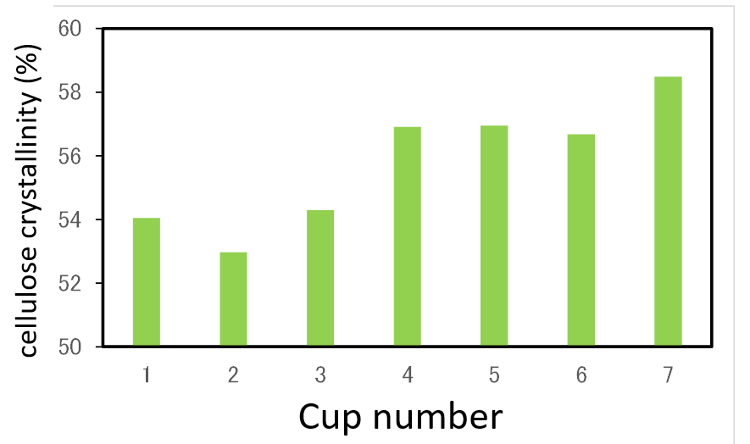
Nanocellulose (CNF) production by irradiation (FYI 2021)
Courtesy of T.Endo (AIST)
Nanocellulose, (cellulose nanofibers(CNF)) is expected to be used in various applications due to its characteristic physical properties.
Motivation of irradiation of woods
A new electron beam irradiation system is applied instead of the conventional treatments to reduce the cost.
Electron Beam
cERL
3.5 – 10 MeV
operation
Woody biomass
Cellulose nanofibers (CNF)
For lower energy of 3.5 MeV
CW
e- beam
10MeV 1.2 MGy pulp
pulp
Stable CW beam operation was achieved.
Cup number
Irradiation area much reduced the cellulose crystallinity →CNF produced on irradiation area
We now try to solve the mechanism of CNF production by irradiation.

Slide 16
CDR THz vector beam generation and make new beam line
Y. Honda
R. Kato
For High intensity THz generation, CW beam with short bunch beam is required and non-destructed method of coherent Diffraction radiation is suitable. In cERL, we already observed THz radiation with short bunch (~200fs) by using CDR (Y. Honda, Phys. Rev. Accel. Beams 22, 040703 (2019)). Next target we will transfer this CDR profile to the end station of beam line
Vector beam
Experimental room
THz camera (TZCam Premium)
Spectrum range (0.1 – 5THz)
Measured profile by THz camera set at experimental room
We made new THz beam line and measured the beam profile by using THz camera. We successfully transfer the radial profile (vector beam) at the experimental room.

Slide 17
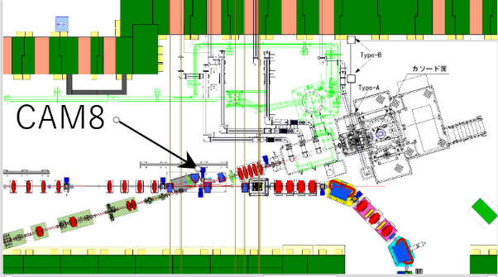
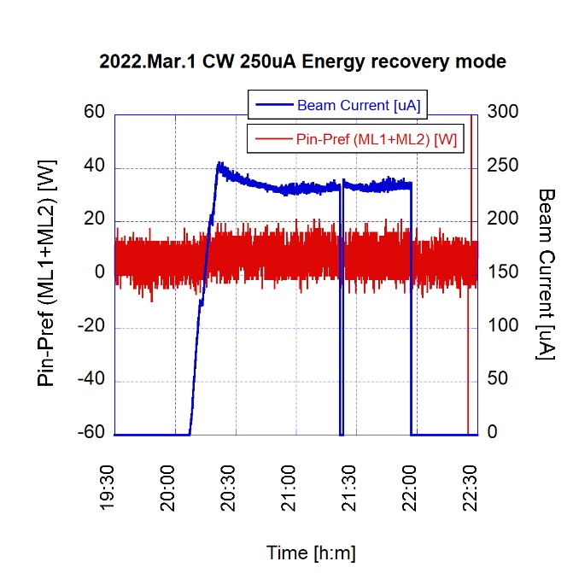
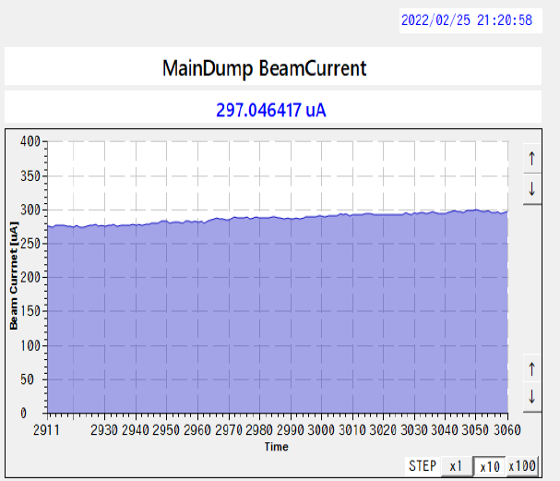
For CW ERL FEL operation (2021.Oct- 2022.Mar.)
This beam tuining is mainly talk by Shimada-san in Tuesday.
In October 2021 (one month operation), we operate the 40pC/bunch with burst mode to make energy recovery operation of 3.5 MeV Injector and 17.5 MeV on recirculation loop. Almost 100% transmission was achieved in high bunch burst mode. But due to the vacuum leak of Gun is issue to make more higher bunch charge of 40 pC/bunch after HV trouble of DC Gun
We operate CW beam with undulator for ERL-FEL. Successfully operate with 0.3 mA beam in Feb. 2022 (one month operation). There are few radiation outside concrete shield. → It is possible to increase more beam current. Next target is ERL with CW beam with high charge (more than 60 pC) for ERL-FEL operation
During operation, we met hardware trouble (broke screen monitor) beam was stopped by vacuum ITL.
→ mode changer (CW <-> Burst) of laser ITL mismatches our protection.
In this FY 2022, we now repair Gun leak and screen monitor.
Broken beam profile monitor
0.3 mA
After break CAM 8
No difference of (Pin-Pref)
100 % Energy recovery with 0.25 mA
CW beam current in the main dump
No beam profile observed.

Slide 18
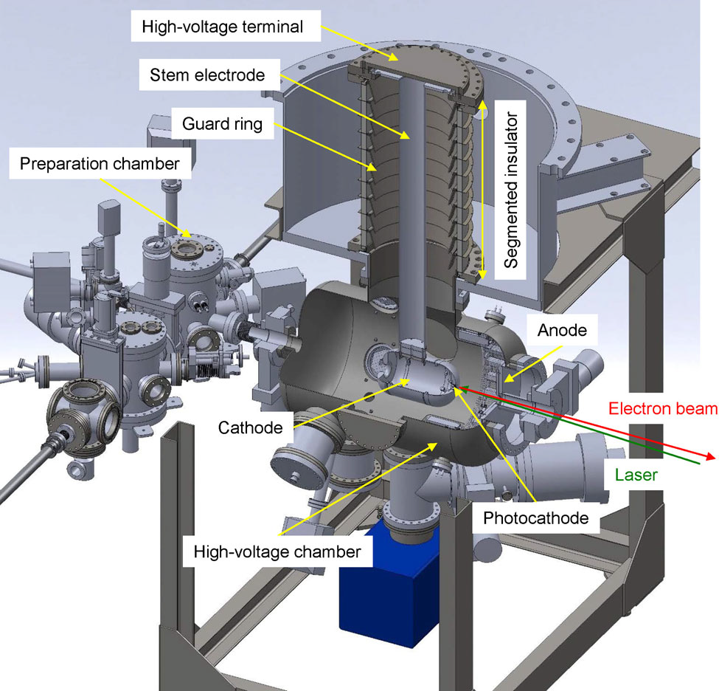
Hardware issue (DC gun trouble and recovery) (And continue to solve vacuum leak)
In FY 2020 (from October 2020)
In FY 2021
Parameter | Units | Value
Operation voltage | kV | 500
Average current | mA | 1 mA
Vacuum level | Pa | ~ 10⁻¹⁰
In October, Q.E was reduced due to the small leak after baking (lifetime is only 2-3 days)
Operates with GaAs photocathodes
Due to trouble caused by misoperation in Oct. 2020, sudden discharge was occurred and burn out Cockcroft diode and resister 100kΩ. Fortunately we have no damage of ceramic but we met field emission from 300kV. We found the FE source and we can increase 480kV again after wiping the electrode before FEL operation in Feb.2021.
Q.E 5.2 %
2021 Oct.11 13:12
2days
Q.E 3.8 % 2021.Oct.13 10:27
The vacuum leak come from SUS-Titanium different material large diameter flange joint. The coefficient of linear expansion of titanium is about half that of SUS. We decided to replace thicker gasket to reduce thermal effect in this FY 2022.
Source of FE and wiped
480kV stop voltage

Slide 19
Summary
We continuously keep ERL beam operation for almost 10 years since 2013.
cERL now move to use for the industrial application by using SCRF technology.
In order to demonstrate ERL-SASE-FEL scheme, IR-FEL production started in cERL. High power IR-FEL with SASE scheme was produced by constructing 2 x 3 m undulators in cERL beam line based by using AI method.
THz beam line was constructed and successfully transfer to the experimental room.
Irradiation beam line was built for RI production and material irradiation with CW beam of 10uA and successfully produce not only ⁹⁹Mo and but also ⁶⁷Cu.
We also proceed material irradiation to woods to produce nanocellulose in cERL.
High current ERL beam operation for EUV-FEL is under testing. 0.3 mA CW ERL was done with undulator . We plan to increase beam current to 10 mA for POC of EUV-FEL by using ERL-SASE-FEL scheme.
500kV DC Gun meet HV severe spark trouble → 480kV beam can be operated but now try to solve vacuum leak problem.
It is important for reliable CW high current beam operation to make many ITL system

Slide 20
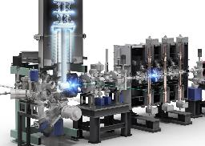



Future plan of iCASA（five years plan) based on cERL development
High intensity
Irradiation material study at cERL
ERL study at cERL
10kW EUV-FEL
❷
Electron beam irradiation facility
ERL-type
EUV-FEL
❶
High current beam for irradiation
High current high quality beam
High quality
Scientific significance & impact
Development of compact high current Nb₃Sn superconducting RF accelerator
Development for EUV-FEL light source
Achieve 10mA ERL operation with SASE-FEL
The ERL-type EUV-FEL is the only solution to realize a high-intensity EUV light source. (details talk by N. Nakamura in Application session)
A compact superconducting accelerator will be realized using recent superconducting technology. → keyword is “without He plant by Nb3Sn cavity” → Compact high-intensity electron beam irradiation facility for industrial application. (development talk by H.Sakai in SRF session )
❸
Ultra-fast electron microscopy
furnace for Nb₃Sn coating (KEK)
Compact ERL (KEK)

Slide 21
ERL2022 presentation from KEK (Japan)
M. Shimada, “Beam tuning for IR-FEL and industrial application at the compact ERL” (Oct. 4th Tue.)
H. Sakai, “SRF performance on the Compact ERL at KEK” (Oct. 4th Tue.)
T. Konomi, “Design of the 9-cell superconducting cavity for EUV light source accelerator” (Oct. 4th Tue.)
N. Nakamura, “ERL based EUV-FEL light source for lithography” (Oct. 5th Wed.)
T. Konomi, “Horizontal test of Superconducting RF gun #2 at KEK” (Oct. 5th Tue.)
cERL facility poster: (M. Shimada, KEK on behalf of cERL development team )
“Recent activities at the compact ERL”

Slide 22
Acknowledgements
The irradiation beamline, target system and extra shieldings are fully supported by Accelerator Inc. and all these R&D are done under the consignment contract.
The radioisotope generations are the joint research with Chiyoda Technol Corporation.
FEL production work is based on the results obtained from NEDO project "Development of advanced laser processing with intelligence based high-brightness and high-efficiency laser technologies (TACMI project).“
Nanocellulose production experiment of cERL is based on the results obtained from NEDO project of “Development of innovative quantum beam technology for high-efficiency nanocellulose production”
THz development work was supported by JSPS KAKENHI Grant Number 18H03473.
We would like to express our gratitude to all members of safety-shift under cryo and beam operation.

