Slide 1


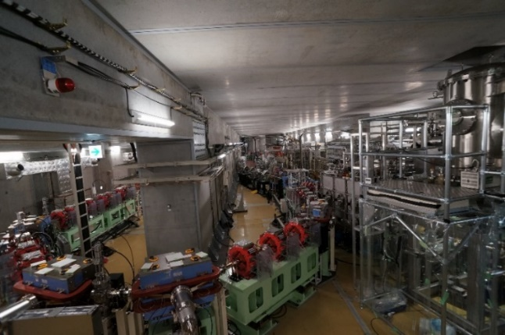
SRF performance on the cERL at KEK
Hiroshi Sakai (on behalf of SRF development team)
Innovation Center for Applied Superconducting Accelerators (iCASA), Accelerator Division
High Energy Accelerator Research Organization (KEK)
Compact ERL (cERL)
Introduction of cERL cryomodules
SRF performance of cERL cryomodules under cERL beam operation in the latest three years
SRF R&D for future EUV-FEL and so on from cERL operation in KEK
Summary
?? pages
15 min. + 5 min.
ERL2022 workshop @ Cornell Univ. (2022.Oct.3-6)

Slide 2
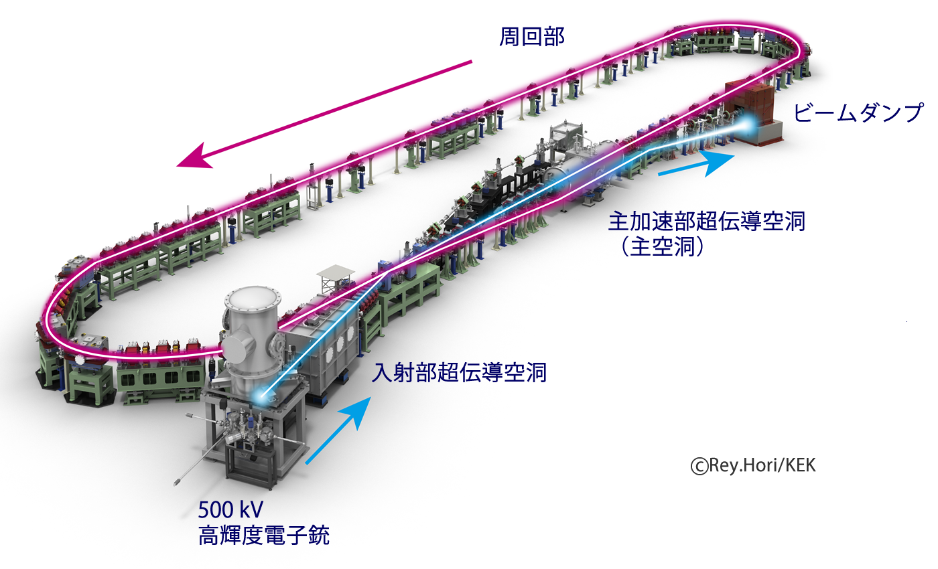
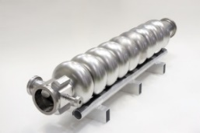
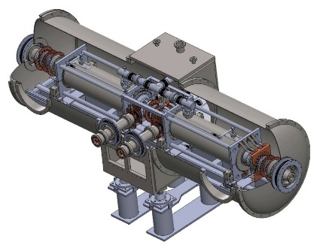
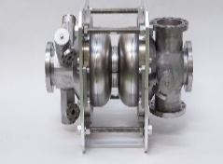
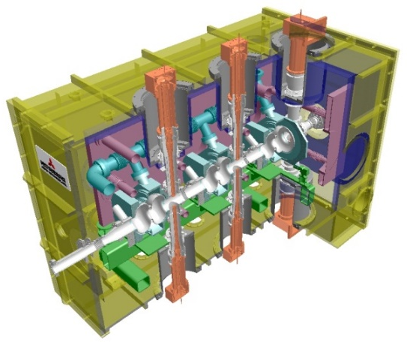
Comact ERL (cERL) in KEK & cERL cryomodules
Irradiation beam
Line (IR) (2019)
Main linac module
Compact ERL Layout
17.5 MeV
HOM damped (for 100mA circulation to suppress HOM-BBU in design)
9-cell cavity (ERL-model2)× 2
Recirculation (return) loop
20MeV
RF frequency: 1.3 GHz
Input power : 20kW CW (SW)
E_{acc}: 15 MV/m（design）
Unloaded-Q: Q₀ > 1×10¹⁰
H.Sakai et al. “Field emission studies in vertical test and during cryomodule operation using precise x-ray mapping system”. Phys. Rev. Accel. Beams 22, 022002 (2019)
Injector diagnostic line
Dump
Main-linac
Cryostat
Two 9-cell SC cavities
HOM absorber
Merger
Injector-linac
Tuner
Photocathode DC gun
(Not SRF Gun)
Target Energy : 35MeV
→ Change 20MeV due to field emission
3MeV
Tuner
Input couplers
e-
Injector module
K. Watanabe, et al. “Development of the superconducting rf 2-cell cavity for cERL injector at KEK” Nucl. Instru. Meth. A Vol. 714, p67-82 (2013)
Requirement was satisfied at V.T. Issue: Heavy F.E was met @9-10MV/m after string assembly. & met quench shown later In detail
2-cell Cavity
Tuner
2-cell cavity × 3
Double coupler
Cryostat
Design parameters of the cERL
RF frequency: 1.3 GHz
Input power :
10kW/coupler (10mA, 5MeV)
180kW/coupler (100mA, 10MeV)
E_{acc}: 7.6MV/m（5MeV）
15MV/m (10MeV)
Unloaded-Q: Q₀ > 1×10¹⁰
Nominal beam energy | 35 MeV → 20MeV →17.5MeV
Nominal Injector energy | 5 MeV →2.9MeV
Beam current | 10 mA (initial goal) 100mA (final)
Normalized emittance | 0.1 ‒ 1 mm⋅mrad
Bunch length (bunch compressed) | 1-3ps (usual) 100fs (short bunch)
Input Coupler
e-
HOM Coupler &
RF Feedthrough
Issue: We met the HOM coupler heating if field inceased more than 7MV/m. It is the reason for heating not perfectly to be filiterd in HOM coupler iand results in lower Q0 than 1x10¹⁰.

Slide 3
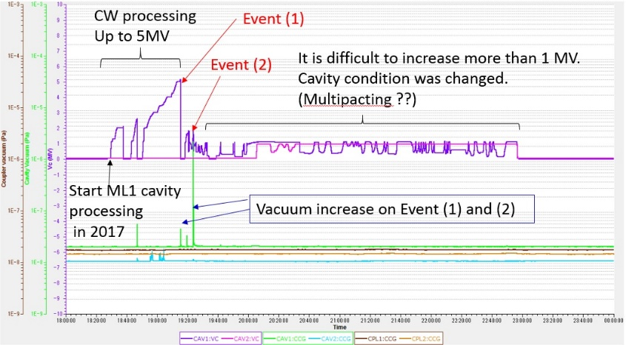
Operational history of cERL cryomodule (almost 10 years)
Construction, Maintenance
Operation
Start beam operation
ERL2019
Talk about SRF operation (& SRF R&D )
Beam operation
2012 | 2013 | 2014 | 2015 | 2016 | 2017 | 2018 | 2019 | 2020 | 2021 | 2022
Commissioning of injector& main linac
Commissioning of cERL (with loop)
Commissioning of LCS system
Increasing the beam current
High bunch charge
& THz study
1mA again
RI beam test & production
IR-FEL operation
CW 0.3mA ERL
with undulator
Construction of
Injector and main linac cryomodule
1mA ERL achieved
Construction of IR-FEL
Construction of recirculation loop
Construction of LCS system
Construction of RI beamline
Cryogenic &Gun maintenance work
(Injector performance history) field emitted electrons hitting Faraday cup leading to vacuum discharge and F.E much increased in injector cryomodule in 2015
(Main linac performance history) Unknown burst event was occurred at ML1 in 2017. Finally processed but quenched 6.9 MV.
We cooled 2K before beam operation and warmed up after beam operation
cERL beam operation from Oct. 2019 to Feb. 2022
Period(beam operation time) | Energy[MeV] (Comment) | Current
2019.Oct. (3 weeks) | 17.5 (loop) | 60 pC/ bunch
 | 19.0 (IR) | ~1 uA (CW)
2020.Jun. (4 weeks) | 17.5 (loop) | 60 pC/ bunch
2020.Jun. (3 weeks) | 17.5 (loop) | 60 pC/ bunch
2021.Feb-Mar. (6 weeks) | 17.5 (loop) | 60 pC/ bunch
 | 23.0 (IR) | 1pC/bunch (pulse)
2021.Oct. (3 weeks) | 17.5 (loop) | 40 pC/ bunch
 | 10.0 (IR) | ~1uA (CW)
2022.Feb-Mar. (3 weeks) | 17.5 (loop) | 300uA (CW)
 | 10.0 (IR) | ~1uA (CW)
High-power pulse processing found to reduce radiation. It works to recover nominal operation field of 7MV/m.
But from 2017 ML1 did not reach more than 7MV after unknown burst event. (before reach >10MV)
E. Kako “Degradation and Recovery of CavityPerformance in compact-ERL Injector Cryomodule” talk in ERL2019
H.Sakai et al. “LONG-TERM OPERATION WITH BEAM AND CAVITY PERFORMANCE
DEGRADATION IN COMPACT-ERL MAIN LINAC IN KEK” Proc. of LIINAC2018
What happened in long term beam operation ? And how do we keep cavity performance in latest three years?
3

Slide 4
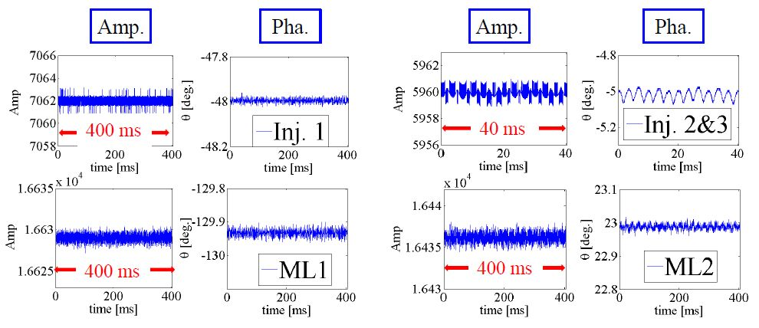
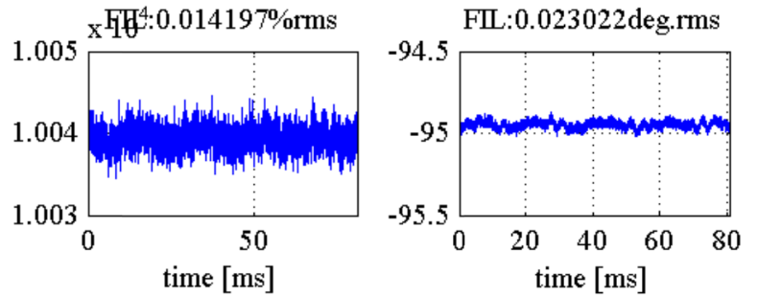
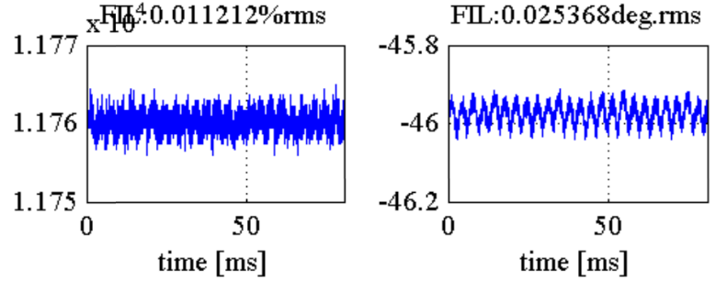
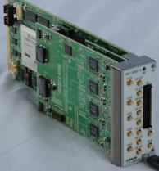
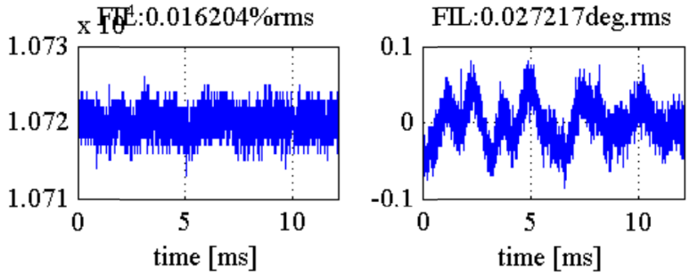
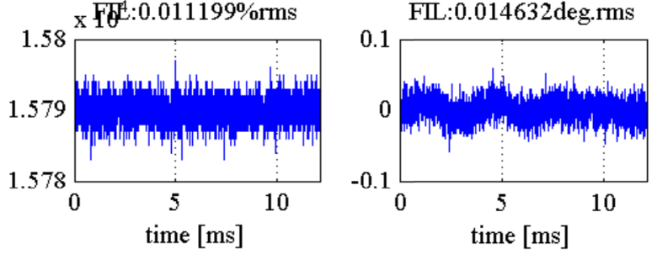
Power & LLRF stability in cERL beam operation
Data taken in 2021.Feb.5. Basically suppress michrophonics and almost close our requirements of ΔA/A ~ 0.01% , Δθ ~ 0.01 deg.
FPGA
Virtex5-FX
T. Miura, IPAC2014 @Dresden
Microphonics suppression in ML
Inj1
Inj2,3
Beam stability was also achieved about 0.01% by measuring momentum jitter at screen monitor on arc section thanks to LLRF optimization
ML1
ML2
dBc/Hz
Present (2022) | Inj1(2cell) | Inj2(2cell) | Inj3(2cell) | ML1(9cell) | ML2(9cell)
Acc. Field | 3.4 MV/m | 3.6 MV/m | 3.2 MV/m | 5.2 MV/m | 8.2 MV/m
power | 0.6 kW | 1.4 kW | 1.1 kW | 0.7 kW | 2kW
Power source | 25 kW klystron | 300kW klystron (Vector sum) |  | 16 kW solid state Amp | 8kW solid state Amp
QL | 1.2e6 | 5.8e5 | 4.8e5 | 1.3e7 | 1.0e7
ΔA/A(% rms) | 0.014% | 0.011% |  | 0.016% | 0.011%
Δθ(deg rms) | 0.023deg | 0.025deg |  | 0.027deg | 0.015deg
Hz
Phase noise by Microphonics was suppressed well by RF FB.
Phase noise of Vc with FB was almost the same as that of Master Oscillator.
(Up to now, we keep the RF stability after ML1 field reduced 8.3 MV/m → 5.2 MV/m in 2017 )
Total beam energy 17.5 MeV
Injector gain : 3.0 MV
Main linac gain : 14.0 MV

Slide 5
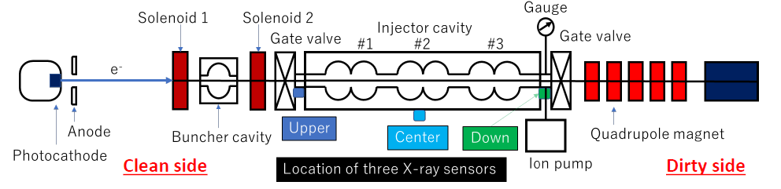
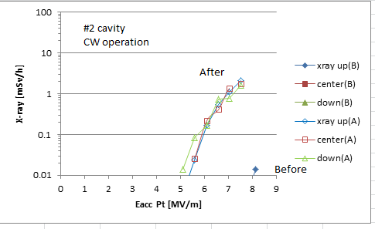
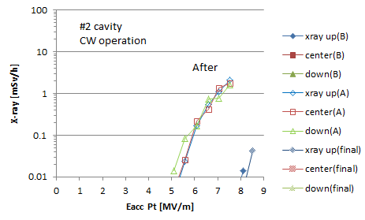
Injector performance from Oct. 2019 to Feb. 2022
We once met the sudden severe X-ray increase during beam operation in Jun. 2020.
F.E onset reduced from 8 MV/m to 5 MV/m in Inj #2 cavity. We do not know the reason.
After pulse processing, F.E onset recovered at normal level. → kept 7 MV/m operation
(Before pulse processing)
CW = 8MV/m (onset 5MV/m)
Pulse duty (0.5ms 10Hz)
18 MV/m (~2 hours)
final
Pulse duty (5ms 10Hz)
12 MV/m (~1 hours)
(After Pulse processing)
CW = 8MV/m (onset 8MV/m)
2020.Jun.18
2020.Jun.19
Suddenly x-ray onset reduced
X-ray onset before and after pulse processing、
From now, we apply same pulse processing after 2 K cooldown before beam operation.

Slide 6
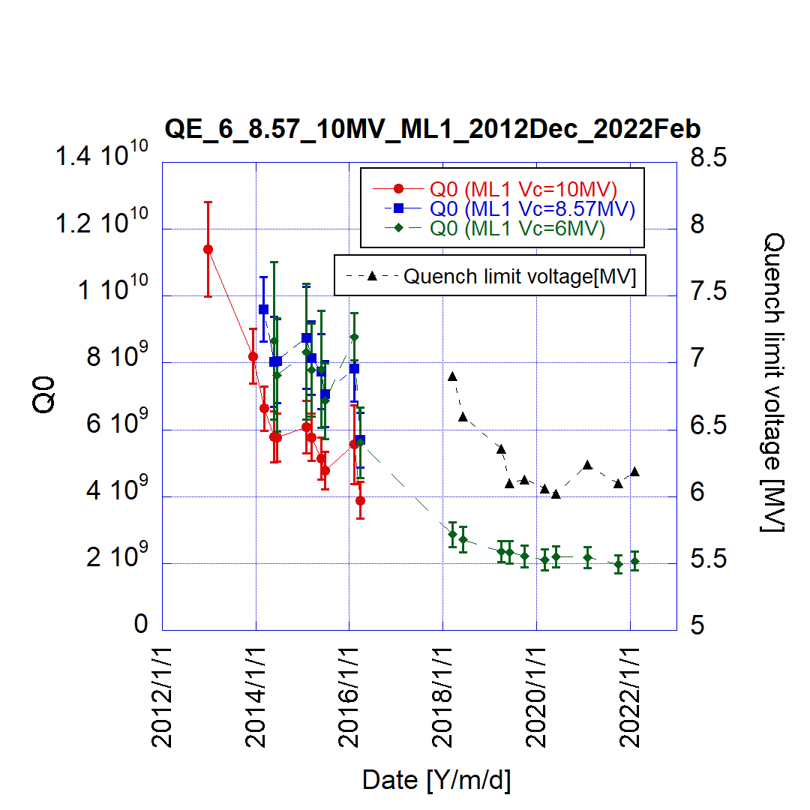
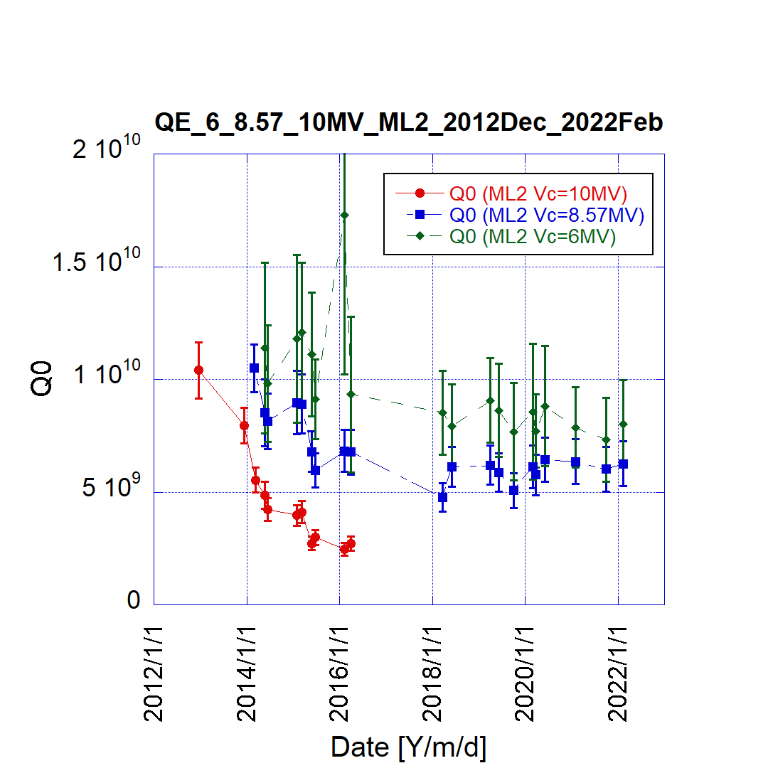
Main linac performance (long-time Q-value history (2012.Dec – 2022.Feb))
ML Pulse processing (peak 11.7MV)
Vc = 8.8MV(CW) + 2.9MV(pulse 10Hz 4ms) (3 hours apply)
ML1
ML2
Before
Beam operation
Before
Beam operation
Kept same level of
Q-values on 3years
Kept same level of
Q-values on 3years
After pulse processing, 0.5 MV onset of x-ray was increased. X-ray monitor was set at the downstream of cryomodule.
Before the beam operation, we could keep 1x10¹⁰ at 10MV on both cavities in 2012.
Main degradation of ML1 is thermal breakdown from 2017. we doubt the some ceramic and/or HOM absorber crack and/or something from outside of the cryomodule (NEG?) might come into the ML1 cavity ??
After that quench limit and Q-values gradually reduced. But in latest three years both kept same level.
In first five years (2012-2016), we see the degradation by the field emission. In the latest three years, we kept the same Q-values in both cavities by applying the pulse processing on every cERL operational phase.
Up to now, we apply same pulse processing for both ML cavities after 2 K cooldown before beam operation.

Slide 7
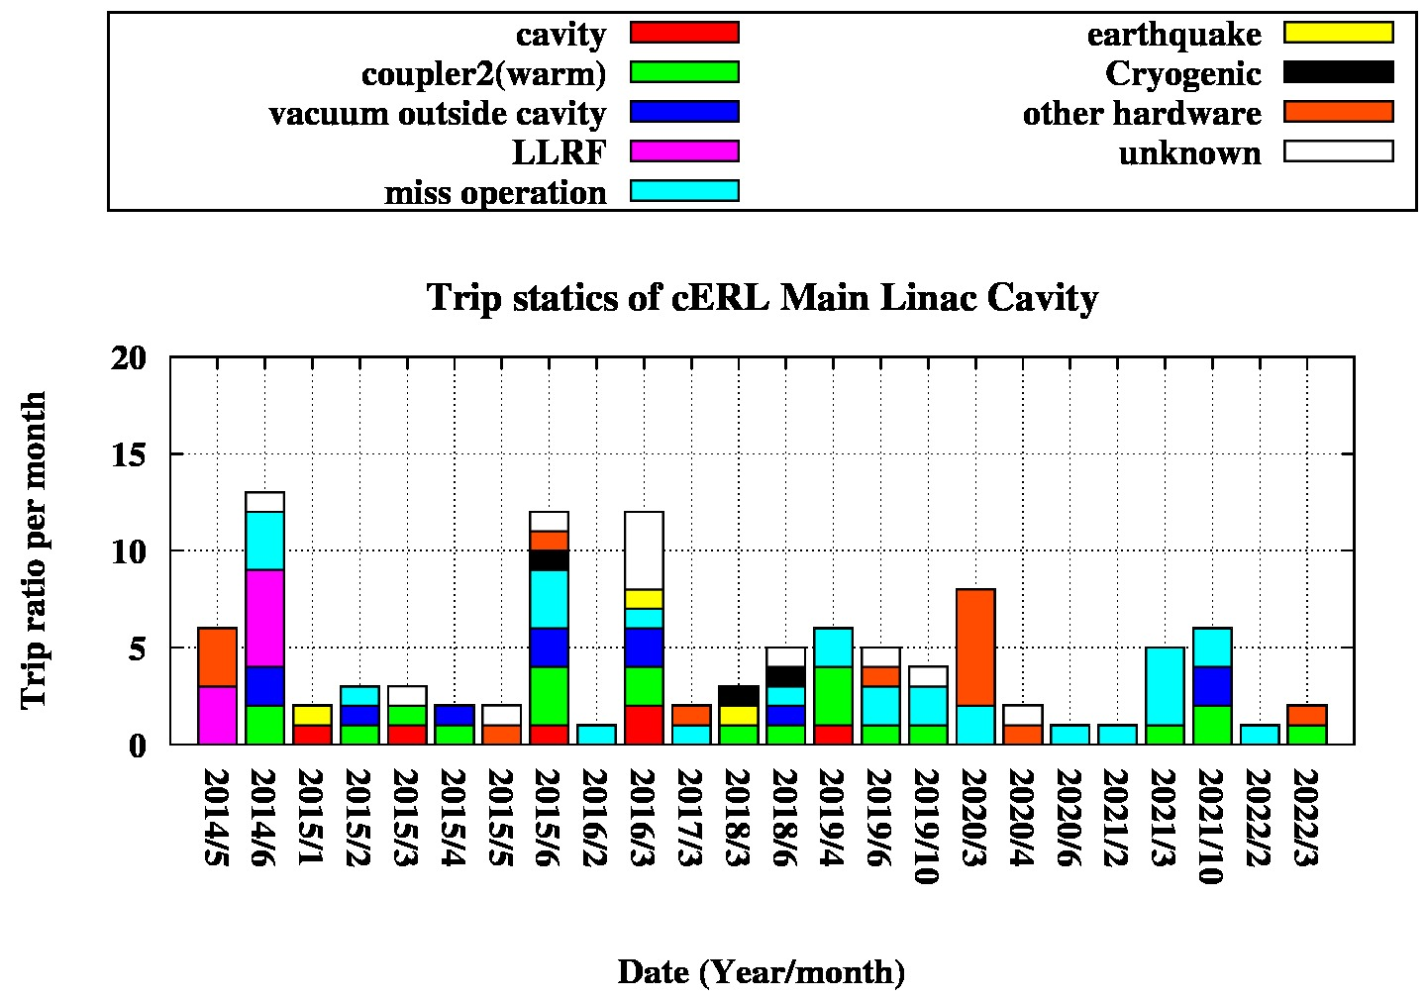
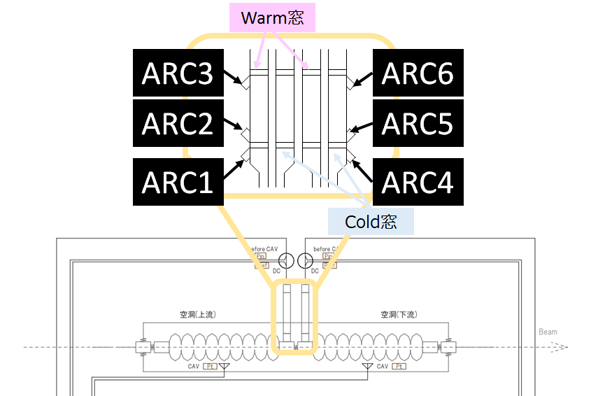
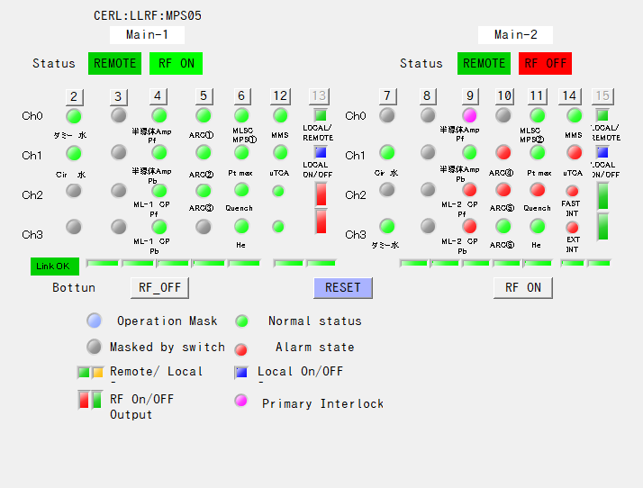
ML Trip ratio (longterm) (2014.Apr. ~ 2022.Mar.) (almost 9 years) & Inj
After optimization of LLRF gain in 2014, we kept small trip ratio in 2015. If cavity field increased higher in 2015. trip ratio increased. Main reasons of trip come from the warm coupler (ML2) discharge event (light green). We did not know why these discharged events would occur. However, we could safely turn off RF within 10us by using ITL of arc sensor of input coupler.
We note that cERL injector did not meet the trip caused by Inj cryomodule itself in 3 years
Stably operated without severe hardware problem on both Inj and ML cryomodule until now.

Slide 8
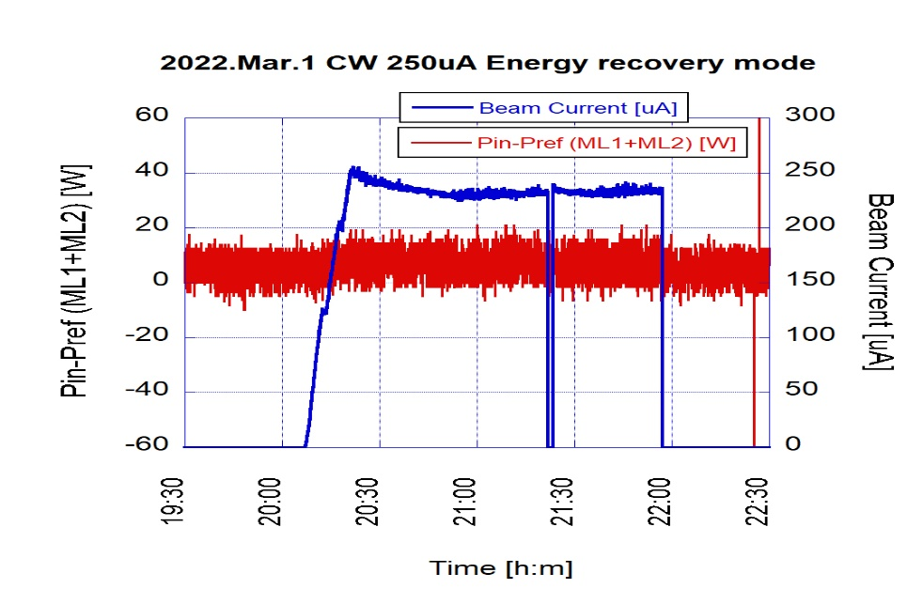
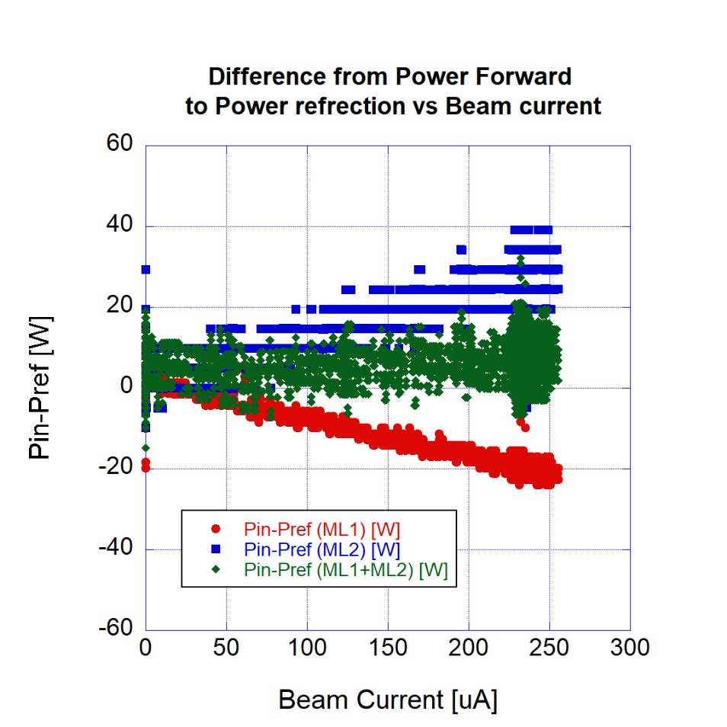
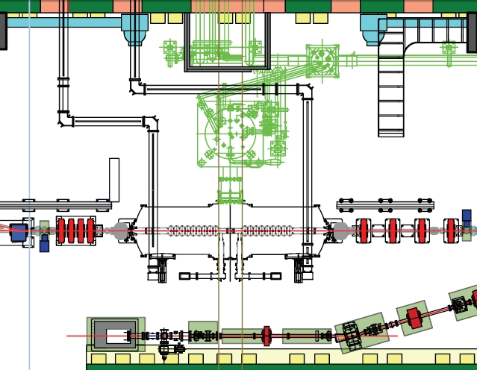
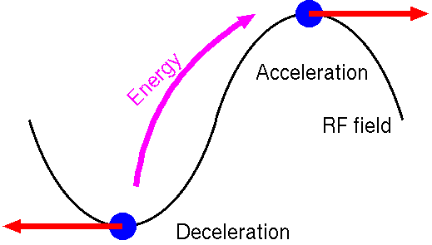
Successful ~ 0.3mA CW beam operation with energy recovery with Undulator
Change CW mode and increase the beam current :Reach 0.3 mA on Feb/2022 with undulator.
0.25 mA
Trend of beam current under energy recovery
Beam current [μA]
Required power without recovery is :
14.0 MV x 250 uA = 3.5 kW
2 hours
Energy recovery was successfully done with 100%
Feed power : less than 10W !! (r.m.s 4 W)
ML2: Δ(Pin2-Pref2)
Main linac
（lower）ML2
5.5 MV
（upper） ML1
8.5 MV
Δ(Pin-Pref) [W]
e-
Pref
Pin
Total (ML1+ML2): Δ(Pin-Pref)
ML1: Δ(Pin1-Pref1)
Beam current [μA]
Next, we try to increase beam current more
Stable energy recovery of about 0.3 mA was successfully done without beam loss.

Slide 9
Trial for Pulsed beam operation for higher energy in cERL
Courtesy of T. Miura , F.Qiu
Motivation
F. Qiu et al., “Application of disturbance observer-based control on pulsed superconducting radio frequency cavities”, Phys. Rev. Accel. Beams 24, 012804 (2021)
For irradiation beam line, we would like to increase higher energy for not only produce 99Mo but also other RI like 67Cu,whose giant resonance is a little higher than 99Mo.
-> more than 23 MeV is required.
Einj ≈ 7 MeV
Etotal ≈ 23 MeV
10 MV/m
10 MV/m 10 MV/m
5.8 MV/m
9.7 MV/m
CAM8
~2.2 MV ~2.2 MV ~2.2 MV ~6 MV ~10 MV
Inj.1
Inj.2
Inj.3
ML1
ML2
Irradiation beam line
Pulse Pulse Pulse CW Pulse
For cERL injector, it is difficult to increase higher field of > 8MV/m due to the HOM heat load. But we could escape from HOM heat load with pulse mode and can reach higher field. (ML2 also similar)
Pg=Vc^2/(4*r/Q*QL)
QL ~ 1e6
QL ~ 1e7
We made 5ms pulse mode operation with lower duty

Slide 10
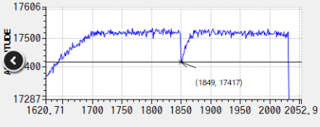
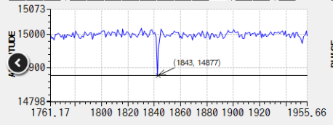
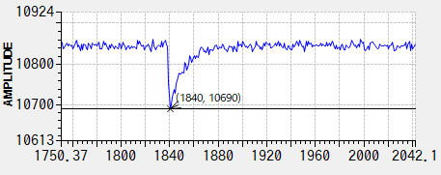
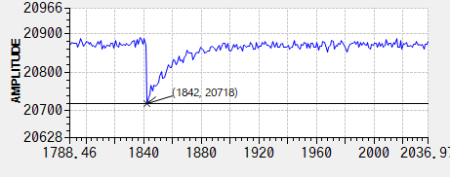
Momentum stability (2020.Apr)
Beam loading
Einj ≈ 7 MeV Etotal ≈ 23 MeV
Inj1: -0.6%
10 MV/m
10 MV/m 10 MV/m
Screen monitor (CAM14)
~2.2 MV ~2.2 MV ~2.2 MV ~6 MV ~10 MV
Inj.1
Inj.2
Inj.3
ML1
ML2
Irradiation beam line
Pulse Pulse Pulse CW Pulse
Inj2,3: -0.8%
Peak beam current : 1.3mA (100ns)
Charge : 1 pC/bunch
Beam stability is 0.012 %
ML1: -1.4%
ML2: -0.8%
Momentum (Beam center @CAM14)
We have stably operated with pulse operation on higher energy with ~1% beam loading
We could proceed 67 Cu generation

Slide 11
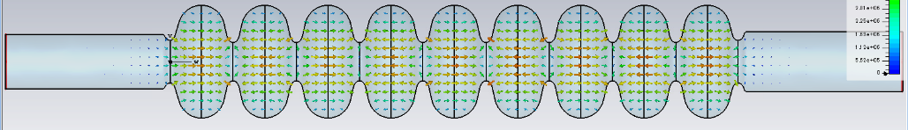
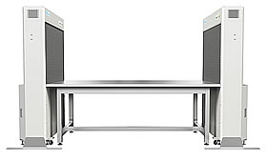
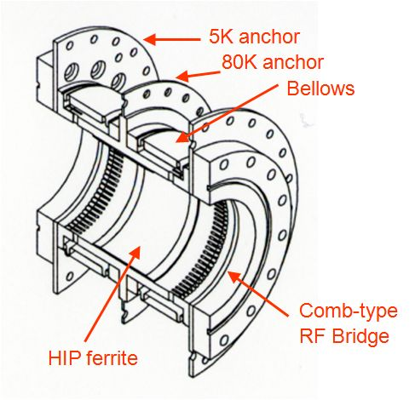
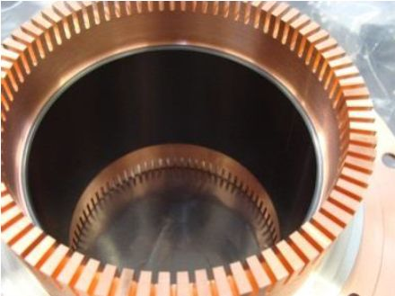
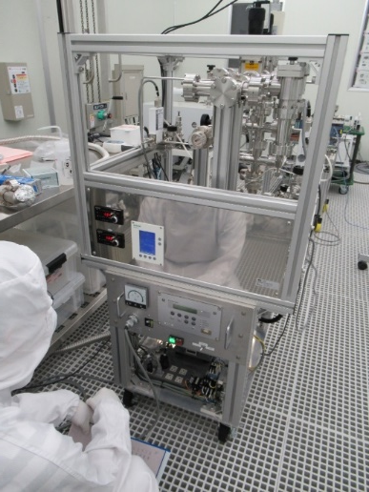
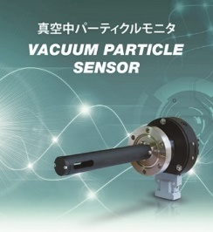
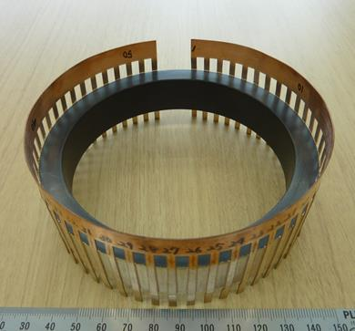
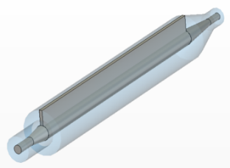
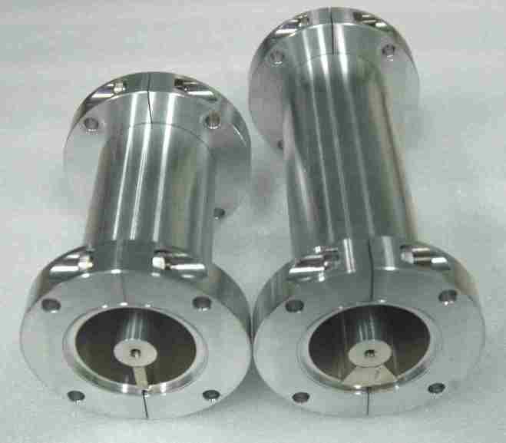
Toward more reliable operation for SRF cryomdule for high current beam on cERL & future EUV-FEL
Field emission & crack of HOM damper are main issues for reliable operation. → How to overcome field emission
EUV cavity design
Done by T.Konomi
 | ERL Model 2 | EUV
R_{sh}/Q | 897 Ω | ~1000 Ω
E_{p}/E_{acc} | 3.0 | ~ 2.0
Iris diameter | 80 mm | 70 mm
H_{p}/E_{acc} | 42.5 Oe/(MV/m) | ～42.0 Oe/(MV/m)
T. Konomi
“Design of the 9-cell superconducting cavity for EUV light source accelerator”
Detailed talk in this ERL2022
T. Konomi
“Horizontal test of Superconducting RF gun #2 at KEK”
Detailed talk in this ERL2022
EUV cavity – TESLA-type 9-cell cavity + Large beam pipes(100φ & 110φ)
Satisfy the HOM-BBU threshold of more than 100mA by EUV cavity.
Stable operation at 12.5 MV/m seems achievable due to reduced E_{p}/E_{acc}.
H. Sakai, et., al. “SUPERCONDUCTING ACCELERATOR FOR ERL BASED FEL EUV LIGHT SOURCE AT KEK ” Porc, of SRF2017, Lanzhou, China, MOXA04, p13 (2017)
R&D for SRF Gun for more high quality and high current operation
R&D for Clean assembly work
Open clean bench
KOACH (ISO class 1) for local clean bench
cERL HOM damper
Ferrite with HIP bonding
Fragile under thermal cyle
T. Ota, et. al. SRF workshop 2019
M.Sawamura, “Development of HOM coupler
with C-shaped waveguidefor ERL operation” ERL2019
Cavity
Test stand
Slow pumping/venting system with vacuum particle sensor.
Both were already applied for STF cryomodule assembly work.
C-shaped waveguide
AlN cylinder
H. Sakai, et. al. SRF workshop 2019

Slide 12
Toward High-Q cavity approach in KEK
Courtesy of T. Ito
Mid-T furnace baking
Developed on recent 1-2 years
Surface condition was changed
300 ~ 400deg,3h
Standard recipe (120deg,48h), 200deg,3h
600 ~ 800deg,3h
For cavity baking.
We observed the drastic temperature dependence about Q-values. High-Q values were also observed by only applying Mid temperature about 300-400deg without Nitrogen doping
T. Ito et al, “Influence of furnace baking on Q–E behavior of superconducting accelerating cavities”
https://doi.org/10.1093/ptep/ptab056
Mid-T furnace baking is new approach for producing Higher-Q cavity compared with N-doped cavity
Notes:
理由（仮説）：
１．従来から実はMulti-layer構造(Nb2O5 , NbO, NbH(tc = 1.4K), Nb(bulk))になっているのだが、この構造が変わって、従来よりhigh-Qが出ているかもしれない。(酸化ニオブがlossy、
2. 空洞側の処理でn-dopingの場合は窒素の拡散でdirtyにしている。 → furnace bakingでは酸素に置き換えている。これでN-dopingと同等のHigh-Qが出ているのではないか？

Slide 13
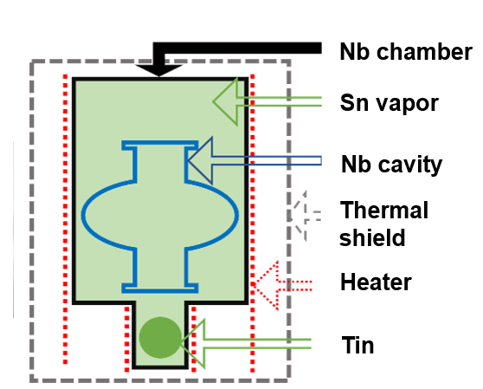
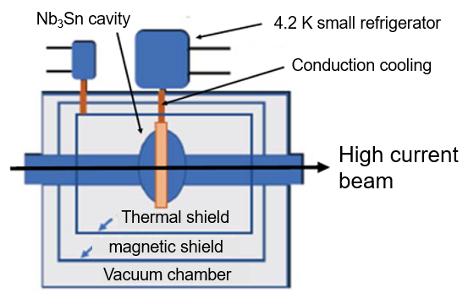
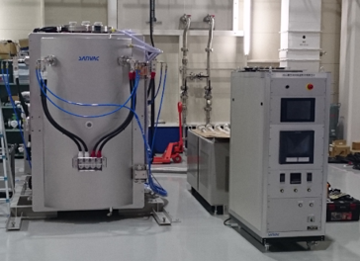

Nb₃Sn cavity development in KEK
Courtesy of K. Takahashi, K. Umemori, T. Konomi, T. Ito, T. Yamada,
S. Posen and D. L. Hall. Superconductor Science and Technology, 30(3):033004, 2017
2K
4.2K
$$Q_{0}∝1/R_{S}$$
Can operate 4.2 K or higher temp ?
→ Results in using cryocooler operation.
Nb₃Sn cavity (coating) KEK
Nb₃Sn furnace in KEK
x7
KEK first results
Cavity development already started. We will wait Nb3Sn accelerator
K.Takahashi, et al., FIRST NB3SN COATING AND CAVITY PERFORMANCE RESULT AT KEK”, Proc of SRF2021.

Slide 14
Summary
KEK cERL cryomodule are operating from 2012 until now for almost 10 years.
For injector, one we met the severe degradation in 2020. But we could recover the normal radiation onset level by the pulse processing.
For Main iinac we met the cavity degradation under beam operation after the unknown burst event of ML1. But for the latest 3 years, we did not see more degradation. Main issues is field emission for ML2 and thermal breakdown for ML1.
Finally, by applying the pulse processing for both cryomodule before the beam operation, we kept the stable beam operation under LLRF optimization.
For higher energy operation, we applied pulsed operation to escape the HOM quench of injector. We could increase the energy from 17.5 MeV to 23.0 MeV for irradiation beam line.
More reliable operation, we design the F.E suppression and HOM suppression cavity for EUV-FEL and develop the F.E reduction approaches (clean assembly , HOM damper)
SRF Gun is under developing for CW high current beam generation in KEK. (now FRIB)
Higher-Q R&D and Nb₃Sn cavity R&D also tried to reduce CW heat load.
We plan to make high-Q cryomodule for EUV-FEL R&D under cERL operation .

