Slide 1
ERL based EUV-FEL light source for lithography
Norio Nakamura
High Energy Accelerator Research Organization (KEK), Tsukuba, Japan
ERL2022, 3 – 6 Oct. 2022, Cornell University
International Conference on EUV Lithography 2021, 27 September – 1 October 2021

Slide 2
Outline
EUV Lithography
ERL based EUV-FEL Light Source
Summary

Slide 3
Outline
EUV Lithography
ERL based EUV-FEL Light Source
Summary

Slide 4
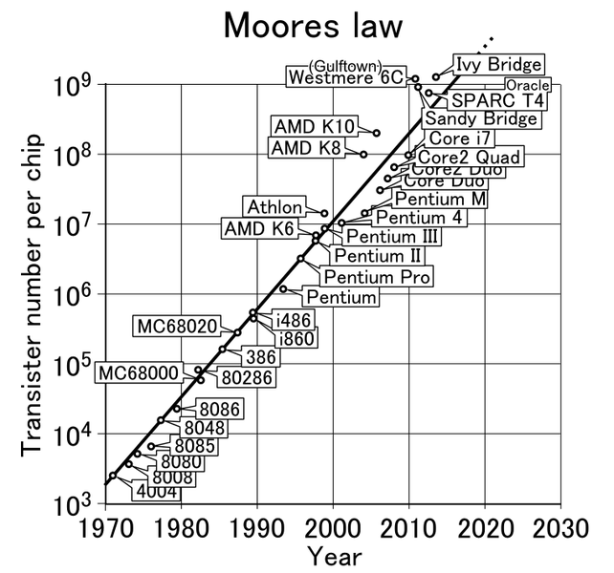
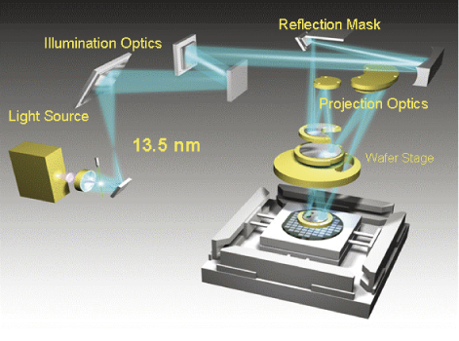
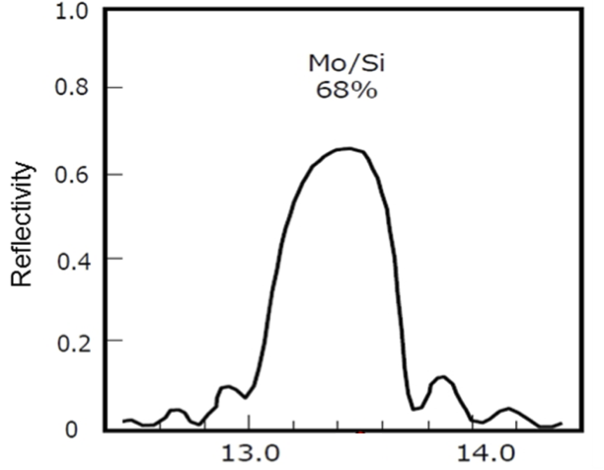
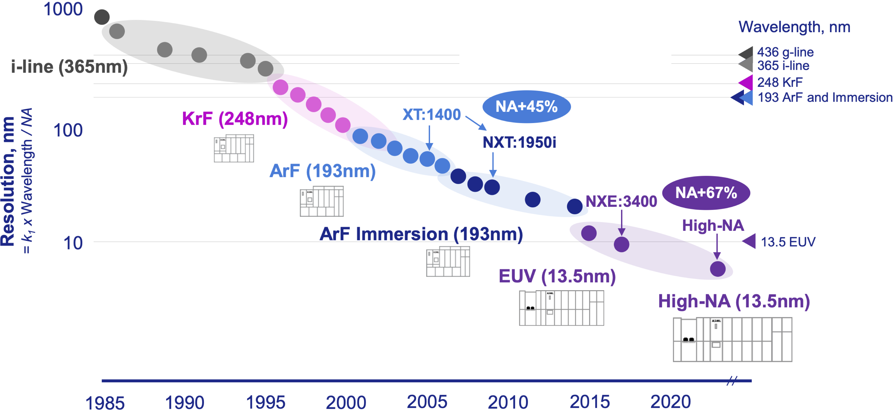
Moore’s Law & Lithography
Moore’s law
Light source wavelength
Schematic of EUV exposure tool
Hg lamp g-line 436 nm
Hg lamp i-line 365 nm
Mo/Si reflectivity
KrF laser 248 nm
Mo/Si 68 %
Reflectivity
ArF laser 193 nm
(+immersion)
Wavelength[nm]
H. Mizoguchi et al., Komatsu Technical Report 63-170 (2017)
EUV 13.5 nm
Doubles every 2 years
Resolution
R=k₁$\frac{λ}{NA}$
NA=n sinθ
n : refractive index (n=1 for air)
θ : maximum half-angle of light
collected by the objective lens
λ : wavelength
NA : numerical aperture
k₁ : process parameter
J. van Schoot et al., 5th EUV FEL Workshop (2021).

Slide 5
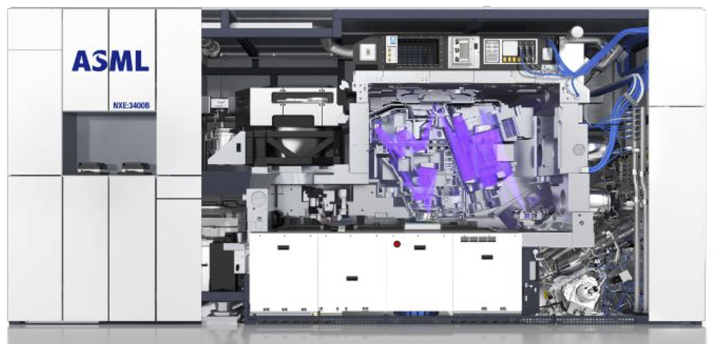
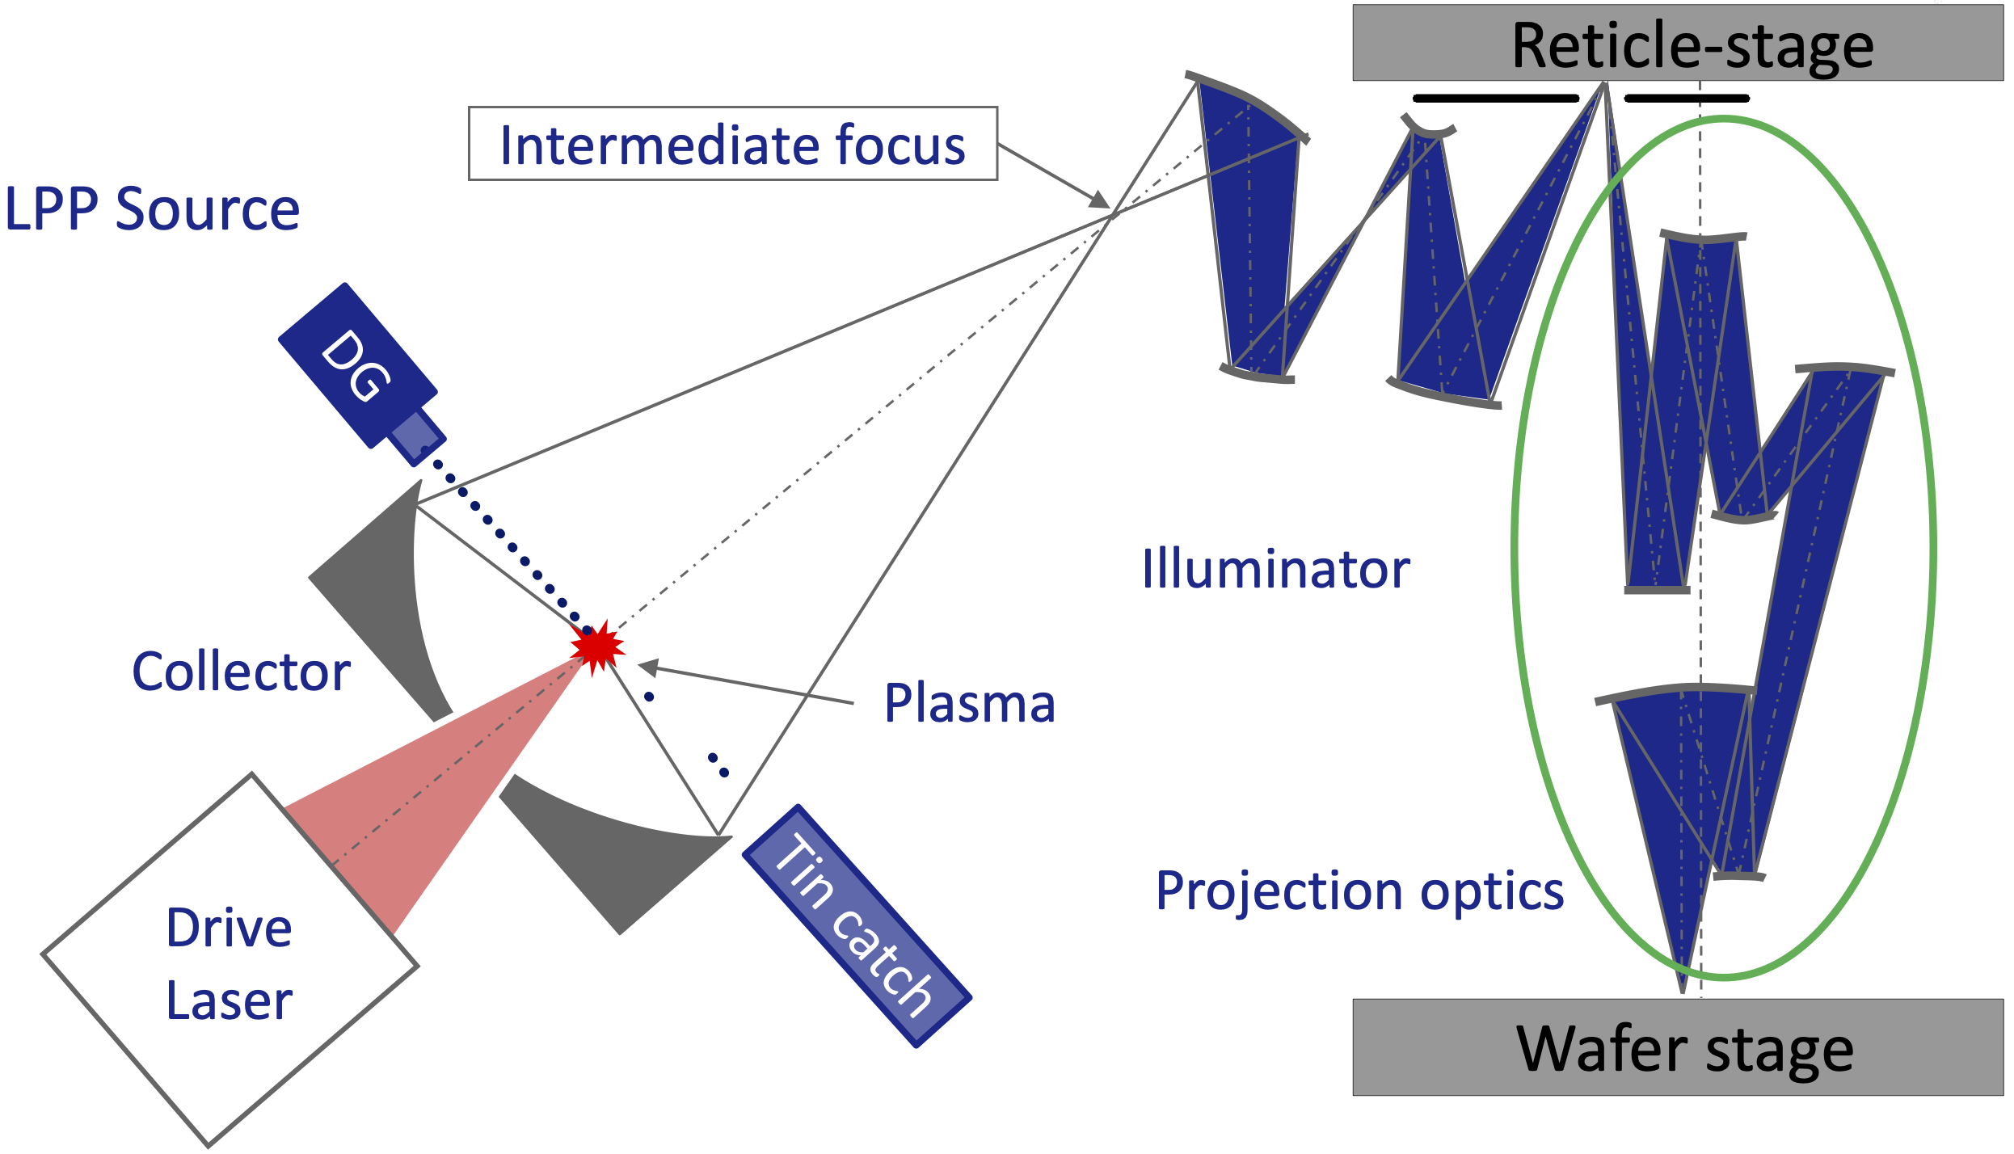
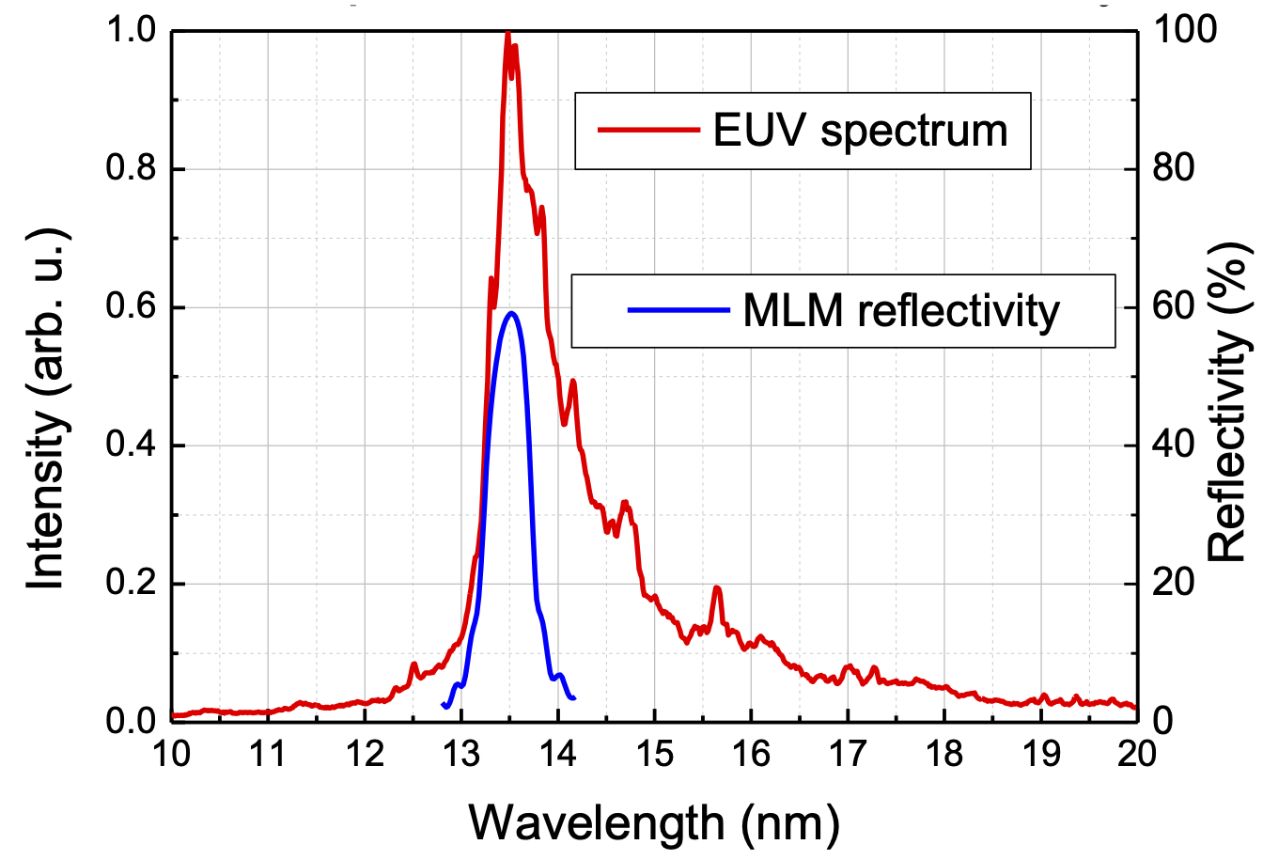
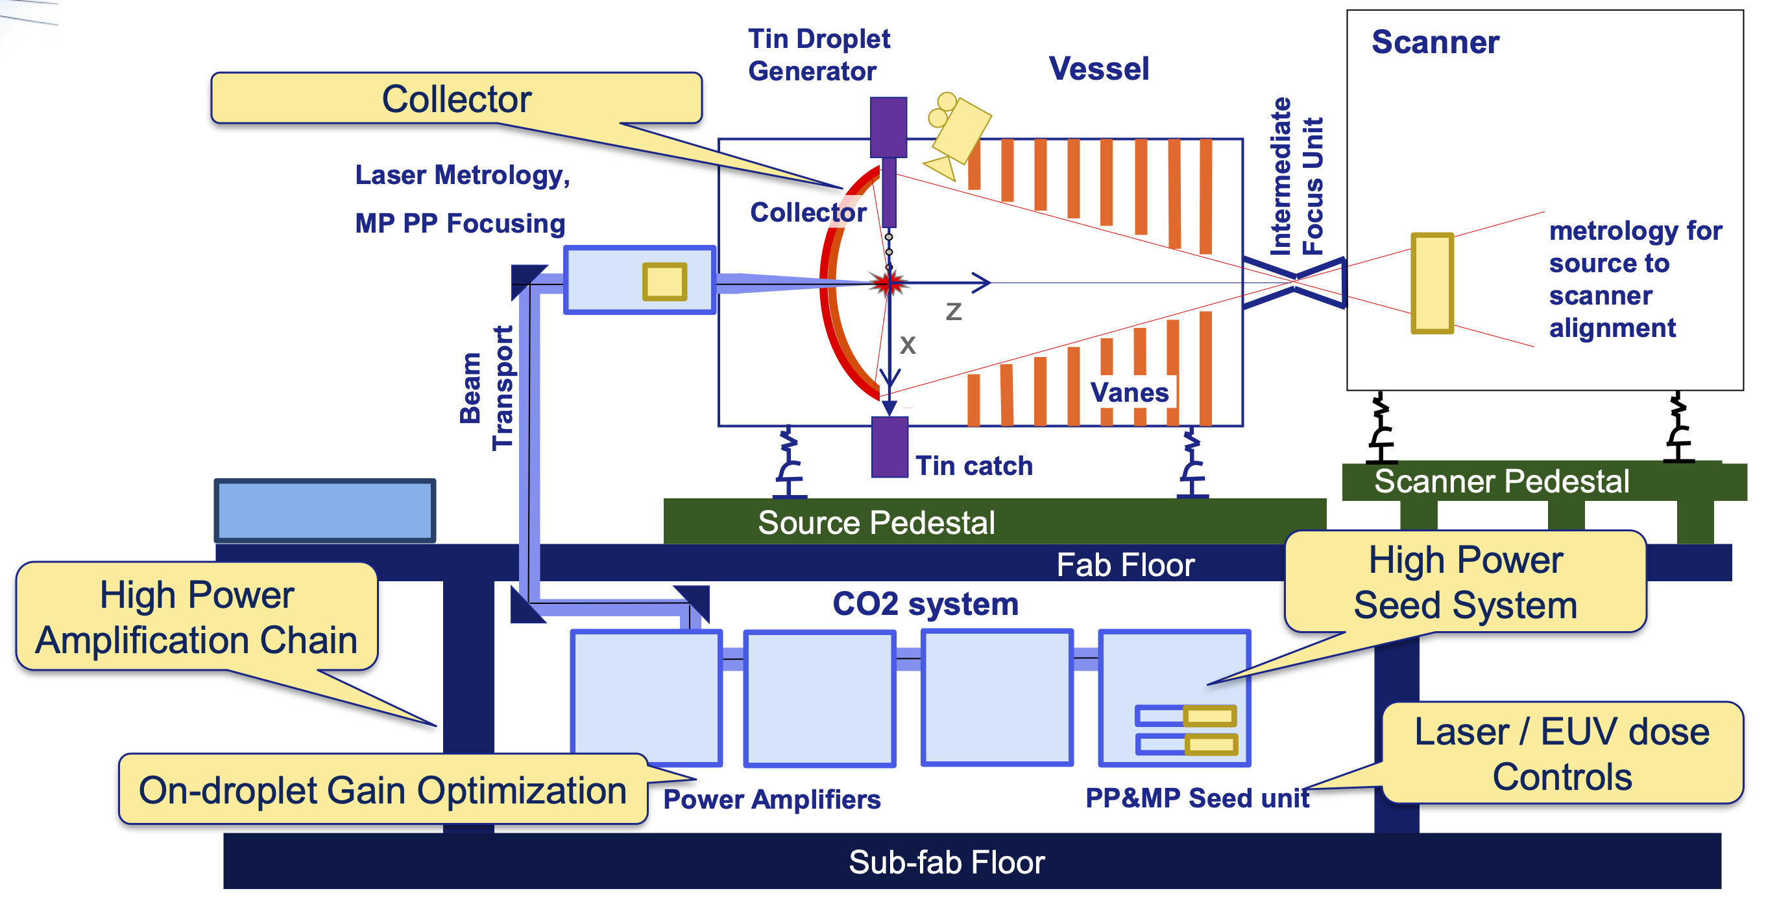
EUVL Exposure Tool & LPP Source
A. Yen, EUVL Workshop 2018.
I. Fomenkov, Source Workshop 2019.
Contamination of tin debris is an issue.
EUV optics
Droplet Generator
LPP Vessel
Wafer stage
EUV Lithography Exposure Tool (NXE3400B from ASML)
Laser-Produced Plasma(LPP) source and EUV optics
I. Fomenkov, EUVL Workshop 2015.
Mo/Si
I. Fomenkov,
Source Workshop 2019.
Structure of LPPsource
EUV spectrum from LPP source

Slide 6
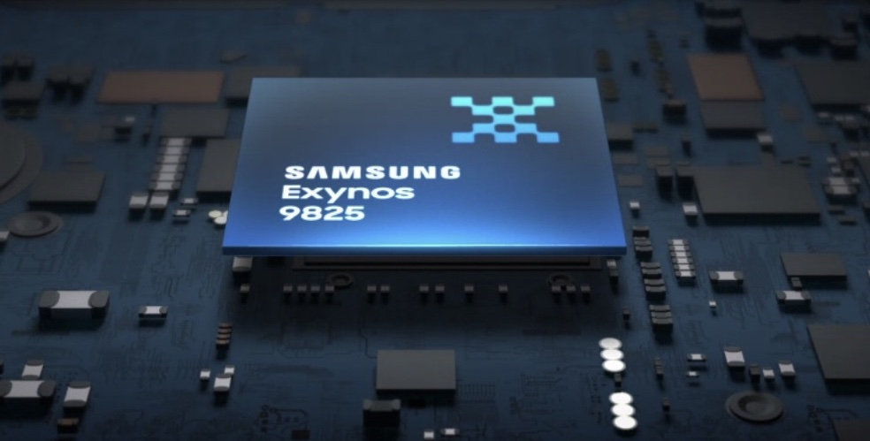
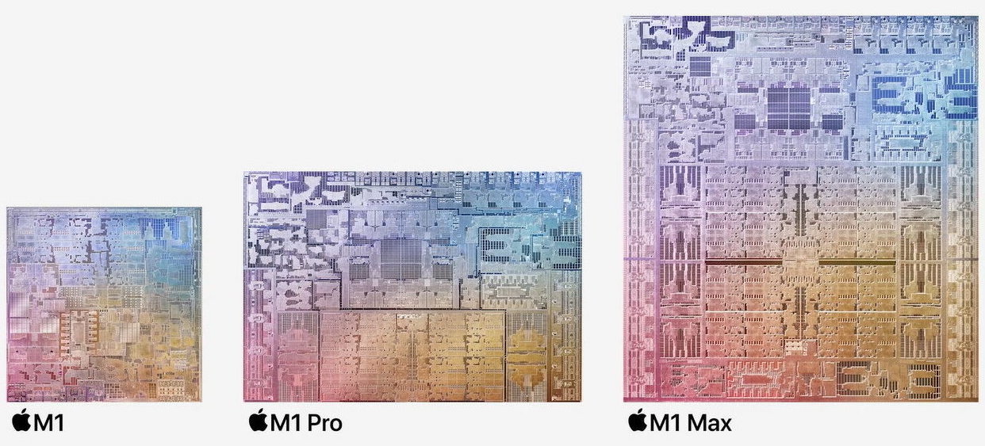
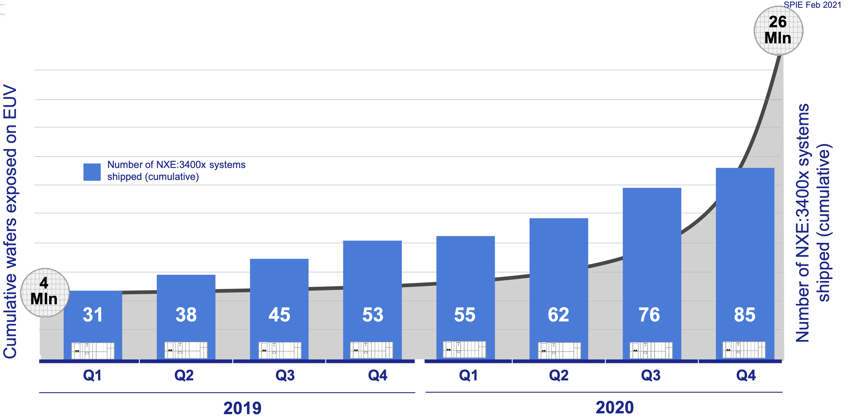
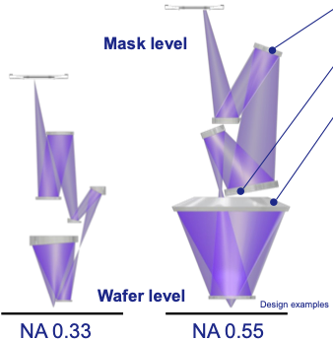
Current State of EUV Lithography
Mobile processor
7 nm node (EUV)
New Apple computer chips
5 nm node (EUV)
https://semiconductor.samsung.com/processor/mobile-processor/exynos-9825/
Improved wavefront
J. van Schoot et al., 5th EUV FEL Workshop (2021).
Higher ttransmission
High-NA
LPP source power:
P_{LPP} = 250 W
High-NA optics design
J. van Schoot et al.,
5th EUV-FEL Workshop (2021).
High Volume Manufacturing started with a 250-W LPP source and high-NA project is in progress.

Slide 7
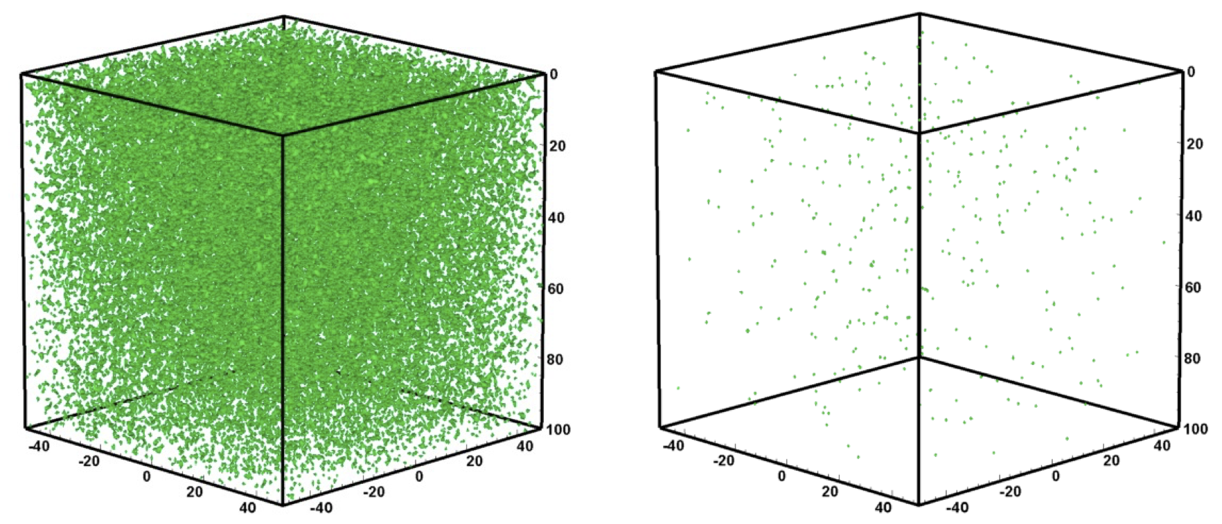
Stochastic Effects in EUV Lithography
ArF (6.4 eV)
EUV (92.5 eV)
Dose = 10 mJ/cm²
α = 4 /μm
n_{absorbed} = 366528
E_{absorbed} = 2354 keV
Dose = 10 mJ/cm²
α = 4 /μm
n_{absorbed} = 25328
E_{absorbed} = 2326 keV
Less photons/J
in EUV Lithography
Absorbed photon distribution
J. J. Biafore et al.,
Proc SPIE 7273 (2009) 727343.
Defects caused by stochastic effects
P. De Bisschop et al., Proc SPIE 9048 (2014) 904809.
High EUV power is needed for suppressing the stochastic effects at a high throughput.

Slide 8
Required EUV Power in Future
Required EUV power at maximum throughput of future scanners
N3 (3nm node) → 1.5 kW
N2 (2nm node) → 2.8 kW
S. Inoue (KIOXIA), 4th EUV-FEL Workshop (2019)
EUV lithography will require a more powerful EUV source in future.

Slide 9
Outline
EUV Lithography
ERL based EUV-FEL Light Source
Summary

Slide 10
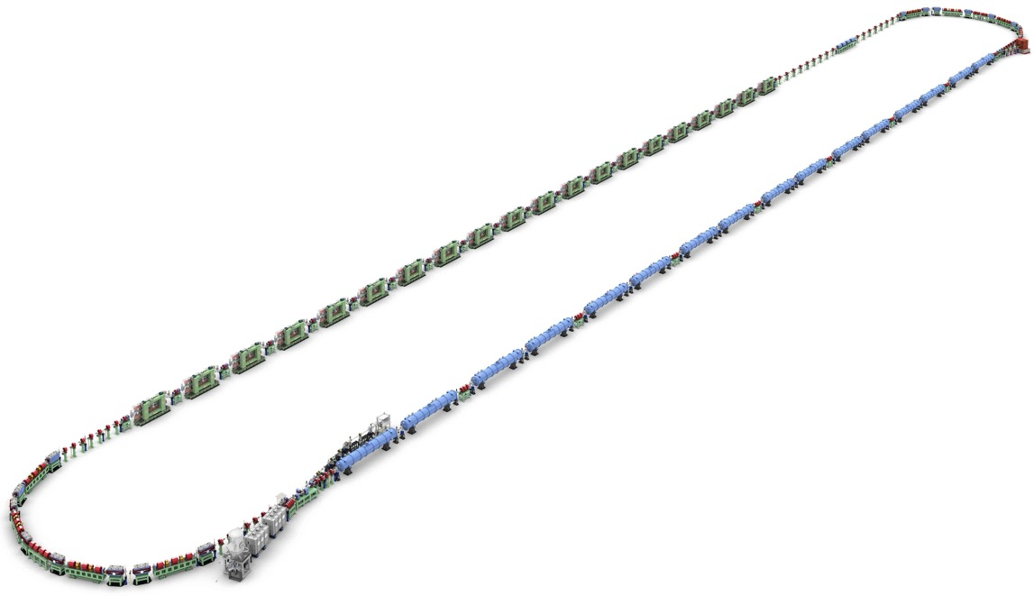
ERL Based EUV-FEL Light Source
ERL based EUV-FEL light source
Advantages (compared to LPP source) :
(1) High EUV power ( > 10 kW ) without Tin debris
→ 1-kW EUV power x 10 scanners
(2) Upgradable to a Beyond EUV(BEUV) FEL (6.6 - 6.7 nm)
(3) Variable control of polarization
→ polarization use for high-NA lithography
(4) Low electricity consumption
→ carbon neutral & sustainability
1st Arc
Beam Dump
Undulators(FEL)
150 ~ 200 m
Parameter | Design value
Beam Energy | 800 MeV
Bunch Charge | 60 pC
Bunch Repetition | 162.5 MHz
Average Current | 10 mA
RF Frequency | 1.3 GHz
EUV Wavelength | 13.5 nm
EUV Power | > 10 kW
Main Linac
Injector Diagnostic Line
EUV Light
2nd Arc
Merger
Injector Linac
©Rey.Hori/KEK
~20 m
Gun
N. Nakamura et al., Proc. ERL2015, pp.4-9(2015)
H. Kawata et al, J. Micro/Nanopattern Mater. Metrol. 212(2), 021210(2022).

Slide 11
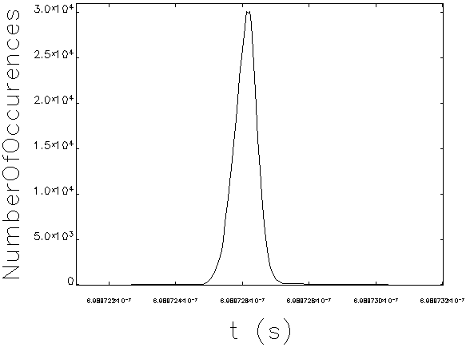
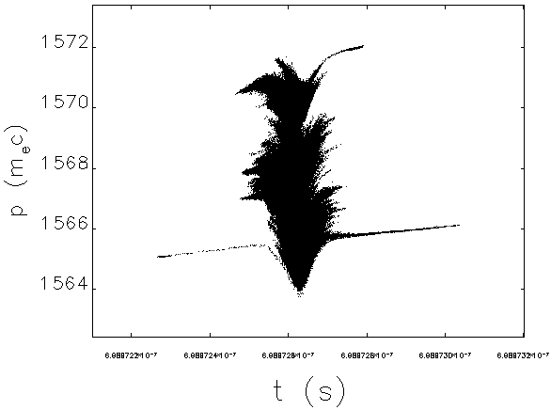
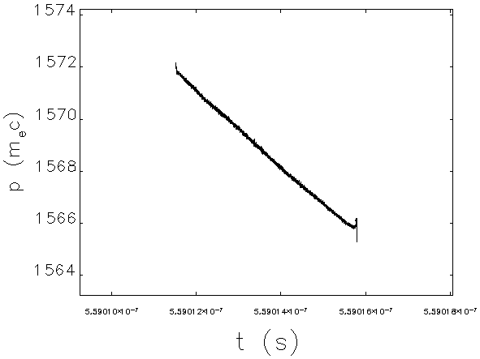
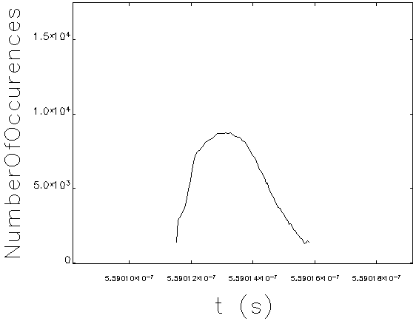
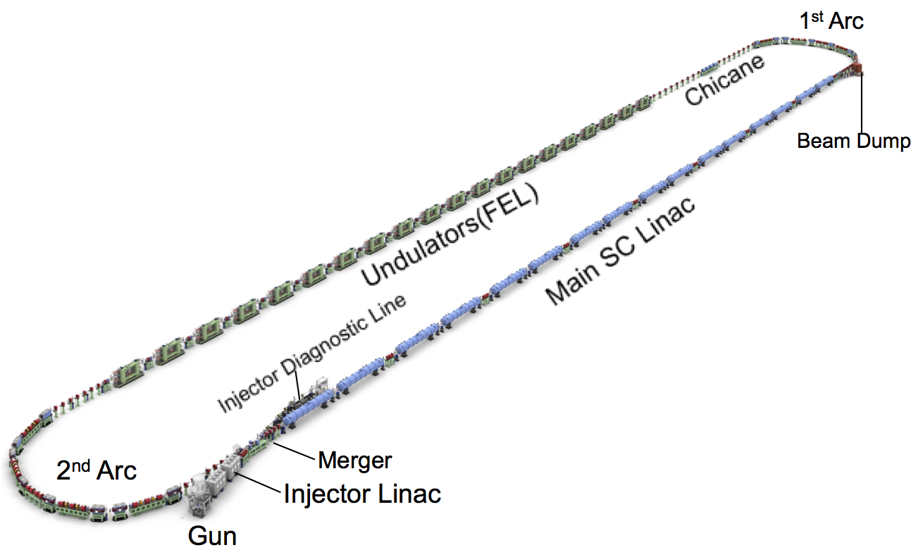
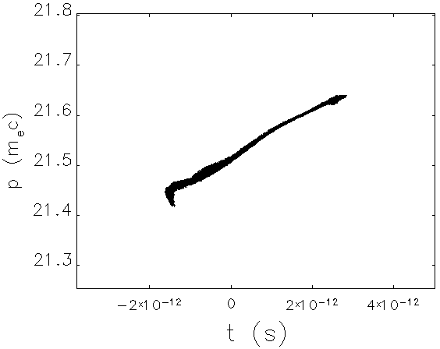
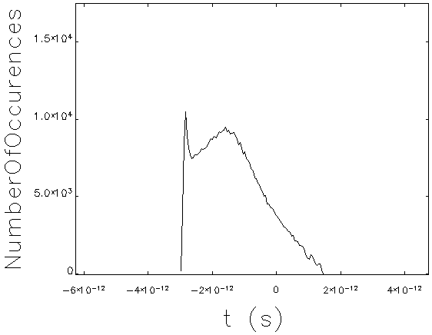
Injector & Bunch Compression Simulation
FEL entrance
σ_{t} = 38.9 fs
σ_{p}/p = 0.106 %
1st arc entrance
I_{peak} = 724 A
2 ps
σ_{t} = 0.99 ps
σ_{p}/p = 0.092 %
I_{peak} = 21 A
200 fs
200 fs
2 ps
ε_{nx} = 2.02 mm mrad
ε_{ny} = 0.90 mm mrad
ε_{nx} = 0.94 mm mrad
ε_{ny} = 0.90 mm mrad
E~801 MeV
e⁻
simulation by GPT & Elegant
(N_{p}=500k)
merger exit
σ_{t} = 1.01 ps
σ_{p}/p = 0.225 %
2 ps
2 ps
E~11 MeV
ε_{nx} = 0.94 mm mrad
ε_{ny} = 0.90 mm mrad

Slide 12
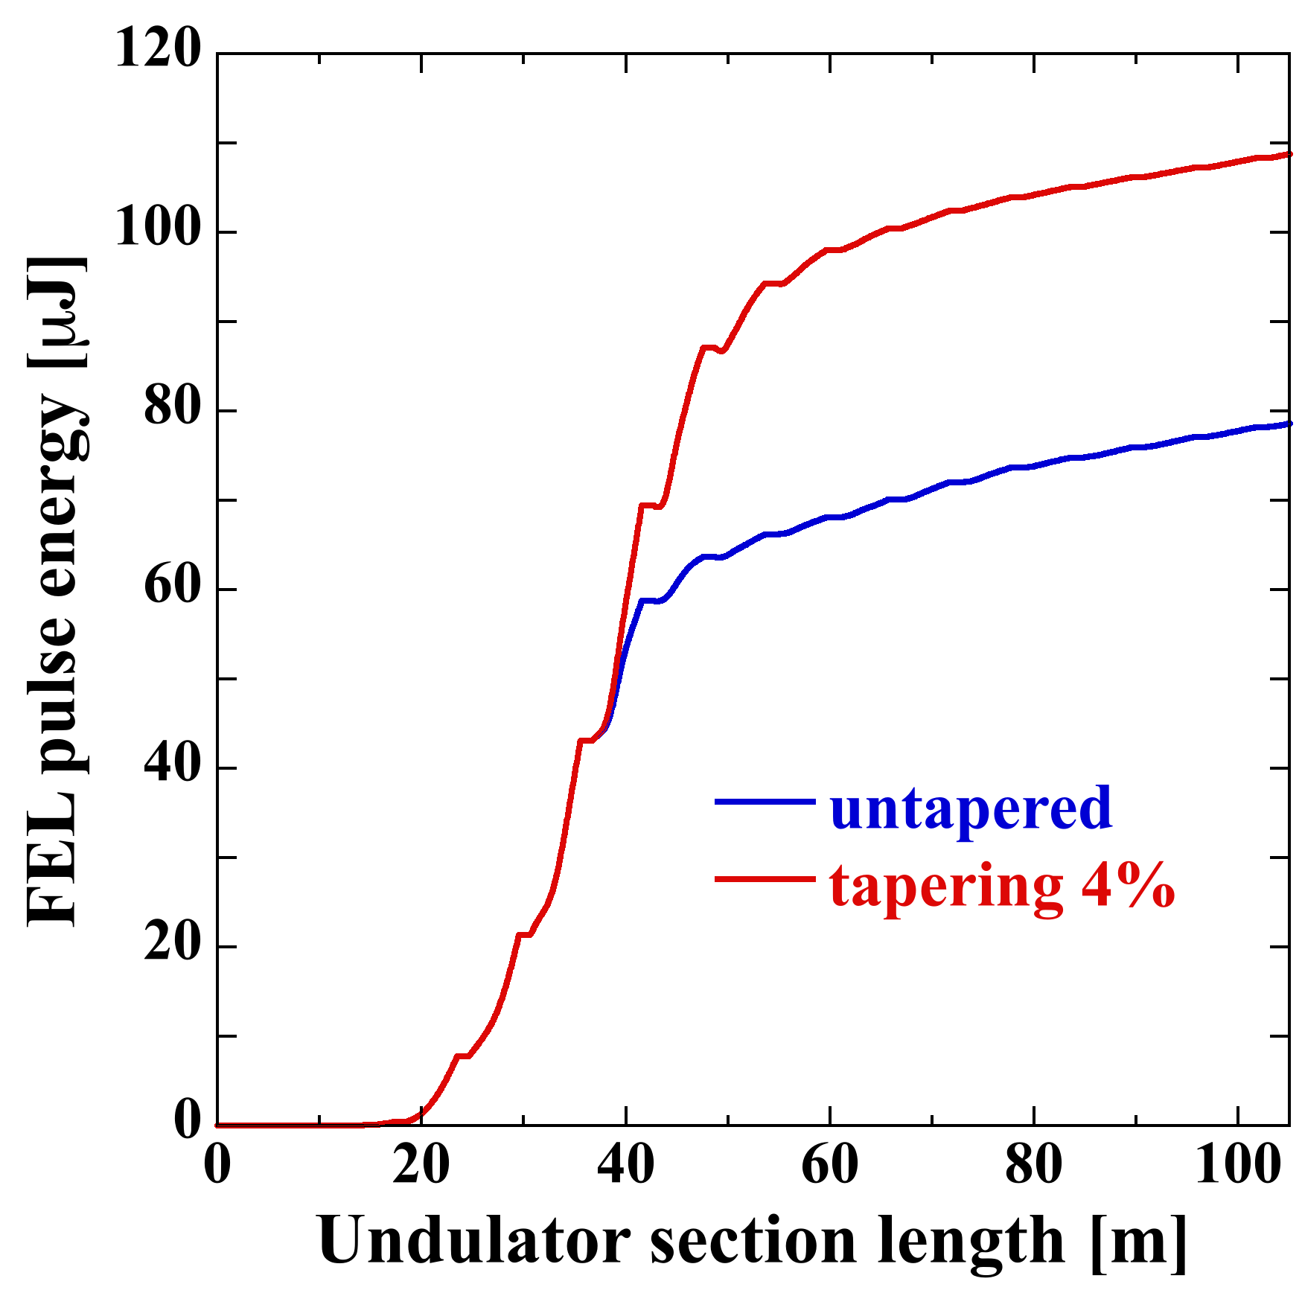
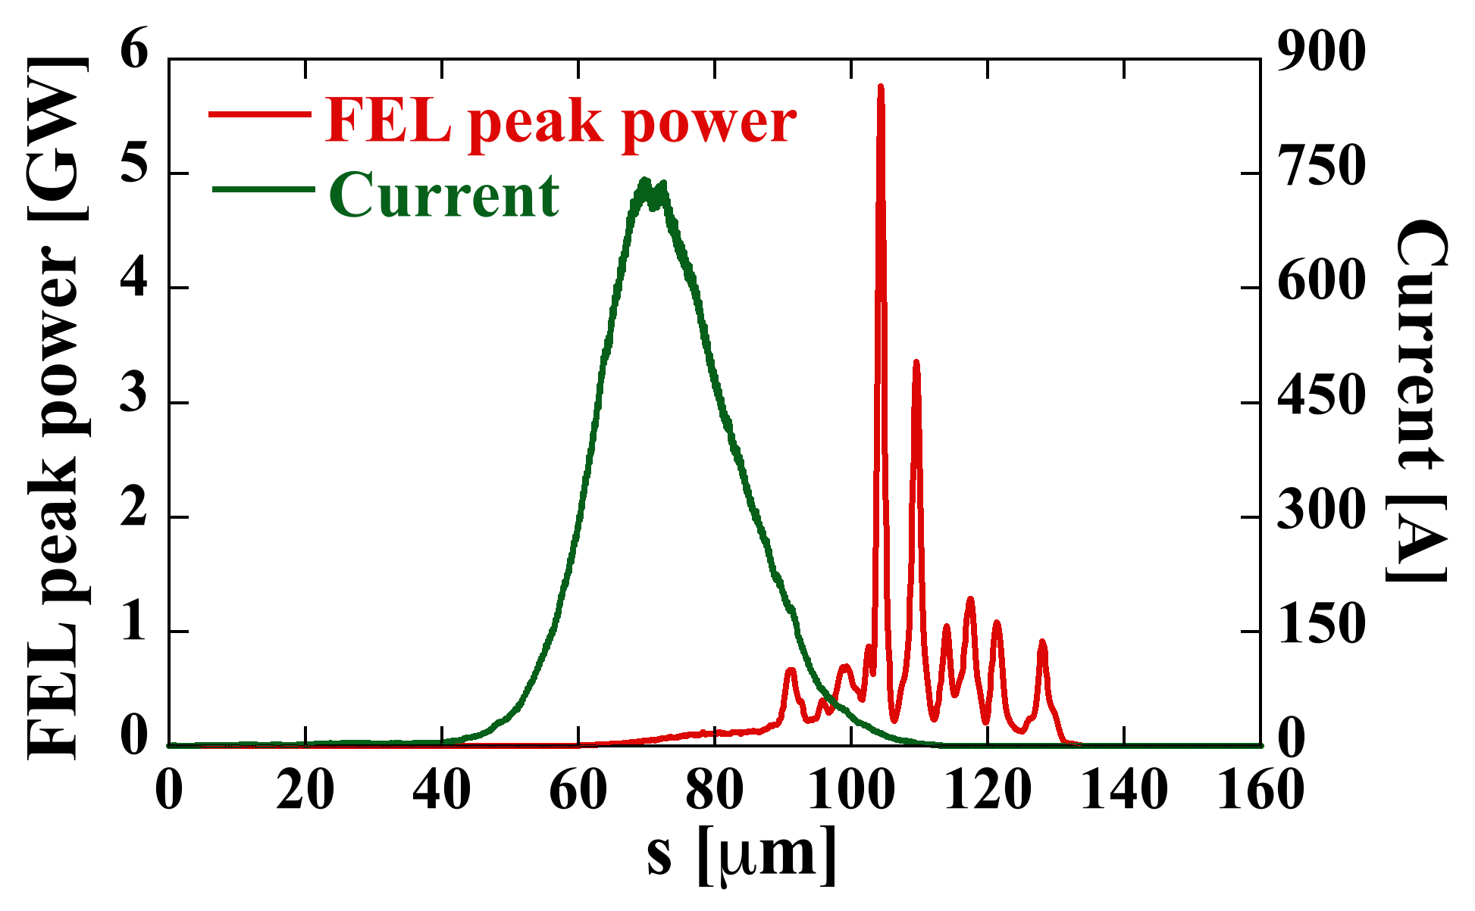
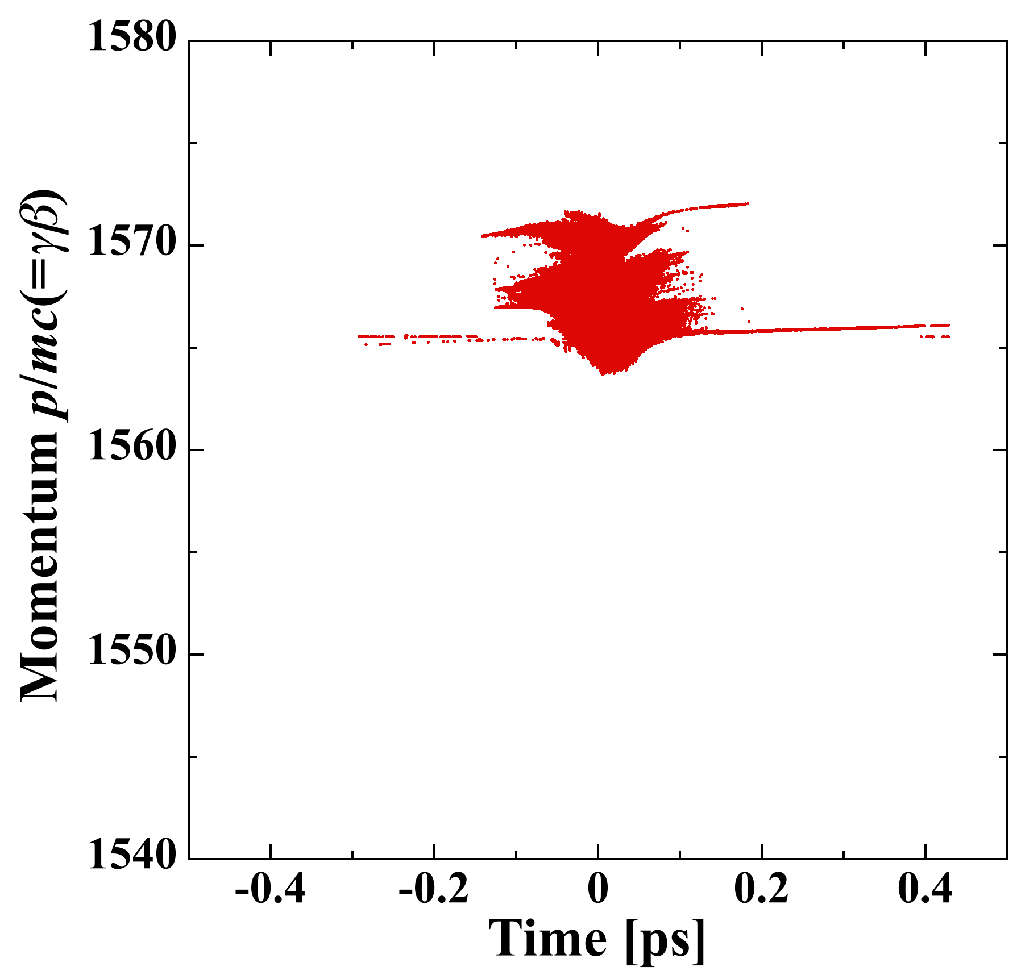
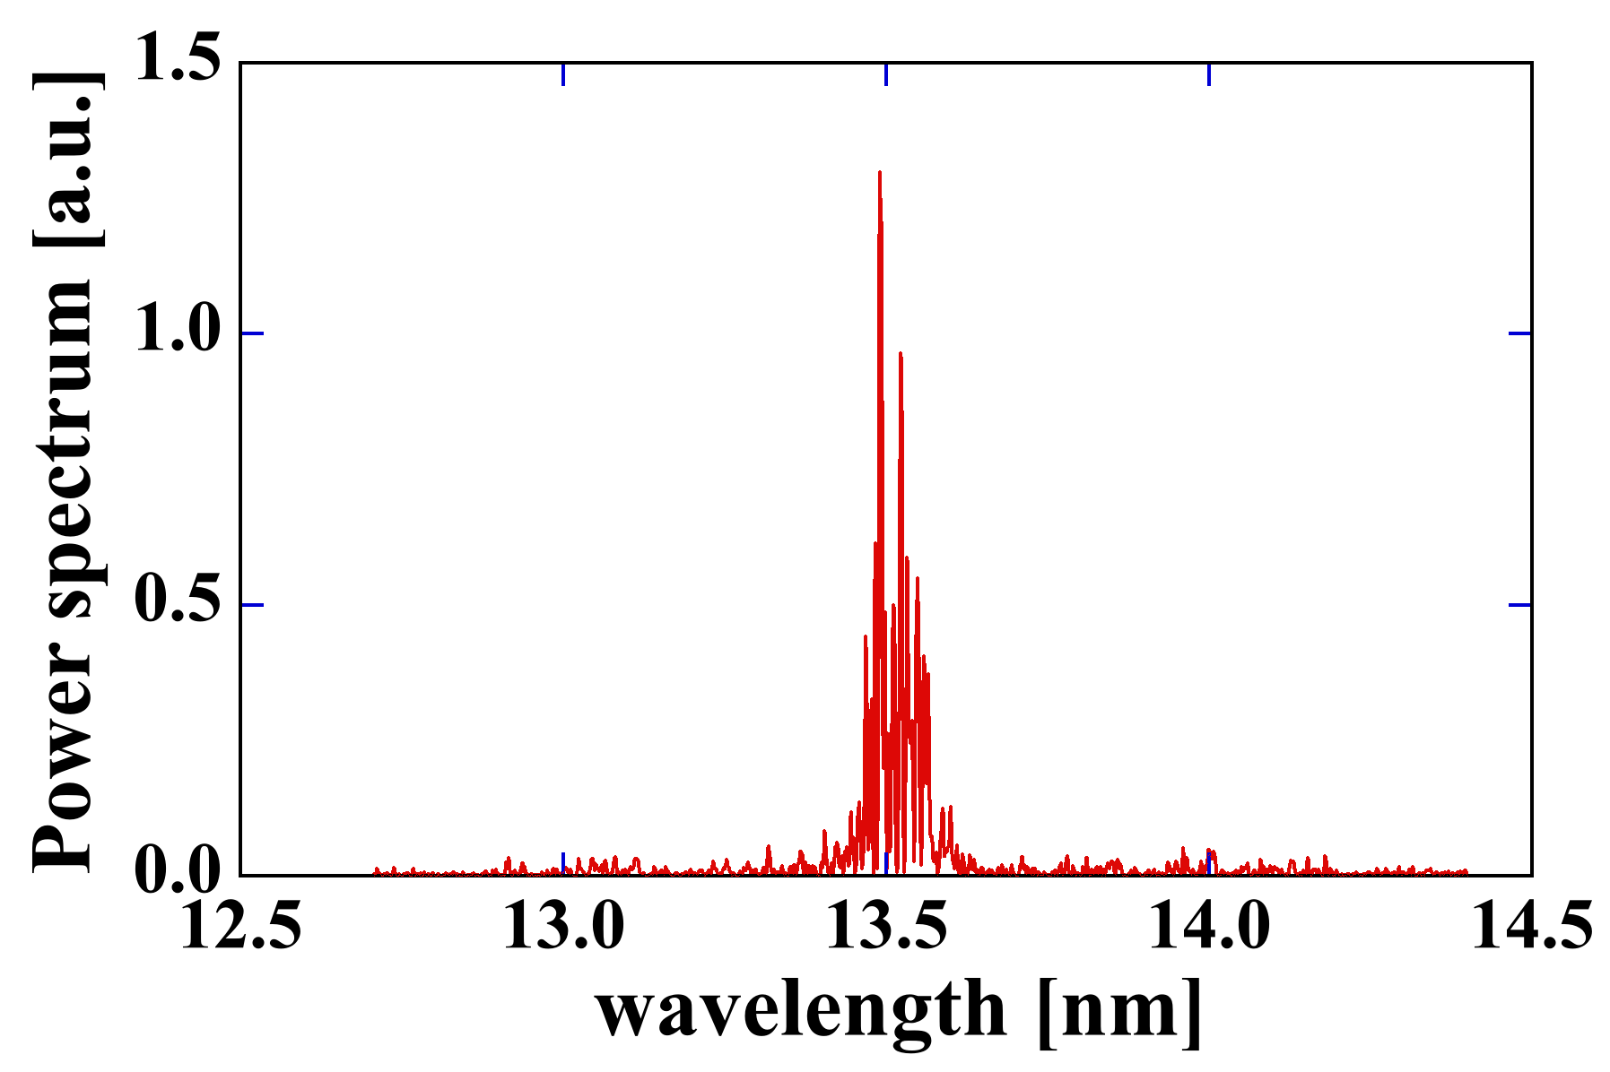
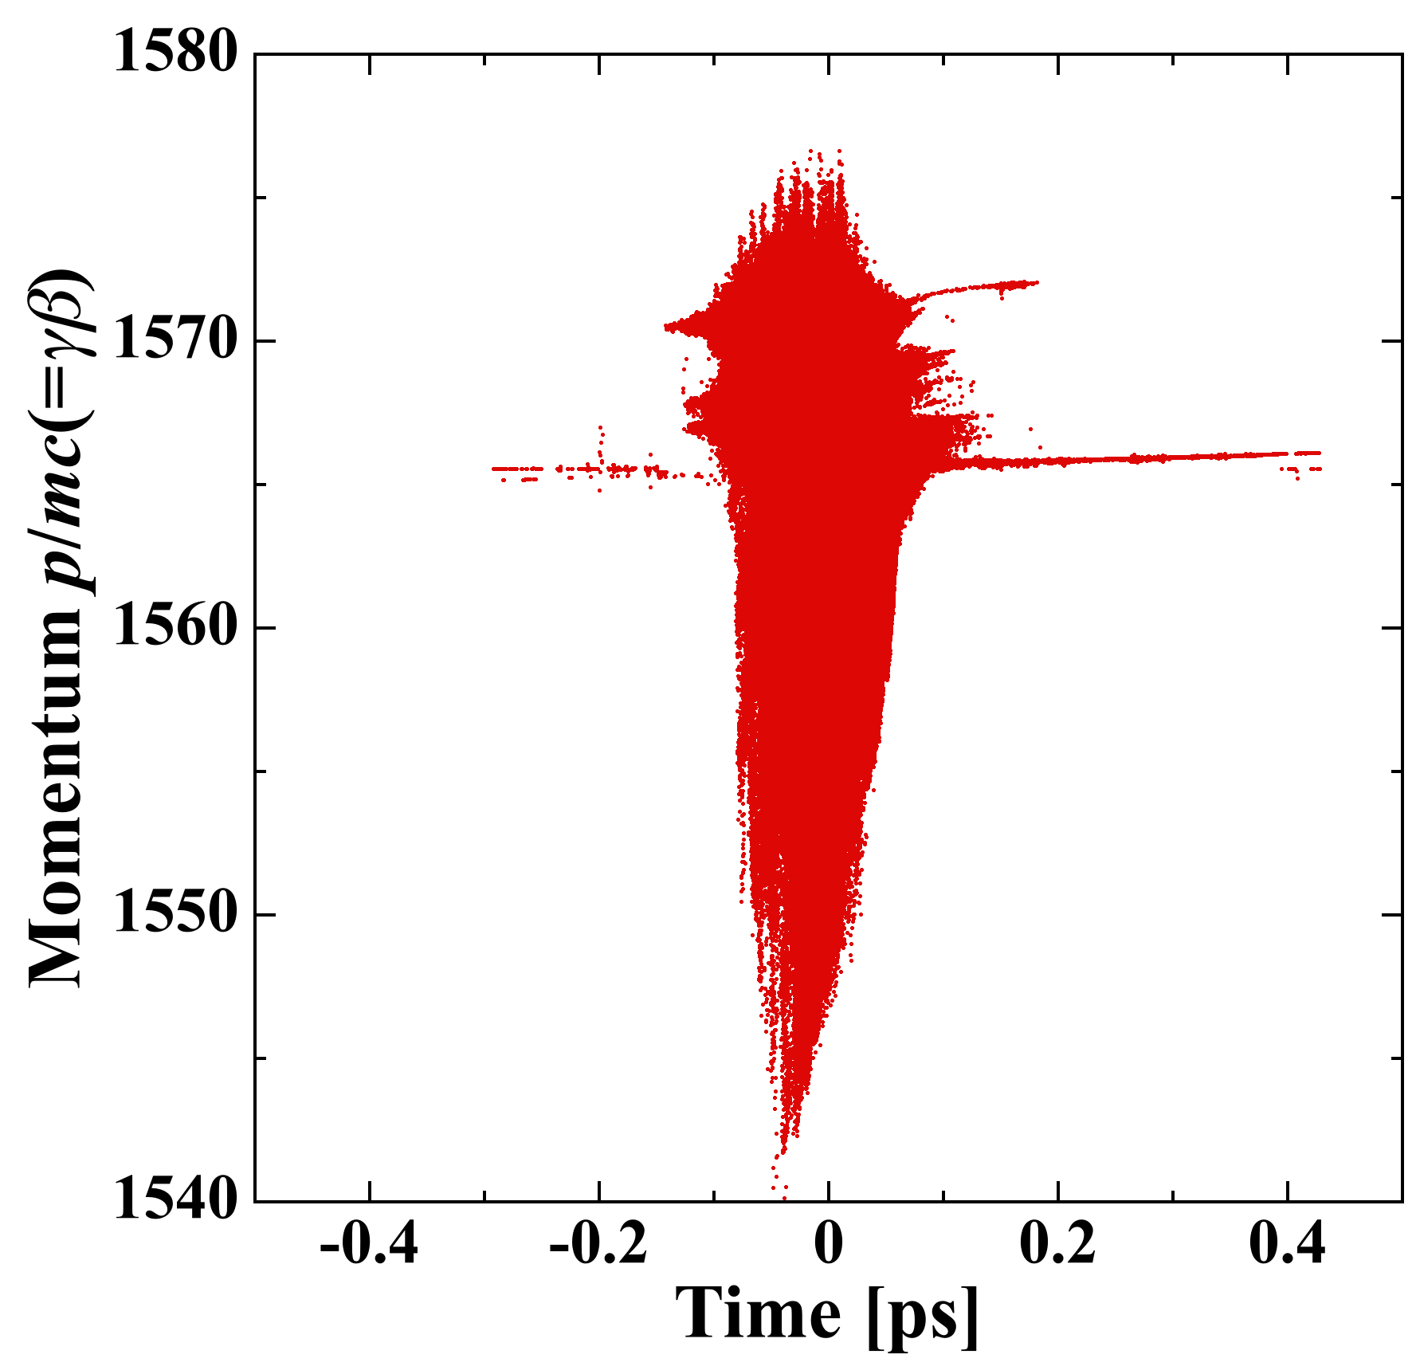
FEL Simulation
109.4 μJ
<γβ>=1567.8
σ_{t}=38.6 fs
σ_{p}/p=0.106 %
ε_{nx}=1.98 mm·mrad
ε_{ny}=0.88 mm·mrad
79.2 μJ
Bandwidth of
Mo/Si reflectivity
FEL power with 4% tapering: 17.8/35.5 kW @ 9.75/19.5 mA (162.5/325 MHz)
Energy spread is increased.
<γβ>=1564.3
σ_{t}=38.6 fs
σ_{p}/p=0.342 %
ε_{nx}=2.00 mm·mrad
ε_{ny}=0.90 mm·mrad
e⁻
simulation by Genesis
P_{FEL} > 10 kW is achieved.
Notes:
.

Slide 13
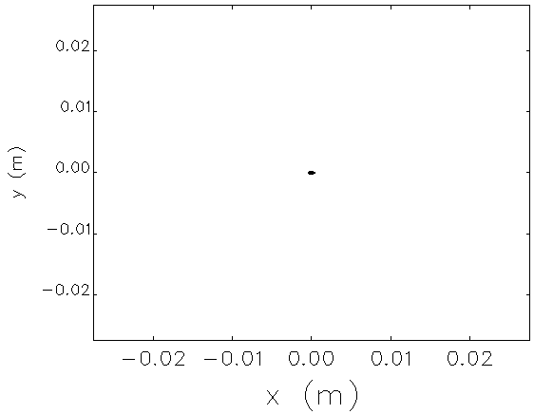
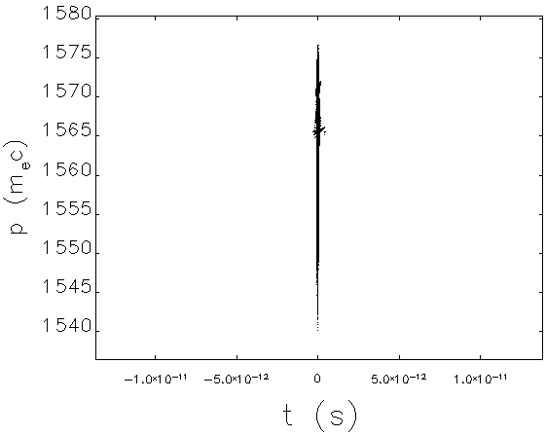
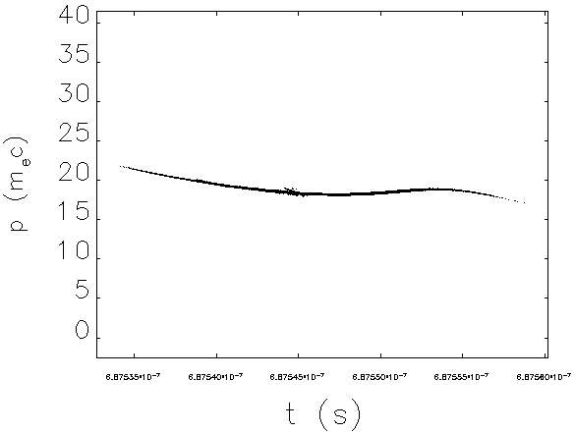
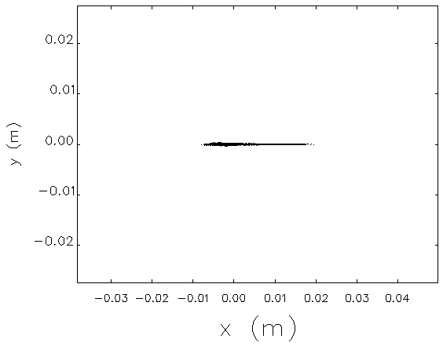
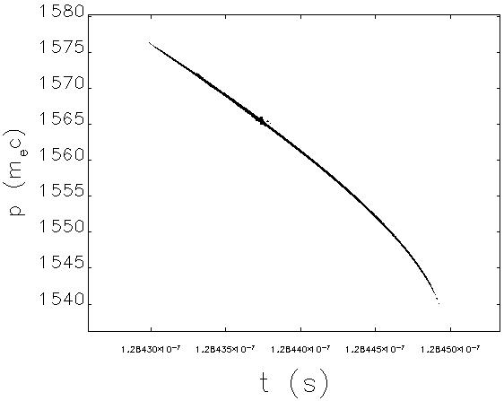
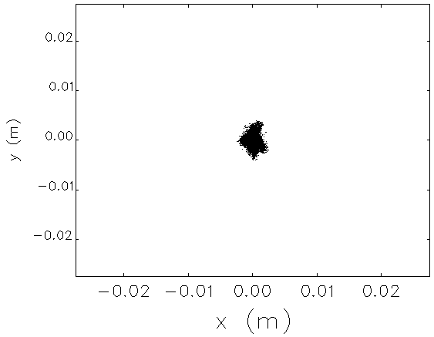
Bunch Decompression & Deceleration Simulation
FEL exit
Electron beam is transported without beam loss.
σ_{x}=0.13 mm
σ_{y}=0.066 mm
σ_{t}=38.6 fs, σ_{p}/p=0.342 %
simulation by elegant
E~9.5 MeV
5ps
e⁻
main linac exit
1cm
σ_{t}=3.49 ps
σ_{p}/p=2.26 %
ε_{nx}/ε_{ny}=2.00/0.90 mm mrad
5ps
E~799 MeV
ε_{nx}=6.68 mm mrad
ε_{ny}=0.90 mm mrad
Maximum horizontal beam size
2nd arc exit
σ_{x}=3.54 mm
σ_{y}=0.024 mm
σ_{t}=3.20 ps
σ_{p}/p=0.336 %
σ_{x}=0.61 mm
σ_{y}=0.30 mm
2cm
5ps
ε_{nx}=10.92mm mrad
ε_{ny}=0.88 mm mrad
1cm
Assumed arc-duct aperture

Slide 14
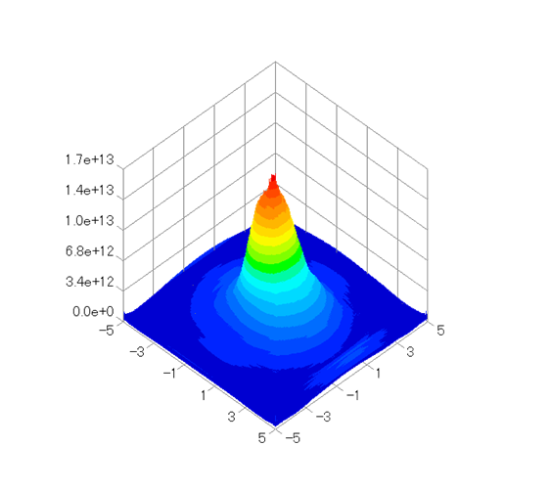
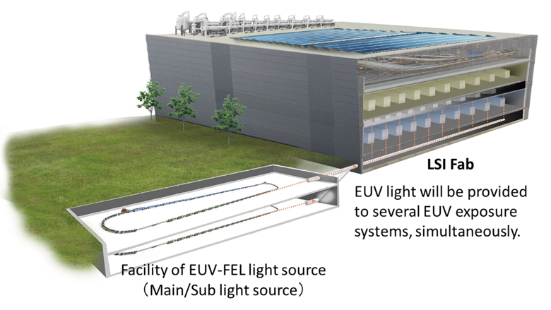
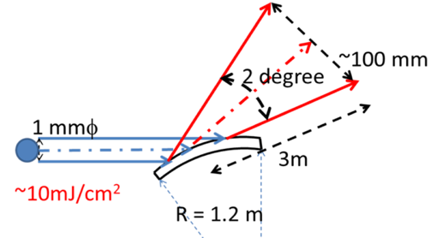
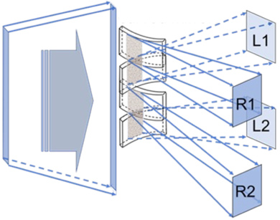
Optical Beamline
LSI Fab and EUV-FEL light source
Characteristics of the EUV-FEL light
Energy density per pulse of EUV light at 3 m far from the FEL exit : ~10 mJ/cm²/pulse
c.f. Mo/Si and Al ablation threshold : ~20 mJ/cm²/pulse (< 10 ps)
M. Nishikino et al.,
Proc. of 2018 Source Workshop (2018) .
Preliminary beamline design concept
curved grazing mirror
(2) Segmented multi curved mirror
Vertical expansion of the FEL light
~0.1 mJ/cm²
Horizontal separation and
expansion of the EUV light
Vertically expanded
EUV-FEL light
To each scanner
system
EUV-FEL light
~0.1 mJ/cm²
…
~2.5 μJ/cm²
~20 x 20 mm²
at 3 m after the mirror
The expanded EUV light is transported to each scanner system without serious loss and mirror damage.

Slide 15
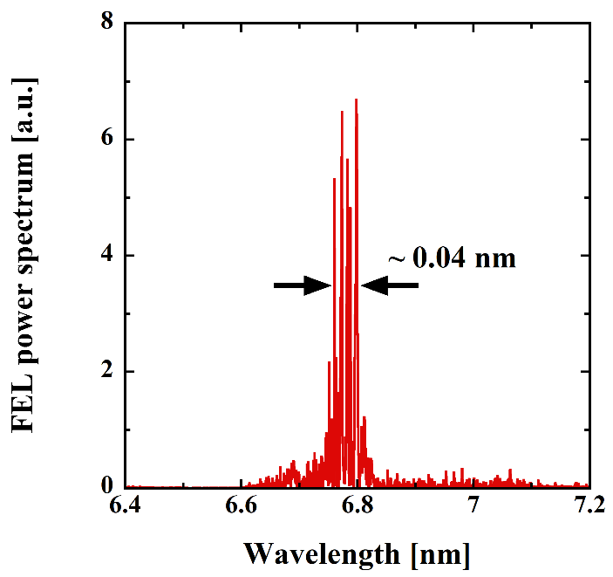
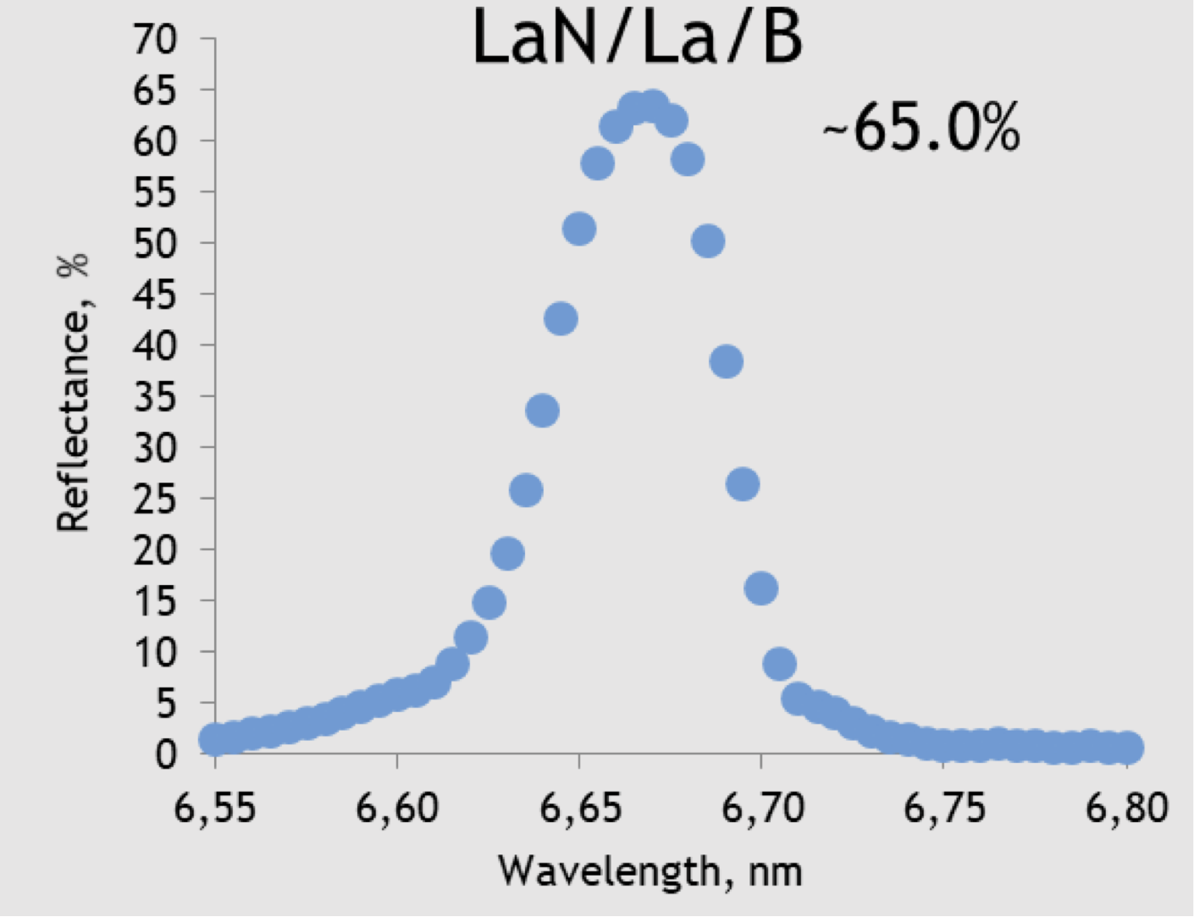
Upgrade Scheme to BEUV FEL
Dump
Injector
Dump
Injector
EUV FEL
Main Linac(ML)
Main Linac(ML)
Undulators(FEL)
EUV FEL
Undulators(FEL)
EUV Light
EUV Light
Dump
Injector
Dump
Injector
Main Linac(ML)
Combiner
Main Linac(ML)
Spreader
BEUV FEL
BEUV FEL
Undulators(FEL)
(A) Sigle-loop layout
BEUV Light
Undulators(FEL)
BEUV Light
(C) Doule-loop layout 2
Dump
Injector
M. D. Ackermann et al.,
Proc. of 2021 Source Workshop, S1.
EUV FEL
Main Linac(ML)
Undulators(FEL)
EUV Light
FEL power spectrum [a.u.]
BEUV Light
Undulators(FEL)
Dump
Injector
BEUV FEL
Main Linac 1(ML1)
0.04 nm
Main Linac 2(ML2)
Combiner
Spreader
Wavelength [nm]
(B) Doule-loop layout 1
BEUV FEL spectrum
BEUV Mirror reflectivity
An ERL based FEL is also a promising light source for BEUV lithography.

Slide 16
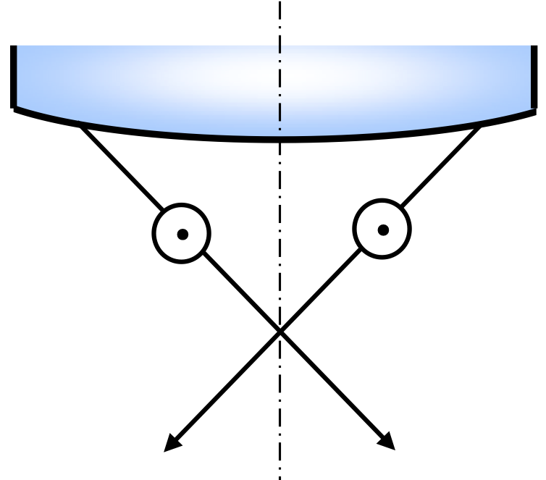
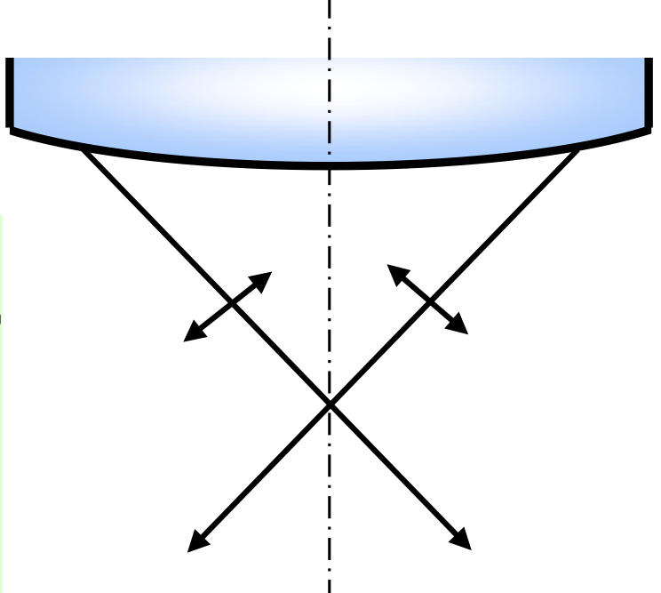
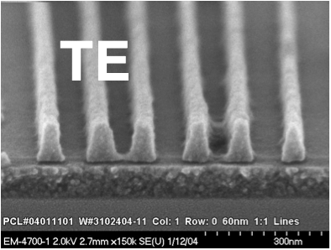
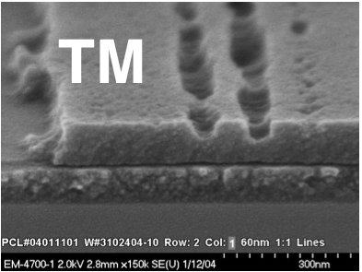
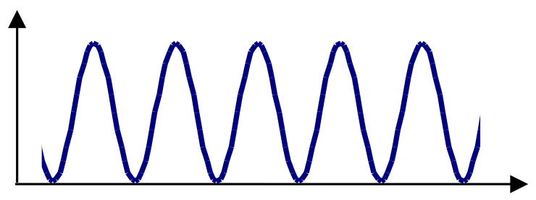
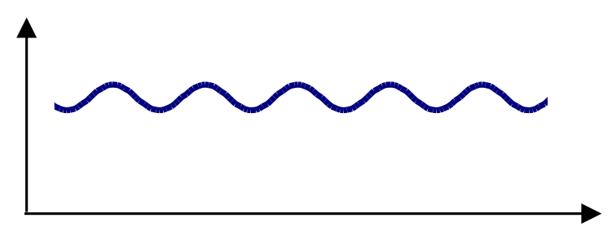
Polarization Effect & Control
Polarization effect in high-NA lithography
High NA → finer pattering
(a) s-polarized light
(b) p-polarized light
(a) s-polarization(TE)
(b) p-polarization(TM)
Low-NA
High-NA
wafer
157-nm light, NA=0.85, 60nm half-pitch
Intensity of (a) s-polarized and (b) p-polarized light
in high NA lithography (by A. Suzuki)
Examples of polarization experiments
Schematic of low and high NA
lithography
B. W. Smith et al., Proc. of SPIE 5377, 68-79 (2004).
Polarization control scheme
e⁻
…
…
EUV light
BEUV light
Circularly-polarizing (helical) undulators
・Majority of the FEL undulators
・Higher FEL gain than linearly-polarizing undulators
→ Higher EUV/BEUV FEL power
Variably-polarizing undulators
・Last several undulators
・Equipment of polarization control mechanism
→ Generation of variably-polarized light
The EUV-FEL can control polarization of the FEL light for high-NA lithography.

Slide 17
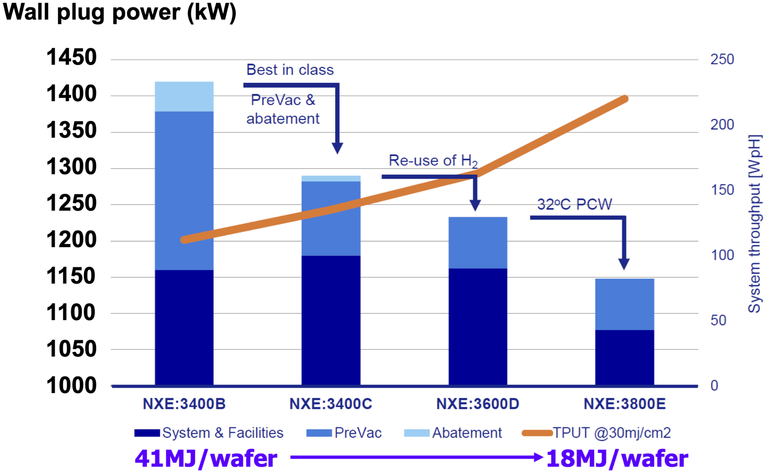
Electricity Consumption
Sustainable semiconductor technologies & systems(SSTS) program
・CO₂ footprint of semiconductor manufacturing is rapidly rising.
・Environmental score is newly added to the traditional ones.
NXE:3X00 electricity consumption
2022
Requirements of chips in technology development
L. V. den Hove, Proc. Metrology, Inspection, and Process Control XXXVI, PC1205301(2022).
Electricity consumption
EUV-FEL : ~7.0 MW/10-kW EUV ⇒ ~0.7 MW/1-kW EUV(or scanner)
LPP : ~1.1 MW/250-W EUV ⇒ ~4.4 MW/1-kW EUV(or scanner)
M. van den Brink, ITF USA (2020)
EUV-FEL electricity consumption (tentative)
EUV-FEL can greatly reduce the electricity consumption.
Items | Electric power
Refrigerator System | ~3.2 MW
RF Source | ~1.3 MW
Other components | ~1.0 MW
Infrastructure | ~1.5 MW
Total | ~7.0 MW
Construction cost
EUV-FEL : ~US$350M/10-kW EUV ⇒ ~US$35M/1-kW EUV
LPP : ~US$20M/250-W EUV ⇒ ~US$80M/1-kW EUV
LPP running cost: ~US$16M/250-W EUV ⇒ ~US$64M(?)/1-kW EUV
EUV-FEL can also reduce the cost per scanner.

Slide 18
Potential Problems in EUV-FEL
R&D expense of EUV-FEL
Who pays the cost? International collaboration necessary.
Cost of ownership
To be less than LPP source
Footprint
Stable operation
Two beam lines are necessary for back up
Generation of radioactive materials
High peak power
Potential damage in mirrors and reticles
Coherent light
Based on H. Ishiuchi’s presentation in 1st EUV-FEL Workshop (2016)

Slide 19
Potential Problems in EUV-FEL
R&D expense of EUV-FEL → Paid by governments, companies, …
Who pays the cost? International collaboration necessary.
Cost of ownership → Cost per scanner reduced (to be investigated in detail)
To be less than LPP source
Footprint → Reduced by high-E_{acc} SRF cavity and/or multi-loop/turn ERL
Stable operation → Twin light sources or redundancy system of critical parts
Two beam lines are necessary for back up
Generation of radioactive materials → Much reduced by energy recovery
High peak power → No damage of mirrors & reticles (< ablation threshold)
Potential damage in mirrors and reticles
Coherent light → Elimination of coherence effects in optics should be studied
* Possible solutions or mitigations of the EUV-FEL problems
Based on H. Ishiuchi’s presentation in 1st EUV-FEL Workshop (2016)

Slide 20
Outline
EUV Lithography
ERL based EUV-FEL Light Source
Summary

Slide 21
Summary
Higher EUV power (> 1 kW) will be required in future to overcome the stochastic effects for a higher throughput and higher NA.
The ERL based EUV-FEL is a promising light source for future lithography and has advantages in EUV power, upgradability to BEUV, polarization control, electricity consumption and so on.
We should continue to solve or mitigate all the problems on the EUV-FEL for industrialization in collaboration with researchers in other fields.
Changing to the EUV-FEL is a paradigm shift in the semiconductor society and will need joint efforts of all the stakeholders.

Slide 22
Acknowledgement (1)
EUV FEL Light Source Study Group for Industrialization (since 2015)
Past activities and Events
Six EUV-FEL Workshops
1st EUV-FEL Workshop(2016)
2nd EUV-FEL Workshop(2017)
3rd EUV-FEL Workshop(2018)
4th EUV-FEL Workshop(2019)
5th EUV-FEL Workshop(2021)
6th EUV-FEL Workshop(2022)
Twelve group meetings
Several seminars
Other local meetings

Slide 23
Acknowledgement (2)
cERL Collaboration Team
High Energy Accelerator Research Organization (KEK)
M. Adachi, D. Arakawa, H. Araki, M. Egi, S. Eguchi, M. Fukuda, T. Furuya, K. Haga, K. Harada, N. Higashi, T. Honda,
Y. Honda, T. Honma, X. Jin, E. Kako, Y. Kamiya, R. Kato, H. Kawata, Y. Kobayashi, Y. Kojima, T. Konomi, M. Murata,
H. Matsumura, S. Michizono, C. Mitsuda, T. Miura, T. Miyajima, H. Miyauchi, Y. Morikawa, S. Nagahashi, H. Nakajima,
N. Nakamura, K. Nakanishi, K. Nigorikawa, T. Nogami, T. Obina, H. Sagehashi, H. Sakai, M. Shimada, T. Shioya,
M. Shiozawa, M. Tadano, T. Tahara, T. Takahashi, R. Takai, H. Takaki, O. Tanaka, T. Tanikawa, Y. Tanimoto, K. Tsuchiya,
T. Uchiyama, A. Ueda, K. Umemori, M. Yamamoto
National Institutes for Quantum and Radiological Science and Technology (QST)
R. Hajima, K. Kawase, R. Nagai, M. Sawamura, M. Mori, N. Nishimori
Hiroshima University M. Katoh, M. Kuriki, A Kano
National Institute of Technology, Akita College F. Sakamoto
Collabolation Team for NEDO Project (IR-FEL)
National Institute of Advanced Industrial Science and Technology (AIST)
T. Sato, M. Kakehata, H. Yashiro
Tokyo University of Science (TUS) K. Tsukiyama, T. Kawasaki
Hamamatsu Photonics T. Edamura, N. Akikusa

Slide 24
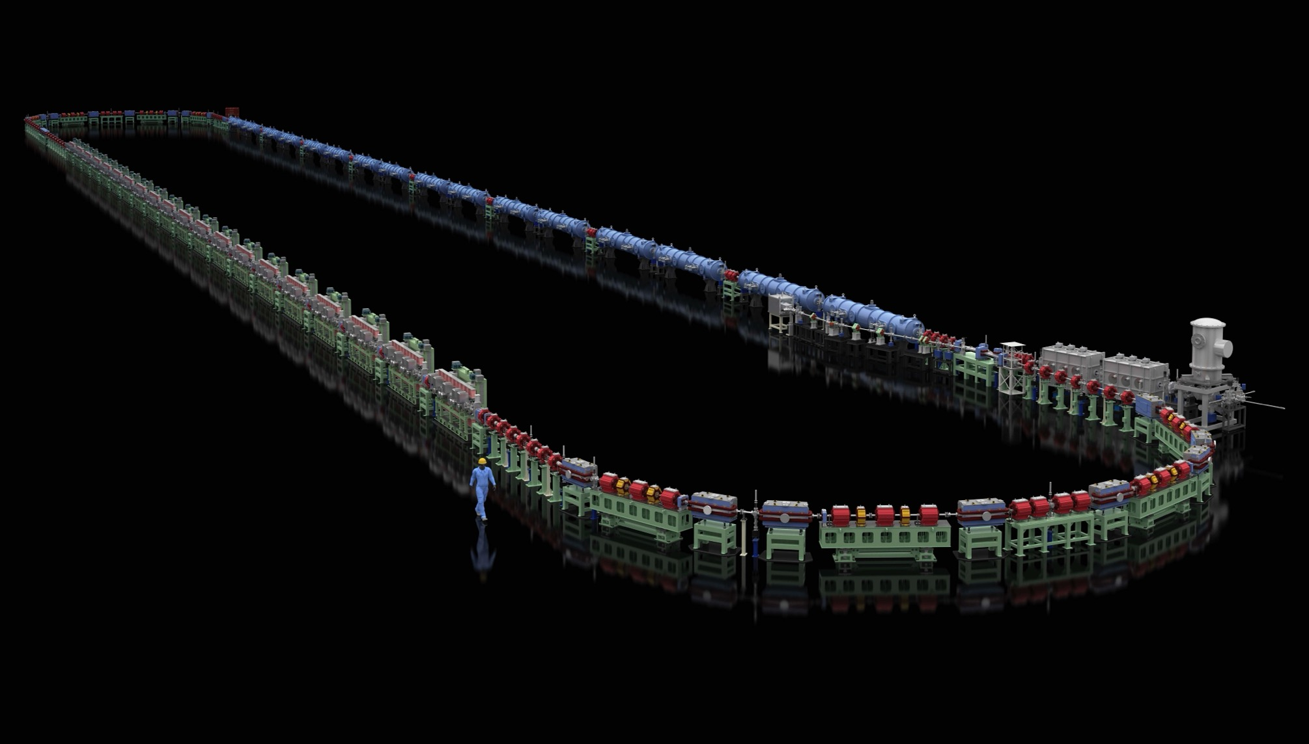
Thank you for your attention!
Thank you for your attention!

