Slide 1
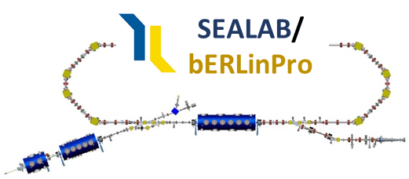

SRF photo-injector and Booster modules at bERLinPro: Assembly and commissioning status
Can progress be measured?
10/04/22, A. Neumann for the Sealab/bERLinPro SRF Team*
66th ICFA Advanced Beam Dynamics Workshop on Energy Recovery Linacs
Cornell University, Ithaca, NY
*A. Frahm, F. Göbel, S. Klauke, H. Plötz, M. Schuster, Y. Tamashevich, J. Ullrich

Slide 2
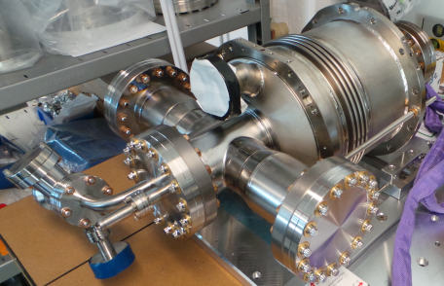
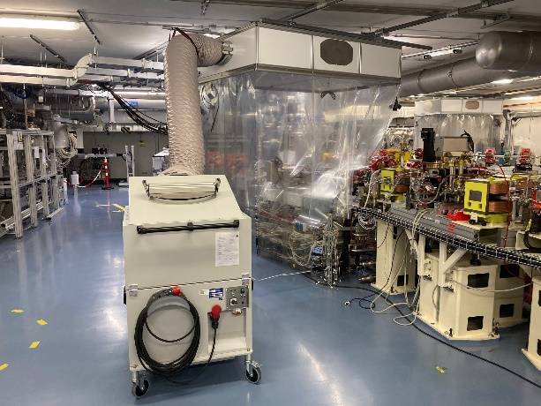
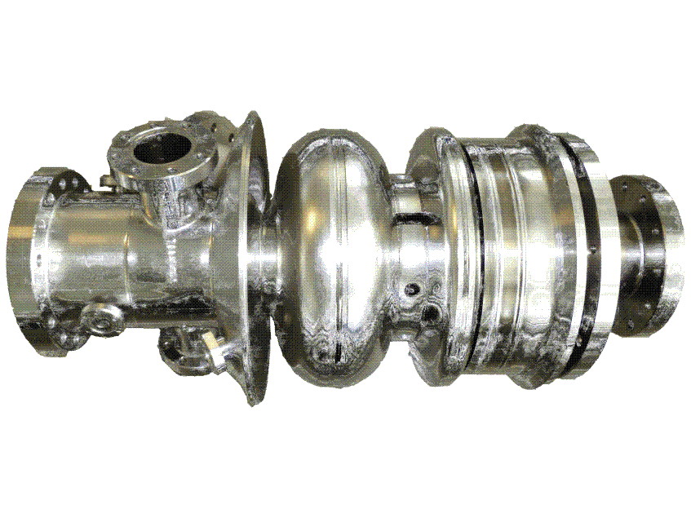
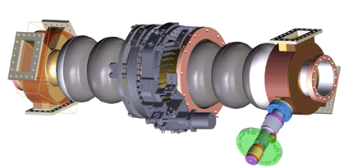
Challenges for the SRF+vacuum systems
Introduction
+4.5 MeV (100mA)
Compact machine: All vacuum parts need to be treated
within ISO 4-5 environment
Complete machine analyzed and optimized by wake/impedance
studies
SRF booster cavity (Cornell)
High beam power
High beam current
Intermediate field levels
10 MV/m
Low coupler kicks
Zero-crossing operation
+45 MeV (2x 100 mA, recovered)
Main linac cavity
2.3 MeV, 100 mA
SRF Gun:
Low emittance high brightness beam
Insertion of a thermally isolated high QE
Cs-K-Sn cathode (particulate free)
Control of field emission to avoid dark current based
losses and halo formation
High current, high beam power operation (HOM, FPCs)
High emission RF field → beam dynamics optimized
shape
Avoid coupler kick-based emittance dilution
Synchronization Laser ←→ RF, precise RF control
Low beam power
High beam current
Strong higher order mode damping
Higher field levels: 19 MV/m
Multi-pass beam
Precise field control and tuning
Movable local cleanrooms
ISO 5, rail system
on the ceiling for proper
placement

Slide 3
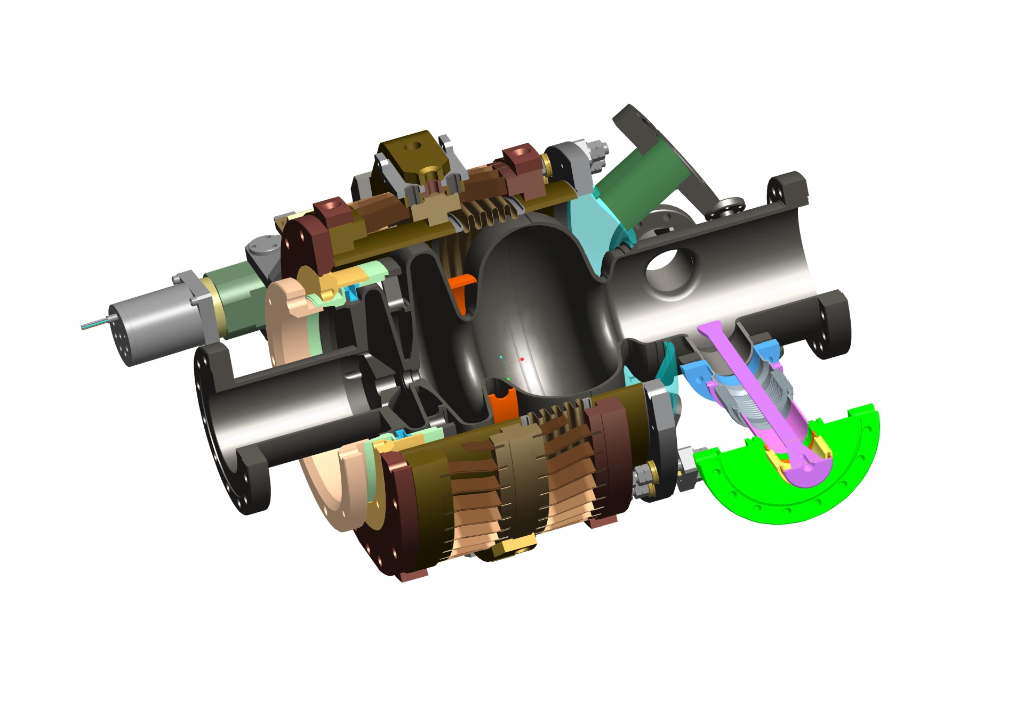
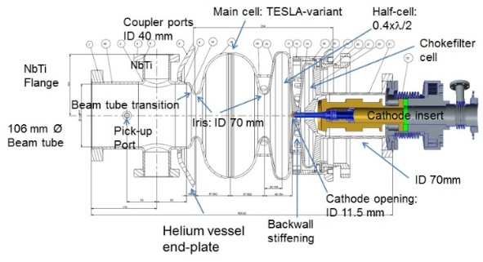
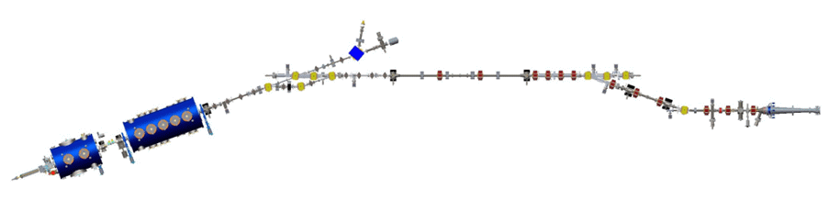
Status of the SRF gun
SRF gun
0.4.λ/2 cell + full cell:
Optimized
emission phase
Chimney 22 cm²~35 W at 1.8 K
about E_{peak}=45 MV/m at Q₀=3.5.10⁹
Stiffening ring:
Δf/ΔP minimized
106 mm beam tube:
Allows propagation of
lowest TM₁₁₀ mode:
HOM studies
HZDR cathode
insert and choke
cell design:
Proven system
Cathode exchange
with HZDR
3 pick-up antennas
to measure HOM
polarization
Blade tuner with
motor and 4x piezo tuner:
Microphonics compensation
2xCW modified TTF-III
Coupler: Q_{ext} 3.6.10⁶
for up to I_{avg}=6-10 mA,
10 kW each
Study 2 coupler operation

Slide 4


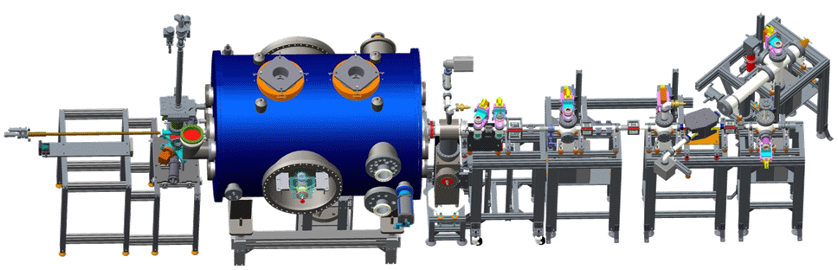
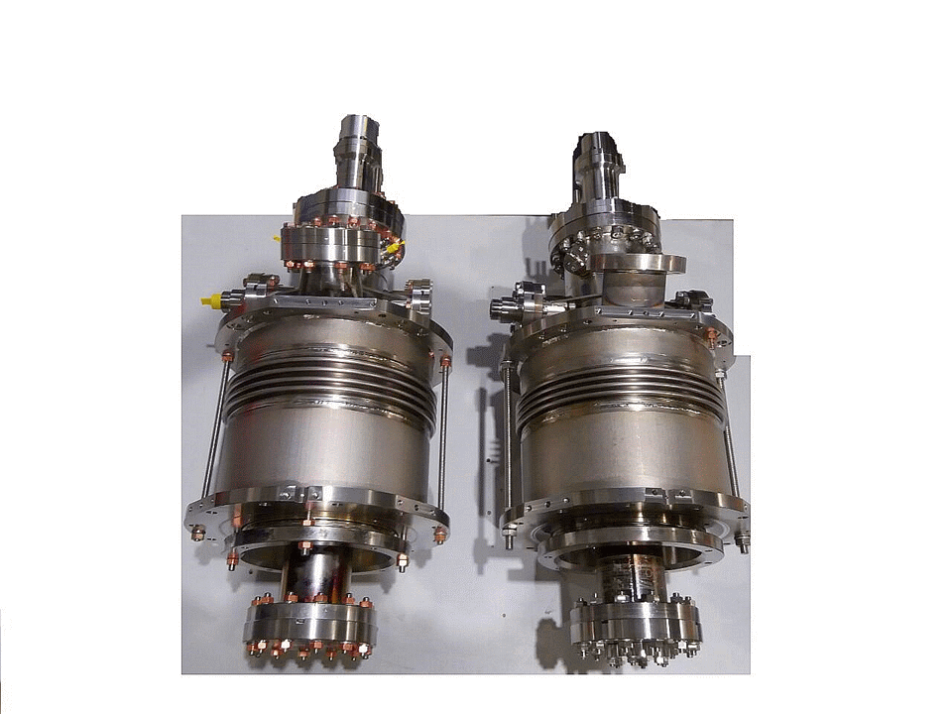
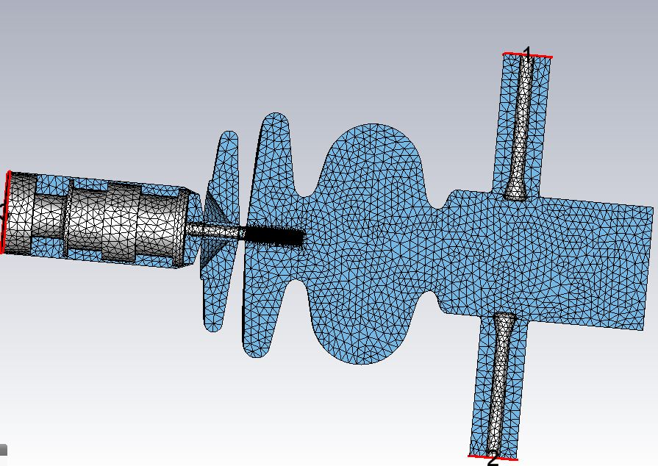
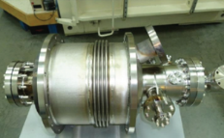
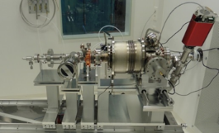
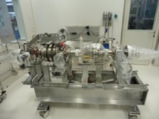
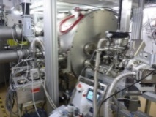
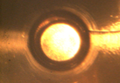
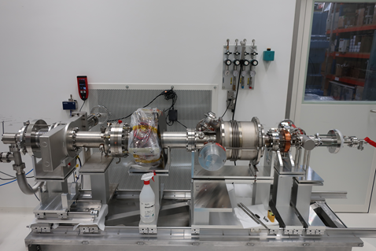
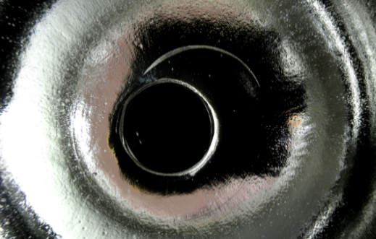
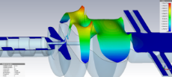

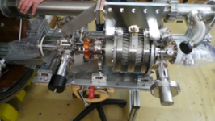
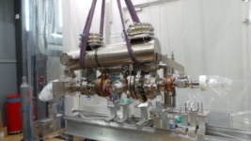
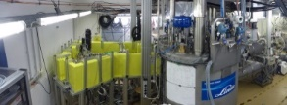
Evolution of the SRF Gun at HZB
SRF gun history
SRF photo-injector: From cradle to grave and resurrection
Fully in-house developed SRF photoinjector with strong partners
HZB
HZB
HZB
ERL17
ERL19
PC
VTA
VTA/HTA
HTA
Gunlab
1.1
1.0
Reassembly
1st Beam
Cathode transfer
Design
Manufacture
Test/Assembly
String test
String/Cold mass
Module assembly
Commissioning
Damage and Recovery
2011-2012
2013
2014-2016
2016
2017/2018
2018-2021
2022
Time

Slide 5
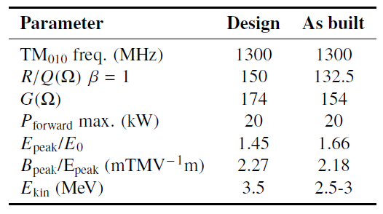
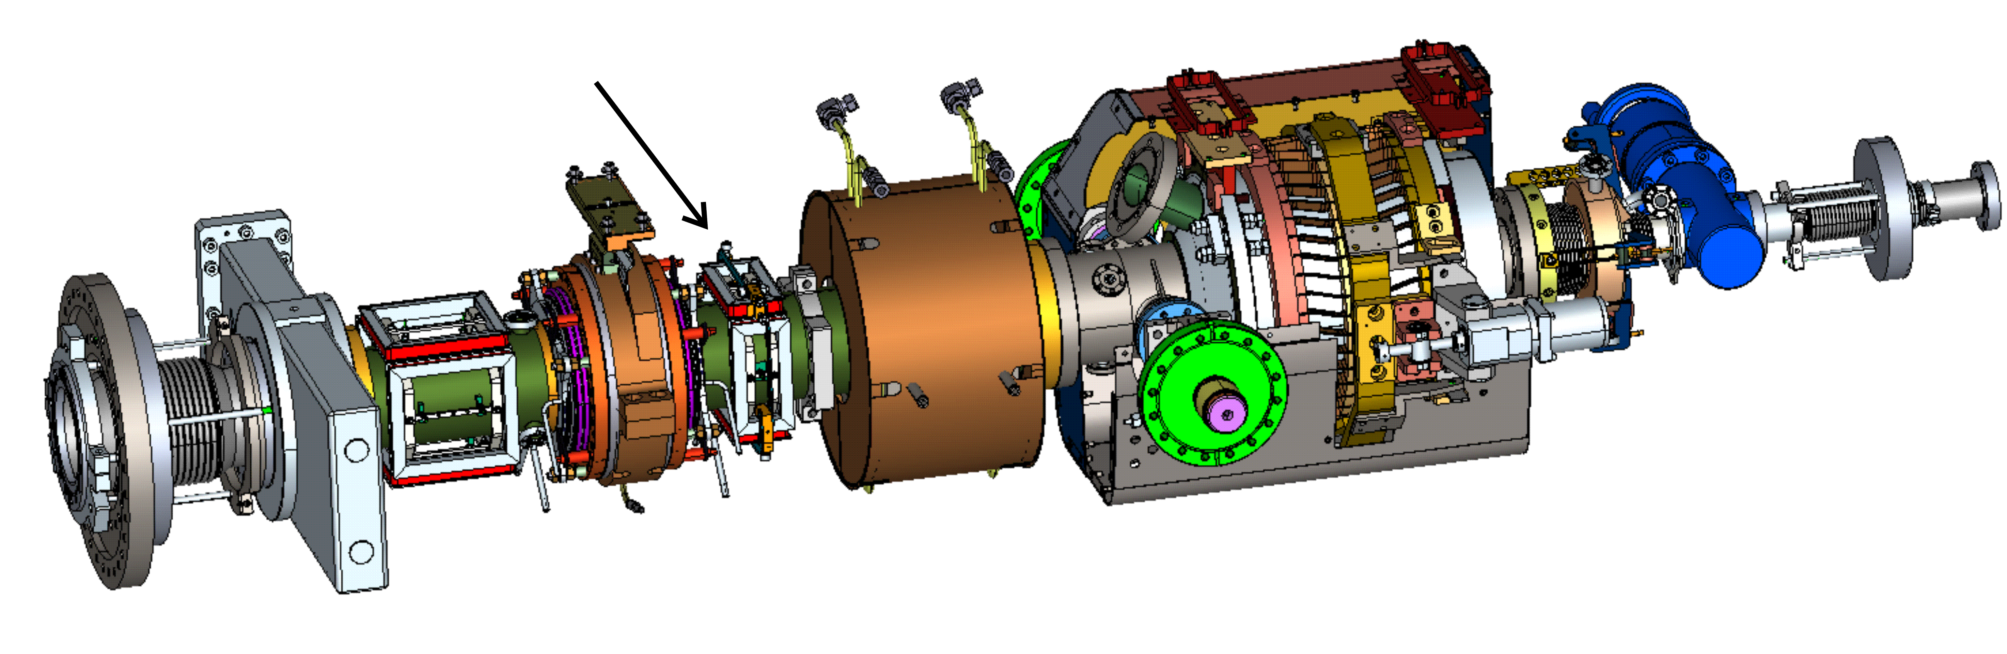
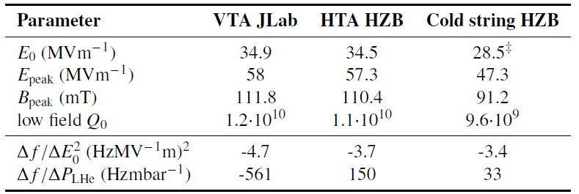
Cold String layout of bERLinPro SRF Gun
Parameters
Twin CW-modified
TTF-III coupler
up to 20 kW
Support
structure
Gate valve
and transition
to 300K
Cathode tube
with tuner (HZDR)
x, y steerer
4K
80K
1.4xλ/2 cells + Choke cell
80K
4K
1.8K
Cavity+LHe vessel
(HZB, JLab),
Cornell-type blade tuner,
2 layer magnetic shielding
SiC HOM
absorber (Cornell)
SC solenoid
*
*
*
*15-20% higher
found by beam
energy
measurements
Prototype designed by HZB
manufactured by JLab

Slide 6
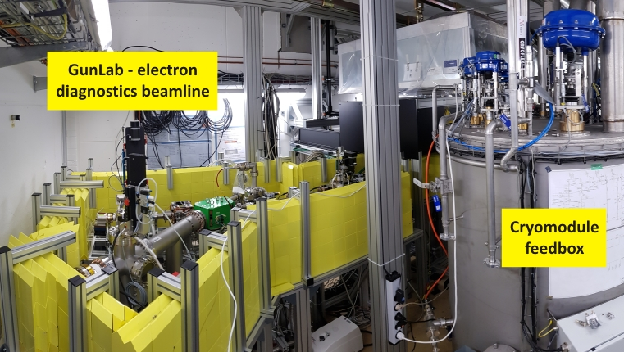
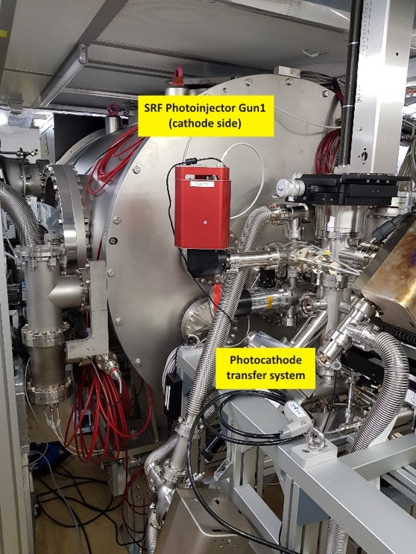




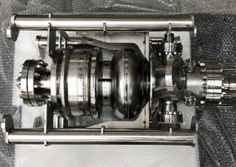
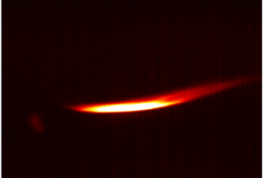
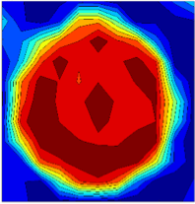
Operation of first 1.4 cell SRF Gun with cathode exchange mechanism
First beam
SRF Gun module
First beam 12/2017
01/2018 Operation with high QE cathode failed,
as cathode plug dropped into Gun cavity by malfunction of holder mechanism ☹

Slide 7
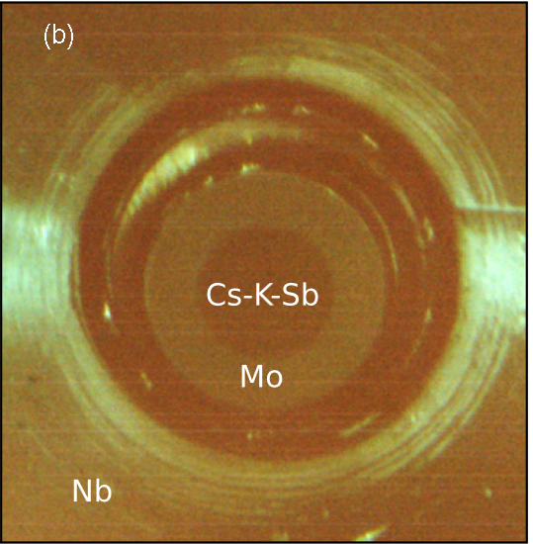
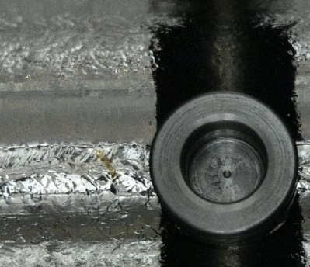
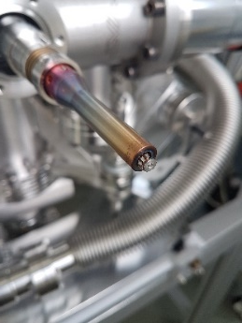
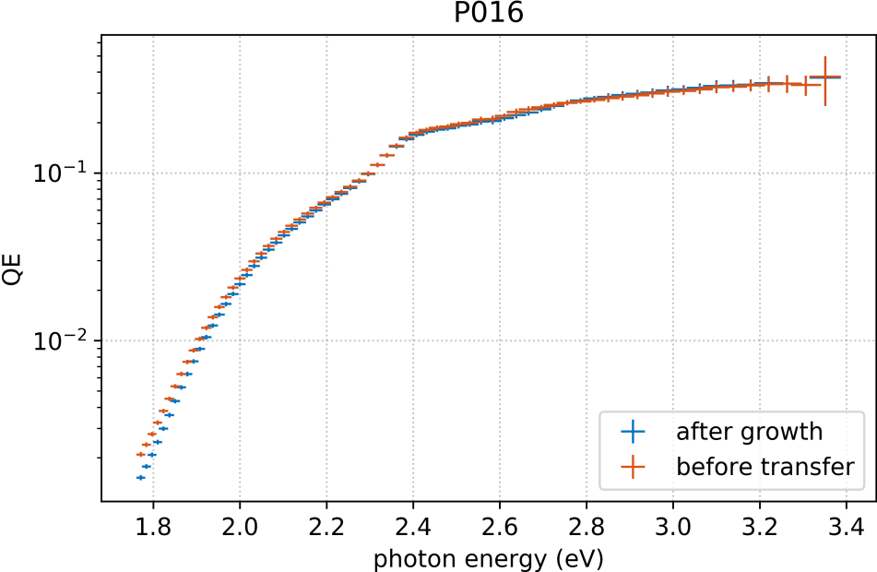
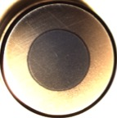
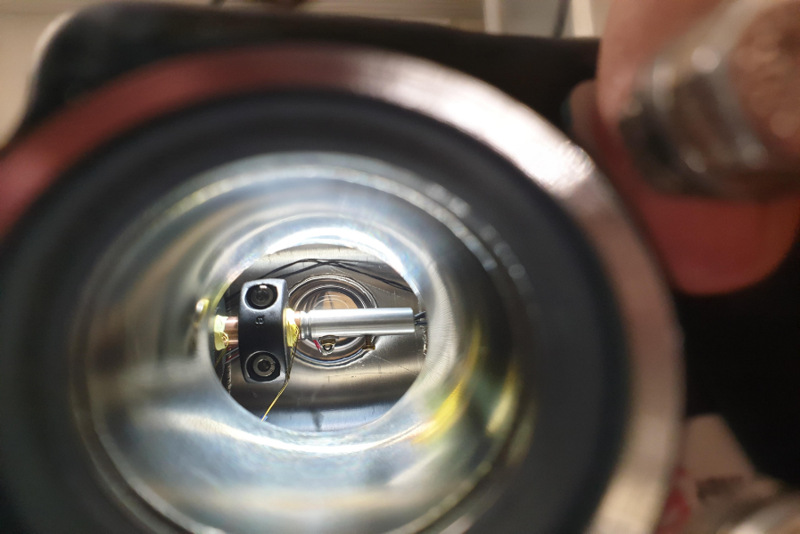
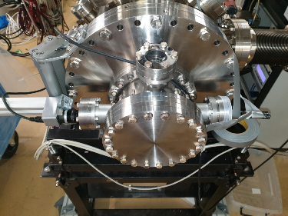
Development of high QE cathode and drive Laser
High QE cathode
Photocathode preparation and analysis laboratory up and running since 2015
- insight into growth process with material science studies in parallel
- achieved quantum efficiency of 16.8% at
515 nm (specs 1%)
- successful transfer from cathode lab to SRF gun
- demonstrated, that cooling of cathode to
120 K do not harm quantum efficiency
(unlike prediction by other researchers!)
Last evidence of cathode being alive
We were close to
operate this record
cathode in Gunlab…….
And learned from our
fails…..
doi:10.1103/PhysRevAccelBeams.21.113401
…cathode holder
heating and shock
experiments, Na based
cathodes…..and the cavity?

Slide 8
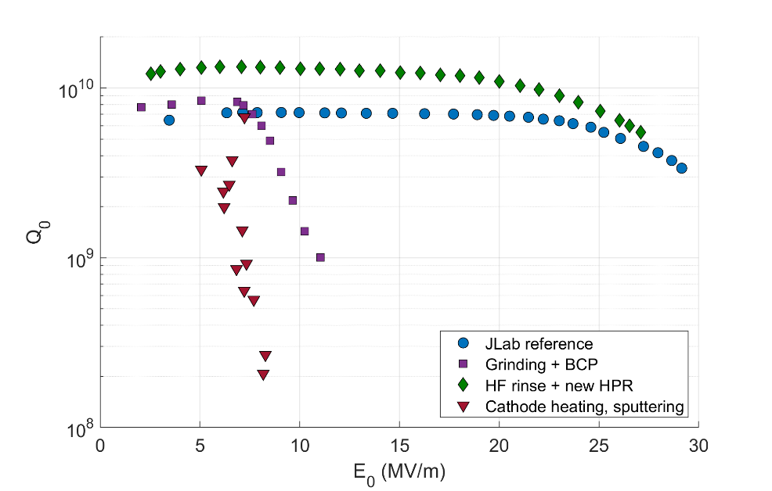
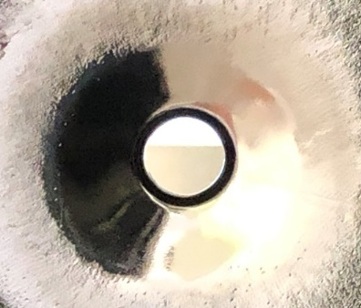
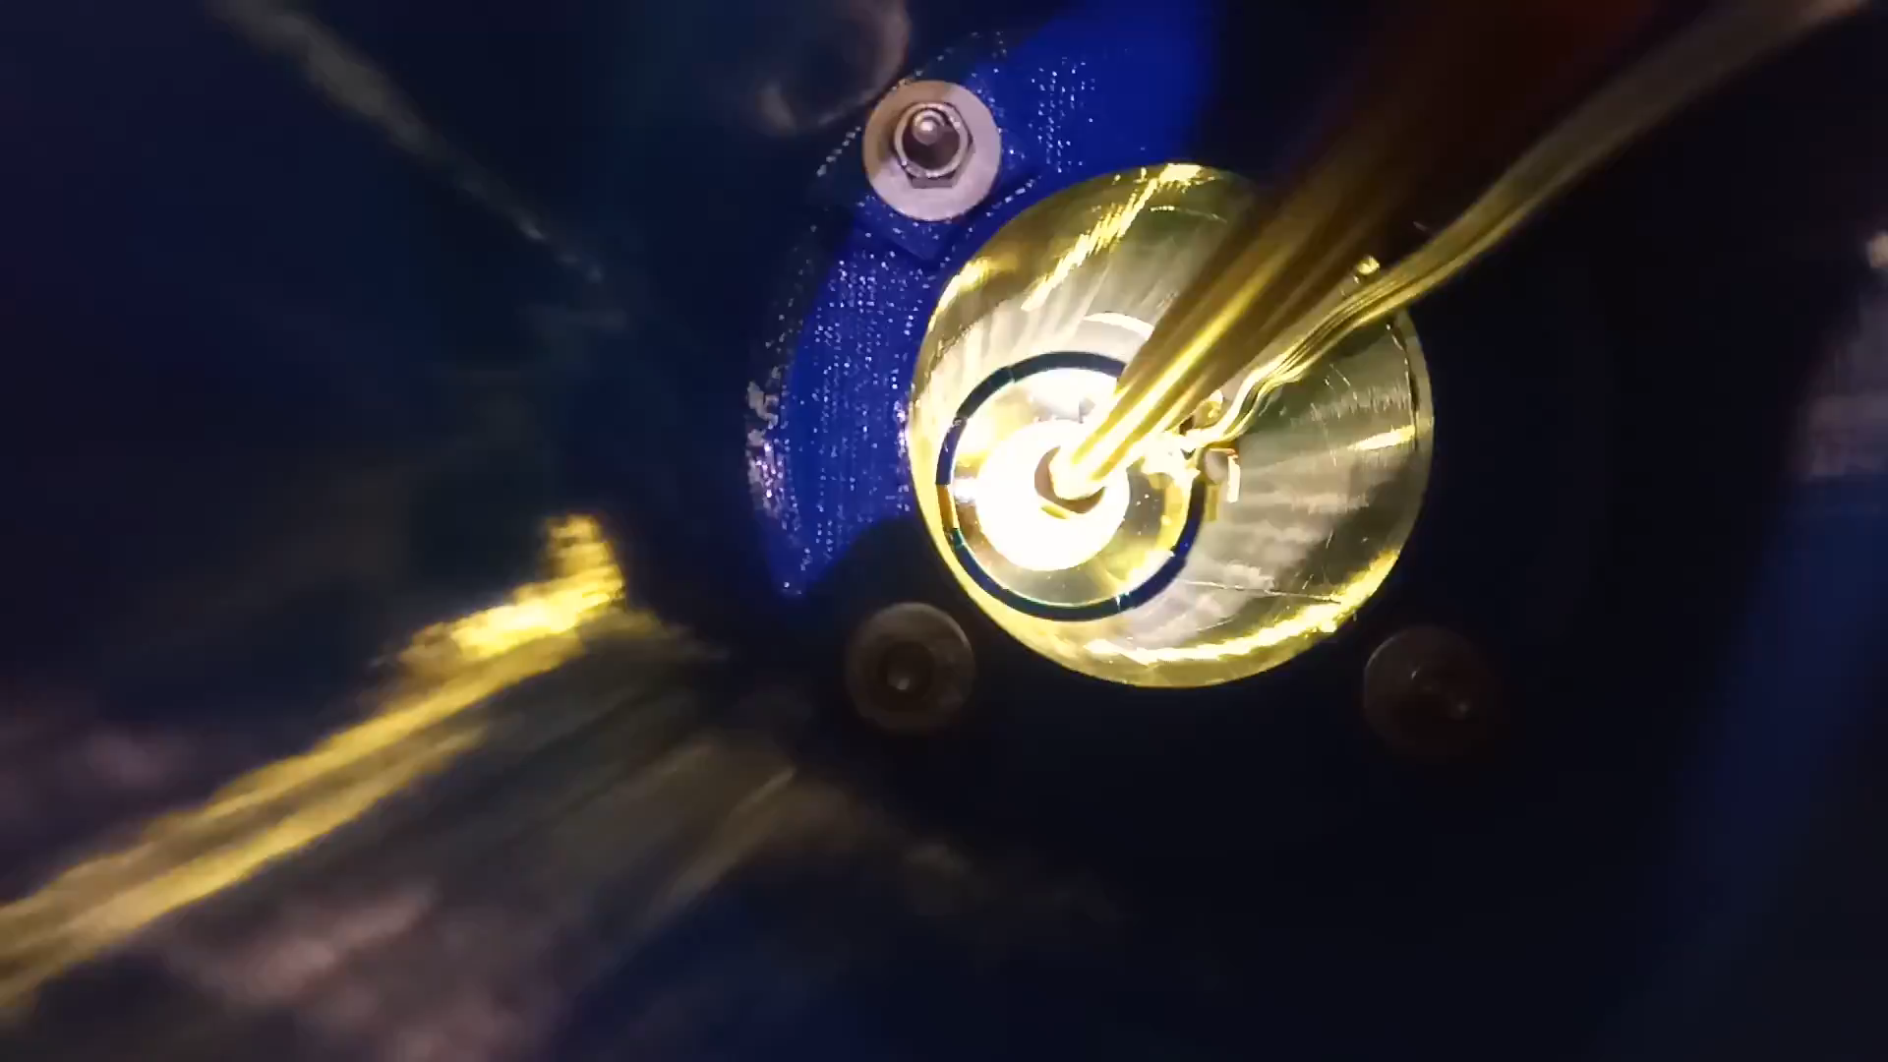
Recent Achievements → Refurbish SRF Gun
repair
Both cavities were damaged:
1.0 Initial scratch after production → Dark current
1.1 got damaged at manufacturer
A repair and refurbishment program was set up between 06/2019 until 06/2021
Treatment by grinding, polishing, BCP and optimized HPR system, HF rinsing →
Gun 1.0
1.1
1.0
1.1: HPR lance scratch
1.1 After grinding and
polishing
Y. Tamashevich, et al.
published SRF21
Gun 1.0 is back on track
Gun 1.1 close to old level
1.0: surface defects

Slide 9
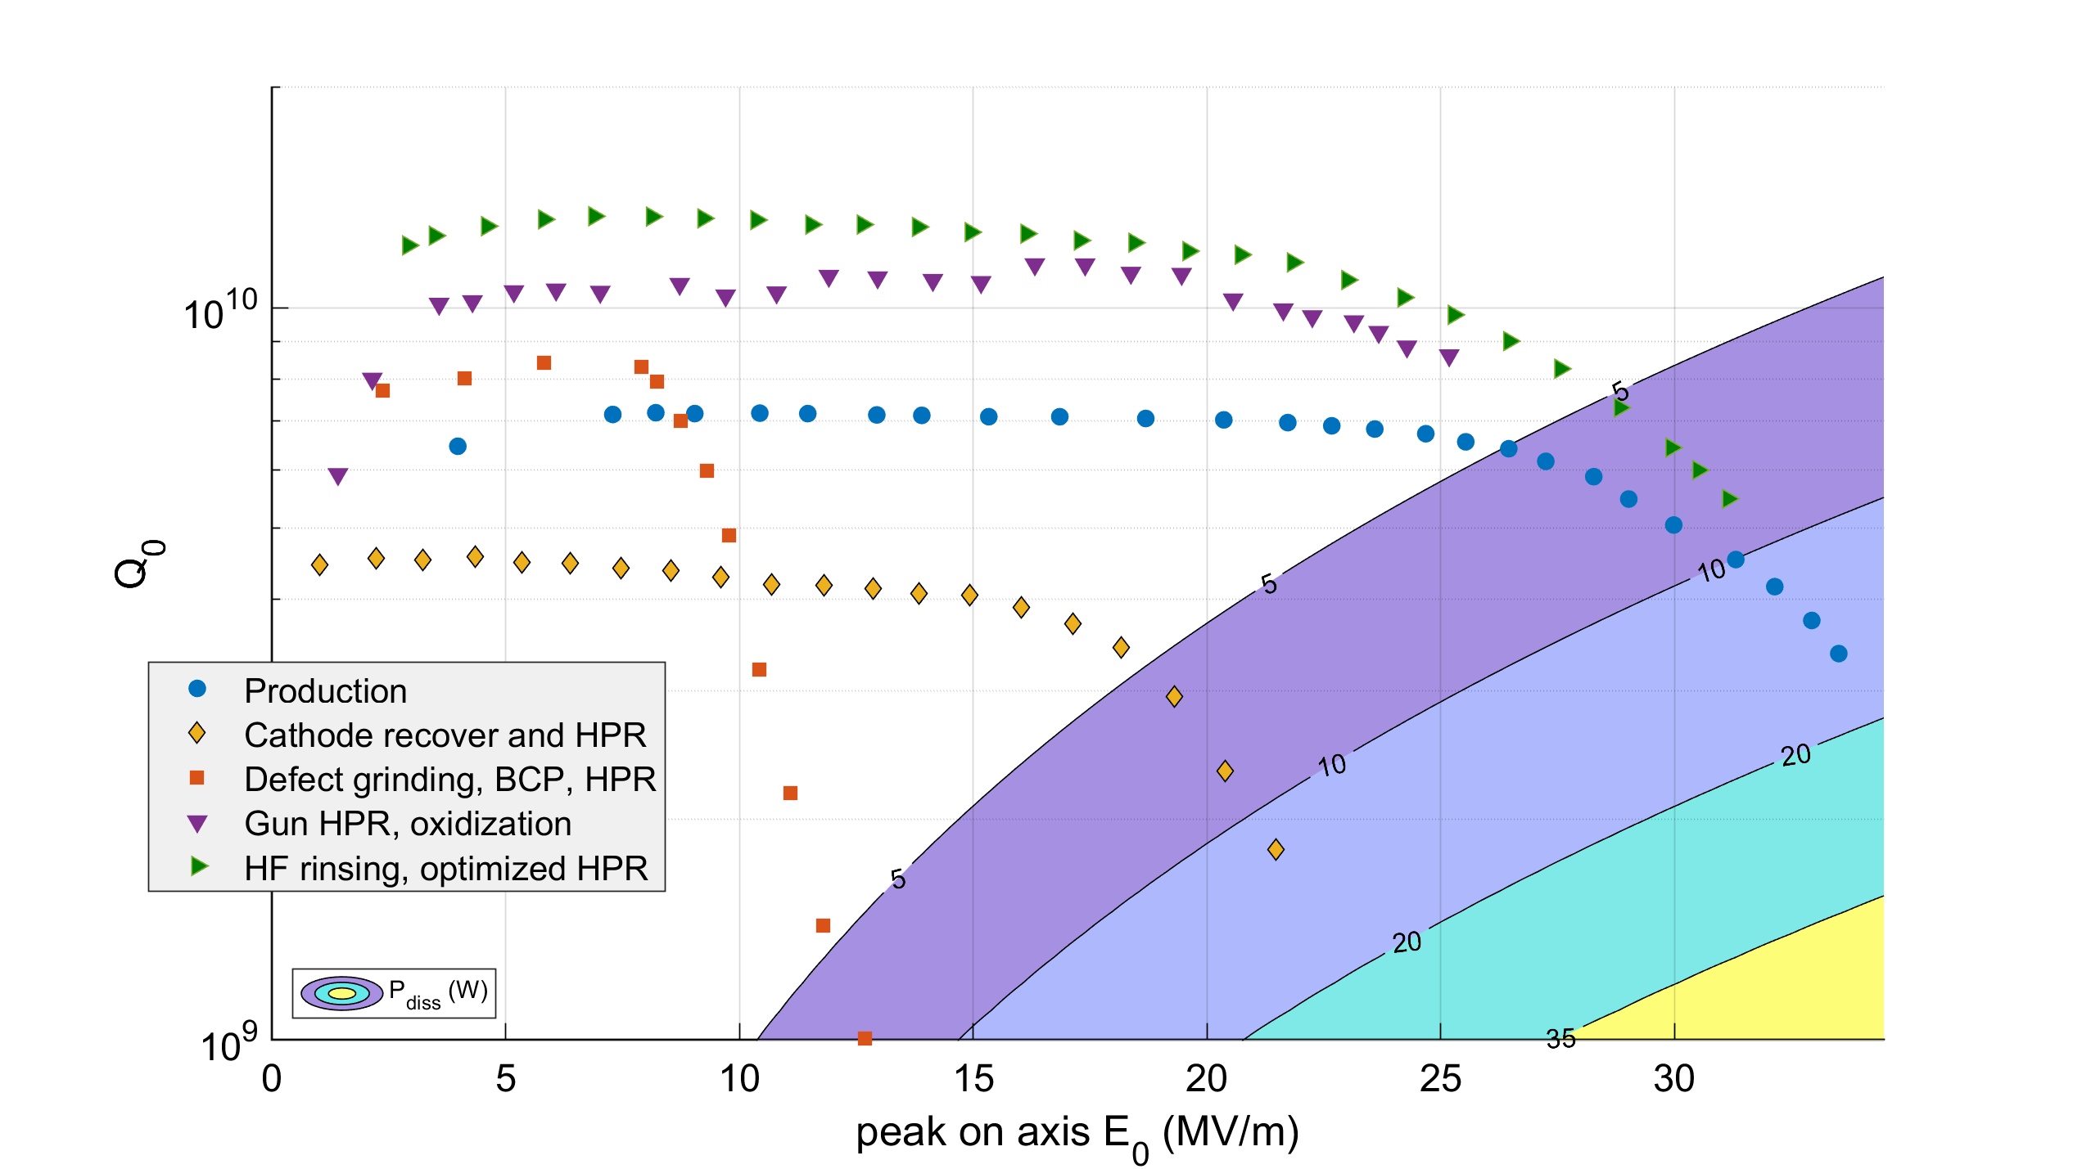
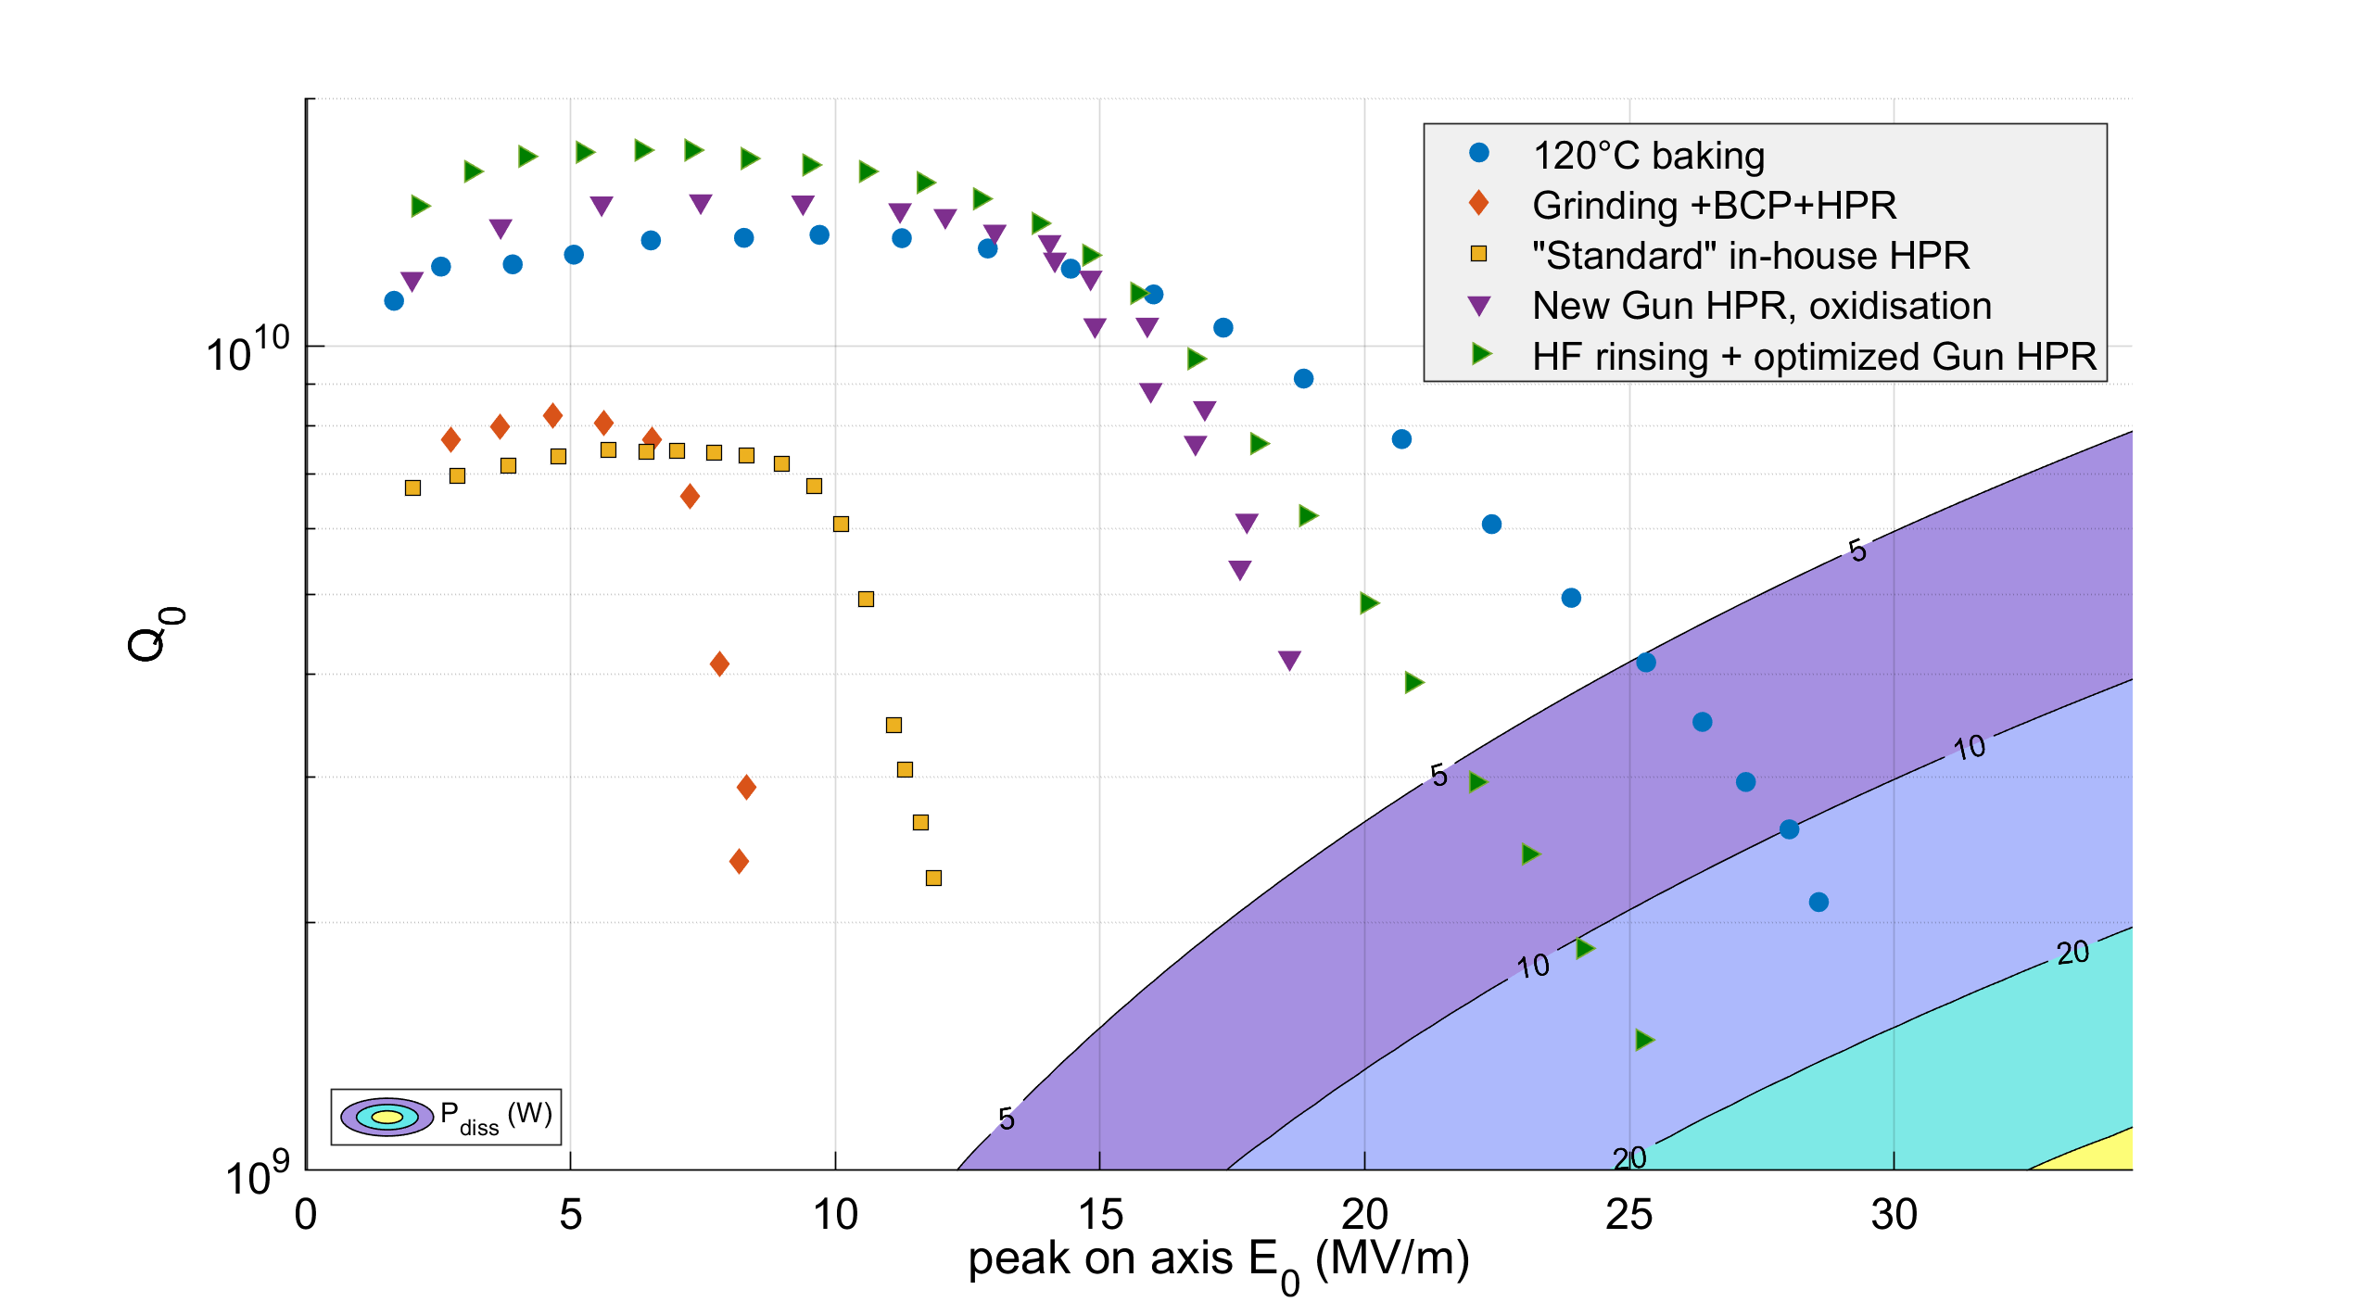
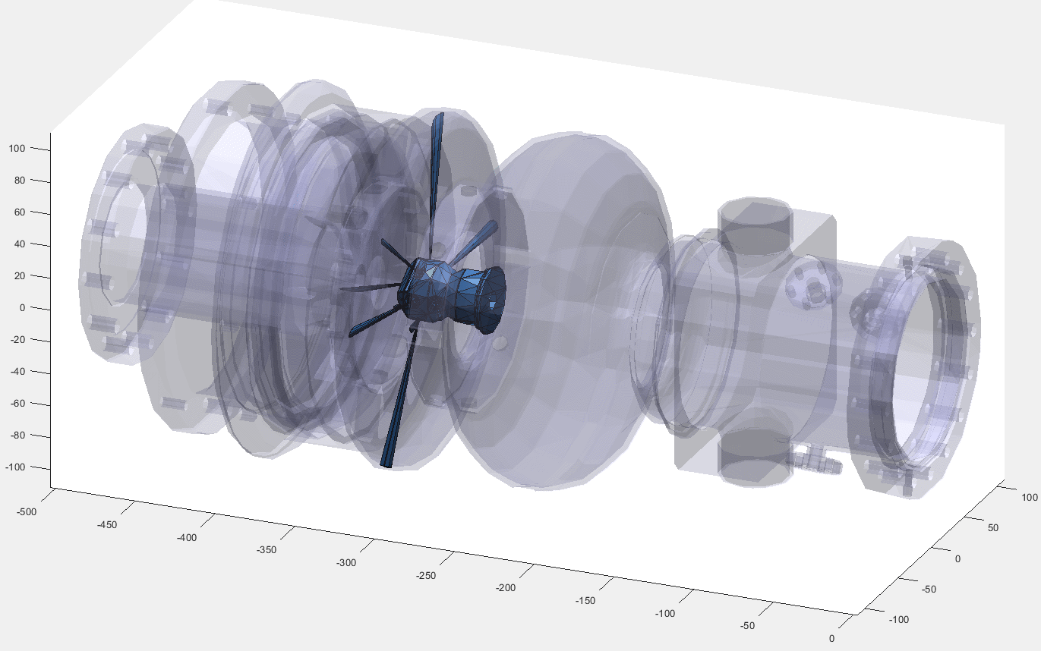
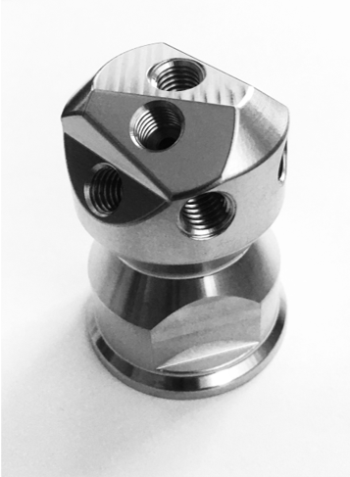
A closer look to the procedure and testing
Repair
1.0
1.1
Prototype cavity served as pilot to test and develop all procedures:
Defect analysis by replica method and laser microscopy
Defect grinding by special polishing method in high E-field area
BCP+HPR by vendor, later standard in-house HPR
In-house new HPR nozzle head for SRF gun geometry (several iteration)
HF rinsing of oxidization and following HPR with found parameters
F. Göbel
Y. Tamashevich et al., Superconductor Science and Technology
To be published

Slide 10

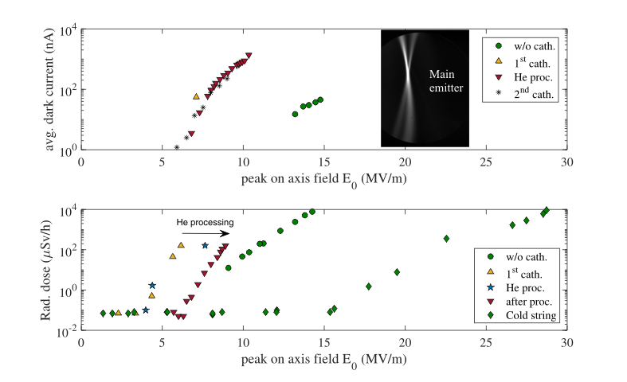
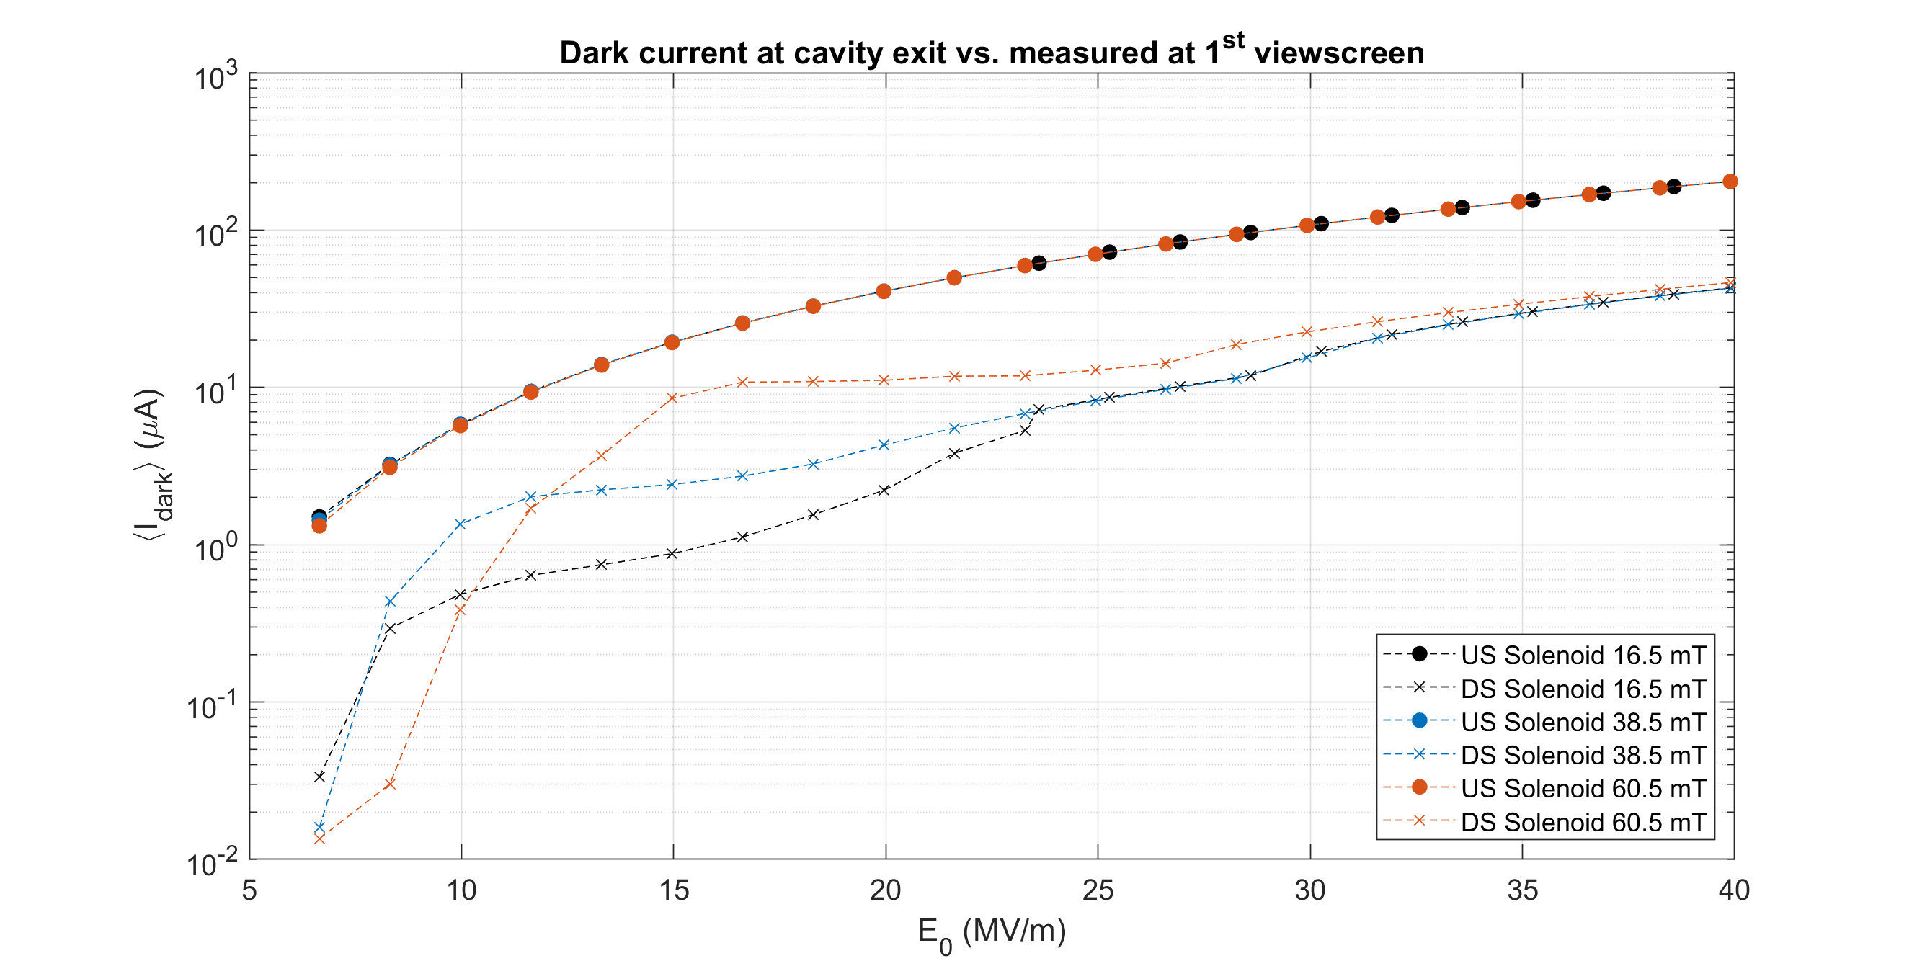
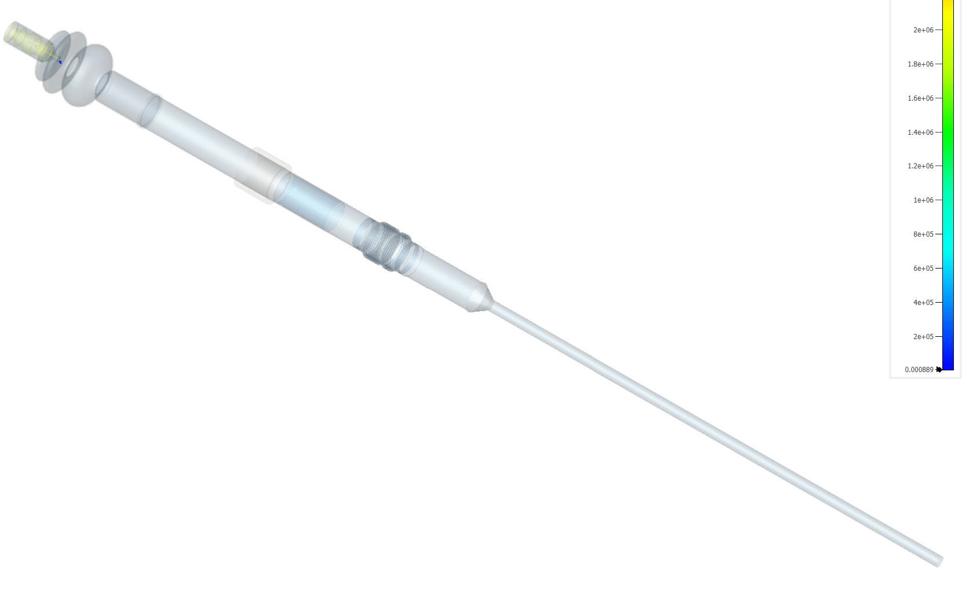
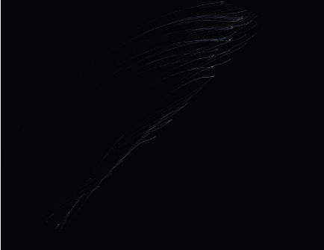
Dark current analysis of Gun 1.0
Could we have continued with Gun 1.0 as it was from the start?
Dark current
Upstream
Adjust Fowler
Nordheim
field emission
to measured
values.
Measured dark current
downstream is only
fraction of real amount
of current and depends
on solenoid settings
E₀=30 MV/m
100µA vs 100 mA at
cavity exit
20µA vs 100 mA 1m
downstream: 2.10⁻⁴
losses!!!
1st viewscreen
Cavity exit
Measured dark current distributions
with Solenoid scan (left) on 1st screen
and I_{dark} (E₀) at different stages of
assembly/operation
1st viewscreen
Goal:
Recreate situation of Gun 1.0 at
Gunlab and assembly stages
Simulate dark current from the found
defects close to the cathode hole opening
Analyze dark current distribution in injector
by simulation and varying parameter towards ERL range
Simulated propagation
Simulated dark current on 1st
view screen
2nd viewscreen

Slide 11
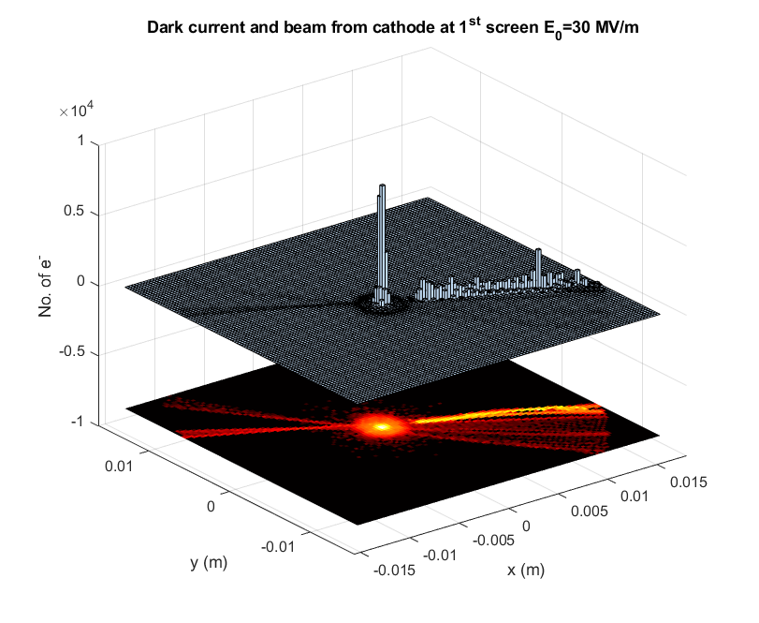
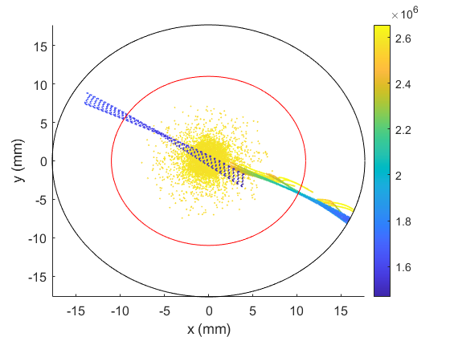
Screen based beam measurements with dark current
Gunlab and defect analyzed
Halo
E_{kin} (eV)
Beam tube diameter
Screen size
Beam distribution with dark current by two backwall
defects and E₀=30 MV/m
Scan of 20 ns, aka laser rep. rate of 50 MHz,
afterglow effect of scintillating screen?
77 pC beam charge vs. 0.5 pC dark current charge
Large fraction of co-propagating dark current at
similar energy levels as beam

Slide 12




Dark current studies with defects
Gunlab and defect analyzed
Half-cell
5.9/5.4
E₀=30 MV/m
Fractional losses of all surface
losses here in % with
Solenoid 75 mT
Solenoid off
Beamtube HOM
0.75/43.0
Ratio of dark current
level from cavity exit
to 1st screen to 2nd screen:
9:3:1 → only about 11%
leave to Booster
Bellow
22.3/6.3
Taper
13.4/5.5
Cathode Plug
5.0/4.6
Full-cell
1.9/1.8
Beamtube Steel
50.4/33.0
Losses in Watt at 1.8 K
Cathode Plug*: 8.5
Half-cell: 9.9
Full-cell: 3.3
Limit by 1.8 K cryo budget
and cathode cooling (32% of total)
Emission peak shifted
by 45 deg. from optimum
phase (E_{kin,max})
Some particles in SEY>1 region of Nb
→ rise of multipacting
*actually at 80K, but part of cavity system

Slide 13
Intermediate result
By the damage applied by the manufacturer during the last cleaning before shipping Gun 1.1 to HZB
we lost about 2 years to develop and perform a SRF gun recovery program, but:
As shown here, Gun 1.0 in the state as produced would have not sufficed for any kind of ERL operation
We are now able to recover cavities with a harmful damage of the surface layer and do the follow-
up treatment by chemistry and high-pressure water rinsing specialized for SRF gun structures, also
HF rinsing possible to remove eventual oxidizations
In vertical tests before cleanroom assembly, both Gun cavities were without any field emission
We better preserve this state

Slide 14






Impressions of Gun cold string assembly
Recent activities
Completed cold string leak tight and
evacuated, accomplished for Nikolaus 2021!
Petrov+cooler
positioning
Determine
cathode position
Concentricity
check with
dummy cathode
Preassembled sub-
components
Detailed, accurate preparation led to
quick, but not imprecise assembly
Key was documentation of the past (2016)
and a motivated and well working team
Thanks to:
André, Michael, Henry, Jan, Frank
and fast support from the workshop

Slide 15




Cold String Role out and preparation for cold string test in HTA
Recent activities
Role out
Cold String inside
HoBiCaT
Cold String test assembly
Prior to module assembly, a full cold string test is the final acceptance test in HoBiCaT:
Test if Q₀ and max. E-field is preserved after assembly
Did we activate any field emitters by improper handling?
Test of tuner system, coarse and piezo stacks
Characterization of parameters for LLRF control

Slide 16



Cold string test:First power ramp
Power ramp
At 14:00, 26th of January, the measurements were stopped
by an event:
Vacuum activity measured by both beamline sensors
Losses increase from static level to 2.2 g/s
No radiation was observed downstream
This happened at about E₀=19.6 MV/m, known as MP prone
regime due to shortened geometry of half cell
Note: no heating of beam tube observed
LF detuning -3.6 Hz/(MV/m)² confirmed field level
A second power ramp showed strong radiation, aka field
emission, the test was stopped, RF processing did not work
“Hard” Field emitter activated at 19.6 MV/m

Slide 17



Current SRF gun activities
Current Status
Gun cold string being disassembled
Assembly training with “used” SRF gun parts
Assembly of cold string with second gun and
newly conditioned power couplers
(CW optimized XFEL/TTF-III version)
Cold mass installation
Cryo module and cold mass integration
Setup and alignment of cryo-module in
accelerator hall, cryo- and vacuum connections,
diagnostics, RF, LLRF
Vacuum and cooldown tests
RF test without cathode
First cathode transfer (metal plug only)
RF test with cathode, adapting cathode
position
Cathode transfer, Laser on cathode, beam
Cathode transfer system in cleanroom:
Optimize transfer mechanics and insert placement
into cathode cooler/RF filter unit
Training of transfer procedure, monitor mechanical
feedback
Prepare transfer system for in-vacuum particulate
counter test

Slide 18


Status of the Booster
SRF gun
3x2cell Cornell style cavities
Modified coupler section to
house a redesigned version of the
KEK CERL couplers
120 kW travelling wave per coupler
at 100 mA
For first stage, loaded Q is increased
to be optimized for max. current
of SRF gun
Coupler tip optimized for improved
coupling, low penetration depth,
low kick and emittance dilution
Zero-crossing
2.1 MV
2.1 MV
Cornell style SiC beamtube HOM
absorber

Slide 19





High power Booster module parts
Booster
Cavities outperform specs
Coupler are being conditioned
One cavity has been tested with tuner
and magnetic shielding
HOM arrival last winter→ all parts for cold string in house
Xelera Research
HOM absorber
parts

Slide 20




High power coupler conditioning for Booster
Booster fpc
A lot of diagnostics and
Cooling water manifold
Assembly stages

Slide 21



Parameters under observation
Booster fpc
CST FD Solver: P_{in}=0.5 W rms
TW
SW
Reflecting end
Field amplitude x2
By coupled RF-
thermal simulations
potential hotspots
were identified and
equipped with
temperature sensors
All cooling water channels
kept separated to learn,
where most of the load
will happen
Phase
shift
Max. field at transition, fluctuates between FPCs
5.7 A/m
Max. field localized
10.6 A/m
TW electric field pattern

Slide 22




First trials
Booster fpc
Orange: CF, Green, parts covered
by new gasket type
95 kW TW reached at 10% duty cycle, vacuum processing starts
with 70 kW
Improved bake out procedure and replaced CF gaskets with
RF sealed version, improved S₁₁ parameter by 25 dB

Slide 23



Follow-up results
Booster fpc
Pulses from 1‰ to 980‰
Imbalance in couplers?
LOS of sensors?
1e2
Ca 0.25 K/kW at ceramic window→
about 55 °C at 120 kW TW expected
Confirms the values obtained in simulations

Slide 24


Achievements so far → High Power Coupler Processing
Booster fpc
3 out of 4 pairs conditioned, 4th pair in winter 2022/23
Parameter | Required Gun 1: 6 mA | Required Gun 2: 100 mA | Values reached so far
Traveling wave | 7 kW | 110 kW | 60 kW CW 120 kW 10% Duty Cycle
Standing wave | 1.75 kW | 54 kW | 15 kW

Slide 25
Summary
And?
Currently, we focus on finalizing the SRF gun, which means to mainly exchange the
cavity and couplers
The SRF gun will be installed in the injector and deliver first beam
The booster is going to be assembled, once the gun is installed (not enough personnel
for parallel work)
This winter, the last, currently only back-up coupler pair, will be processed to full
level: 120 kW TW and 30 kW SW (with overhead)
We better come back next ERL workshop with beam results
Thanks for your attention and to all co-workers at HZB and our collaboration partners,
who supported us on this way

Slide 26


Module layout
Module layout of bERLinPro SRF Gun
Achievements
Holders and bellows for alignment
80K
helium
shield
Both doors can be opened
HGRP
2nd magnetic
shield
Modified: Issue
with thermal short
Beam
Cathode transfer system port
4K cooling:
  Solenoid
  HOM load
  FPCs
4K filling line cavity
1.8 K JT line cavity
80K FPC and HOM
80 K shield and cathode
Solenoid shielding:
Cryoperm around solenoid
might saturate
Replaced by Nb disc
between Solenoid
and cavity outer shield,
efficiency factor 5-8
to be published by
J. Völker et al.
External Solenoid hexapod mover with feedthroughs

Slide 27





Transfer system and cathode carrier (HZDR modification)
Achievements
Transfer system behind module
Module+transfer system
Plug: Ø 10 mm
3(4) thermal
transitions
Cathode insert with Plug
and transfer rod
Cathode cooler (80 K Helium)
and Petrov filter holding the insert with tuner

Slide 28

Major project challenge:
3 different type of cavities and modules for different requirements

