Slide 1
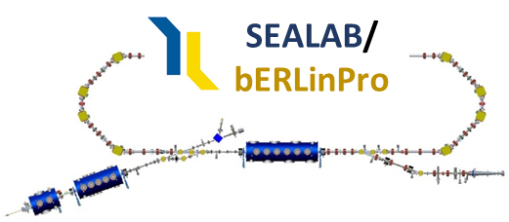

Status and Perspective of the Energy Recovery Linac at HZB
a new perspective for bERLinPro?
10/03/22, A. Neumann for the Sealab/bERLinPro Team
66th ICFA Advanced Beam Dynamics Workshop on Energy Recovery Linacs
Cornell University, Ithaca, NY

Slide 2
bERLinPro: Past, present, future
Introduction
What I would like to be the message of this talk:
bERLinPro seems to be quite a while around already…..
ERL 2013, 2015, 2017, 2019,….2022
What is the current status of the facility?
Some highlights of the on-going work
What do we plan with bERLinPro?
When will we finally have first beam inside the accelerator hall?
All that above I hope to answer within the next 15 minutes
Disclaimer: SRF related status will follow in the first SRF session on Tuesday
>
Back
to the Future?

Slide 3
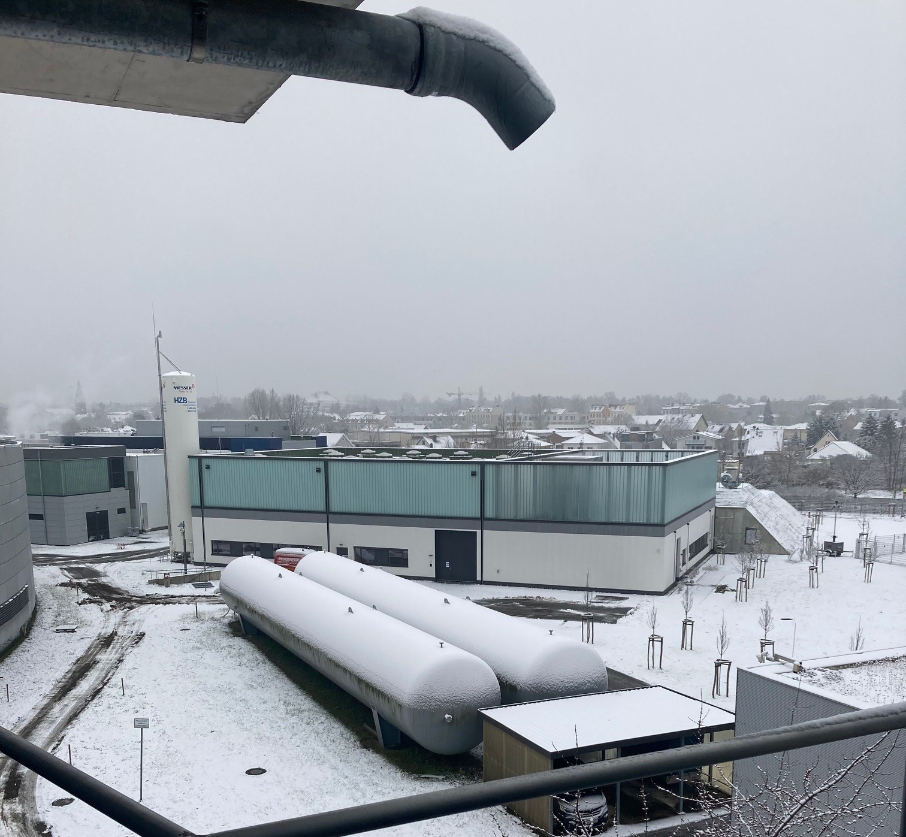
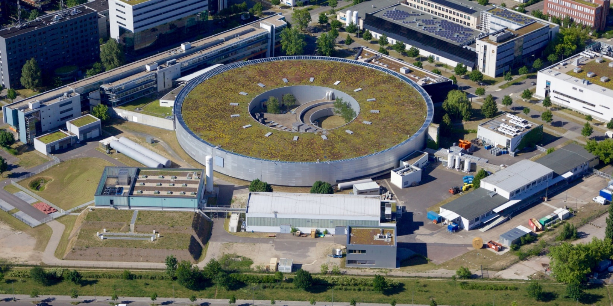

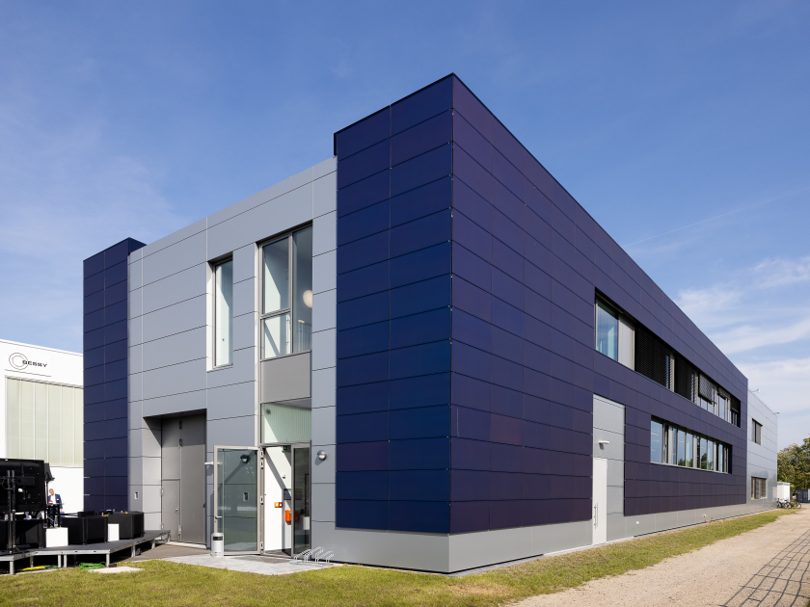
Where is bERLinPro?
bERLinPro in Berlin Adlershof
Introduction
Fala-FEL Place
ERLs in
Europe
(past, present
future)
BESSY II
MLS
Daresbury
Berlin
Mainz, Darmstadt
Orsay
N
Cern, Geneva
SEALAB
SLH
bERLinPro
TH2, TH1: Cleanrooms, SRF Teststands

Slide 4
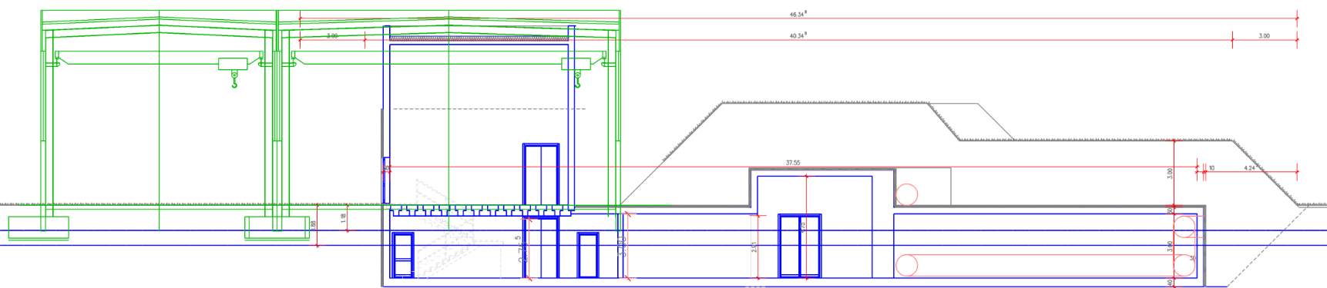

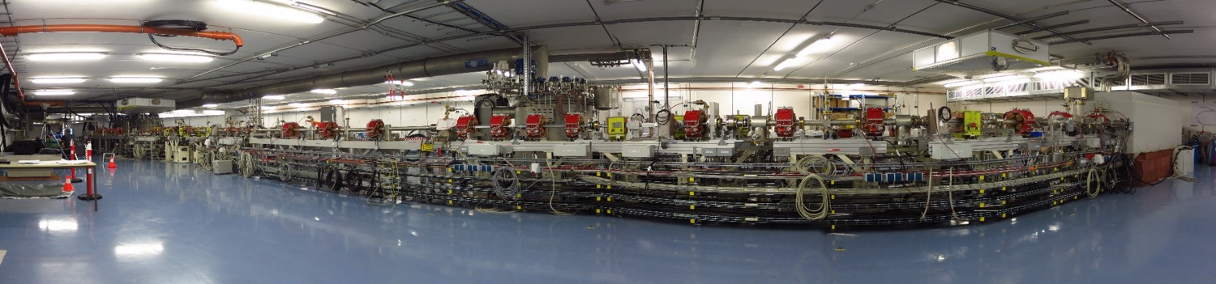

bERLinPro/SEALab: A quick orientation
Technical Hall
Radiation protection cover
Basement
Accelerator Hall
BESSY II
bERLinPro is located in a
sub-terranous radiation protection
shelter prepared for maximum
beam loss
All technical infrastructure, besides
the klystron and some cryogenic
installations are above ground in a
technical hall
HoBiCaT, sVTS
bERLinPro
LVTs,mVTS

Slide 5

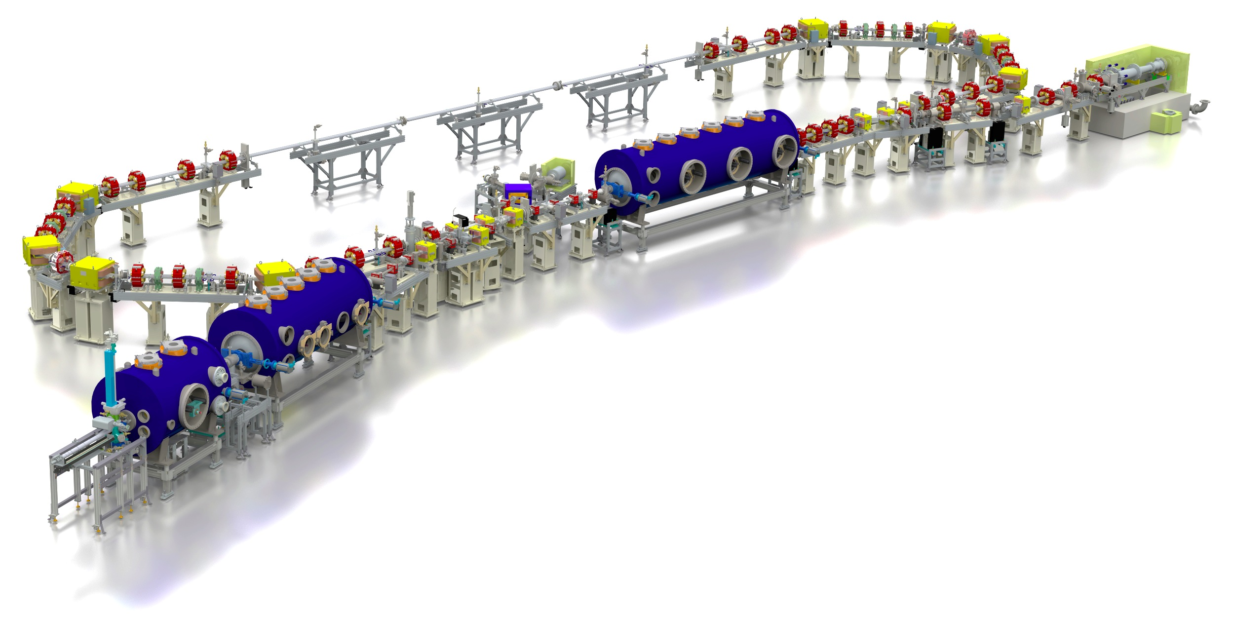
bERLinPro ERL after re-scoping in 2012
introduction
bERLinPro: A demonstration facility for ERL science and technology
New developments:
Beam dynamics and manipulation
(merger, recirculator, study beam break-up)
SRF systems: Photo-injector, high power
booster, HOM damped Linac
Electron source: High repetition laser system
high QE cathode development
Control of beam losses and
radiation protection
High power beam dump
High power CW RF
  Few 100 kW class
  klystrons → Power couplers!
  Some 10 kW solid
  state amplifier
Diagnostics, synchronization
machine protection, beam
loss monitoring, LLRF and detuning control
A stable Cryoplant
Recirculator
test and
diagnostic line
beam dump
6.5 MeV, 100 mA
= 650 kW
linac module
3 x 7 cell SRF cavities
44 MeV
merger
dogleg
modified Cornell booster
3 x 2 cell SRF cavities
4.5 MeV
Parameter | bERLinPro
Beam energy recirculator (MeV) | 50
Beam current ERL mode (mA) | 100
Frequency RF and Laser (GHz) | 1.3
Normalized emittance (mm mrad) | 1 (< 0.6 in simulations)
Bunch length (ps) | < 2 (ERL mode), 100 fs @ 10 mA
Beam losses | << 10⁻⁵ @ 100 mA
srf-gun
1.4 cell SRF cavities
1.5-2.3 MeV, single SC solenoid,
A fully funded 42 M€ project (including completely new building!)

Slide 6
Why bERLinPro, why ERLs?
Introduction
From next generation Lightsource to many applications, e.g. HEP
Next generation multi-user light source
(e.g XFEL oscillators, multi-ID facility as former ARC-en-ciel or 4GLS)
High energy electron cooling of bunched proton/ion beams
(e.g. hadron cooling of Electron-Ion-Collider EIC by BNL/JLAB)
Ultra high luminosity electron – ion collider (EIC, LHeC)
(ERL serving as high intensity electron factory for electron
hadron collisions at LHeC (7TeV p, 50 GeV e-), similar as former HERA )
Many applications bERLinPro would deliver important results or milestones for
High energy, high luminosity e⁺e⁻ collider
(Two ERL based ring collider with larger luminosity than FCCee or ILC
proposal: Physics Letters B 804 (2020) 135394)
Compact radiation sources, nuclear physics
(FEL, inverse Compton sources, next generation lithography, THz facility,
MESA, Triumf)
and more …: UED by injector
Prospect: ERLs allow efficient operation at high average brightness/luminosity with Linac class beam quality
→ Reduces ecological footprint of large-scale science, especially when combining with higher
T_{C} SRF technology, vision of sustainable large-scale science driver

Slide 7
Some recent achievements
Status of the facilty
(remember w/o SRF)
Achievements

Slide 8
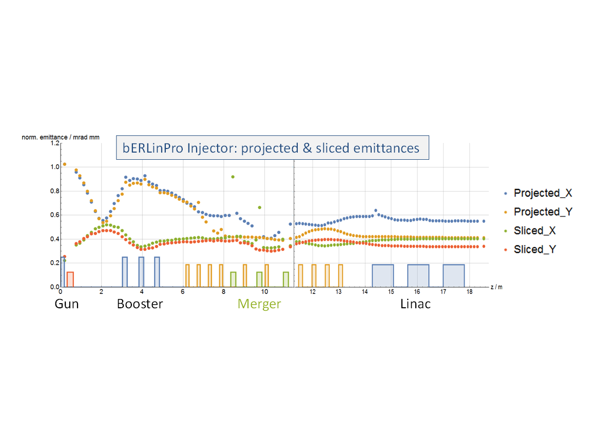
Design optics versus challenges
Achievements
Injector and recirculator
optics design, magnet
layout, collimators
Start to end simulations (Astra+
Elegant), full 3D studies (OPAL),
genetic optimization algorithms
(MOGA), first look into ML
Wanted vs. unwanted
beam studies, dark
current, halo formation,
Beam break-up studies
and countermeasures, wake
analysis and component opt.
Orientation of injector cavities
optimized to:
  Reduce coupler kick effects
  Limit back travelling dark current
  towards cathode
  Short pulse and low emittance modes
Parameters at LINAC exit
Energy / MeV | 50.1
Bunch length / ps | 4.65
Emittance x,y / µm | 0.58/0.41
Energy spread / keV | 254
Dark current losses along
injector
M. Abo-Bakr, M. McAteer, J. Völker
B. Kuske, M. Matveenko, E. Panofski et al.
see Bettina’s talk on Tuesday

Slide 9
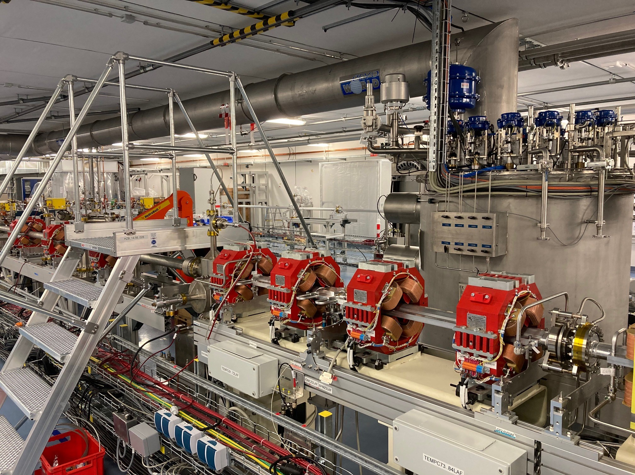
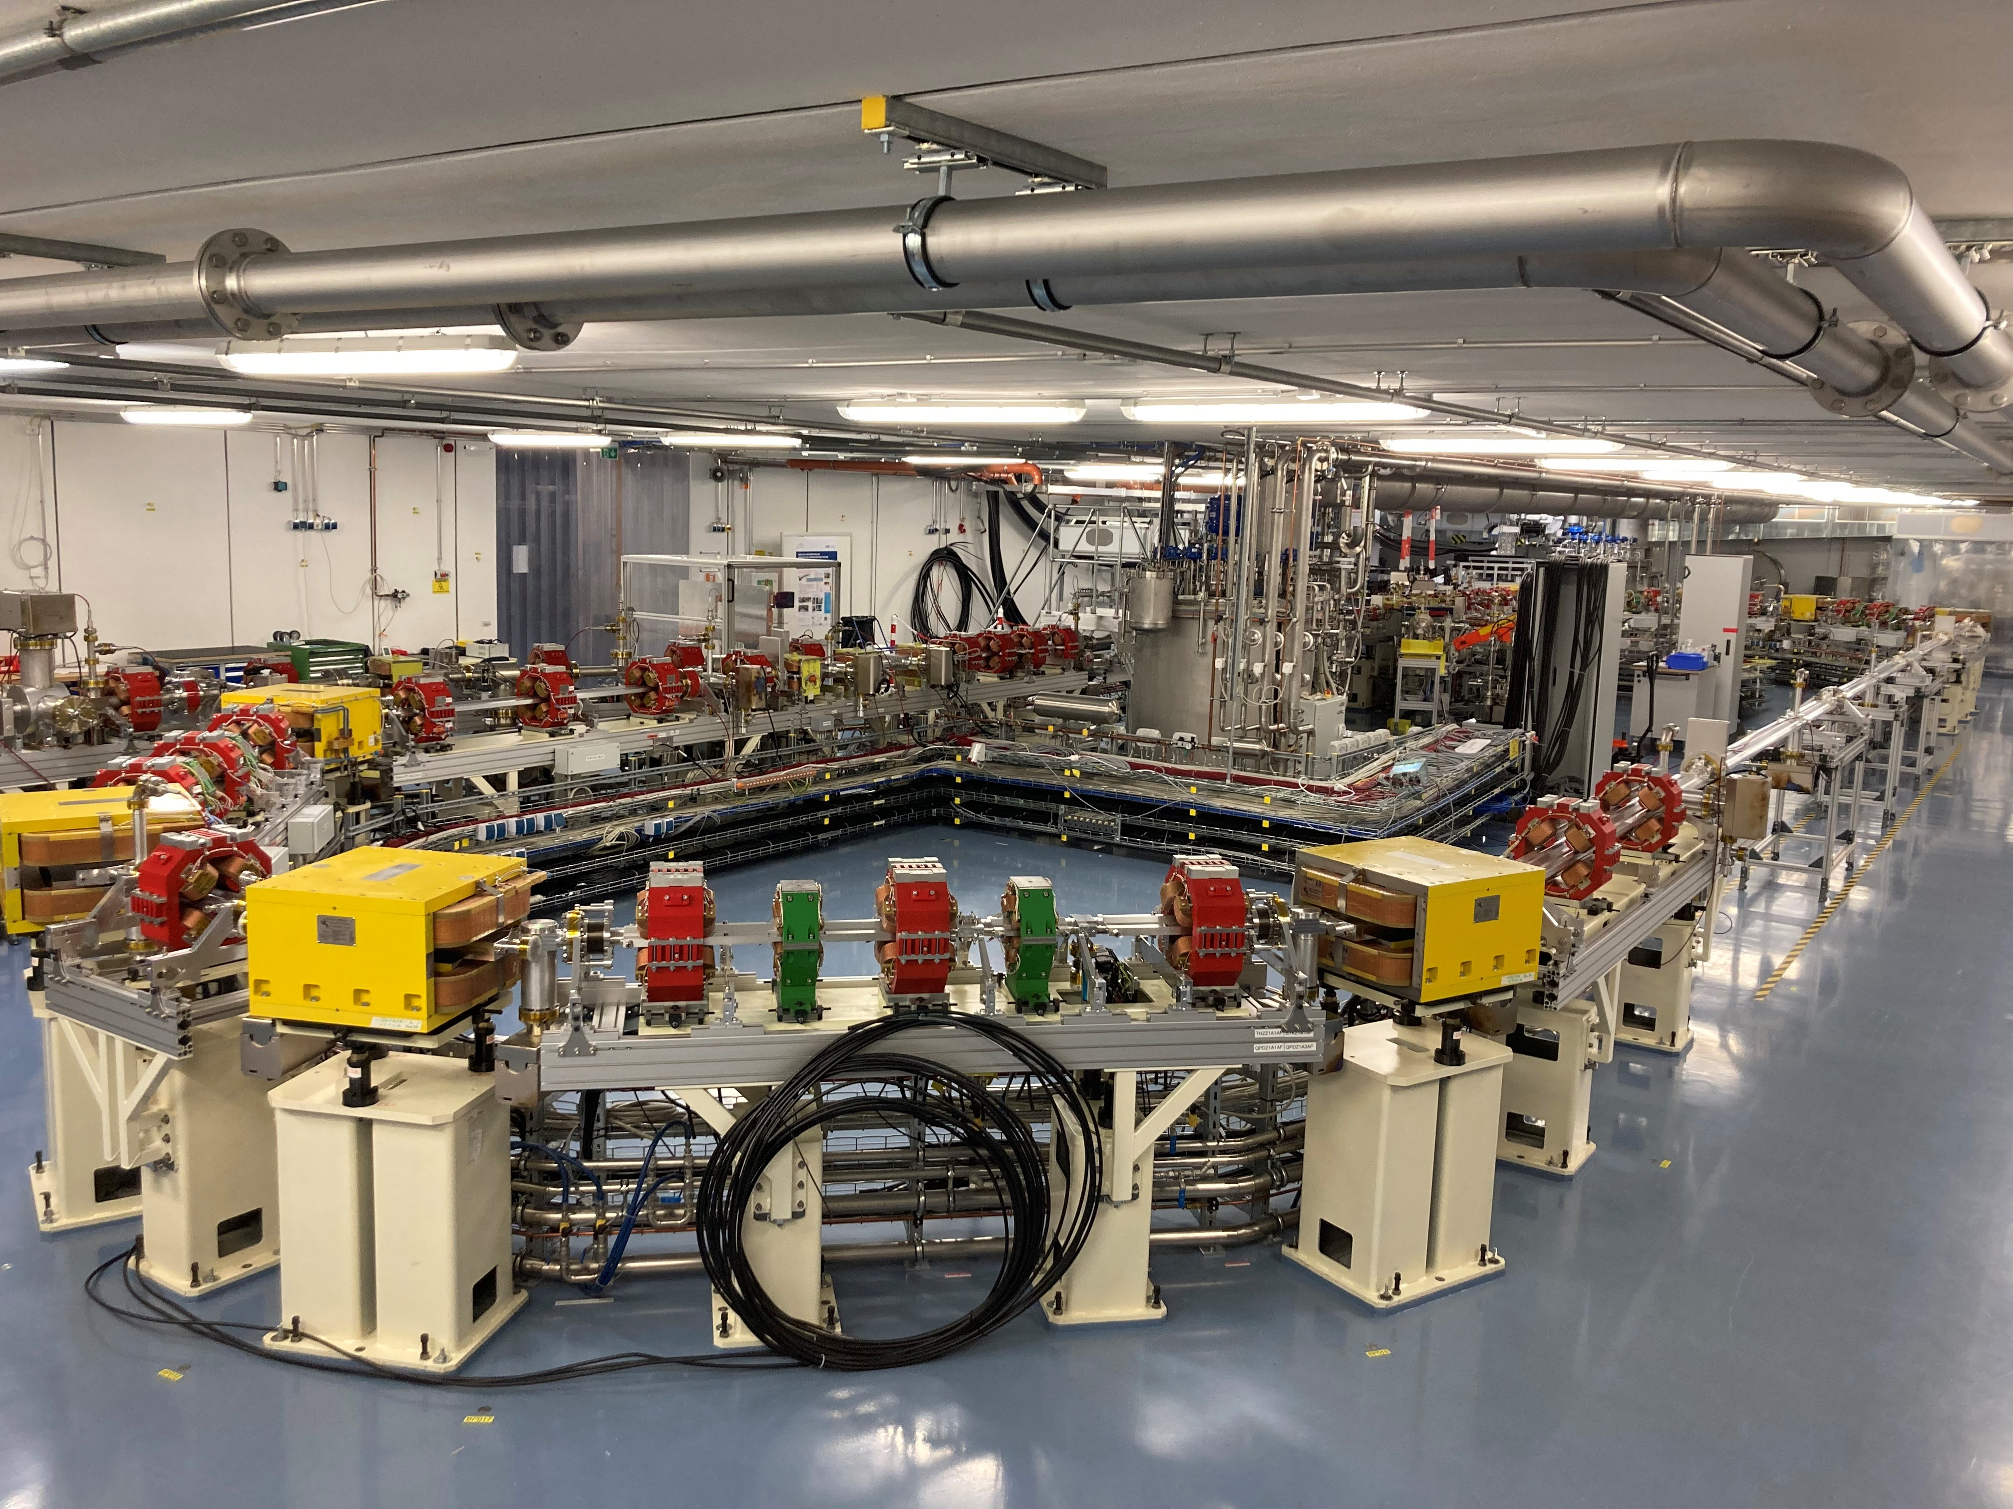
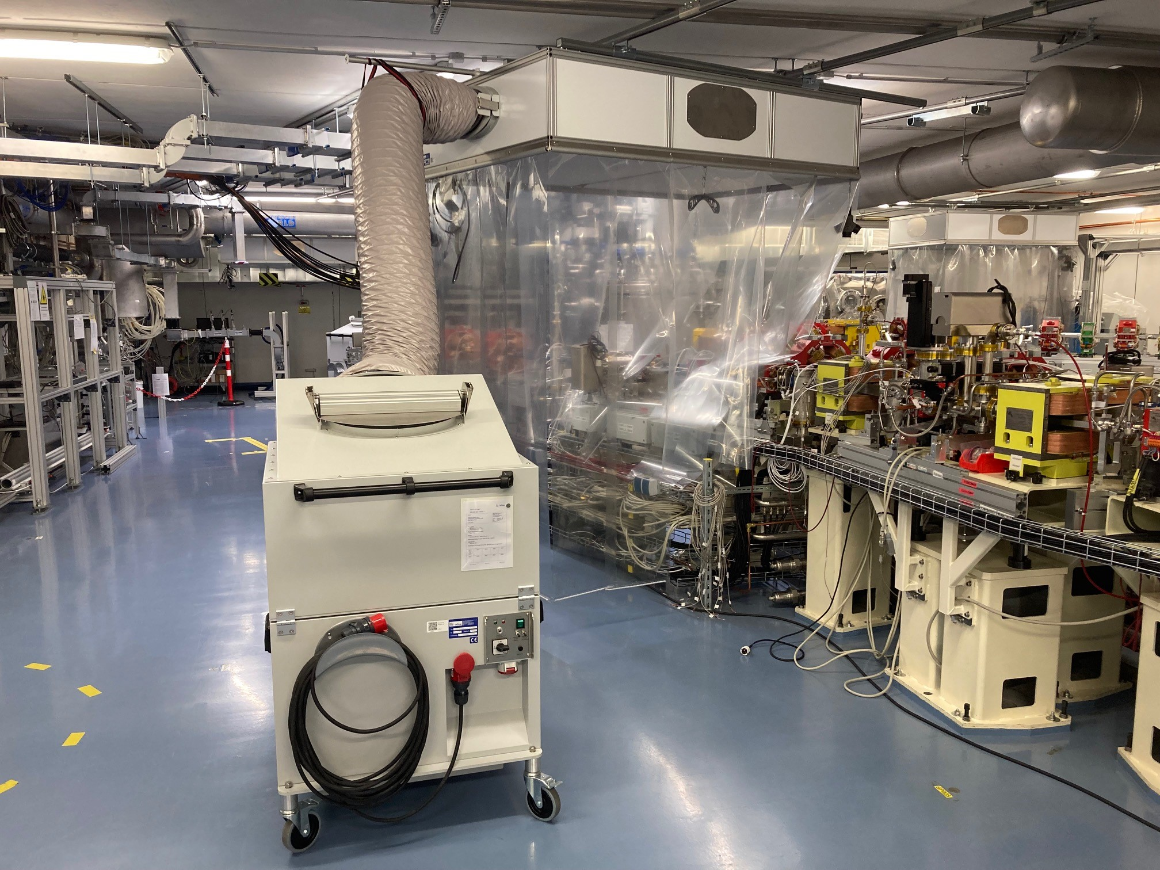
Beam vacuum system, magnets, cold boxes
Achievements
Linac section with
coldbox for cryogenics
supplies
Rail system at ceiling
to allow ISO5 flow-
boxes everywhere at
the machine to avoid
particulates
Vacuum system complete, realigned with coordinate system
adjusted to building (moved over the years)
Cabling of diagnostics well advanced

Slide 10
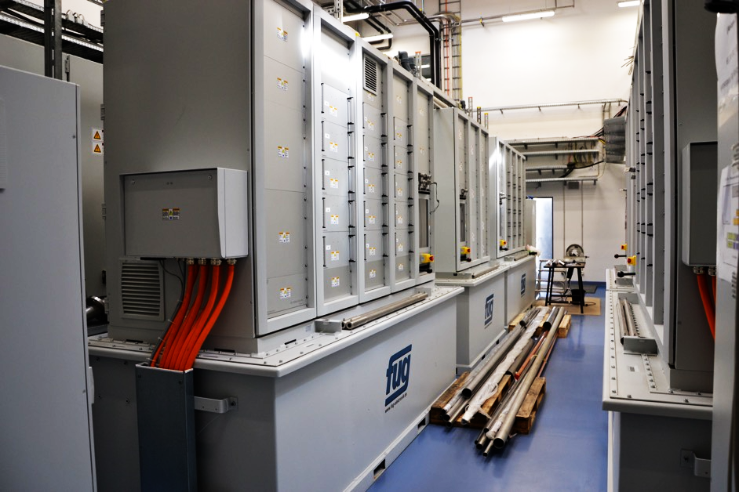
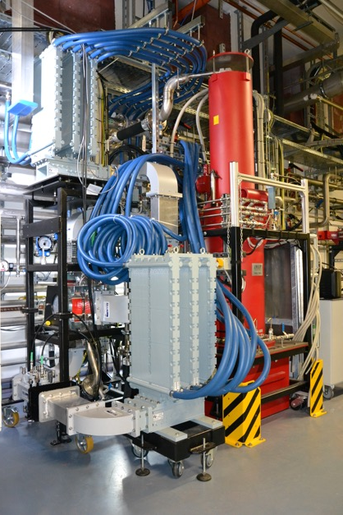
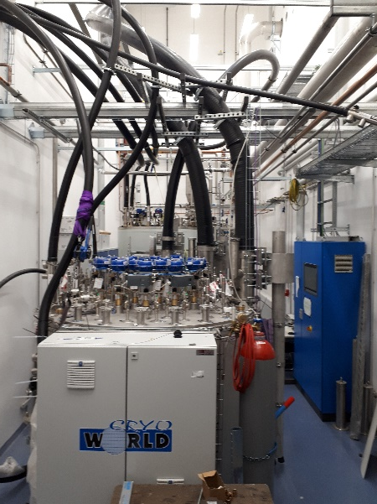
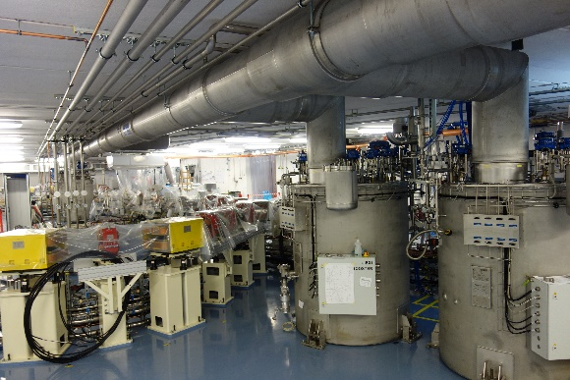
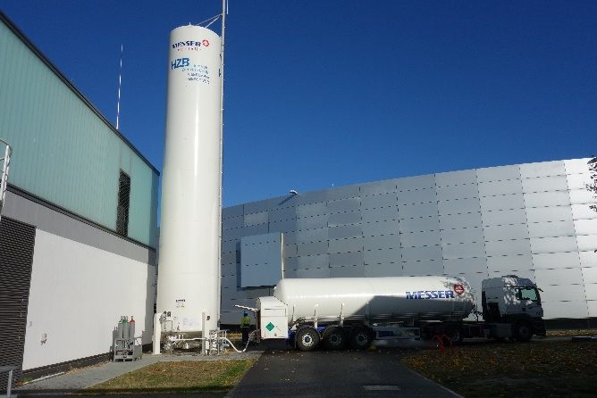
RF and cryogenics installation status
Achievements
1.3 GHz CW 270 kW Klystron
Second test in dummy
load
Final commissioning ongoing
mainly cold compressor operation missing (1.8K)
Pics
courtesy
W. Anders
600 kW FuG power supply
3 Klystrons in house, 1 tested in
SLH and at bERLinPro up to 270kW,
currently in use for coupler
conditioning
2 Klystrons will power Booster,
1 an high-power gun at some point
15 kW solid state amplifiers for Linac
Tcav and 1st Booster (zero-crossing)
Made by CPI
N₂ to cool L700
Booster+Gun coldbox

Slide 11
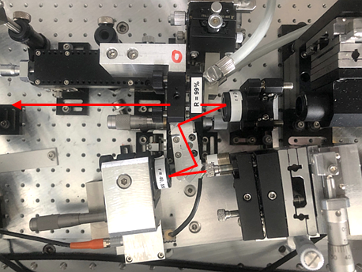
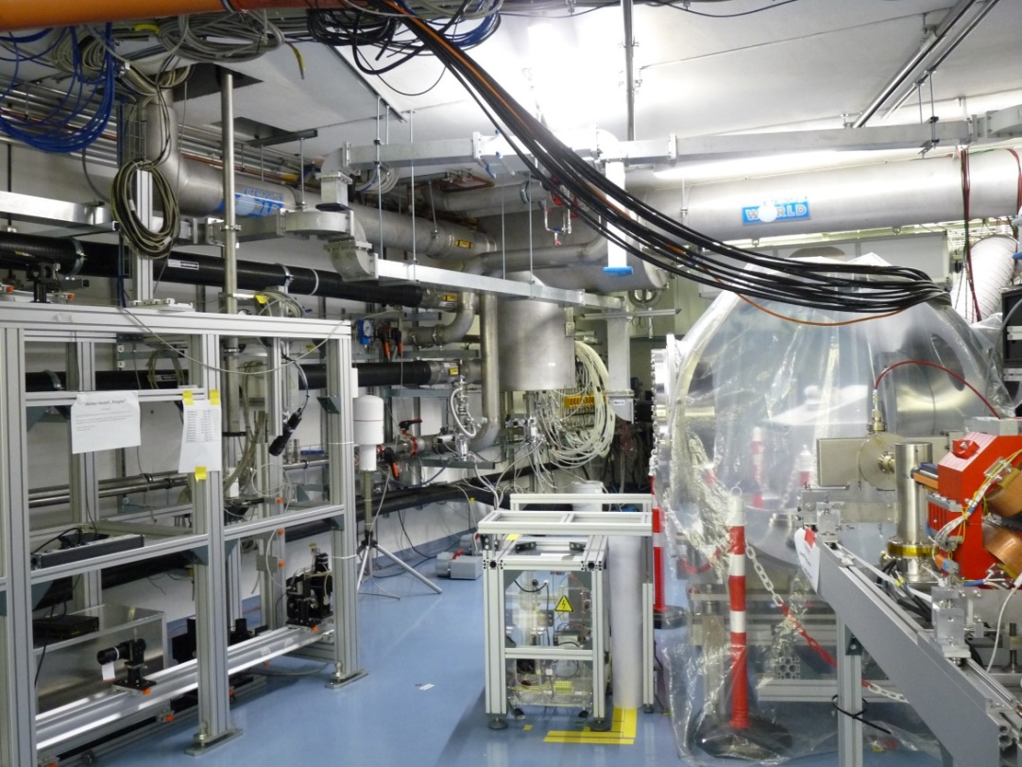

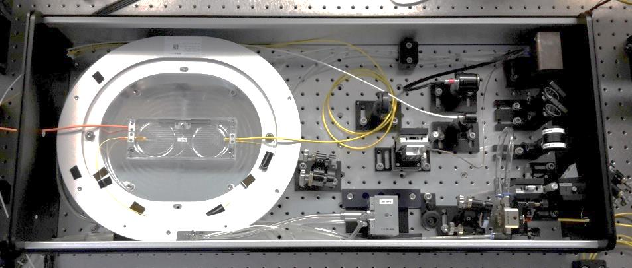
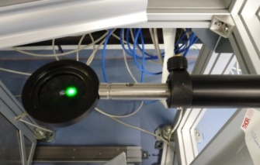
Drive laser ready for operation, laser beamline on-going (80% complete)
Two oscillators (50 MHz and 1.3 GHz), many pulse schemes, high average power (up to ~40 Watt) at 515 nm output
mode-locked (NIR)
1.3 GHz oscillator
Bunch spacing and current options:
50 MHz Laser:
  1-100 Hz macro-pulse:
  → I_{avg} = 77 pA – 7.7 µA
  CW 3.8 mA
1.3 GHz Laser:
  1 Hz – 1 kHz macro-pulse:
  → Iavg = 77 pA – 20 µA
  CW 100 mA
All this with 77 pC bunch charge,
laser power set up for QE of 1 %
last section of 20 m long vacuum pipeline for laser beam transport
photoinjector module
laser window
Water cooled fiber
power amplifier:
laser spot in accelerator hall
G. Klemz, I. Will, et al

Slide 12
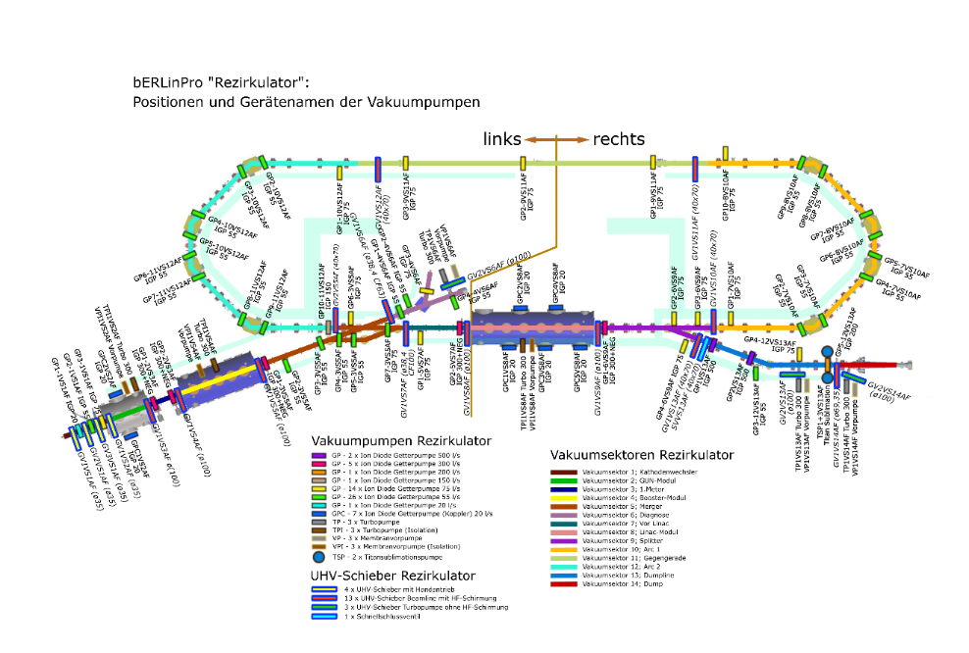
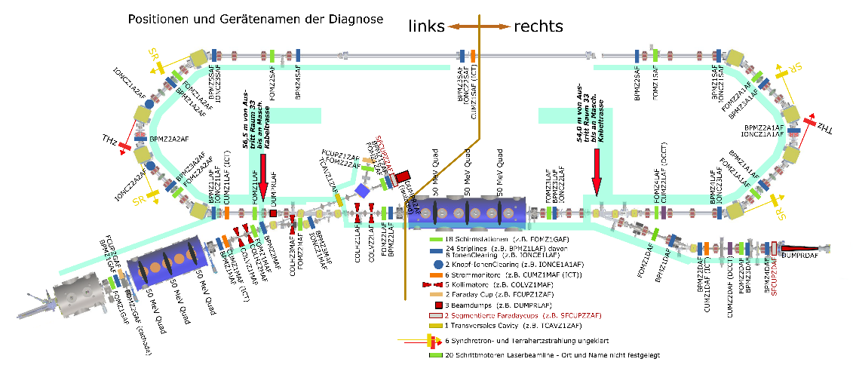
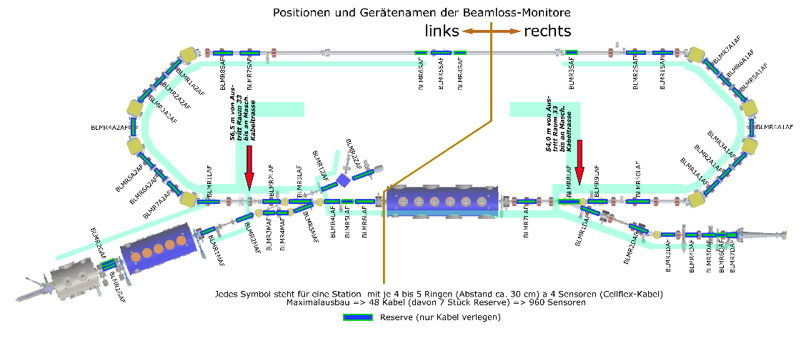
A glance at diagnostics and vacuum system
Achievements
Vacuum sectors
Beam
diagnostics
Beamloss
diagnostics
18x screen stations
24x Striplines, of which 8 with Ion clearing
2x button ion clearing
6x current monitors (ICT)
5x collimators
2x Faraday cups
3x Beam dumps
2 segmented Faraday cups
1 transverse defl. Cavity
Option: 6x THz/Sync. Rad.
+ Control system EPICS, visualization and data archiving
Jupyter Notebooks for
Python based data analysis and
measurement programs

Slide 13
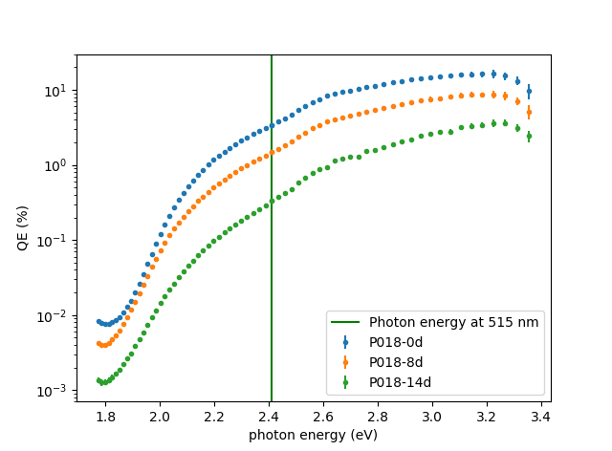
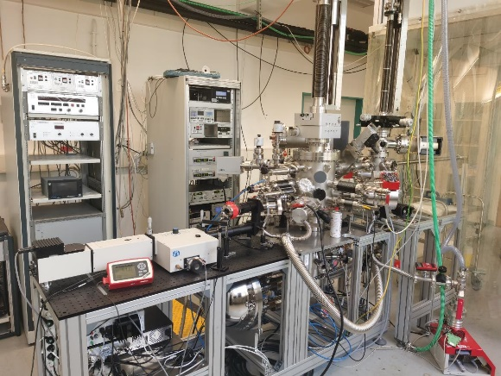
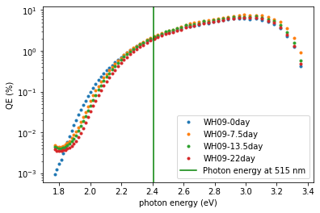



Optimizing the recipe for Na-K-Sb growth by QE and XPS measurements
Investigations into Na-K-Sb as more temperature robust alternative to Cs-K-Sb (baseline cathode)
Photocathode Preparation & Analysis System
Sepctral Response Na-K-Sb (WH09)
Spectral response Cs-K-Sb (P18)
Remember:
Best so far 16.8% at
515 nm (specs 1%)
Time after deposition | Na-K-Sb (WH09) QE @ 515 nm | Cs-K-Sb (P18) QE @ 515 nm
0 days | 2.0% | 3.4 %
8 days | 2.4% | 1.5 %
14 days | 2.2% | 0.3 %
22 days | 2.0% | -
High QE photocathodes for SEALAB photoinjector:
Explore multi-alkali Cs- and Na-K-Sb systems, from theoretical modeling (DFG fund), growth and characterization, towards operation in a SRF gun.
Complete infrastructure: growth and characterization system, UHV transport vessels, access to materials science lab EMIL at HZB, collaboration with theory.
J. Kühn, S. Mistry, C. Wang, J. Dube, C. Cocchi, R. Schier, H. Sassnick, et al.

Slide 14
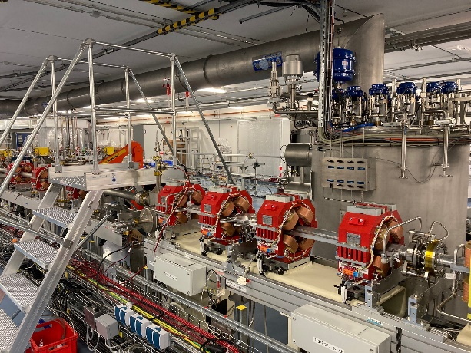
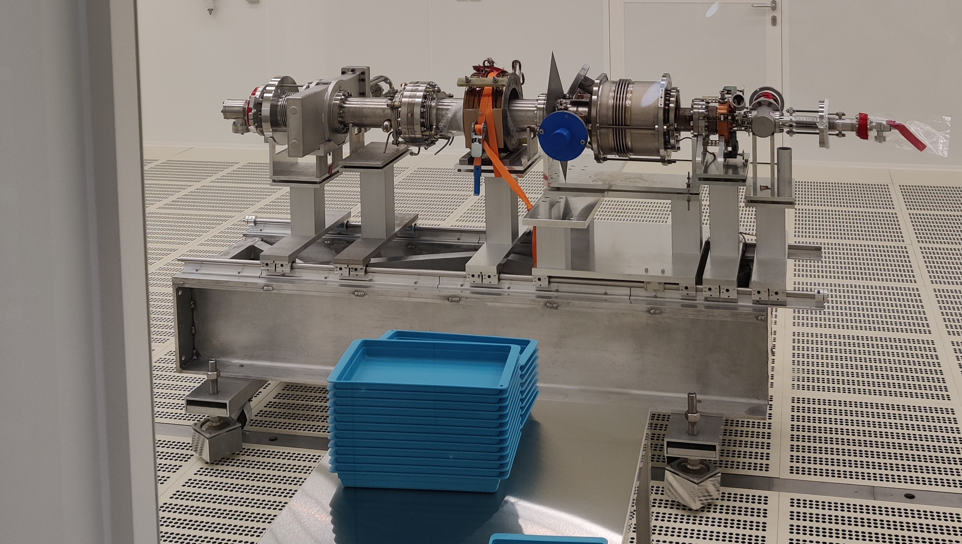
test and
diagnostic line
beam dump
6.5 MeV, 100 mA
= 650 kW
Status of bERLinPro:
linac module
3 x 7 cell SRF cavities
44 MeV
merger
dogleg
modified Cornell booster
3 x 2 cell SRF cavities
4.5 MeV
srf-gun
1.4 cell SRF cavities
2.0-2.7 MeV, single SC solenoid,
How do we continue from here?
SRF gun coldstring in cleanroom
bERLinPro project accomplished in 2020, readiness of building, infrastructure, warm machine, diagnostics, cryo-plant
and high-power RF stations
Commissioning of SRF photo-injector on-going, high quantum efficiency cathodes preparation , Laser system,
high-power RF conditioning of SRF Booster module couplers are on track to allow first beam from the injector spring/summer 2023
Beam commissioning program in development to map the injector’s parameter space from short pulse-low charge to,
via medium average currents to high charge regime

Slide 15

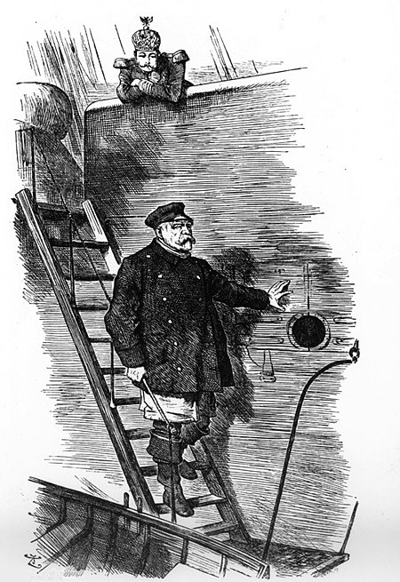
bERLinPro, quo vadis?
outlook
New project heads?
ARD
HMS bERLinPro
bERLinPro?
Old project heads?
JEAN LOUIS THÉODORE GÉRICAULT - La Balsa de la Medusa (Museo del Louvre, 1818-19)
The project was officially completed in 2020
….. to continue as an accelerator research facility!
What’s next?
John Tenniel - Punch, 29. März 1890, “Der Lotse geht von Bord”

Slide 16
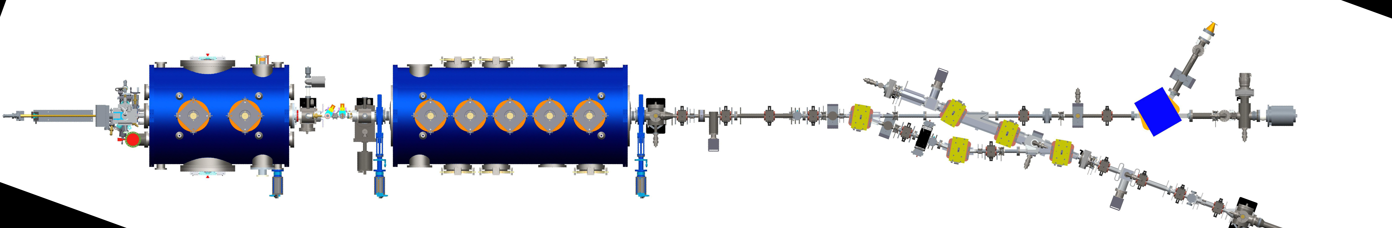
What is coming next?
outlook
From bERLinPro to SEALAB (SRF Electron Accelerator LABoratory)
FE-FRT, courtesy
N. Shipman
CERN
We want to open the machine up to internal and external applications
within Helmholtz ARD program and beyond:
  Completion of the injector and linac/dump lines: Commissioning Injector with beam
  (up to 5-10 mA, up to few 100 pC, up to 6.5 MeV)
  UED experiment → Aiming for shortest pulses, synchronization, exact LLRF control
  Offer the injector as a testbed to test and commission AI/machine learning techniques, digital
  twins, as long as Linac gap is open: Test area for (S)RF cavities, modules (e.g. MESA)
  Map the complete attainable injector phase space for many applications: From FEL, UED to HEP
  Testing of new diagnostics, acceleration concepts and controls
  Collaborate with external partners for a 100 mA compatible Linac module in most
  efficient design: Combine 4K operation with FE-FRT tuner to minimize Cryo and RF power consumption
  Contribute to the European ERL Roadmap in collaboration with PERLE with Injector and Linac studies
Dual approach: Develop on SRF injector and follow up on Linac studies
SRF Gun
FCUPZGAF
Aperture
SRF Booster
FOMZ1MAF at 7.64
UED Target & Viewscreen
FOMZ1ZAF at 12.69
UED Detector
Ultrafast Electron
Diffraction modifications
Solenoid

Slide 17
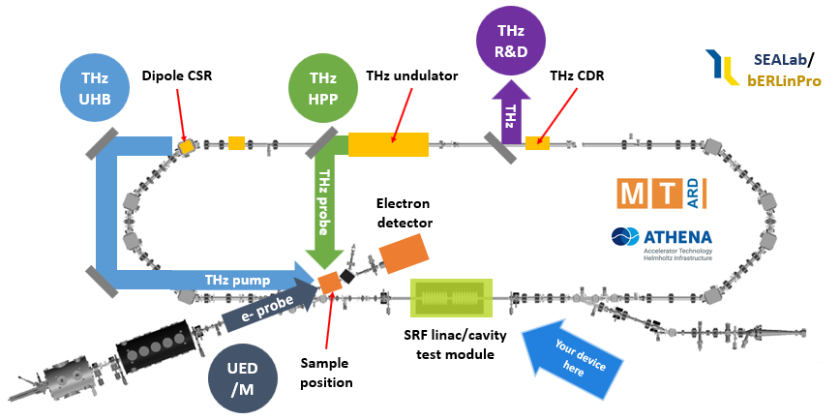

The dream: Opening up SEALAB
An accelerator test facility [3] with pilot application experiments, a multi-science factory [1,2]
Requires a Linac
bERLinPro offers potentially a large range of beam parameters due to its two
photo-cathode laser systems (50 MHz, 1.3 GHz) and their macro-pulse capabilities
As long as there is no Linac installed within the ERL recirculator, this can be
used as a passive beam (no effective acceleration) test stand.
Adaptation to the existing cryogenic installations and particulate free installations are the key for success
[1] T. Kamps et al., arXiv:1910.00881v2 [physics.acc-ph] 8 Jan 2020
[2] J.-G. Hwang et al., J. Korean Phys. Soc. 77, 337–343 (2020). https://doi.org/10.3938/jkps.77.337
[3] A. Neumann et al., IPAC 2022

Slide 18

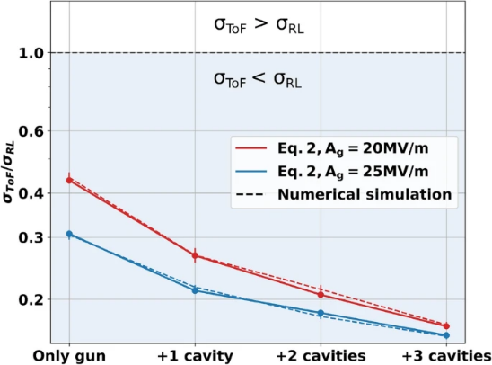



Ultra-fast scattering experiments with the SRF photoinjector
Many ARD aspects: SRF, beam dynamics, instrumentation, controls, …
SRF Gun
Aperture
SRF Booster
Sample Area A
Sample Area B
Detector Area
Dogleg option
Demonstrator phase within funds!
0
1
2
3
4
5
6
7
8
9
10
11
12
13
14
16
Capabilities of the photoinjector:
1 to 3.5 MeV beam energy with variable bunch charge (1 fC to 100 pC), pulse length (10 fs to 6 ps) and spot size (10 to 100s μm), high stability at MHz repetition rate.
Very flexible longitudinal accelerator/lens system: one gun cavity and three booster cavities, done optimization for bunching scheme, see B. Alberdi et al. [1].
TOF jitter at position A in units of initial jitter
vs number of cavities in the photoinjector
Ultrafast science drivers:
Diffraction camera for molecular movies with MHz repetition rate (UED).
Imaging of macromolecular structures in liquid phase (UEI).
Complementary to SR and FEL light sources. Enabling multi-modal capabilities for Bessy II/III.
[1] B. Alberdi, et al, Sci. Rep. 12, 13365 (2022)
T. Kamps, B. Alberdi Esuain, J. Völker, T. Spohr, E. Ergenlik, A. Neumann, J.-G. Hwang, S. Barg, et al.

Slide 19
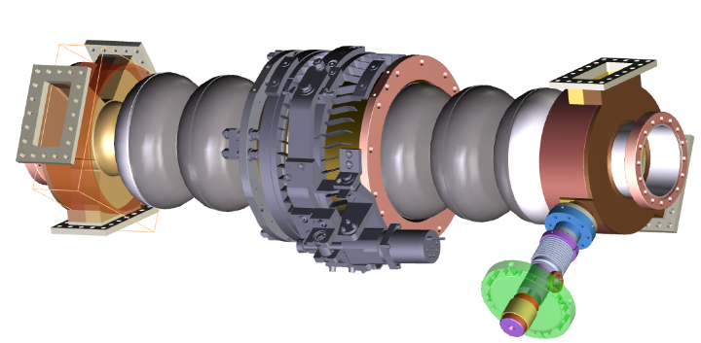
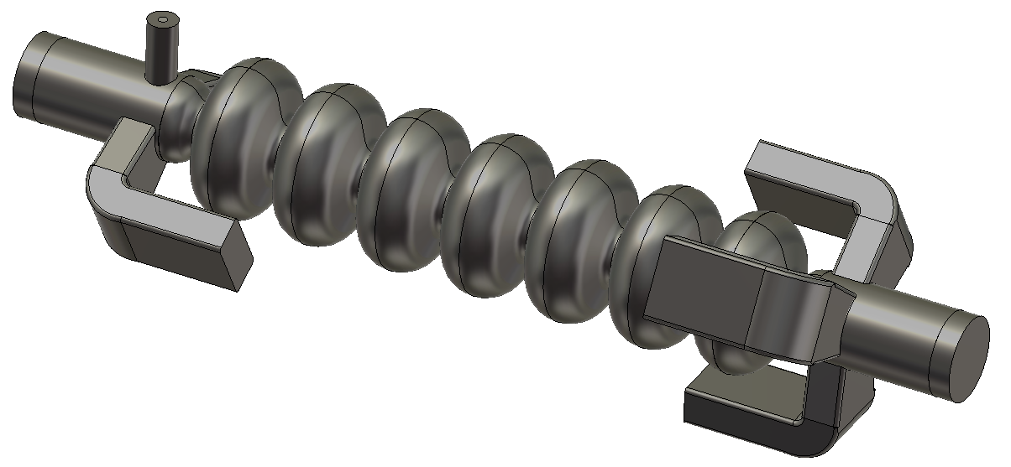
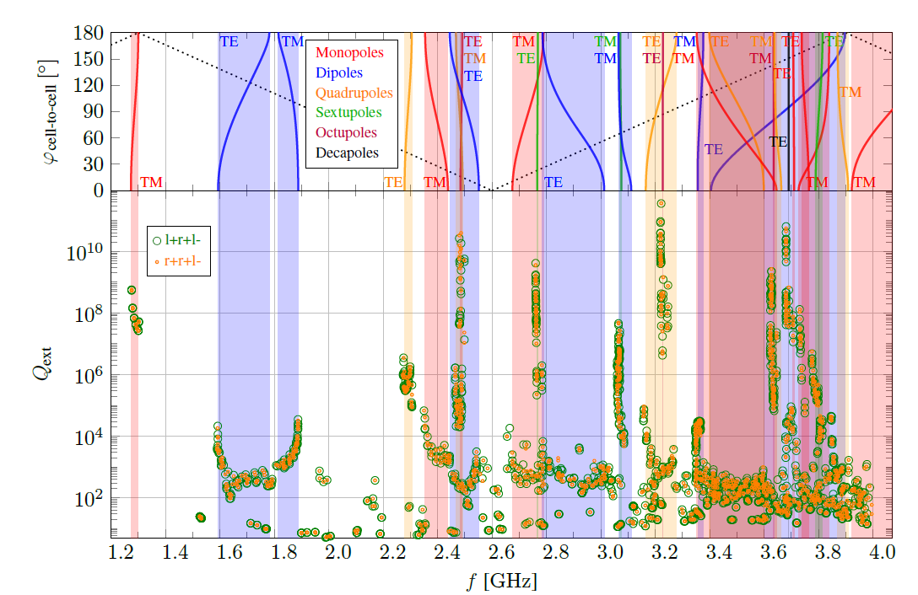
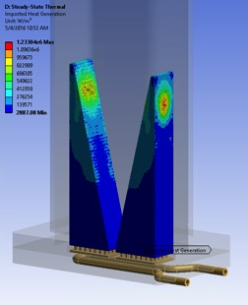
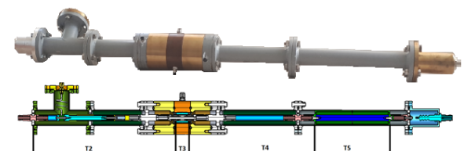
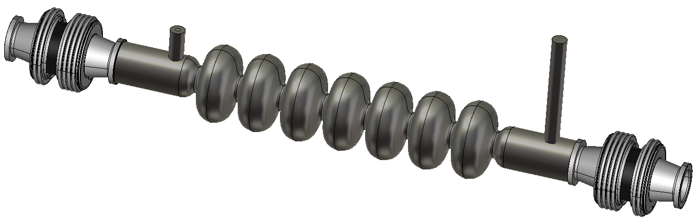
Realize a Linac for SEALab/bERLinPro
Linac for sealab
A bERLinPro Linac was developed
New baseline:
Cut down to a simplified more cost saving, less complicated design
Simplified module concept, Cornell like, no room temperature parts
Contributes to
European ERL
roadmap
Not funded yet!
Cryo allows to potentially operate one cavity at 4 K as new material demonstrator
Full three-cavity string HOM
analysed, coupler kick studies, manufacturing
study etc….
For a BBU threshold of 2x 100 mA
+ margin this design is an overkill
threshold current in the Ampère regime!
Cornell shape cells
No waveguides, TTF coupler + Fast reactive
tuner port
Beamtube HOM absorber like Booster/Gun

Slide 20
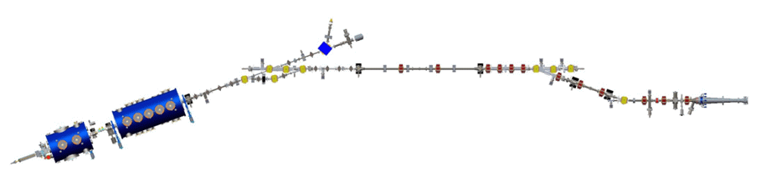
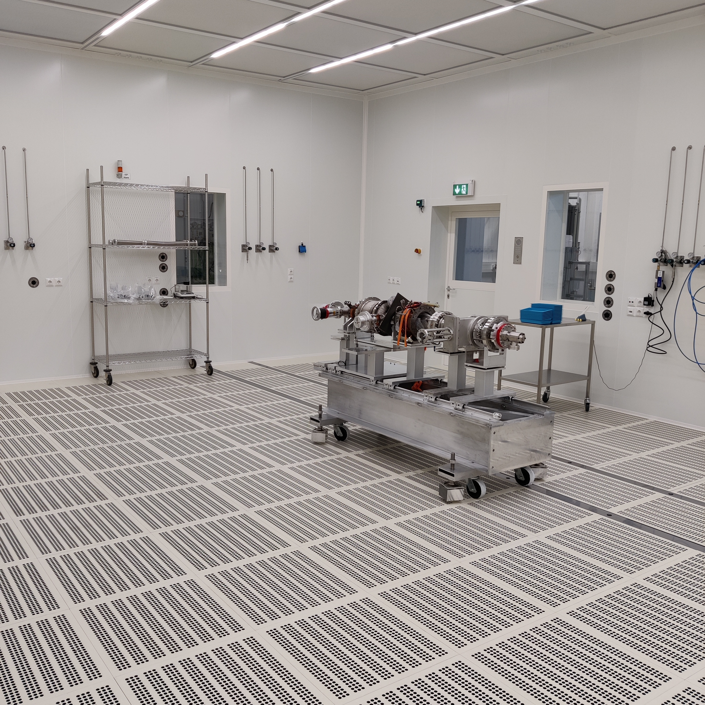
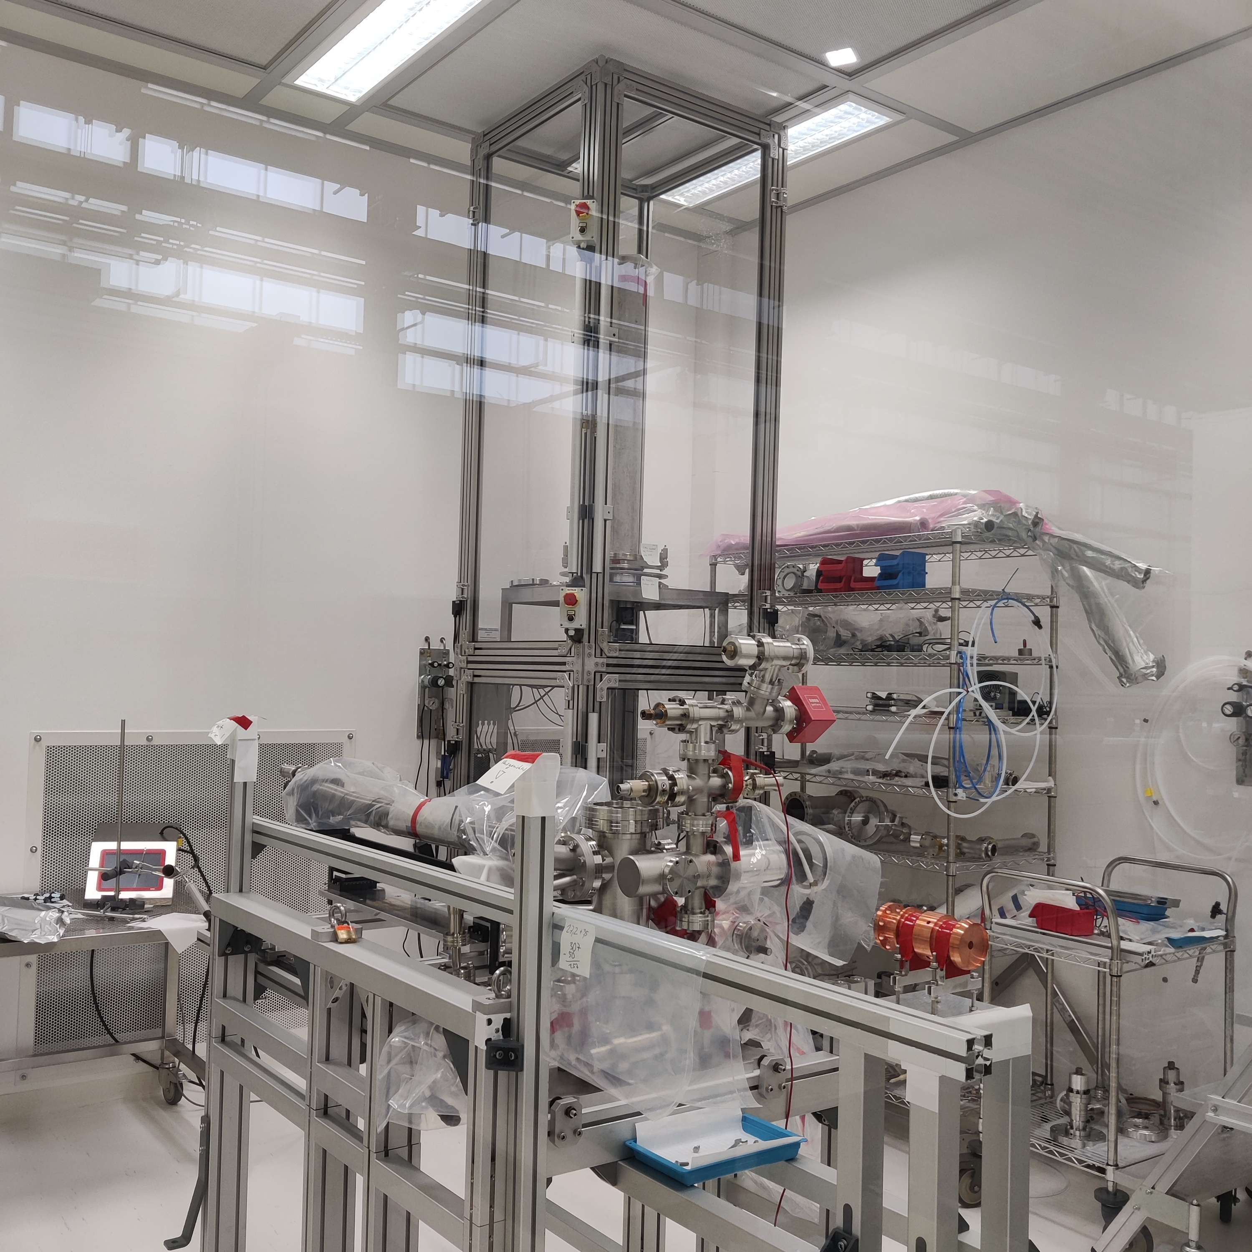
When will we have first beam?
First beam?
TCav
30 kW dump
Injector line
Booster
Gun
MESA
“Banana line”
650 kW dump
Focus on commissioning injector with SRF gun and transverse deflecting cavity + diagnostic line
Next stage installation of the Booster module, possible beam transfer into the high power dump
Recirculation, when Linac funding is secured or an interim arrangement can be found
Cathode transfer
system
SRF gun coldstring and cathode transfer
system currently being reworked and setup
in the cleanroom (Tuesday SRF talk)
First beam to be expected around late Spring
2023

Slide 21
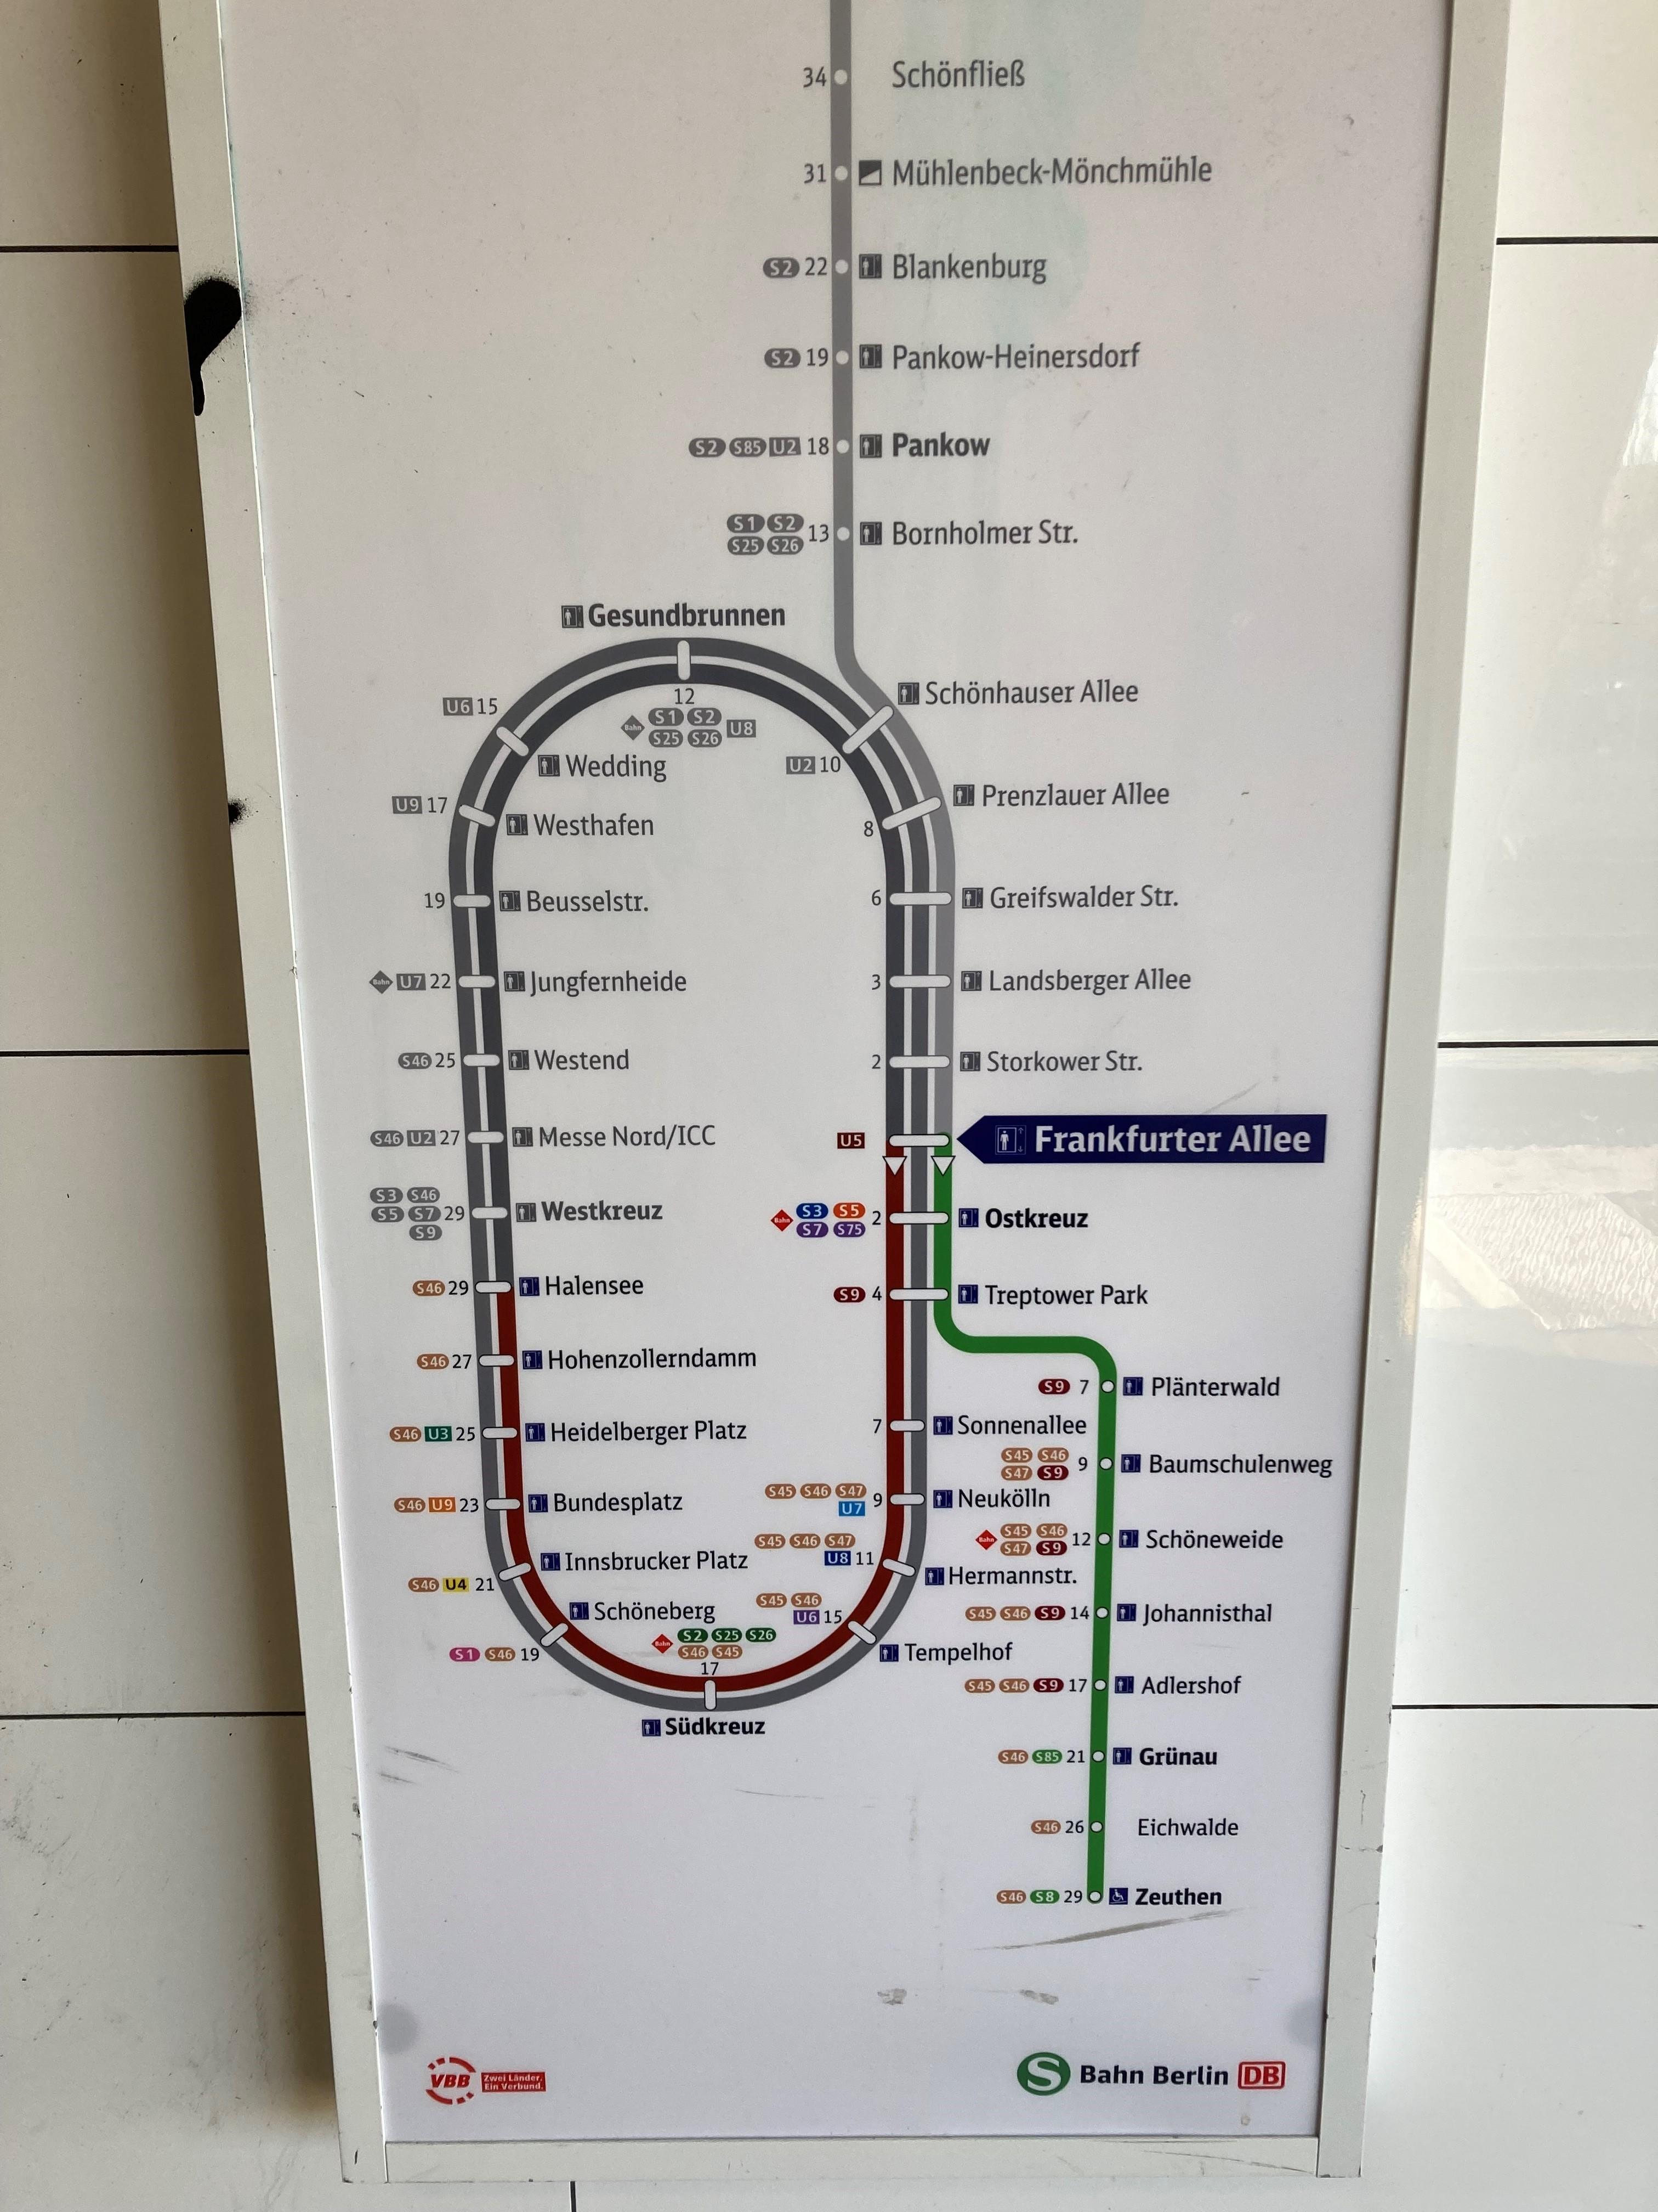
But…….
surpirse
….in case you did not know,
there is already a running multi-turn
ERL in Berlin!

Slide 22
















Acknowledgements
Fin
Many thanks to:
J. Teichert, A. Arnold, P. Murcek, R. Rimmer, A. Burrill, F. Marhauser, S. Belomestnykh, E. Zaplatin, E. Kako, N. Shipman
R. Eichhorn, J. Sekutowicz, P. Kneisel, G. Ciovati, A. Matheisen, B. van-der-Horst, M. Schmökel, W.A. Clemens, C. Dreyfuss, D. Forehand, T. Harris, R.B. Overton, L. Turlington, M. Schalwat, S. Lederer, V. Volkov, I. Will, MAC members
+many more
HZB bERLinPro Team & friends
former colleagues
Team Sealab
Thanks for your attention!
Funding: Bundesministerium für Bildung & Forschung
Bundesland Berlin, Helmholtz Gemeinschaft

