Slide 1
Circular-Linear energy recovery accelerator to probe the energy-frontier
I. V. Konoplev, S.A. Bogacz
Ya. Shashkov
I.V. Konoplev et al 2022 JINST 17 P0101
https://iopscience.iop.org/article/10.1088/1748-0221/17/01/P01011/pdf

Slide 2
Introduction: Different types of limitations*
physical limits on high-gradient acceleration, high-field bending, beam size, beam brightness, and luminosity
technology-dependent limits e.g. material properties (critical current, tensile properties, …)
societal imprints (e.g. size, cost, electrical energy)
* Frank Zimmermann, “the grand challenges and opportunities of ultimate high energy colliders”, CPM, A10, Tuesday 6 October 2020

Slide 3
Introduction: Different types of limitations to be addressed
physical limits on high-gradient acceleration, high-field bending, beam size, beam brightness, threshold current and luminosity
technology-dependent limits e.g. material properties (critical current, tensile properties, …)
societal imprints (e.g. size, cost, electrical energy)

Slide 4
Introduction: Different types of ERL limitations to be addressed
Physical limits (ERL): threshold current to increase beam intensity for ERL brightness, luminosity
Societal impact (ERL): threshold current
  financial (construction and energy efficiency )
  societal cost (delivering blue sky research and giving immediate reward to society - acceptance by society )

Slide 5
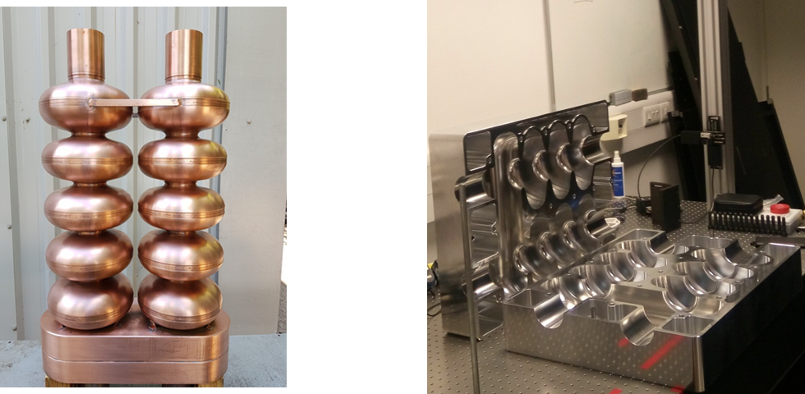
Introduction
History: AERL (JAI, Oxford & JLab, 2015-2019)
Aim:
  To surpass any existing designs of ERL in the e-beam current handling capabilities
Radio frequency cavities
I Konoplev, G Burt
US Patent 10,237,963
R. Ainsworth, G. Burt, I.V. Konoplev and A. Seryi, Asymmetric dual axis energy recovery linac for ultrahigh flux sources of coherent x-ray and THz radiation: Investigations towards its ultimate performance, Phys. Rev. Accel. Beams 19 (2016) 083502 [arXiv:1509.03675].

Slide 6
Introduction: JLAB dual axis cavity
The cavity was used as a prototype during the optimisation
It was considered as an indication that such structure can be machined
[1] A. Hutton and H. Areti, Accelerator stewardship test facility program — Elliptical twin cavity for accelerator applications, JLAB-HEP15-03 (2015) and online at https://www.osti.gov/biblio/1209532.
[2] S.U. De Silva, H. Park, J.R. Delayen, F. Marhauser and A. Hutton, Electromagnetic design of a superconducting twin axis cavity, in proceedings of the 28th Linear Accelerator Conference (LINAC2016), East Lansing, MI, U.S.A., 25–30 September (2016).
[3] H. Park, F. Marhauser, A. Hutton, S.U. De Silva and J.R. Delayen, Development of a superconductingtwin axis cavity, in proceedings of the 28th Linear Accelerator Conference (LINAC2016), East Lansing, MI, U.S.A., 25–30 September (2016).

Slide 7
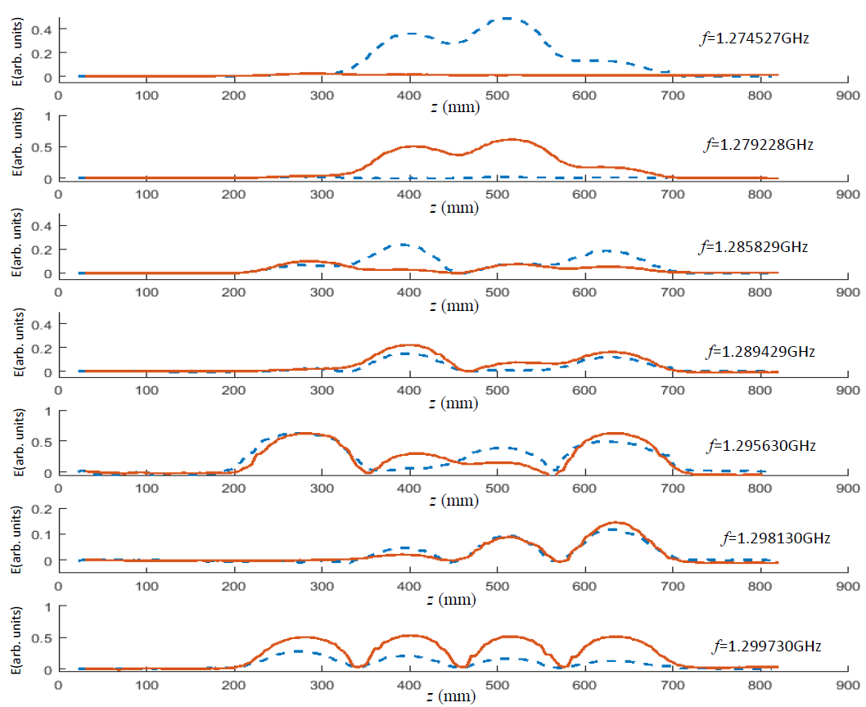
Pass band modes experimental studies at two axes
evanescent coupling
evanescent coupling
The RF coupler is located on one axis (active) while the field measurements are conducted on both axes
normal coupling
evanescent coupling
normal coupling
evanescent coupling
Red line active axis
Blue line passive axis
normal coupling
I.V. Konoplev, K. Metodiev, A.J. Lancaster, G. Burt, R. Ainsworth and A. Seryi, Experimental studies of 7-cell dual axis asymmetric cavity for energy recovery linac, Phys. Rev. Accel. Beams 20 (2017)103501 [arXiv:1712.00494]

Slide 8
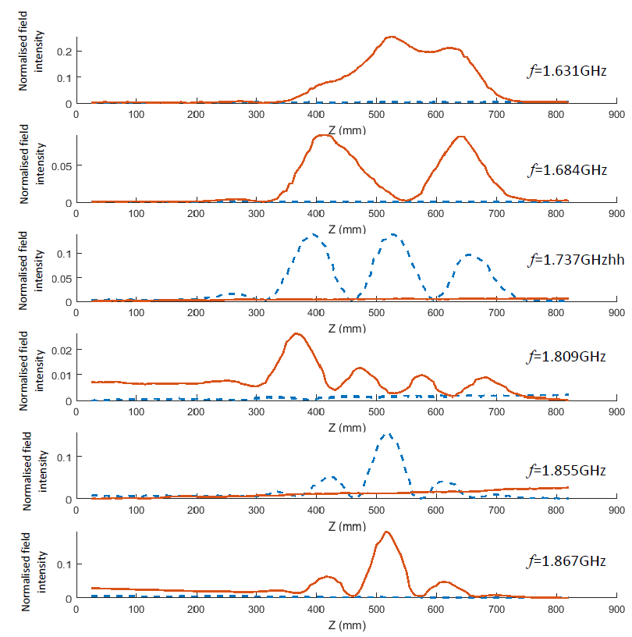
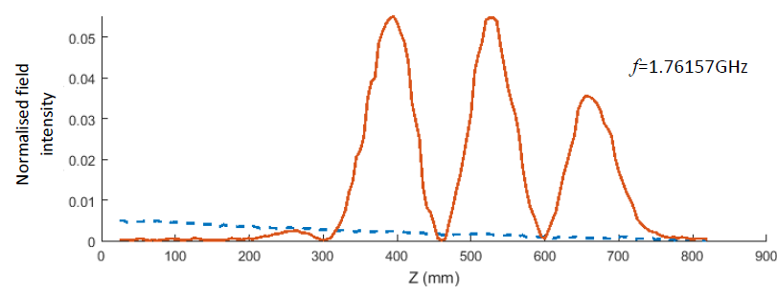
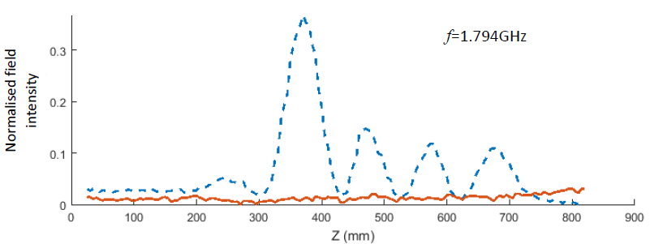
HOMs measurements
HOMs localisation at one or another axis
The RF coupler is located on one axis (active) while the field measurements are conducted on both axes
Red line active axis
Blue line passive axis
M. Topp-Mugglestone, I.V. Konoplev, H. Zhang and A. Seryi, Studies of high order modes in asymmetric dual-axis cavity, Appl. Phys. Lett. 113 (2018) 243503.

Slide 9
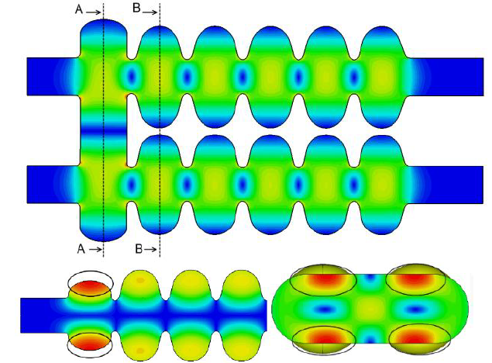
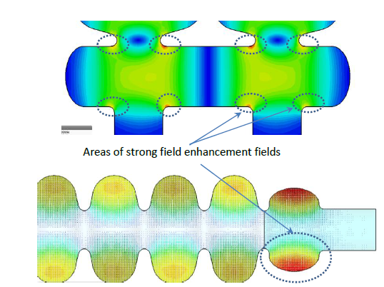
Cavity optimisation
Risk points due to high field intensity on the surface
Tesla like cavity (TT)
Other risk factors:
Multipacting
Proximity on modes to operating mode
Cost
Low Loss like cavity (LL)
I.V. Konoplev, Y. Shashkov, A. Bulygin, M.A. Gusarova and F. Marhauser, Ultimate energy recovery from spent relativistic electron beam in energy recovery linear accelerators, Phys. Rev. Accel. Beams 23 (2020) 071601

Slide 10
Cavity optimisation
LL&TT+LL cavity
TT&LL cavity
TT&LL+TT cavity
I.V. Konoplev, Y. Shashkov, A. Bulygin, M.A. Gusarova and F. Marhauser, Ultimate energy recovery from spent relativistic electron beam in energy recovery linear accelerators, Phys. Rev. Accel. Beams 23 (2020) 071601

Slide 11
Asymmetric dual axis cavity with different number of cells on the axes
I.V. Konoplev, Y. Shashkov, A. Bulygin, M.A. Gusarova and F. Marhauser, Ultimate energy recovery from spent relativistic electron beam in energy recovery linear accelerators, Phys. Rev. Accel. Beams 23 (2020) 071601

Slide 12
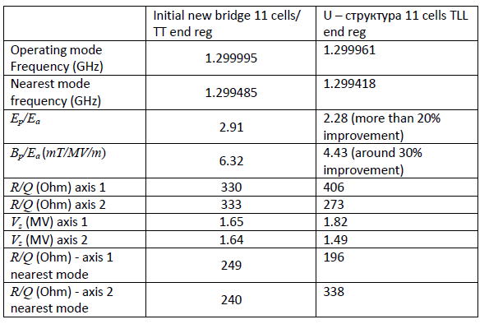
Bridge optimisation
- Resolved high field risk
- Improved the modes proximity
- Resolve the challenge with multipacting

Slide 13
Asymmetric dual axis cavity with different number of cells on the axes
collector
cathode
I.V. Konoplev, Y. Shashkov, A. Bulygin, M.A. Gusarova and F. Marhauser, Ultimate energy recovery from spent relativistic electron beam in energy recovery linear accelerators, Phys. Rev. Accel. Beams 23 (2020) 071601

Slide 14
Circular-Linear energy recovery accelerator to probe the energy-frontier

Slide 15
Circular-Linear energy recovery accelerator to address
Physical limits (ERL): threshold current to increase beam intensity for ERL brightness, luminosity
Societal impact (ERL): threshold current
  financial (construction and energy efficiency )
  societal cost (delivering blue sky research and giving immediate reward to society - acceptance by society )

Slide 16
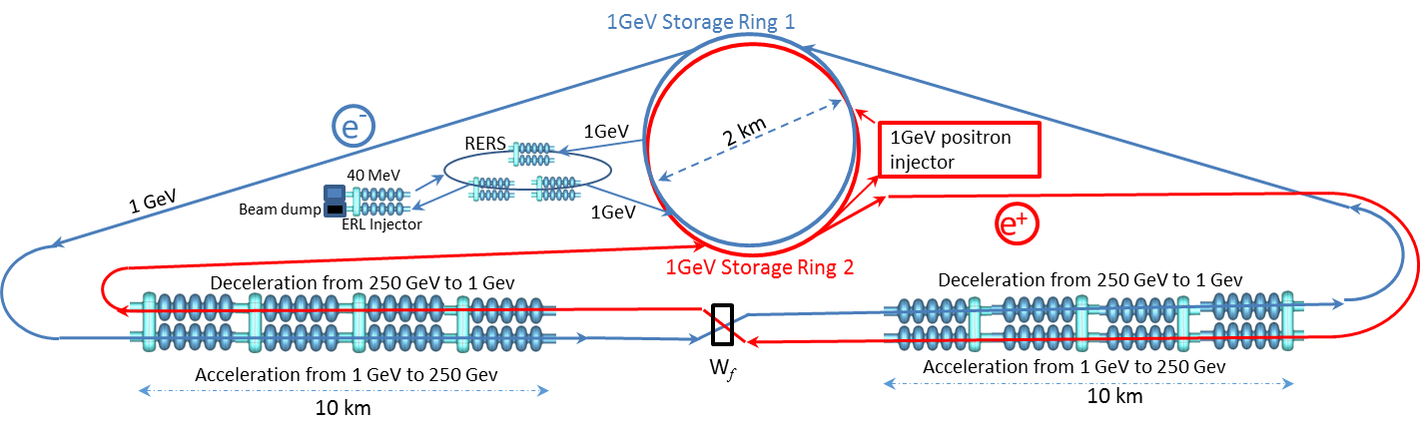
Circular-Linear Energy Recovery Collider
“Triangular” or ILC-configuration

Slide 17
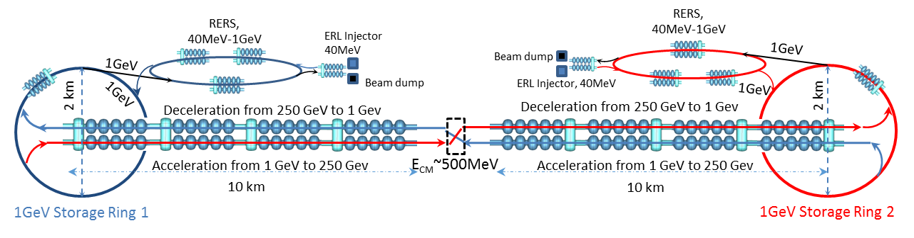
Circular-Linear Energy Recovery Collider
“Linear” configuration

Slide 18
Injection into storage ring
Conventional ERL based on dual axes asymmetric cavity

Slide 19
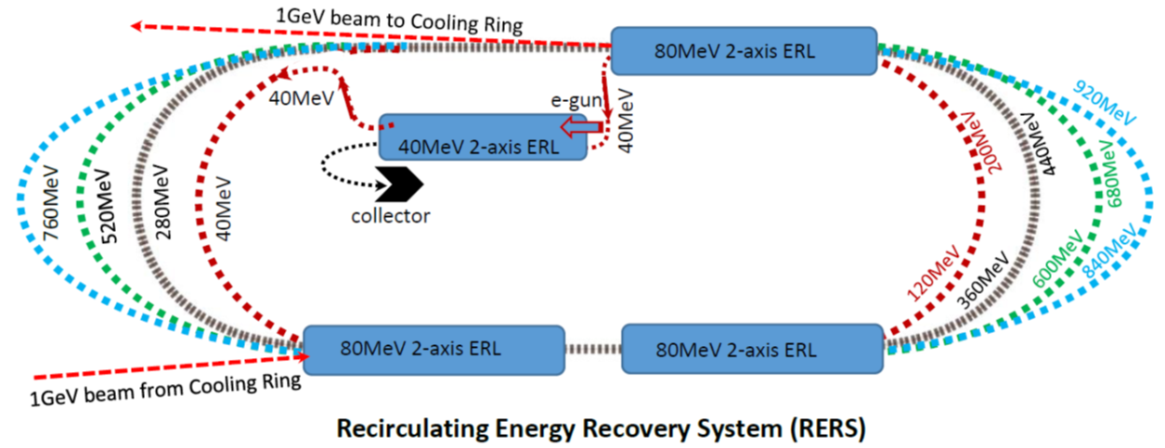
Injection into storage ring
Recirculating Energy Recovery system (RERS)

Slide 20
Injection into storage ring
Recirculating Energy Recovery system

Slide 21
Storage Ring
intermediate energy (1 GeV), large (2 km) diameter, weekly radiating (below 1kW) storage ring with indication of the FEL stations for photon production.
[1] P.F. Tavares, S.C. Leemann, M. Sjöström and Å. Andersson, The MAX IV storage ring project, J. Synchrotron. Radiat. 21 (2014) 862.
[2] P.F. Tavares et al., Commissioning and first-year operational results of the MAX IV 3 GeV ring, J. Synchrotron. Radiat. 25 (2018) 1291.

Slide 22
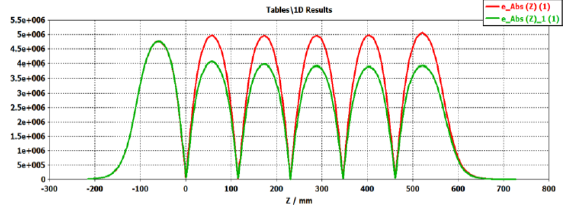
Storage Ring
Illustration of an example of the FEL station with dog-bone beam line for the beam energy recovery
intermediate energy (1 GeV), large (2 km) diameter, weekly radiating (below 1kW) storage ring with indication of the FEL stations for photon production.

Slide 23
Storage Ring
Illustration of an example of the FEL station with dog-bone beam line for the beam energy recovery
intermediate energy (1 GeV), large (2 km) diameter, weekly radiating (below 1kW) storage ring with indication of the FEL stations for photon production.

Slide 24
Liner Energy Recovery Collider

Slide 25
Liner Energy Recovery Collider

Slide 26
Circular-Linear Energy Recovery Collider

Slide 27
Circular-Linear Energy Recovery Collider

Slide 28
Circular-Linear Energy Recovery Collider

Slide 29
Conclusion
The aluminium (7-cells) and copper (11-cells) dual axis asymmetric cavities were constructed
Preliminary studies of HOMs and path-band modes were carried out and HOMs localisation has been demonstrated
The first design of the SRF dual axes asymmetric cavity has been completed
Outlines of the new concepts of CLER –C and CLER-FEL have been presented
Acknowledgement:
Dr I.V. Konoplev would like to thank Sevastopol State University for partial support of the work via internal grant (42-01-09/169/2021-3). Dr. I. V. Konoplev would also like to thank STFC UK for partial support via grant (The John Adams Institute for Accelerator Science, ST/P002048/1). Work at Jefferson Lab has been supported by U.S. DOE under contracts DE-AC05-06OR23177 and DE-SC0012704. We would also like to acknowledge useful discussions with Dr. Ryan Bodenstein (JLAB). We would like to thank Dr. Andrew Hutton (JLAB) for useful suggestions and encouragements.
Thank you

