Slide 1
Energy Recovery Linac Designs and Studies for Electron Cooling of Hadron Beams DoE Phase II SBIR October 4, 2022
Val Kostroun (PI), Christopher Mayes, Colwyn Gulliford, Nicholas Taylor,
Bruce Dunham, Ralf Eichhorn, Joseph Conway, David Douglas

Slide 2
Outline
Xelera Background
EIC Cooler ERL Specs and Layout
Design Details
Next steps: Precooler
Conclusion
Notes:
(karl = 25 years, Val = 50 years, Bruce = 35 years, Chris? 10 years? Ralf = 25 years… that’s 145, so let’s call it 150+ years)

Slide 3
Xelera Research LLC: Company Overview
Formed in 2013 by 5 partners – 150+ years of accelerator design expertise
Most of Xelera came from the Cornell ERL development team, who designed and built the world’s highest current, high brightness photoinjector, which evolved into significant component of CBETA
Now at 10 total employees
Focus Areas:
Accelerator design & simulations (EIC magnetized injector design, EIC Cooler)
Radiation physics consulting (ASU BioDesign C safety systems design)
Accelerator hardware:
Electron & X-ray beam stops (ASU Graves Lab)
Cathode transport systems (ASU Karkare Lab)
Vacuum system designs, coatings (JLab, Poelker)
Higher Order Mode loads (HZB, Germany)
Electron source design and fabrication (JLEIC Cooler Magnetized Gun)
www.XeleraResearch.com
Notes:
(karl = 25 years, Val = 50 years, Bruce = 35 years, Chris? 10 years? Ralf = 25 years… that’s 145, so let’s call it 150+ years)

Slide 4
Project Technical Objectives
ERL Beam Dynamics Designs Satisfying Specifications for CeC of the EIC
Optimized lattice from cathode to beam stop
Include relevant effects: space charge, CSR
Tolerance Studies:
Investigate error effects (misalignments, mis-powering, and field inhomogeneities)
Practical correction strategies
Cost/benefit analysis of higher quality hardware versus cost.
Beam Breakup (BBU) Studies: demonstrate the threshold current is below the operating current.
Start-to-End Simulation Studies: High fidelity simulations to confirm cooling specs satisfied and beam can be energy recovered
Beam Halo Studies: Catalogue likely sources, investigate mitigation strategies

Slide 5
Collaboration
Erdong Wang, Steve Peggs, Will Bergan, Derong Xu (BNL)
Steve Benson, Kirsten Deitrick (JLab)
Georg Hoffstaetter, Ningdong Wang (Cornell)

Slide 6
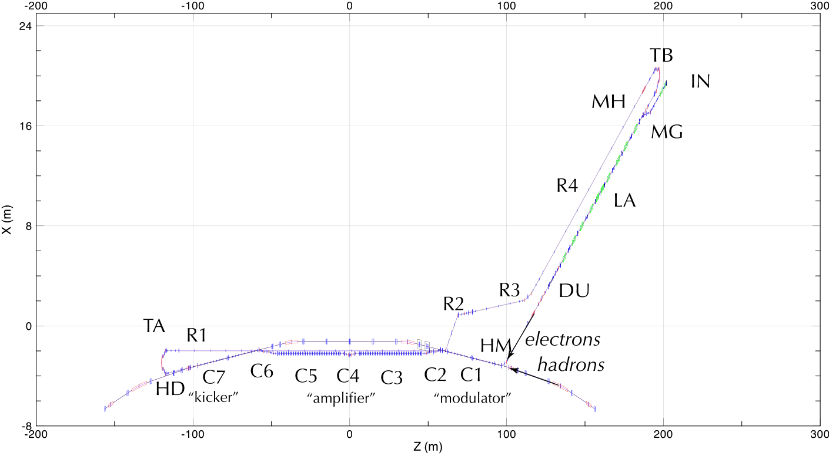
ERL Designs: Specs and Original Layout
Electron Beam Parameters | Mode A: 275 GeV Hadrons | Mode B: 100 GeV Hadrons
Energy | 150 MeV | 55 MeV
Bunch charge | 1 nC | 1 nC
Bunch length | 7 mm | 14 mm
Slice energy spread | 1E-04 | 1E-04
Bunch rep. rate | 98.5 MHz | 98.5 MHz

Slide 7
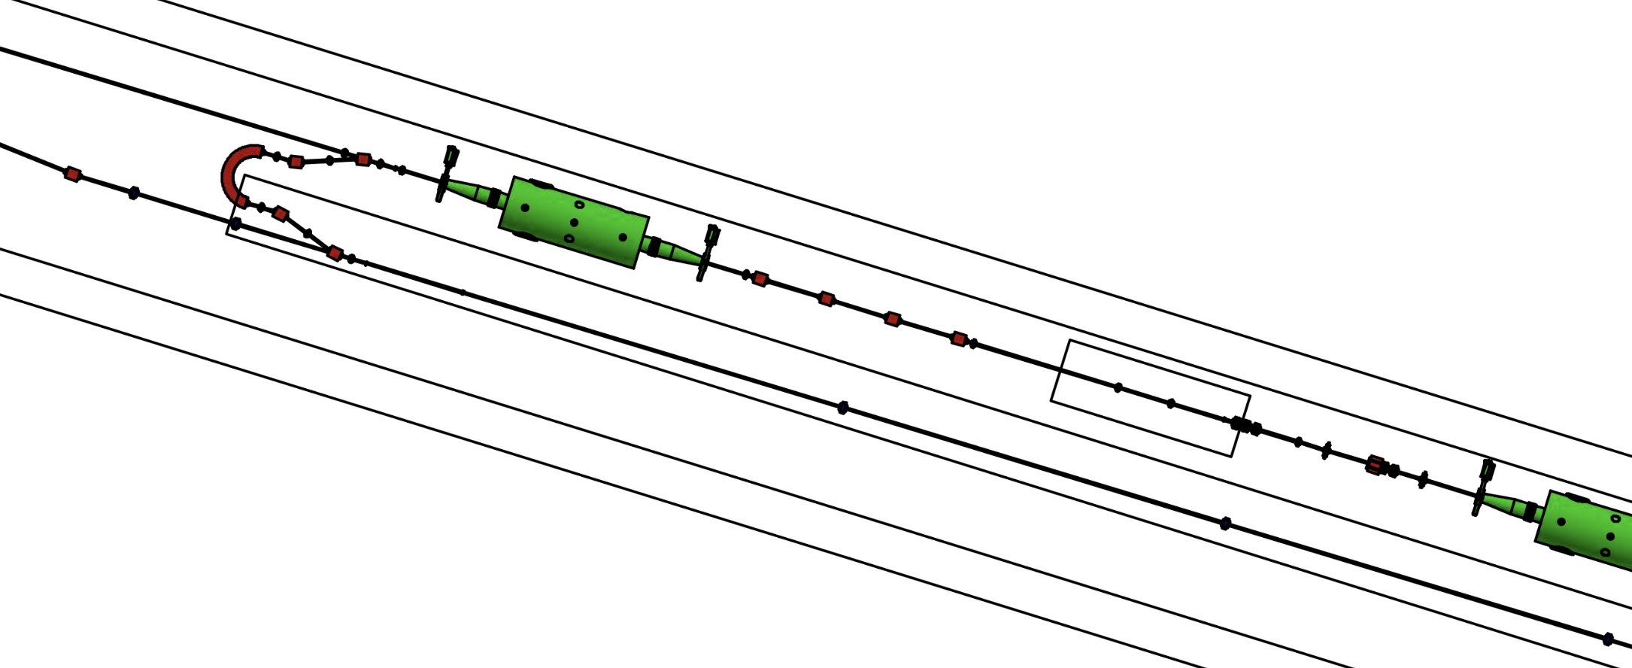
Layout: Plan View
Original Layout
Inside Layout
Addition of
Early turn around

Slide 8
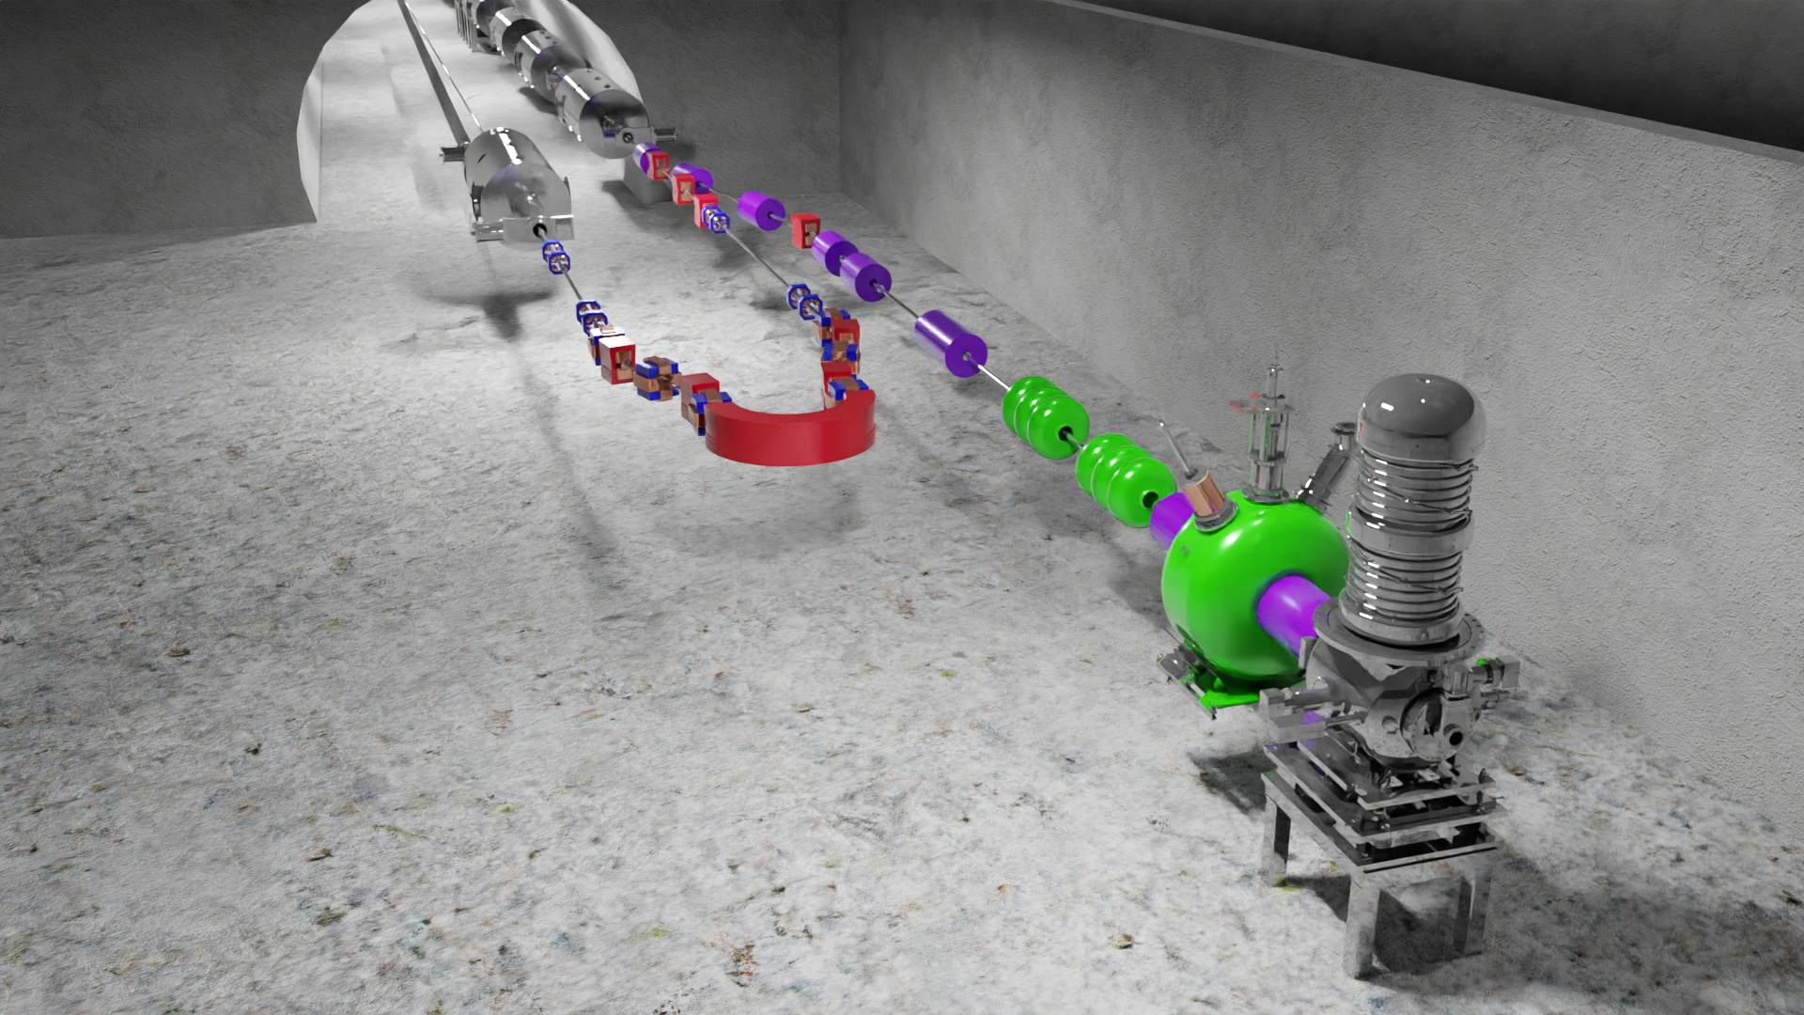
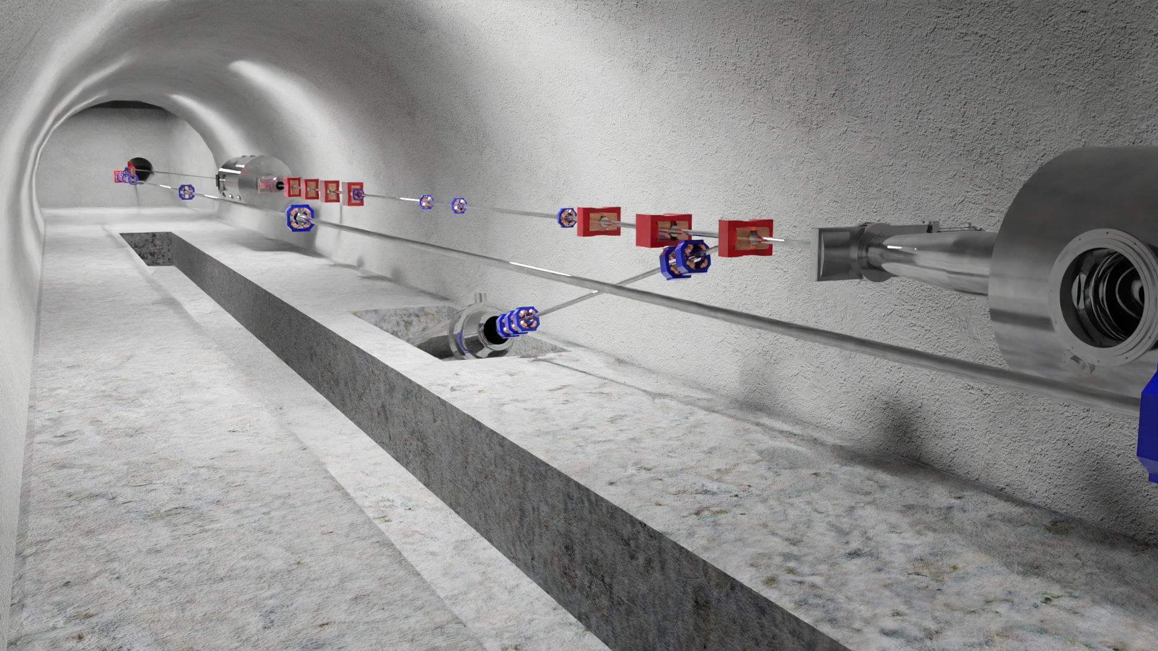
3D Models and Renders (Blender)
Injector, Merger, Return
End of Linac, Dump, to Hadrons, Return

Slide 9
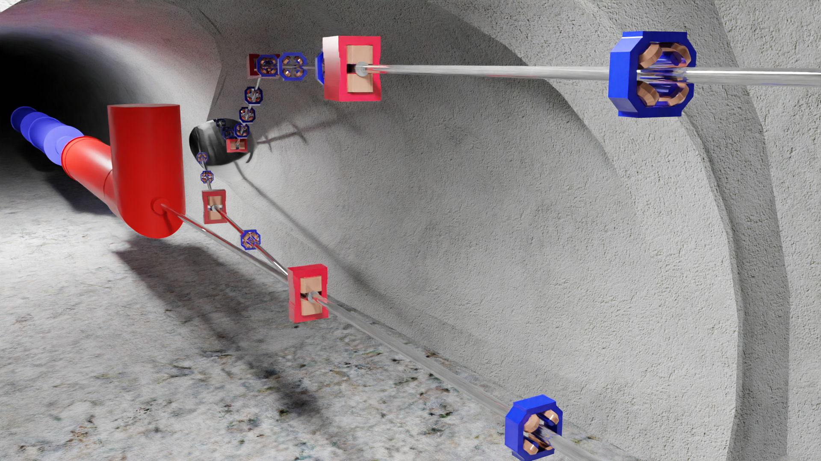
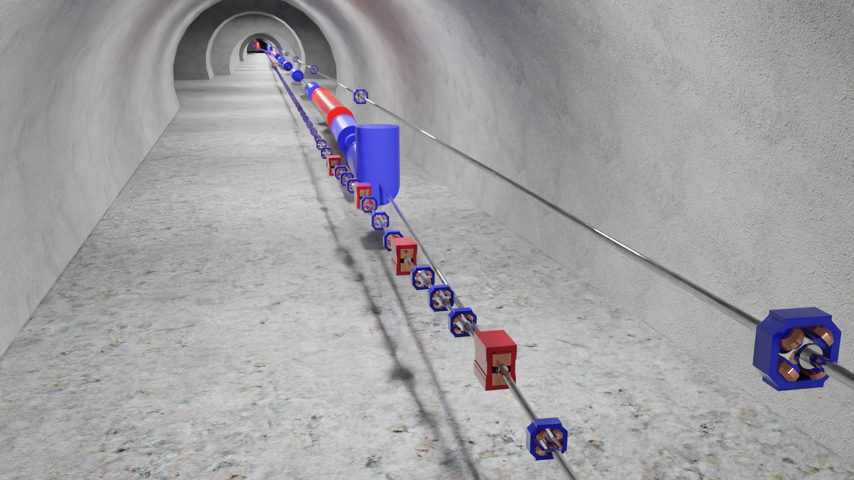
3D Models and Renders (Blender)
Merge electrons with hadrons into common “Modulator” cooling section.
Demerge electrons from hadrons, into the “Amplifier” section.

Slide 10
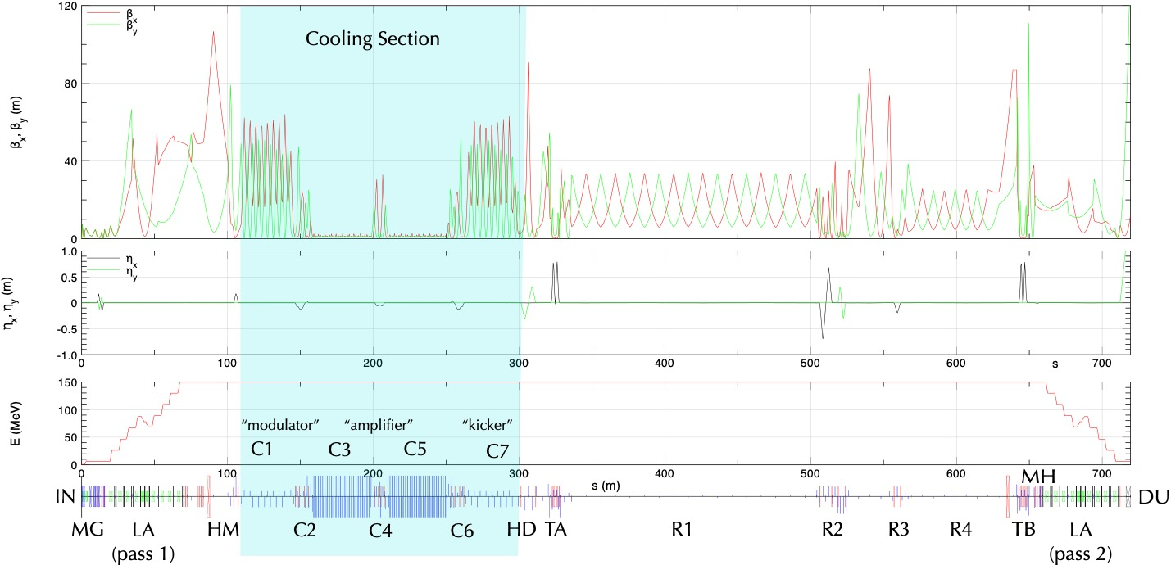
ERL Beam Dynamics Designs: Optics

Slide 11
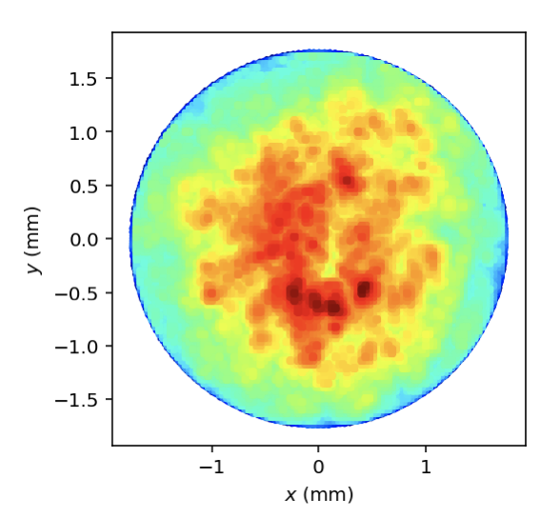
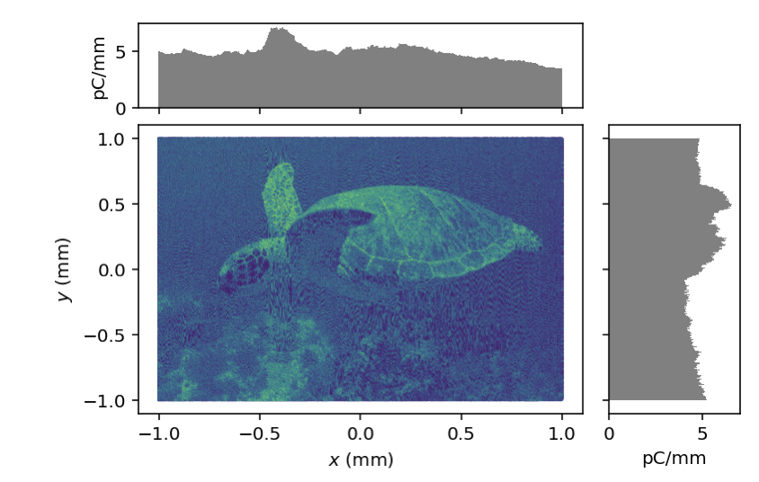
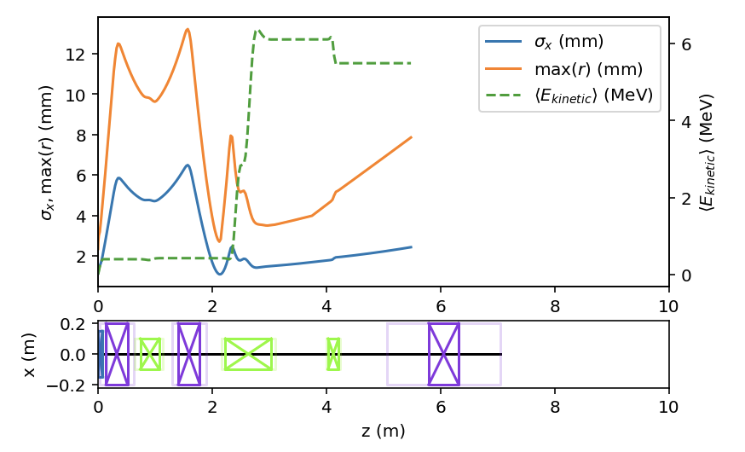
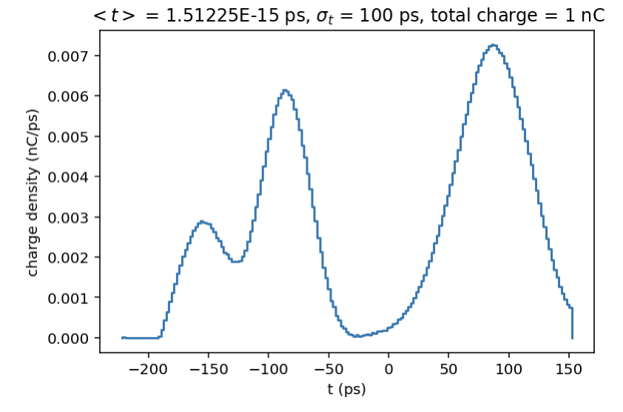
Distgen and LUME-GPT
Distgen: Python code for generating initial particles
LUME-GPT: Python wrapper for running and
displaying GPT simulations
- Generate GPT lattice files
- Plot lattice layouts
- Standard distribution types
- Low-discrepancy (Hammersley, etc)
- Pseudo random generation (“rand”)
- Output to GPT, ASTRA, h5 (Bmad), etc
https://github.com/ColwynGulliford/distgen
https://github.com/ColwynGulliford/lume-gpt
Part of larger ecosystem:
https://www.lume.science

Slide 12
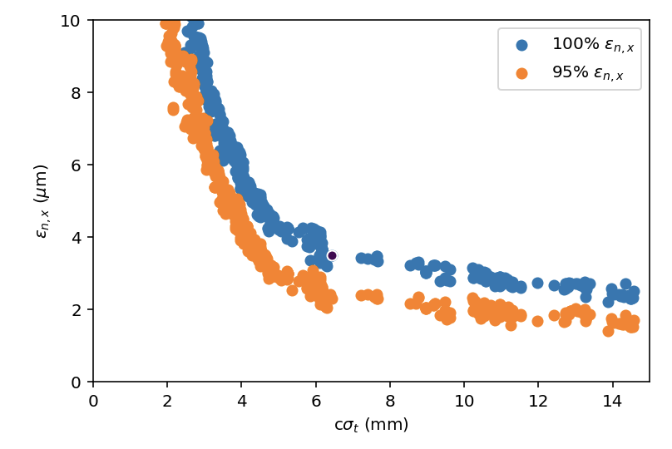
GPT:Bmad Hybrid Injector + Merger Model
Bmad Merger + Linac Model
GPT Injector Model
Optimize emittance vs. bunch length after 1st linac cryomodule

Slide 13
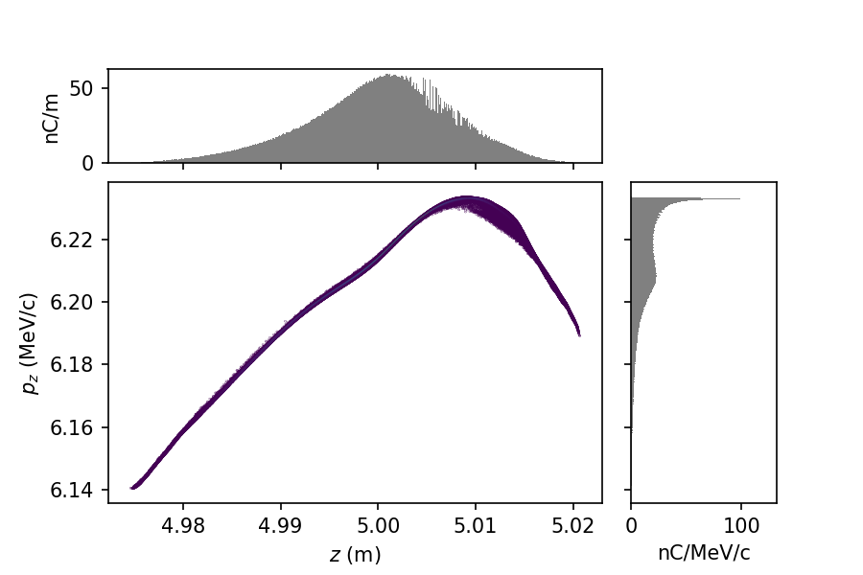
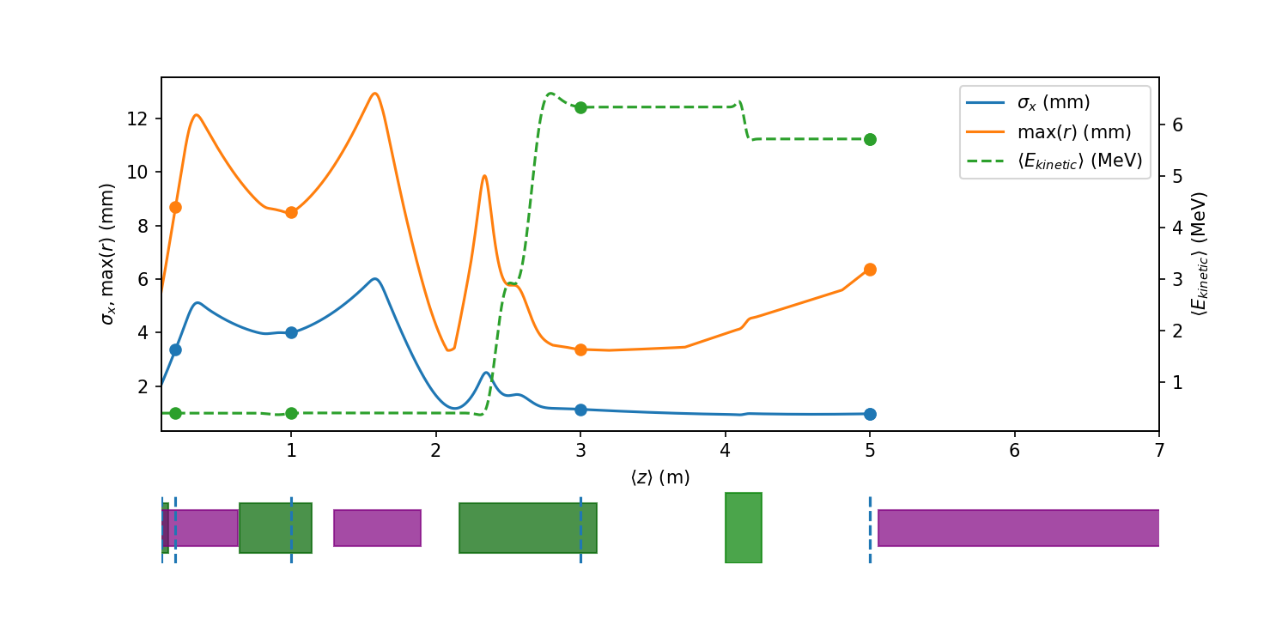
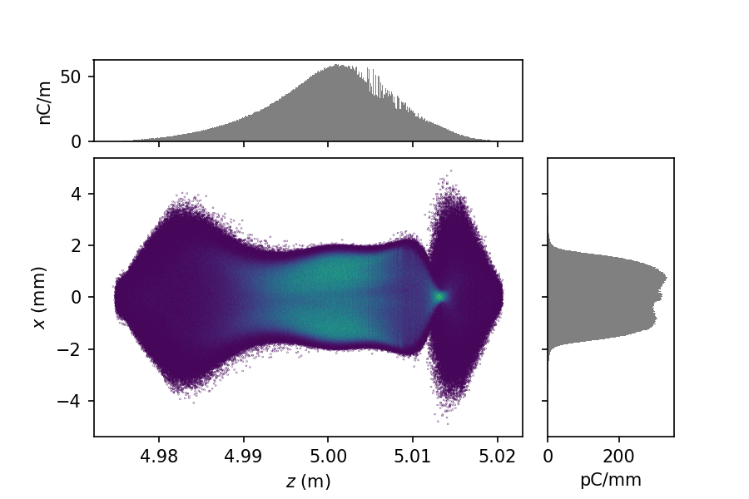
Impact-T Injector: 10 Million particle tracking

Slide 14
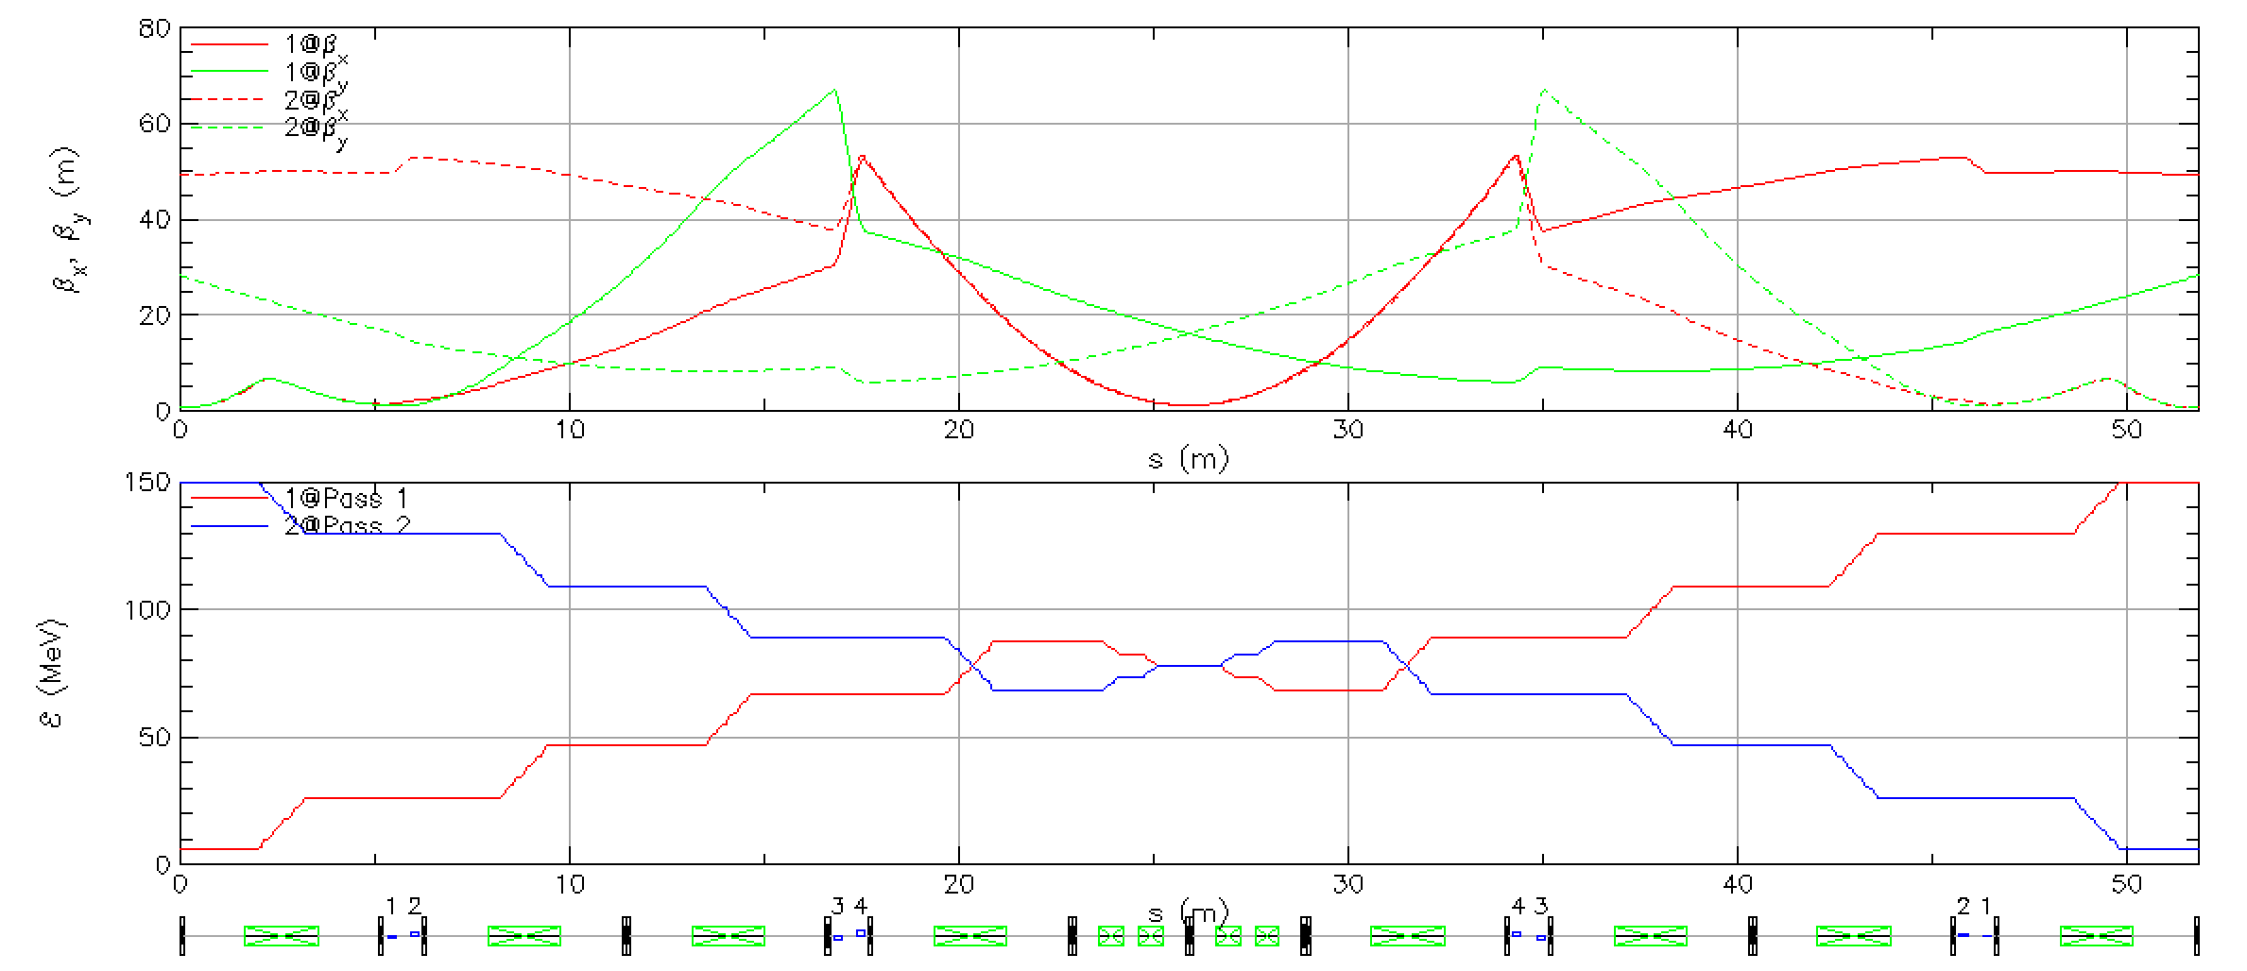
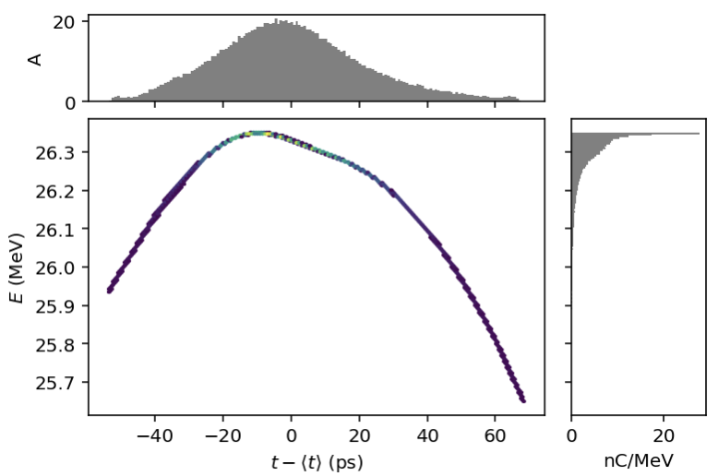
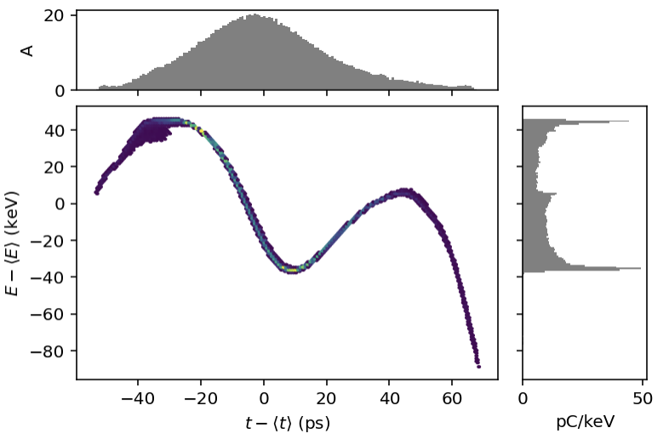
Multipass Linac Optics: Mode A (150 MeV)

Slide 15
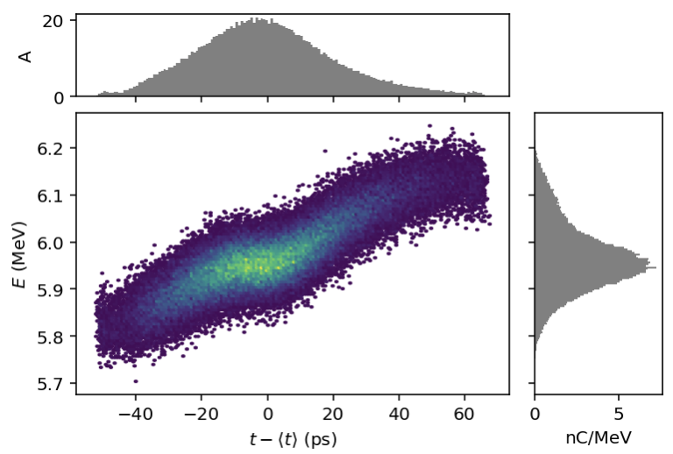
Beam Tracking, Mode A (100k particles)
LA.CRMOD01.Mar.END\1
LA.Mar.END\1 (150 MeV)
LA.Mar.END\2 (6 MeV)

Slide 16
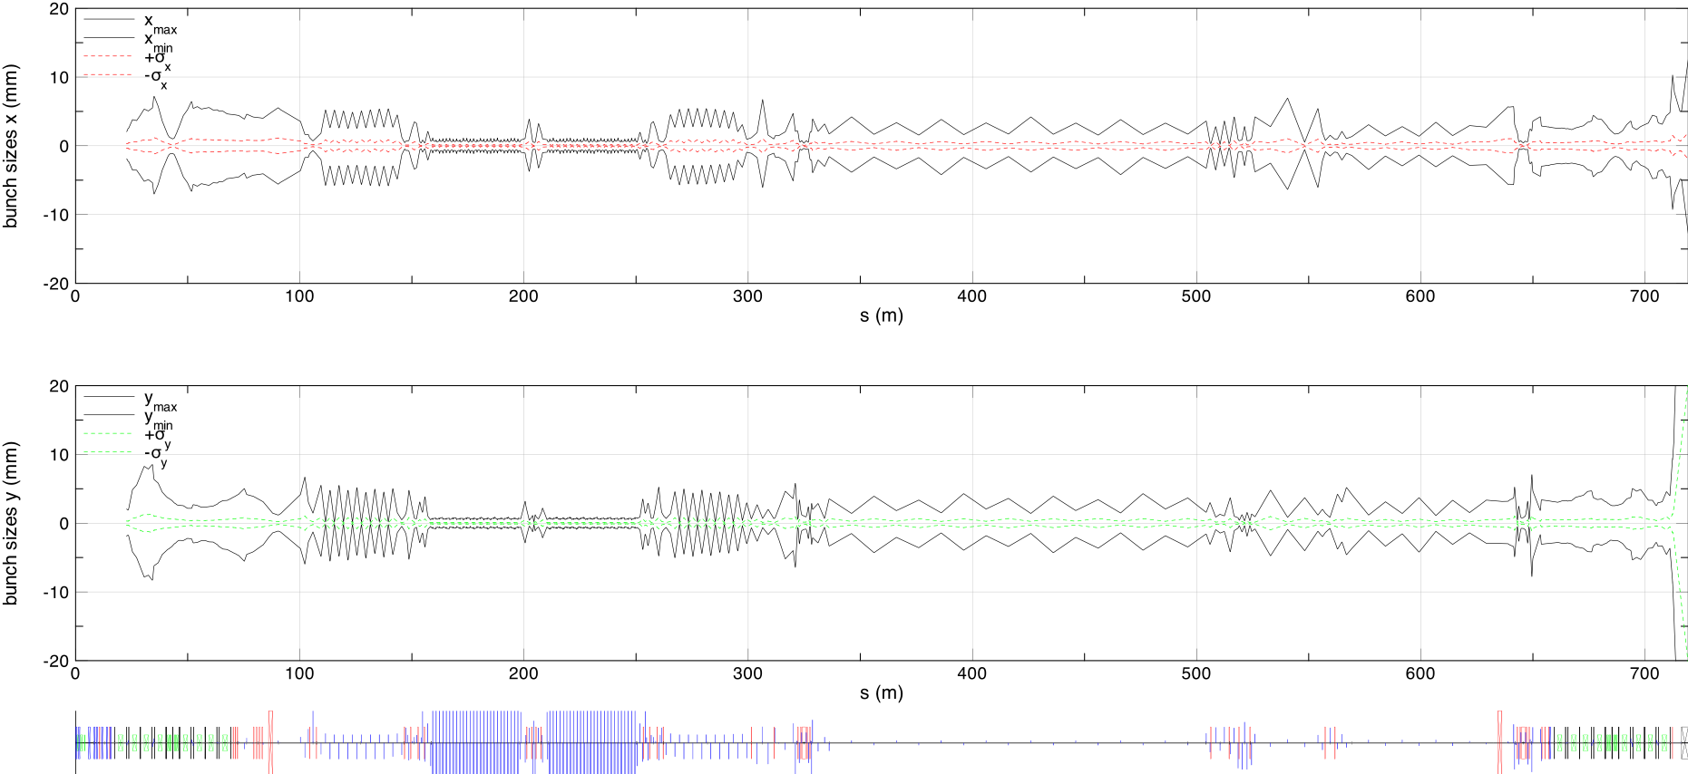
Beam Tracking, Mode A (100k particles)

Slide 17
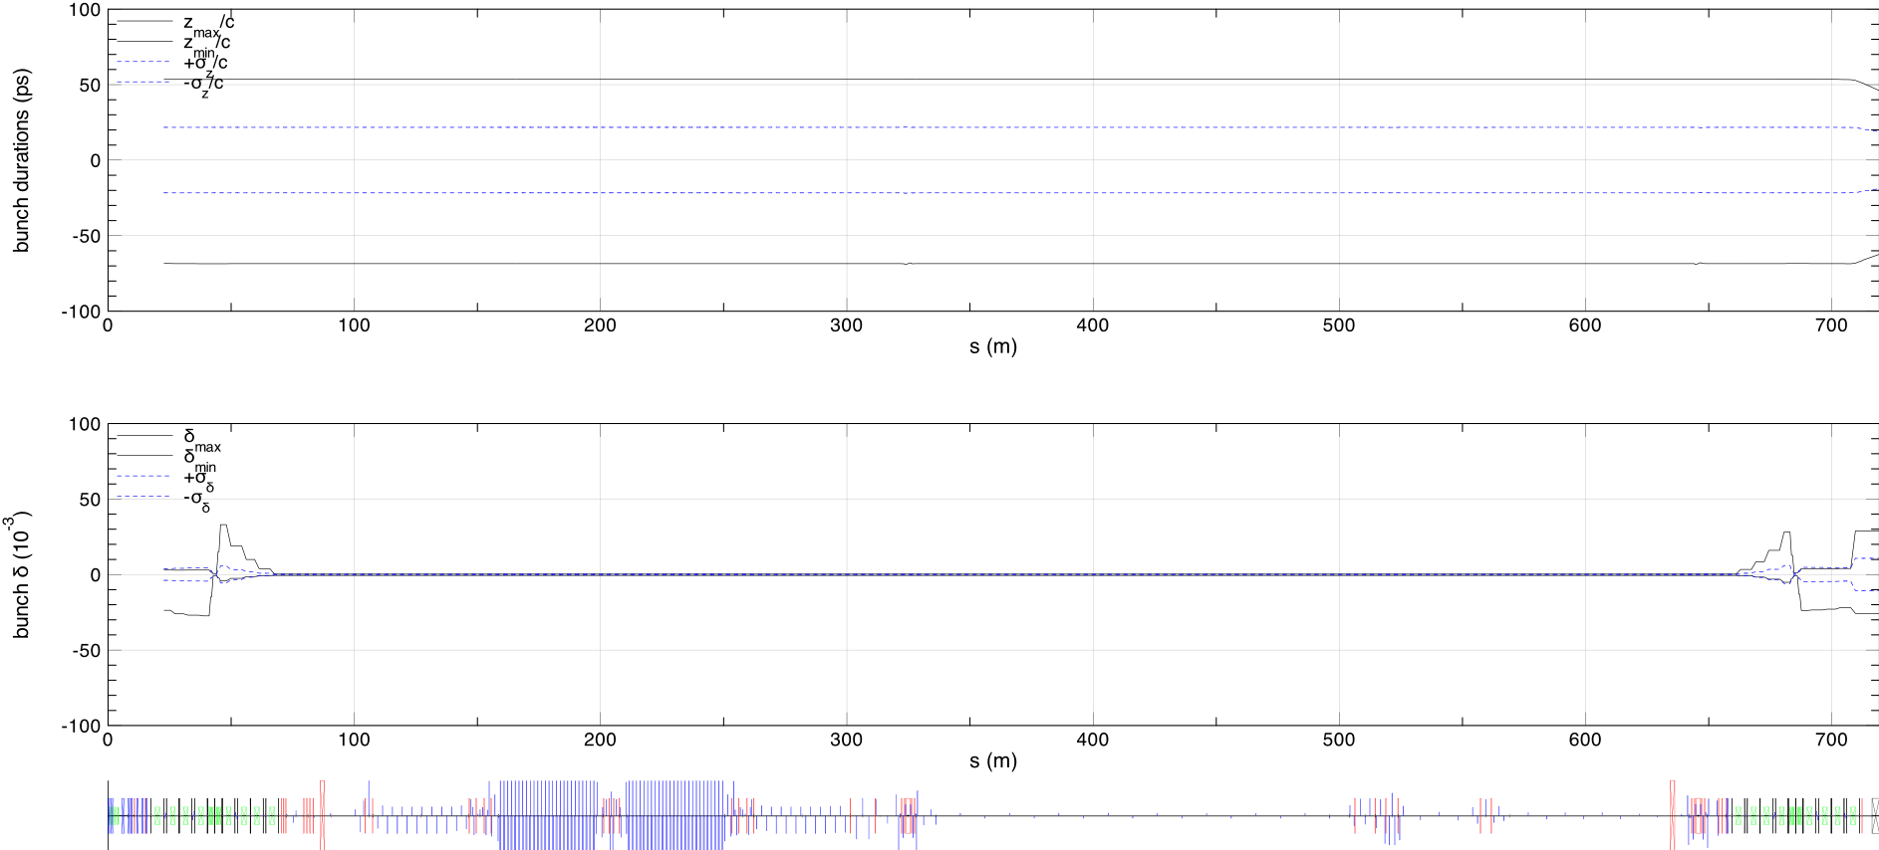
Beam Tracking, Mode A (100k particles)

Slide 18
Incorporating Precooler:
SHC only: 591 MHz Injector
(591 MHz SRF injector)
Ballistic compression
Also requires significant modifications to cooling section
Combined SHC with Precooler
(197 MHz SRF injector)
Chicane compression

Slide 19
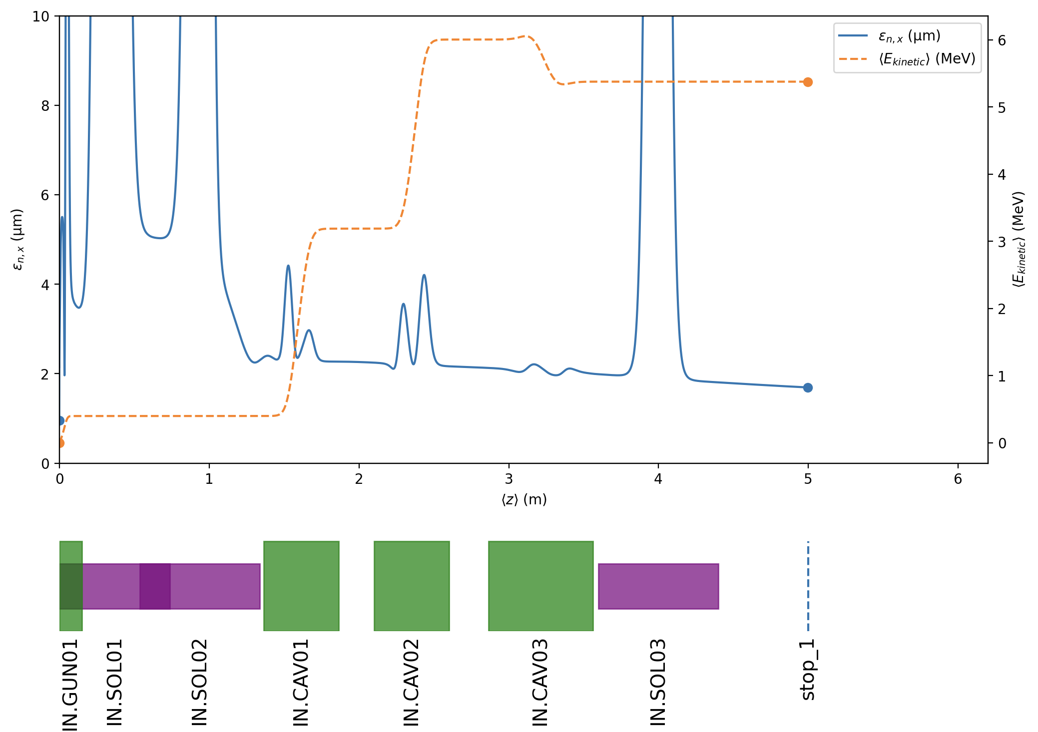
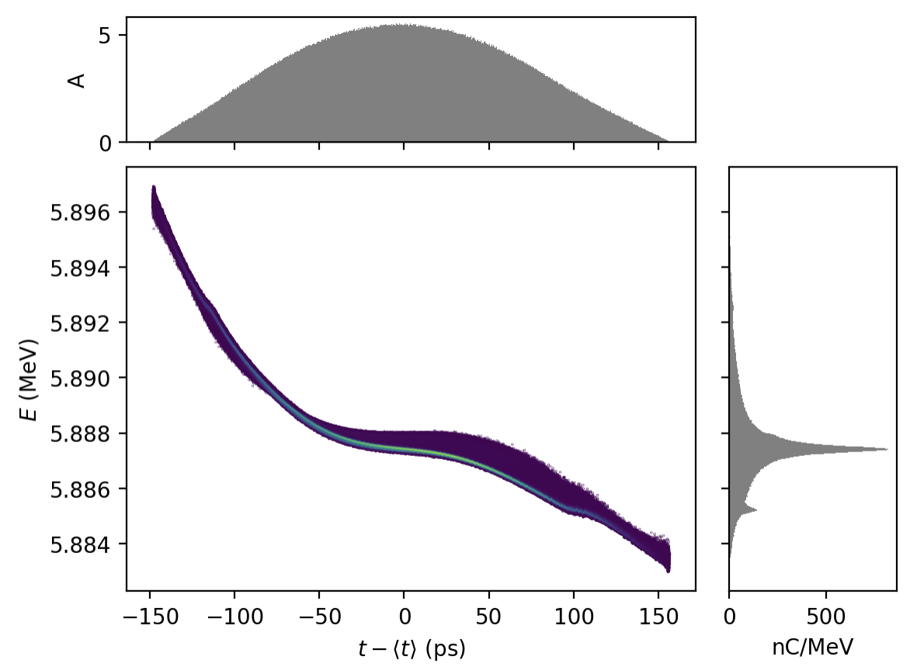
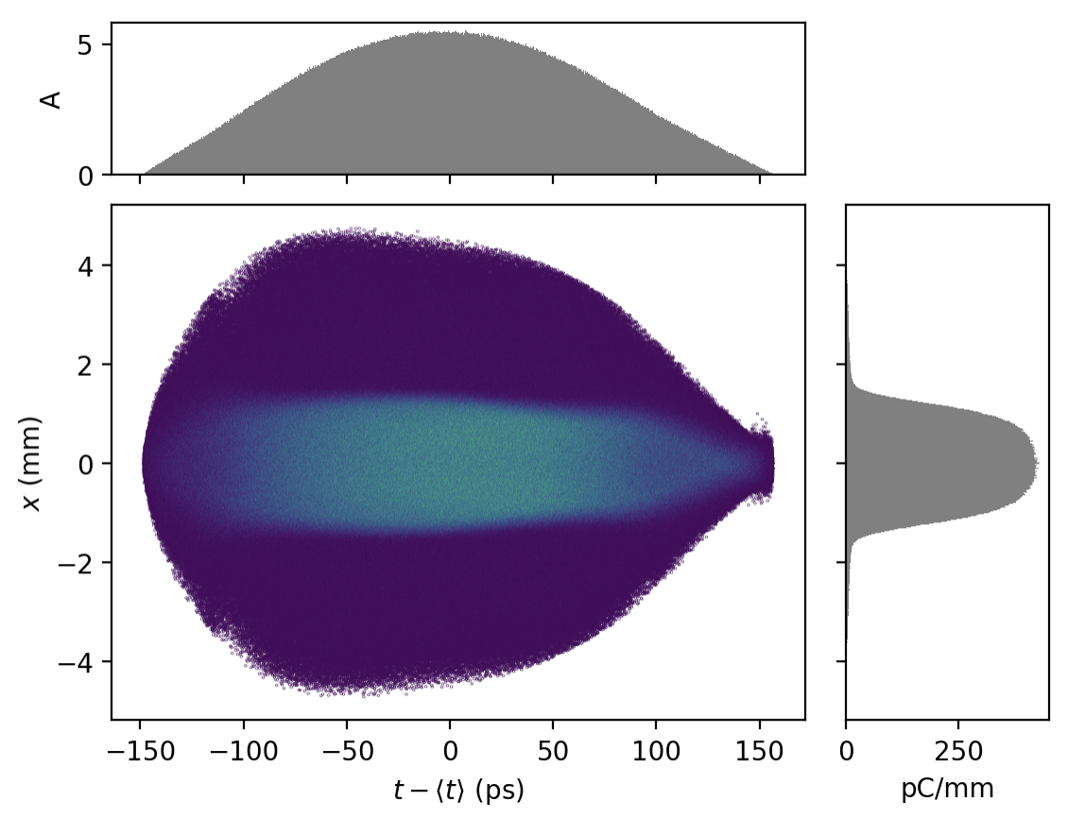
Impact-T New Injector: 10 Million particle tracking

Slide 20
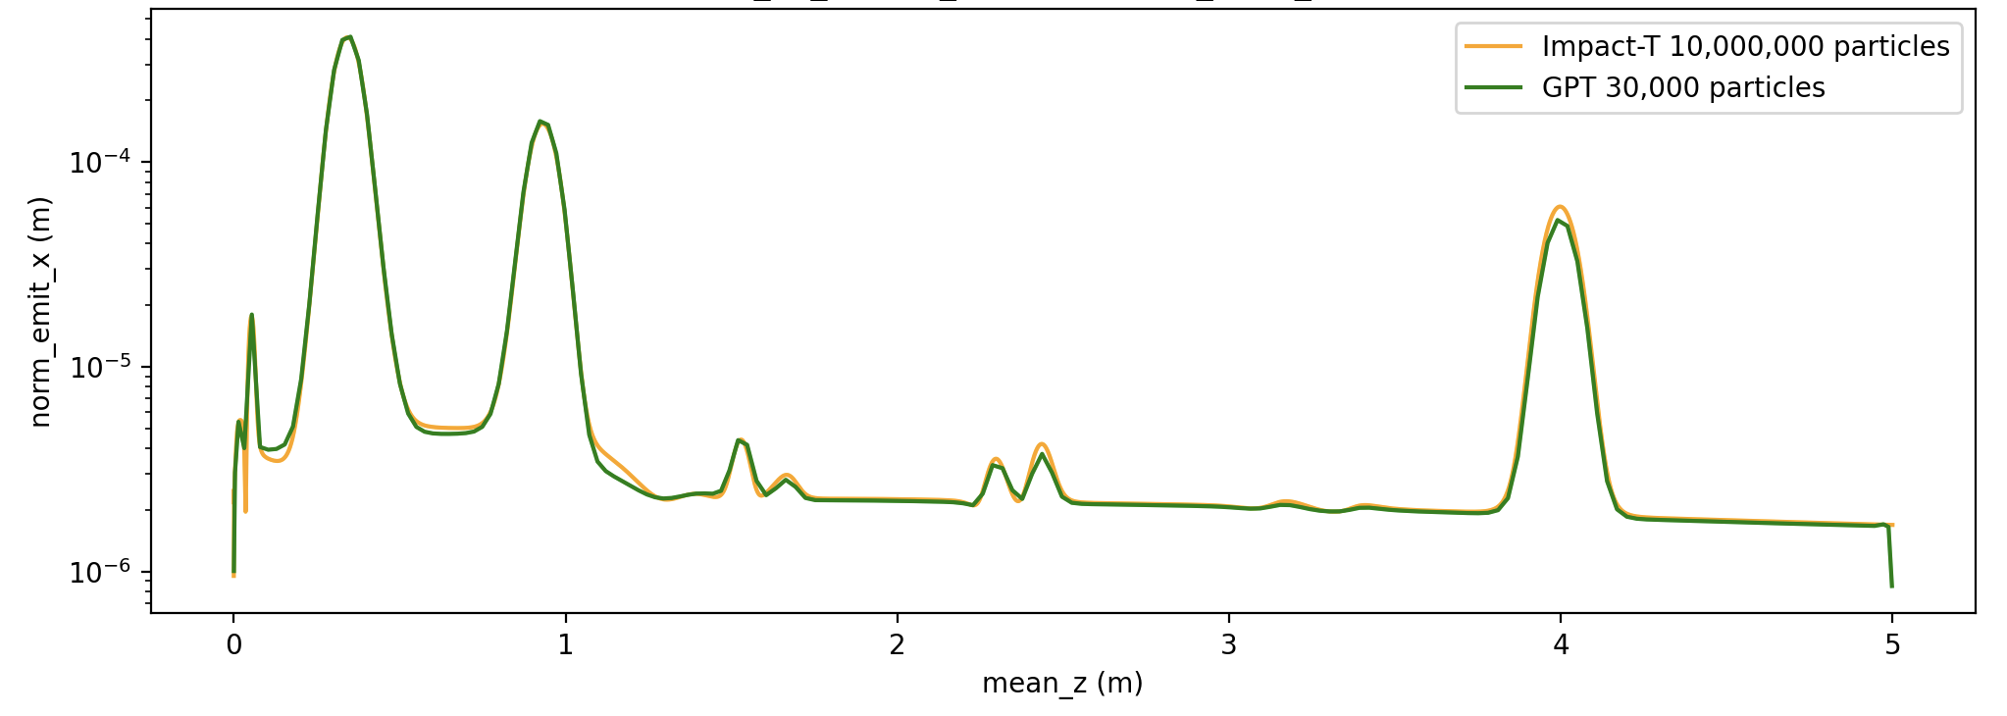
Impact-T New Injector: 10 Million particle tracking

Slide 21
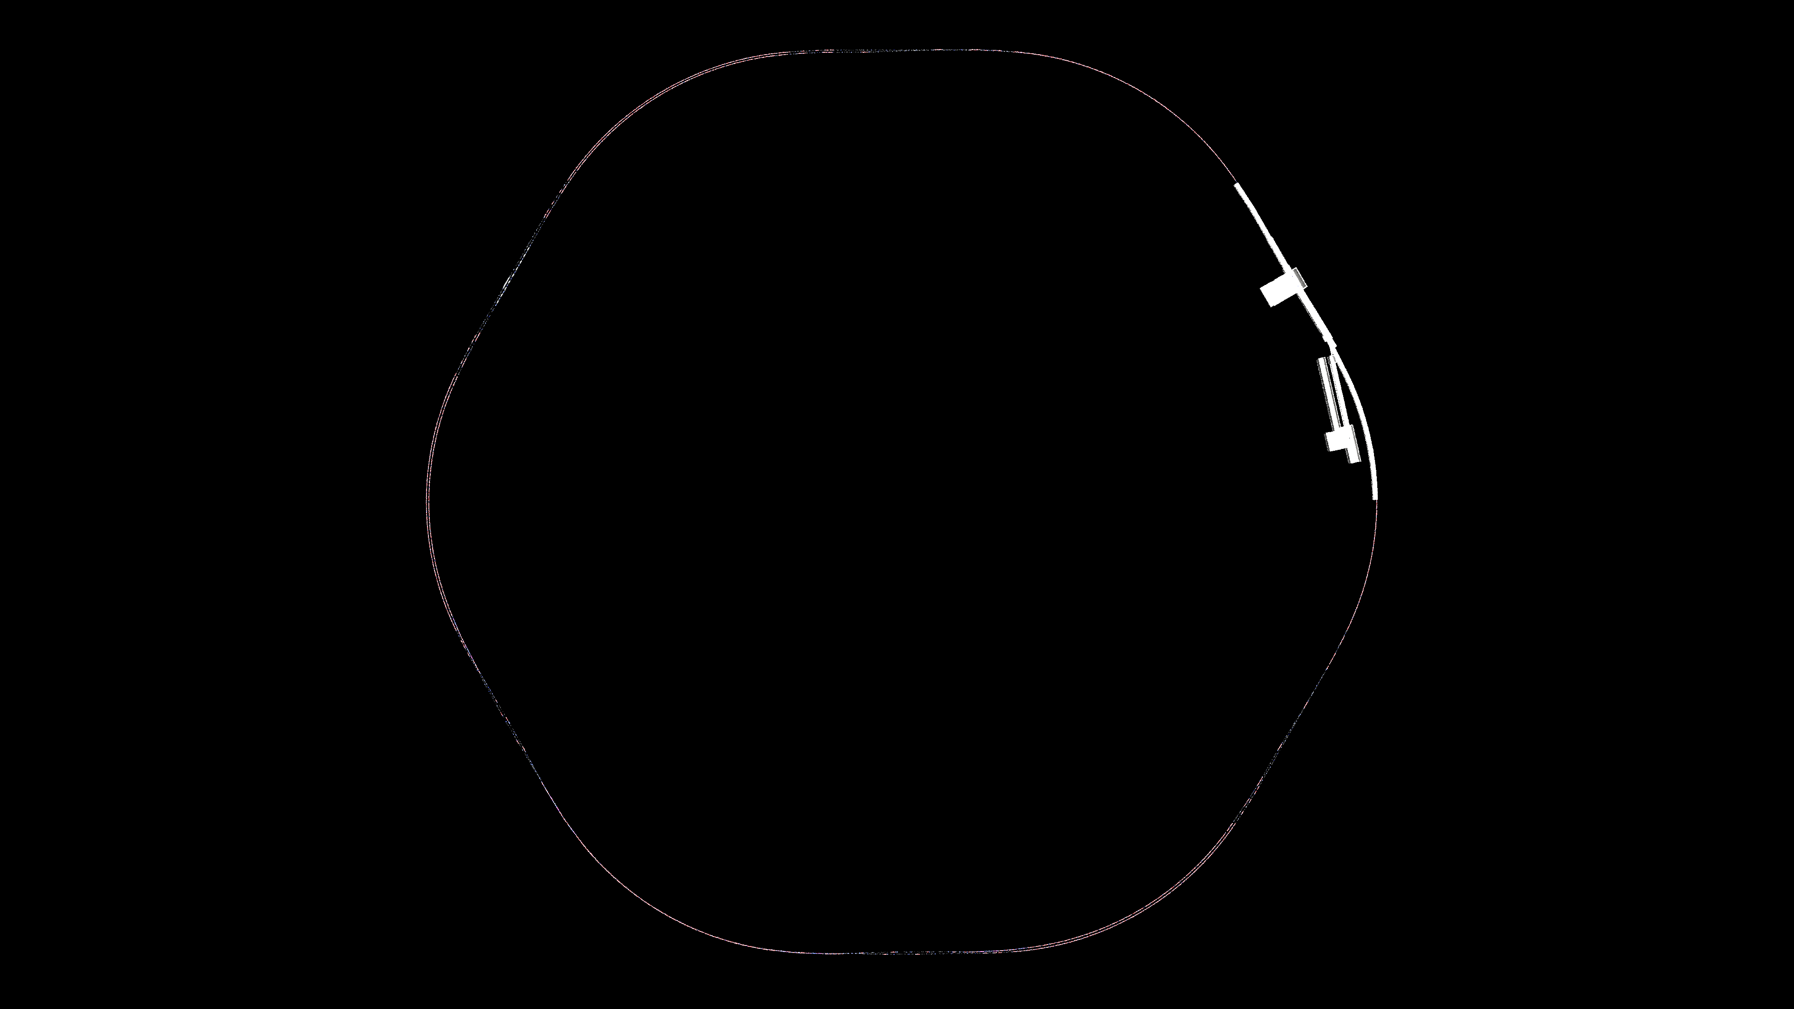
Updated Layout

Slide 22
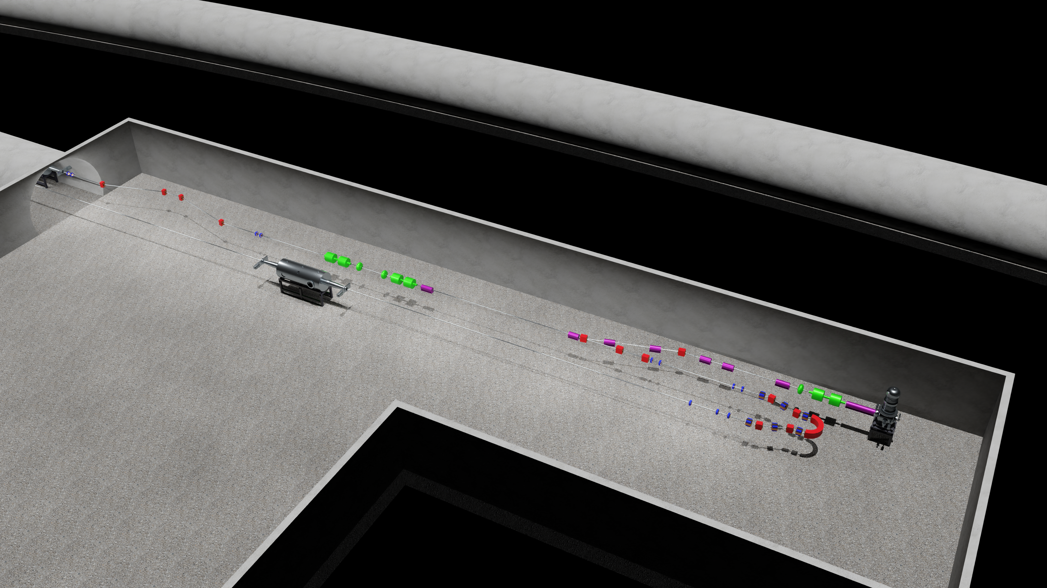
Updated Layout

Slide 23
https://www.youtube.com/watch?v=4CugHYR-bQI&t=65s

Slide 24
Conclusions
Produced an initial closed lattice for EIC ERL cooler.
Used this as the basis for further studies (e.g. tolerances, start-to-end, BBU).
Incorporating major changes into the design (precooler and new cooling section design).
Thank you to our colleagues at BNL/JLAB/Cornell
Thank you ERL’22

