Slide 1
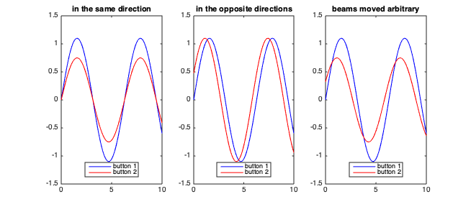
Test of ERL BPM at RHIC
Igor Pinayev
Brookhaven National Laboratory
Commonly used BPMs process average amplitude of the signal induced on the pick-up electrodes. This technique is not acceptable for ERL where two or more beam can propagate through a vacuum system and each has own trajectory. The solution is in utilizing the phase information.
$$δ_{2}$$
Δt₁₂
$$δ_{1}$$
For the small displacement we can neglect the second order terms and assuming V₁=V₂=V₀ receive
Amplitude processing gives average position of the beams. Phase processing gives:
Phase shift gives information on the difference in the orbits.
Traces from four channels in the same BPM. The buffer holds slightly longer than two turns data. The abort gap introduces amplitude modulation and sidebands fitting might be required for more accurate measurements.
The processing frequency ω should be multiple of the revolution (repetition) frequency but generally not equal to RF frequency (since the decelerated beam is 180 degree off).
For k=10 mm, 100 microns difference gives 0.01 radians (0.57°) relative phase shift.
The distance from location of BPM to the center of straight section (hadron beam aligned) is 3.3 m. Hence, the time delay is 22 nanoseconds and tangent values is 0.75 for processing frequency of 9.31 MHz.
There are presently seven PUE which are equipped with diplexers to separate signals for the hadron and electron BPMs. The lumped LC diplexer ZDPLX-2150-S+ by Mini-Circuits has lower passband from DC to 25 MHz and higher passband above 30 MHz. At low frequency port the insertion loss is below 1 dB at 18.6 MHz. Three CeC BPM units are Libera Single Pass tuned to 9.3 MHz. There are also two DX BPMs located on the same straight that are part of RHIC Instrumentation.
There are four BPM pick-ups available in the coherent electron cooling section for additional units. We can control and measure beam position in the arcs independently as well as adjust bunch separation in time by changing the RF settings in the RHIC. Two quadrupoles located at the common straight section can be used to measure the beam trajectories independently with possibility to extrapolate beam trajectories to the location of the BPMs.
The signals from two electrodes with different shifts of the beams from center of beampipe.
The measurements will start with establishing phase shifts in the individual channels. It will be performed with a single ring filled. The long-term stability can be studied during regular RHIC operations when during refill only one ring has circulating beam.
We will study spectral contend of the PUE signal to evaluate best frequency for signal processing.
For each ring filled we will establish the dependence of the beam trajectory in the common section with BPM readings just outside the common section to find independent way to steer the beams in controlled manner.
The first test will be aimed at proof-of-the-principle. With beams with equal intensity and known trajectories we will calculate the positions with time separation measured with oscilloscope connected to the BPM button (part of the CeC diagnostics) and known distances between the elements.
Next, we will steer the beam and measure change in the orbit. The BPM readings will be compared with measurements based on the steering by the quadrupoles.
We will change the timing between bunches using RHIC RF and study the system applicability for obtaining reasonable readings including small separation time.
We will study systematic errors due to the unequal beam intensities when intentionally reduce circulating current in one of the rings using scrapers.
The described above measurements will be performed with different processing frequency and/or filling pattern in RHIC.
I. Pinayev, Beam Position Monitor for Energy Recovery Linac, Proc. IBIC2012, TUPA15
I. Pinayev, Monitoring Beam Position in the Multibeam Accelerators, Proc. ERL2013, WG405

