Slide 1


ERL longitudinal matches for light sources
Gustavo Pérez Segurana
Lancaster University & The Cockcroft Institute

Slide 2
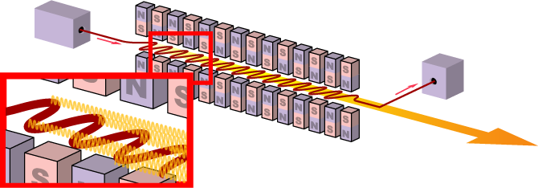
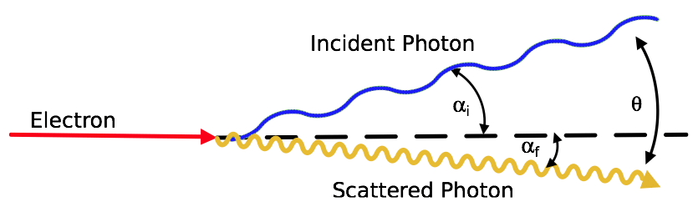
Context
Provide high 6-D brightness electron bunches for use in:
FEL
  Compressive match
Inverse Compton Scattering
  Energy spread minimizing match
In all cases, we want high average power/high luminosity.
These conditions can be achieved in an ERL with high efficiency.

Slide 3
ERL topologies
Common Transport
Separate Transport
Beam traverses the same arc accelerating and decelerating.
Decelerating arc path lengths and longitudinal dispersions defined during acceleration.
Beam only traverses each arc once.
Independent control over all arc path lengths and longitudinal dispersions.

Slide 4
Local and Global Constraints on ERLs
Separate transport:
  Achieve right energies at interaction point and dump.
  Achieve constrained longitudinal phase space at interaction point.
  Withstand and transport disruptions at interaction point with very low losses.
  Achieve constrained longitudinal phase space at dump.
  At every point in the system, the beam energy spread must fit within the energy acceptance (< few %).
Common transport:
  All the above.
  Intermediate energies are the same accelerating and decelerating.

Slide 5
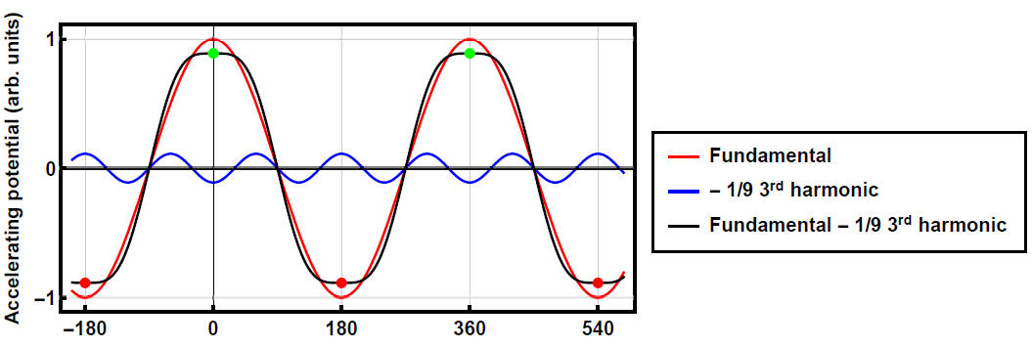
Preferred match properties
Favour isochronous arcs over non-isochronous arcs.
  Minimize beam degradation due to collective effects that become magnified by $R_{56}$ excursions and the resulting longitudinal bunch charge distribution modulations.
No parasitic compressions.
  Also know as overcompressions, where the bunch head and tail exchange places.
  Expect significant beam degradation.
No harmonic RF
  Odd harmonics used for linearization.
  Even harmonics required to compensate for energy
  lost due to synchrotron radiation.
  Cost.

Slide 6
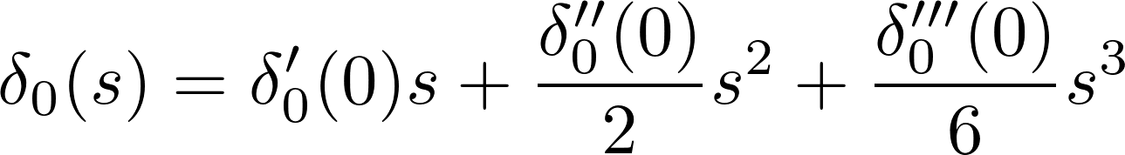
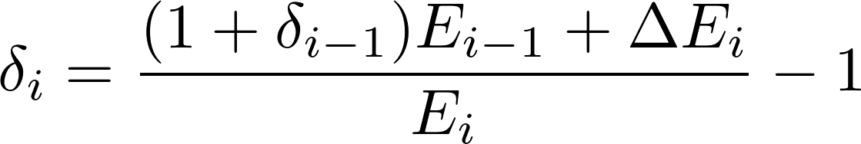
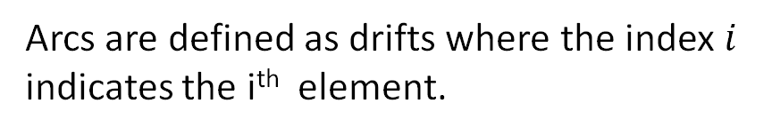
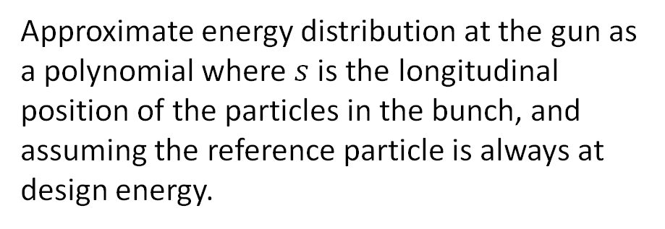
Semi-analytical model
Approximate energy distribution at the gun as a polynomial where $s$ is the longitudinal position of the particles in the bunch, and assuming the reference particle is always at design energy.
Arcs are defined as drifts where the index $i$ indicates the i^{th} element.
$r_{56i}=R_{56}^{(i)}$ $t_{56i}=T_{566}^{(i)}$ $u_{56i}=U_{5666}^{(i)}$
RF cavities are approximated as thin lenses.
I. Zagorodnov and M. Dohlus, Semianalytical modeling of multistage bunch compression with collective effects, Phys. Rev. ST Accel. Beams 14, 014403 (2011).

Slide 7
Longitudinal matches

Slide 8
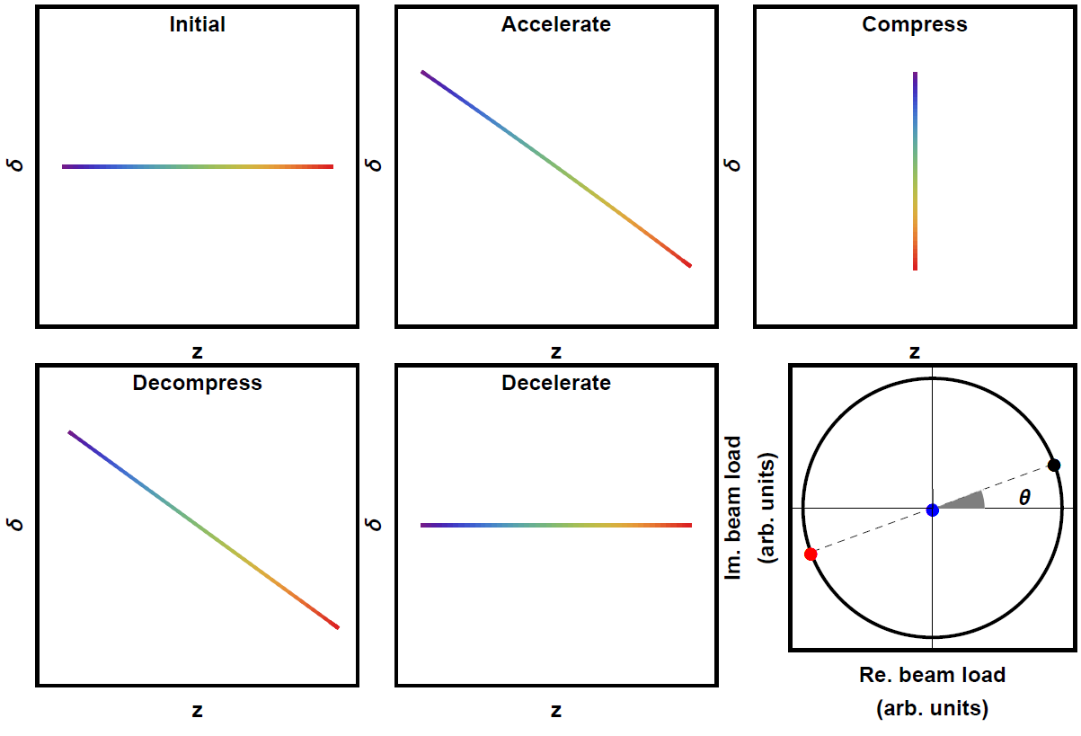
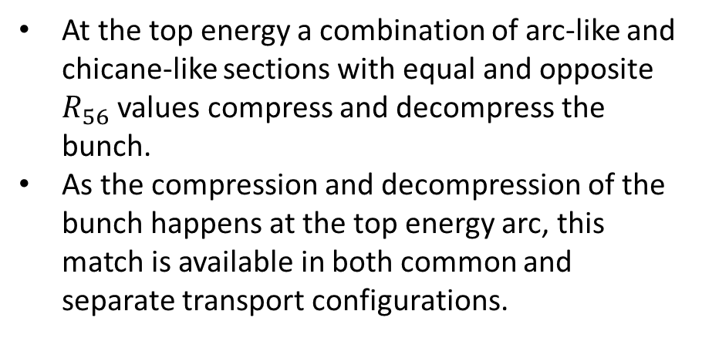
Compressive match
At the top energy a combination of arc-like and chicane-like sections with equal and opposite $R_{56}$ values compress and decompress the bunch.
As the compression and decompression of the bunch happens at the top energy arc, this match is available in both common and separate transport configurations.
Acceleration
Deceleration
Resultant

Slide 9
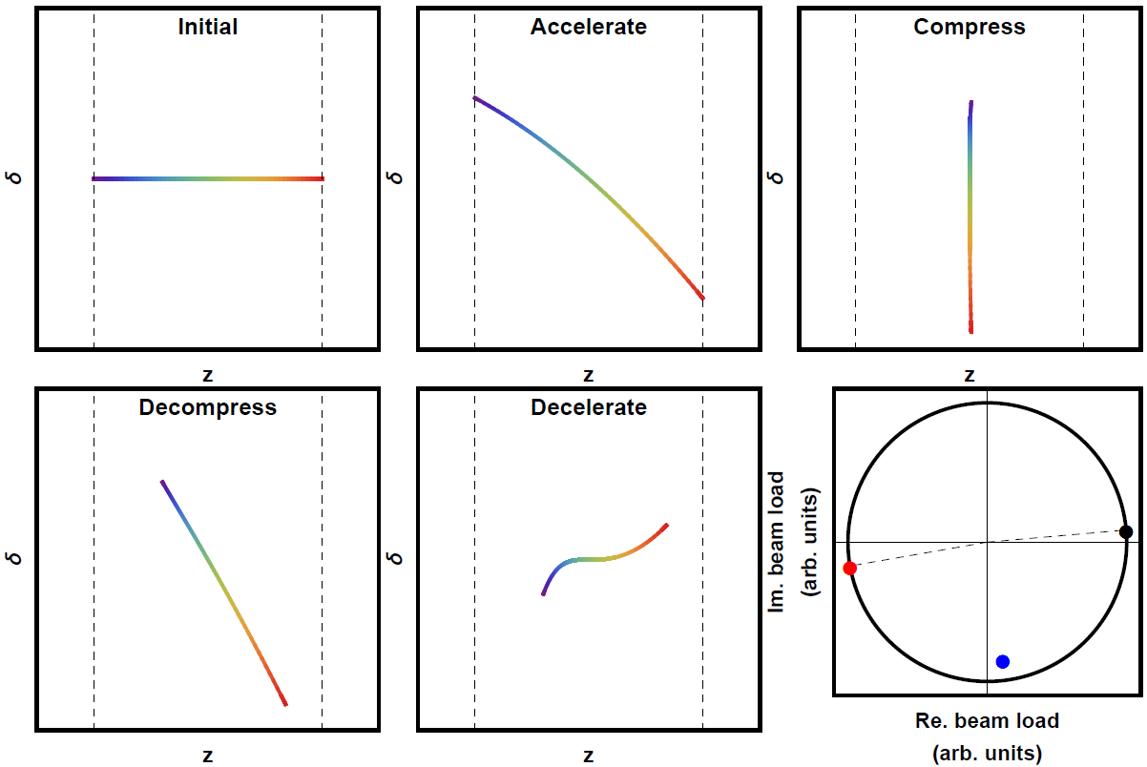
Compressive match with SR loss compensation – Separate Transport
Independent control of longitudinal dispersions enables linearization during acceleration and deceleration as well as bunch length control.
(x10 resultant)

Slide 10
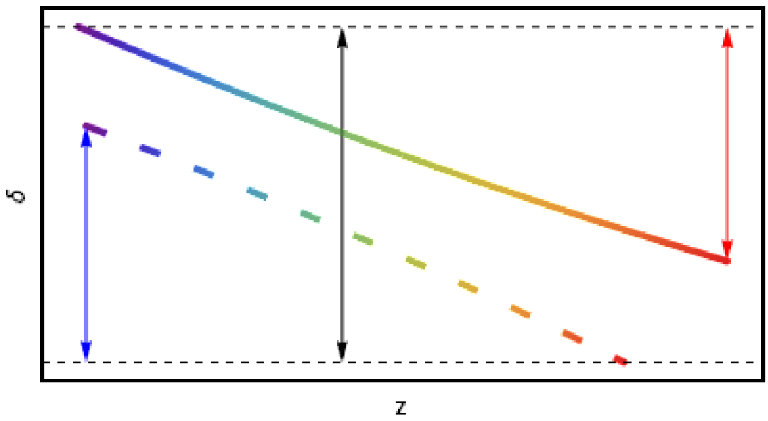
Compressive match with SR loss compensation – Common transport
Path length symmetry between acceleration and deceleration passes does not match the energy asymmetry.
If we choose to match the energy compensation we cannot match the chirp compensation.
As the energy lost to SR increases, the difference between the average energy of accelerating and decelerating beams will also increase.

Slide 11
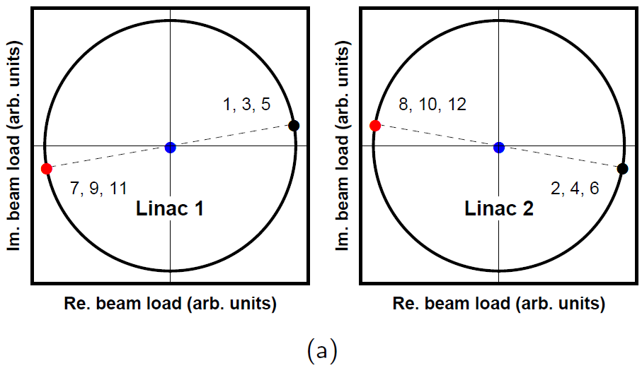
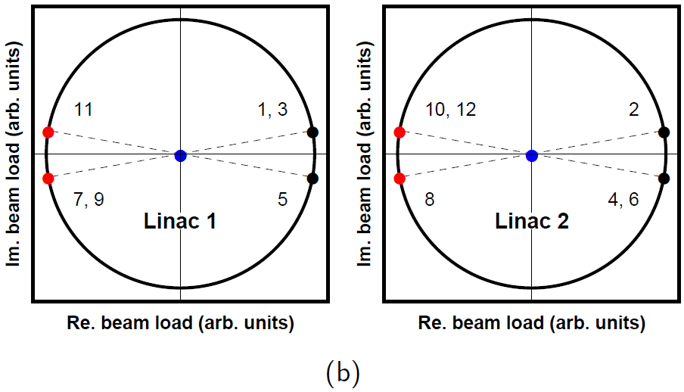
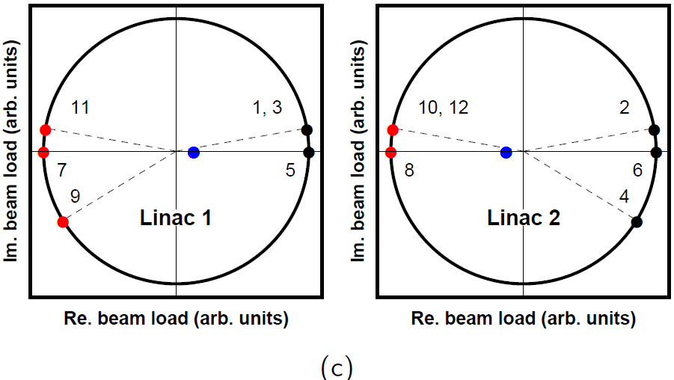
Energy spread minimization –
RF phase configurations
The bunch is thus chirped into all odd arcs and dechirped into all even arcs.
  Linearize with arcs 1, 3 & 5.
First half of accelerating passes are on the same phase and the second half on the opposite side of crest.
  Linearize with arcs 1, 2 & 3.
First half of accelerating passes are on the same phase, beam is dechirped in the next pass, remaining passes on crest.
  Imbalance between the two linacs.

Slide 12
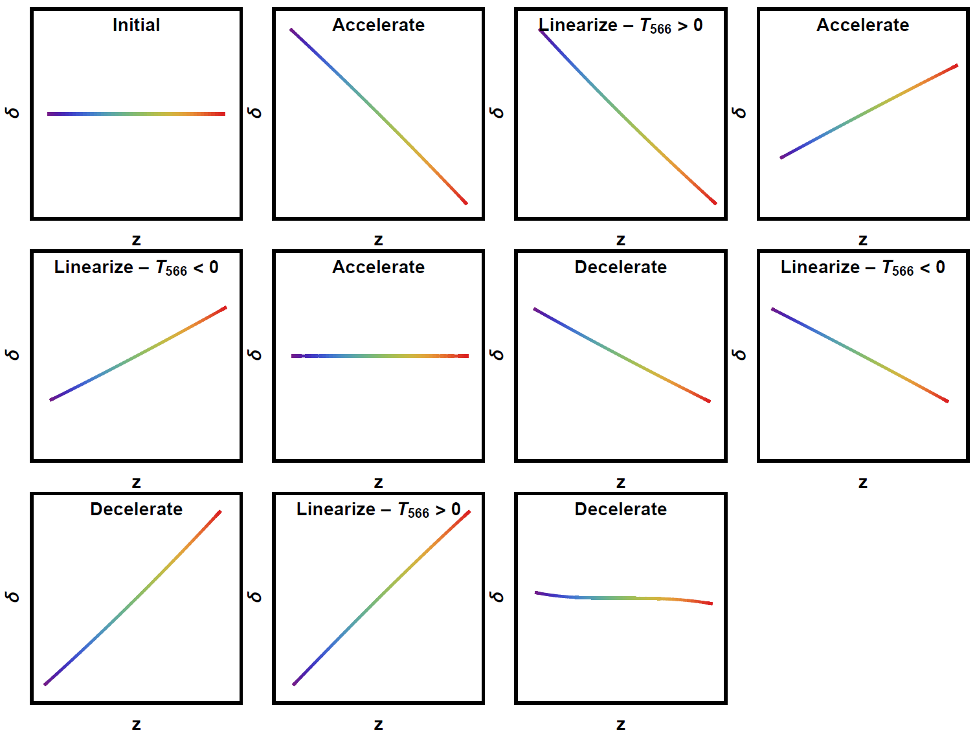
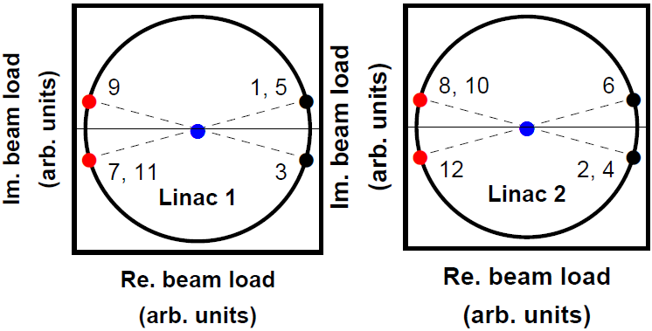
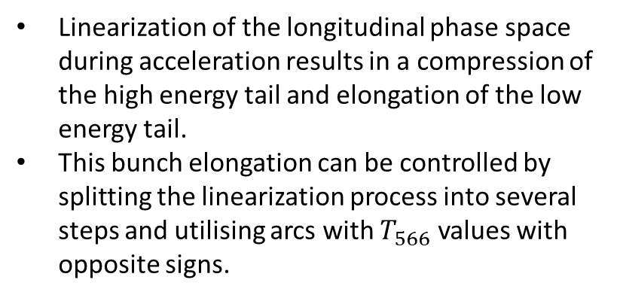
Bunch length control through alternate sign linearization
Linearization of the longitudinal phase space during acceleration results in a compression of the high energy tail and elongation of the low energy tail.
This bunch elongation can be controlled by splitting the linearization process into several steps and utilising arcs with $T_{566}$ values with opposite signs.

Slide 13
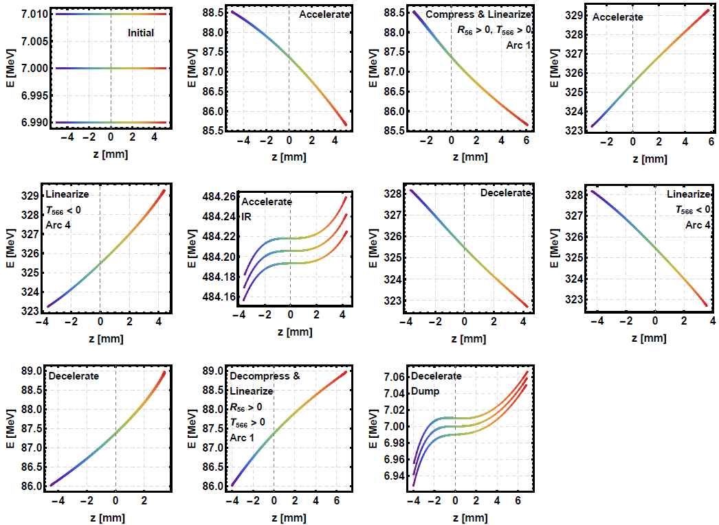
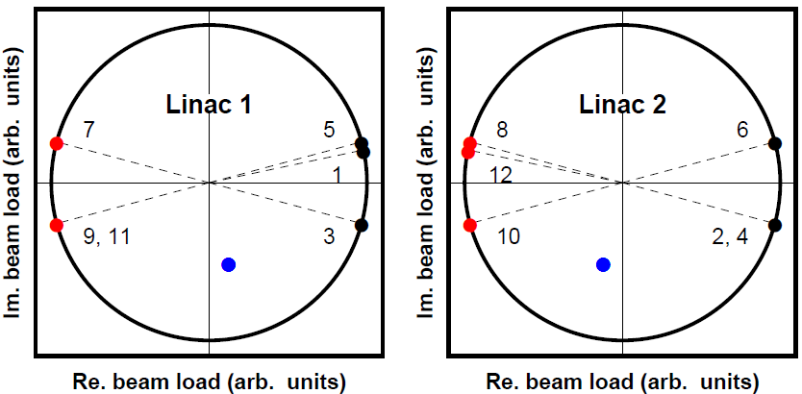
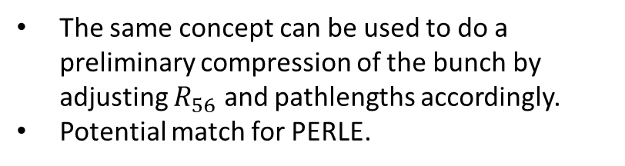
Bunch length control through alternate sign linearization
The same concept can be used to do a preliminary compression of the bunch by adjusting $R_{56}$ and pathlengths accordingly.
Potential match for PERLE.
(x10 resultant)
(x10 resultant)

Slide 14
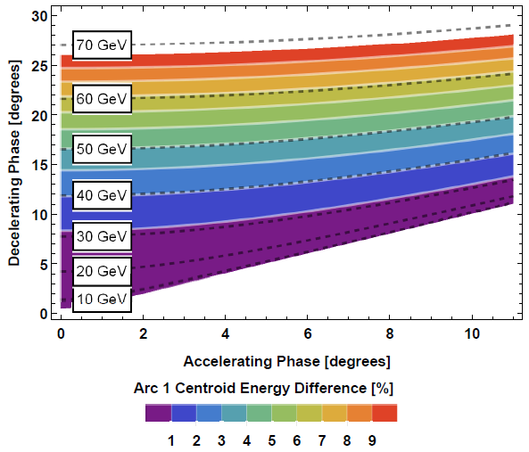
Energy spread minimization with SR loss – Common Transport
Energy acceptance necessary in arc 1 of a 3-turn common transport ERL (LHeC-like) for a range of peak energies (black dashed contour lines), injection and dump energies matched.
Tuning the top energy arc path length can only match the decelerating energy at a single stage.
Numerical optimizations where all arc path lengths are allowed to change result in very far off-crest passes.

Slide 15
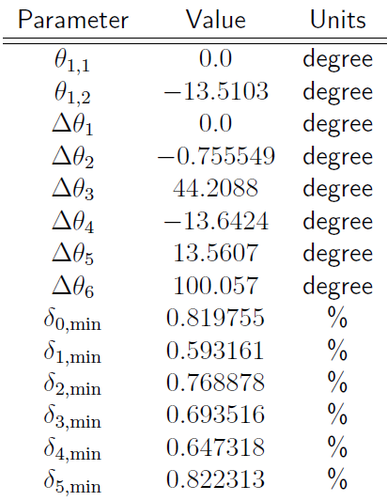
Energy spread minimization with SR loss – Common Transport
Energy acceptance necessary in arc 1 of a 3-turn common transport ERL (LHeC-like) for a range of peak energies (black dashed contour lines), injection and dump energies matched.
Tuning the top energy arc path length can only match the decelerating energy at a single stage.
Numerical optimizations where all arc path lengths are allowed to change result in very far off-crest passes.

Slide 16
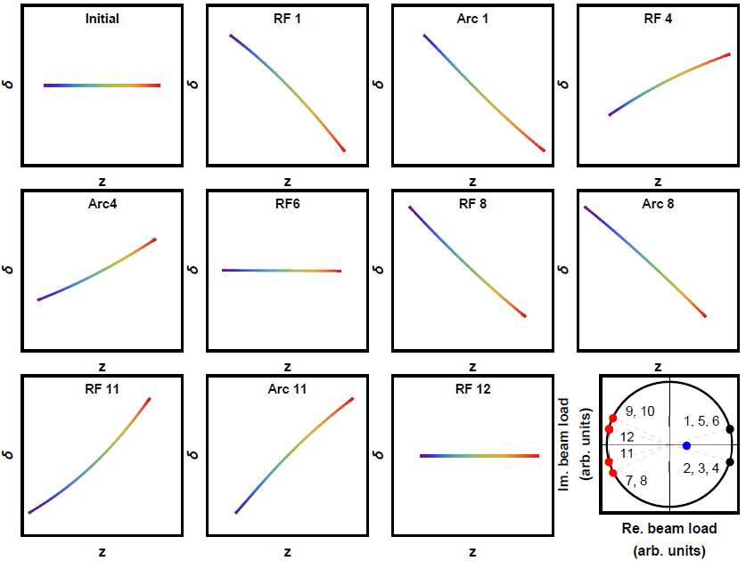
Energy spread minimization with SR loss – Separate Transport
A separate transport solution is readily available since accelerating and decelerating beams need not share the same centroid energy.
First 4 deceleration passes made further off-crest.
Linearization in arcs 1 and 4 during acceleration and arcs 8 and 11 during deceleration (chirps of opposite sign).

Slide 17
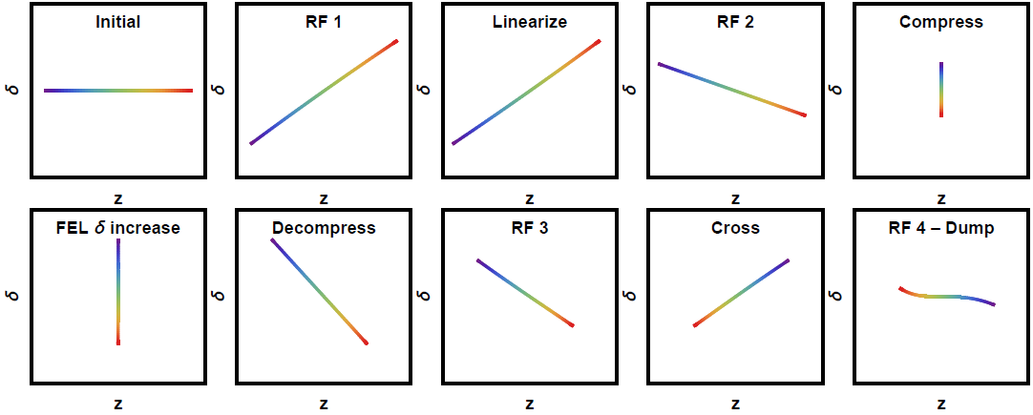
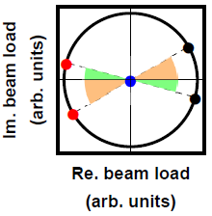
Parasitic crossings
Although a parasitic crossing has the potential to significantly degrade the beam, this may be mitigated by keeping the minimum bunch lengths relatively large during the compression due to uncompensated rf curvature.
Compressive longitudinal match with energy spread growth at the interaction point.
The separate transport configurations' independent control over each arc's longitudinal dispersions enables the use of these transformations during deceleration without compromising the beam quality before it reaches the interaction region.

Slide 18


Conclusions & Further work
Comprehensive study of possible longitudinal matches for ERLs.
Matches without need for synchrotron radiation energy loses compensation available for both separate transport and common transport.
Synchrotron radiation compensating matches available for separate transport topologies.
Common transport solutions for synchrotron radiation compensating matches present issues due to the large energy acceptance requirements.
New PhD student at Lancaster University and Cockcroft Institute continuing this work implementing collective effects to the analysis.
Construction of self-consistent longitudinal matches in multipass energy recovery linacs

