Slide 1
Beam Dynamics Challenges of a Far-Future ERL-Based Collider - The Ghost Collider
Andrew Hutton

Slide 2
Motivation
From the European Accelerator R&D Roadmap https://arxiv.org/pdf/2201.07895.pdf
For percent-level measurements, a luminosity of 10³⁶ cm⁻² s⁻¹ is required
This is significantly beyond the present proposals and will need a new vision
The “Ghost Collider” is an initial concept for such a facility, but would need significant R&D before it could be adopted
This talk describes the concept and lists the R&D required
A particularly interesting prospect is to design and possibly build an energy efficient, ultra-high- luminosity ERL-based electron-positron collider, which would enable the exploration of the Higgs vacuum potential with a precise measurement of the tri-linear Higgs coupling. The e+e− → ZH → HH production cross-section is maximal near 500 GeV collision energy with a value of about 0.1 fb

Slide 3
ERLC Proposal by Valery Telnov
V. Telnov, Journal of Instrumentation 16 (2021) P12025

Slide 4
Origin of the Twin-Axis e+e- Colliders (2)
Erk Jensen suggested a different layout*, and realized that if accelerating electrons and decelerating positrons (or vice versa) shared the same bucket, there would be:
No excitation of higher modes (HOMs)
No Multi-bunch Beam Break-Up (MBBU)
Bunches consisting of equal numbers of electrons and positrons going in the same direction can be thought of as “ghost” bunches which do not interact electromagnetically with their environment
They produce synchrotron radiation
They will be visible on a fluorescent screen
Magnetic fields will separate the electrons and positrons
* https://indico.cern.ch/event/1040671/#9-energy-recovery-and-sustaina

Slide 5
Suggested Layout by Erk Jensen

Slide 6
“Ghost” Bunches
There are also other advantages to “ghost” bunches:
No excitation of dipole HOMs
No requirement for a large aperture to allow HOMs to couple out
Higher frequencies are possible – 3 GHz or (perhaps) 6 GHz
Alternatively, the aperture could be reduced to reduce the cryogenic load at 1.3 GHz
Minimize requirement to couple out HOMs to higher temperature (with associated heat leakage)
Obviously, these advantages are only true to first order
Note that bunches are accelerated in both directions in the Linacs
The twin-axis linac can be considered as a folded linac with the same total length and equal gradient
Energy is transferred between electrons and positrons in each bucket
Intra-bucket energy recovery
The two linacs do not need to be coupled for energy recovery – no twin axis cavities!

Slide 7
Questions to be Addressed
Since the electrons and positrons don’t have the same energy, they don’t have exactly the same velocity
There is a finite probability that an electron and a positron will collide and annihilate
How do you calculate the annihilation probability?
What is the energy of the two photons that are emitted?
Is it just the particle total energy (kinetic energy plus the rest mass) for each particle?
Magnetic fields deflect the electrons and positrons in opposite directions
Quad transverse position errors will tend to separate the electrons and positrons
This separation excites transverse dipole HOMs in the cavities leading to BBU instability
Need simulations to estimate the orbit differences between electrons and positrons to determine the threshold for BBU

Slide 8
Further Opportunities – The Ghost Collider
If positrons and electrons in a single bucket can be brought into collision with positrons and electrons which are also in a single bucket
This is like two neutral plasmas colliding
There will be no coherent beam-beam effect
This was first tried (unsuccessfully) at Orsay by Joel Le Duff and the DCI Storage Ring Team
“Experimental results on space charge compensation with the two rings are presented which include studies with three beams (strong-weak interaction) and four beams (strong-strong interaction). These studies were carried out at the energy of 0.8 GeV
“The present status of the space charge compensation does not permit a gain in luminosity with double ring operation, apart from a factor 2 that could be achieved with two independent rings”
In a high-energy linear collider, the interaction would be more stable
And again, this cancellation is only true to first order
So how can this be achieved?
“Status Report on D. C. I, The Orsay Storage Ring Group, IEEE Transactions on Nuclear Science, Vol. NS-26, No.3, June 1979

Slide 9
The Idea (1)
Inject electrons into a bucket which accelerates the electrons
Inject positrons into the bucket 𝜆/2 behind the electrons which accelerates the positrons
Introduce a chicane for the electrons between the Linac and the Interaction Region to delay the electrons by 𝜆/2
Do the same for the other linac
Collide with a small crossing angle
← e-
e+ →
← e+
e- →
Linac
Arrows indicate change in energy

Slide 10
Linac and Chicane Layout
After collision, send the positrons through the opposite chicane to delay them by 𝜆/2
Requires a total of four chicanes
e- →
← e+
e+ →
← e-
← e-
e+ →
← e+
e- →
Linac 1
Linac 3
Linac 1
Linac 2
Linac 4
e+ →
← e-
e- →
← e+
← e+
e- →
← e-
e+ →
Alex Bogacz proposed a different layout in the muon collider for a similar purpose: https://indico.fnal.gov/event/8903/contributions/110580/attachments/71967/86347/Acceleration_NF_MC.pdf

Slide 11
Chicane Dimensions
Assuming the chicane radius of curvature equal to the FCC
Here are the chicane dimensions:
Conclusion: Chicanes need a separate tunnel

Slide 12
Questions to be Addressed
The injection/extraction of the four beams is complex
8 transfer lines!
Is there a viable kicker design with short pulses and high repetition rate?
Need to consider the stability of the whole machine
This is not a single-pass collider because the beams are recovered and reinjected
Can the beams be sufficiently damped in the Injector to prevent multi-turn instabilities?

Slide 13
Arc Energy Replacement
Both the electrons and positrons lose energy in the Arcs
There are two superposed Arcs, one for electrons and one for positrons
The two bunches in each Arc are separated by 𝜆/2
One going to the IR
One coming from the IR
An RF system in the Arc would have to be at twice the Linac frequency to accelerate both bunches
The linac frequency is already high to reduce 𝜆, so this is not a good option
In addition, the bunches will produce HOMs which must be coupled out
Need a lower, not higher, frequency
Solution - no RF in the Arcs

Slide 14
Estimated Synchrotron Energy Losses
To estimate the synchrotron radiation energy loss in the Arcs, assume that the bend radius 𝜌 = 2,690 m, one quarter that of the FCC-ee (10.76 km)
For a circular ring U_{Ring}(eV) = 8.85 x 10⁴ x E(GeV)⁴ /𝜌(m) = 6.8 GeV
For both Arcs = 7/6 times the length, U_{Arcs} = 16.32 GeV
Chicane losses are small compared to the Arc losses

Slide 15
Linac Pre-Acceleration Boosters
The only viable place to compensate for the energy loss due to the synchrotron radiation is between the Injector and the Linacs
Since the beam energy is low, BBU in the cavities is a concern
Ideally, a low frequency for the Booster with a large aperture would be preferred
Offsetting the injectors would enable separation of the bunches in the Boosters
Same sign particles can be separated by many 𝜆, minimizing BBU
Need to estimate the maximum bunch charge in the Booster

Slide 16
Approximate Energies in the Arcs
Required IR energy = 250 GeV
Injector energy = 1 GeV
Booster energy gain = 16 GeV
Each Arc loses 8 GeV
Ignore Chicane losses
IR energy = 250 GeV = 1 + 16 + Linac energy gain - 8 + Linac energy gain GeV
Linac energy gain = 120.5 GeV
Energies in Arc after first acceleration: 137.5 GeV at entrance, 129.5 GeV at exit Energies in Arc after first deceleration: 129.5 GeV at entrance, 121.5 GeV at exit
Each arc has particles of the same sign with energies 137.5 GeV and 129.5 GeV at the entrance and 129.5 GeV and 121.5 GeV at exit
A correction for the energy droop must be applied to the Arc bend magnets
The Arcs will still need a ~ ±3% energy acceptance

Slide 17
Interaction Region
Electrons and positrons arrive at the IR from both directions, focused by the same IR quads
It is hard to make unequal transverse beta values for both particles in both directions
Usually, electrons and positrons travel in opposite directions, so the focusing is identical
Best solution is equal transverse beta values at the IR
Triplet focusing in the IR final focus quads can make a secondary focus with equal beta values in the chicanes and chords where the electrons and positrons are separated
Focusing in the chicanes can match to the equal beta values in the secondary focus
Because, to first order, there is no coherent beam-beam effect and no disruption, there is no requirement that the emittance ratio be equal to the ratio of the beta values
The injector complex can provide either flat or round beams depending on the coupling
It is not obvious which is better for luminosity
Ultra-flat beams are not required

Slide 18
Questions to be Addressed
Chromaticity created by the Final Focus Quads must be corrected
The chicanes have dispersion which can be used
The chords have ~zero dispersion
Is chromatic correction of the IR possible on only one side?
Can a secondary focus be used to partially compensate the chromatic errors?
Are flat beams or round beams better for luminosity?

Slide 19
Collisions in the IR
The ILC* operates with a large vertical disruption parameter (34.5)
This leads to vertical oscillations in the collision and a luminosity enhancement of 2.55
The ghost collider will have a quasi-zero disruption parameter so for the same bunch charge, loses a factor 2.55
However, there is a factor 4 increase in luminosity as four bunches are colliding not two, and the luminosity is proportional to the bunch number squared
Alternatively, consider that there are e+e+, e+e-, e-e+, and e-e- collisions, i.e. four times the luminosity
The ghost collider produces a higher luminosity with the same collision repetition rate, bunch population, and IR design as the ILC
And it hasn’t been optimized yet . . . .
Unfortunately, the synchrotron radiation in the Arcs is also large due to the four bunches
* https://arxiv.org/pdf/1711.00568.pdf

Slide 20
Luminosity and Electrical Power Consumption
I am not yet sure how to estimate the luminosity, but here are some considerations:
Facility energy consumption is dominated by cryogenic requirements and Booster RF power
Operation at 4.5K is preferred
Linac RF frequency should be lower to reduce RF requirements, but higher to reduce chicane length
Booster RF power is proportional to circulating current
Minimize the circulating current
High-charge bunches maximize luminosity for the same colliding current
Bunch charge limited by BBU in Booster and instabilities in the Arcs (CSR)
Setting up the required bunch patterns is complicated; imposes CW operation

Slide 21
Future studies
How should the luminosity be estimated and optimized?
Require high luminosity, but need low current to minimize both RF power in the booster section and synchrotron radiation power loss in the Arcs
Need high bunch charge for high luminosity, but high bunch charge increases HOMs in the Booster, which can create BBU instability
How well timed and steered do the bunches have to be?
Timing errors mean excitation of longitudinal HOMs
Steering errors mean excitation of transverse HOMs
High RF frequency is preferred to minimize the chicane length, low RF frequency is preferred to minimize cryogenic power requirements. How should the best frequency be selected?
What is the best balance between high bunch current and high bunch repetition rate?
What codes should be used to simulate beam-beam interaction?
Is beamsstrahlung a problem?

Slide 22
Thank you for your attention

Slide 23
Backup Slides

Slide 24
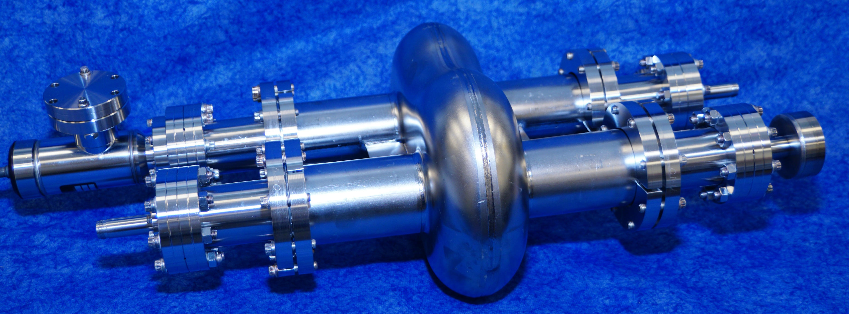
Origin of the Twin-Axis e+e- ERL Collider
The initial idea for a linear collider ERLC based on twin-axis cavities came from Valeri Telnov V. Telnov, A high-luminosity superconducting twin e+e- linear collider with energy recovery, Journal of Instrumentation 16 (2021) P12025
The development of twin axis cavities goes back further, including this cavity built at Jefferson Lab

Slide 25
Twin Axis Cavity Proposals

Slide 26
ERLC Proposal by Valeri Telnov
V. Telnov, A high-luminosity superconducting twin e+e- linear collider with energy recovery, Journal of Instrumentation 16 (2021) P12025

Slide 27
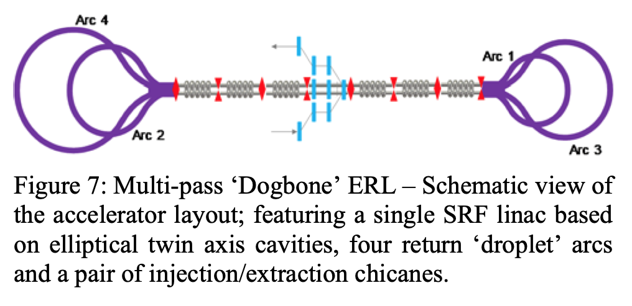
Note: Similarity with Dogbone ERL
Alex Bogacz proposed a somewhat similar layout for the LHeC
S.A. Bogacz, 'The LHeC ERL - Optics and Performance Optimization' Proceedings of ERL 2019, doi:10.18429/JACoW-ERL2019-TUCOXBS04, https://epaper.kek.jp/erl2019/papers/tucoxbs04.pdf

Slide 28
Quadrupole HOMs
Since the electrons and positrons in the same bucket have different polarities, one will be focused while the other is defocused, and vice versa
In addition, since they have different energies (except for a couple of specific places) the transverse sizes of the two beams will be different
Here is the progression of the beam sizes through a 60° lattice with energy ratio of about 3:1, the ratio near the center of the linacs
This shape change is no different from an electron bunch traversing a cavity in a FODO lattice
Quadrupole HOM modes will be not be excited

Slide 29
Orbit Correction
Thread electron orbit coming from left side
Save the BPMs and correctors
Thread positron orbit coming from left side
Save the BPMs and correctors
Thread electron orbit coming from right side
Save the BPMs and correctors
Thread positron orbit coming from right side
Save the BPMs and correctors
With four different orbits, minimize the average orbit error using all of the correctors
Would minimizing the orbit difference between electrons and positrons going in the same direction be better?

Slide 30
Chicane Geometry
Chicane length L
Offset
Chord
Arc Radius R
𝜃/2

Slide 31
Chicane Dimensions
Consider the central arc: it is exactly half the chicane length L/2, the chord is exactly half the chicane length and the transverse displacement is exactly half of the chicane offset O/2
The goal is to create a difference between the chicane and the straight beamline D = 𝜆/2
Using the standard formulae for the central arc intersected by a chord:
Arc length = R𝜃 where R is the radius of the arc and 𝜃 is the bending angle
Here assume that R ≃ 14,800 m (similar to FCC)
Chord length = L/2 = 2Rsin(𝜃/2) ≃ R𝜃 - 2R[𝜃/2 – (𝜃/2)³/3!]
Arc length – chord length D = 𝜆/2 ≃ R𝜃³/24
𝜃 = (12𝜆/R)^{1/3}
Chicane length = L = 2R(12𝜆/R)^{1/3} = 4(3𝜆R²)^{1/3}
Sagitta ≃ (L/2)²/8R = L²/32R
Chicane offset = L²/16R = 16(3𝜆)^{1/3}R^{1/3}
Weak dependence of offset on bending radius

Slide 32
Arc Geometry
Using the normal scaling for a storage ring, the radius of curvature should scale as the square of the energy
So the arcs in the Ghost Collider should have a radius and circumference ¼ of that of a circular collider of the same energy at the IP
Assume that the entry and exit to the arcs is a 60° bend of the same radius
The circumference of each arc is then 7/6 of a ring
The total circumference of two arcs is 7/12 of the circumference of a full-energy ring
The total synchrotron radiation energy loss is also 7/12 of the same current in a full energy ring
Requires two superposed rings, one for electrons, one for positrons
60°
60°

Slide 33
Arc Energy Replacement
Both the electrons and positrons lose energy in the Arcs
There are two superposed Arcs, one for electrons and one for positrons
The two bunches in each Arc are separated by 𝜆/2,
One going to the IR
One coming from the IR
An RF system in the Arc would have to be at twice the Linac frequency to accelerate both bunches
The linac frequency is already high to reduce 𝜆, so this is not a good option
In addition, the bunches will produce HOMs which must be coupled out
Need a lower, not higher, frequency
Solution - no RF in the Arcs

Slide 34
Estimated Synchrotron Energy Losses
To estimate the synchrotron radiation energy loss in the Arcs, assume that the bend radius 𝜌 = 2,690 m, one quarter that of the FCC-ee (10.76 km)
For a circular ring U_{Ring}(eV) = 8.85 x 10⁴ x E(GeV)⁴ /𝜌(m) = 6.8 GeV
For both Arcs = 7/6 times the length, U_{Arcs} = 16.32 GeV
Bend angle per Chicane = 90.3 mrad (L-Band), 68.4 mrad (S-Band), 54.3 mrad (C-Band)
Each bunch traverses 4 chicanes, two before the IR, two after the IR
Total Chicane bend 𝜃_{Tot} = 361.2 mrad (L-Band), 273.6 mrad (S-Band), 217.2 mrad (C-Band)
Total energy loss in Chicanes = 8.85 x 10⁴ x E(GeV)⁴ / 𝜌(m) x (𝜃_{Tot} /2𝜋) = 0.18 GeV (L-Band), 0.14 GeV (S-Band), 0.11 GeV (C-Band)
Chicane losses are small compared to the Arc losses

Slide 35
Entrance and Exit from the Arcs
Assume that the cavities in the twin axis cryomodule are stacked vertically
At the end of the Linac 1, a small vertical bend can separate electrons from positrons
The electrons and positrons can then be bent into two separate Arcs
Because of the energy droop, best if particles go in the same direction in twin axis dipoles
Allows for the same droop correction in both Arcs
Simultaneously, electrons and positrons that are decelerated in Linac 2 arrive at the Arc entrance
Again a small vertical bend can separate electrons from positrons
However, when the accelerating electrons and positrons arrive at the end of the Arc, the small bend will send them to the wrong place
Positrons bend the same as electrons going in the opposite direction
The energy difference between the two electron bunches and the two positron bunches can be used to separate the two bunches in each Arc by incorporating a high dispersion region and a septum magnet in the entrance and exit beamlines

Slide 36
Luminosity and Electrical Power Consumption
I am not yet sure how to estimate the luminosity, but here are some considerations:
Facility energy consumption is dominated by cryogenic requirements and Booster RF power
Operation at 4.5K is preferred
Linac RF frequency should be lower to reduce RF requirements, but higher to reduce chicane length
Booster RF power is proportional to circulating current
Minimize the circulating current
Linac RF power determined by luminosity causing incomplete compensation, as well as timing and steering errors which generate HOMs
Energy of particles that collide is not recovered
High-charge bunches maximize luminosity for the same colliding current
Bunch charge limited by BBU in Booster and instabilities in the Arcs (CSR)
Setting up the required bunch patterns is complicated; imposes CW operation

Slide 37
Incomplete Current Compensation
How equal do the bunches have to be to avoid significant HOM production?
High luminosity means a loss of particles due to beam-beam collisions
Decelerating bunches will have fewer particles than the accelerating bunches
Means incomplete energy cancelation and excitation of HOMs
How can we estimate the size of this effect?
In all colliders, it is desirable to reduce the number of interactions per crossing to make it possible to isolate the reactions
Assume that there will be at most 10 interactions per bunch
In all colliders, the bunch population is ~10¹⁰ particles/bunch
The difference of outgoing and incoming bunch populations will be <<10⁻⁹
The effect is too small to have an impact on energy recovery

Slide 38
CEBAF as Ghost Bunch Testbed
Install the positron source in the South stub tunnel
Electrons are accelerated in the North Linac
The South Linac is tuned a half-period away from nominal so electrons are decelerated
Inject positrons into the same bucket as the electrons to create ghost bunches
Positrons will be accelerated as the electrons are decelerated so no power is needed in the South Linac
Requires two dumps at the first splitter magnet in Arc 2
One for electrons above the splitter magnet for an energy equal to the Injector
One for positrons below the splitter magnet for an energy equal to the sum of the positron Injector and the South Linac
Electrons and positrons can be tuned up separately to minimize timing and steering errors
Best would be to have a cryomodule equipped with probes to measure HOMs in the cavities
Requires a positron source – is Jefferson lab proposing to build one?

Slide 39
Ghost Collider Test Facility
Because of the intra-bunch energy recovery, the two linac axes do not need to be coupled for energy recovery
A test facility does not have to wait for the development of an integrated twin-axis cryomodule
Injection energy needs to be “sufficiently” relativistic
Particles must stay synchronized over the length of the Linac
5 MeV injection should be more than sufficient for 5 - 10 MeV Linacs, with collisions at 15 - 25 MeV
Could all be CEBAF ¼ cryomodules
Needs positron and electron bunches with high charge
Positron accumulation in a storage ring is certainly required
Electrons may also need a storage ring
Would fit inside the LERF vault
Test facility could test the Ghost Collider concept, particularly for the beam optics and the factors determining the luminosity

