Slide 1
Design of the 9-cell superconducting cavity for EUV light source accelerator
ERL2022, October 3-6, 2022, Cornell
SRF/24
October 4, 2022
Taro Konomi*, Kensei Umemori, Hiroshi Sakai, Eiji Kako (KEK),
Tomoko Ota, Atsushi Miyamoto(Toshiba)
*Current affiliation is Michigan State University (MSU) - FRIB.

Slide 2
Outline
Introduction
  Accelerator Parameter
  Module and cavity layout
Cavity design for 10 mA class cERL-FEL.
  Cavity parameter
  Center cell design
  Beam pipe design
  End cell optimization method
  End cell optimization
  HOM parameter with ideal HOM damper
HOM damper design
  HOM damper structure
  Damper material property
  Damper design
  HOM parameter with designed HOM damper
Summary

Slide 3
Introduction

Slide 4
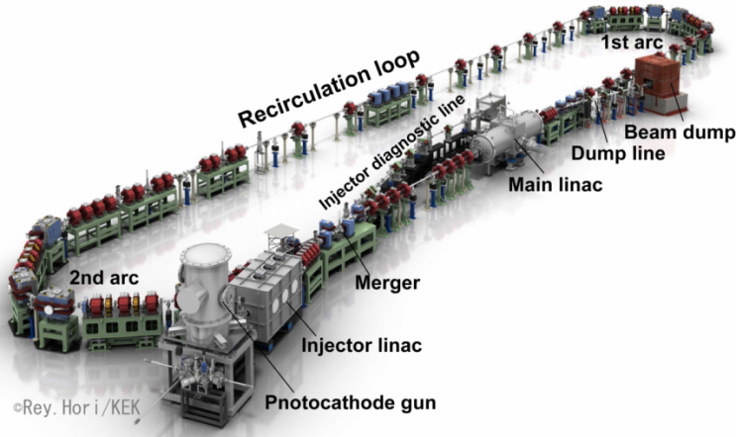
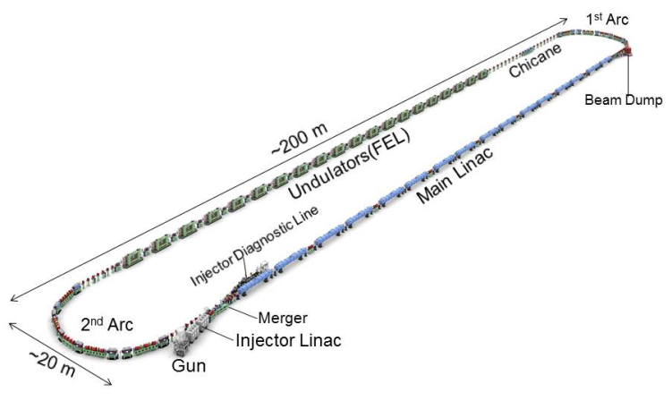
Introduction
cERL-FEL Accelerator Parameters
KEK-cERL
KEK- EUV Light source
Parameters | Target value
Wavelength | 13.5 nm
EUV Power | 10 kW
Bunch charge | 60 pC
Beam energy | 800 MeV
Repetition frequency | 162.5 MHz
Average current | 9.75 mA
Accelerating gradient | 12.5 MV/m
Number of cavities | 64
The beam current is lower than KEK-cERL target
  ⇒ Requirement of HOM damping efficiency decreases.
12.5 MV/m can be realized with high reliability

Slide 5
Module and cavity Layout
～10m
Support
Cold Box
Room Temp.
80K Shield
5K Shield
2K Return Pipe & Cavity Support
80K
80K
80K
80K
80K
80K
80K
80K
80K
80K
HOM Damper
Input Coupler
2K gas out
2K in
Damper
HOM antenna &BPM
5K in
2K 2-Phase
5K out
Cable
80K out
W/C line
Tuner
Tuner
80K in
2K 2-Phase
5K
80K
300K
Tuning Shaft
Tuning Shaft
EUV module is designed based on ILC module.

Slide 6
Cavity design

Slide 7
Target cavity parameters
Concepts of Cavity design
EUV cavity designed based on KEK-cERL main linac
⇒Large beam pipe ＋ Beamline damper
Beam pipe diameters is Φ100mm and Φ110mm.
The center cell shape is TESLA cell to decrease Ep/Eacc=2
Cavity Parameters | KEK-EUV | KEK-cERL | TESLA
Frequency (MHz) | 1300 | 1300 | 1300
Iris diameter (mm) | 70 | 80 | 70
R/Q (Ω) | 1009 | 897 | 1036
G (Ω) | 269 | 289 | 270
Ep/Eacc | 2.0 | 3.0 | 2.0
Hp/Eacc (mT/(MV/m)) | 4.23 | 4.25 | 4.26
BBU limit | >195 mA | ~600 mA | ~80 mA
End Cell
TESLA Center Cell
End Cell
Φ100 mm BP
Φ110 mm BP
HOM
HOM Damper

Slide 8
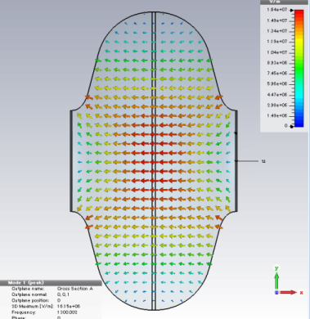
Center cell
EUV cavity was designed focusing on the low frequency HOMs.
Passband of 9-cell HOMs are ruled by the center cell
⇒ R/Q and Rt/Q changes are small
⇒ Qext control the impedance R and Rt
Frequency matching lower R and Rt.
Passband of TESLA center cell
End Cell
Center Cell
End Cell
HOM
HOM Damper

Slide 9
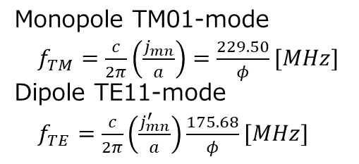
Beam pipe
φ100mm and φ110mm Beam pipes are selected.
Beam pipe diameter are minimized.
Asymmetry design to damp the high frequency HOMs
Passband of TESLA Center Cell
Beam pipe diameter | Cutoff monopole (TM01) | Cutoff Dipole (TE11)
φ110 | 2086.4 | 1597.1
φ100 | 2295.0 | 1756.8
Formula of cutoff
Monopole TM01-mode
$f_{TM}=\frac{c}{2π}\left(\frac{j_{mn}}{a}\right)=\frac{229.50}{φ}[MHz]$
Dipole TE11-mode
$f_{TE}=\frac{c}{2π}\left(\frac{j_{mn}^{′}}{a}\right)\frac{175.68}{φ}[MHz]$

Slide 10
End cell optimization method
Low Frequency HOMs: TE111, TM110, and TM011
Sweep end cell HOM frequency and tune to high impedance HOMs of center cell.

Slide 11
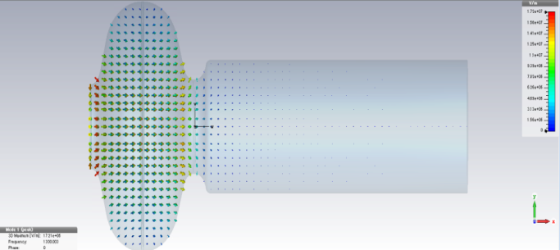
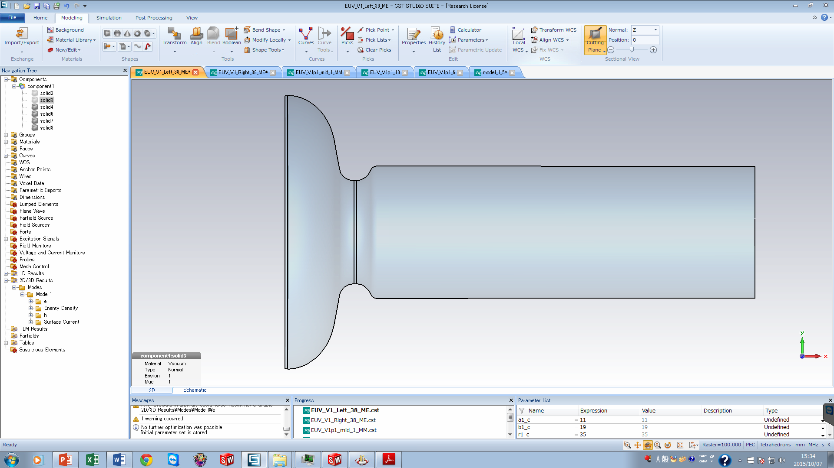
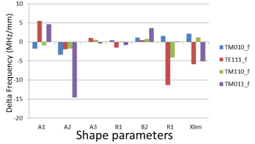
End cell tuning method (1)
End cell frequency was calculated by tuning curve method.
Zoom
Magnetic
Boundary
Electric
boundary
Beam pipe resonance
Change the beam pipe length
Cavity resonance
Imaginary short plane is magnetic boundary.
⇒ End cell can be calculated only π mode.
TM010,TE111,TM110,TM011 response.
Cell length and iris diameter have the major effect.
B2
Cavity side circle
Φ110 BP side cell
B1
A2
A1
R1
xlen
B3
R2
A3
Beam pipe side circle

Slide 12
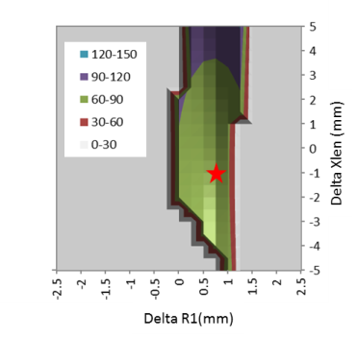
End cell tuning method (2)
Modify the end cell shape to match the center cell frequency.
There is no shape matching more than 3 HOMs at once.
TE111 Qext of Φ110 BP side cell
Condition Δf (TE111)=0MHz, Δf(TM011)=0MHz
Qext
φ110BP side cell adjust TE111 and TM011.
φ100BP side cell adjust TM110 and TM011.
Minimum Qext.
This is the best shape.
B2
Cavity side circle
B1
Constrained conditions
Not re-entrant shape：
  Xlen-A1-A2>0mm
Pressing is possible :
  Absolute value>5mm
Feasible shape：
  Change amount <20mm
A2
A1
R1
xlen
B3
R2
A3
Beam pipe side circle

Slide 13
End cell optimization: Dipole
The end cell frequency is changed to match the high impedance mode.
Because the end cell frequency is the π mode frequency.
Target impedance is 5.5x10⁴ which BBU threshold is 200mA.
  ⇒ All Shapes satisfy dipole mode target.
  ⇒ EUV shape is designed focusing on Monopole HOMs
φ110BP side cell tuning for TE111
φ100BP side cell tuning for TM110

Slide 14
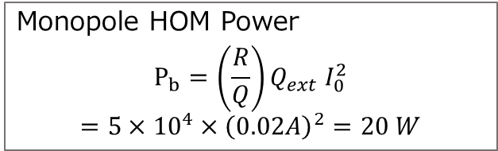
End cell optimization: Monopole
TM011-π/9
Highest impedance of monopole HOM is the TM110-π/9 mode.
Both end cells were tuned to the highest impedance mode.
Minimum value of R/Q*Qext is 5x10⁴ Ohm.
⇒ Heating Power is 20W
Monopole HOM Power
$$P_{b}=\left(\frac{R}{Q}\right)Q_{ext} I_{0}^{2}$$
$$=5×{10}^{4}×{\left(0.02A\right)}^{2}=20 W$$

Slide 15
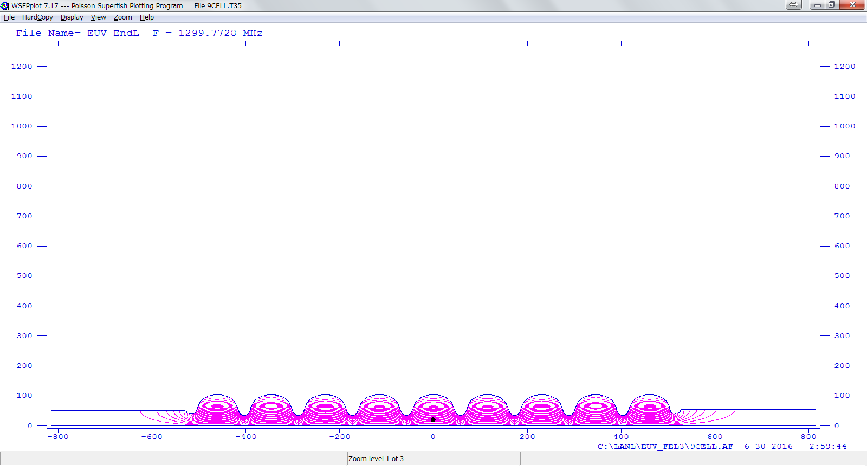
Cavity parameter with perfect HOM damper
Monopole HOM
Dipole HOM
Accelerating parameters
Cavity Parameters | KEK-EUV | KEK-cERL | TESLA
Frequency (MHz) | 1300 | 1300 | 1300
Iris diameter (mm) | 70 | 80 | 70
R/Q (Ω) | 1009 | 897 | 1036
G (Ω) | 269 | 289 | 270
Ep/Eacc | 2.0 | 3.0 | 2.0
Hp/Eacc (mT/(MV/m)) | 4.23 | 4.25 | 4.26
BBU limit | >190 mA | ~600 mA? | ~80 mA?

Slide 16
HOM damper design

Slide 17
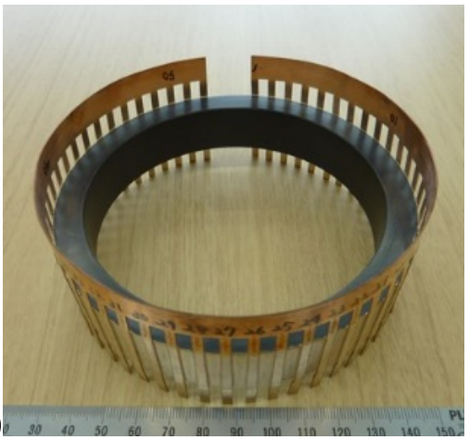
HOM damper structure

Slide 18
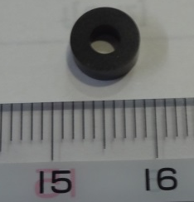
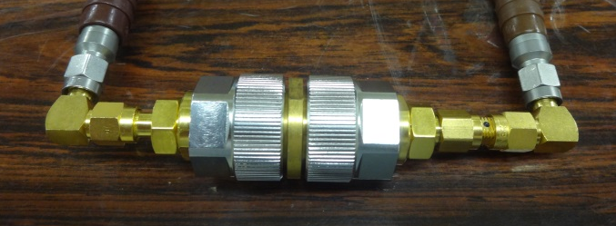
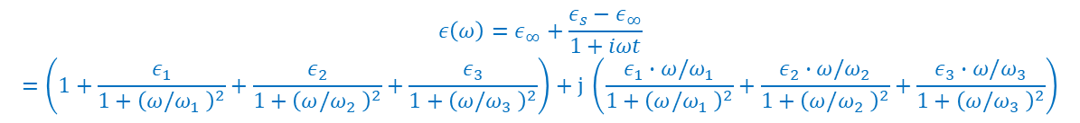
Damper material
AlN (Sienna Tec. : STL-150D) is one candidate for absorber.
We measured Loss tangent, outgassing and tested brazing.
RF parameter measurement
(a)
(b)
$$ε\left(ω\right)=ε_{∞}+\frac{ε_{s}−ε_{∞}}{1+iωt}$$
$$=\left(1+\frac{ε_{1}}{1+{\left(ω/ω_{1} \right)}^{2}}+\frac{ε_{2}}{1+{\left(ω/ω_{2} \right)}^{2}}+\frac{ε_{3}}{1+{\left(ω/ω_{3} \right)}^{2}}\right)+j \left(\frac{ε_{1}∙ω/ω_{1}}{1+{\left(ω/ω_{1} \right)}^{2}}+\frac{ε_{2}∙ω/ω_{2}}{1+{\left(ω/ω_{2} \right)}^{2}}+\frac{ε_{3}∙ω/ω_{3}}{1+{\left(ω/ω_{3} \right)}^{2}}\right)$$

Slide 19
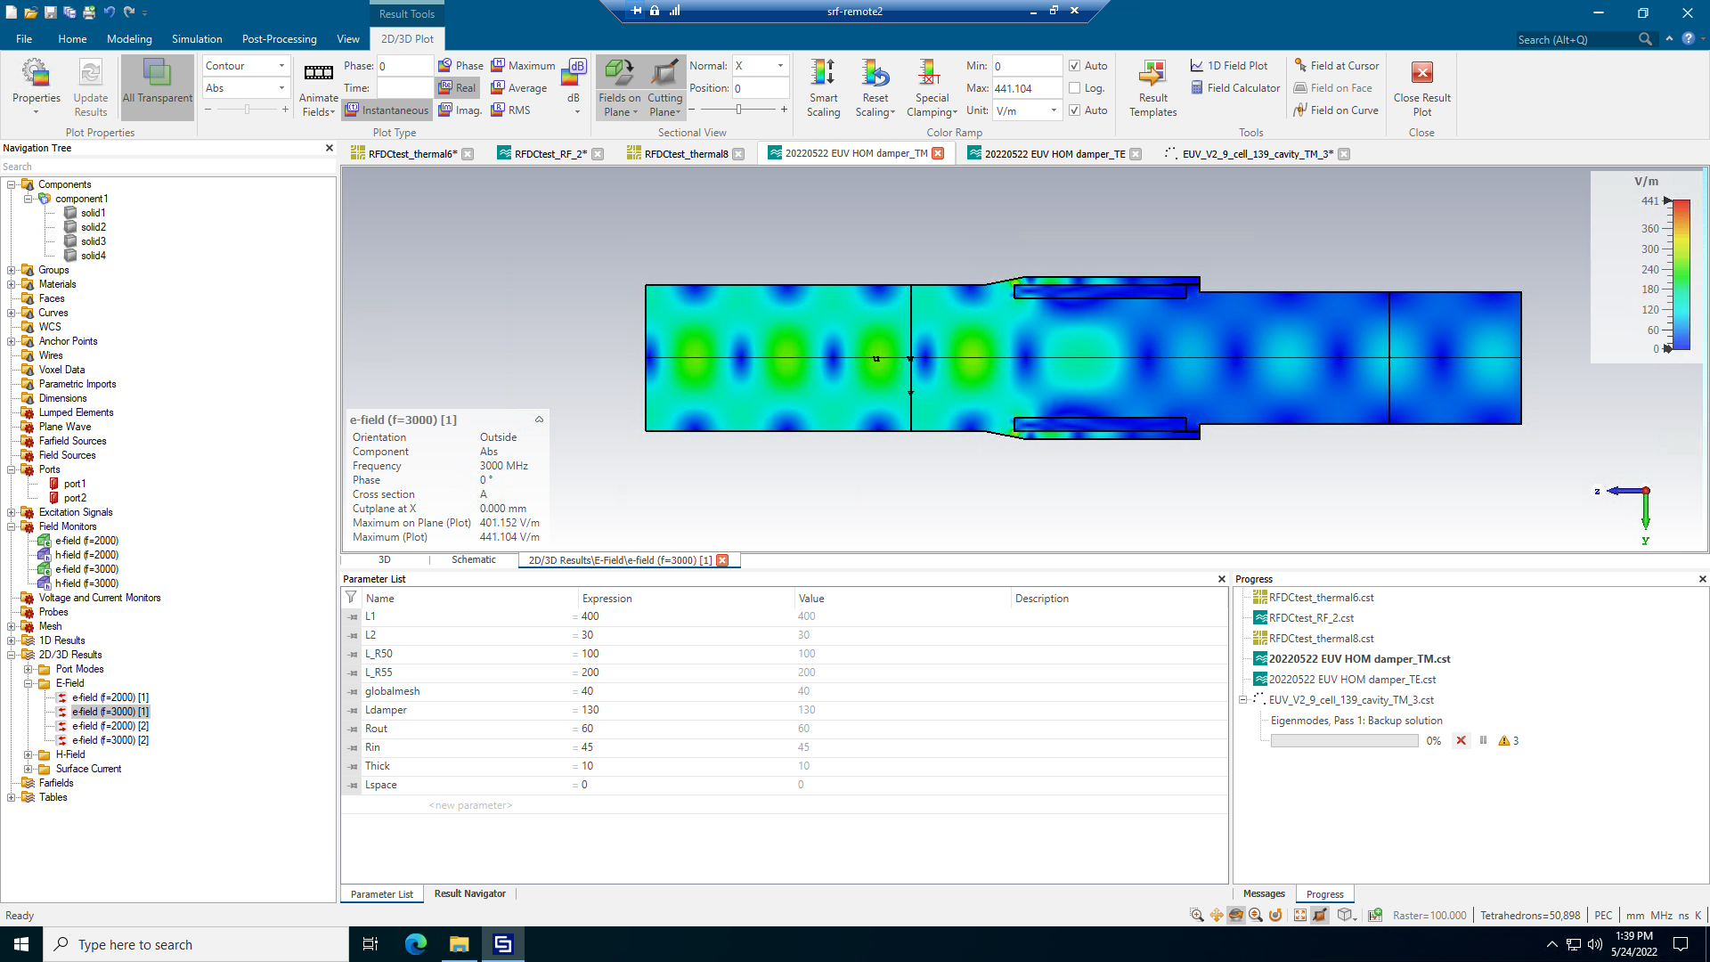
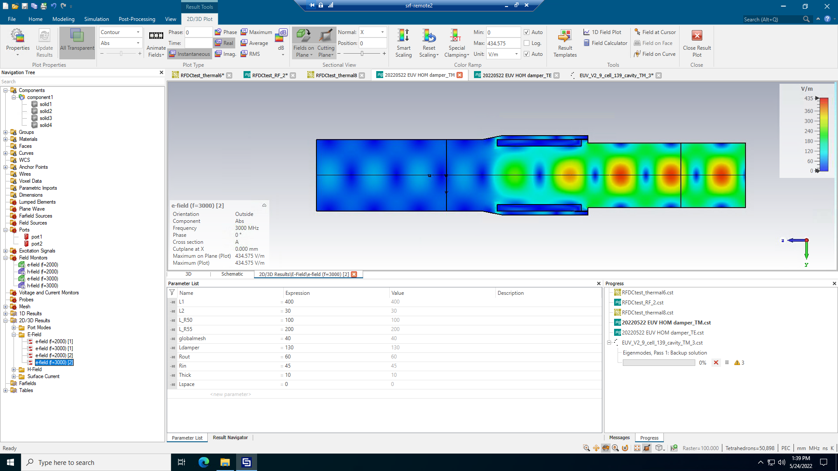
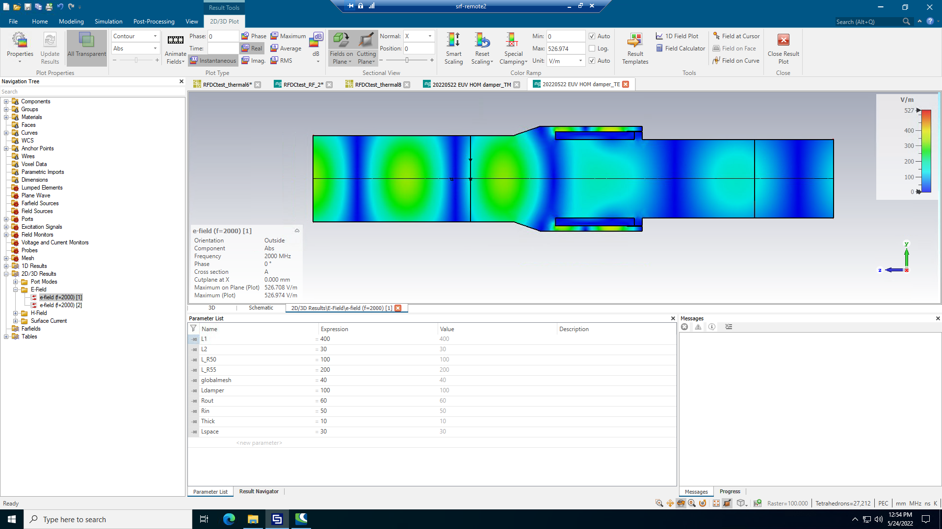
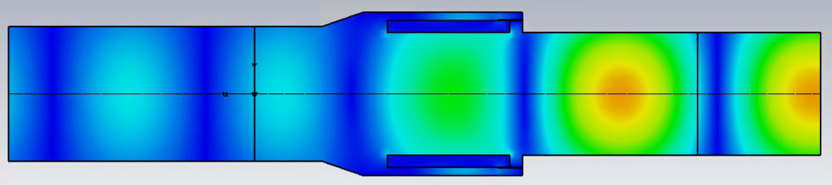
Damper shape optimization method
TM01 mode From Port 1
3000MHz
Port1
Port2
TM01 mode From Port 2
3000MHz
TE11 mode From Port 1
2000MHz
TE11 mode From Port 2
2000MHz

Slide 20
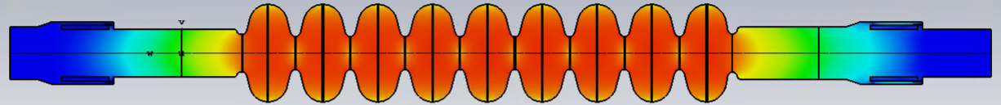
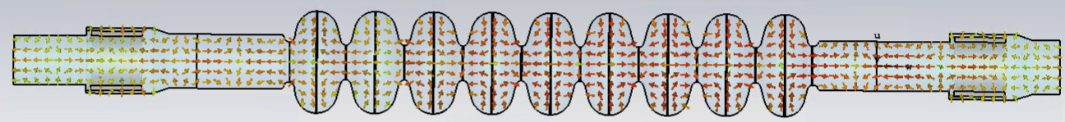
Full cavity HOM simulation: monopole mode
Magnetic or Electric
Magnetic or Electric
127
182
Accelerating
mode
2468.9 MHz

Slide 21
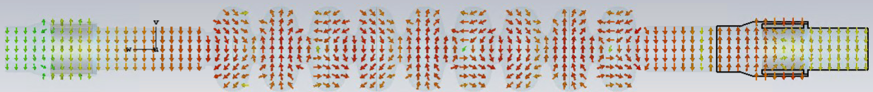
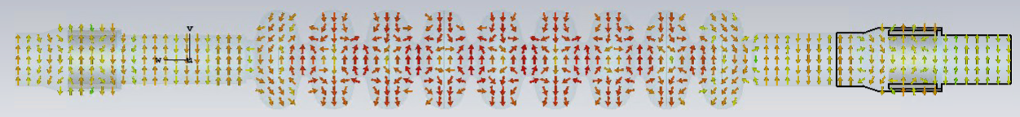
Full cavity HOM simulation: Dipole mode
1730.8 MHz
2590.9 MHz

Slide 22
Comparison Simulation
Cavity Parameters | KEK-EUV | TESLA
Frequency (MHz) | 1300 | 1300
Iris diameter (mm) | 70 | 70
R/Q (Ω) | 1009 | 1036
G (Ω) | 269 | 270
Ep/Eacc | 2.0 | 2.0
Hp/Eacc (mT/(MV/m)) | 4.23 | 4.26
BBU limit | >190 mA | ~80 mA
Monopole mode of EUV FULL (include HOM damper shape)
→ 2468.9 MHz HOM is higher than Ideal HOM damper simulation.
Dipole mode of EUV FULL
→ Well agree with Ideal HOM damper simulation
Monopole HOM
Dipole HOM

Slide 23
Summary
EUV cavity has been designing for EUV-ERL/FEL accelerator.
Cryomodule has been designing based on ILC cryomodule.
Cavity designed based on KEK-cERL cavity.
⇒9-cell cavity + beam line damper
Center cell is TESAL shape.
Maximum impedance of Dipole HOM is 3x10⁴ Ohm/cm²/GHz.
⇒ BBU limit is more than 195 mA.
Maximum impedance of Monopole HOM is 1.1x10⁵ Ohm.
  ⇒ This HOM power is about 40 W

Slide 24
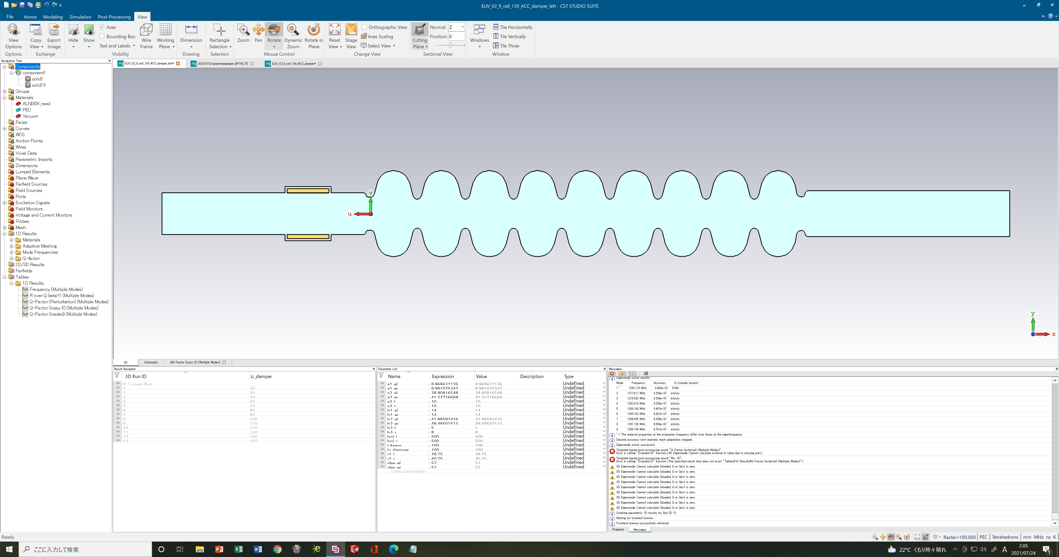
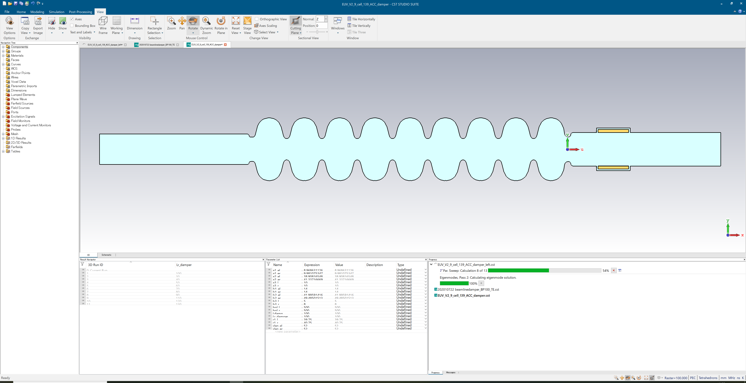
Damper Position requirement
ID100mm
OD120mm
ID110mm
OD130mm
L
L
左右・外周隙間5㎜
左右・外周隙間5㎜
φ100
100
100
φ110
HOMダンパーのQを1E12以上にしようとすると、
Φ100㎜側は260mm以上、Φ110㎜側は290mm以上

Slide 25
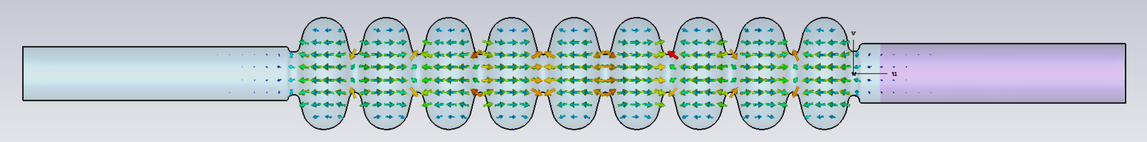
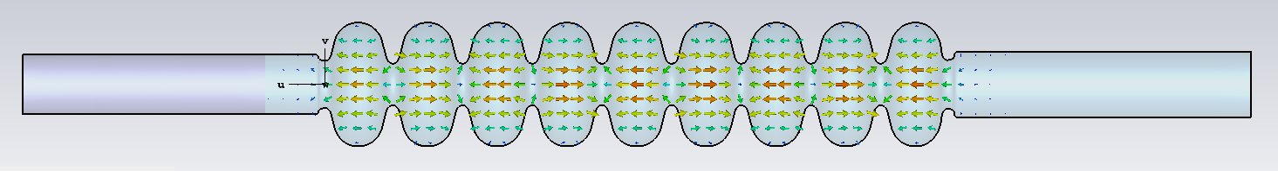
Nb Beam Pipe requirement
SUS Conductivity:7.69e+06
L
L
 | Nb BP length Q>1E12 | AlN position Q>1E12
Φ100 BP | > 120mm | >260mm
Φ110 BP | > 150mm | >290mm

