Slide 1
Strong Hadron Cooling in EIC with an ERL
Erdong Wang on behalf of SHC BNL/JLab design Team
Brookhaven National Laboratory
ERL 2022
October 3-6, 2022

Slide 2
Outline
Strong hadron cooling introduction
Strong hadron cooling physics
  Requirements
  Challenges
Energy Recovery Linac design
  Requirements
  Challenges
Summary

Slide 3

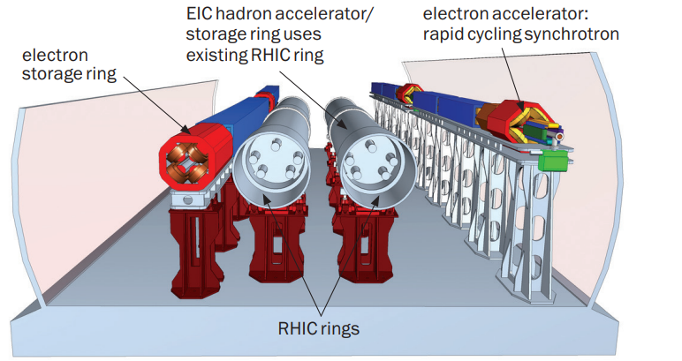
EIC Accelerators
E_{cm} = 20 GeV -141 GeV
High luminosity goal: L = 10³⁴cm⁻²s⁻¹
Electron Ion collider design based on existing RHIC.​
​
Hadron storage ring 40-275 GeV (existing) ​
  RHIC Yellow(Blue) Ring​
  Many bunches, 1160 @ 1A beam current ​
  Bright beam emittance ​
  Strong hadron cooling (new) ​
Electron storage ring (2.5–18 GeV, new)​
  Many bunches, ​
  Large beam current (2.5 A) 10 MW S.R. power​
  s.c. RF cavities​
Electron rapid cycling synchrotron (new)​
  High charge polarized pre-injector​
  Spin transparent due to high periodicity​

Slide 4
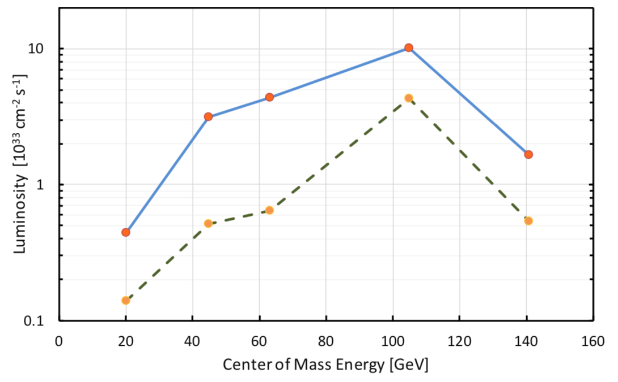
EIC cooling requirements
Luminosity of lepton-hadron colliders in the energy range of the EIC benefits strongly (factor ≈ 3-10) from cooling the transverse and longitudinal hadron beam emittance.
Cool the proton beam at 275 GeV,100 GeV ,and 41 GeV.
IBS longitudinal and transverse(h) growth time is 2-3 hours. The cooling time shall be equal to or less than the diffusion growth time from all sources.
Must cool the hadron beam normalized rms vertical emittance from 2.5 um(from injector) to 0.3 um in 2 hours.
The cooling section must fit in the available IR 2 space.
with SHC
Using SHC
Using precooler
w/o SHC
SHC: Strong Hadron Cooling, the cooling technique that provides strong cooling rate at high energies
Precooler: Cool proton at injection energy (24 GeV) using electron cooling, extendable to 41 GeV.
Notes:
In evaluation of average luminosity, we should cool the vertical in first 2 hours in the store. We plan to maintain the collisions in the same time, by slowly adjusting down electron vertical beta-function in the IP as the proton vertical emittance decreases. After 2 hours the proton beam emittances should be at their design table values, then the cooler is retuned to maintaining these emittances against IBS.

Slide 5
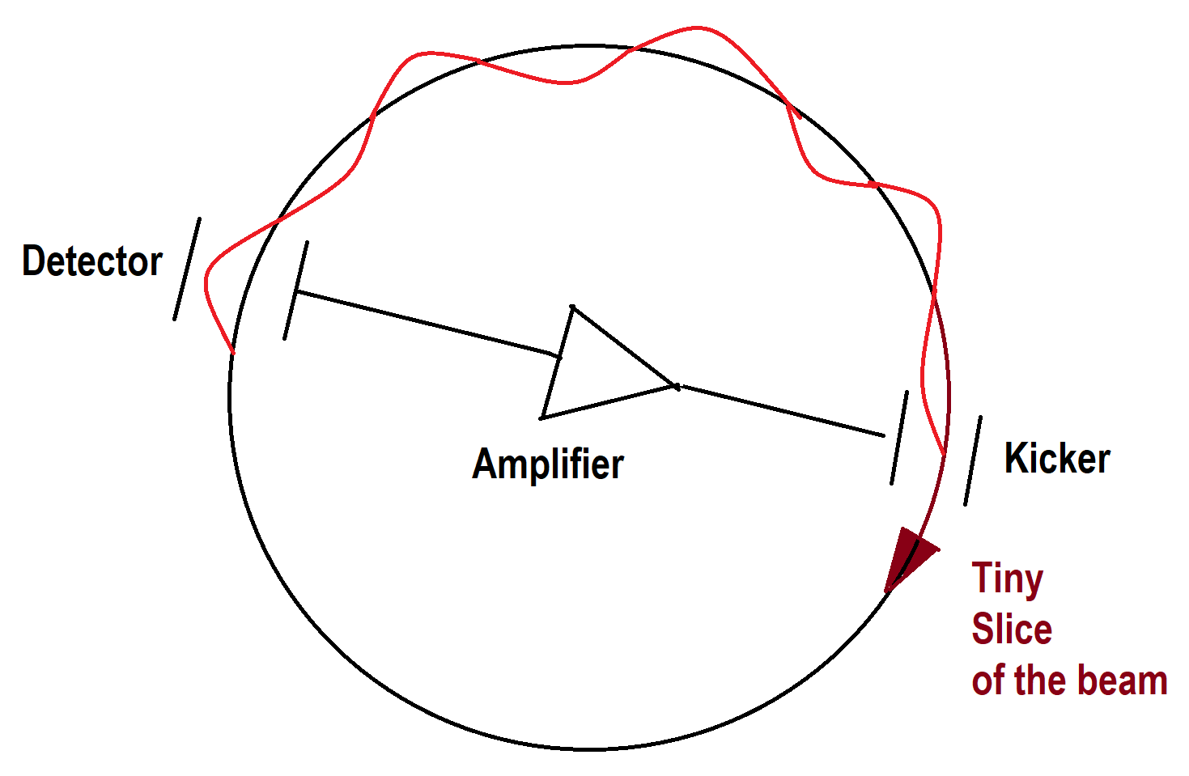
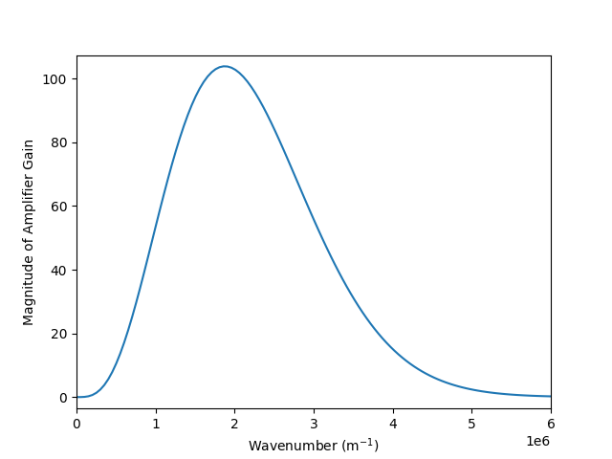
SHC: Coherent Electron Cooling (CEC)
Similar to stochastic cooling, tiny fluctuations in the hadron beam distribution (which are associated with larger emittance) are detected, amplified and fed back to the hadrons thereby reducing the emittance in tiny steps on each turn of the hadron beam
High bandwidth (small slice size)
Detector(Modulator), amplifiers and fed back (kicker)
For high energy protons, a large bandwidth(tens of THz) is required:
➔ Using an electron beam to detect fluctuations, to amplify and to kick.
CDR baseline Amplification: micro-bunching amplifier (D.Ratner PRL, 111, 084802 (2013))
E<E₀
H⁺
Modulator
E>E₀
Kicker
R₅₆
R₅₆
R₅₆
e⁻
The pickup and the kicker are implemented via the Coulomb interaction of the hadrons and electrons, 𝜸_{e}= 𝜸 _{h}. The electron modulated signal has to be amplified. (Derbenev, AIP Conf. Proc. 253, 103 (1992); Litvinenko, Derbenev. PRL, 102, 114801 (2009)).

Slide 6
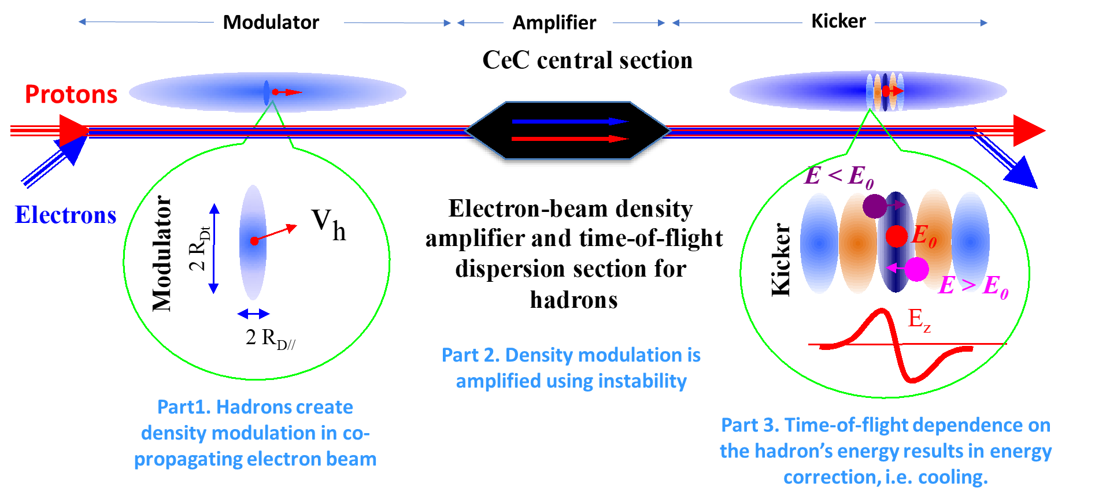
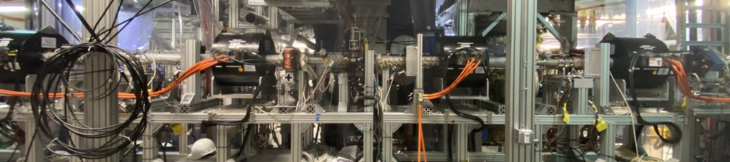
CeC experiment
Experimental study for cooling at BNL: Coherent Electron Cooling Experiment (CeC-X)
Solenoids for Plasma-Cascade Amplifier
The experiment of demonstrating PCA-amplification is ongoing at each RHIC run. Beam parameters are tuned to within target range.
We observed
  PCA-amplified imprint of ion beam in the electron beam radiation
  Observed high PCA gain at frequencies between 5 and 10 THz
  Regular electron cooling – albeit very weak – of 26.5 GeV/u ion beam – the highest energy electron cooling.
CeC-X will continue with next RHIC run
G. Wang, EIC Machine Advisory Review, July 2022
V. Litvinenko et. al., Coherent Electron Cooling Experiment at RHIC: Status and Plans, COOL2019

Slide 7
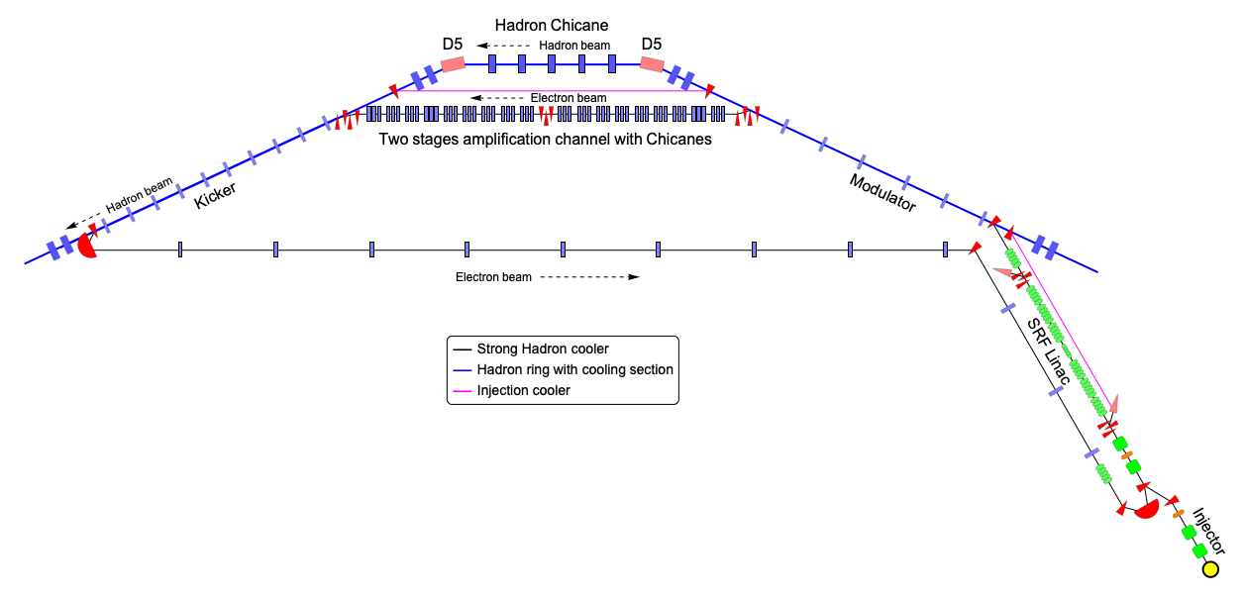
SHC/precooler facility layout
400-500kV DC gun for 100 mA of beam and 5.6 MV SRF injector
Dogleg ERL merger
Kick the beam out at 13 MeV for precooler
149 MeV Superconducting Energy Recovery LINAC
Electron and hadron overlapped cooling section. FODO cells are used to control ebeam size
Amplification section with chicanes and triplets for electrons
Hadron chicane path length matching & R₅₆ adjust
Return of electrons to ERL

Slide 8
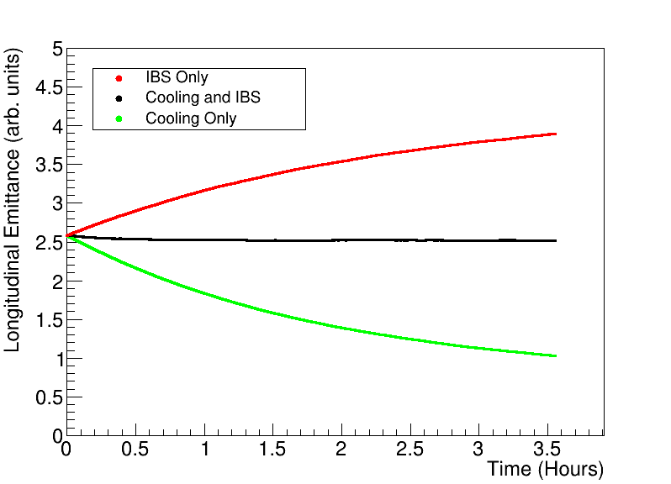
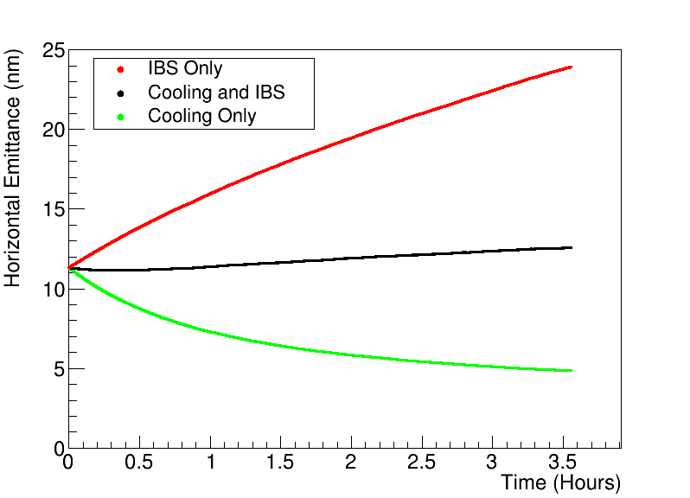
Simulations of SHC cooling time for EIC
Cooling needs a low-noise electron beam
At 275 GeV, increasing the Poisson noise by a factor of 2 increases the cooling times to 2 hours horizontally and 3 hours longitudinally, close to the IBS limit. At 100 GeV, the noise in the electron beam is limited to 3 times the Poisson random noise.

Slide 9
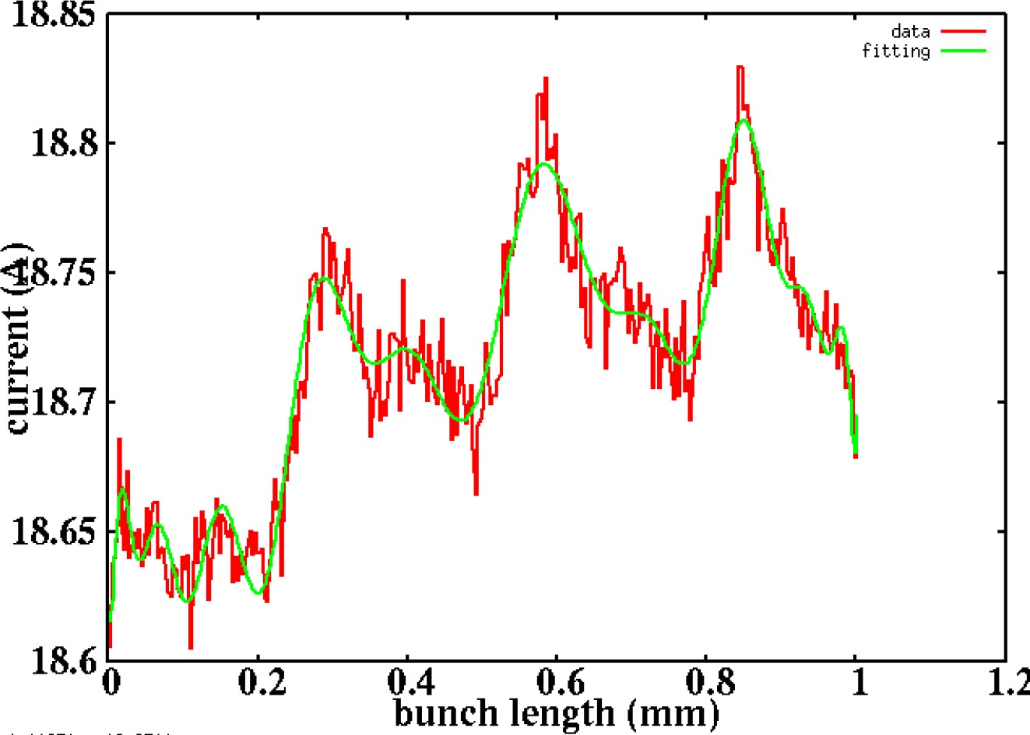
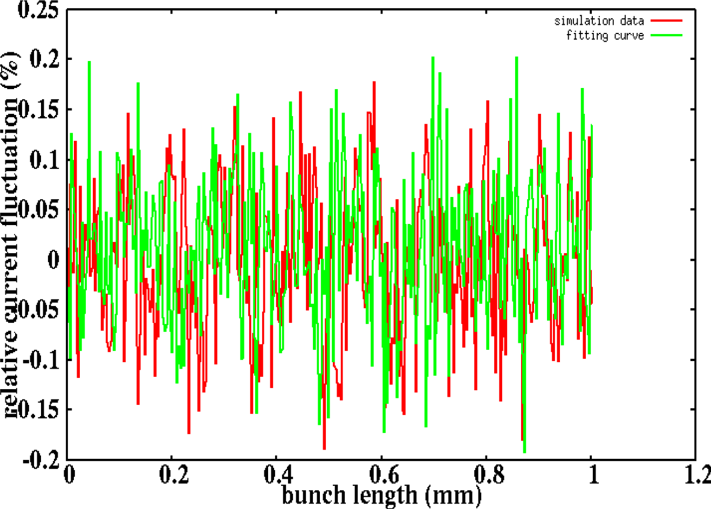
Beam noise simulation
The kick generated by one proton in the kicker section
Zoom in current profile
Compare simulation and directly sampled shot noise
IMPACT simulation: energy spread, emittance, and bunch length are well matched to GPT results.
Observed > 280 um modulation;
Noise amplitude is 2x shot noise.
Cooling frequency bandwidth is 40 THz(3 um), which is far away from 280 um.
The rest noise is at the same level as the shot noise
Should not affect cooling performance

Slide 10
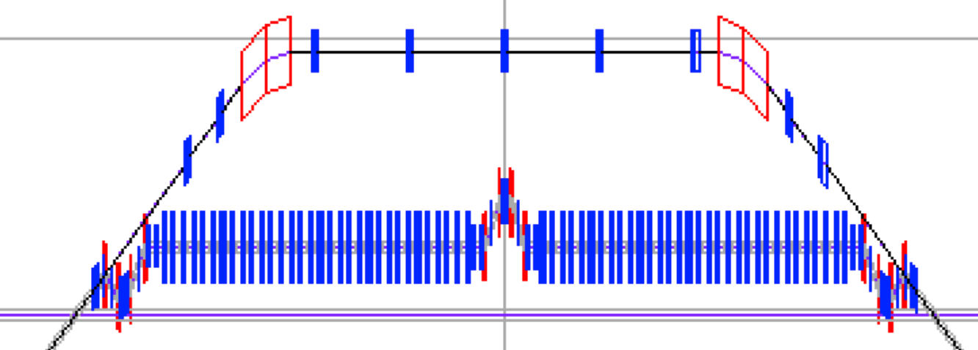
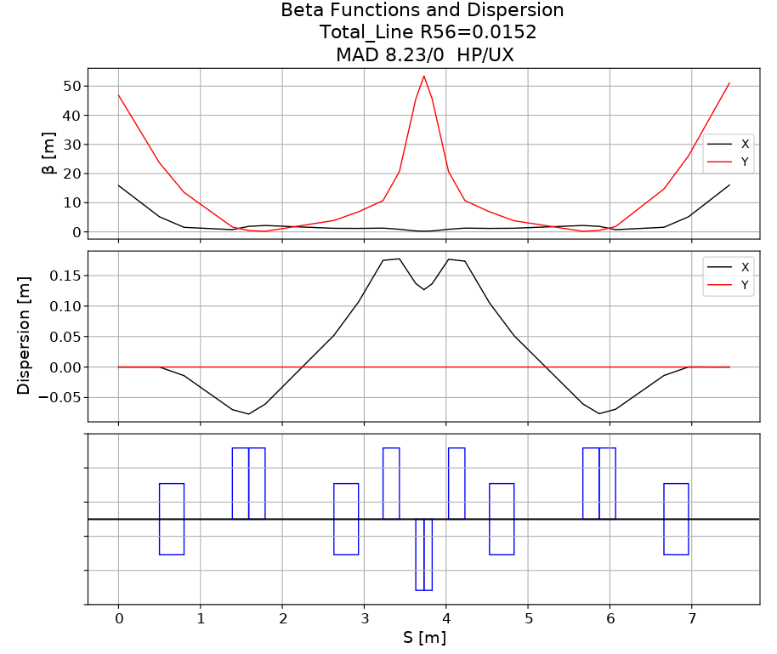
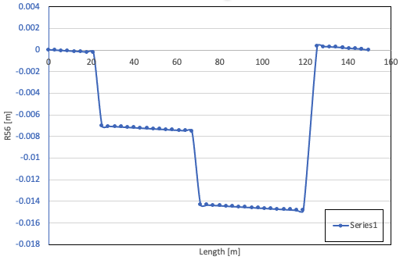
Chicanes of the amplification section
Requirements:
  R56_e from Mid M to K is zero.
  R56_e tunable for each chicane
The micro-bunched amplification has three chicanes.
Between the chicane there are drifts with triplets maintain small beam size to get quarter of plasma wavelength.

Slide 11
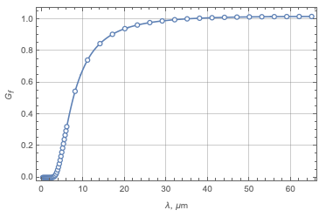
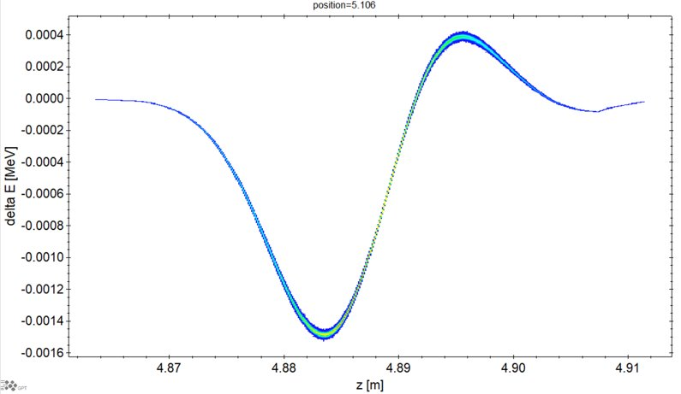
CSR in chicane
CSR micro-bunch gain
dp/p=1.3e-5
Send a small density perturbation in the beam with the wavenumber k.
Calculate the ratio(G) of its amplitude at the exit to the amplitude at the entrance.
The CSR microbunch is eliminated in the amplification chicanes.
CSR caused energy spread increasing is much smaller than sliced dp/p
Micro bunch shift~ R56_local x R56~140nm.
S. Heifets, G. Stupakov and S. Krinsky. “Coherent synchrotron radiation instability in a bunch compressor”, PRAB,5,064401 (2002).

Slide 12
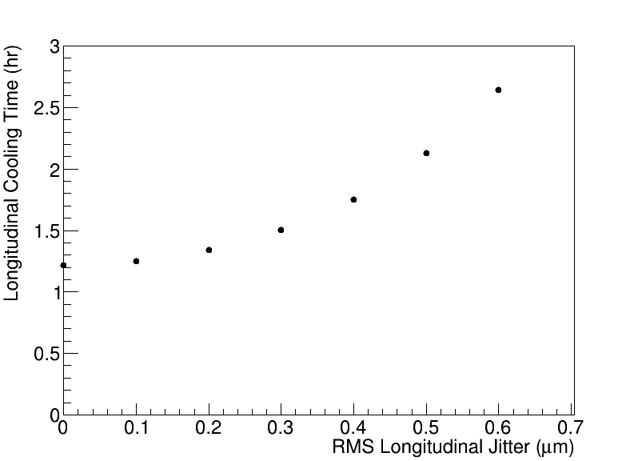
Unequal path-length of electrons and protons
Jitter of the path-length of electrons and ions between M/K leads to deterioration of cooling*. Simulations show that the rms pathlength jitter ~0.5 $μ$m noticeably increases the cooling time.
$$E<E_{0}$$
$$E=E_{0}$$
$$E>E_{0}$$
Contributions to the jitter:
Cooling section electron beamline PS instability
Hadron PS and Cryo instability
RF amplitude and phase jitter
Laser jitter
A feedback system for the path control seems
necessary.
*) S. Seletskiy, A. Fedotov, D. Kayran. “Effect of coherent excitation in coherent electron cooler”, arXiv:2106.12617 (2021).
Notes:
Because of we have chicane in amplification stage, one effect we find is unequal path length of electron and protons caused cooling time increase

Slide 13
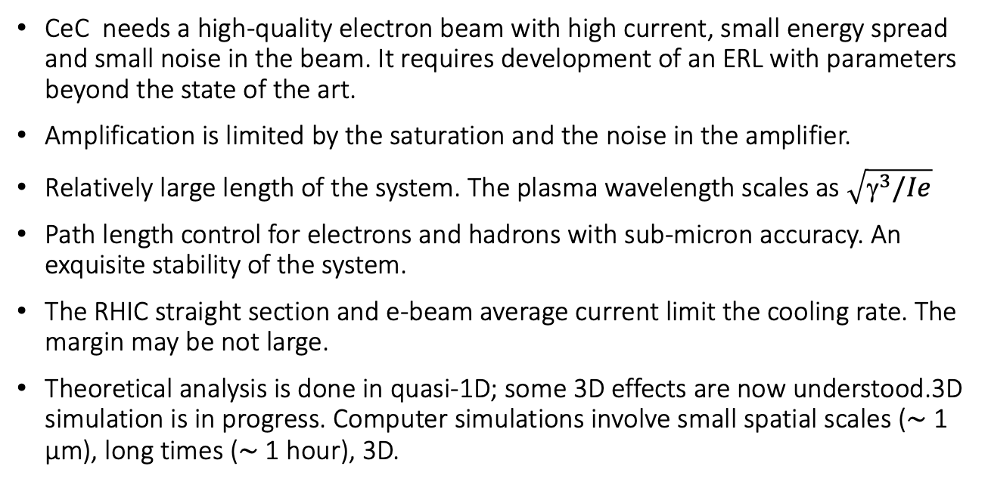
CeC challenges
CeC needs a high-quality electron beam with high current, small energy spread and small noise in the beam. It requires development of an ERL with parameters beyond the state of the art.
Amplification is limited by the saturation and the noise in the amplifier.
Relatively large length of the system. The plasma wavelength scales as $\sqrt{{\text{g}}^{3}/Ie}$
Path length control for electrons and hadrons with sub-micron accuracy. An exquisite stability of the system.
The RHIC straight section and e-beam average current limit the cooling rate. The margin may be not large.
Theoretical analysis is done in quasi-1D; some 3D effects are now understood.3D simulation is in progress. Computer simulations involve small spatial scales (∼ 1 μm), long times (∼ 1 hour), 3D.

Slide 14
Strong Hadron Cooler ERL Specifications
The EIC cooler ERL features an unprecedented large beam current and small energy spread.
Case 100 GeV 275 GeV
Electron Energy (MeV) 55 150
Electron Norm. Emit. (x/y) (mm-mrad) 2.8 / 2.8 2.8 / 2.8
Repetition rate (MHz) 98.5 98.5
Electron Bunch Charge (nC) 1 1
Electron Peak Current (A) 10 17
Electron Bunch Length (mm, rms)* 12 7
Electron Fractional Energy Spread 10⁻⁴ 10⁻⁴
Hor./Vert. Elec. Betas in Modulator (m) 86.6 / 14.1 64/ 11
Hor./Vert. Electron Betas in Kicker (m) 49.7 / 10 16 / 2
Modulator Length (m) 55 55
Kicker Length (m) 55 55
H/V/L Cooling time(hr) 1.3/2.5/1.7 0.8/2.1/1.2
H/V/L IBS time(hr) 2/4/2.5 2/5/2.9

Slide 15
ERL Longitudinal matching plan
Due to the long proton bunches, we need very long electron bunches with very small energy spread.
We use the 5 cell 591 MHz SRF cavity as the main linac
At 7 mm rms, the 6σ full bunch length is 30° of RF phase. We have to cancel the RF curvature using third harmonic cavity.
Take space charge and CSR into account to minimize any energy slew or curvature in the bunch.
A 12 mm rms bunch is 50° so it must be stretched by R₅₆ chicane and dechirper cavity..
The return beam has to be chirped and compressed before back to the Linac
Precooler beam is kicked out at 13 MeV

Slide 16
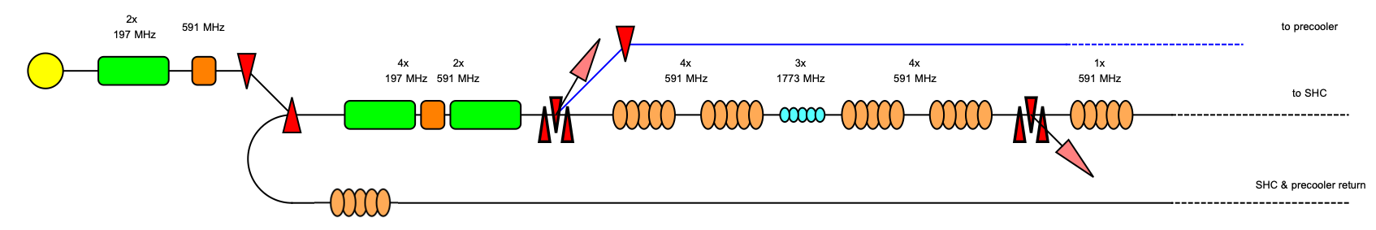
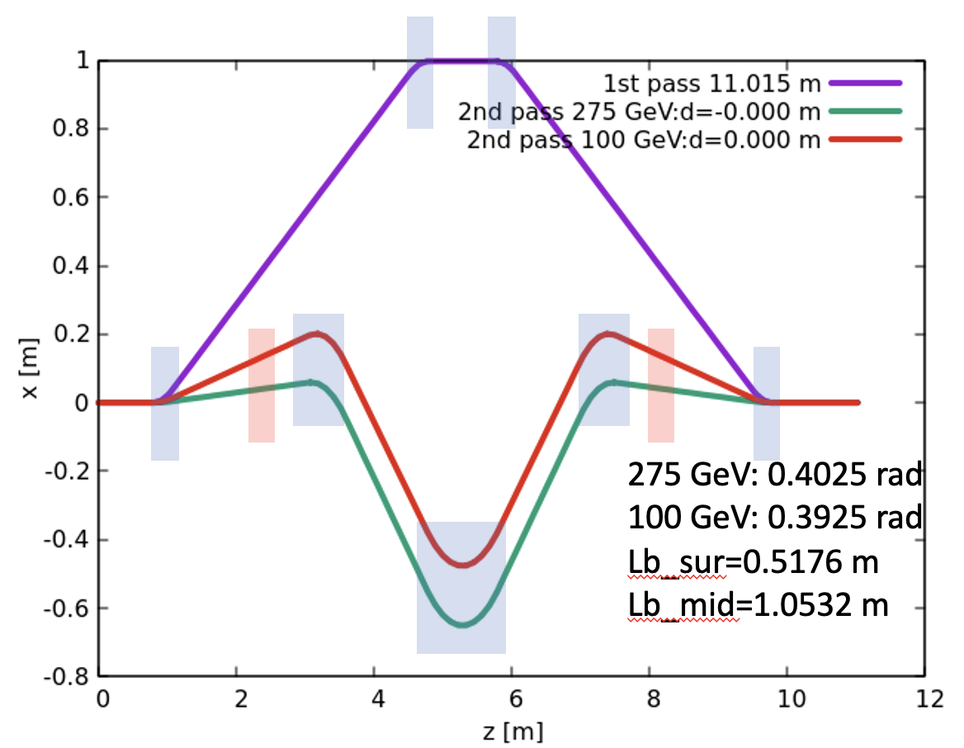
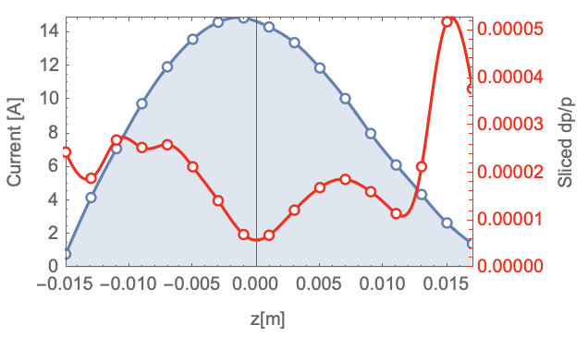
SHC+pre-cooler hybrid ERL
off-crest=30 deg
R56=0.475 m
off-crest=1.2 deg
 | SHC+ precooler
Bunch charge | 1 nC
RMS emittance x/y | 2.4/2.5 mm-mrad
rms dp/p | 4e-5
Slice dp/p | 2e-5
rms Bunch length | 7 mm
Precooler bunch charge is 2 nC for 10⁻⁴ dp/p, 197 MHz cavities will be needed.
SHC takes advantage of using 197 MHz and compresses the beam at 14 MeV using chicane.
The chicane has four dipoles for 14 MeV beam and other three dipoles for high energy return beam. They have the same time of flight.
Using 591 MHz+1774 MHz cavity to accelerate beam to the cooling energy.
Chicane with dechirp cavity to stretch beam from 7 mm to 12 mm.

Slide 17
Challenges of SHC ERL
Cathode lifetime maintenance – 100 mA operation.
Control of Halo – Derive realistic collimation scheme.
Test out ion clearing schemes.
Work out RF transient response and control – must maintain energy and energy spread to 10⁻⁴.
Demonstrate BBU threshold above 100 mA.
Try to shorten the linac to reduce cost and technical risk.
Demonstration of low noise and microbunching gain before cooler.
Beam transport must demonstrate factor of 12 dynamic range.
ERL magnets small PS instability
Several test facilities might be used to carry out this R&D:
SBU & LEReC Gun Test facility – With a high current power supply this could test out 100 mA operation.
CBETA can demonstrate several important technologies and techniques.
Shorted ERL in new EIC tunnel to commission the machine while HSR is being commissioned.

Slide 18
Summary
The SHC will boost EIC luminosity by factor of 3-10.
It will establish a major advance in accelerator science and technology.
It needs a high-quality electron beam with high current, small energy spread, and small noise in the beam.
It requires development of an ERL with parameters beyond the state of the art.
The SHC and ERL challenges have been evaluated and are being addressed with our detailed design and R&D.

Slide 19

Acknowledgements
BNL: W. Bergan, M. Blaskiewicz, A. Fedotov, D. Holmes , D. Kayran, V. Litvinenko, J. Ma, S. Peggs, V. Ptitsyn, J. Skaritka, G. Wang, F. Willeke, D.Xu, W. Xu
Jlab: S. Benson, K. Deitrick, S. Wang
SLAC: G. Stupakov
LBNL: J. Qiang
Xelera: D. Douglas, C. Gulliford, C. Mayes, N. Taylor
Cornell University: N. Wang, G. Hoffstaetter

Slide 20
Thanks!
Questions?

Slide 21
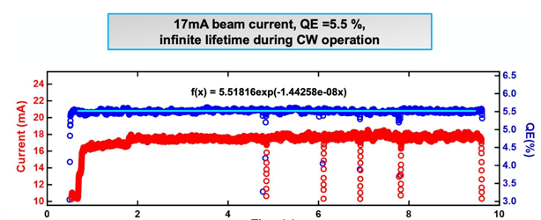
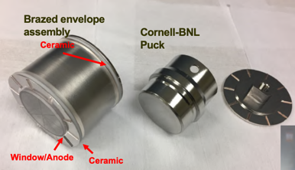

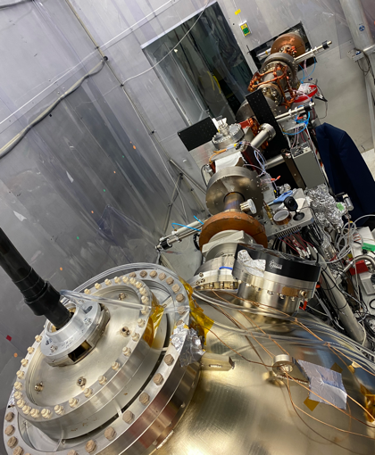
SHC Electron source R&D_ Electron source
 | parameters
Cathode QE(%) | 1%-8%
Average current [mA] | 120
Average laser power [W] | 23-3
Pulse energy [nJ] | 230-30
Charge lifetime [C/mm] | 20000/2.5
Extrapolated Cl [C/mm] | 80000/5~ 9 days
By increasing the multiakali cathode area, it looks promising to get reasonable charge lifetime with good vacuum
Cool the cathode will big advantage to extend cathode lifetime.
R&D focus on demonstration of high charge/ high current e-beam

Slide 22
CeC needs amplification
Three different amplification mechanisms:
Free electron laser [V. Litvinenko, Y. Derbenev, PRL 102, 114801 (2009)]. This is a narrow-band amplifier.
Microbunching instability (MBEC) - broadband amplifier [D. Ratner, PRL, 111, 084802 (2013)].
Plasma-cascade instability (PCA) – a broadband amplifier [V. Litvinenko et al., arXiv:1902.10846 (2019)].
SHC-CeC
SHC
FEL
MBEC
SHC-Ring
PCA

Slide 23
Cooling methods in EIC
SHC-CeC cooling time@100, 275 GeV ~2 hrs
Pre-cooler@24 GeV cooling time<1 hr
Use pre-cooler to reduce the vertical hadron RMS normalized emittance from 2.5 um to 0.3 um within 2 hours or less of storage time at the injection energy of 24 GeV. Achieve the hadron collision emittance.
Use SHC to maintain the emittance during collisions.
Alternatives：
Use pre-cooler to reduce the hadron RMS normalized emittance from 2.5 um to 1 um in both directions at the injection energy of 24 GeV. Booster energy up to collision energy
Use SHC to reduce vertical emittance and achieve the hadron collision emittance, then maintain the emittance during collisions

Slide 24
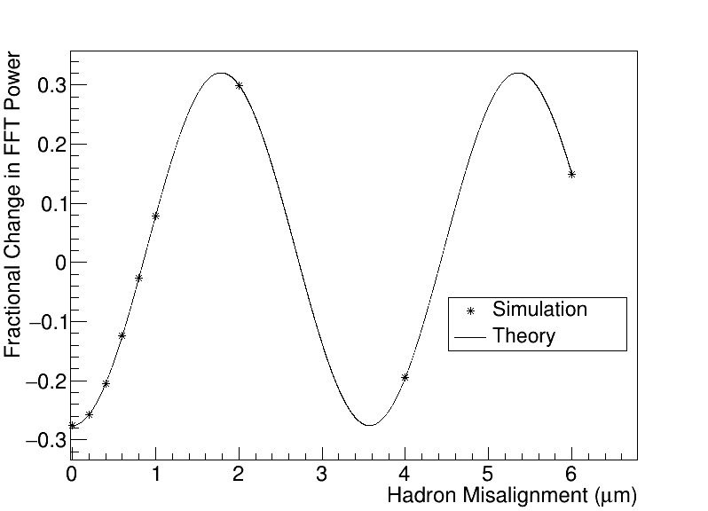
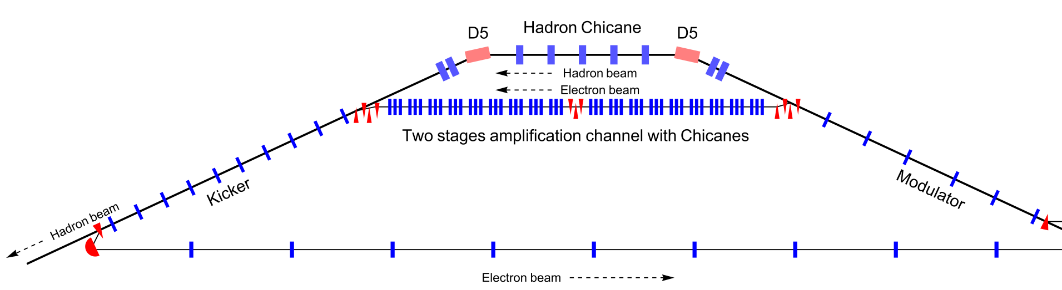
e-h longitudinal alignment using Schottky signal modification
@ W. Bergan
M 56
Schottky signal detector
Electron and hadron beams have to be aligned on sub-um scale.
Feedback will be needed to stabilize the path length
At “detector” element downstream of kicker, fractional change in hadron noise at wavenumber k is -A cos(kΔz), where Δz is the electron/hadron misalignment, and A is some amplitude
Details in W. Bergan arXiv:2205.02898
Notes:
Fractional change in the spectral power in the hadron beam at the 3.6 µm wavelength for the fully nonlinear case. Good agreement between theory and simulation is observed. Hadron FFT signal, square of amplitude

Slide 25
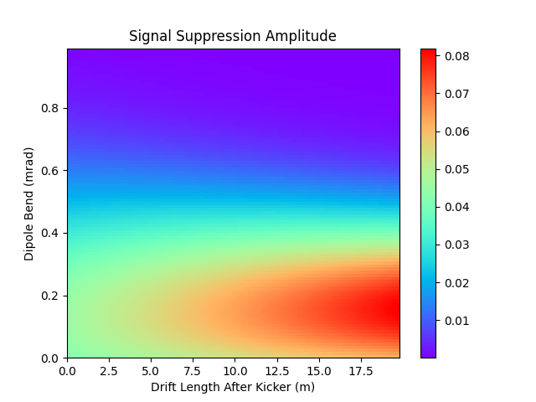
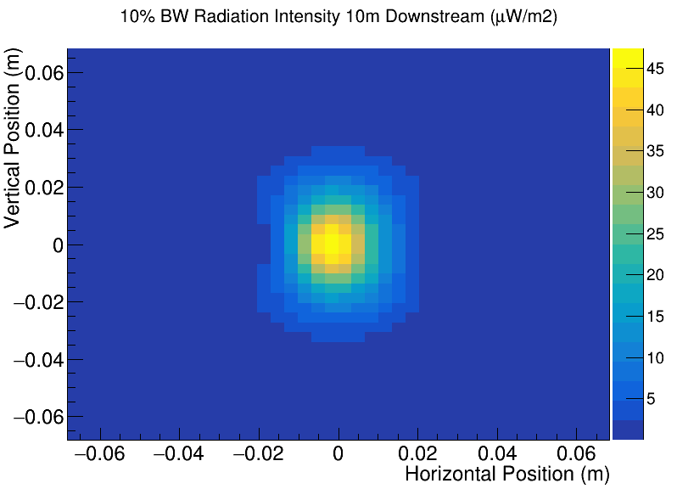
Signal Modification in Main Arc Dipole
Signal modification amplitude at 275 GeV and 3.6 μm wavelength with using synchrotron radiation from dipole placed specified distance behind kicker
W. Bergan arXiv:2205.02898
Notes:
Matrix is sum of drift and bend

Slide 26
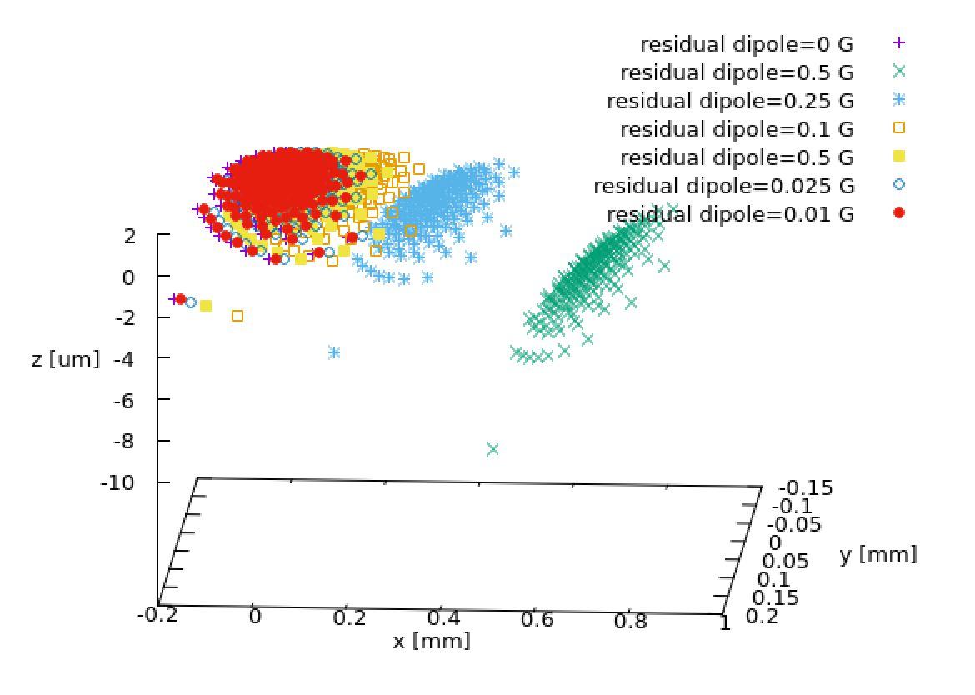
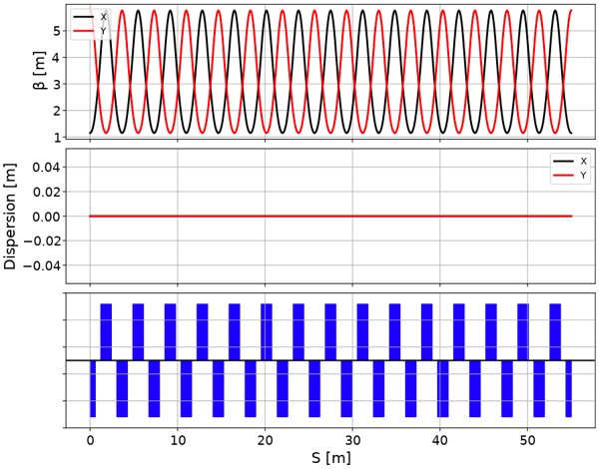
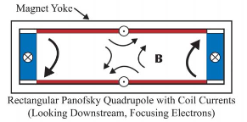
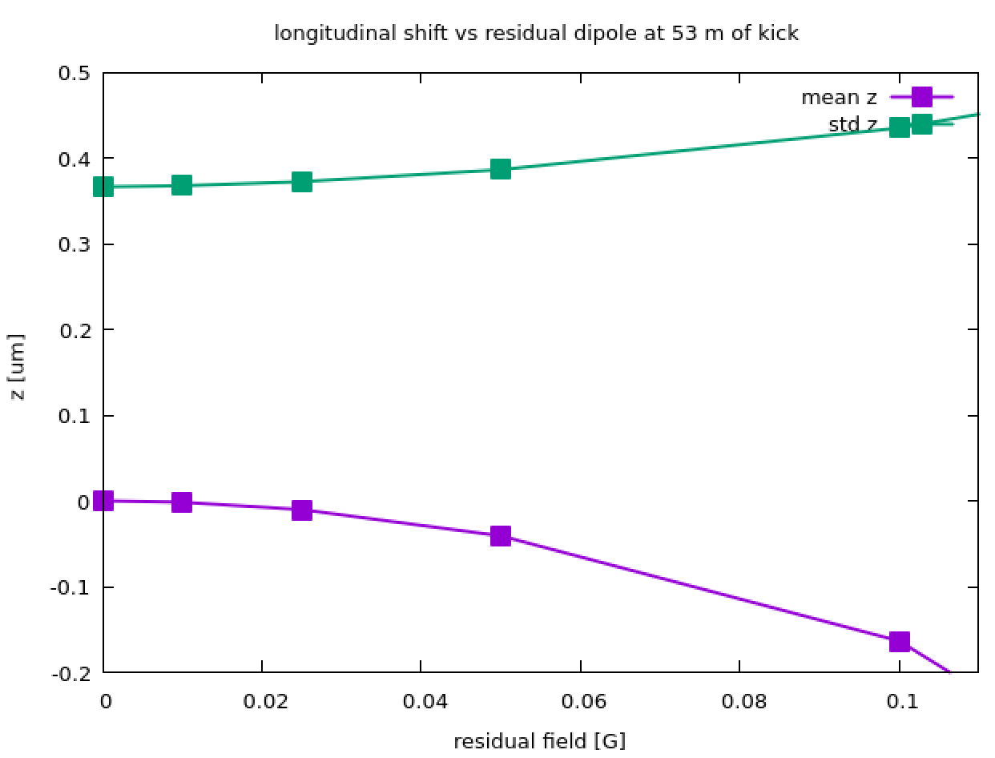
External field impact in cooling section
External field in the cooling section will cause e beam to travel longer path in FODO cell.
Tracking shows the external field shall be reduced down to 0.05 G (53m).
2nd order optics will cause microbunch curvature.
Use of Panofsky quads and high-mu films can reduce external field.
0.05 G. 53 m

Slide 27
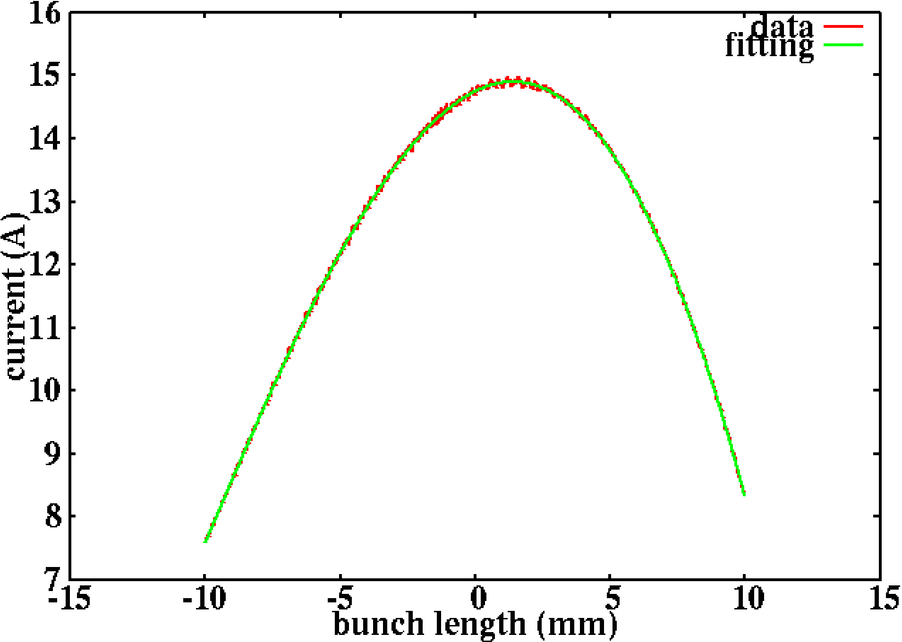
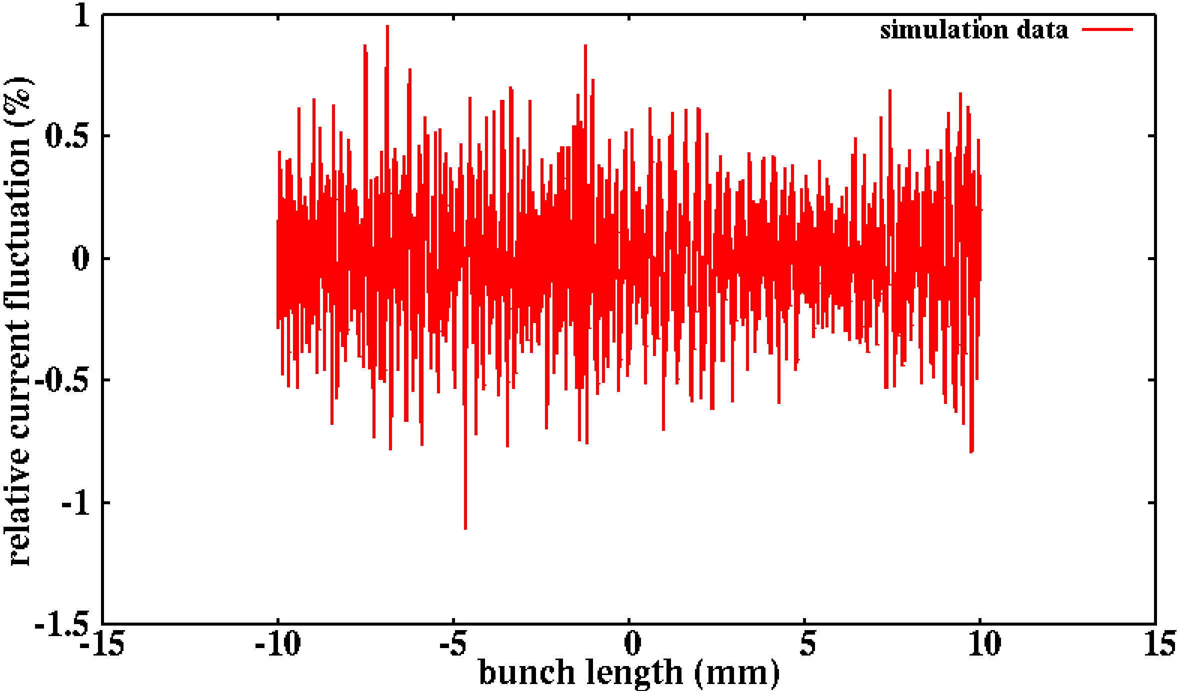
Beam noise for hybrid ERL
Final Current Profile with Finer Grid Points
(Simulation Data vs. Polynomial Fitting)
Relative Current Fluctuation (I_{d}-I_{f})/I_{f}
Relative current modulation with a wavelength ~250um.

Slide 28
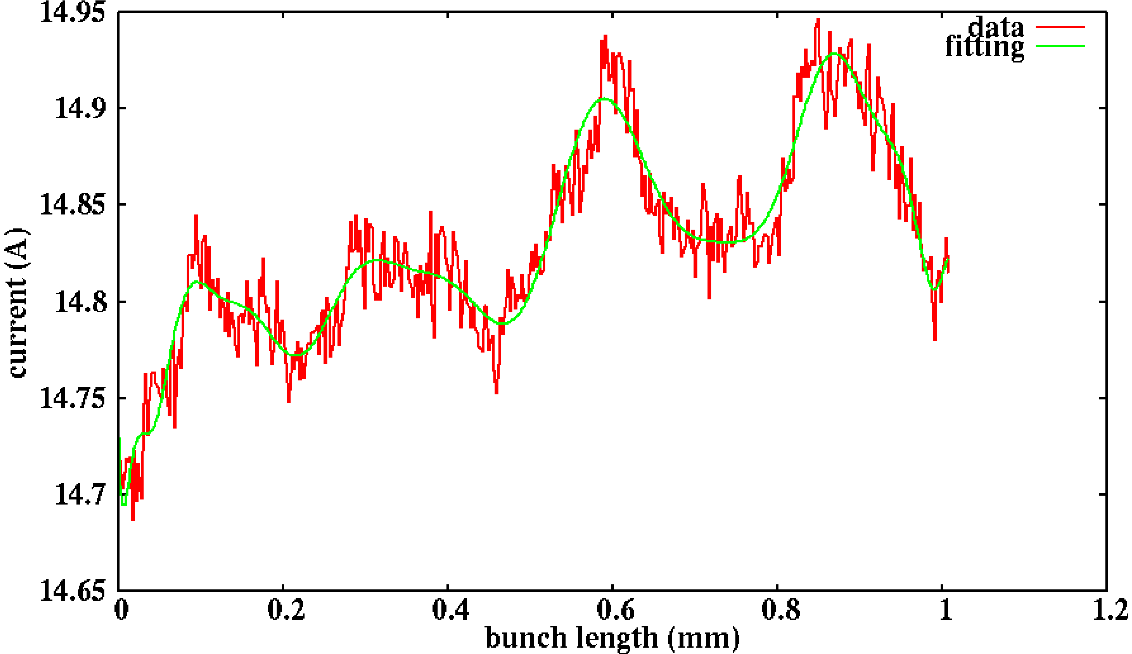
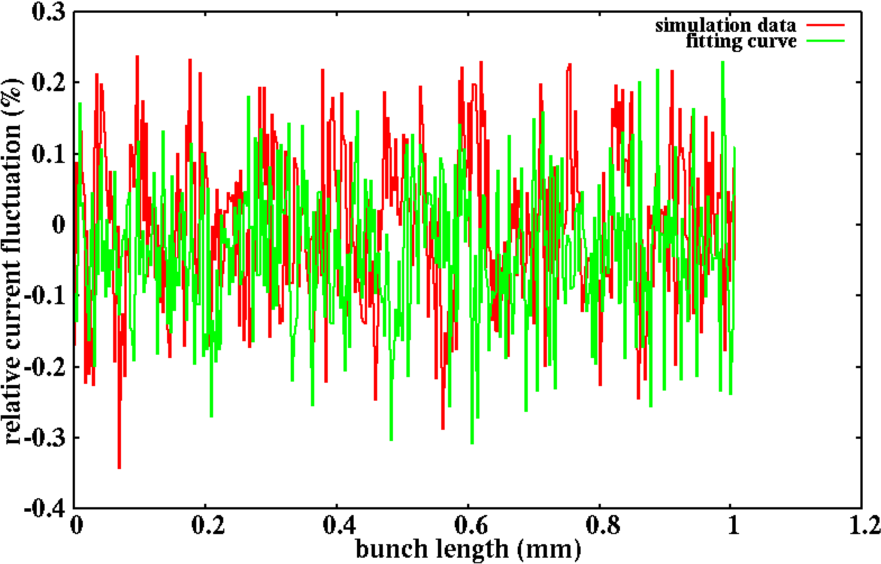
Relative Current Fluctuation (I_{d}-I_{f})/I_{f}
from Simulation and from Sampling+
Deposition of the Fitting Current
Zoom-in Current Profile
(Simulation Data vs. Polynomial Fitting)
Relative current fluctuation after removing modulation is about
the same level as the directly sampled shot noise.
RMS Fluc_simulation ~ 1.1e-3
RMS Fluc_analytical ~ 1.0e-3

Slide 29

275 GeV case (150 MeV) , 1st path
Gun
Injector 197
Injector exit
chicane in
1773 out
chicane out
591 out
2nd 591 out

Slide 30
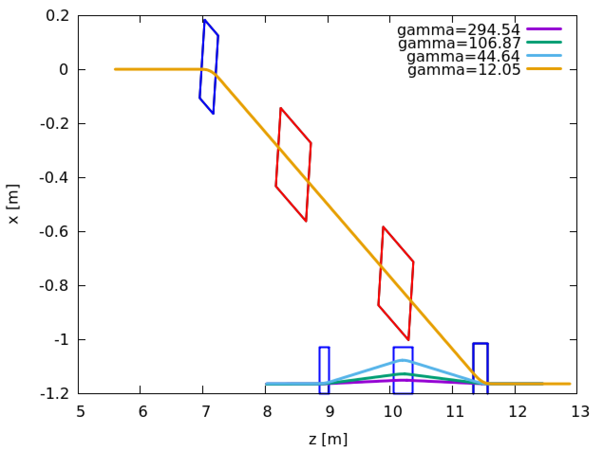
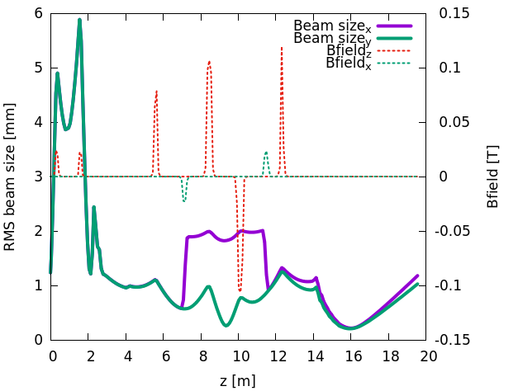
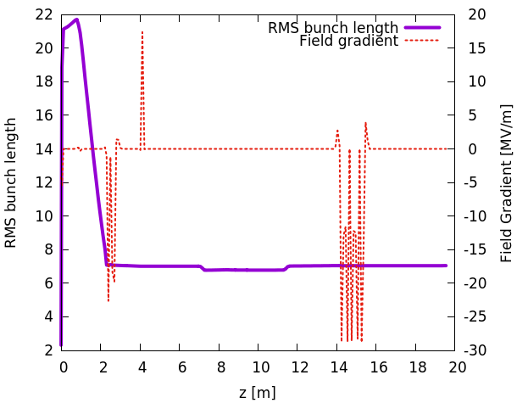
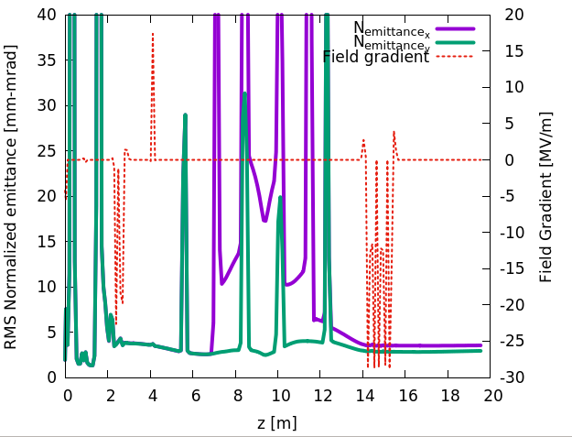
Injector
HVDC gun with multi-alkali photocathode
Ballistic compression
Injector(buncher+booster) energy 5.6 MeV
Dual solenoids dogleg merger( three energies)
HVDC
197 MHz buncher
591 MHz SRF
1773 MHz
7 mm
ex=2.8 u
ey=3.5 u
Notes:
Before we use Pamela to study entire beamline. Now we use 3D PIC code

Slide 31
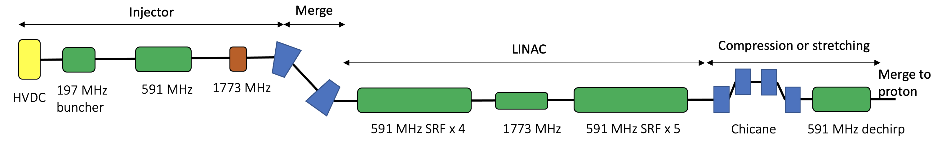
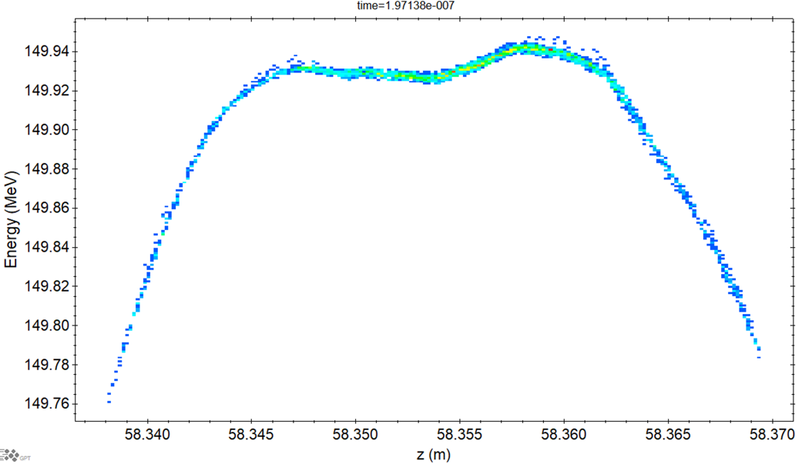
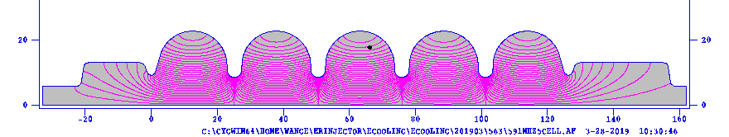
e-beam quality before entering cooling section
 | parameter
Bunch charge | 1 nC
Peak current | 8.5-34 A
RMS Bunch length | 14-3.4 mm
RMS Normalized emittance | 3 mm-mrad
Energy | 150 MeV
RMS dp/p | <1 e-4
Rms dp/p=1.1e-4
Slice dp/p=5.3e-5
Injector and Linac up to cooling section are simulated by advanced 3D space charge code GPT 3.4.

Slide 32
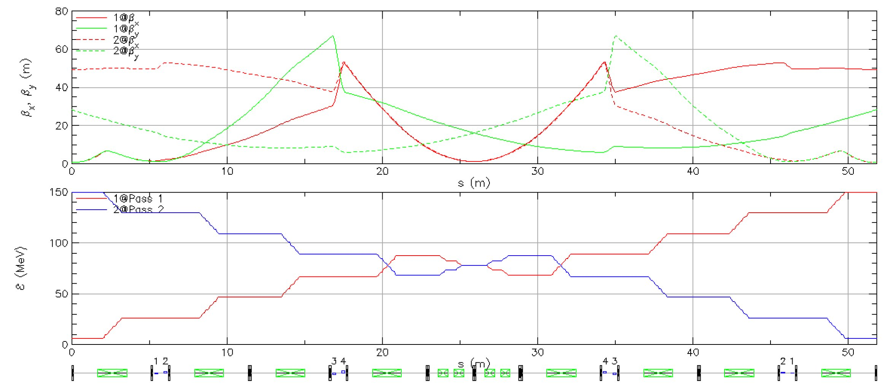
Energy recovery lattice
1773 MHz
591 MHz
591 MHz
1st and 2nd passes of the electron beam matched transversely in the Linac section using BMAD.

Slide 33
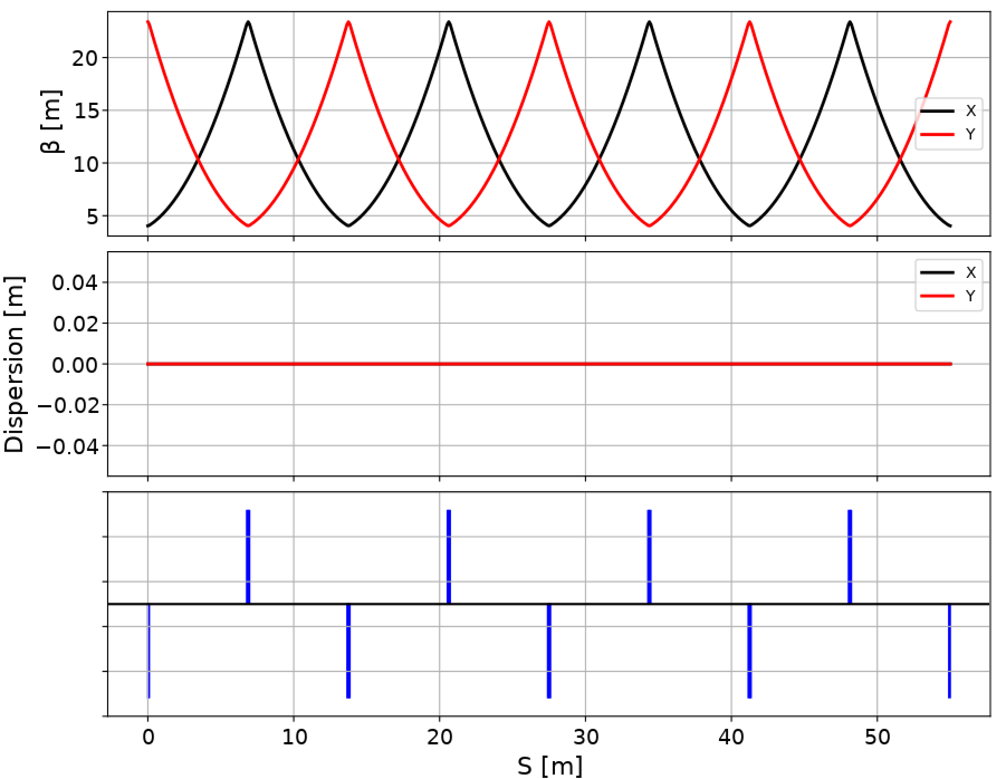
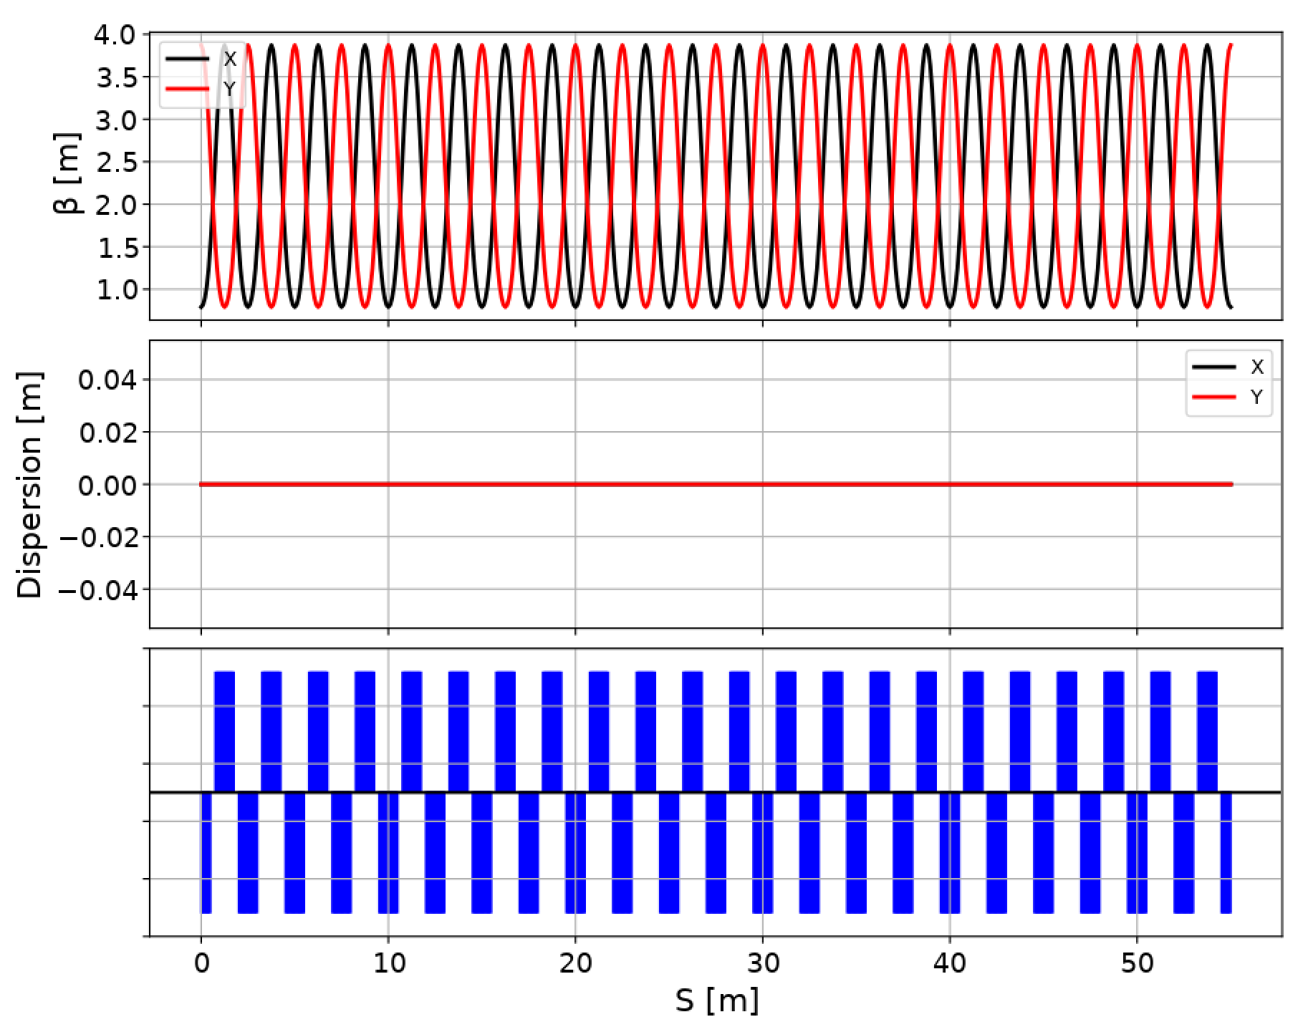
Cooling section lattice
Amplifier section
Modulator section
Kicker section
Cooling section includes 55 m of modulator(M), 100 m of amplification and 55 m kicker (k).
FODO cells are used for K and M section, the beta function can be tuned from 2.5 to 50 m for K and 11 to 85 for M.
Triplets are used for the amplification section; the beta function is 1-2 meters.
(-+)R56 tunable chicanes are designed for amplification section.
Total R56 from M to K has to be zero

Slide 34
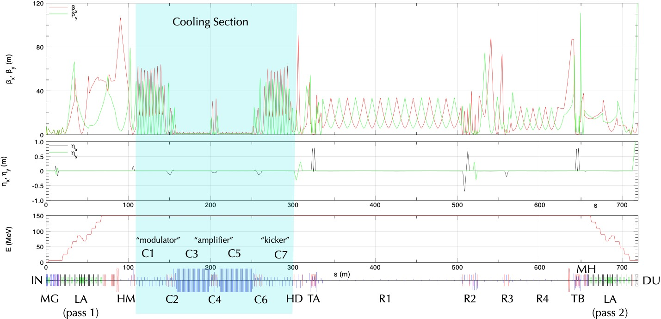
ERL optics: closed lattice
Linac
Return Line
Linac

Slide 35
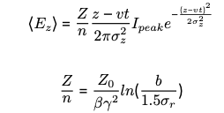

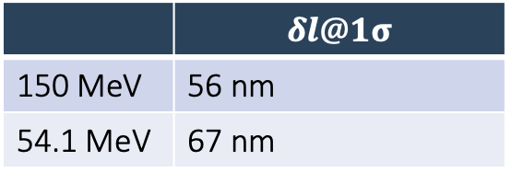
Longitudinal space charge
The longitudinal space charge causes longitudinal kick. The microbunches slips due to R56 of drift and chicanes
The slippage is significantly reduced by the choice of positive and negative R56 of chicane in amplification.
Considering the beam pipe, assume a round Gaussian beam: Longitudinal space charge field is
LSC force is
 | $$δl@1σ$$
150 MeV | 56 nm
54.1 MeV | 67 nm
E. Wang, et.al Longitudinal space charge kick in CeC NL-220638-2020-TECH. EIC-ADD-TN-011

Slide 36
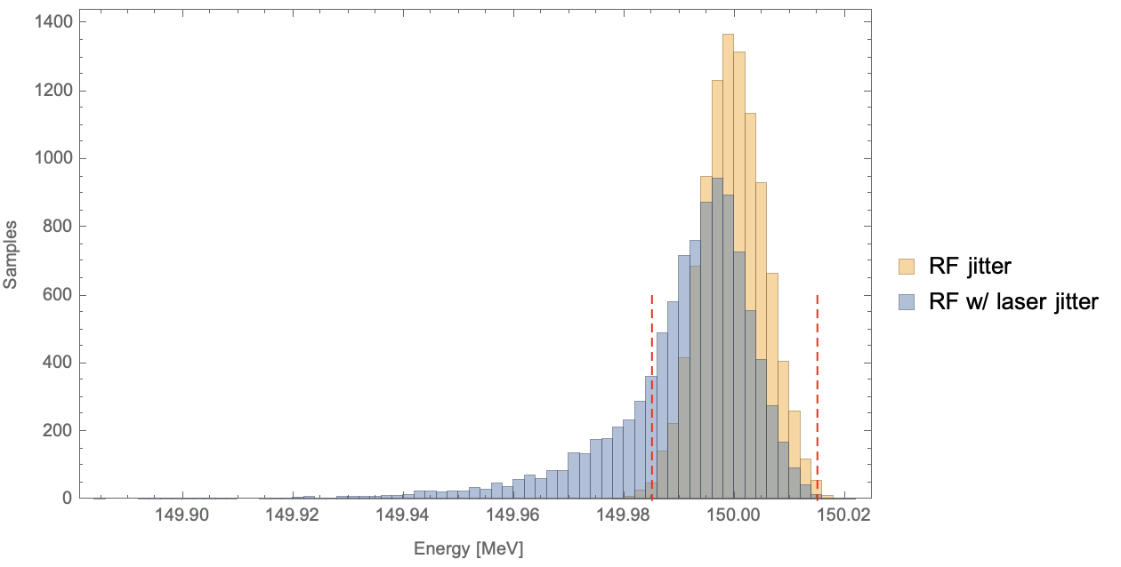


Longitudinal slippage summary
$$∆s1=R_{51}x_{err}+R_{52}{x′}_{err}+\frac{R_{56_err}dp}{p}$$
$$∆s2=\frac{1}{2}<x^{′2}>s0$$
dominated :$∆s3=\left(ρ+ρ_{err}\right)\left(θ+θ_{err}\right)−ρθ$
R56_err,dp
$ρ_{err}, θ_{err}$
Cooling section electron beamline PS stabilization ~ 3 ppm, longitudinal shift ~200nm
CSR caused longitudinal shift ~140nm
Longitudinal SC caused shift ~56 nm
Hadron chicane still in study. A feedback system looks necessary.
S. Seletskiy, A. Fedotov, D. Kayran. “Effect of coherent excitation in coherent electron cooler”, arXiv:2106.12617 (2021)

Slide 37





Saturation of amplifier
In theory we assume a linear amplifier, but simulations show that nonlinear effects are important due to a relatively large value of $\sqrt{<δ{n_{e}}^{2}>}/n_{0}$ in the kicker.
$\sqrt{<δ{n_{e}}^{2}>}/n_{0}$=0.32
Rms kick=29 keV/c
The large value of $\sqrt{<δ{n_{e}}^{2}>}/n_{0}$ is one of the limitations of the cooling rate.

Slide 38


Energy kick (wake) in the kicker section
$$E<E_{0}$$
$$E=E_{0}$$
$$E>E_{0}$$
The kick generated by one proton in the kicker section. The longitudinal scale of the wake is $z\sim 3μ$m, corresponding to the frequency bandwidth $Δf\sim c/πz≈40$ THz. In the optimal settings, the cooling rate is estimated as
$$\frac{1}{t_{c}}\sim \frac{Δf}{{CNh}/{σ_{z}}}\sim \text{0.5}\min^{−1}$$
$Δf=40$ THz, $C$=3834 m, $Nh$=6.9 $×{10}^{10}$, $σ_{z}$=6 cm. In reality, we calculate the cooling rate ∼ 2 h for EIC with 2 amplification sections. It is enough to counteract the IBS in the machine.

Slide 39

MBEC computer simulations
W. Bergan wrote (in C++/Python) a cloud-in-cell computer code that simulates the cooling process through macro-particle tracking*. First, a small fraction (~50 μm) of the two beams is simulated to find the wake. This wake is then used to calculate the cooling over many (~10⁹) passages through the cooling section.
Synchrotron motion of the ions is included.
The code allows the horizontal dispersion D (and D’) in the modulator and kicker and simulates horizontal cooling of hadrons together with the longitudinal cooling.
It includes diffusion due to the noise in the hadron and electron beams, and IBS.
The cooling time is averaged over the longitudinal distribution of the e-bunch
Wake for the case of one amplifier for 275 GeV protons, both from the linear theory and the average of 100 runs of the simulation. Good agreement is observed.
*) W. Bergan. Paper TUPAB179, IPAC 2021; W. Bergan et al. Paper TUPAB180, IPAC 2021.

