Slide 1
ER@CEBAF A 5-pass energy recovery experiment
Gustavo Pérez Segurana
Lancaster University & The Cockcroft Institute

Slide 3
ER@CEBAF - Layout
Injector & Injector Chicane
North Linac
Pathlength doglegs
Even Arcs
Splitter/
Recombiner
Splitter/
Recombiner
Odd Arcs
Pathlength doglegs
South Linac
New delay chicane
ER Dump

Slide 5
ERL Operation Considerations
RF optics
Multi-objective optimization to avoid beam break-up instabilities.
Common transport arc optics
Increment of energy acceptance with low dispersion optics.
Longitudinal match
RF phase and pathlength set-up
Compressive match

Slide 7
Linac optics optimization
Strong focus required at low energies to avoid BBU
Balance between over-focusing at high energies and beta excursions at lower energies.
Genetic algorithm employed to handle the multi-objective optimization (NSGA II implemented within a python framework)
Work presented by I. Neththikumara at IPAC22

Slide 8
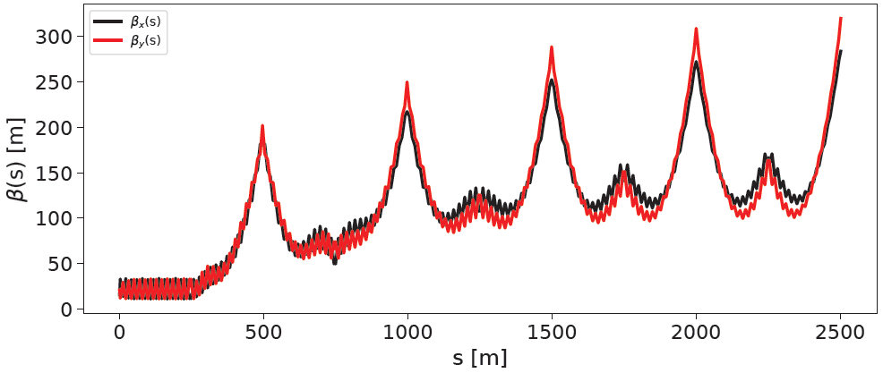
Linac optics optimization
Multipass linac optics:
Pre-optimization. FODO-like layout with $60°$ phase advance per cell.
Work presented by I. Neththikumara at IPAC22

Slide 9
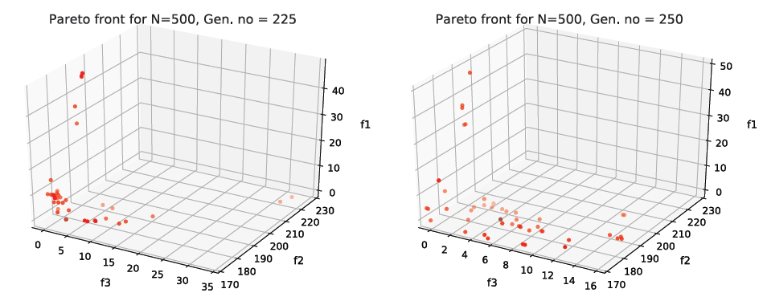
Linac optics optimization
30 variables: 26 quadrupole settings + 4 initial twiss conditions.
Work presented by I. Neththikumara at IPAC22

Slide 10
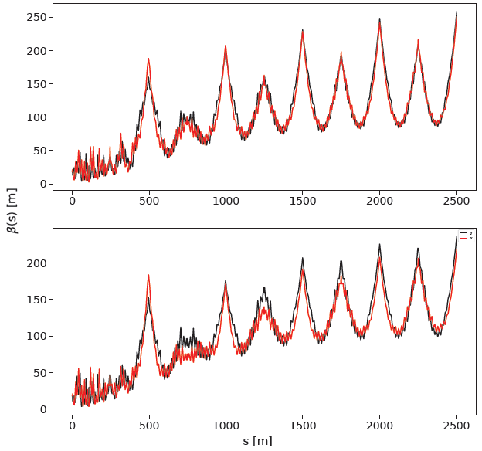
Linac optics optimization
Results from these two searches.
Both solutions look similar, but slight differences between them.
Non-trivial to determine “best” solution without compromising any of the requirements.
This solutions will be used for both North and South linacs. Arcs can be scaled to match and obtain a 10-pass beamline for ER@CEBAF.
Work presented by I. Neththikumara at IPAC22

Slide 11
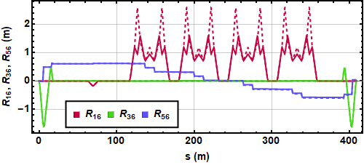
Arc modifications
First order horizontal (red), vertical (green) and longitudinal (blue) dispersion before (dashed) and after (solid) reduction of the peak dispersion.
Note that energy acceptance depends on the maximum value of both vertical and horizontal dispersions.
The horizontal bending section of Arc 1 needs a net $R_{56}$ to compensate for the splitter/recombiner section. This gives us a constraint on our dispersion manipulations.

Slide 12
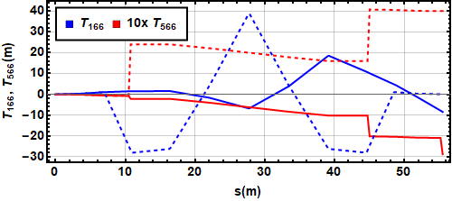
Injector and linearization
Dipoles
Quadrupoles
Sextupoles
Second order horizontal (red) and longitudinal (blue) dispersions in the injector chicane with (dashed) and without (solid) additional sextupoles.
The range of $T_{566}$ values available to us in the injector chicane before the beam enters the main ERL loop will proof invaluable when optimizing our longitudinal match.

Slide 13
Compressive longitudinal match
Accelerate off-crest
Decompress in intermediate arc
Compress at top energy
Decompress in intermediate arc
Compensate chirp and decelerate to dump
$$δ$$
$$δ$$
$$δ$$
$$δ$$
$$δ$$
z
z
z
z
z

Slide 14
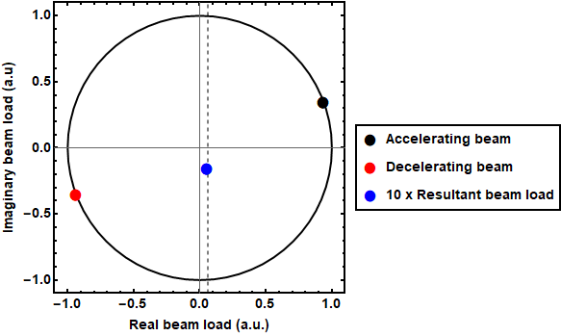
RF Phase
Compensate for energy lost to synchrotron radiation by decelerating further off-trough than accelerating off-crest.
Decelerate on same side off-trough as accelerate off-crest (ahead or behind) to reduce energy spread decelerating.
Energy recovery efficiency reduction
due to energy loss
Rf beam load in accelerating passes (black), decelerating
passes (red) and resultant (blue).

Slide 15
Example Match
 | Top arc $R_{56}$ (m) | Decompressing arc $R_{56}$ (m) | Accelerating phase (degrees, 0$°$ =accelerating crest) | Notes
Match 1 | $−0.30$ | $0.23$ (arc 5) | $$8°$$ | Longest stretch with compressed bunch.
Match 2 | $−0.38$ | $0.22$ (arc 8) | $$8°$$ | Compromise between compressed bunch duration and energy spread growth between compression and decompression.
Match 3 | $−0.44$ | $0.25$ (arc 9) | $$8°$$ | Flat bunch in arc 1 minimizes energy spread.
Match 4 | $−0.29$ | $0.17$ (arc 9) | $$12°$$ | Shorter bunch through. Eased arc $R_{56}$ requirements.
Match 5 | $$−0.19$$ | $0.11$ (arc 9) | $$18°$$ | Reduce further $R_{56}$ requirements.

Slide 16
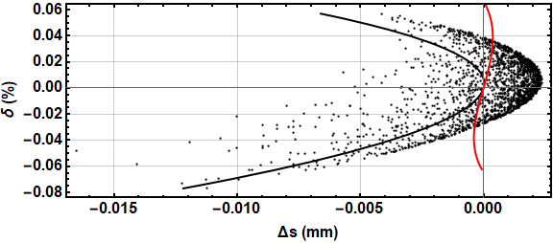
Example Match
Tracked bunch longitudinal phase space, prediction of the tracked bunch from semianalytical model (black line) and semianalytical prediction after preliminary second order corrections (red line).
In order to obtain the second order corrected longitudinal match, the only changes are the correct $T_{566}$ setting of the injector chicane and top energy arc.

Slide 17
