Slide 1
The European ERL Roadmap
Andrew Hutton and Max Klein
for the ERL Roadmap Panel
Prepared for the Sixth Workshop on Energy for Sustainable Science at Research Infrastructures in Grenoble, France

Slide 2
European Roadmap Process
In 2020, the European Strategy Group recommended:
  The particle physics community should ramp up its R&D effort focused on advanced accelerator technologies [...]
  The European particle physics community must intensify accelerator R&D and sustain it with adequate resources
  A roadmap should prioritize the technology [...]
  Deliverables for this decade should be defined in a timely fashion and coordinated among CERN and national laboratories and institutes
To achieve this, five Roadmap Panels were set up:
  Superconducting Magnets: Pierre Vedrine (IRFU)
  Plasma Acceleration: Ralph Assmann (DESY)
  RF: Sebastien Bousson (IJCLab)
  Muons: Daniel Schulte (CERN)
  ERL: Max Klein (Liverpool)

Slide 3
ERL Panel Members
A team of experts was assembled in January 2021 to develop a Roadmap for ERLs
The Panel had members from every laboratory that has, or has had, an ERL bringing a wealth of experience to the Panel
Deepa Angal-Kalinin (STFC)
Kurt Aulenbacher (Uni Mainz)
Alex Bogacz (Jefferson Lab)
Georg Hoffstaetter (Cornell)
Andrew Hutton (Jefferson Lab) – Co-Chair
Erk Jensen (CERN)
Walid Kaabi (IJCLab)
Dmitry Kayran (BNL)
Max Klein (Liverpool) – Chair
Jens Knobloch (Helmholtz-Zentrum Berlin)
Bettina Kuske (Helmholtz-Zentrum Berlin)
Frank Marhauser (Jefferson Lab)
Norbert Pietralla (Darmstadt)
Olga Tanaka (KEK)
Cristina Vaccarezza (lNFN, Frascati)
Nikolay Vinokurov (BINP)
Peter Williams (STFC)
Frank Zimmermann (CERN)

Slide 4
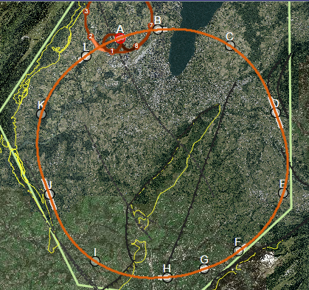

Long-Term Vision for ERLs for HEP
The ERL Roadmap should identify R&D required to take the next steps in energy and power
What are the options?
  Proposals for LHeC and FCC-eh have been developed in detail (LHeC CDR, arXiv:2007.14491) and Eur.Phys.J.ST 228 (2019) 4, 755 FCC-hh/eh
LHeC FCC-eh
ERL
Operation in parallel with LHC/HE-LHC/FCC-hh
TeV scale collisions ➔ 50-60 GeV e-beam energy
power consumption < 100 MW

Slide 5
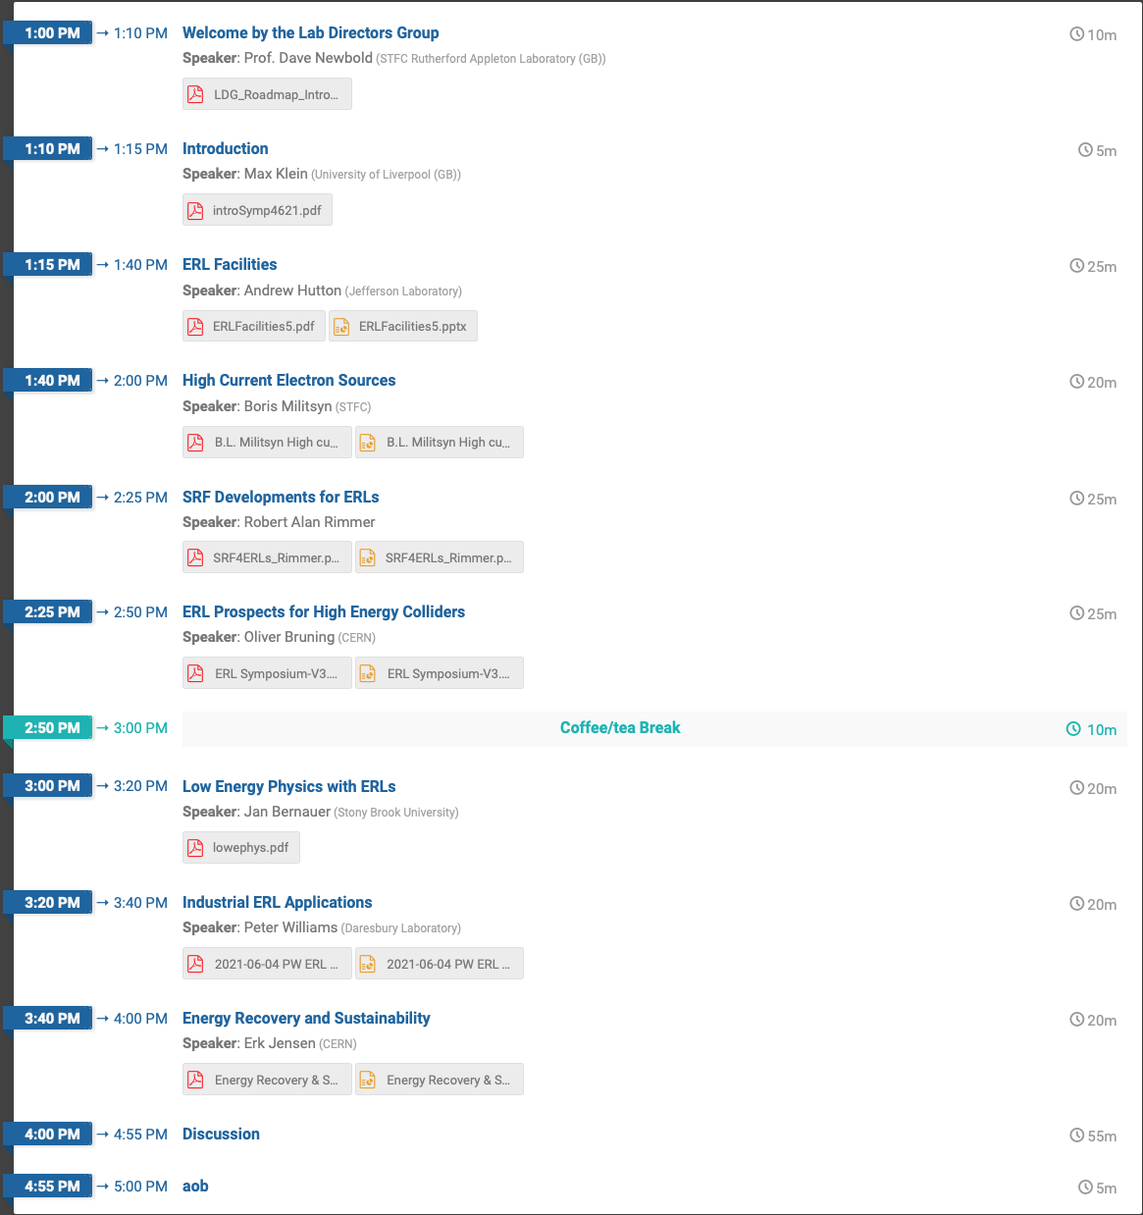
Process
Establish the Roadmap Panel
Collect information on every ERL that is operating, or has ceased operation but still holds a record in some parameter, and proposed future projects
  A spreadsheet was developed to facilitate this
Request a status report from each of the facilities
Seek input via a Symposium*
Panel Members took responsibility for preparing Chapters of a long report with the status of all the projects
Prepare a shorter report for integration with the other Roadmap panels
*https://indico.cern.ch/event/1040671/

Slide 6
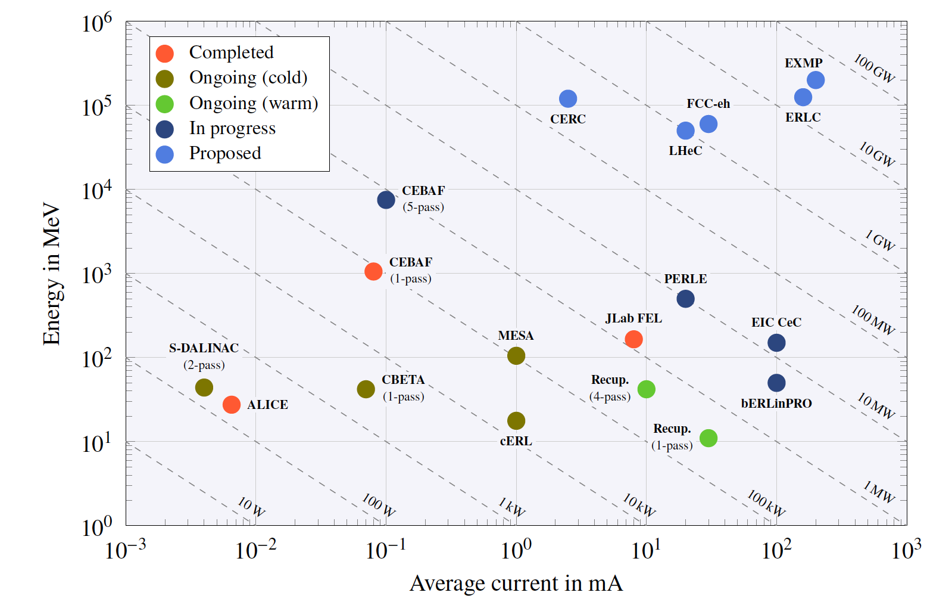
Overview of ERL Facilities
Financial
Technology

Slide 7
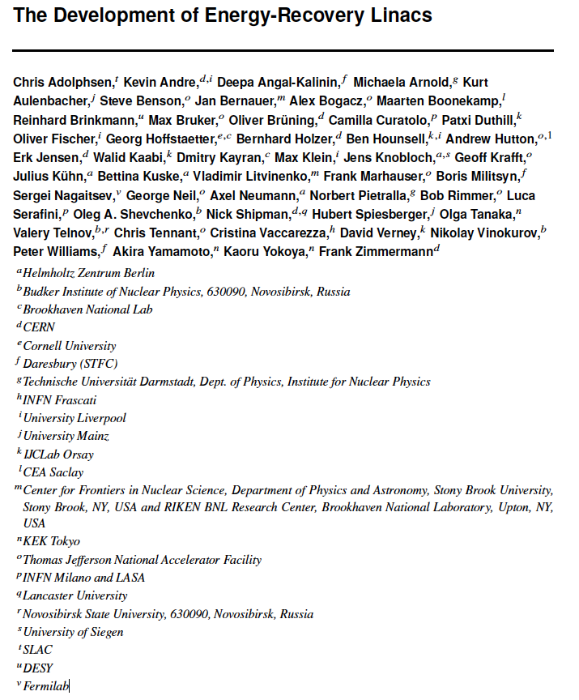
Long Report
The long report was completed in July 2022 – a marathon that took 18 months!
  Editor: Max Bruker (Jefferson Lab)
  49 authors
  22 institutions
  270 pages
  58 figures
  419 references
Available at https://arxiv.org/abs/2201.07895
Accepted for publication in JINST

Slide 8
Contents
1 Introduction
2 ERL—Facilities and Current Status
  2.1 Completed Facilities
    2.1.1 ALICE at Daresbury
    2.1.2 JLab FEL
    2.1.3 CEBAF Single-pass Energy Recovery Experiment (CEBAF-ER)
  2.2 Ongoing Activities
    2.2.1 CBETA at Cornell
    2.2.2 S-DALINAC at Darmstadt
    2.2.3 cERL at KEK
    2.2.4 Recuperator at Novosibirsk
    2.2.5 MESA
3 ERL—New Facilities in the Twenties
  3.1 bERLinPro
  3.2 PERLE at Orsay
  3.3 CEBAF 5-pass Energy Recovery Experiment
  3.4 Electron Cooler at BNL
4 Key Challenges—a Concerted Effort
  4.1 Low-Emittance, High-Current Sources
  4.2 Challenges of SRF Cavities and Cryomodules
  4.3 Multi-turn ERL Operation and the Art of Arcs
  4.4 ERL Operation Challenges
  4.5 Interaction Region
5 Energy and Intensity Frontier Physics
  5.1 High-Energy Colliders
    5.1.1 LHeC and FCC-eh
    5.1.2 CERC: FCC-ee as an ERL
    5.1.3 ERLC: ILC as an ERL
    5.1.4 Photon-Photon Collider
    5.1.5 Electrons and X-rays to Muon Pairs (EXMP)
  5.2 Low-Energy Particle Physics
  5.3 Low-Energy Electron-Ion Scattering
  5.4 Photonuclear Physics

Slide 9
Contents (cont.)
6 Applications
  6.1 ERL-Driven High-Power FEL
  6.2 EUV-FEL Semiconductor Lithography
  6.3 ICS Gamma Source
7 ERLs and Sustainability
8 Conclusions
Appendix A Overview on ERL Facilities
Appendix B ERL High-Energy e+e- sub-Panel Report

Slide 10
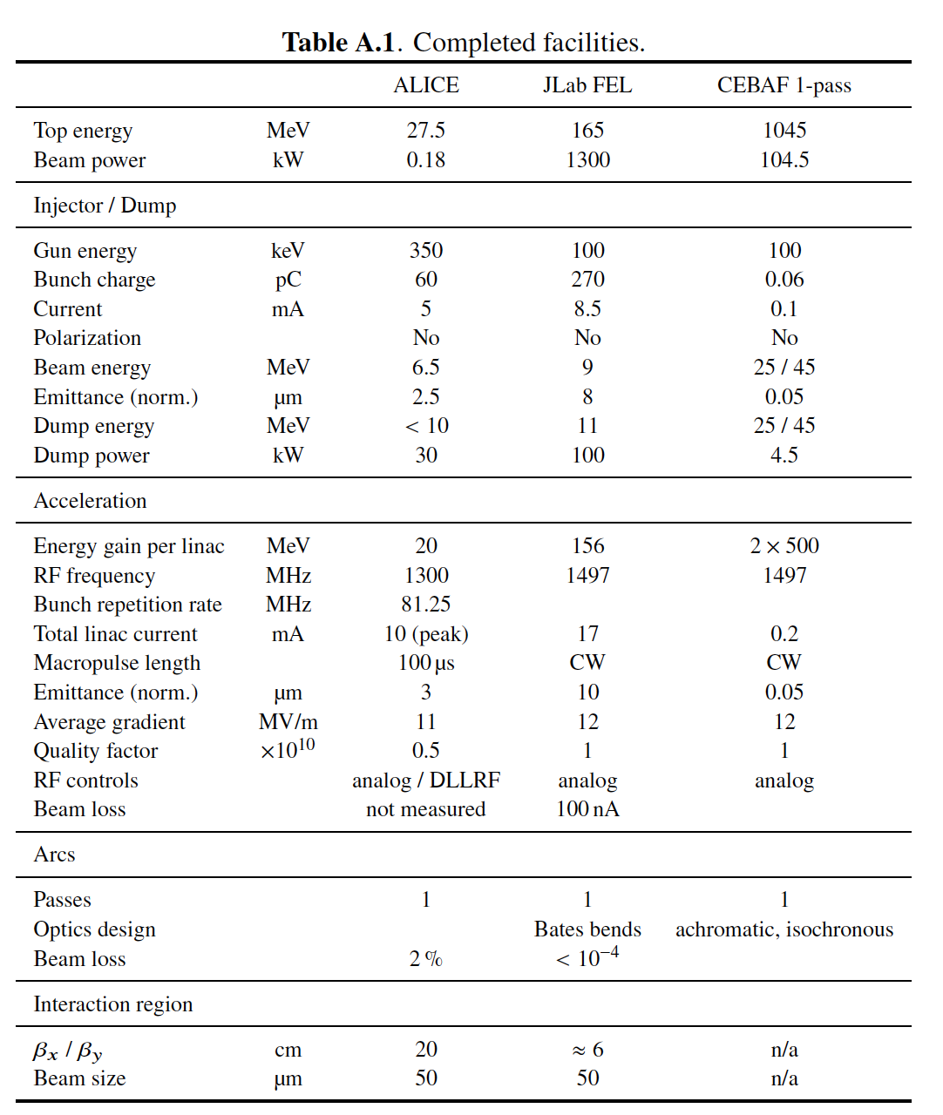
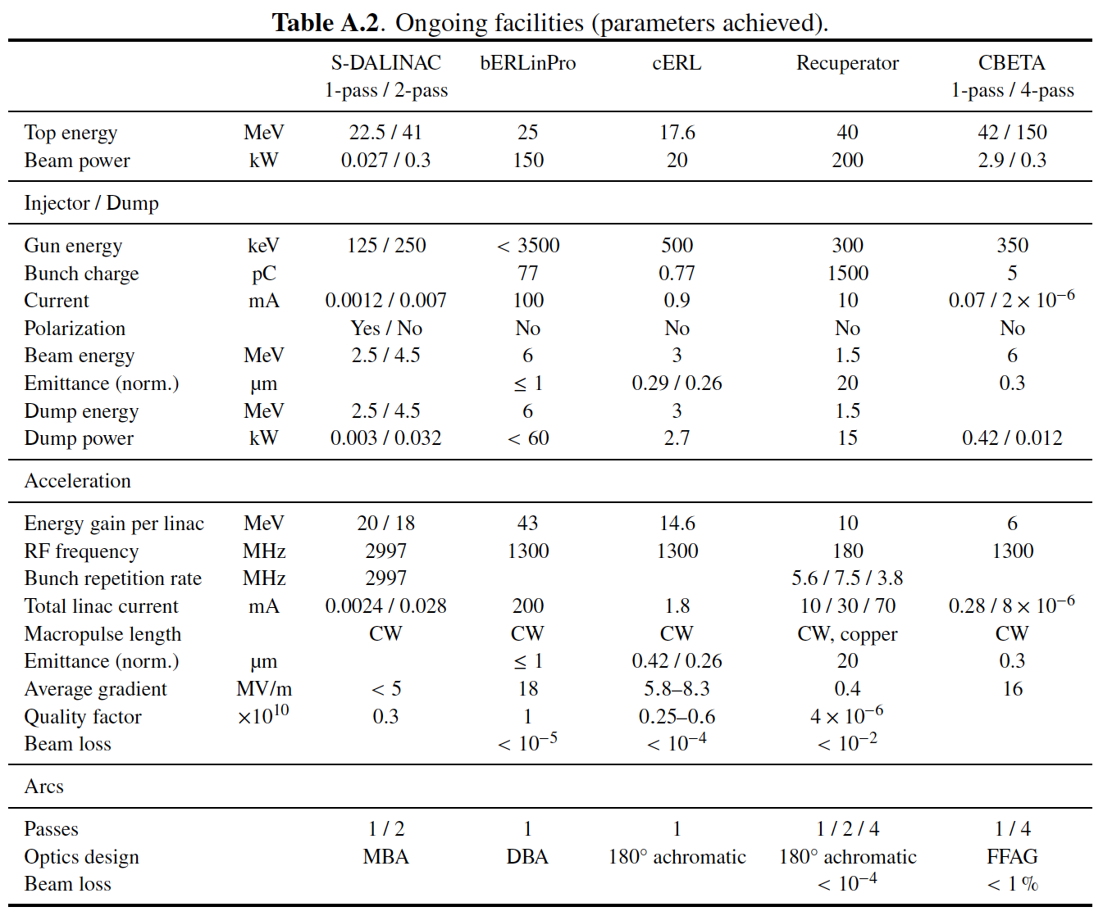
Appendix A: Completed and Ongoing Facilities

Slide 11
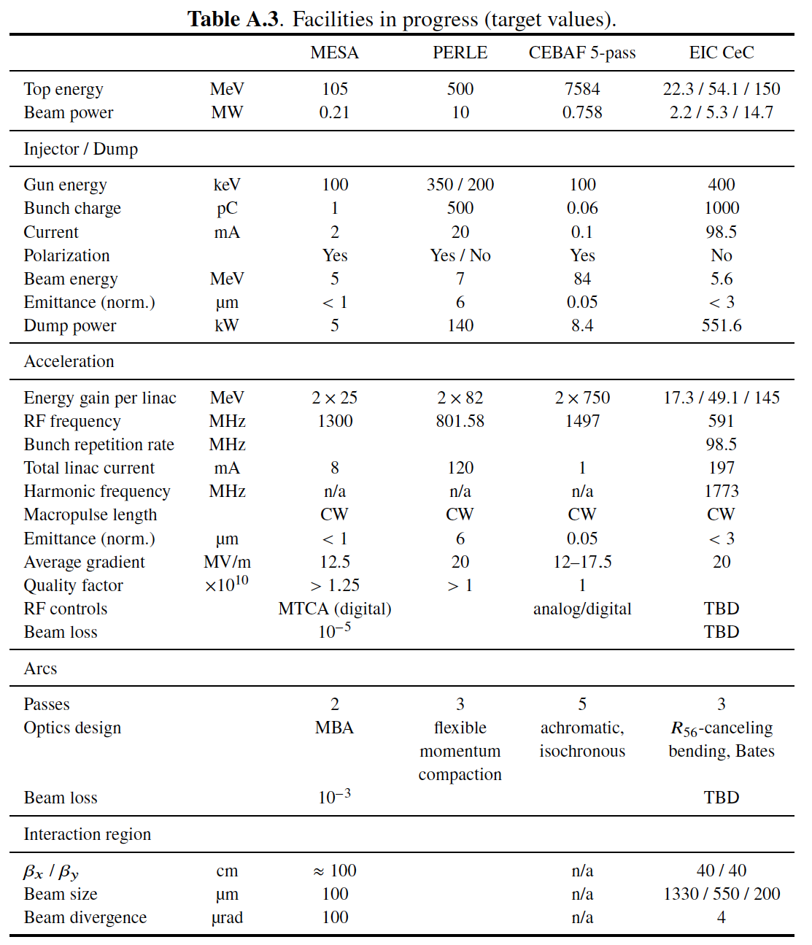
Appendix A: Facilities in Progress
Appendix B addresses two proposals:
CERC and ERLC, discussed later

Slide 12
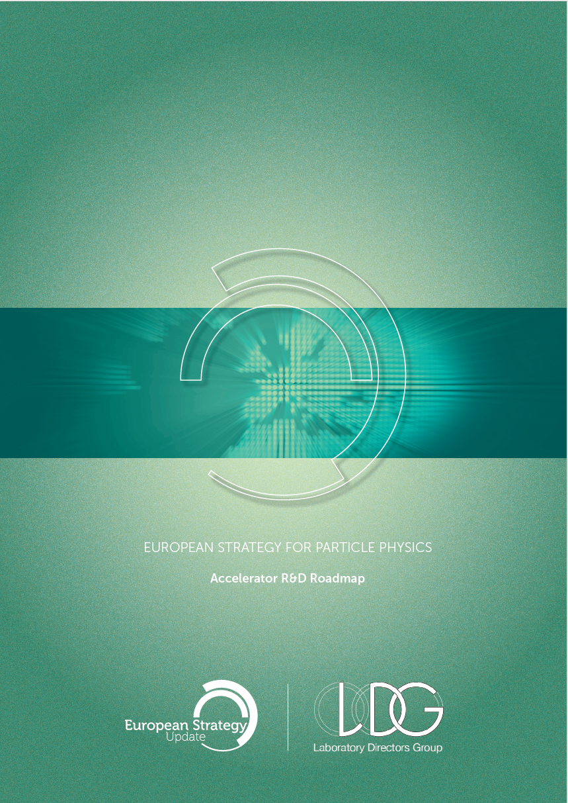
Accelerator R&D Roadmap
A compendium of the five Roadmap Panels has been published as a CERN Report
  https://e-publishing.cern.ch/index.php/CYRM/issue/view/146
  arXiv:2201.07895
The ERL Roadmap section contains the recommendations of the ERL panel for future R&D

Slide 13
Justification for the ERL Accelerator R&D
ERLs are the means to reach very high luminosity in the next-generation energy-frontier electron-hadron colliders, LHeC and FCC-eh
An ERL-based proposal has been published for the generation of picometer-emittance-class muon beams by electron-photon collisions*
Two concepts were published and explored as part of this roadmap process for reaching higher luminosity at high energies: for the FCC-ee, termed CERC**; and for the ILC, termed ERLC***
A particularly interesting prospect is to design and possibly build, in the further future, an energy-efficient, ultra-high-luminosity (~10³⁶ cm⁻²s⁻¹) 500 GeV ERL-based electron-positron collider, termed HH500, which would enable the exploration of the Higgs vacuum potential with a measurement of the tri-linear Higgs coupling in e+e-
  A recent publication proposes an energy recycling linear collider ReLiC**** that could meet this requirement
* C. Curatolo and L. Serafini. Appl. Sci. (2022), 12(6), 3149
** V. N. Litvinenko, T. Roser, and M. Chamizo-Llatas. Phys. Lett. B, 804:135394, 2020
*** V. I. Telnov. Journal of Instrumentation 16 (2021) P12025
**** V. N. Litvinenko, T. Roser, and M. Chamizo-Llatas. https://arxiv.org/pdf/2203.06476.pdf

Slide 14
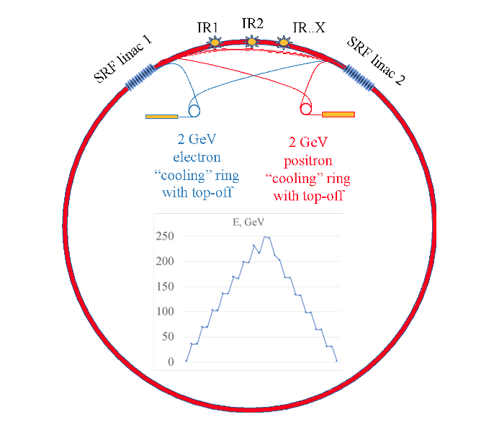
Circular Energy Recovery Collider Concept: CERC proposal
Two 11 to 90 GeV SRF linacs in 4 pass configuration
1/3rd of power consumption as compared to circular collider
CM Energy reach of 600 GeV in 100 km circumference tunnel
Damping rings for emittance reduction and recycling of beams
https://arxiv.org/abs/1909.04437
Physics Letters B, 804 (2020) 135394
Maximum Power of 300 MW per beam @ 120 GeV and 2.47 mA
V. Litvinenko BNL and Stony Brook University; T. Roser BNL; C. Llatas BNL

Slide 15
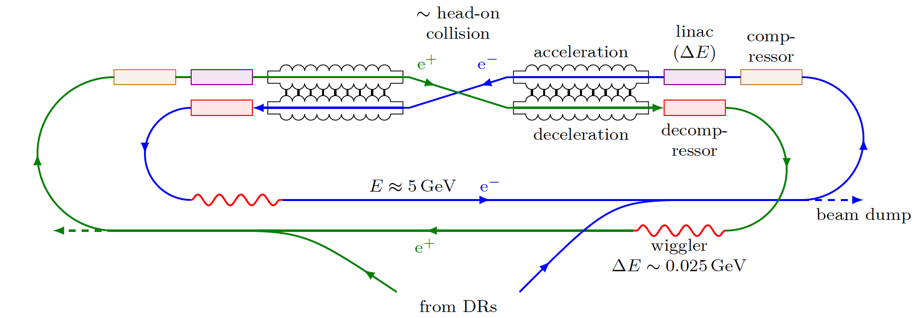
Energy Recovery Linear Collider Concept: ERLC proposal
V. I. Telnov. JINST 16 (2021) P12025
ERLC consists of two parallel superconducting linacs connected to each other with RF-couplers, so that the fields are equal at any time
  One line is for acceleration, the other for deceleration.
Damping is provided by wigglers (no damping rings) at the “return” energy about E~5 GeV
The energy loss per turn 𝛿E/E~1/100
Damping is needed to reduce the energy spread arising from collision of beams

Slide 16
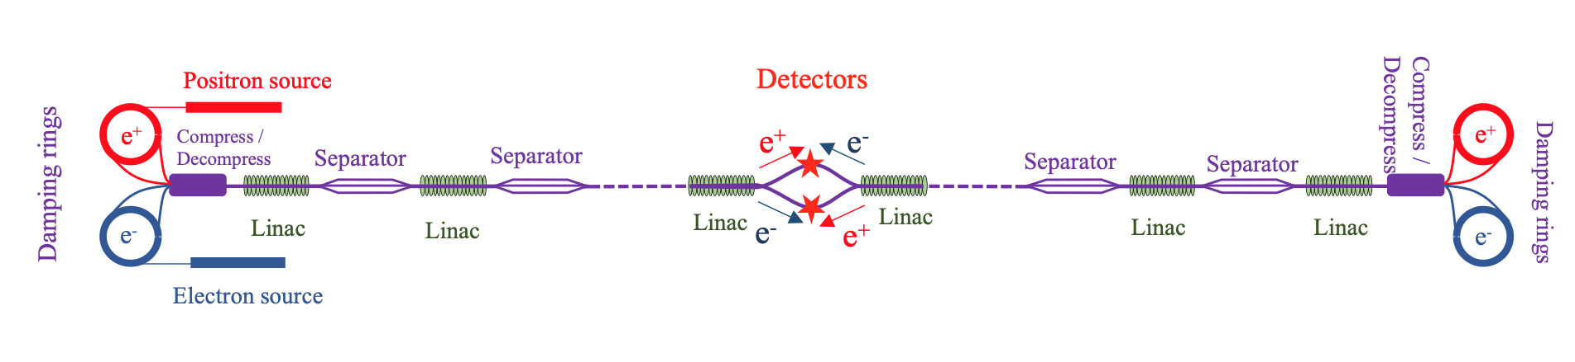
ReLiC
The concept is based on segmenting superconducting (SRF) linear accelerators into sections divided by separators, where used (decelerating) beams are separated from colliding with accelerating beams by a combination of DC electric and magnetic fields
This design provides for undisturbed straight trajectories of the accelerating beams and on-axis beam propagating both accelerated and decelerated beams in the linac’s SRF structures
Vladimir N Litvinenko, Nikhil Bachhawat, Maria Chamizo-Llatas, Yichao Jing, François Méot, Irina Petrushina, Thomas Roser, https://arxiv.org/abs/2203.06476

Slide 17
The ERL roadmap has three major, interrelated elements
A) Current facilities, including crucial technological developments and operational experience
  These comprise S-DALINAC (TU Darmstadt, Germany), MESA (U Mainz, Germany), CBETA (U Cornell and BNL, US), cERL (KEK, Japan) and the normal-conducting, lower-frequency Recuperator facility (BINP Novosibirsk, Russia)
    All these projects are being presented at this conference so I will not discuss them in this talk
B) A key technology R&D program focused on:
  High-current electron sources
  High-power Superconducting RF (SRF) technology development and operation in the years ahead, including the technical target of cavity quality factors, Q₀, approaching 10¹¹
    This is included in the RF Roadmap Panel
  Next-generation ERLs lead to the major goal of being able to operate at 4.5K cryogenic temperature with high Q₀, also including higher-order mode damping at high temperature, dual-axis cavity developments and novel means for high-current
  ERL diagnostics and beam instrumentation to deal with effects such as beam break-up or RF transients

Slide 18
The ERL roadmap has three major, interrelated elements (cont.)
New ERL facilities in preparation for reaching higher currents and electron beam energies at minimum power consumption by the mid-twenties
In Europe:
  bERLinPro (Berlin, Germany) with the goal to operate a 100 mA, 1.3 GHz facility
  PERLE IJCLab (Orsay, France) as the first multi-turn, high-power, 802MHz facility with novel physics applications
In the US:
  ERL operation near 10 GeV with CEBAF5 (Jefferson Lab, Newport News)
  Develop a challenging 100mA electron cooler for hadron beams at the EIC (BNL, Brookhaven)
These projects are also being presented at this conference so I will not discuss them in this talk

Slide 19
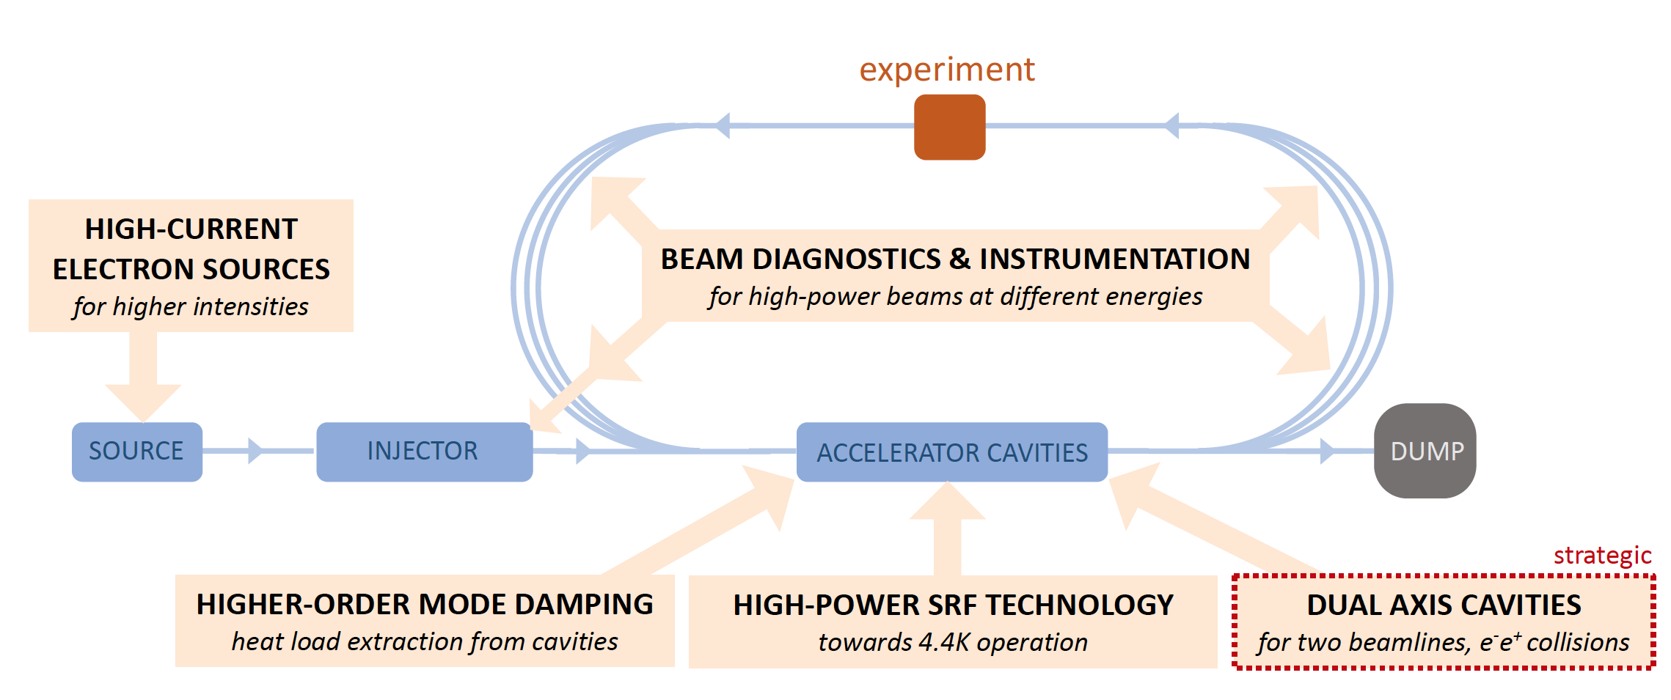
Key Aspects of an Energy Recovery Accelerator

Slide 20
Delivery Plan
The continuation and development of the various facility programs, for which no funds are needed from the particle physics field
  For Europe these are S-DALINAC in Darmstadt and MESA in Mainz (both in Germany).
A number of key technologies to be developed
  Some of these, such as electron sources of high brightness (reaching the 100mA electron current regime), Fast Reactive Tuners (FRTs) and, for longer term, the development of an 802 MHz, 4.4K cavity-cryomodule have been integrated in the plans for bERLinPro and PERLE as all require beam operation
Two other, aspirational items of strategic importance deserve separate support and are included:
  HOM damping at high temperature
  The development of twin-axis cavities
The timely upgrade of bERLinPro and construction of PERLE at Orsay are the necessary steps to move ERLs forward to their introduction to collider developments, possibly mid-term and long-term

Slide 21
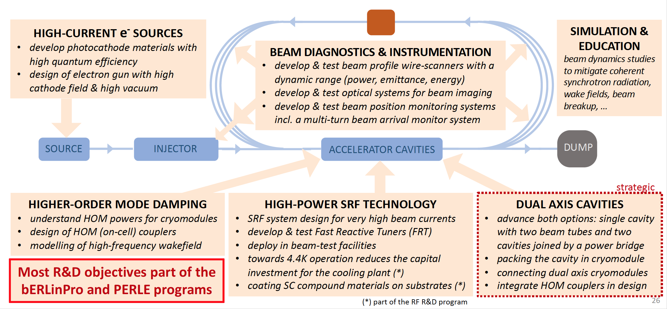
Main R&D objectives for Energy Recovery

Slide 22
High-Current Electron Sources and Guns
Ongoing research topics in the field of photocathodes are the understanding of the photocathode materials (e.g. electronic properties), the photoemission process, and their intrinsic emittance
  New growth procedures of high quantum efficiency, smooth, mono-crystalline photocathodes or multi-layer systems, and the screening of new photocathode materials are crucial for future electron accelerators
A main research topic in the field of gun development is the design of accelerating structures which can provide a high cathode field in combination with extremely-high-vacuum conditions
  Major efforts concentrate on the development of DC guns (Cornell University), VHF NCRF (LBNL), and lower-(BNL) and high-frequency SRF guns (bERLinPro)
  Important insights can be gained from operating smaller facilities with high-current thermionic guns (BINP)
Laser systems for electron injectors, including technology of lasers with sufficient power to operate with antimonide-based photocathodes, are rather well developed
  Major efforts concentrate on the generation of laser pulses with elliptical temporal profile, which are necessary to deliver high-charge bunches with ultra-low emittance.

Slide 23
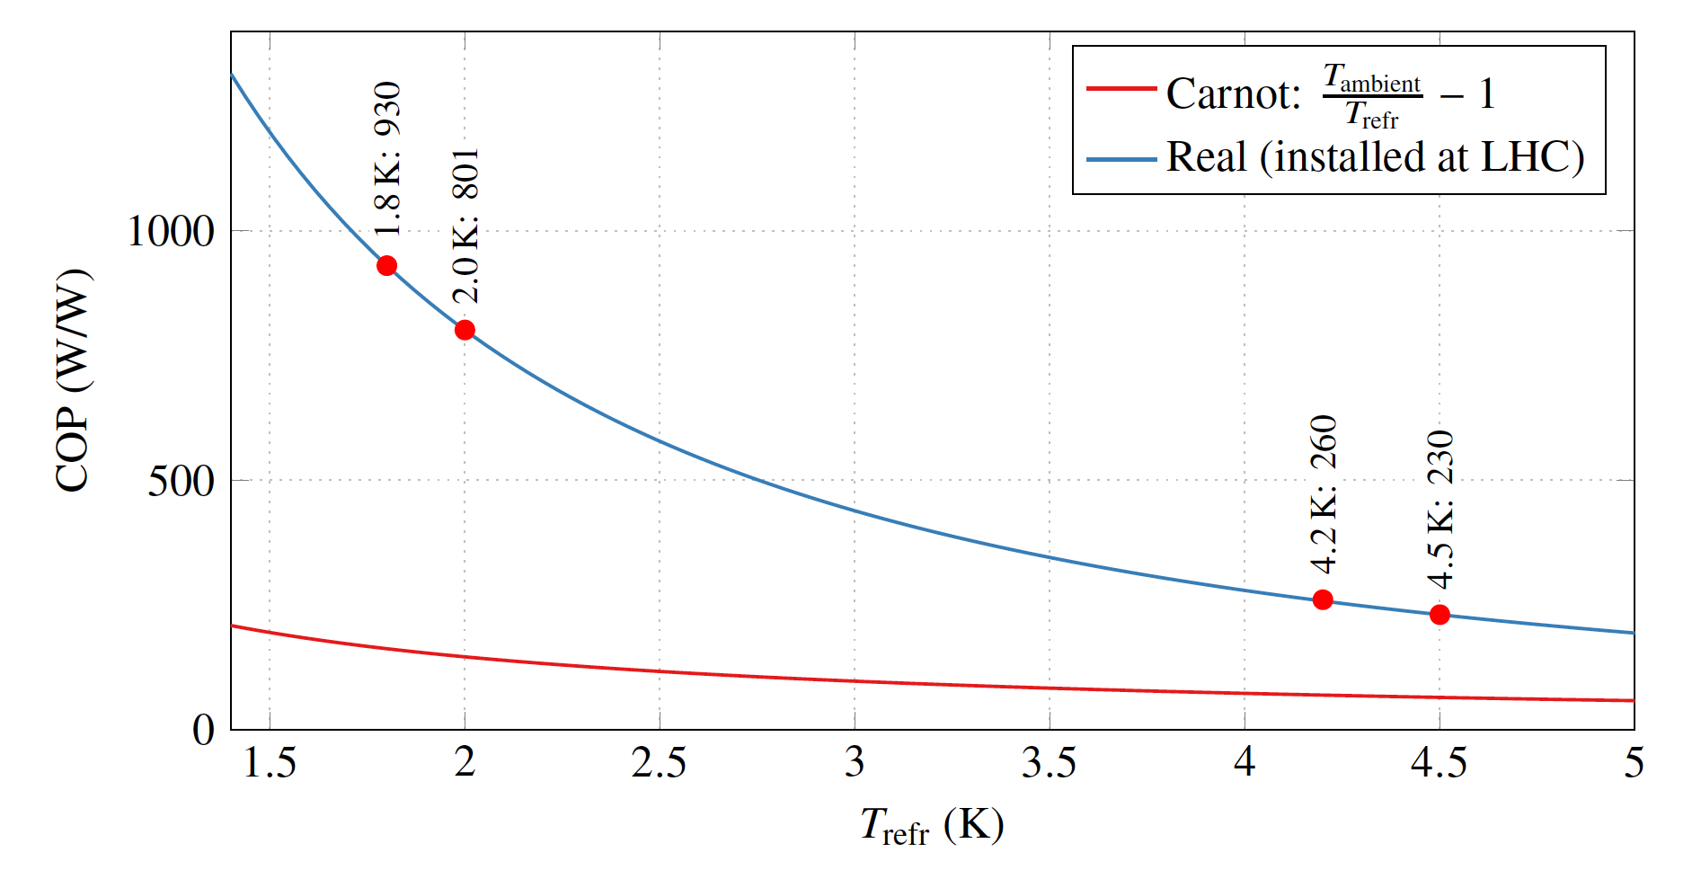
4.5K Operation of SRF Cavities
Coefficient of performance (COP) as a function of temperature of a cryogenic system for the LHC [thanks to P. Lebrun]
Efficiency improved by factor 3.5 between 2K and 4.5K
An imperative for ERLs
It is important for SRF everywhere
It will be supported by the SRF Roadmap panel

Slide 24
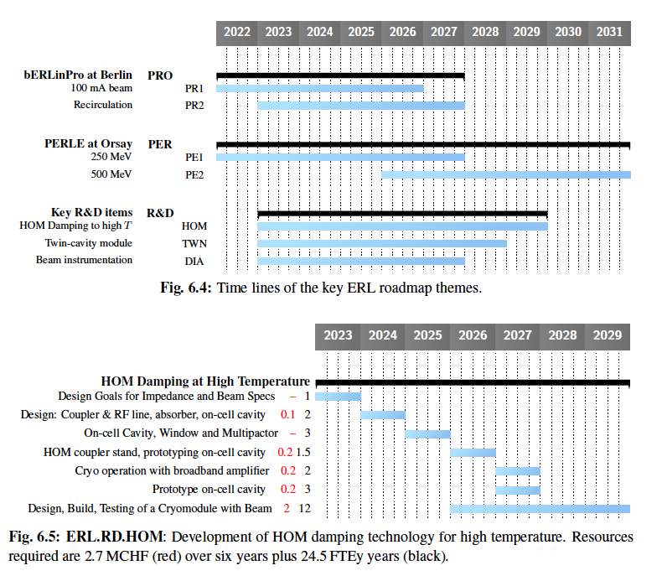
HOM Damping and Transfer to Higher Temperature
Because ERLs operate at high current, the HOM power produced can be very high
  Depositing the heat load in the cold mass is highly inefficient; hence, the power must be extracted and deposited into room temperature loads
HOM couplers come in two main types, coaxial and waveguide
Coaxial couplers are normally associated with low powers
  But, the HOM couplers for the HL-LHC crabs were designed to handle up to 1kW per coupler
  Coaxial couplers are small and hence have a lower static heat load
Waveguide couplers are typically used for high powers but have a larger static heat load as they comprise a large metal link from room temperature to the cavity

Slide 25
Superconducting Twin-Axis Cavities
Twin-axis cavities are required when the accelerating and decelerating beams travel in opposite directions through long linacs
Four examples of twin-axis cavities have been considered:
Two purely theoretical calculations
A design comprised two three-cell cavities joined by a bridge at the power coupler end
  A prototype carved out of a solid block of aluminum was built and the expected performance demonstrated
  The advantage of this design is that the accelerating and decelerating cavities do not have to be identical, so the cavities can be designed so the higher order modes do not overlap, extending the threshold for transverse beam break-up by a factor of two
A design of a single cavity with separate beam tubes for the beams being accelerated and decelerated
  The advantages are smaller transverse dimensions and the power is recovered in each cell
  A single-cell prototype was built from niobium and successfully tested at cryogenic temperatures
  However, this was a single cell without the necessary power and HOM couplers, etc.

Slide 26
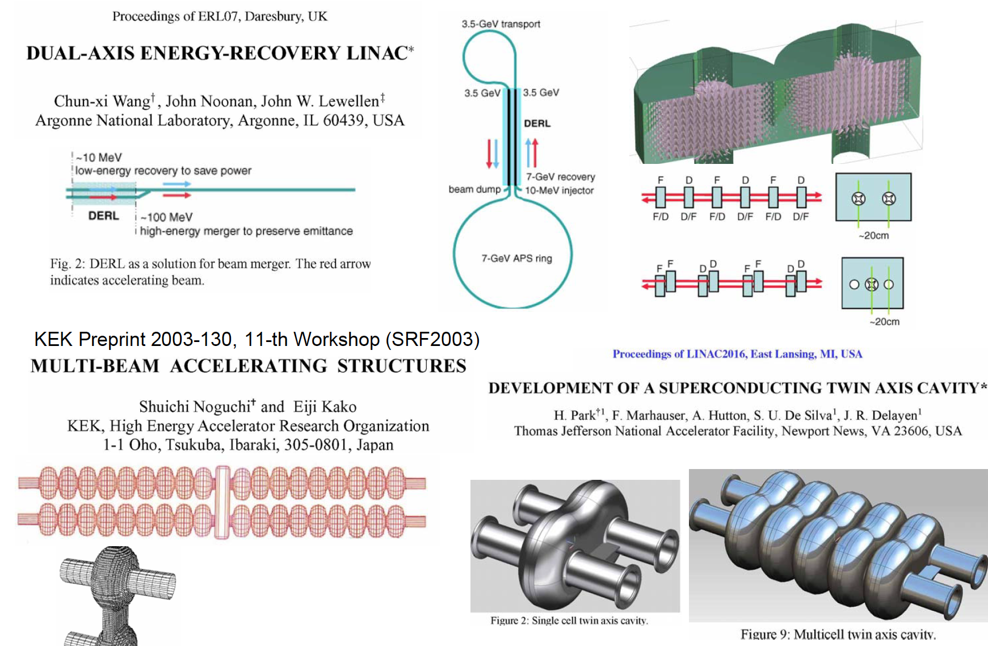
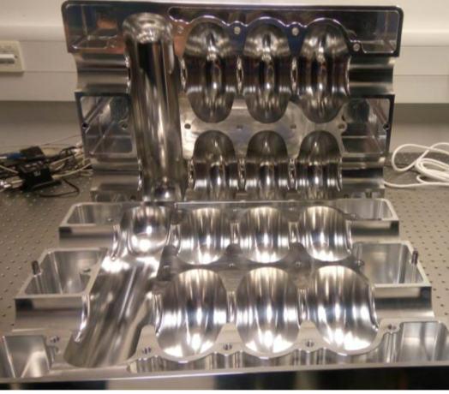
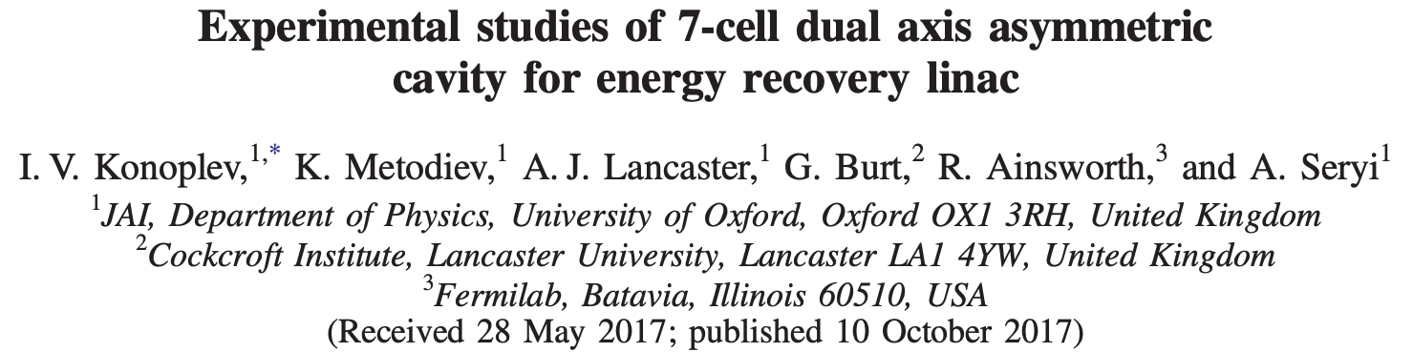
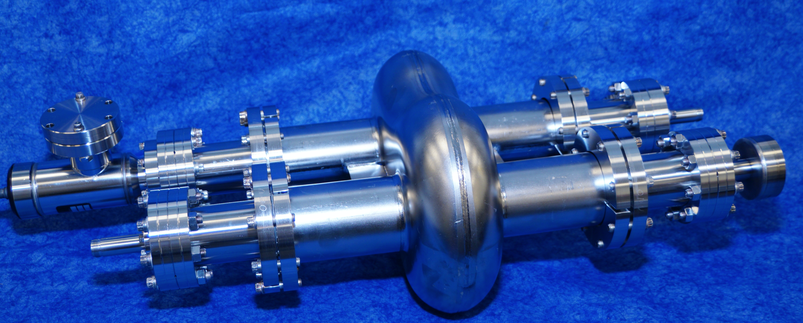
Twin Axis Cavity Proposals

Slide 27
Diagnostics
ERLs have specific diagnostics needs because of the large beam power, the small emittance, and the low beam loading in the main linac cavities
The large beam power can lead to continuous beam losses that can easily damage vacuum components, magnets, and electronics
  It can also create dark current in accelerating cavities
Halo diagnostics and radiation detection in critical regions is essential
Existing ERLs have developed solutions, e.g.
  High-dynamic-range halo monitors at the JLab FEL
  Continuous radiation monitors along both sides of the beam pipe in CBETA
Solutions for larger beam powers still have to be developed

Slide 28
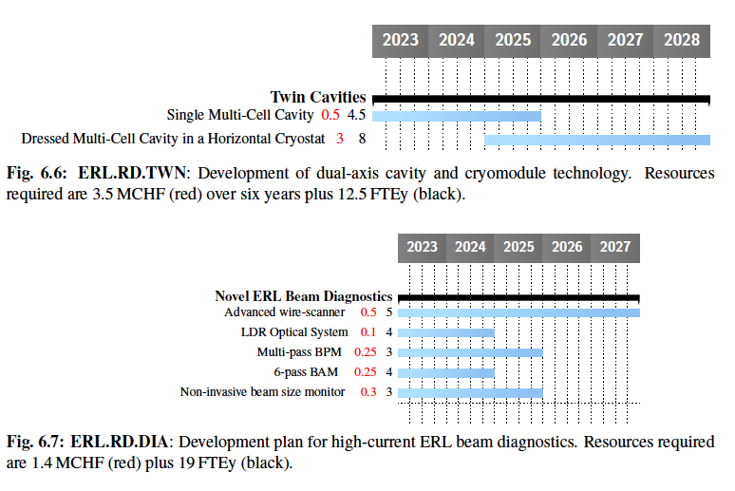
Funding Profile for Twin Cavities and Diagnostics

Slide 29
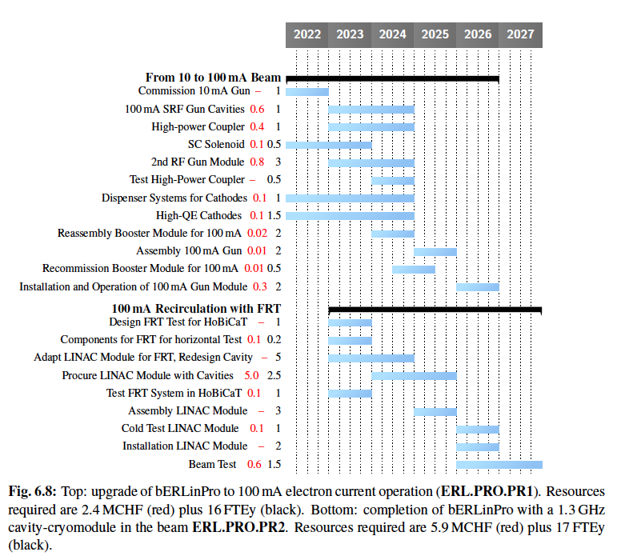
bERLinPro Funding Profile
bERLinPro has two separate projects:
Develop a 100 mA SRF Gun
Test recirculation at 100 mA
PERLE and LHeC propose 3-pass 20 mA = 120 mA in the linacs
bERLinPro test recirculation will demonstrate that HOM damping is adequate
It will also test Fast Reactive Tuners (FRTs)

Slide 30
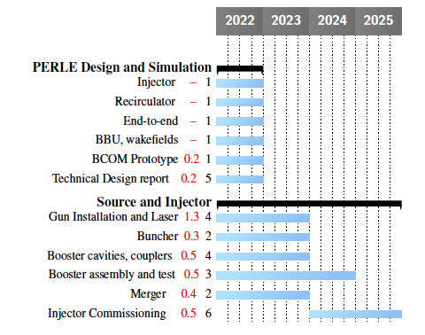
PERLE Injector Funding Profile
Goal is to rebuild ALICE gun and build a booster
  ALICE gun is currently being assembled at IJCLab
  Booster is a collaboration between CERN, Jefferson Lab and IJCLab
The path to the PERLE technical design report and commissioning of the injector. Resources required are 3.9MCHF (red), 31 FTEy (black)

Slide 31
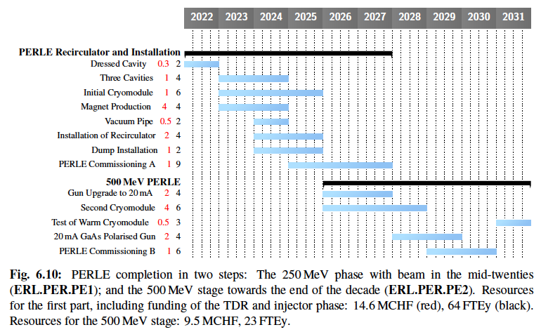
PERLE Recirculator Funding Profile

Slide 32
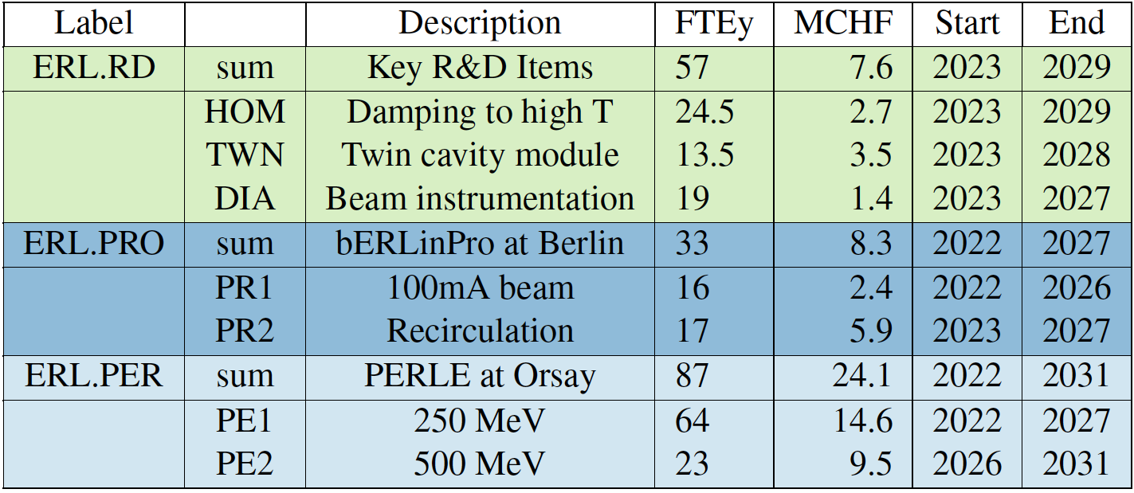
Total Support Requested
Total effort for the R&D program on energy recovery linacs as presented in this roadmap, providing the total number of FTE years and MCHF for the duration as indicated
The table does not include in-kind and infrastructure contributions nor further investments in ongoing facilities
Total 177 FTEy 40 MCHF

Slide 33
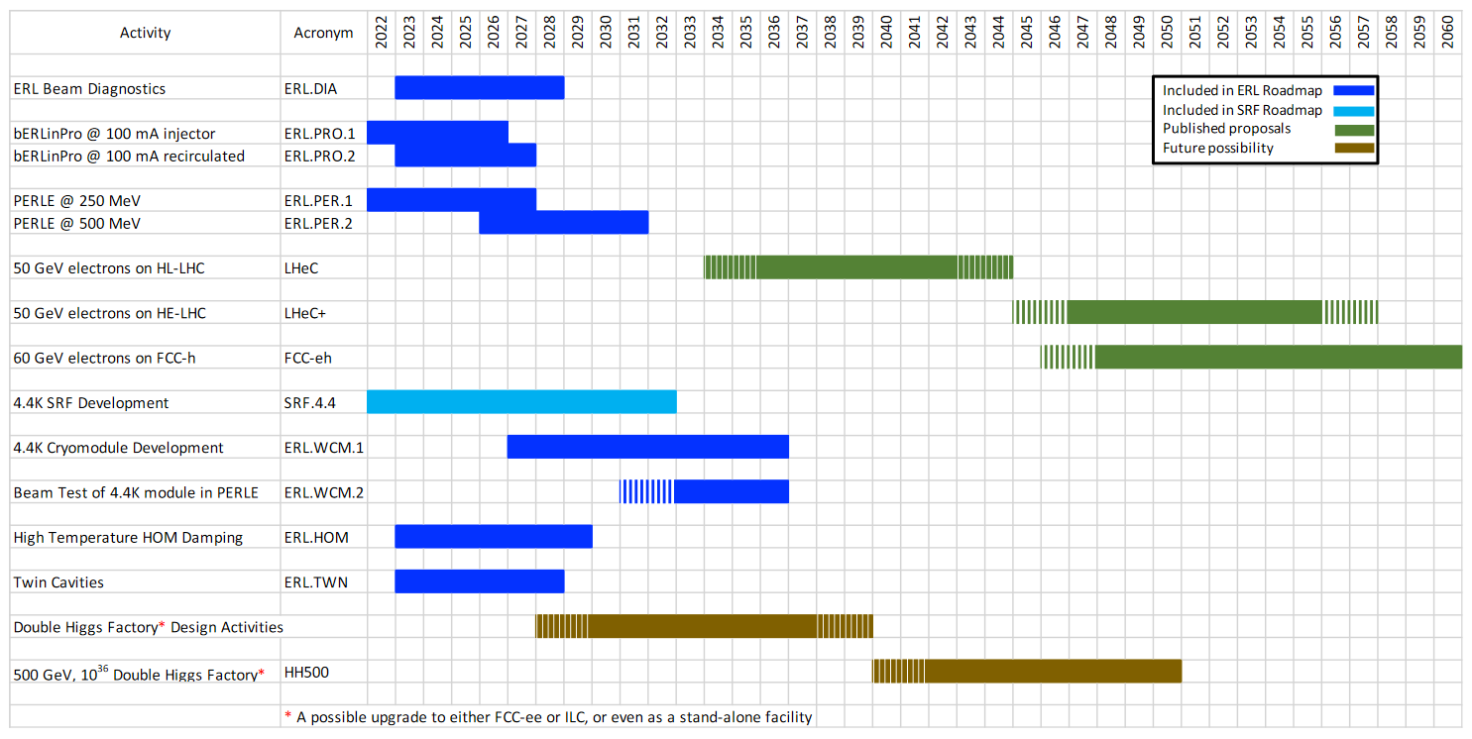
Roadmap Timetable for the next Five to Ten Years
Leads to multiple options for future HEP Colliders
European
operational
facilities
energy frontier eh
Technology
development
towards an e+e-,
H-HH facility

Slide 34
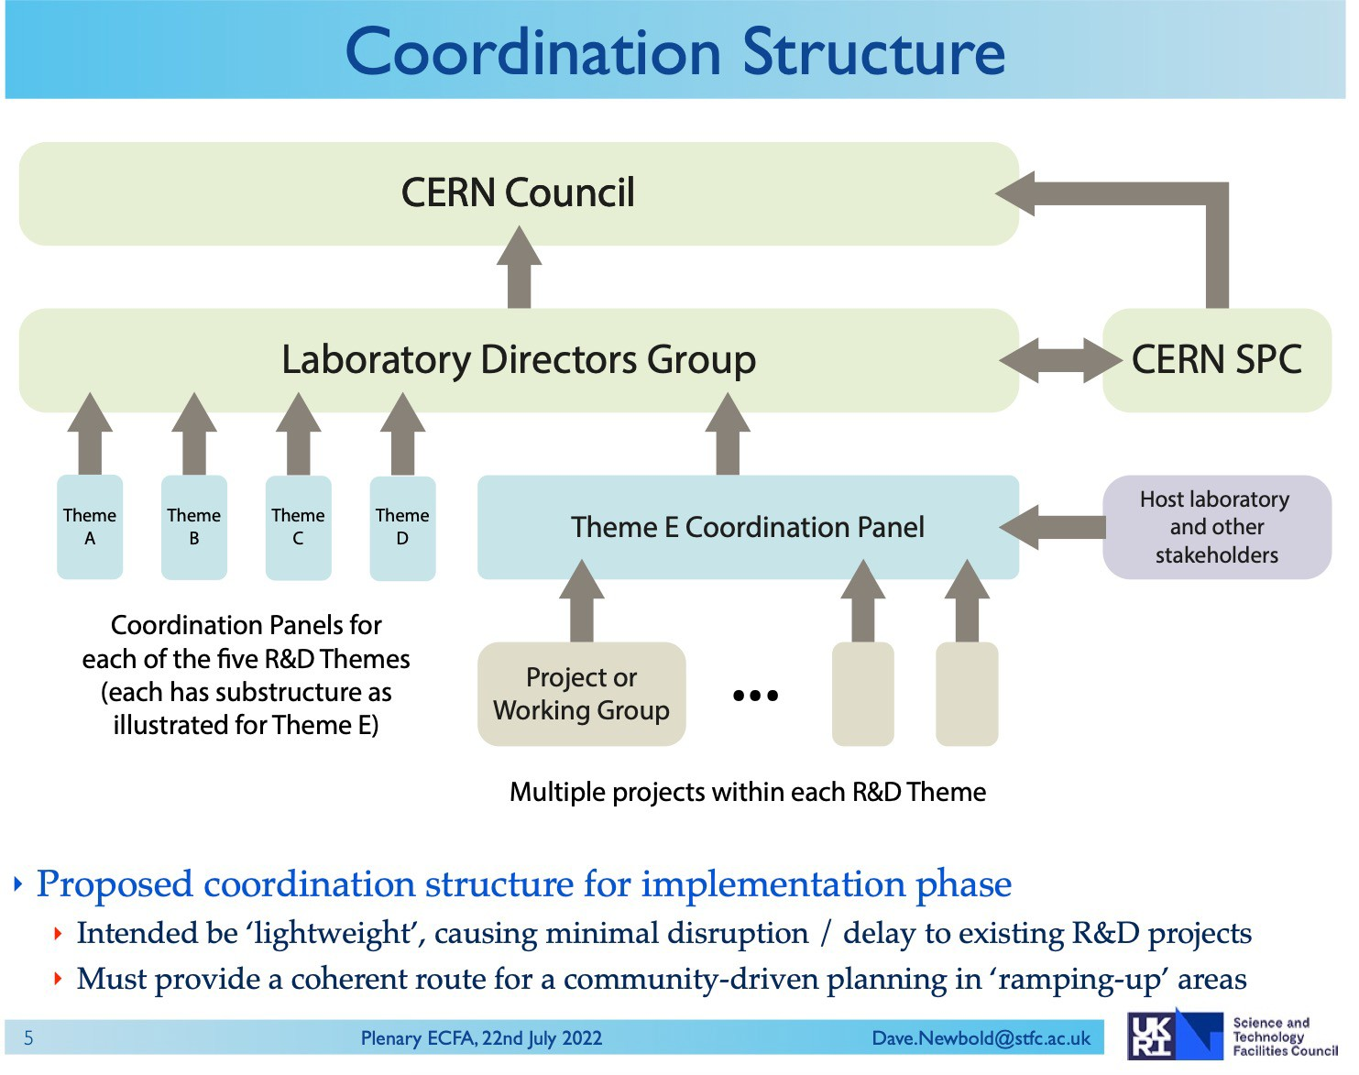
Organizing the European R&D for Energy Recovery in HEP
From Dave Newbold (chair of the Lab Directors Group, LDG), slides shown during Plenary ECFA meeting July 2022, https://indico.cern.ch/event/1172215/

Slide 35
Organizing the European R&D for Energy Recovery in HEP
connecting the ERL R&D community with the HEP steering and funding bodies
leverage on ongoing ERL R&D towards implementations in HEP applications
strengthen collaboration across the field to reach the HEP-related R&D objectives
incl. representative of ongoing & upcoming ERL facilities
Courtesy of Jorgen D’Hondt

Slide 36

Organizing the European R&D for Energy Recovery in HEP
ERL Coordination Panel – mandate from LDG with frequent meetings
  Organize, coordinate, oversee and steer the implementation of the ERL R&D Roadmap with a view to allow the implementation of Energy Recovery in HEP applications
  Within the scope of the ERL R&D Roadmap act as a decision-making and prioritization body
  Contact with stakeholders and funding agencies
ERL Stakeholder Forum – meets at least once per year in an open meeting
  Inform the community on ERL R&D strategy, progress and challenges in the realm of HEP
  Review the sharing of resources among participating institutions
ERL International Advisory Board – meets at least once per year
  Connect with partners in other regions relevant for ERL R&D, Energy Savings and applications
  Provide international oversight and advises to the ERL Coordination Panel
ERL Working Group Conveners – frequent WG meetings
  Establish collaboration across the field on the WG topic (focus on R&D topics for HEP applications)
37

Slide 37
Organizing the European R&D for Energy Recovery in HEP
ERL R&D oversight: Andrew Hutton (Jefferson Lab, USA)
Working Groups & Conveners
  Higher-Order Mode Damping convener: TBD
  Beam Diagnostics & Instrumentation convener: TBD
  Simulations (incl. education) convener: TBD
  Designs of e+e- colliders with Energy Recovery (incl. Dual Axis R&D) convener: TBD
Additional
  High-Power SRF (*) contact person to RF Coordination Panel (TBD)
  Electron Source work integrated in the bERLinPro & PERLE programs
  Design of ep collider ongoing in the realm of the LHeC and FCC-eh programs
Many of these topics are also addressed in the bERLinPro and PERLE programs
38

Slide 38
Immediate next steps
Create the Working Groups
  Coordination of R&D efforts worldwide
  Looking for volunteers from around the world who are involved in ERL R&D
Prepare for presentation to the CERN Council in December
  The members of the CERN Council come from funding agencies in the member states
  Looking for endorsement of the plan
  Financial support for carrying out the R&D program
From Jorgen D’Hondt
  “Given the energy crisis in Europe, the request may emerge for a stronger consideration of integrating Energy Recovery systems in the design of future HEP colliders, for example e+e- Higgs factories”

Slide 39
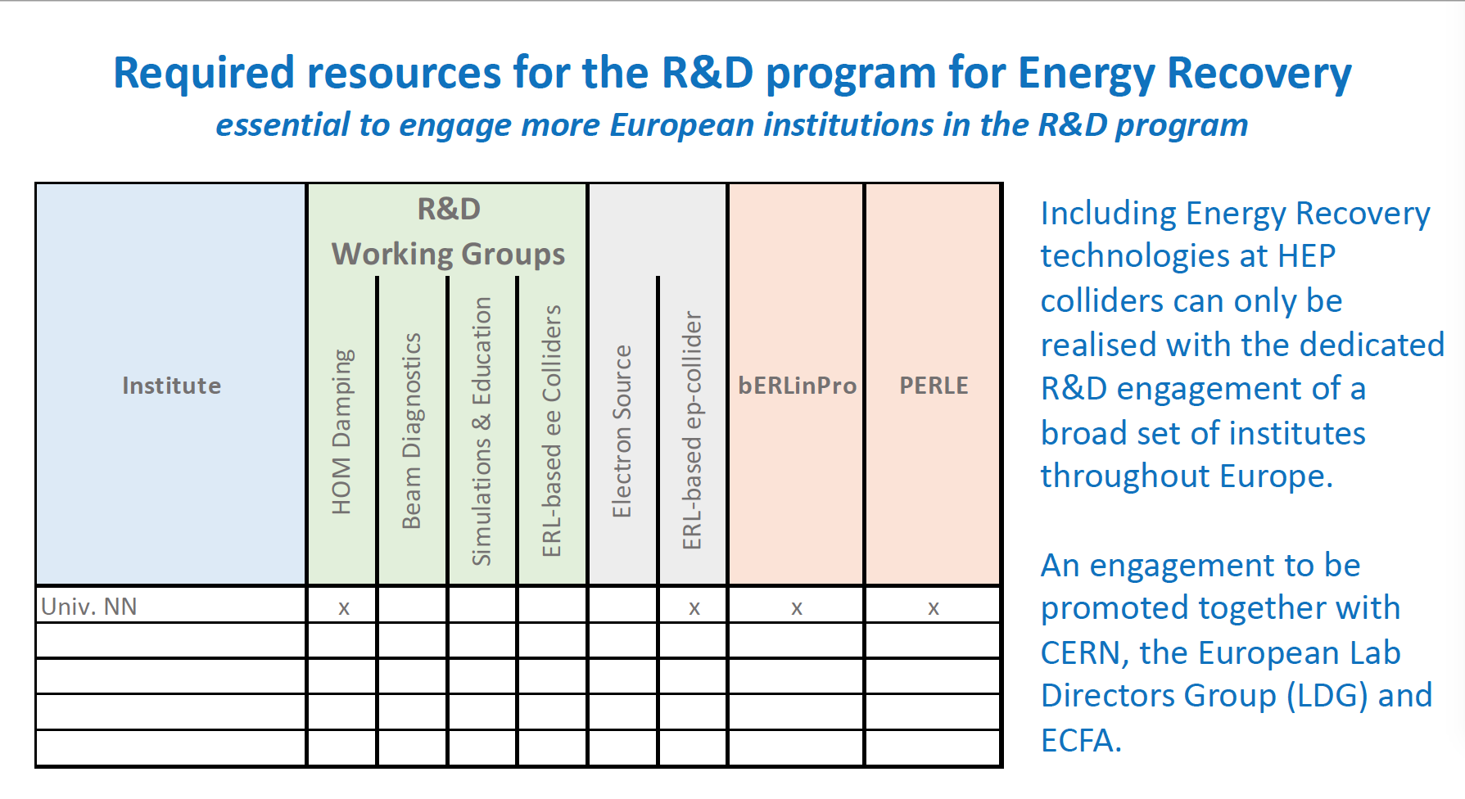

Slide 40
Back-Up

Slide 41
Contents - Facilities
1 Introduction
2 ERL—Facilities and Current Status
  2.1 Completed Facilities
    2.1.1 ALICE at Daresbury
    2.1.2 JLab FEL
    2.1.3 CEBAF Single-pass Energy Recovery Experiment (CEBAF-ER)
  2.2 Ongoing Activities
    2.2.1 CBETA at Cornell
    2.2.2 S-DALINAC at Darmstadt
    2.2.3 cERL at KEK
    2.2.4 Recuperator at Novosibirsk
    2.2.5 MESA
3 ERL—New Facilities in the Twenties
  3.1 bERLinPro
    3.1.1 Goals and expectations
    3.1.2 Revised Focus
    3.1.3 Current Status
  3.2 PERLE at Orsay
    3.2.1 Facility Overview
    3.2.2 Injector
    3.2.3 Accelerator Characteristics
    3.2.4 Prospect
  3.3 CEBAF 5-pass Energy Recovery Experiment
    3.3.1 Modifications to CEBAF
    3.3.2 New path-length chicane
    3.3.3 Longitudinal Match and Considerations
    3.3.4 Momentum Acceptance
    3.3.5 Multi-pass Linac Optics
    3.3.6 New Arc Optics for ER
    3.3.7 Operational Challenges—Diagnostics
    3.3.8 Measurements
  3.4 Electron Cooler at BNL

Slide 42
Contents – Key Challenges
4 Key Challenges—a Concerted Effort
  4.1 Low-Emittance, High-Current Sources
    4.1.1 Electron guns
    4.1.2 High-Current Photocathodes
    4.1.3 Buncher and Booster
    4.1.4 Merger
    4.1.5 Conclusion
  4.2 Challenges of SRF Cavities and Cryomodules
    4.2.1 General Challenges and Concerns
    4.2.2 Coaxial HOM Dampers
    4.2.3 Waveguide HOM Dampers
    4.2.4 Beam Line Absorbers
    4.2.5 Multipacting
    4.2.6 Field Emission
    4.2.7 Frequency Choice
    4.2.8 Cavity Design Choice
    4.2.9 Prospects of New Cavity Surface Treatments and Recipes
  4.3 Multi-turn ERL Operation and the Art of Arcs
    4.3.1 Multi-turn Recirculating Linacs and their Extension to Multi-turn ERLs
    4.3.2 Topology and Recovery Transport Choices
    4.3.3 Arc Lattice Choices
    4.3.4 The Spreader-Arc-Recombiner as a single system
  4.4 ERL Operation Challenges
    4.4.1 Challenges
    4.4.2 Space Charge
    4.4.3 Beam Breakup Instability
    4.4.4 Coherent Synchrotron Radiation
    4.4.5 Microbunching Instability
    4.4.6 Halo
    4.4.7 RF Transients
    4.4.8 Wakefields and Interaction of Beam with Environment
    4.4.9 Magnet Field Quality
    4.4.10 Multi-turn, Common Transport
    4.4.11 A summary of critical open issues
  4.5 Interaction Region
    4.5.1 Interaction with electromagnetic fields
    4.5.2 Fixed targets
    4.5.3 Colliders

Slide 43
Contents Energy and Intensity Frontier Physics
5 Energy and Intensity Frontier Physics
  5.1 High-Energy Colliders
    5.1.1 LHeC and FCC-eh
    5.1.2 CERC: FCC-ee as an ERL
    5.1.3 ERLC: ILC as an ERL
    5.1.4 Photon-Photon Collider
    5.1.5 Electrons and X-rays to Muon Pairs (EXMP)
  5.2 Low-Energy Particle Physics
    5.2.1 Elastic Electron-Hadron Scattering
    5.2.2 Weak Interaction at Low Energy
  5.3 Low-Energy Electron-Ion Scattering
    5.3.1 Introduction, physical and historical contexts
    5.3.2 The Luminosity challenge
  5.4 Photonuclear Physics
    5.4.1 Testing Fundamental Symmetries
    5.4.2 Constraining Nuclear Models
    5.4.3 New Phenomena of Nuclear Collective Modes
    5.4.4 Key Reactions for Stellar Evolution and Cosmic Nucleosynthesis
    5.4.5 Technological and Commercial Applications

Slide 44
Contents Applications, Sustainability and Appendices
6 Applications
  6.1 ERL-Driven High-Power FEL
  6.2 EUV-FEL Semiconductor Lithography
    6.2.1 Example ERL-FEL high-power EUV light source for lithography
    6.2.2 Future prospects
  6.3 ICS Gamma Source
    6.3.1 Non-destructive assay via radiography, nuclear resonance fluorescence and photofission
    6.3.2 Nuclear waste management via photonuclear transmutation
    6.3.3 Medical radionuclide production
    6.3.4 Detector calibration
7 ERLs and Sustainability
  7.1 Power consumption
  7.2 Beam Energy Recovery
  7.3 Technology and Infrastructure
8 Conclusions
Appendix A Overview on ERL Facilities
Appendix B ERL High-Energy e+e- sub-Panel Report
  B.1 Introduction
  B.2 Executive Summary
  B.3 CERC—Vladimir Litvinenko, Thomas Roser, Maria Chamizo-Llatas
  B.4 ERLC—Valery Telnov

