Slide 1
CBB Theme 1/3 Joint Meeting September 30th, 2021
William Li and Cameron Duncan
Cornell University

Slide 2
MEDUSA
Preparing paper for publication on performance of MEDUSA
Motivation
Micron-scale beam sizes at sample with sub-picosecond temporal resolution
Micron-scale beams allow for the exploration of new classes of samples
Still able to keep temporal resolutions on the scale of 100s of femtoseconds

Slide 3
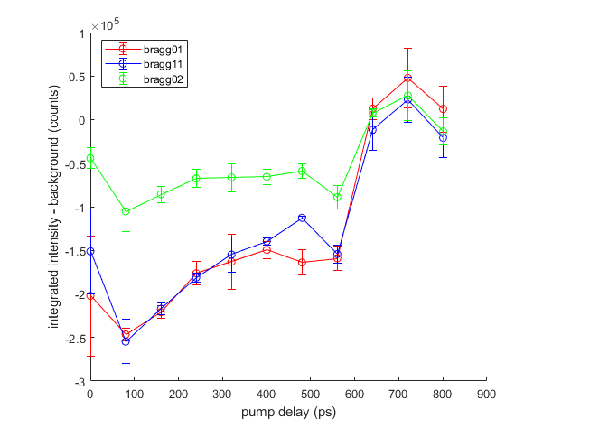
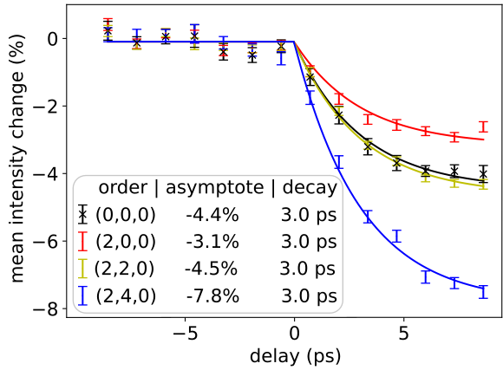
Since April...
April UED data:
Pump position instability led us to increase pump energy beyond sample damage threshold
July UED data
Improved position feedback makes us sensitive to pump energies below damage threshold

Slide 4
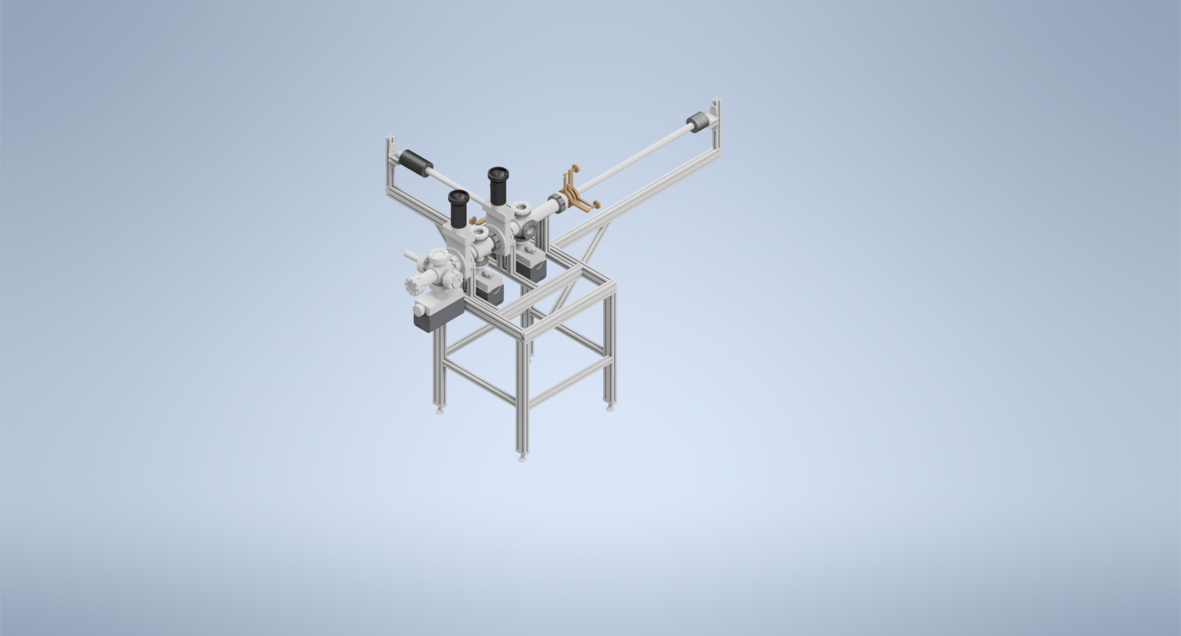
Beamline overview
Cathode transfer system

Slide 5
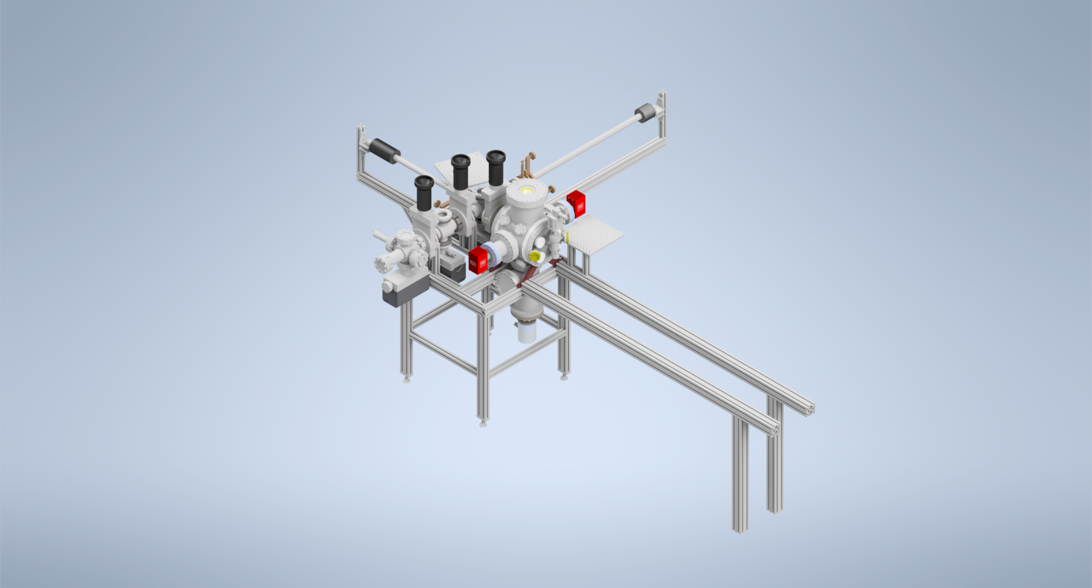
Beamline overview
Gun

Slide 6
Beamline overview
Focusing solenoid

Slide 7
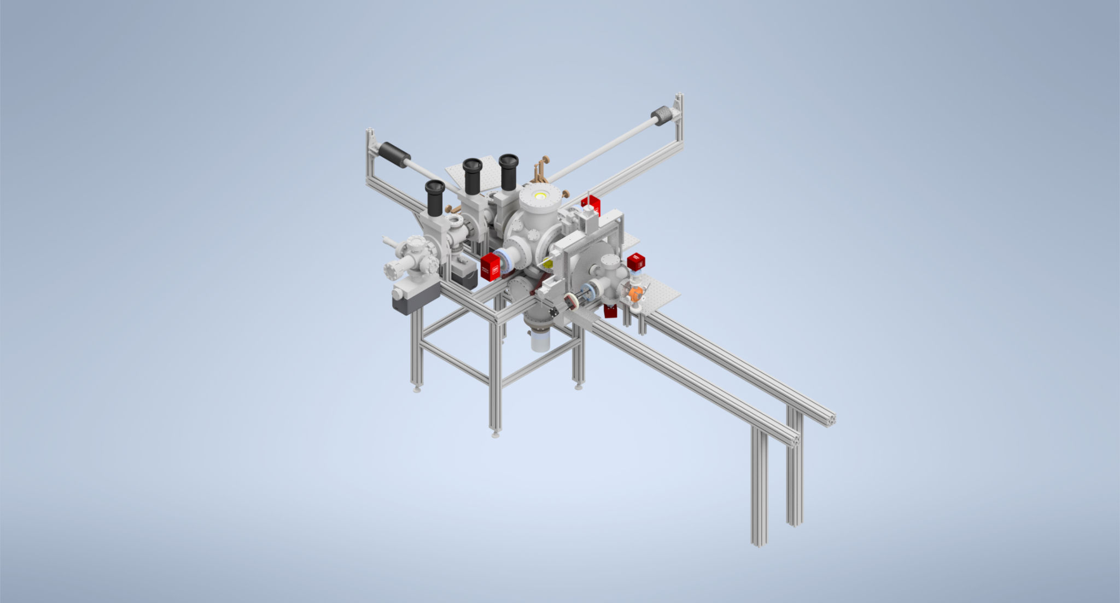
Beamline overview
Viewscreen
Buncher

Slide 8
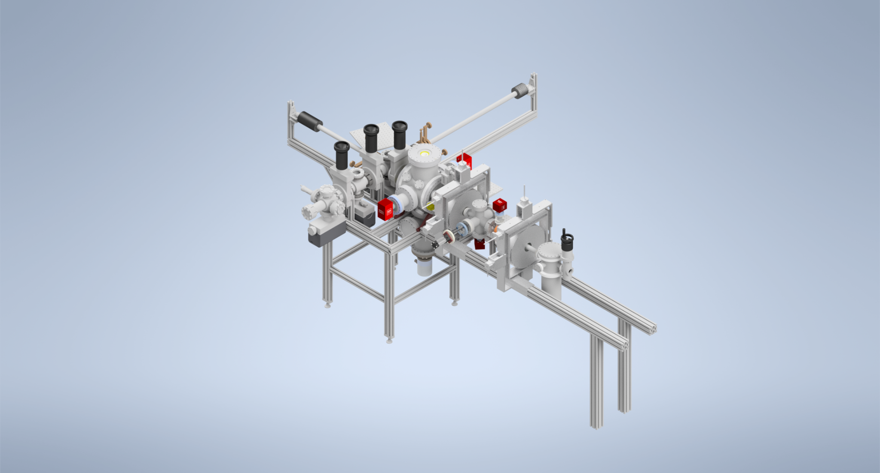
Beamline overview
Second focusing solenoid

Slide 9
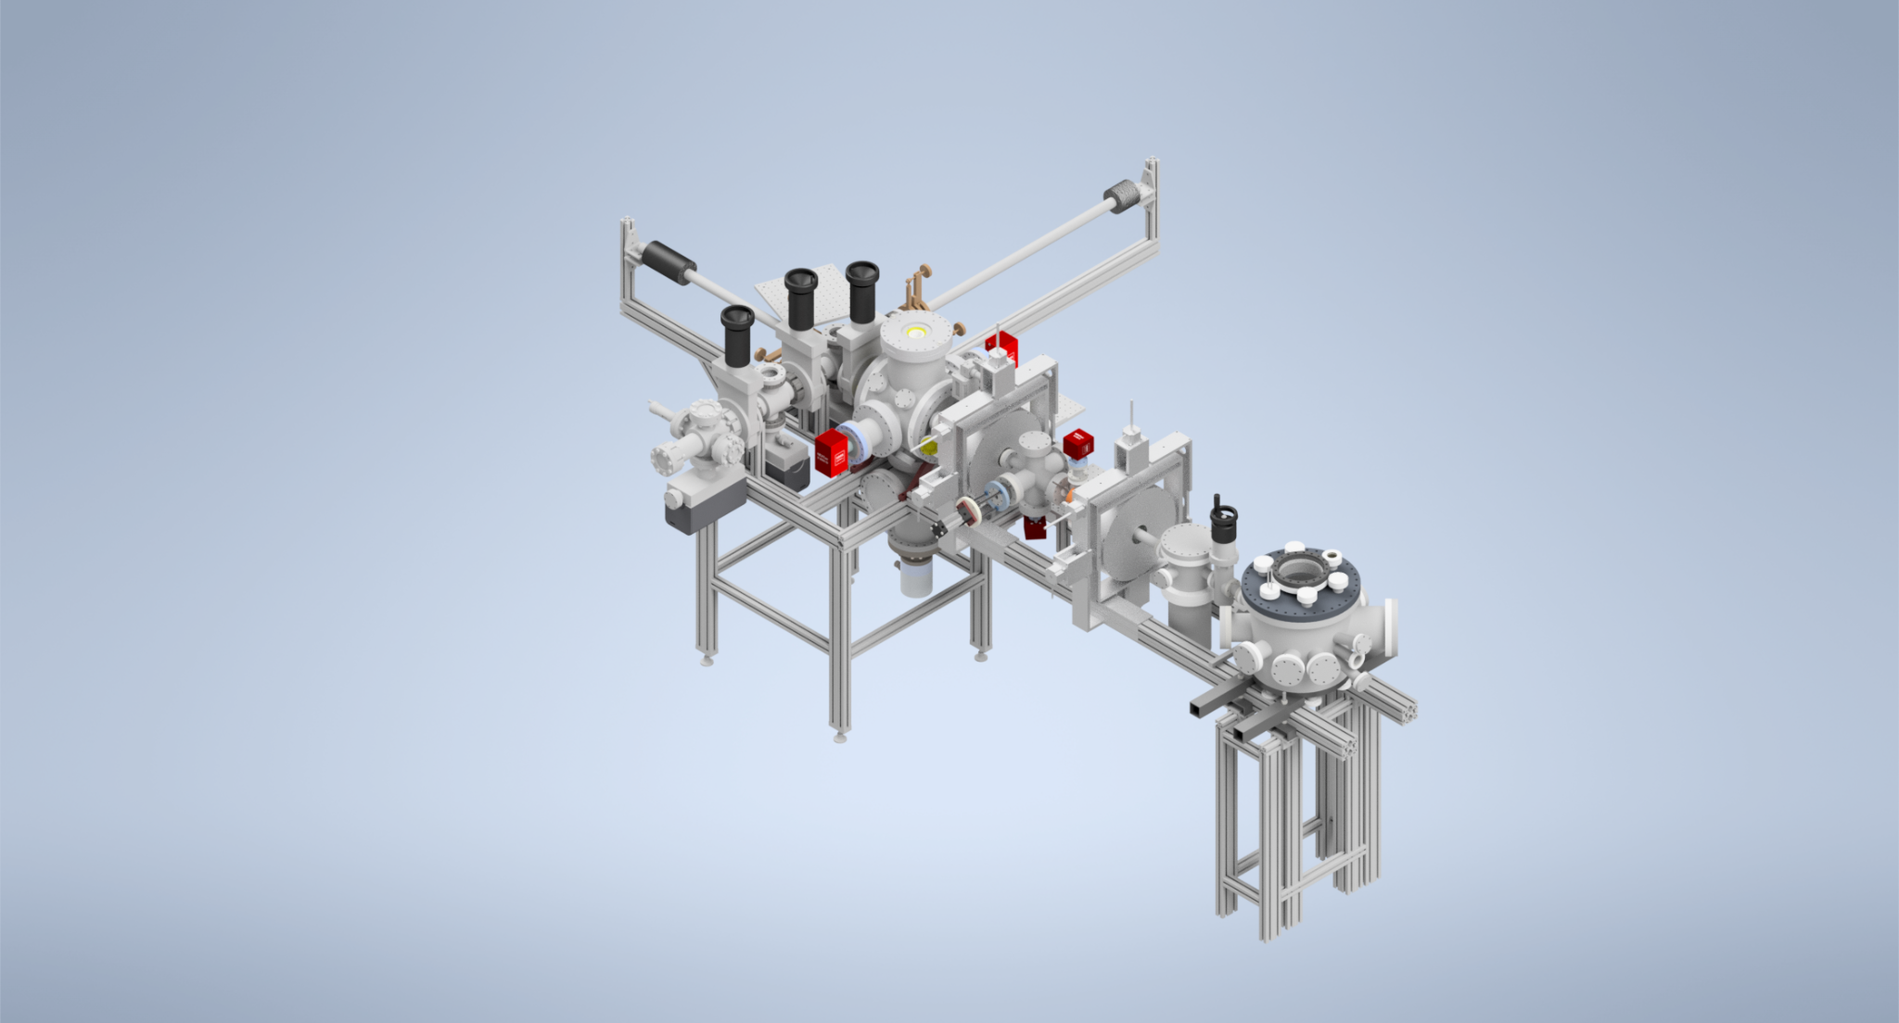
Beamline overview
Sample chamber

Slide 10
Beamline overview
Detector

Slide 11
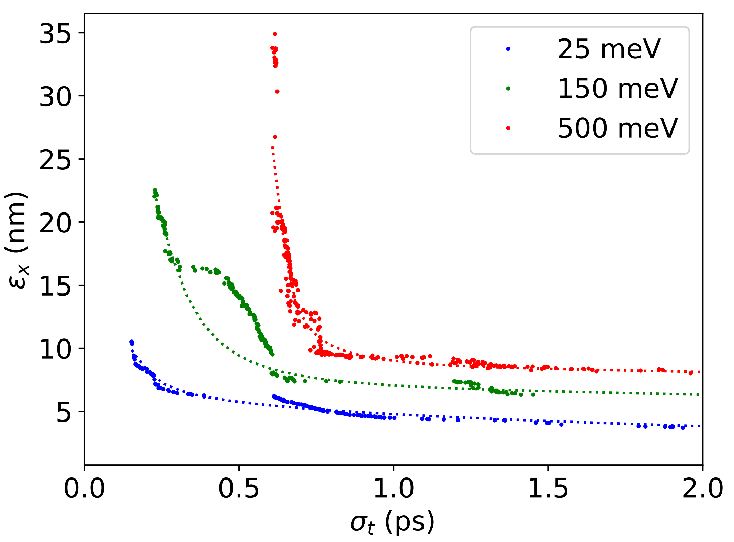
Cathode
NaKSb cathode grown at Cornell
Alkali antimonides have been measured to have high (percent-level) QE and low (~25 meV) MTE
In simulation, decreasing MTE has a noticeable effect on emittance at the sample, around a factor of 2 at sub-picosecond bunches

Slide 12
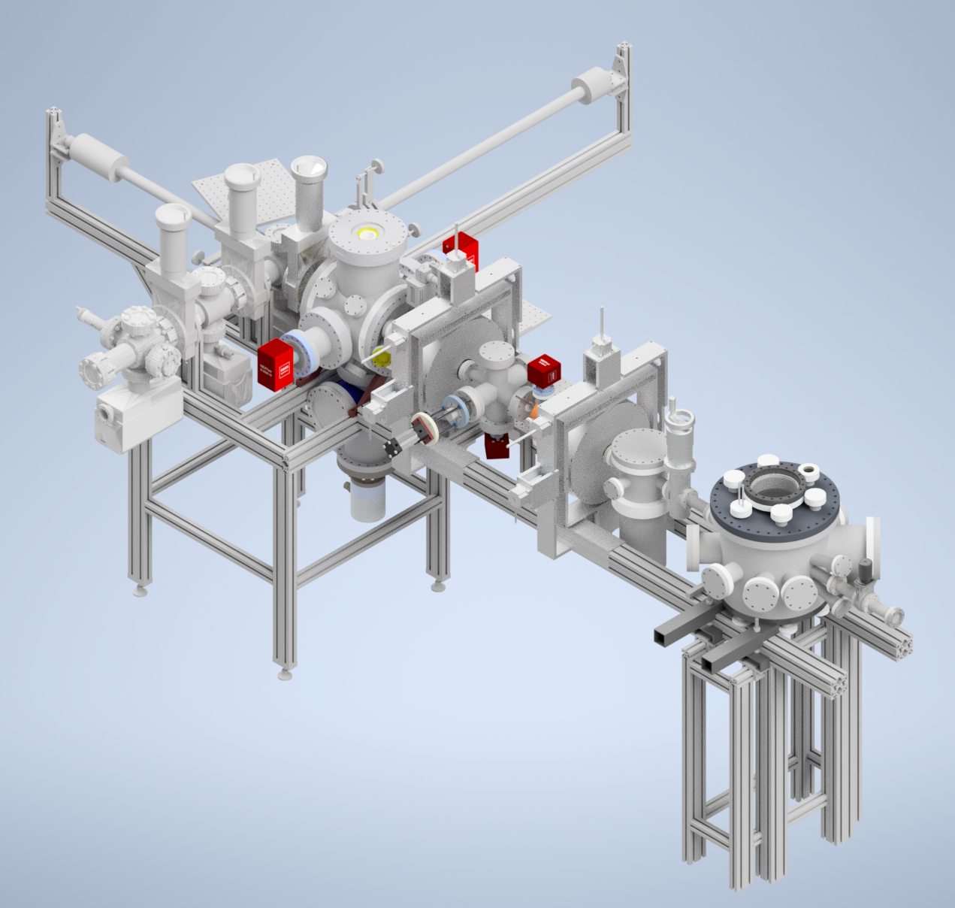
Vacuum
Baking out sample chamber is impractical
Conductance aperture and NEG can between sample chamber and beamline
Gun remains below 10⁻¹¹ Torr even with the sample chamber at 10⁻⁸ Torr.
< 10⁻¹¹ Torr
~3x10⁻¹⁰ Torr
1000 l/s
NEG can
~10⁻⁸ Torr
Vacuum conductance aperture

Slide 13
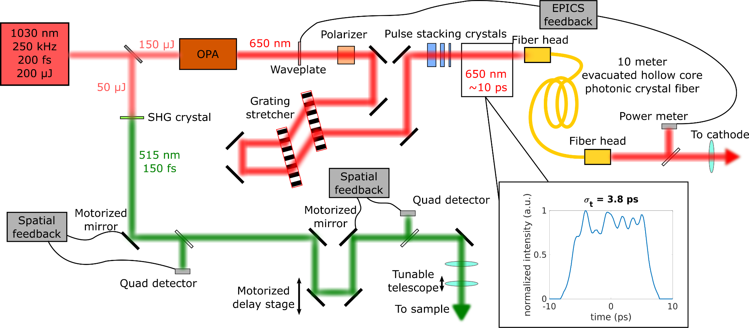
Laser setup
It is advantageous to use the same oscillator for the pump and probe to maintain temporal synchronization between the two
We split a 1030 nm seed, generating 515 nm light for the pump and 650 nm light for the cathode
1030 nm
Oscillator
(50 MHz)
Master RF Clock

Slide 14
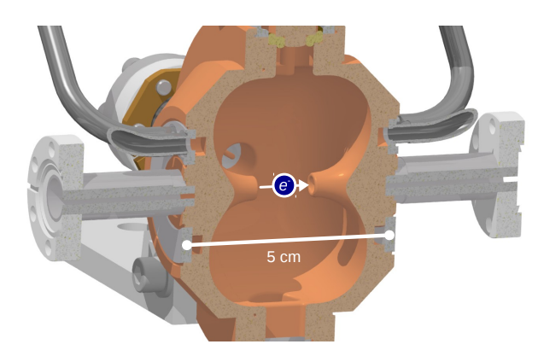
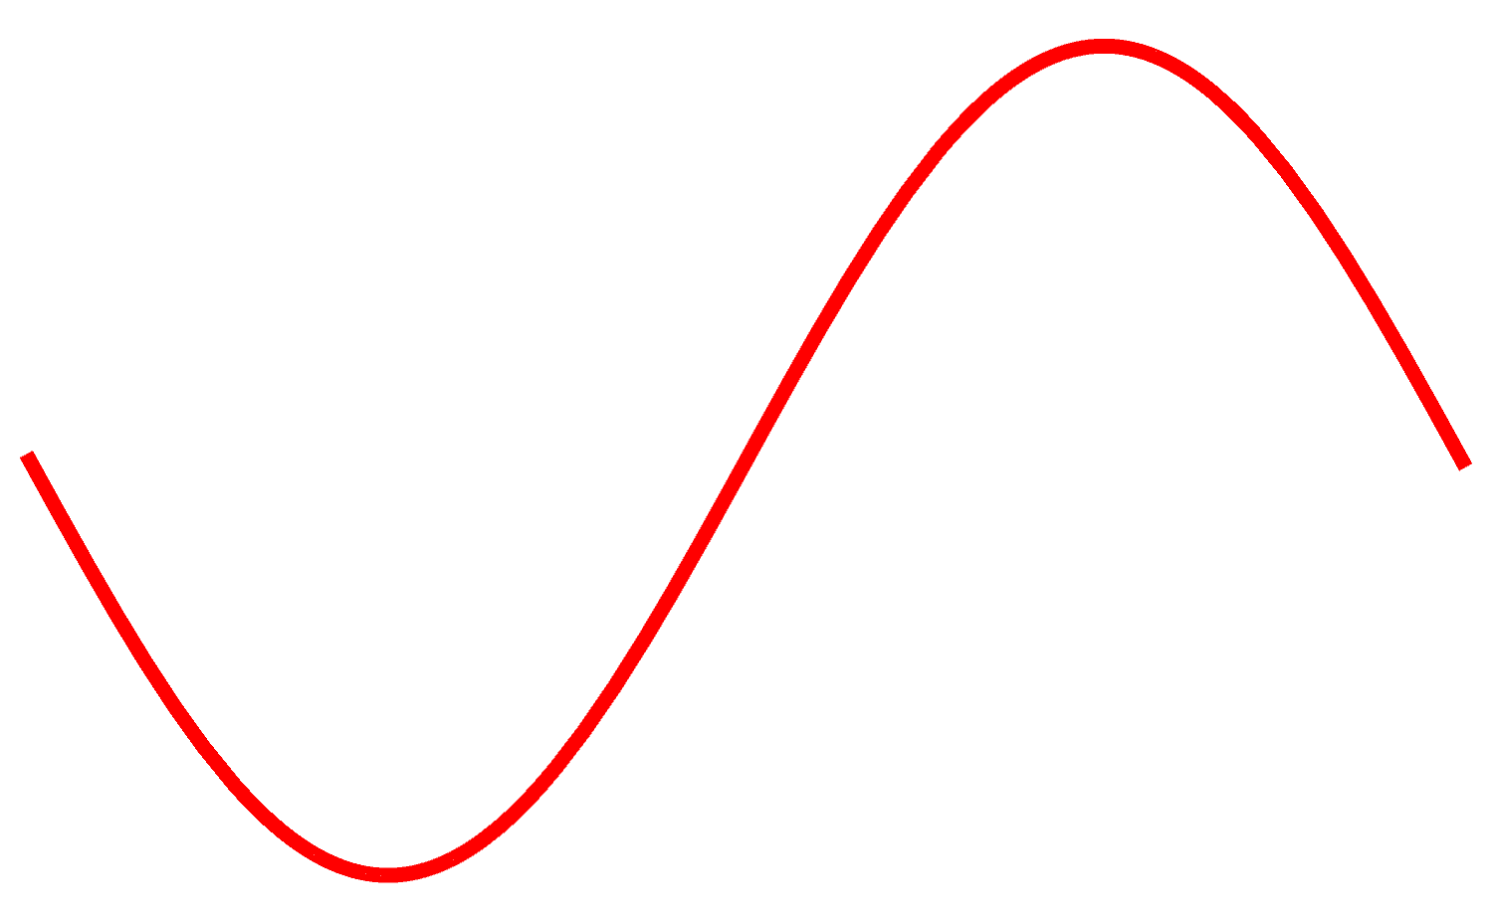
RF buncher
RF clock driven by laser oscillator
3 GHz cavity of Eindhoven design
Phase and amplitude both controlled by PIDs fed back by a field probe
Δp_{z}
Time of arrival

Slide 15
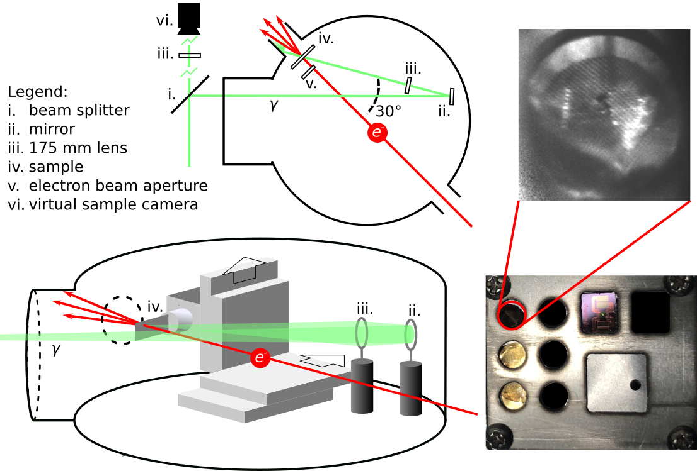
Sample chamber
Chamber viewed from above
Sample as seen by external camera during experiments
Chamber viewed from the side
Image of sample holder out of vacuum

Slide 16
Sample chamber
Chamber viewed from above
Sample as seen by external camera during experiments
Chamber viewed from the side
Image of sample holder out of vacuum

Slide 17
Sample chamber
Chamber viewed from above
Sample as seen by external camera during experiments
Chamber viewed from the side
Image of sample holder out of vacuum

Slide 18
Detector
From sample chamber to detector
Detector screen
Sample plane
45 cm drift distance, no focusing
Two detector modalities
YAG screen with zoom lens,
Higher spatial resolution, useful for emittance measurements
Phosphor screen with large numerical aperture lens,
450 times as many counts for the same current, useful for diffraction experiments
Future detector:
Almost ready to install a direct electron detector for at least an order of magnitude increase in speed and sensitivity

Slide 19
Field cancellation
Linear Research Associates/ETS Lindgren field cancellation system
Uses two Helmholtz coils for each axis to set the field at a probe to 0
DC to >kilohertz
Other two axes not shown
I
I

Slide 20
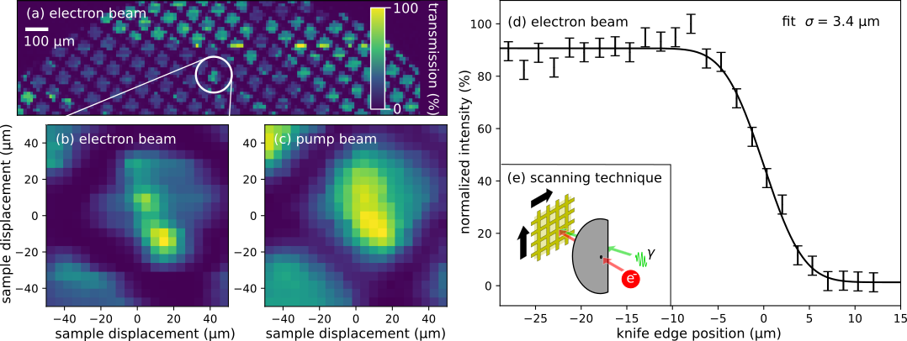
Spatial resolution
10 μm aperture placed just before sample (~1000 electrons through)
We characterize the size of the electron beam in two different ways
TEM grid scan (a)-(c)
Also gives us spatial overlap with pump beam
Direct knife edge scan (d)

Slide 21
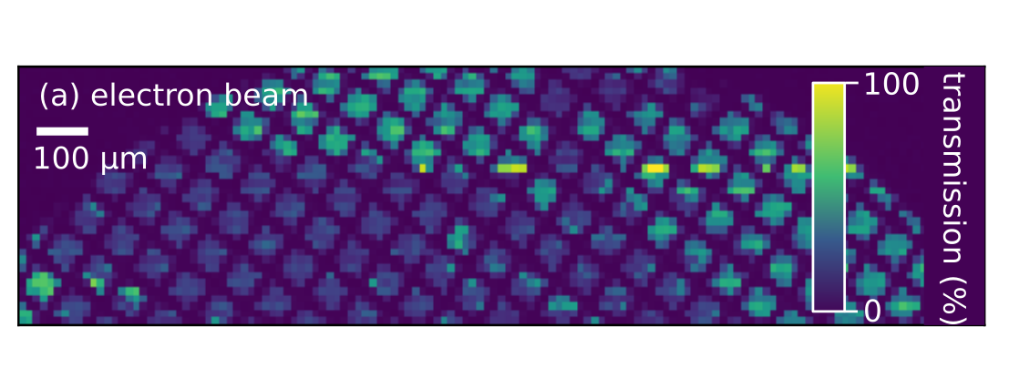
Spatial resolution
Average of 780 TEM grid squares
Single TEM grid squares
Single TEM grid square
Transmission scan of TEM grid

Slide 22
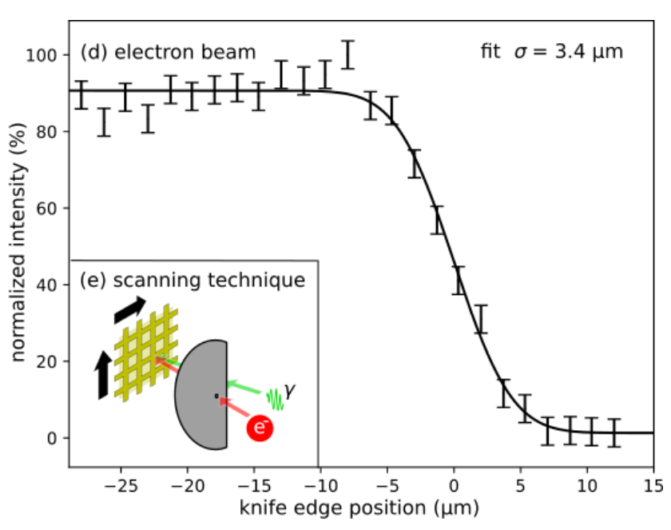
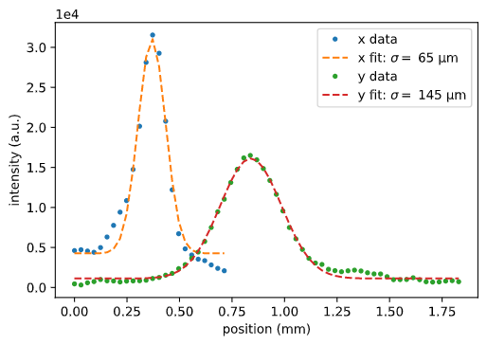
Emittance
At waist,
For the ~1000 electrons passing through aperture: 0.7 nm normalized emittance!
Size measured with knife edge
Momentum spread measured with size on final screen

Slide 23
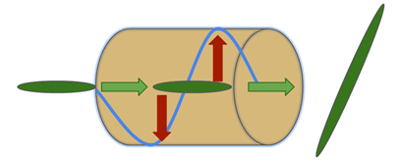
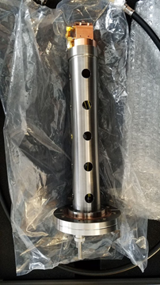
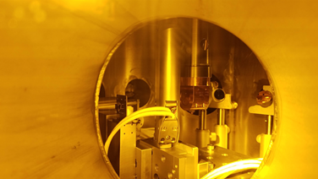
Temporal resolution
Two components: time of arrival stability and bunch length
Can measure both with deflector
These measurements were done with no aperture

Slide 24
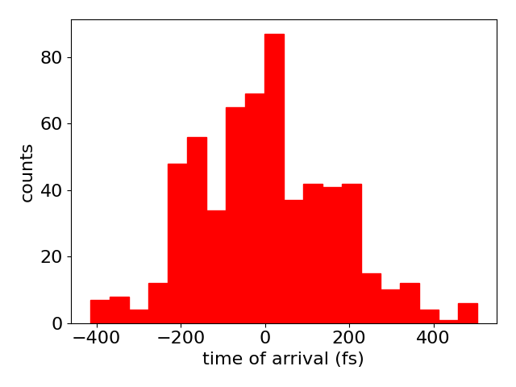
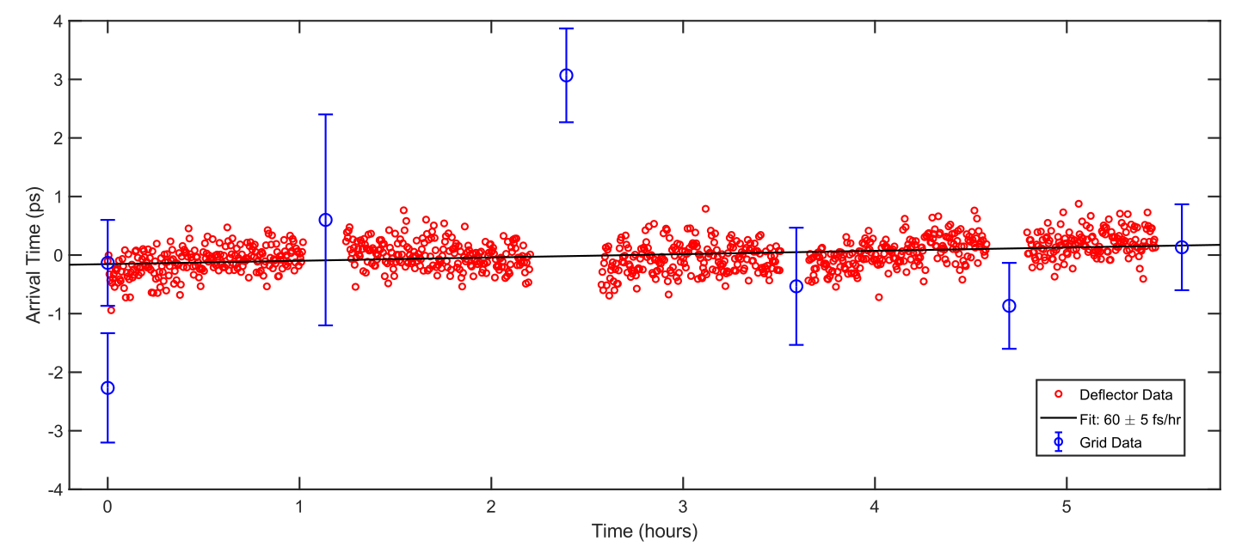
Time of arrival
Time of arrival jitter is deflected into a centroid jitter
We can measure both the short- and long-term stability of the time of arrival
Short term jitter: 170 fs
Long term drift: 60±5 fs/hr
We can measure time of arrival with the TEM grid as well (more later)
Notes:
jmm comment: long term drift needs an error bar. It’s essentially consistent with zero.

Slide 25
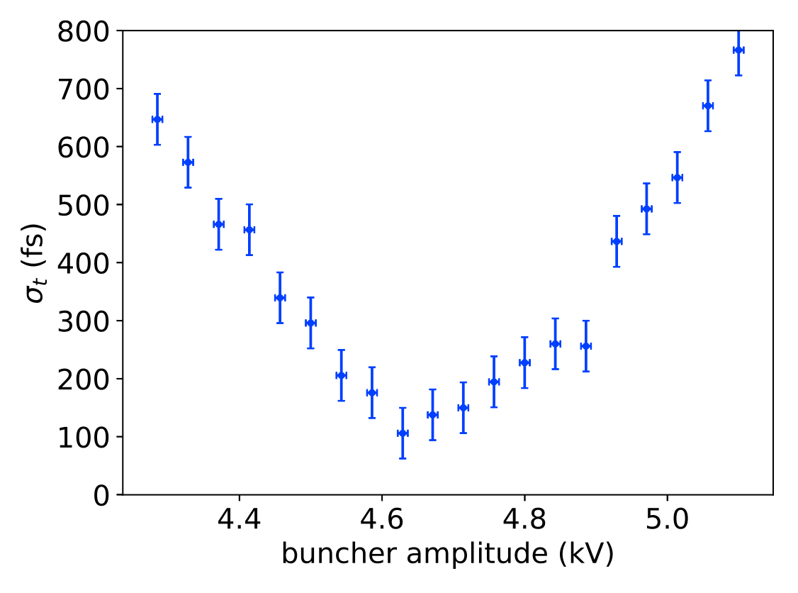
Bunch length
The bunch length can be obtained by measuring the beam size along the deflected axis.
Reduced minimum bunch length by factor of 4 from April! Pulse stacking crystals drastically improved initial longitudinal profile
10 fC forward charge
Minimum: 100±50 fs

Slide 26
Synchronizing Pump and Probe
cf. Scoby, Ultramicroscopy, 127, 14-18 (2013)
Pump laser
Copper target
Detector screen
Primary electron beam
Rutherford scattering
Shadow of emission region
Electrons photoemitted from copper target

Slide 27
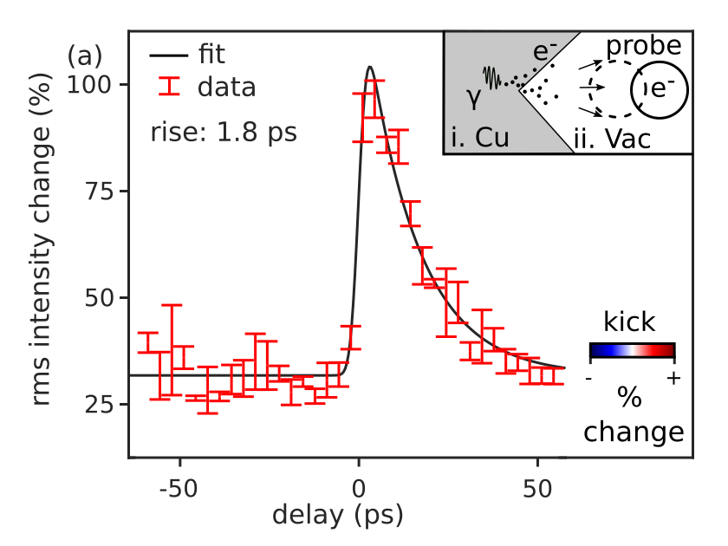
Synchronising Pump and Probe

Slide 28
Gold UED
Signal S is the relative change in intensity I:
I - I
hot
cold
S =
I
cold
In our experiment, |S| ~ 1%

Slide 29
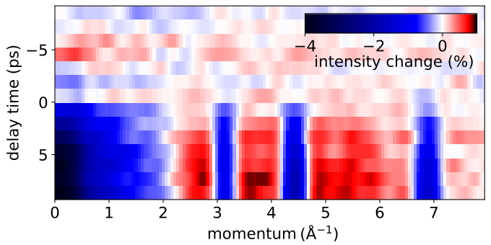
Gold UED
average over θ
θ
momentum

Slide 30
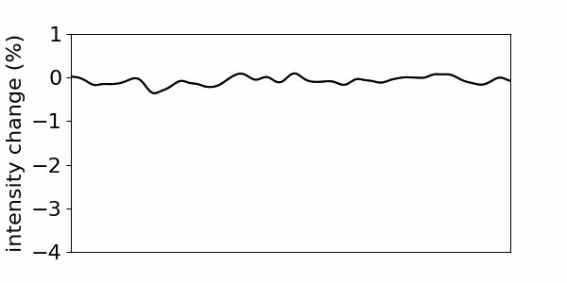
Gold UED
average over θ
θ
momentum

Slide 31
Gold UED
average over θ
θ
momentum
Data taken at:
◦ 5 kHz repetition rate ◦ 100 exposures per delay
◦ 5 s exposures ◦ 100 < e⁻ per shot < 1000

Slide 32
Gold UED
In thermal equilibrium,
2
S ∝ -k ∆T
(2,0,0)
(2,4,0)
(0,0,0)
k
(2,2,0)
We don’t see this quadratic dependence on k, and our decay time fit implies too low a ∆T.
Sample doesn’t reach equilibrium.

Slide 33
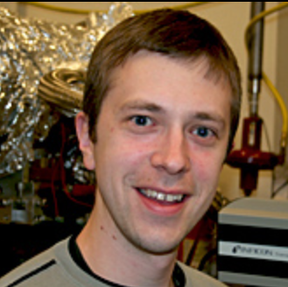
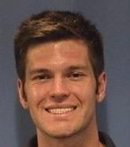
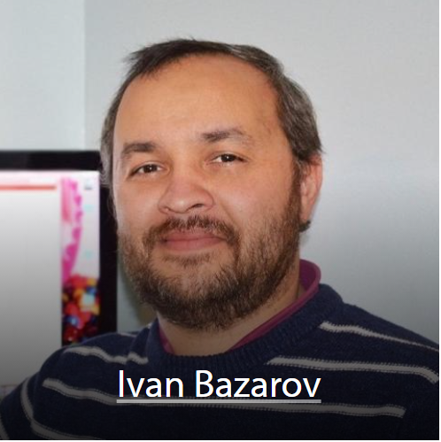
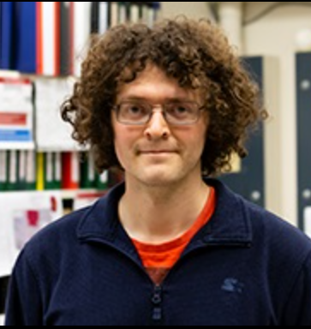
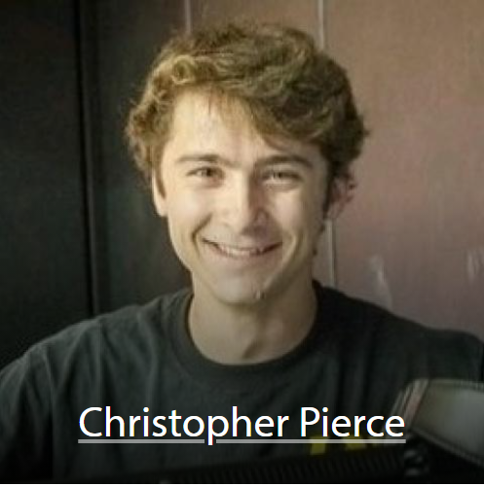
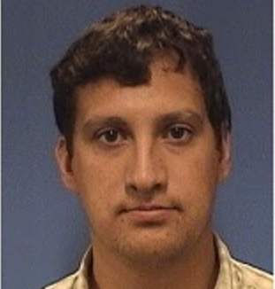
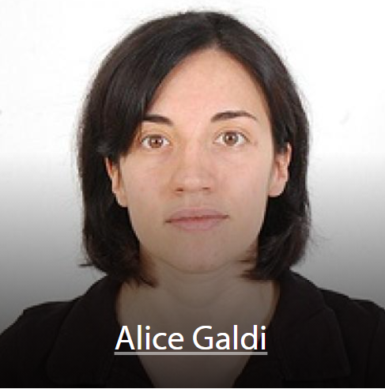
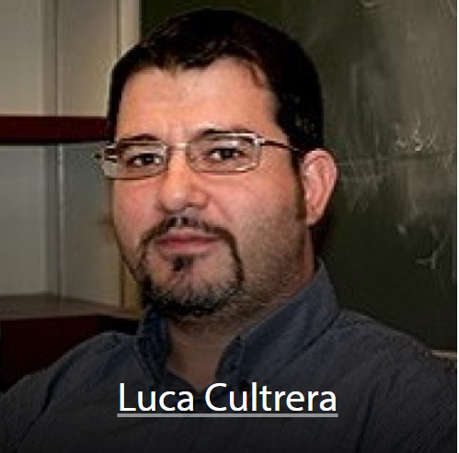
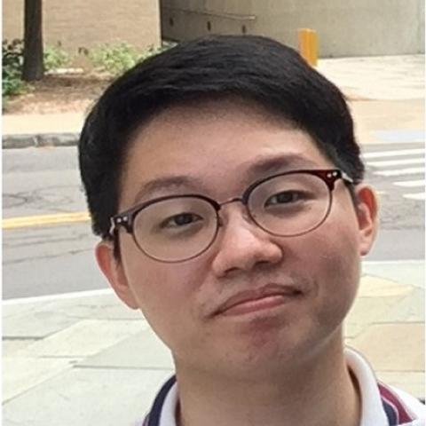
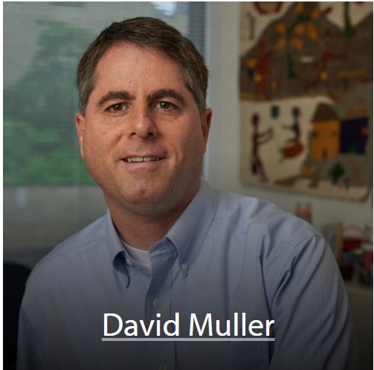
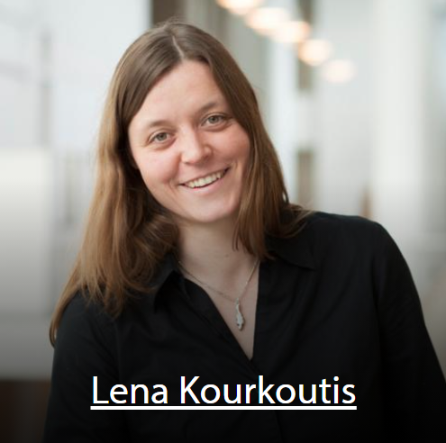
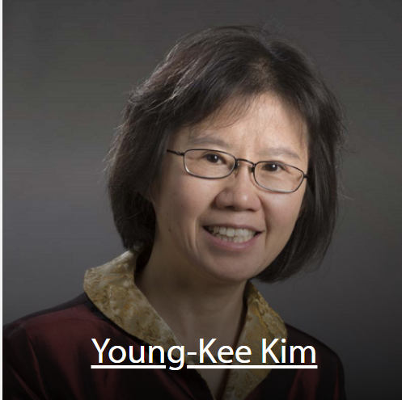
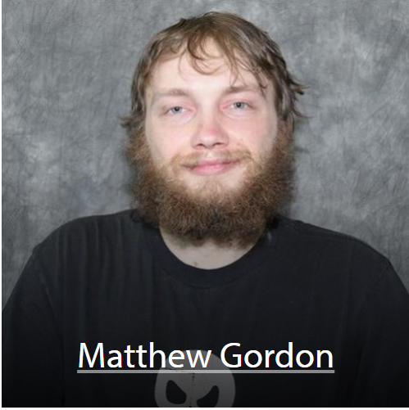
Acknowledgements
Maxson Group
Bazarov Group
Jared Maxson
Adam Bartnik
Chad Pennington
Matthew Andorf
Mike Kaemingk
Jai Kwan Bae
Now at U. Salerno.
Now at BNL
Cornell Electron Microscopy
U. Chicago Beam Dynamics
‹#›

Slide 34
Conclusion
The MEDUSA beamline has demonstrated the ability to measure UED signals
Major improvements since April have made UED signals much easier to see
Performance specs below:
Beam energy | 140 keV
Cathode spot size | Down to 15 μm rms
Charge on target | 0.16 fC
Beam size on target | <5 μm rms
Normalized emittance on target | <1 nm-rad
Bunch length | ~100 fs rms
Pump fluence | Up to 1 J/cm²
Pump size | Down to 10 μm rms

