Slide 1

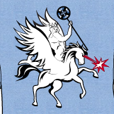


Markov Chain Monte Carlo Sampling for Solenoid Scan Analysis
Particle Beam Physics Laboratory
Frederick “Eric” Cropp
In Collaboration With T. Sutter, Y. Park, A. Ody, P. Denham, A. Kogar, D. Filippetto and P. Musumeci
Notes:
Introduce title and thank funding agencies (slide 1)

Slide 2
Outline
Introduction to Markov Chain Monte Carlo (MCMC)
  The Inverse Problem
  Background
  Advantages and Disadvantages of MCMC
  Mathematical Background
  Surrogate Modeling with MCMC
Application to HiRES Data
  Introduction to HiRES
  Surrogate Model Details
  In Simulation
  Real data and comparison with Fmincon

Slide 3
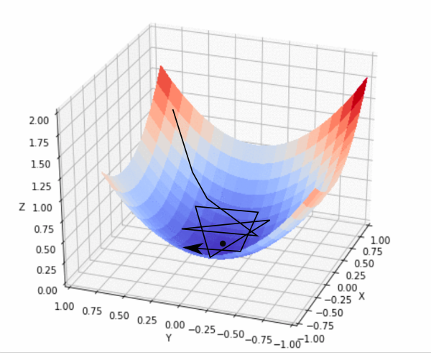
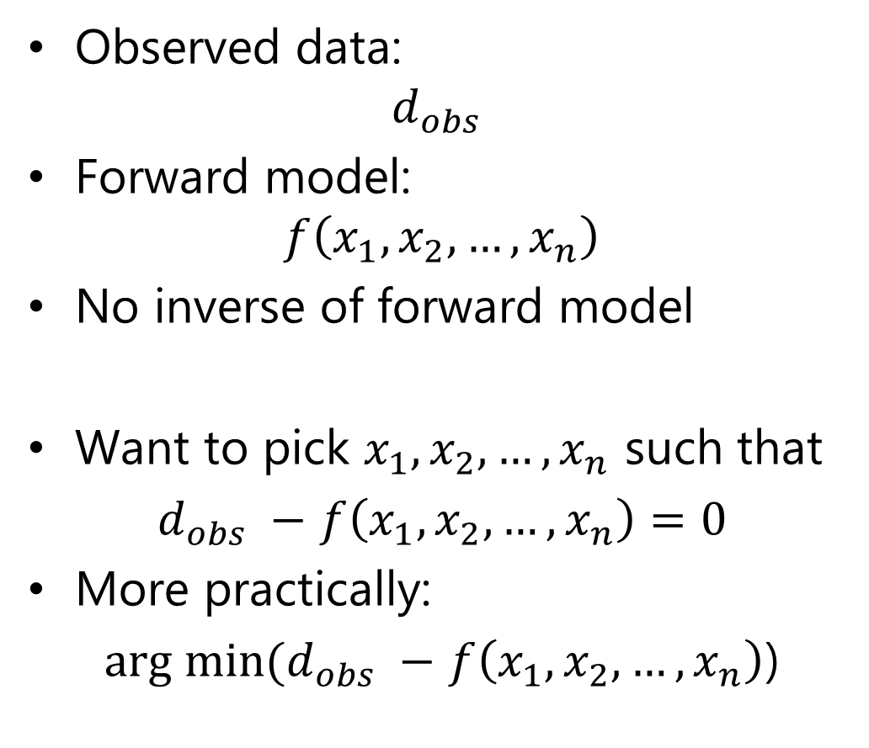
The Inverse Problem
Observed data:
$d_{obs}$
Forward model:
$f\left(x_{1},x_{2},…,x_{n}\right)$
No inverse of forward model
Want to pick $x_{1},x_{2},…,x_{n}$ such that
$d_{obs} −$ $f\left(x_{1},x_{2},…,x_{n}\right)=0$
More practically:
${arg min⁡(d}_{obs} −$ $f\left(x_{1},x_{2},…,x_{n}\right)$)
https://blog.paperspace.com/intro-to-optimization-in-deep-learning-gradient-descent/

Slide 4
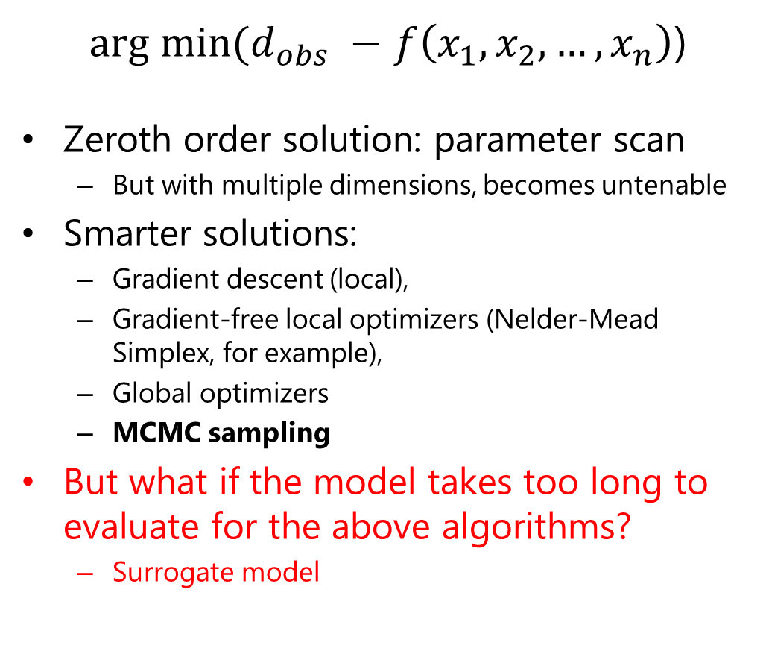
The Inverse Problem
${arg min⁡(d}_{obs} −$ $f\left(x_{1},x_{2},…,x_{n}\right)$)
Zeroth order solution: parameter scan
  But with multiple dimensions, becomes untenable
Smarter solutions:
  Gradient descent (local),
  Gradient-free local optimizers (Nelder-Mead Simplex, for example),
  Global optimizers
  MCMC sampling
But what if the model takes too long to evaluate for the above algorithms?
  Surrogate model
https://blog.paperspace.com/intro-to-optimization-in-deep-learning-gradient-descent/

Slide 5
Markov Chain Monte Carlo (MCMC) Background
Sampling, not fitting
  Predict posterior distributions, not singular points
Used in many fields inside and outside physics (e.g. [1-4])
  For example
    Astronomy
    Cosmology
    High Energy
    Public Health
Relative to other fields, underutilized in accelerator and beam physics
[1] B. Macintosh, J. Graham, P. Ingraham, et al., First light of the Gemini Planet Imager, Proc. Natl. Acad. Sci. U.S.A. 111 (35) 12661-12666 (2014)
[2] J. L. Bernal, L. Verde and A. G. Riess, The trouble with H0, J. Cosmol. Astropart. Phys. 19 (2016)
[3] J. E. Bernhard, J. S. Moreland, S. A. Bass, J. Liu, and U. Heinz, Applying Bayesian parameter estimation to relativistic heavy-ion collisions: Simultaneous characterization of the initial state and quark-gluon plasma medium, Phys. Rev. C 94, 024907 (2016)
[4] W. C. Roda, M. B. Varughese, D. Han, M. Y. Li, Why is it difficult to accurately predict the COVID-19 epidemic? Infect. Dis. Model. 5:271-281 (2020)

Slide 6
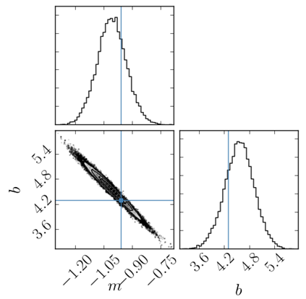
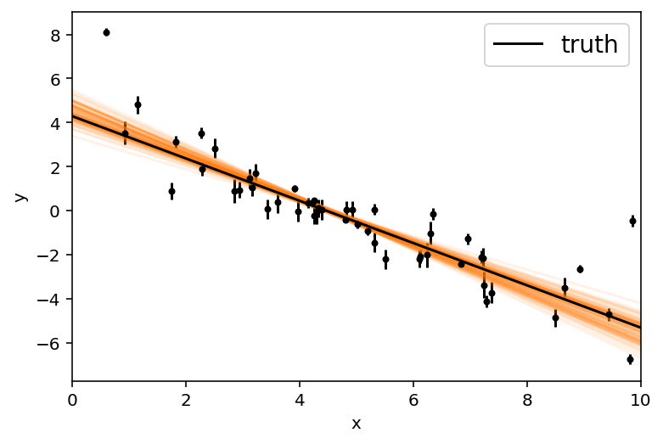
Advantages and Disadvantages of MCMC
Advantages
Disadvantages
Posterior probability distribution of model parameters given
  Covariance & correlations
  Error estimation
  Faster than optimization for certain non-convex optimization problems [5]
Generally slower than optimization
[5] Y. A. Ma et al. PNAS 116 (42) 20881-20885 (2019)
Figures adapted from https://emcee.readthedocs.io/

Slide 7
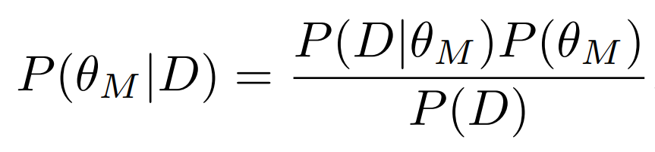
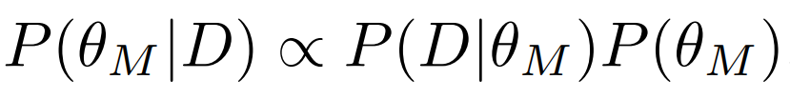
Description of Markov Chain Monte Carlo
Make use of MCMC sampling algorithms to sample the space to evaluate posterior probability at each point
“Markov chain” allows each walker to settle to maximum posterior probability
Framework leads to easy error estimation in parameter space
Likelihood function
Prior probability
Posterior probability
(probability of model parameters given evidence)
Probability of evidence: often neglected – posterior estimated without this term

Slide 8
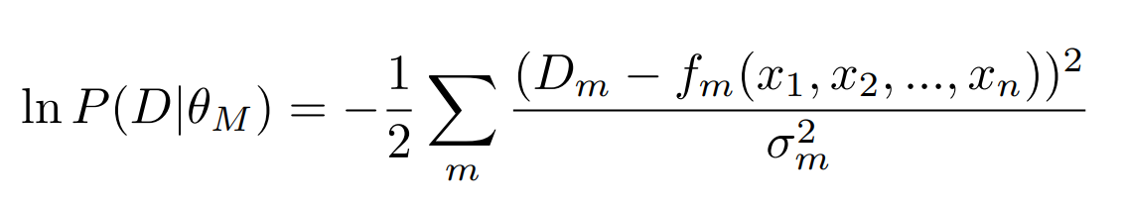
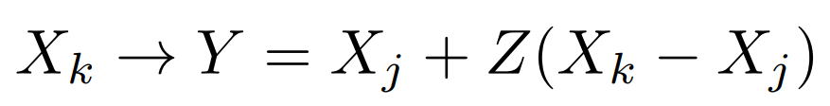
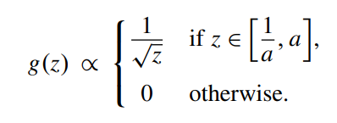
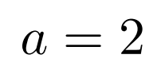
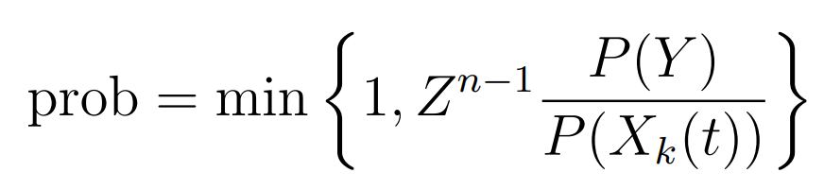
Algorithm Details
Posterior probability
(probability of model given evidence)
Likelihood function:
Prior probability
  Limits of the sampling
Markov chain: future step depends only on current step
Initialize walkers and have them update based on probability of proposed move
  Goodman and Weare algorithm [7] (instead of Metropolis-Hastings) [8]
  Many walkers
Prior probability
Likelihood function
Proposal:
Choose:
Acceptance Probability:
[7] J. Goodman and J. Weare, Communications in applied mathematics and computational science 5, 65 (2010)
[8] W. Hastings, Biometrika, 57: 97–109 (1970)

Slide 9
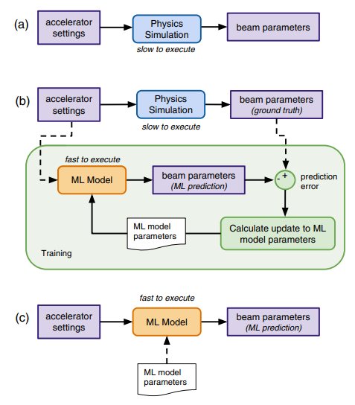
Surrogate Modeling
Make a (limited), fast executing copy of the model: the “surrogate model”
Often accomplished using a neural network
  Simply predicts the output of the model given its input
Fast, efficient
  Training data creation can be parallelized
  Can use fewer model evaluations for training data than in optimization [6]
[6] A. Edelen, N. Neveu, M. Frey, Y. Huber, C. Mayes, and A. Adelmann Phys. Rev. Accel. Beams 23, 044601 (2020)

Slide 10
Example Problem and the Prescription
Example problem
The prescription
HiRES (LBNL) gun: matching GPT simulation to real data
Find the following parameters based on beam second order moments in solenoid scan:
  Cathode MTE
  Beam energy
  Solenoid quadrupole moment
  Solenoid skew quadrupole moment
  Cathode recession depth
Run GPT in parallel for rough parameter scan
Train NN surrogate model
MCMC sampling of surrogate model to match model to data

Slide 11
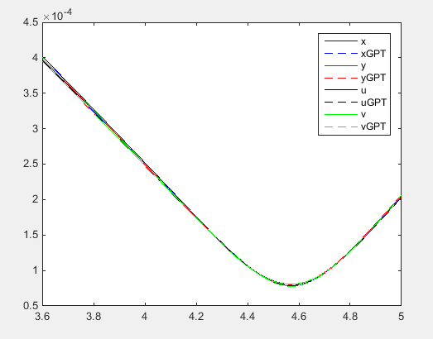
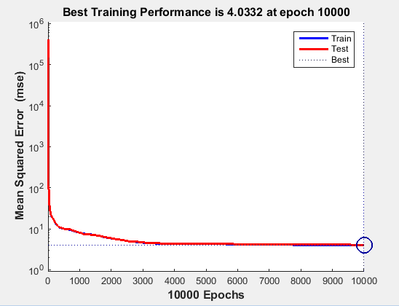
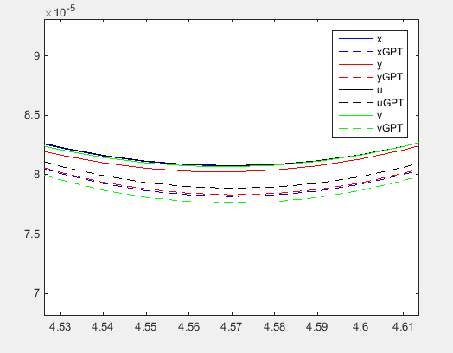
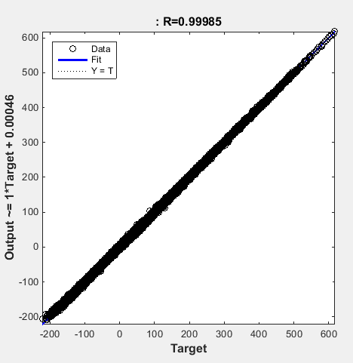
The Surrogate Model
~20k training data points (70%/20%/10% train/validation/test)
  10 input parameters for each
    Cathode MTE
    Beam energy
    Solenoid quadrupole moment x2
    Solenoid skew quadrupole moment x2
    Cathode recession depth
    VCC xrms
    VCC yrms/xrms
  4 output parameters for each
    x, y, u, v second moments (u, v in 45 degree rotated frame)
  Feed forward, fully connected network
    6 hidden layers
    10 neurons each
    Tanh activation

Slide 12

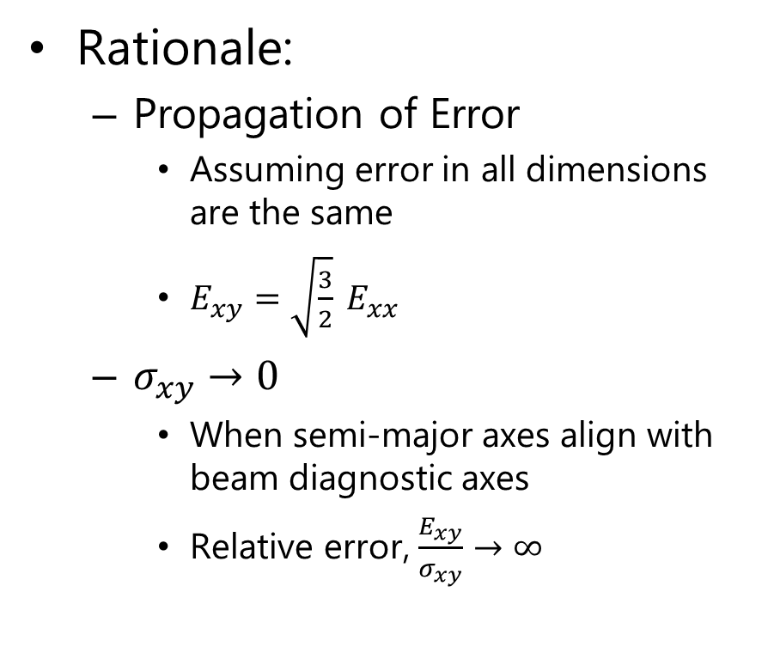
Using Rotated Projections
CCW Rotation of Images; CW Rotation of Coordinates
(x,y)→(u,v) in rotated frame
a
U-V uniquely determine xy (angle) term
Without need for 2-D fit
Rationale:
  Propagation of Error
    Assuming error in all dimensions are the same
    $E_{xy}=\sqrt{\frac{3}{2}} E_{xx}$
  $σ_{xy}→0$
    When semi-major axes align with beam diagnostic axes
    Relative error, $\frac{E_{xy}}{σ_{xy}}→∞$

Slide 13
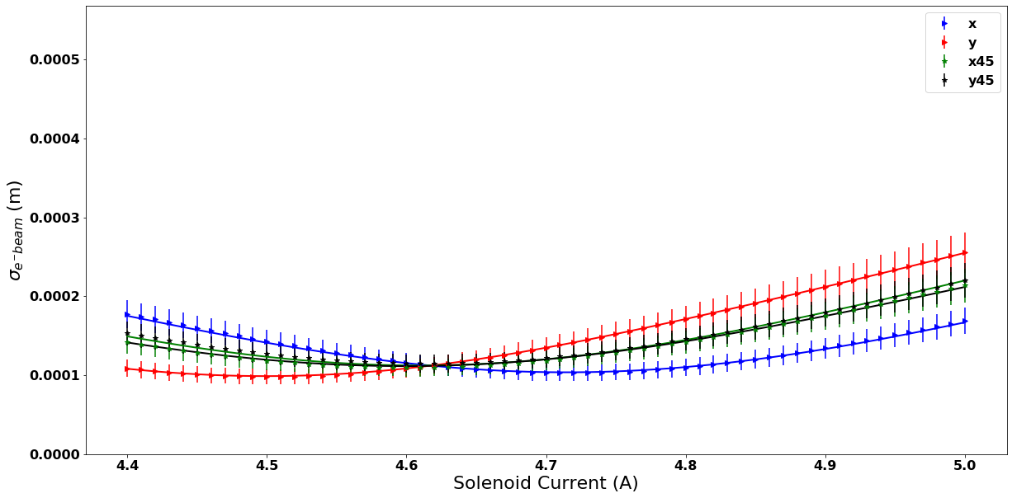
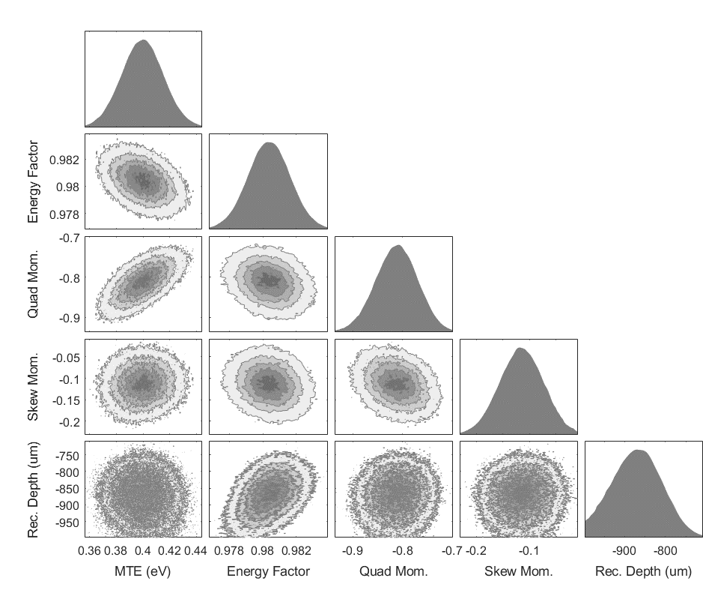
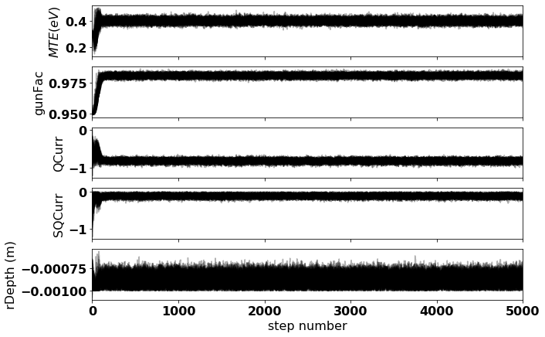
Proof of Principle: Simulated MCMC Sampling
Left: Plot of posterior distributions
Right: Plot of simulated solenoid scan using MCMC mean values (with simulated data for comparison)
MTE (eV)
0.40+/-0.02
gunFac
0.980+/-0.001
Simulated in GPT with:
MTE=0.4
gunFac=0.98
Qcurr=-0.8
SQCurr=-0.1
rDepth=-850e-6
QCurr
-0.81+/-0.04
Simulated “error”: 10%
SQCurr
-0.11+/-0.04
rDepth (m)
-870e-6+/-61e-6

Slide 14
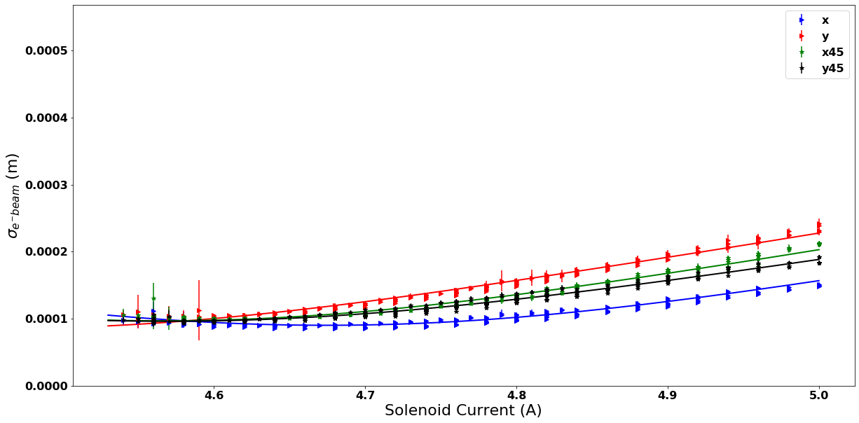
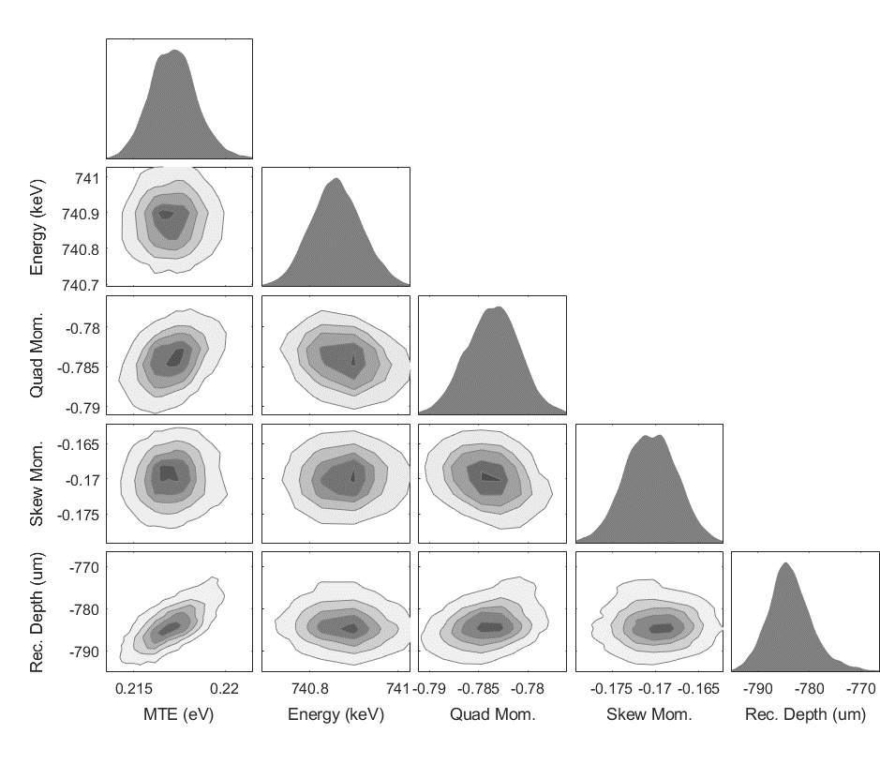
Comparison with Interior Point Method (Fmincon)
Below: Plot of posterior distributions
Right: Plot of simulated solenoid scan using MCMC mean values (with data for comparison)
Parameter | Fmincon Value | MCMC Mean | MCMC Error
MTE (eV) | 0.217 | 0.217 | 0.001
gunFac | 0.9878 | 0.9878 | 0.0001
QCurr | -0.784 | -0.784 | 0.003
SQCurr | -0.170 | -0.171 | 0.003
rDepth (m) | -785e-6 | -784e-6 | 4e-6

Slide 15
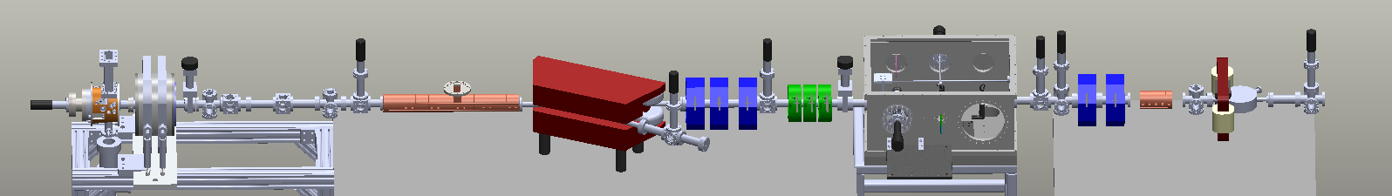
In Parallel Work
Application to other beamlines
  Pegasus (UCLA)
  HyRes (UCLA)
Selection of better “knobs” to show correlations
Verification of error analysis

Slide 16
Conclusion
MCMC is a well-established algorithm, often used for to solve the inverse problem
Fundamentally different than optimization; several advantages
  Covariance and correlations
  Error analysis
Showed its viability in simulation
Showed work in progress on HiRES data analysis

Slide 17
Questions

