Slide 1
HOM damping schemes for the FCC-ee cavities
by Shahnam Gorgi Zadeh
Acknowledgements: Dr. Rama Calaga and Prof. Dr. Ursula van Rienen

Slide 2
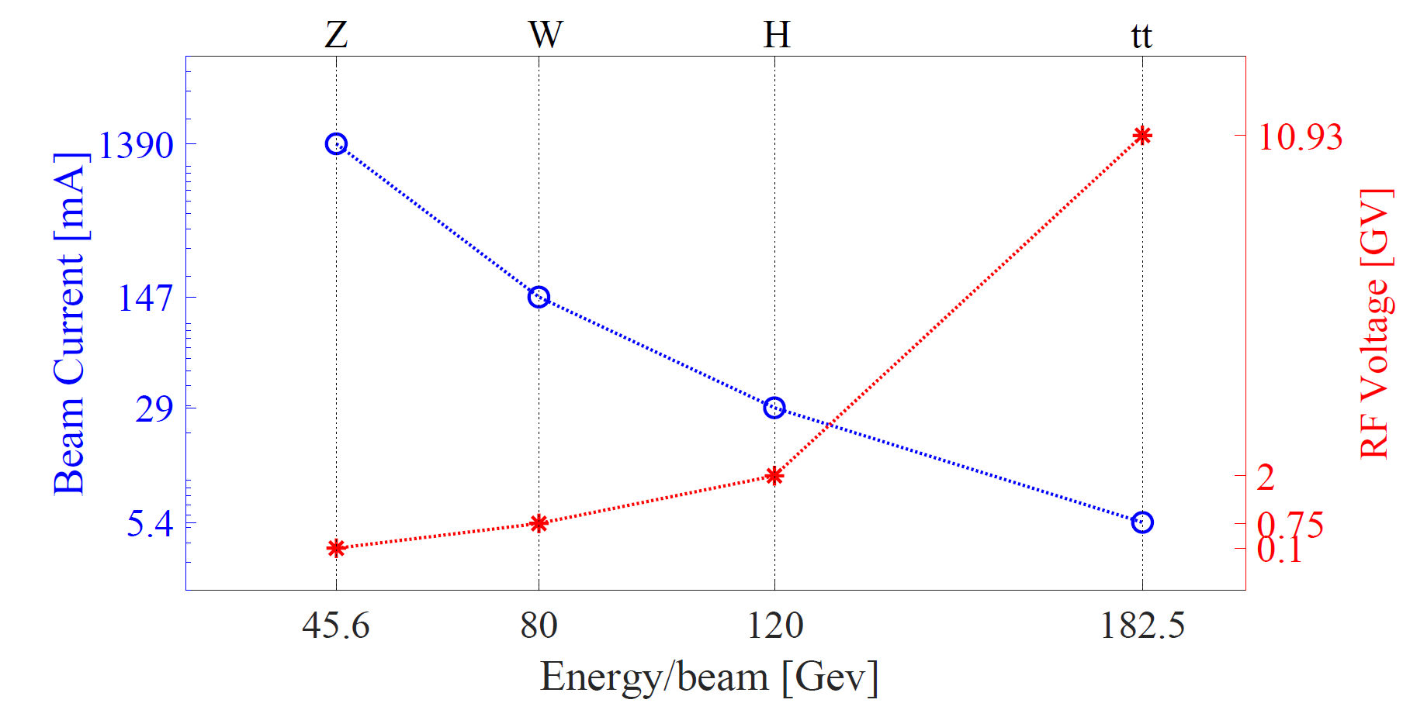
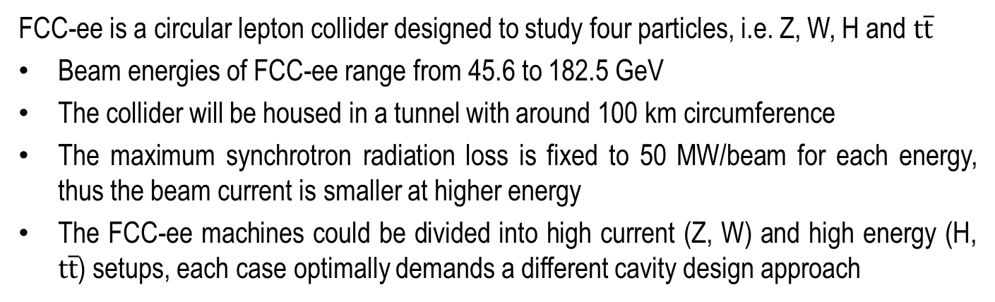
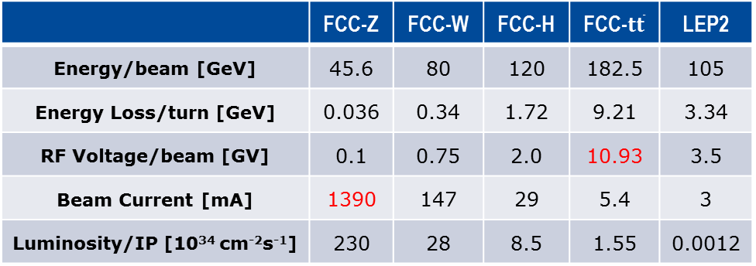
RF Parameters of FCC-ee
FCC-ee is a circular lepton collider designed to study four particles, i.e. Z, W, H and $t\overline{t}$
Beam energies of FCC-ee range from 45.6 to 182.5 GeV
The collider will be housed in a tunnel with around 100 km circumference
The maximum synchrotron radiation loss is fixed to 50 MW/beam for each energy, thus the beam current is smaller at higher energy
The FCC-ee machines could be divided into high current (Z, W) and high energy (H, $t\overline{t}$) setups, each case optimally demands a different cavity design approach
FCC
 | FCC-Z | FCC-W | FCC-H | FCC-$t\overline{t}$ | LEP2
Energy/beam [GeV] | 45.6 | 80 | 120 | 182.5 | 105
Energy Loss/turn [GeV] | 0.036 | 0.34 | 1.72 | 9.21 | 3.34
RF Voltage/beam [GV] | 0.1 | 0.75 | 2.0 | 10.93 | 3.5
Beam Current [mA] | 1390 | 147 | 29 | 5.4 | 3
Luminosity/IP [10³⁴ cm⁻²s⁻¹] | 230 | 28 | 8.5 | 1.55 | 0.0012

Slide 3
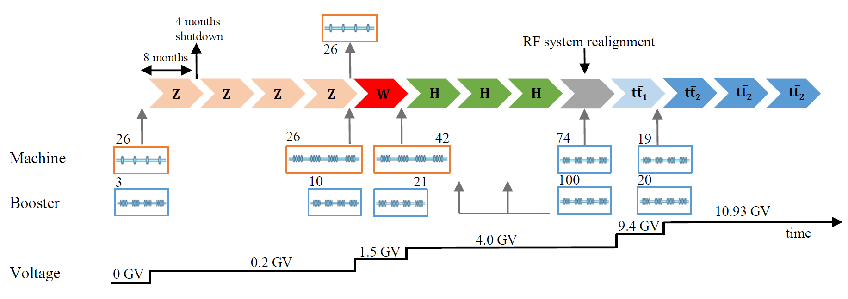
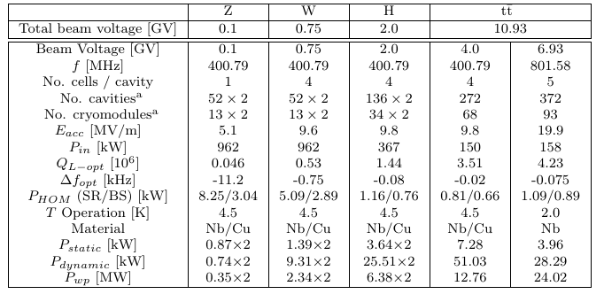
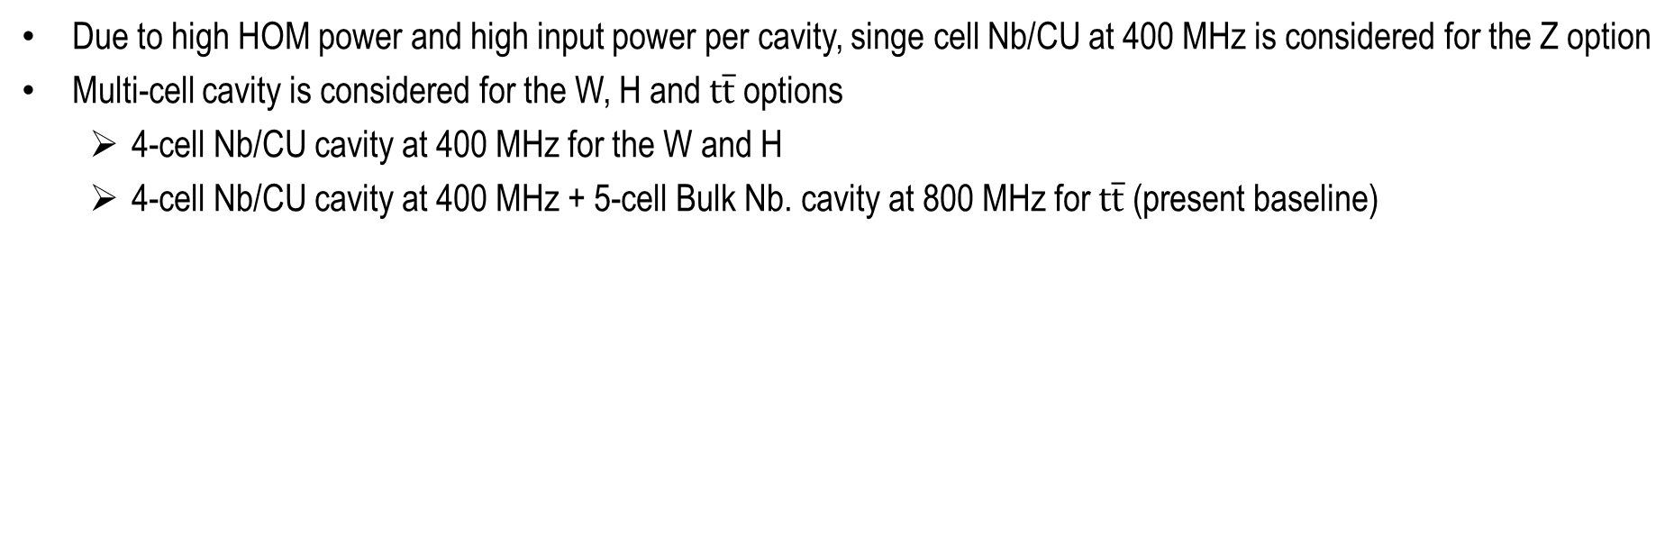
FCC-ee Present Baseline
Due to high HOM power and high input power per cavity, singe cell Nb/CU at 400 MHz is considered for the Z option
Multi-cell cavity is considered for the W, H and $t\overline{t}$ options
  4-cell Nb/CU cavity at 400 MHz for the W and H
  4-cell Nb/CU cavity at 400 MHz + 5-cell Bulk Nb. cavity at 800 MHz for $t\overline{t}$ (present baseline)
Figure adapted from: Andy Butterworth, ”Options for the FCC Superconducting RF System”, FCC week 2018, Amsterdam 2018

Slide 4
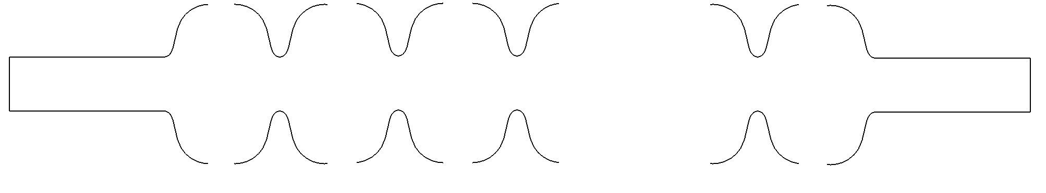
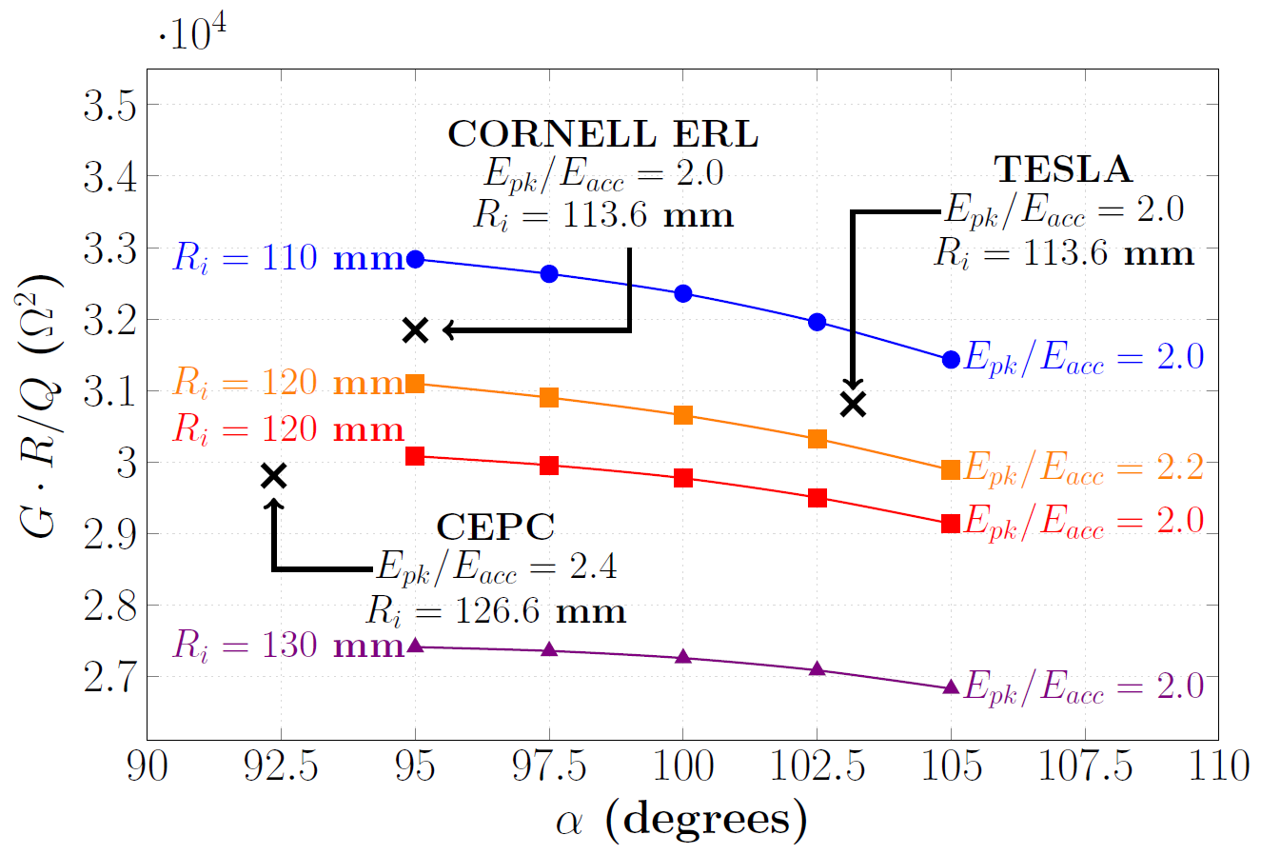
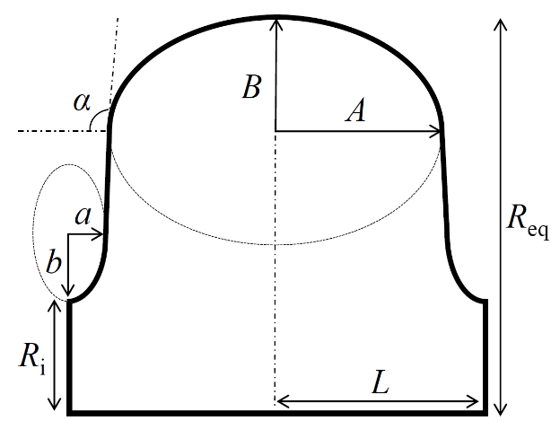


Mid-cell Optimization (I)
Mid
Dumbbell 1
Mid
Dumbbell 2
Mid
Dumbbell 3
Mid
Dumbbell n-1
In Multi-cell cavity optimization, the design of mid-cells and end-cells can be separated
A Mid-cell is designed at 400.79 MHz and rescaled to 801.58 MHz for $\text{t}\overline{\text{t}}$ operation
Minimizing the intrinsic cavity losses can save considerable energy on large scale for huge machines such as FCC_ee$\text{t}\overline{\text{t}}$
Optimization problem of mid-cell can be formulated as:
End half-cell
…
End half-cell
$\max_{A, B,a,b}{G∙R/Q}$
s.t. $E_{pk}/E_{acc}≤c_{1}$
$$α≥c_{2}$$
$$R_{i}=c_{3}$$
× All radii are scaled to 400.79 MHZ.

Slide 5
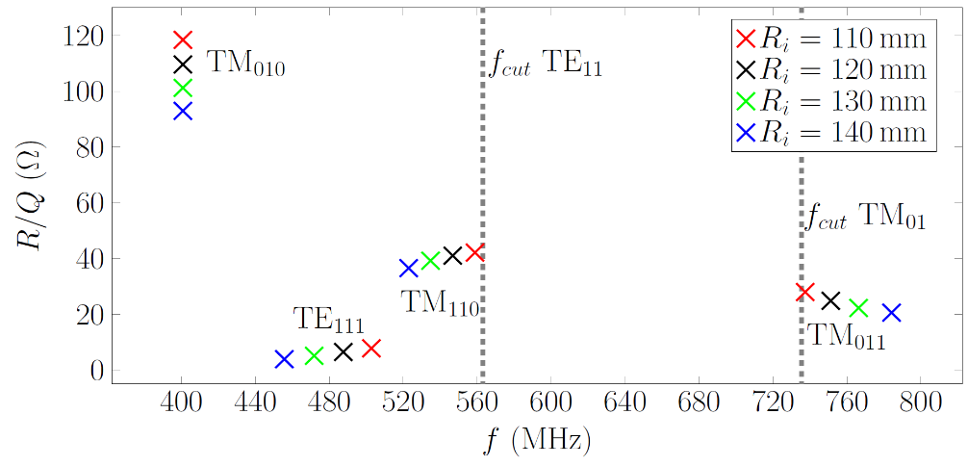
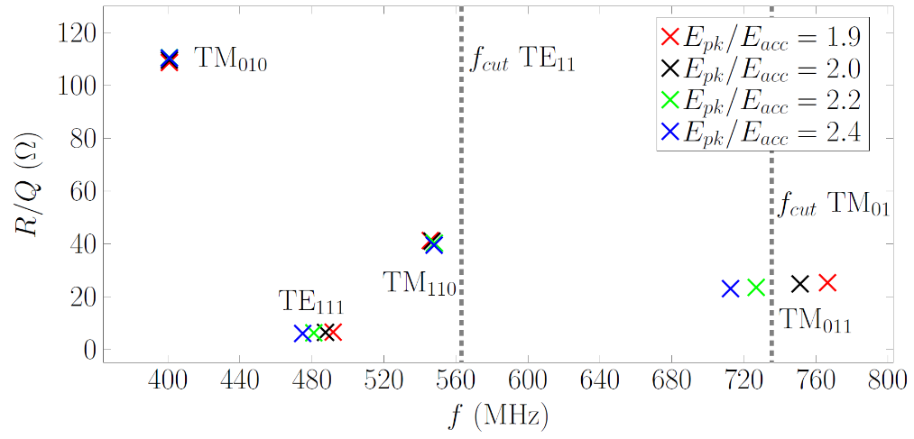
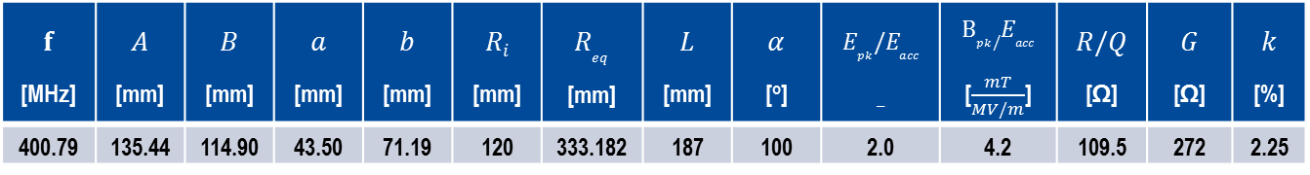
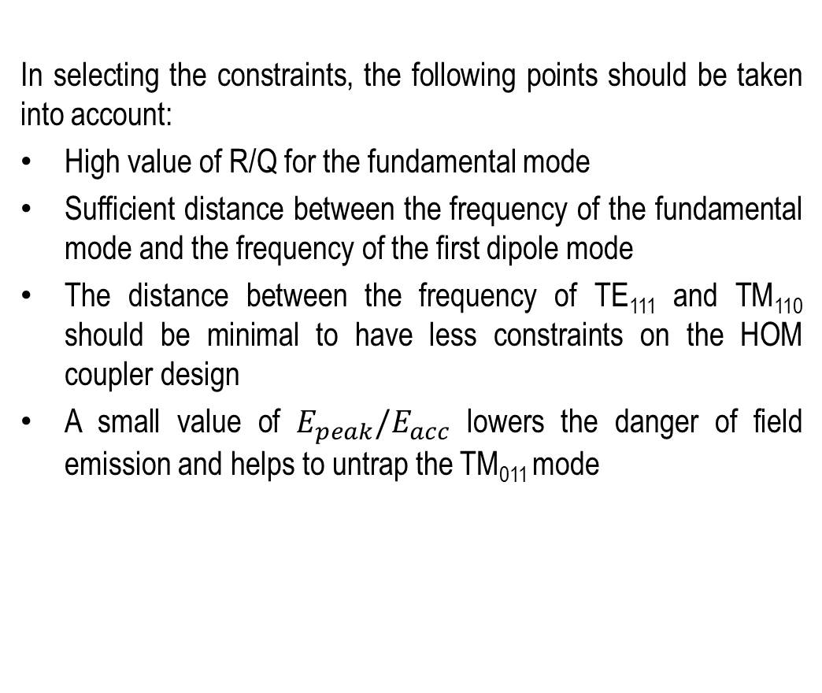
Mid-cell Optimization (II)
In selecting the constraints, the following points should be taken into account:
High value of R/Q for the fundamental mode
Sufficient distance between the frequency of the fundamental mode and the frequency of the first dipole mode
The distance between the frequency of TE₁₁₁ and TM₁₁₀ should be minimal to have less constraints on the HOM coupler design
A small value of $E_{peak}/E_{acc}$ lowers the danger of field emission and helps to untrap the TM₀₁₁ mode
Selecting$Ri=120 mm$, $α=100$ and $E_{peak}/E_{acc}=2.0$ in the optimization problem yields:
× Cut-off frequency is for a beam-pipe radius of 156 mm
$$f$$ [MHz] | $$A$$ [mm] | $$B$$ [mm] | $$a$$ [mm] | $$b$$ [mm] | $$Ri$$ [mm] | $$R_{eq}$$ [mm] | $$L$$ [mm] | $$α$$ [º] | $$E_{pk}/E_{acc}$$ _ | $$B_{pk}/E_{acc}$$ [$\frac{mT}{MV/m}$] | $$R/Q$$ [Ω] | $$G$$ [Ω] | $$k$$ [%]
400.79 | 135.44 | 114.90 | 43.50 | 71.19 | 120 | 333.182 | 187 | 100 | 2.0 | 4.2 | 109.5 | 272 | 2.25

Slide 6
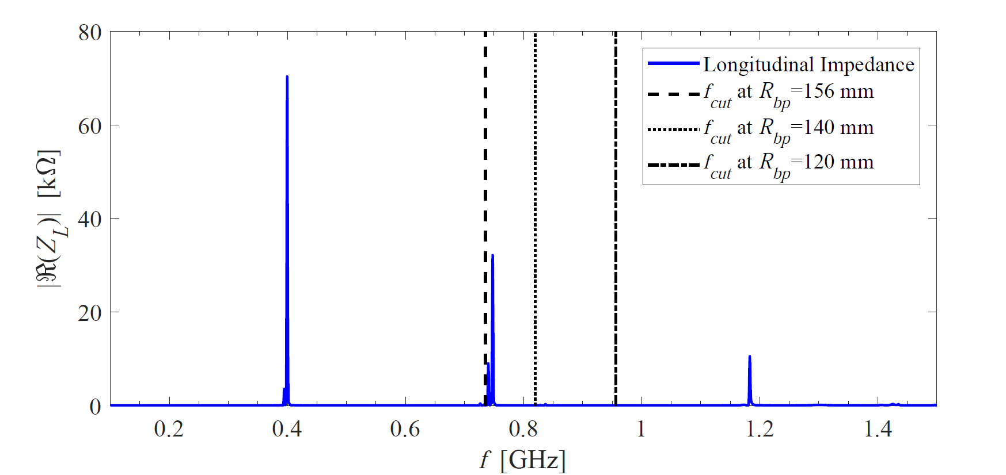
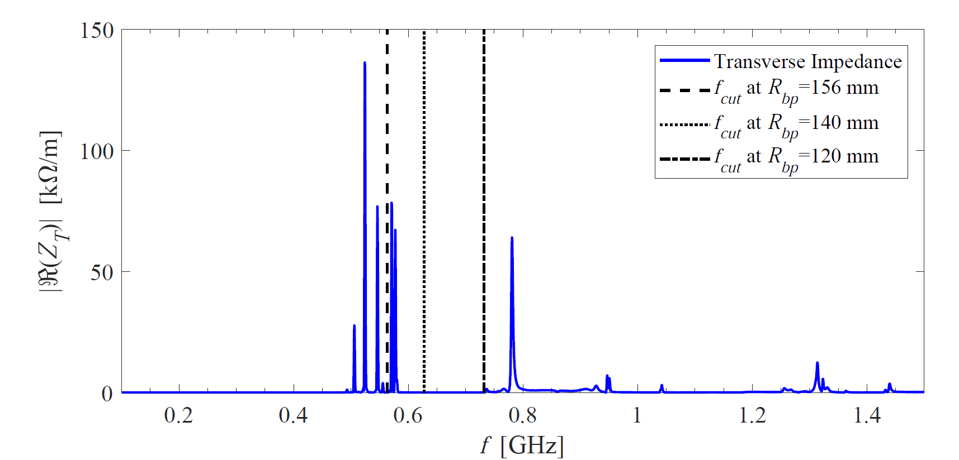
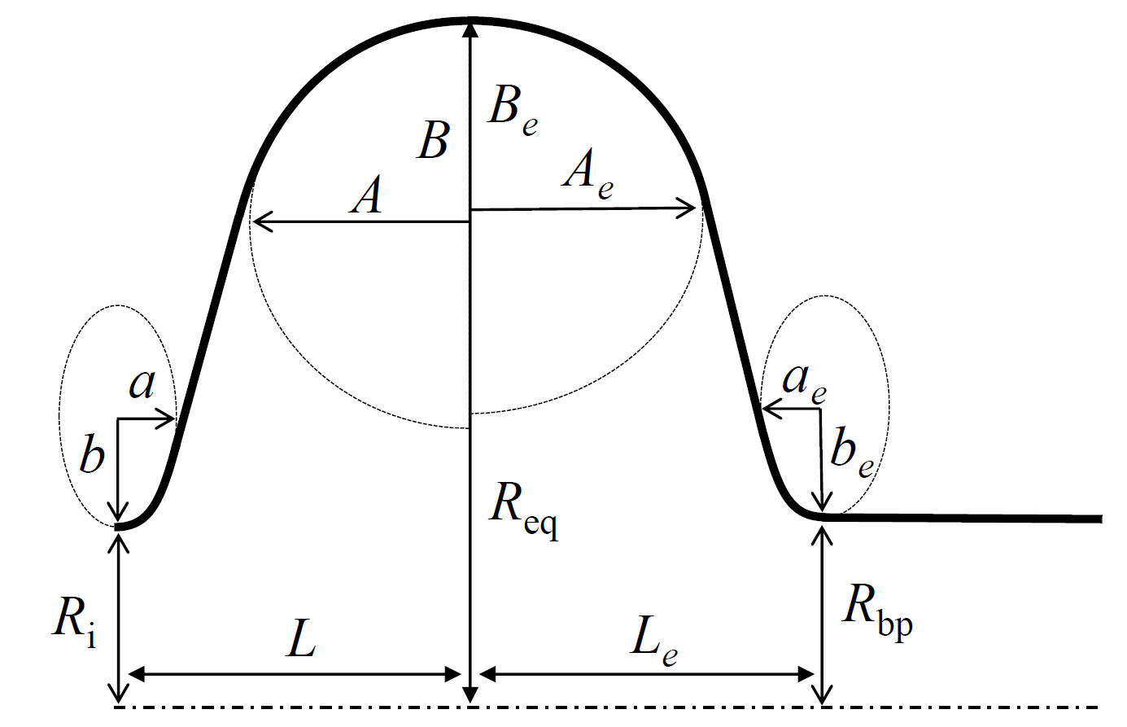
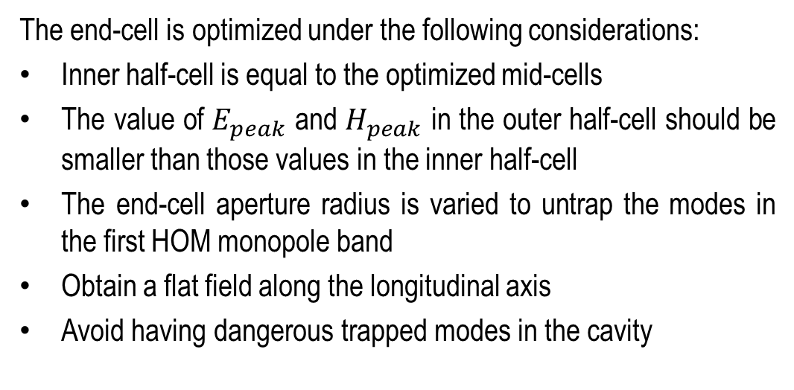
End-cell Optimization
The end-cell is optimized under the following considerations:
Inner half-cell is equal to the optimized mid-cells
The value of $E_{peak}$ and $H_{peak}$ in the outer half-cell should be smaller than those values in the inner half-cell
The end-cell aperture radius is varied to untrap the modes in the first HOM monopole band
Obtain a flat field along the longitudinal axis
Avoid having dangerous trapped modes in the cavity
Parameters | Value
A_{e} [mm] | 133
B_{e} [mm] | 102
a_{e} [mm] | 34
b_{e} [mm] | 46
R_{bp} [mm] | 156
R_{eq} [mm] | 333.182
L_{e} [mm] | 171.532
α_{e} [º] | 96.9
Impedances are for bare cavity and the peaks are not fully resolved.

Slide 7
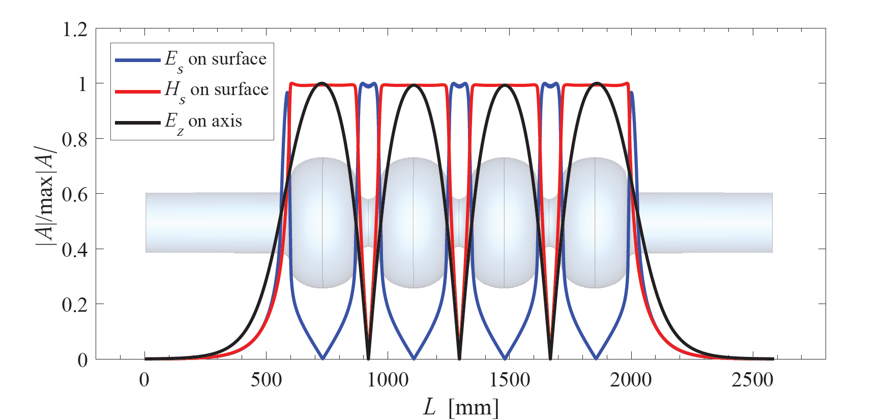
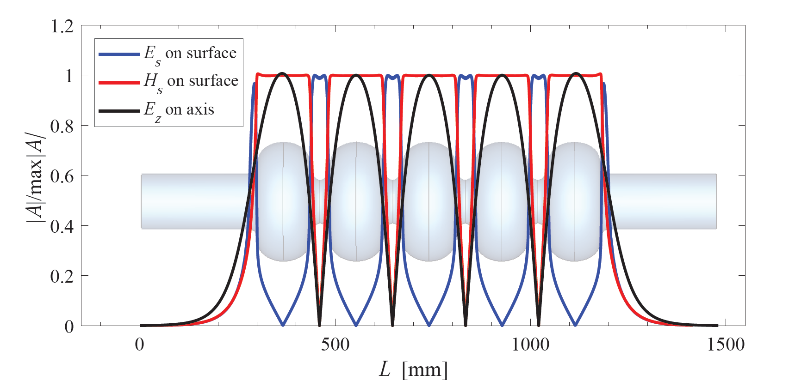
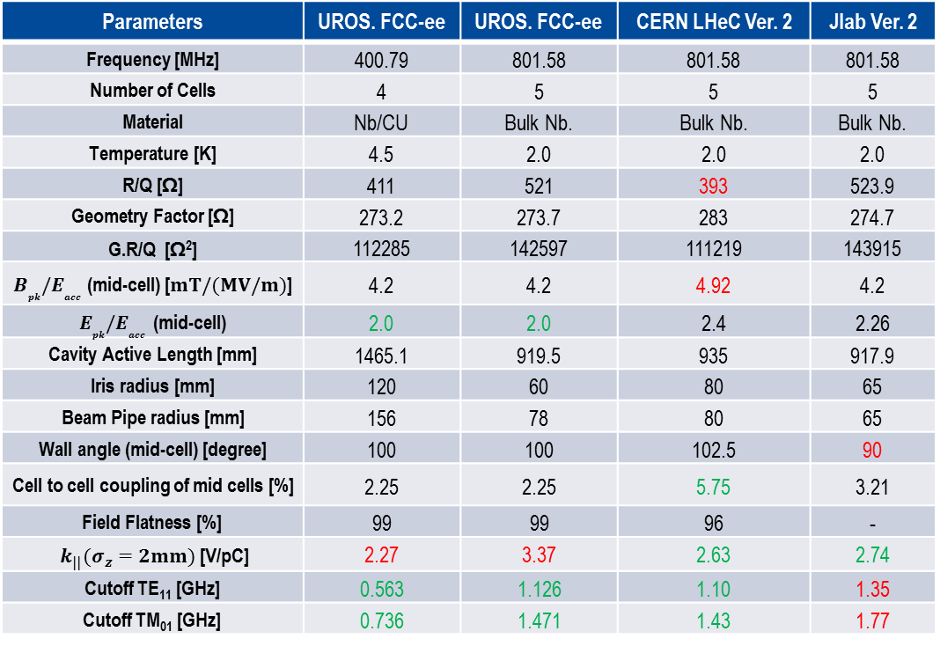
Main Parameters of the Multi-cell Cavities
4-cell cavity at 400.79 MHz
Parameters | UROS. FCC-ee | UROS. FCC-ee | CERN LHeC Ver. 2 | Jlab Ver. 2
Frequency [MHz] | 400.79 | 801.58 | 801.58 | 801.58
Number of Cells | 4 | 5 | 5 | 5
Material | Nb/CU | Bulk Nb. | Bulk Nb. | Bulk Nb.
Temperature [K] | 4.5 | 2.0 | 2.0 | 2.0
R/Q [Ω] | 411 | 521 | 393 | 523.9
Geometry Factor [Ω] | 273.2 | 273.7 | 283 | 274.7
G.R/Q [Ω²] | 112285 | 142597 | 111219 | 143915
$B_{pk}{/E}_{acc}$ (mid-cell) [$mT/(MV/m)$] | 4.2 | 4.2 | 4.92 | 4.2
$E_{pk}{/E}_{acc}$ (mid-cell) | 2.0 | 2.0 | 2.4 | 2.26
Cavity Active Length [mm] | 1465.1 | 919.5 | 935 | 917.9
Iris radius [mm] | 120 | 60 | 80 | 65
Beam Pipe radius [mm] | 156 | 78 | 80 | 65
Wall angle (mid-cell) [degree] | 100 | 100 | 102.5 | 90
Cell to cell coupling of mid cells [%] | 2.25 | 2.25 | 5.75 | 3.21
Field Flatness [%] | 99 | 99 | 96 | -
$k_{||}(σ_{z}=2mm)$ [V/pC] | 2.27 | 3.37 | 2.63 | 2.74
Cutoff TE₁₁ [GHz] | 0.563 | 1.126 | 1.10 | 1.35
Cutoff TM₀₁ [GHz] | 0.736 | 1.471 | 1.43 | 1.77
5-cell cavity at 801.58 MHz

Slide 8
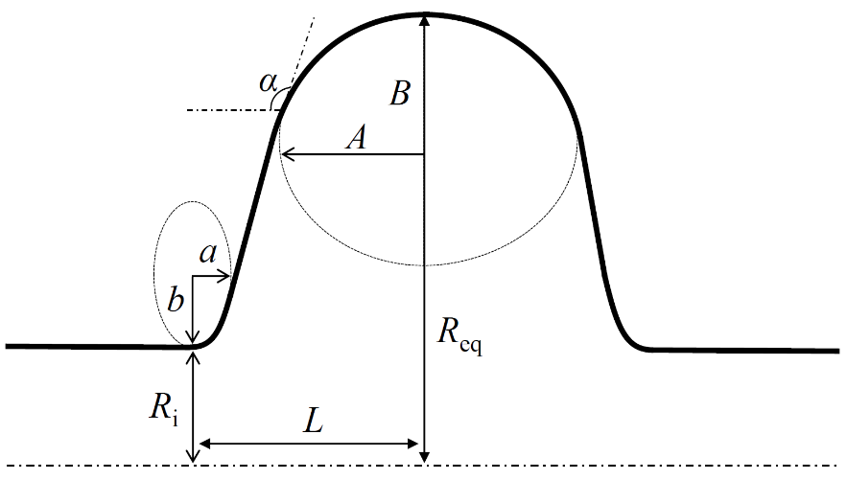
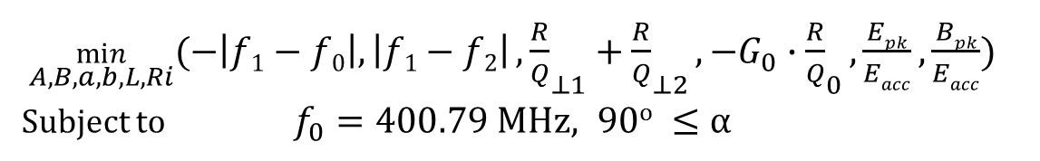

Single Cell Cavity Design for the Z Option (I)
The surface losses and peak surface fields are not so crucial for the Z option due to low $E_{acc}$ (≈ 5 MV/m)
  instead main focus is on the HOM aspects specially strong damping of the first dipole band
In a single-cell part of the field leaks into the beam-pipe, thus the cell and beam-pipe are simulated together
$L$ is not fixed to $λ/4$ and is considered as a free variable in the optimization (in fact if highly influences the frequency of TE₁₁₁ mode)
Aperture radius is considered as a free variable (above 145 mm to untrap TM₀₁₁ and have small loss factor)
Ideally the following objectives have to be optimized at the same time:
$\min_{A, B,a,b,L,Ri}{(−\left|f1−f0\right|,\left|f1−f2\right|},{\frac{R}{Q}}_{⊥1}+{\frac{R}{Q}}_{⊥2},{−G}_{0}∙{\frac{R}{Q}}_{0},\frac{Epk}{Eacc}, \frac{Bpk}{Eacc})$
Subject to $f_{0}=400.79 MHz, 90o ≤α$
Indices 0, 1 and 2 correspond to the first monopole mode, the first dipole mode and the second dipole mode respectively.
R_{eq} is used for tuning f₀ to the desired frequency.
 | G.R/Q | f of TE₁₁₁ | f of TM₁₁₀ | f of TM₀₁₁ | k||
R_{i} ↑ | ↓ | ↓ | ↓ | ↑ | ↓

Slide 9
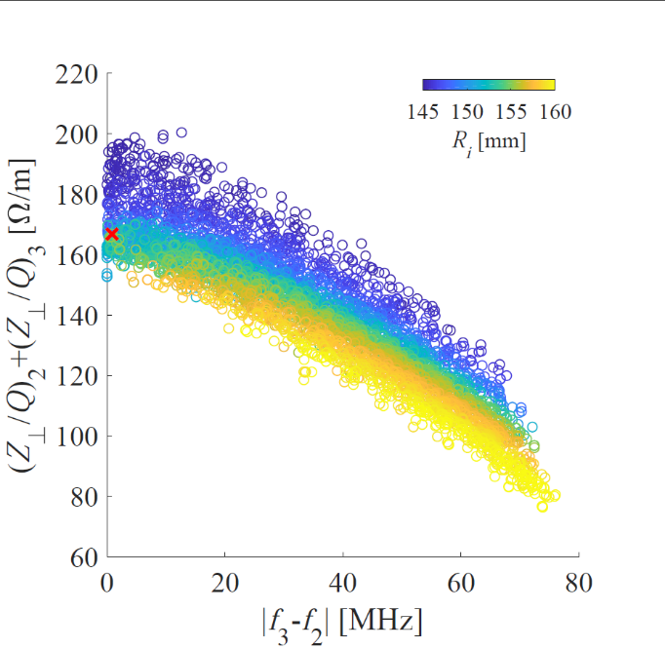
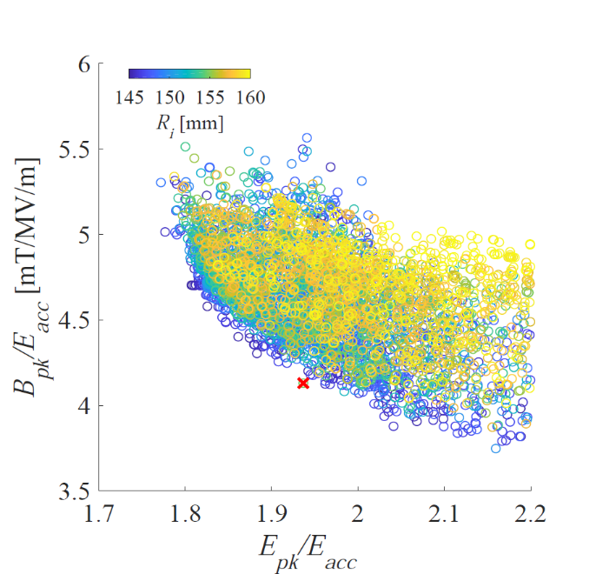
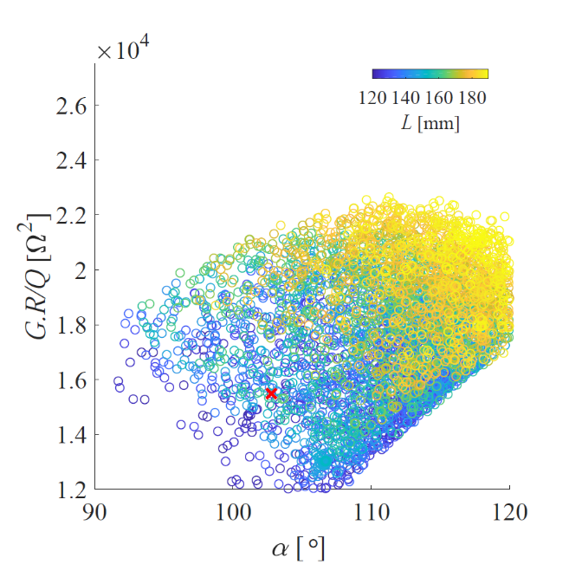
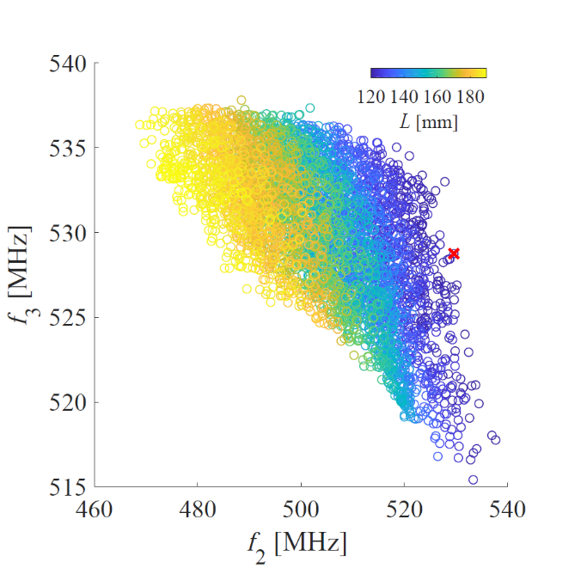
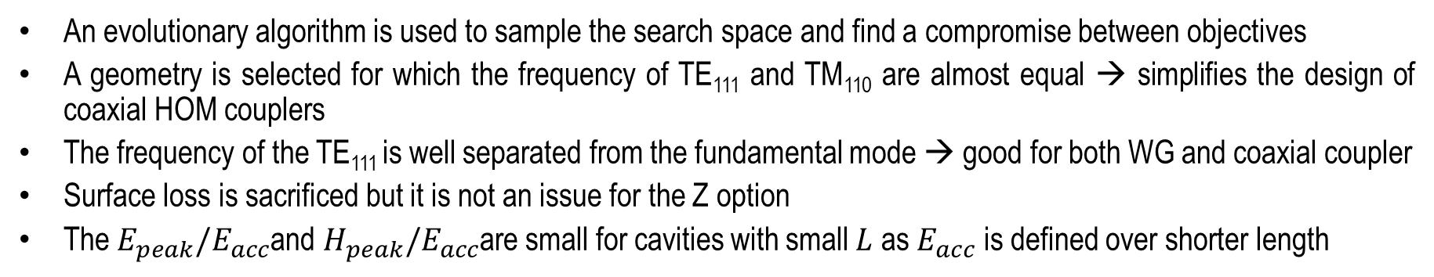



Single Cell Cavity Design for the Z Option (II)
An evolutionary algorithm is used to sample the search space and find a compromise between objectives
A geometry is selected for which the frequency of TE₁₁₁ and TM₁₁₀ are almost equal → simplifies the design of coaxial HOM couplers
The frequency of the TE₁₁₁ is well separated from the fundamental mode → good for both WG and coaxial coupler
Surface loss is sacrificed but it is not an issue for the Z option
The $E_{peak}/E_{acc}$and $H_{peak}/E_{acc}$are small for cavities with small $L$ as $E_{acc}$ is defined over shorter length
$E_{acc}$ calculated with the actual length of the cell
$R_{i}$fixed to 156 mm
$R_{i}$ fixed to 156 mm

Slide 10
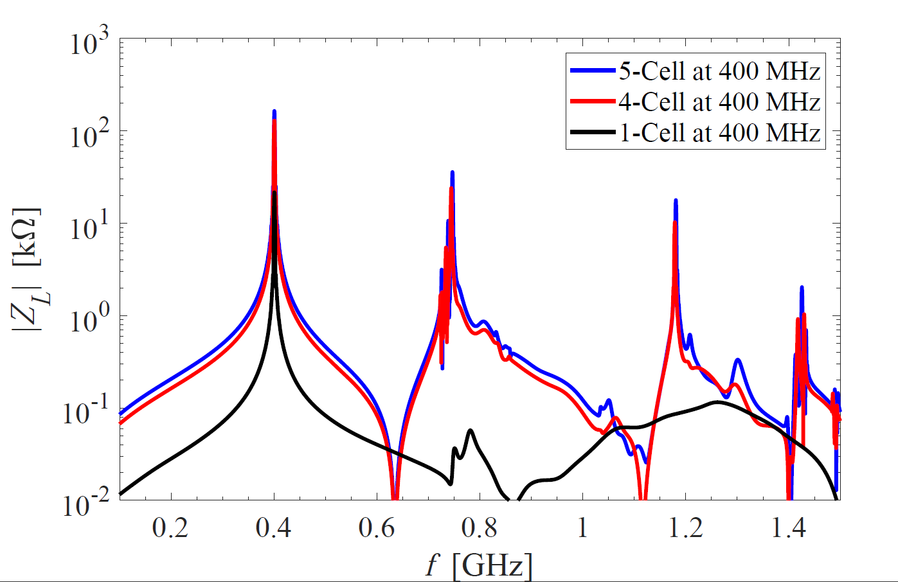
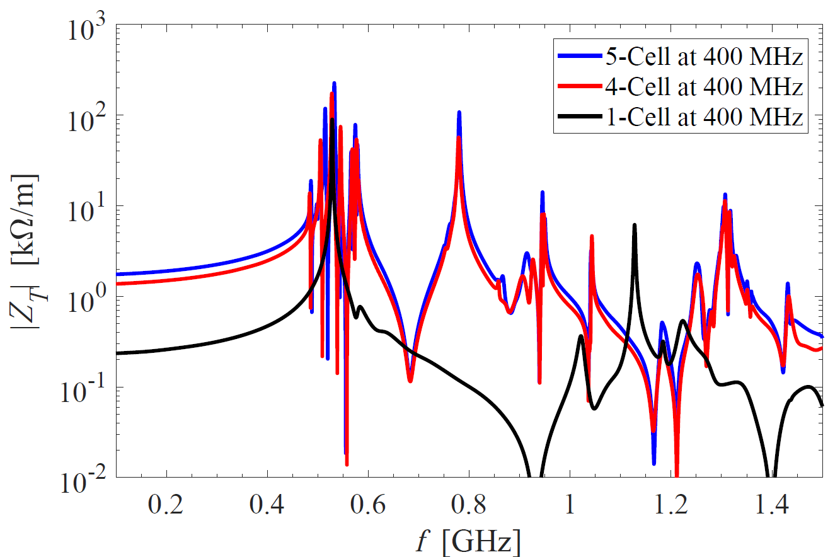
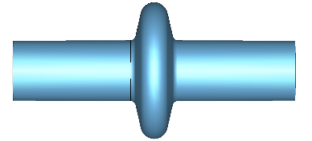
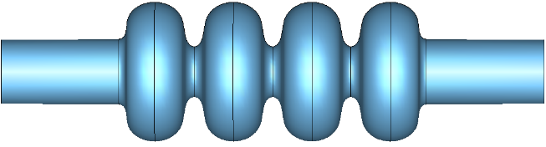



HOM Impedance of Cavities
The single-cell cavity for Z is designed with the main focus on HOM damping aspects
  No dangerous trapped monopole mode
  The first dipole band is trapped in the cavity and needs strong damping → both modes are at around 529 MHz
The multi-cell cavities are optimized with the main focus on minimizing surface losses
  The HOM spectrum of the four-cell and five-cell cavity is similar
  A HOM coupler is designed with respect to the spectrum of 400 MHz (or 800 MHz) cavity and rescaled to the other frequency
  (mechanical and thermal aspects are not studied here)
Single-cell at 400 MHz for Z
Five-cell at 800 MHz for $t\overline{t}$
Four-cell at 400 MHz for W, H, $t\overline{t}$
Impedance of the five-cell cavity is scaled to 400 MHz for comparison. Impedances are for bare cavity and the peaks are not fully resolved.

Slide 11
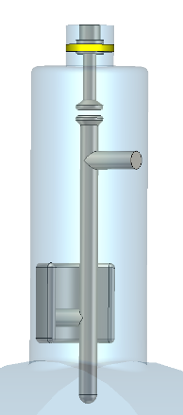
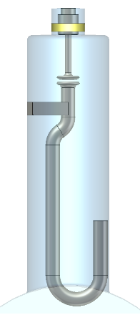
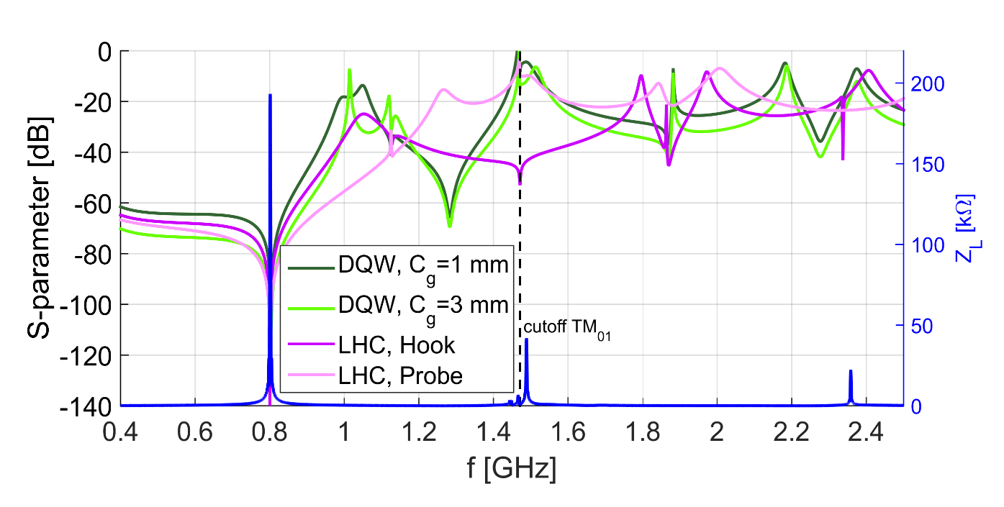
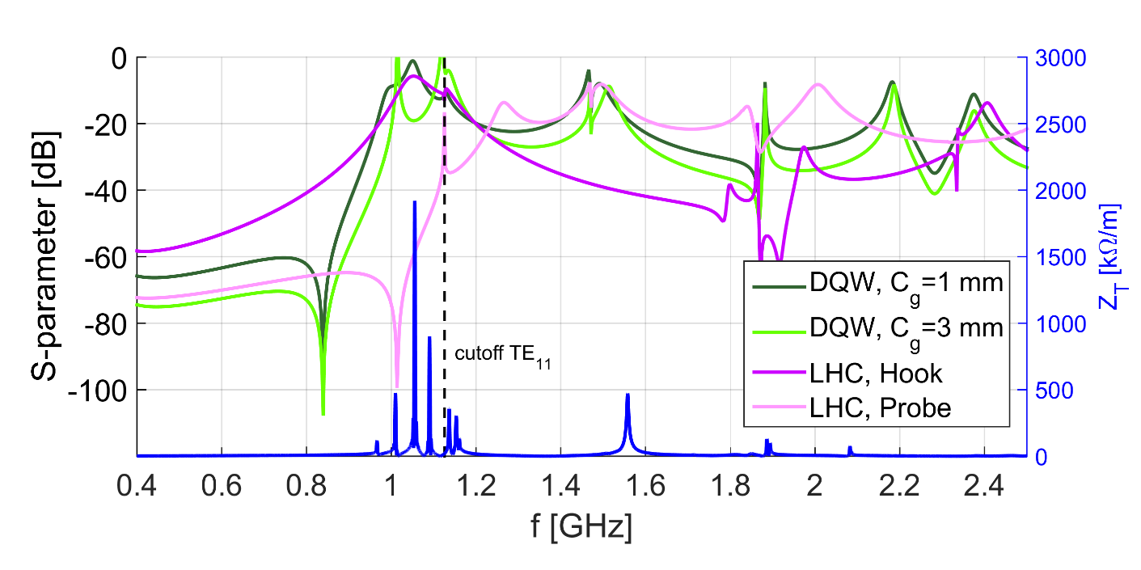
Coaxial HOM Coupler
The notch effect of all couplers are tuned to 801.58 MHz for the monopole coupling.
The DQW HOM coupler can deliver a high value of transmission at both first higher order dipole and monopole band.
LHC Probe-type
LHC Hook-type
DQW HOM Coupler
TM01-TEM transmission (Monopole coupling)
TE11-TEM transmission (Dipole coupling)
TE11-TEM transmission (Dipole coupling)
Impedances are for bare cavity and the peaks are not fully resolved.

Slide 12
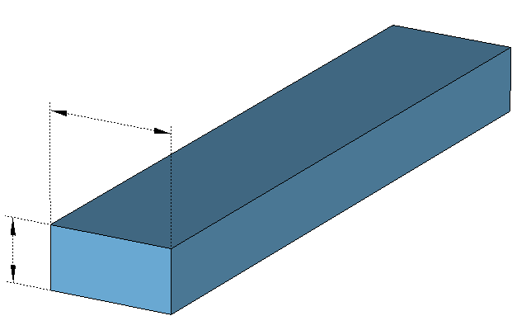
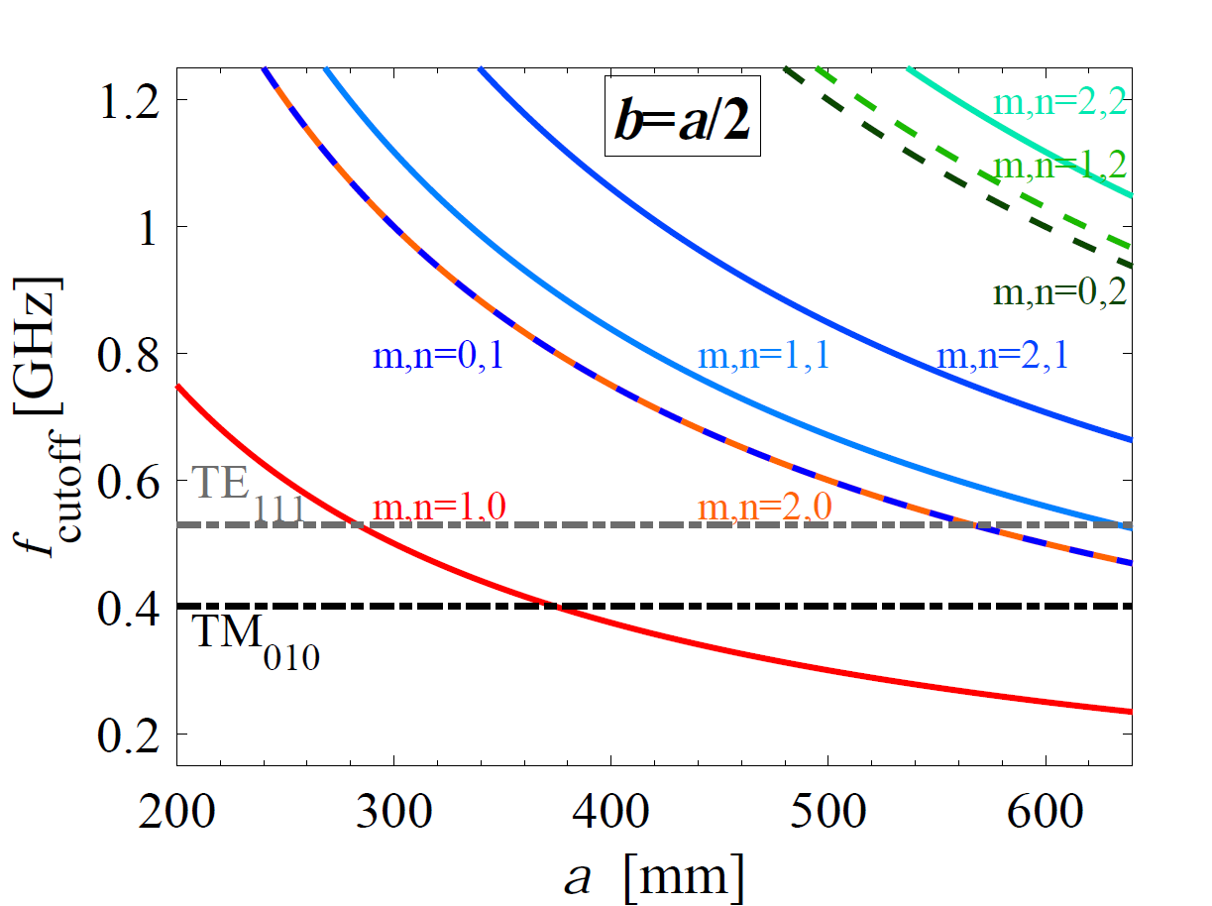
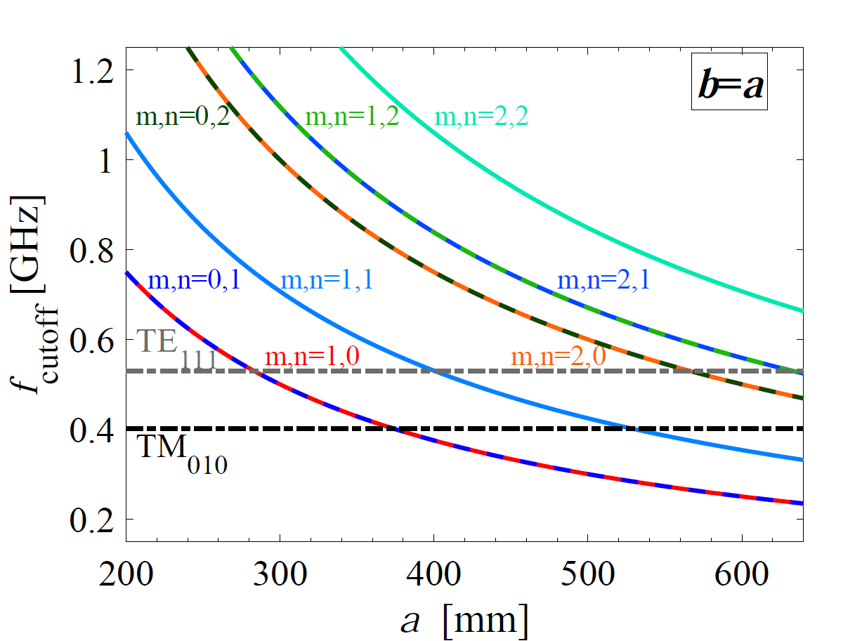
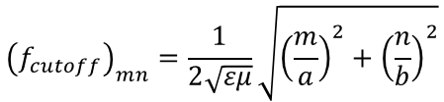
Rectangular Waveguide HOM Coupler
The cutoff frequency of the first mode of the waveguide HOM coupler has to be between the fundamental mode of the cavity and the first dipole mode.
Standard aspect ratio of 2:1 of the WG dimensions gives rise to maximum frequency band for one-mode operation
  not efficient for damping the first dipole band with two polarizations
Square-shaped WG has same cutoff frequency for the first two modes but
  bulky specially at low frequencies
  trapped modes could be created by the WG
TM₀₁₀
TE₁₀
TE₁₁₁
TM₁₁₀
f [MHz]
Fundamental Mode
f_{cutoff}
Waveguide
First Dipole band
a
$${\left(f_{cutoff}\right)}_{mn}=\frac{1}{2\sqrt{εμ}}\sqrt{{\left(\frac{m}{a}\right)}^{2}+{\left(\frac{n}{b}\right)}^{2}}$$
b

Slide 13
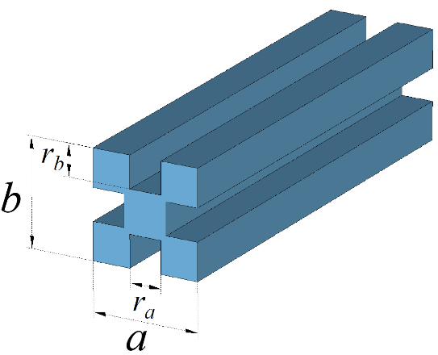
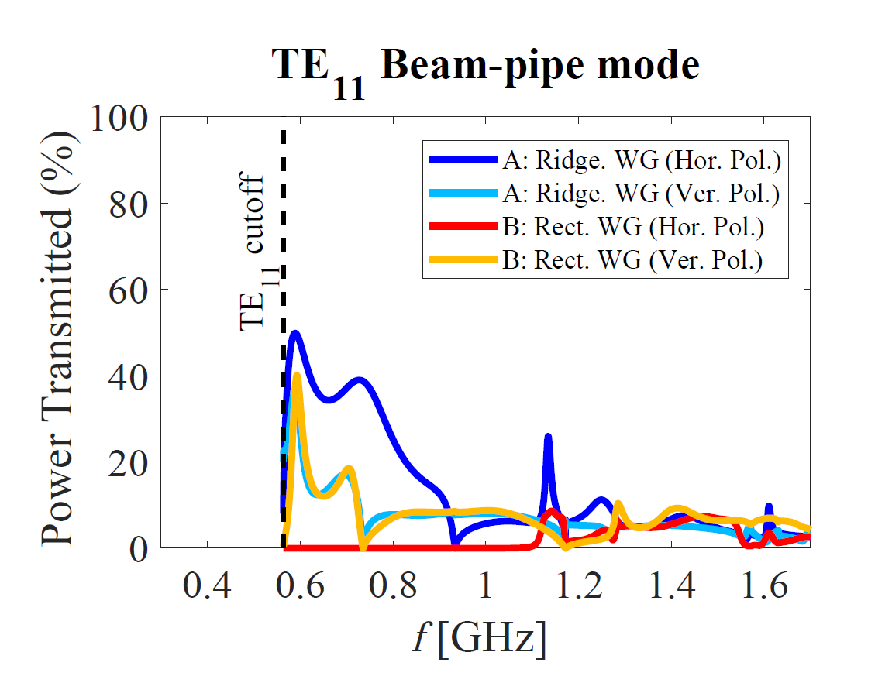
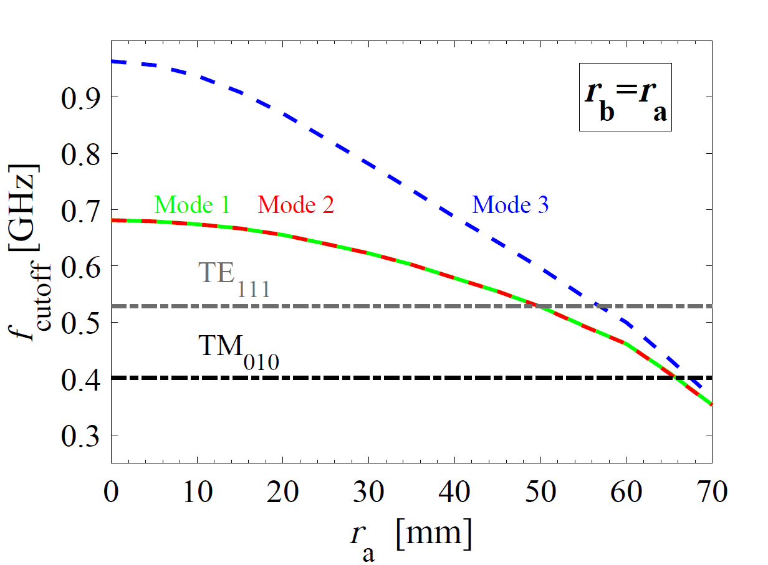
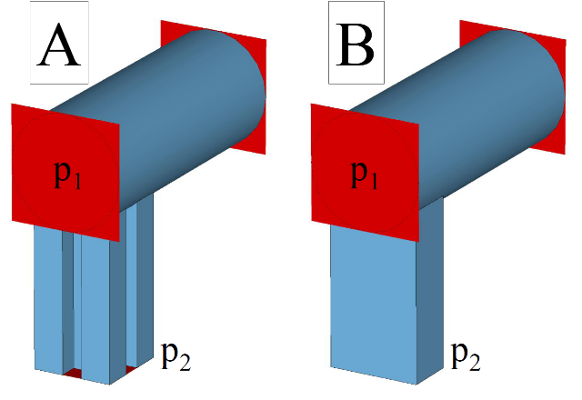
Quad-Ridged Waveguide
The cutoff frequency could be lowered by adding ridges in the WG
The damping of the two polarizations of the dipole modes is improved using quad-ridged WG
a=b=220 mm
Quad-Ridged WG vs. Rect. WG with the same cross section area
Power calculated from the S-parameters

Slide 14
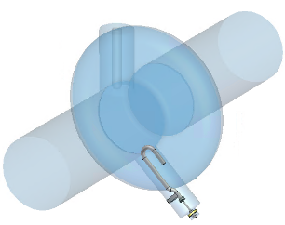
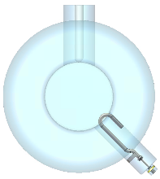
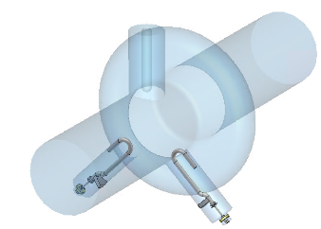
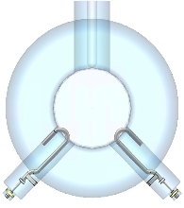









HOM Coupler Design for the Z Option
HOM coupler is tuned with respect to the modes in the first dipole band
By using four hook-type HOM couplers, the $Q_{ext}$of the modes in the first dipole band are reduced below 100

Slide 15








Wake Impedance of the Z Option
A combination of hook-type coupler and quad-ridged WG can reduce the transverse impedance below the limit defined by synchrotron radiation
Quad-ridged WG is optimized to have low cutoff frequency for the first two modes and avoid having modes trapped in the WG
Modes created by the square ridged WG
3 Hook + 1 Rect. WG
4 Hook
3 Hook + 1 Rect. Ridged. WG
3 Hook + 1 Square Ridged. WG

Slide 16





HOM Damping for the Multi-cell Cavities at 800 MHz
1 WG + 2 DQW Couplers
WG cutoff frequency is set at 1.11 GHz
3 WG Couplers
WG cutoff frequency is set at 0.91 GHz
2 DQW Couplers
Coaxial coupler performs better than waveguide couplers in damping the first dipole band
No clear difference between 2 DQW and 2 DQW + 1 WG
  Reason: beam pipes also act like WG and adding another WG does not make much difference
  Yet, in a module composed of several cavities the effect of WG in damping HOMs is more visible

Slide 17



Quality Factor of Modes in a 4-Cavity Module
The damping of monopole, dipole and quadrupole bands is improved by adding the WG
Octopole and decapole modes are trapped, thus adding another coupler does not influence their damping - these modes however are not excited by on-axis beams
Monopole (TE)
Octopole (TE)
Hexapole
Decapole
Monopole (TM)
Dipole
Quadrupole

Slide 18


Modes Trapped in the Beam Pipes
With 2 DQW HOM couplers, three dipole modes around 0.579 GHz have a transverse impedance above the W threshold. The energy of these modes is mainly located in the beam pipes.
Adding a ridged WG coupler improves the damping of such modes.
Electric field density of the dipole mode with highest transversal impedance at frequency 0.579 GHz

Slide 19




Impedance of Damped Cavities
The stability threshold can increase by 1-2 orders of magnitude if the frequency spread between cavities is taken into account
Using a feedback system can increase the stability threshold above the synchrotron radiation limit
1-cell cavity at 400 MHz (top)
4-cell cavity at 400 MHz (middle) and
5-cell cavity at 800 MHz (bottom)
Thresholds are normalized to the number of cavities needed at 400 MHz

Slide 20


Average HOM Power
The high HOM power of Z machine reaffirms the choice of 1-cell cavity at 400 MHz
Coaxial HOM coupler can handle the HOM power of H and $t\overline{t}$
Bunch spectrum of the beam needed to make a more accurate estimation of HOM power
 | Z | W | H | $$t\overline{t}$$
4-cell cavity at 400 MHz
Bunch Length [mm] | P [kW] | P [kW] | P [kW] | P [kW]
SR (3.5, 3.0, 3.15, 1.97) | 47.95 | 5.09 | 1.16 | 0.81
BS (12.1, 6.0, 5.3, 2.54) | 17.34 | 2.89 | 0.76 | 0.66
5-cell cavity at 800 MHz
Bunch Length [mm] | P [kW] | P [kW] | P [kW] | P [kW]
SR (3.5, 3.0, 3.15, 1.97) | 66.11 | 6.94 | 1.59 | 1.09
BS (12.1, 6.0, 5.3, 2.54) | 23.91 | 4.09 | 1.06 | 0.89
1-cell cavity at 400 MHz
Bunch Length [mm] | P [kW] | P [kW] | P [kW] | P [kW]
SR (3.5, 3.0, 3.15, 1.97) | 6.86 | 0.71 | 0.16 | 0.11
BS (12.1, 6.0, 5.3, 2.54) | 2.53 | 0.43 | 0.11 | 0.09
* Average HOM power for both BS and SR bunch lengths calculated from $P_{HOM}=k_{||}q_{b}I$

Slide 21

Summary
A multi-cell cavity is designed for the W, H and $\text{t}\overline{\text{t}}$ options
  Mid-cells optimized for minimal intrinsic losses with constraints on different figure of merits such as $E_{pk}/E_{acc}$
  End-cells optimized to allow sufficient HOM damping without significantly changing $E_{pk}/E_{acc}$ and $B_{pk}/E_{acc}$ of the cavity
A single-cell cavity is designed for the Z option with the main focus on HOM aspects of the cavity
Waveguide couplers were compared with coaxial HOM couplers
Quad-ridged WG introduced as an alternative to rectangular WG HOM couplers
A single waveguide for high frequency modes with targeted coaxial dampers for low frequency HOMs looks very promising as we approach higher current with high HOM power

Slide 22




Appendix: Waveguide HOM coupler optimization
In designing the waveguide HOM coupler, special attention is given to the modes induced by the waveguide (boundaries of the waveguide can act like a small cavity)
f_{cutoff} = 0.911 GHz
f=0.898 GHz and R/Q=35.5 Ω
f_{cutoff} = 0.911 GHz
f=1.05 GHz and R/Q=1.6 Ω

Slide 23



Appendix: Eigenmode simulation of the module
A catalogue containing the information of all lossy HOMs with their frequency, quality factor, longitudinal and transversal R/Q, the percentage of coupling to each port, etc. for a 4-cell cavity at 400 MHz and a 5-cell cavity at 800 MHz is generated using the State Space Concatenation (SSC) method to simulate the whole module.

