Slide 1
Measuring HOM parameters with beam for Cornell’s ERL cavities
Adam Bartnik

Slide 2
Talk Outline
The Horizontal Test Cryomodule (HTC)
  Introducing the HTC and the ERL injector (ca. 2014)
HOM measurements with beam
  Using beam to identify and characterise HOMs

Slide 3
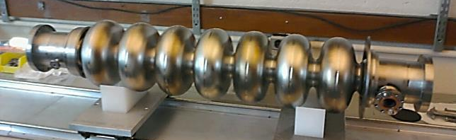
The Main Linac Cavity
Cavity parameter | Specification
Gradient (MV/m) | 16.2
Q0 at 1.8 K | > 2 × 10¹⁰
Target beam current (mA) | 100
Notes:
The 7-cell ERL cavity is based upon the ILC TESLA design.
It is a solid niobium cavity, with an operating mode frequency of 1.3 GHz.
To optimise the beam for operation at 100 mA operation, and to maximise the threshold current at which BBU onsets, we consider the geometry of 4 (animate) different sectors of the cavity:
The HOM loads, which determine specific mode losses,
The beam pipe, which determines the linac fill factor and fundamental mode losses,
The centre cells, which determine the general properties of the HOM spectrum,
The assymetric end cells, which are responsible for coupling HOMs to the HOM absorber as well as preventing trapped modes.
Here is what the cavity looks like once fabricated.

Slide 4
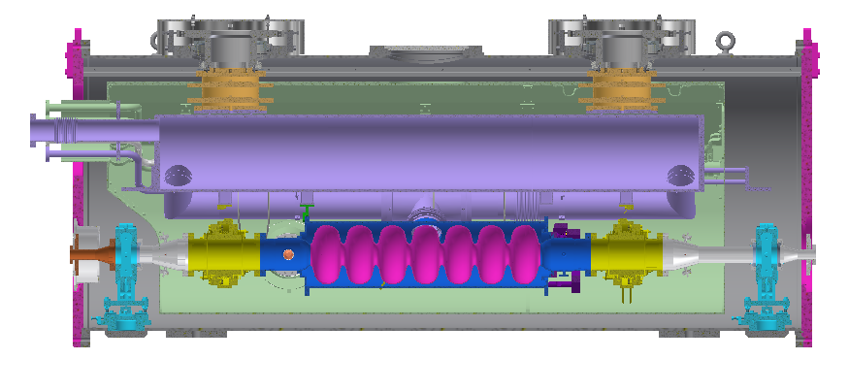
Horizontal Test Cryomodule (HTC)
Fully equipped for operation with beam
ERL Cavity
HOM Load
HOM Load
RF Input Coupler
RF Field Probe
Notes:
The cavity is mounted inside our Horizontal Test Cryomodule.
The fabrication and assembly process of this cryomodule is as close as possible to the procedure expected to be used in the fabrication of the Main Linac Cryomodules.
It is fully equipped with everything needed for operation with beam.
(Animate)
At the centre is the 7-cell main linac cavity.
On the left is the input RF high current coupler.
On the right is an RF field probe for HOM diagnostics.
On either end are the two HOM loads.

Slide 5
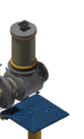
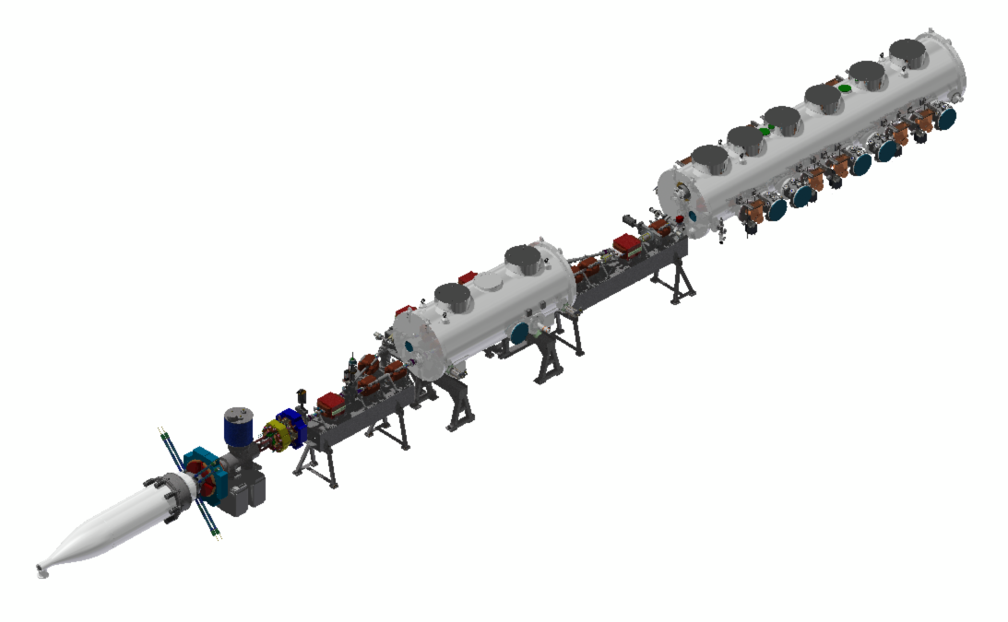
ERL Injector prototype (ca. 2014)
Beam energy : 5 MeV
Maximum current : 75 mA CW
Operating current : 2 mA CW
HTC
DC Gun
@ 400 kV
Injector Cryomodule
(ICM) @ 5 MeV
Beam stop
Notes:
To supply the HTC with beam, we use the ERL injector prototype. This is a small accelerator that consists of essentially the first 20 metres of the actual ERL. It is capable of accelerating a beam of electrons to 5 MeV at up to 75 mA of continuous beam current. The device consists of (animate) the DC gun, from where the beam originates, the injector cryomodule, which accelerates the electrons to 5 MeV, the beamline where the HTC will be installed, and the beam stop where the beam terminates. (Animate) Here is the ERL, zoomed in slightly, with the HTC now integrated into the beamline after the injector.

Slide 6
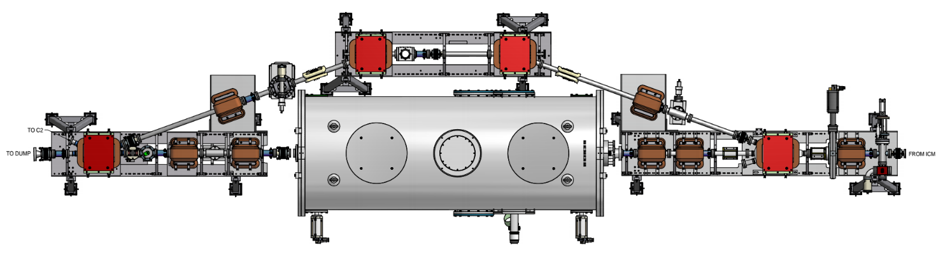
Experimental setup
3.4 meters drift
Beam direction
HTC
Corrector pair used to steer off-axis
BPM connected to spectrum analyzer.
BPMs used for position feedback.
Beam is held off-axis at a fixed position to excite HOMs

Slide 7
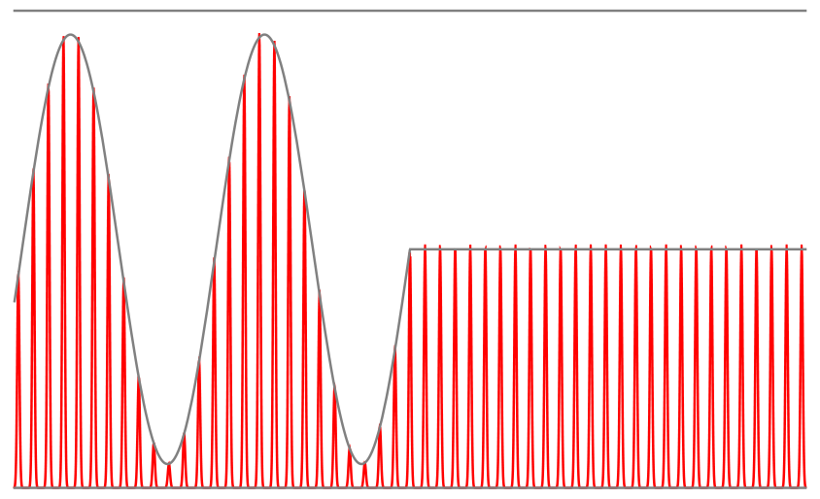
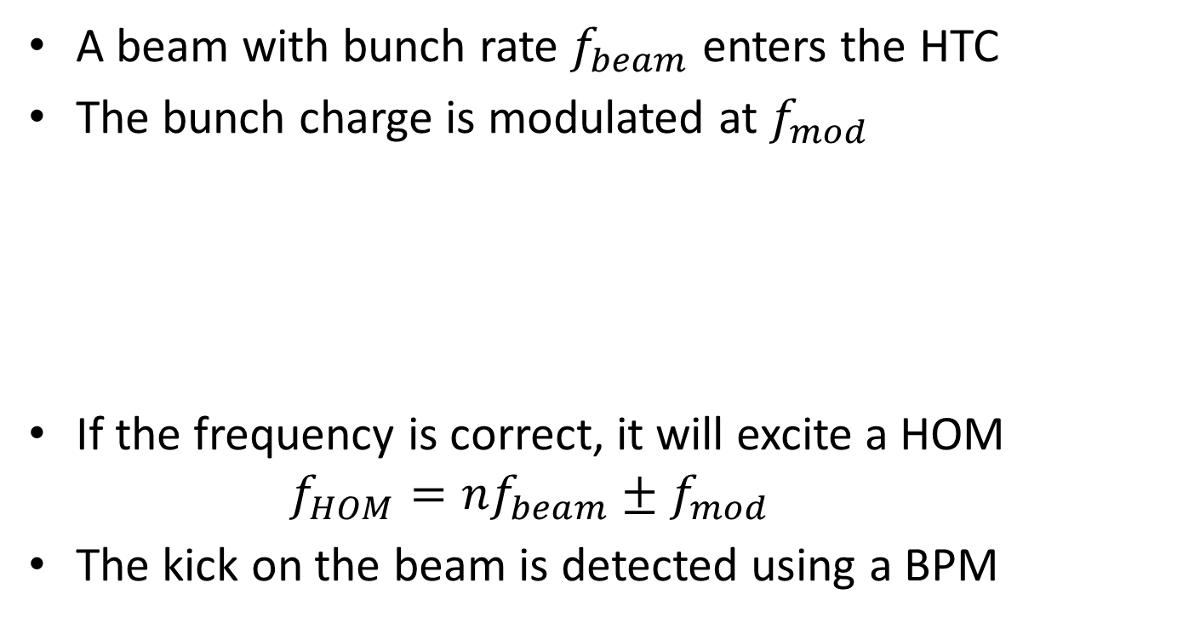


HOM excitation with beam
A beam with bunch rate $f_{beam}$ enters the HTC
The bunch charge is modulated at $f_{mod}$
If the frequency is correct, it will excite a HOM
    $$f_{HOM}=nf_{beam}±f_{mod }$$
The kick on the beam is detected using a BPM
$$f_{beam}$$
$$f_{mod }$$
Notes:
We installed the HTC into the beamline of the ERL. It’s unpowered, but any beam going through it will excite modes in the cavity
We hooked up the 50 MHz laser to the ERL. We can modulate the amount of charge in each bunch by some frequency
If this frequency is correct, you’ll excite a higher order mode

Slide 8
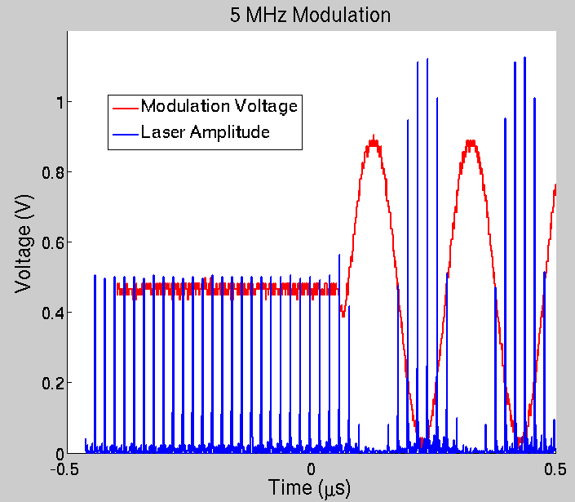
Modulating the Bunch Charge
Charge modulation via laser modulation
50 MHz laser
  Search from 0-25 MHz
  Can modulate the amplified, frequency-converted laser beam, reducing unwanted harmonics

Slide 9
BPM Details
Spectrum analyzer in zero span mode
Baseband (0-25 MHz) has poor BPM response and background noise
Use sideband around higher harmonic of 50 Mhz
  1.3 GHz is convenient, but also has larger background
  1.3 GHz – 50 MHz = 1.25 GHz was used instead

Slide 10
BPM Details
1.3 GHz
1.25 GHz
f
Switch
Laser
50 MHz
BPM signal
Spectrum
Analyzer
(1.25 GHz – f)
Cathode
trigger
Pulse
Generator
180º hybrid
BPM

Slide 11
Theory
Theory – what do we expect to see?
Bunch charge:
HOM excited
On resonance:
SA Signal
Decay gives loaded Q/f
Otherwise:
SA Signal
Time
Image credit: Adam Bartnik
Notes:
We have the BPM hooked up to a spectrum analyzer. As the bunch charge is modulated, the signal is dominated by this charge modulation.
When the modulation is turned off, if a HOM has been excited, we should see a decay. We can use this decay to get the loaded Q of the mode, as well as details regarding how much kick it has given the beam

Slide 12
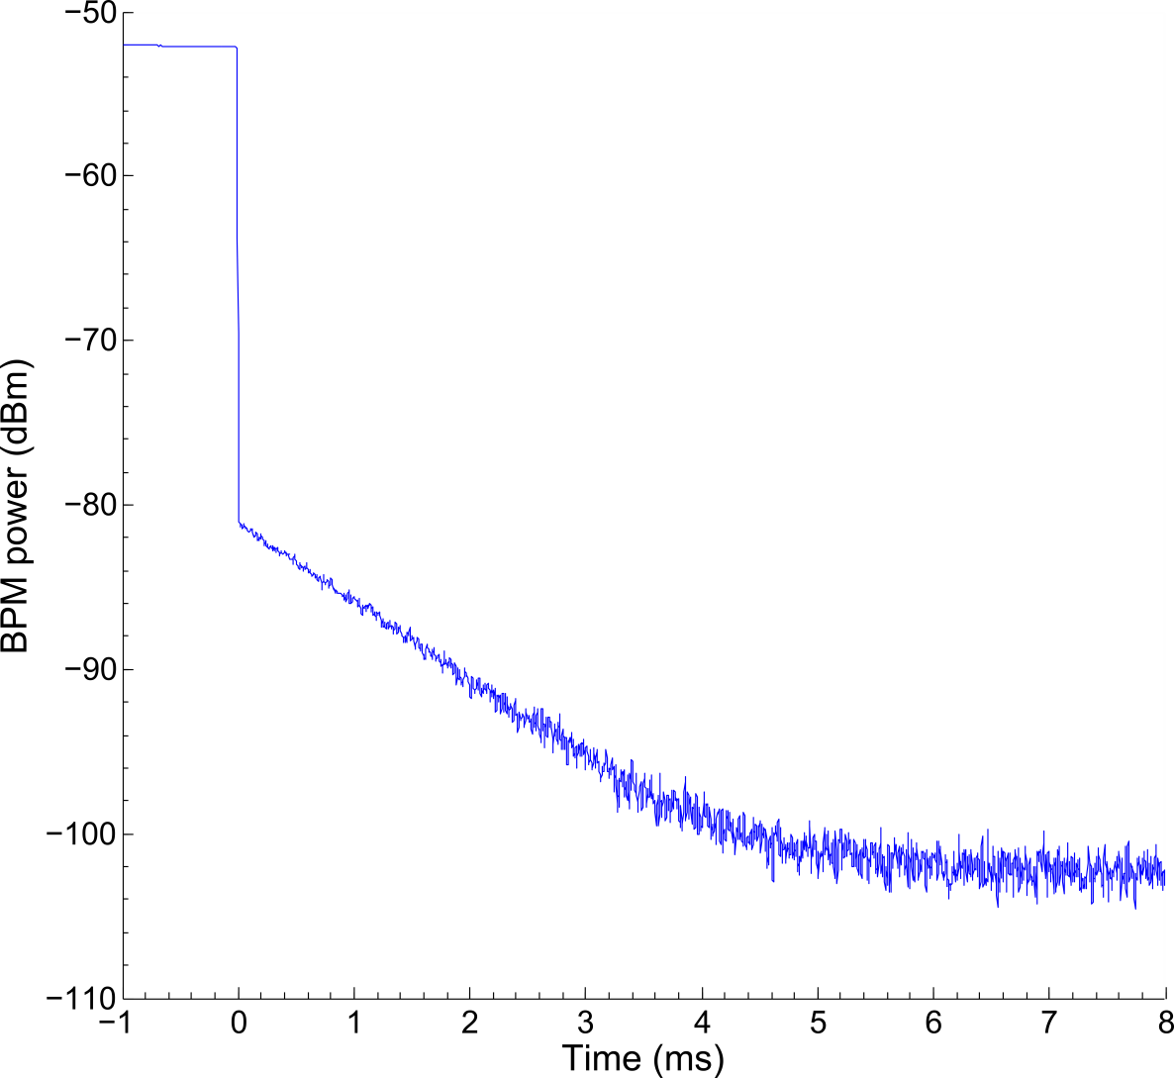
Example raw data
Modulation frequency = 10.03 MHz
Loaded Q/f ≈ 5 × 10⁶ GHz⁻¹
Notes:
Here is an example of a decay seen on the spectrum analyser connected to the BPM. When the modulation is turned off, the power drops suddenly but does not reach the noise floor. Instead it stops at a peak power and then decays with a characteristic time factor.

Slide 13
Scanning details
BPM Signal
Problem: Is this off resonance, or just a really big/small Q?
Big Q modes (slow decay, narrow resonance)
Depending on scan step size, modes will be missed anyway
May appear flat unless scan length is chosen appropriately
Small Q modes (fast decay, wide resonance)
Need larger SA bandwidth, which hurts noise floor
So, what SA bandwidth is the best choice?

Slide 14
Choosing scan parameters
Scan step size is determined by beam time
  Single frequency takes ∼20 seconds
  10 kHz steps = 14 hours for single data set
10 KHz steps
  Δf_{min} ∼1 kHz
  Q_{max} ∼10⁶−10⁷
  Scan length ∼1-10 ms
0.1-1 MHz SA bandwidth
  Q_{min} ∼10³⁻10⁴

Slide 15
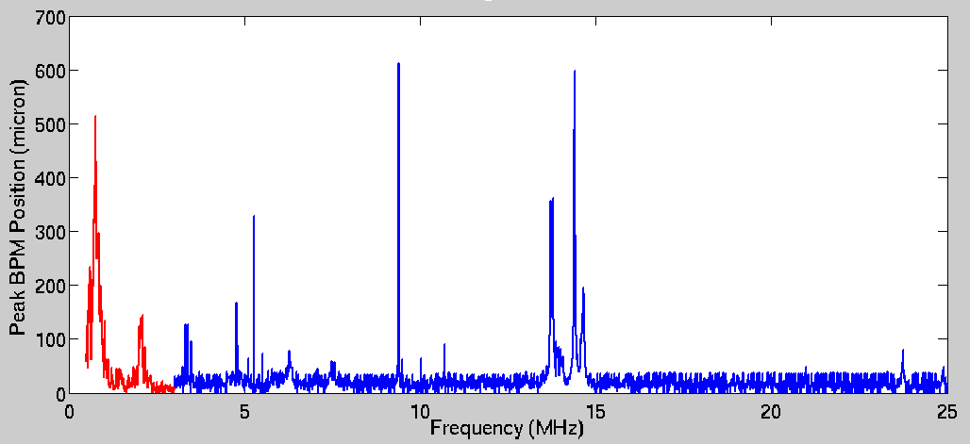
Broad scan
10 kHz steps
SA bandwidth: 100 kHz (red), 1 MHz (blue)
Found lots of peaks!

Slide 16
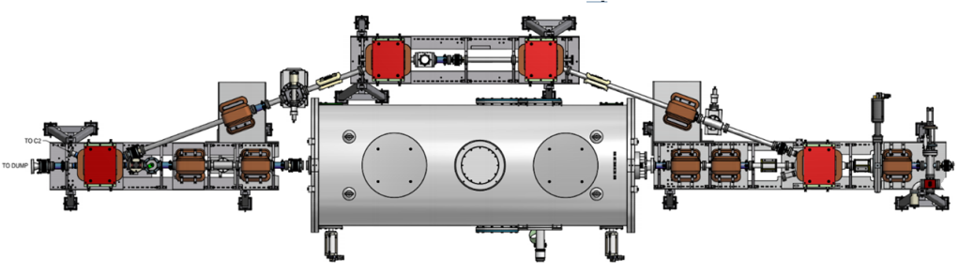
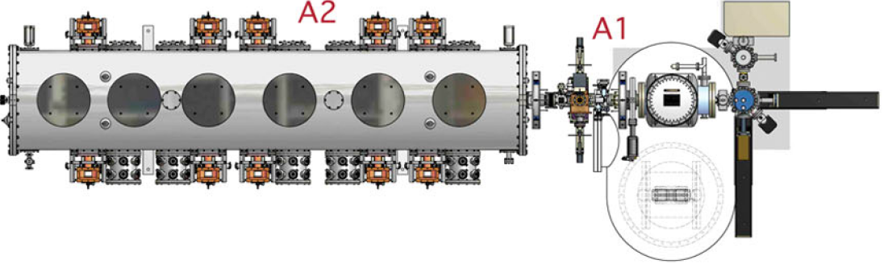
But there are other cavities…
The beam also passed through the ICM cavities
Repeat all scans with BPM before the HTC
Last BPM before HTC

Slide 17
Modes actually in HTC
One of the peaks in this group
These peaks

Slide 18
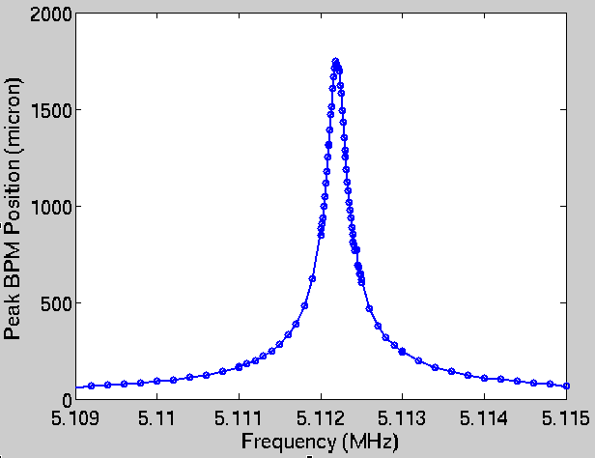
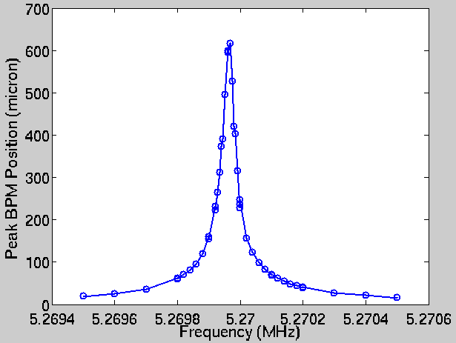
Next step: fine scan
Find peak frequency from field probe on 2nd SA
Double check expected peak width
Q/f = 4.9x10⁶ GHz⁻¹
Q/f = 3.3x10⁷ GHz⁻¹

Slide 19
List of modes found in the ERL 7-cell
Modulation frequency f_{mod} (Mhz) | Mode frequency f (GHz) | Quality factor Q | Mode width ∆f (KHz)
5.27 | 1.295 | 4.3x10⁷ | 0.030
10.03 | 2.290 | 1.3x10⁷ | 0.18
3.36 | 2.303 | 8.3x10⁶ | 0.28
24.30 | 2.476 | 4.7x10⁶ | 0.12
10.70 | 2.489 | 1.7x10⁶ | 1.5
5.52 | 2.494 | 2.0x10⁷ | 0.12
5.11 | 2.495 | 1.1x10⁷ | 0.22
8.86 | ? Not found | 1.5x10⁴ (GHz⁻¹) | 70
M
A
B
?
Notes:
Here’s the grand list. We can divide these into four groups.
The first is our one lonely monopole mode.
The second two lie within the first quadrupole passband
The third group lies in the second quadrupole passband. Our two strongest modes are also found here, at 5.52 and 5.11 MHz modulation frequency
And finally, our mystery mode. This is also our weakest mode, which might be why we can’t find it on the HOM coupler.

Slide 20
The mode landscape
Where our modes lie amongst simulation and data from HTC-1 (no HOM loads present)
Notes:
This plot shows the expected Qs of the modes (and their nature) in HTC-1
It also shows the location of modes found using the NA. Their nature is unknown.
6 of the 8 modes could be placed on this plot.
Two lie within the first quadrupole passband. One is highly likely to be a quadrupole, although the second could be an enhanced dipole.
The other four lie inside or within reach of the second quadrupole passband. However, almost all of these have a chance of being either an enhanced dipole or a quadrupole.

Slide 21
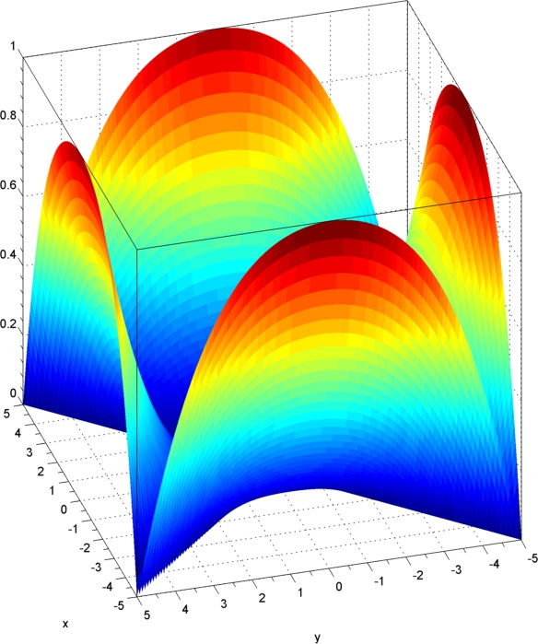
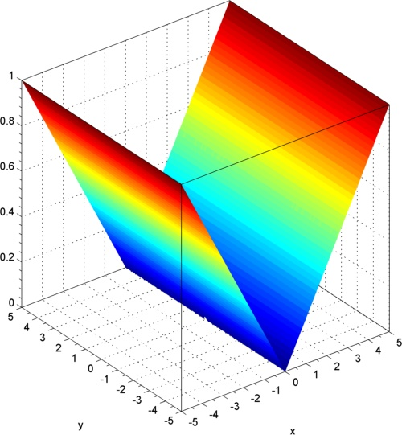


Expected kick landscape
By moving the beam, we can determine the position-dependence of the mode
Dipole:
$$\left|{Δr}_{kick}\right|∝r \left|\cos\left( θ\right)\right|$$
Quadrupole:
$$\left|{Δr}_{kick}\right|∝r^{3} \left|\cos\left( 2 θ\right)\right|$$
Kick
Kick
x
x
y
y
Notes:
Here’s what a dipole should look like. We see the linear dependence, and one azimuthal zero. The x and the y axes give the distance from the centre of the mode, and the magnitude of the kick is given on the z axis

Slide 22
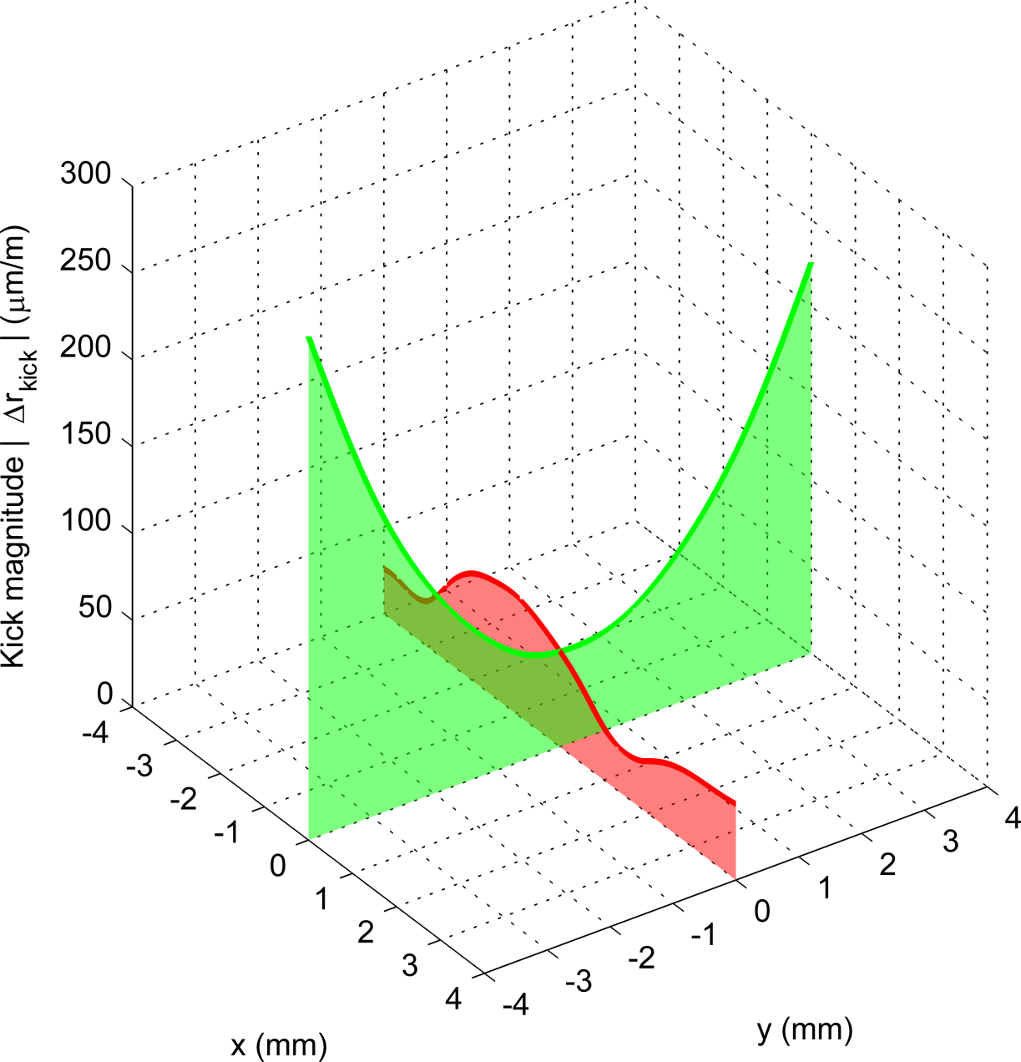
But, the data is confusing…
Mode at 2.494 GHz, second Quadrupole passband
Notes:
Here’s an example. This mode is pretty likely a quadrupole mode.
In fact, the x-axis has an almost perfect cubic dependence.
The directions indicate that this should likely be a quadrupole mode.
But! 1) Why doesn’t the kick go to zero at the centre?
2) Why doesn’t the kick go down to the noise floor?
3) Where are the azimuthal zeroes we were promised?

Slide 23
Conclusions
A beam-based method for detection of HOMs was successfully demonstrated
The frequency of the detected modes strongly suggests that they are all quadrupoles
However, fitting is inconclusive, precluding determination of R/Q

Slide 24
Thank you for listening
Acknowledgements
Daniel Hall
Matthias Liepe
Mike Billing
John Dobbins
Ivan Bazarov
Georg Hoffsteatter
Nicholas Valles
Ralf Eichhorn

Slide 25
Extra slides

Slide 26
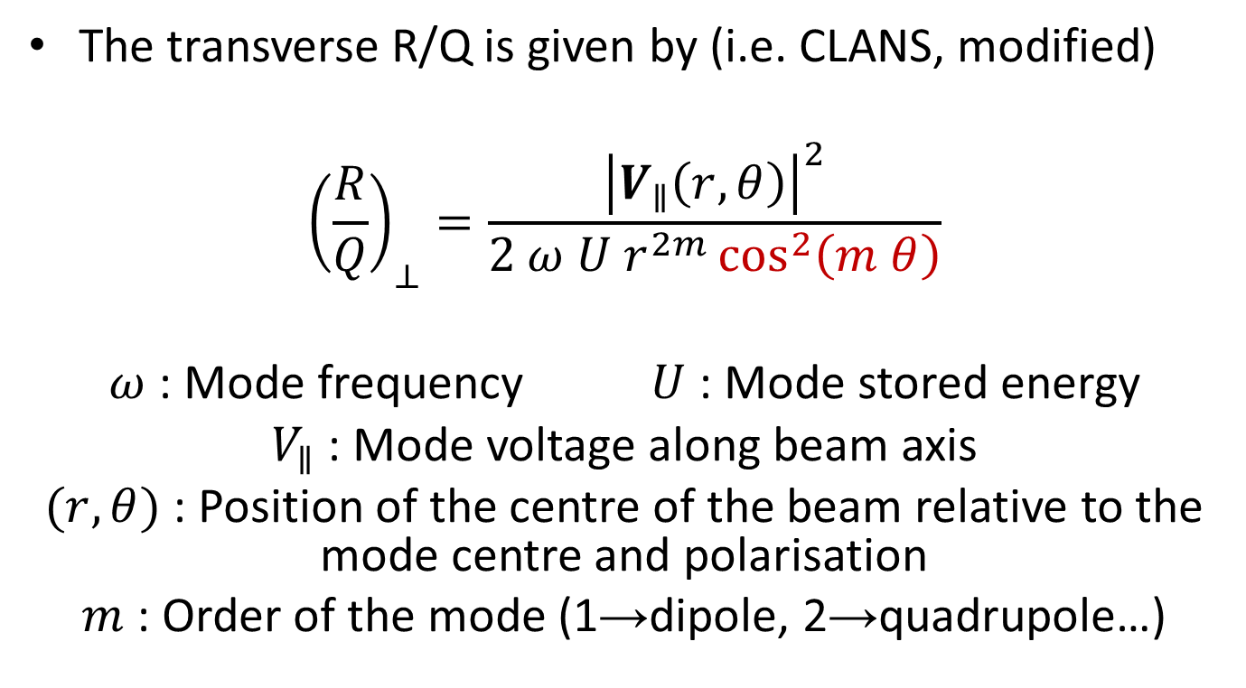
Characteristic factor: the R/Q
The transverse R/Q is given by (i.e. CLANS, modified)
$${\left(\frac{R}{Q}\right)}_{⊥}=\frac{{\left|V_{∥}\left(r,θ\right)\right|}^{2}}{2 ω U r^{2m}\cos^{2}\left(m θ\right)}$$
$ω$ : Mode frequency $U$ : Mode stored energy
$V_{∥}$ : Mode voltage along beam axis
$(r,θ)$ : Position of the centre of the beam relative to the mode centre and polarisation
$m$ : Order of the mode (1→dipole, 2→quadrupole…)
Notes:
Here is the circuit definition of R/Q, as used in the code CLANS, modified to take into account that the mode might not necessarily be polarised in the same angle as the beam.
This definition of R/Q, which uses the circuit definition and hence includes a factor of 2, is normalised to the distance from the centre of the mode.
On top of this, we have to also normalised for the polarisation of the mode relative to the beam.

Slide 27
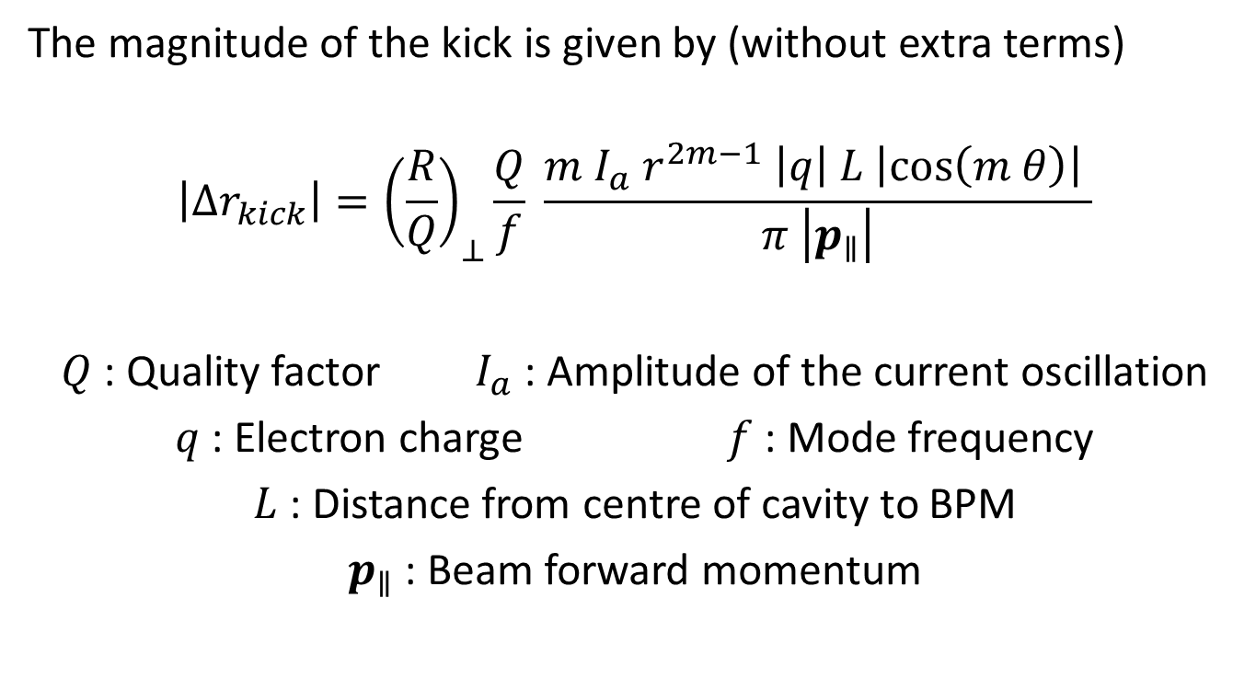
Magnitude of the HOM kick
The magnitude of the kick is given by (without extra terms)
$$\left|{Δr}_{kick}\right|={\left(\frac{R}{Q}\right)}_{⊥}\frac{Q}{f} \frac{m I_{a} r^{2m−1} \left|q\right| L \left|\cos\left(m θ\right)\right| }{π \left|p_{∥}\right|}$$
$Q$ : Quality factor $I_{a}$ : Amplitude of the current oscillation
$q$ : Electron charge $f$ : Mode frequency
$L$ : Distance from centre of cavity to BPM
$p_{∥}$ : Beam forward momentum
Notes:
It is possibly, in theory, to use the magnitude of the kick as a function of the position of the beam in the cavity to determine the nature and R/Q of the mode excited.
From the Panofsky-Wenzel theorem we can obtain a formula that tells us how we expect the mode to kick
This formula gives the magnitude of the peak kick from a mode.
We see that as we increase the amplitude of the driving current, this kick increases – of course, we’re putting more energy into the mode.
We have an L term – the further we are from the cavity, the bigger this kick will look.
The further we get from the centre of the mode, the greater the kick
If we go bang through the centre of the mode, or along one of it’s azimuthal zeroes, we will get no kick whatsoever. Since the cavity is not perfectly axially symmetric, we can expect this to happen since the polarisations will be frozen.

Slide 28
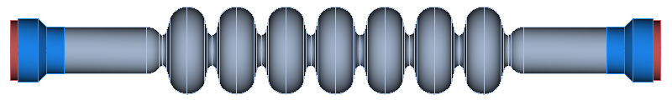
The Main Linac Cavity
Developed from the ILC TESLA design
Solid niobium cavity – operating at 1.3 GHz
4 sectors of the cavity were optimised to maximise the current at which BBU onsets
Beam
pipe
Centre cells
End cells
HOM load
Notes:
The 7-cell ERL cavity is based upon the ILC TESLA design.
It is a solid niobium cavity, with an operating mode frequency of 1.3 GHz.
To optimise the beam for operation at 100 mA operation, and to maximise the threshold current at which BBU onsets, we consider the geometry of 4 (animate) different sectors of the cavity:
The HOM loads, which determine specific mode losses,
The beam pipe, which determines the linac fill factor and fundamental mode losses,
The centre cells, which determine the general properties of the HOM spectrum,
The assymetric end cells, which are responsible for coupling HOMs to the HOM absorber as well as preventing trapped modes.
Here is what the cavity looks like once fabricated.

Slide 29
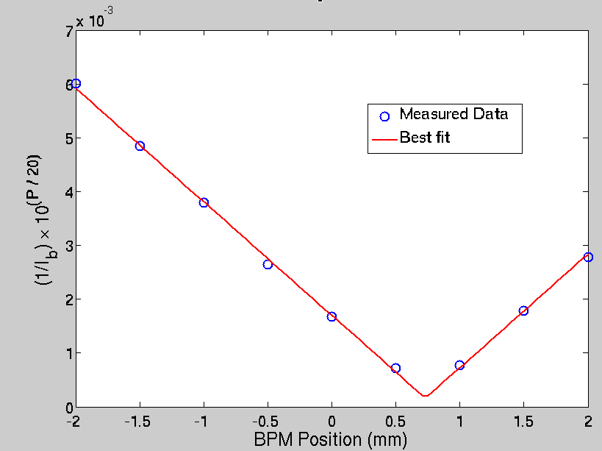
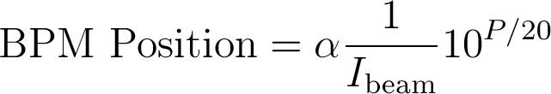
What can we find?
SA noise floor: P ~ -100 dBm
Noise floor ~ 5 μm @ 2 mA

Slide 30
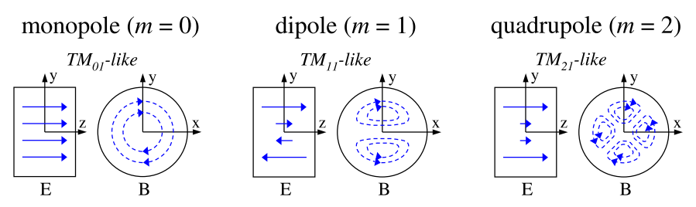
How do we expect the mode to kick?
The direction of the kick is given by the field pattern of the mode
Kick is perpendicular to the magnetic field at that point, with a magnitude determined by the coupling
Notes:
So long as there are no longitudinal zeroes in the mode, the kick should be predominantly due to the magnetic field.
To first order, monopoles do not kick.
Dipoles are particularly dangerous since they have a kick even on axis, although there is no coupling there.
The direction of the kick is perpendicular to the magnetic field, as given by the Lorentz force.

Slide 31
Breaking symmetry
If the cavity has perfect symmetry, the mode can have any polarisation and the kick is always inward/outward for any m > 0
But the couplers break symmetry!
We can expect to see azimuthal zeroes as we move our beam
Knowing the polarisation of the mode is crucial in getting the correct R/Q
Notes:
If a cavity has perfect symmetry – as it would do in CLANS – then the mode can have any polarisation, and will always angle itself for strongest coupling.
However, the presence of couplers and machining defects will break this symmetry
Dipoles, Quadrupoles, will now split into their various polarisations. For modes with frequencies in the GHz region, this splitting can be anything up to a few 10s of KHz.
This means that we can excite each polarisation independently. We should now expect to see azimuthal zeroes in our modes.
Knowing the polarisation of the mode is now crucial for obtaining the R/Q of the mode

