Slide 1


Time-Dependent Ginzburg Landau simulations to guide Nb3Sn SRF cavity development
Mark Transtrum
Nb3SnSRF’20

Slide 2
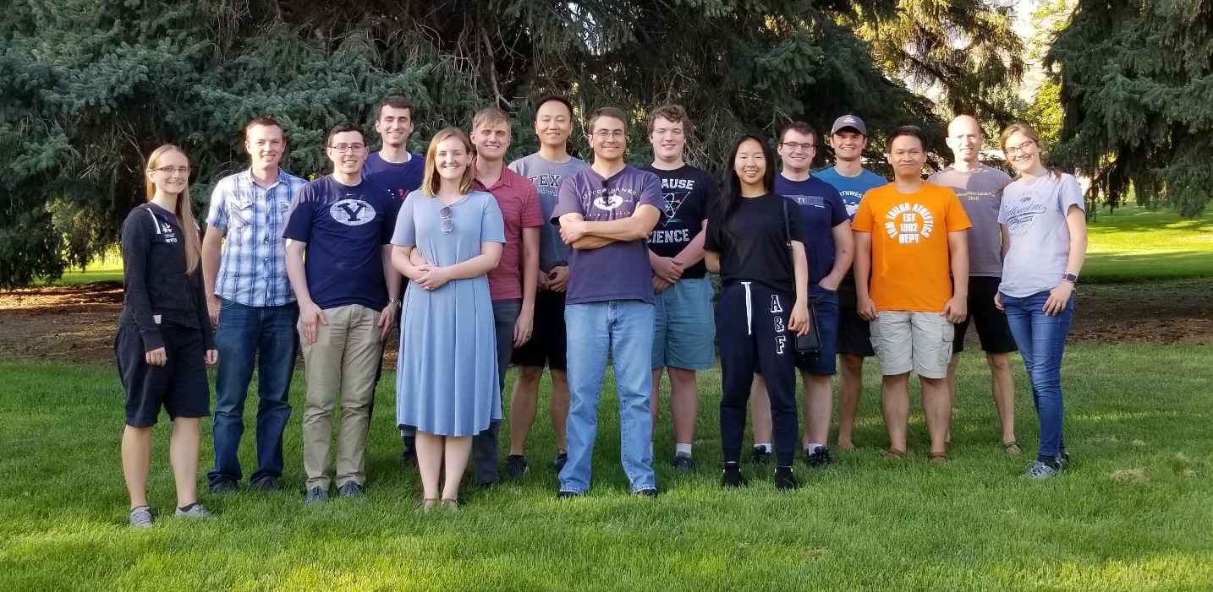

Acknowledgements
Alden Pack (former grad, Sandia)
Jared Carlson (former UG, Michigan State)
Spencer Wadsworth (former UG, Iowa)
Ben Francis (Post-doc)
Aiden Harbick (Grad)
Braedon Jones (UG)
Cole Abbott (UG)
Reese Clawson (UG)
Recent References:
arXiv:2003.03362 (2020)
Physical Review B, 101(14), 144504 (2020)
Superconductor Science and Technology 30 033002 (2017)
Physical Review B 94 144504, (2016)
Physical review applied, 4(4), 044019 (2015)
arXiv:1309.3239 (2013)
Physical Review B. 83 094505, (2011)
Collaborators:
Jim Sethna
Danilo Liarte
Tomas Arias
Richard Hennig
Sam Posen
Matthias Liepe

Slide 3
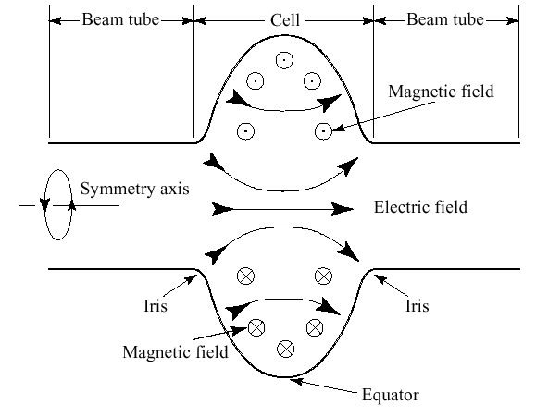
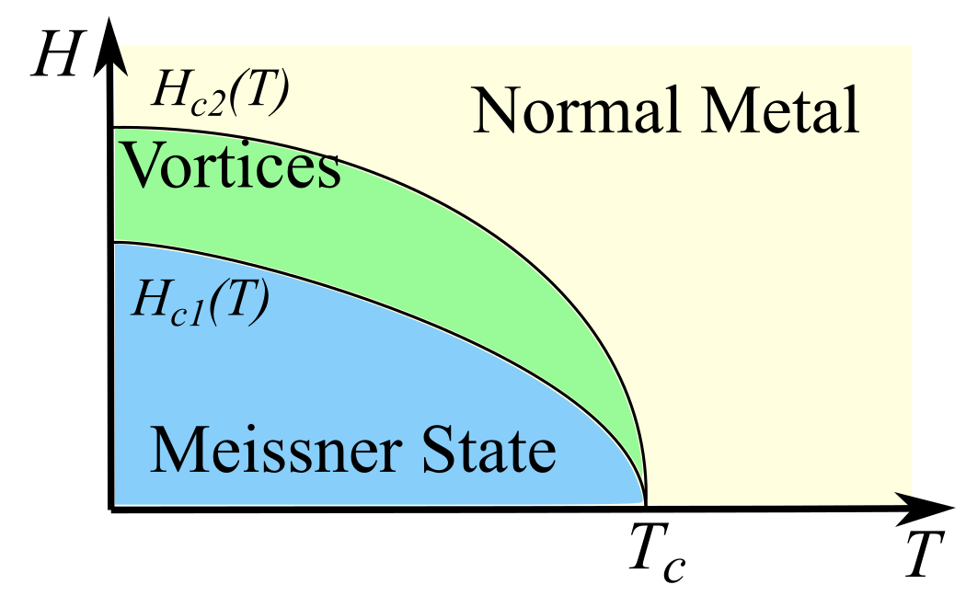
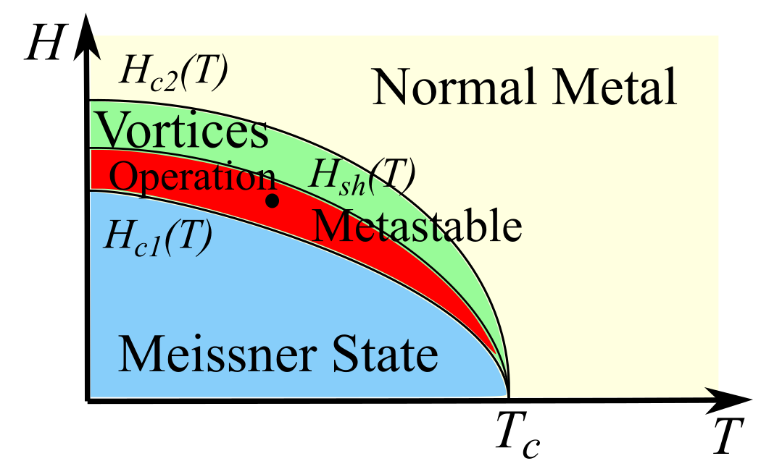
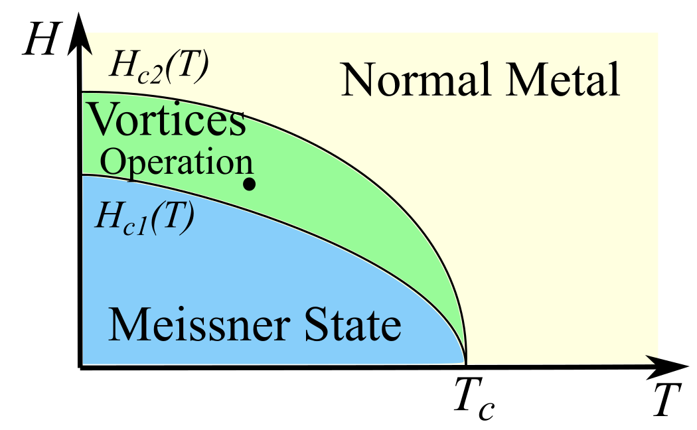
Superconducting RF Cavities
Superconductivity enables efficient RF cavities for particle acceleration
Performance is limited by breakdown of the Meissner state in high magnetic fields
Traditional Nb cavities can operate above H_{c1}.
Meissner state is metastable up to the Superheating field, H_{sh}.
Which factors limit performance in Nb₃Sn cavities?

Slide 4
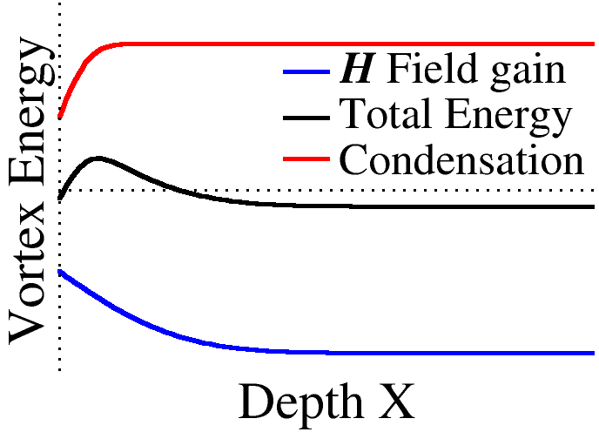
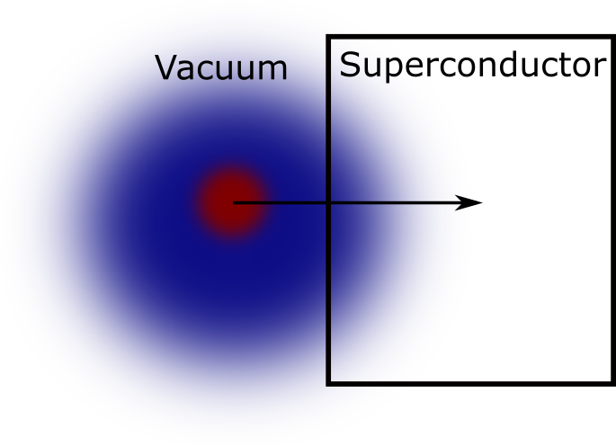
Metstability in SRF vortex nucleation
Energy balance:
  Normal metal = “Cost”
  Magnetic fields = “Pay off”
Surface effect:
  Barrier to vortex nucleation
  Pay the “cost” of the core first
  “Payoff” of the magnetic field comes later

Slide 5
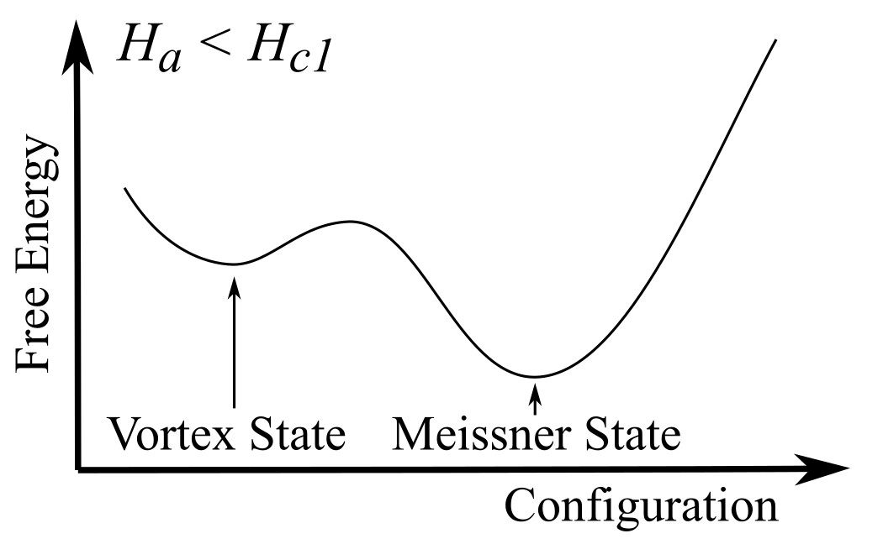
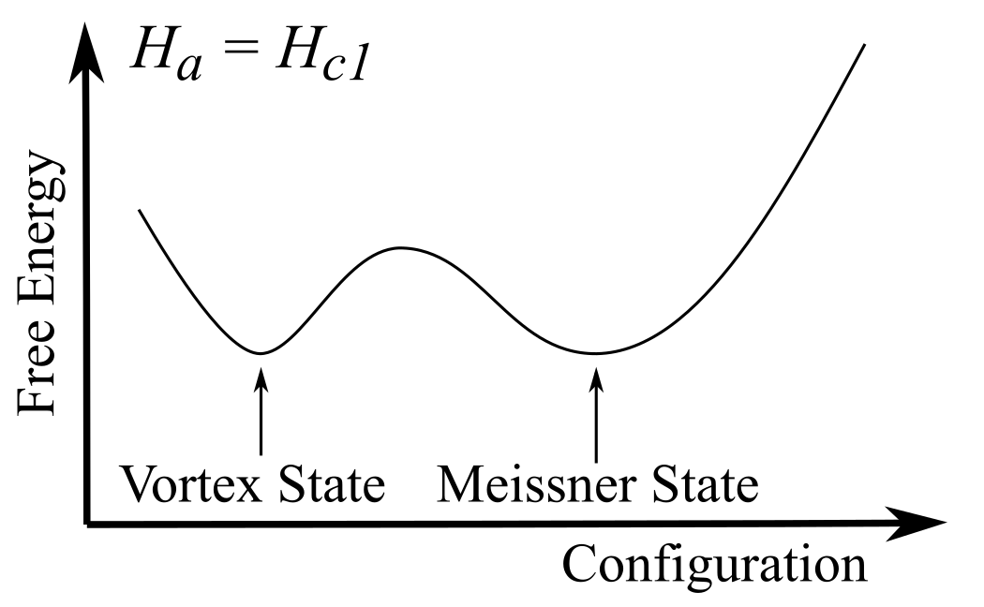
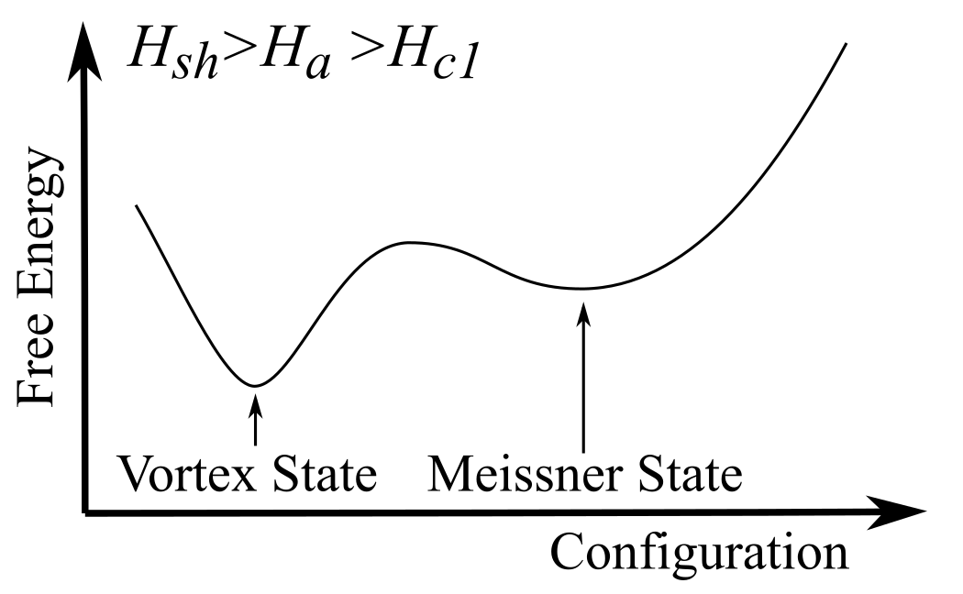
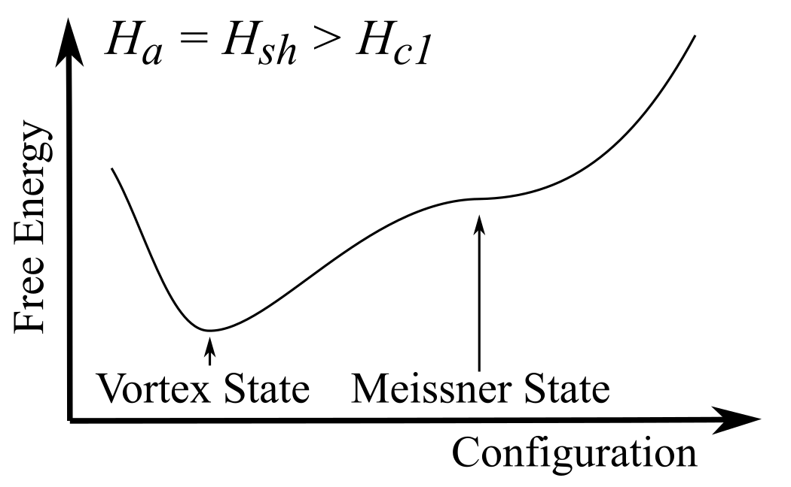
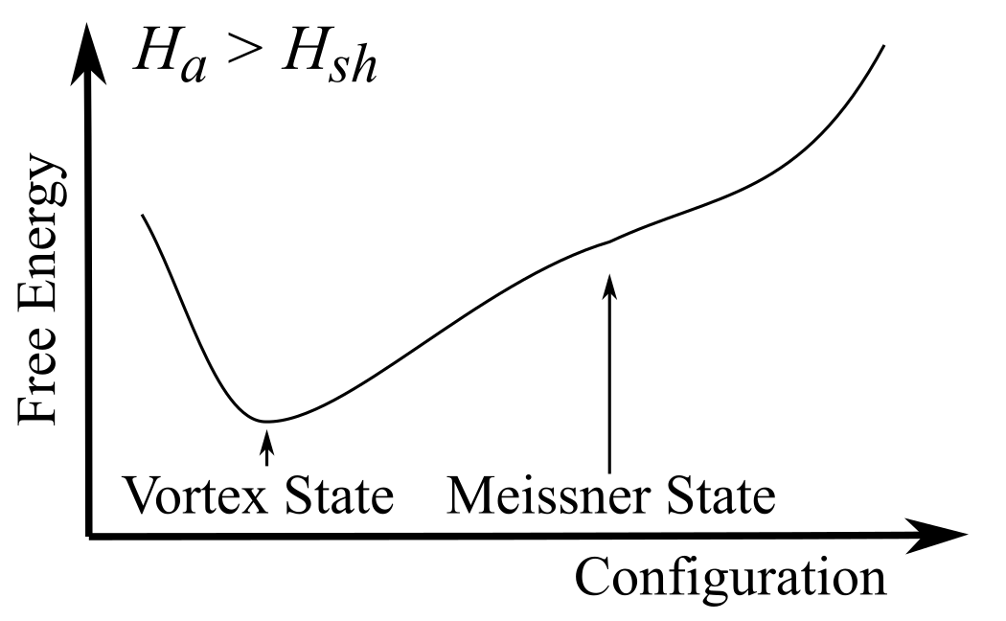
Calculating Hsh: Stability Analysis
Absolute minimum of the Free Energy changes at H_{c1}.
Meissner state is a local minimum up to H_{sh}
Meissner state is a saddle point at H_{sh}
To calculate H_{sh}:
  Choose a model (Free Energy)
  Solve for Meissner state (first variation = 0)
  Check if second variation is positive

Slide 6
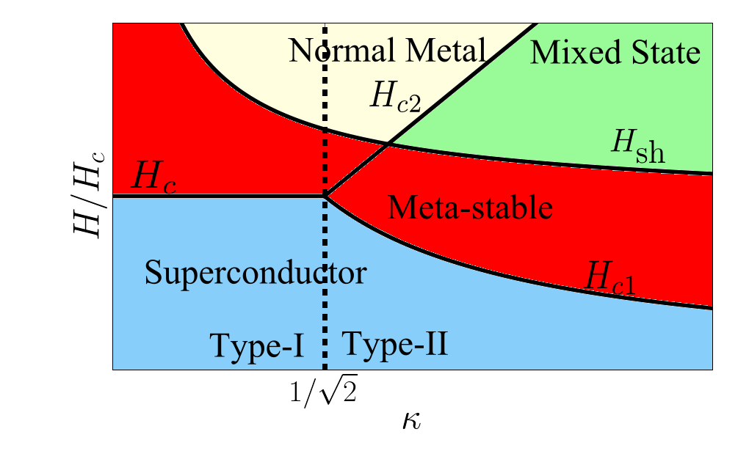
Some Previous Results
Ginzburg-Landau theory:
  Physical Review B. 83 094505, (2011)
Eilenberger theory:
  Catelani, Sethna. Physical Review B 78.22 (2008)
  Lin, Gurevich. Physical Review B 85.5 (2012): 054513.
What kinds of imperfections are most relevant for limiting vortex nucleation in real samples?
Sample specific H_{sh}

Slide 7
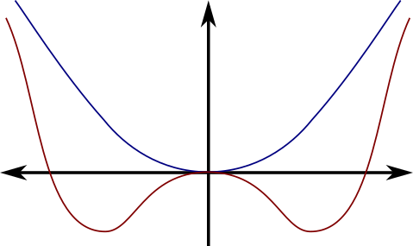



Time-Dependent Ginzburg-Landau
$F=∫d^{3}x \left\{f_{n0}+α{\left|ψ\right|}^{2}+ \frac{β}{2}{\left|ψ\right|}^{4}+ \frac{1}{2m}{\left|\left(\frac{ℏ}{i}∇− \frac{e}{c}A\right)ψ\right|}^{2}+ \frac{h^{2}}{8 π}\right\}$
$Γ\left(\frac{dψ}{dt}+\frac{2ie φ}{ℏ}ψ\right)=−\frac{δF}{δψ}$
Phenomenological/Material Parameters:
  $α\left(T\right)∝H_{c}^{2}λ^{2}$
  $β\left(T\right)∝H_{c}^{2}λ^{4}$
  $m$ = effective mass of a cooper pair
  $Γ$ = characteristic relaxation time
Spatially varying material parameters model inhomogenous superconductors.
  Incorporate experimental characterization
  Theoretical calculations, i.e., DFT
$$T>T_{c}$$
$$α>0$$
$$T<T_{c}$$
$$α>0$$

Slide 8
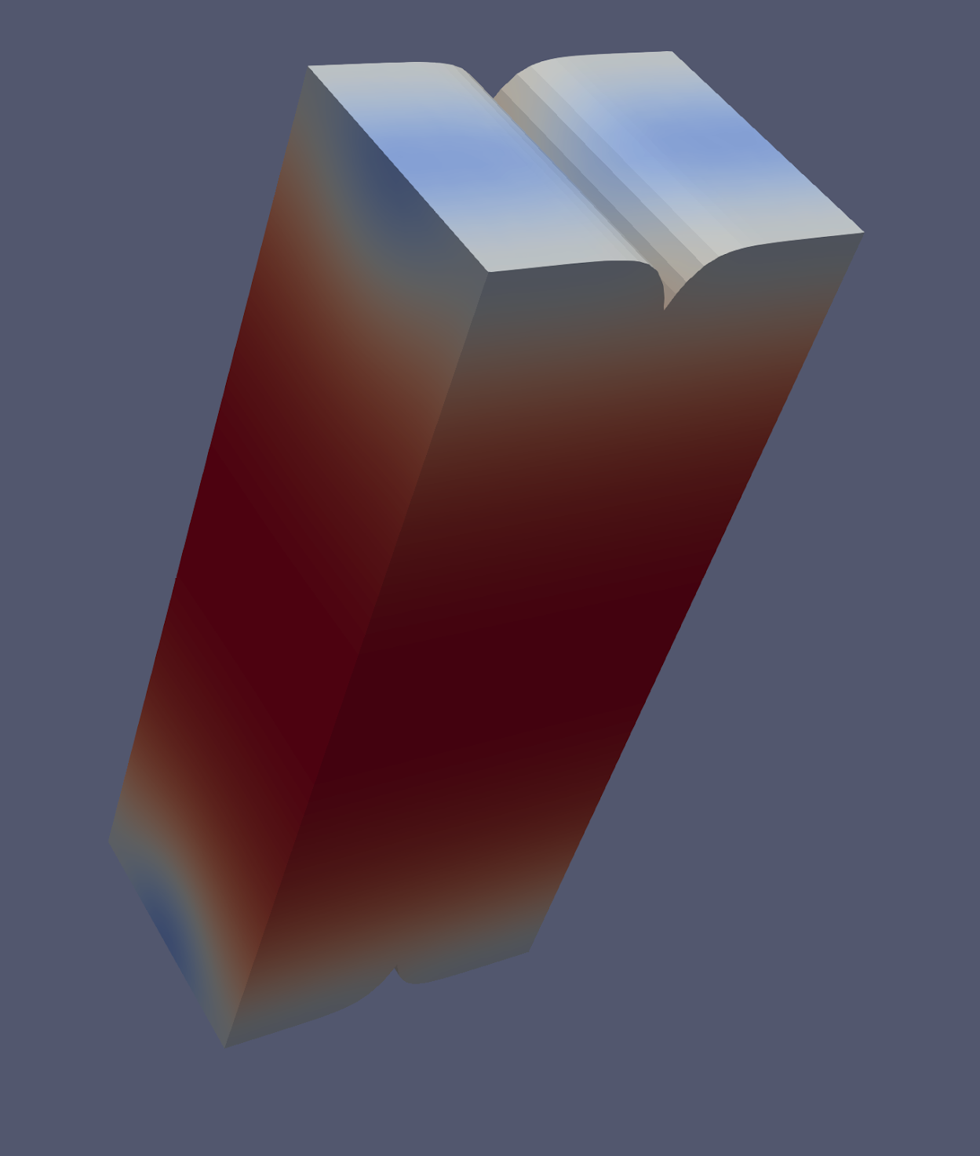
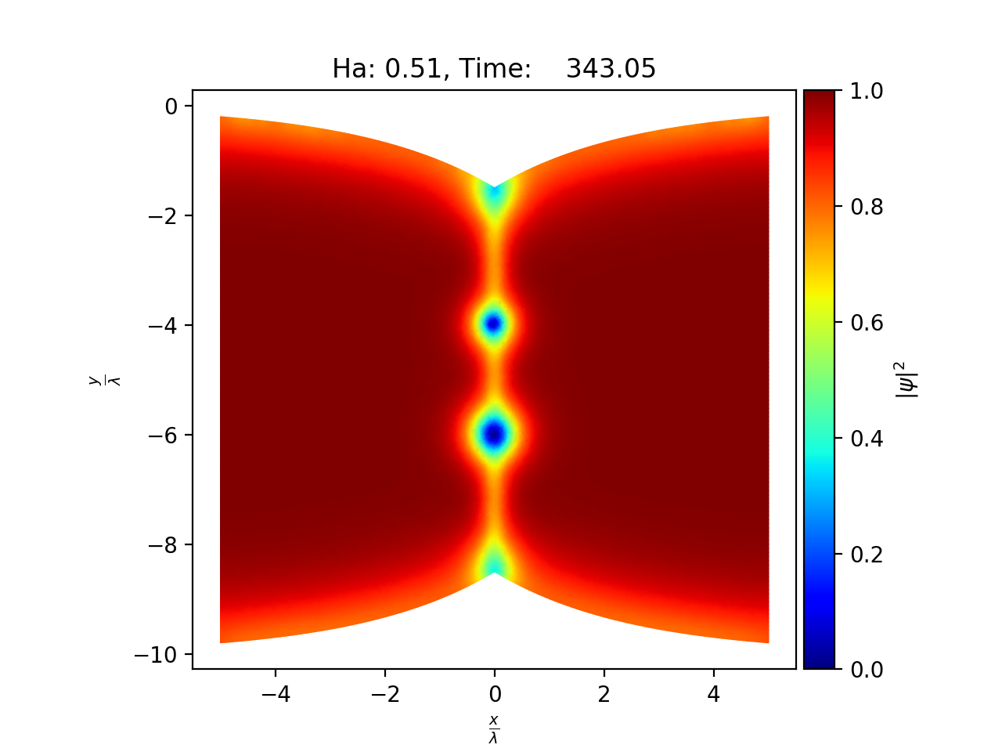
Simulation Geometries
Finite-element formulation
  Enables complicated geometries
  Spatially varying material parameters
  Recent theoretical advances
Two dimensions:
  xy-plane (symmetry in z)
  Cylinder
  Film: Periodic in x
Three dimensions
  Periodic in x and y

Slide 9
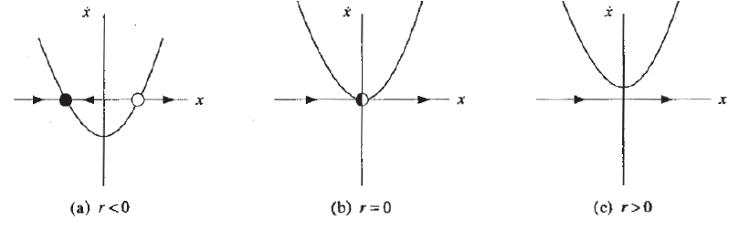

Calculating H_{sh} from dyanmics: Bifurcation analysis
The superheating transition is a saddle-node bifurcation
Normal form: $\frac{dx}{dt}=r+x^{2}$
For $r<0$:
  Two equilibrium points: $Ha<Hsh$
For $r=0$
  One equilibrium: $Ha=Hsh$
For $r>0$
  No equilibrium points: $Ha>Hsh$

Slide 10

Calculating Hsh from dyanmics: Bifurcation analysis
Normal form: $\frac{dx}{dt}=r+x^{2}$
Near the stable equilibrium (Meissner) state, the system relaxes to equilibrium with a characteristic time scale $∼1/\sqrt{r}$.
Algorithm:
Calculate the Meissner state
Estimate r from the decay of small perturbations
Repeat 1-2 for multiple applied fields.
Extrapolate to $r=0$.

Slide 11
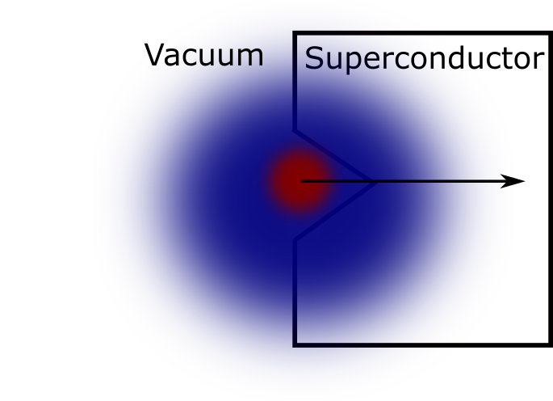
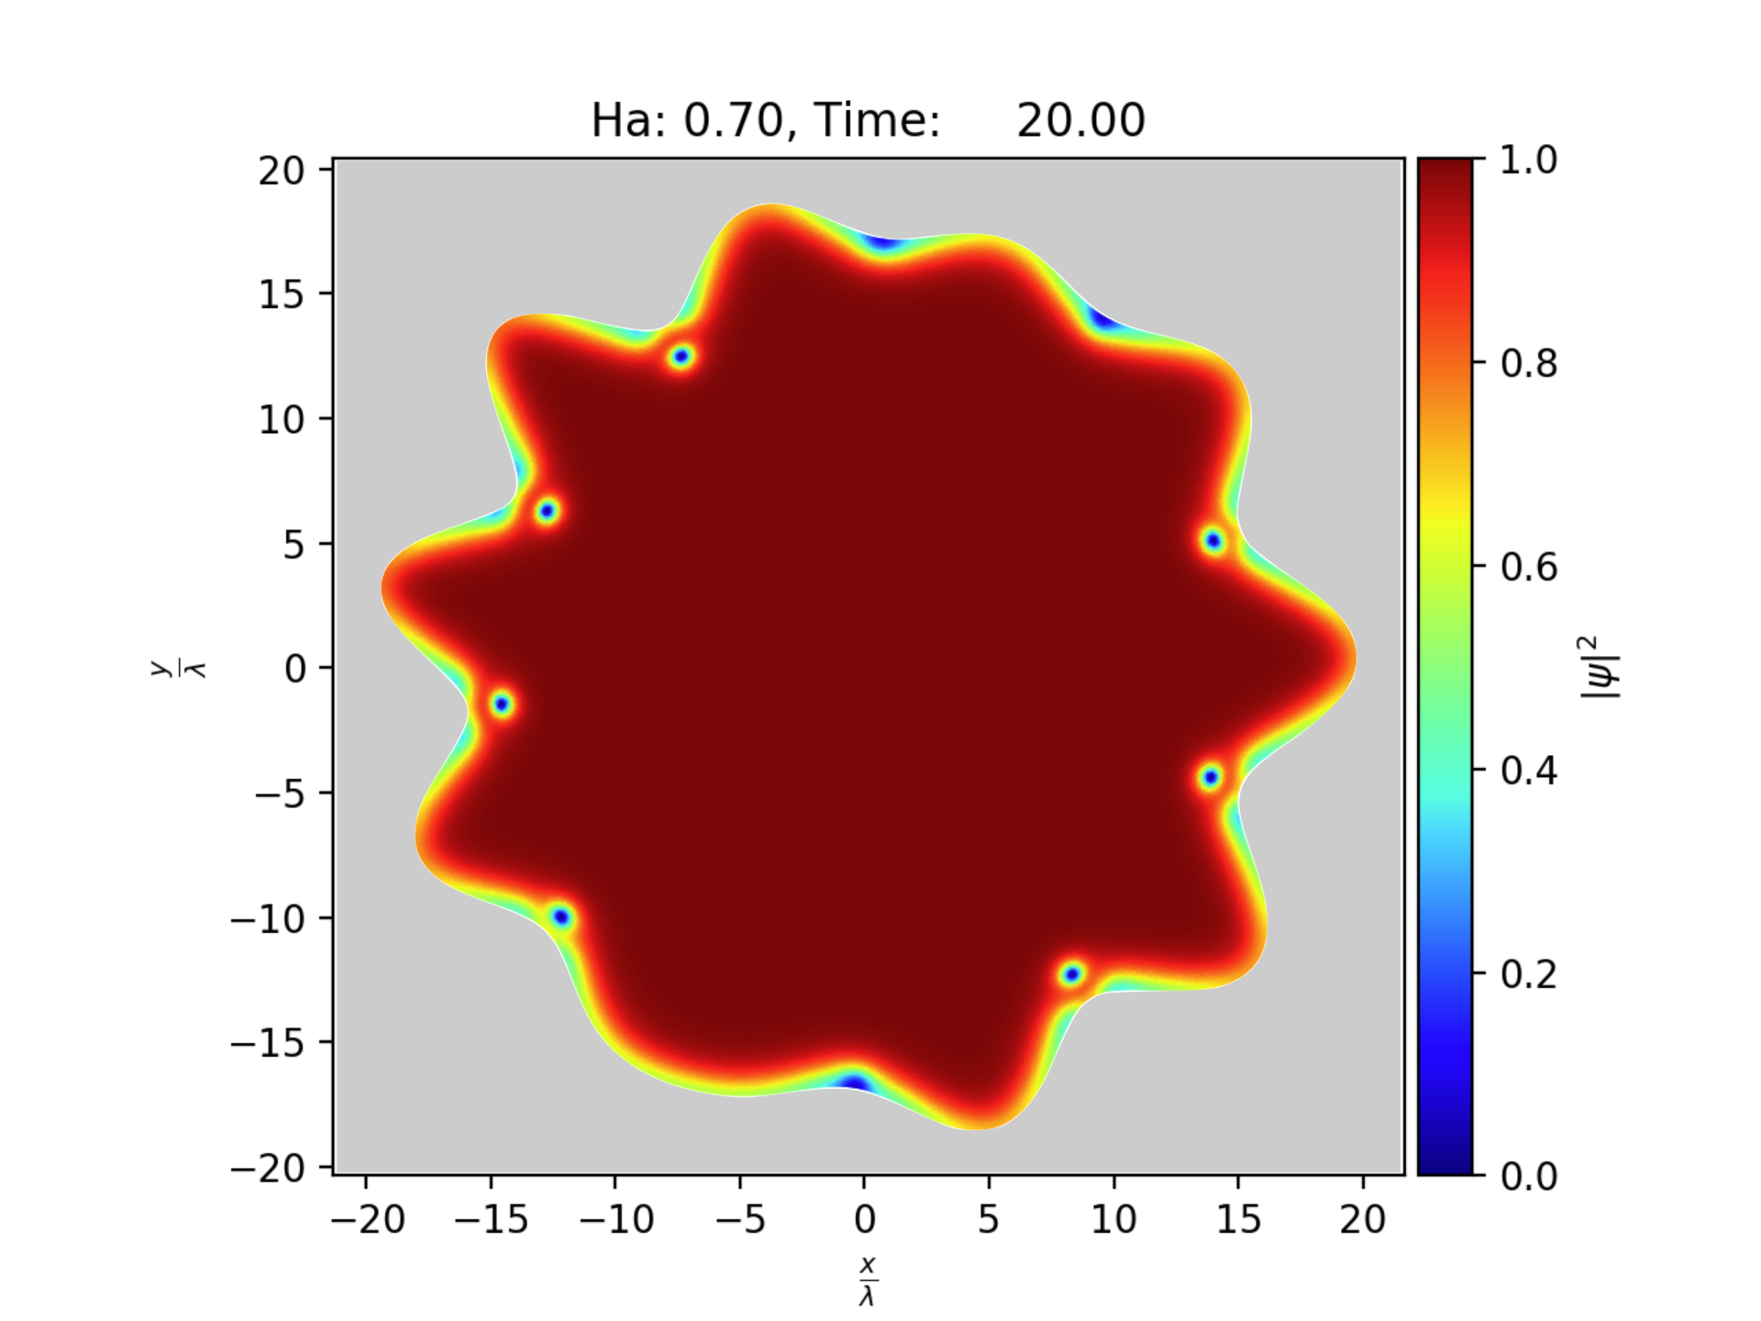
Surface Roughness in two dimensions
Divots realize the “pay off” from the magnetic field sooner.
Vortices tend to nucleate in concave regions.
Magnetic field must be aligned with the divot.

Slide 12
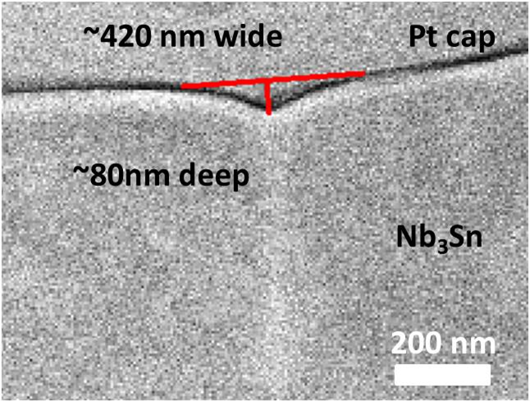
Single Divots
Divots form at grain boundaries
Angle determined by the orientation of the crystalline axes
Dangerous divots are deep and narrow
Realistic geometries lead to ~25% reduction in H_{sh}

Slide 13
Magnetic Field orientation
When divots are not aligned with the magnetic field, they are less dangerous.
Future work: Field enhancement effects

Slide 14
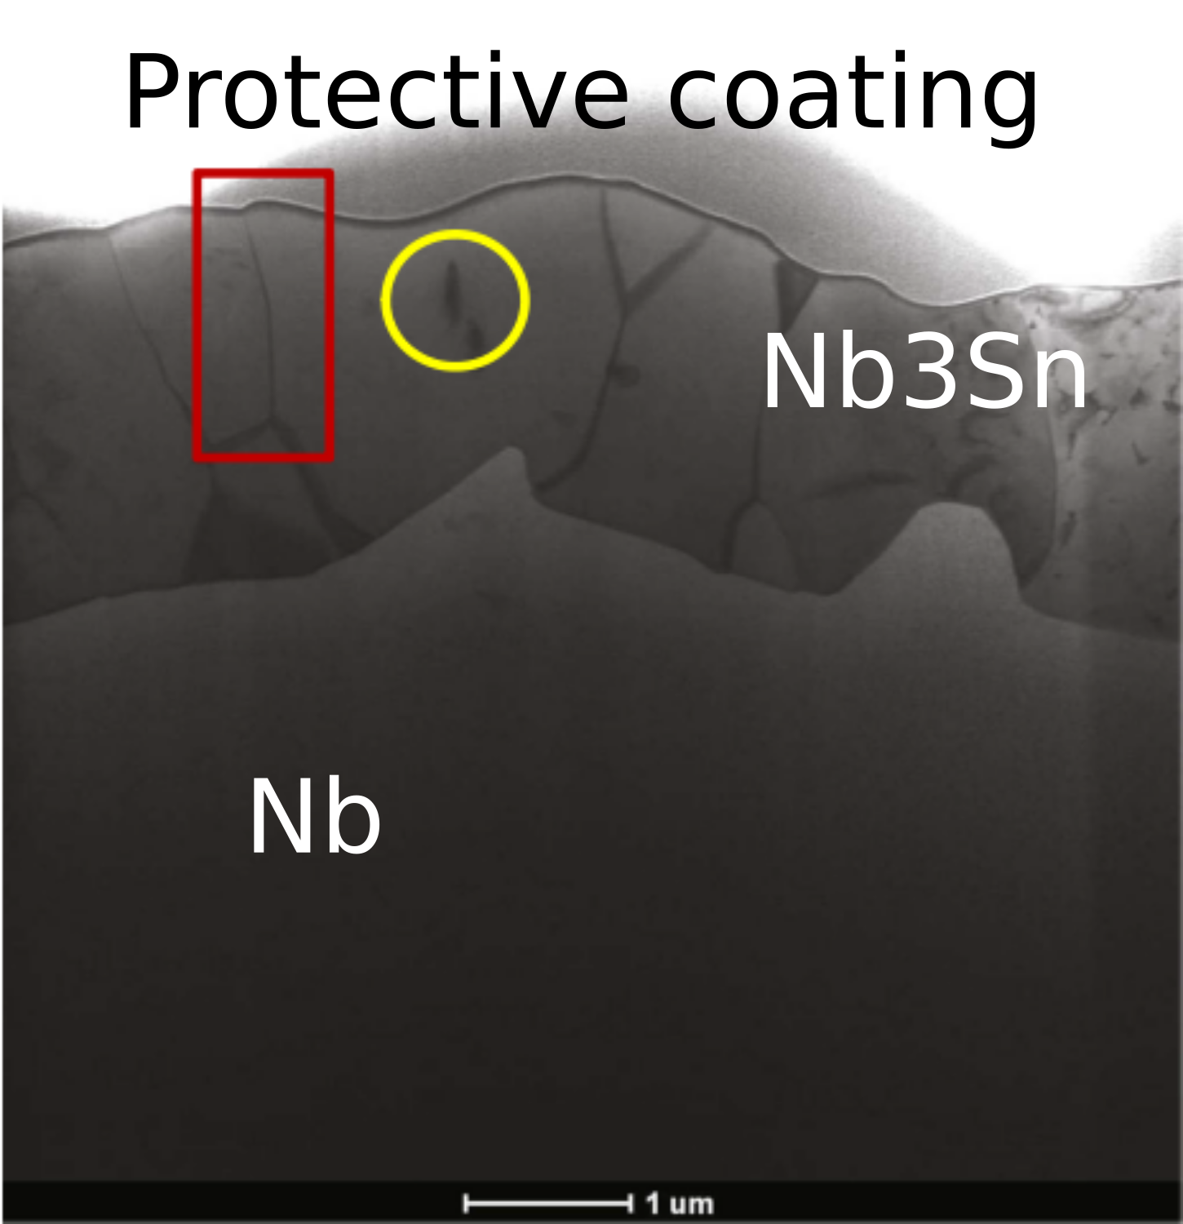
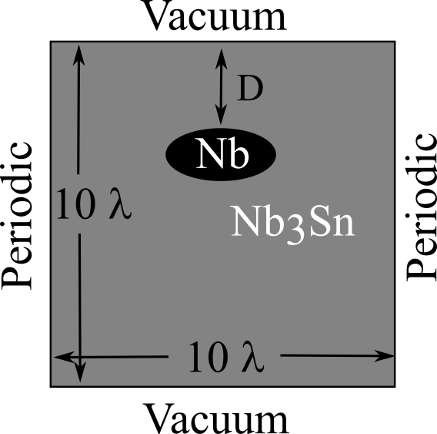
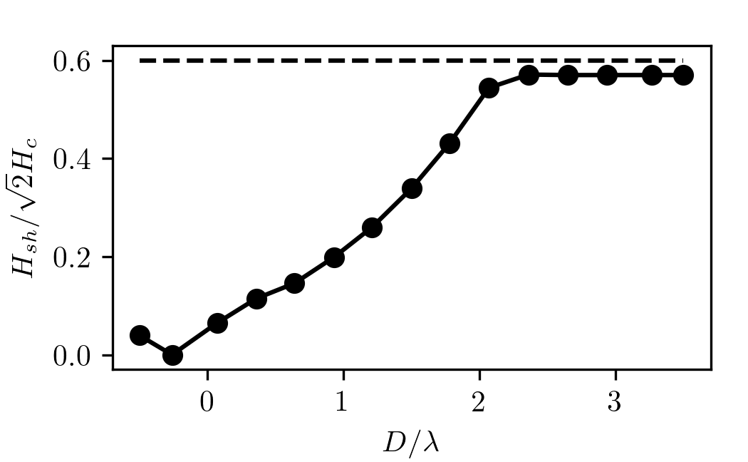
Material Inhomogeneity:
Sn-poor islands
(Braedon Jones, Preliminary)
Empirical observation: Islands of low Sn concentration
Simulations suggestion:
  Islands begin to degrade performance if within a few 100 nm of surface
  Island size/shape less significant
  Significant degradation for islands near surface.

Slide 15
Beyond stability: Dynamics

Slide 16
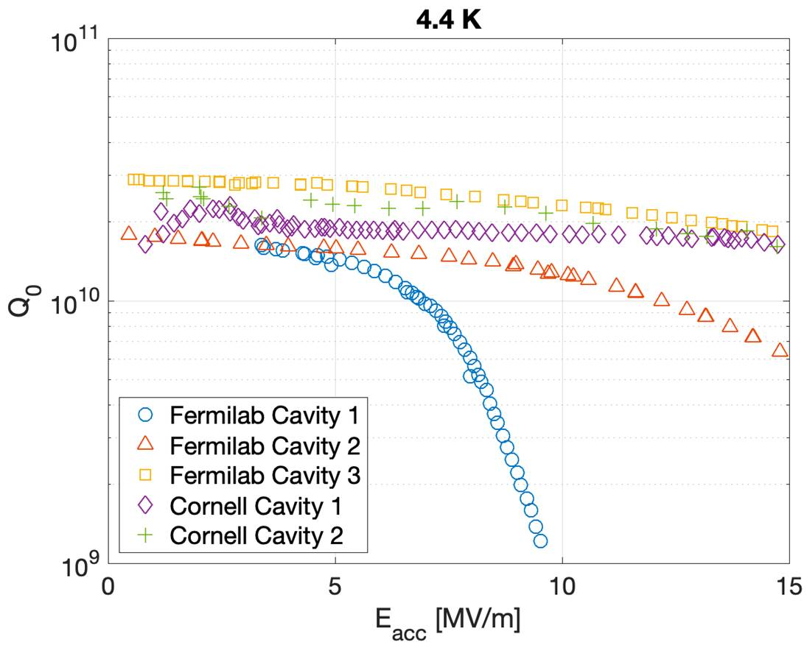
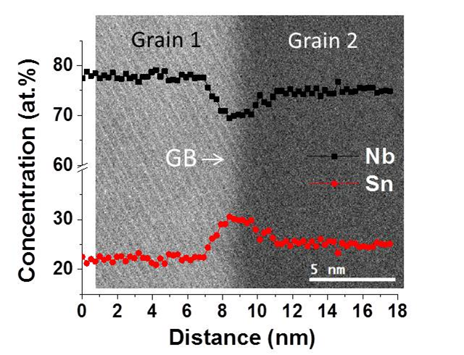
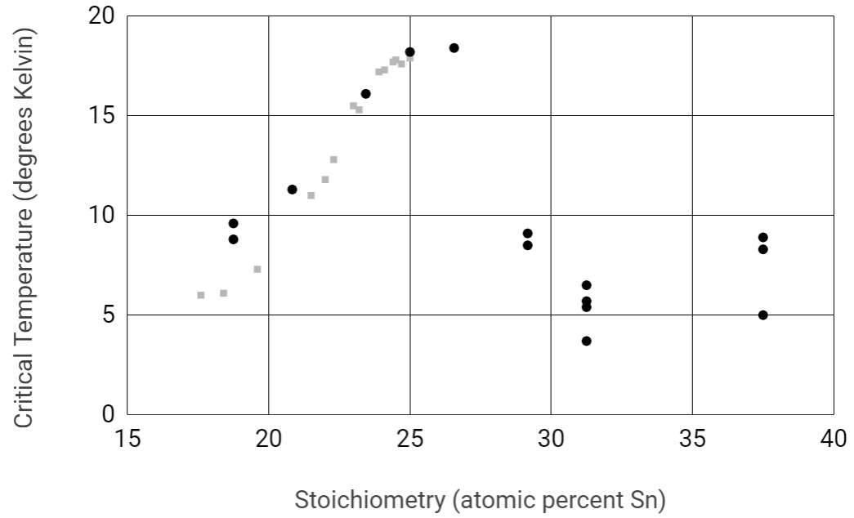
Segregated Grain Boundaries
Some Nb3Sn cavities exhibit a negative “Q-slope” at high fields.
Empirical correlation with Sn-segregated grain boundaries
  Segregation over a few nm
  Inhomogenous superconductor
DFT suggests excess Sn lowers Tc to ~5K.

Slide 17
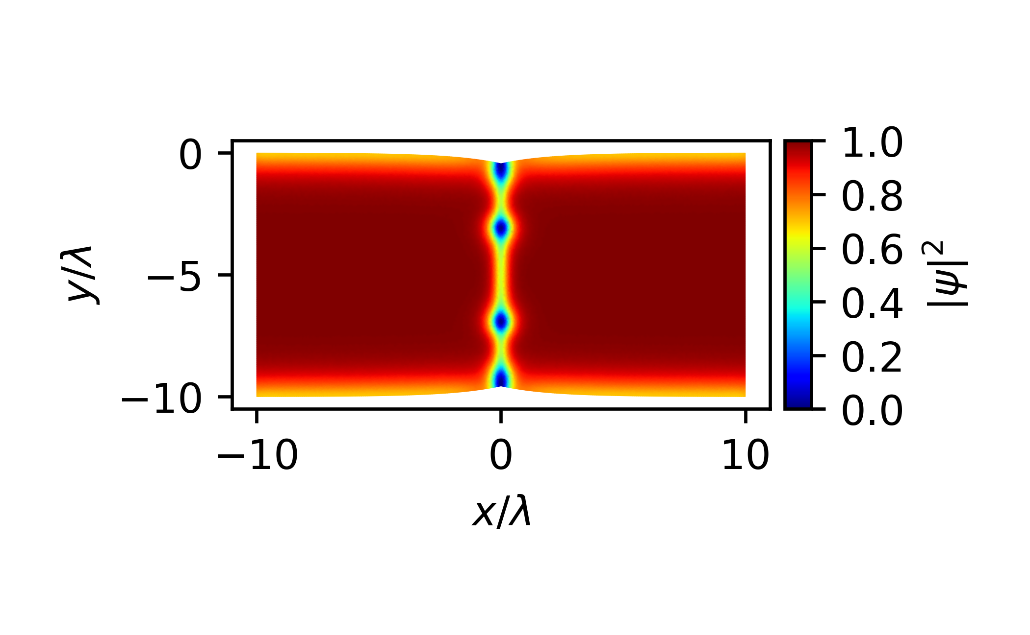

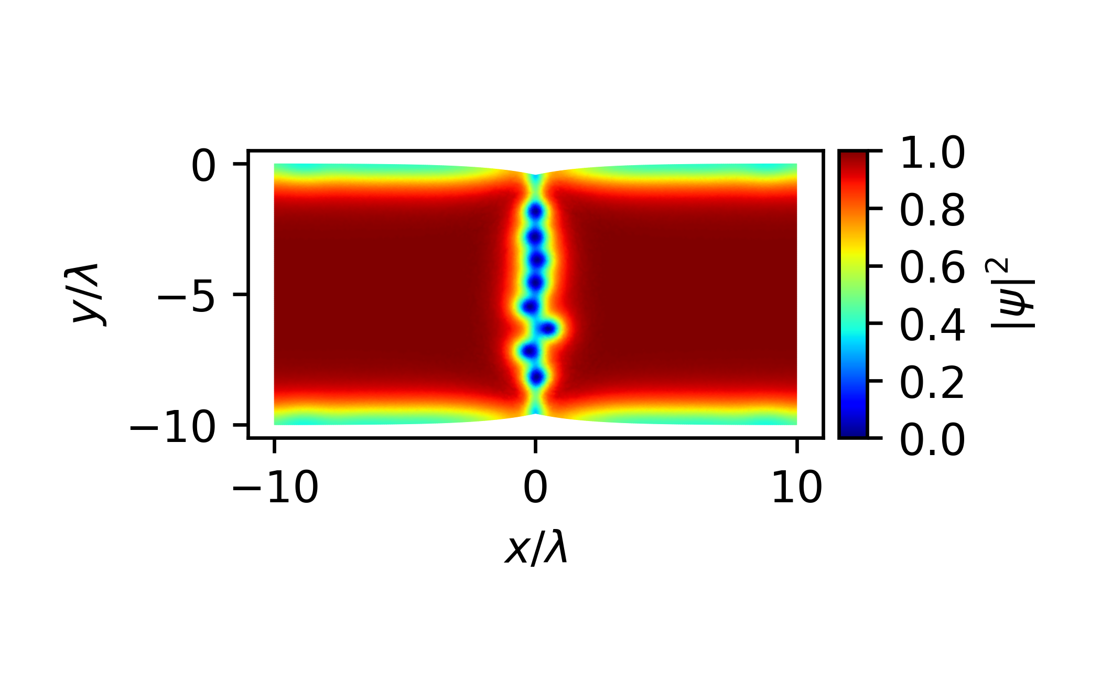
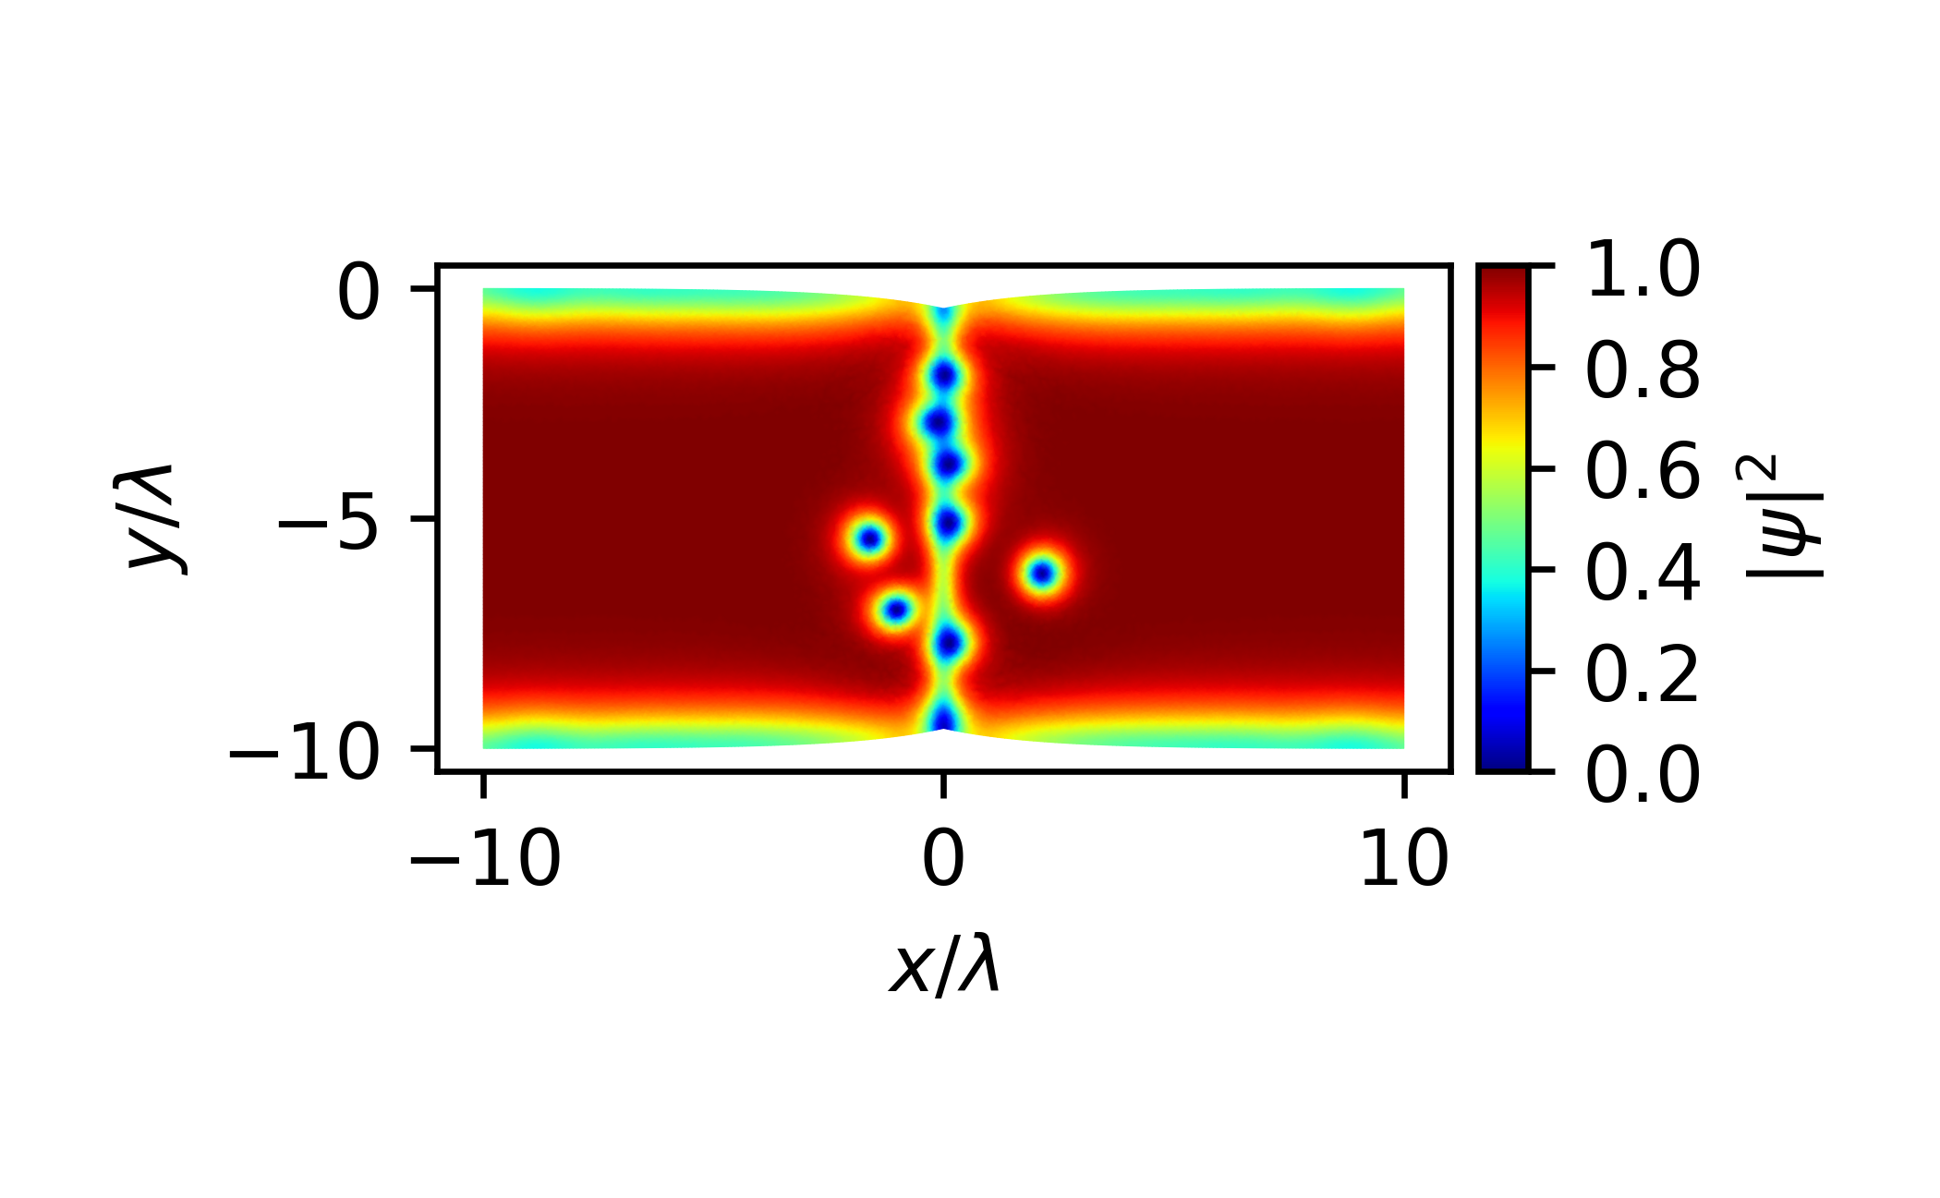
Segregated Grain Boundaries
(Jared Carlson)
Time Dependent Ginzburg-Landau relates DFT/HAADF-STEM to large-scale cavity performance
Segregated GBs act as a nucleation site
At moderate fields, vortices remain “pinned” to the GB.
  These vortices are not enough to trigger a quench, but do degrade performance
At high fields, vortices penetrate the bulk grain.

Slide 18
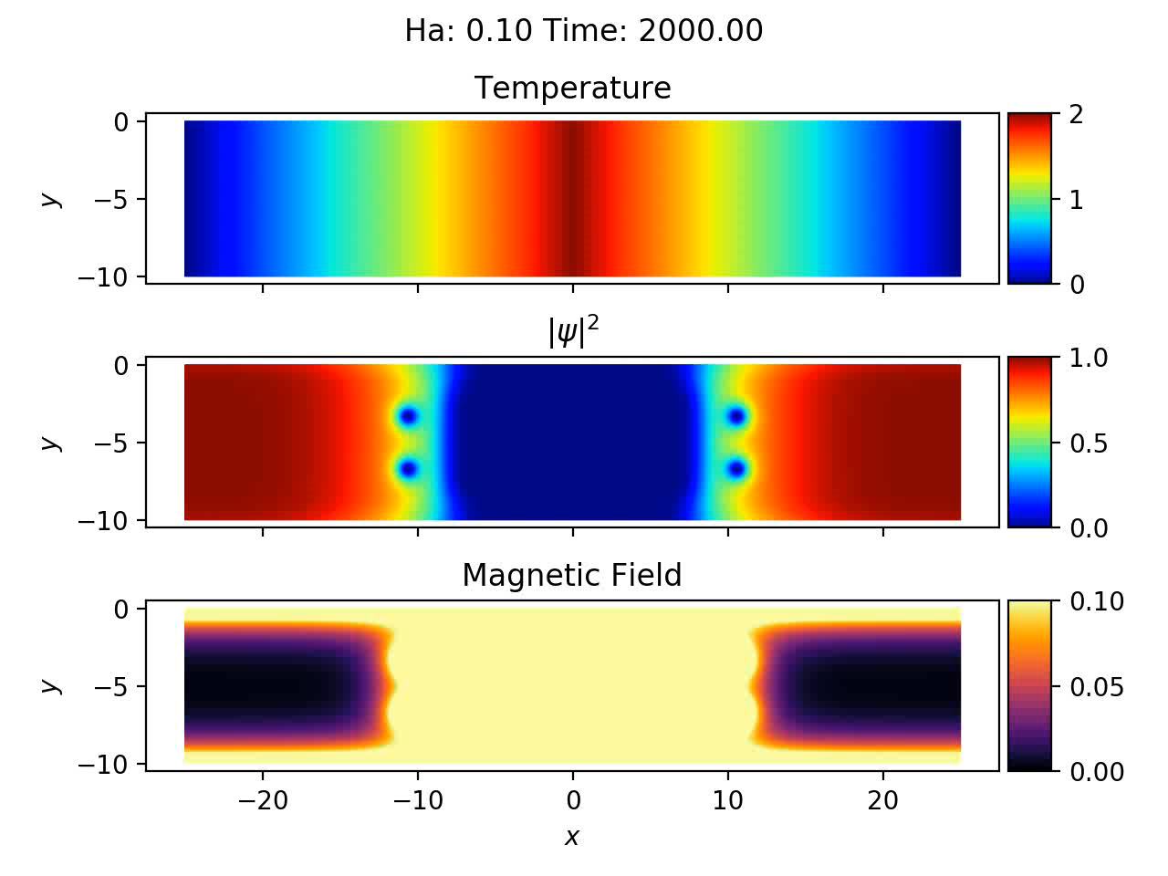
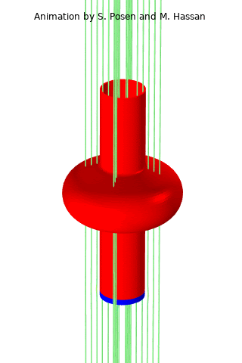

Flux Expulsion
(Aiden Harbick, Preliminary)
As a cavity is cooled below Tc, magnetic flux is expelled.
How does flux expulsion interact with material inhomogeneities such as pinning sites?
  High $κ$ materials have a low H_{c1}.
Simulations suggest a range of pinning strengths that can trap residual flux.
Relevant parameters seem to be the size/strength of the pinning site and the velocity of temperature front

Slide 19
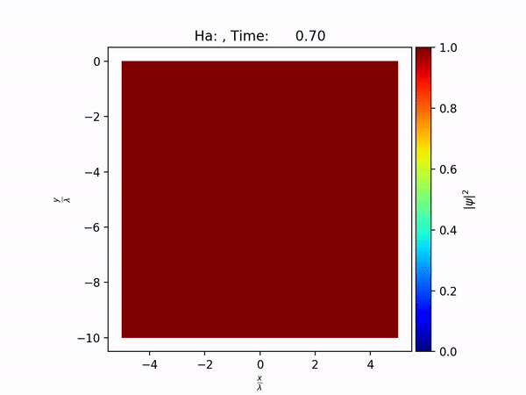
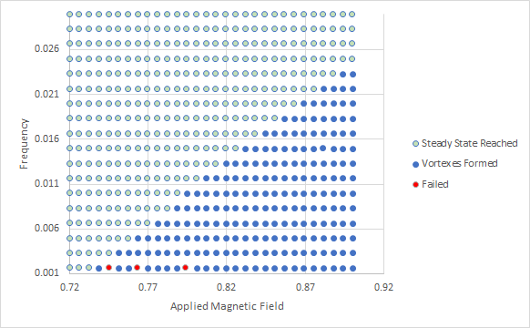

Frequency dependence
(Cole Abbott, preliminary)
High-frequency magnetic fields can inhibit vortex nucleation.
Preliminary results suggest $≈1\%$ increase in H_{sh} for each 1 GHz increase in operation frequency.
Relevant parameters:
  $Γ$ – electron relaxation time
  Conductance of normal electrons
  $κ$ – Ginzburg-Landau parameter.

Slide 20
Summary
TDGL connects microscopic characterizations to cavity performance
STEM
DFT
Performance
Mesoscpic Models
(TDGL)

Slide 21
Summary
TDGL connects microscopic characterizations to cavity performance
Spatially varying material parameters model inhomogenous superconductors
Bifurcation analysis studies stability properties
  Surface Roughness, Divots near grain boundaries
  Sn-depeleted Islands
Dynamic processes
  Vortex nucleation/pinning in segregated grain boundaries
  Pinning during flux expulsion
  Frequency dependence of H_{sh}

Slide 22
Outlook
Multi-scale modeling is challenging and requires interdisciplinary collaborations
SRF is an exciting domain for probing interesting superconducting phenomena
Future work
  Refine numerical values of preliminary work (e.g., frequency dependence)
  Field enhancement effects
  Gapless superconductors
  More sophisticated theories (e.g., Eilenberger)?

