Slide 1

Center for Bright Beams
Ab Initio Calculations on Point Defect Thermodynamics in Nb₃Sn
Nathan Sitaraman, Michelle Kelley, André Fonseca, Zhaslan Baraissov, Ryan Porter, Zeming Sun, David Muller, Matthias Liepe, and Tomás Arias
NSF award PHY-1549132, the Center for Bright Beams
Nb3SnSRF’20

Slide 2
Background: The Importance of Point Defects
What is a “point defect”?
Nb3SnSRF’20

Slide 3
Background: The Importance of Point Defects
What is a “point defect”?
-Antisite defects
Nb3SnSRF’20

Slide 4
Background: The Importance of Point Defects
What is a “point defect”?
-Antisite defects
-Interstitials (O, H)
Nb3SnSRF’20

Slide 5
Background: The Importance of Point Defects
What is a “point defect”?
-Antisite defects
-Interstitials (O, H)
Why study point defects?
Nb3SnSRF’20

Slide 6

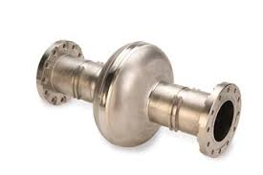
Background: The Importance of Point Defects
What is a “point defect”?
-Antisite defects
-Interstitials (O, H)
Why study point defects?
Understanding larger defects begins with understanding point defects
Nb3SnSRF’20

Slide 7
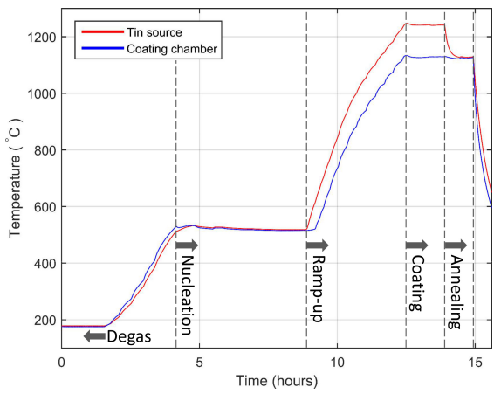
Point defects during cavity cooldown
Nb3SnSRF’20

Slide 8
Point defects during cavity cooldown
The coating process is long, but this talk is short.
Nb3SnSRF’20

Slide 9
Point defects during cavity cooldown
The coating process is long, but this talk is short.
Let’s focus only on the cooldown step
Nb3SnSRF’20

Slide 10
Antisite defects
Nb3SnSRF’20

Slide 11
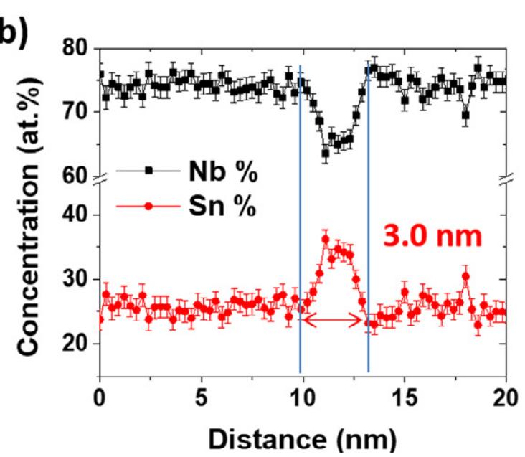
Antisite defects
Experimental studies have shown that grain boundaries contain excess tin immediately after coating stage
Jaeyel Lee et. al., Grain-boundary structure and segregation in Nb₃Sn coatings on Nb for high-performance superconducting radiofrequency cavity applications, Acta Materialia 188,155 (2020)
Nb3SnSRF’20
Notes:
Atom probe tomography, TEM

Slide 12
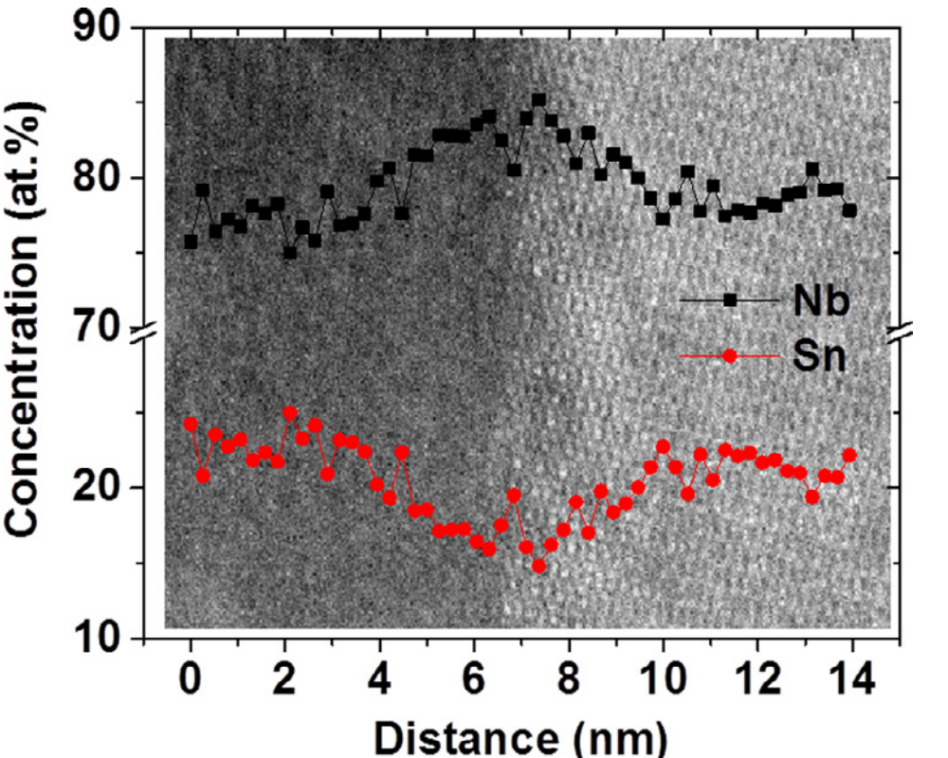
Antisite defects
Experimental studies have shown that grain boundaries contain excess tin immediately after coating stage
After a long anneal step (3 hours), grain boundaries contain excess niobium
Jaeyel Lee et. al., Grain-boundary structure and segregation in Nb₃Sn coatings on Nb for high-performance superconducting radiofrequency cavity applications, Acta Materialia 188,155 (2020)
Nb3SnSRF’20

Slide 13
Antisite defects
Experimental studies have shown that grain boundaries contain excess tin immediately after coating stage
After a long anneal step (3 hours), grain boundaries contain excess niobium
In both cases, antisite defects infiltrate material around the boundary core.
Jaeyel Lee et. al., Grain-boundary structure and segregation in Nb₃Sn coatings on Nb for high-performance superconducting radiofrequency cavity applications, Acta Materialia 188,155 (2020)
Nb3SnSRF’20

Slide 14
Antisite defects
Experimental studies have shown that grain boundaries contain excess tin immediately after coating stage
After a long anneal step (3 hours), grain boundaries contain excess niobium
In both cases, antisite defects infiltrate material around the boundary core.
Both cases likely harm cavity performance (see following talk!)
Jaeyel Lee et. al., Grain-boundary structure and segregation in Nb₃Sn coatings on Nb for high-performance superconducting radiofrequency cavity applications, Acta Materialia 188,155 (2020)
Nb3SnSRF’20
Notes:
Both processes thermodynamically favorable, kinetics determine final GB composition

Slide 15
Antisite defects
Eliminating tin antisite defects
Sn
Nb
Nb3SnSRF’20

Slide 16
Antisite defects
Eliminating tin antisite defects
Nb3SnSRF’20
Niobium

Slide 17
Antisite defects
Eliminating tin antisite defects
Nb3SnSRF’20
Niobium
Notes:
At some time during the annealing step this happens, which is when this grain boundary effectively begins its annealing process

Slide 18
Antisite defects
Eliminating tin antisite defects
Niobium vacancy: 2.1 eV
Nb3SnSRF’20
Niobium

Slide 19
Antisite defects
Eliminating tin antisite defects
Niobium vacancy: 2.1 eV
Nb3SnSRF’20
Niobium

Slide 20
Antisite defects
Eliminating tin antisite defects
Niobium vacancy: 2.1 eV
Nb3SnSRF’20
Niobium

Slide 21
Antisite defects
Eliminating tin antisite defects
Niobium vacancy: 2.1 eV
Nb3SnSRF’20
Niobium

Slide 22
Antisite defects
Eliminating tin antisite defects
Niobium vacancy: 2.1 eV
Nb3SnSRF’20
Niobium

Slide 23
Antisite defects
Eliminating tin antisite defects
Niobium vacancy: 2.1 eV
Nb3SnSRF’20
Niobium

Slide 24
Antisite defects
Eliminating tin antisite defects
Niobium vacancy: 2.1 eV
Hopping energy: 1.2 eV
Nb3SnSRF’20
Niobium

Slide 25
Antisite defects
Eliminating tin antisite defects
  Total activation energy: 3.3 eV
Niobium vacancy: 2.1 eV
Hopping energy: 1.2 eV
Nb3SnSRF’20
Niobium

Slide 26
Antisite defects
Eliminating tin antisite defects
  Total activation energy: 3.3 eV
Creating niobium antisite defects
Nb3SnSRF’20
Niobium

Slide 27
Antisite defects
Eliminating tin antisite defects
  Total activation energy: 3.3 eV
Creating niobium antisite defects
Niobium vacancy: 2.1 eV
Nb3SnSRF’20
Niobium

Slide 28
Antisite defects
Eliminating tin antisite defects
  Total activation energy: 3.3 eV
Creating niobium antisite defects
Niobium vacancy: 2.1 eV
Nb3SnSRF’20
Niobium

Slide 29
Antisite defects
Eliminating tin antisite defects
  Total activation energy: 3.3 eV
Creating niobium antisite defects
Niobium vacancy: 2.1 eV
Hopping energy: 2.3 eV
Nb3SnSRF’20
Niobium

Slide 30
Antisite defects
Eliminating tin antisite defects
  Total activation energy: 3.3 eV
Creating niobium antisite defects
Niobium vacancy: 2.1 eV
Hopping energy: 2.3 eV
Nb3SnSRF’20
Niobium

Slide 31
Antisite defects
Eliminating tin antisite defects
  Total activation energy: 3.3 eV
Creating niobium antisite defects
  Total activation energy: 4.4 eV
Niobium vacancy: 2.1 eV
Hopping energy: 2.3 eV
Nb3SnSRF’20
Niobium

Slide 32
Antisite defects
Eliminating tin antisite defects
  Total activation energy: 3.3 eV
Creating niobium antisite defects
  Total activation energy: 4.4 eV
  (tin on Nb site eliminated with same
  activation energy as before)
Niobium vacancy: 2.1 eV
Hopping energy: 2.3 eV
Nb3SnSRF’20
Niobium

Slide 33
Antisite defects
Eliminating tin antisite defects
  Total activation energy: 3.3 eV
Creating niobium antisite defects
  Total activation energy: 4.4 eV
  (tin on Nb site eliminated with same
  activation energy as before)
Niobium vacancy: 2.1 eV
Hopping energy: 2.3 eV
Nb3SnSRF’20
Niobium

Slide 34
Antisite defects
Eliminating tin antisite defects
  Total activation energy: 3.3 eV
Creating niobium antisite defects
  Total activation energy: 4.4 eV
  (tin on Nb site eliminated with same
  activation energy as before)
At 1400K (~1130C)
  1/(1 THz * e^{-ꞵ*3.3eV}) = 0.8 seconds
  1/(1 THz * e^{-ꞵ*4.4eV}) = 2 hours
Niobium vacancy: 2.1 eV
Hopping energy: 2.3 eV
Nb3SnSRF’20
Niobium
Notes:
Mention 2 hours on the same order of magnitude as the anneal step

Slide 35
Antisite defects
Eliminating tin antisite defects
  Total activation energy: 3.3 eV
Creating niobium antisite defects
  Total activation energy: 4.4 eV
  (tin on Nb site eliminated with same
  activation energy as before)
At 1400K (~1130C)
  1/(1 THz * e^{-ꞵ*3.3eV}) = 0.8 seconds
  1/(1 THz * e^{-ꞵ*4.4eV}) = 2 hours
Want to ensure tin antisite defects are
eliminated without allowing niobium
antisite defect formation. How?
Niobium vacancy: 2.1 eV
Hopping energy: 2.3 eV
Nb3SnSRF’20
Niobium

Slide 36
Antisite defects
T=0
At 1400K (~1130C)
  1/(1 THz * e^{-ꞵ*3.3eV}) = 0.8 seconds
  1/(1 THz * e^{-ꞵ*4.4eV}) = 2 hours
Variations in effective annealing time
Nb₃Sn
Nb₃Sn
Nb₃Sn
Nb3SnSRF’20
Notes:
Mention various sources of heterogeneity

Slide 37
Antisite defects
T=15
At 1400K (~1130C)
  1/(1 THz * e^{-ꞵ*3.3eV}) = 0.8 seconds
  1/(1 THz * e^{-ꞵ*4.4eV}) = 2 hours
Variations in effective annealing time
Nb₃Sn
Nb₃Sn
Nb₃Sn
Nb3SnSRF’20

Slide 38
Antisite defects
T=30
At 1400K (~1130C)
  1/(1 THz * e^{-ꞵ*3.3eV}) = 0.8 seconds
  1/(1 THz * e^{-ꞵ*4.4eV}) = 2 hours
Variations in effective annealing time
Nb₃Sn
Nb₃Sn
Nb₃Sn
Nb3SnSRF’20

Slide 39
Antisite defects
T=45
At 1400K (~1130C)
  1/(1 THz * e^{-ꞵ*3.3eV}) = 0.8 seconds
  1/(1 THz * e^{-ꞵ*4.4eV}) = 2 hours
Variations in effective annealing time
Nb₃Sn
Nb₃Sn
Nb₃Sn
Nb3SnSRF’20

Slide 40
Antisite defects
T=60
At 1400K (~1130C)
  1/(1 THz * e^{-ꞵ*3.3eV}) = 0.8 seconds
  1/(1 THz * e^{-ꞵ*4.4eV}) = 2 hours
Variations in effective annealing time
Nb₃Sn
Nb₃Sn
Nb₃Sn
Nb3SnSRF’20

Slide 41
Antisite defects
T=60
At 1400K (~1130C)
  1/(1 THz * e^{-ꞵ*3.3eV}) = 0.8 seconds
  1/(1 THz * e^{-ꞵ*4.4eV}) = 2 hours
Variations in effective annealing time
  Timing differences become less important at lower T
Nb₃Sn
Nb₃Sn
Nb₃Sn
Nb3SnSRF’20

Slide 42
Antisite defects
T=60
At 1400K (~1130C)
  1/(1 THz * e^{-ꞵ*3.3eV}) = 0.8 seconds
  1/(1 THz * e^{-ꞵ*4.4eV}) = 2 hours
Variations in effective annealing time
  Timing differences become less important at lower T
At 1300K (~1030C)
  1/(1 THz * e^{-ꞵ*3.3eV}) = 6 seconds
  1/(1 THz * e^{-ꞵ*4.4eV}) = 30 hours
Nb₃Sn
Nb₃Sn
Nb₃Sn
Nb3SnSRF’20

Slide 43
Antisite defects
T=60
At 1400K (~1130C)
  1/(1 THz * e^{-ꞵ*3.3eV}) = 0.8 seconds
  1/(1 THz * e^{-ꞵ*4.4eV}) = 2 hours
Variations in effective annealing time
  Timing differences become less important at lower T
At 1300K (~1030C)
  1/(1 THz * e^{-ꞵ*3.3eV}) = 6 seconds
  1/(1 THz * e^{-ꞵ*4.4eV}) = 30 hours
Longer anneal at cooler temperature may be better, especially in multi-cell coatings where inhomogeneities are most likely
Nb₃Sn
Nb₃Sn
Nb₃Sn
Nb3SnSRF’20

Slide 44
Oxygen
Nb3SnSRF’20

Slide 45
Oxygen
Oxide surface thought to play a key role in Nb cavity physics
Nb3SnSRF’20

Slide 46
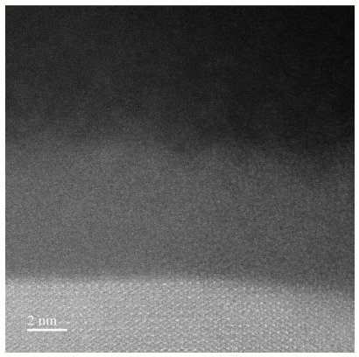
Oxygen
Oxide surface thought to play a key role in Nb cavity physics
Recent experiments begin to characterize Nb₃Sn oxide surface
Niobium oxide
Nb₃Sn crystal
Nb3SnSRF’20
Image by Zhaslan Baraissov
Notes:
TEM

Slide 47
Oxygen
Oxide surface thought to play a key role in Nb cavity physics
Recent experiments begin to characterize Nb₃Sn oxide surface
How does this oxide form, and how does it compare to the Nb native oxide?
Niobium oxide
Nb₃Sn crystal
Nb3SnSRF’20
Image by Zhaslan Baraissov

Slide 48
Oxygen
For cavity grade Nb, the following is true under typical conditions:
  F_{O_int} < F_{O_oxide}< F_{O_gas}
F
Nb NbO_{x} O₂
Nb3SnSRF’20

Slide 49
Oxygen
For cavity grade Nb, the following is true under typical conditions:
  F_{O_int} < F_{O_oxide}< F_{O_gas}
  Oxides form for kinetic reasons: at low T, O can’t diffuse
  fast enough to reach low-F interstitial sites deep in bulk
F
Nb NbO_{x} O₂
Nb3SnSRF’20

Slide 50
Oxygen
For cavity grade Nb, the following is true under typical conditions:
  F_{O_int} < F_{O_oxide}< F_{O_gas}
  Oxides form for kinetic reasons: at low T, O can’t diffuse
  fast enough to reach low-F interstitial sites deep in bulk
  Oxide formation rate complicated, but O diffusion
  rate simple: J = -D*⛛n
F
Nb NbO_{x} O₂
Nb3SnSRF’20

Slide 51
Oxygen
For cavity grade Nb, the following is true under typical conditions:
  F_{O_int} < F_{O_oxide}< F_{O_gas}
  Oxides form for kinetic reasons: at low T, O can’t diffuse
  fast enough to reach low-F interstitial sites deep in bulk
  Oxide formation rate complicated, but O diffusion
  rate simple: J = -D*⛛n
F
Nb NbO_{x} O₂
Hopping barrier
Nb3SnSRF’20

Slide 52
Oxygen
For cavity grade Nb, the following is true under typical conditions:
  F_{O_int} < F_{O_oxide}< F_{O_gas}
  Oxides form for kinetic reasons: at low T, O can’t diffuse
  fast enough to reach low-F interstitial sites deep in bulk
  Oxide formation rate complicated, but O diffusion
  rate simple: J = -D*⛛n
F
Nb NbO_{x} O₂
Hopping barrier
n
n_{max}
Nb3SnSRF’20

Slide 53
Oxygen
For cavity grade Nb, the following is true under typical conditions:
  F_{O_int} < F_{O_oxide}< F_{O_gas}
  Oxides form for kinetic reasons: at low T, O can’t diffuse
  fast enough to reach low-F interstitial sites deep in bulk
  Oxide formation rate complicated, but O diffusion
  rate simple: J = -D*⛛n
F
Nb NbO_{x} O₂
Hopping barrier
n
n_{max}
⛛n ∝ n_{max}
Nb3SnSRF’20
Notes:
Concentration drops from limit nmax to deep bulk value over some distance

Slide 54
Oxygen
For cavity grade Nb, the following is true under typical conditions:
  F_{O_int} < F_{O_oxide}< F_{O_gas}
  Oxides form for kinetic reasons: at low T, O can’t diffuse
  fast enough to reach low-F interstitial sites deep in bulk
  Oxide formation rate complicated, but O diffusion
  rate simple: J = -D*⛛n
F
Nb NbO_{x} O₂
Hopping barrier
n
n_{max}
⛛n ∝ n_{max} ∝ e^{ꞵ(E_ox - E_int)}
Nb3SnSRF’20
Notes:
NOT exponential

Slide 55
Oxygen
For cavity grade Nb, the following is true under typical conditions:
  F_{O_int} < F_{O_oxide}< F_{O_gas}
  Oxides form for kinetic reasons: at low T, O can’t diffuse
  fast enough to reach low-F interstitial sites deep in bulk
  Oxide formation rate complicated, but O diffusion
  rate simple: J = -D*⛛n
F
Nb NbO_{x} O₂
Hopping barrier
Interstitial energy
n
n_{max}
⛛n ∝ n_{max} ∝ e^{ꞵ(E_ox - E_int)}
Nb3SnSRF’20

Slide 56
Oxygen
For cavity grade Nb, the following is true under typical conditions:
How do things change in an Nb₃Sn cavity?
F
Nb NbO_{x} O₂
Nb3SnSRF’20

Slide 57
Oxygen
For cavity grade Nb, the following is true under typical conditions:
How do things change in an Nb₃Sn cavity?
F
Nb NbO_{x} O₂
?
F
Nb₃Sn NbO_{x} O₂
Nb3SnSRF’20

Slide 58
Oxygen
For cavity grade Nb, the following is true under typical conditions:
How do things change in an Nb₃Sn cavity?
F
Nb NbO_{x} O₂
?
F
 | Barrier | E_ox-E_int | n_{max} (1000K)
Nb | 1.18 eV | -0.37 eV | 2.0 at. %
Nb₃Sn | ? | ? | ?
Nb₃Sn NbO_{x} O₂
Nb3SnSRF’20

Slide 59
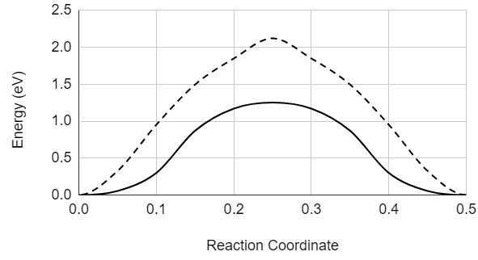
Oxygen
For cavity grade Nb, the following is true under typical conditions:
How do things change in an Nb₃Sn cavity?
        Nb₃Sn hopping barrier very similar to Nb
F
Nearest-neighbor
Next-nearest-
neighbor
Nb Barrier
Nb NbO_{x} O₂
?
F
 | Barrier | E_ox-E_int | n_{max} (1000K)
Nb | 1.18 eV | -0.37 eV | 2.0 at. %
Nb₃Sn | 1.22 eV | ? | ?
Nb₃Sn NbO_{x} O₂
Nb3SnSRF’20

Slide 60
Oxygen
For cavity grade Nb, the following is true under typical conditions:
How do things change in an Nb₃Sn cavity?
        Nb₃Sn hopping barrier very similar to Nb
        Nb₃Sn interstitial energy much
        higher than Nb
F
Nearest-neighbor
Next-nearest-
neighbor
Nb Barrier
Nb NbO_{x} O₂
?
F
 | Barrier | E_ox-E_int | n_{max} (1000K)
Nb | 1.18 eV | -0.37 eV | 2.0 at. %
Nb₃Sn | 1.22 eV | -1.46 eV | ?
Nb₃Sn NbO_{x} O₂
Nb3SnSRF’20

Slide 61
Oxygen
For cavity grade Nb, the following is true under typical conditions:
How do things change in an Nb₃Sn cavity?
        Nb₃Sn hopping barrier very similar to Nb
        Nb₃Sn interstitial energy much
        higher than Nb
        ⛛n, n_{max} much smaller in Nb₃Sn
F
Nearest-neighbor
Next-nearest-
neighbor
Nb Barrier
Nb NbO_{x} O₂
?
F
 | Barrier | E_ox-E_int | n_{max} (1000K)
Nb | 1.18 eV | -0.37 eV | 2.0 at. %
Nb₃Sn | 1.22 eV | -1.46 eV | 10⁻⁵ at. %
Nb₃Sn NbO_{x} O₂
Nb3SnSRF’20

Slide 62
Oxygen
For cavity grade Nb, the following is true under typical conditions:
How do things change in an Nb₃Sn cavity?
        Nb₃Sn hopping barrier very similar to Nb
        Nb₃Sn interstitial energy much
        higher than Nb
        ⛛n, n_{max} much smaller in Nb₃Sn
F
Nearest-neighbor
Next-nearest-
neighbor
Nb Barrier
Nb NbO_{x} O₂
?
F
 | Barrier | E_ox-E_int | n_{max} (1000K)
Nb | 1.18 eV | -0.37 eV | 2.0 at. %
Nb₃Sn | 1.22 eV | -1.46 eV | 10⁻⁵ at. %
Nb₃Sn NbO_{x} O₂
Native oxide may form at higher T, lower partial pressure than is typical for Nb
Nb3SnSRF’20

Slide 63
Hydrogen
Nb3SnSRF’20

Slide 64
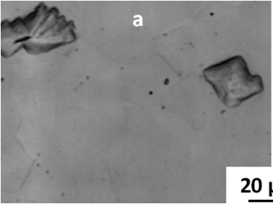

Hydrogen
In niobium cavities, hydrogen is known for forming hydride precipitates at cryogenic temperatures (~100K).
F. Barkov, A. Romanenko, Y. Trenikhina, and A. Grassellino, Precipitation of hydrides in high purity
niobium after different treatments, J. Appl. Phys. 114, 164904, 2013
[citations]
Nb3SnSRF’20

Slide 65
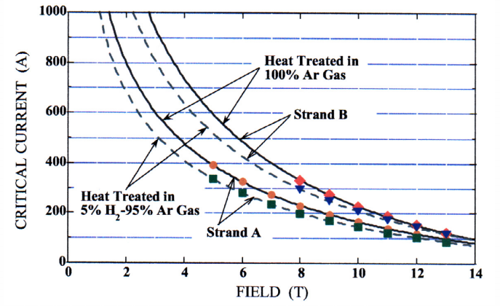
Hydrogen
In niobium cavities, hydrogen is known for forming hydride precipitates at cryogenic temperatures (~100K).
Previous studies have shown that hydrogen can affect the superconductivity of Nb₃Sn wires
F. Barkov, A. Romanenko, Y. Trenikhina, and A. Grassellino, Precipitation of hydrides in high purity
niobium after different treatments, J. Appl. Phys. 114, 164904, 2013
M. Takayasu et. al., Multifilamentary Nb₃Sn wires reacted in hydrogen gas, proc. ICMC, Vol. 48, 2002
Nb3SnSRF’20

Slide 66
Hydrogen
In niobium cavities, hydrogen is known for forming hydride precipitates at cryogenic temperatures (~100K).
Previous studies have shown that hydrogen can affect the superconductivity of Nb₃Sn wires
What role might hydrogen play in Nb₃Sn cavities?
F. Barkov, A. Romanenko, Y. Trenikhina, and A. Grassellino, Precipitation of hydrides in high purity
niobium after different treatments, J. Appl. Phys. 114, 164904, 2013
M. Takayasu et. al., Multifilamentary Nb₃Sn wires reacted in hydrogen gas, proc. ICMC, Vol. 48, 2002
Nb3SnSRF’20

Slide 67
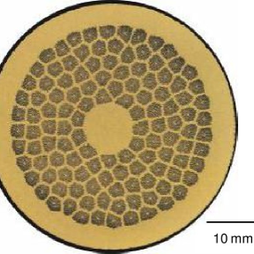
Copper matrix
Nb₃Sn Filaments
Hydrogen
Comparing Cu-Nb₃Sn, Nb-Nb₃Sn systems
Nb3SnSRF’20

Slide 68
Copper matrix
Nb₃Sn Filaments
Hydrogen
Comparing Cu-Nb₃Sn, Nb-Nb₃Sn systems
Hydrogen prefers Nb₃Sn over Cu,
explaining why Nb₃Sn wires may
be affected by hydrogen
Cu
Nb₃Sn
E_{Cu}- E_{Nb3Sn} | 0.76 eV
E
Nb3SnSRF’20

Slide 69
Copper matrix
Nb₃Sn Filaments
Hydrogen
Comparing Cu-Nb₃Sn, Nb-Nb₃Sn systems
Hydrogen prefers Nb₃Sn over Cu,
explaining why Nb₃Sn wires may
be affected by hydrogen
However, hydrogen prefers Nb
Over Nb₃Sn, suggesting that cavity
Nb₃Sn should contain very little hydrogen
Nb
Nb₃Sn
E_{Cu}- E_{Nb3Sn} | 0.76 eV
E_{Nb}- E_{Nb3Sn} | -0.08 eV
E
Nb3SnSRF’20

Slide 70
Copper matrix
Nb₃Sn Filaments
Hydrogen
Comparing Cu-Nb₃Sn, Nb-Nb₃Sn systems
Hydrogen prefers Nb₃Sn over Cu,
explaining why Nb₃Sn wires may
be affected by hydrogen
However, hydrogen prefers Nb
Over Nb₃Sn, suggesting that cavity
Nb₃Sn should contain very little hydrogen
For 1 at. % H in Nb, expect ~1 ppm H in Nb₃Sn at 100K
Nb
Nb₃Sn
E_{Cu}- E_{Nb3Sn} | 0.76 eV
E_{Nb}- E_{Nb3Sn} | -0.08 eV
E
Nb3SnSRF’20

Slide 71
Copper matrix
Nb₃Sn Filaments
Hydrogen
Comparing Cu-Nb₃Sn, Nb-Nb₃Sn systems
Hydrogen prefers Nb₃Sn over Cu,
explaining why Nb₃Sn wires may
be affected by hydrogen
However, hydrogen prefers Nb
Over Nb₃Sn, suggesting that cavity
Nb₃Sn should contain very little hydrogen
For 1 at. % H in Nb, expect ~1 ppm H in Nb₃Sn at 100K
Unlikely to form hydride precipitates at Nb₃Sn surface
Nb
Nb₃Sn
E_{Cu}- E_{Nb3Sn} | 0.76 eV
E_{Nb}- E_{Nb3Sn} | -0.08 eV
E
Nb3SnSRF’20
Notes:
Emphasize copper for wire

Slide 72
Conclusions
Nb3SnSRF’20
Notes:
(and this is my final slide)

Slide 73
Conclusions
Many unexplored degrees of freedom during cooldown process. Could further improve GB composition and control oxide formation.
Nb3SnSRF’20

Slide 74
Conclusions
Many unexplored degrees of freedom during cooldown process. Could further improve GB composition and control oxide formation.
Sn antisite defect elimination, Nb antisite defect formation happen on different characteristic timescales
Nb3SnSRF’20

Slide 75
Conclusions
Many unexplored degrees of freedom during cooldown process. Could further improve GB composition and control oxide formation.
Sn antisite defect elimination, Nb antisite defect formation happen on different characteristic timescales
  Can anneal at lower temperature to improve GB stoichiometry
Nb3SnSRF’20

Slide 76
Conclusions
Many unexplored degrees of freedom during cooldown process. Could further improve GB composition and control oxide formation.
Sn antisite defect elimination, Nb antisite defect formation happen on different characteristic timescales
  Can anneal at lower temperature to improve GB stoichiometry
Oxygen diffusion through Nb₃Sn should be very slow
Nb3SnSRF’20

Slide 77
Conclusions
Many unexplored degrees of freedom during cooldown process. Could further improve GB composition and control oxide formation.
Sn antisite defect elimination, Nb antisite defect formation happen on different characteristic timescales
  Can anneal at lower temperature to improve GB stoichiometry
Oxygen diffusion through Nb₃Sn should be very slow
  Surface oxide properties could be sensitive to cooldown rate, O2 partial pressure
Nb3SnSRF’20

Slide 78
Conclusions
Many unexplored degrees of freedom during cooldown process. Could further improve GB composition and control oxide formation.
Sn antisite defect elimination, Nb antisite defect formation happen on different characteristic timescales
  Can anneal at lower temperature to improve GB stoichiometry
Oxygen diffusion through Nb₃Sn should be very slow
  Surface oxide properties could be sensitive to cooldown rate, O2 partial pressure
Hydrogen nearly insoluble in Nb₃Sn at cryogenic temperatures
Nb3SnSRF’20

Slide 79
Conclusions
Many unexplored degrees of freedom during cooldown process. Could further improve GB composition and control oxide formation.
Sn antisite defect elimination, Nb antisite defect formation happen on different characteristic timescales
  Can anneal at lower temperature to improve GB stoichiometry
Oxygen diffusion through Nb₃Sn should be very slow
  Surface oxide properties could be sensitive to cooldown rate, O2 partial pressure
Hydrogen nearly insoluble in Nb₃Sn at cryogenic temperatures
  Less potential for surface hydride formation compared to Nb surface
Nb3SnSRF’20

