Slide 1
Deconvoluting Initial Nb-Sn-O Interactions: Spatially Resolved Electronic Characterization of Sn Reconstructions on (3×1)-O Nb(100)
November 2020
Nb₃Sn SRF
Sarah A. Willson, Rachael G. Farber, Ajinkya Hire ‡, Richard G. Hennig ‡, and Steven J. Sibener
Department of Chemistry, The University of Chicago, IL
‡Department of Materials Science and Engineering, University of Florida, Gainesville, FL

Slide 2
Production of High Performing Nb₃Sn Coated SRF Cavities is Contingent Upon Continued Growth Optimization
Sn Vapor Diffusion on Nb
Nb₃Sn thin films on Nb SRF cavities deposited using vapor deposition procedure
  Resultant Nb₃Sn films do not approach theorized accelerating gradients
Scaling up Nb₃Sn coatings to larger Nb SRF cavities requires further improvements to coating procedure
S. Posen, D.L. Hall. Supercond. Sci. Technol. 30 033004 (2017).

Slide 3
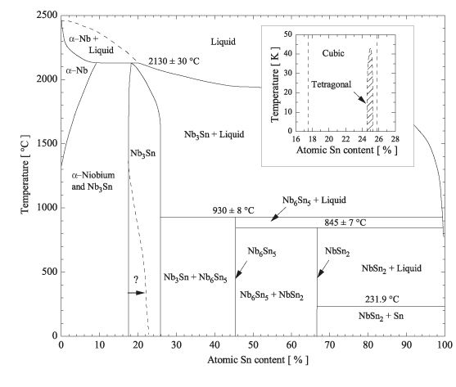
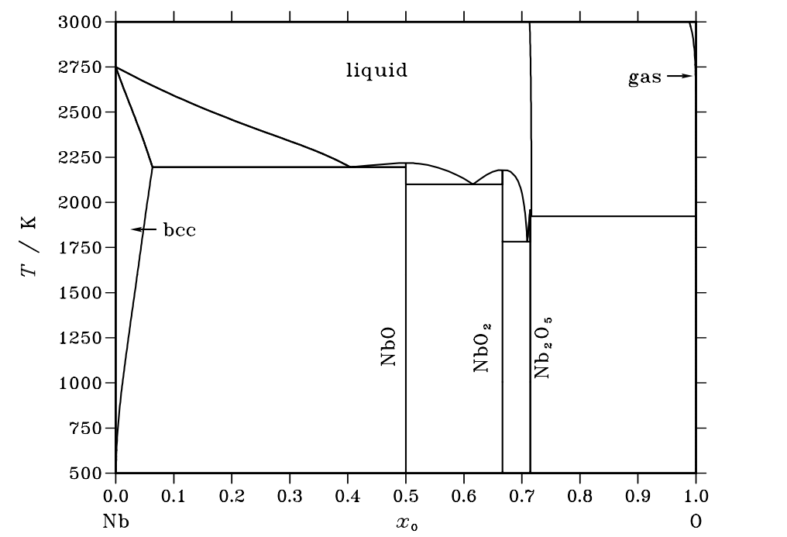
Deconvoluting Factors that Influence Nb-Sn-O Morphology May Aid in Producing High Performing Nb₃Sn Films
Experimentally producing theorized high performing Nb₃Sn films may be limited by:
  Islands of low T_{C} species
    Elemental Sn
    Alternate alloys: NbSn₂, Nb₆Sn₅
    Oxide species: NbO, NbO₂, Nb₂O₅, SnO, SnO₂, Nb-Sn-O complexes
    Nb hydrides and nitrides
  Grain morphology
  Defects in surface and sub-surface region
L. Luxmann, R. Dobner. Metal (Berlin), 34 (1980), p. 821
Godeke, A. Supercond. Sci. Technol. 19, R68-R80 (2006).
Y. Inoue, N. Hiraide, K. Ushioda. ISIJ International. 58. 1117-1125 (2018).

Slide 4
Deconvoluting Factors that Influence Nb-Sn-O Morphology May Aid in Producing High Performing Nb₃Sn Films
Experimentally producing theorized high performing Nb₃Sn films may be limited by:
  Islands of low T_{C} species
    Elemental Sn
    Alternate alloys: NbSn₂, Nb₆Sn₅
    Oxide species: NbO, NbO₂, Nb₂O₅, SnO, SnO₂, Nb-Sn-O complexes
    Nb hydrides and nitrides
  Grain morphology
    Grain boundary density and type
    Surface roughness
    Film thickness
  Defects in surface and sub-surface region
Nb₃Sn Grown via Vapor Diffusion
https://cbb.classe.cornell.edu/Research/Nb3SnFilmGrowthViaVaporDiffusion.html

Slide 5
Deconvoluting Factors that Influence Nb-Sn-O Morphology May Aid in Producing High Performing Nb₃Sn Films
Experimentally producing theorized high performing Nb₃Sn films may be limited by:
  Islands of low T_{C} species
    Elemental Sn
    Alternate alloys: NbSn₂, Nb₆Sn₅
    Oxide species: NbO, NbO₂, Nb₂O₅, SnO, SnO₂, Nb-Sn-O complexes
    Nb hydrides and nitrides
  Grain morphology
    Grain boundary density and type
    Surface roughness
    Film thickness
  Defects in surface and sub-surface region
    Structural defects in A15 lattice
    Interstitial species in Nb₃Sn/Nb: O, N, H
Nb₃Sn Grown via Vapor Diffusion
https://cbb.classe.cornell.edu/Research/Nb3SnFilmGrowthViaVaporDiffusion.html

Slide 6
Deconvoluting Factors that Influence Nb-Sn-O Morphology May Aid in Producing High Performing Nb₃Sn Films
Experimentally producing theorized high performing Nb₃Sn films may be limited by:
  Islands of low T_{C} species
    Elemental Sn
    Alternate alloys: NbSn₂, Nb₆Sn₅
    Oxide species: NbO, NbO₂, Nb₂O₅, SnO, SnO₂, Nb-Sn-O complexes
    Nb hydrides and nitrides
  Grain morphology
    Grain boundary density and type
    Surface roughness
    Film thickness
  Defects in surface and sub-surface region
    Structural defects in A15 lattice
    Interstitial species in Nb₃Sn/Nb: O, N, H
Vapor Deposition Conditions
Nb substrate
  Surface roughness
  Grain size
  Oxidation
  Contaminants
  Surface corrugation
Vapor deposition conditions
  Substrate nucleation temperature
  Sn flux
  Nucleation species
  Coating/annealing time
  Annealing temperature
  Background pressure
  Evaporation source
+ many others
Fundamental surface studies with tunable growth conditions allow us to promote growth mechanisms for optimal Nb₃Sn film formation

Slide 7
Designing a Fundamental Surface Study to Develop Nb₃Sn Vapor Deposition Growth Model
Adsorption/Diffusion
Adsorption & lateral diffusion
  ML vs. island growth modes
    Morphology of Sn adlayer structures and oxidized Nb substrate
  Coverage dependence on aggregation at low energy surface sites
  Thermal/kinetic barriers to lateral diffusion
Incorporation
Sn Incorporation
surface
Sn
Sn
oxide
Nb₃Sn
Nb/Sn/O
interface
Nb
Nb
Nb
Deposition Growth Modes
Frank-van-der-Merve
Stranksi-Krastanow
Volmer-Weber
Using a well characterized oxidized Nb(100) single crystal under controlled UHV conditions, the atomic scale interactions guiding Sn adsorption and diffusion behavior are probed with atomic scale spatial resolution

Slide 8
The Few Fundamental Sn Adsorption Studies Demonstrate Nb Characteristics and Sn Exposure Impact Alloy Formation
Single Crystal Metallic Nb Studies
Substrate chemically and electronically distinct from Nb oxides
Results using unoxidized Nb(110) and Nb(100) demonstrate distinct Sn behavior
  Ensemble Sn reconstructions captured at sub-ML coverages
  Nb₃Sn alloy formation temperature depends on both Sn coverage and underlying Nb surface corrugation
    Epitaxial growth not achieved on Nb(110)
A highly ordered oxidized Nb surface serves as a model system for examining Nb-Sn-O in an alloying process with few comparable systems and a strong dependence on substrate conditions
J.A. Strozier, D. L. Miller, O. F. Kammerer, M. Strongin. Journal of App. Phys. 47 1611 (1976).

Slide 9
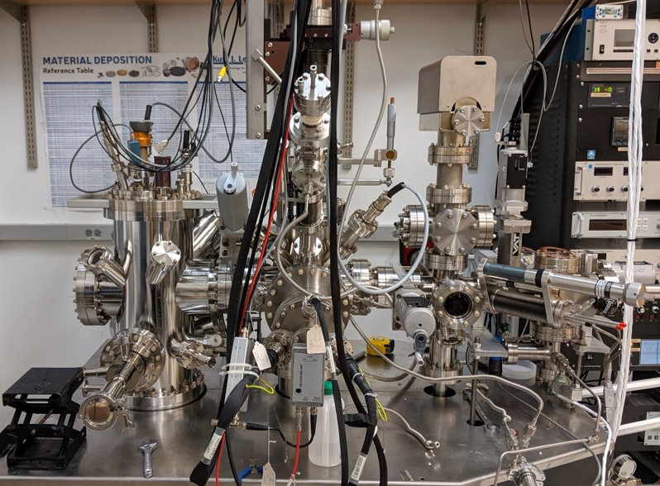
Ultra-High Vacuum Chamber Equipped for in situ Sn Deposition and Non-Destructive Surface Characterization
Deposition
Electron beam evaporator deposits Sn with sub-ML precision
  Sn exposure calibrated with quartz crystal microbalance (QCM)
Surface Analysis
Auger electron spectroscopy (AES)
X-ray photoelectron spectroscopy (XPS)
Temperature programmed desorption (TPD)
Scanning tunneling microscopy (STM)
Scanning tunneling spectroscopy (STS)
Sn chamber
STM chamber
Prep/ analysis chamber
QCM Flux Calibration

Slide 10
Characterization of Clean (3×1)-O Nb(100) Surface Shows Pristine and Thermally Stable Reconstruction
Sample Preparation
Complete removal of native oxide (Nb₂O₅​, NbO, NbO₂)
  Continuous annealing at ~2600 K required
Thin oxide (NbO) ladder formation
  Annealing at ~1800 K
  2 ML(3×1)-O surface oxide forms on Nb(100) upon cooling
    Stable >1200 K
Clean (3×1)-O Nb(100) as a Model System
1st layer Nb
2ndlayer Nb
3rd layer Nb
1st layer O
2nd layer O
D.R. Veit, N.A. Kautz, R.G. Farber, S.J. Sibener. Surface Science. 688, 63-68 (2019).

Slide 11
Sub-ML Coverages of Sn form Various ML Reconstructions on (3×1) Surface Following 500°C Anneals
Sn uniformly deposited on clean ladders
  0.5 ML Sn, T_{sample}=RT
Annealed at 500°C before transferring to STM chamber
  (3×1) ladder structure maintained before and after annealing
  Heat treatment induces Sn migration from edge sites to form various structures
After RT Sn Deposition
After 90 min at 500°C

Slide 12
Sub-ML Coverages of Sn form Various ML Reconstructions on (3×1) Surface Following 500°C Anneals
Hexagonal
Situated between ladder rows
Most prevalent Sn structure
Bright multilayer hexagonal formations coexist with monolayer hexagonal features
Rectangular
Between rows and along ladder rungs
Ladder Edges
Individual Sn atoms adsorbed on ladder edges

Slide 13
Sub-ML Coverages of Sn form Various ML Reconstructions on (3×1) Surface Following 500°C Anneals
Hexagonal
Situated between ladder rows
Most prevalent Sn structure
Bright multilayer hexagonal formations coexist with monolayer hexagonal features
Rectangular
Between rows and along ladder rungs
Ladder Edges
Individual Sn atoms adsorbed on ladder edges

Slide 14
Sub-ML Coverages of Sn form Various ML Reconstructions on (3×1) Surface Following 500°C Anneals
Hexagonal
Situated between ladder rows
Most prevalent Sn structure
Bright multilayer hexagonal formations coexist with monolayer hexagonal features
Rectangular
Between rows and along ladder rungs
Ladder Edges
Individual Sn atoms adsorbed on ladder edges

Slide 15
Atomic Resolution STM Images Reveal the Morphology of Sn Aggregates and Underlying NbO
Sn adlayer appearance affected by:
  Tip states
  Bias magnitude
  Bias polarity
Same ML formation imaged as both hexagonal and honeycomb structures
  Theoretical modeling required to confirm coordination of surface structure
Some induced ladder damage
+0.8 V Bias, 90 pA current
-0.2 V Bias, 90 pA current

Slide 16
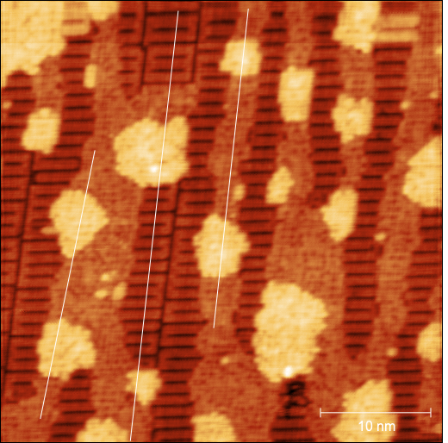
Multilayer and Monolayer Sn Reconstructions Have Consistent Heights and Spacing
ML and bright multilayer Sn adlayers are topographically consistent
  Sn ML structures feature honeycomb/hexagonal and occasional rectangular packing
  Bright adlayers typically 3 ML with some ~ 5-7 ML protrusions
2
1
3

Slide 17
Bright Sn Layers Electronically Distinguished From (3×1)-O Nb(100) at Room Temperature
Surface bandgap at Sn feature broadened compared to underlying NbO ladder
  Observed semiconducting behavior
Clean (3×1)-O Nb(100)
1.3 eV
Sn Adlayer
4.3 eV

Slide 18
Bright Sn Layers Electronically Distinguished From (3×1)-O Nb(100) at Room Temperature
STS taken at edge of a bright Sn adlayer site
Bandgap: 1.85 eV
  Reduced compared to other comparable Sn structures

Slide 19
Bright Sn Layers Electronically Distinguished From (3×1)-O Nb(100) at Room Temperature
STS taken at edge of a bright Sn adlayer site
Bandgap: 1.85 eV
  Reduced compared to other comparable Sn structures
Line scan indicates higher topography at STS location
  ~1 nm raised above surrounding bright Sn adlayer
  More metallic-like behavior

Slide 20
Summary: Characterization of Sn Reconstructions on NbO using Electronically Specified Surface Microscopy
Preliminary STM/STS data of Sn on (3×1)-O Nb(100)
  Ladder structure preserved during thermally activated Sn diffusion
    Some areas show higher defect density
  Sn forms structurally distinct ML reconstructions
    STS data indicates electronic variation among Sn adlayers
(3×1)-O Nb(100) + Sn data illustrate the role of the underlying Nb substrate, Sn exposure, and annealing conditions in guiding Sn surface behavior

Slide 21
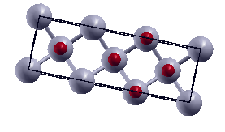
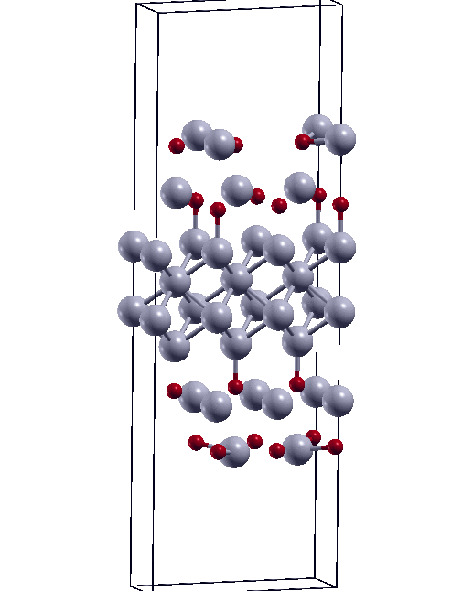
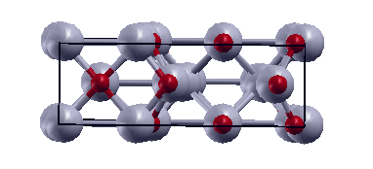
Ongoing Studies and Collaborations Aim to Fully Characterize Sn Adlayers and Eventually Nb₃Sn Grains
XPS to track Nb, Sn oxidation at varying coverages and annealing conditions
  Induced defects from Sn coordination with NbO
  Destructive Sn diffusion pathways
Further spatial & electronic characterization of Sn ML structures on NbO
  Calculations using machine learning algorithms are underway to support observed surface structures and phases (Hennig group)
Continue studies on Nb₃Sn grains formed on NbO
(3×1)-O Nb(100) Unit Cell
Structural Relaxation of (3×1)-O Nb(100)
Spatially resolved electronic data of adsorbed Sn on (3×1)-O Nb(100) provides insight towards the interactions guiding Sn adsorption and diffusion on NbO surfaces
Calculations done by Ajinkya Hire

Slide 22


Acknowledgements & Questions
Center for Bright Beams
  U.S. National Science Foundation under award PHY-1549132, the Center for Bright Beams
Sibener Group at UChicago
  Professor Steve Sibener
  Postdoc Rachael Farber
Hennig Group at University of Florida
  Professor Richard Hennig
  Graduate student Ajinkya Hire

