Slide 1
Thin-film CVD Nb₃Sn Coating Process
Development for Copper SRF Cavities
Shawn McNeal Victor Arrieta Mohamed Cheikh
ULTRAMET
Pacoima, California
ultramet.com 818-899-0236
Nb3SnSRF’20
Virtual International Workshop on Nb3Sn SRF Science, Technology, and Applications
Online 10–13 November 2020
Hosted by the National Science Foundation Center for Bright Beams and Cornell University

Slide 2
Agenda
Company Overview
Ultramet SRF-related R&D Project Path for DOE-SBIR
  Thick-film CVD Niobium on Copper Cavity Optimization
  Copper Cavity Optimization
Current Project Status, Results and Path Forward
  Phase I: CVD Process Development for Nb₃Sn
  Phase II: Precursor Development
  Thin-film Nb₃Sn on copper ILC cavities
Conclusions and Path Forward
Acknowledgments
2

Slide 3
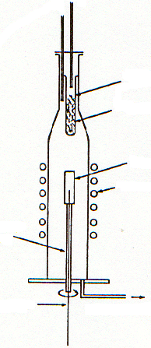
Company Overview
Privately owned company founded in 1970
– 75% Manufacturing (aerospace/medical)
– 25% R&D
Development and manufacture of advanced high temperature materials, primarily by chemical vapor deposition (CVD) technologies
Quality Management System based on
ISO 9001-2015
Melting Points of Some Materials Deposited by Ultramet, °C
TaC 3987
HfC 3947
C 3827
ZrC 3540
NbC 3500
W 3410
HfN 3305
HfB₂ 3250
Re 3180
TiC 3140
TaN 3100
TaB₂ 3093
ZrB₂ 3038
Ta 3014
BN 3000
ZrN 2980
TiN 2930
NbB₂ 2900
HfO₂ 2897
TiB₂ 2871
VC 2810
SiC 2797
WC 2777
ZrO₂ 2715
W₂B 2671
Mo 2610
Nb 2468
Ir 2443
B₄C 2350
NbN 2327
VN 2320
Hf 2227
B 2027
Rh 1966
Si₃N₄ 1900
V 1890
Ta₂O₅ 1872
Zr 1852
TiO₂ 1840
Pt 1772
SiO₂ 1723
Ti 1660
Fe 1535
Ni 1455
Si 1410
Cu 1083
Cold Wall Process
Hot Wall Process
Selective heating and preferential deposition
Isothermal heating and uniform temperature control
Metal
Chlorinator
Metal
Chlorinator
Substrate
Furnace
Substrate
Induction coil
Induction coil
Rotating holder
Rotating holder
To vacuum pump
To vacuum pump
3

Slide 4
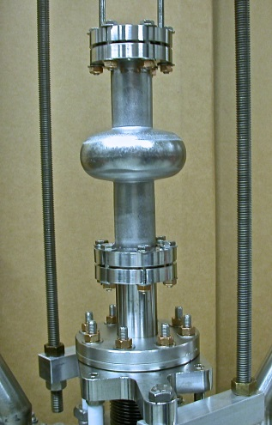
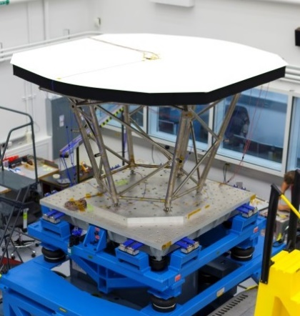
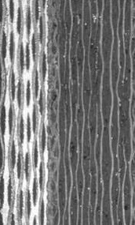
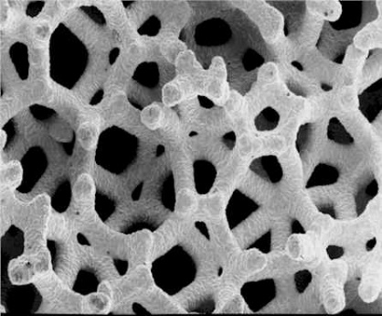
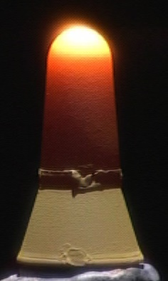
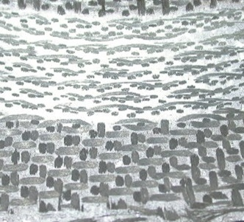
Ultramet Technologies
CVD
CVI
UVCVD
Melt infiltrated CMCs
4

Slide 5
SRF-SBIR R&D Project Path
Ultramet SRF R&D Project Path (2005 to Present)
CVD fabrication of seamless bulk niobium cavity
High-RRR CVD niobium process evaluation and development
Thick-film CVD niobium-on-copper process development
CVD Nb₃Sn process development
Thin-film CVD Nb₃Sn-on-copper via pre-alloyed precursors
Support
  HEP & NP DOE offices
  SRF Group at Cornell
  Jefferson Lab (JLab)
  Niowave
    UCLA
    Oak Ridge National Laboratory
    Florida State University (FSU) - MagLab
    Bailey Tool & Manufacturing
5

Slide 6
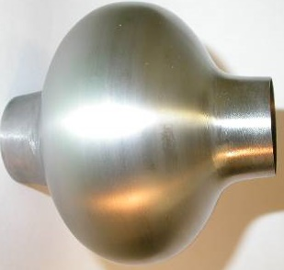
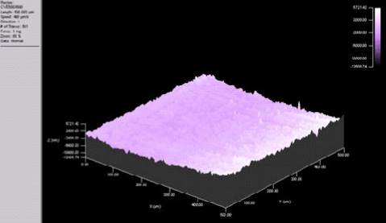
SRF-SBIR R&D Project Path
2005 SBIR DOE Phase I
“Cost-Effective, High-Performance, High Purity Niobium Superconducting Radio Frequency Cavities”
Project Objectives
Establish benchmarks and feasibility of CVD-based SRF cavity fabrication
Evaluate CVD process purity (coupon level)
Demonstrate freestanding cavity fabrication capabilities
UCLA: SQUID/Tc results
Atomic force spectroscopy:
as-deposited CVD niobium ID surface roughness (312 nm) after mandrel removal (courtesy JLab)
CVD niobium cavity
(of arbitrary design)
6

Slide 7
SRF-SBIR R&D Project Path
2009 SBIR DOE Phase I with ORNL
“Cost-Effective, High-Performance, High Purity Niobium for Superconducting Radio Frequency Cavities”
RRR Results for Ultramet CVD Niobium (ORNL)
Precursor | RRRª
Precursor A: Niowave RRR > 200 niobium scrap | 238
Precursor B: commercial niobium chip-scrap | Moderate
CVD coating 1 | precursor A | 282
CVD coating 2 | precursor A | 233
CVD coating 3 | precursor B | 226
CVD coating 4 | precursor B | 213
Solid molybdenum rod substrate used for all specimens. All niobium provided by Niowave was reported to be RRR>200.
ª No heat treatment before RRR readings.
7

Slide 8
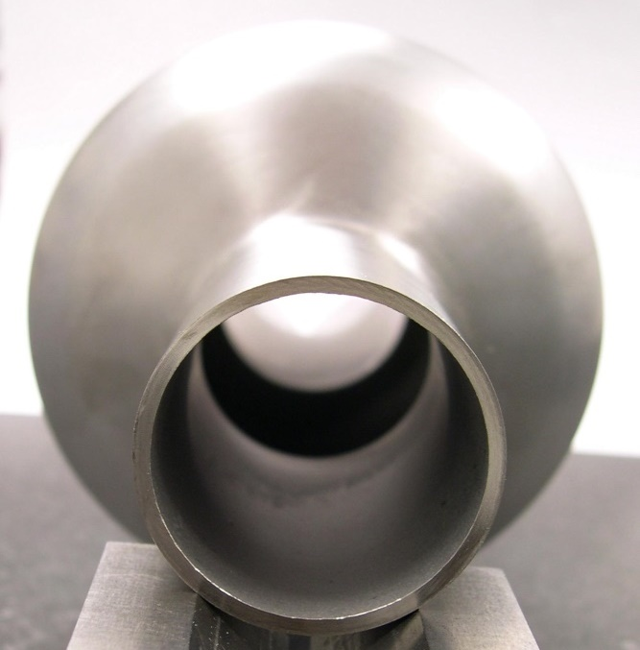
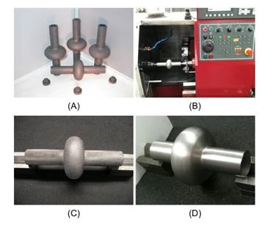
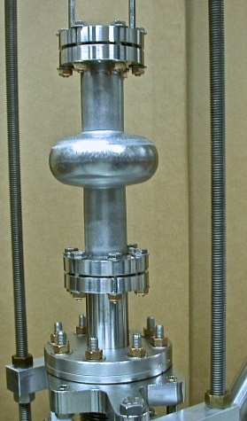
SRF-SBIR R&D Project Path
2012 SBIR DOE Phase I with Cornell’s SRF Group:
“Advanced Manufacturing and Testing of Seamless High Purity CVD Niobium Superconducting Radio Frequency Cavities”
RF test results: 3-GHz SRF niobium cavity
At 4.2 K, the CVD cavity reached an intrinsic quality factor of 7.4 × 10⁷.
At 1.5 K the maximum field was limited by quench of the cavity at ~1.3 MV/m.
Intrinsic quality factor was limited by the residual surface resistance of ~570 nΩ.
Primary cause: surface defects caused by machining during mandrel removal.
8

Slide 9
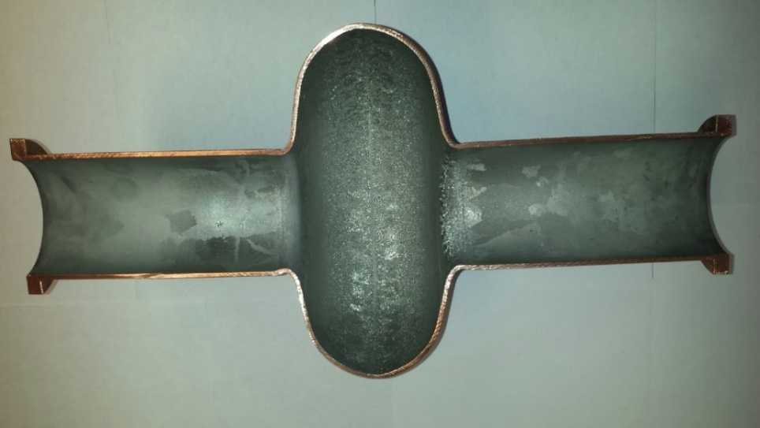
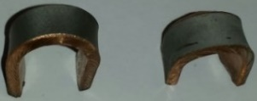
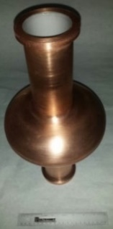
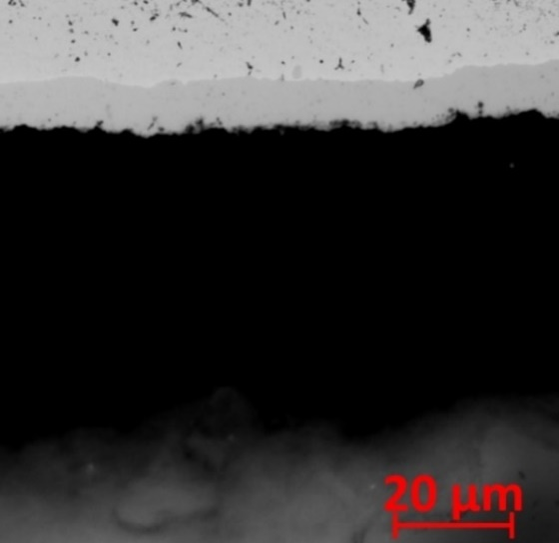
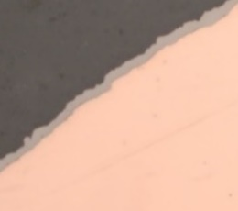
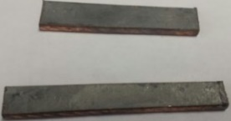
SRF-SBIR R&D Project Path
2016 SBIR DOE Phase I with Cornell’s SRF Group:
“Low Temperature CVD Process Development for Forming Niobium Layers on Copper”
2017 SBIR DOE Phase II with Cornell’s SRF Group:
“Fabrication and Testing of Thick Film CVD Niobium-lined Copper
SRF Cavities for High Gradient Applications”
The most recent RF testing by Cornell of an Ultramet CVD niobium-lined seamless copper SRF ILC cavity demonstrated a quench field of ~ 5.5 MV/m and Q₀ of ~2 × 10⁹ at 2 K.
9

Slide 10
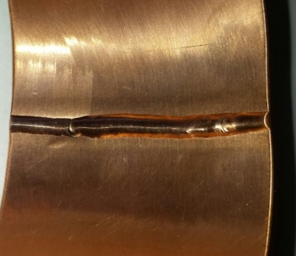
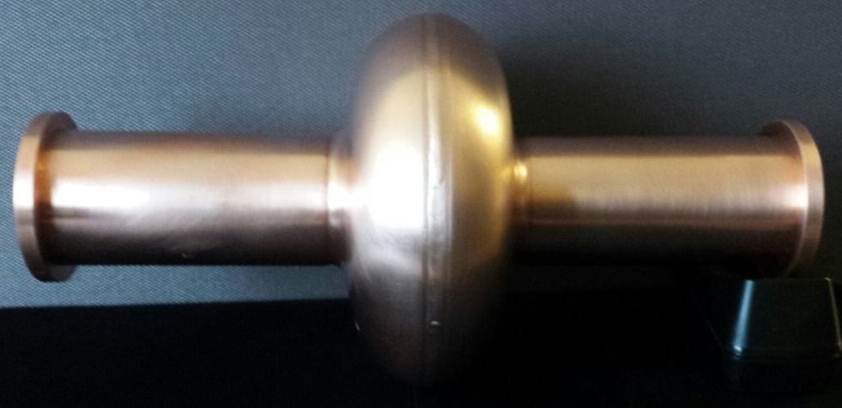
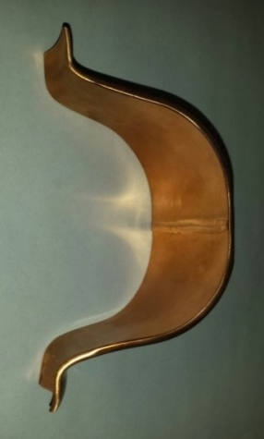
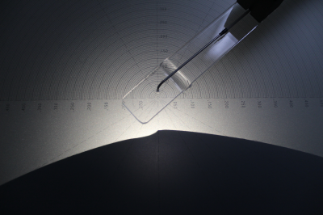
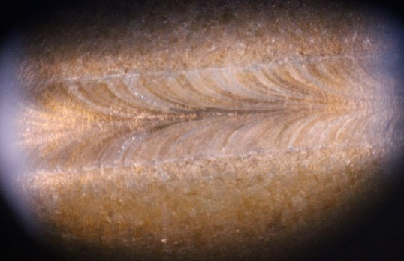
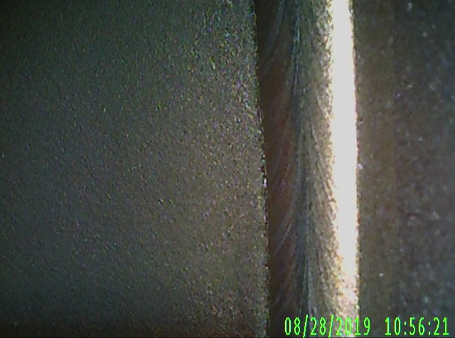
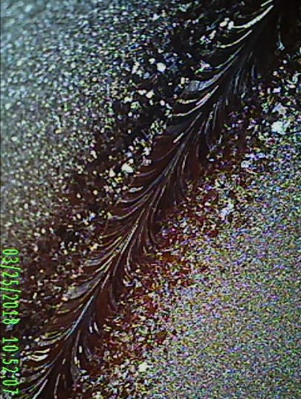
Copper Cavity Optimization
Weld bead profile issues: random ID weld bead profile features
Solution: mechanical grind followed by centrifugal barrel polish operation
10

Slide 11
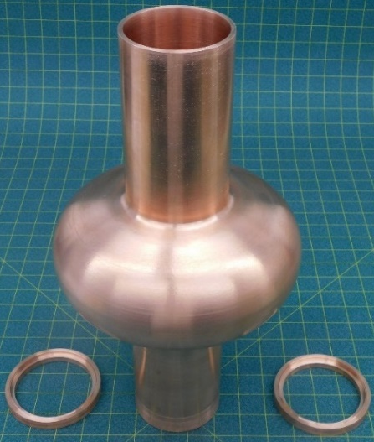
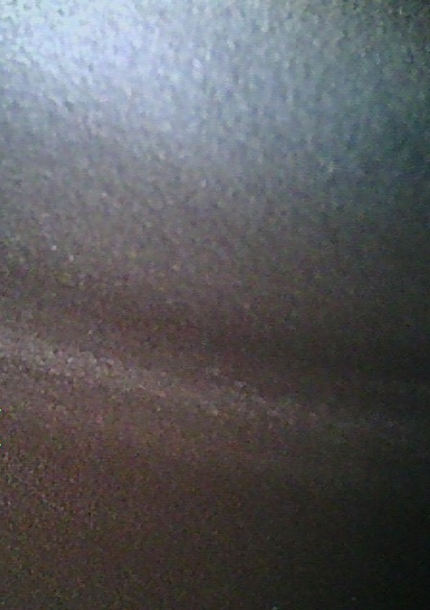
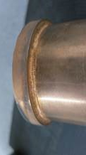
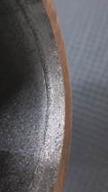
Copper Cavity Optimization
Weld bead profile issues: random ID weld bead profile features
Single-weld scheme: mechanical stresses during centrifugal barrel polish led to failed flange welds.
Solution: seamless OFHC copper cavities developed by Bailey Tool with double weld scheme to strengthen flange-tube attachment
Seamless cavity equator ID surface profile
Double weld scheme
11

Slide 12
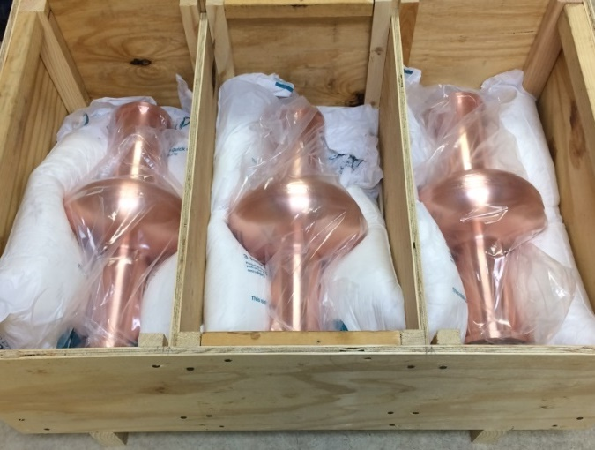
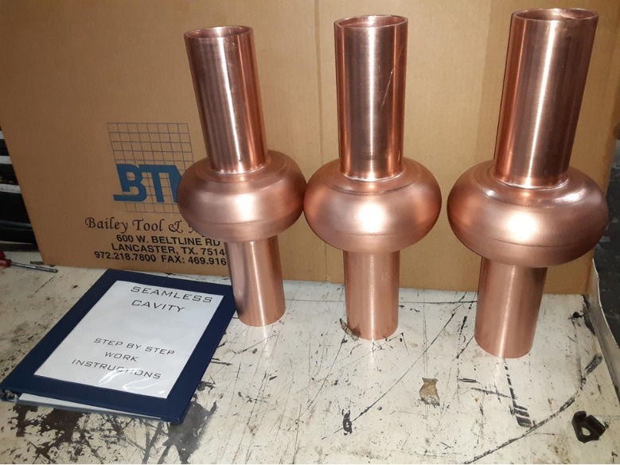
Current Project
2017 SBIR DOE Phase I with Cornell’s SRF Group
“CVD Process Development of Thin Film Triniobium-Tin for SRF Applications”
2018 SBIR DOE Phase II with Cornell’s SRF Group and FSU - MagLab
“CVD Process Development of Thin Film Triniobium-Tin on Copper SRF Cavities”
Niowave welded cavities
Bailey Tool seamless cavities
12

Slide 13
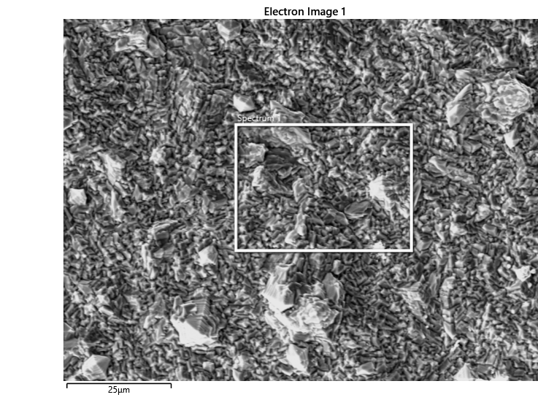
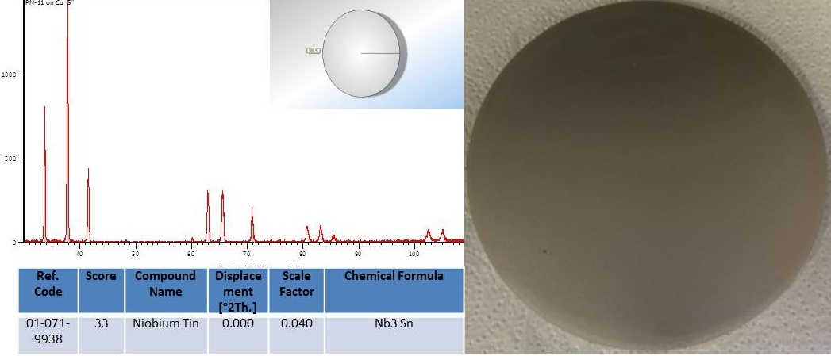
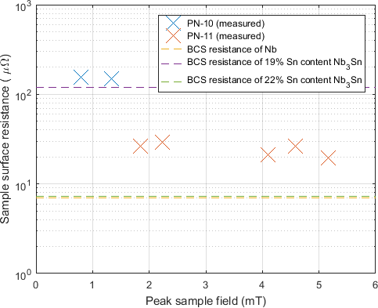
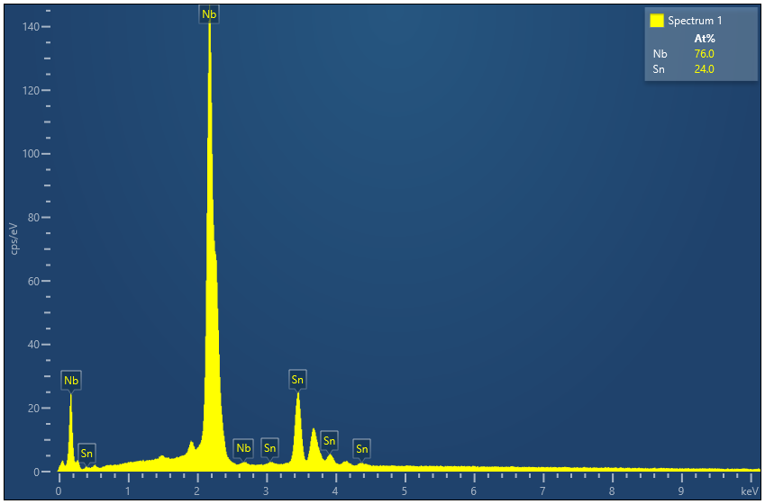
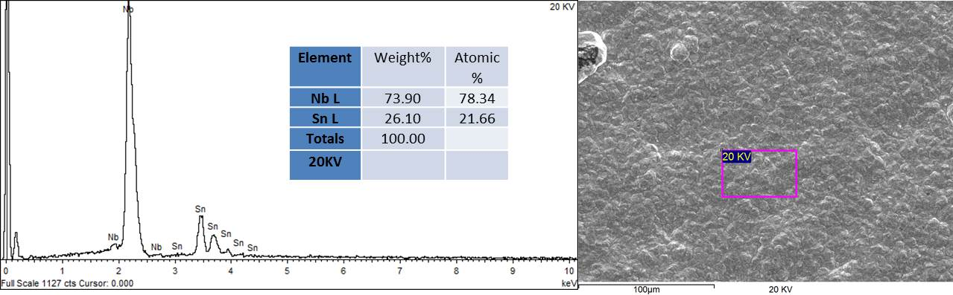
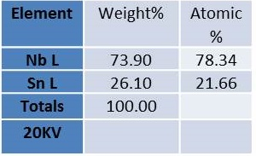
CVD Nb₃Sn Process Development
ACI Alloys — arc-melted CVD precursors
Precursor development initiated
Measured 4.2 K average surface resistance of CVD Nb₃Sn plates PN-10 and PN-11 vs. peak surface magnetic field on plate
Phase I: 0.75″ diameter copper disk
Phase I: RF test specimen: 5″ diameter Nb₃Sn-coated copper disk
13

Slide 14
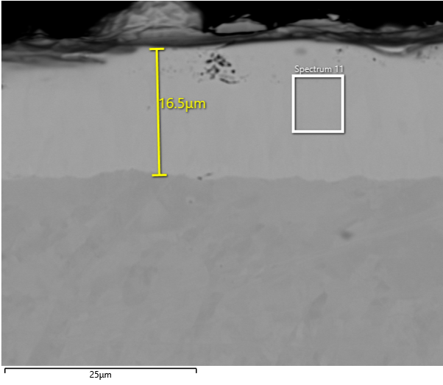
Nb₃Sn Precursor Development
Phase I development involved ACI material
with varied tin content.
Initial Phase II work continued with ACI Nb-Sn.
  Contaminant constituents found (copper, carbon, etc.)
  Insufficient homogeneity of precursor materials
FSU fabrication process for Nb-Sn compounds
  Process A: improved homogeneity, reduced contamination
  Process B: increased material yield
16.5-µm thick tin at 24%; Nb₃Sn coating applied to niobium coupon using
FSU precursor A
SUMMARY
Precursor Supplier | Fabrication process | Precursor | Results
ACI | Arc melt | Nb:Sn-ACI | Contaminated coatings, ceased use
FSU | A | A-Nb:Sn-1 | Demonstration on coupons and ILC cavities
FSU | A | A-Nb:Sn-2 | Ultramet CVD process development
FSU | B | B-Nb-Sn-2 | Now In-process at FSU
14

Slide 15
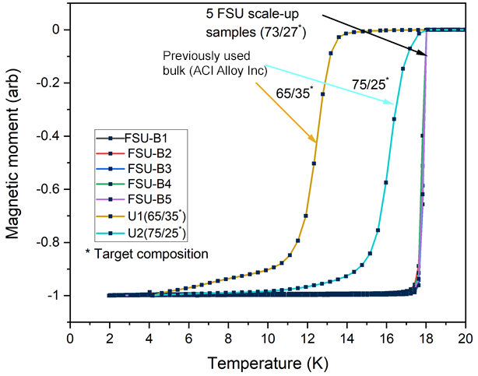
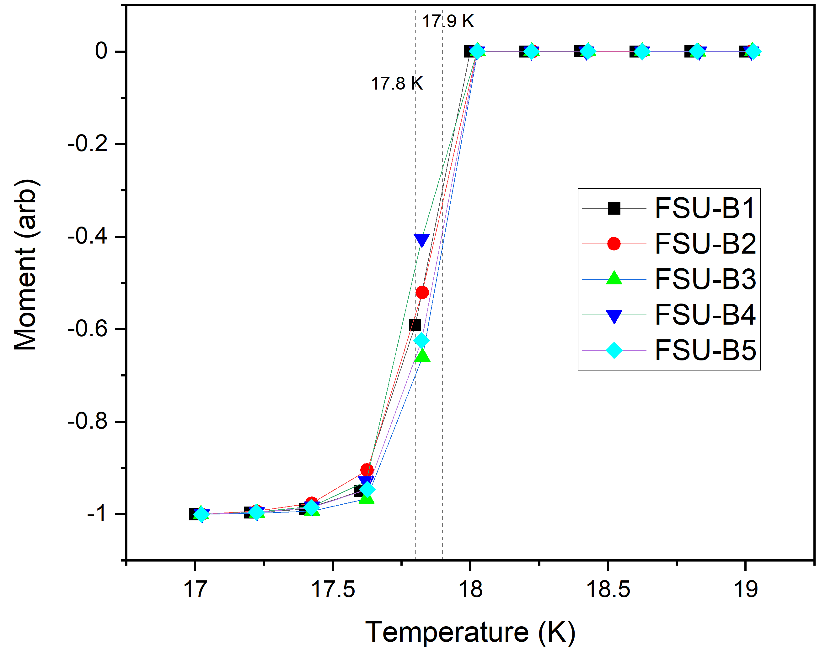

FSU Nb₃Sn Precursor Development
Magnetization vs. temperature of different batches of FSU Nb-Sn precursor samples. Sharp transition is indicative of homogeneity of sample tested, and distribution in T_{c} between batches is within 0.5 K.
[Data and description courtesy of FSU]
Results courtesy FSU
Homogeneity of bulk material is important for achieving reliable CVD coating composition.
15

Slide 16
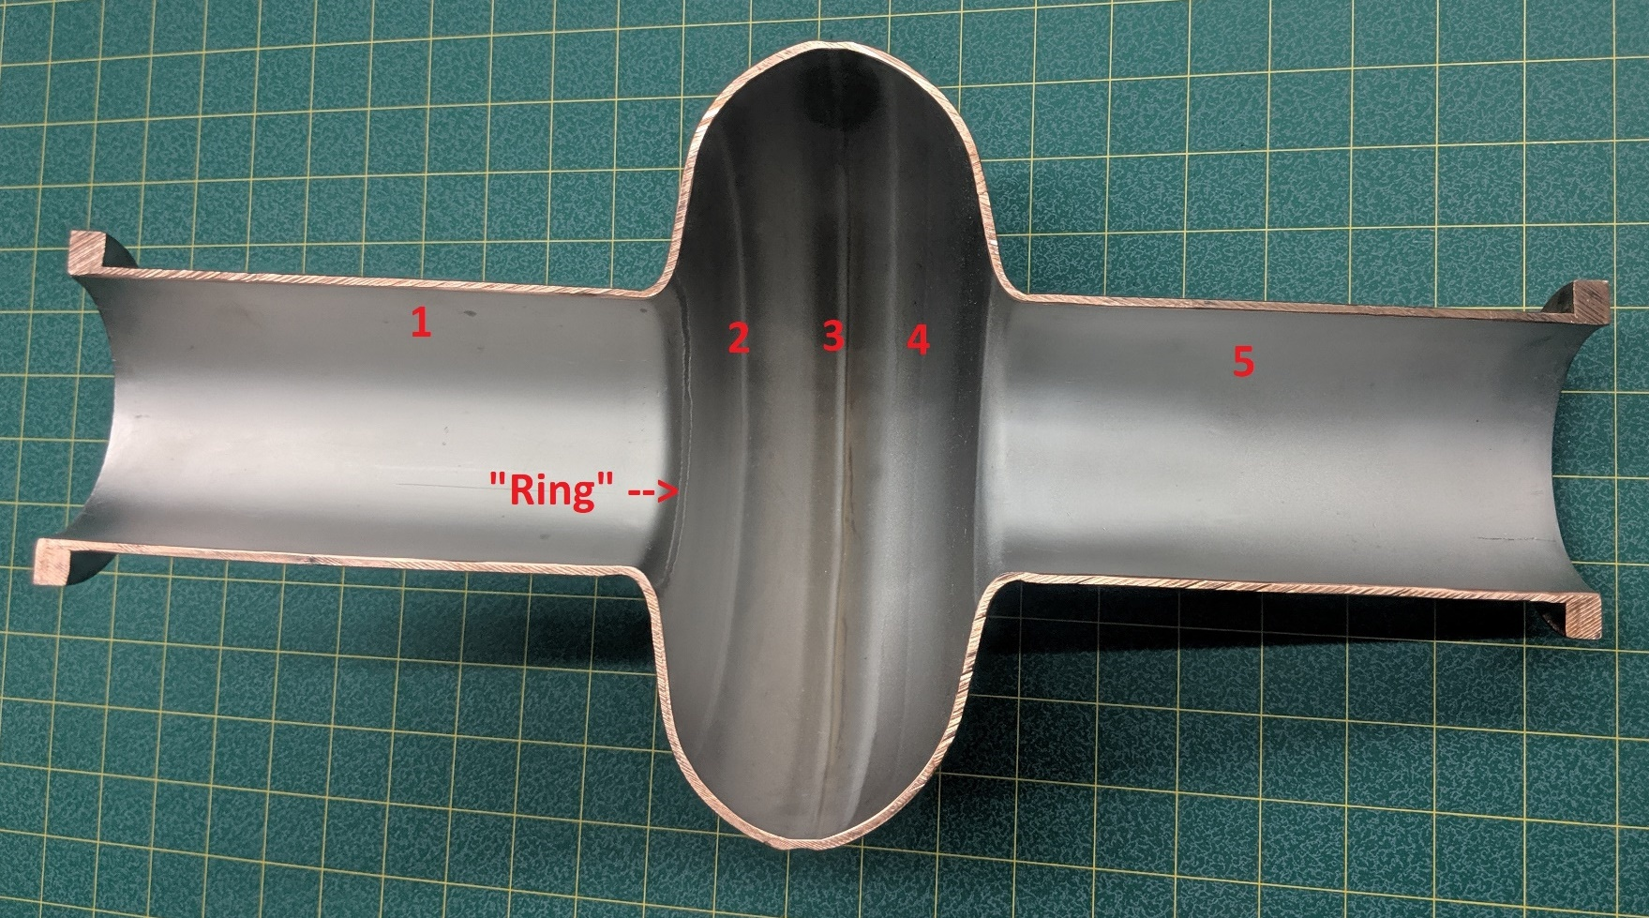
Nb₃Sn on Copper Cavity
First Ultramet CVD Nb₃Sn coating on bare copper ILC cavity
Ultramet CVD Nb₃Sn on bare Niowave welded copper cavity (SN43-45) using FSU A-Nb:Sn-1 precursor
16

Slide 17
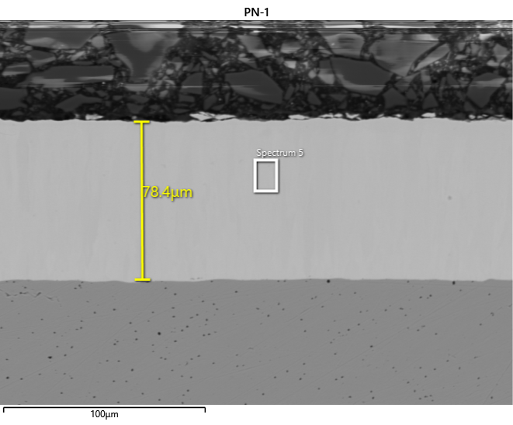
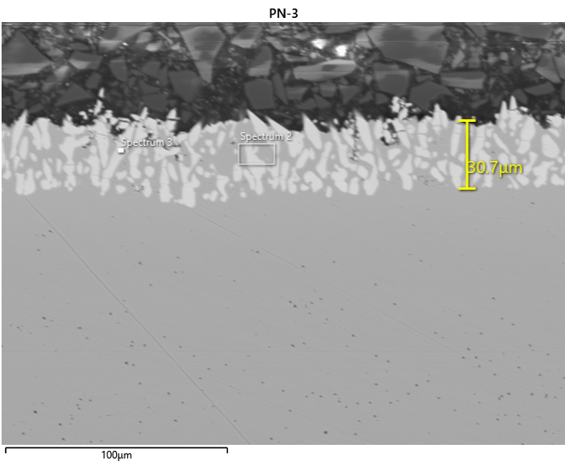
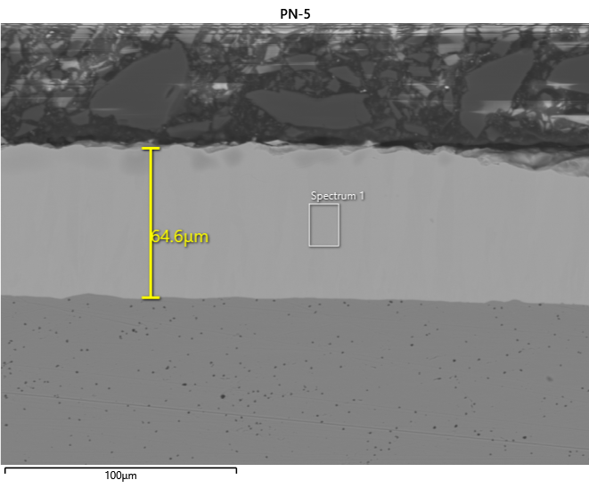
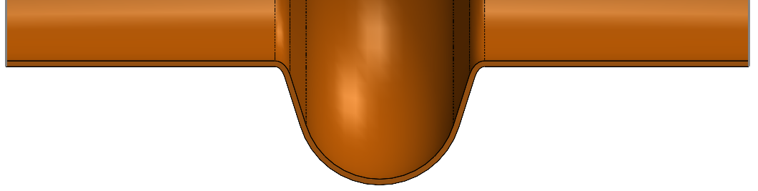
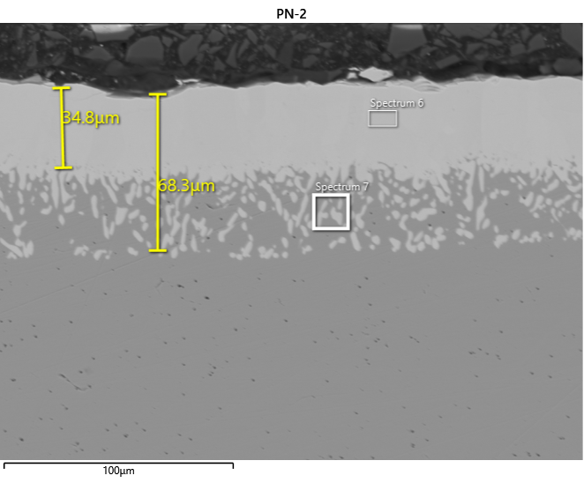
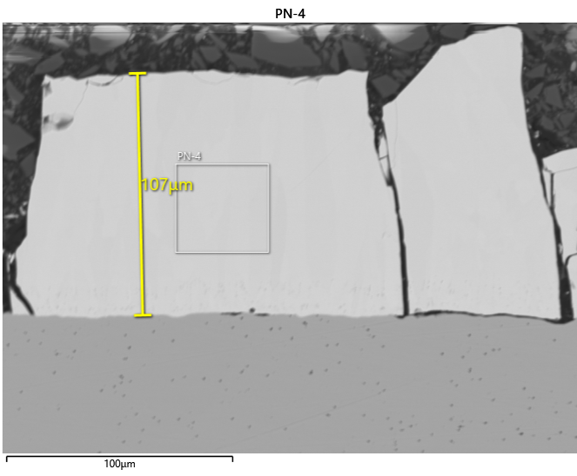
Nb₃Sn on Copper Cavity
First Ultramet CVD Nb₃Sn coating on bare copper ILC cavity
Site 1
Site 3
Site 5
1
2
3
4
5
Site 2
Site 4
SEM results mapping thickness of Ultramet CVD Nb³Sn coating on bare Niowave welded copper cavity (SN43-45) using precursor FSU A-Nb:Sn-1
17

Slide 18
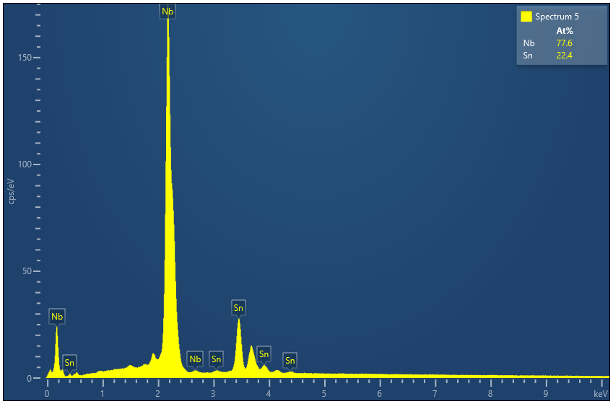
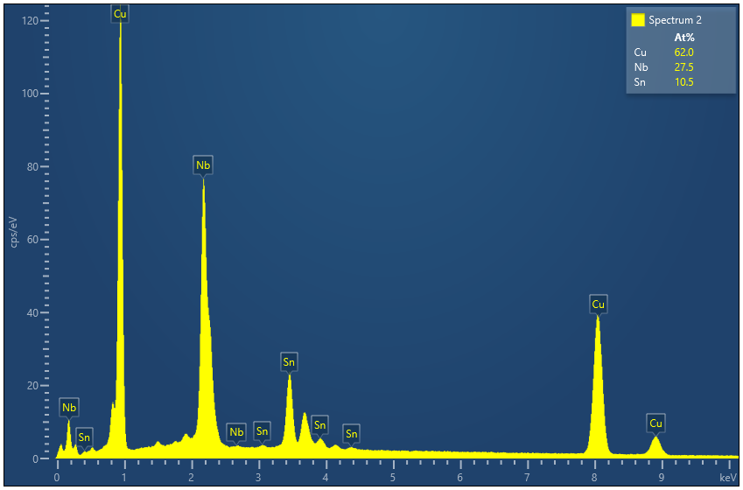
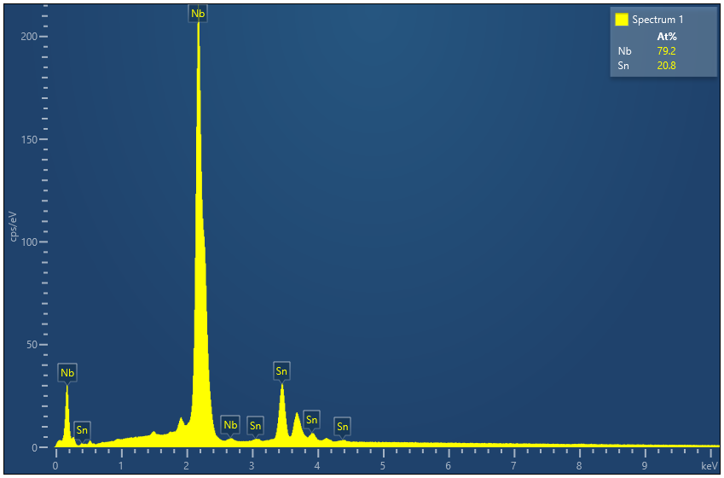



Nb₃Sn on Copper Cavity
First Ultramet CVD Nb₃Sn coating on bare copper ILC cavity
Site 1
Site 3
Site 5
1
2
3
4
5
Site 2
Site 4
EDS results showing Sn content of Ultramet CVD Nb₃Sn coating on bare Niowave welded copper cavity (SN43-45) using precursor FSU A-Nb:Sn-1
18

Slide 19


FSU Analysis of Ultramet Nb₃Sn
on Copper Sample
Nb₃Sn
(Sn: 21 atm%)
Copper
EDS map indicates that there is no copper contamination (within EDS resolution limit).
Interface hardness indent does not show debonding at copper–Nb-Sn interface.
Process leads to good bonding.
Hardness Vickers, 50-g load, 15-sec dwell time
Results courtesy FSU
19

Slide 20

Nb₃Sn on Niobium-lined
Copper Cavity
Second Ultramet CVD Nb₃Sn coating on copper ILC cavity with CVD niobium interlayer
Ultramet CVD Nb₃Sn on CVD niobium-lined Niowave welded copper cavity
(SN19-20) using FSU A-Nb:Sn-1 precursor
20

Slide 21





Nb₃Sn on Niobium-lined
Copper Cavity
Second Ultramet CVD Nb₃Sn coating on copper ILC cavity with CVD niobium interlayer
Site 1
Site 3
Site 5
1
2
3
4
5
Site 2
Site 4
SEM results mapping thickness of Ultramet CVD Nb₃Sn coating on CVD niobium-lined Niowave welded copper cavity (SN19-20) using precursor FSU A-Nb:Sn-1
21

Slide 22





Nb₃Sn on Copper Cavity
Second Ultramet CVD Nb₃Sn coating on copper ILC cavity with CVD niobium interlayer
Site 1
Site 3
Site 5
1
2
3
4
5
Site 2
Site 4
EDS results showing tin content of Ultramet CVD Nb₃Sn coating on niobium-lined Niowave copper cavity (SN19-20) using precursor FSU A-Nb:Sn-1
22

Slide 23
Conclusions and Path Forward
Current effort
Identified and produced precursor materials for CVD of Nb₃Sn in the A15 phase with a tin content at/near 24%
Continued precursor, CVD, and copper cavity fabrication
optimization efforts
Vapor deposited well-adhered Nb₃Sn coatings on OFHC copper, niobium, and molybdenum coupon substrates
Demonstrated ability to form uniform CVD Nb₃Sn coatings with tin content of >20% on ID surface of OFHC copper cavities of full-scale single-cell ILC design with and without niobium interface coatings
Ongoing and future efforts
  Optimization of CVD reactor and process to reliably achieve uniform Nb₃Sn coatings with the ideal 24% tin content
CVD Nb₃Sn coat OFHC copper cavities suitable for RF testing at cryogenic temperatures by Cornell’s SRF Group
23

Slide 24
Acknowledgments
DOE TPOC
Dr. Ken Marken
Niowave
Dr. Terry Grimm
Mr. John Diemer
Cornell & SRF Group
Dr. Matthias Liepe
Dr. Lou Hand
Mr. Charles McNeal
Bailey Tool & Manufacturing
Mr. John Buttles
Florida State University - MagLab
Dr. Peter Lee
Dr. Shreyas Balachandran
Dr. David Larbalestier
ACI Alloys, Inc.
Mr. Larry Albert
JLab
Dr. Charlie Reece
Dr. Larry Phillips
Oak Ridge
Dr. David Christen
24

Slide 25
Questions?
Shawn R. McNeal
shawn.mcneal@ultramet.com
ULTRAMET
ultramet.com
818-899-0236
12173 Montague St. | Pacoima CA 91331
Victor M. Arrieta
victor.arrieta@ultramet.com
Mohamed Cheikh
mohamed.cheikh@ultramet.com
25

