Slide 1
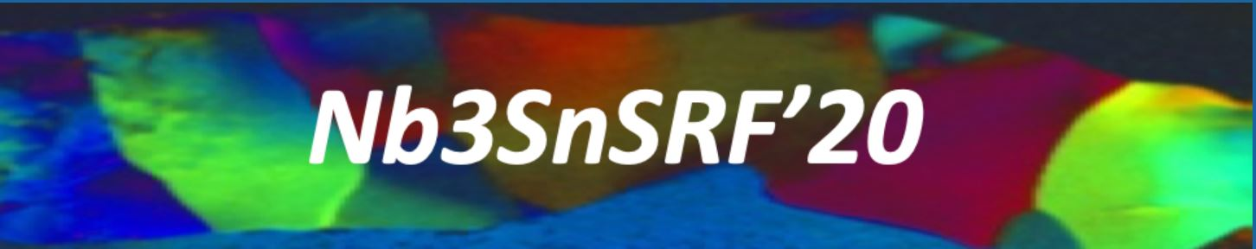

Development and Understanding of Nb₃Sn films for radiofrequency applications through a sample-host 9-cell cavity
Tiziana Spina
Associate Scientist
11.11.2020

Slide 2
Outline
Introduction
Experimental Results
Discussion
Conclusions

Slide 3
Outline
Introduction
Experimental Results
Discussion
Conclusions

Slide 4
Introduction
T. Spina et al. Supercond. Sci. Tech. 2020 [recently accepted]
https://iopscience.iop.org/article/10.1088/1361-6668/abbec4
“In this work, we report on successful Nb₃Sn coatings on Nb in a 1 m-long 9-cell sample-host cavity at Fermilab.
The geometry of the first coating with only one Sn source made it possible to study the influence of Sn flux on the microstructure.
Based on these results, we postulate a connection between recently observed anomalously large thin grains and uncovered niobium spots observed in the past by other authors [Trenikhina 2018].
A phenomenological model to explain how these anomalously large grains could form is proposed. This model is invoked to provide possible explanations for literature results from several groups and to guide key process parameters to achieve uniform vapor-diffusion coatings, when applied to complex structures as the multi-cell cavity under study.”

Slide 5
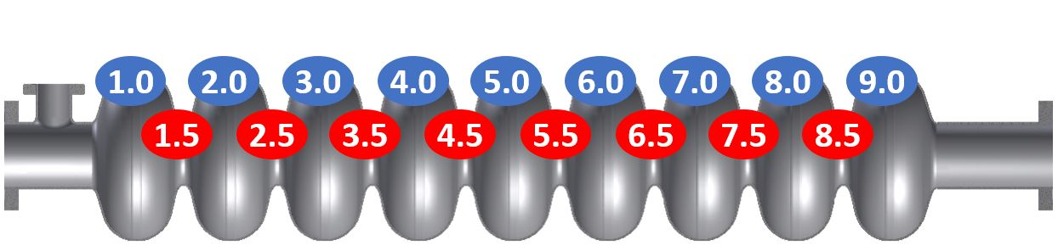
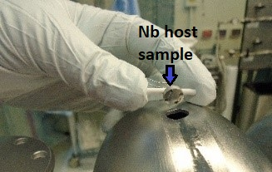
1.3GHz 9-cell sample-host cavity
Two types of sample locations : samples on the irises (in red) and on the equators (in blue).
Host sample under study

Slide 6
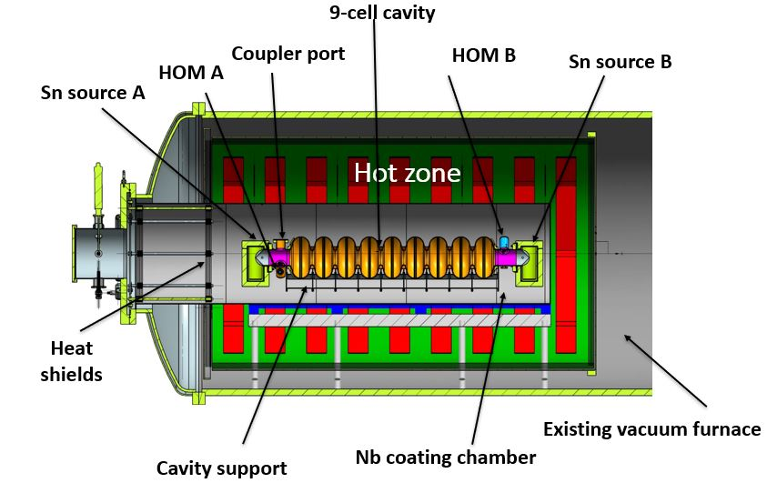
Fermilab’s Nb₃Sn coating system
Horizontal furnace modified to support the coating chamber
R-type thermocouples are placed in each heater to control the temperature (two thermocouples in each for redundancy)

Slide 7
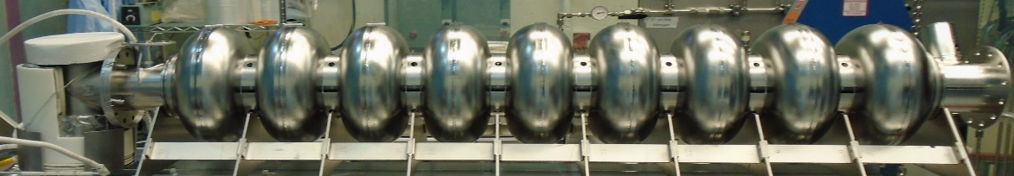
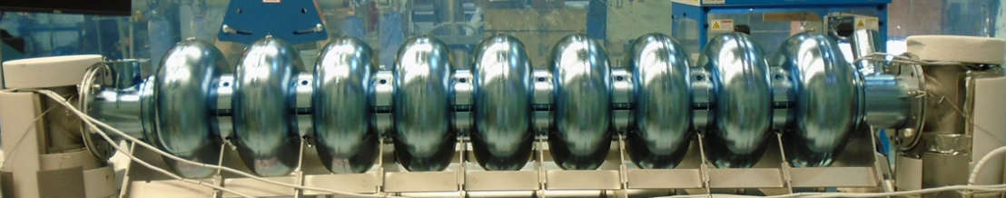
Two Set-up for Nb₃Sn 9-cell cavity
Sn source
1-Sn source
Sn source
Sn source
2-Sn sources

Slide 8
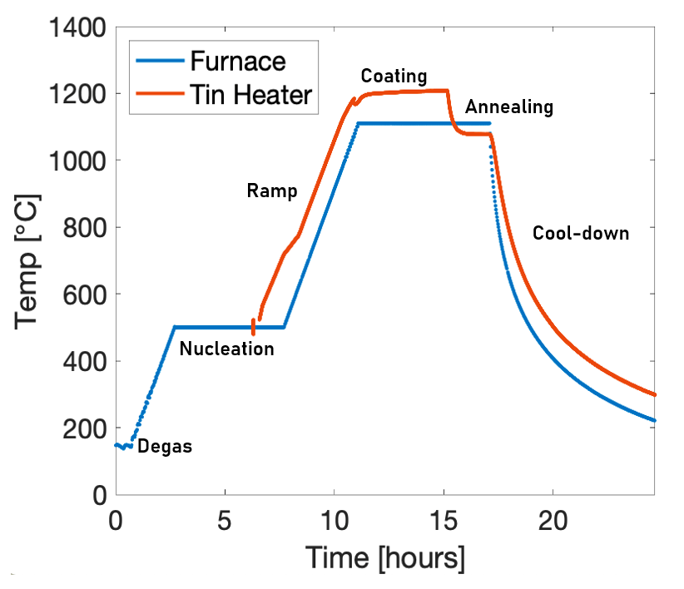
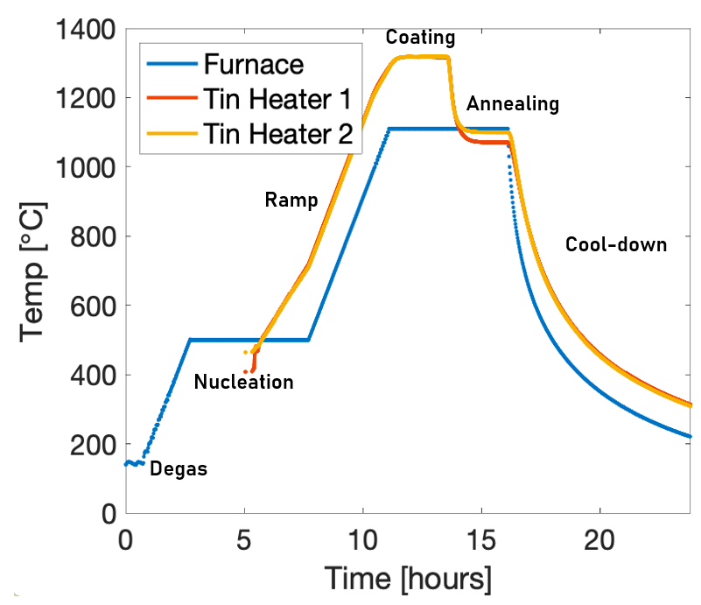
Temperature profile during Vapor Diffusion Coating
Issue with heater
1-Sn source
2-Sn sources

Slide 9
After coating...
1-Sn source
close to Sn source, the cavity looks to be coated with Nb₃Sn. On the other side, furthest from the Sn source, the cavity resembles bare Nb.
2-Sn sources
both sides look like matte Nb₃Sn, except for some Sn spots probably due to an excess of Sn flux from the source.

Slide 10
Outline
Introduction
Experimental Results
Discussion
Conclusions
Samples extracted from each cell were characterized using microscopy measurements:
SEM/EDS at Fermilab
FIB/HAADF-TEM/EBSD at Northwestern University

Slide 11
SEM comparison
1-Sn source
2-Sn sources
I: Uniform
II: Intermediate
II: Uncoated

Slide 12
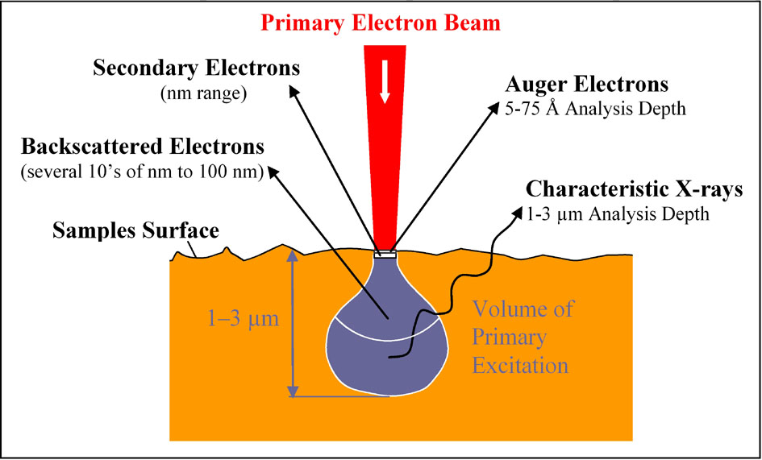
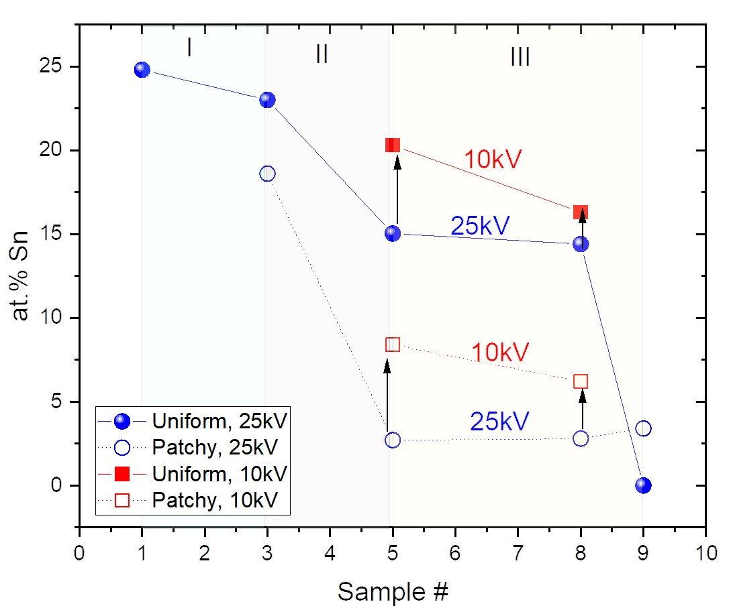
EDS comparison
1-Sn source
2-Sn sources
The deeper penetrating 25 kV beam measures a higher Nb content, suggesting that it is passing through a relatively thin Nb₃Sn layer into the Nb bulk.
2-Sn sources treatment can produce great uniformity of film thickness along the length of multi-cell structures
More evidence is found from a 25 kV EDS line scan across patchy regions

Slide 13
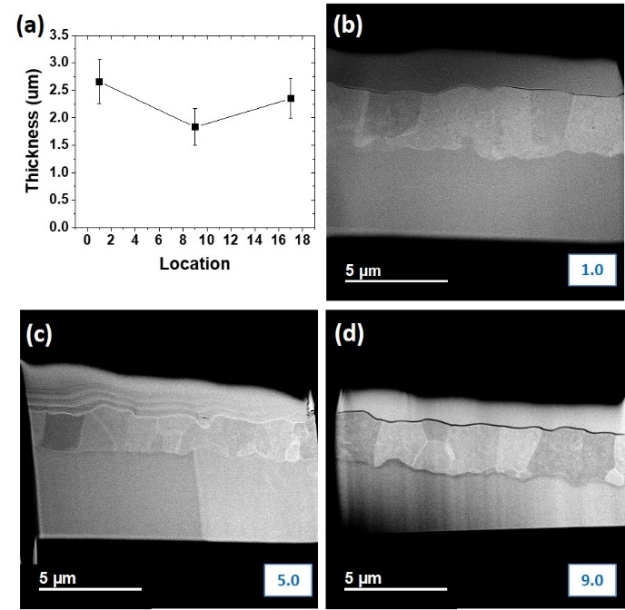
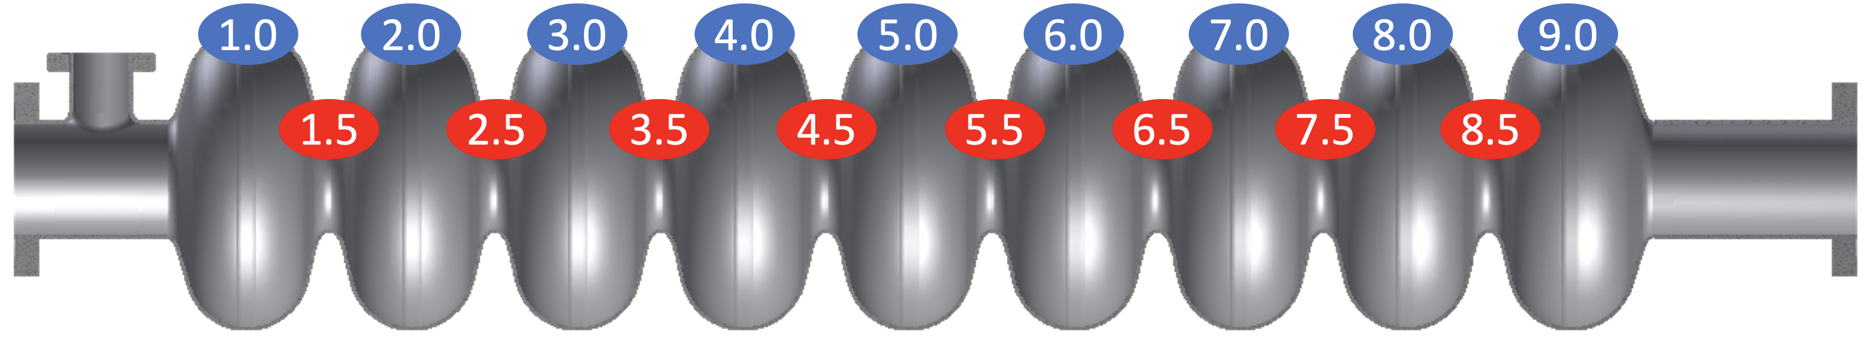

Uniform Nb₃Sn layer:
2-Sn sources treatment
Sn source
Sn source
~46% variation in the thickness at different locations, 1 to 9, in the host cavity
Nb₃Sn
>2.5 μm
Nb₃Sn
1.8 μm
Nb₃Sn
2.5 μm
Nb
Nb
Nb

Slide 14
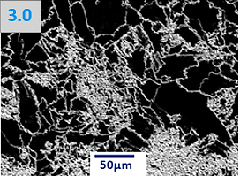
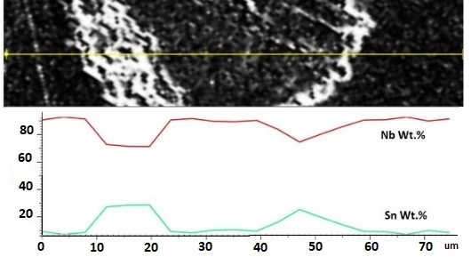
Patchy regions: 25kV EDS Line scan profile
Sn source
1-Sn source coating
Patchy regions:
Nb₃Sn thinner layer at the center with a thicker Nb₃Sn layer displayed around it.

Slide 15
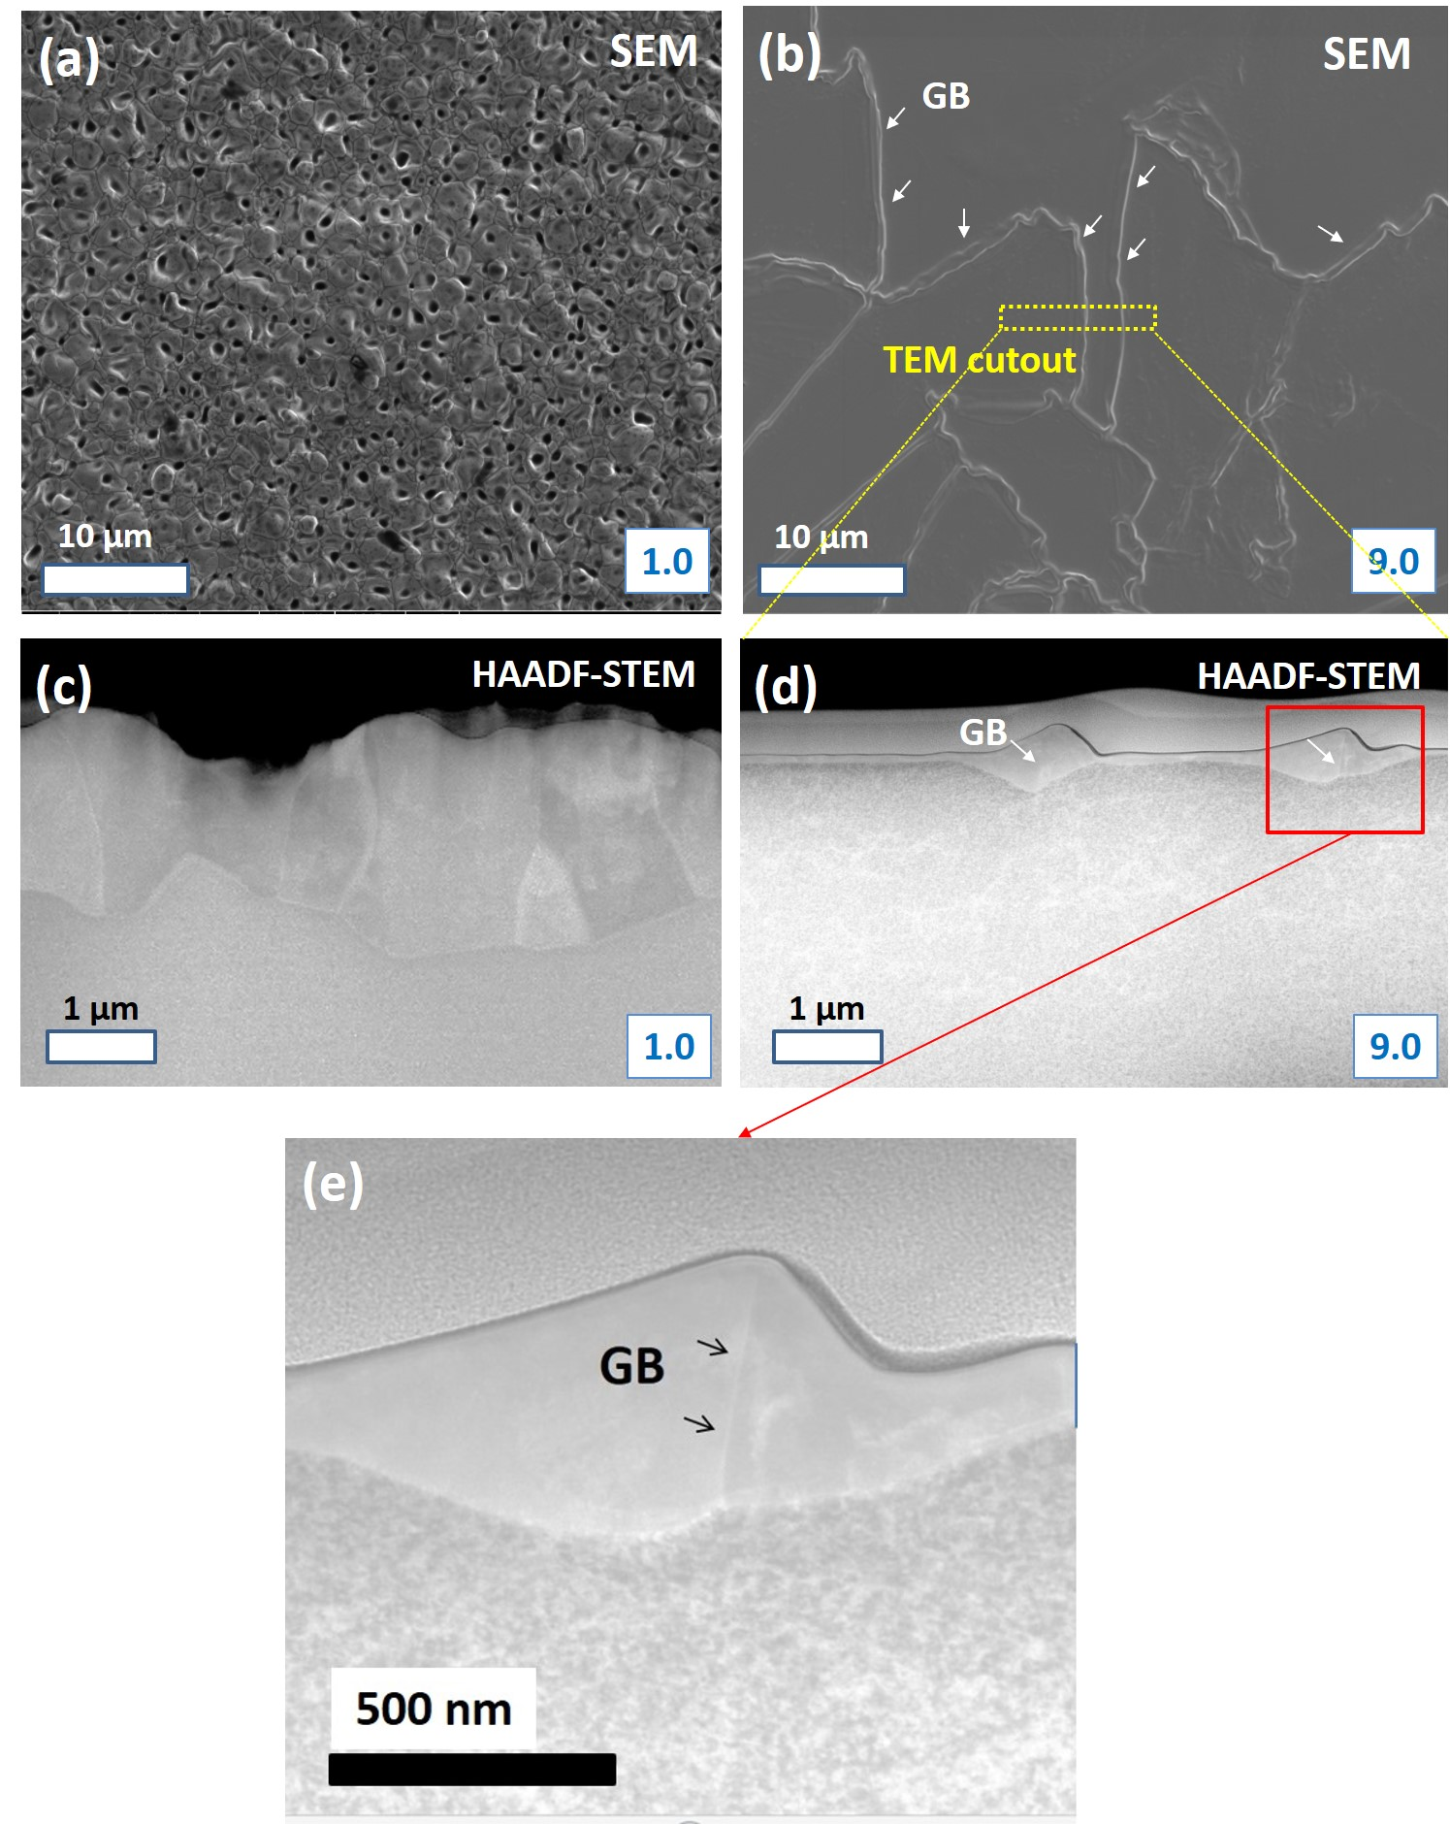
Patchy Regions
Sn source
1-Sn source coating
SEM (FEI Quanta FEG 650) and cross-sectional HAADF-STEM at Northwestern
Extremely thin grains ~100nm thick (Patchy regions) are displayed in #9.0 (far from Sn source)
Film thickness is ~5 times thicker near GBs than the grain interior
➔GBs are the main path for Sn-diffusion and supply for the growth of Nb₃Sn grains.
Nb₃Sn
~2.0μm
Nb
Nb₃Sn
~100nm
Nb
Notes:
SEM and cross-sectional HAADF-STEM images of 1-Sn source coating samples #1.0 and #9.0
5times thicker ➔ Support the idea of Sn diffusion through grain boundaries is much faster than bulk diffusion

Slide 16
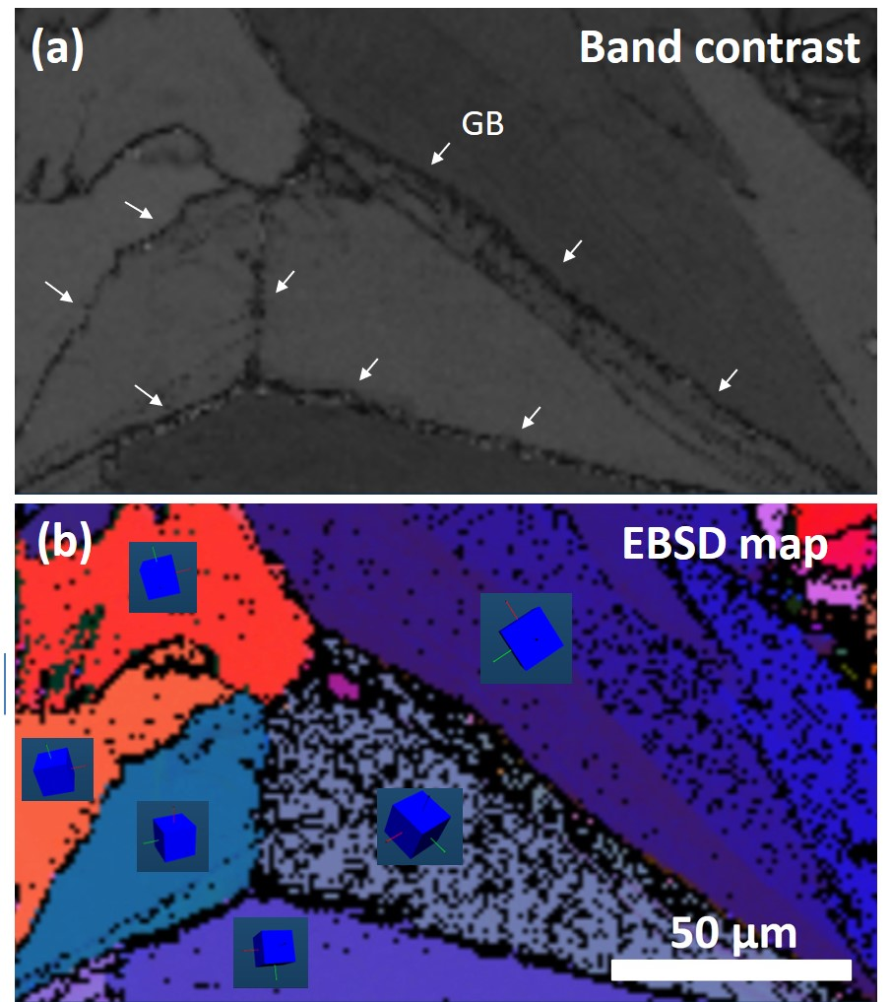
Patchy Regions: EBSD analysis
Sn source
1-Sn source coating
EBSD map on the patchy regions indicates that the grain diameter is more than 50 μm.
Patchy regions have large lateral grain diameters
Notes:
An EBSD map performed on sample #9.0 reveals that these PR have large lateral grain diameters from 10s to 100s um

Slide 17
Outline
Introduction
Experimental Results
Discussion
Conclusions

Slide 18
Previous studies
Hillenbrand et al.,1977 – from empirical observation they suggest that “nucleation may become more homogeneous with a high Sn supply at the niobium surface.”
➔Recomendations for preventing «uncovered niobium spots»:
  providing a high flux of Sn vapor early in the coating process
  use of high vapor pressure Sn halides
  pre-anodizing the niobium substrate
These methods are typically used in modern vapor diffusion coatings, but their mechanism for helping improve layer quality has not been clear.
More investigation of anomalously large thin grains (so-called patchy regions) can be found in more recent studies at Fermilab [Trenikhina et al., 2018], Cornell [Posen, 2017], and Jlab [Pudasaini et al. 2019].
These were directly correlated with RF degradation in a cavity [Posen 2015]

Slide 19
Based on the observations of previous studies on:
Texturing;
Sn flux dependence;
thick oxide layer (anodization): it may act as a barrier between Nb and Sn to permit for a significant amount of Sn to build up on the surface before meeting the Nb layer
Two possible models are proposed to explain how patchy regions form
See next...

Slide 20
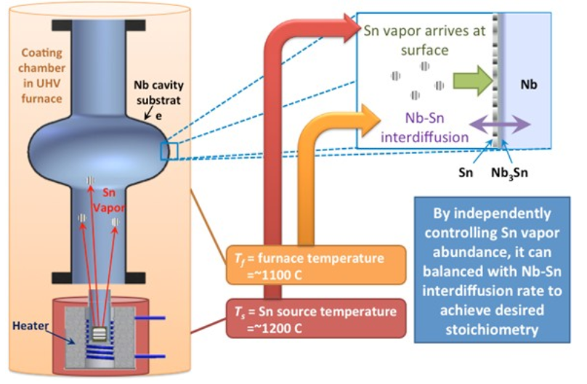
Phenomenological models (I)
Nucleation dominated process:
early in the growth process, Nb₃Sn nuclei form on the surface.
  If the Sn flux is low, a sparse network of nuclei form. These nuclei coarsen as the Sn vapor arrives. As the nuclei meet one another, nuclei that have an energetically favorable orientation (either relative to the substrate or the surface) may influence nearby nuclei to rotate into the same orientation.
  If the Sn flux is high, a dense network of nuclei form. Even though some nuclei may randomly have an energetically favorable orientation. Once the Nb₃Sn nuclei impinge forming a dense network of GBs, the Nb₃Sn nuclei (grains), have a difficult time rotating to form stable Nb₃Sn/Nb interfaces.

Slide 21

Phenomenological models (II)
Time dominated process:
the Sn flux determines the duration for which the Nb₃Sn layer exists, but it is very thin.
  If the Sn flux is low, there will be a long duration in which the thickness of the Nb₃Sn layer is very small, meaning that the energy associated with the Nb/Nb₃Sn interfaces will contribute with a large fraction to the overall energy of a grain. Over many minutes or hours with a low Sn flux, grains with a favorable interfacial energy may have a chance to grow laterally, forming high aspect ratio thin grains (patchy regions).
  If the Sn flux is high, the film may thicken quickly enough to make the interfacial free energy less of a dominant factor in the overall free energy.

Slide 22
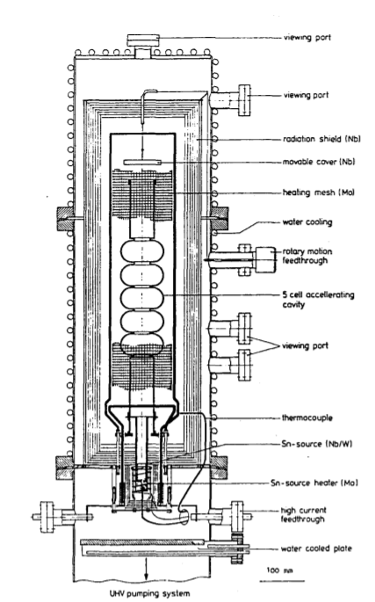
Discussion
Why Cornell [Posen 2014] obtained better results than Wuppertal [Peiniger 1988]?
Wuppertal cavities experienced a strong Q-slope at 5 MV/m due to anomalously large thin grains while the Cornell procedure was able to avoid this because of a higher Sn flux: open cavity to the coating chamber.
Similarly, Fermilab now employs an open cavity geometry, whenever possible, to permit a high Sn-flux without condensation by utilizing the coating chamber and cold region of the furnace as a Sn “sink”.
JLab has also used a procedure that permits a high Sn flux by connecting the main cavity to be tested to a secondary “sacrificial” cavity to absorb the excess Sn flux [Pudasaini 2019].
Notes:
The connection between Sn flux and patchy regions may explain another significant feature of coatings in the literature

Slide 23
Multi-cell elliptical cavity coating
A long coating process with a relatively low Sn flux (e.g. this may apply to the 60-hour-long coating of the Wuppertal 5-cell cavity) is likely to result in patchy regions.
A short process with a high Sn vapor pressure to all regions of the cavity is more likely to produce a successful film.
➔Final coating is affected not just by the integrated dose of Sn to the surface, but also by the local dose rate during the coating process.
New understanding
High Sn flux
Short process with high Sn flux
Sn «sink»
Hillenbrandt recomandations (pre-anodization, thermal gradient, nucleation agent)
Recommendations

Slide 24
Outline
Introduction
Experimental Results
Discussion
Conclusions

Slide 25

Conclusions
Two Nb₃Sn vapor diffusion processes on 9-cell cavities have been compared and discussed.
The 1-Sn source coating provided a unique opportunity to study the microstructure as a function of Sn flux due to the geometry of the cavity, showing clearly that the formation of anomalously large thin grains is more likely when the Sn flux is small.
Higher vapor Sn flux supplied during the 2-Sn sources coating led to a uniform $\sim$2 μm thick Nb₃Sn coating layer without patchy regions.
A model was presented on how these regions form, which was used to provide possible explanations for previous results of Nb₃Sn vapor diffusion coatings. The model was used to guide coatings of large structures, e.g., 9-cell cavities, including recommendations for utilizing a Sn “sink” to permit a high Sn flux without condensation.
Coating with 2-Sn sources led to a highly uniform Nb₃Sn multi-cell coating with only normal regions being observed in all the samples investigated.

Slide 26

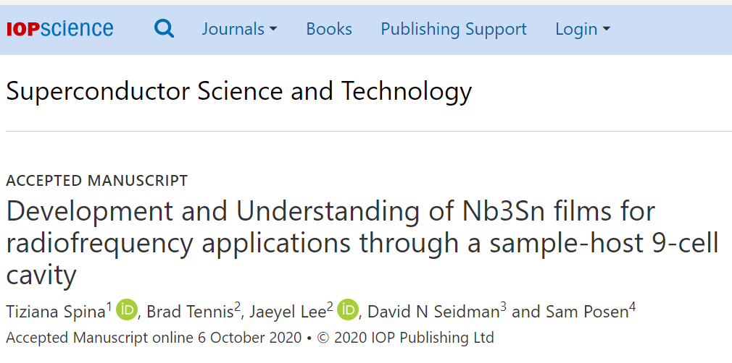
Acknowledgment
This work has been authored by Fermi Research Alliance, LLC under Contract No. DE-AC02- 07CH11359 with the U.S. Department of Energy, Office of Science, Office of High Energy Physics and supported by a DOE Early Career Award. This work made use of the EPIC, Keck-II, and/or SPID facilities of Northwestern University’s NUANCE Center, which received support from the Soft and Hybrid Nanotechnology Experimental (SHyNE) Resource (NSF ECCS-1542205); the MRSEC program (NSF DMR1121262) at the Materials Research Center; the International Institute for Nanotechnology (IIN); the Keck Foundation; and the State of Illinois, through the IIN.
https://iopscience.iop.org/article/10.1088/1361-6668/abbec4

Slide 27


Slide 28
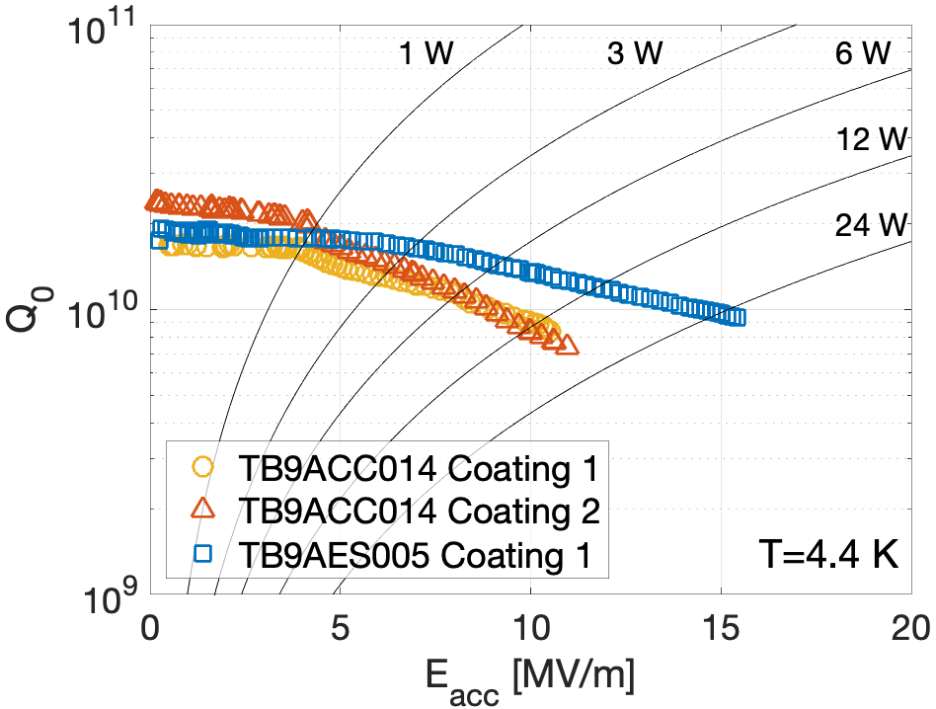
Vertical test: Nb₃Sn 9-cell cavity
Courtesy of S. Posen

Slide 29
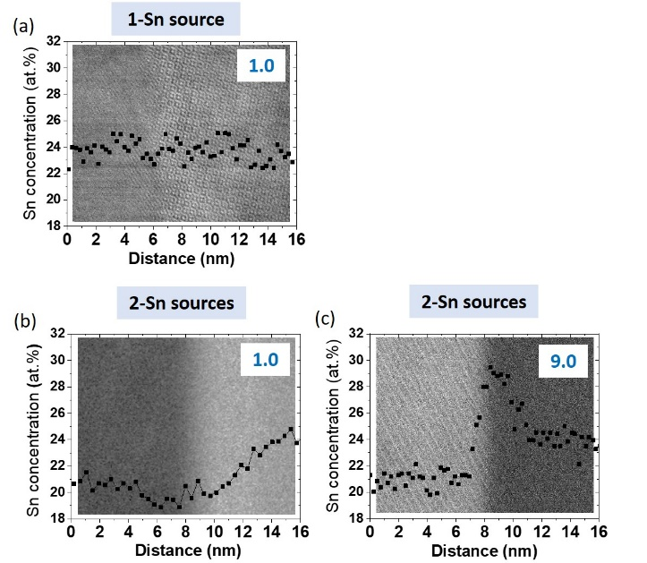
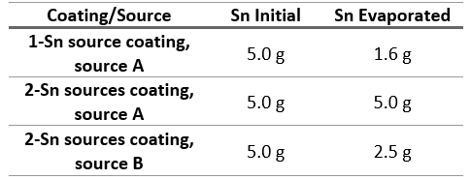
STEM-EDS: at.%Sn across GB
1-Sn source coating: no Sn segregation was observed in sample #1.0.
2-Sn sources coating: Sn segregation was observed only in sample #9.0 probably due to the Sn remaining in source B (closest to #9).
No data available
Some Sn would have continued to evaporate during the annealing step, possibly leading to additional Sn accumulation in the GBs.

Slide 30
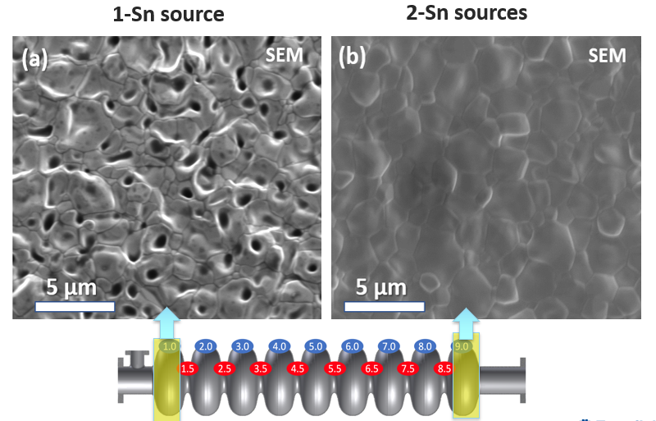
High Resolution SEM comparison
The porous appearance that affected the 1-Sn source coating is not displayed in the 2-Sn sources coating.
The cause of the porous microstructure is unclear.
Possible speculation may be due to the Sn flux being insufficient, but not low enough to cause large thin grain patchy regions.

