Slide 1
Persistence of the Nb(100) Surface Oxide Reconstruction at Elevated Temperatures
Caleb J. Thompson, Ali A. McMillan, Jacob D. Graham, Sarah A. Willson, Rachael G. Farber, and S. J. Sibener
Advisor: Steven Sibener
University of Chicago
Department of Chemistry
Nb₃Sn SRF 2020

Slide 2
Helium Atom Scattering Will Characterize Surface Oxide Behavior on Nb
Corner Niobium (BCC)
Tin
Center Niobium (BCC)
Oxygen
High T/ Sn deposition
well-known (3x1)-O Nb(100)
unknown O and Sn behavior
HAS’s unique capability to analyze a high temperature regime of surface structures will provide novel insight into O and Sn behavior during Nb₃Sn film growth on oxidized Nb.

Slide 3
What Are the Scientific Questions We Want to Answer?
What surface structure and chemical composition for the Nb(100) face interacts with deposited Sn?
How does the surface evolve structurally at elevated temperatures?
Does oxygen dissolve into the Nb bulk in the range of Sn deposition and Nb₃Sn film growth?

Slide 4
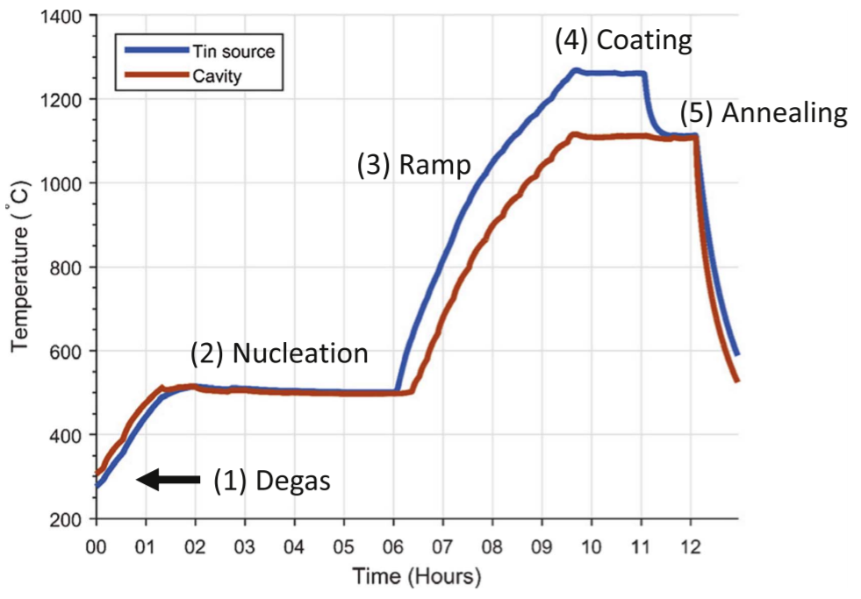
Variations in Surface Oxide Significantly Impact Nb₃Sn Film Growth
Typical Nb₃Sn film growth procedure
1700
Oxide
Sn
Thick Nb₃Sn
Thin Nb₃Sn
1500
(K)
1300
→ Nb₃Sn forms
1100
1293 K
900
SnCl₂ → Sn + Cl₂
Understanding the oxide surface that interacts with Sn is critical to understanding Nb₃Sn film growth.
700
500
R. D. Porter, T. Arias, P. Cueva, D. L. Hall, M. Liepe, J. T. Maniscalco, D. A. Mueller, N. Sitaraman. LINAC’18, Beijing, China, 462-465 (2018)

Slide 5
Film Growth Occurs in High Temperature Regime of Niobium Oxide Surface Structure
1st order
E_{a} = 174 ± 6 kJ/mol
A = 8.9 $×$ 10^{10.0 ± 0.3} s⁻¹
For T_{s} > 598 K
1st order
E_{a} = 134 ± 16 kJ/mol
A = 8.0 $×$ 10^{7.0 ± 0.4} s⁻¹
1st order
E_{a} = 180 ± 18 kJ/mol
A = 5.4 $×$ 10^{10.0 ± 0.5} s⁻¹
Nb₂O₅
NbO₂
NbO
For T_{s} > ?
T_{s} = ?
T_{s} = ?
NbO
?
Nb
Many studies confirm O dissolution of Nb₂O₅ above 598 K in UHV on (100), (110), (111), and polycrystalline Nb surfaces.
Kinetic Data: B. King, H. Patel, D. Gulino, B. Tatarchuk. Thin Solid Films. 192, 351-369 (1990).

Slide 6
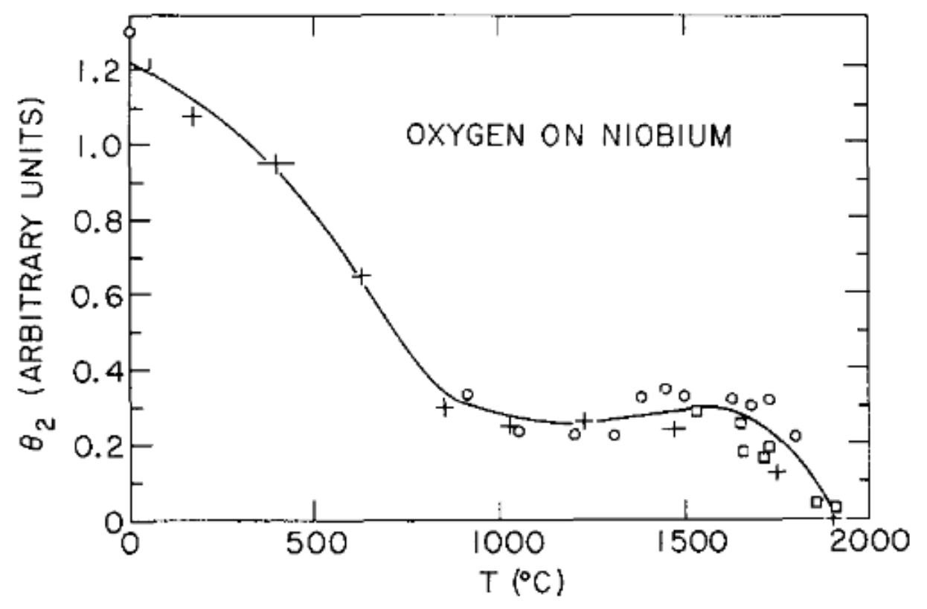
Structure of the Surface at Elevated Temperatures Has Never Been Observed
For T_{s} > ?
T_{s} = ?
T_{s} = ?
NbO
?
Nb
Auger Electron Spectroscopy Data
Data taken at room temperature!
Surface structure during these anneals has never been observed.
0
800
1300
1800
2300
Thermal history (K)
H. H. Farrell, H. S. Isaacs, M. Strongin. Surf. Sci. 38, 31-52 (1973).

Slide 7
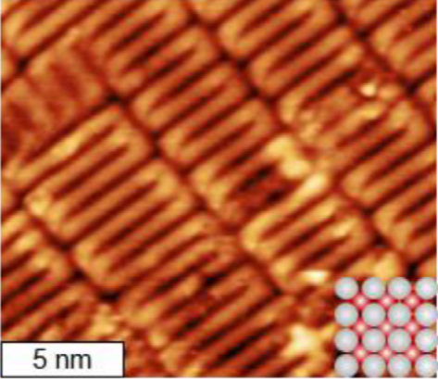
NbO Surface Has Been Well Characterized at Low Temperatures
STM image of Nb(100) (3x1)-O
Nb(100) (3x1)-O
NbO on…
(100) has long-range order
(110) is quasi periodic
(111) has no long-range order
Corner Niobium (BCC)
Oxygen
V_{bias} = -0.5 V, I = -19 pA, T_{STM} = 300 K
Center Niobium (BCC)
NbO superlattice structure on (100) is the (3x1)-O which has only been characterized at RT only.
R. D. Veit, N. A. Kautz, R. G. Farber, S. J. Sibener. Surf. Sci. 688, 63-68 (2019).
B. An, M. Xu, S. Fukuyama, and K. Yokogawa. Phys. Rev. B. 73, 205401 (2006).
Surgers, C., Schock, M. & Lohneysen, H. v. Surf. Sci. 471, 209–218 (2001).

Slide 8
Helium Atom Scattering (HAS) Is Uniquely Suited to Study Surface Structure and Dynamics
Scattering helium
Strictly surface sensitive
Non-destructive
De Broglie wavelength well matched to atomic scale features
Well matched to single-phonon energies
Single translational degree of freedom for collisions
Electron cloud
Surface lattice/phonons

Slide 9
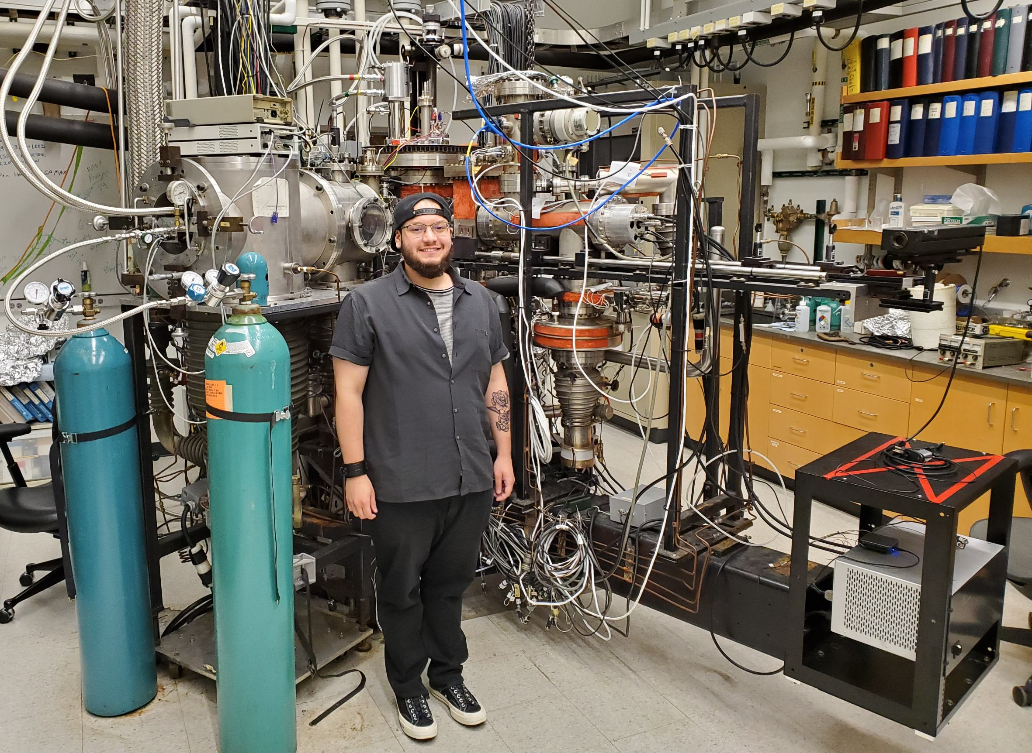
Helium Atom Scattering Instrument
LEED
Helium Beam Source
Bell Jar
Nb Sample
Auger
Nozzle
Chopper Wheel
He
Skimmer
He beam energy: 10 – 100 meV
Sample temperature: 300 – 2000 K
Incident and final angles are varied independently
Incident angle: 20° – 40°
Rotatable
Detector Arm

Slide 10
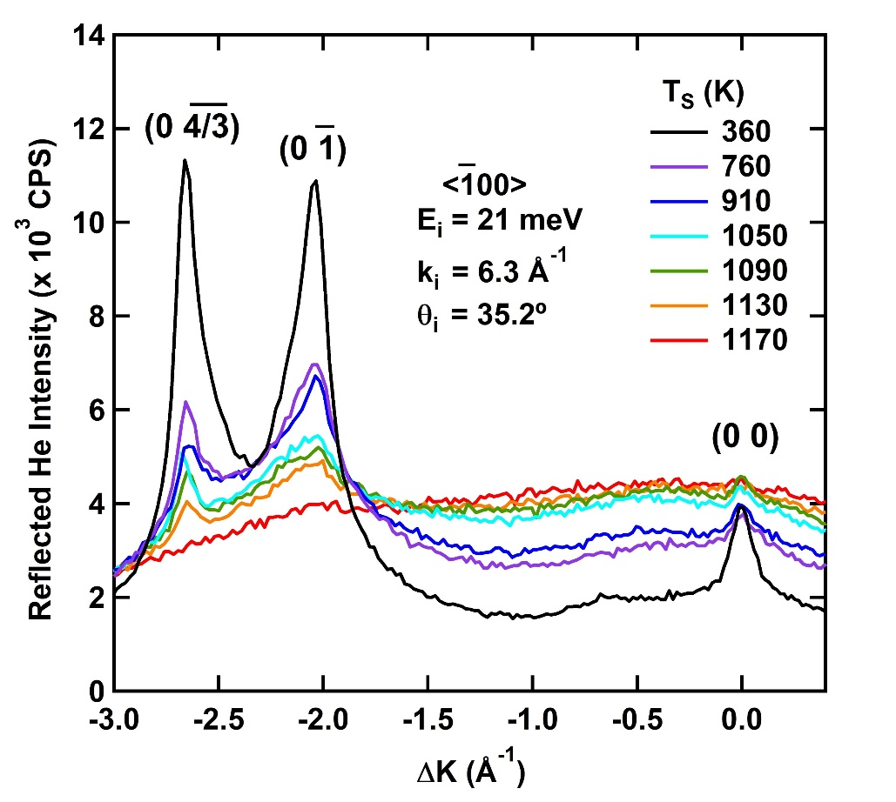
Oxygen Superlattice Diffraction Peaks Are Visible with HAS at 1130 K
A (3x1) superlattice diffraction peak appears in the $<\overline{1}00>$direction
Each diffraction scan was taken 2-3 times (consecutively) to ensure there was no hysteresis.
(01)
LEED
Nb(100) (3x1)-O
The (3x1)-O superlattice appears to be stable up to at least T_{S} = 1130 K.

Slide 11
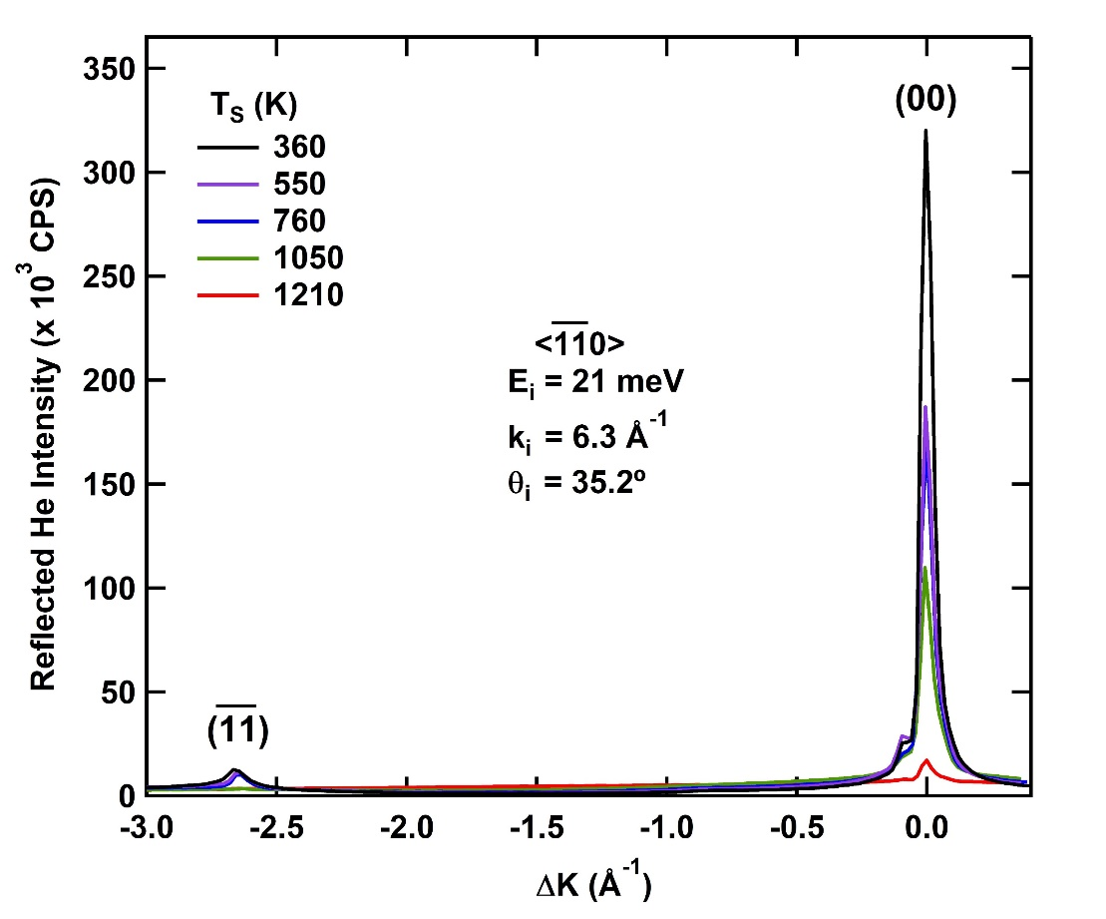
Intense Specular Peak in Other Azimuthal Alignment Allows Addition Intensity and Line Shape Analysis
Rotated azimuthal angle so He beam is aligned along the $<\overline{11}0>$ axis
Specular intensities are ~30x greater than in $<\overline{1}00>$ direction
(11)
LEED
Nb(100) (3x1)-O
Specular intensity is much higher when aligned along $<\overline{11}0>$ axis and appears to corroborate surface stability up to 1210 K.

Slide 12
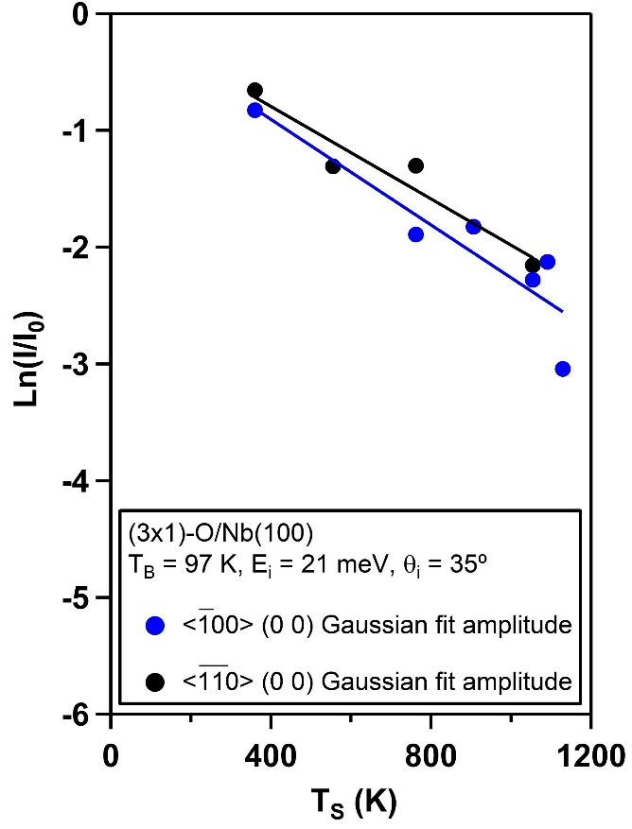
Debye-Waller Analysis Shows Similar $\left\langle u_{z}^{2}\right\rangle$ Values Along Both Crystal Axes
Note: calculated Debye temperature for NbO is $Θ_{D}=$ 472 K ^{[1]}
Debye-Waller Analysis for $$θ_{i}=θ_{f}$$ | $<\overline{1}00>$ | $<\overline{11}0>$
$2W\left(T_{S}\right)=∆k_{z}^{2}\left\langle u_{z}^{2}\right\rangle$ (K⁻¹) | 0.0023 ± 0.0005 | 0.0020 ± 0.0004
$$k_{i}\text{ (Å}\text{−1}\text{)}$$ | 6.32 | 6.32
$∆k_{z}=2k_{i}\left[{\left(\cos^{2}{θ_{i}}+\frac{D}{E_{i}}\right)}^{\frac{1}{2}}\right]$ (Å⁻¹) | 12.68 | 12.67
$D$ (meV), assumed | 7 | 7
$\left\langle u_{z}^{2}\right\rangle$ (Å² K⁻¹) | (1.4 ± 0.3) x 10⁻⁵ | (1.2 ± 0.3) x 10⁻⁵
Excellent fit of Debye-Waller analysis shows that thermal decay of specular is only due to increase in thermal vibrations and not structural changes.
[1] W. Weingarten. Phys. Rev. ST Accel. Beams. 14, 101002 (2011).

Slide 13
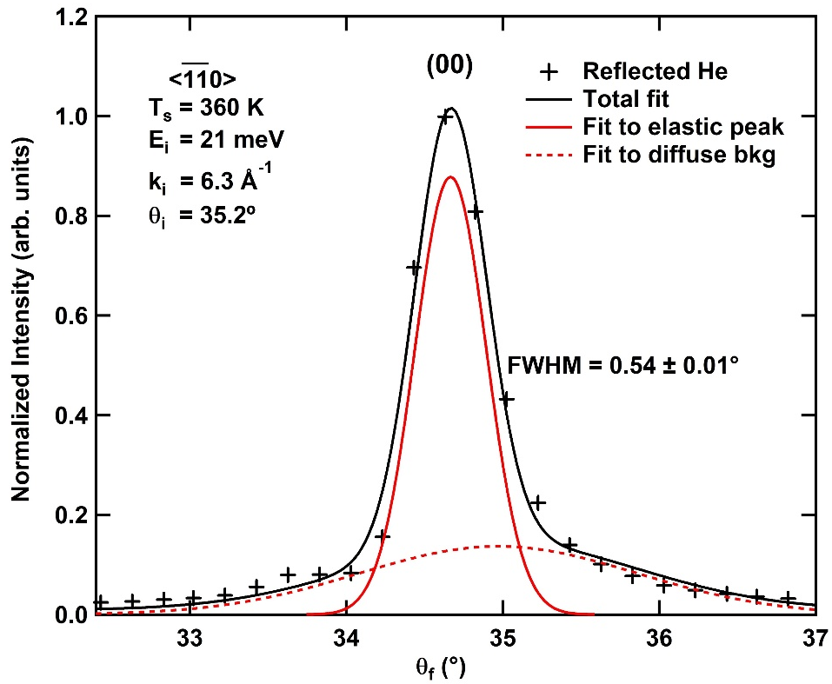
Specular Peak Lineshape Analysis Leads to Average Surface Domain Size
Specular peak in $<\overline{11}0>$ direction is
intense and narrow, so we can calculate the average surface domain size:
$∆θ_{w}$ = peak broadening from average domain size
$∆θ_{exp}$ = experimental peak FWHM = $0.54±0.01°$
$∆θ_{inst}$ = instrument function = $0.45°$
$∆θ_{w}^{2}=∆θ_{exp}^{2}−∆θ_{inst}^{2}$
Average surface domain size $=l_{c}=\frac{5.54}{∆θ_{w}k_{i}\cos\left(θ_{f}\right)}$
$⟹l_{c}=210±10$ Å
Average surface domain size is $210±10$ Å.

Slide 14
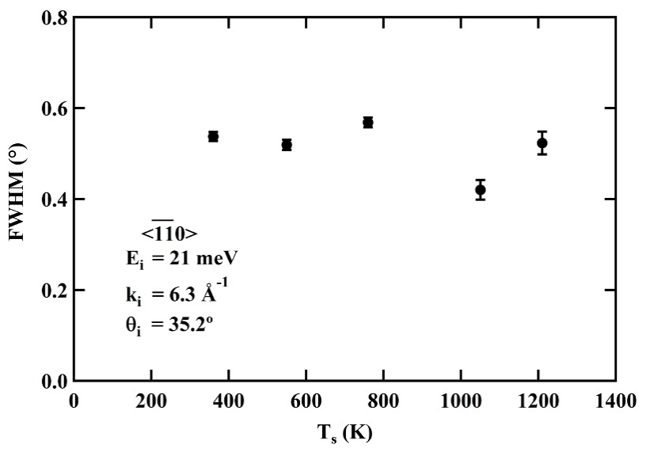
Lineshape Analysis Confirms (3x1)-O Ladder Structure Stability to at Least 1130 K
A change in the FWHM of the specular peak’s elastic portion in $<\overline{11}0>$ direction would indicate changes in surface order
Nearly constant peak widths point to surface stability through 1210 K
Lineshape analysis verifies stable surface coherence length indicating both structure and order are stable up to at least 1130 K.

Slide 15
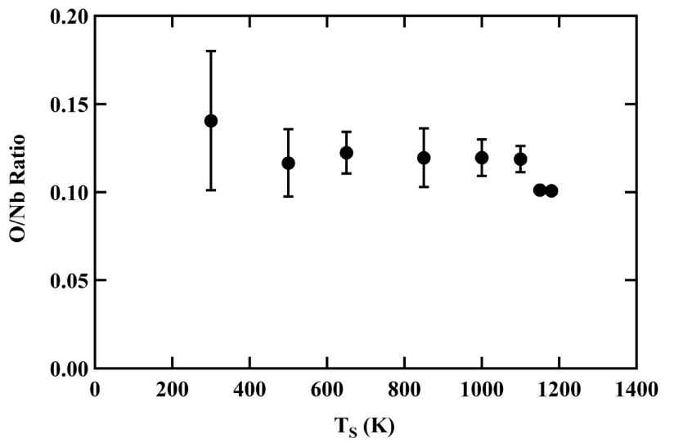
AES Peak Analysis Reveals Constant Near Surface Oxygen Content Up to 1150 K
Relative peak intensities of O/Nb AES peaks do not significantly change, showing that surface structure, order, and composition persist up to 1130 K

Slide 16
Conclusion
(3x1)-O Nb(100) reconstruction is stable and ordered up to 1150 K.
Nb SRF surface’s interaction with Sn is mediated by an oxide layer.
Sn adsorption
Sn diffusion
Nb₃Sn film growth
Understanding this oxide layer will provide a critical foundation for understanding Nb SRF cavities’ interaction with Sn and Nb₃Sn growth.

Slide 17
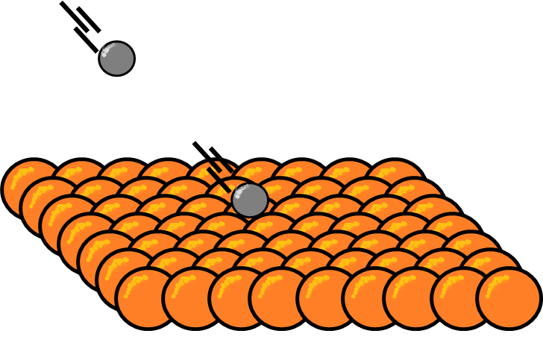
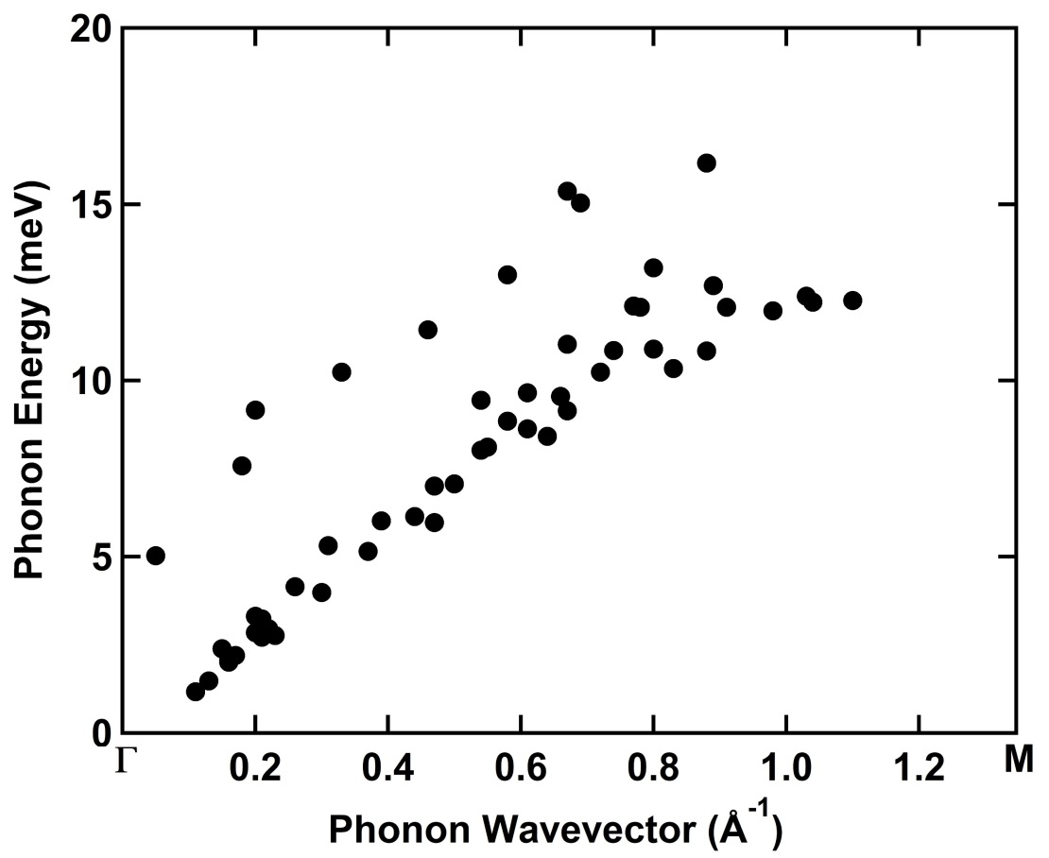
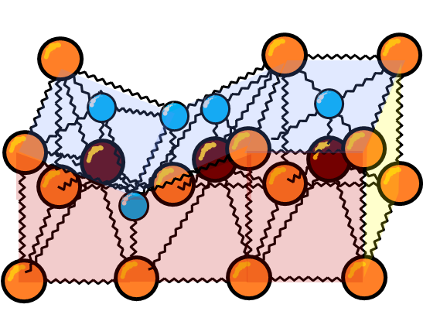
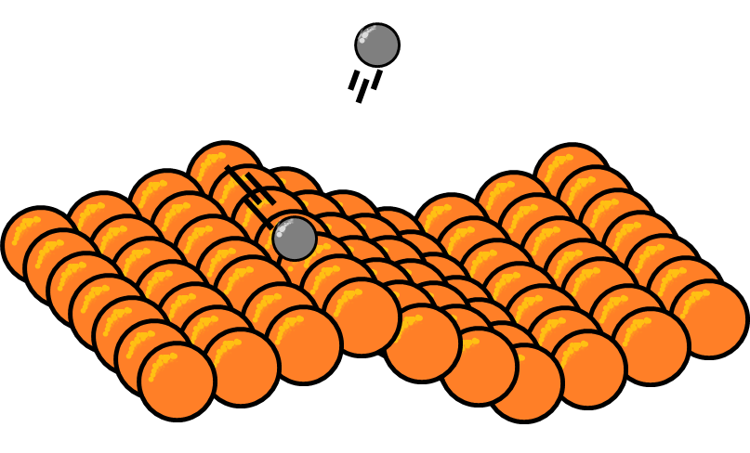
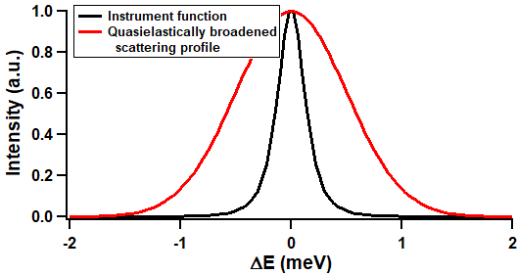
Future Work
Elucidate bonding at surface through surface phonons to understand surface’s initial reaction with deposited Sn.
Investigate mobility of extra O and Sn on surface to understand the role of excess oxygen on Nb₃Sn film growth.
Creation
Bonding model
Annihilation
Diffusion constant
Diffusion mechanism
Diffusion activation energy
Anisotropy
Characterize diffusion
Reveals

Slide 18
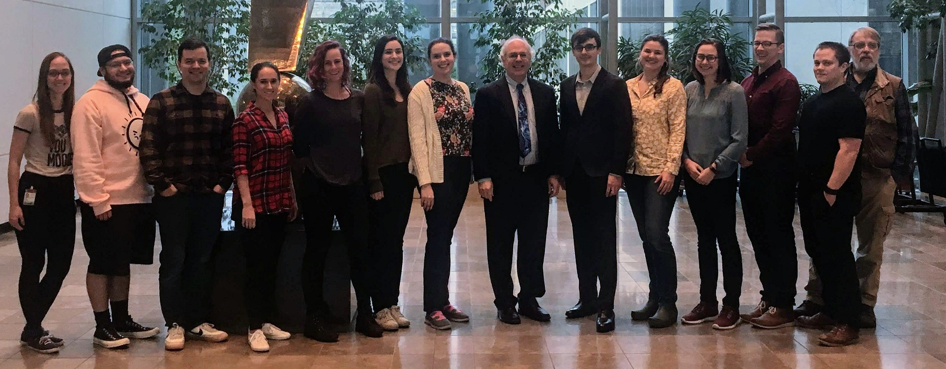
Acknowledgments
Prof. Steven Sibener
Prof. Tomas Arias
Dr. Jacob Graham
Alison McMillan
Michelle Kelley
CBB
Sibener Group

