Slide 1
Investigation of Nb₃Sn Thin Films using Magnetic Field Penetration Measurements
International workshop on SRF Science, Technology and Applications (Nb3SnSRF20), Cornell, Nov. 10, 2020.
PhD Graduate Student
This work is supported by NSF Grants PHY-1734075 and PHY-1416051, and DOE Awards DE-SC0010081 and DE-SC0019399

Slide 2
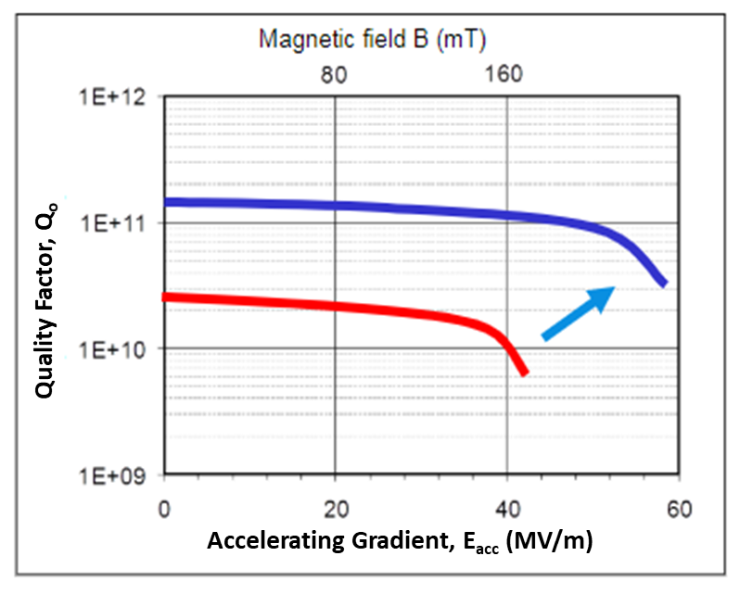
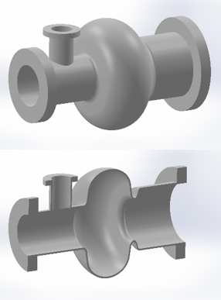
MOTIVATION
Superconducting layers
Insulating layers
Bulk Nb
Layered
Bulk Nb
Typical Nb cavity
Single Cell SRF Cavity
Multilayer Structure
Nb₃Sn is the most promising material for superconducting layers

Slide 3
OBJECTIVE
Design, build and calibrate a simple, efficient and accurate technique to measure onset magnetic field penetration directly through bulk, thin film and multilayer superconducting samples.
Superconducting Magnet
Sample
Hall probe
Basic experimental setup

Slide 4
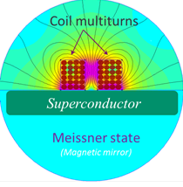
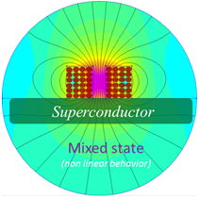
The field lines in the Meissner state and in the mixed state
Adapted from C. Z. Antoine et al 2019 Supercond. Sci. Technol. 32 085005

Slide 5
DESIGN AND FABRICATION

Slide 6
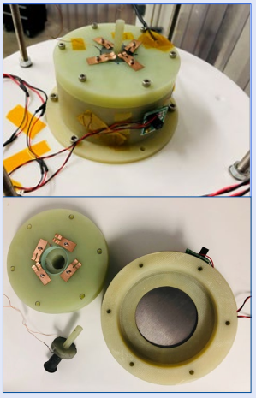
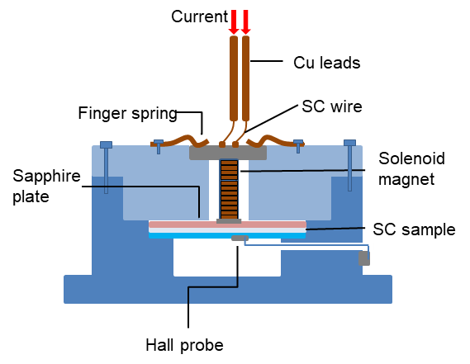
DETAILED EXPERIMENTAL SETUP
To pass the high current
To push the magnet down
To generate magnetic field parallel to the sample
To maintain fixed distance (0.5 mm) between the sample and the magnet
To keep sample intact during the experiment
To measure onset penetration of the magnet field
External (top) and internal (bottom) view of nonmagnetic container which supports the sample, solenoid magnet, and Hall probe symmetrically

Slide 7
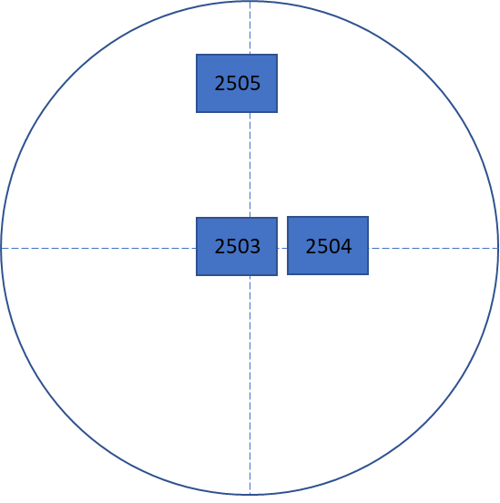
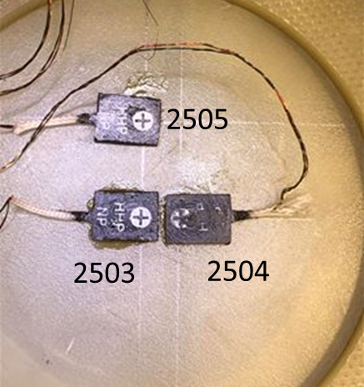
HALL PROBE CONFIGURATION
10.00 mm
0.00 mm
4.00 mm

Slide 8
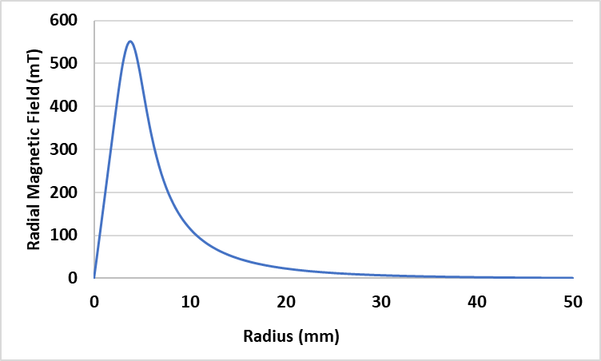
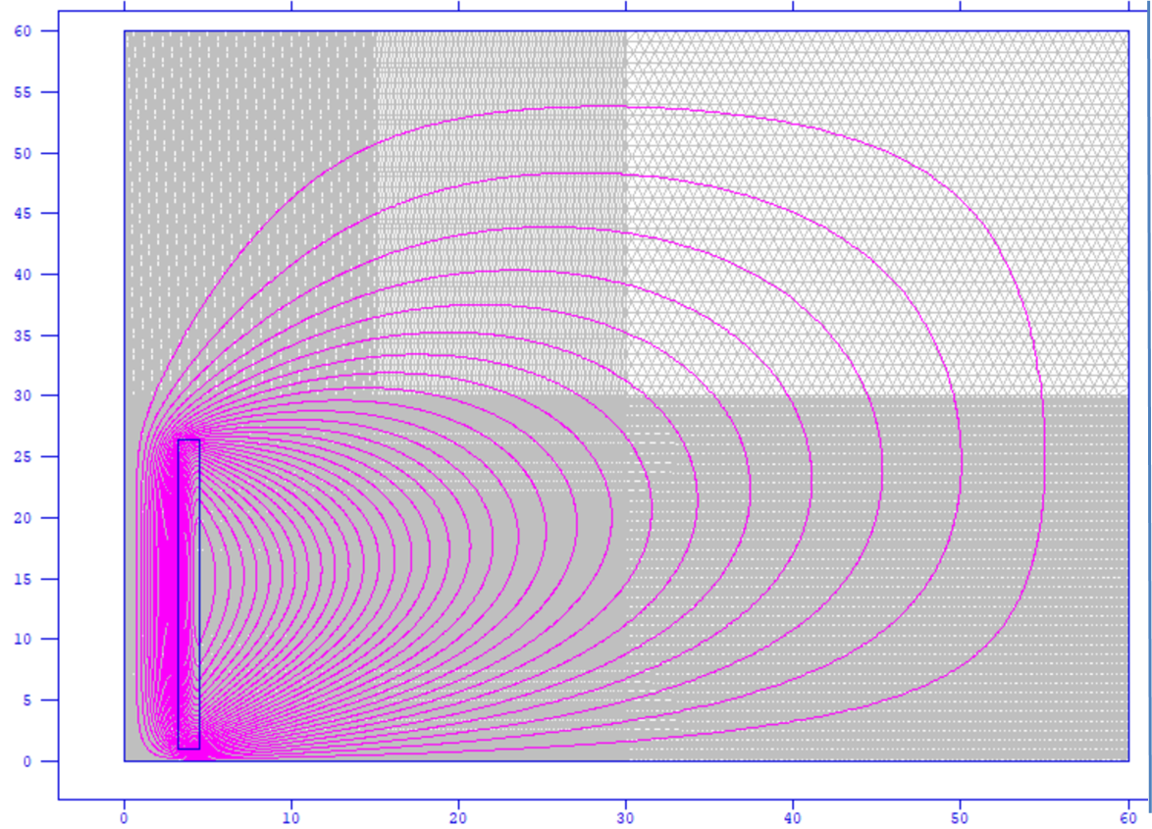
Field from the magnet on the sample
Variation of the radial magnetic field along the sample radius at 100 A
(From Poisson Simulations)
Field lines from the right half of solenoid magnet placed above the superconducting sample
( From Poisson Simulations)
In the Meissner state the sample acts as a magnetic mirror.
Vertical component of the magnetic field cancels out.
The field felt by the sample is equal to twice the radial component of the magnetic field.
Since the radial magnetic field is parallel only to one side of the sample, this field configuration closely resembles the SRF cavities.

Slide 9
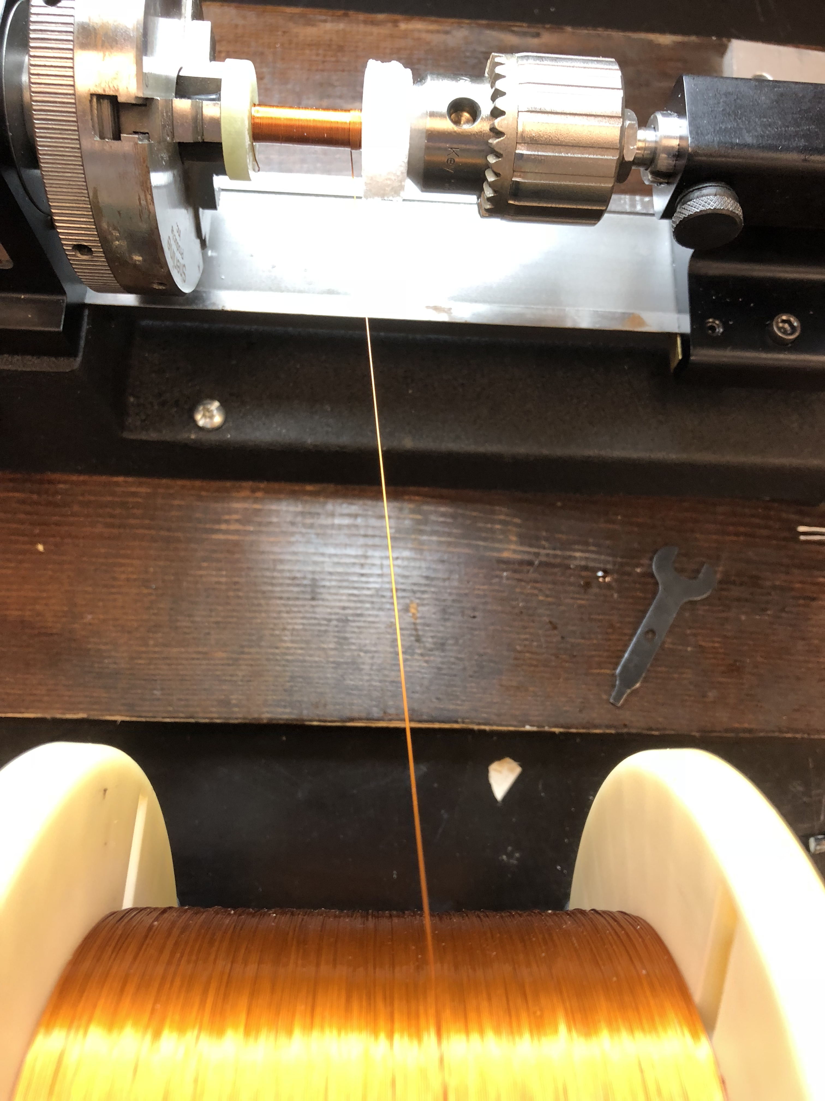
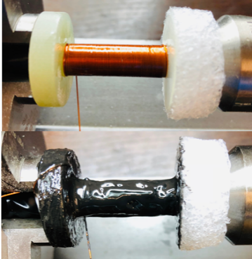
SUPERCONDUCTING SOLENOID MAGNET
NbTi Superconducting solenoid magnet before (top) and after (bottom) applying an epoxy
Magnet winding setup

Slide 10
CALIBRATION

Slide 11
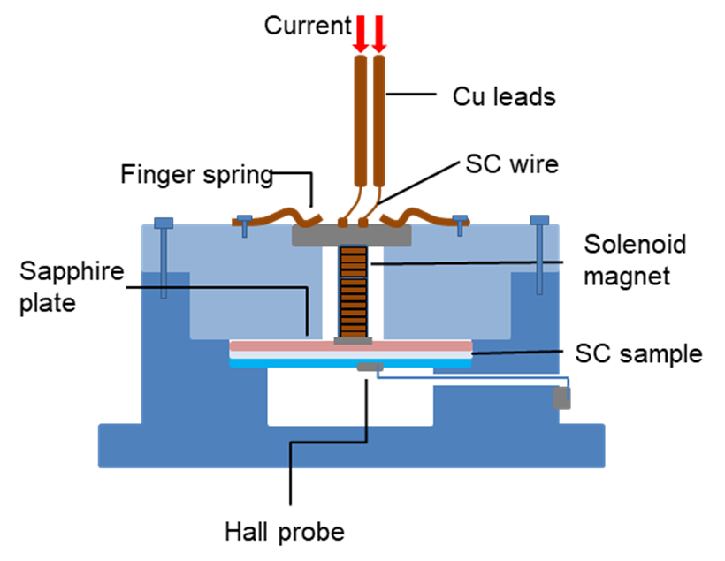
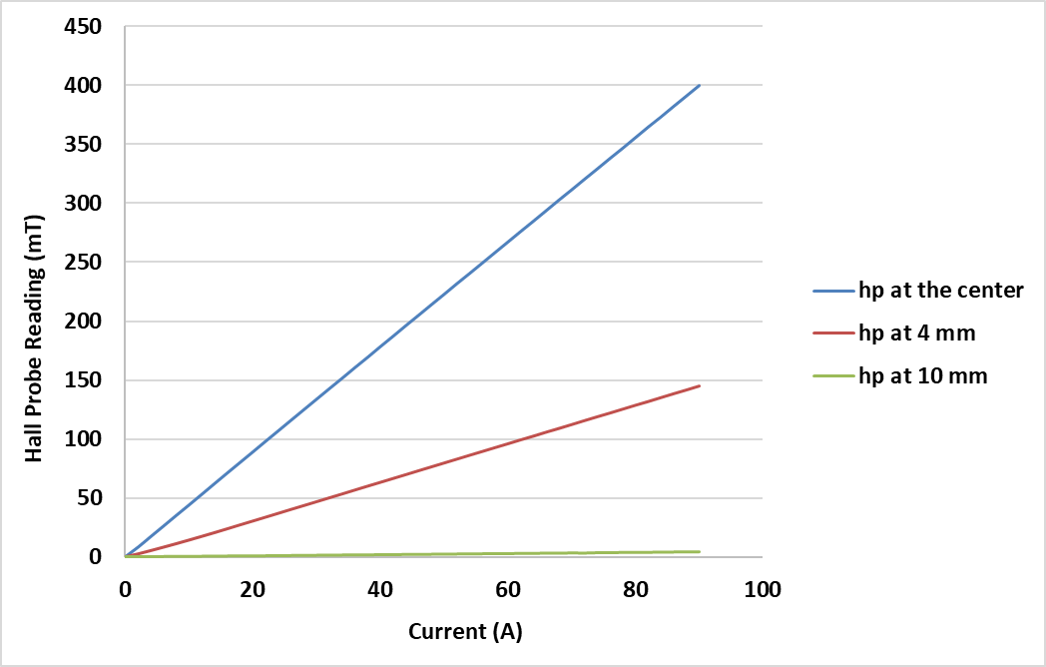
STEP 1: With No Sample at 4.35 K

Slide 12
STEP 1: With No Sample
Finding the correction factor to match experimental field with the simulation
Separation between magnet and the sensor, d (mm) | Magnetic Field for 100 A (mT) |  | Percentage Difference
 | Simulation | Experimental
1.368 | 517 | 445 | 13.90%
1.815 | 445 | 445 | 0%
1.815-1.368= 0.447 mm difference
Correction factor

Slide 13
STEP 2: With Sample
Simulation of surface field by adding correction factor
Poisson Simulation for
d= 1.018 +0.447= 1.465 mm
551 mT at 100 A
Correction factor
Maximum Surface Field = 5.51 mT/A

Slide 14
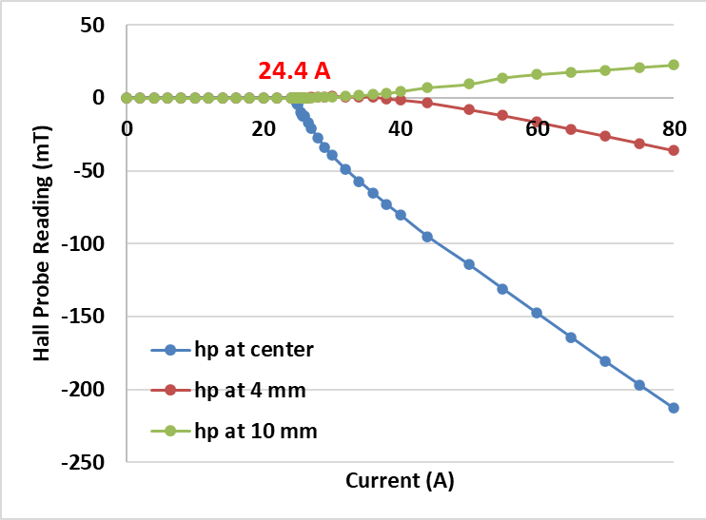
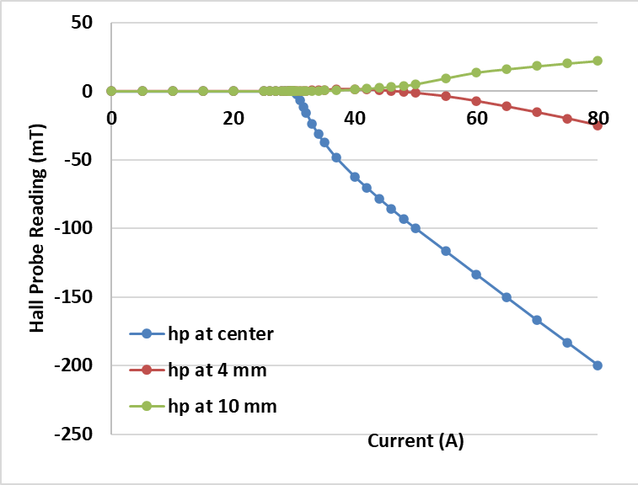
STEP 2: With Sample- Nb foil (88.9 μm thick)
At 4.35 K
At 1.97 K
29.9 A
 | First Critical Field of Nb (mT)
 | At 4.35 K | At 1.97 K
From Reference [9] | 135.60 | 166.12
Experimental | 134.44 | 164.75
$H_{c1}\left(T\right)=H_{c1}\left(0\right){(\text{1−}\text{(}T/{T_{c}})}^{2}$)

Slide 15
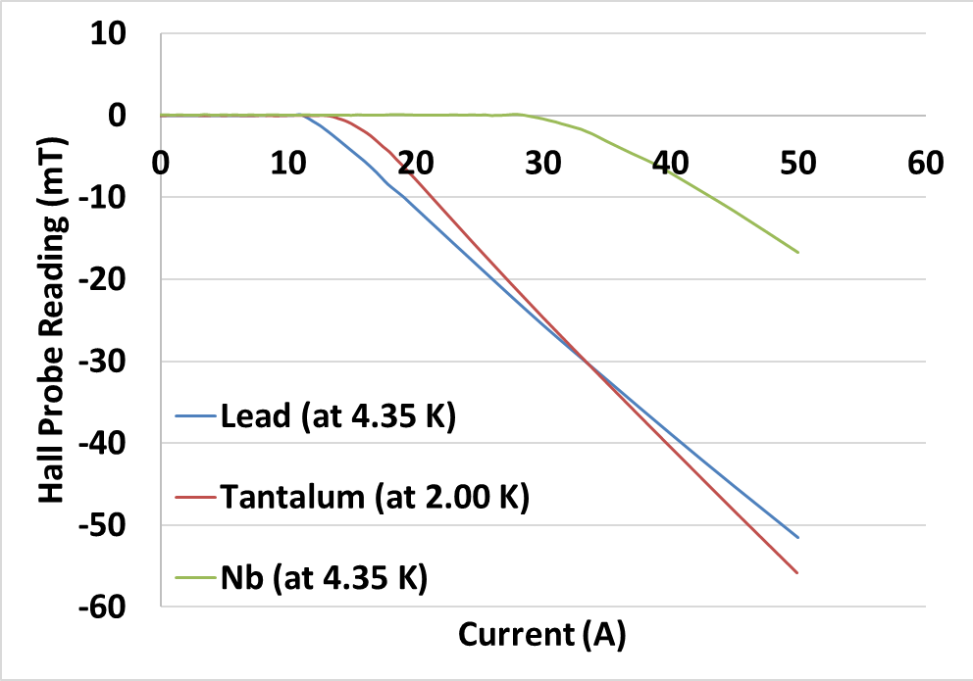
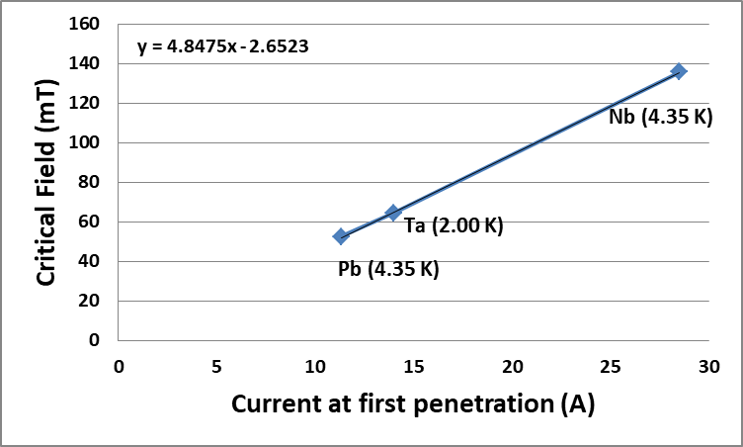
STEP 3: Using Bulk Superconductors (100.0 μm thick)
Hall Probe response against 99.99% pure Pb, Ta, Nb samples (50 mm in diameter and 0.1 mm in thickness) while powering up the magnet with gradually increasing current
The calibration curve of the experimental setup
[7], [8], [9]

Slide 16
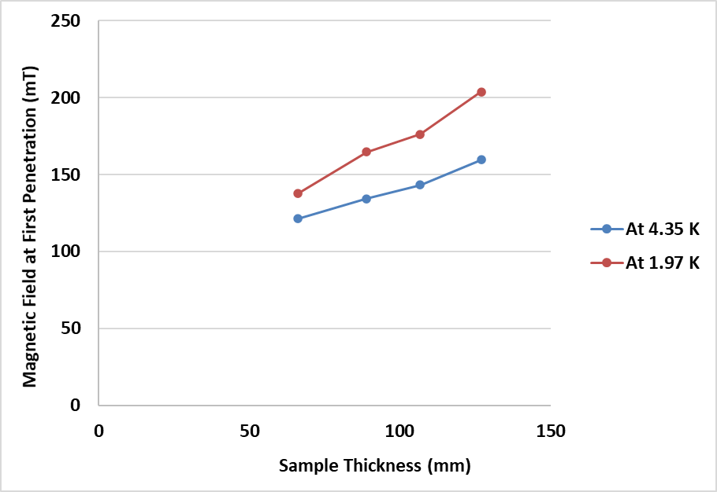
THICKNESS EFFECT ON FIELD PENETRATION
A Nb foil (From Advent Research Materials Ltd ) was used.
Thickness was reduced by BCP starting from 125 μm.

Slide 17
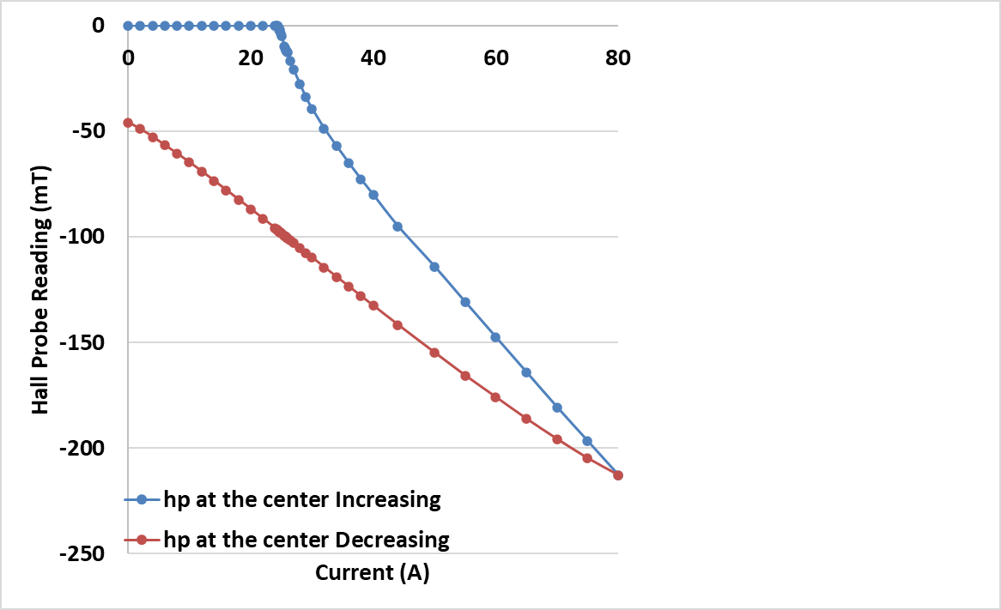
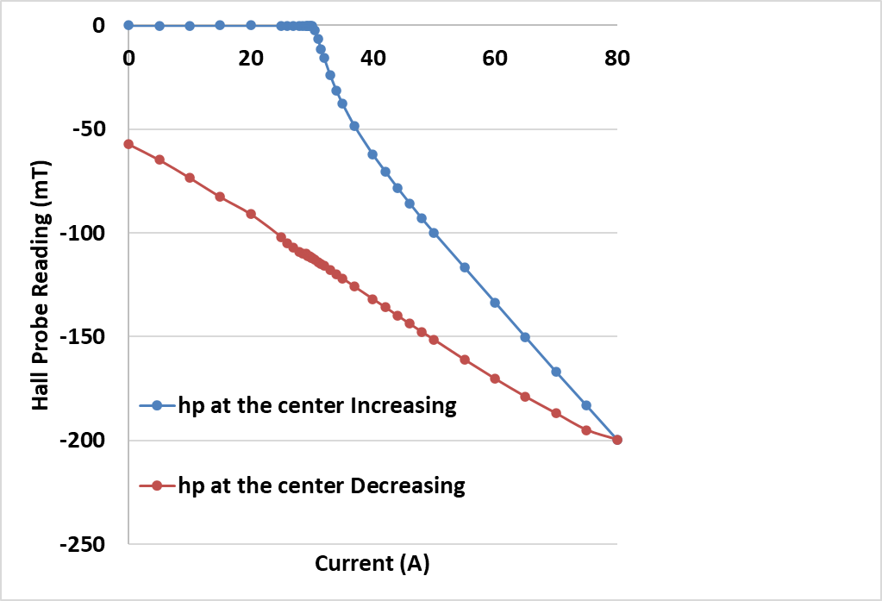
HYSTERISTIC BEHAVIOUR
At 4.35 K
At 1.97 K

Slide 18
THIN FILM MEASUREMENTS

Slide 19
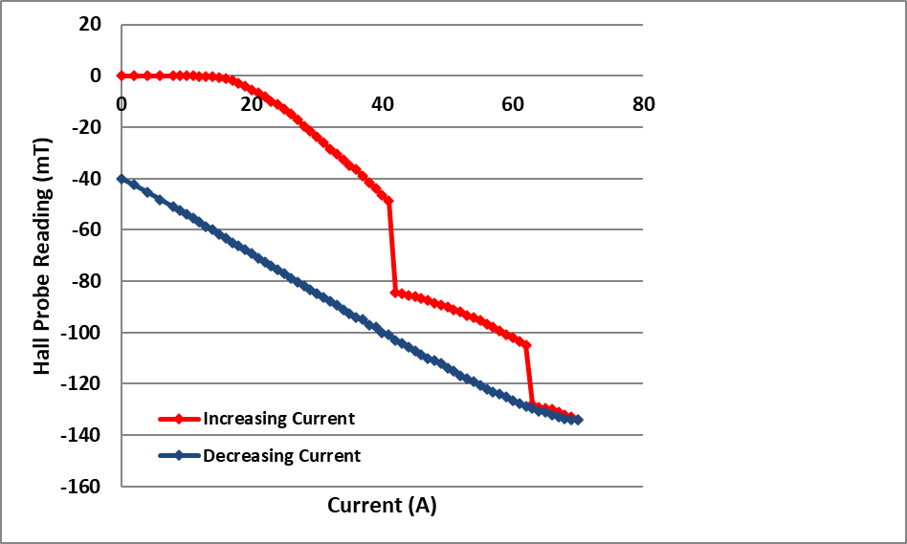
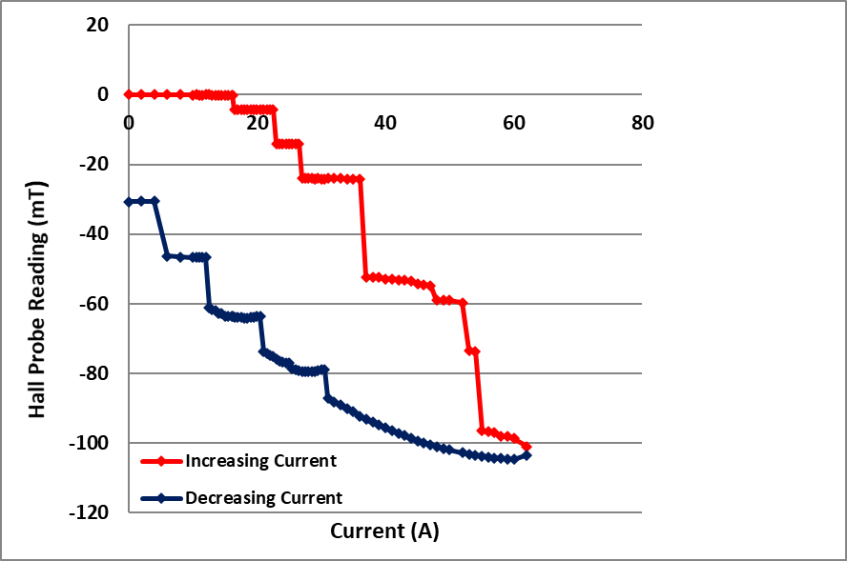
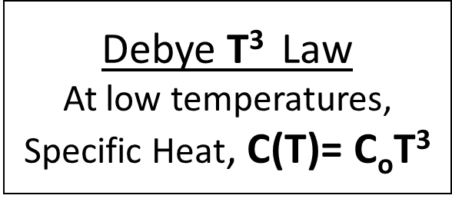
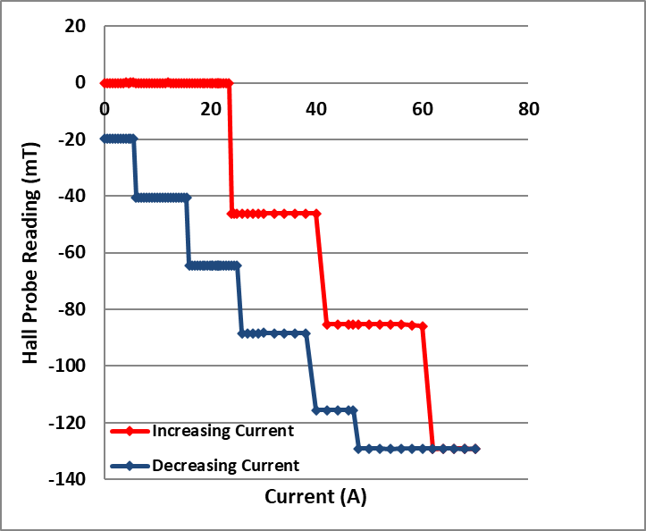
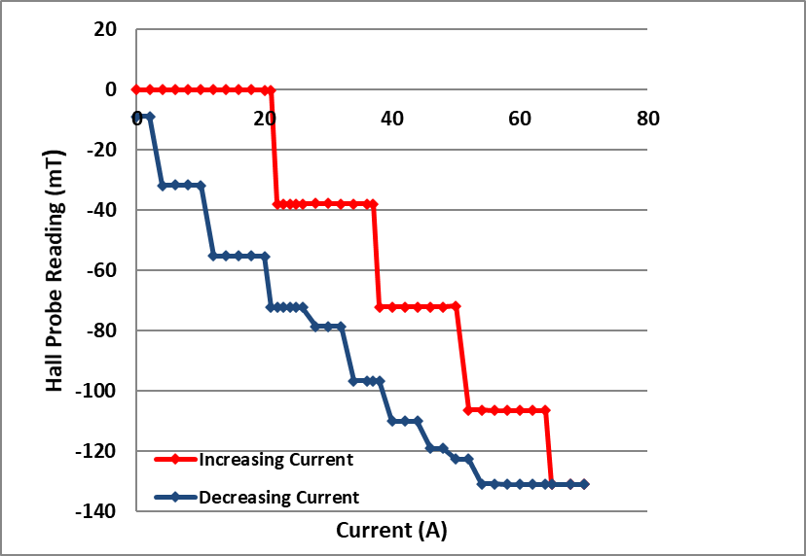
MEASUREMENTS OF THIN FILM SUPERCONDUCTORS
At 4.35 K
At 1.97 K
Nb
Nb thin film with thickness 1.8 µm deposited on sapphire plate using Electron Cyclotron Resonance (ECR)
(From Anne- Marie Valente Feliciano, Jlab)
Nb₃Sn
Nb₃Sn thin film with thickness 1.5 µm deposited on sapphire plate using Magneton Sputtering
(From Nizam Sayeed, Jlab)

Slide 20
CONCLUSION AND FUTURE WORK
The new experimental technique for magnetic field penetration measurements of superconducting samples was designed, built and calibrated successfully at Jefferson Lab. This technique is appropriate for bulk samples as well as thin films.
Future work mainly focus on thin film and multilayer measurements
We are more than happy to get samples from others for our measurements
Samples should be 50 mm in diameter
isene001@odu.edu

Slide 21
REFERENCES
[1] H. Padamsee, “RF superconductivity: Science, Technology and Applications”, Wiley-VCH, Weinheim, 2009, pp. 72-83.
[2] A. Gurevich, “Enhancement of rf breakdown field of superconductors by multilayer coating”, Appl. Phys. Lett. 88, 012511, 2006
[3] A. Gurevich, “Theory of RF superconductivity for resonant cavities”, Supercond. Sci. Technol. 30, 2017.
[4] C. Z. Antoine et al 2019 Supercond. Sci. Technol. 32 085005
[5] N. Katyan, C. Z. Antoine, “Characterization of thin films using local magnetometer”, presented at SRF 2015, Whistler, BC, Canada, paper TUPB058.
[6] O. B. Malyshev, L. Gurran, S. Pattalwar, N. Pattalwar, K. D. Dumbell, R. Valizadeh, A. Gurevich, “A facility for magnetic field penetration measurements on multilayer S-I-S structures ”, presented at SRF 2015,Whistler, BC, Canada, paper TUPB059.
[7] G. Chanin, J. P. Torre, “Critical Field Curve of Superconducting Lead”, Phys. Rev. B, Vol. 5, No. 11, 1972.
[8] C. H. Hinrichs, C. A. Swenson, “Superconducting critical field of tantalum as a function of temperature and pressure”, Phy. Rev. Vol. 123, No. 4, 1961.
[9] T. Junginger, S. H. Abidi, R. D. Maffett, T. Buck, M. H. Dehn, S. Gheidi, R. Kiefl, P. Kolb, D. Storey, E. Thoeng, W. Wasserman, R. E. Laxdal, “Field of first magnetic flux entry and pinning strength of superconductors for rf application measured with muon spin rotation”, Phy. Rev. Accel. Beam 21, 032002, 2018.
[10] I. H. Senevirathne, J. R. Delayen, G. Ciovati “Measurement Of The Magnetic Field Penetration Into Superconducting Thin Films”, presented at SRF 2019, Dresden, Germany, paper THP050

Slide 22
Thank You !
Acknowledgement
Advisor : Jean Delayen
Alexander Gurevich
Gianluigi Ciovati
Anne-Marie Valente-Feliciano
Nizam Sayeed
Jlab SRF staff and the machine shop staff

