Slide 1
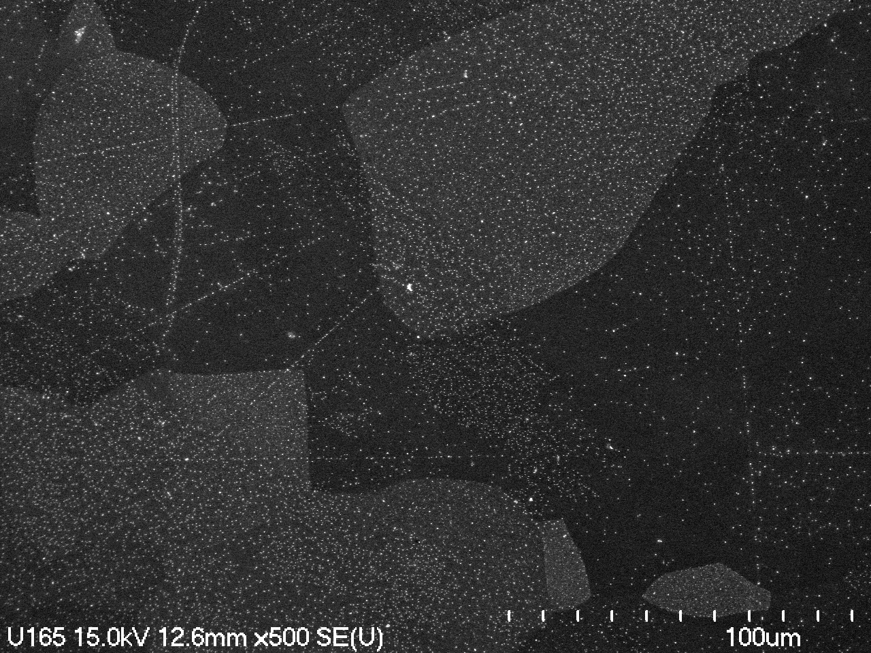
Nucleation of Nb₃Sn films in a tin vapor diffusion process
Uttar Pudasaini (Jefferson Lab)
Charlie Reece (Jefferson Lab)
Grigory Eremeev (Fermilab)
Jay Tuggle (Virginia Tech.)
Michael Kelley (William and Mary, Virginia Tech, and Jefferson Lab)

Slide 2
Outline
Coating evolution
Nucleation
Variation of nucleation parameters
Surface studies
Conclusion

Slide 3
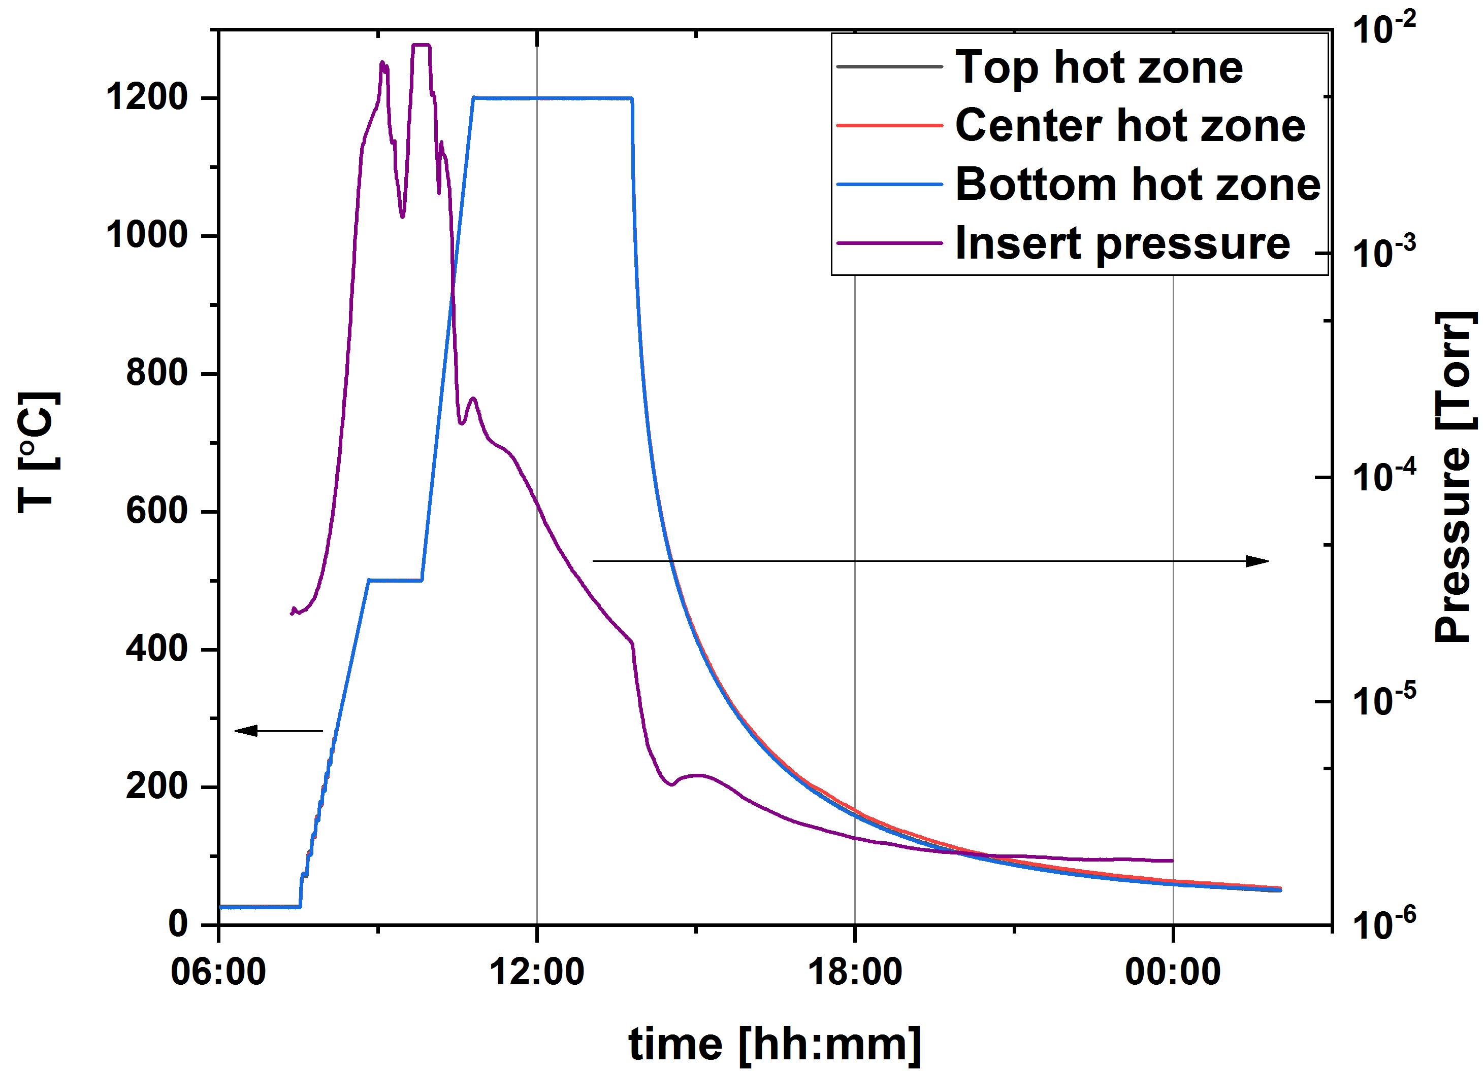
Nb₃Sn coating evolution during vapor diffusion process
Nb, Sn and SnCl₂
3
2
4
1
1
Nucleation

Slide 4
Nb₃Sn coating evolution during vapor diffusion process
2
3
4
2
4
Growth
3
1
2
3
4
4

Slide 5
Nucleation
3
1
2
4
1
Nucleation

Slide 6
Background
At Siemens AG (1970’s) - Nb spots not covered with Nb₃Sn film
Prescribed solution: pre-anodization combined with higher source temperature or application of tin halides
Adopted at Wuppertal, Cornell, JLab, Fermilab, and others with some modification
What happens after the nucleation step?
- How does it help the final coating?
- Can we alter the final coating by changing parameters of the nucleation step?
Nucleation Temperature | 300 °C | 400 °C | 450 °C | 500 °C
Nucleation Time | 1 h - 4 h | 1 h | 1 h | 0.1 - 5 h
Amount of SnCl₂ | 1 g | 1 g | 1 g | 5 mg, 1 g

Slide 7
Variation of nucleation time and temperature
Condition | 1 h at 500 °C | 1 h at 450 °C | 4 h at 500 °C | 5 h at 500 °C (with significantly lower amount of SnCl₂)
Coverage by particles (%) | 2.8 ± 0.6 | 3.9 ± 0.6 | 10.0± 0.8 | 1.9 ± 0.4

Slide 8
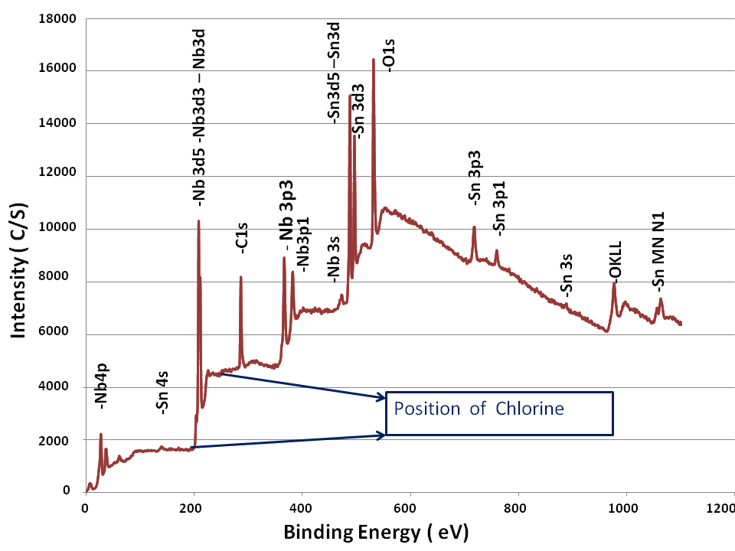
XPS surface analysis
~30 % Sn
Analytical calculation indicated a potential ultra-thin layer of Sn in between particles - no thicker than a few atom layers.
XPS shows more tin ! No Chlorine.
Condition | 1 h at 500 °C | 1 h at 450 °C | 4 h at 500 °C | 5 h at 500 °C (with significantly lower amount of SnCl₂)
$$\frac{Sn}{Nb+Sn} x100$$ | 26.02 | 32.71 | 33.42 | 18.1
Coverage by particles (%) | 2.8 ± 0.6 | 3.9 ± 0.6 | 10.0± 0.8 | 1.9 ± 0.4
Condition | 1 h at 500 °C | 1 h at 450 °C | 4 h at 500 °C | 5 h at 500 °C (with significantly lower amount of SnCl₂)
$$\frac{Sn}{Nb+Sn} x100$$ | 26.02 | 32.71 | 33.42 | 18.1

Slide 9
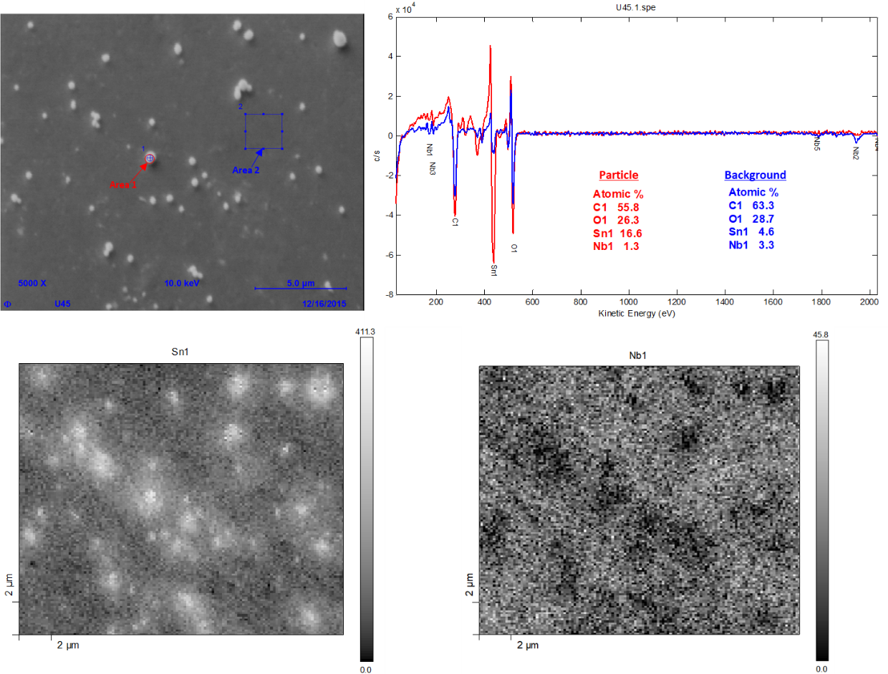
Scanning Auger Microscopy
Elemental mapping
Surface analysis shows the thin film of Sn between Sn particles.

Slide 10
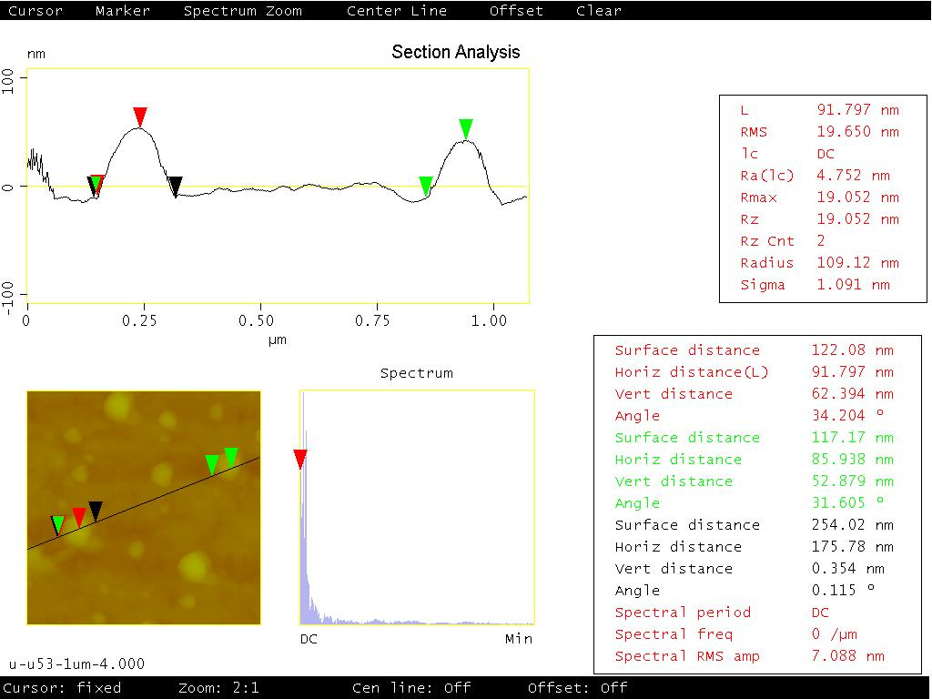
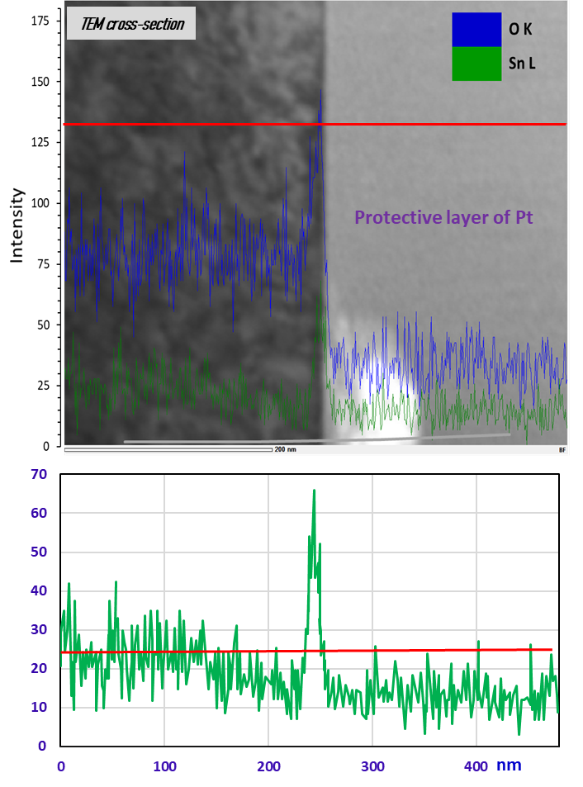
AFM and TEM analysis
Scan line
Surface analysis shows a thin film of Sn beside Sn particles qualitatively resembling the Stranski-Krastanov growth mode.

Slide 11
Variation of particle density
Scratches are decorated with a higher density of particles.
In some cases, the density of particles varies in different grains of Nb. Orientation dependent adatom-surface interaction?

Slide 12
Low vs. high amount of SnCl₂
500 °C × 1 h with 3 mg/cm²
500 °C × 4 h with ~20 µg/cm²
More SnCl₂ produces larger Sn-particles, but the similar surface coverage of Sn can be achieved with a significantly lower amount of SnCl₂.

Slide 13
Coating with different nucleation profiles
No significant differences in terms of structure and composition in SEM/EDS.

Slide 14
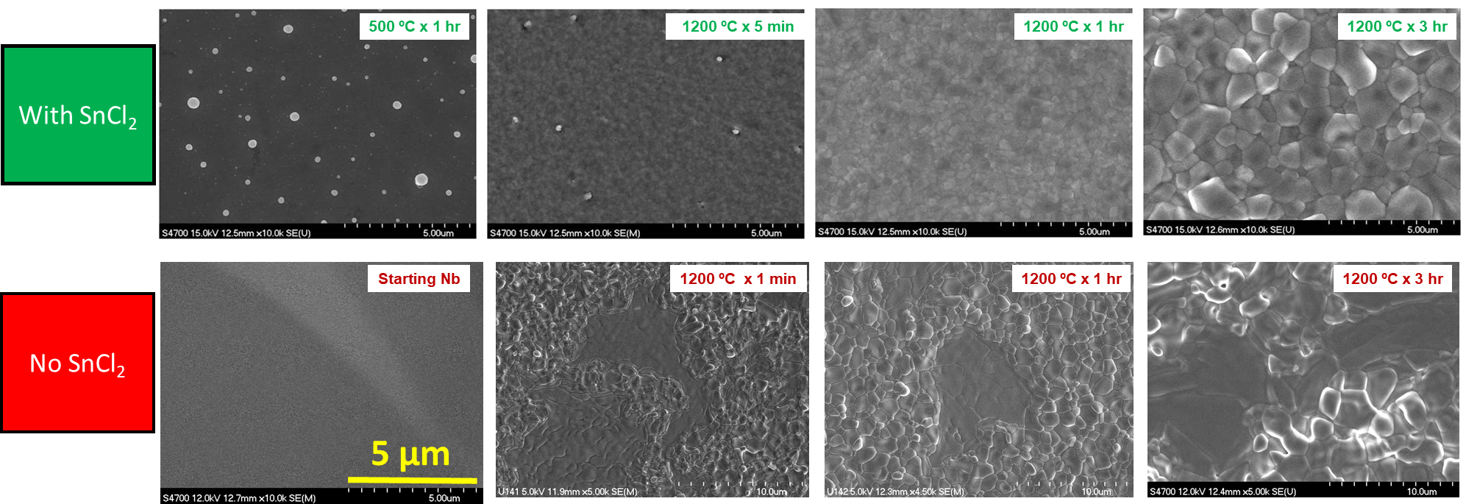
Role of Nucleation
The inclusion of tin chloride in any explored nucleation profile appeared advantageous toward producing a defect-free Nb₃Sn coating compared to the same coating obtained without it.

Slide 15
Role of Nucleation: coating with SnCl₂ only
~16 at. % Sn
XRD data: Courtesy of N. Sayeed
Complete coating of the surface with some patchy areas and elongated grains.
SnCl₂ plays an important role to establish a continuous tin layer prior to tin evaporation during the growth process.

Slide 16
Conclusion
Nucleation yields two tin forms.
At higher loadings, three-dimensional particles are quite visible to scanning electron microscopy.
At all loadings, a two-dimensional form is no thicker than a few atom layers evident to surface spectroscopies and analytical transmission electron microscopy.
Inclusion of SnCl₂ in any explored nucleation profiles is advantageous toward producing more uniform coatings.
The variation of nucleation parameters may not drastically impact the final coating characteristics.
The evolution of coating as it progresses from the nucleation stage to the growth stage needs further studies.

Slide 17
Acknowledgements
Nanoscale Characterization and Fabrication Lab
We are grateful for support from the Office of High Energy Physics, U.S. Department of Energy under grants DE-SC-0014475 to the College of William Mary and DE-SC-0018918 to Virginia Tech. Co-Authored by Jefferson Science Associates, LLC under U.S. DOE Contract No. DE-AC05-06OR23177. This material is based upon work supported by the U.S. Department of Energy, Office of Science, Office of Nuclear Physics.

