Slide 1
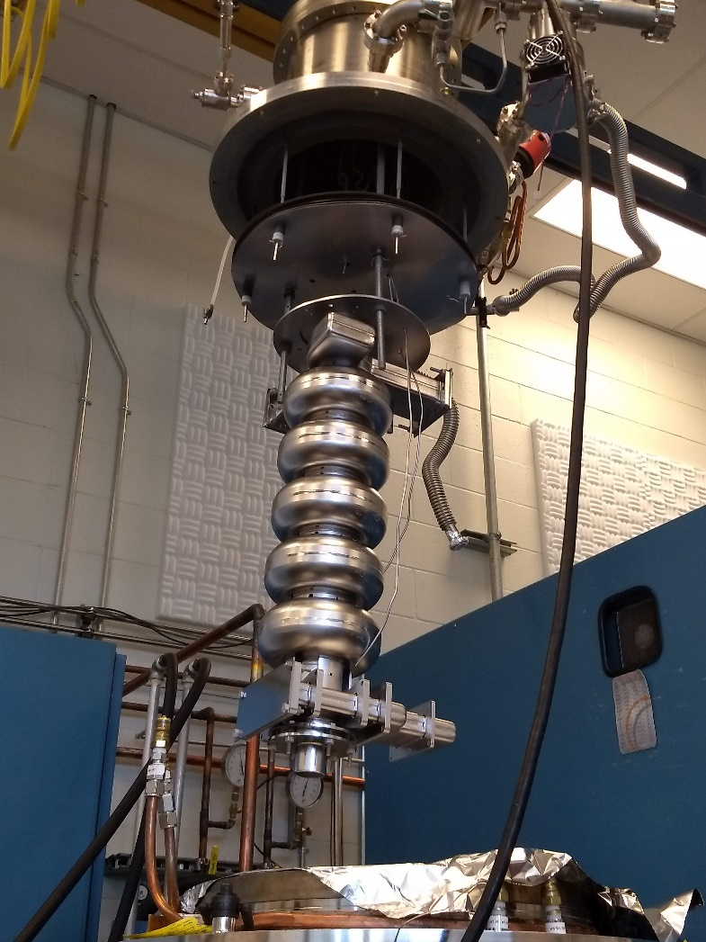
Nb₃Sn growth in vapor diffusion: process design for large surface area coatings
Uttar Pudasaini (Jefferson Lab)
Charlie Reece (Jefferson Lab)
Gigi Ciovati (Jefferson Lab)
Grigory Eremeev (Fermilab)
Michael Kelley (William and Mary, Virginia Tech, and Jefferson Lab)

Slide 2
Outline
Background
Coating of large cavity surfaces
Process development for five-cell cavity coating
Summary

Slide 3
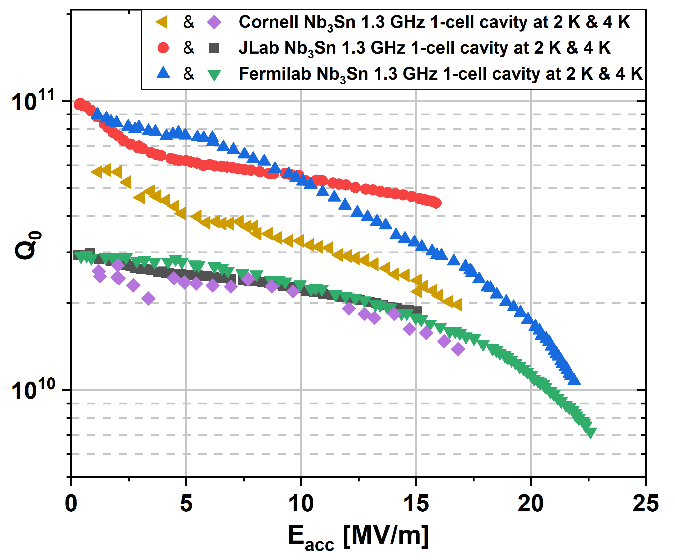
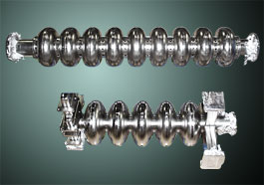
Background
The majority of cavities coated so far are 1.3-1.5 GHz single-cell cavities.
Performance of Nb₃Sn-coated R&D single-cell cavities is improved and approaching specifications necessary for accelerator applications.
Accelerator applications demand multi-cell cavities or cavities with different frequencies and/or geometries than typical R&D single-cell cavities.
What are the challenges with larger surface area coatings?
S. Posen and D. L. Hall Superconductor Science and Technology, vol. 30, (3), pp. 033004, 2017.
S. Posen et al., presented at the 19th Int. Conf. RF Superconductivity (SRF'19), Dresden, Germany, Jun.-Jul. 2019, paper THFUB1
U. Pudasaini et al. presented at the 19th Int. Conf. RF Superconductivity (SRF'19), Dresden, Germany, Jun.-Jul. 2019, paper THFUB1

Slide 4
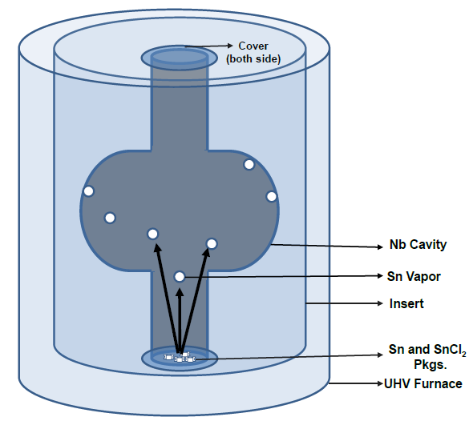
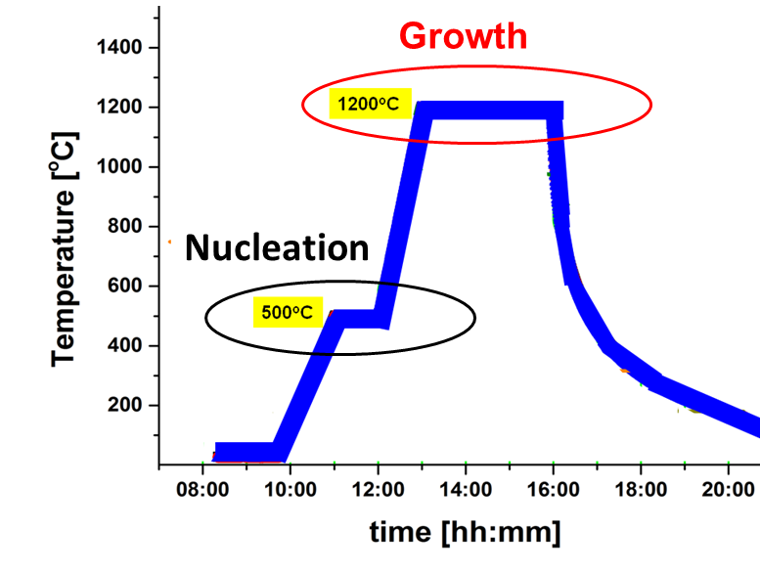
Challenges
Typical vapor diffusion coating process
Requirement for conformal coatings
Defect-free quality coatings
Cavity size and geometry
Coating facility and process design

Slide 5
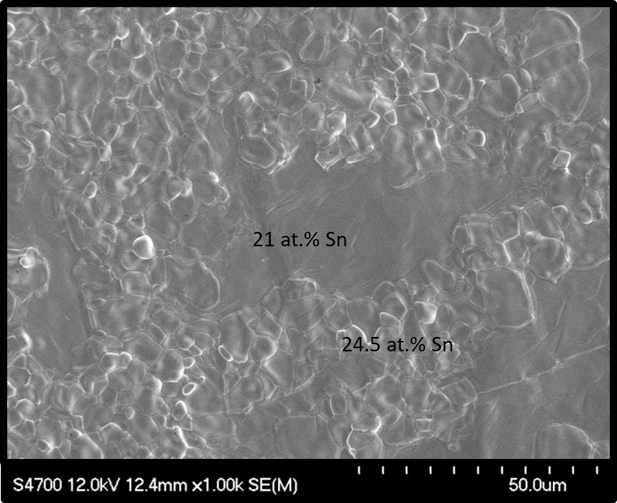
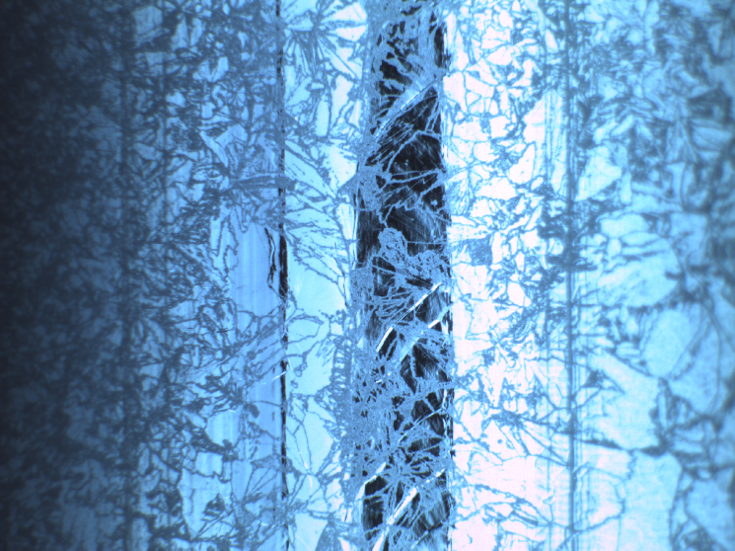
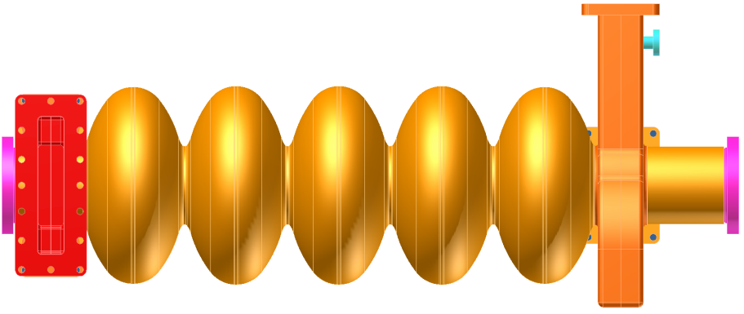
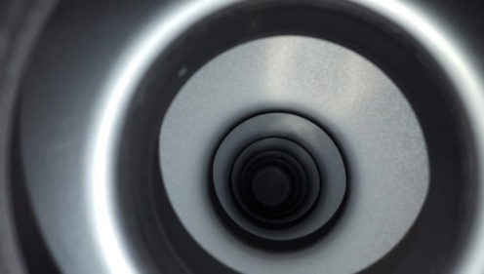
Initial five-cell cavity coatings
Coating setup similar to single-cell cavity coating
Single Sn-source, variation of coating time 3-24 h
Asymmetric appearance of coated cavities
Line of sight and proximity to the Sn source
Process dependent, not the substrate
Sn Source
U. Pudasaini et.al. “Nb₃Sn Multi-cell cavity coating at Jefferson Lab”, in Proc. 9th Int. Particle Accelerator Conf. (IPAC'18), Vancouver, Canada (May 2018), paper WEYGBF3.
5

Slide 6
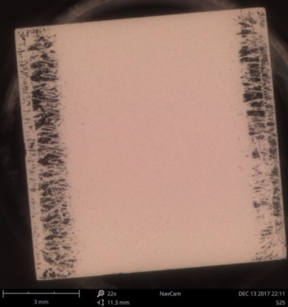
Coating resembling with low tin flux deposition
patches
Supporting edges
restricted tin supply

Slide 7
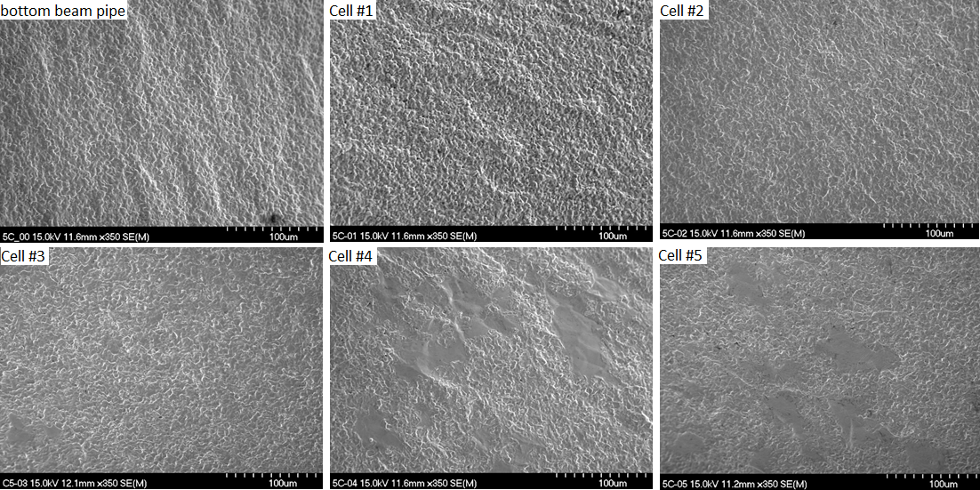
Witness sample analysis
G. V. Eremeev et. al., in Proc. 19th Int. Conf. RF Superconductivity (SRF'19), Dresden, Germany, Paper MOP016
A Witness rod is positioned along the axis of the cavity.
More patchy regions observed moving further away from the Sn source
The coating variation resembles Nb₃Sn coatings produced with different fluxes of Sn
Line of sight and proximity to the Sn-source needs to be considered for conformal coating.

Slide 8
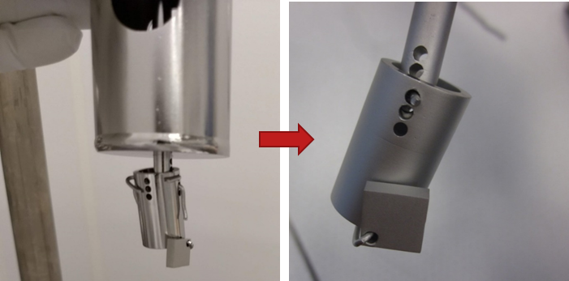
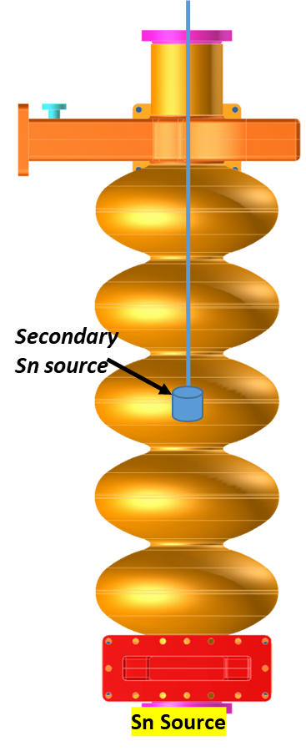
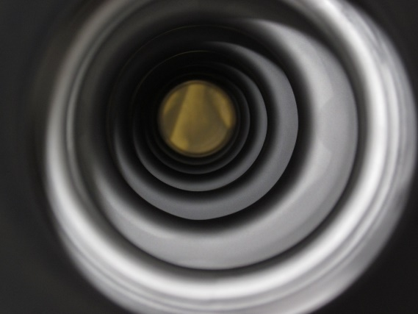
Application of secondary Sn source
Similar coating at both ends of the cavity
BOTTOM
The application of a secondary tin source appears to solve the problem.
Several cavities coated resulted in the uniform coating.
For a similar amount of Sn-consumption, a two-source setup produced uniform coating but not with single-source of Sn, even with longer coating time.
TOP

Slide 9
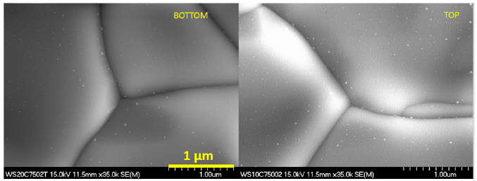
High resolution SEM analysis of witness samples coated with two Sn-sources
Nano residues up to ~ 50 nm in size were seen on the surface
Potential condensation of Sn-vapor during the cool-down phase of the Nb₃Sn coating
Reduce/optimize coating time and supplied amount of Sn to avoid Sn-residues

Slide 10
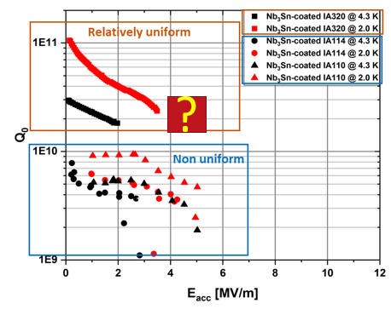
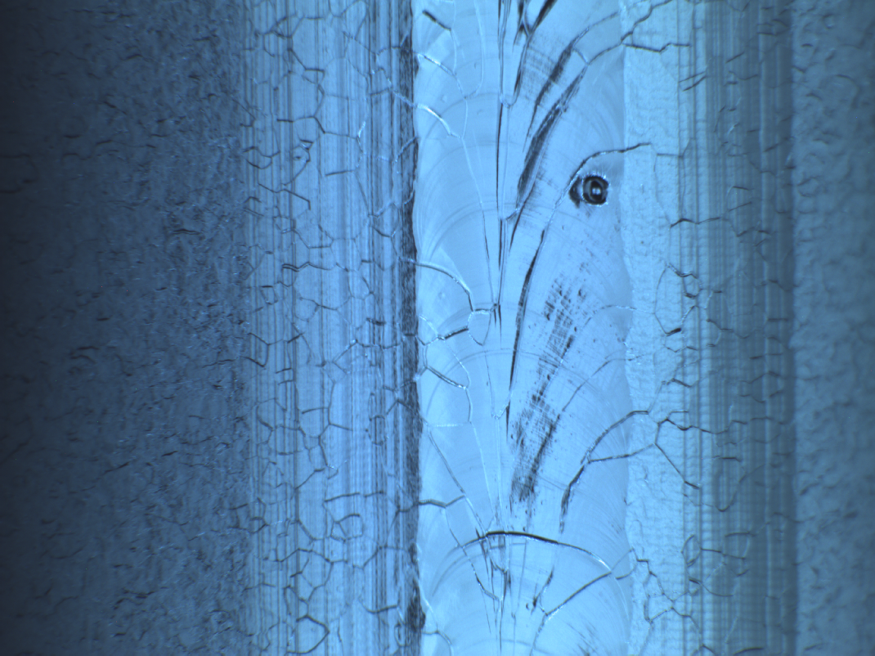
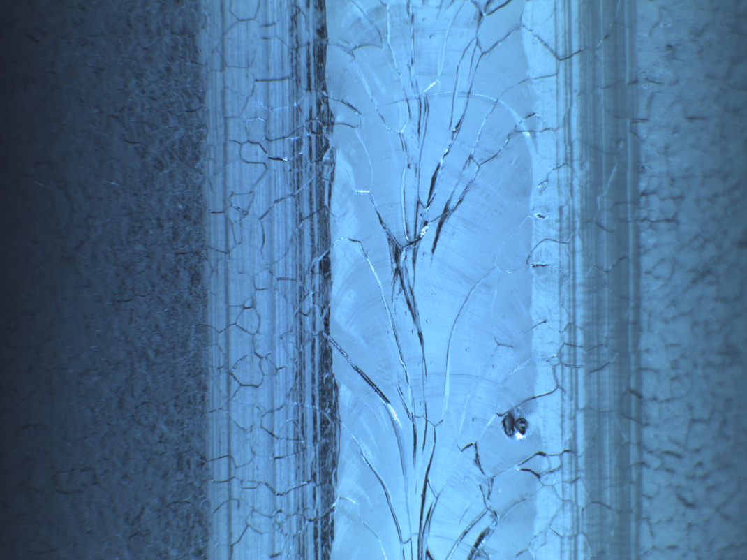
Substrate quality
Defects in the Nb cavity substrates were suspected of limiting the attainable maximum accelerating gradient.

Slide 11
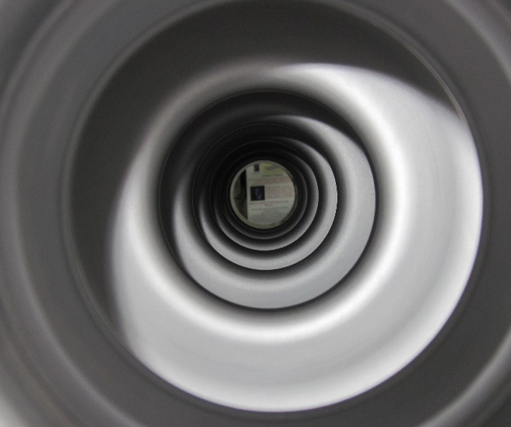
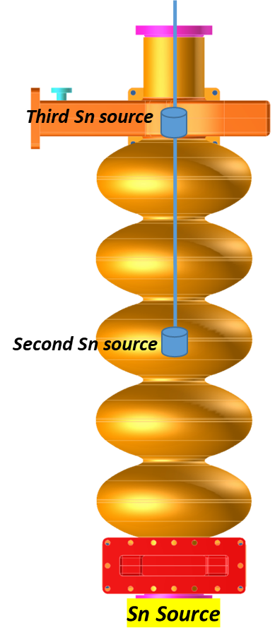
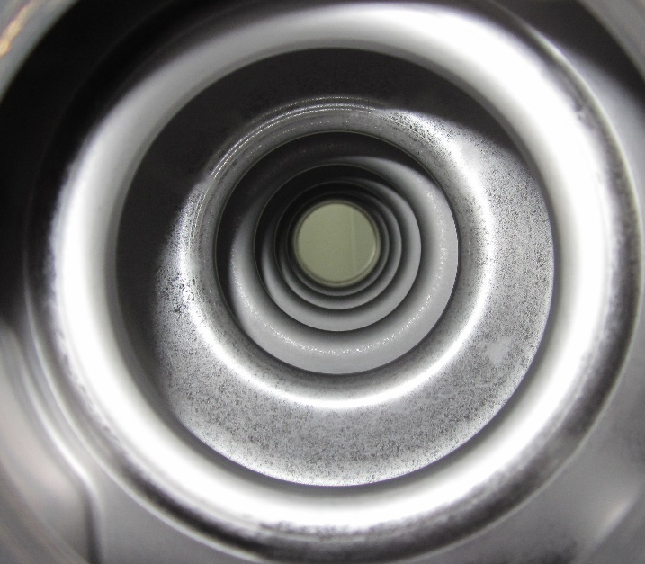
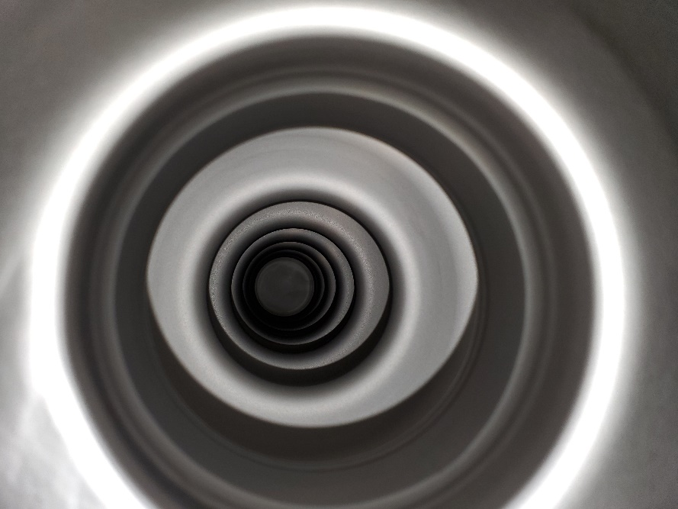
Latest CEBAF five-cell coating
6 h of coating
BOTTOM
BOTTOM
TOP
TOP
Coating time and amount of Sn were reduced.
Additional third Sn-source enhanced uniformity of the coating.

Slide 12
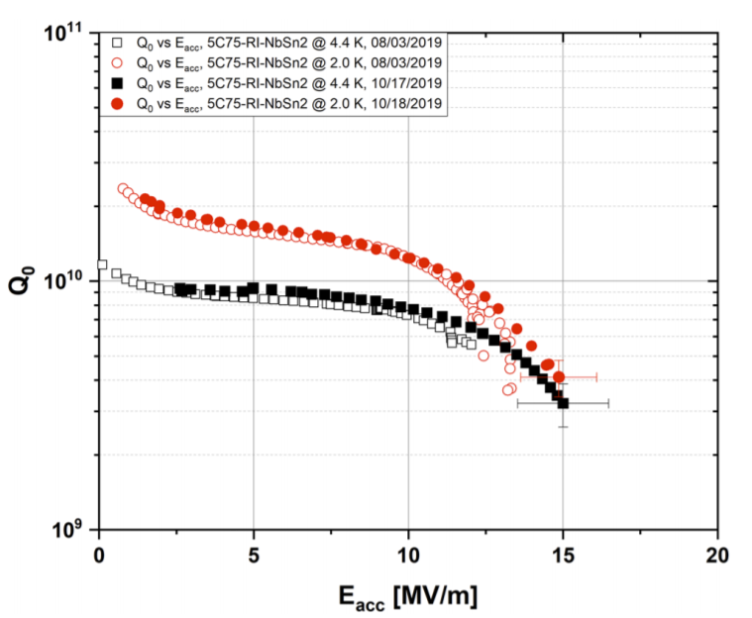
Witness sample analysis and RF performance
Eremeev, G., et al. "Nb₃Sn multicell cavity coating system at Jefferson Lab." Review of Scientific Instruments 91.7 (2020): 073911.
More from G. Eremeev, “Nb3Sn 5-cell cavity qualification for Nb3Sn cryomodule” , Friday at 8:45 AM.

Slide 13
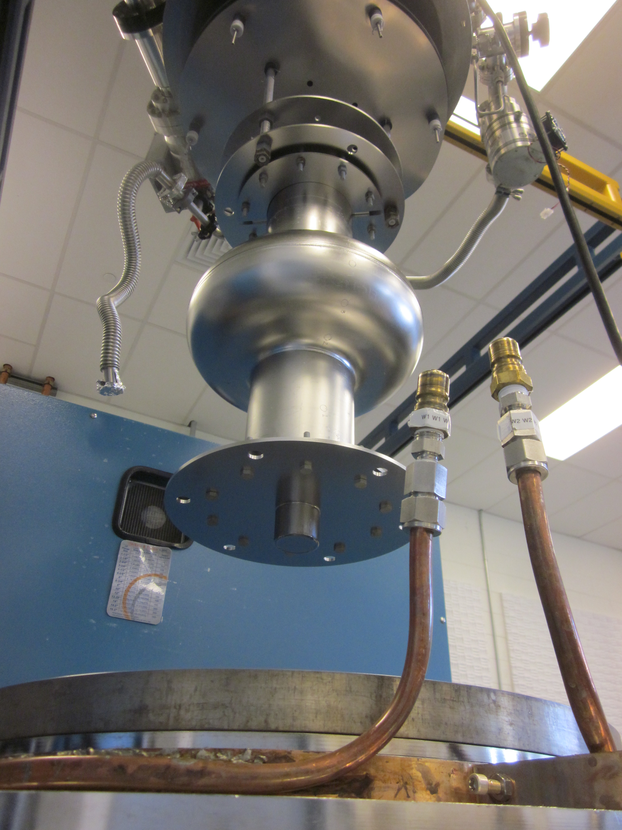
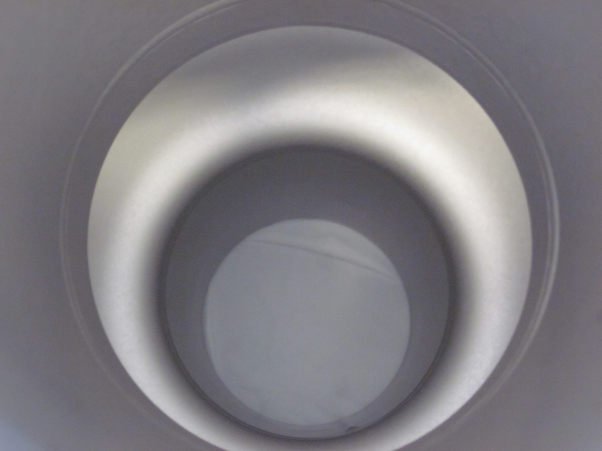
Coating of 952 MHz cavity
Cavity was originally fabricated for the proposed JLEIC.
The first coating was performed with two Sn-sources: one at the bottom and the other at the top.
The non-uniform coating around the equator, farthest and out of the sight region from any Sn sources was observed.
Another Sn source was installed around the center of the cavity in the next coating, eliminated the problem.
Witness sample shows potential Sn-residues as observed during five-cell cavity coatings
With two Sn sources
With three Sn sources
More from G. Ciovati, “Accelerator Stewardship with Nb₃Sn at Jlab” , Friday at 11 AM.

Slide 14
Summary
Nb₃Sn cavities are moving toward accelerator applications, requiring a capability to grow quality coatings on large surface areas.
The coating process may need to be updated depending on the cavity's size and geometry to be coated.
Precise control over Sn-evaporation and distribution is crucial to produce conformal coatings in cavities with large surface area coatings.
May require multiple Sn-sources provided with individual heaters
Optimization of coating parameters and coating configuration to avoid patchy regions and Sn residues
Nucleation and growth parameters need to be explored.
Pudasaini, U., Eremeev, G.V., Reece, C.E., Tuggle, J. and Kelley, M.J., 2019. Initial growth of tin on niobium for vapor diffusion coating of Nb3Sn. Superconductor Science and Technology, 32(4), p.045008.

Slide 15
Acknowledgements
We are grateful for support from the Office of High Energy Physics, U.S. Department of Energy under grants DE-SC-0014475 to the College of William Mary and DE-SC-0018918 to Virginia Tech. Co-Authored by Jefferson Science Associates, LLC under U.S. DOE Contract No. DE-AC05-06OR23177. This material is based upon work supported by the U.S. Department of Energy, Office of Science, Office of Nuclear Physics.
Early Career Award – Dr. Grigory Eremeev.

