Slide 1



PVD Deposition Of Nb₃Sn From An Alloy Target On Copper
Reza Valizadeh
on behalf of the team
Nb₃Sn Workshop 9th - 13th November 2020 Cornell University

Slide 2
MOTIVATION
Bulk niobium (Nb) has been for the past three decades: the material of choice for SRF applications:
  It has the highest Tc (9.25K) for pure metal
  It has highest lower magnetic field H_{c1}
  Easy fabrication
But it has achieved the magnetic field limitation so further improvement of cavity RF performance dictate to turn to other superconducting materials.
Nb₃Sn alloy is type II superconductor with ideal Tc of 18 K and superheating field of 400 mT. Hence can offer improvement
  Cryogenic efficiency
  Higher accelerating field.
  Recently there has been positive progress in producing Nb cavities with Nb₃Sn coating.
The material can be deposited as thin film either in:
  Single layer (Nb₃Sn on Cu or Nb)
  Double layer (Nb /Nb₃Sn on Cu)
  Multilayer (SIS): Nb /Insulator/ Nb₃Sn, on Cu
Image © STFC John Dawson

Slide 3
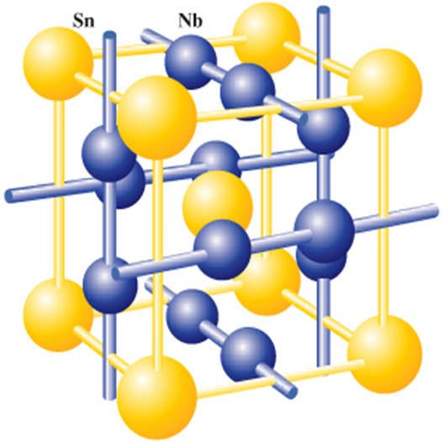
Nb₃Sn unit cell Structure
The Sn atoms forms a bcc lattice and each cube face is bisected by orthogonal Nb chains.
In bcc Nb the shortest distance between the atoms is 0.286 nm starting from a lattice parameters of a = 0.330 nm
In Nb3SN the lattice parameters of about a = 0.529 nm for stoichiometric composition and the distance between the Nb atoms is 0.265 nm
The reduction of distance between the Nb chains is responsible for the high Tc in comparison to bcc Nb.
Sn deficiency may cause the Nb to occupy the site and effect the long range order

Slide 4
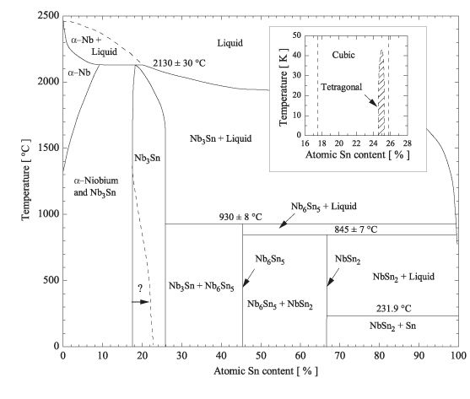
Nb₃Sn binary phase diagram
Intermetallic niobium–tin is based on the superconductor Nb, which exists in a bcc Nb structure or a metastable Nb₃Nb A15 structure
When alloyed with Sn and in thermodynamic equilibrium, it can form either Nb1−βSnβ (about 0.18≤β≤0.25) or the line compounds Nb6Sn5 and NbSn2.
Both the line compounds at β = 0.45 and 0.67 are superconducting, with
  Tc<2.8 K for Nb6Sn5
  Tc<2.68 K for NbSn2

Slide 5
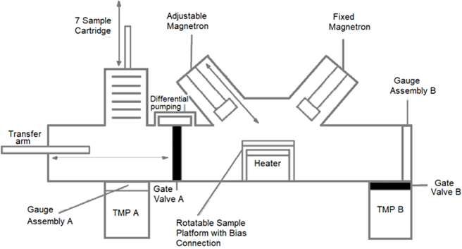
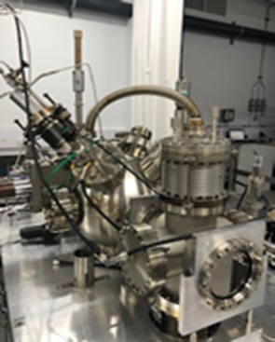
Nb₃Sn deposition system and parameters
Magnetron sputtering from a RRR 300 Nb target
Substrate Temperature, Deposition Rate, Deposition Thickness, Substrate Bias, Concurrent Ion Bombardment can be varied independently.
Substrates are loaded into the load lock and system fully Baked.
Base pressure 2 x 10⁻⁹ mbar is routinely achieved
Nb deposition:
400 W, 470v, 0.85A
4 hours deposition
DC sputtering
Nb3Sn deposition:
200 W, 489 V, 0.41 A
2 Hours deposition
DC sputtering

Slide 6
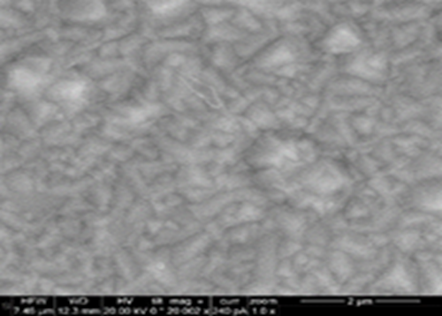
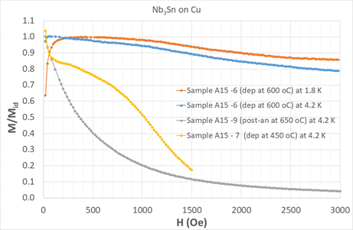
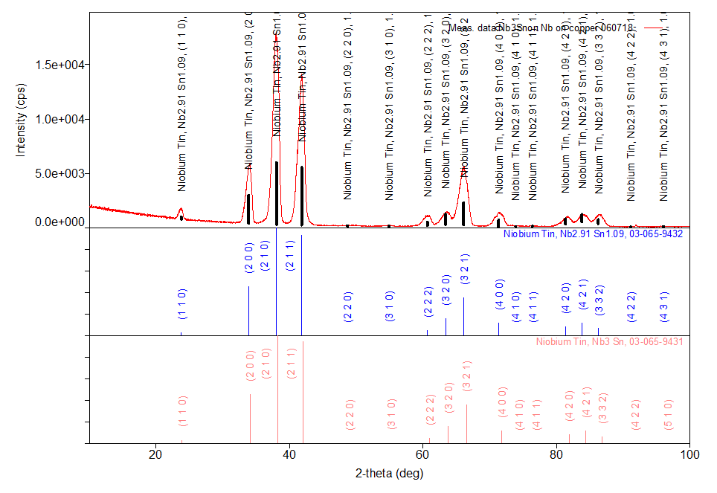
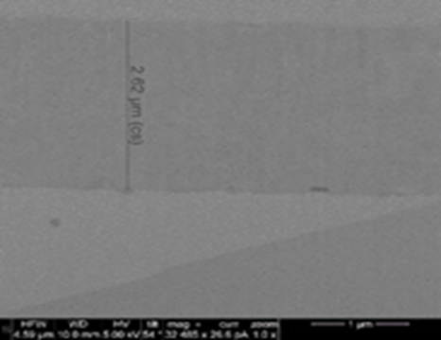
Cu/Nb₃Sn deposition (single layer) at various Temperature
Nb₃Sn were deposited on copper with no prior chemical cleaning such (EP or SUBU5) at various Temperature of RT, 450°C and 600°C. The RT deposition showed no sign of superconductivity.
Best performance in terms of superconducting properties is achieved by the film deposited at 600°C (A15-6) with a Tc of 15.7 K, a lattice parameters of 0.529 nm and grain size in order of 8 to10 nm.
The film deposited at moderate temperature of 450°C was superconducting but its performance is much reduced with Tc of 14.6 K
The film deposited at room temperature and then post annealed at 650°C (A15-9) has the worst performance since M/Mi drop sharply at very low field of about 10 mT.

Slide 7
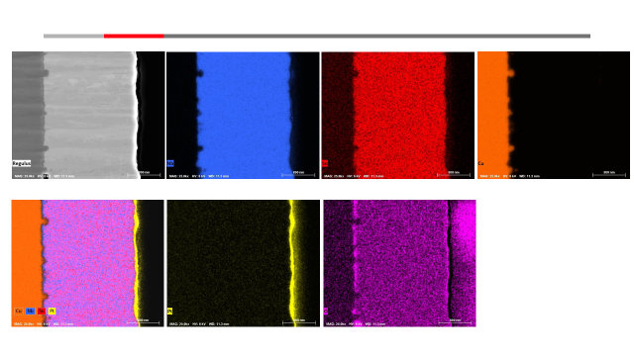
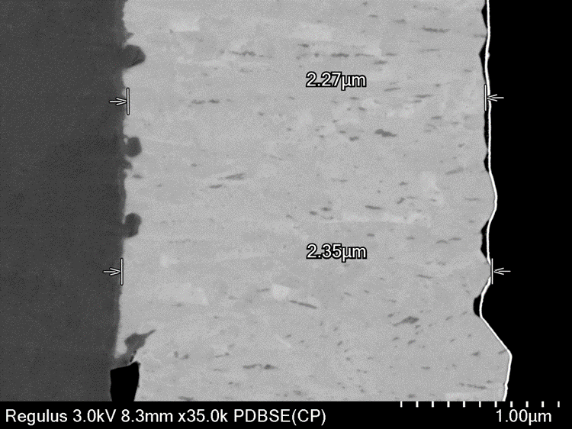
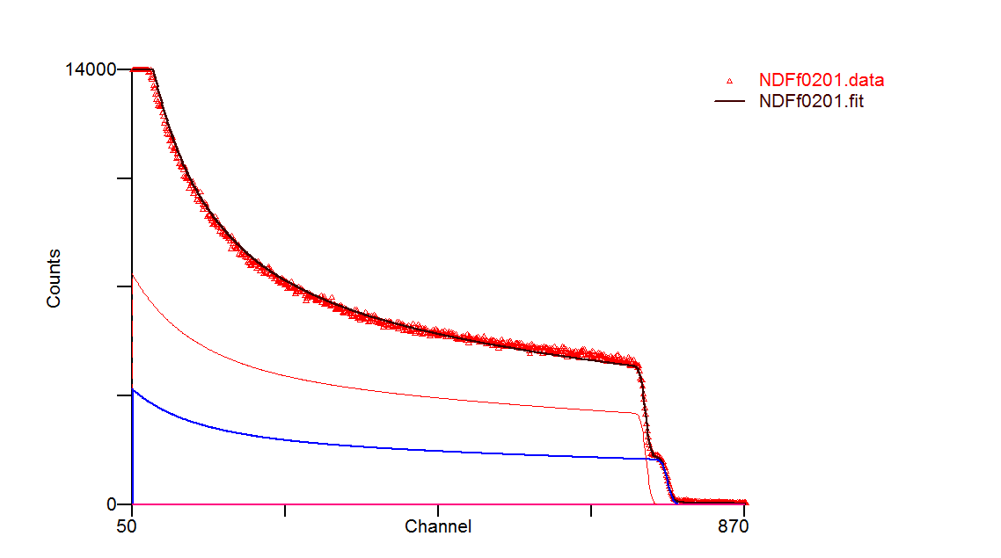
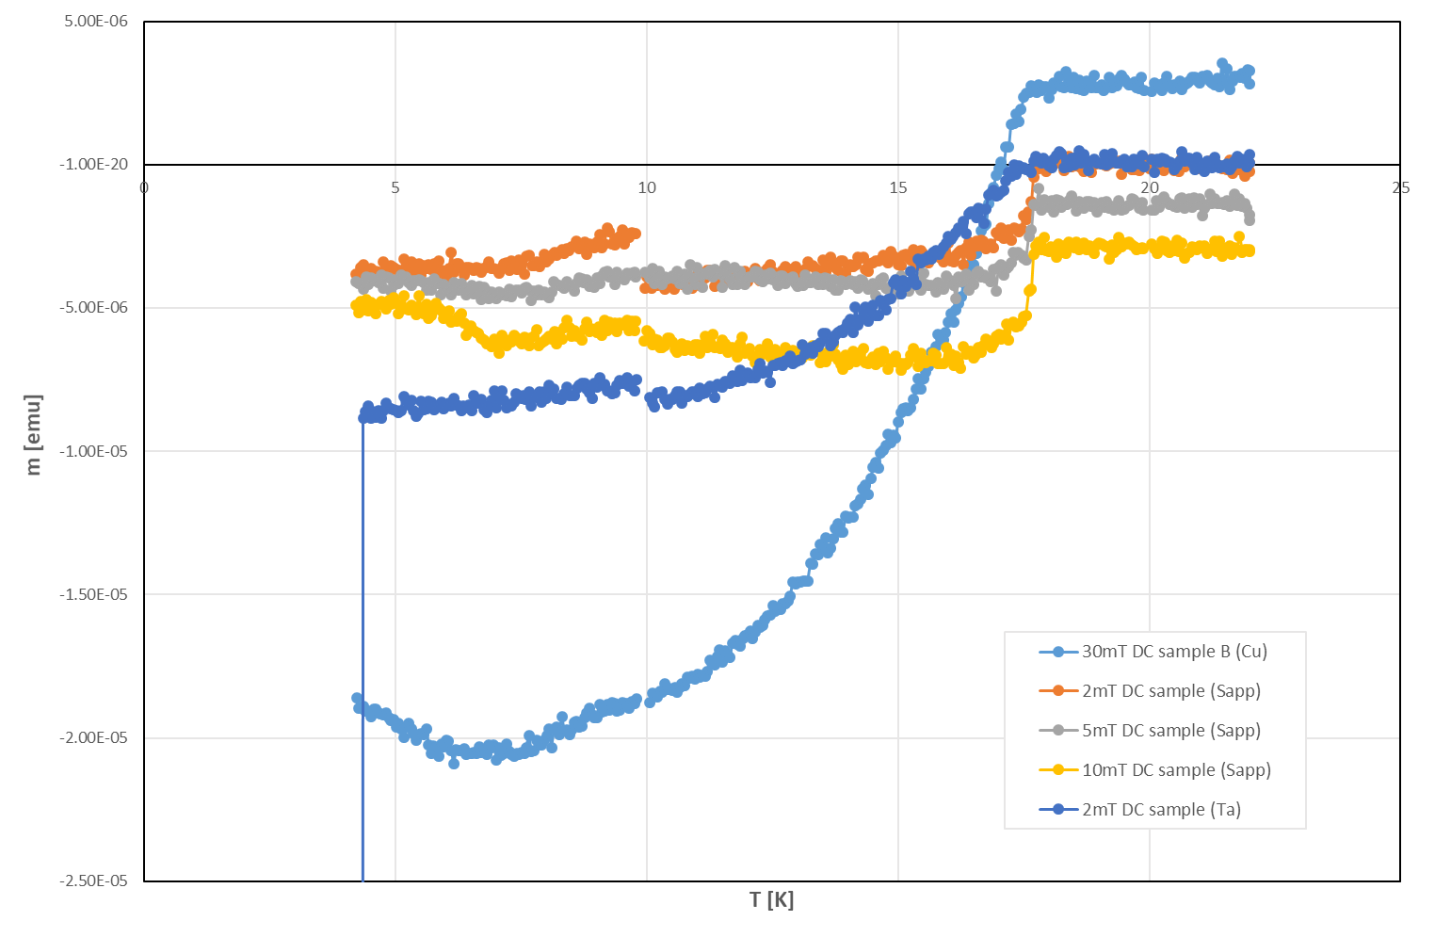
Cu (EP)LNL / Nb₃Sn (single layer)
There is some diffusion of copper at the interface
There is a clear oxide layer at the interface despite high temperature treatment prior deposition (no prior chemical processing)
There are area that it is Sn deficient.
The Tc was determined to be between 17.75K (on sapphire) and 17.5 on copper
First B_{en} estimated to be 50mT and 140mT deposited on Cu and Sapphire.
Layer t (1e15at/cm2) t (nm) r(1e22at/cm3) Nb Sn Al O
1 7606.631 1489.817 5.106 75.0000 25.0000 0.0000 0.0000
2 821647.625 69631.156 11.800 0.0000 0.0000 40.0000 60.0000

Slide 8
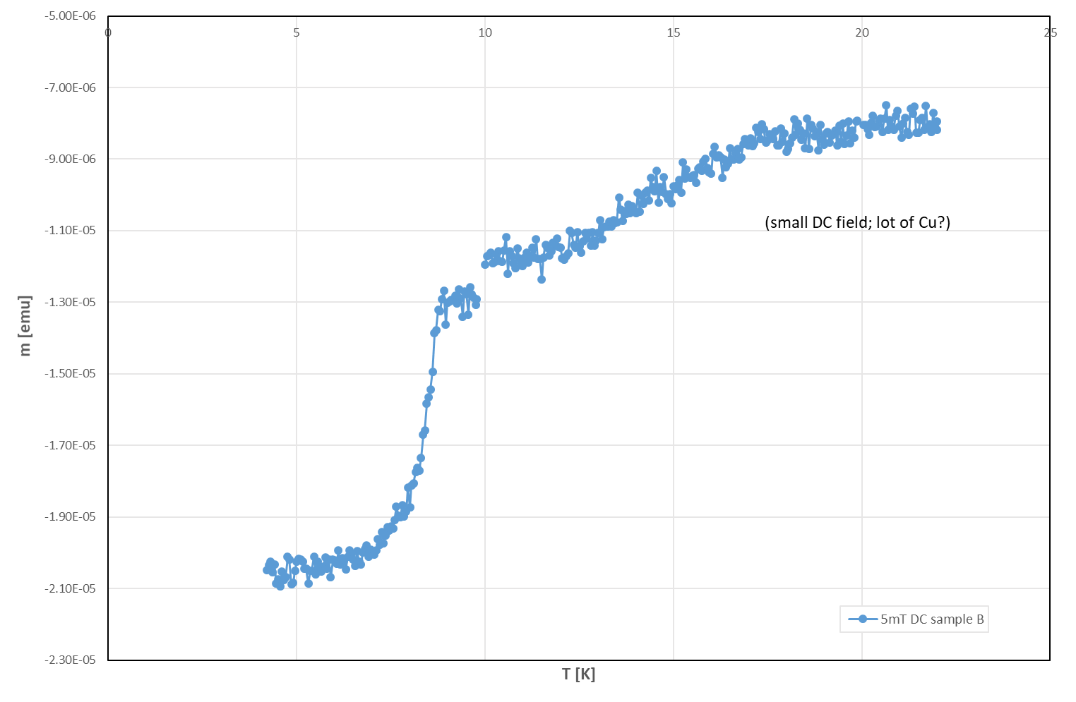
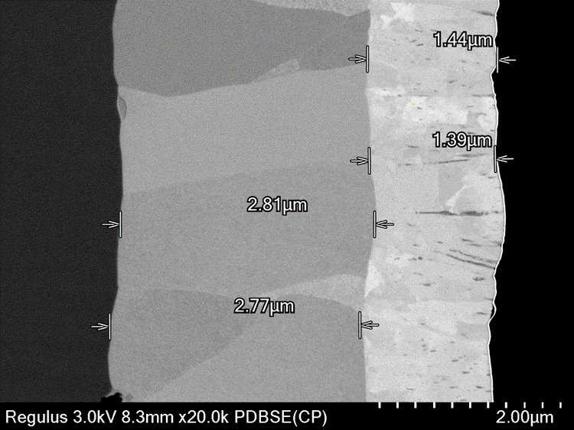
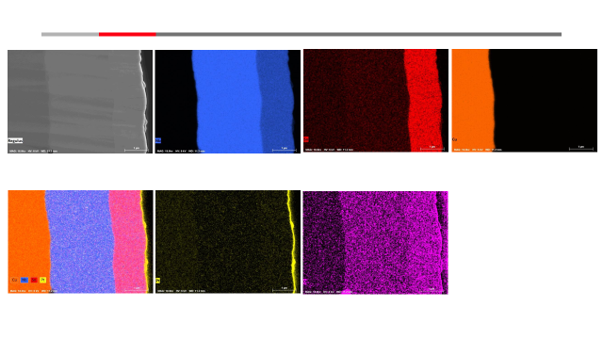
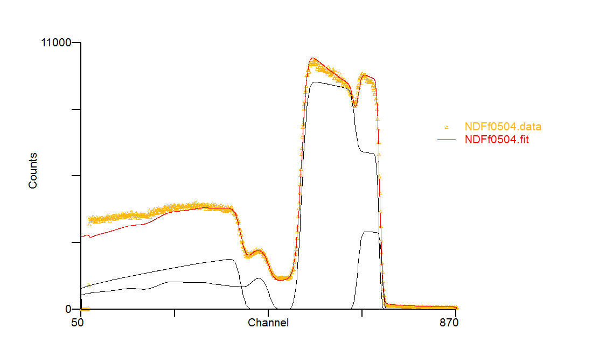
Cu /Nb/Nb₃Sn (double layer)
The interfaces both at Cu/Nb and Nb/Nb3Sn is well define
Nb layer is grown is large grain and in a perpendicular direction to the substrate surface
No intermixing of elements is observed
Some area of Sn deficiency and rich Sn in Nb3Sn layer can be observed
First B_{en} is estimated at 95mT.
Tc(Nb3Sn)~17K
Tc (Nb)~8.8K
Layer t (1e15at/cm2) t (nm) r(1e22at/cm3) Nb Sn O Al
1 7644.333 1497.201 5.106 75.0000 25.0000 0.0000 0.0000
2 15920.986 2855.270 5.576 100.0000 0.0000 0.0000 0.0000
3 898207.563 76119.281 11.800 0.0000 0.0000 60.0000 40.0000

Slide 9
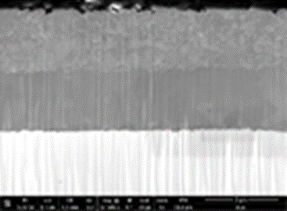
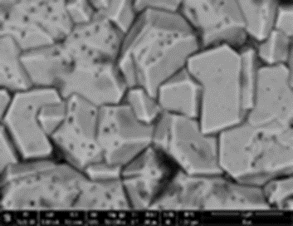
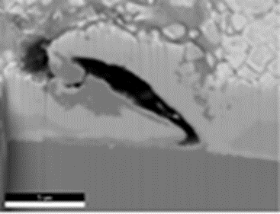
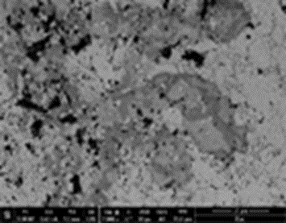
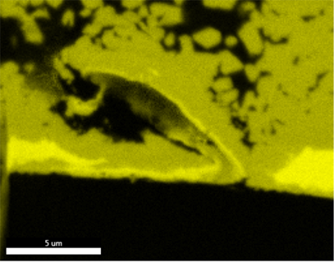
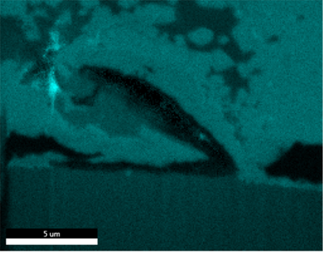
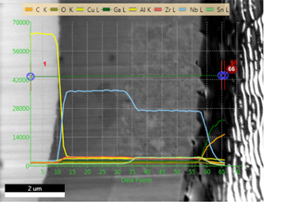


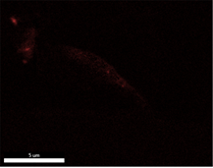
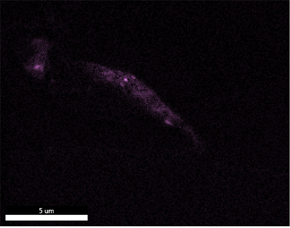


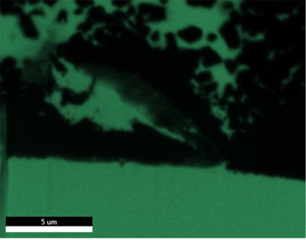
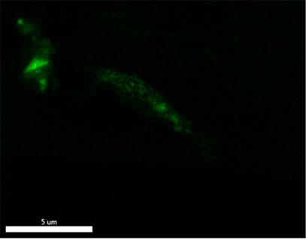


Cu/Nb/Nb₃Sn (double layer)
Two distinct area can be observed:
  Perfect area with sharp interface with correct stoichiometry for Nb3Sn layer
  Copper diffusion from the interface to top surface.
Nb and Nb₃Sn layers are completely intermixed and there is a substantial volume of copper substrate is present throughout the depth of the layer and at the surface
Inside the cavity there are trace silicon and aluminium oxide.

Slide 10
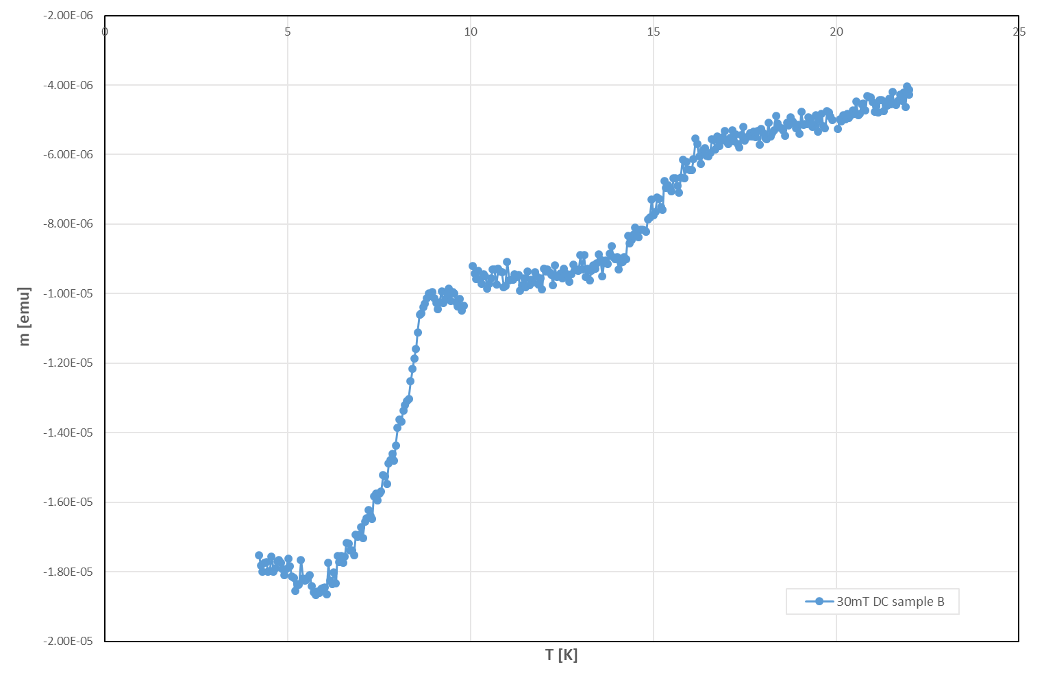
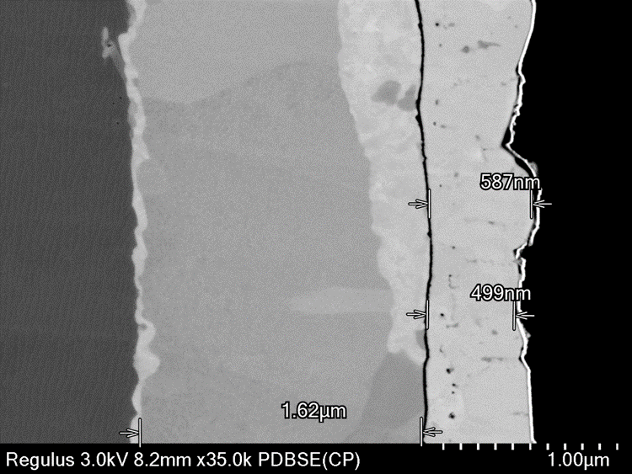
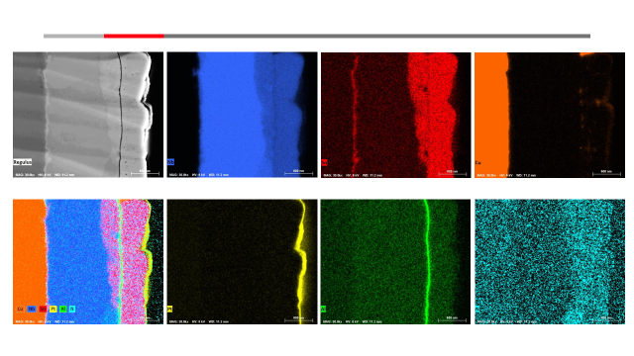
SIS Structure of thick Nb₃Sn/AlN/Nb multilayer on copper
Although the layers are well identified however there is again some degree of mixing can be observed.
Sn segregation at Cu/Nb interface
Nb₃Sn into Nb layer below the AlN layer at some places
Copper diffusion on to the surface
Some level of Nitrogen diffusion into all the layers.
The B_{en} in parallel external field is estimated to be 61mT and 4mT for Cu and Sapphire Substrate
Tc (Nb3Sn)~ 17 K
Tc (Nb)~ 8K

Slide 11
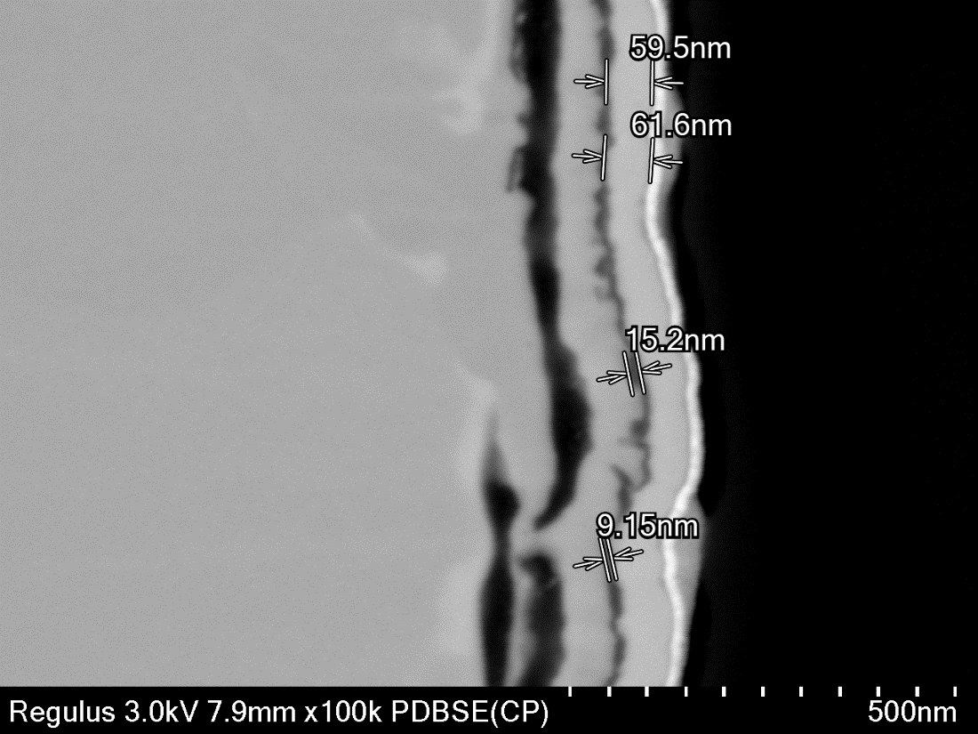
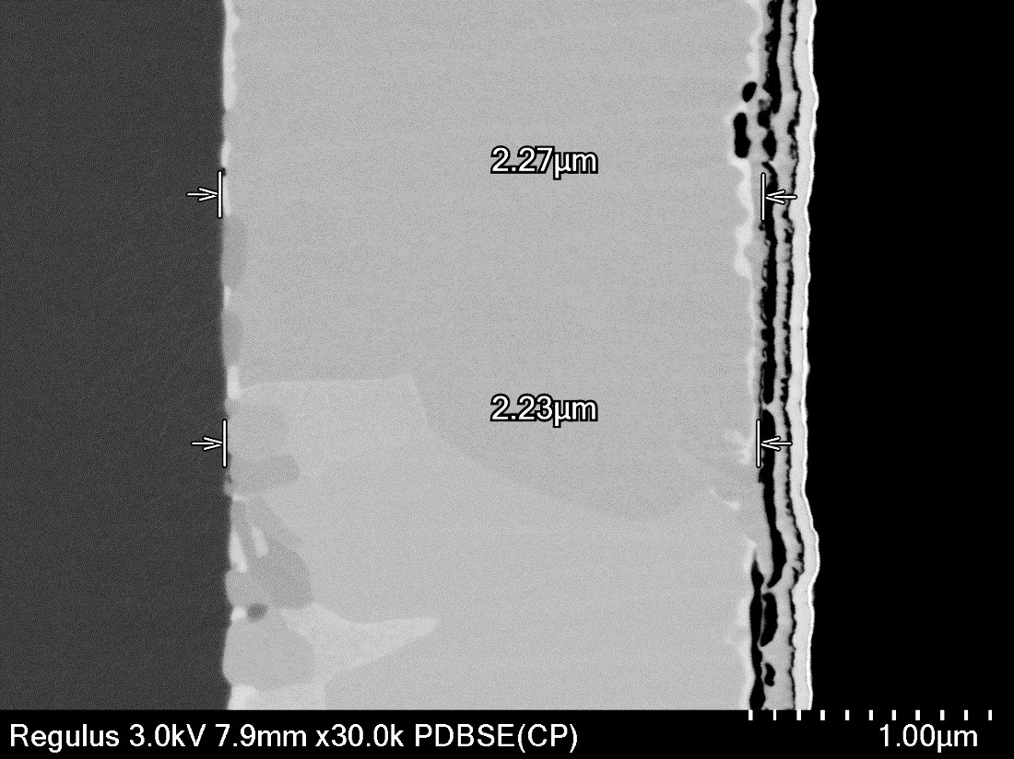
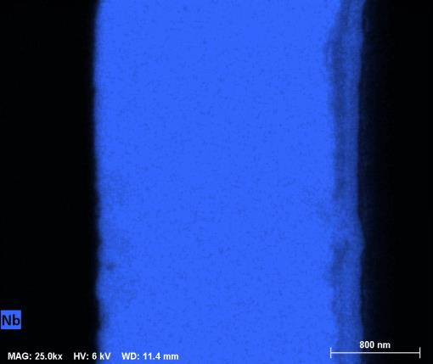
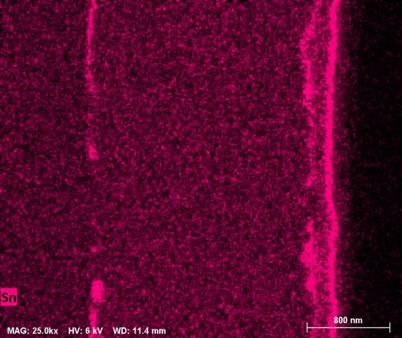
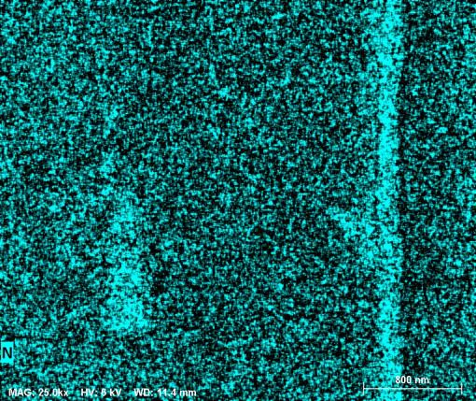
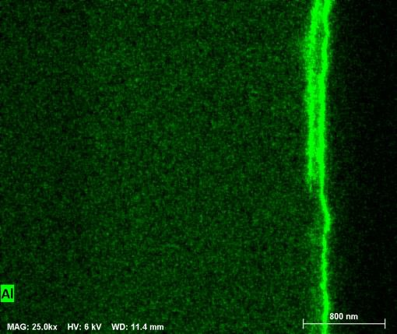
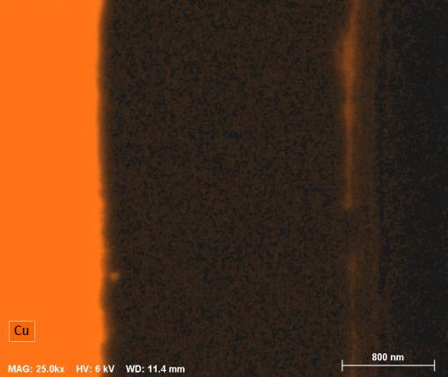
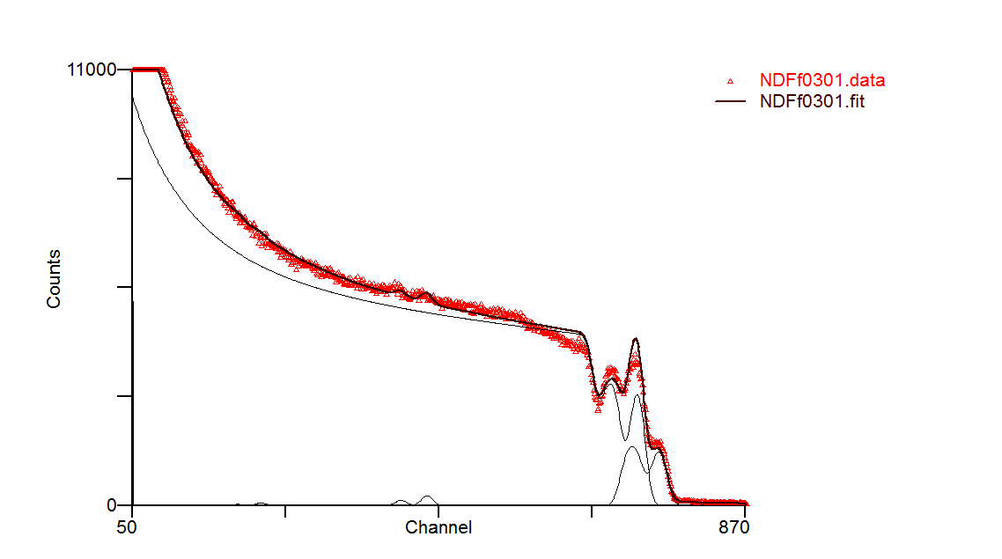
SIS Structure of thin layer (Nb₃Sn/AlN)₂/Nb multilayer on Cu
The observed distortion of the Nb₃Sn / AlN bilayer is most probably due to mechanical polishing prior to ion beam milling, since such distortion is not present in the RBS spectra
The RBS analysis predicts stoichiometric layers with the second AlN layer almost being double the thickness of the first AlN layer. Similarly the first Nb₃Sn layer is 25% thicker than the second Nb₃Sn layer.
Layer t (1e15at/cm2) t (nm) r(1e22at/cm3) Nb Sn Al N O
1 245.384 48.060 5.106 75.0000 25.0000 0.0000 0.0000 0.0000
2 252.853 26.394 9.580 0.0000 0.0000 50.0000 50.0000 0.0000
3 321.916 63.050 5.106 75.0000 25.0000 0.0000 0.0000 0.0000
4 132.522 13.833 9.580 0.0000 0.0000 50.0000 50.0000 0.0000
5 11761.658 2109.336 5.576 100.0000 0.0000 0.0000 0.0000 0.0000
6 1143361.875 96895.070 11.800 0.0000 0.0000 40.0000 0.0000 60.0000

Slide 12
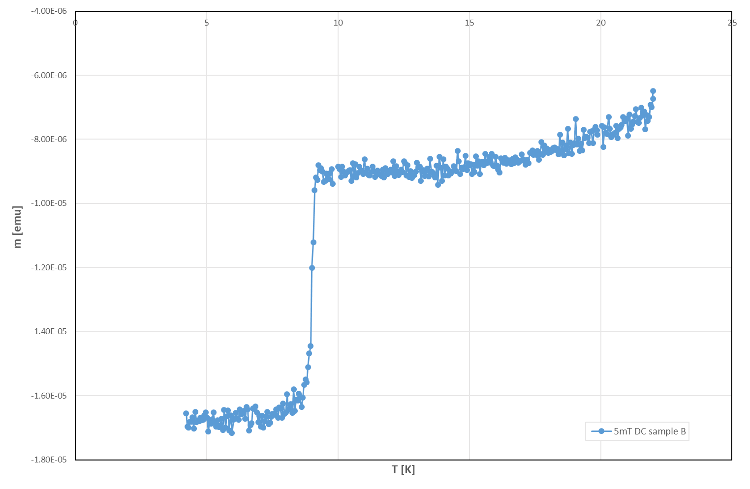
SIS Structure of thin layer (Nb₃Sn/AlN)₂/Nb multilayer on Cu
Tc (Nb3Sn) ~ ??
Due to Small DC field, lots of copper
Tc (Nb) ~ 9.2 K
The B_{en} in parallel external field is estimated to be 108 mT and 130 mT for Cu and Sapphire Substrate
There is nearly no hysteresis in the thin double SIS structure
This can be due to the protective effect of multilayers which reduces the sensitivity to pinning effect.

Slide 13
Summary
Nb₃Sn can be successfully deposited from an alloy target with satisfactory SC properties when it is deposited at high temperature (around 600-650 °C).
Final Smooth surfaces and sharp interface between layers can be achieved by suitable surface preparation method/process of substrate
Impurities such as silicon oxide may cause complex defects to be formed when Nb3Sn is deposited in multilayer structure.
Substrate preparation can influence the growth of the film and hence its SC properties
Protective effect of multilayers to some extend is been shown:
  Less sensitivity to pinning defects
    Multilayer structure even without insulating layer reduced the hysteresis loop
    Defects are still present in individual layers
    Not detected anymore when SIS structure fully SC.
Complementary non-destructive technique such as RBS proved to be a powerful technique to distinguish post sample preparation damage.

Slide 14
Special Thanks to all the team member
STFC
Adrain Hannah
Gavin Stenning
Daniel Turner
Yukari Dan (Hitachi)
Karl Dawson
Spideh Aliasghari
Stuart Wilde
Oleg Malyshev
Tobias Junginger
Graeme Burt
Vinod Dannak
University of Siegen
Michael Vogel
Stewart Leith
IEE
Eugen Seiler
Rastislav Ries
INFN
Cristian Pira
Eduard Chyhyrynets
CEA
C.Z Antoine
JLAB
Anne Marie Valente
HZB
O. Kugeler
D.Tikhonov
RTU
A Medvid

Slide 15






Science and Technology Facilities Council
@STFC_matters
Science and Technology Facilities Council

