Slide 1



Growth Studies and Optimization of Nb₃Sn Coatings
Ryan Porter
Cornell University
Supported by:
U.S. DOE award DE-SC0008431: Coating Furnace Development + Cavity Coating
Center for Bright Beams , NSF Award PHY-1549132: material studies
This works make use of Cornell Center for Materials Research, NSF MRSEC program (DMR-1719875)

Slide 2
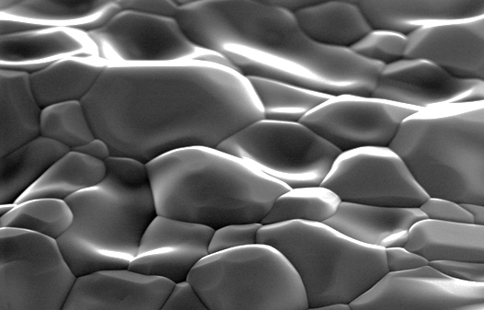
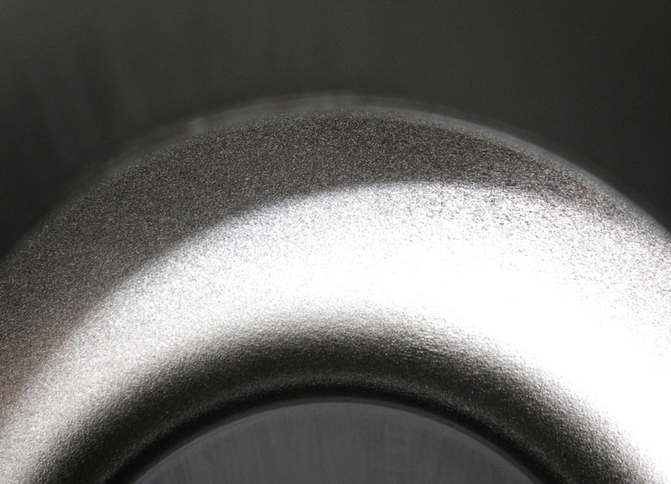
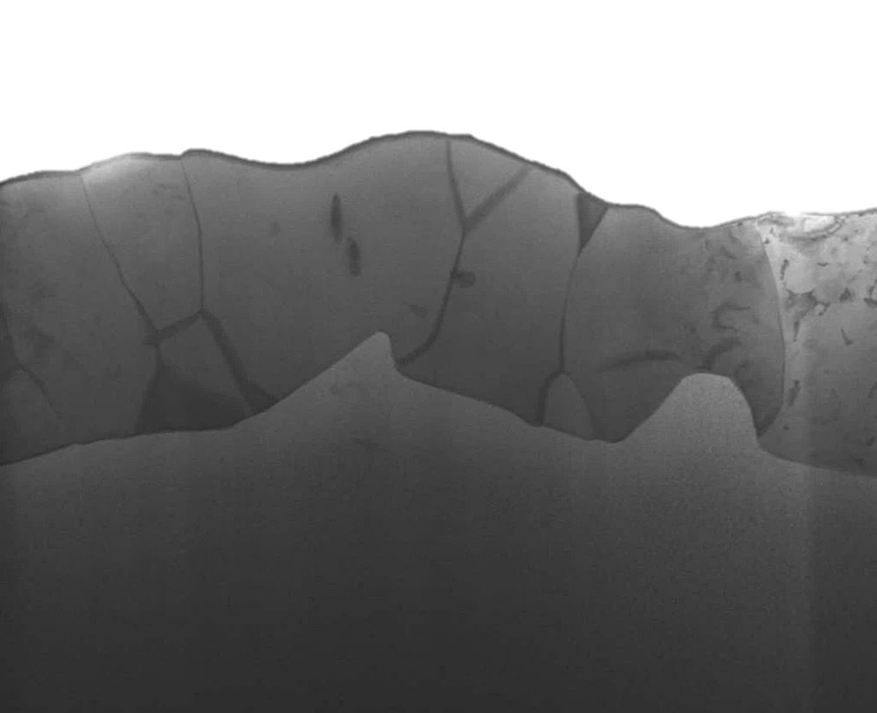
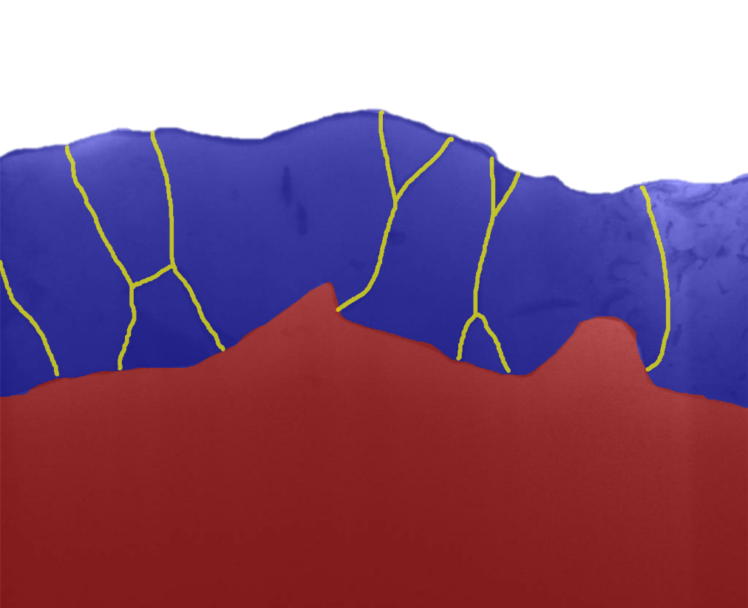
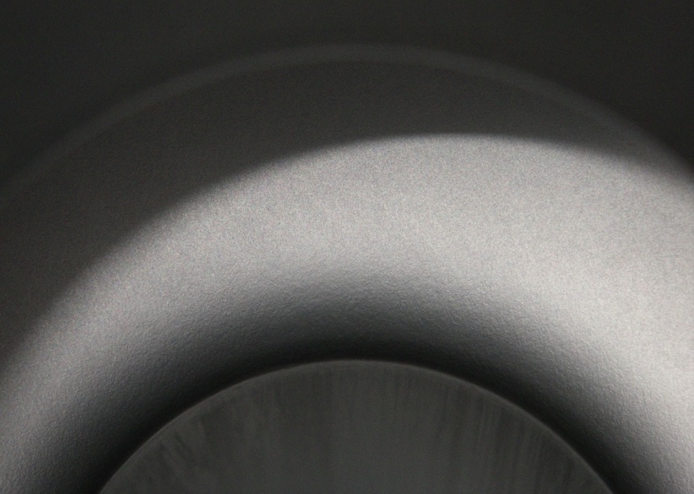
Nb₃Sn Coatings
Nb₃Sn forms a polycrystalline layer on the surface of the niobium
Before Coating
2 μm
RF Surface
≈3 μm
Nb₃Sn
After Coating
Nb
1 μm
1 μm

Slide 3
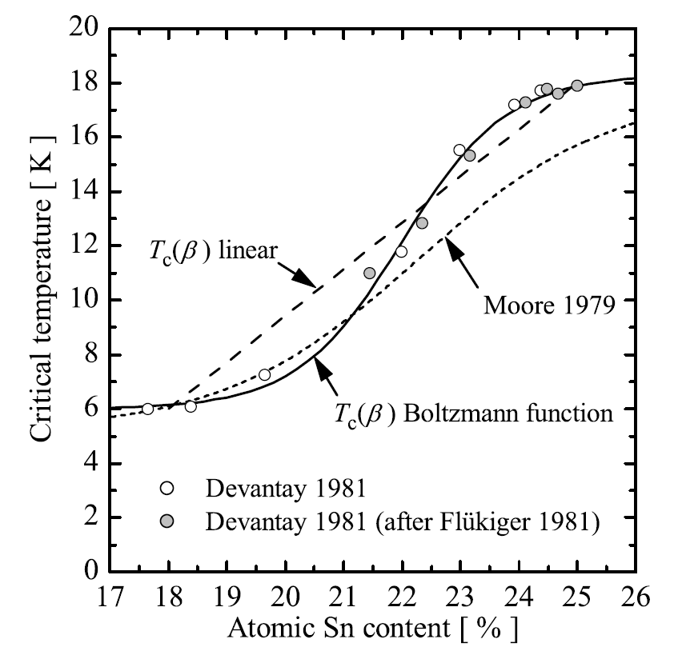
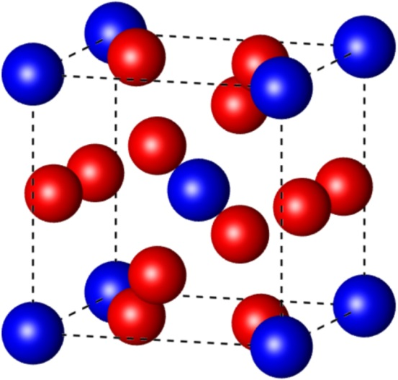
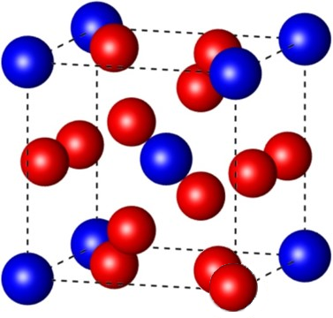
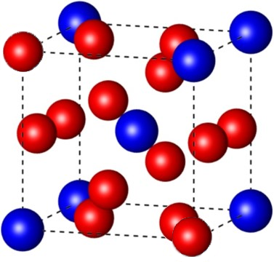
Sn-Depleted Nb₃Sn
Nb₃Sn Phase Diagram
T_{c} vs. Tin Content
Nb₃Sn Structure
Nb
Sn
Nb₃Sn
25% Sn
22% Sn
19% Sn
Sn-depleted Nb₃Sn has poor superconducting properties
16 – 25% Sn
A. Godeke, Supercond. Sci. Tech, 2006

Slide 4
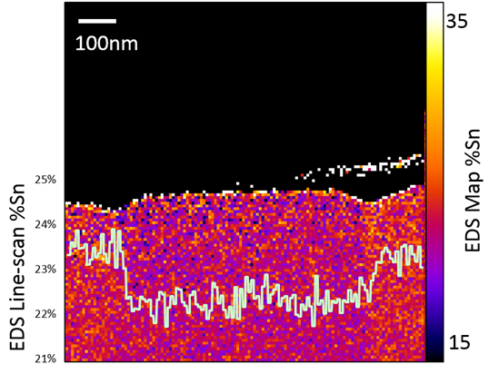
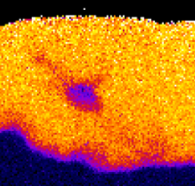
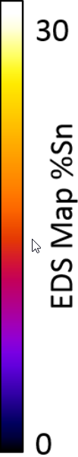
Sn Depleted Surface and Grains
Sn depleted regions on surface or in layer
Annealed too long
2 µm of Nb₃Sn
Depleted Region
Nb₃Sn EDS Cross-section
Sn Depleted Grain on Surface

Slide 5
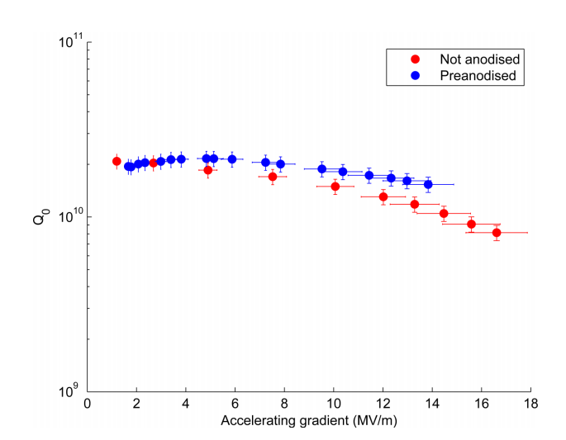
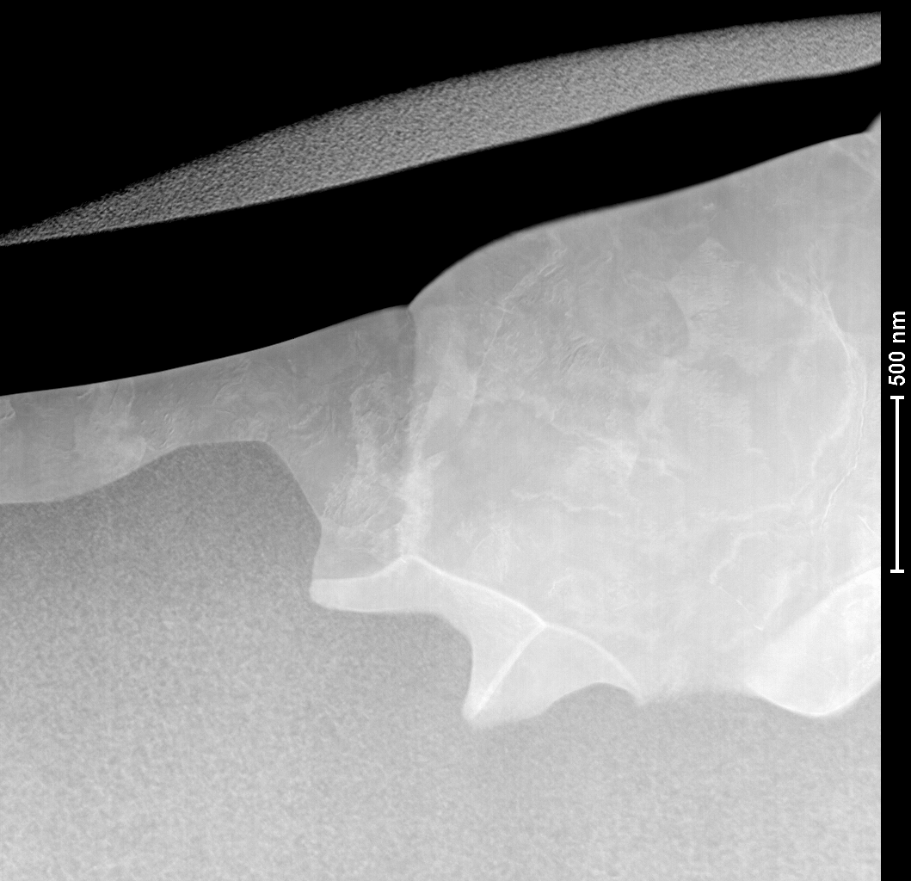
Thin Regions
Q vs E at 4.2 K of Nb₃Sn Cavities
400 nm
Nb₃Sn
No Thin Regions
Not thick enough
to fully shield RF
Has Thin Regions
Nb substrate
D. L. Hall et. al. “First Results From New Single-cell Nb3Sn Cavities Coated at Cornll University,” in proc. of IPAC17, Copenhagen, Denmark, 2017

Slide 6
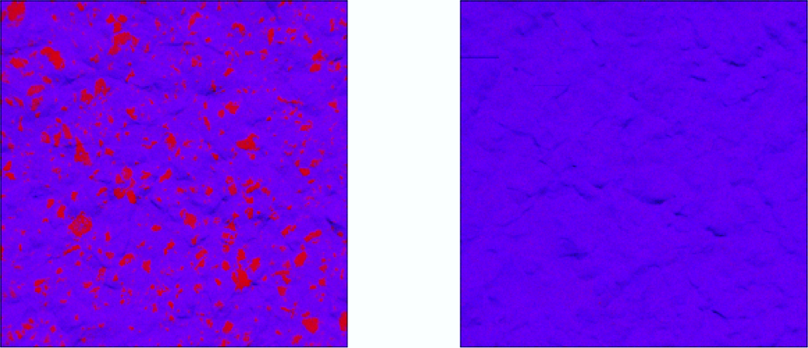
Resolving thin film regions
Growing the substrate oxide prior to coating suppresses the formation of thin film regions
Not pre-anodised
Pre-anodised substrate
Red: too thin Blue: sufficiently thick

Slide 7
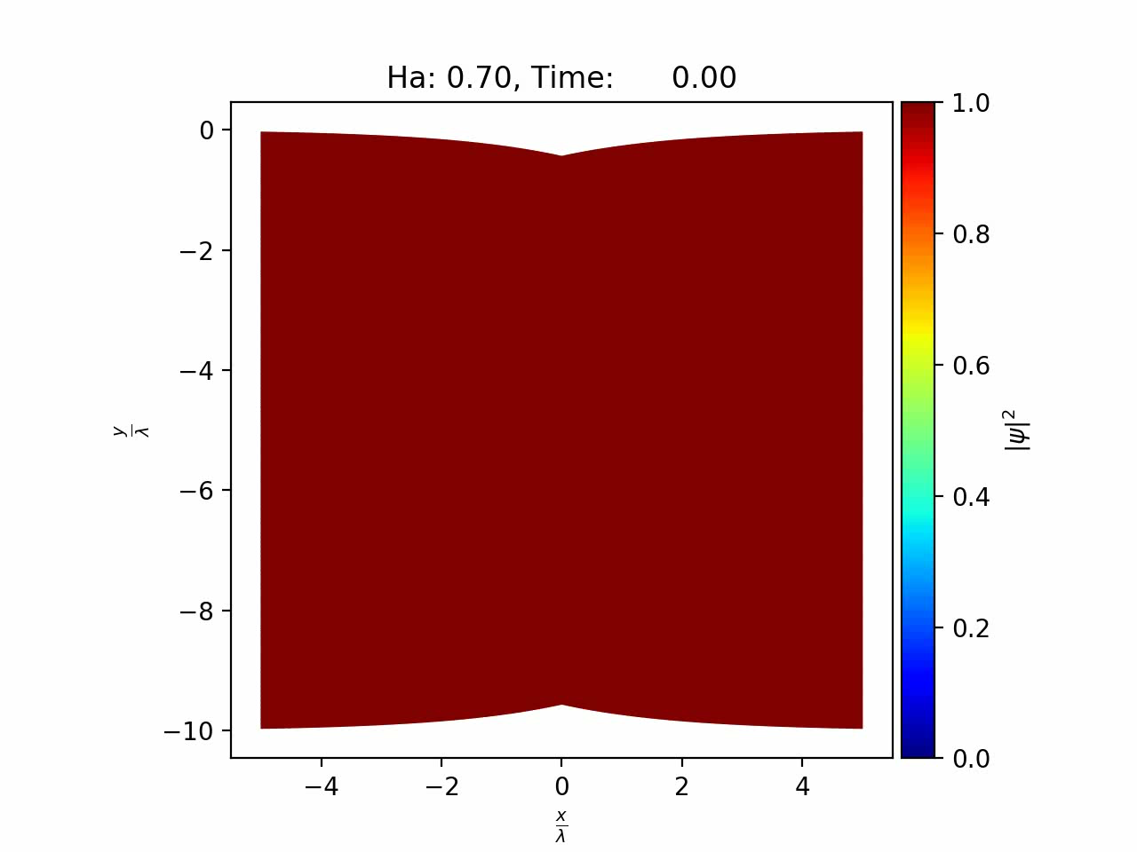
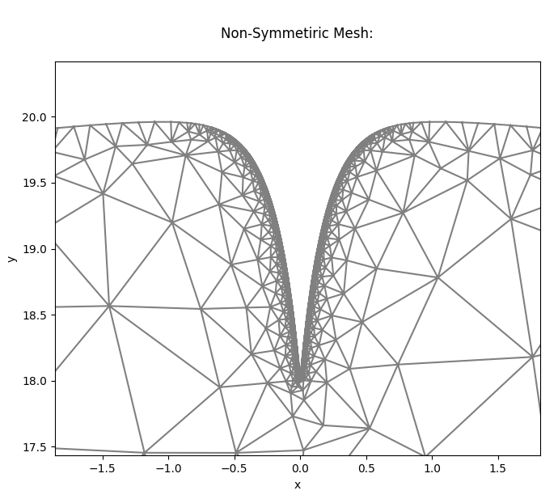
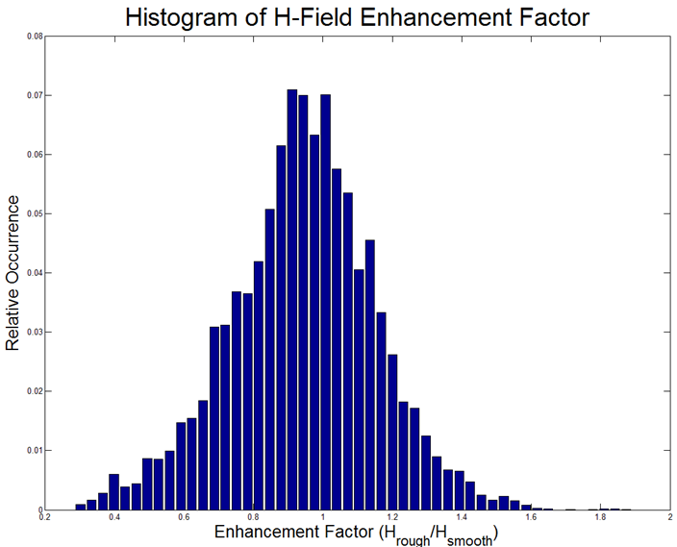
Surface Roughness and Quench Fields
Surface Roughness:
Rough surface → increased magnetic field on some surfaces
  Quench field decreased by 1/3 (?)
Poor grain boundary geometry can decrease magnetic flux entry barrier
  A. R. Pack, M. Transtrum (BYU): SRF’19 conference (Dresden): MOP017
Enhancement Factor (H_{rough}/H_{smooth})

Slide 8
Questions To Answer
Why do Sn depleted regions form?
Why do thin regions form? Why does anodization prevent it?
Why is the Nb₃Sn surface rough? Can we fix it?

Slide 9
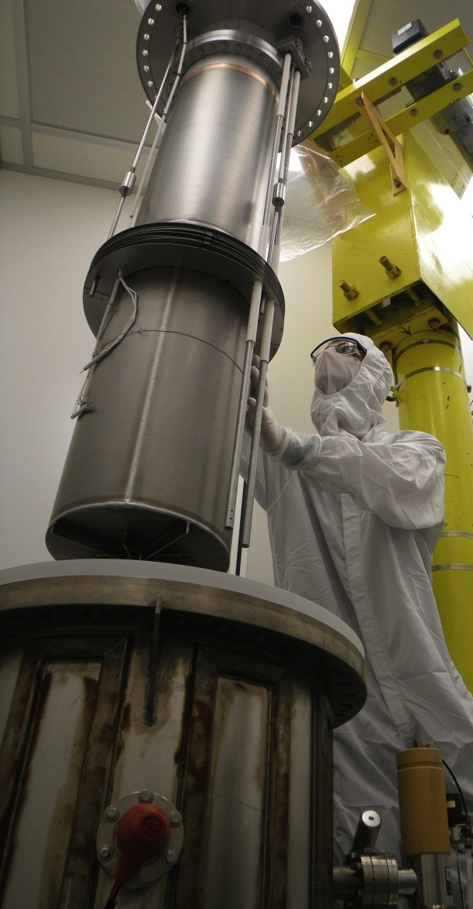
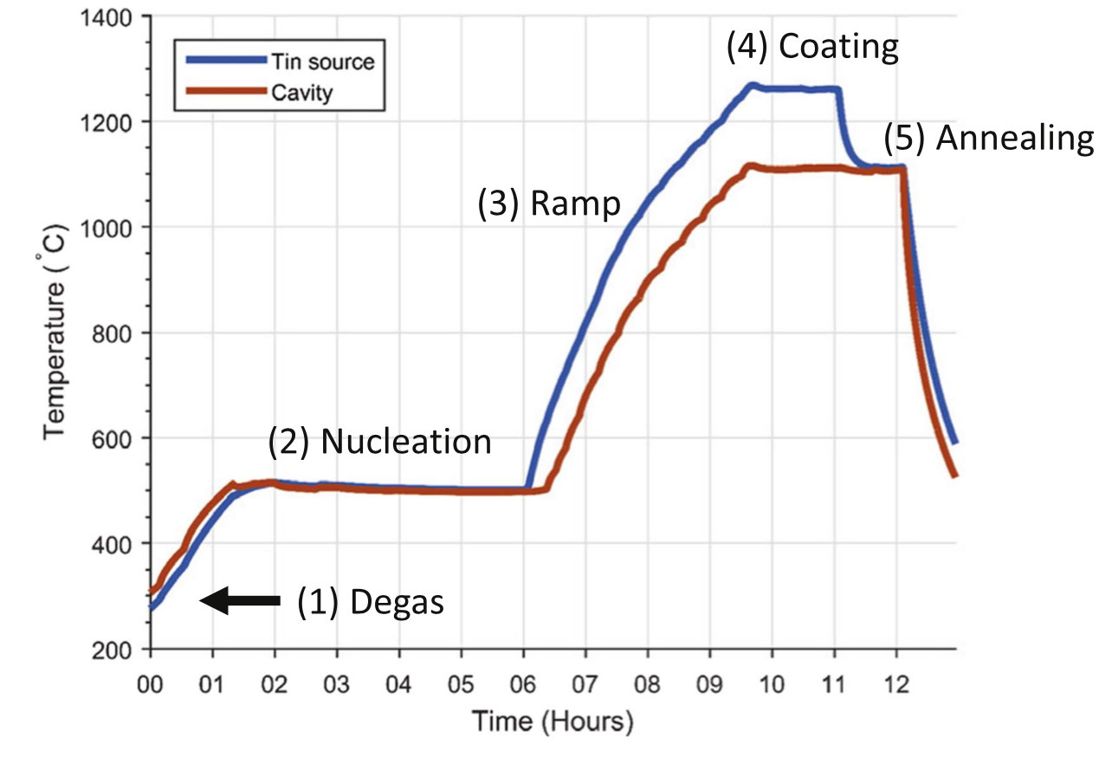
The Nb₃Sn Vapor Diffusion Process
Coating chamber
Cavity
Nucleation agent (SnCl₂ )
Primary heater
UHV Furnace
Secondary heater
Tin source
“Wuppertal” configuration, i.e., with secondary heater for the tin source
Optimized nucleation and temperature profile
S. Posen and M. Liepe, Phys. Rev. ST Accel. Beams 15, 112001 (2014).

Slide 10
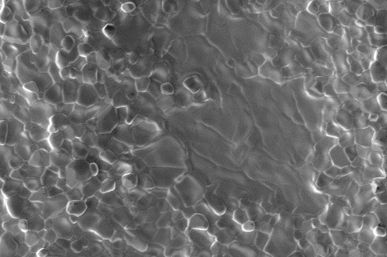
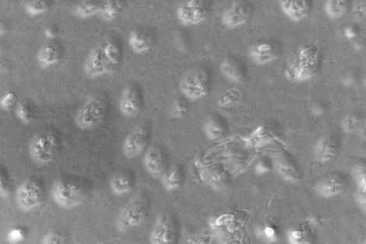
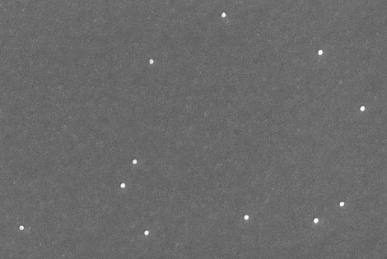
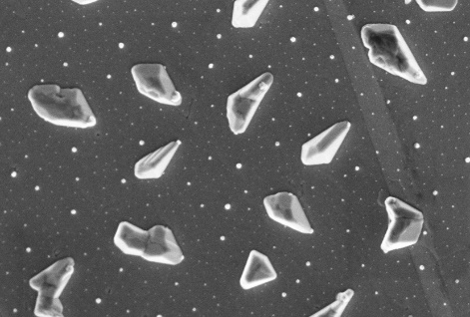
Layer Growth Studies
Coating
Want to understand how surface grows
Stop growth at different steps and examine surface
1350 C
1100 C
Temperature
Anneal
Nucleation
500 C
Time
Notes:
Why does this work? Well, let’s take a stop-motion capture of the growth of the layer, as we move from the nucleation stage, in which the layer is seeded with tin, and the coating stage, in which the layer grows.

Slide 11
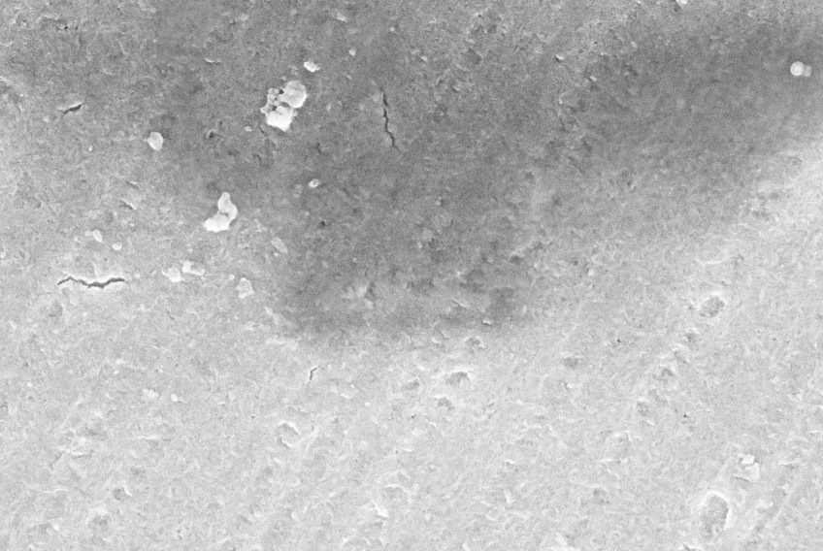
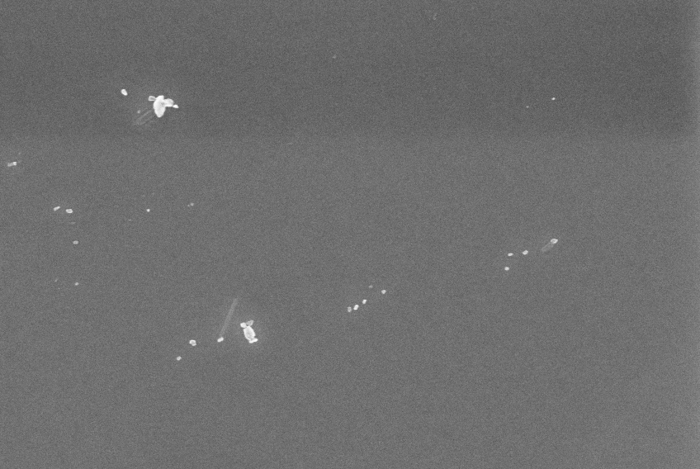
Stop-motion sequence
Pre-anodised
Not pre-anodised
70 nm oxide
5 nm oxide
1 µm
1 µm
2 µm
Temperature
START
Time
Notes:
Oxide is about 70 nm thick, naturally is 5 nm

Slide 12
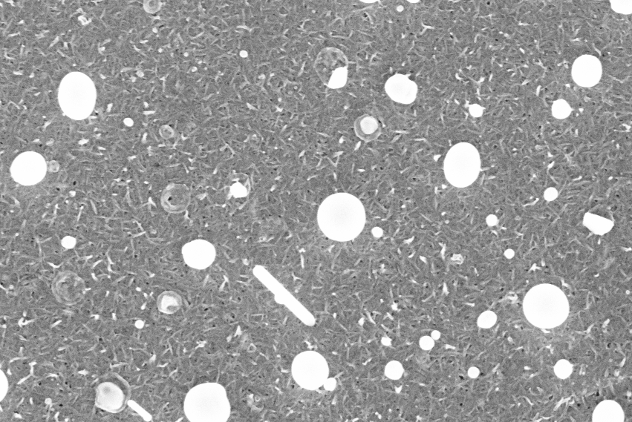
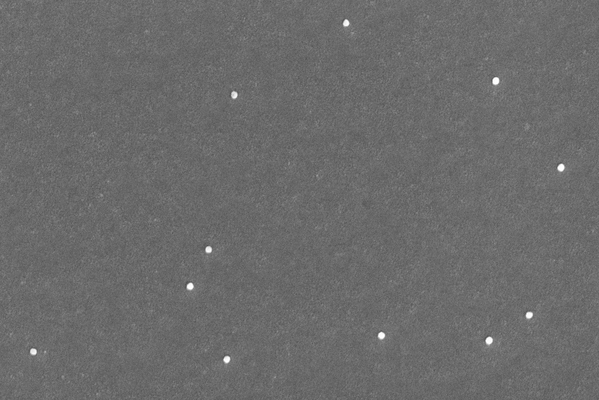
Stop-motion sequence
Pre-anodised substrate
Not pre-anodised
1 µm
1 µm
2 µm
Temperature
500°C
Time

Slide 13
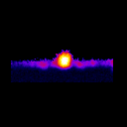
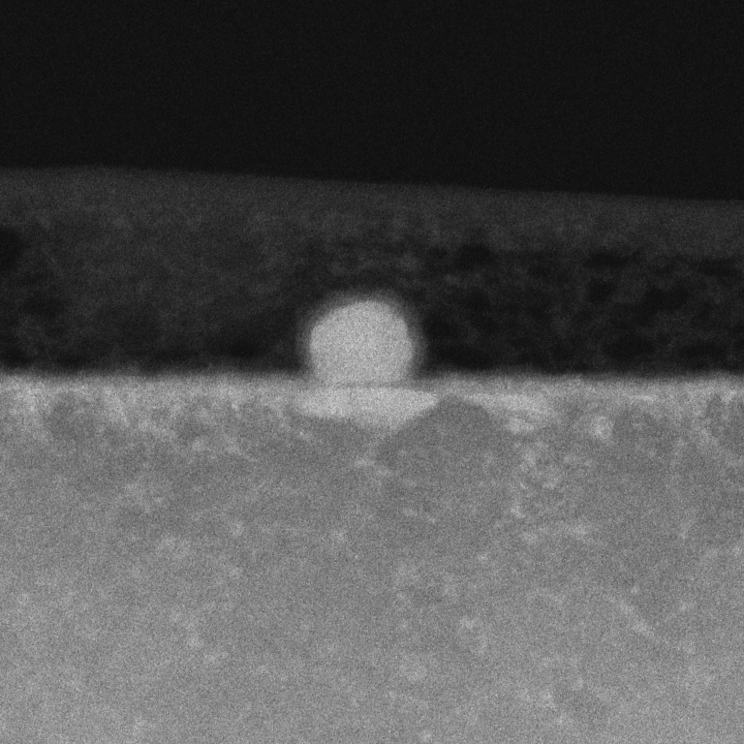



Stop-motion sequence
Not pre-anodised
50
200 nm
1 µm
% $\frac{\text{Sn}}{\text{Sn}\text{+}\text{Nb}}$
0
Niobium + Sn rich ‘blob’ (NbSn₂ + Sn liquid?) + Nb₃Sn
Temperature
500°C
Time

Slide 14
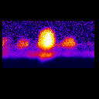
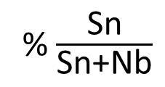
Stop-motion sequence
Pre-anodised substrate
1 µm
200 nm
50
% $\frac{\text{Sn}}{\text{Sn}\text{+}\text{Nb}}$
0
Niobium + Sn rich ‘blob’ (NbSn₂ + Sn liquid?) + Nb₃Sn blobs
+ oxide layer + Nb₃Sn forming under the oxide
Temperature
500°C
Time

Slide 15
Stop-motion sequence
Pre-anodised substrate
Not pre-anodised
1 µm
1 µm
2 µm
Temperature
500°C
Time

Slide 16
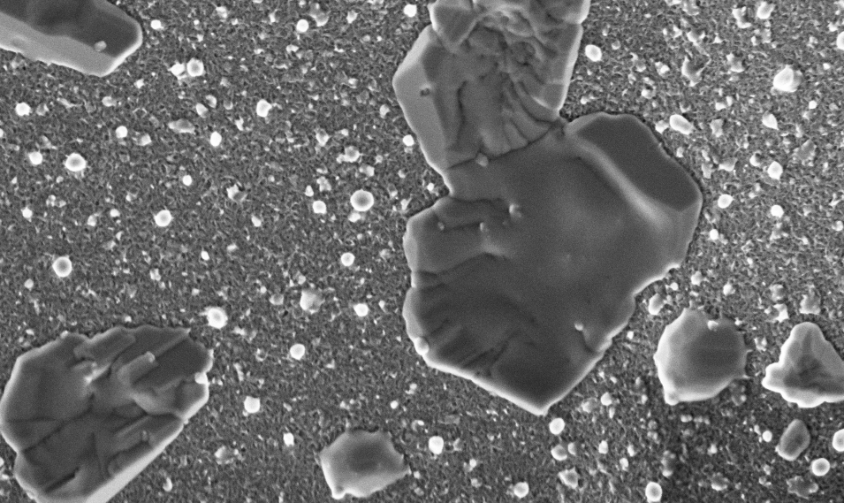

Stop-motion sequence
Pre-anodised substrate
Not pre-anodised
1 µm
1 µm
2 µm
Temperature
800°C
Time

Slide 17
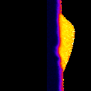
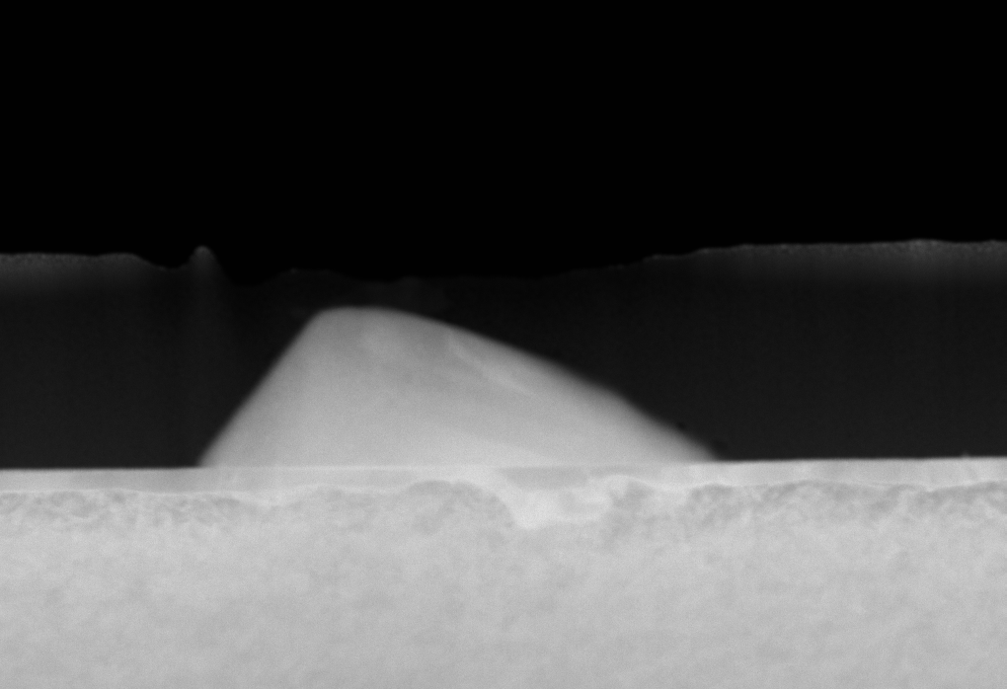
Stop-motion sequence
Not pre-anodised
200nm
1 µm
50
% $\frac{\text{Sn}}{\text{Sn}\text{+}\text{Nb}}$
0
Niobium + Thin Nb₃Sn Layer + amorphous Nb₃Sn + Nb₆Sn₅
Temperature
800°C
Time

Slide 18
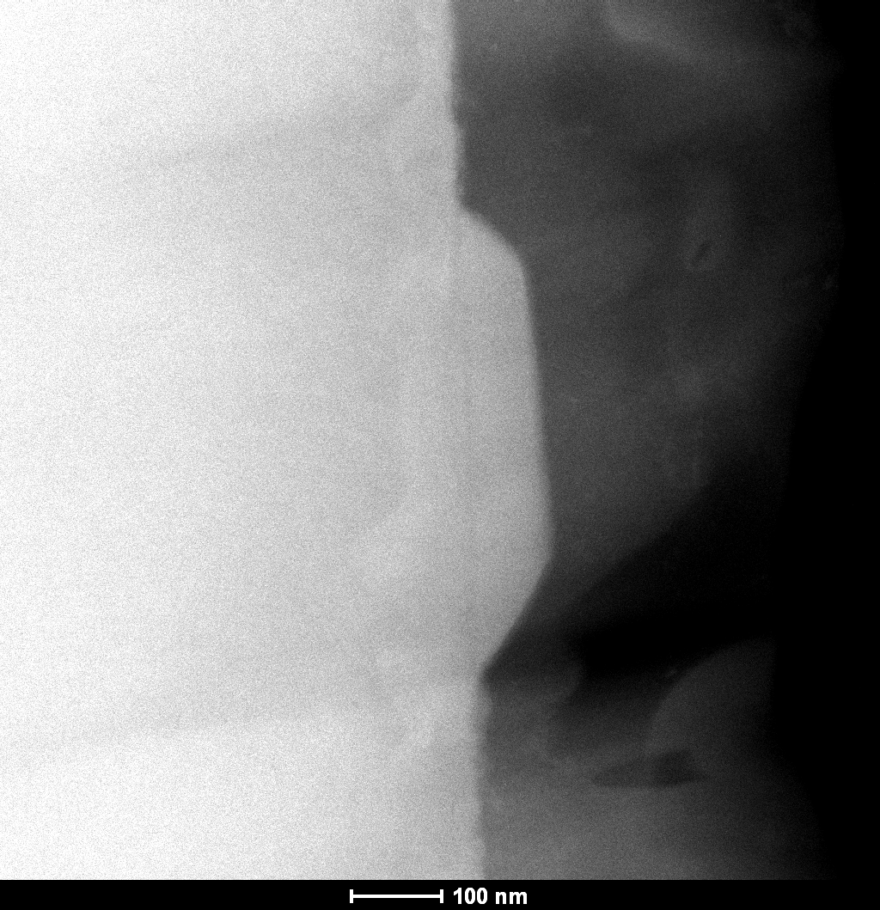
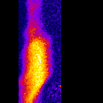
Stop-motion sequence
Pre-anodised substrate
1 µm
50
100 nm
% $\frac{\text{Sn}}{\text{Sn}\text{+}\text{Nb}}$
0
Niobium + Thin Nb₃Sn Layer + amorphous Nb₃Sn + Nb₆Sn₅
Temperature
800°C
Time

Slide 19
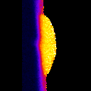

Initial Growth: Lessons
TEM/EDX of Nb₃Sn Throughout Growth
Simulation of Diffusion and Growth
nucleation
800° C
50
Initial growth:
Thin Nb₃Sn forms very early
200nm
non-preanodized
% $\frac{\text{Sn}}{\text{Sn}\text{+}\text{Nb}}$
Non-anodized:
Nb + Sn diffusion
Anodized:
Oxide acts as barrier
Creates more Sn
nucleation sites
0
Sn
Sn
Nb₃Sn
Nb
Nb₃Sn
Nb
NbO_{x}
preanodized
Sn
Sn
Nb
Nb₃Sn
Nb
N. Sitaraman, T. Arias
D. Muller, P. Cueva

Slide 20
Stop-motion sequence
Pre-anodised substrate
Not pre-anodised
1 µm
1 µm
2 µm
Temperature
800°C
Time

Slide 21
Stop-motion sequence
Pre-anodised substrate
Not pre-anodised
1 µm
1 µm
2 µm
Temperature
875°C
Time

Slide 22
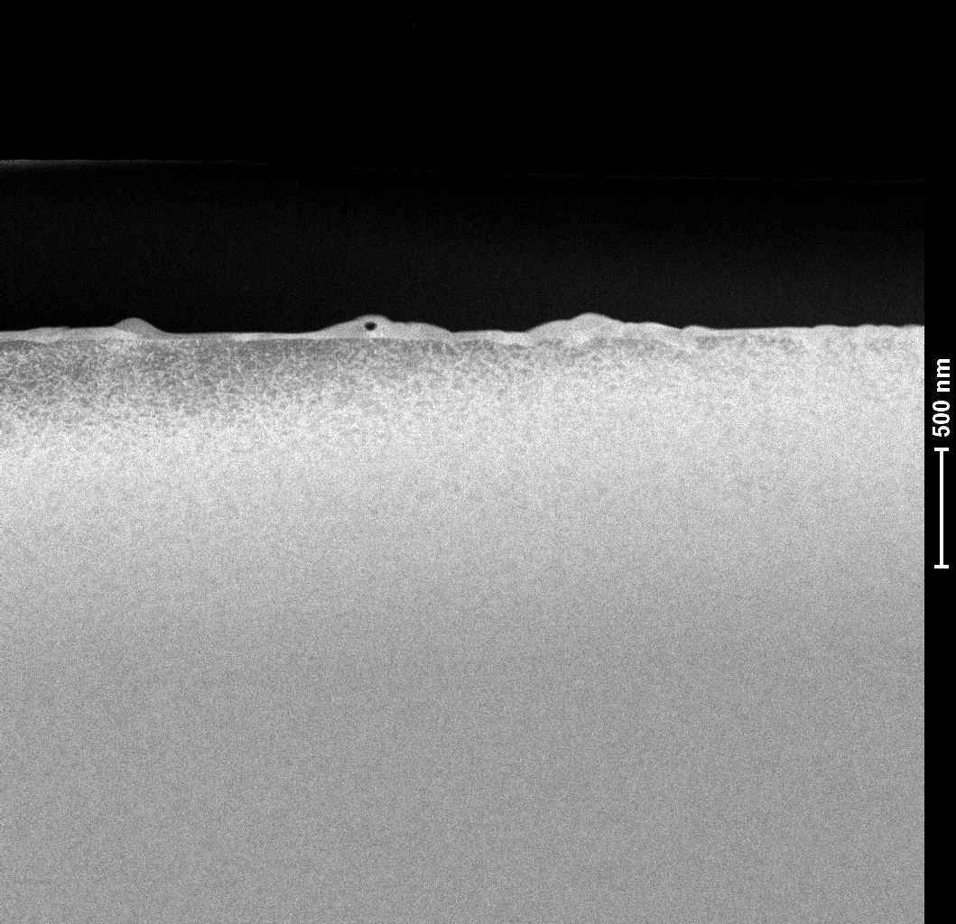
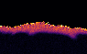
Stop-motion sequence
Not pre-anodised
200nm
1 µm
50
% $\frac{\text{Sn}}{\text{Sn}\text{+}\text{Nb}}$
0
Sn-Rich regions phase-transition to Nb₃Sn and break into crystals
Temperature
875°C
Time

Slide 23
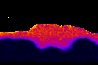
Stop-motion sequence
Pre-anodised substrate
1 µm
200nm
50
% $\frac{\text{Sn}}{\text{Sn}\text{+}\text{Nb}}$
0
Sn-Rich regions phase-transition to Nb₃Sn and break into crystals
Temperature
875°C
Time

Slide 24
Stop-motion sequence
Pre-anodised substrate
Not pre-anodised
1 µm
1 µm
2 µm
Temperature
875°C
Time

Slide 25
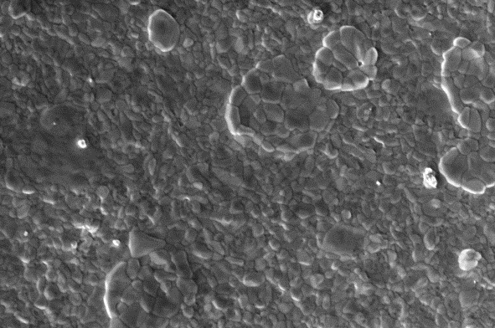
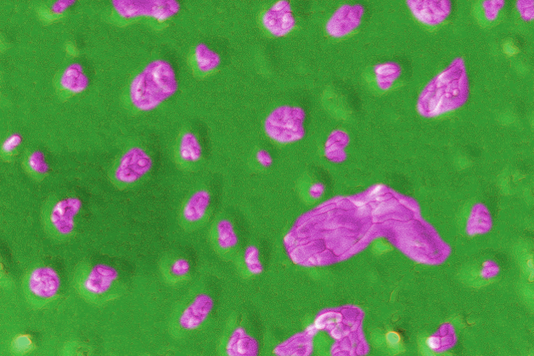
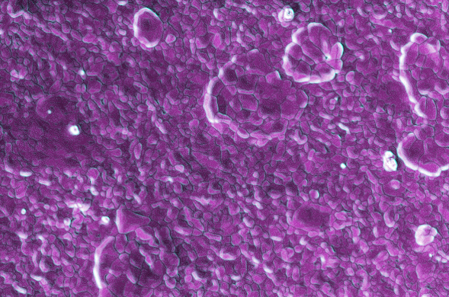

Stop-motion sequence
Pre-anodised substrate
Not pre-anodised
2 µm
2 µm
2 µm
Temperature
950°C
Time

Slide 26
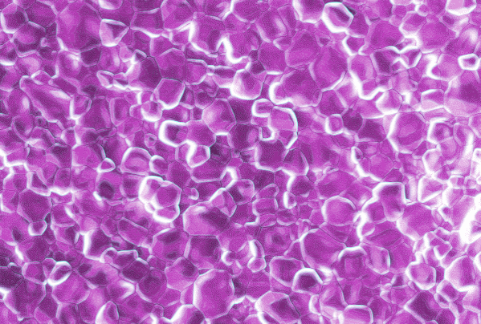

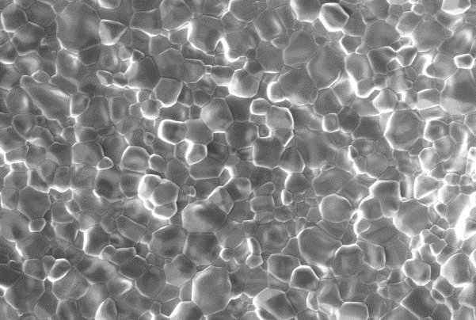
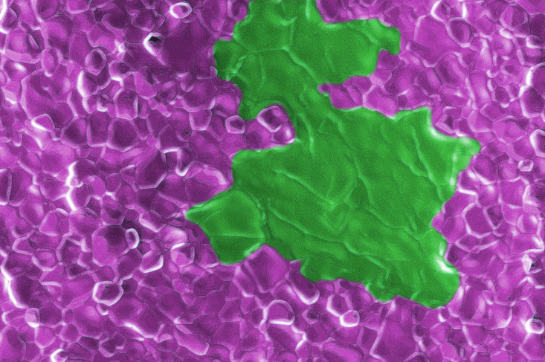
Stop-motion sequence
Pre-anodised substrate
Not pre-anodised
2 µm
2 µm
2 µm
Temperature
1120°C
Time

Slide 27
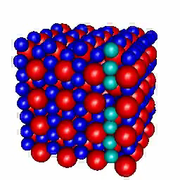
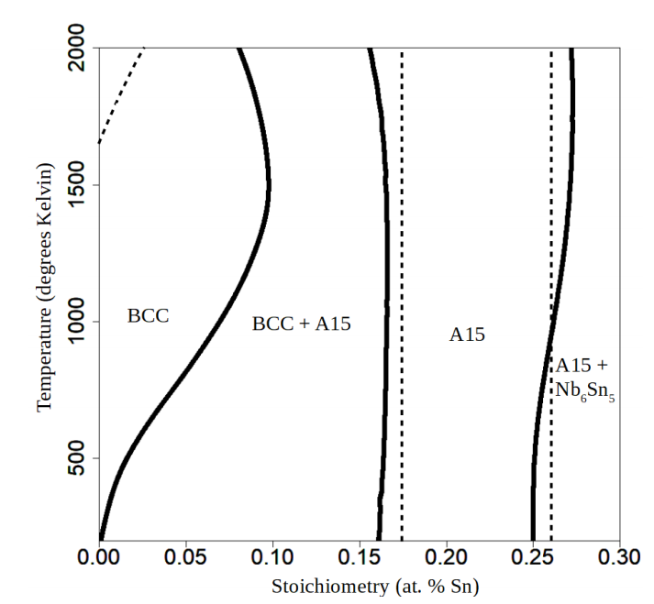

Theory Insights
Key Takeaways:
Sn diffusion through Nb₃Sn Crystal slow
  Fast through grain boundaries
Energetically favorable to grow Sn-depleted Nb₃Sn if out of Sn
Sn
Nb
Nb₃Sn
Sn
Nb
[0.1 ns runtime]
Theoretically Calculated Phase Diagram
Nathan Sitaraman
N. S. Sitaraman et. al., “Ab Initio Study of Antisite Defects in Nb3Sn: Phase Diagram and Impact on Superconductivity,” https://arxiv.org/abs/1912.07576
Notes:
We need to be able to alter the prevalence of all these features to see how they affect the quench field. We’re using sample studies, as well as simulation codes, to understand how the layer growth works, and how we can modify the coating recipe to change RF performance – show movie before this

Slide 28
Nb₃Sn growth mechanism
Early growth:
Sn + Nb diffuses through Nb₃Sn
Later growth:
Tin moves down through grain boundaries
Sn
Sn
Sn
Nb₃Sn
Nb
Nb₃Sn
Nb₃Sn
Sn
Sn
Nb
Nb
Nb
Slow
Fast

Slide 29
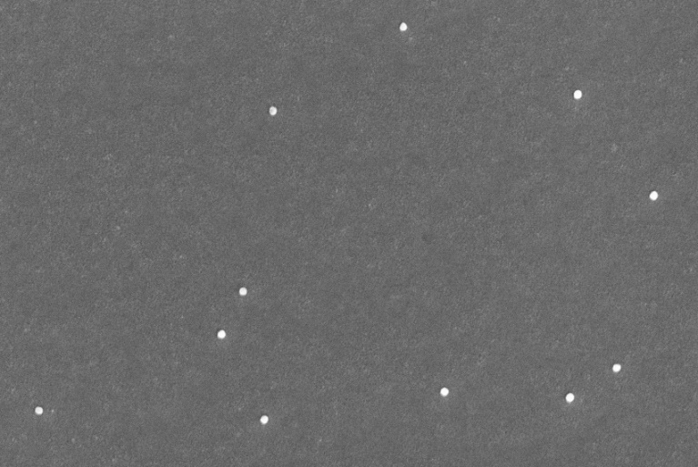

Why do thin regions form?
‘Poor’ nucleation creates some large single grain Nb₃Sn
Slow Sn diffusion slows growth
1 µm
1 µm
2 µm
Nb₃Sn
Diffusion Limited Growth
Nb

Slide 30


Why do Sn Depleted Regions Form?
Sn depleted region formed by running out of Sn
Can fix by adding more Sn at key time
Don’t anneal for too long
Available Tin During Coating
No available Sn
Grain Boundaries
Excess surface tin (arb. units)
Nb₃Sn
Nb₃₊Sn₁₋
Nb₃₊Sn₁₋
Nb₃Sn
time (Hours)
More Nucleation Agent
Nb
Available Sn!
Depleted Region
Nb₃Sn EDS Cross-section
Excess surface tin (arb. units)
time (Hours)

Slide 31




Why is Nb₃Sn Rough?
Nb₃Sn Growth:
Nb₃Sn roughness comes from growth
  Bad Sn nucleation -> rough surface
  Good Sn nucleation -> smooth surface
2 µm
200 nm
500 C
2 µm
200 nm
800 C
50
2 µm
200 nm
2 μm
875 C
% $\frac{\text{Sn}}{\text{Sn}\text{+}\text{Nb}}$
0

Slide 32
Questions Answered
Why do Sn depleted regions form?
  Running out of Sn
  Kinetic process
Why do thin regions form?
  Nb₃Sn forms early without an oxide barrier
  Sparse nucleation sites
  Anodization improves both
Why is the Nb₃Sn surface rough? Can we fix it?
  Poor nucleation likely causes some roughness

Slide 33
Conclusions
Insights:
Nb₃Sn forms early in the process
Oxide layer acts as a barrier, delaying growth and creating more nucleation sites
Thin regions and rough surface come from ‘poor’ nucleation
Sn diffusion through crystal slow, through grain boundary fast
Proposed optimizations:
Better nucleation to reduce roughness
More SnCl₂ to prevent Sn-depleted pockets

Slide 34
Acknowledgements
The Cornell Nb₃Sn program is supported by:
U.S. DOE award DE-SC0008431: Coating furnace development + cavity coatings/tests
Center for Bright Beam (NSF Award 1549132)
This works make use of Cornell Center for Materials Research, NSF MRSEC program (DMR-1719875)
with special thanks to
Prof. Matthias Liepe
Prof. Tomas Arias
Prof. David A. Muller
Dr. Daniel Hall
Paul Cueva
Nathan Sitaraman
Michelle Kelley
James Sears
Greg Kulina
John Kaufman
Holly Conklin
Terri Gruber
Paul Bishop
Katherine (Jixun) Ding

