Slide 1
Surface Resistance, Frequency Dependence, and Field Limitation in Nb₃Sn Cavities
Ryan Porter
Cornell University
Supported by:
U.S. DOE award DE-SC0008431: 1.3 GHz coatings + tests
NSF Award 1734189: 2.6 GHz + 3.9 GHz coatings + tests
Center for Bright Beams , NSF Award PHY-1549132: material studies
This works make use of Cornell Center for Materials Research, NSF MRSEC program (DMR-1719875)

Slide 2
Current performance
Data taken at 4.2 K using 1.3 GHz ILC single-cells
What limits quality factors?
Q = 2·10¹⁰
How does performance vary with frequency?
What limits maximum gradients?
E_{acc max} ~ 17 MV/m

Slide 3
High Frequency Cavities

Slide 4
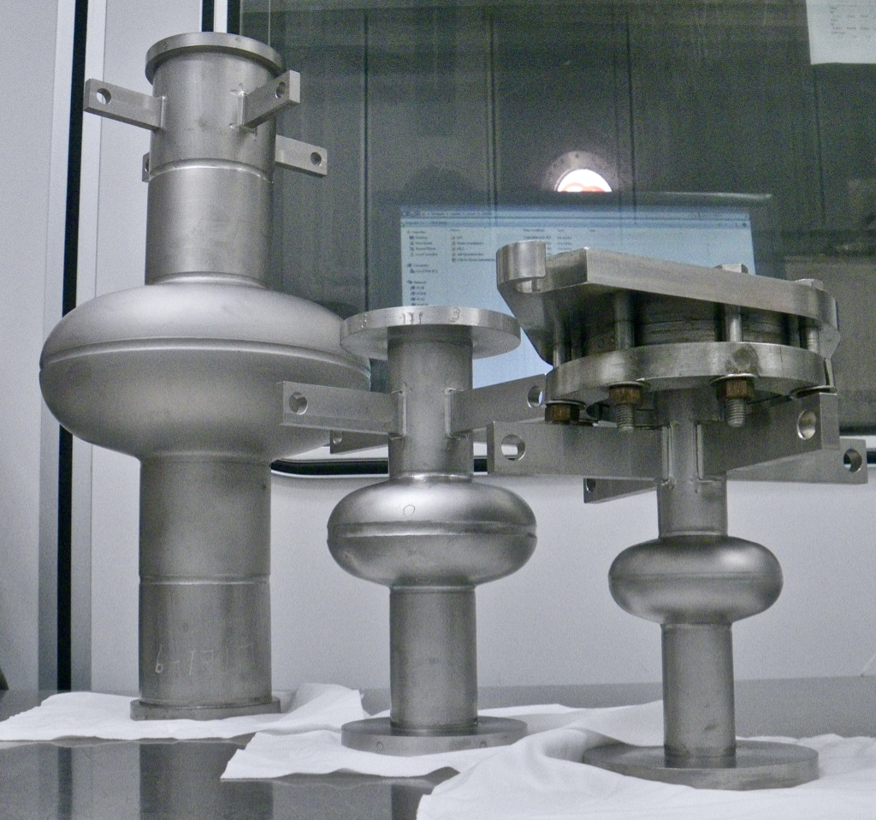
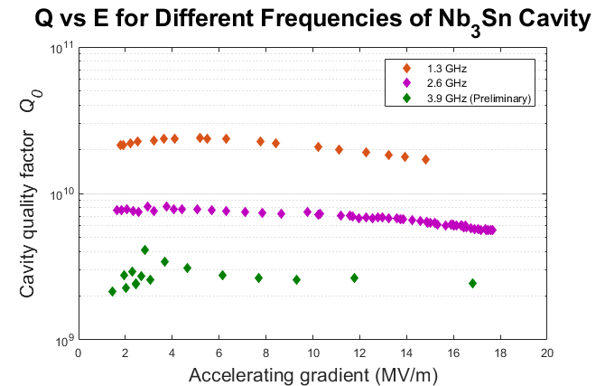
High Frequency Nb₃Sn
All 4.2 K

Slide 5
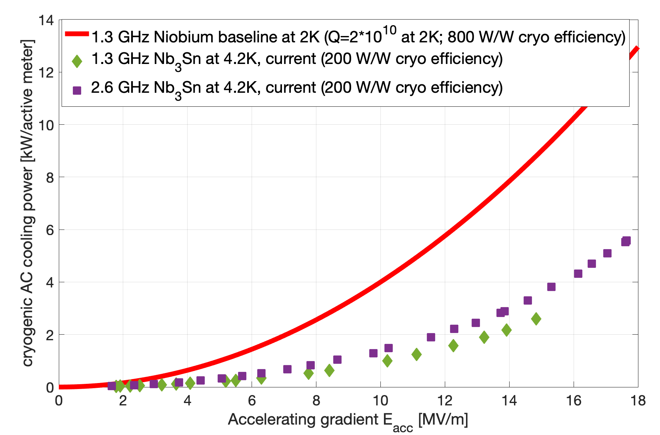
Cryo-Efficiency
1.3 GHz Nb at 2K
2.6 GHz Nb₃Sn at 4.2K
1.3 GHz Nb₃Sn at 4.2K

Slide 6
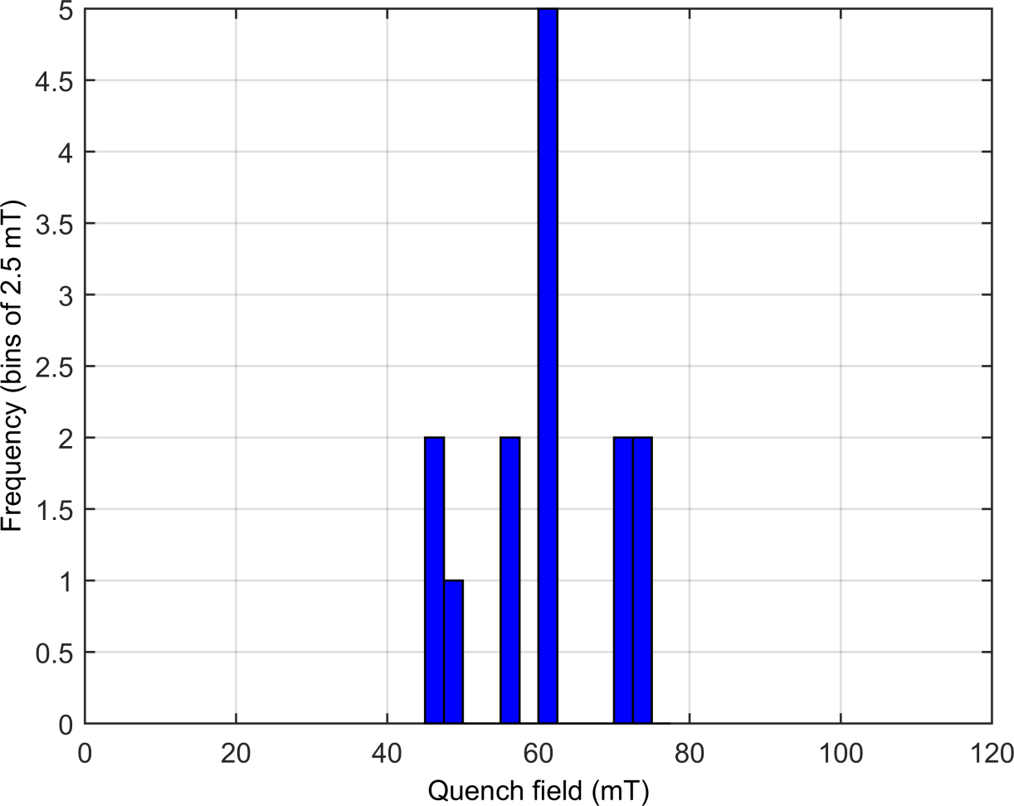
Quench Field Frequency Dependence
The 2.6 GHz Nb₃Sn cavities’ quench field is consistent with 1.3_GHz Nb₃Sn cavities.
Results show quench defect does not depend on frequency!
-> Limits possible defects that cause quench
Quench Mechanism Frequency Independent
3.9 GHz (preliminary)
2.6 GHz

Slide 7
Surface Resistance

Slide 8
Increasing Efficiency
Surface resistance at 4.2 K and 10 MV/m
16 nΩ
Ambient fields
Trapped magnetic flux
“Double Gap”
BCS Resistance
Thermal gradients
Thermal gradients
0 nΩ
Notes:
This is what I have figured out over the last 3 years

Slide 9
Thermal currents
Induced thermocurrent
HOT
Slide from Daniel Hall
Nb₃Sn
Nb
$$V=−S ∇T$$
S – Seebeck coefficient
Generated B field
‘Solved’ (for Nb₃Sn on Nb) by slow-cooling cavity
COLD
Cooling in a large thermal gradient will generate a large amount of trapped flux!

Slide 10
Increasing Efficiency
Surface resistance at 4.2 K and 10 MV/m
16 nΩ
Ambient fields
Trapped magnetic flux
“Double Gap”
BCS Resistance
Thermal gradients
Thermal gradients
Good magnetic shielding can eliminate
0 nΩ
Notes:
This is what I have figured out over the last 3 years

Slide 11
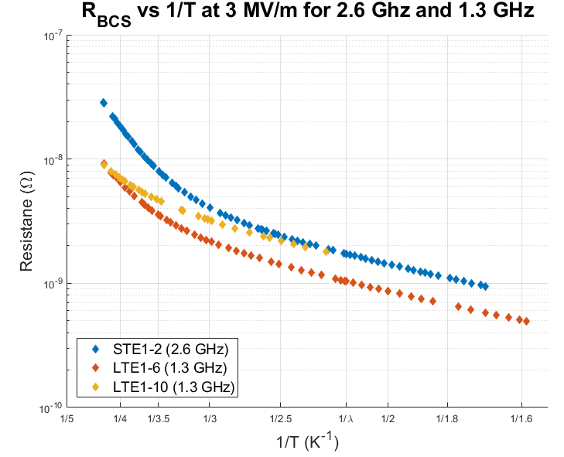
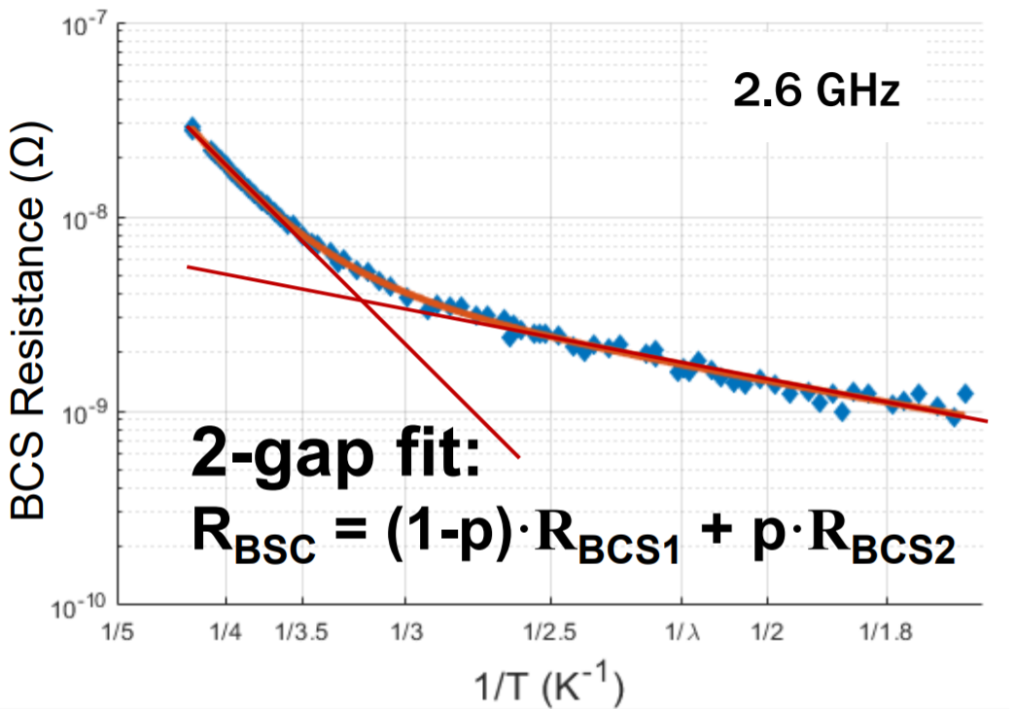
“Double Gap”
Temperature dependent resistance shows two slope behavior
R_{BCS} for 2 Gaps (3 MV/m)
R₀ ~ 5.5 nΩ (from trapped magnetic flux)

Slide 12
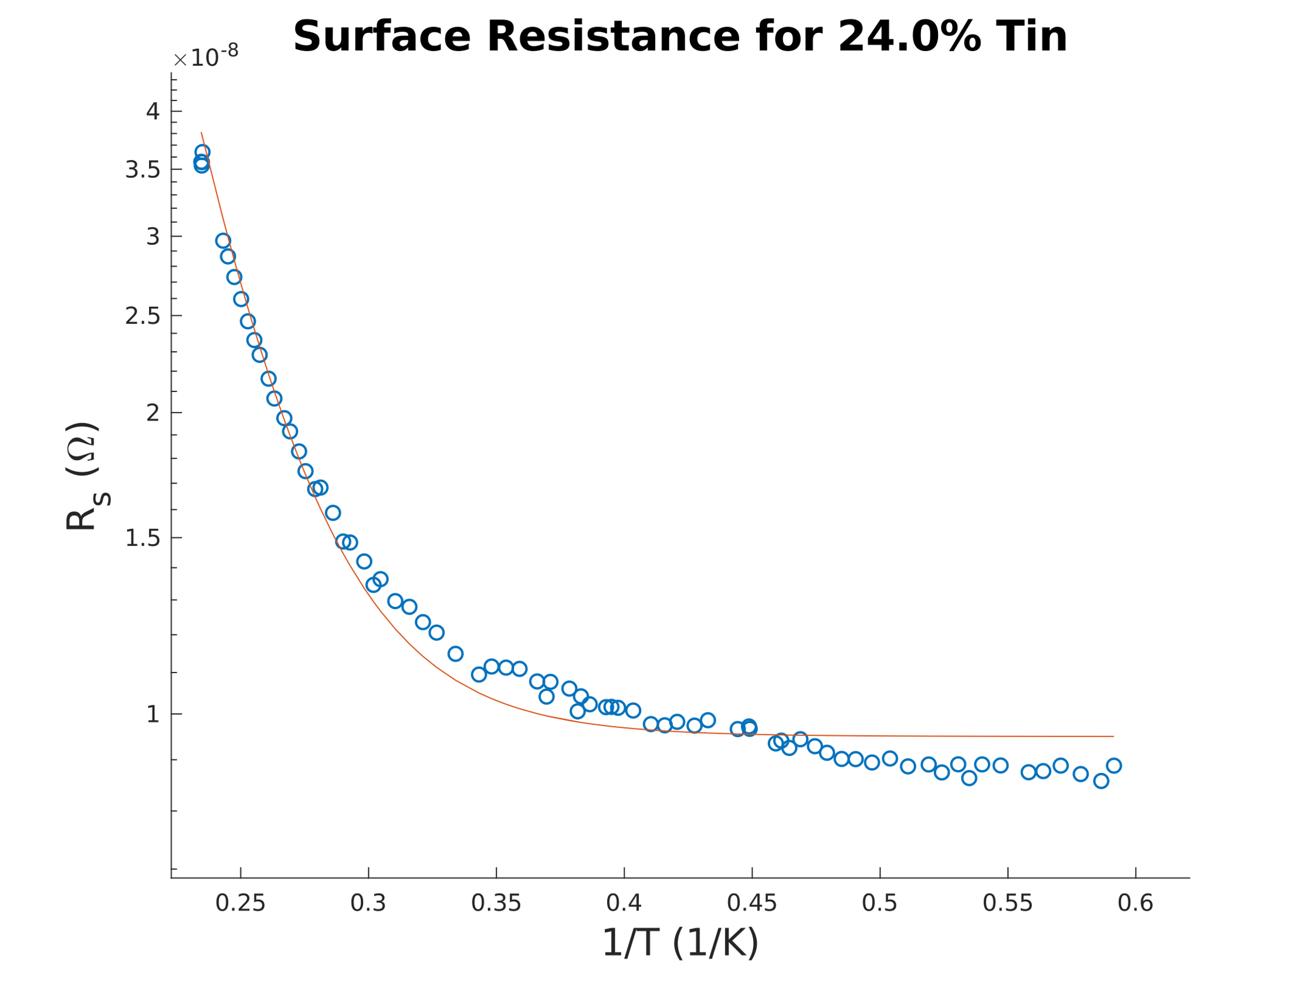
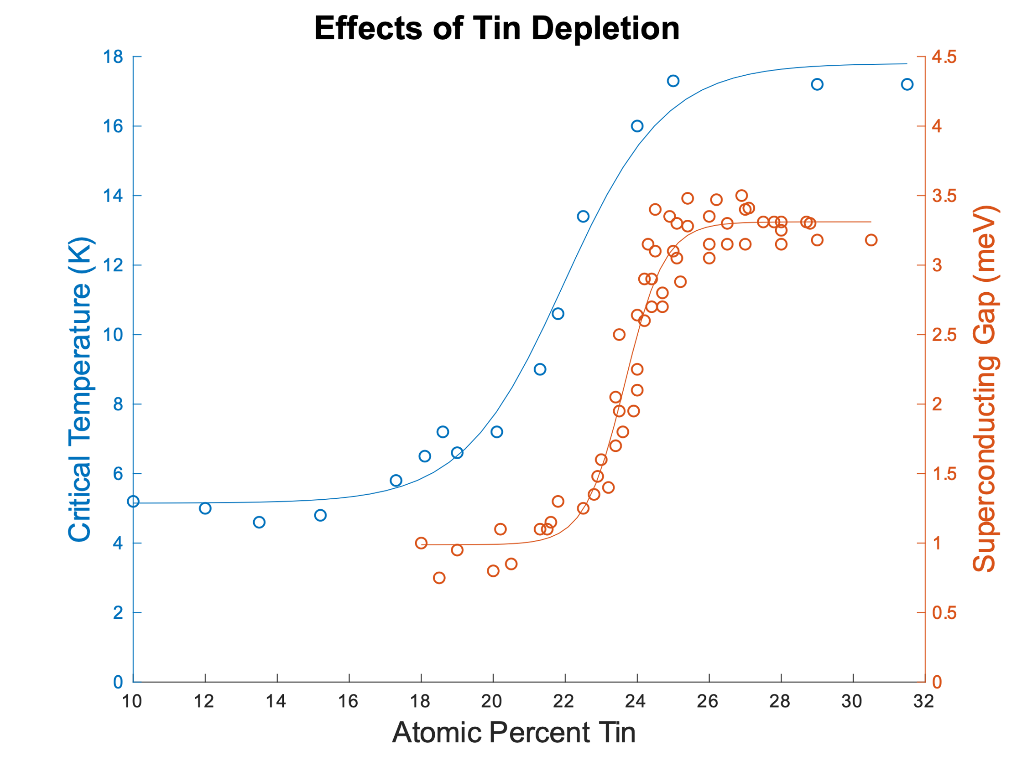
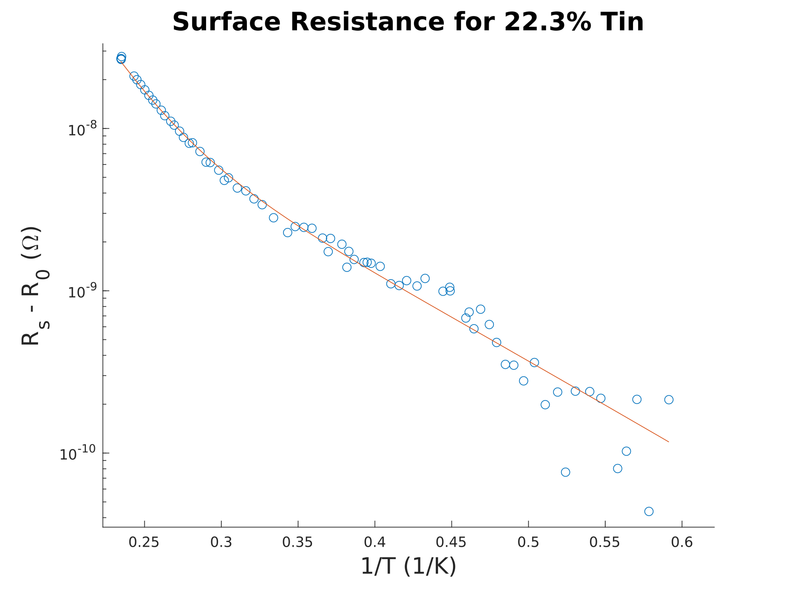
Tin Depleted Regions
Model 1: Sn depleted regions (fit p, R₀, vary at. % Sn)
R = (1-p)·R_{BCS}(25%* Sn) + p·R_{BCS2}( x-% Sn) + R₀
(Possible) Conclusion: Presence of low Sn-content Nb₃Sn
p = percent of surface 2nd material
2.6 GHz
Is this related to quench?
Bad Fit
p ~ 1·10⁻⁵
Good Fit
Data from: A. Godeke, Supercond. Sci. Tech, 2006
S. Ginnett, “Two-Gap Superconductivity in Nb3Sn SRF Cavities,” Cornell CLASSE REU Report, Aug. 2020, https://cornell.app.box.com/s/uyq28qj9q7vuxu1mn6appcuoiv9m4hek

Slide 13
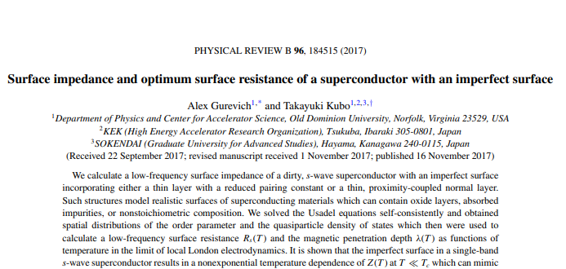
Normal Layers
Model 2: Proximity coupled normal layer:
Oxide layer on surface
Normal conducting?
Thin layer of Sn?
Normal layer “proximity coupled” to superconductor
Normal layer gains superconductivity
Depresses superconductivity nearby
Using model by Gurevich and Kubo
Solves Usadel Equations
~5 nm Oxide
3 µm Nb₃Sn
Nb

Slide 14
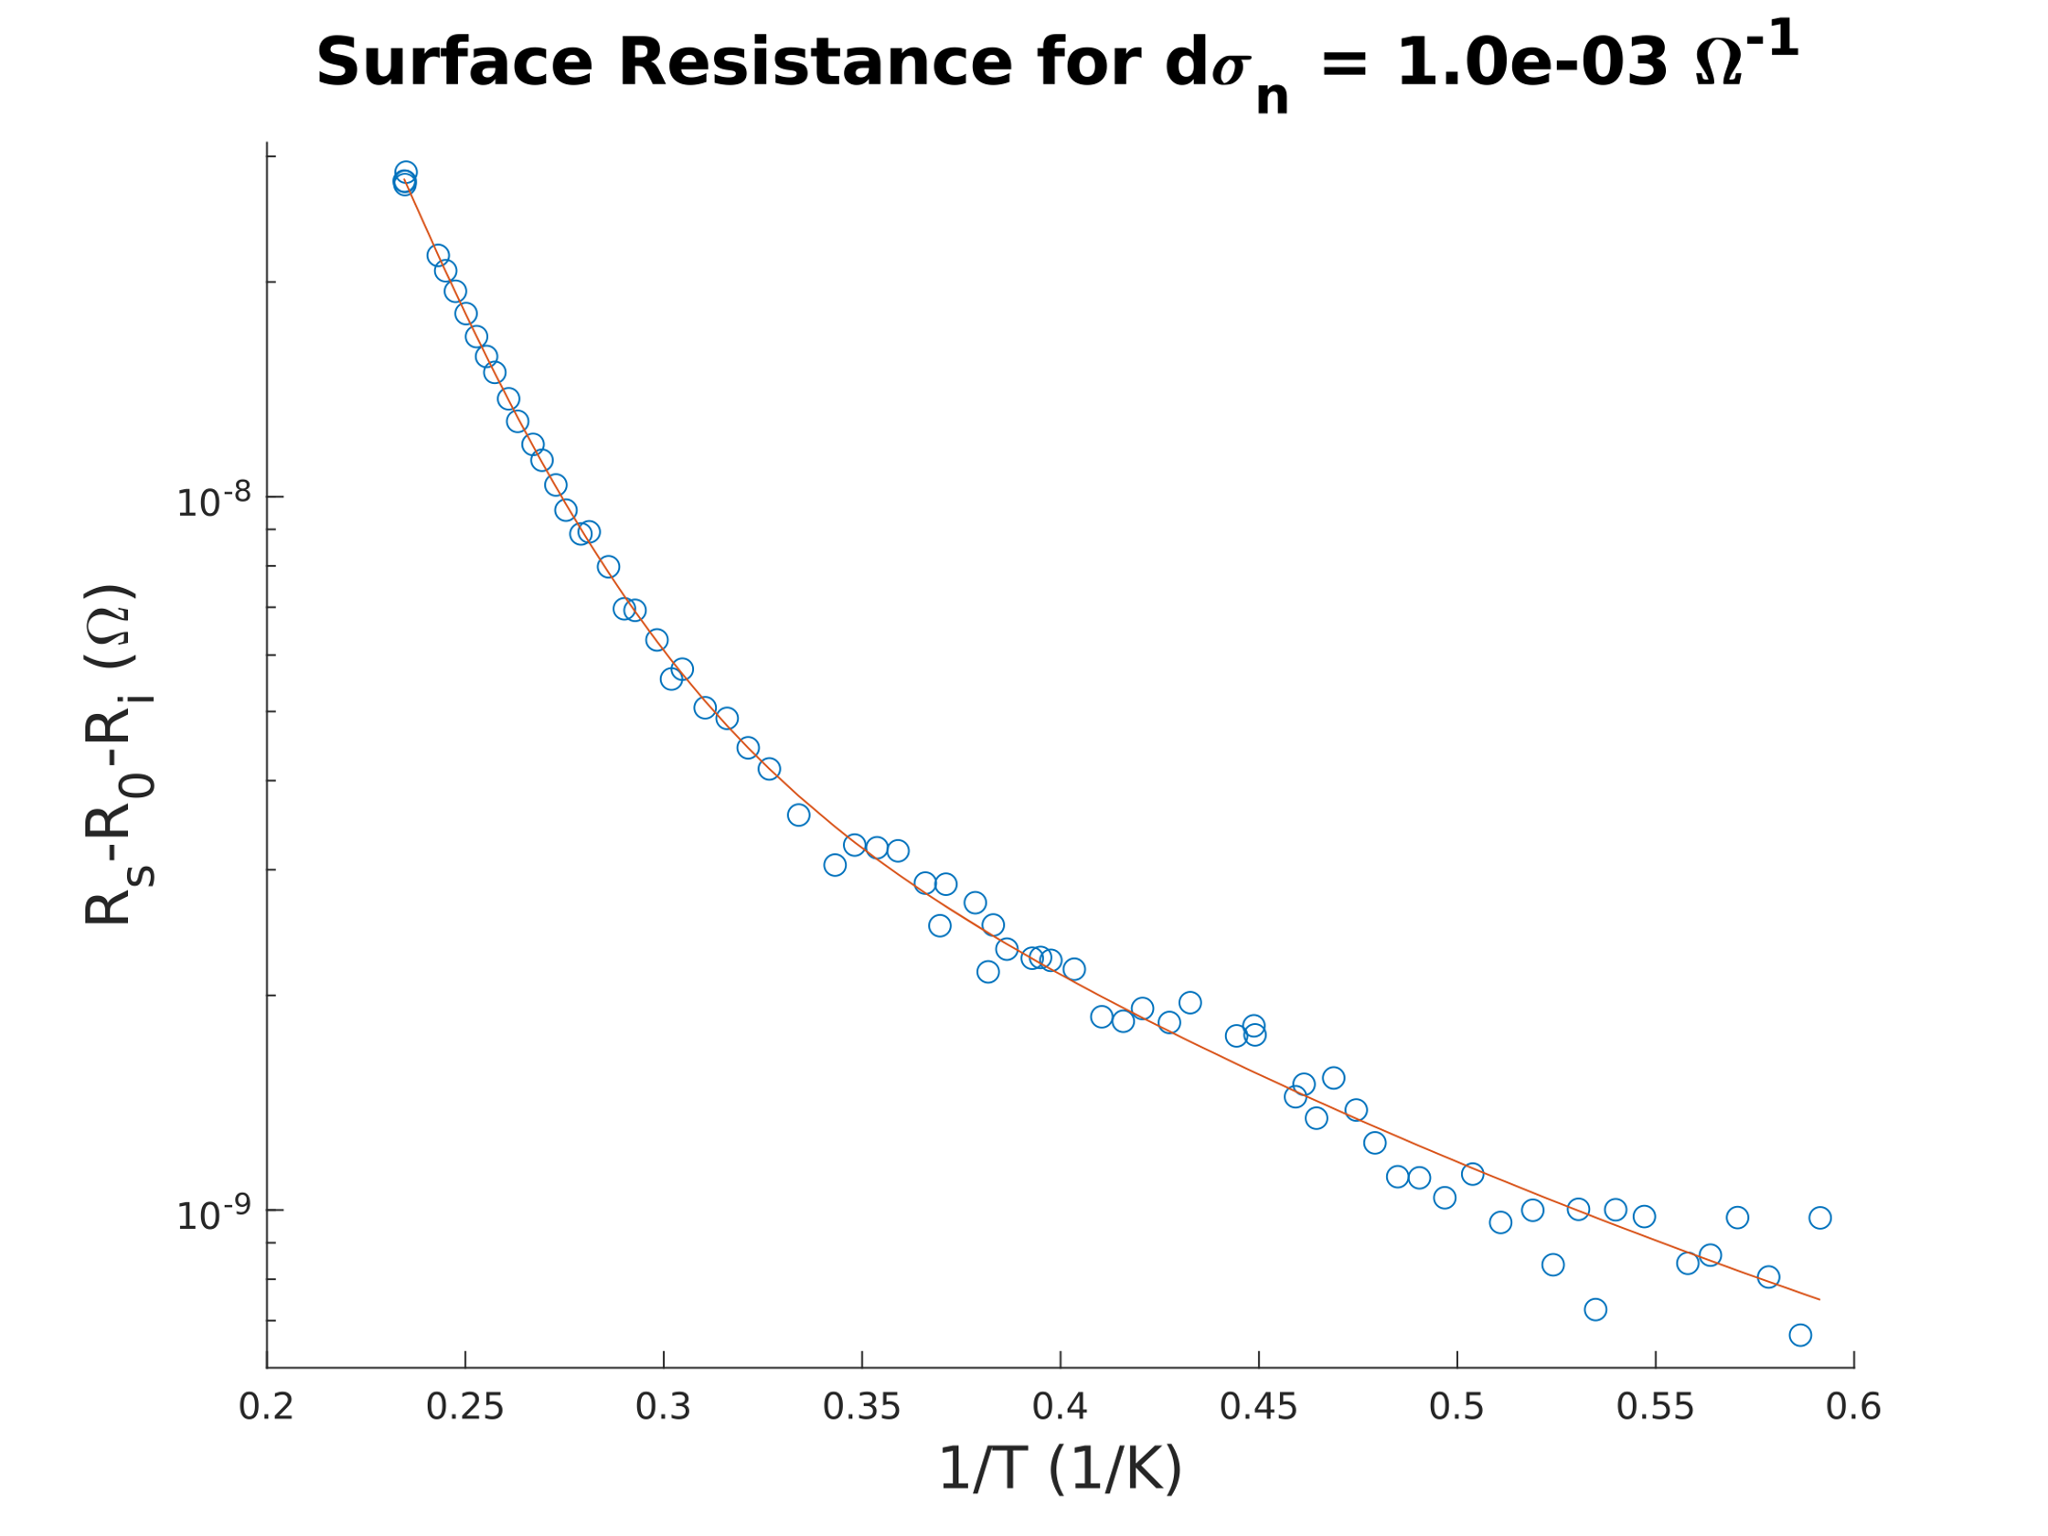
Normal Layers
Model 2: Proximity coupled normal layer:
Can fit data nicely for some parameter sets
Need more experimental data to narrow down correct model
Conclusion: Other models could explain ‘double gaps’
S. Ginnett, “Two-Gap Superconductivity in Nb3Sn SRF Cavities,” Cornell CLASSE REU Report, Aug. 2020, https://cornell.app.box.com/s/uyq28qj9q7vuxu1mn6appcuoiv9m4hek

Slide 15
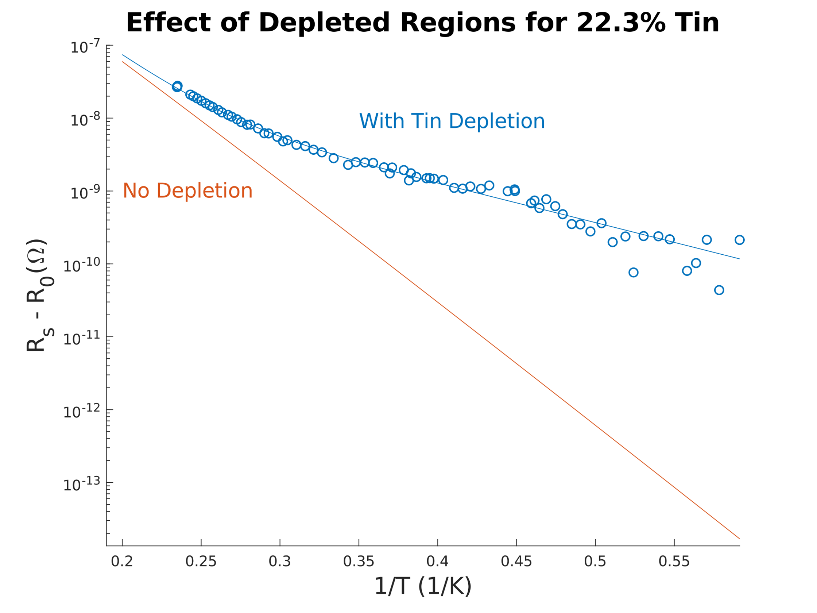
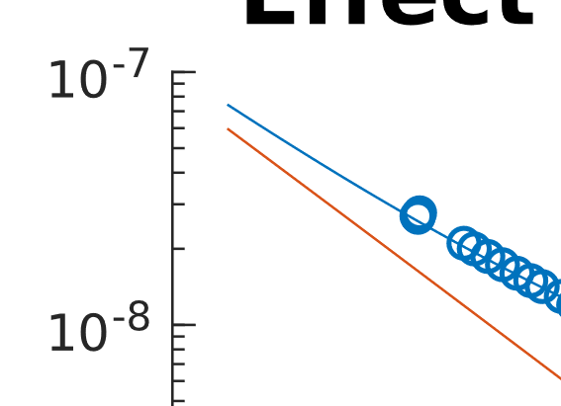
Removing Second Gap
Good news:
Removing ‘second gap’ will reduce resistance
May be over-estimating BCS-resistance of good Nb₃Sn
By how much?
Needs more modeling/work
2.6 GHz
4.2 K
Potential improvement
S. Ginnett, “Two-Gap Superconductivity in Nb3Sn SRF Cavities,” Cornell CLASSE REU Report, Aug. 2020, https://cornell.app.box.com/s/uyq28qj9q7vuxu1mn6appcuoiv9m4hek

Slide 16
Increasing Efficiency
Surface resistance at 4.2 K and 10 MV/m
16 nΩ
Trapped magnetic flux
“Double Gap”
BCS Resistance
Could remove?
Q = 2·10¹⁰
4·10¹⁰
0 nΩ
Notes:
This is what I have figured out over the last 3 years

Slide 17
Quench Field Limitations

Slide 18
Limitations in quench field
Nb₃Sn cavities consistently quench at fields between 14_and 18_MV/m in CW operation
14 MV/m
The superheating field suggests we can achieve fields up to 96 MV/m!
Conclusion: Small Range of Quench Fields
18 MV/m
Fermilab’s best cavity

Slide 19
What is limiting the quench field?

Slide 20
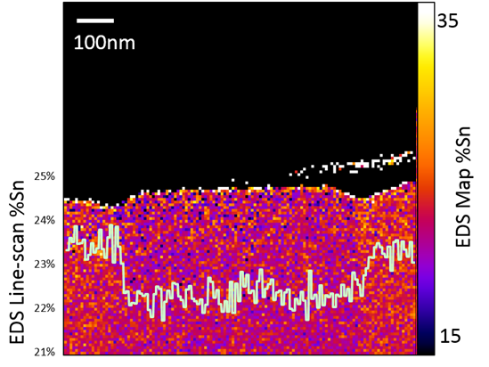
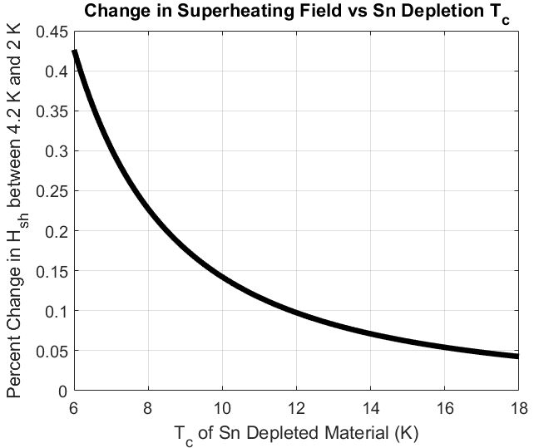
Quench Field Impact of Sn Depletion
Could Sn depleted regions (directly) cause quench?
Quench field change with temperature too small
$$H_{sh}\left(T\right)=H_{sh}\left(T=0\right)∙\left(1−{\left(\frac{T}{T_{c}}\right)}^{2}\right)$$

Slide 21
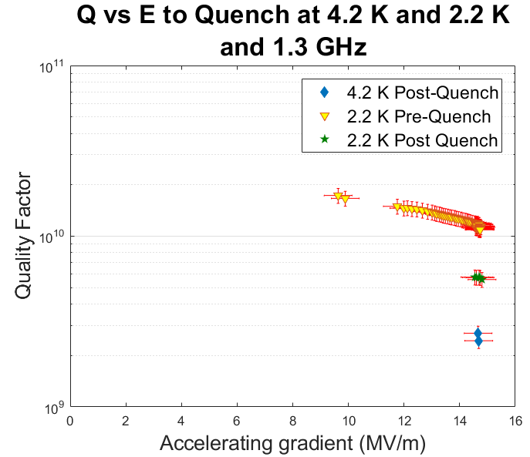
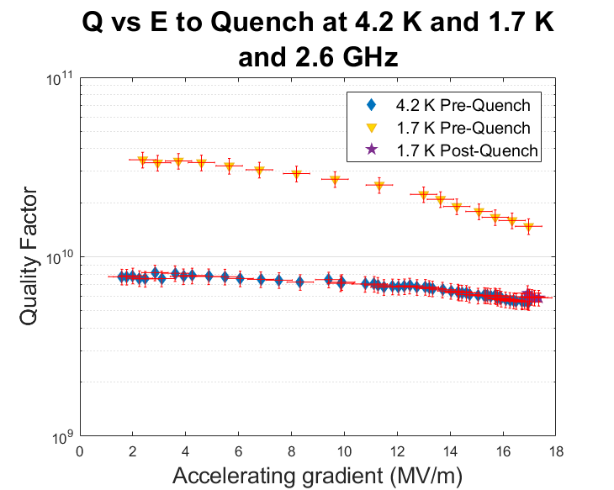
Quench Field Temperature Dependence
Quench 4.2 K vs 2 K
Quench fields within ~1% (~3.4% error bar)
No temperature dependence of quench field!
Limits possible quench mechanisms
Conclusion: 1. Quench Mechanism Temperature Independent
2. Sn-depleted regions are not (directly) responsible for quench
Q vs E to Quench at 4.2 K and 1.7 K
and 2.6 GHz
Notes:
Rules out Sn depleted as quench on second slide. Show my plot.

Slide 22
Thermometry

Slide 23
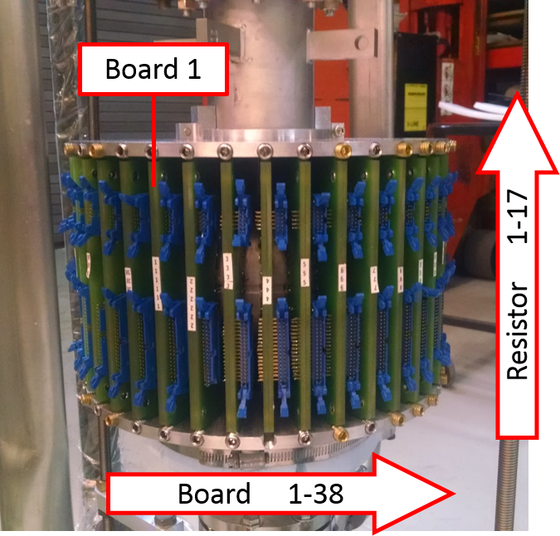
T-Map experiment
Use temperature map to look for quench mechanism/site:
Niobium surface
T-Map board
Thermal paste
T-Map sensor
Pogo stick
Connector leads

Slide 24
Localised quench
Nb₃Sn cavities are limited by a quench at a localized spot
Conclusion: Quench is localized
What could be at fault?

Slide 25
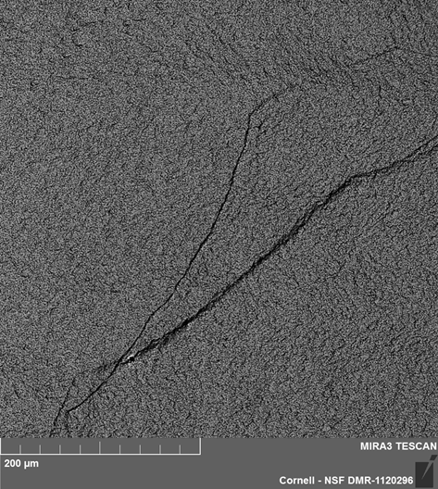
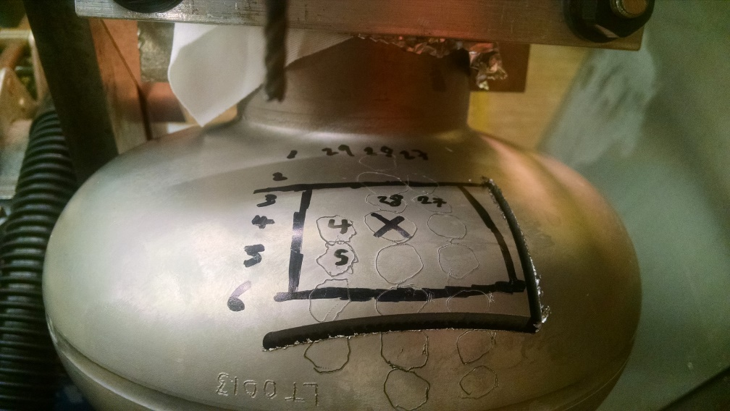
What is happening at the surface?
Cut out this region and examined with microscopy
Nothing obvious except Nb grain boundary cliff
Rough Surface
Nb₃Sn surface
Nb substrate grain boundary?
Quench Site

Slide 26
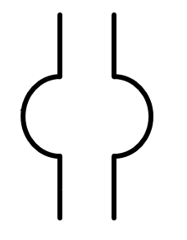
Quench Videos
Old Systems
Old New System
~1 Minute
Exposure Picture
50 kHz
Video

Slide 27
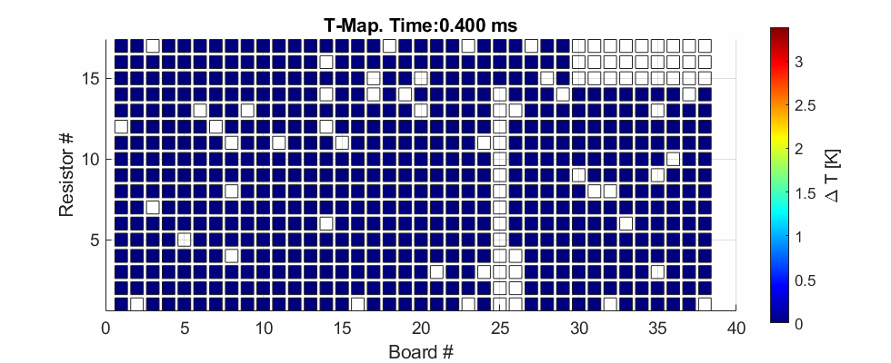
Cavity Quench
Preliminary. Only finished commissioning. Have seen interesting dynamics.
Have seen temperature jumps.

Slide 28
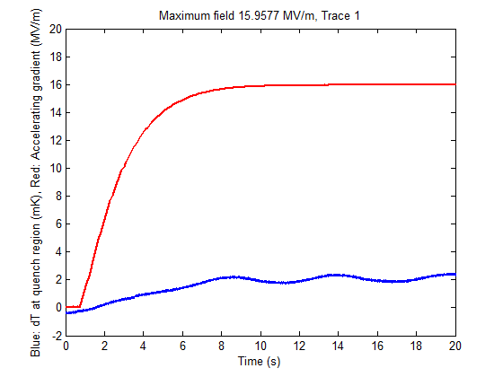
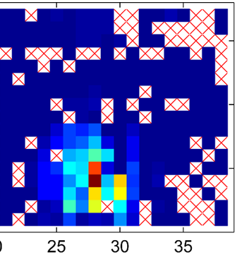
Near quench behavior
Measure temperature of sensor near the quench point as field is increased
Sudden jumps in temperature
Max Field
Temperature
Time

Slide 29
Near quench behaviour
Previous conclusion: The sudden nature of these jumps and hysteresis suggests flux entry
Conclusion: Vortex entry a candidate for quench

Slide 30
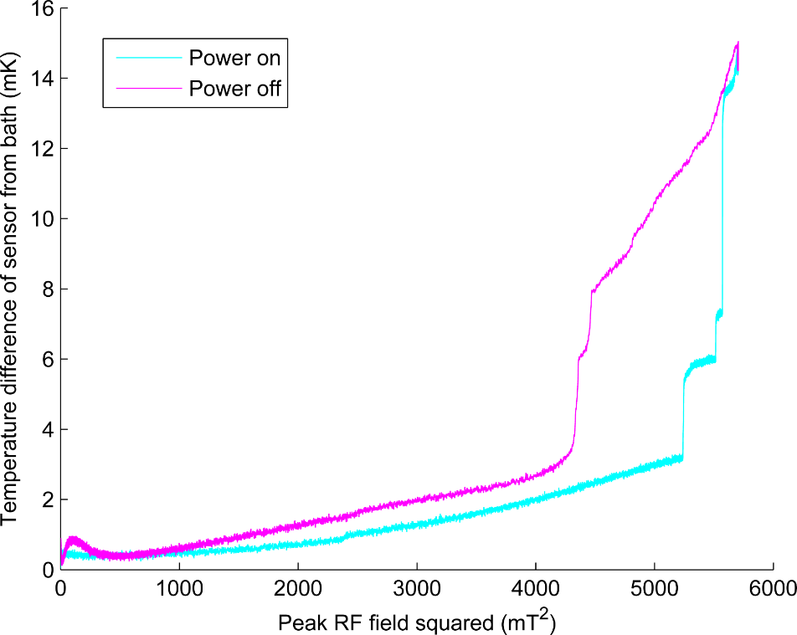
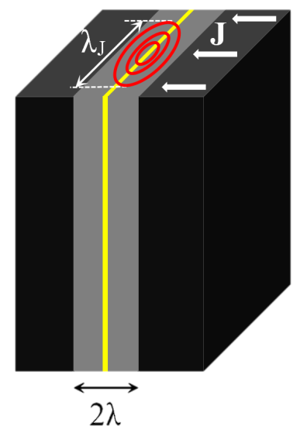
Grain boundary flux penetration
Power dissipated
Increasing current across boundary
Ahmad Sheikhzada and Alex Gurevich
Physical Review B 95, 214507 (2017)
arXiv:1702.02843
Notes:
Grain acts as Josephson Junction. Flux expands across whole boundary. Blocks Current.

Slide 31
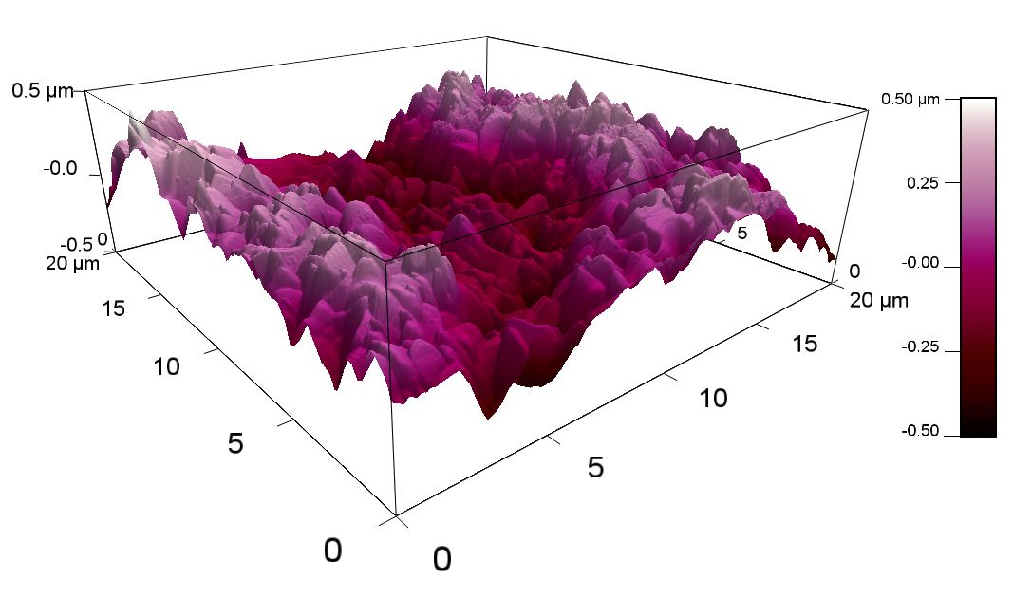
Surface Roughness
Nb₃Sn we create is rougher than EP Nb
~1 µm peak to peak
This causes large enhancement of the surface magnetic field

Slide 32
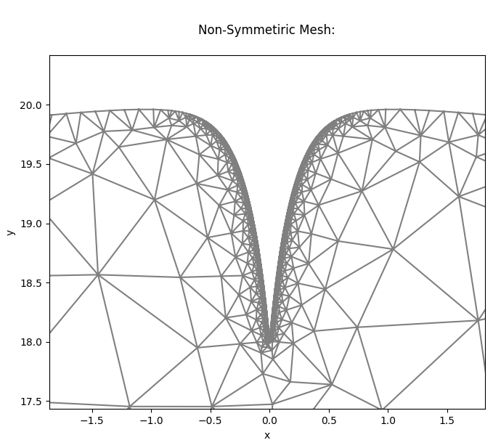
Grain Boundary Flux Penetration (BYU)
Ginzburg-Landau Simulation of Vortex Nucleation In Grain Boundaries
Center for Bright Beams (CBB): A. R. Pack, M. Transtrum (BYU): MOP017
Poor grain boundary geometry -> lower flux entry field
Geometry effect: T, f independent*
H_{sh} Reduction from Surface Defect
*in cavity operating range (f << 1/T_{vortex nucleation}, T << T_{c})

Slide 33
Grain Boundary Pinning (BYU)
A. R. Pack, M. Transtrum (BYU):
Conclusion: Grain boundary geometry/roughness lowers quench field
See M. Transtrum’s Tuesday talk “Time-Dependent Ginzburg Landau simulations to guide Nb3Sn SRF cavity development”

Slide 34
Thermal Modeling
20 K
3 µm Nb₃Sn +
3 mm Nb +
3 µm Nb₃Sn
2 K Helium
T
2.015 K

Slide 35
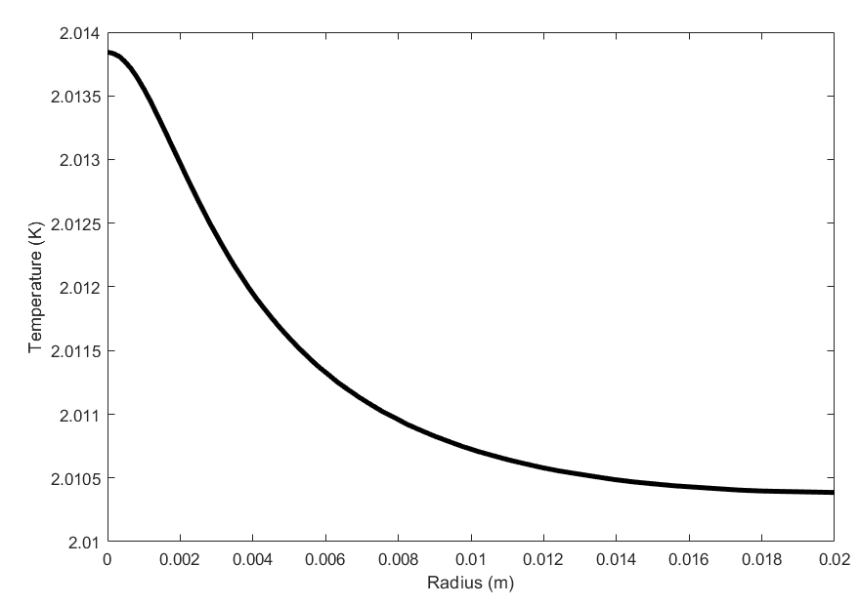
Thermal Modeling
Wrote multilayer thermal equilibrium solver
Based on Cornell HEAT code
Temperature dependent conductivities, resistances, etc.
Modeling temperature jump (equilibrium)
Model: smallest jump: ~750 µW
Temperature on Outside of Cavity vs r
Observed Temperature Rise*
Problem:
~40 µW (in 1 µm radius area) causes thermal runaway in pure Nb₃Sn
*Assuming Kapitza resistance is the same as Nb, 0.35 sensor efficiency.

Slide 36
Thermal Runaway in Single Material
A small region of normal conducting will not cause thermal runaway
Beyond a critical size it will cause thermal runaway

Slide 37
Thermal Runaway in Single Material
If a defect is generating heat, there will be a critical heat load before quench
Beyond heat load, quench occurs
Q < Q_{crit}
Q > Q_{crit}
Q_{crit} ~ 40 µW in Nb₃Sn

Slide 38
Thermal Runaway in Single Material
1D model: infinite volume of material. Spherically symmetric defect (radius r₀) in the middle. Integrate heat over a sphere radius r.
$$∯_{∂V}^{ }{\overset{⃑}{q}∙ⅆ\overset{⃑}{s}=Q}$$
$$=q 4πr^{2}=−k\left(T\right)4πr^{2}∇T$$
$$k(T)dT=\frac{−Q}{4πr^{2}}dr$$
$$\int_{T_{B}}^{T(r_{0})}{k(T)dT}=\int_{r_{0}}^{∞}{\frac{Q}{4πr^{2}}dr}=\frac{Q}{4πr_{0}}=\frac{RB^{2}}{4μ_{0}^{2}}r_{0}, Q= \frac{RB^{2}}{2μ_{0}^{2}}πr_{0}^{2}∙2$$
k is more of the form below and involves elliptical integrals. Computation is then numerical.
$$k\left(r\right)=a+be^{−∆{{ T}_{c}}/T}$$
For Nb₃Sn critical size (T(r₀) = T_{c_effective}) is ~1 µm, and for Nb is about ~100 µm
$$k_{Nb3Sn}≪k_{Nb}$$
$$r_{c−Nb3Sn}≪r_{c−Nb}$$
Niobium can support a much larger normal conducting region than Nb₃Sn

Slide 39
Thermal Runaway in Bilayer material
Since the critical size in Nb₃Sn is smaller than Nb, Nb₃Sn could enter local runaway, until it is in good enough contact with the Nb
Contact with Nb thermally stabilizes the region
Rough guess, 3 µm radius as stable gets ~1 mW heating
Roughly observed heating in experiment from 1 jump*
k_{Nb3Sn} < k_{Nb}
k_{Nb3Sn}
k_{Nb}

Slide 40
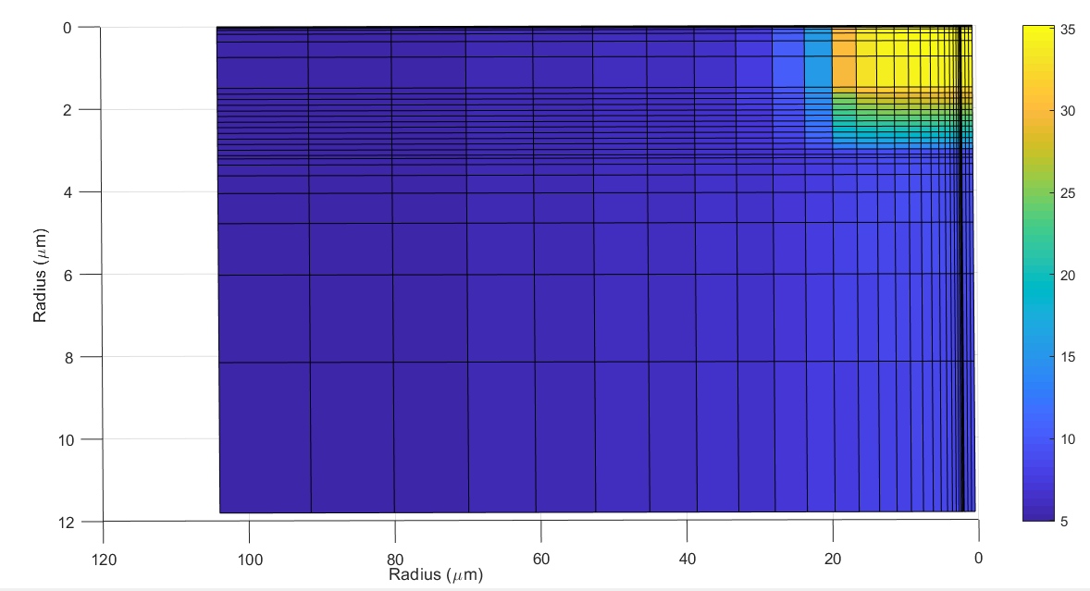
Can Normal Regions Form in the Model?
See stable normal conducting regions in model
Size determined by film thickness + thermal parameters

Slide 41
Revisiting Temperature Jumps
Alt. interpretation: Jumps caused by normal islands forming. Quantized nature is because size/heating is characteristic of film.

Slide 42
Experimental Data Summary for Quench Mechanism
Narrow range of quench fields
Quench localized
Quench site warms just before quench + quantized
Vortex entry?
Thermal effect/’local quench’?
High surface roughness -> Can decrease quench field
No temperature dependence
No frequency dependence
Likely have Sn depleted regions

Slide 43
Conclusions
Nb₃Sn performs well at 2.6 GHz
Same cryo-efficiency and E_{acc} while more compact
Quality factors limited by ‘double gap’
Possibly caused by Sn-depleted regions
Could potentially
What is main quench limitation?
Vortex entry at grain boundary -> reduce roughness
Sn depleted regions -> improve stoichiometry
Local quench -> reduce film thickness
Can be triggered by other mechanisms

Slide 44
Acknowledgements
The Cornell Nb₃Sn program is supported by:
U.S. DOE award DE-SC0008431: 1.3 GHz Nb3Sn tests and Nb3Sn R&D
NSF Award 1734189: 2.6 GHz and 3.9 GHz tests and R&D
Center for Bright Beam (NSF Award 1549132): Materials studies
This works make use of Cornell Center for Materials Research, NSF MRSEC program (DMR-1719875)
with special thanks to
Prof. Matthias Liepe
Prof. Tomas Arias
Prof. David A. Muller
Prof. James P. Sethna
Prof. Mark Transtrum
Dr. Danilo Liarte
Dr. Zeming Sun
Dr. Daniel Hall
Paul Cueva
Nathan Sitaraman
James Maniscalco
Nilanjan Banerjee
Alden Pack
James Sears
Greg Kulina
John Kaufman
Holly Conklin
Terri Gruber
Paul Bishop
Sam Ginnett

